Slide 1
Exotic decays
ECT* 30/6/2021
Notes:
I am an experimental physicist working on subatomic physics

Slide 2
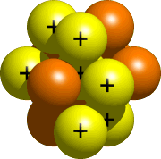
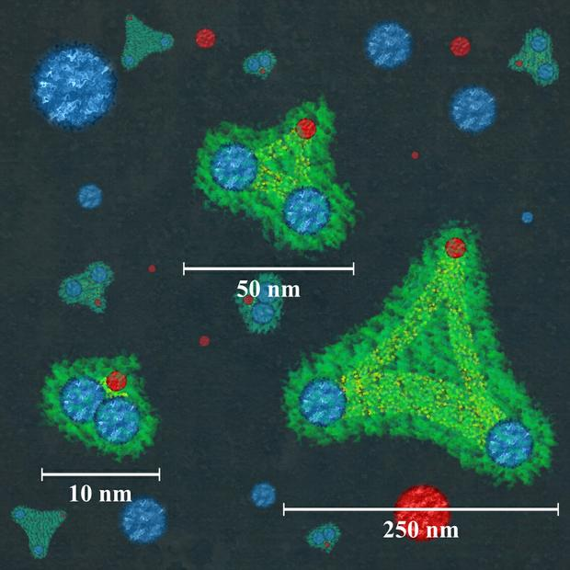
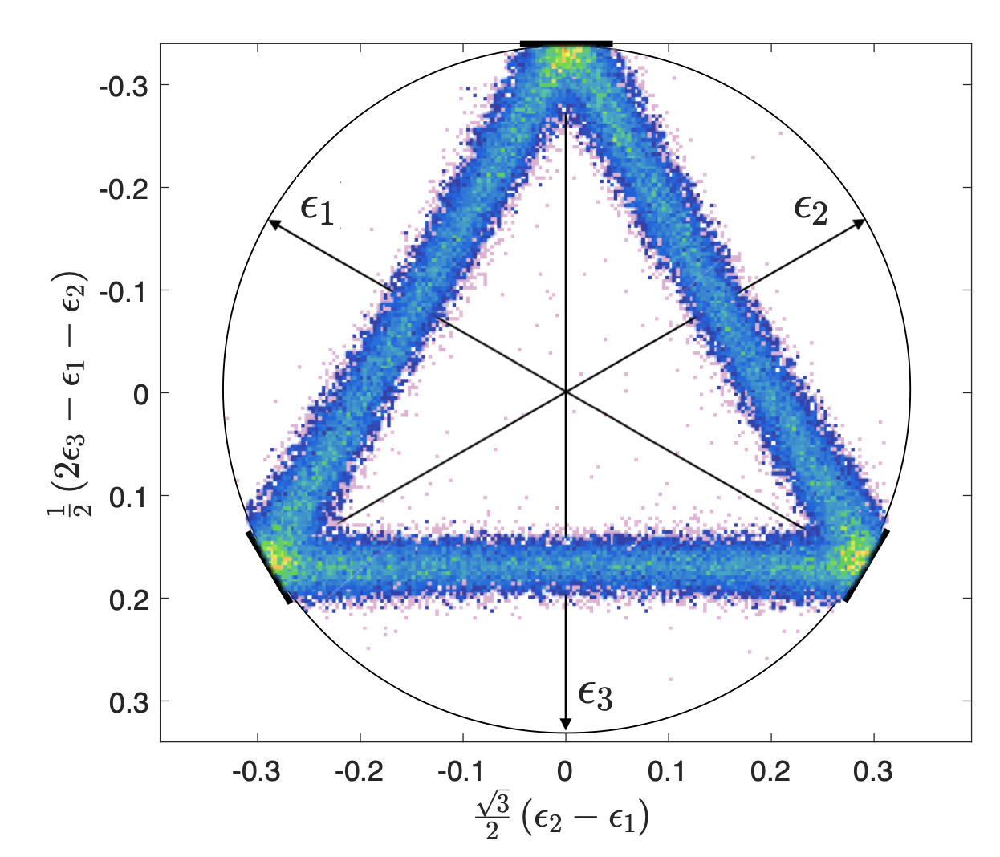
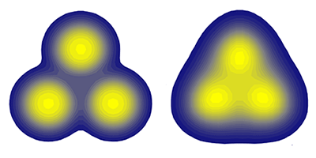
Themes of this workshop
Several overlapping continua
Few/many-body physics with the strong interaction (QCD)
n
¹¹C+n
p
¹¹B+p
Efimov states?
3body decays
Continua
⁸Be(2⁺)+α
α
⁸Be(0⁺)+α
3α
Clustering
¹²C

Slide 3
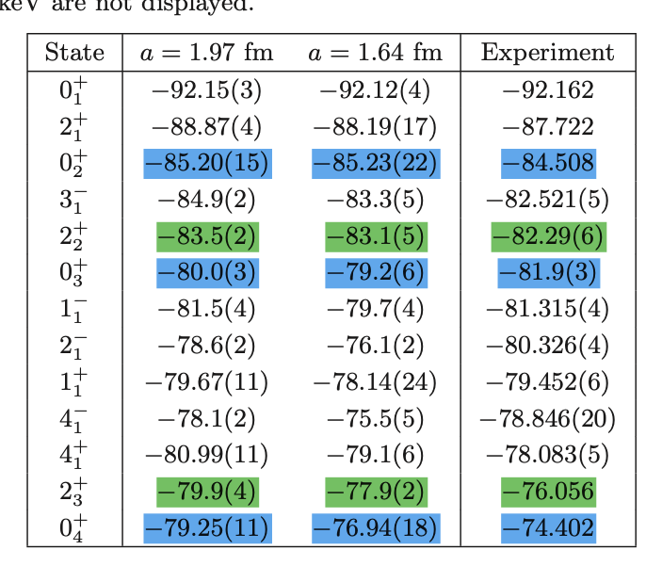
TUNL
Resonances in ¹²C
Efimov state?
MeV
~7
~9
~12-13
~12-14
~12-15
Shen, Lähde, Dean Lee, and Ulf-G. Meißner
arXiv 2106.04834

Slide 4
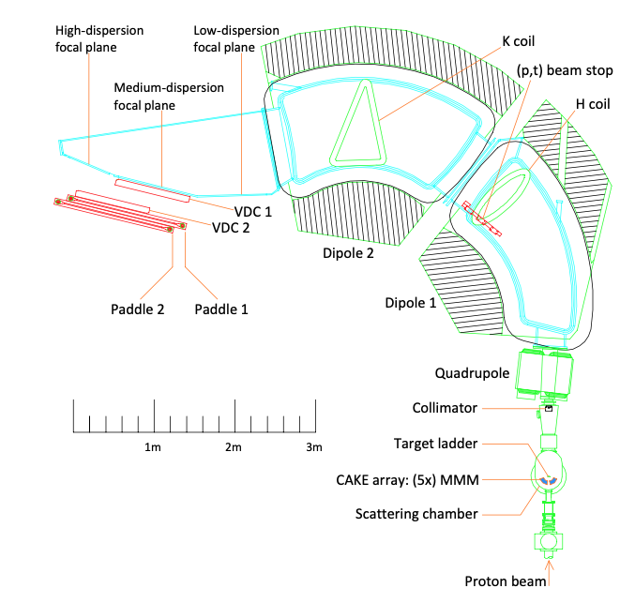
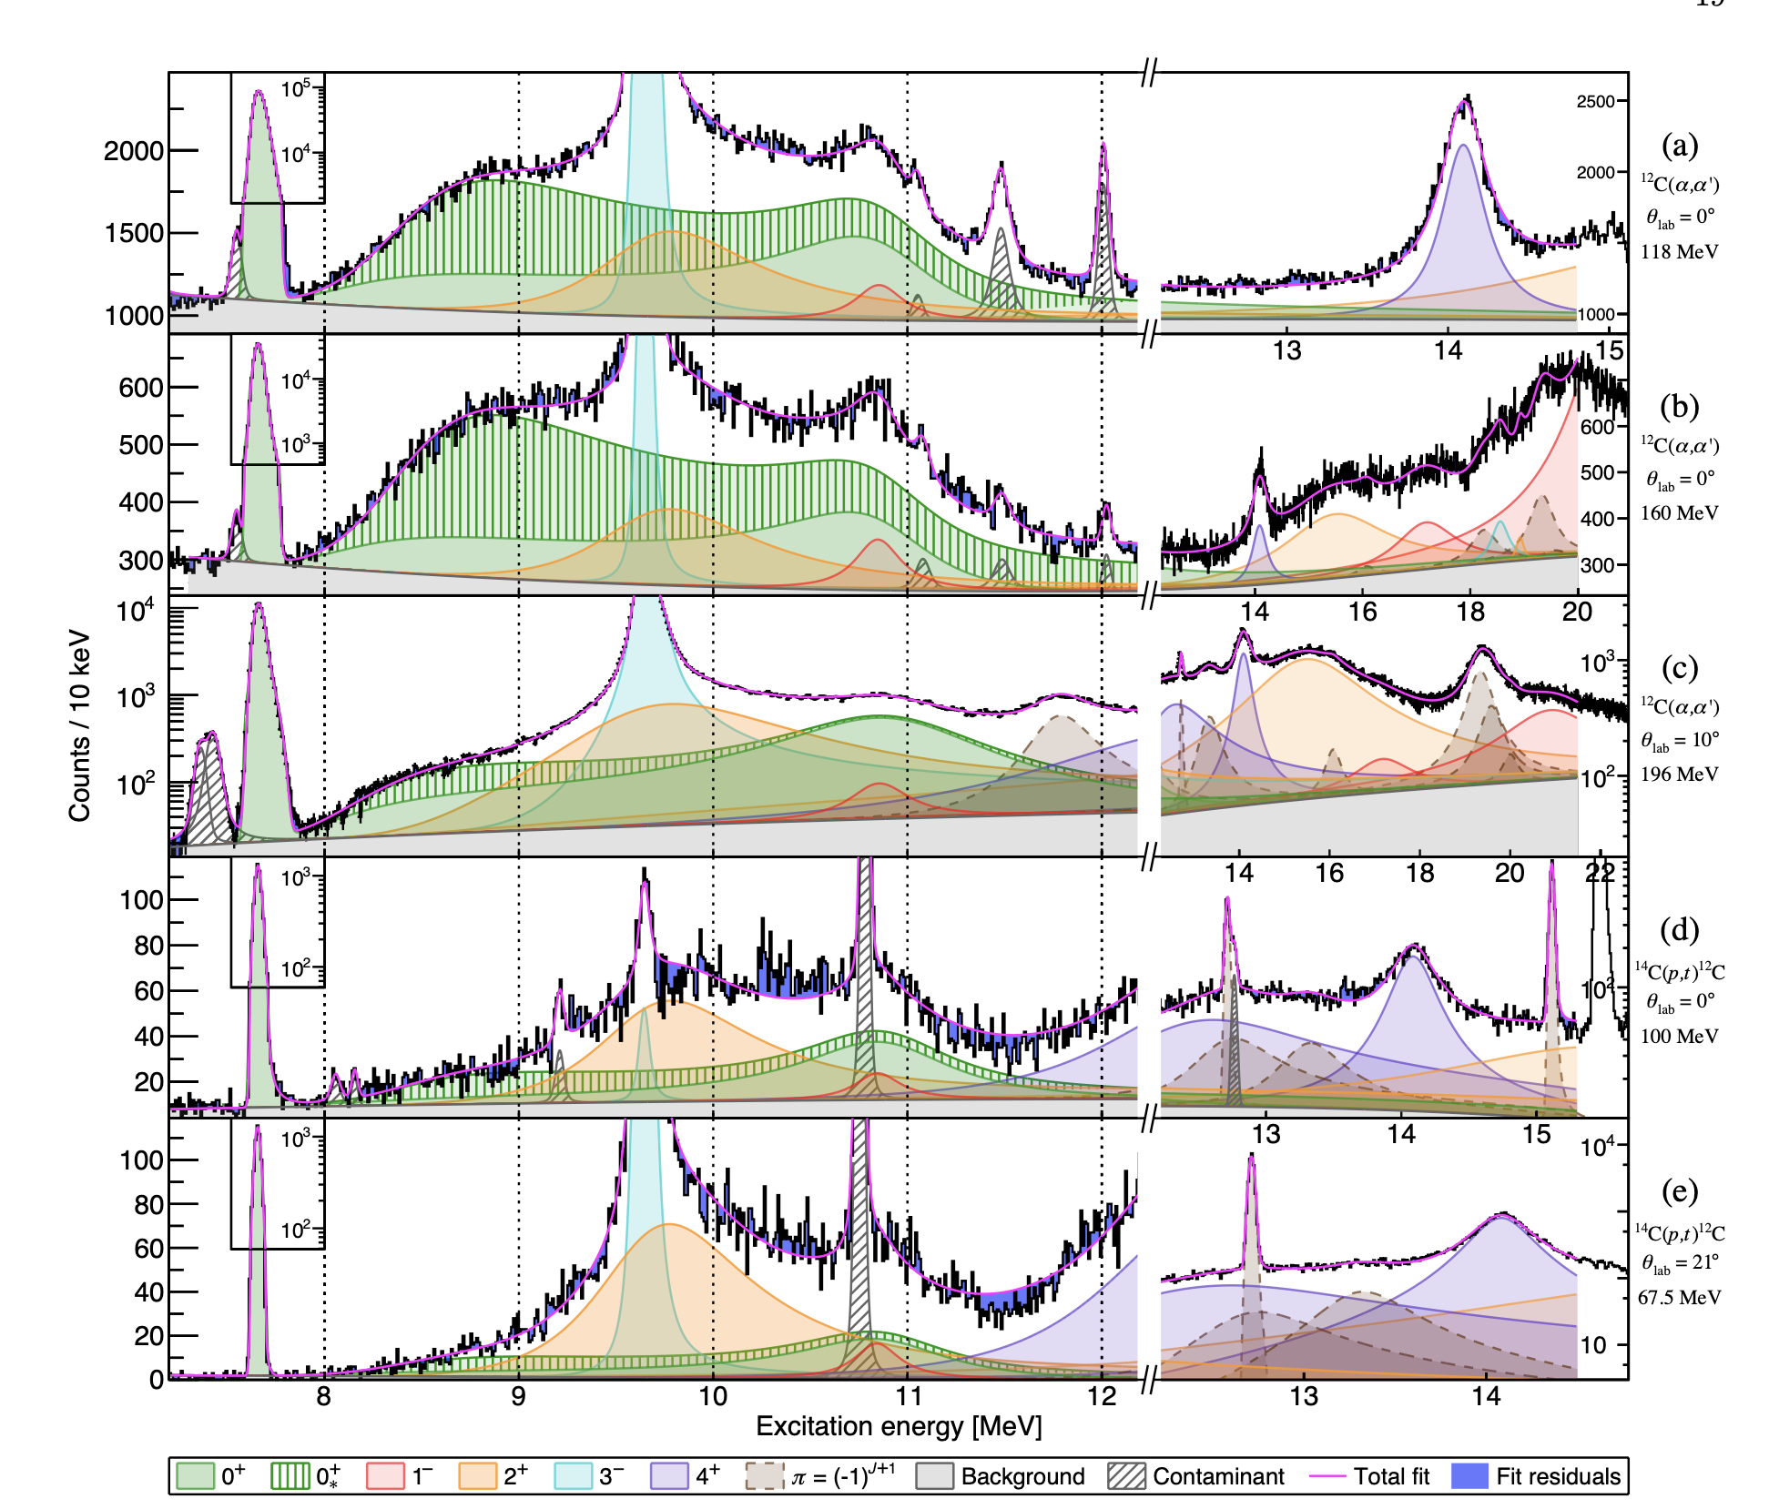
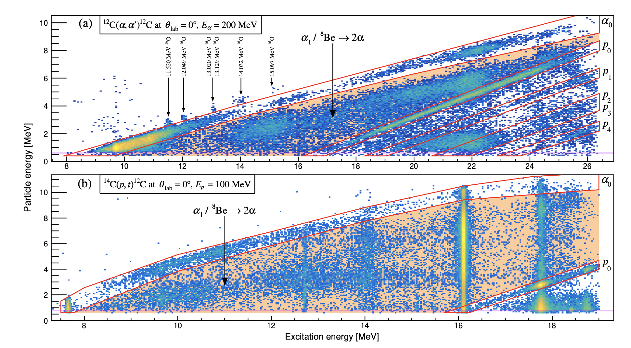
iThemba arXiv:2011.10112

Slide 5
TUNL
Resonances in ¹²C
→
→
→
→
→
→
→

Slide 6
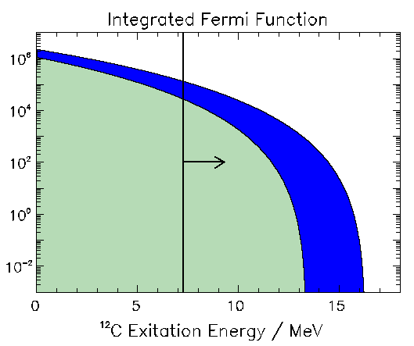
β-decay basics
¹²N/¹²B
1⁺
β-decay
(0⁺, 1⁺ or 2⁺)
1⁺
0⁺ or 2⁺ ?
3α
1-3%
3α
0⁺
97-99%
0⁺
¹²C
Notes:
-Selection rules
-N12
-Difficulty : produce + 3a measurement.
-Method – setup
-Data
-Conclusions 0+ 2+
-Problem with 0+ - key idea.

Slide 7
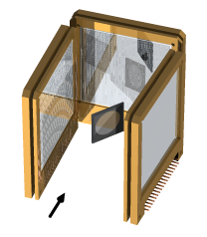
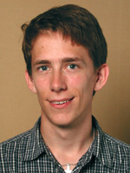
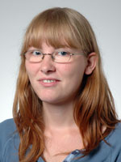
”Historical” introduction I
IGISOL/CERN
Experiments
PL B678, 459 (2009)
PR C80, 044304 (2009)
PR C80, 034316 (2009)
PR C81, 024303 (2010)
¹²N/¹²B
ISOL-beams
C. Diget
(York)
Solveig
Hyldegaard
(Industry)

Slide 8
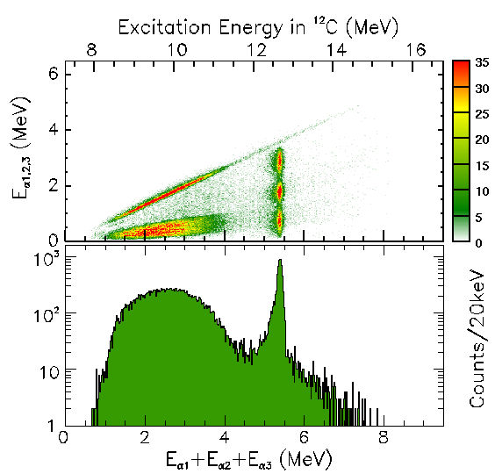
¹²N Q_{beta}=16.32
Natural parity states
15.11 1⁺
12.71 1⁺
≈10
7.65 0⁺
4.44 2⁺
g.s. 0⁺
¹²C

Slide 9
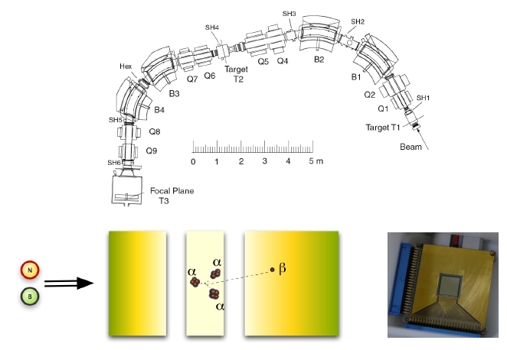
”Historical” introduction II
PL B678, 459 (2009)
PR C80, 044304 (2009)
PR C80, 034316 (2009)
PR C81, 024303 (2010)
K. Jungmann
H. Wilschut
TRIμP separator
Solveig
Hyldegaard
¹²C/¹¹B
beam
¹²N/¹²B
4-5 MeV/u
R.Raabe

Slide 10
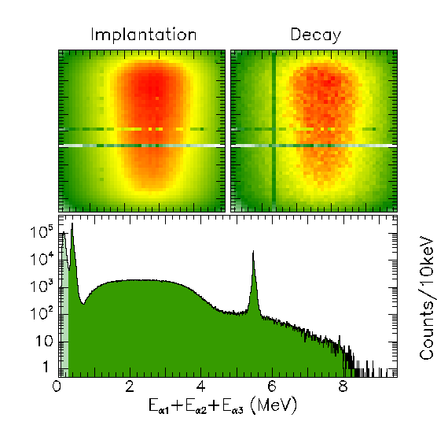
¹²N Q_{beta}=16.32
15.11 1⁺
12.71 1⁺
≈10 0⁺
Efimov?
7.65 0⁺
4.44 2⁺
1⁺
g.s. 0⁺
¹²C
Notes:
Next I show our results from the alternative method where we implanted, in this case 12N, in a thin implantation detector and measured the sum energy directly.
The two scatter plots in the top part show how events are distributed over the surface of the implantation detector, which was segmented with 48 times 48 segments. To the left is the contour plot of implantation events, and to the right is the contour plots of subsequent decays of in this case 12N. The two distributions are consistent with each other.
In the lower part is shown the energy spectrum of decay events. This spectrum shows like the ISOL data the narrow 1+ state at 12.71MeV and the broad distribution around it. In this approach we can measure much lower in sum energy and therefore also have the low energy 7.6MeV 0+ state in the spectrum. The peak at lower energy is from decays to the bound states where only the beta-particle deposits energy. In fact there is also evidence for feeding to the Isobaric Analogue state at 15.1MeV, which mainly decays by gamma-decay.
This analysis is performed by PhD student Solveig Hyldegaard.

Slide 11
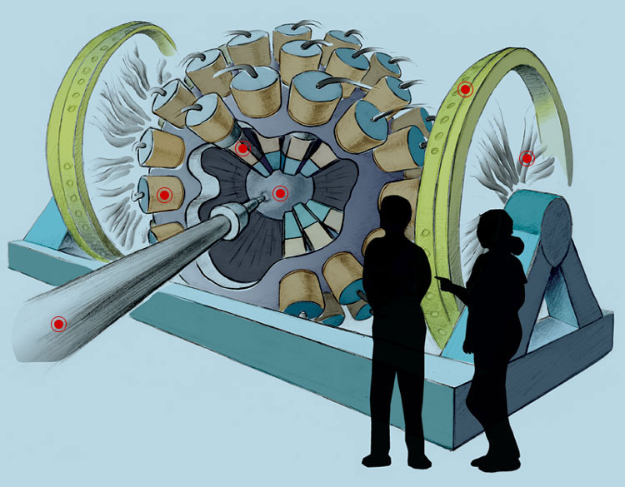
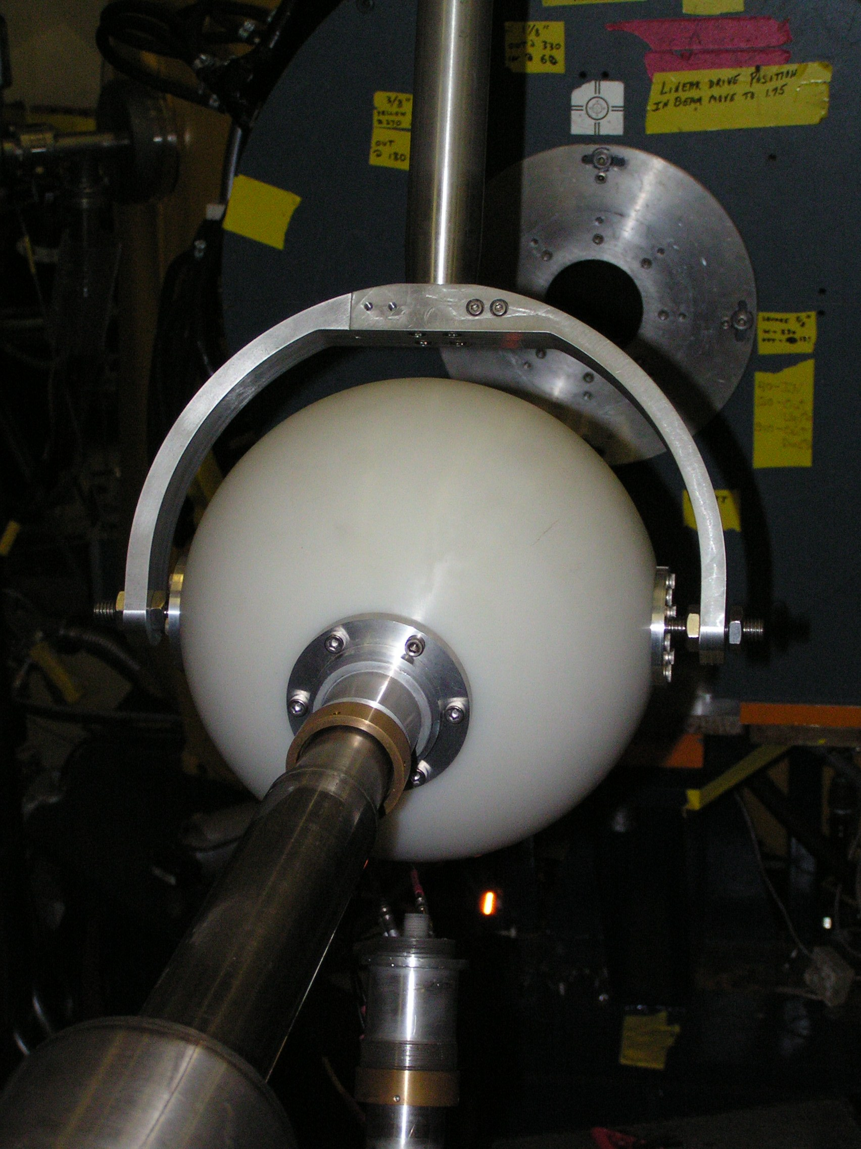
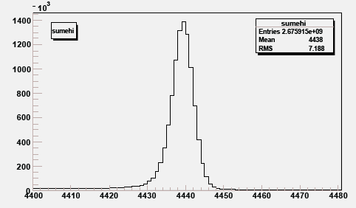
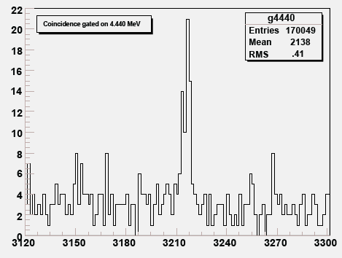
Intro III
Γ_{γ} (Hoyle)
¹²B
1⁺
β-decay
(0⁺, 1⁺ or 2⁺)
Plastic vacuum
chamber
GammaSphere
1⁺
0⁺ or 2⁺ ?
Efimov?
3α
0⁺
0.04%
2⁺
0⁺
¹²C
Munch et al. PRC 93, 065803 (2016)

Slide 12
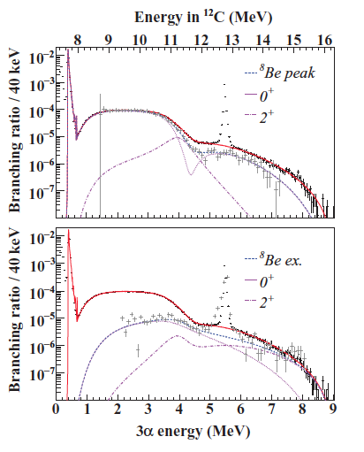
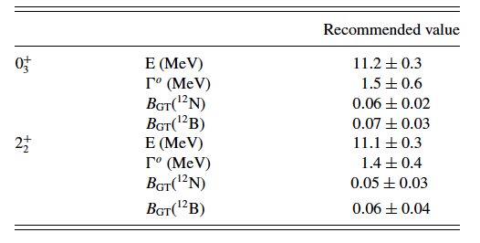
End of”Historical” introduction
PL B678, 459 (2009)
PR C80, 044304 (2009)
PR C80, 034316 (2009)
PR C81, 024303 (2010)
S. Hyldegaard, C. Diget

Slide 13
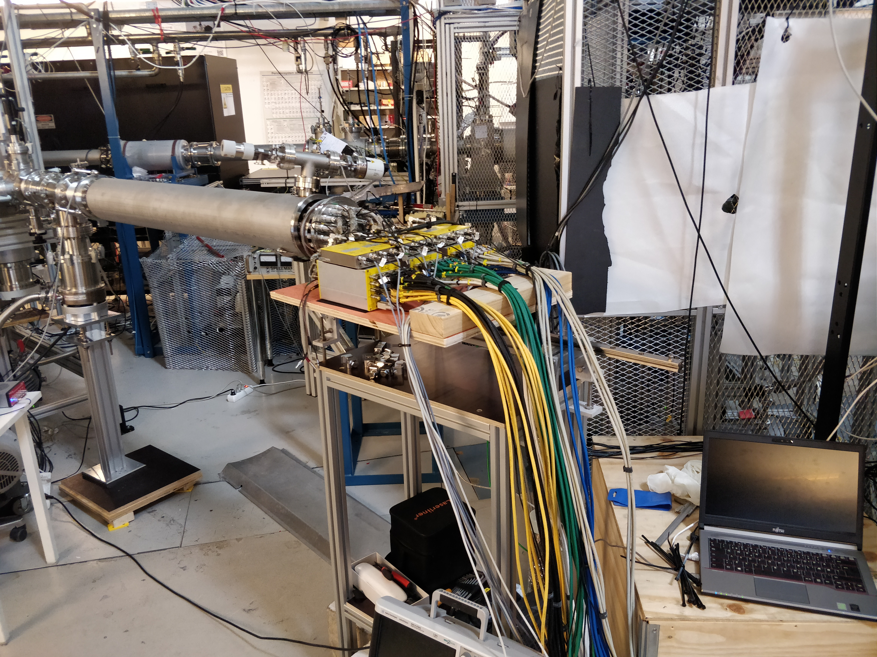
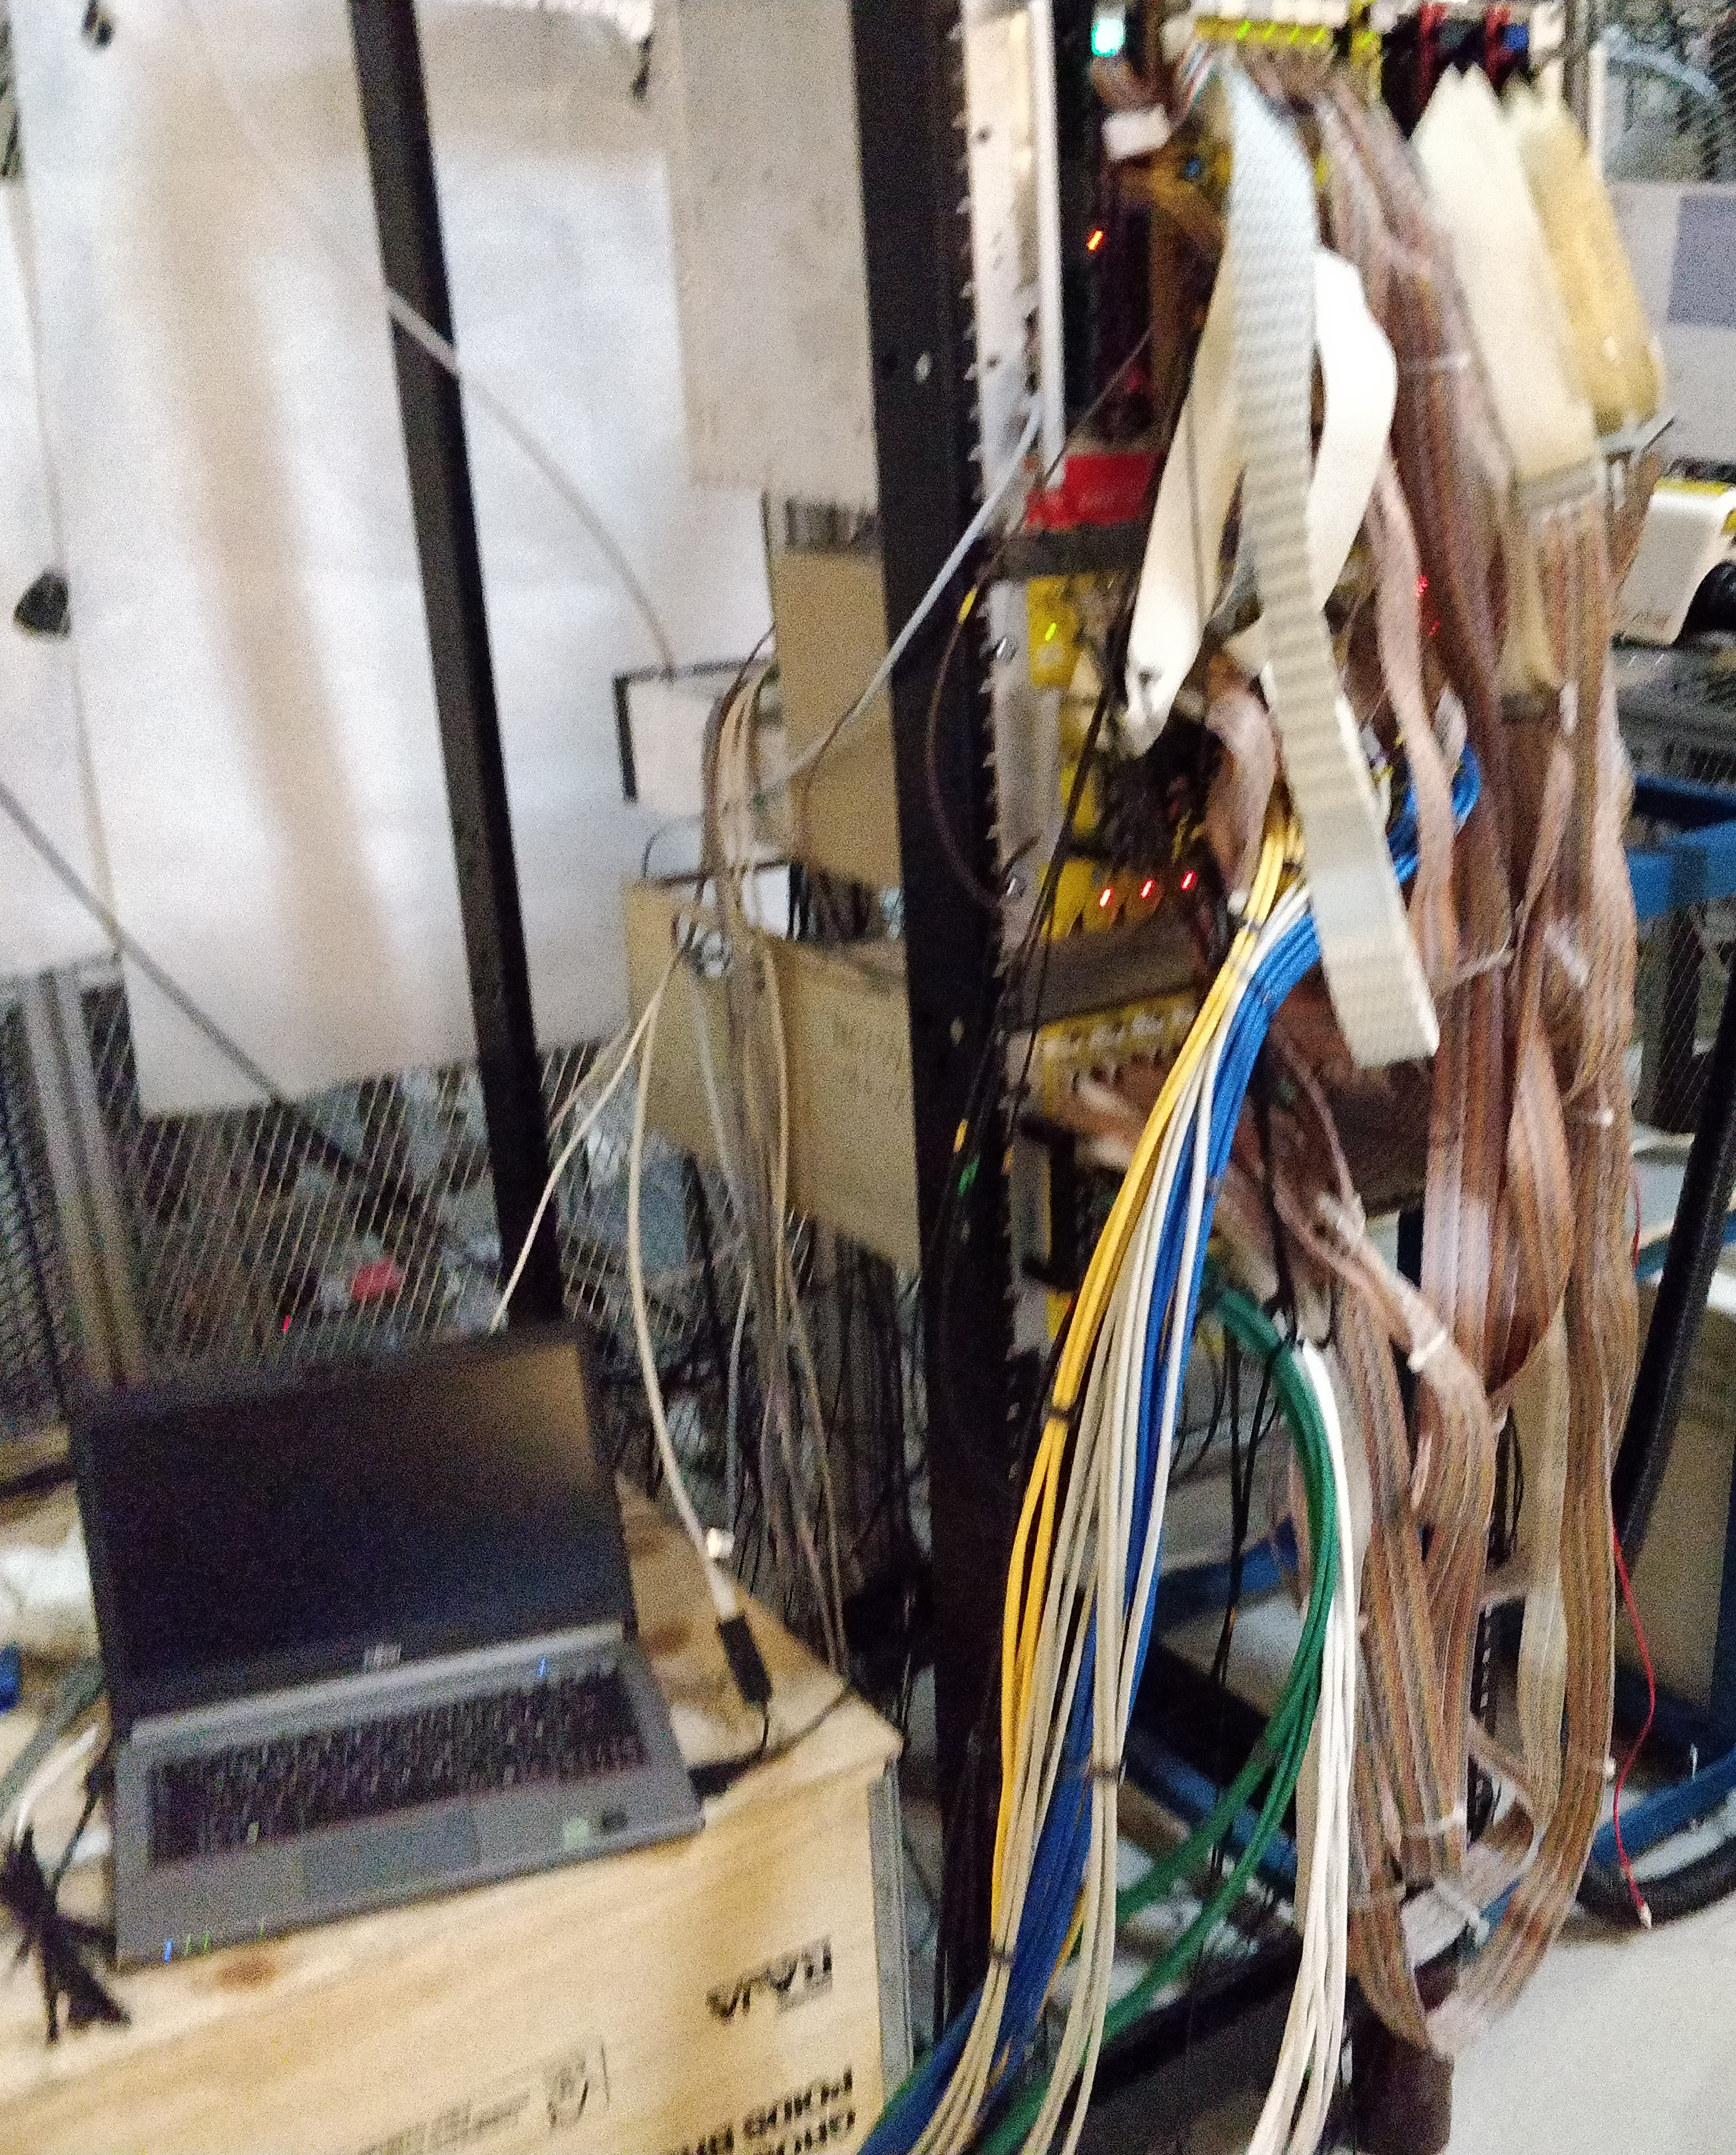
“New” IGISOL Experiments
¹²N 2014 Jonas Refsgaard
¹²B 2020 Andreas Gad, Erik Jensen

Slide 14
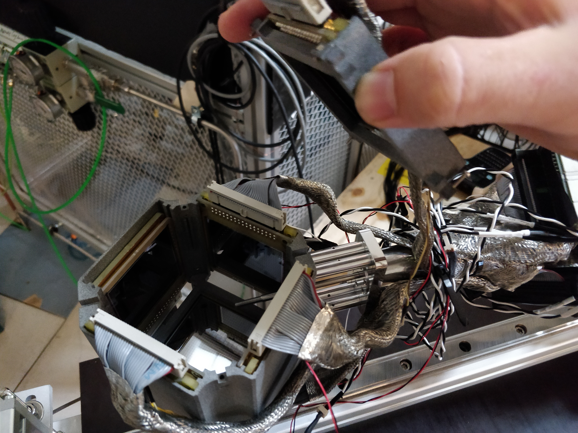

Slide 15
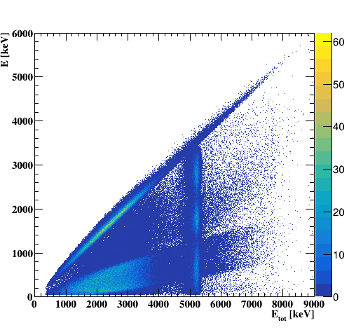
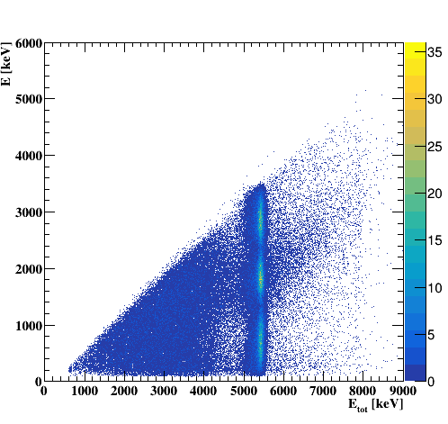
Preliminary
¹²N Q_{beta}=16.32
Natural parity states
15.11 1⁺
12.71 1⁺
≈10
7.65 0⁺
4.44 2⁺
g.s. 0⁺
¹²C

Slide 16
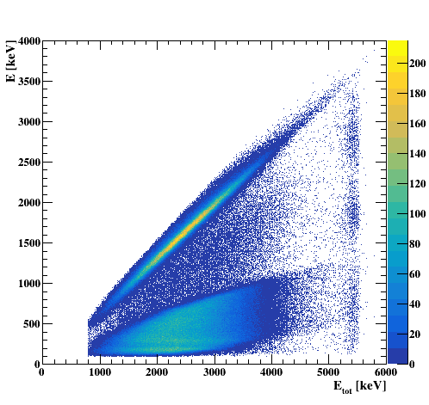
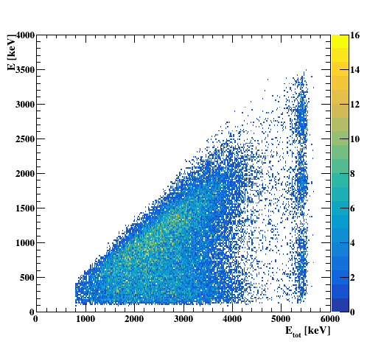
Preliminary
15.11 1⁺
¹²B Q_{beta}=13.37
12.71 1⁺
≈10 0⁺
7.65 0⁺
4.44 2⁺
g.s. 0⁺
¹²C
Notes:
I now present the same series of results for the mirror decay, that of 12B.
First the results from the ISOL experiment at IGISOL, Jyvaskyla.
Due to the lower Q-value in this decay the feeding to the 1+ state is now much less, but other than that the qualitative features are the same.
Note that we now see feeding to the 1+ state in this decay as well.

Slide 17
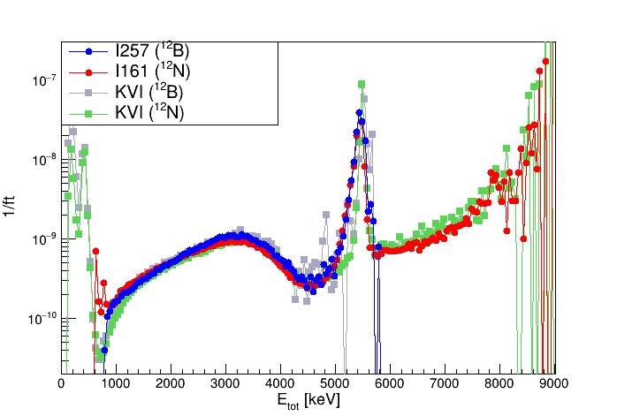
Preliminary
Consistency?
B.R / (f * T_{1/2})

Slide 18
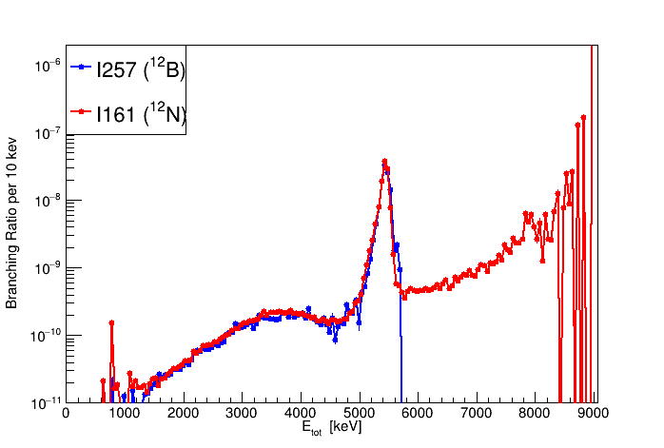
Preliminary
Consistency?
B.R / (f * T_{1/2})

Slide 19
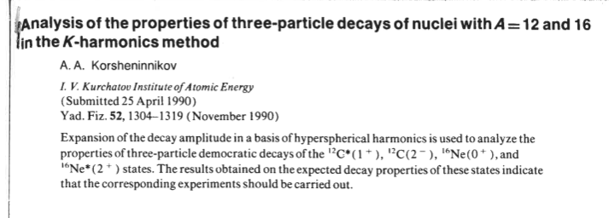
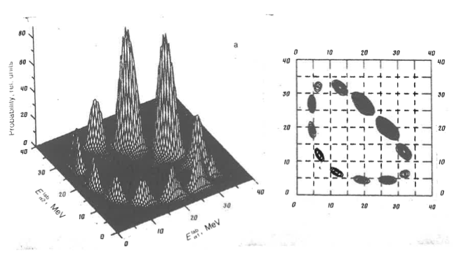

Slide 20
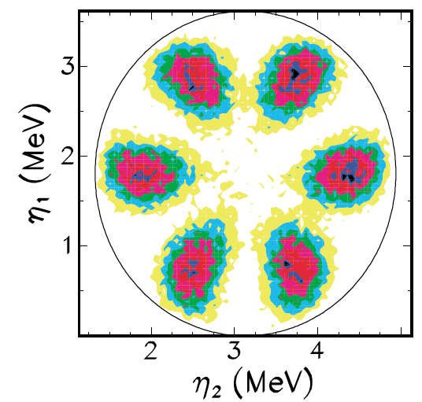
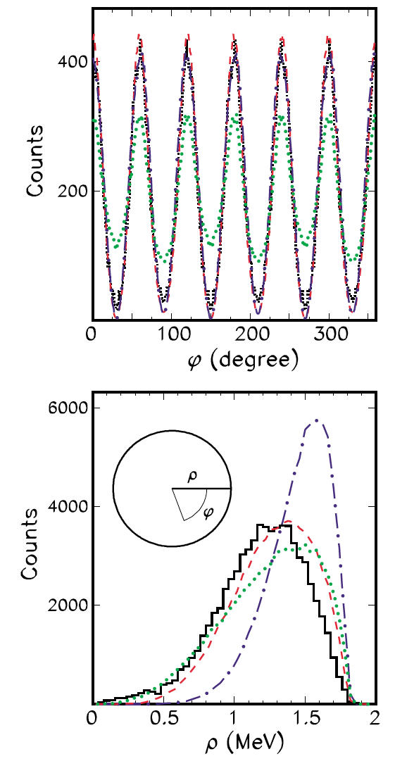
Alvarez-Rodriguez et al. :
PRL 99, 072503 (2007),
Eur. Phys. J. A 31, 303 (2007),
PRC 77, 064305 (2008),
PRL 100, 192501 (2008)
Fynbo et al., PRC 79, 054009 (2009)

Slide 21
¹²B
1-2MeV
2-3MeV
3-4MeV
4-5MeV
5-6MeV
¹²N
Preliminary

Slide 22
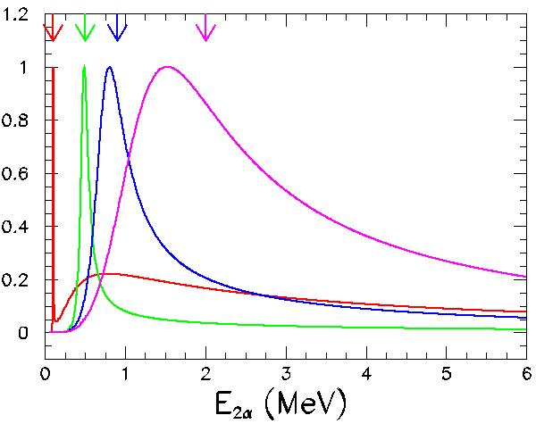
E,Γ
Y : a + b
X
Inner region
Channel radius
Outer region : a + b

Slide 23
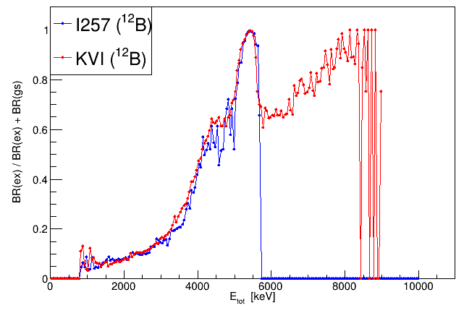
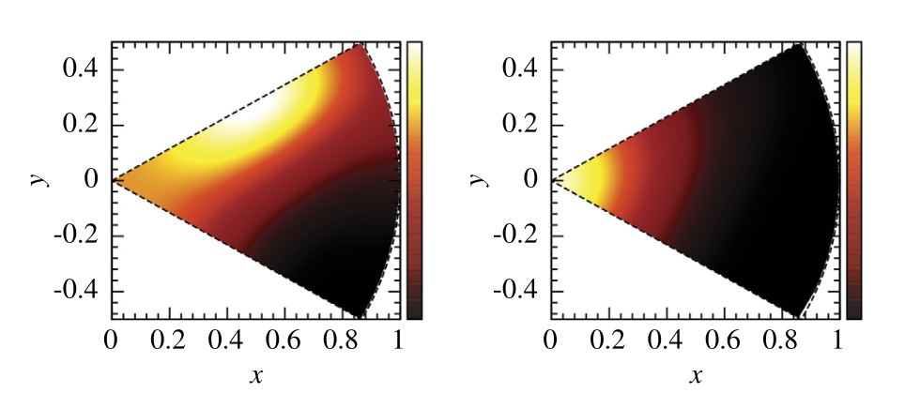
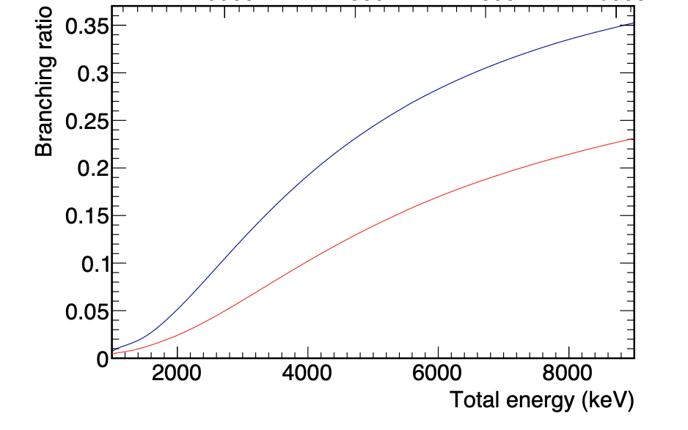
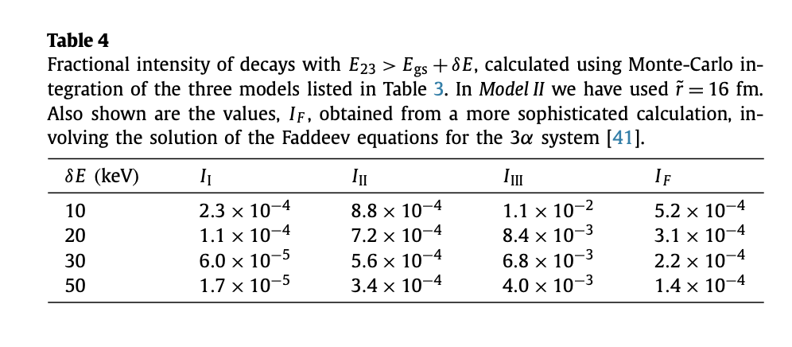
Preliminary
A. Gad
⁸Be 2⁺
Refsgaard et al.
Phys. Lett. B 779 (2018) 414–419
J. Refsgaard

Slide 24
Preliminary
Refsgard (¹²N)
Gad (¹²B)
Data
Fit

Slide 25
→
→
→
?
→
?
→
?

Slide 26
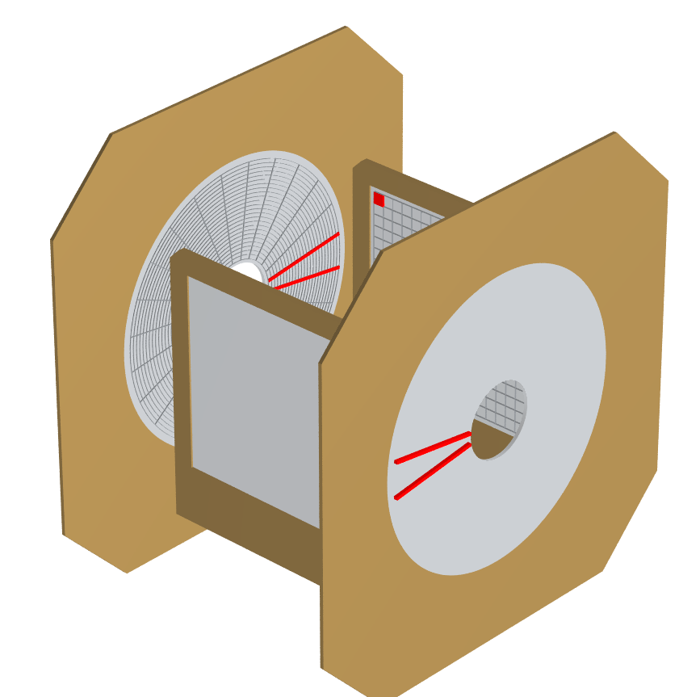
γ-decay to the continuum : ¹²C
Michael Munch
Kasper Laursen
Oliver Kirsebom
← 165 keV p+¹¹B
¹¹B target
p
Notes:
-Gamma instead of beta.
-Data from B11 + p. Accelerator in Aarhus. Setup.
-2+. Alpha-decay. Rare gamma-decays seen from less energy.
-Broad structures. Must be 2+. Confirms beta-decay results. No 0+.
-Validates key idea. Lots to do. Difficulties.

Slide 27
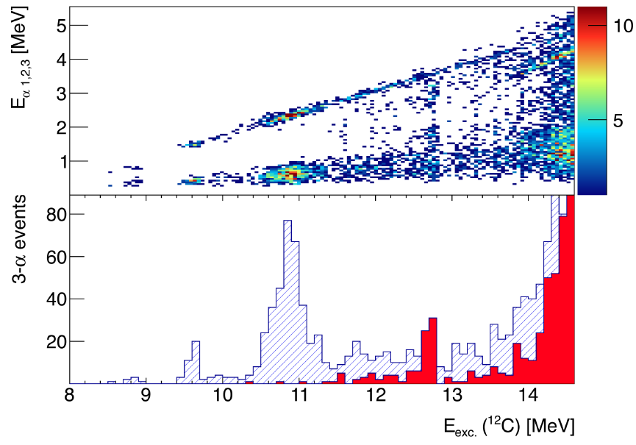
γ-decay to the continuum : ¹²C
Eur. Phys. J. A (2016) 52: 370.
← 165 keV p+¹¹B
B(M1) / B(E1) values in paper
Notes:
-Gamma instead of beta.
-Data from B11 + p. Accelerator in Aarhus. Setup.
-2+. Alpha-decay. Rare gamma-decays seen from less energy.
-Broad structures. Must be 2+. Confirms beta-decay results. No 0+.
-Validates key idea. Lots to do. Difficulties.

Slide 28
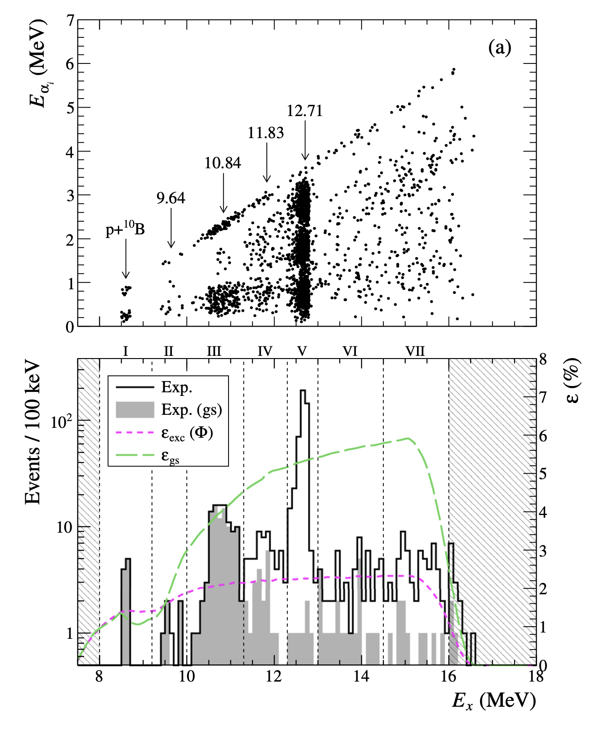
γ-decay to the continuum : ¹²C
Eur. Phys. J. A (2020) 56: 179.
2 MeV p+¹¹B→0⁺ (T=1)
B(M1) / B(E1) values in paper
Notes:
-Gamma instead of beta.
-Data from B11 + p. Accelerator in Aarhus. Setup.
-2+. Alpha-decay. Rare gamma-decays seen from less energy.
-Broad structures. Must be 2+. Confirms beta-decay results. No 0+.
-Validates key idea. Lots to do. Difficulties.

Slide 29
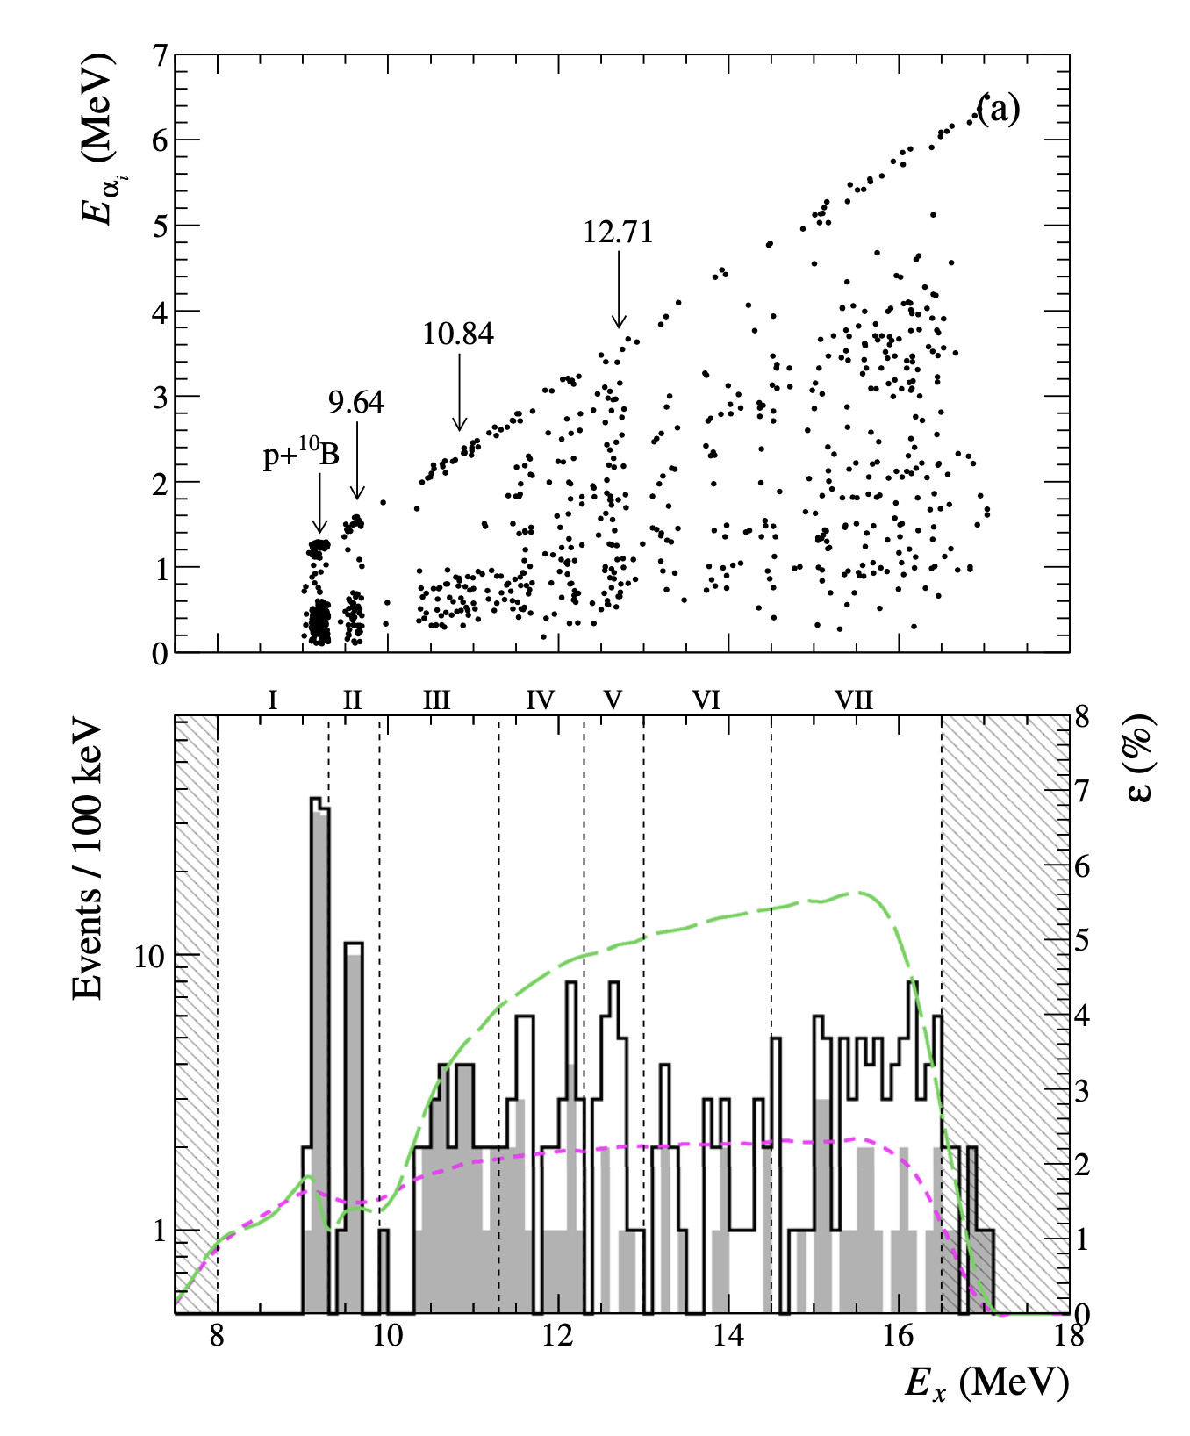
γ-decay to the continuum : ¹²C
Eur. Phys. J. A (2020) 56: 179.
2.65 MeV p+¹¹B→3⁻ (T=1)
B(M1) / B(E1) values in paper
Notes:
-Gamma instead of beta.
-Data from B11 + p. Accelerator in Aarhus. Setup.
-2+. Alpha-decay. Rare gamma-decays seen from less energy.
-Broad structures. Must be 2+. Confirms beta-decay results. No 0+.
-Validates key idea. Lots to do. Difficulties.

Slide 30
Decay-spectroscopy
of neutron deficient
Al, Si, P and S

Slide 31
Thank you for your attention!

