Slide 1
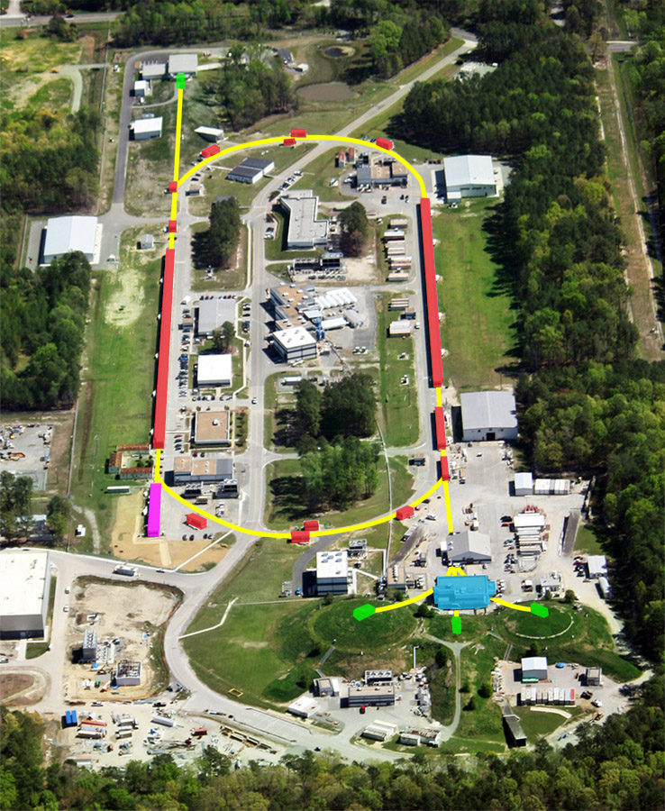
Nuclear Parton Distributions from nCTEQ
Cynthia Keppel
F. Olness, J. Owens, D.B. Clark, E. Godat, T. Jezo, CK, K. Kovarik, A. Kusina, F. Lyonnet, J. Morfin, I. Schienbein, J.Y. Yu
https://ncteq.hepforge.org/ncteq15/ncteq15.html

Slide 2

Why Nuclear PDFs???
PDFs broadly serve two purposes…
A tool for interpreting collider physics
A way to understand the partonic struture of nucleons
nPDFs the same…
A tool for interpreting heavy ion collisions (LHC, RHIC)
A tool for interpreting neutrino experiments (use nuclear targets)
A way to look at medium modifications to nucleon PDFs
DIS e-A, mu-A (JLab, SLAC, CERN NMC, EMC, EIC,....)
A way to look at nuclear structure from a partonic point of view

Slide 3
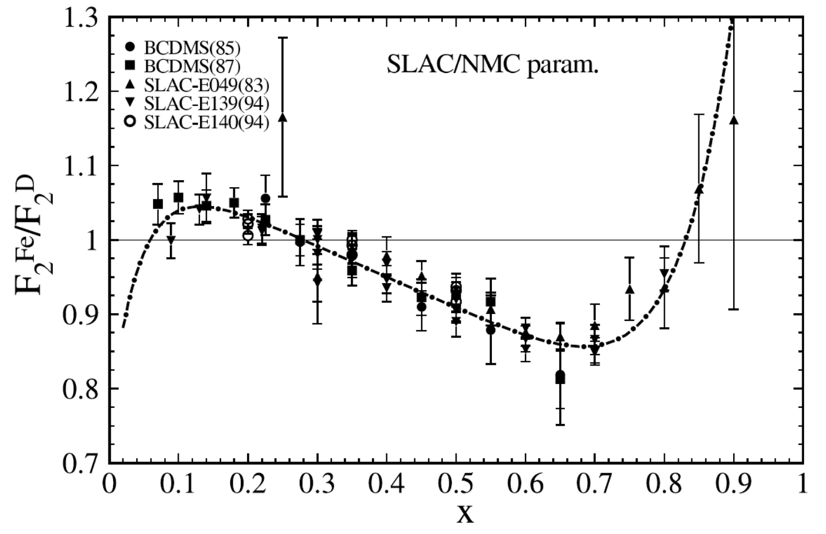
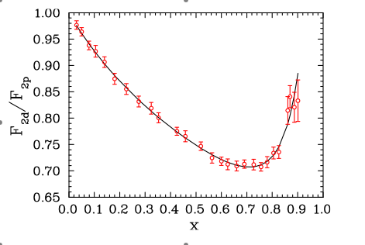
Nuclear PDFs
Parton momentum distributions modified by nuclear environment
Historically nuclear effects are described in regions of x
      Shadowing
      Anti-Shadowing
      EMC Effect
      Fermi Motion
    Nuclear corrections are needed for A>1!
(2)
(4)
(1)
(3)
F₂^{d}/F₂^{p}
J. Arrington, F. Coester, R.J. Holt, T.-S.H. Lee, J.Phys. G36 (2009) 025005
3/
Notes:
4/16/18
3
3

Slide 4
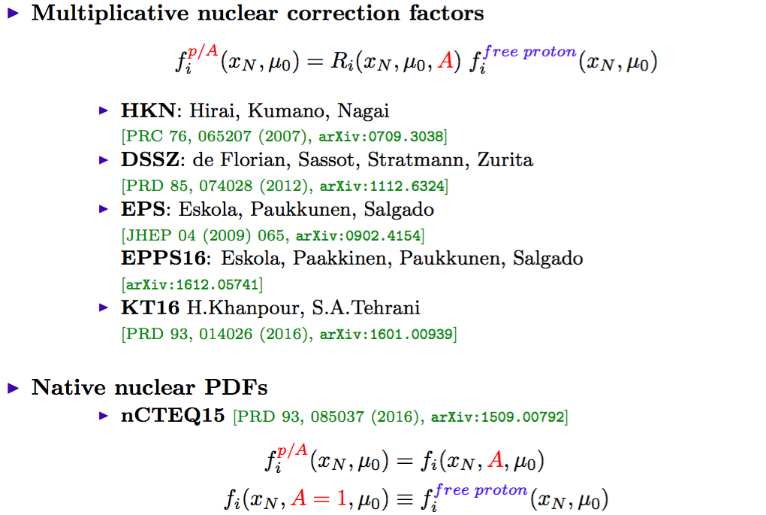
Available Nuclear PDFs

Slide 5

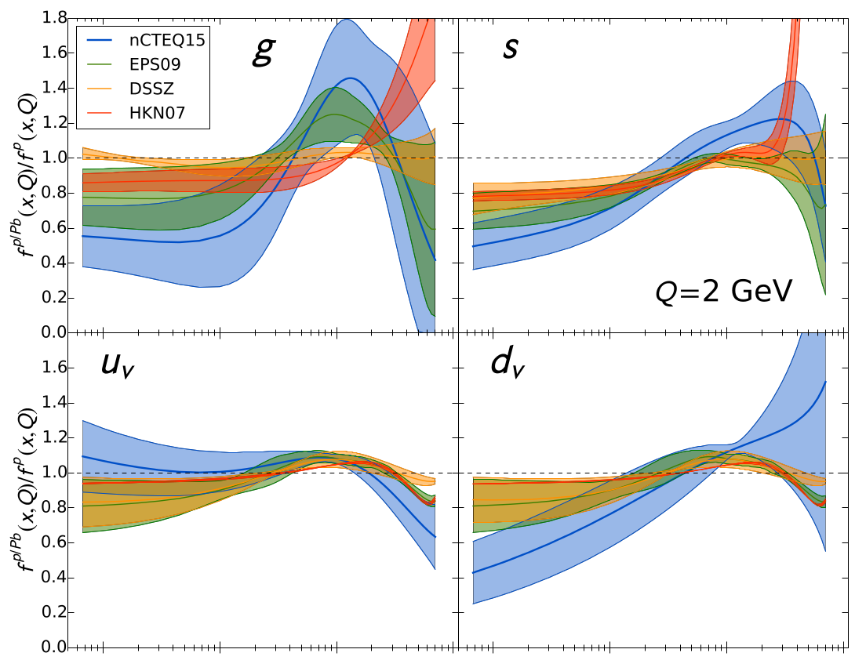
nCTEQ PDFs Formalism: Generalized A Parameterization
Bound proton (f_{i}^{p/A}) PDFs parametrized
Bound neutron PDFs (f_{i}^{n/A}) constructed assuming isospin symmetry
F_{i}^{n,p/A} -> 0 as x -> 1
~3 times more parameters than nucleon fits
    But… Fewer data points
5/
Notes:
4/16/18
5
5

Slide 6
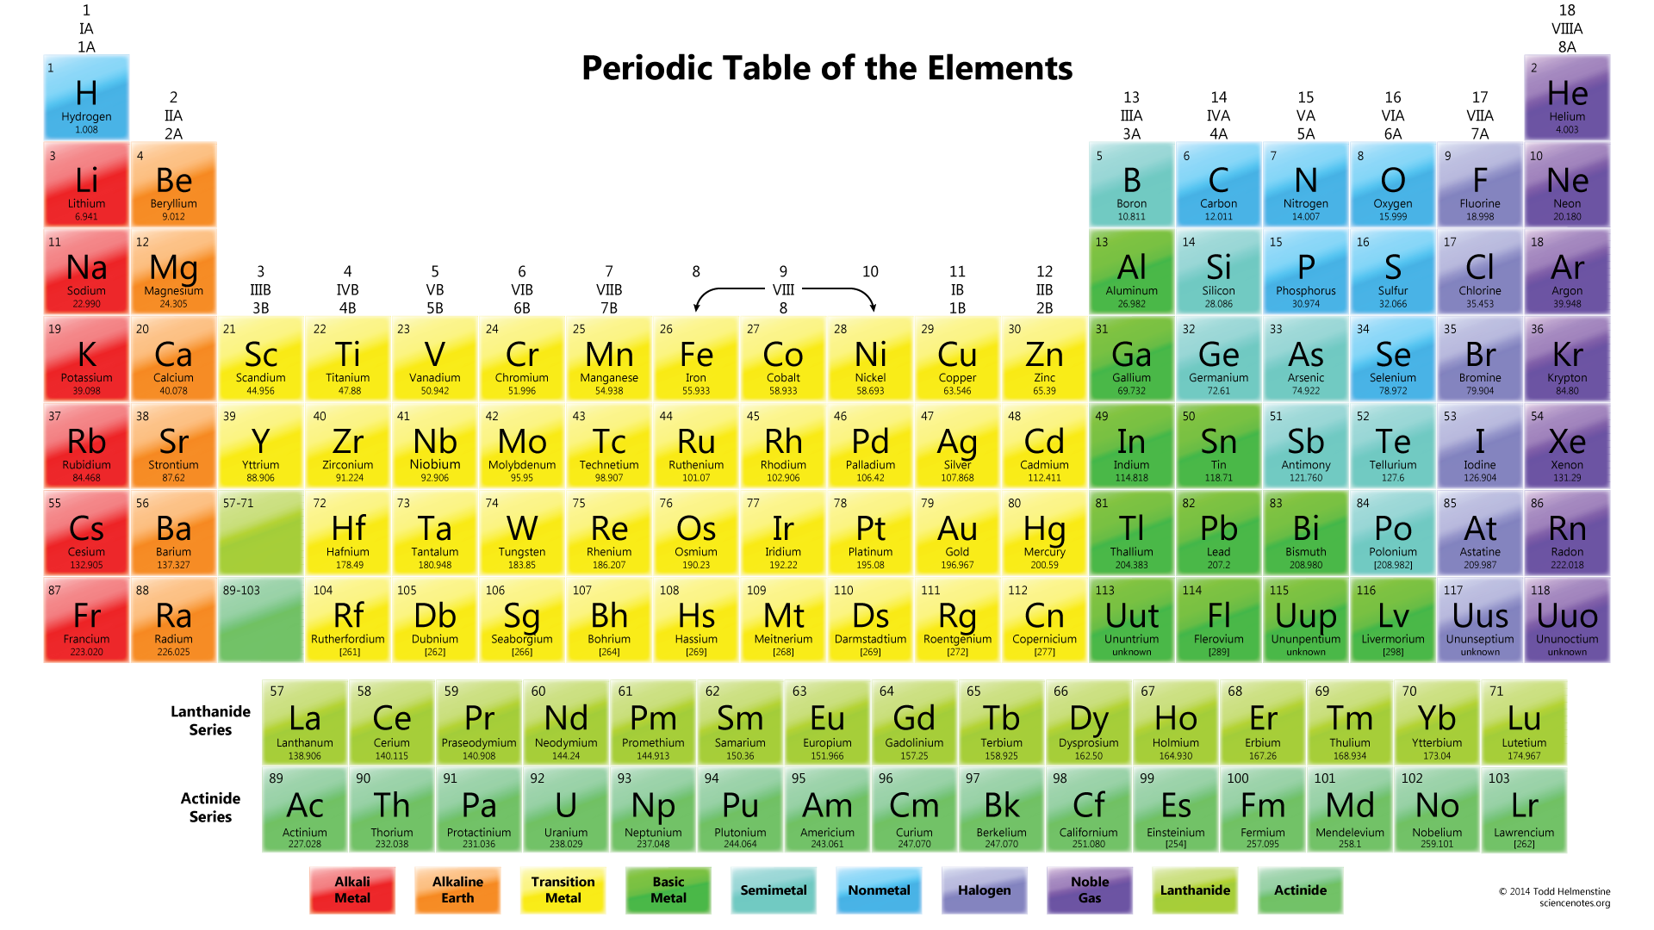
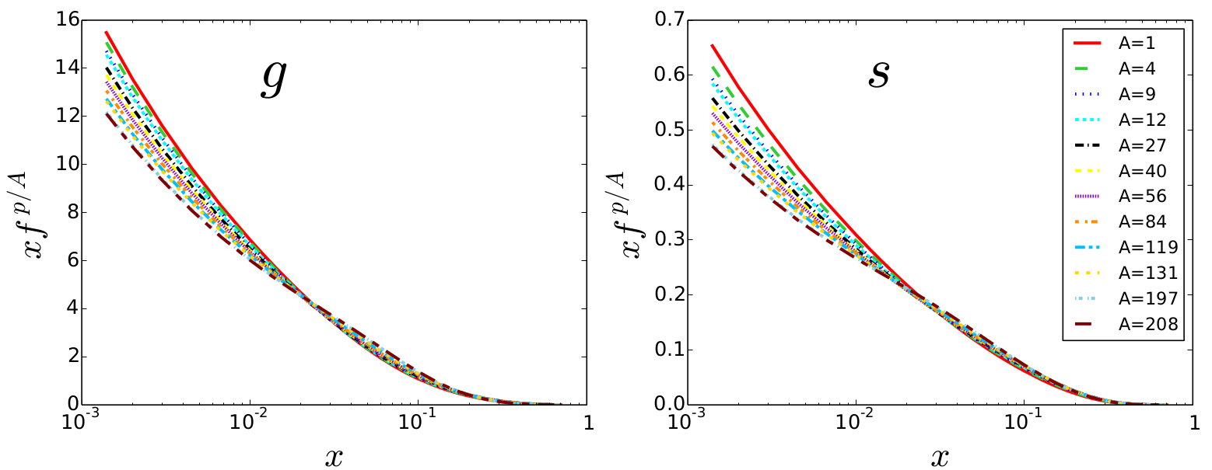
nCTEQ PDFs
  Nuclei with DIS data included in nCTEQ15
  Currently at NLO
  Parameterization allows for construction of any nuclei
6/
Notes:
4/16/18
6
6

Slide 7
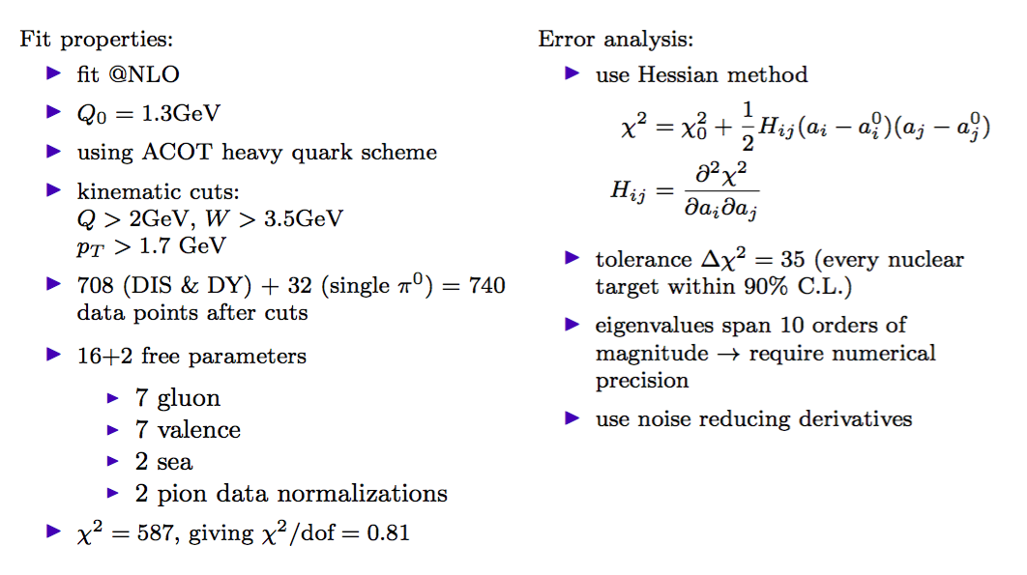
nCTEQ15 Fit Details
(2947 points for CT14 proton!)
K. Kovarik et al. [The nCTEQ Collaboration], Phys. Rev., D93(8):085037, 2016

Slide 8
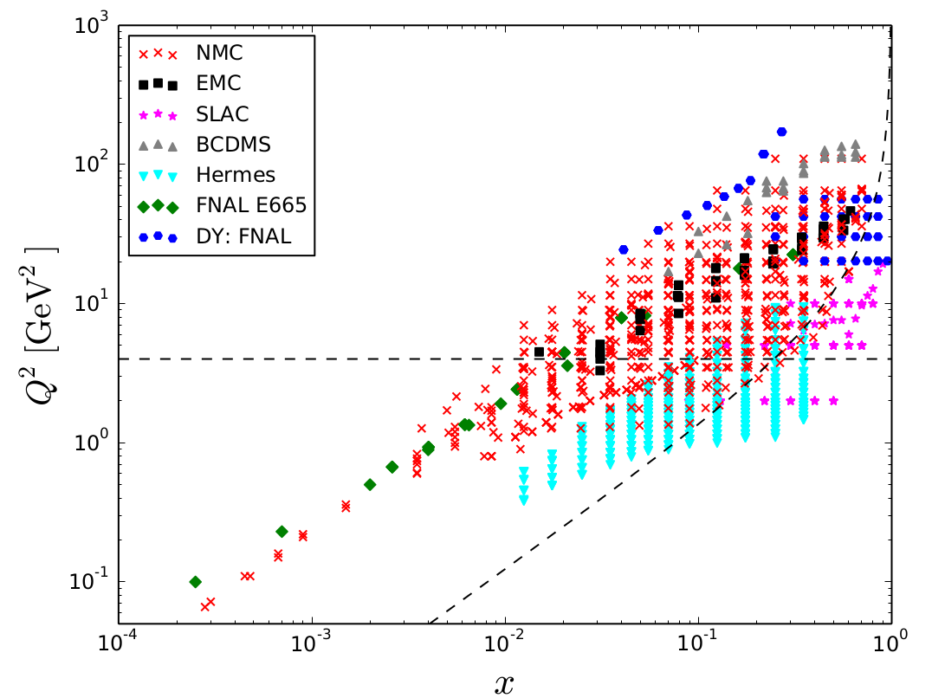
nCTEQ15 PDF Set
Included Points
Typical W² = 12.25, Q² = 4 GeV² cuts remove large amount of large x data
8/
Notes:
4/16/18
8
8

Slide 9
A digression….
Going a bit outside the traditional nPDF pen….
Notes:
4/16/18
9
9

Slide 10

CTEQ-Jefferson Lab “CJ” PDF Fits
Phys. Rev. D81:034016 (2010) Phys. Rev. D84:014008 (2011)
Phys. Rev. D87:094012 (2013) Phys. Rev. D93 114017 (2016)
PDFs at http://lhapdf.hepforge.org/lhapdf5/pdfsets CJ collaboration: http://www.jlab.org/CJ
Goals:
  Extend CTEQ (not yet nCTEQ!!) fit to larger values of x and lower values of Q²
  Incorporate data previously subject to kinematic cuts (SLAC and JLab largely)
To accomplish this:
  Need to relax conventional cuts defining “safe” region for issues such as higher twist, target mass - now need to take these into account
  Allow d/u to go to a constant (not just (1-x)ª type form)
  Need accurate deuteron nuclear corrections

Slide 11
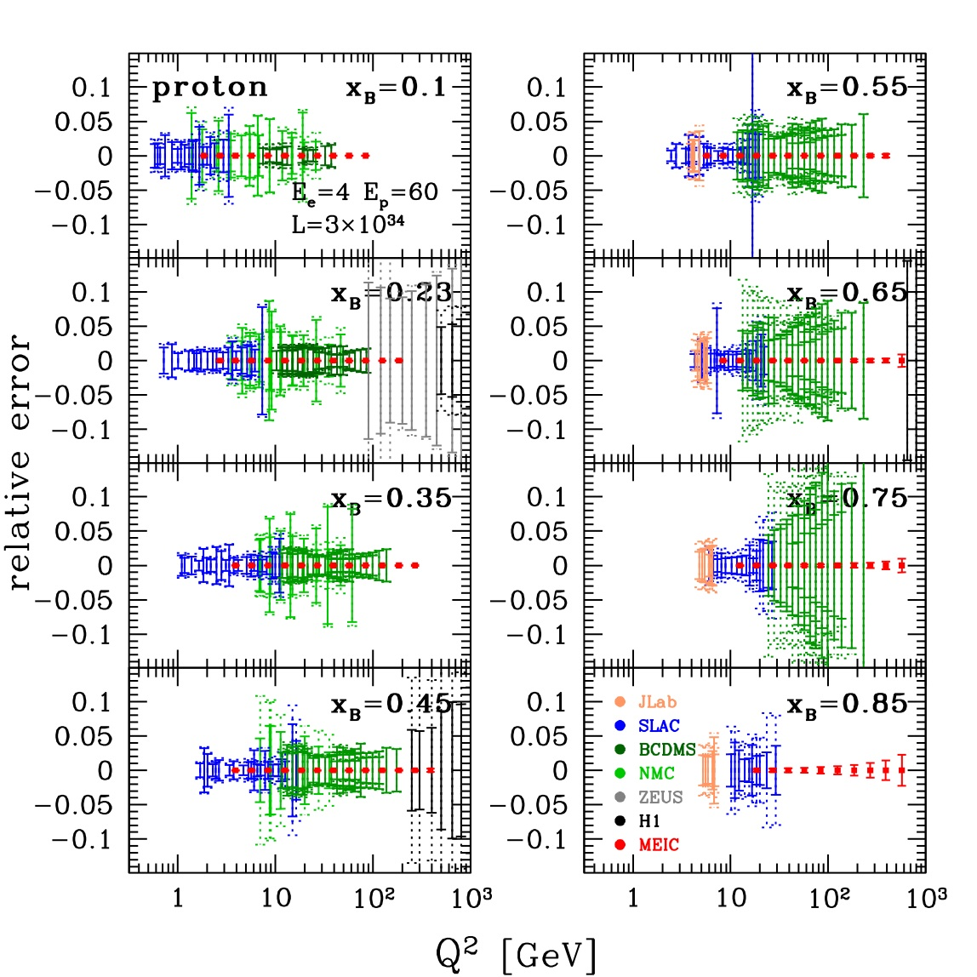
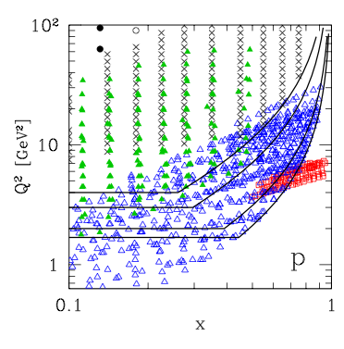
Typical W, Q cuts are restrictive….
Current Q² > 4 GeV², W² > 12.25 GeV², cuts
Reduced CJ cuts
Typical cuts essentially leave no data below x~0.75
What large x data there is has large uncertainty
(Ignore red, projected mEIC data points.)

Slide 12
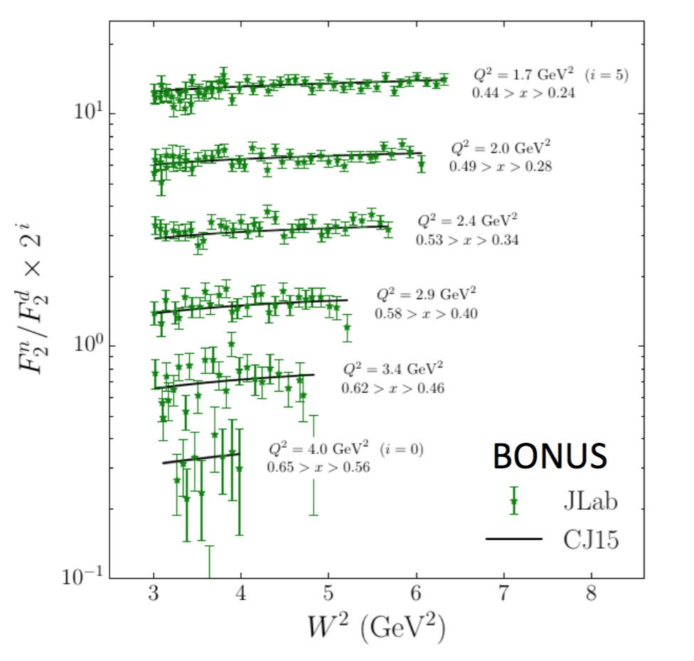
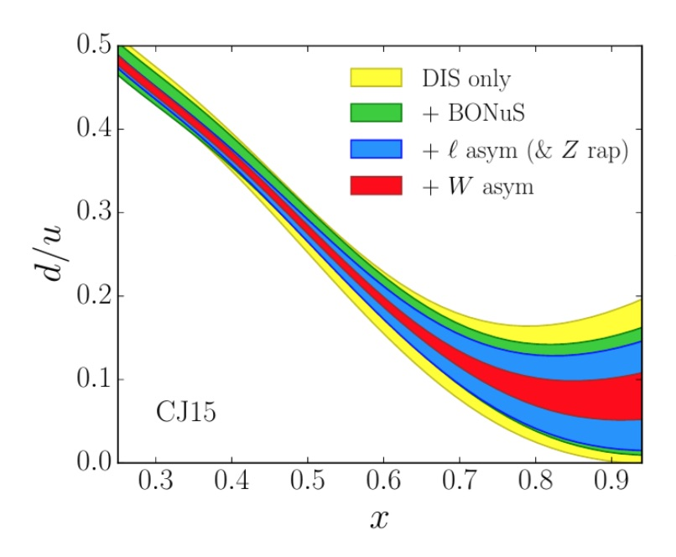
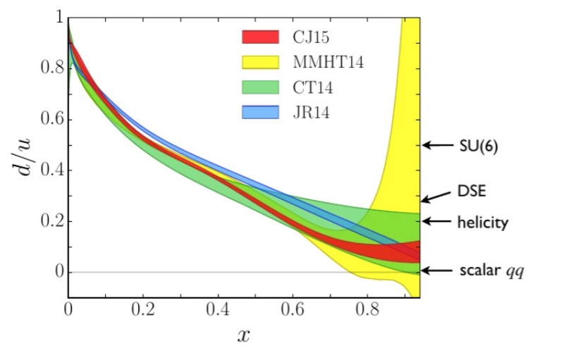
CJ15
Results
Dedicted neutron paper in draft
BONuS data well fit by CJ
Effect of adding BONUS (also W, l asymmetries from D0)
Substantial reduction in d/u uncertainty at large x!
www.jlab.org/theory/cj/index.html

Slide 13
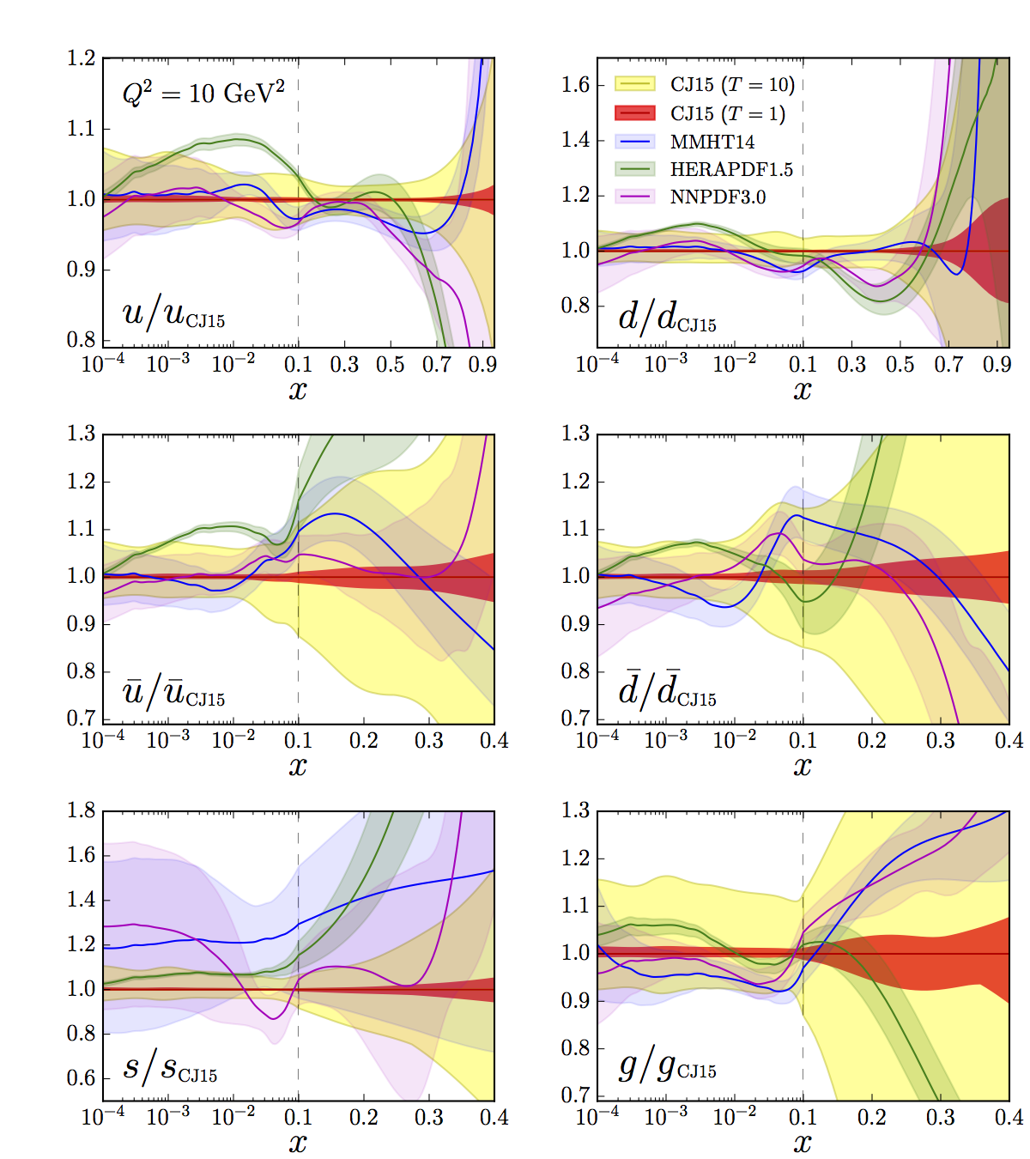
CJ15 Global Fit
Phys. Rev. D93 114017 (2016)
State-of-the-art in large x PDFs
> 50% uncertainty on d(x) above x ~ 0.6
> 50% uncertainty on g(x) above x ~ 0.2
More experiments still needed at large x… JLab MARATHON (just completed!), BONUS12 (Fall 2019 run), SoLID PVDIS,...

Slide 14
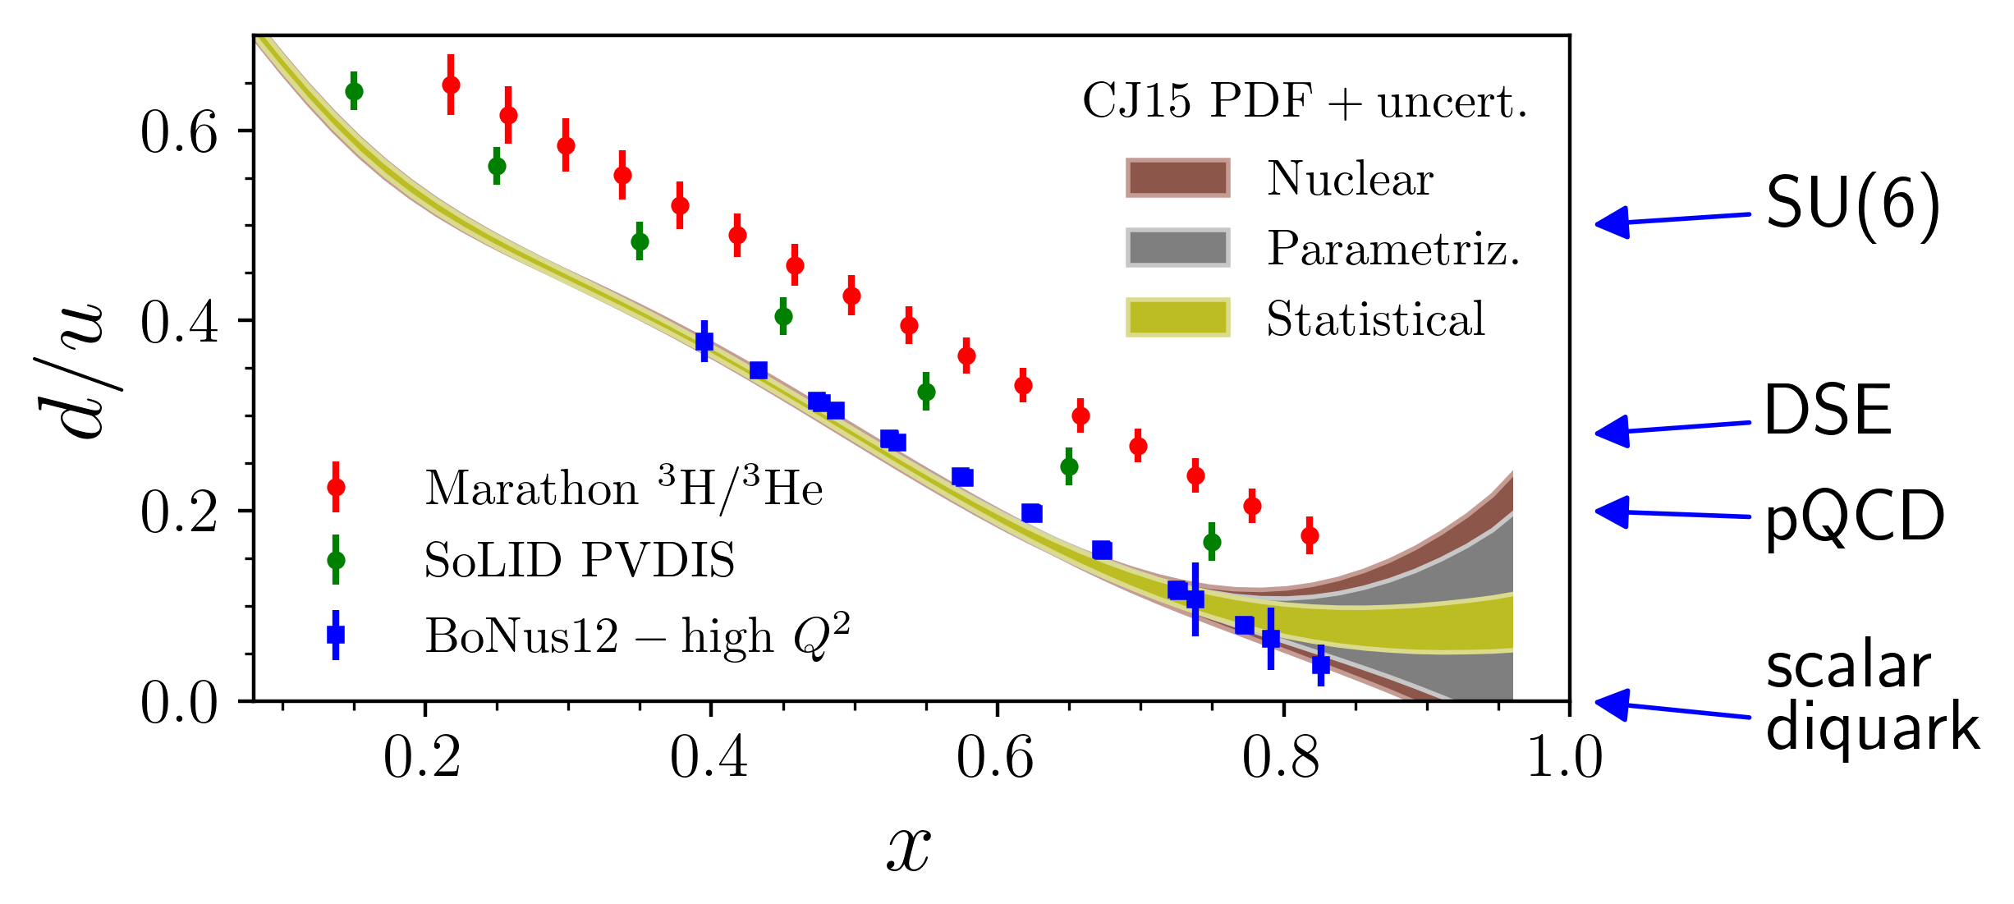
Probing the Valence Regime at JLab12
New generation of experiments at JLab at 12 GeV will access the regime where valence quarks dominate
First experiments COMPLETED!
  Hall C F2p,d
  Hall A 3H/3He
Dedicated effort to extract valence PDFs
  “CJ”, (CTEQ-Jefferson Lab) – and also “JAM” (polarized pdf) collaborations
Also SeaQuest Drell-Yan experiment E906 at FNAL focused on high x sea
Expect large improvements in our understanding of the valence regime in the next 1-2 years!

Slide 15
A little further off the ranch…. (but I think a nice point for this meeting)....
Notes:
4/16/18
15
15

Slide 16

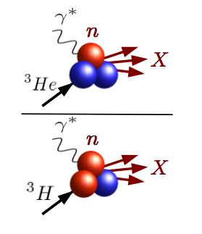
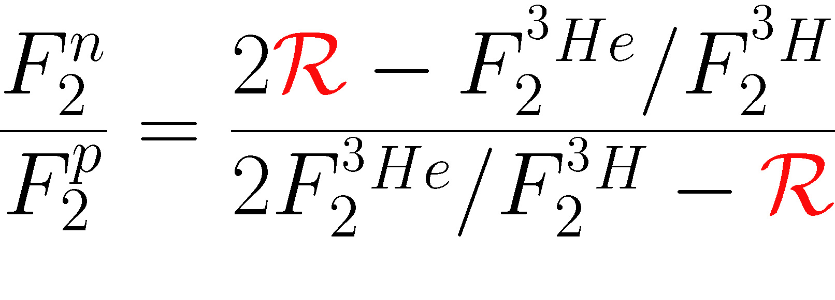
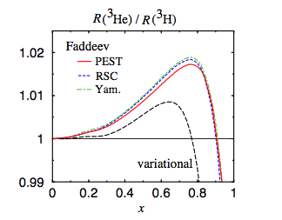
MARATHON: Deep Inelastic Scattering from A=3 Nuclei
Mirror symmetry of A=3 nuclei
  Extract F₂^{n}/F₂^{p} from ratio of measured ³He/³H structure functions
R = SUPER ratio of ”EMC ratios” for ³He and ³H
- Relies only on difference in nuclear effects in ³H, ³He
- Calculated to within 1%
- Most systematic and theoretical uncertainties cancel
I. Afnan et al, PRC 68 (2003)

Slide 17
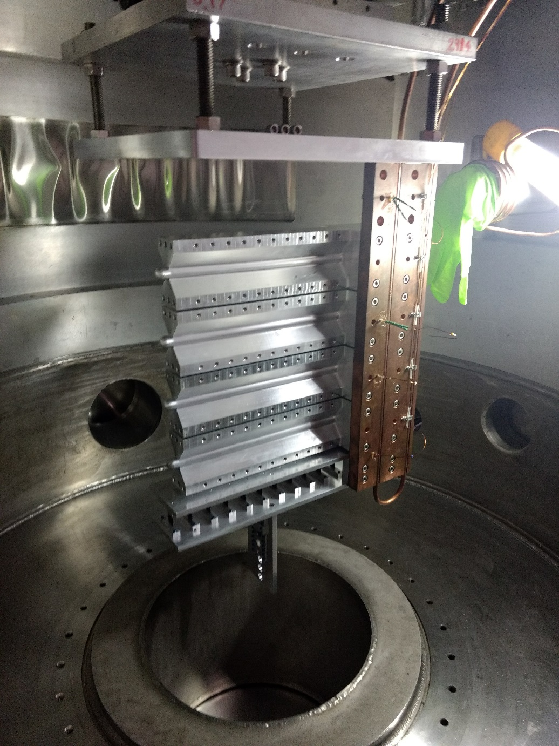
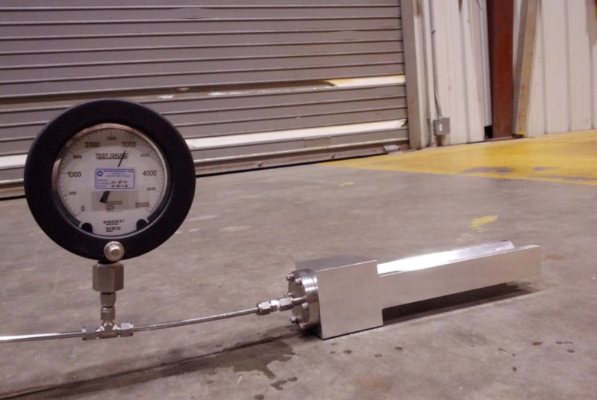
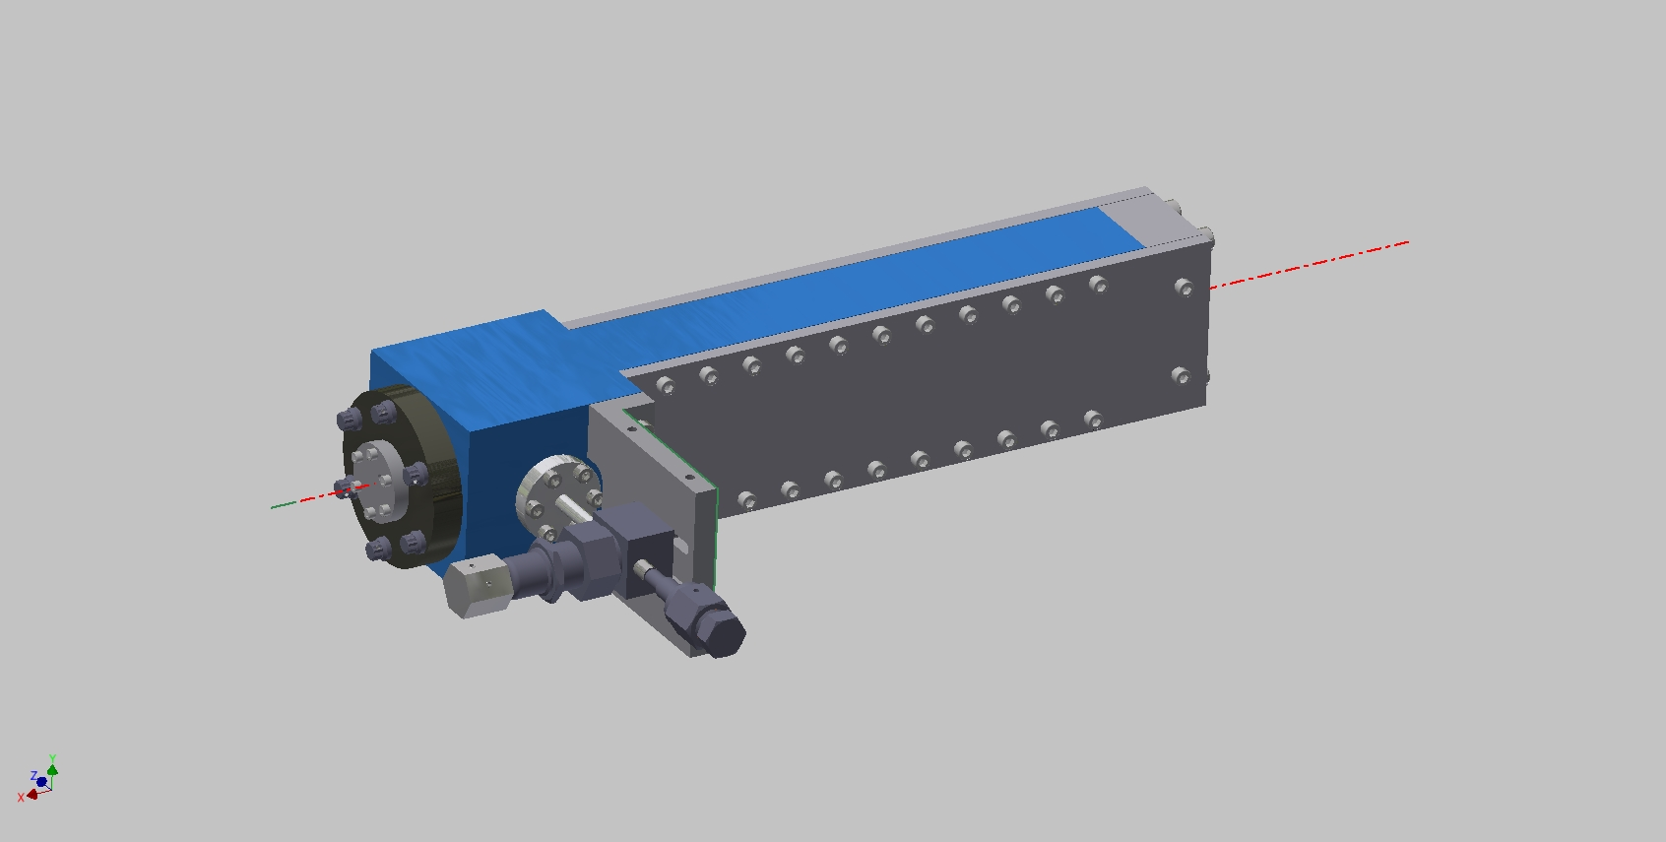
Hall A Tritium Target is first in over 3 decades!!
Running Now
Lab | Year | Quantity (kCi) | Thickness (g/cm²) | Current (μA) | Current x thickness (μA-g/cm²)
Stanford | 1963 | 25 | 0.8 | 0.5 | 0.4
MIT-Bates | 1982 | 180 | 0.3 | 20 | 6.0
Saskatoon | 1985 | 3 | 0.02 | 30 | 0.6
JLab | 2017 | 1 | 0.08 | 20 | 1.6
JLab Luminosity ~ 2.0 x 10³⁶ tritons/cm²/s

Slide 18
MARATHON Just Completed Running Last Week
Mirror symmetry of A=3 nuclei
  Extract F₂^{n}/F₂^{p} from ratio of measured ³He/³H structure functions
R = SUPER ratio of ”EMC ratios” for ³He and ³H
- Relies only on difference in nuclear effects in ³H, ³He
- Calculated to within 1%
- Most systematic and theoretical uncertainties cancel
I. Afnan et al, PRC 68 (2003)

Slide 19
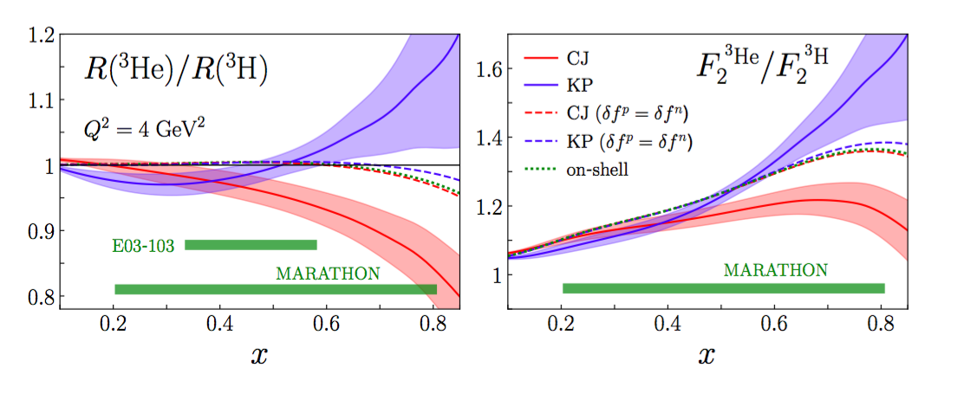
Newest calculations from J. Ethier, W. Melnitchouk, N. Sato, A. Tropiano (2018)….
  Look at Hall C E03-103 ³He/d data, favors...
  Isospin-dependent off-shell functions
  δ^{p,n} = off-shell correction
LARGE corrections (~15%!)
Global QCD analysis of proton, deuteron and A=3 data on the CJ to do list!

Slide 20
Comparison with BONuS12, SoLID could answer isospin-dependence question….
Different techniques
  BONuS different (and isoscalar) corrections
  SoLID p PVDIS no nuclear dependence

Slide 21
End digression….
nPDF Pen
Notes:
4/16/18
21
21

Slide 22
nCTEQ15 PDF Set
Included Points
Typical W² = 12.25, Q² = 4 GeV² cuts remove large amount of large x data
Large amount of EMC data (SLAC, JLab) NOT YET utilized!
22/
Notes:
4/16/18
22
22

Slide 23
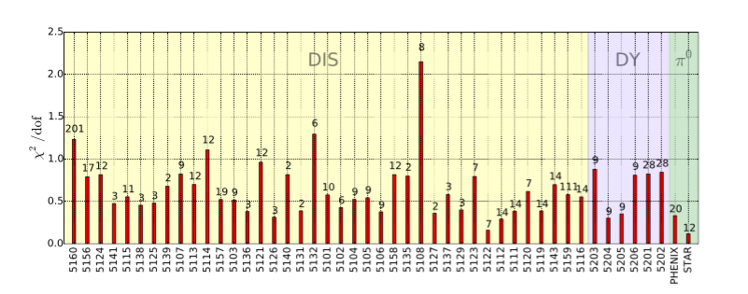
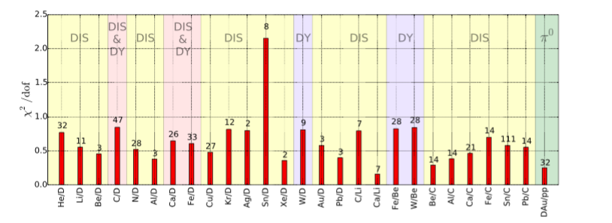
  χ² by dataset
  χ² by nucleus
A ->

Slide 24
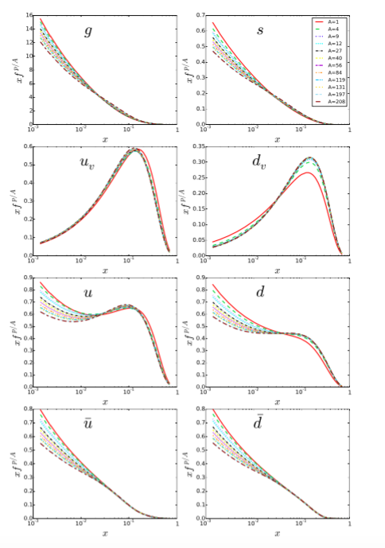
nCTEQ Results: Bound Proton PDFs
Range of nuclei from the free proton (A = 1) to lead (A = 208)
Q = 10 GeV
The gluon and sea-distributions decrease at small x values with increasing A
nPDF nuclear correction factors for u_{v} and d_{v} treated as independent
  u_{v} is suppressed and d_{v} is enhanced in the EMC region.
  Flavor dependence for the EMC effect?
I. C. Cloet, W. Bentz, and A. W. Thomas (Phys. Rev.
Lett. 102 (2009) 252301)
D. Dutta, J. C. Peng, I. C. Cloet, and D. Gaskell, Phys. Rev. C83 (2011) 042201

Slide 25
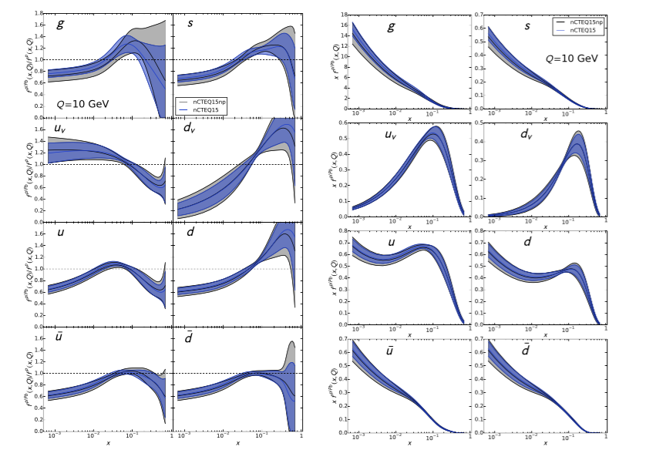
nCTEQ Results: Medium Modifications in Pb
Blue and Gray are with and without pion data
Gluon anti-shadowing
u_{v}, d_{v} differ in valence regime
Ratios of bound (Pb) proton PDFs to free proton PDFs
Bound proton PDFs for lead

Slide 26
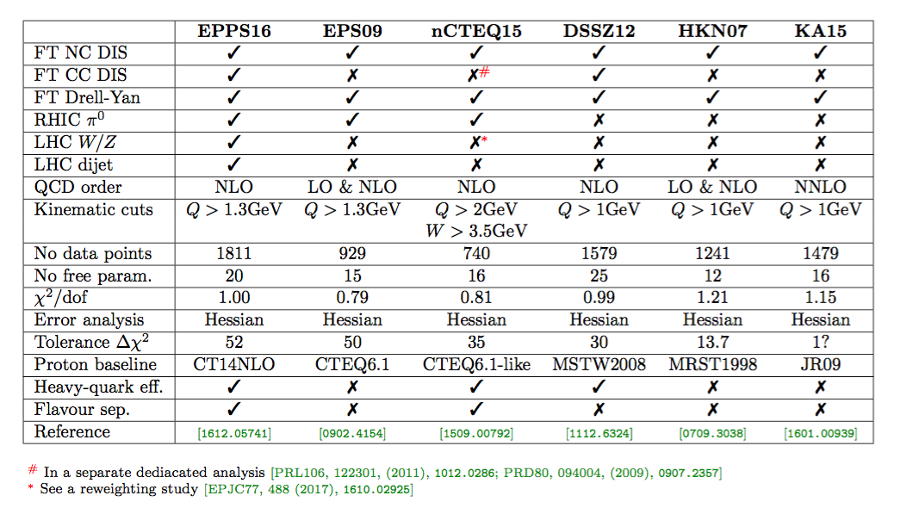
Comparison of Available nPDFs
The W² cut limits nCTEQ, but still the nPDFs lack for data….

Slide 27
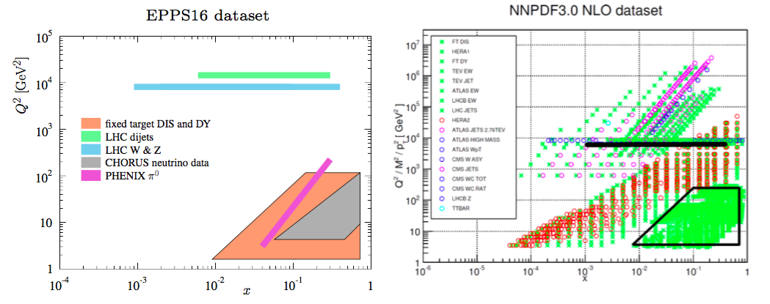
Differences with Free Proton PDFs
Theoretical status of Factorization
Parametrization – more parameters to model A-dependence
Different data sets – much less data:
Less data → less constraining power → more assumptions
Even using neutrino, large x/low Q data

Slide 28
Another digression....
Neutrino data discussion
Notes:
4/16/18
28
28

Slide 29
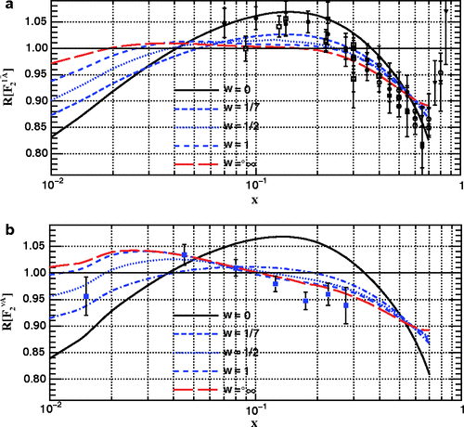
nCTEQ15 PDFs
The compatibility of neutrino and charged lepton nuclear DIS data has been studied independently by several nPDF groups.
nCTEQ:
Phys. Rev. D 77, 054013 (2008)
Phys. Rev. D 80, 094004 (2009)
Phys. Rev. Lett. 106, 122301 (2011)
K. Kovarik et al.. Phys.Rev. D 93 8, 085037 (2016)
Q > 2.0 GeV, W > 3.5 GeV
(standard CTEQ cuts)
A-dependence introduced directly into distributions at input scale Q = 1.3 GeV
Use ACOT - heavy quark mass
effects - in NLO QCD
Charged lepton data
Neutrino data
Fits with different weighting of neutrino data
Q² = 5 GeV²
29
ν-A dependence different from e/μ-A

Slide 30
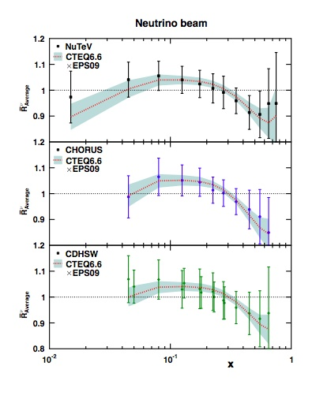
BUT…
Conclusions from different groups are contradictory, ranging from a violation of the universality up to a good agreement
Example:
H. Paukkunen, C. Salgado, Phys. Rev. Lett. 110:212301 (2013)
Consider non-negligible differences in the absolute normalization between different neutrino data sets… procedure to accommodate this.
With the normalization procedure, the NuTeV data seem to display tension with the other neutrino data.
ν-A dependence compatible with e/μ-A
30

Slide 31

The nPDF efforts fit nuclear effects using the canonical F₂^{A}/F₂^{D} ratios as a function of x
However, there are essentially NO neutrino F₂^{D} data!
Comparisons are necessarily to modeled deuterium data
We decided to try and compare only F₂^{A} data
- start with Fe, largest data set covering both charged lepton and neutrino data over a range of x,Q….
What’s going on?
Notes:
F2 and C12 scans good for acceptance studies

Slide 32
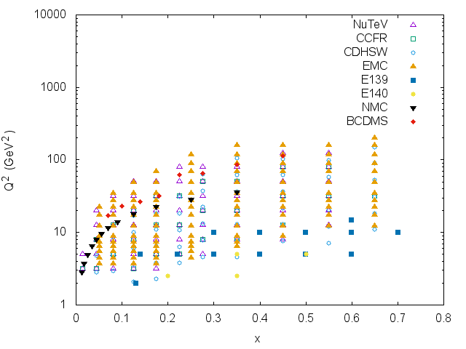
World F^{Fe}₂ Data
Neutrino Expts (open symbols):
CCFR, CDHSW, NuTeV
Charged Lepton (e/μ) Expts:
BCDMS, EMC, E140, E139,NMC
Most available at Durham data base:
http://hepdata.cedar.ac.uk/review/f2/
E139 cross sections available at:
slac/stanford.edu/exp/e139/
- used parameterization of R to get F₂
BCDMS and NMC were available in ratios of Fe to D
- used fit of F₂^{D} from NMC to obtain F₂^{Fe}
Evaluated model dependence of the above
Q²
Q²[ GeV²]
x
Wide range in x, Q²!
x
32

Slide 33
Analysis
All data used were isoscalar corrected when published. We did not alter these corrections, used data as presented.
  Large at small x for neutrino, and large x for charged leptons
  Correction is SMALL for Fe
Applied “DIS” cuts; Q² > 2, W² > 4 GeV²
Set F^{Fe}₂ data to a common Q² (bin-centering) using NMC fit*, checked for dependence on this fit
Neutrino data are a flux-weighted average of nu, nu_bar data
Multiply neutrino data by 5/18 to account for quark charges.
*H.Abramowicz, A.Levy, hep-ph/9712415,
Q² dependent, with F2n/F2p added by A. Bruell
33

Slide 34
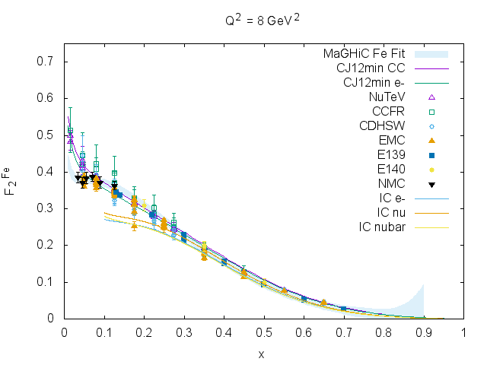
Results: F₂^{Fe} Data – NOT a ratio to deuterium!
Q² = 8 GeV²
Neutrino data open symbols, charged lepton closed
2 < Q² < 20 GeV²,
bin-centered to 8 GeV²
MaGHiC fit is to charged lepton data (Malace, Gaskell, Higinboham, Cloet, Int. J. Mod. Phys. E 23 (2014) 1430013)
Cloet fit is valence only
- good agreement!
Charged lepton data agree with charged lepton and neutrino data with neutrino, no normalizaions applied
Remarkable agreement of all data at x > 0.1, 18/5 works within ~5%
F₂^{Fe}
x
Discrepancy at small x between neutrino and charged lepton data
Notes:
F2 and C12 scans good for acceptance studies

Slide 35
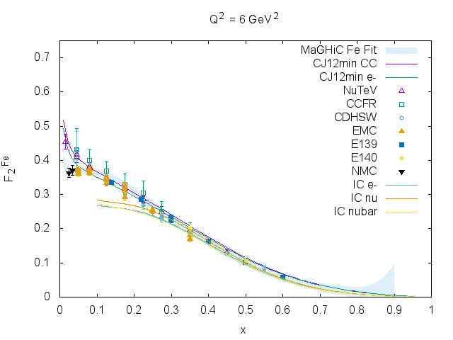
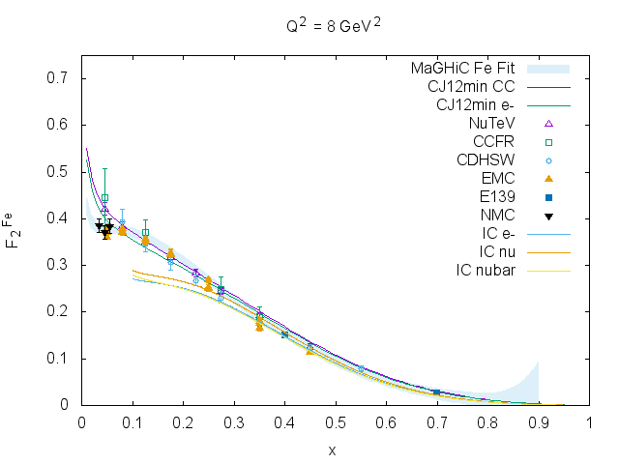
Smaller bins in Q²
4 < Q² < 8
centered at Q² = 6 GeV²
6 < Q² < 10
centered at Q² = 8 GeV²
F₂^{Fe}
Same observations:
  remarkably good agreement of neutrino, charged lepton at large x
  surprisingly bad at small x
Both CJ and Cloet theory curves are shown with both electron and CC
  Should depict size of strangeness difference
  Does not account for large discrepancy at low x
Charged lepton data agree with MaGHiC fit – not surprising
Neutrino data seem to be in agreement with CJ12min fit (Phys. Rev. D 87 094012 (2013))
  no nuclear effects taken in to account, just add free neutrons and protons
35

Slide 36

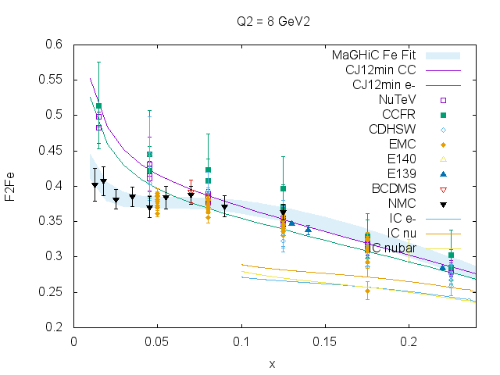
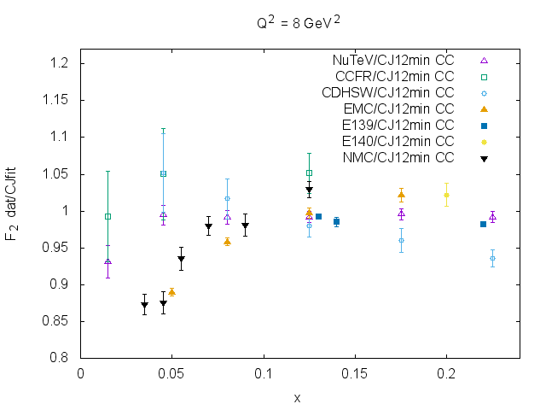
Look closer
F₂^{Fe} zoom
Q² = 8 GeV²
Ratio to CJ electron, at lowest x:
- Neutrino data ratio ~1
- Charged lepton ratio < 0.9
Note relatively good
N. Kalantarians, CK, M.E. Christy Phys.Rev. C96 (2017) no.3, 032201
Looks to be ~10-15% effect
36

Slide 37
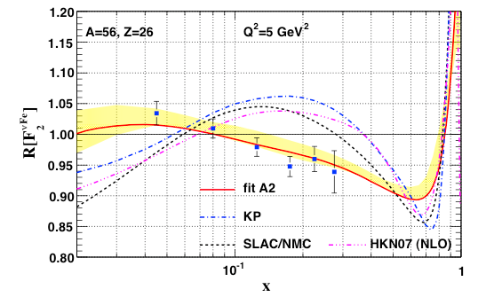
Compare with nCTEQ
x
Same trend, perhaps somewhat larger effect in data
Deuteron model in nCTEQ could make some difference
Not completely new..
C. Boros, J.T. Londergan, A.W. Thomas, Phys.Rev.Lett. 81 4075 (1998!)
CCFR and NMC only, smaller data set available
Ascribed discrepancy to CSV
37

Slide 38
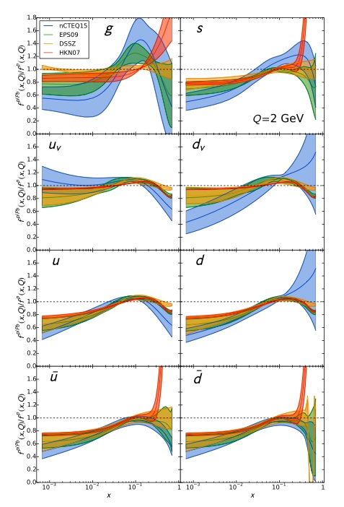
Good reasons to consider nuclear effects may be DIFFERENT in ν - A:
  Shadowing effects ~similar in Drell-Yan and DIS for x < 0.1, BUT, no Anti-Shadowing in Drell-Yan (in DIS 5-8% effect)
  Different probes sensitive to different partons
    Global nuclear PDF fits suggest different nuclear effects for valence and sea
    F_{L} dominance in low Q neutrino, vanishes for charged lepton
    Presence of axial-vector current
    Coherence length differences for vector, axial vector masses
  A variety of theory predictions...
nCTEQ15 PDFs

Slide 39
Many Theory Predictions…
Sizeable, A-dependent effects in shadowing region (Frankfurt, V. Guzey, M. Strikman, Phys. Rept. 512, 255 (2012))
    Isospin-dependent nuclear forces lead to flavor-dependence of nuclear PDFs (Cloet, Bentz, Thomas, Phys.Rev.Lett. 109 (2012) 182301)
Nuclear medium effects important, meson cloud contributions (Haider, Simo, Athar, and Vacas, Phys. Rev. C 84, 054610 Phys. Rev. C 84 054610 (2011))
Global analysis including nucleon binding, Fermi motion, off-shell effects,.. (Kulagin and Petti, Phys. Rev. D76:094023, Phys. Rev. C 90, 045204 2007)
The axial-vector current allows shadowing at lower n than the vector current (B. Kopeliovich, Nucl. Phys. Proc. Suppl. 139: 219-225, 2005)
Qiu and Vitev, Phys. Lett. B 587, 52 (2004)
And More… please accept my apologies for not mentioning all!
39

Slide 40
Although nuclear effects in neutrino and charged lepton scattering are observed to be different, the effects observed in charged lepton scattering are applied directly to:
Neutrino interaction models and Monte Carlos.
  Can effect neutrino oscillation experiments
Neutrino data as used in many nPDF fits. The nPDFs are:
  Sometimes input for the above
  Employed regularly for numerous studies, such as p-A benchmarking [H. Honkanen, M. Strikman, V. Guzey]
  Critical tool for studying nuclear medium modifications

Slide 41
Back to nCTEQ – reweighting and rewriting!
nPDFs
Notes:
4/16/18
41
41

Slide 42
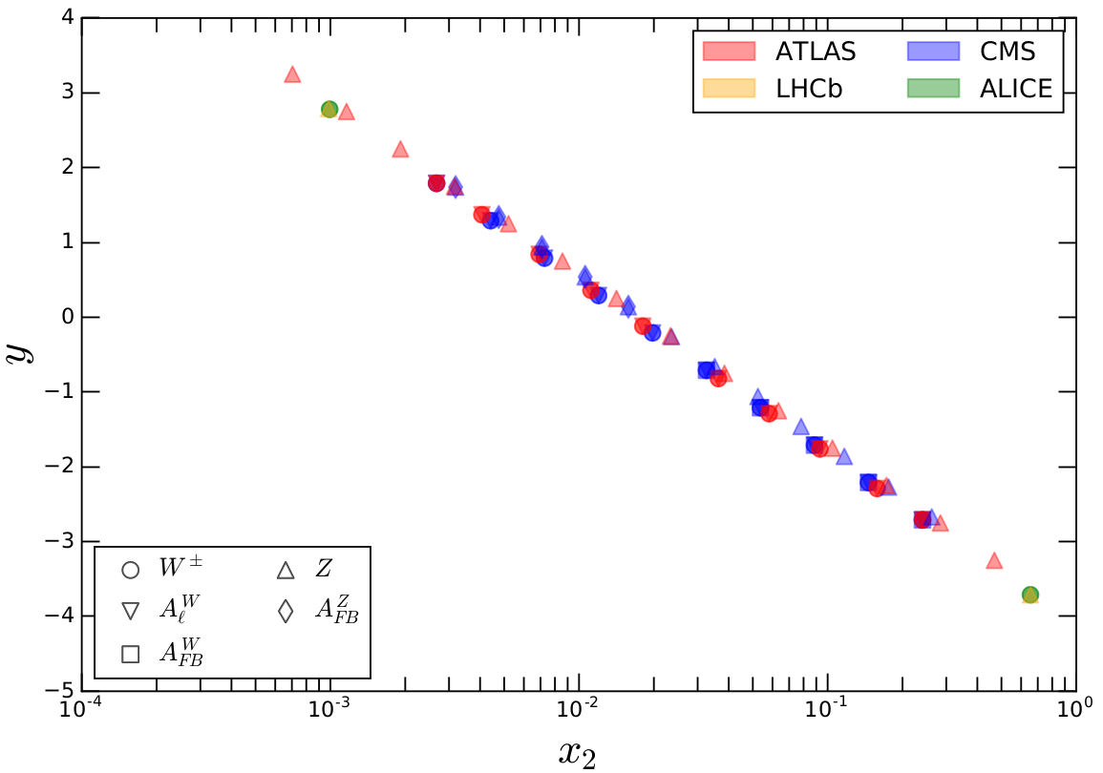
nCTEQ PDFs at the LHC
– extend low x range
Smaller x range corresponds to larger rapidities
LHC
DIS
x₂ covered by LHC W/Z Data
x₂ is the Lead PDF
x₂ Covered by Existing DIS Data
Eric Godat - SMU
42/
Notes:
4/16/18
42
42

Slide 43
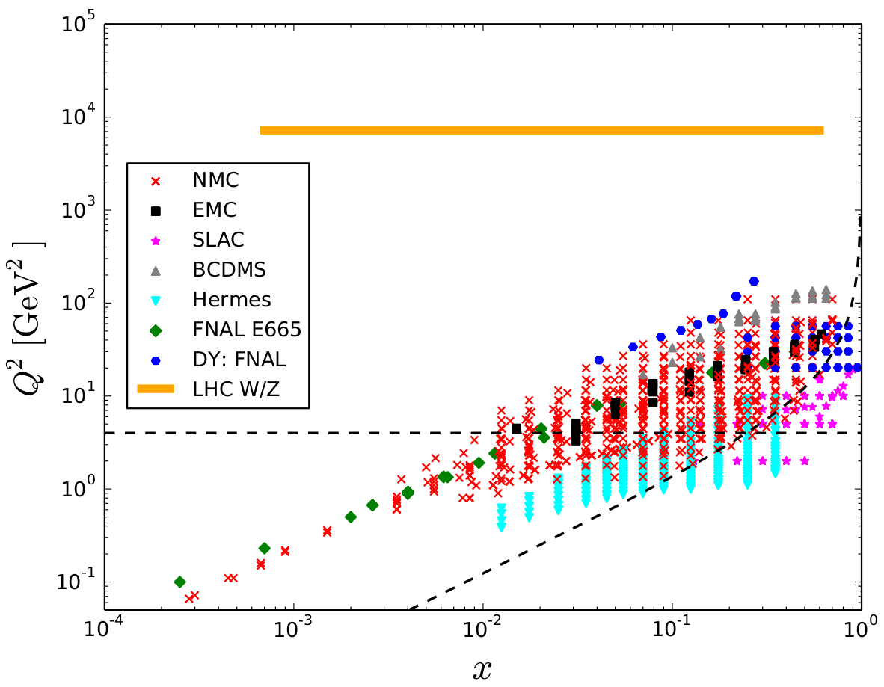
LHC Run 1 Data in nCTEQ
pPb and PbPb collisions
  LHCb:
  ALICE:
  ATLAS:
  CMS:
Included Points
43/
Notes:
4/16/18
43
43

Slide 44
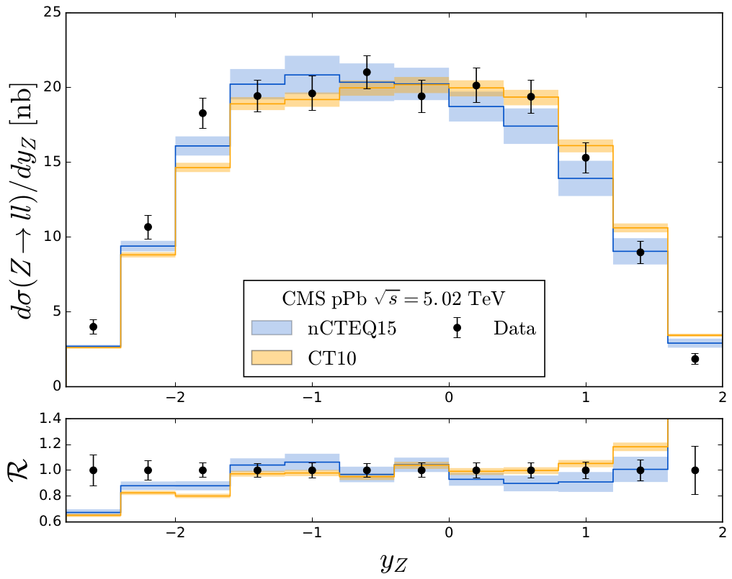
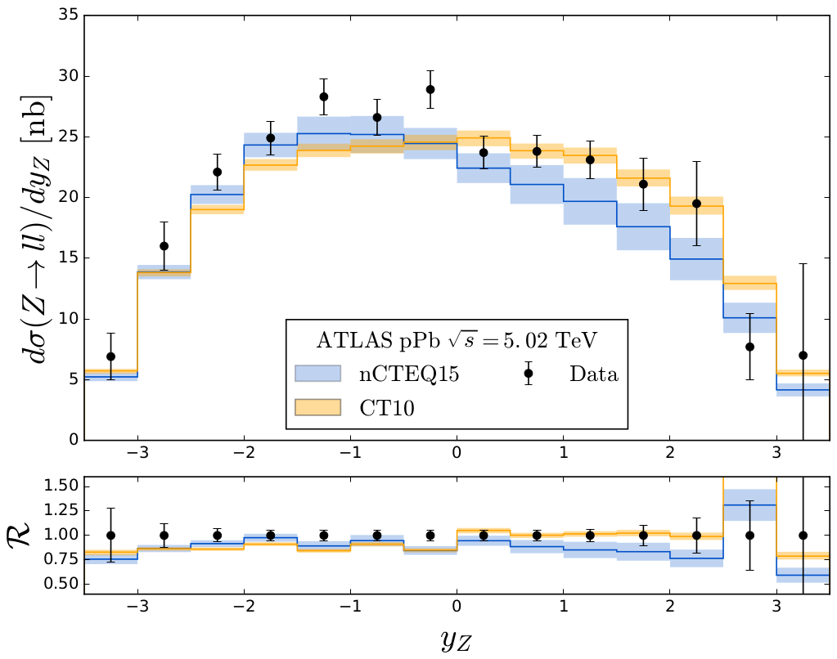
W/Z Production
CMS pPb Z
ATLAS pPb Z
Slight deviance between data and CT10 from nCTEQ15
  Good agreement for negative rapidities, where we have data to constrain the PDF
44/
Notes:
4/16/18
44
44

Slide 45
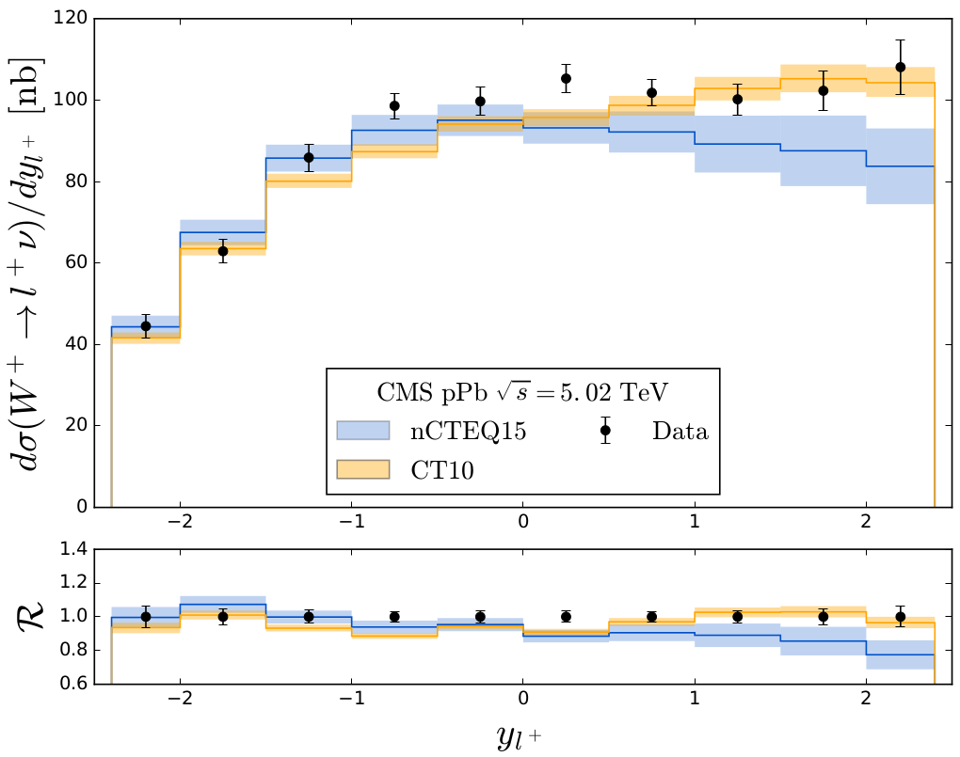
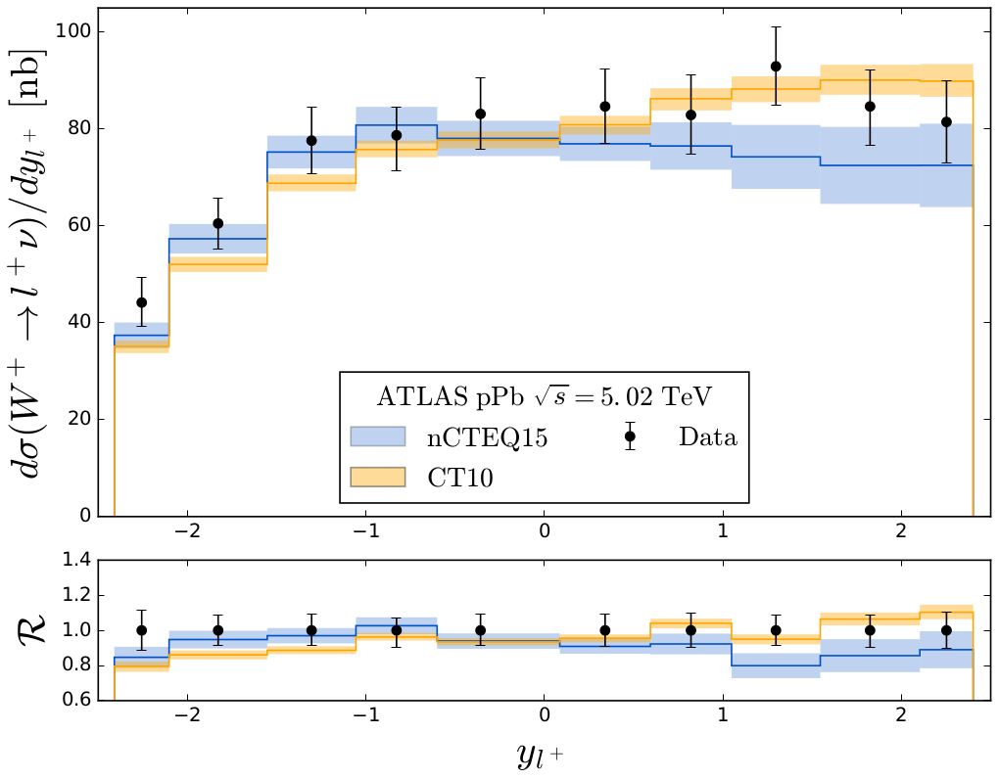
W/Z Production
CMS pPb W⁺
ATLAS pPb W⁺
Definite separation between data and CT10 from nCTEQ15
  Indicates this data could be useful in constraining PDFs in this region
45/
Notes:
4/16/18
45
45

Slide 46
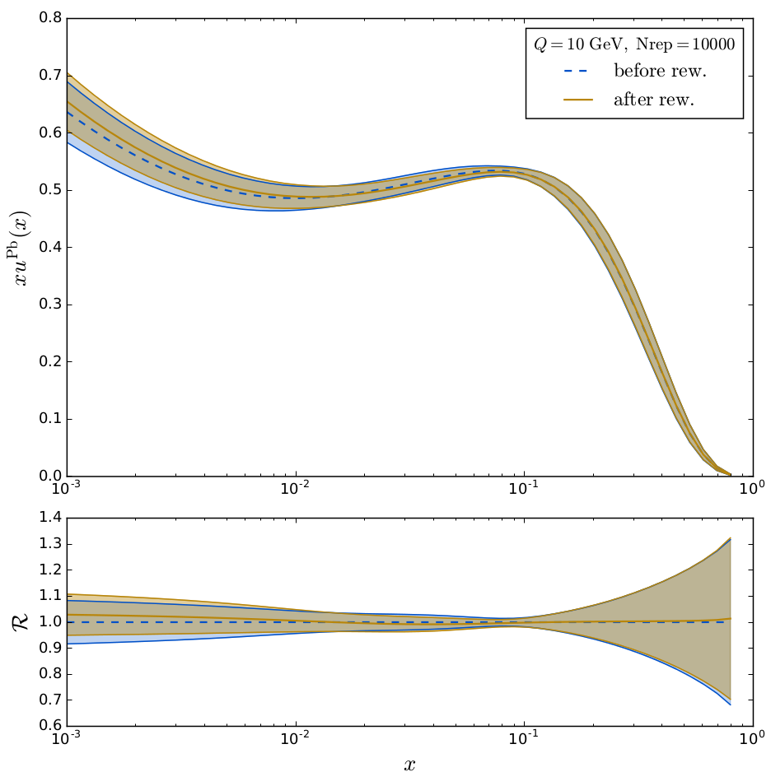
Reweighting – Example with W, Z Production
Use Bayesian statistics to shift existing PDF
  Allows for new data to be added
    Previously lacked data in this range
Limited to existing parameterization
Reweighted PDF shifts slightly
46/
Notes:
4/16/18
46
46

Slide 47
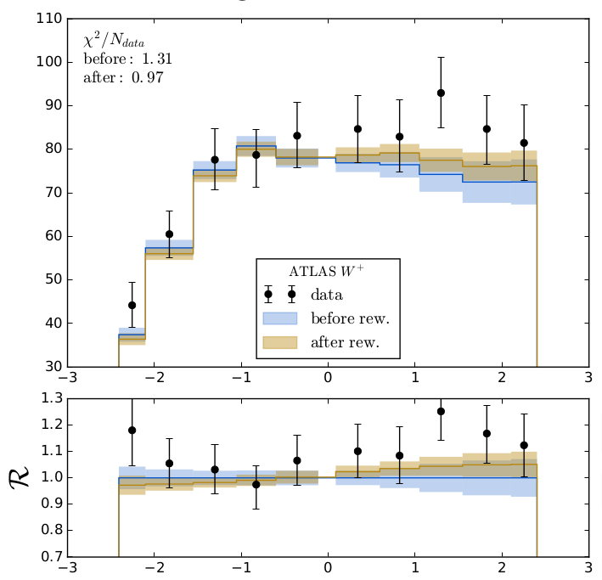
Reweighting
ATLAS pPb W⁺
  Extrapolation in x₂ region corresponding to positive rapidity
    Can suggest the impact data might have on a future fit
  Strange quark parameter could be opened (currently fixed to up and down quarks)
  Results depend current parameterization - refit needed
Observable slightly shifts towards data
47/
Notes:
4/16/18
47
47

Slide 48
nCTEQ++
Moving to the future….
Notes:
4/16/18
48
48

Slide 49
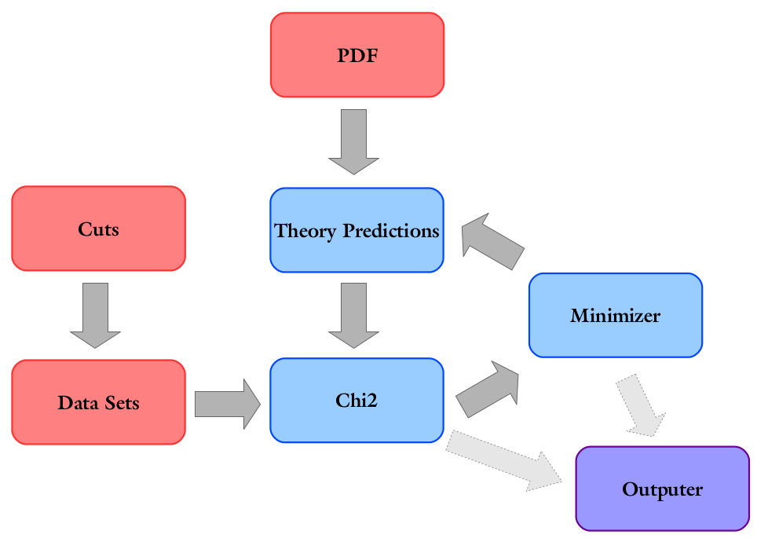
What is nCTEQ++?
A complete rewrite of the original nCTEQ FORTRAN fitting code in C++
Allows for modules when building a PDF
  - Evolution
  - Interpolation
  - Parameterization
Fitting using Minuit
Minor bug fixes
nCTEQ++
49/
Notes:
4/16/18
49
49

Slide 50
pPb Data for nCTEQ+LHC
  New gridded theory predictions make this possible
ATLAS:
  ID: 6211 Npts: 10
  ID: 6215 Npts: 14
Included Points
CMS:
  ID: 6231 Npts: 10
  ID: 6233 Npts: 10
50/
Notes:
4/16/18
50
50

Slide 51
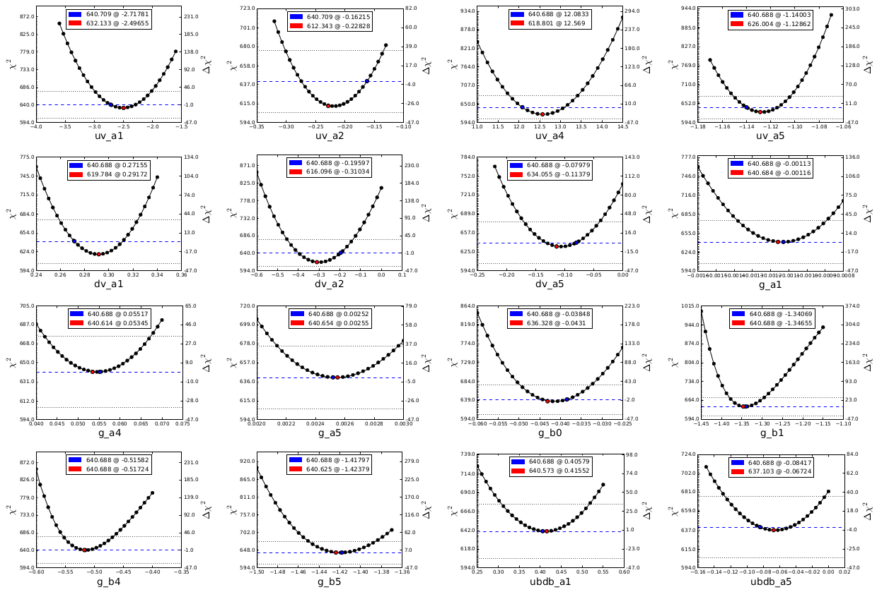
Validation: χ²
How did the χ² change for nCTEQ15np in nCTEQ++?
Original:
  χ² : 625.6
  708 points
  0.883 χ²/d.o.f.
nCTEQ++:
  χ² : 640.7
  708 points
  0.905 χ²/d.o.f.
Δ χ²: 15.1
  Less than t=35
Scans for the 16 parameters fit in nCTEQ15np
51/
Notes:
4/16/18
51
51

Slide 52
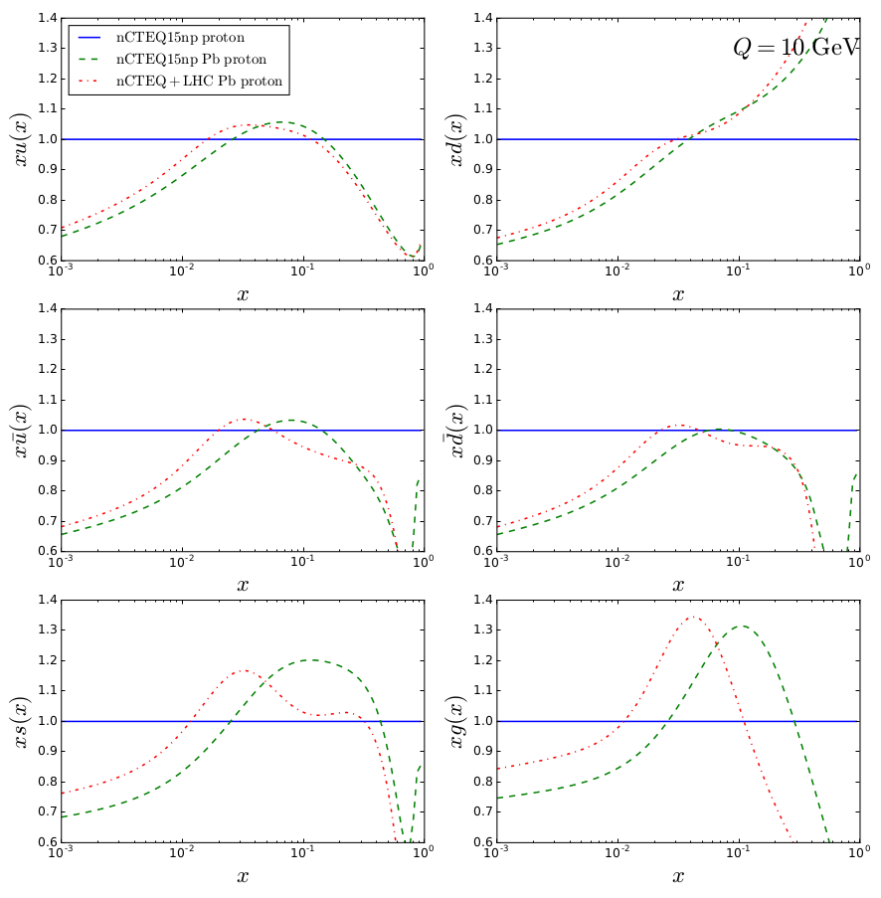
nCTEQ+LHC
u
d
nCTEQ15np Proton
nCTEQ15np Lead
Ratio to nCTEQ15np Proton
u
d
nCTEQ+LHC Lead
Observe general shift toward lower x
s
g
10³
10⁰
x
52/
Notes:
4/16/18
52
52

Slide 53

Fit with Normalization
Fit with optimally normalized LHC data
  ATLAS 4 σ (10.8%)
  CMS 2 σ (7.0%)
    No χ² normalization penalty
53/
Notes:
4/16/18
53
53

Slide 54
Summary
THANKS!!!!
F. Olness, J. Owens, D.B. Clark, E. Godat, T. Jezo, CK, K. Kovarik, A. Kusina F. Lyonnet J. Morfin I. Schienbein, J.Y. Yu

Slide 55
Reweighting Formalism
Bayesian Reweighting Technique
  Generate Replica:
  Calculate Giele-Keller weights:
  Estimate weighted average and standard deviation:
Eric Godat - SMU
55/
Notes:
4/16/18
55
55

Slide 56

Relating x₁ and x₂ to Rapidity
x₂ is the Lead PDF
56/
Notes:
4/16/18
56
56

Slide 57


Collider Definitions
Rapidity:
  A measure of how far forward a particle is boosted
  Pseudorapidity:
    The massless equivalent of rapidity
Cross Section:
  A measure of how likely an interaction will occur
Luminosity:
  Ratio of the number of events to the cross section
    More luminosity = More Data
Image Source
Eric Godat - SMU
57/
Notes:
4/16/18
57
57

Slide 58

Parton Distribution Functions (PDFs)
Describe the probability of a parton inside a nucleon with a given momentum fraction at a given energy interacting
Parameterized fits to experimental data
Universal across processes
Broken down into discrete grids by:
    All quark flavors + gluon
    Momentum transfer, Q
    Momentum fraction, x
  Nuclear corrections are needed for A>1
58/
Notes:
4/16/18
58
58

Slide 59



Improved Extraction of F₂^{n} from F₂^{d} and F₂^{p}
Method
Convolution of light cone momentum distribution on nucleons in nucleus

