Slide 2
The CERN Quantum Technology Initiative
Quantum Machine Learning at CERN openlab
Sofia Vallecorsa
AI and Quantum Research - CERN openlab
CERN IT Department

Slide 3
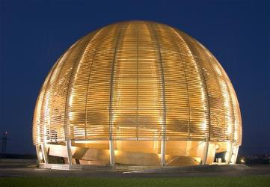
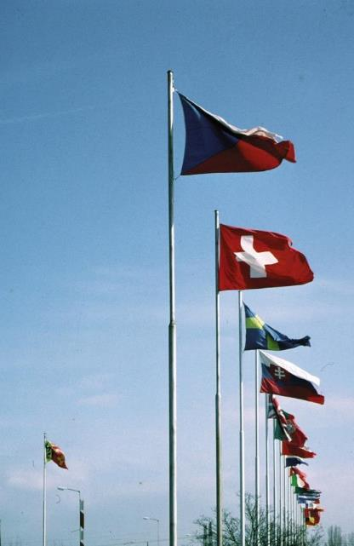
CERN
“Science for peace”
1954: 12 Member States
International organisation close to Geneva, straddling Swiss-French border, founded 1954
Facilities for fundamental research in particle physics
23 member states, 1.1 B CHF budget
~3’200 staff, fellows, trainees, …
>13’000 associates
Members: Austria, Belgium, Bulgaria, Czech republic, Denmark, Finland, France, Germany, Greece, Hungary, Israel, Italy, Netherlands, Norway, Poland, Portugal, Slovak Republic, Slovenia, Spain, Sweden, Switzerland, United Kingdom Candidate for membership: Cyprus, Slovenia
Associate members: Croatia, India, Lithuania, Pakistan, Turkey, Ukraine
Observers: EC, Japan, JINR, Russia, UNESCO, United States of America
Numerous non-member states with collaboration agreements
>2’500 staff members, 645 fellows, 21 trainees
7’000 member states, 1’800 USA, 900 Russia, 270 Japan, …

Slide 4
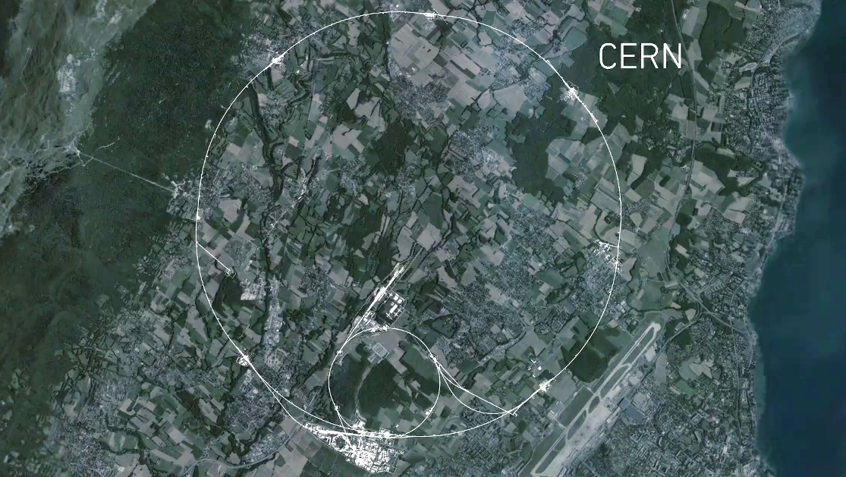
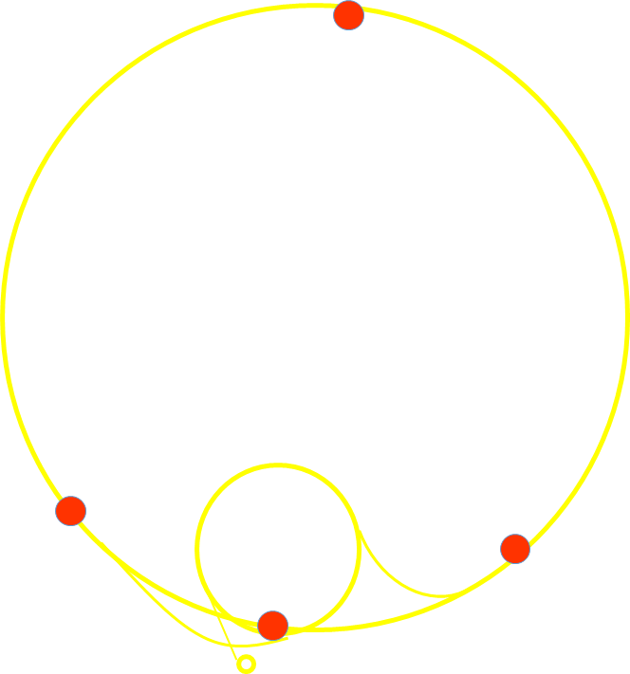
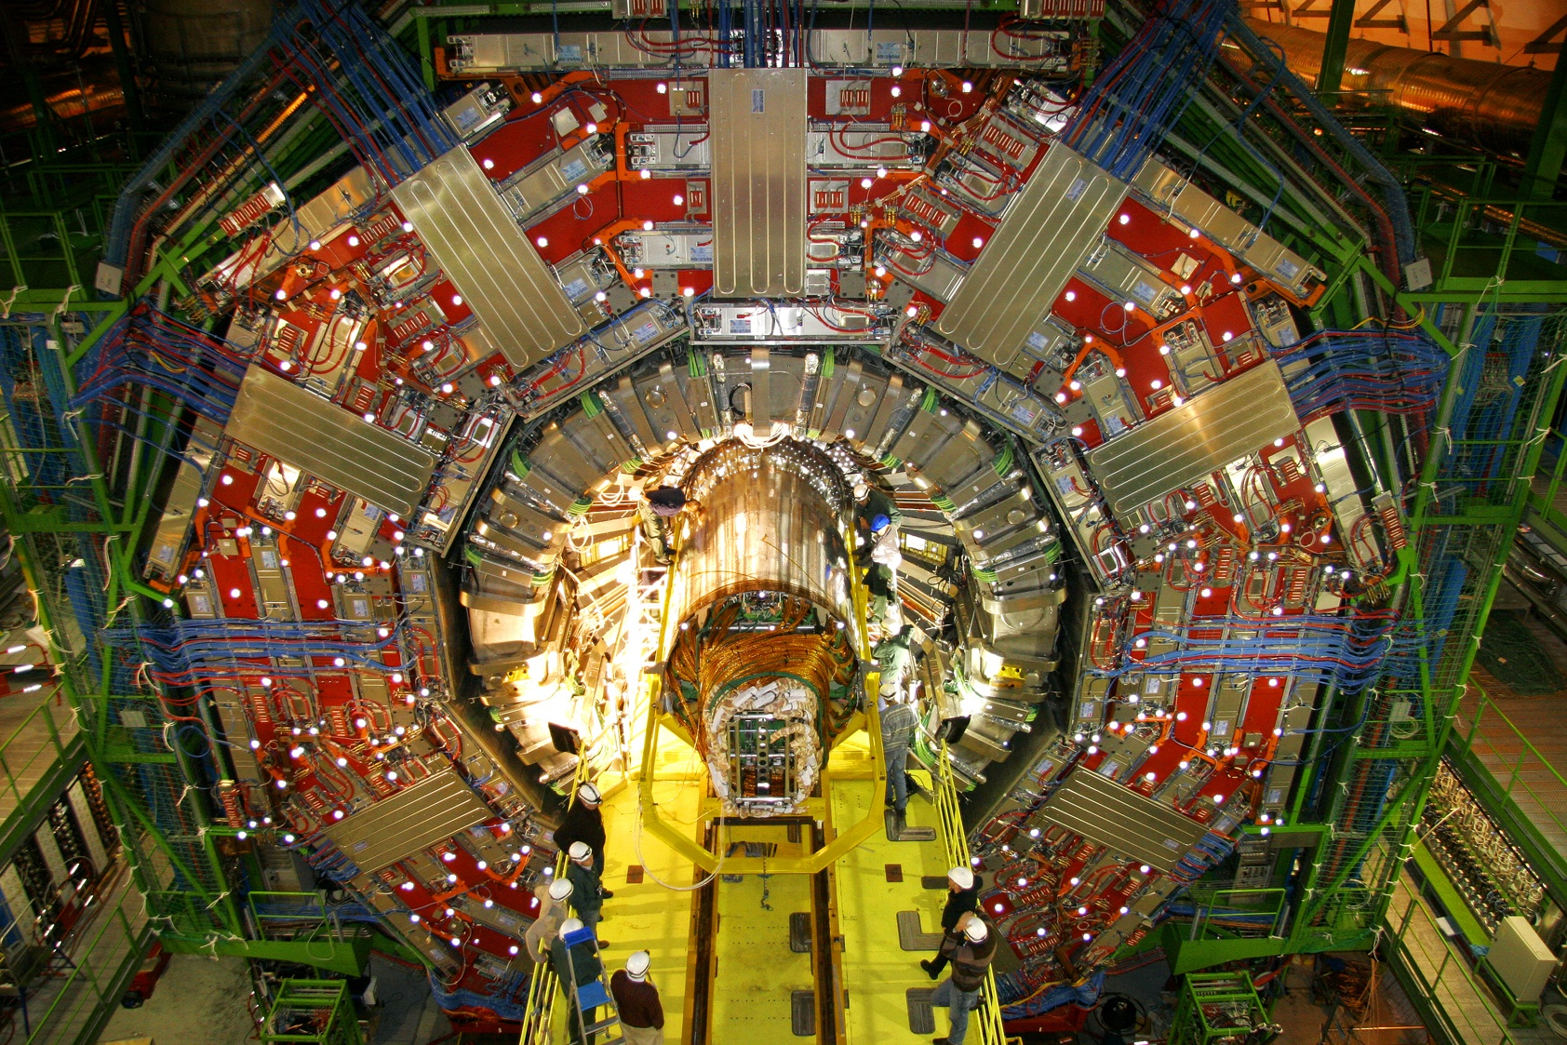
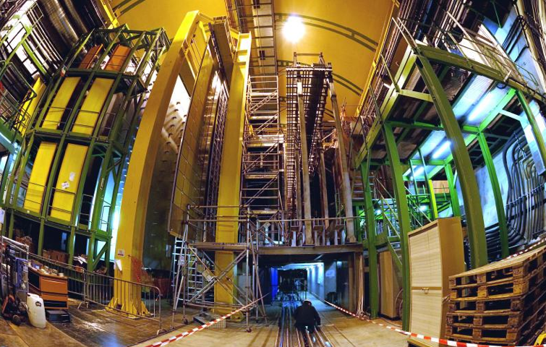
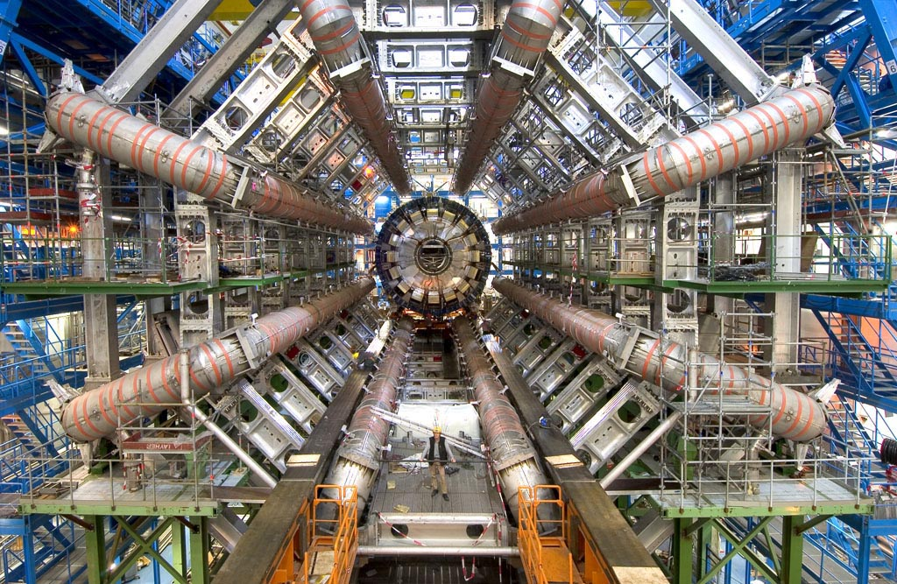
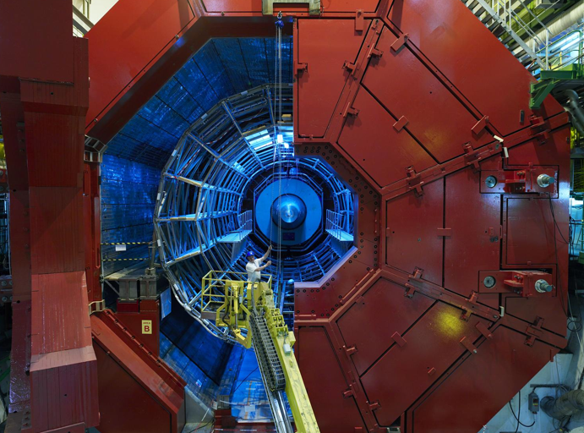
CMS
CMS
High Luminosity LHC
Projection (CMS experiment)
LHCb
ALICE
LHCb
ALICE
ATLAS
ATLAS

Slide 5
D. Contardo - European Particle Physics Strategy Update Symposium, May 2019
Arxiv:1910.11775

Slide 6
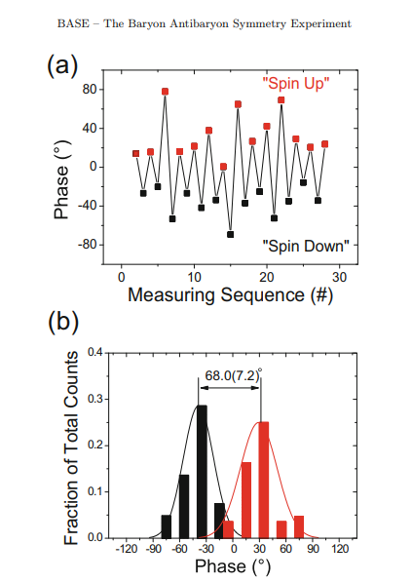
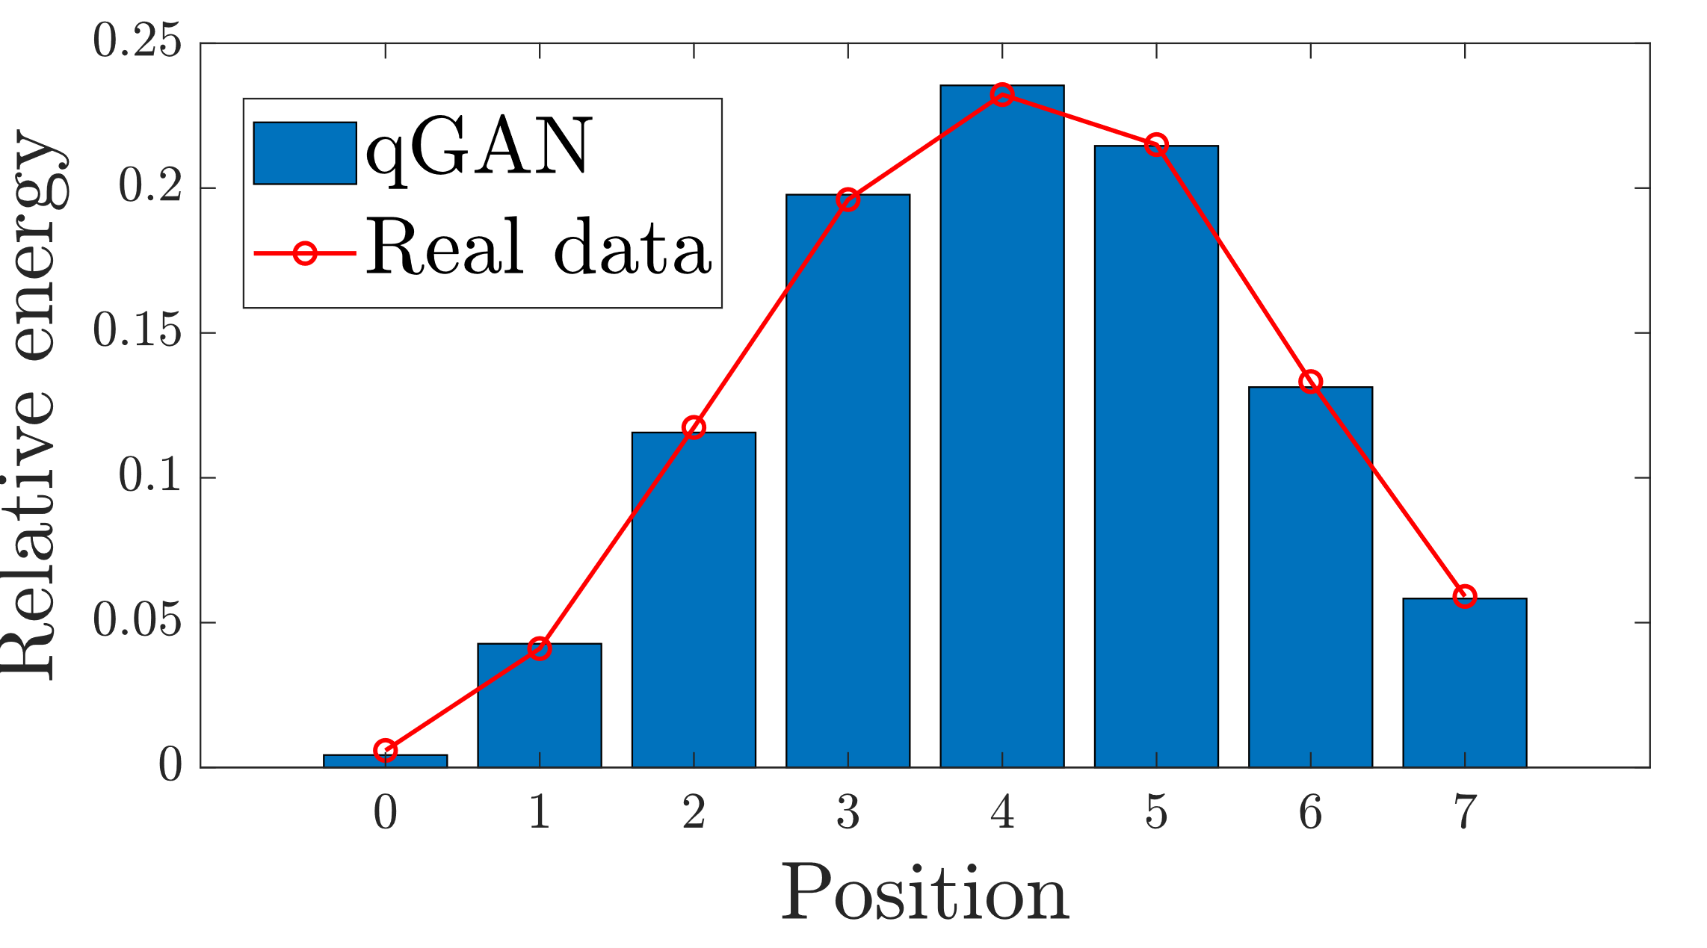
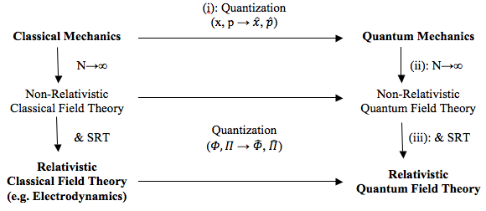
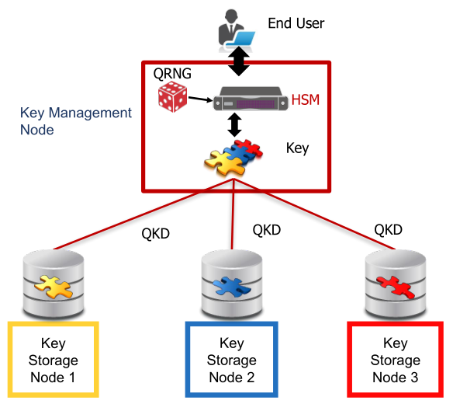
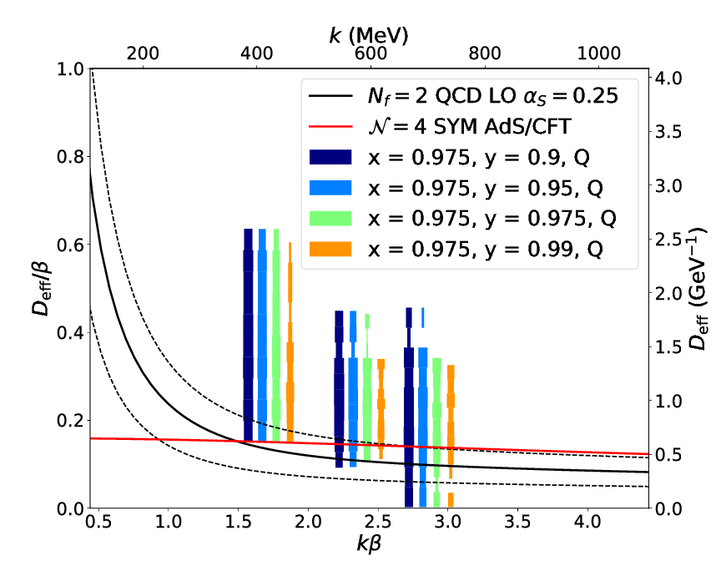
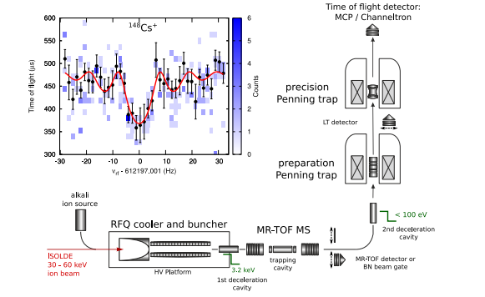
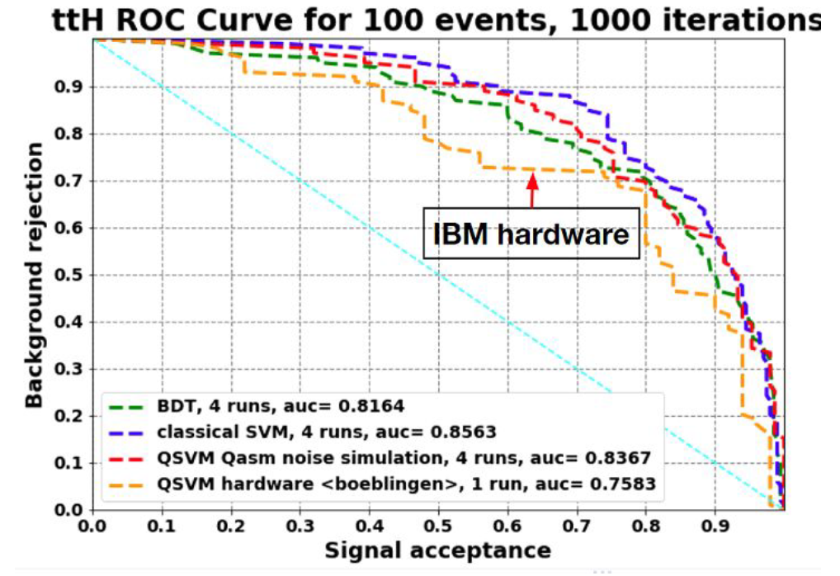
Quantum Expertise and Activities @CERN
Computing
Sensing
Communications
Theory
Simulation
https://doi.org/10.1140/epjst/e2015-02607-4
Quantum Field Theory
BASE phase-sensitive measurement of spin allowing very precise magnetic field drift measurements
Reconstruction
QKD node
Secure Data
Classification
https://cds.cern.ch/record/2703396
https://doi.org/10.1088/1361-6471/aa5a20
Lattice QCD
ISOLTRAP Mass-Spec
Many pilot projects already started as part of the CERN openlab quantum programme (https://openlab.cern/quantum)

Slide 7
CERN Quantum Technology Initiative
CERN Management
Sensing, Detectors R&D
Communication
Joint HEP R&D Programme
QT Advisory Board (Member States)
QT Initiative Management
Computing & Engineering
Simulation, Information Processing
Strategy
Coordination
R&D
Capacity building
Academic Programmes / Industrial Collaborations / Knowledge Transfer

Slide 8
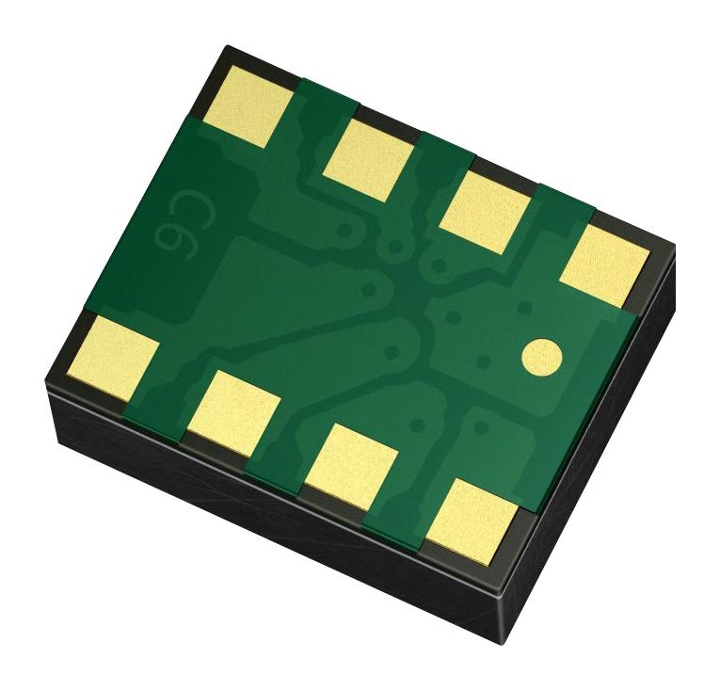
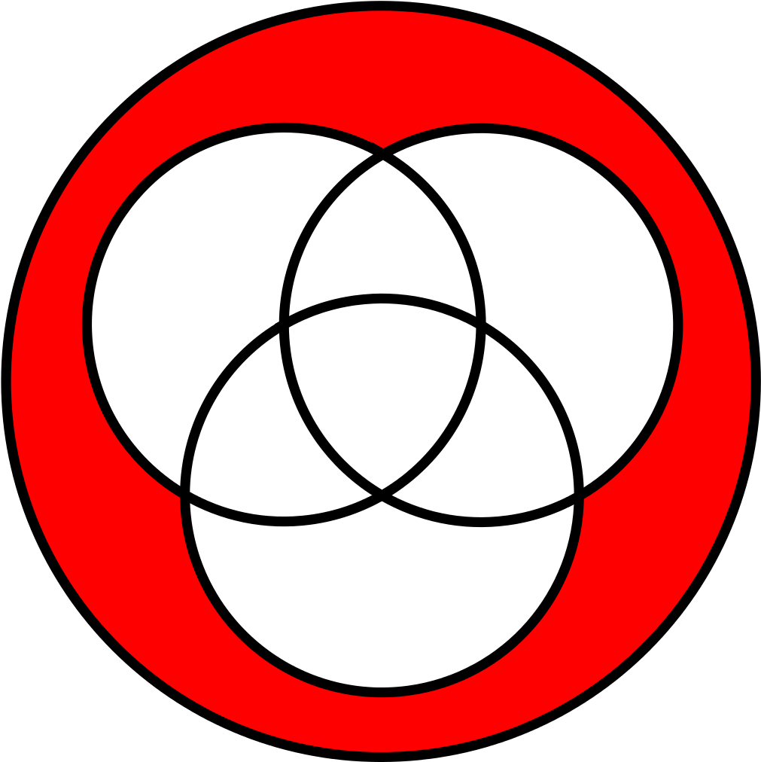
High-Level Objectives
Assess QC potential in HEP
Build expertise in state-of-the-art software stack
Develop quantum systems simulators
Set up a distributed QC Simulation platform
Explore possible applications of QKD
Comms+sensing for detectors?
European Quantum Network/Internet
Knowledge sharing
Education
Training
Computing
Communications
Ion/particle traps as computing/sensing devices
Mass/charge/gravity sensors
Quantum clocks
Nanowires/nanodots for particle tracking/calorimetry
Rydberg calorimetry
Simulation of quantum systems
Quantum gravity
Information processing, error mitigation/correction strategies
Sensing
Theory

Slide 9
QC Examples Applications
Quantum Support Vector Machines for Higgs boson classification
Quantum Graph Neural Networks for particle trajectory reconstruction
Quantum Generative Adversarial Networks for detector simulation
Quantum Boltzman Machines for ALICE Grid optimisation
Hybrid quantum-classical tracking hits embedding
Pattern recognition
Reinforcement learning
data
Collaborations with institutes (DESY, U. Aachen, INFN, U.Tokyo, U. Wisconsin, METU, P. U. Bucharest, U. Oviedo, …) and companies (IBM, Google, Intel, CQC, ...)​

Slide 10
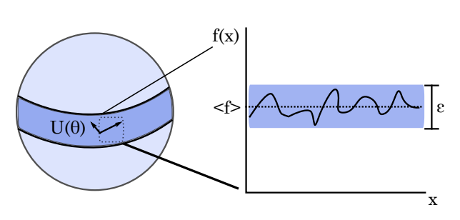
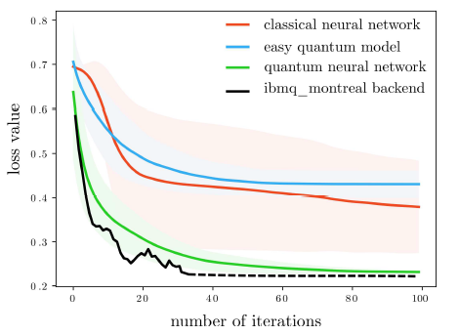
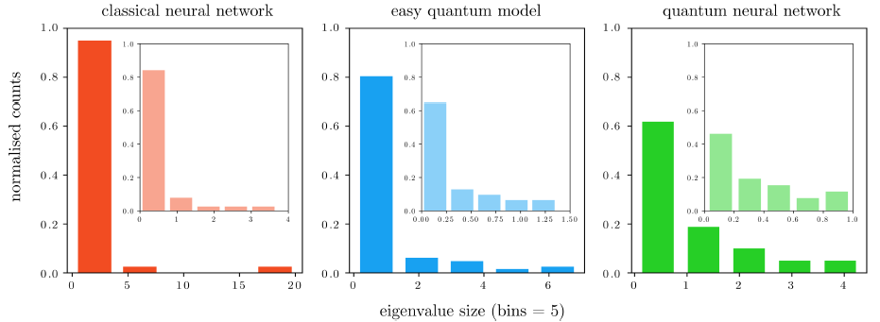
Quantum Machine Learning
Exploit quantum effects for machine learning but
How do we represent learning rules?
Convergence?
How do we address data loading?
Quantum Advantage?
J. McClean at al. arXiv:1803.11173
Fisher information spectrum
A. Abbas et al. arxiv:2011.00027

Slide 11
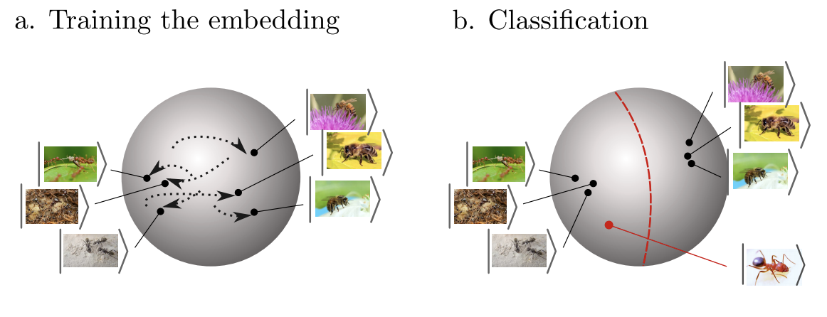
QML implementation
Variational circuit approach with adjustable continuous parameters
Can use stochastic gradient-descent or gradient-free methods
Data embedding can be learned
Input data
〈Out〉
Updates
Loss
M. Schuld et al., arXiv: 2001.03622v2

Slide 12
QC Examples Applications
Quantum Support Vector Machines for Higgs boson classification
Quantum Graph Neural Networks for particle trajectory reconstruction
Quantum Generative Adversarial Networks for detector simulation
Quantum Boltzman Machines for ALICE Grid optimisation
Hybrid quantum-classical tracking hits embedding
https://quanthep-seminar.org/session/session-2/
Pattern recognition
Reinforcement learning
data
Collaborations with institutes (DESY, U. Aachen, INFN, U.Tokyo, U. Wisconsin, METU, P. U. Bucharest, U. Oviedo, …) and companies (IBM, Google, Intel, CQC, ...)​

Slide 13
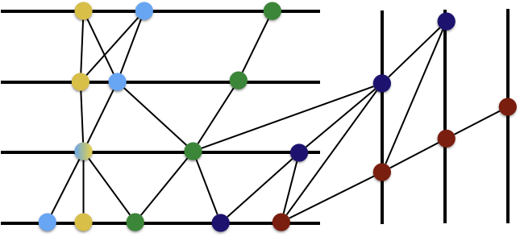
Charged particle tracking
Graph Neural Networks for particle trajectory reconstruction
Data as a graph of connected hits
Connect plausibly-related hits using geometric constraints
Full event embedding requires large graphs ( ~10⁵ nodes)
A cascade of Input, Edge and Node Networks
Edge network to classify segments
Node network to classify detector hits
Hep.TrkX project arXiv:1810.06111
Exa.TrkX projct arXiv:2007.00149

Slide 14
GNN for particle tracking
C. Tüysüz
4th IML workshop
HEP.TrkX GNN Scores:
Purity: 99.5%
Efficiency: 98.7%
Overall Accuracy: 99.5% with 0.5 threshold
Quantum: replace Edge and Node networks with quantum variational circuits
arXiv:2003.08126

Slide 15
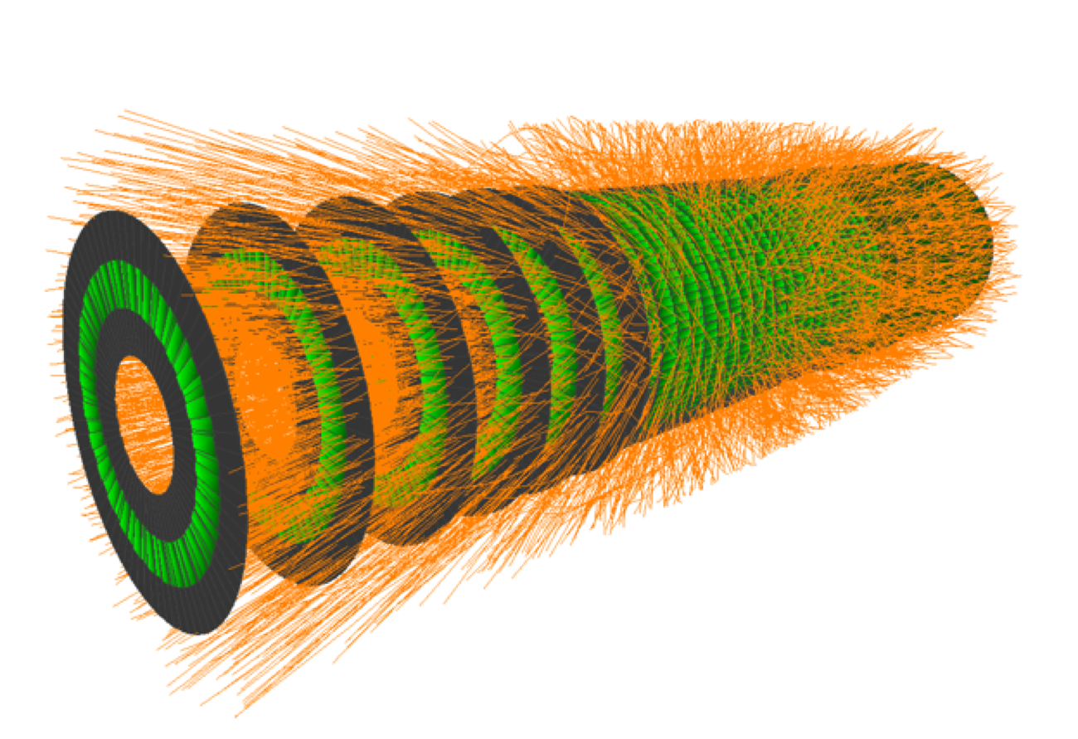
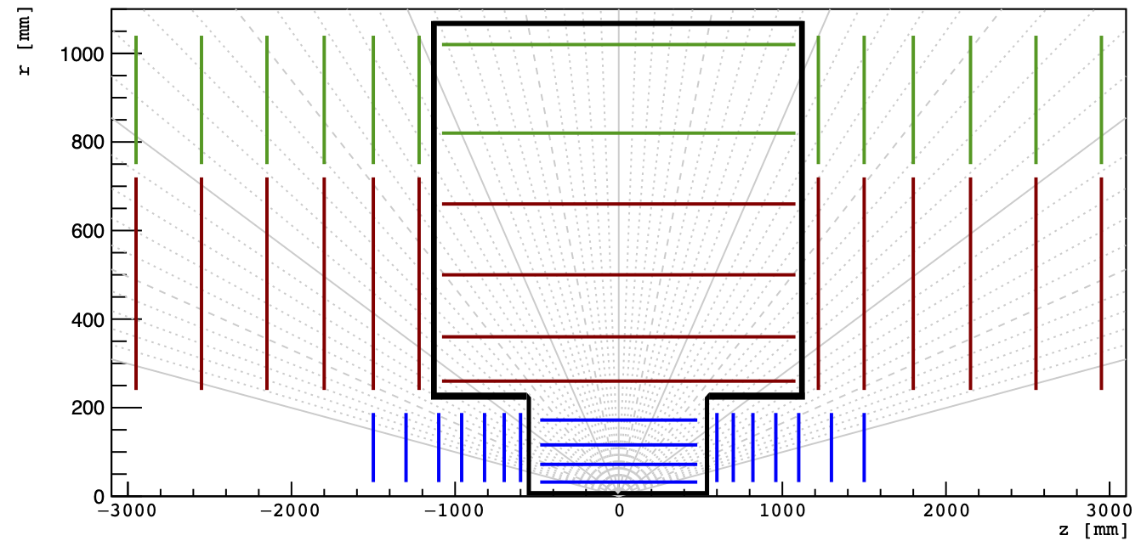
Input data
TrackML⁽¹⁾ challenge dataset
Preprocessing reduces track ambiguity and data dimensionality
Edge Network Input
Node information of each edge
Node Network Input
Triplet node information
Node 1
Neighbour Nodes
Edge
Features
Node 0
Target Node
(1) https://www.kaggle.com/c/trackml-particle-identification/overview
arXiv: 1904.06778

Slide 16
Hierarchical Quantum Classifiers
Hierarchical quantum circuits that can perform binary classification
Tree Tensor Networks (TTN)
MERA graphs (additional entangling, reproduces long-range correlations)
Robust against noise
Test TTN on the Iris dataset (IBM Q experience – 5 qubits)
Increasing std, decreasing accuracy
npj Quantum Information 4, 65 (2018)

Slide 17
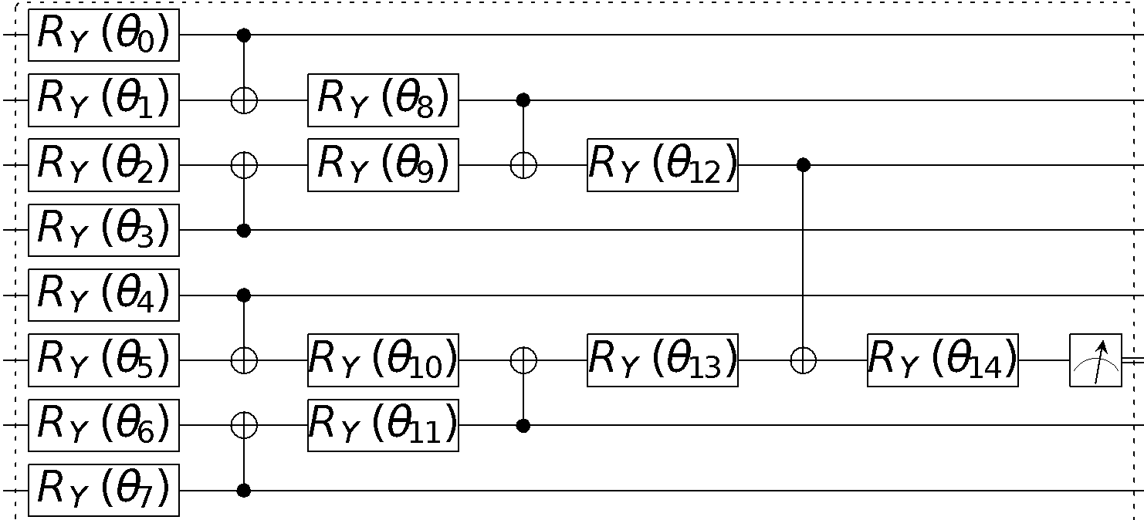
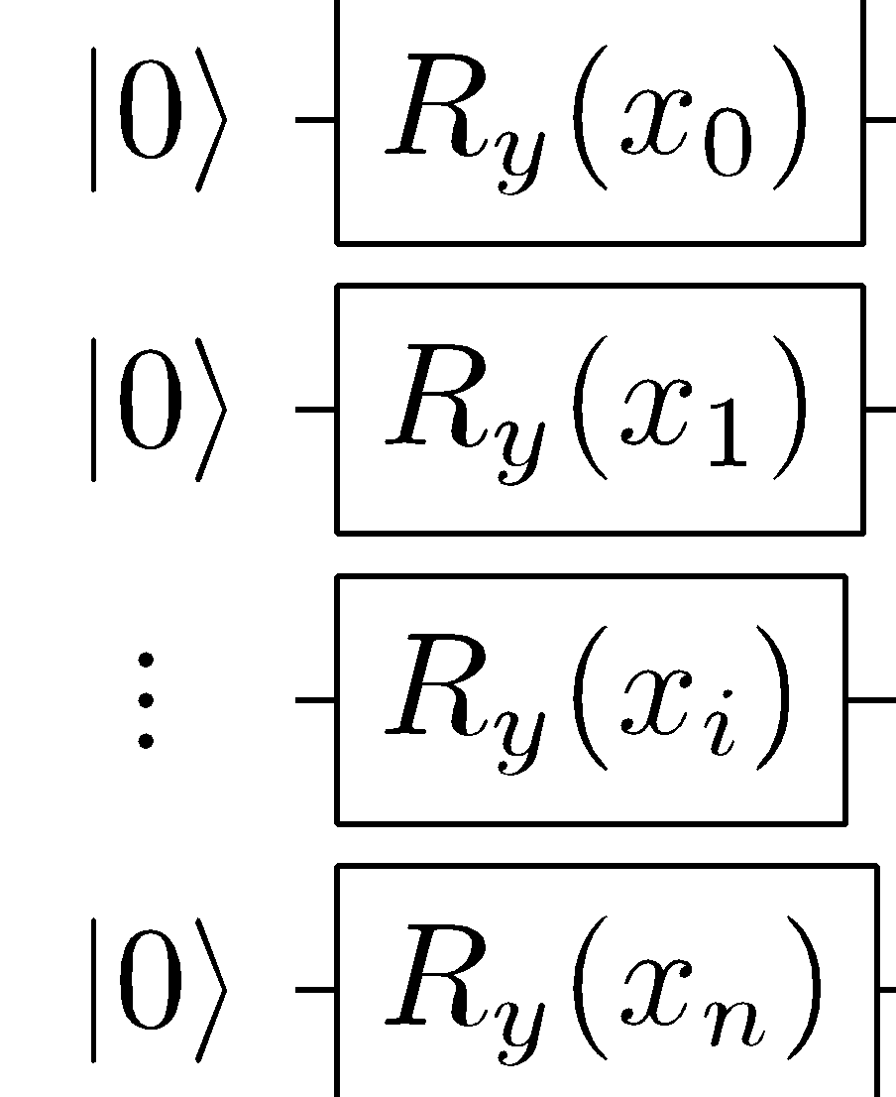
Quantum Graph Neural Network
C. Tüysüz
4th IML workshop
Node information
(3D cylindrical coordinates)
Graph connectivity matrix
PQC (Parametrized Quantum Circuit)
HNN (Hybrid Neural Network):
IQC
(Information Encoding Quantum Circuit)

Slide 18
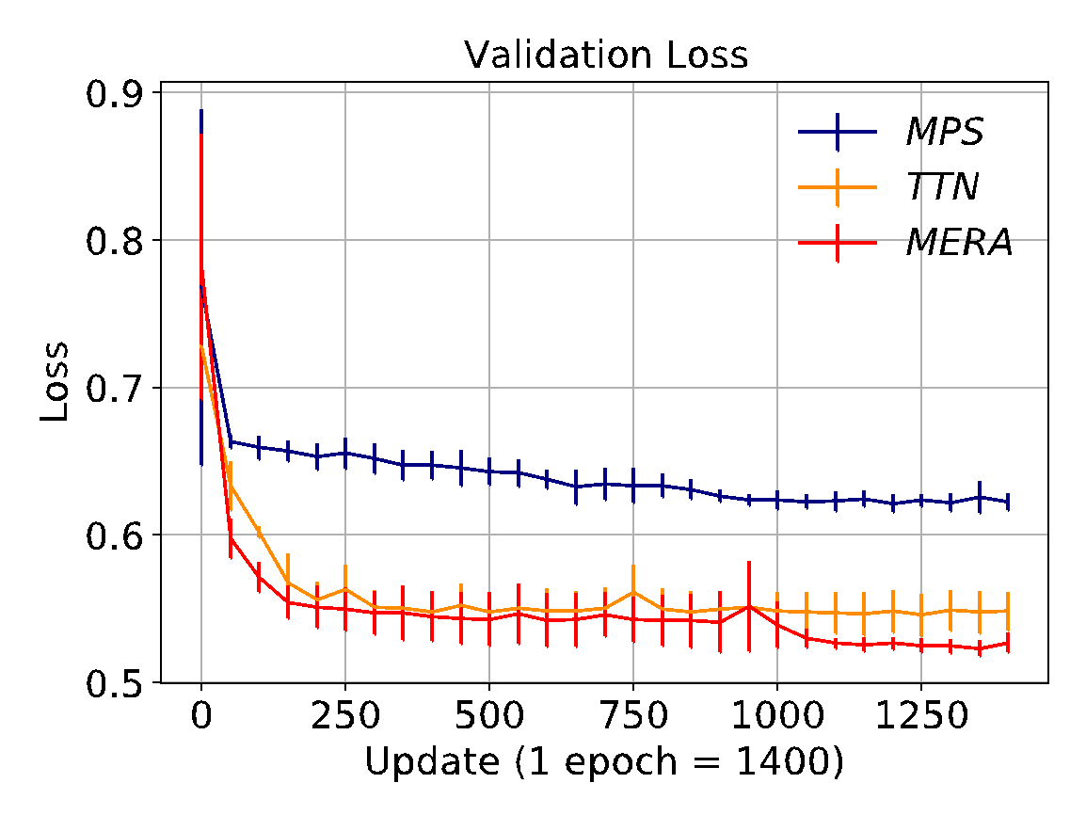
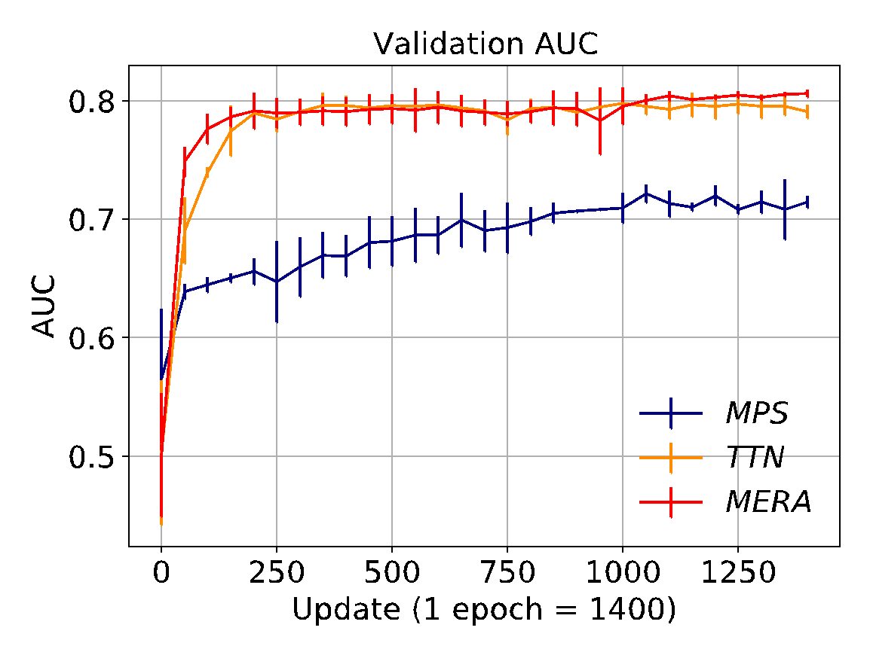
Training Results
C. Tüysüz
4th IML workshop
Training set: 1400 subgraphs, Validation set: 200 subgraphs,
using ADAM, binary cross entropy, lr = 0.03, shots =1000. Hidden Dimension Size = 1.

Slide 19
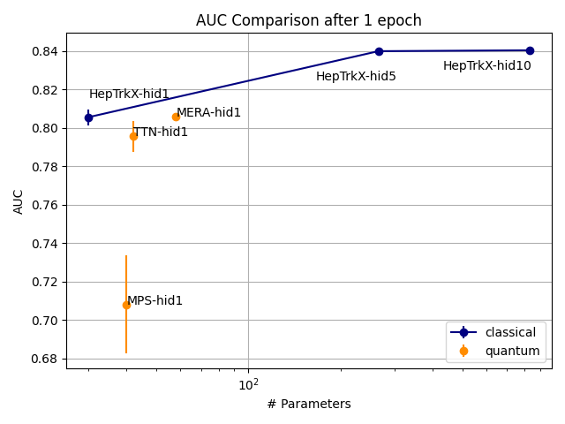
Comparison to classical GNN
C. Tüysüz
4th IML workshop

Slide 20
Learning the embedding
Improving accuracy by representing the input data in an embedded state
Original x-y space
Embedded space:
Hinge-loss based MLP
Selected hits in original space
Exa.TrkX project: arXiv:2007.00149

Slide 21
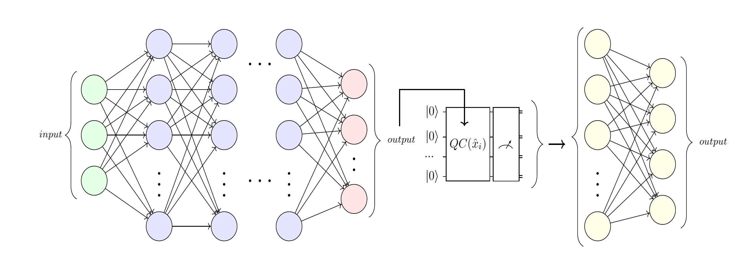
Hybrid embedding
C. Rieger
IOP Quantum 2020

Slide 22
Example circuits
[1] S. Sim at al, http://dx.doi.org/10.1002/qute.201900070

Slide 23
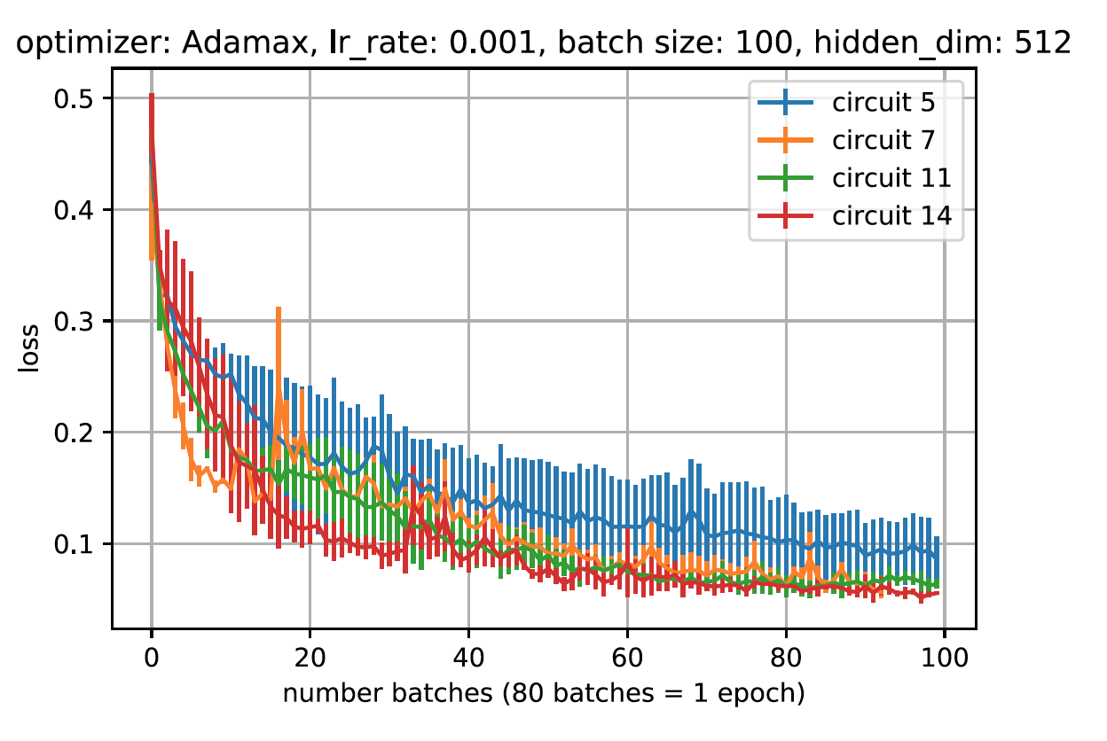
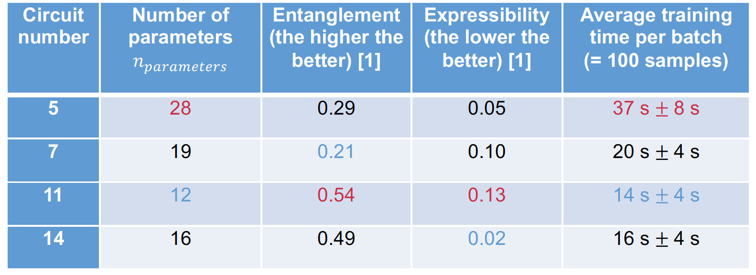
Results
C. Rieger
IOP Quantum 2020
Hybrid Network Validation loss
Long training times for simulation: O(days)
Effect of parameter initialization and circuit depth
[1] Sukin Sim at al, http://dx.doi.org/10.1002/qute.201900070

Slide 24
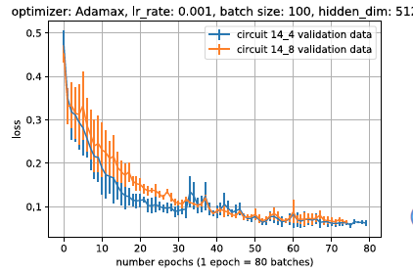
Results (II)
C. Rieger
IOP Quantum 2020
Increasing depth
Increasing N_{qubits}

Slide 25
Generative Models
Classical Generative Models can be used for many different applications
replace Monte Carlo simulation
Quantum Generative Models might have larger representational power
Generative Adversarial Networks:
Generator : Generates a fake output from a random noisy input
Discriminator : Classify fake and real data
Vanilla GAN: play minmax game with value function V
Likelihood to assign correct label to real samples
Likelihood to assign correct label to generated samples
$$V=\min_{G}{\max_{D}{E_{x\sim p_{real}(x)}[\log{D_{θ}(x)]}+E_{z\sim p_{z}}[log(1−{D_{θ}(G_{φ}\left(z\right)))]}}}$$

Slide 26
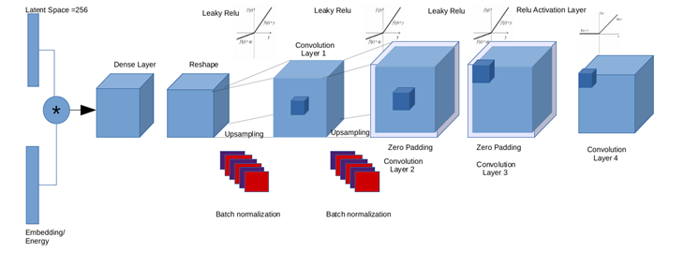
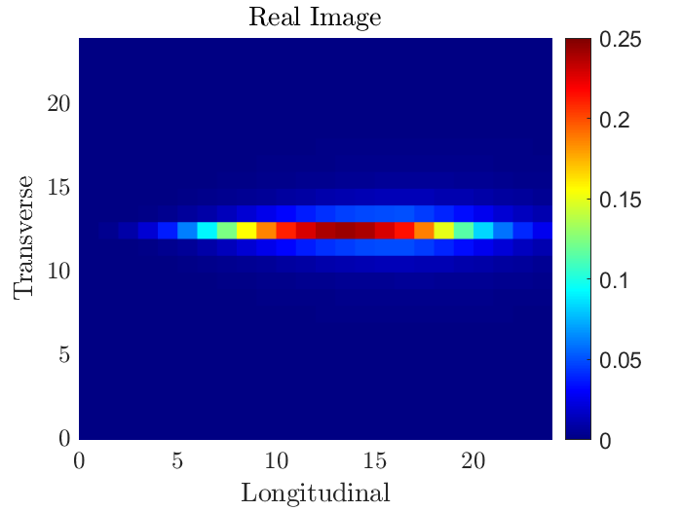
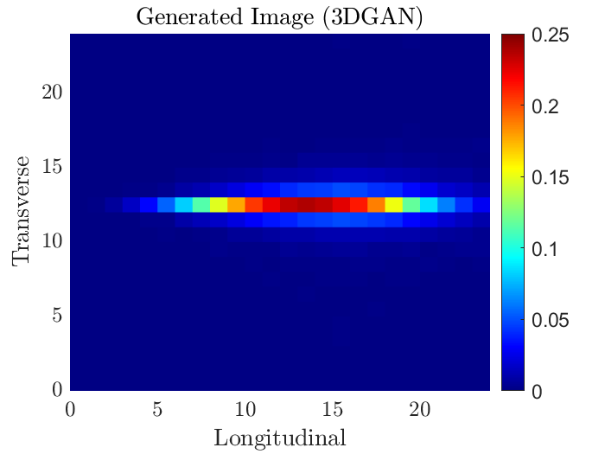
Quantum Generative Models
S. Y. Chang
IOP Quantum 2020
Classical use case 3DGAN prototype for calorimeter simulation
Detector output interpreted as a 3D image.
Quantum GAN investigations
Down sample 3DGAN use case to manageable number of pixels
Use compressed data representation in quantum states.
Qubits or Continuous Variables
Different hybrid classical-quantum combinations
3DGAN generator
https://doi.org/10.1051/epjconf/201921402010
Real image
3DGAN output
Calorimeter Depth
Calorimeter Depth

Slide 27
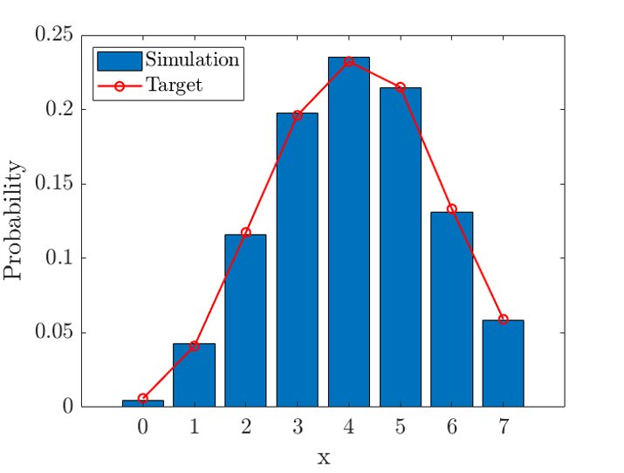
Hybrid Classical-Quantum GAN
S. Y. Chang
IOP Quantum 2020
IBM qGAN can load probability distributions in quantum states
Simplify dataset: extract 1D energy profiles from 3DGAN images
2^{n} classical pixels expressed by n qubits
Probability of getting state | k⟩ = (Relative) Energy at pixel k
Train a hybrid classical-quantum GAN to generate few-pixels image
Classical Discriminator (pyTorch): 512 nodes + Leaky ReLU → 256 nodes + Leaky ReLU → single-node + sigmoid
Quantum Generator (Qiskit): 3 R_{y} layers
https://doi.org/10.1038/s41534-019-0223-2
Relative Energy Profile
Calorimeter Depth

Slide 28
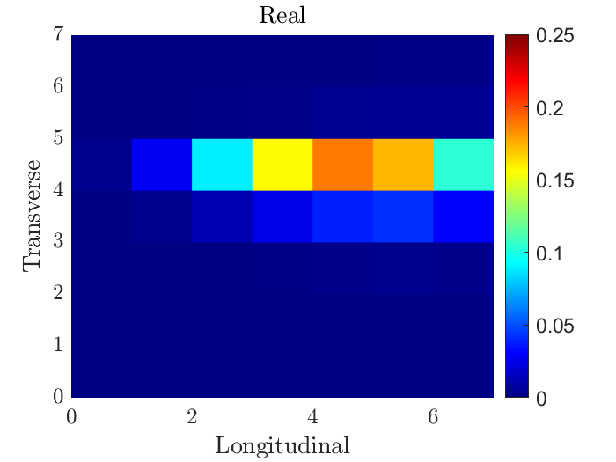
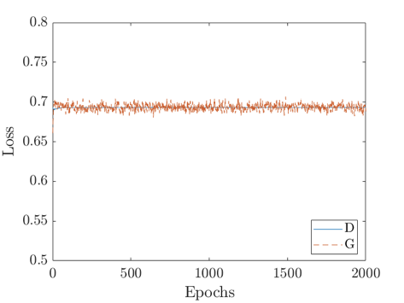
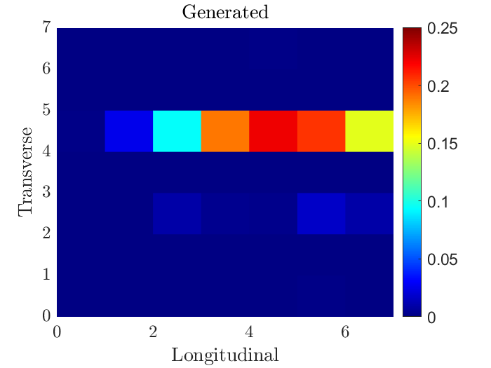
qGAN for calorimeter simulation
S. Y. Chang
IOP Quantum 2020
Real image
Low resolution 2D energy profile
Increase generator and discriminator depth (6 qubits – 64 pixels)
Realistic 2D images
Stable training losses
IBM qGAN is not a real generative model
It uses the adversarial training approach to embed image probability distribution in a quantum circuit
Need a way to sample single images
Calorimeter Depth
qGAN image
Calorimeter Depth

Slide 29
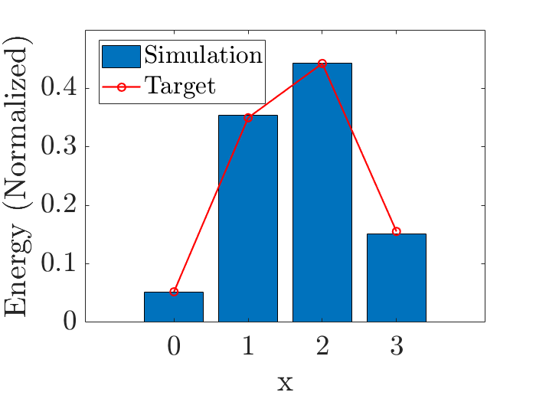
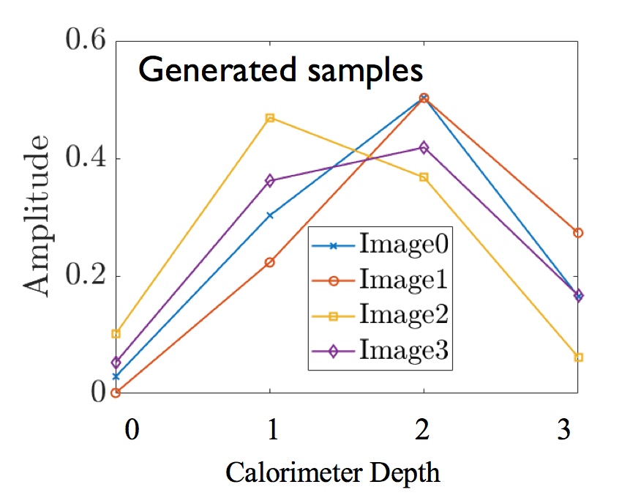
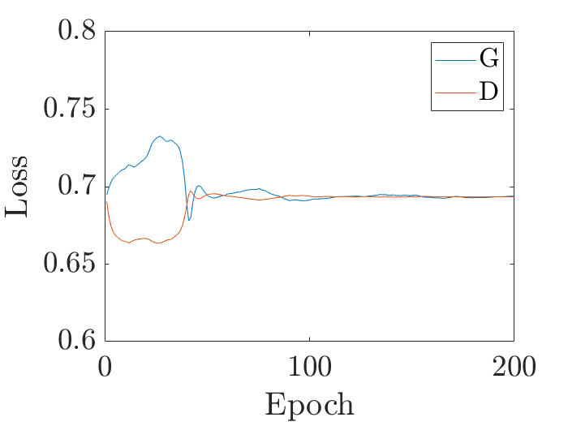
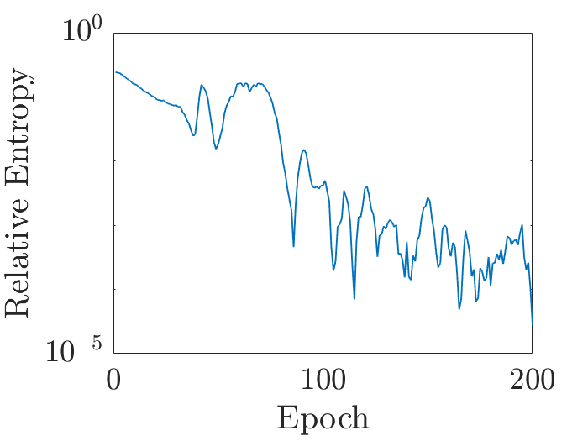
Extending the qGAN model
S. Y. Chang
IOP Quantum 2020
Collaboration with Cambridge Quantum Computing
Two-steps quantum generator to learn the average distribution and sample images from it
Ry variational form implemented using qiskit & t|ket
Uniform parameter initialization
AMSGRAD optimizer with lr = 10⁻⁴, lr2 = 10⁻³
Classical discriminator (pyTorch) 4 nodes → 512 nodes → 256 nodes → 1 node
Leaky ReLu between hidden layers + sigmoid
AMSGRAD optimizer + Gradient penalty for stability and convergence
Mean Image
Calorimeter Depth

Slide 30
QC Simulation Platform
1
Enable building skills and starting R&D work, both as a preparation to real H/W and to explore “quantum-inspired” computational models
“Standardized” access to different simulators, hardware, tools, libraries (e.g. pre-packaged containers, Jupyter notebooks, GitHub, etc.)
Multiple participating sites, capitalizing on CERN world-level expertise in operating distributed infrastructures
2
3

Slide 31
Summary
CERN Quantum Technology Initiative established
Assess the potential of QC in the time scale of the High Luminosity LHC runs and beyond
Build skills for future programmes
Provide a thematic HEP focus for international collaborations
CERN openlab has started investigating opportunities in QC and across QC and other relevant fields (AI, HPC)
Foster collaborations between scientists and industry
Major focus on education and skills development
Initial studies on QML yield very exciting results
Hints of quantum advantage ?
More work in understanding trainability, capacity and effective dimensions is needed

Slide 32
Thanks!
https://quantum.cern/
Sofia.Vallecorsa@cern.ch

Slide 33
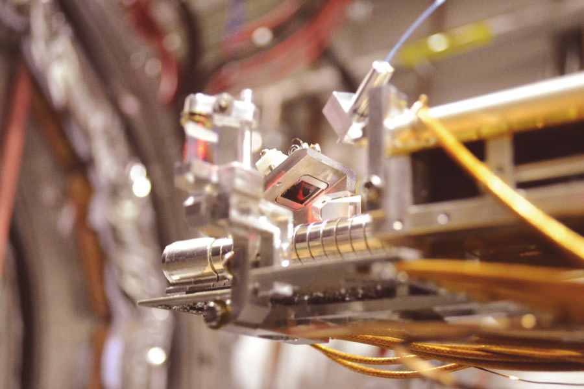
Quantum Sensing and Low-Energy Physics
M. Doser, CERN
Scope
Low-Energy Physics: antimatter, dark matter searches, symmetries, EDM’s (AD, AeGIS, ISOLDE, etc.)
Strategy
Discrete processes, changes of quantum states
Novel devices: nanowires, photon upconverters,
microwaves, magnetic junctions, SQUIDs, TES
Measurements of properties of trapped, atoms, ions, molecules, Rydberg atoms,
neutral systems
Correlations of entangled systems: e.g. e⁺ e⁻ 3γ decay: simultaneous measurement
of E, polarization and direction
Applications

Slide 34
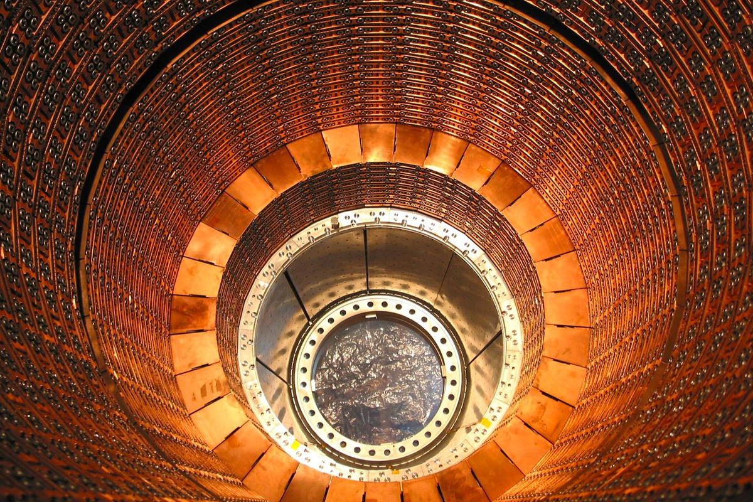
Quantum Sensing for High-Energy Physics
M. Doser, CERN
Scope
High-Energy Physics, particle tracking, calorimetry, identification in HEP detectors
Quantum “priming” of detectors before measurement, signal enhancement
by laser excitation, quantum effects due to size, cryogenics
Strategy
Applications
Chromatic particle trackers composed of arrays of nanodots of varying size,
Calorimeters and low-energy single-particle (photons, mip’s, ions,...) detectors
made of arrays of nanowires (SNSPD)
“Rydberg-amplified” calorimeters with high dE/dx

Slide 35
D. Grabowska, CERN
Numerical Methods and Simulations
in Particle Theory
Modern day HEP requires high performance computing, relying on Monte Carlo simulations
But not every physics problem is amenable to Monte Carlo simulation
Mass Spectrum and Scattering in Low Energy Nuclear Physics
Hadronic contributions to BSM Experimental Searches
Event generation for Particle Collisions
Nuclear Physics at Finite Density (sign problem)
Interference effects in Parton Showers (must work at amplitude level)
Transfer Phenomena (must work in real time)
Baryonic Physics (signal to noise problem)
Main focus is developing methodologies and algorithms that would allow us to address these questions using quantum computers, without relying on importance sampling
CERN QTI - 19/10/2020
35

Slide 36
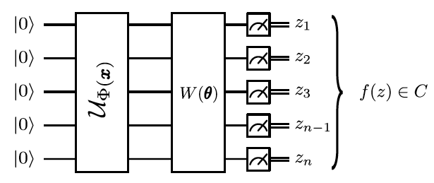
Quantum Support Vector Machine
Prof. Sau Lan Wu
SVM are kernel methods:
Feature maps in high dimensionality space improve separation power
A quantum variational classifier
Support Vectors
Define a quantum SVM in Qiskit
Test different input encoding (qubit and amplitude)
Reduce number of input features using PCA : 8,10,20 features (N qubits)
Test different entanglement configurations
Shallow variational classifier + Binary measurement
Maximize margin
Nature volume 567, pages209–212(2019)
Notes:
ttH (H->γγ)

Slide 37
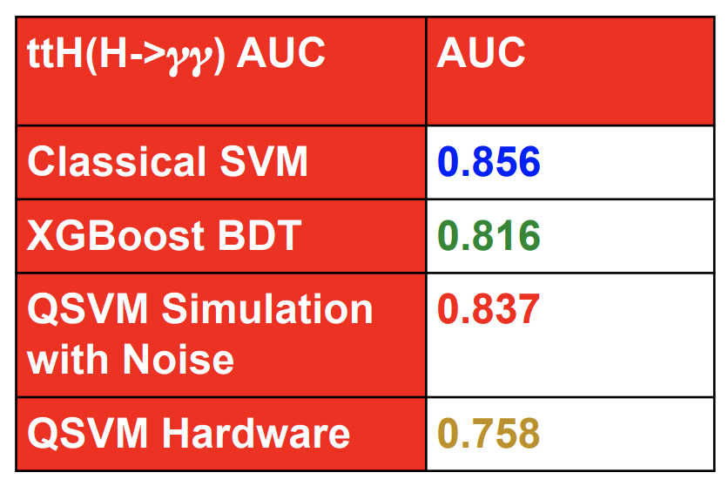
Quantum SVM
Comparison to BDT and classical SVM
100 training events, 100 test events, and 5 qubits
1000 iteration on IBM boeblingen
Quantum SVM for ttH(H → γγ) classification
Running full training with quantum simulators requires large computing resources
Memory increases with qubit, training events and complexity

