Slide 1
Spontaneous Fission of SHE: A New Source of Insights into the Structure of Neutron-Rich Nuclei
C. J. Zachary¹, J. H. Hamilton¹, E. Wang¹, G. Ter-Akopian², Yu. Ts. Oganessian²
¹Department of Physics and Astronomy, Vanderbilt University, Nashville, TN 37235, USA
²Joint Institute for Nuclear Research, Dubna 141980, Russia

Slide 2
Outline
Review of new physics from Spontaneous Fission of ²⁵²Cf
Prospects from spontaneous fission of Z>102 from Super Heavy Elements
(a) Confirmation of predicted octupole deformation around Z = 56, N = 88 in ^{143–145} Ba and ¹⁴⁸ Ce and the first evidence of both S = ±1 doublet bands in even-even nuclei;
(b) unexpected drop in first 2⁺ energy at N = 98 and then to rise again at N = 100 in ^{162,164}Gd;
(c) importance of triaxial shapes in A = 100-118 nuclei.
(d) first evidence for one and two phonon γ-type vibrational bands in odd-Z and even-Z-odd-A nuclei;
(e) first evidence for chirality & wobbling motion in even-even A = 110-114 Ru and Pd nuclei;
(f) changing structure in 110-116 Pd nuclei from prolate to triaxial oblate to oblate;
Structure of Higher Z neutron-rich nuclei
Reactions with large cross-sections with the new SHE factory in Dubna.
  ²⁴⁸Cm (²²Ne, 4n) ²⁶⁶Sg
  ²⁵⁰Cf (²²Ne, 4n) ²⁶⁸Hs
  Super-symmetric SF in ²⁶⁶Db (EC) ²⁶⁶Rf (SF)

Slide 3
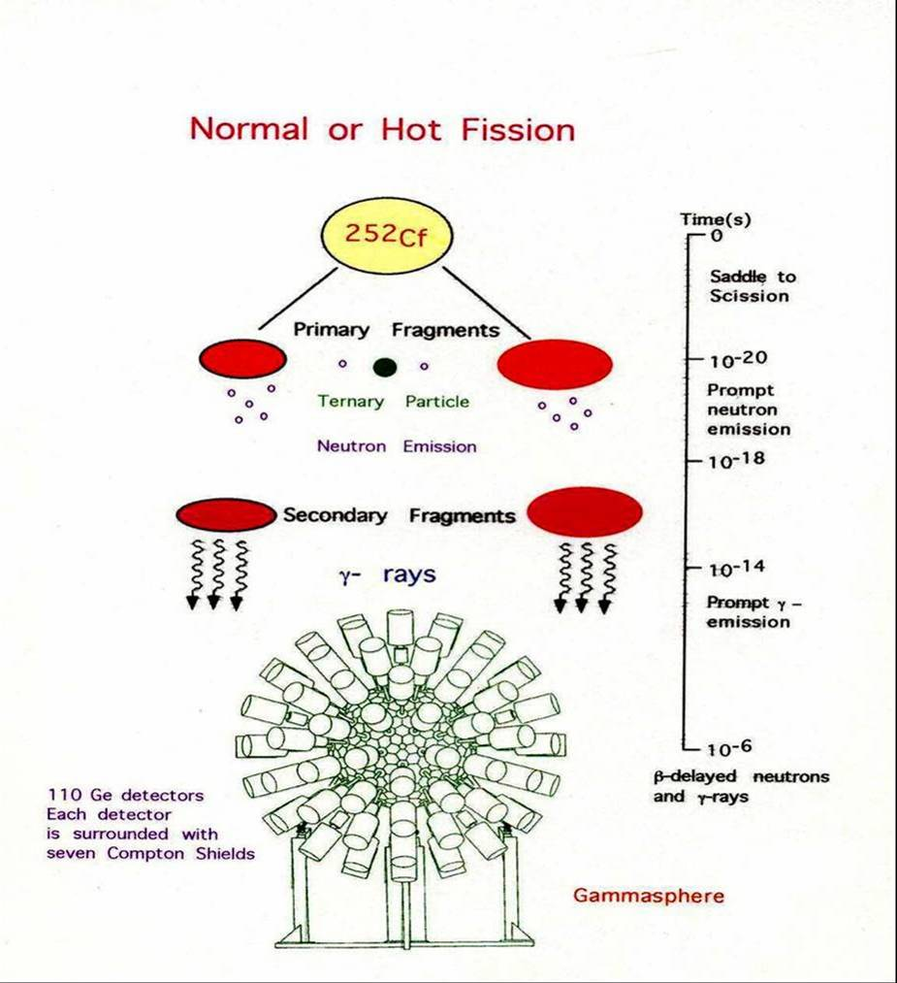
Observed:
5.7×10¹¹ γ-γ-γ events.
&
1.9×10¹¹ γ-γ-γ-γ events.

Slide 4
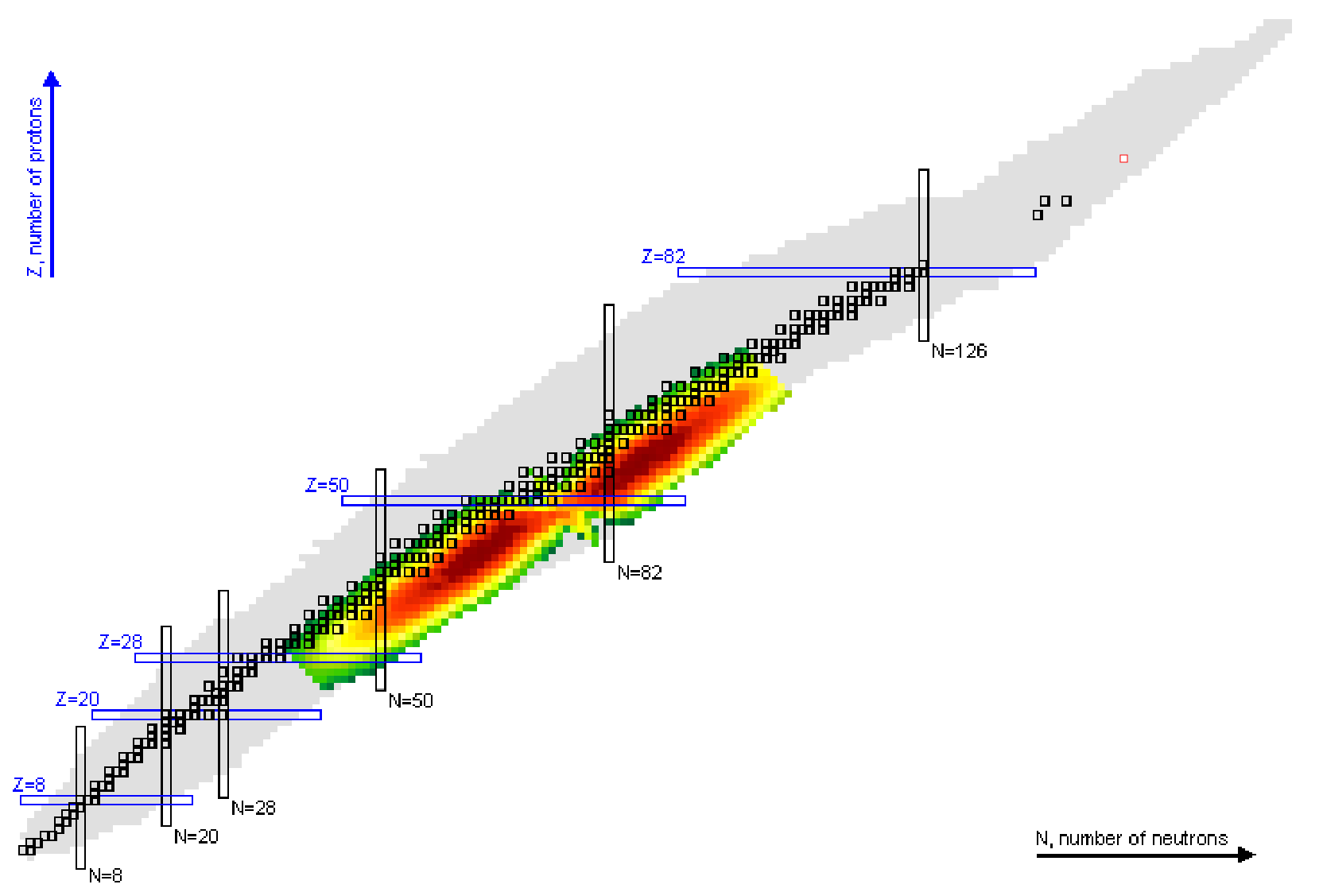
Yields of ²⁵²Cf as plotted by Nudat2: https://www.nndc.bnl.gov/nudat2/

Slide 5
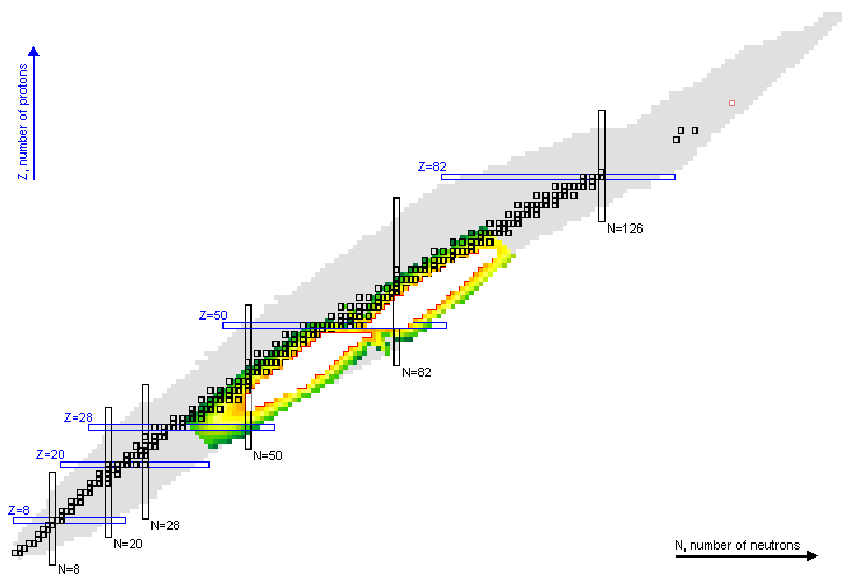
Yields of ²⁵²Cf as plotted by Nudat2: https://www.nndc.bnl.gov/nudat2/

Slide 6
Octupole Deformation

Slide 7
Theorized octupole deformation around ¹⁴⁵Ba by G.A. Leander, et al.
A suggestion of Octupole deformation near ¹⁴⁵Ba was made from discrepancies between ground state masses in experiment and theoretical masses.
The 5/2⁻ ground state of ¹⁴⁵Ba was predicted to be the negative parity member of a 5/2± doublet.
Such parity doublets from reflection asymmetry can be identified in γ-ray spectroscopy via enhanced E1 transitions between opposite parity rotational bands.

Slide 8
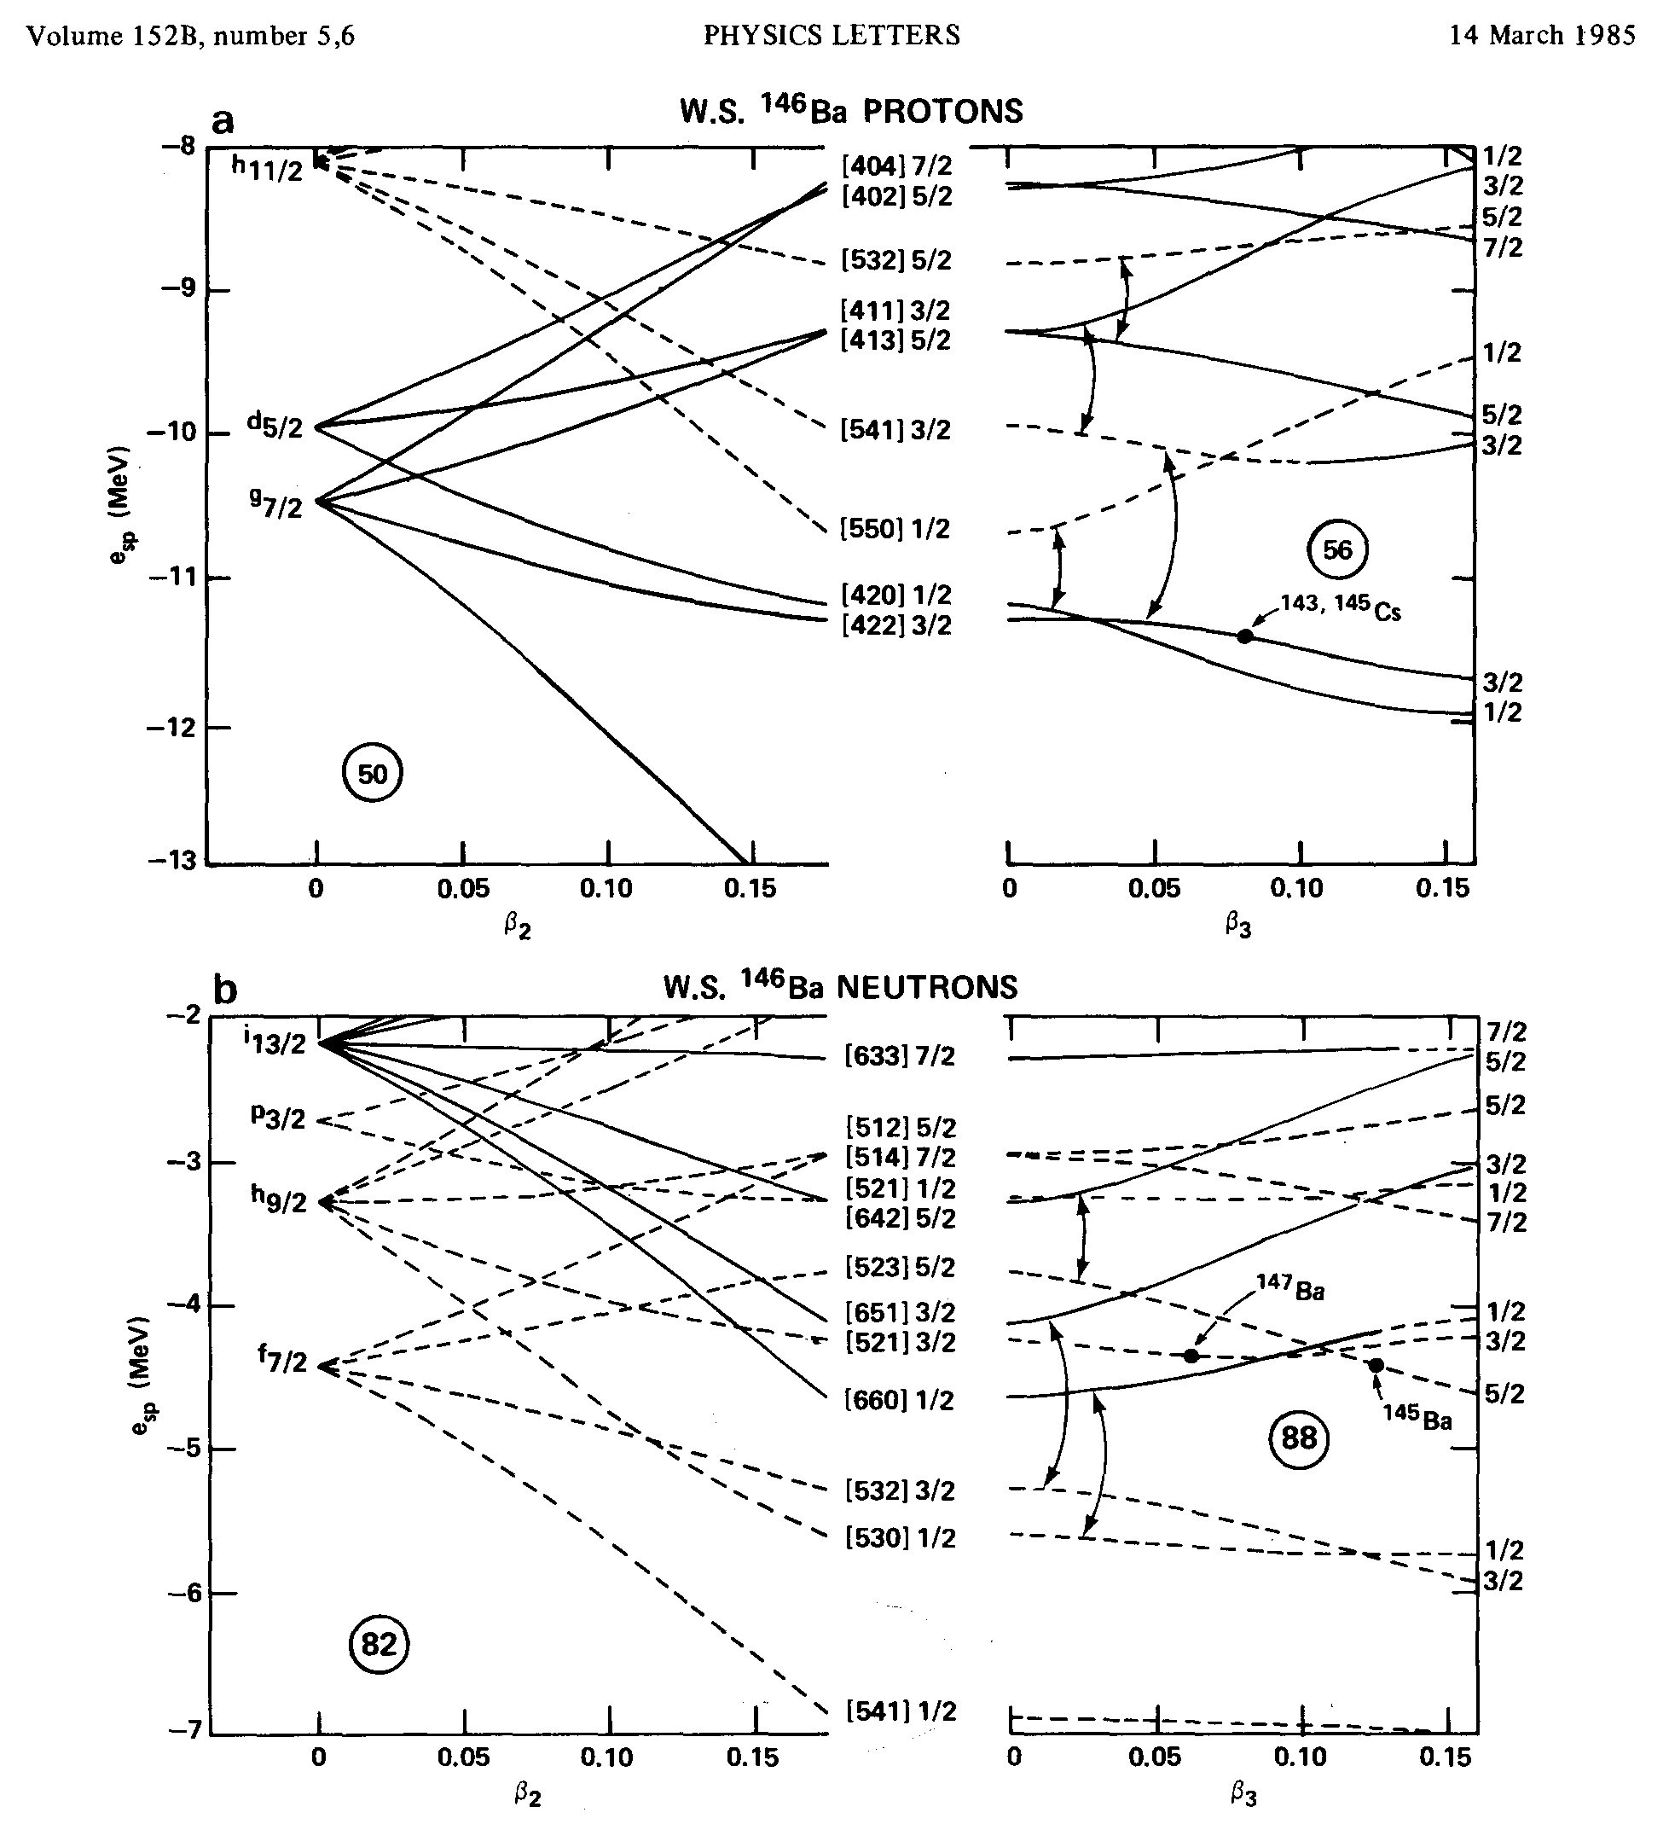
Diagram from:
G.A. Leander, et al. Phys. Lett.,
B152 (1985), p. 284

Slide 9
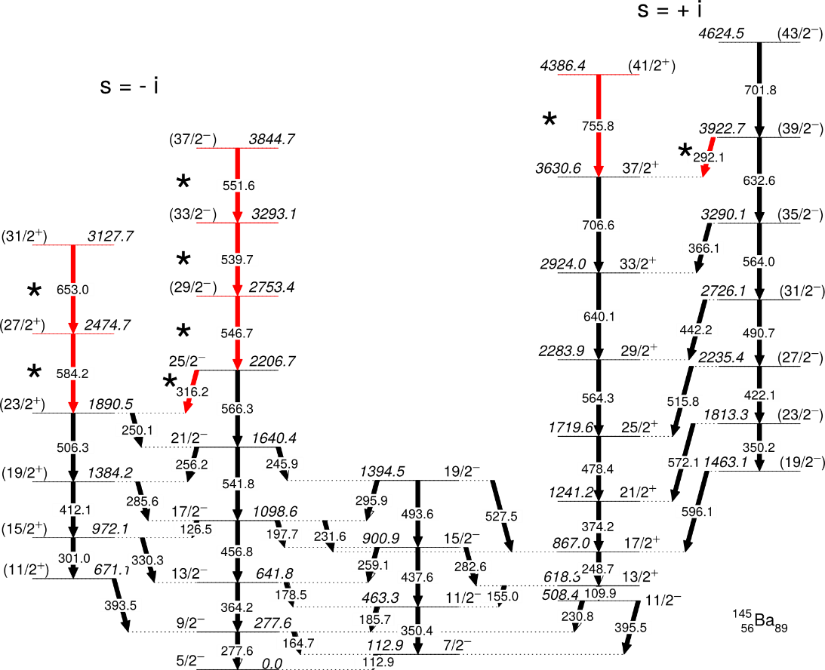
Transitions in black from: S.J. Zhu, et al. PRC 60 051304
Transitions in red from the Dissertation of N.T. Brewer

Slide 10
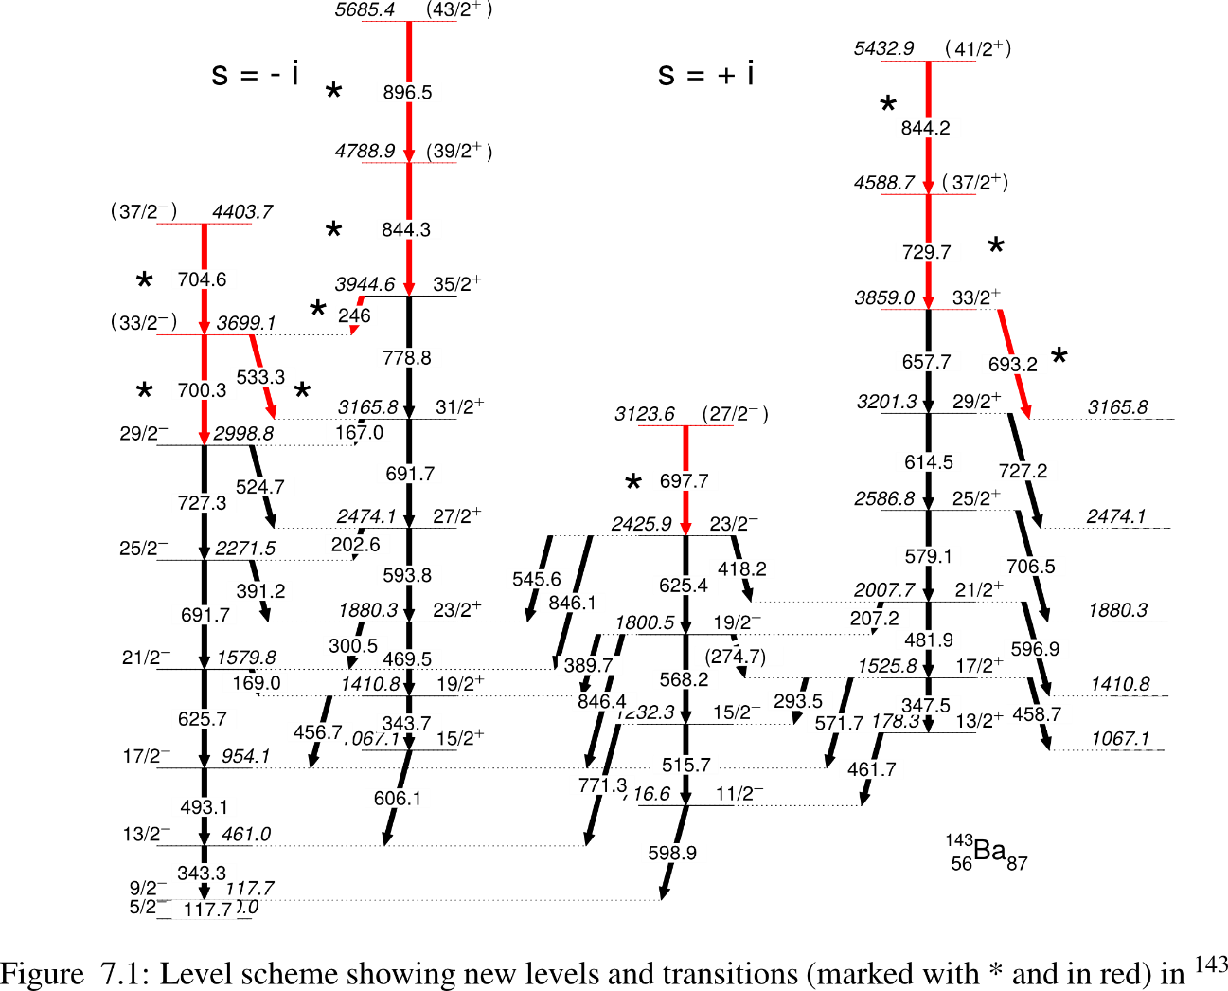
Transitions in black from: S.J. Zhu, et al. PRC 60 051304
Transitions in red from the Dissertation of N.T. Brewer

Slide 11
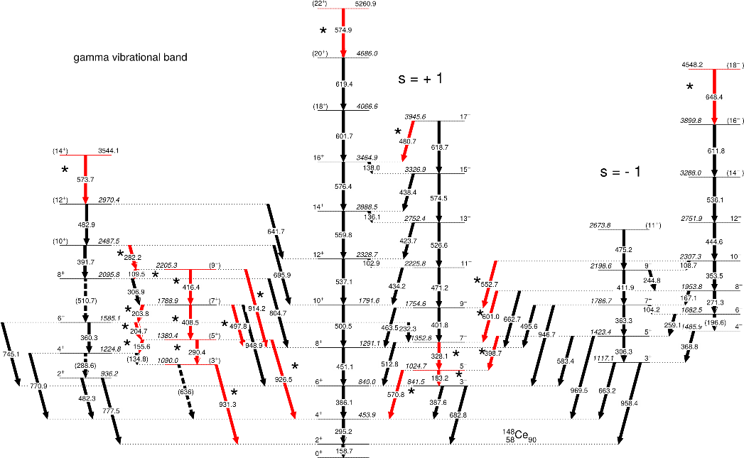
Transitions in red from the Dissertation of N.T. Brewer

Slide 12
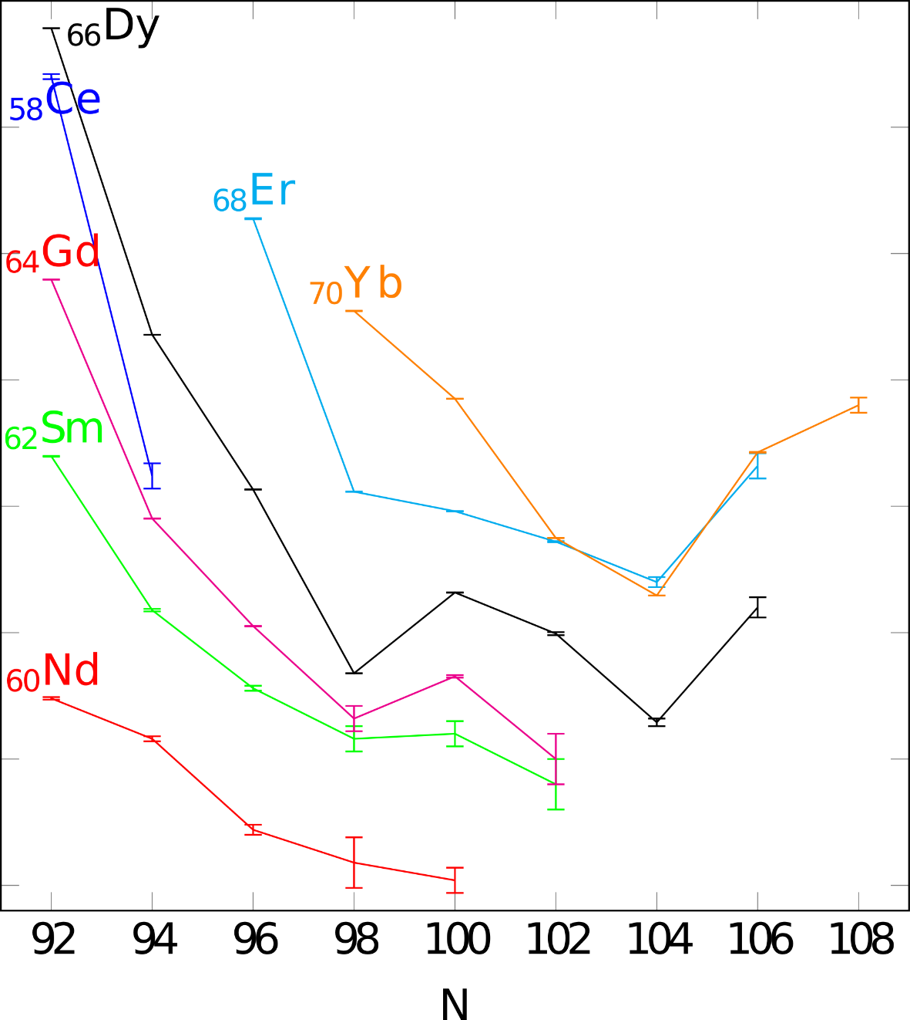
Unexpected drop & rise in 1st 2⁺ energy
Neutron mid-shell

Slide 13
Yields of ²⁵²Cf as plotted by Nudat2: https://www.nndc.bnl.gov/nudat2/

Slide 14
Effects of Triaxiality in the A=100-118 region
Transition from super-deformed ⁹⁹Y to triaxial ¹¹³Rh
One and two phonon γ vibrational bands in even-even isotopes and first observations in odd A and odd Z nuclei, ^{103,105,107}Mo, ^{103,105}Nb, ^{107,109}Tc
Chiral doublet bands in triaxial nuclei, ^{110,112}Ru, ¹¹⁴Pd
Wobbling motion of triaxial shapes, ¹¹²Ru, ¹¹⁴Pd
Prolate-to-oblate transition ¹¹²Pd->¹¹⁸Pd

Slide 15
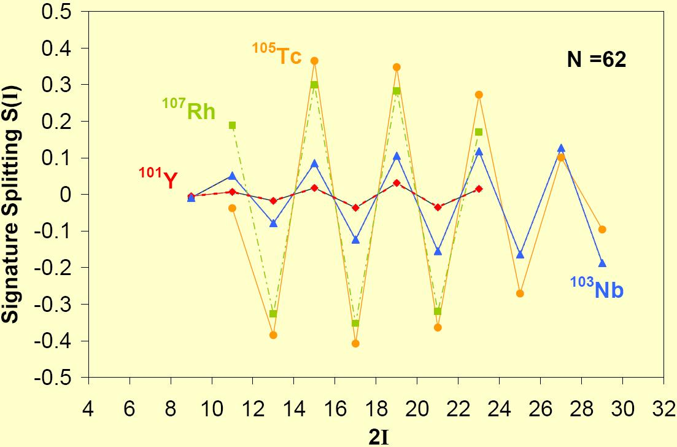
The trend of signature splittings in N=62 isotones of Z=39 – 45: The S(I) is increasing with increasing Z, observed by our collaboration
Signature splitting in gb increasing from A=99 to109 n-rich nuclei

Slide 16
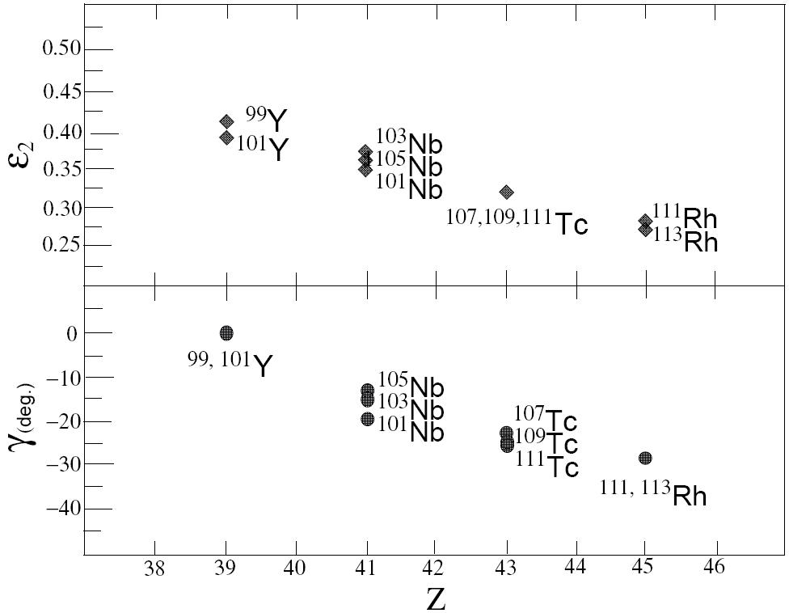
(N)
(60)
(62)
Symmetric
Maximum Triaxiality

Slide 17
Multi Phonon γ Vibration

Slide 18
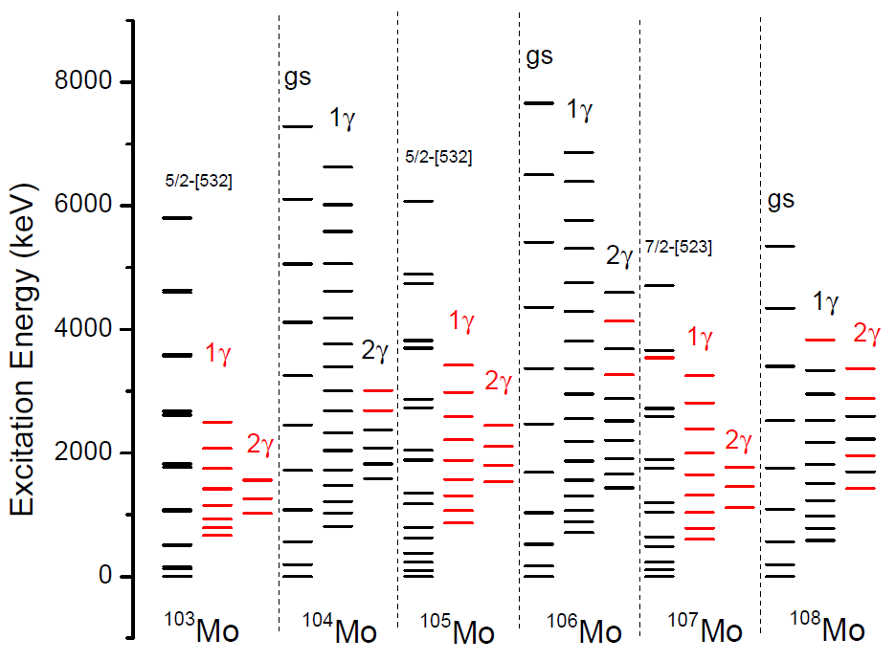
In red are new levels observed by Vanderbilt-China-Berkeley-Dubna-India collaboration.

Slide 19
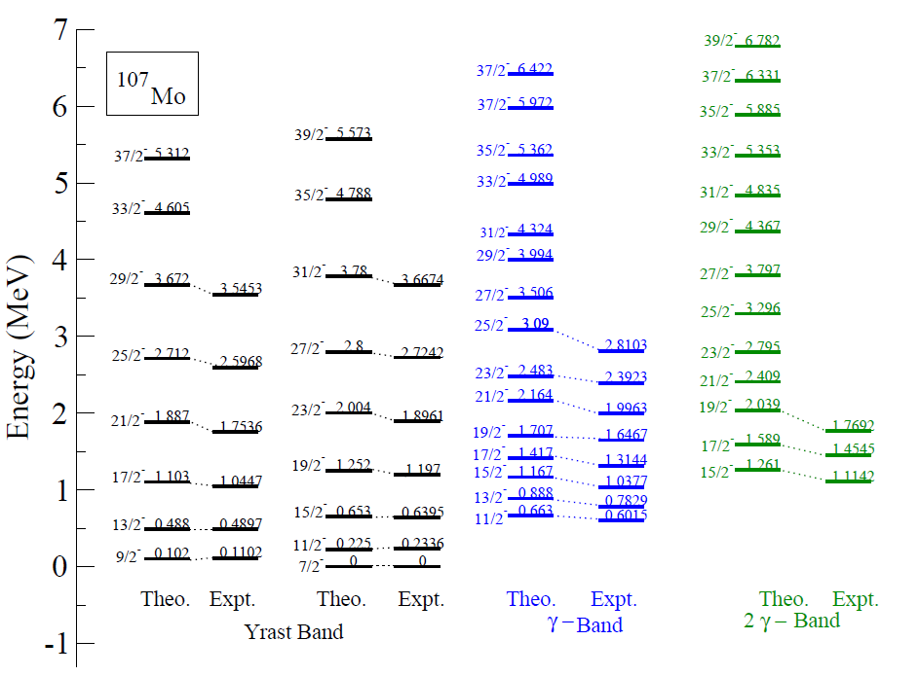
Comparison with Triaxial Projected Shell Model (TPSM) calculation

Slide 20
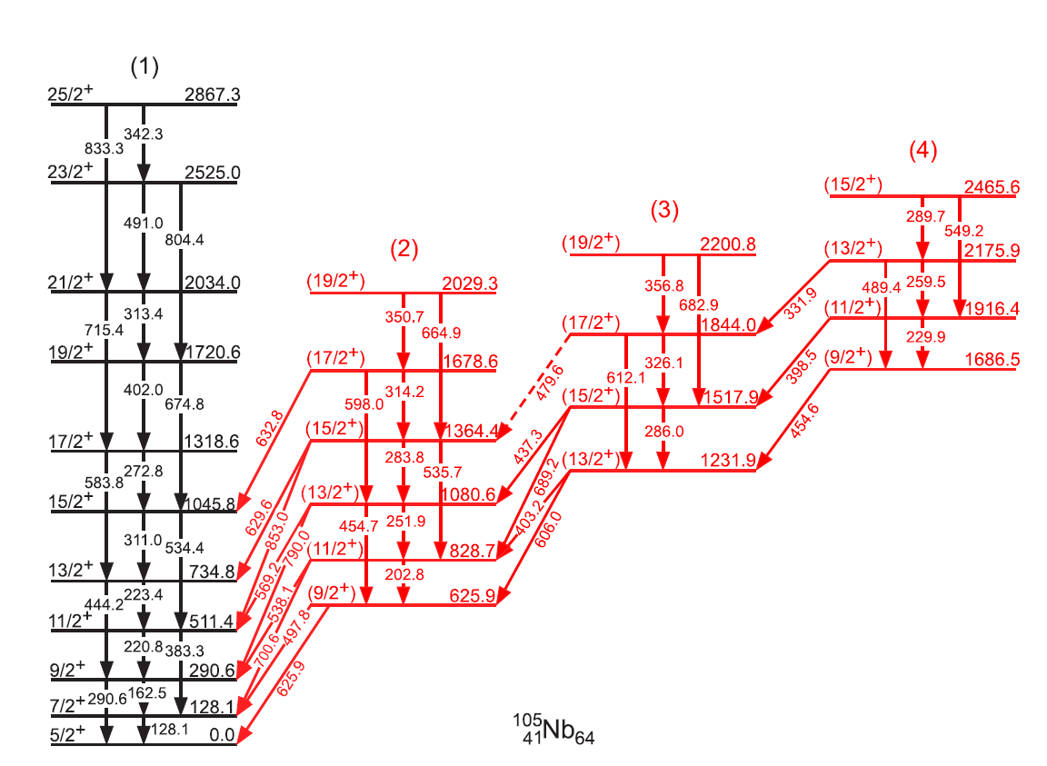
Discovered first γ bands in odd-N-even-Z and odd-Z-even-N nuclei
^{103,105,107}Mo, ^{103,105}Nb, ^{107,109}Tc
γγγ?
γγ
γ
Note 1 and 2 and possible 3 phonon γ bands
H.J.Li et al., Phys. Rev. C 88, 054311 (2013). Tsinghua-Vanderbilt-Berkeley-Dubna-Shanghai collaboration.

Slide 21
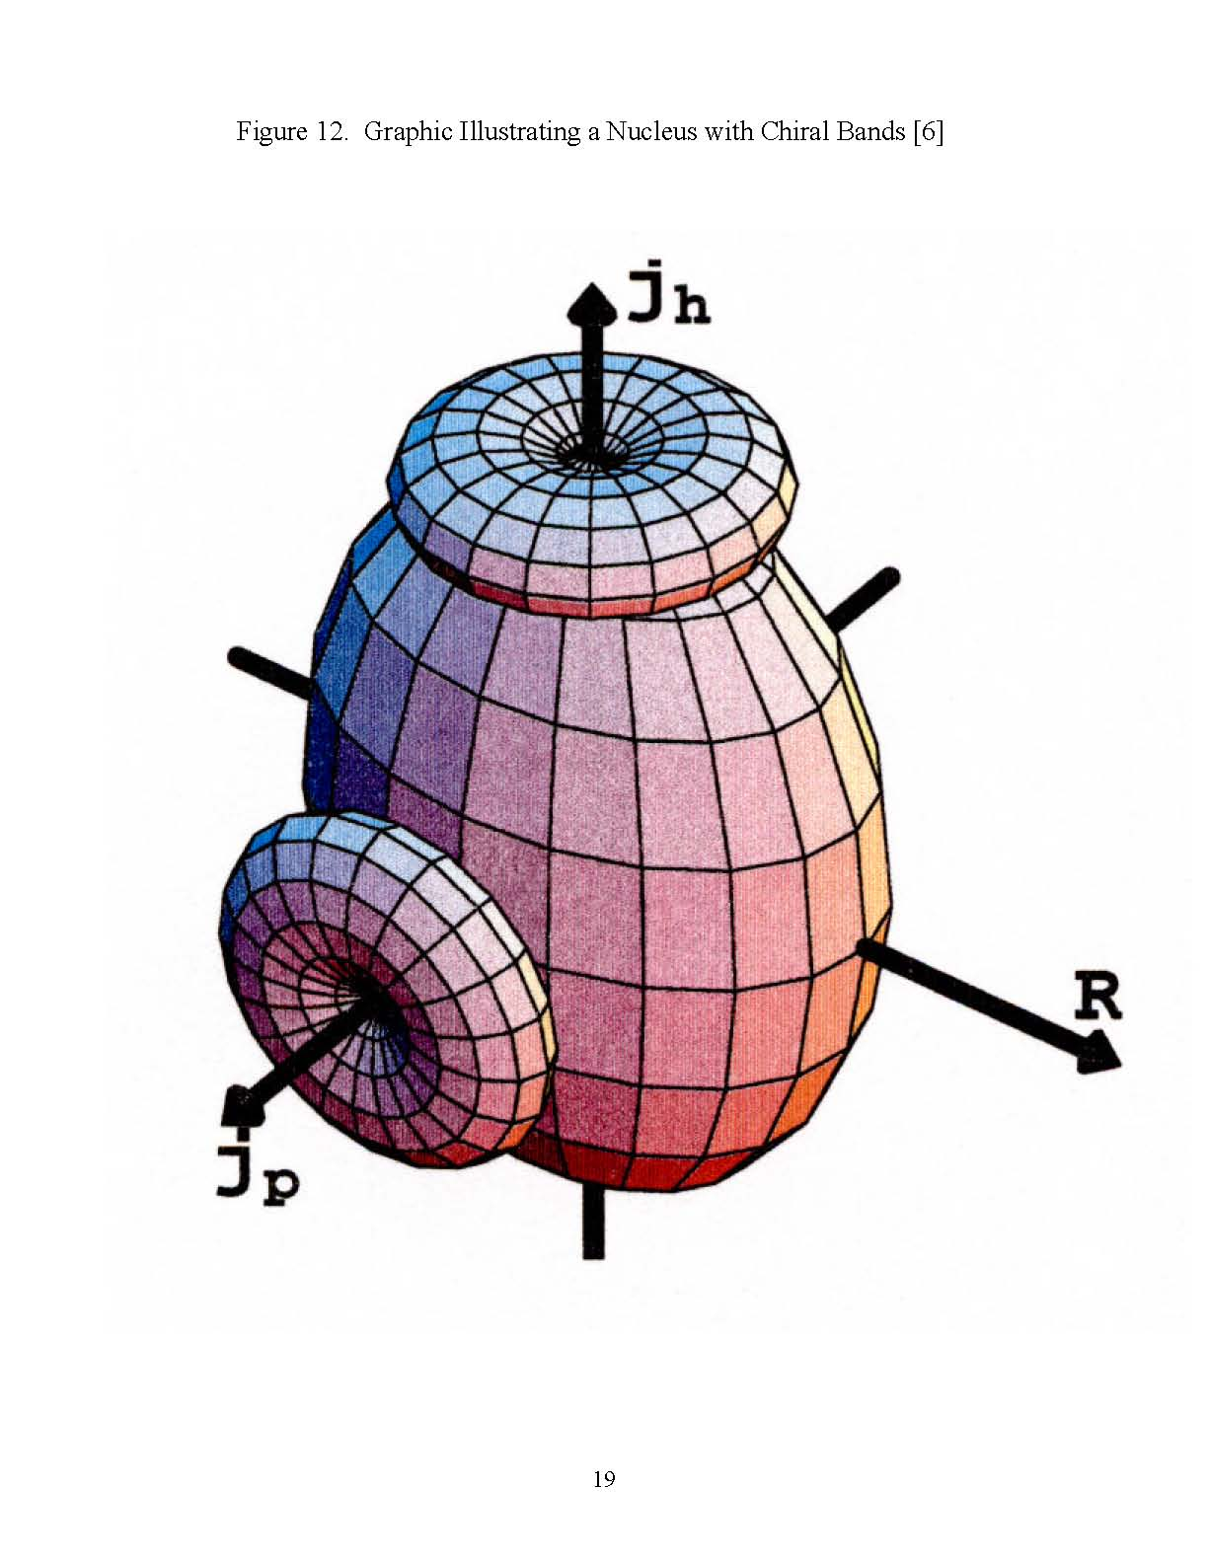
Prototype tri-axial nucleus with angular momentum along all three axes can have chiral doublets.
The prototype
of a triaxial
chiral rotor
High J hole
S. Frauendorf and J. Meng, Nucl. Phys. A617, 131(1997)
Rotation
High J particle

Slide 22
Fingerprints of Chirality
ΔI = 1 doublet bands with the same parity and nearly degenerate energy for same spin states.
S(I) = [E(I)-E(I-1)]/2I constant and equal with increasing spin for the two bands.
Similar B(E2)/B(M1) ratios for the same spin states.

Slide 23
Soft chiral vibrations in ^{104,106}Mo
The mechanism is quite different from the known chiral examples where high j particles generate angular momentum along short axis and high j hole along the long axis and the remaining nucleons generate angular momentum along the intermediate axis.
TAC calculations support this chiral assignment which is generated by neutron h_{11/2} particle and mixed d_{5/2}, g_{7/2} hole coupled to the short and long axis. It comes about as an interplay of neutrons in the open shell to produce soft chiral vibrations.

Slide 24
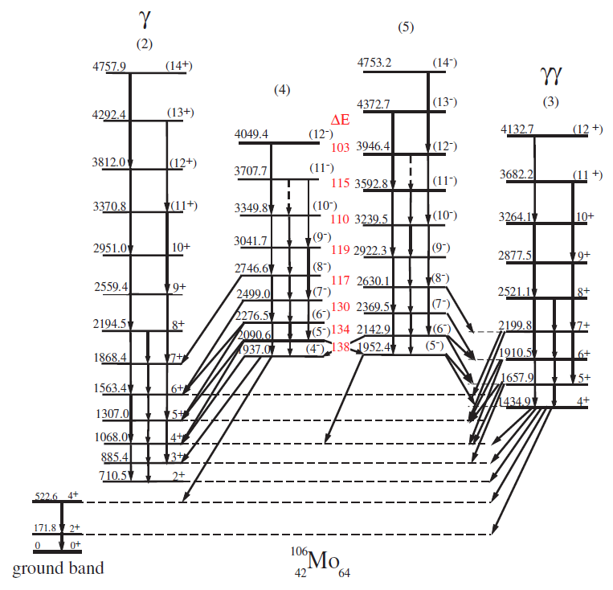
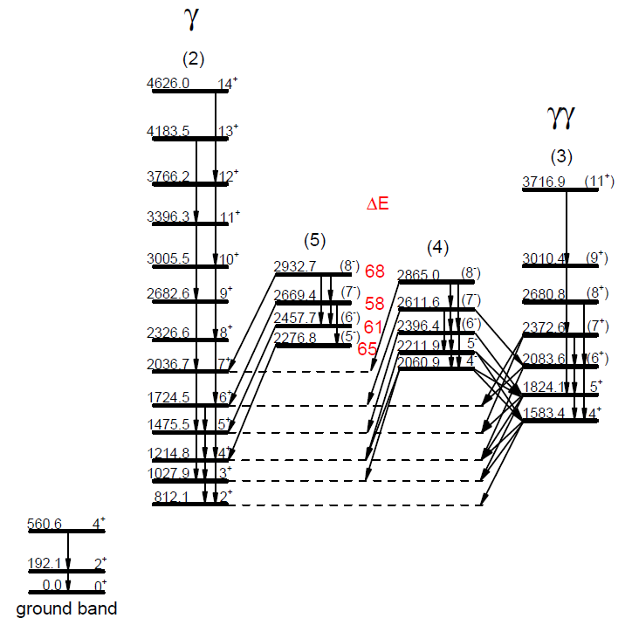


Soft chiral vibrations in ^{104,106}Mo
B. Musangu, et al.
6th Int. Con. On Fis. And Prop.
Of Neut. Rich Nuclei, World
Scientific Singapore, (2017)
P. 255-259
S.J. Zhu, et al.
Prog. in Part. and Nucl. Phys.
59 (2007) 329–336
$$106Mo64$$
$$104Mo62$$
Note ΔE for ¹⁰⁴Mo is less than half ΔE for ¹⁰⁶Mo in closer agreement with theoretical expectations.

Slide 25
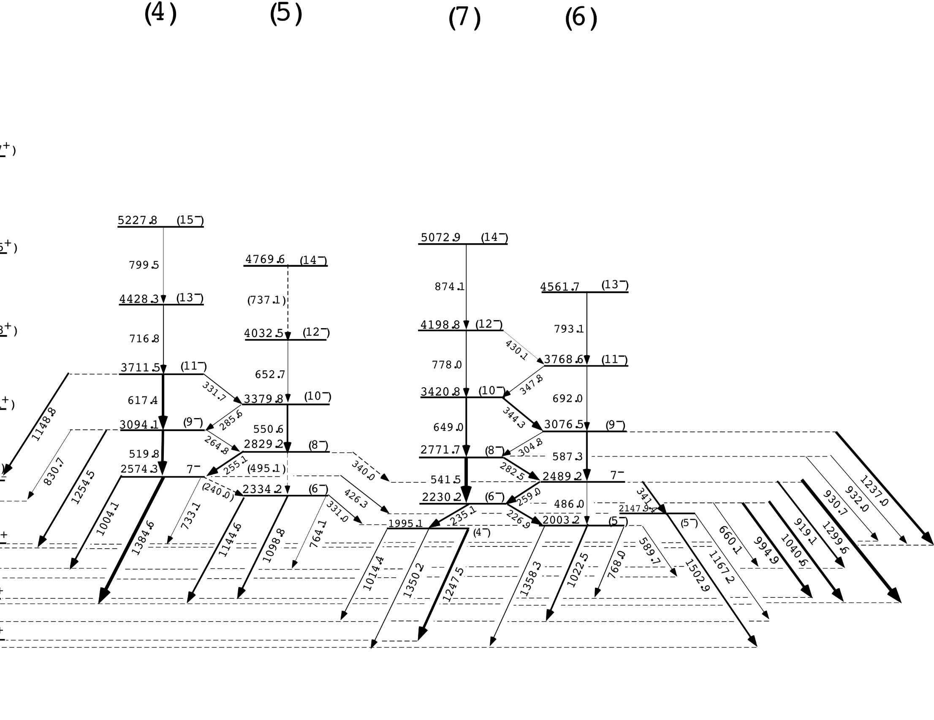
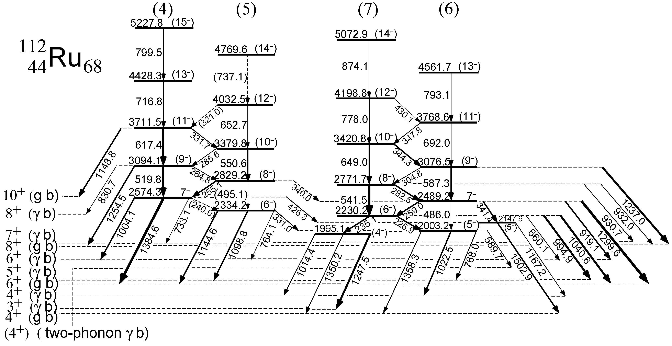
Spins 7 from γ -γ(θ) angular correlations
Y.X. luo, et al. Int. Jour. of Mod. Phys. E
Vol. 18, No. 8 (2009) 1697–1716
10+
^{γ}8+
^{γ}7+
8+
^{γ}6+
^{γ}(4+)
^{γ}5+
6+
^{γ}4+
^{γ}3+
4+
Similar structures observed for ^{108,110}Ru.
Though enhanced E1 transitions in ¹⁰⁸Ru indicated octuple def.

Slide 26
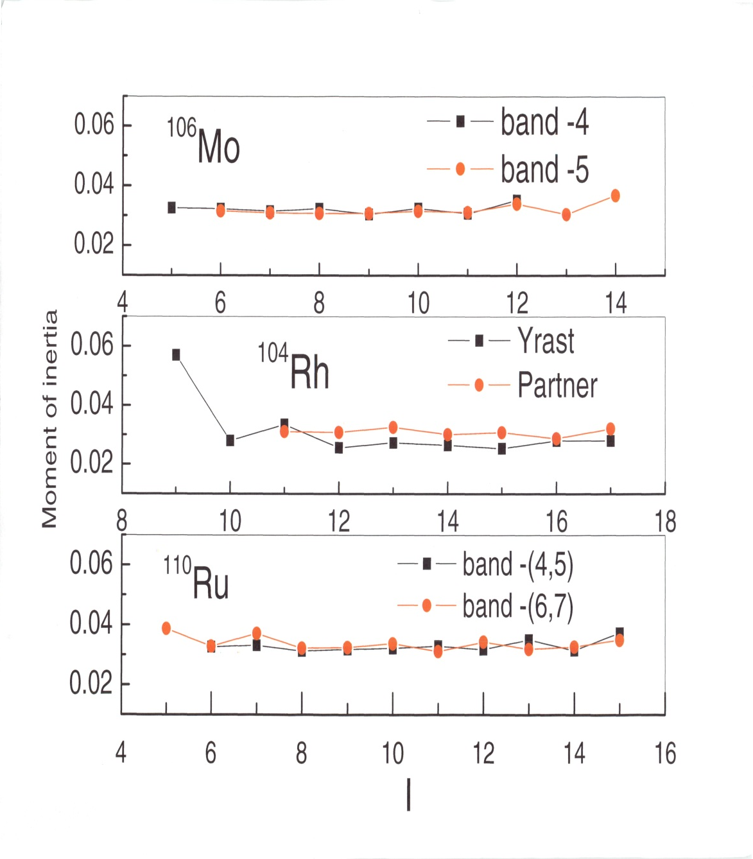
^{104, 106} Rh suggested to have best chiral bands
¹⁰⁶Mo chiral bands reported earlier.
Constant MoI with spin
Equal MoI in both bands
Signature splitting constant with spin
Equal value for partner bands

Slide 27
Wobbling Motion
In triaxial nuclei, wobbling motion of the angular momentum also may occur.
Wobbling motion is described as a deviation of the axial collective motion, away from the axis with largest MOI to give a rise to a series of wobbling bands with quantum number n_{w}=0, 1 ,2 …
Wobbling bands have been discovered at high spin in ^{161,163,165,167}Lu and ¹⁶⁷Ta.

Slide 28
Theoretical Expectation
Odd I high
Experimental signature:
relative order of the states with even and odd I in the “γ -band”
Odd spin states above even spin states is the normal order.

Slide 29

112
Ru
44 68
Y.X. luo, et al. Int. Jour. of Mod. Phys. E
Vol. 18, No. 8 (2009) 1697–1716

Slide 30
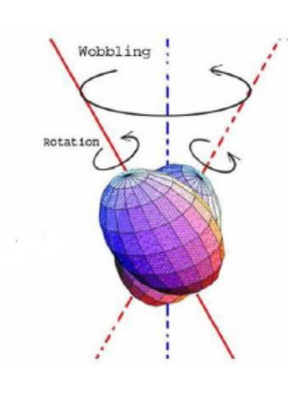
First even-even wobbler predicted by Frauendorf and by Caprio
odd I lower not higher than even I
p=-
J.H. Hamilton, et al. Nucl. Phys. A
834 (2010) 28c-31c

Slide 31
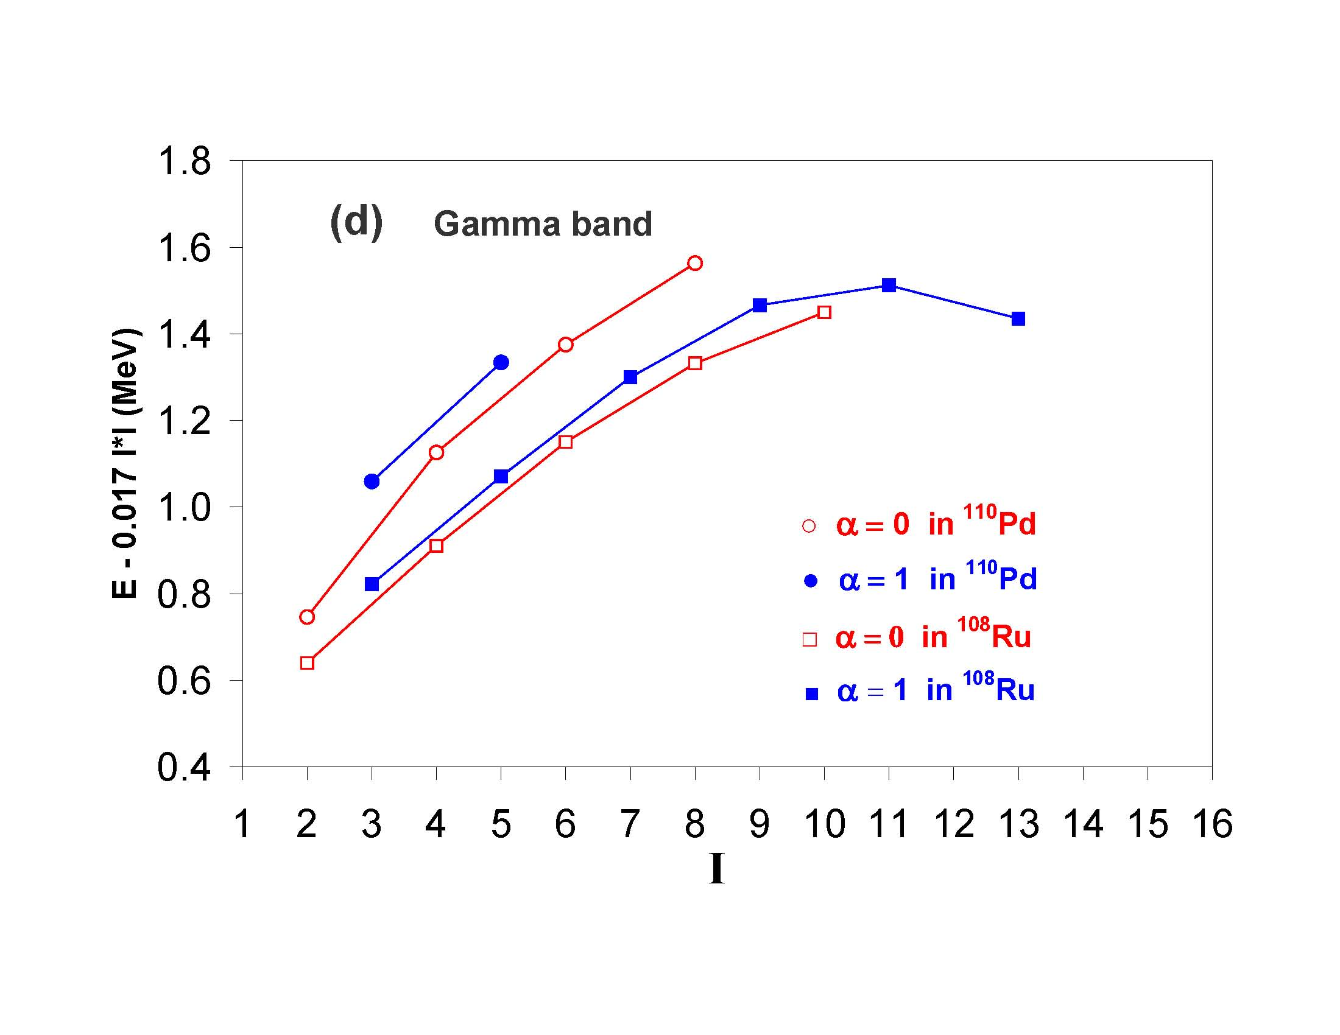
Normal gamma band energies
No evidence for wobbling motion
Even spin lower as expected
Even spin
Odd spin

Slide 32
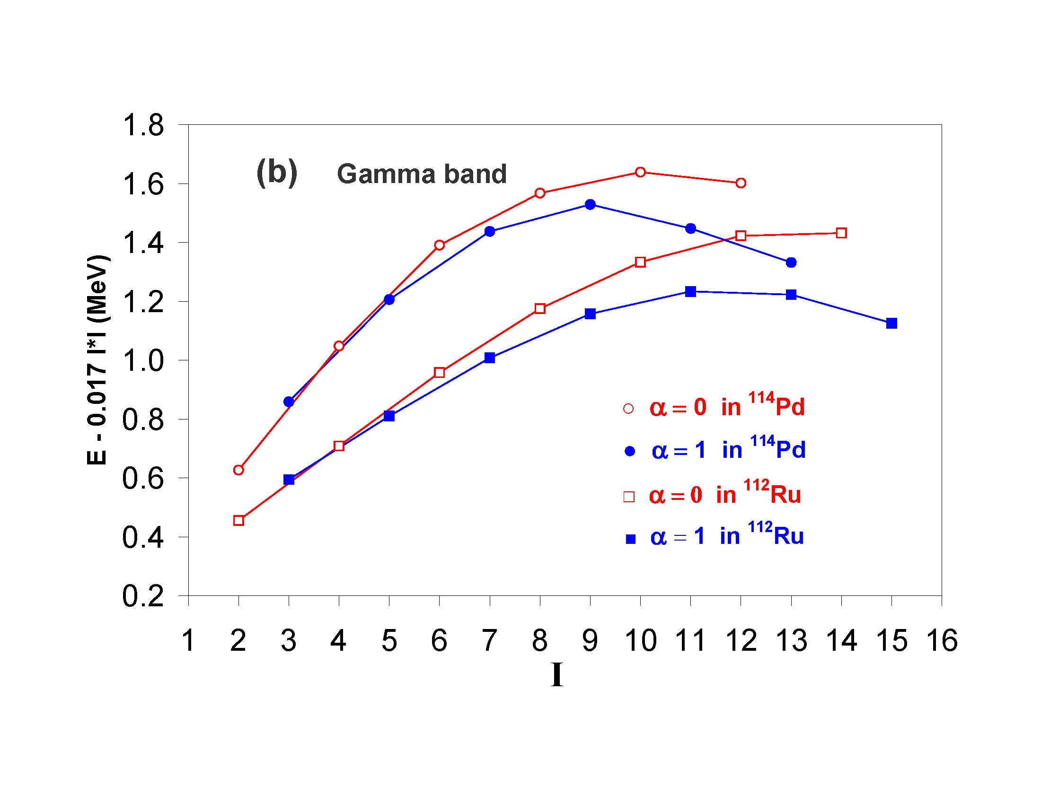
Clear evidence for wobbling above spin 5
Even spin
Odd spin
N=68 is the center of triaxial minimum not 64 predicted by Mӧller et al..

Slide 33
Nuclear structure shape transition of neutron rich 112,114-118 Pd isotopes.
Our Pd data and our Total Ruthian Surface calculations show an overall shape evolution from triaxial prolate in 112 via triaxial oblate to oblate in 118 as N increases from 66 to 72 (Pd Z=46).
With Prolate-Oblate shape coexistence in ¹¹⁵Pd during the mid point of this mass range.
Already shown are the evidence for triaxial wobbling in Pd isotopes between 112-118.

Slide 34
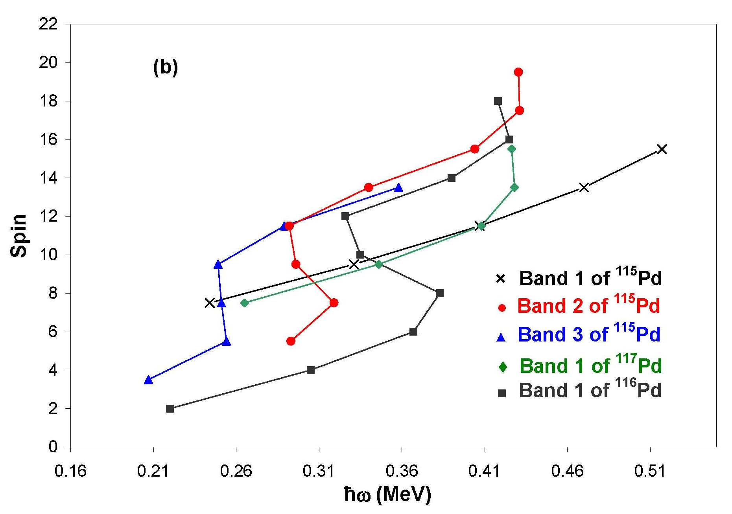
Oblate
Back bends predicted Total Routhian Surface Calculations
(πg_{9/2})²
(νg_{7/2})²
Prolate
P
O
O
O
Note ¹¹⁶Pd and ¹¹⁷Pd have back bendings at 0.41.
TRS calculations predict this occurs from (πg_{9/2})² alignments.
Bands 1 and 2 in ¹¹⁵Pd arise from prolate oblate shape coexistence.

Slide 35
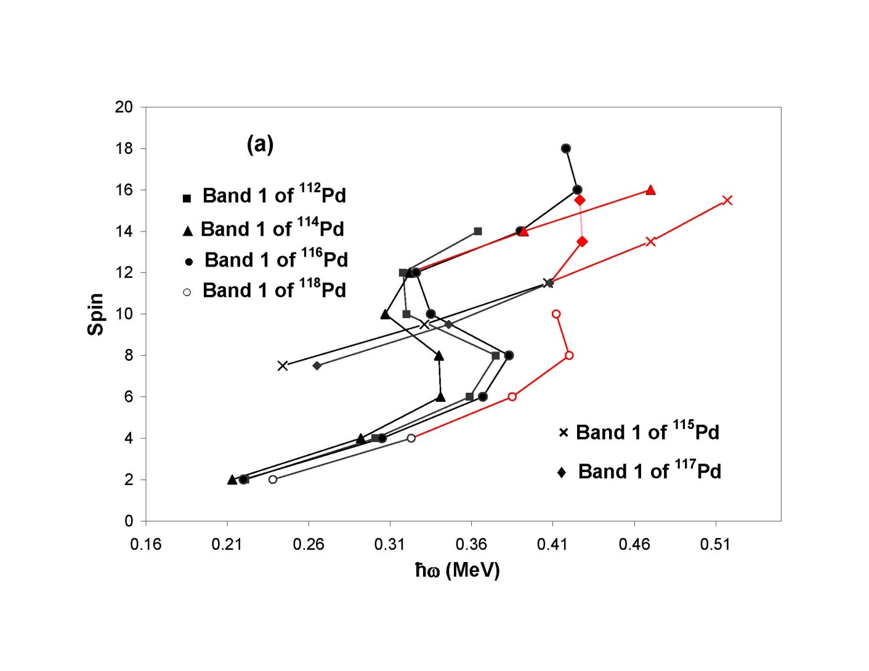
These data and our TRS calculations show an overall shape evolution from triaxial prolate in 112 via triaxial oblate to oblate in 118 as N increases from 66 to 72 (Pd Z=46).

Slide 36
Summary of Triaxial Behaviors
First observation of multi phonon γ-type vibrational bands in odd-A nuclei.
First evidence for stable triaxial shapes centered at Z=44, N=68 (¹¹²Ru).
Identification of chiral excited bands.
Shape evolution from triaxial prolate to oblate in ¹¹²⁻¹¹⁶Pd, with shape coexistence in ¹¹⁵Pd.
First wobbling motion in even-even nuclei observed in N=68 ¹¹²Ru and ¹¹⁴Pd.

Slide 37
Yields of ²⁵²Cf as plotted by Nudat2: https://www.nndc.bnl.gov/nudat2/

Slide 38
Spontaneous Fission Yield from ²⁵²Cf
Broad yield peaks -> more coincidence & events needed
for clear high spin results
Yields of ²⁵²Cf as plotted by Nudat2: https://www.nndc.bnl.gov/nudat2/

Slide 39
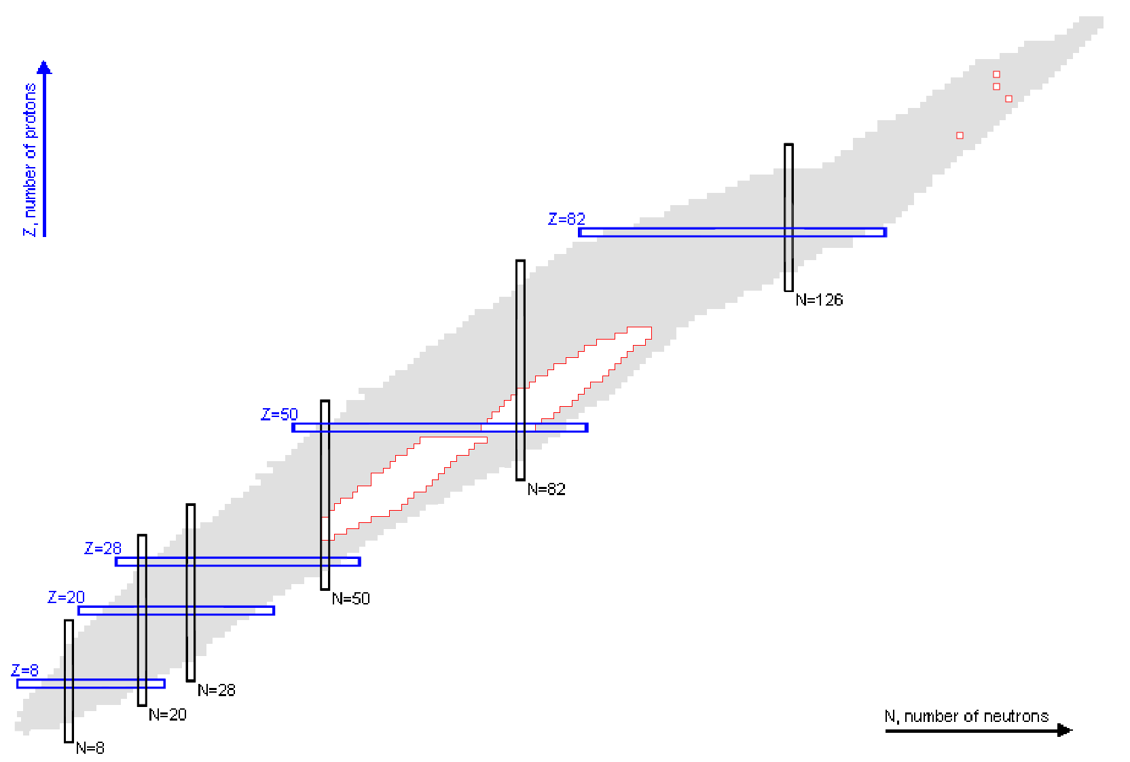

  Observations made with ²⁵²Cf (SF)
  γ-γ-γ-γ and high statistics
  allow exploring further
  from yield peaks
Known nuclei as plotted by Nudat2: https://www.nndc.bnl.gov/nudat2/

Slide 40
Nuclear Structure for SF of Z>102
Structure of Higher Z neutron-rich nuclei
Reactions with large cross-sections possible with the new SHE factory in Dubna.
  ²⁴⁸Cm (²²Ne, 4n) ²⁶⁶Sg
  ²⁵⁰Cf (²²Ne, 4n) ²⁶⁸Hs
  Super-symmetric SF in ²⁶⁶Db (EC) ²⁶⁶Rf (SF)
    Symmetric fission -> enhanced γ-spectroscopy near peak yields.

Slide 41
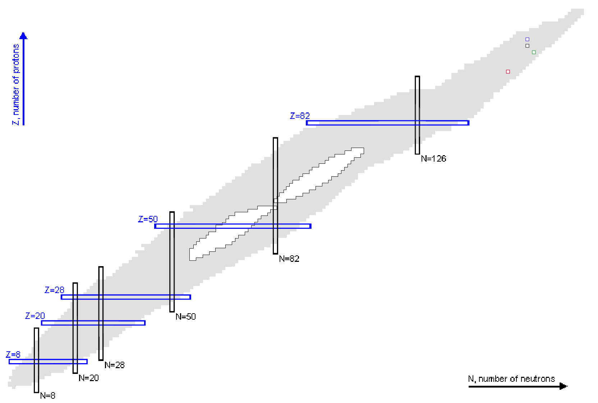

  ²⁴⁸Cm (²²Ne, 4n) ²⁶⁶Sg
  Hypothetical yield peaks, assuming asymmetric fission and a nearly double magic fragment.
Use of a variety of fissioning systems
with more concentrated yield
peaks would allow for collection
of data that can be analyzed with
lower order of coincidence.
Known nuclei as plotted by Nudat2: https://www.nndc.bnl.gov/nudat2/

Slide 42
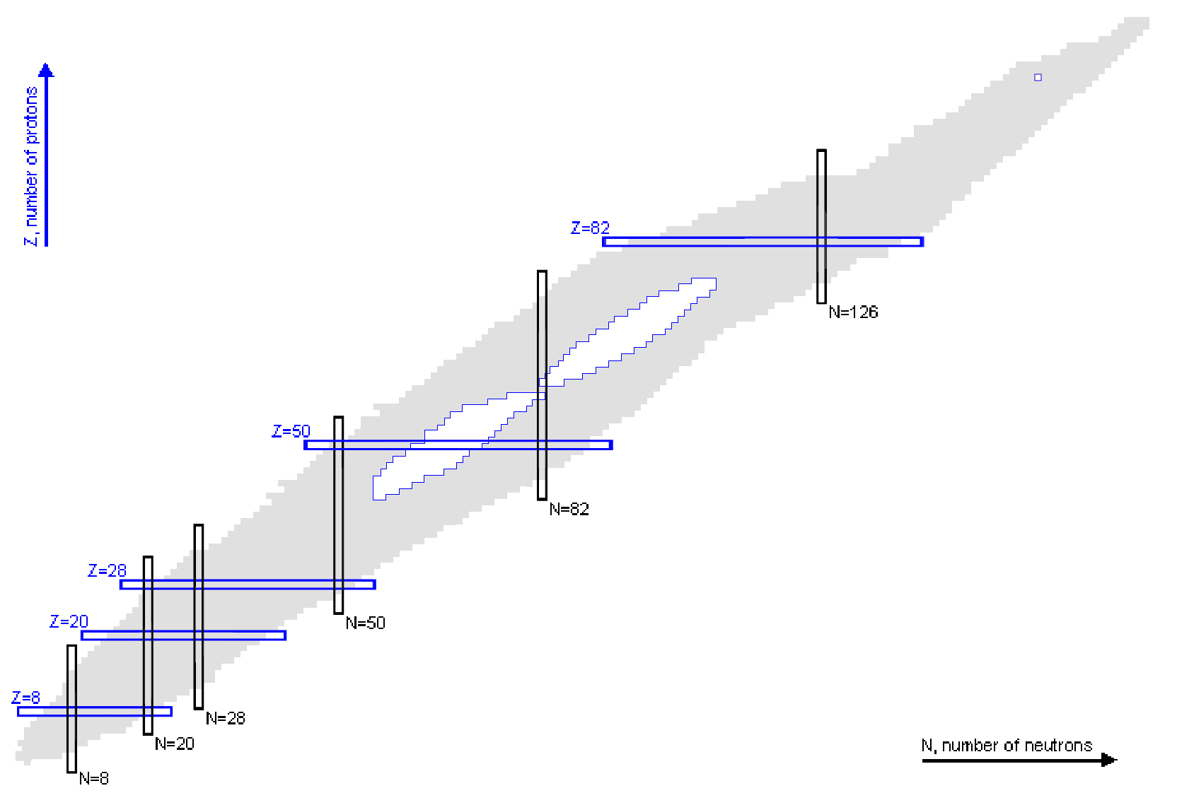
  ²⁵⁰Cf (²²Ne, 4n) ²⁶⁸Hs α-> ²⁶⁴Sg
Hypothetical yield peaks, assuming asymmetric
fission and a nearly double magic fragment.
Known nuclei as plotted by Nudat2: https://www.nndc.bnl.gov/nudat2/

Slide 43
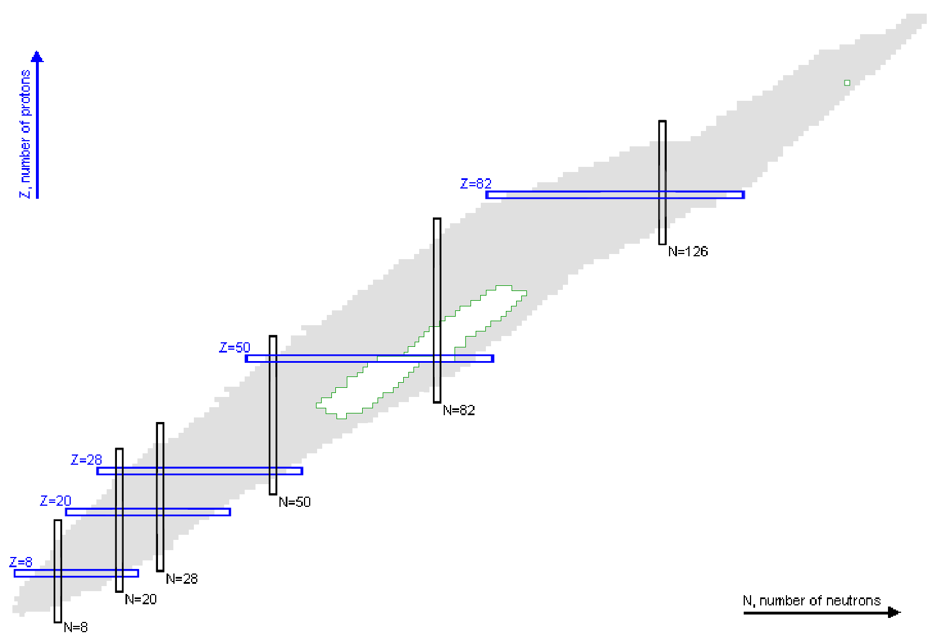
  Super-symmetric SF in ²⁶⁶Db (EC) ²⁶⁶Rf (SF)
H. PAŞCA, et al. PHYS. REV. C 97, 034621 (2018)
Calculated for symmetric SF
charge yields peaked at 50-54 in ²⁶⁶Rf
Known nuclei as plotted by Nudat2: https://www.nndc.bnl.gov/nudat2/

Slide 44
Summary
Spontaneous Fission of Californium has been used extensively in the investigation of Neutron-rich nuclei to yield new physics.
  Across the A~110 mid shell region and on the lower side of the A~170 mid shell region
New facilities like the SHE factory offer opportunities for the study of fission products from a variety of additional heavier elements to search for new insights.
  Production of heavy spontaneously fissioning isotopes with anticipated rates near ~25 SF/s
  Region of symmetric fission enhancing utility for γ-ray spectroscopy
Thank you!

