Slide 1
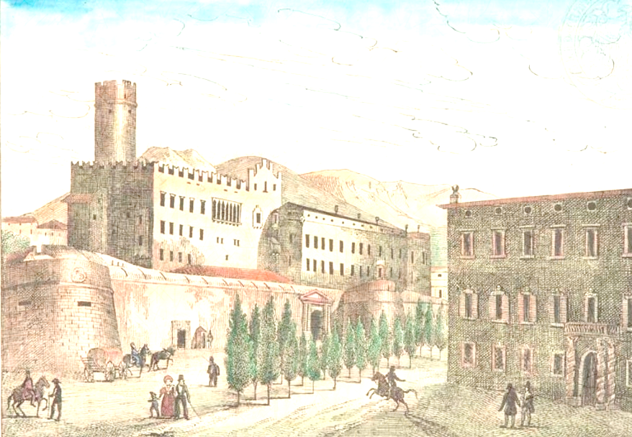
Spontaneous and induced fission of very heavy and superheavy nuclei
Trento(Italy) – April 9-13, 2018
Symmetric, Asymmetric and Superasymmetric modes in Fission and Quasifission
I.M. Itkis
FLNR JINR
Notes:
First of all I would like to thank the organizing committee for the opportunity to present my talk at this workshop.

Slide 2
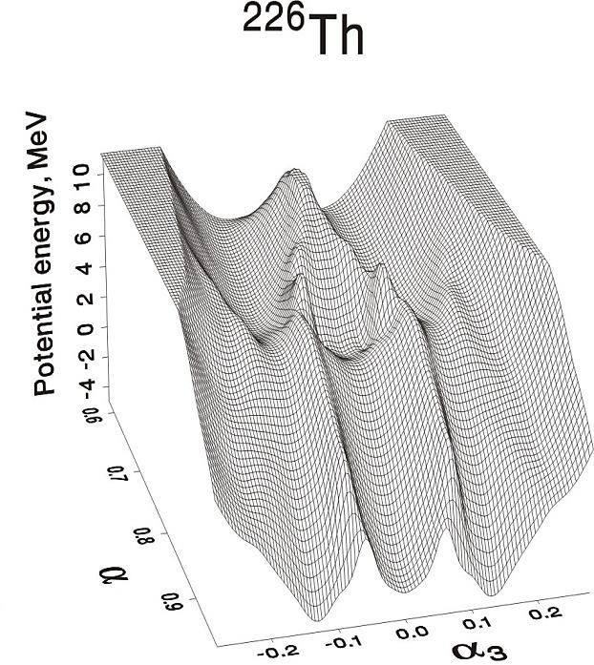
Fission process
Liquid Drop Model: fission fragments have a Gaussian shape of mass distribution and parabolic dependence of average TKE on fragment mass - fission of heated nuclei
Shell effects: valley structure of the potential energy surface in the multidimensional space of the fissioning nucleus - multimodal nuclear fission (spontaneous and low energy fission)
V.Pashkevich
Fission modes (proposed by U. Brosa)
SuperLong - strongly elongated shapes of a fissioning nucleus (symmetric mode with the bottom of valley at A_{CN}/2)
Standart I - caused by the influence of the spherical shell closure in the fission fragments with the average mass 132-134 u (Z= 50 and/or N=82)
Standart II - appears due to deformed neutron shell closure N=88 formed also in the heavy fragment with average masses ~ 140 u
Standart III - conditioned by the spherical shell closure N=50 formed in the light fragments which are in pair with heavy deformed fragments in the region of actinides
SuperShort - both light and heavy fission fragments are close to the double magic tin
Notes:
The question about symmetric and asymmetric modes in low-energy nuclear fission arose immediately after the discovery of nuclear fission.
Following the LDM it’s favorable for CN to divide symmetrically, (in fact, heated nuclei follow sym fission) but it was in contradiction with experimental data, For actinide nuclei with Z = 90-102 and A = 226-256 the asymmetric mode prevails in spontaneous fission as well as in induced fission at excitation energies up to 30-40 MeV
-> the shell effects explained this fact -> valley structure of pot energy surface in the multidimensional space of the deforming fissioning nucleus-> the modal fission was introduced
Numerous experimental investigations of the mass and energy distributions of fragments in the fission of nuclei from Pb to No have confirmed the validity of a hypothesis about the existence of independent fission modes for the first time stated by Turkevich and Niday in1951. This hypothesis has received its physical prove in theoretical works by Pashkevich Moller Brosa etc. These works showed that multimodality of the MEDs of fission fragments is caused by the valley structure of the deformation potential energy surface of a fissioning nucleus.
Four main fission modes have been distinguished in theoretical calculations as well as experimentally. In accordance with the Brosa model the modes are as follows: the SuperLong symmetric mode; the Standard I mode caused by the influence of proton Z=50 and neutron N=82 shells; the standard II mode determined by deformed nuclear shells with Z≈54-56 and N≈86-88; Later the standard III mode was introduced
Свойства классического жидкокапельного деления + оболочки – модальное деление - частный случай – бимодальное деление

Slide 3
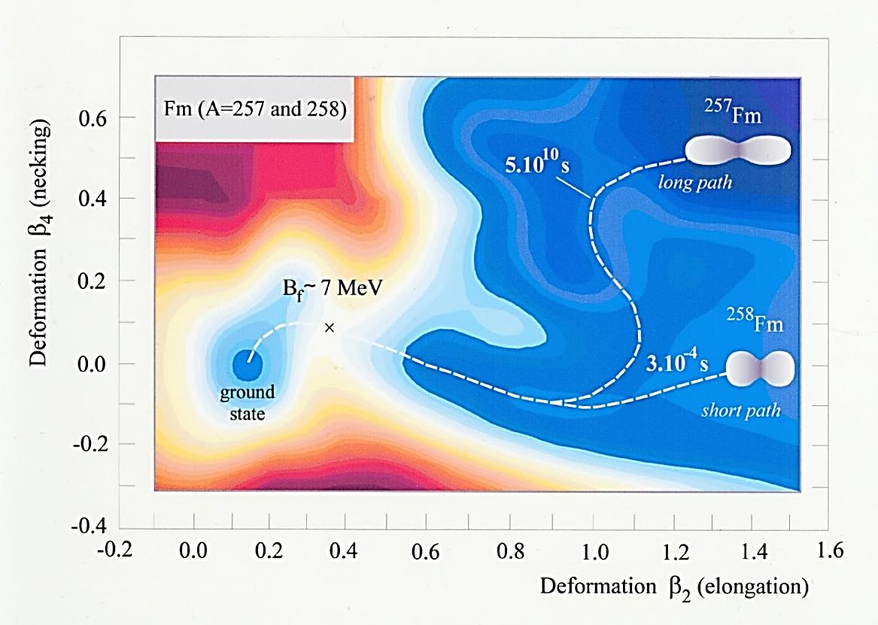
Bimodal fission
Z₁ = Z₂ ≈ 50
N₁ = N₂ ≈ 82
E.K. Hulet et al., Phys. Rev. Lett. 56, 313 (1986)
Notes:
Super-Short Mode (Brosa) manifests itself only when both light and heavy fission fragments are close in their nucleon composition to the double magic tin with A≈132.
The phenomenon of Bimodal fission was discovered in the 1980’s for the case of spontaneous and low energy fission of nuclei in the Fm-Rf region
Some spontaneously fissioning isotopes of Fm, Md, and No were found to exhibit symmetric fragment mass distributions, whose widths are changing very rapidly from nucleus to nucleus. For example, for spontaneous fission of ²⁵⁸Fm the mass distribution is unusually narrow, while for the neighboring nucleus ²⁵⁹Md with only one more proton it is rather broad. Even more spectacular are the distributions of TKE, which are double humped.
the high-energy mode is linked to a narrow mass distribution while the low-energy mode has a wide mass distribution.
By theory, bimodal fission is explained by the existence of two different paths on the potential energy surface leading to fission
One path is described by the LDM, while for the other path shell effects play an important role.
The LDM path leads to elongated scission configurations while the shell effect path corresponds to compact configurations. Both paths result in symmetric (or nearly so) mass distributions, but the high TKE valley is narrower while the low TKE valley is much wider. This explains the difference in width of the mass distributions.
феномен бимодальности был обнаружен для спонтанного и низкоэнергетического деления в области ядер Fm - Rf (Z=100-104)
Они имели двугорбую форму (две долины)
связано с возможностью для этих ядер иметь одновременно в обоих осколках околомагические значения чисел нейтронов и протонов Z ~ 50, N ~ 82 (дважды магическое олово) – компактная конфигурация –> большая ТКЕ

Slide 4
Map of mass distributions for spontaneous and low-energy fission
Notes:
Overview of mass distributions for spontaneous and low-energy fission of trans-Bk isotopes in dependence of their neutron and proton numbers
The phenomenon of bimodality has been found for the isotopes ^{258,259}Fm, ^{259,260}Md, ^{258,262}No, ^{262,266,267}Rf, ^{267,268}Db, ^{270,271}Sg and ^{271, 274}Hs.
supershort mode is naively expected to abruptly disappear when moving from Fm to more heavy nuclei.
However, the calculations indicate that the supershort valley is still present for superheavy nuclei up to ^{270, 272}Hs (Z=108)
If the Fm-Hs region is a region of bimodal fission, this is not true for all isotopes. Only nuclei along the red line have a high energy component. For more neutron deficient isotopes the mass distributions remain symmetric but the TKE distributions have no longer a high energy component.
An exception to the rule is ²⁶⁶Hs (58Fe+208Pb). We suppose that in the case of this nucleus a large amount of fragments from quasifission contribute to the symmetric mass region and the high energy component observed is connected with a symmetric quasifission process but not with a fusion-fission process.
The phenomenon may be called pseudo-bimodal fission since unlike standard bimodal fission the two TKE components do not proceed from the same reaction mechanism

Slide 5
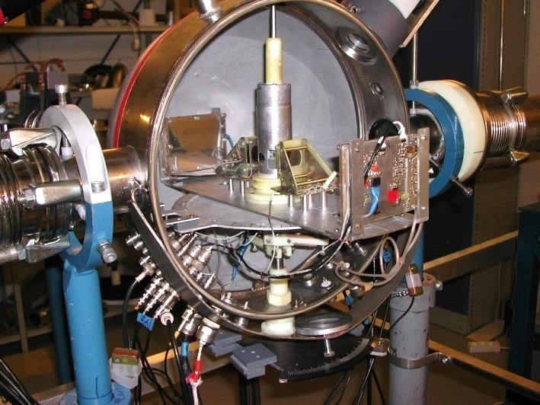
Double-Arm Time-Of-Flight Spectrometer
Time resolution 150 ps
Mass resolution ~2-3 u
Angular resolution 0.3º
TOF₁, TOF₂,
X₁, X₂, Y₁, Y₂
М_{1,2}, ТКЕ
CORSET
Notes:
For all studied reactions the binary reaction products were detected in coincidence by the double-arm time-of-flight spectrometer CORSET
Primary masses, velocities, energies, and angles in the center-of-mass system of reaction products were calculated from measured velocities and angles in the laboratory system using the momentum and mass conservation laws. Fragment energy losses in the target, backing, and the start detector foils were taken into account.
The identification of the binary reaction channel with full momentum transfer and the removal of products of sequential and incomplete fission reactions, induced fission of target and targetlike nuclei, or reactions on impurity atoms in the target was based on the analysis of the kinematic diagram.

Slide 6
Fission and Quasifission of Hs*
Notes:
the mass and energy distributions of binary fragments at energies around the Coulomb barrier : above and below
The reaction products having masses close to those of projectile and target are identified as quasielastic and deep-inelastic events in the total kinetic energy-mass (TKE, M) matrix, and we will not consider them. Reaction products lying between elastic peaks can be identified as totally relaxed events, i.e., as fission (or fissionlike) fragments. We have outlined them by solid lines in the panels. Henceforth we consider the properties of these events only.

Slide 7
Fission of ^{271,274}Hs*
Notes:
at energies above the Coulomb barrier, a near Gaussian form of the mass distributions indicates that the fragments are produced by a CNF process as predicted by the liquid drop model (LDM) in the case of relatively hot nuclei.
This conclusion is supported by the trend in the <tke>(M) and sig_Tke(M).
However, at lower excitation energy, where the deviation from a Gaussian shape is evident - both for symmetric and asymmetric mass regions.
The increased yields of fragments with masses 70-100 u may be caused by the QF process since the interaction energy is ~10 MeV less than the Bass barrier, and the orientation effects on the reaction dynamics become apparent at this energy.

Slide 8

Bimodal Fission of ²⁷⁴Hs*
Z₁ = Z₂ ≈ 50
N₁ = N₂ ≈ 82
²⁷⁴Hs
108 protons
166 neutrons
$ν_{pre}^{syst}$≈ 1.1
E.K. Hulet et al., Phys. Rev. Lett. 56, 313 (1986)
Notes:
На рис приведено распределение ТКЕ для области симметричных масс А/2 ± 20. Хорошо видно, это распределение имеет ярко выраженную высокоэнергетическую компоненту, а само распределение по форме очень похоже на распределение ТКЕ осколков спонтанного деления например, ²⁵⁸Fm или ²⁶²No.
Сравнили с серой – то же ядро.
НО <ТКЕ> выше и дисперсия больше – отличаются -> это не связано с квази как для серы - > особенности самого деления
Поэтому мы приходим к заключению, что в нашем случае реализуется бимодальное деление Hs*, образованного в реакции Mg+Cm при начальной энергии возбуждения 35 МэВ
(для Ne+Cf при энергии ниже барьера тоже дисперсияя ТКЕ больше, -> бимодальность, но статистика слишком мала)

Slide 9
TKE deconvolution
A_{CN} /2±20 u
<TKE>
214±2 MeV
σ_{TKE}
23.2±1.4 MeV
σ_{TKE}
21.3 MeV
σ_{TKE}
21.4 MeV
<TKE>
218±1 MeV
σ_{TKE}
22.6±0.6 MeV
<TKE>
215±1 MeV
σ_{TKE}
21.6±0.1 MeV
σ_{TKE}
21.7 MeV
σ_{TKE}
21.6 MeV
<TKE>
215±1 MeV
σ_{TKE}
22.6±0.1 MeV
σ_{TKE}
22.5 MeV
V. E. Viola et al., Phys.Rev.C 31,1550 (1985)
<TKE>
215 МэВ
<TKE>
215±1MeV
σ_{TKE}
22.5±0.1 MeV
M.G. Itkis and A. Ya. Rusanov, Phys.Part.Nucl. 29, 160 (1998)
Notes:
the TKE distributions of symmetric fragments of the ²⁶Mg + ²⁴⁸Cm at subbarrier energies:
LDM component was fixed ( <TKE> -> Viola, sig_tke → calculated from LDM) -> we discribed the exp distr
-> they may be deconvoluted into two Gaussians, with the peaks lying near ~214 MeV and ~230 MeV.
Only the lower energy corresponds to the established linear dependency of the TKE on the Coulomb parameter in the LDM
Hence, for the reaction Mg + Cm leading to ²⁷⁴Hs*, bimodal fission is observed.
In the case of the ²²Ne + ²⁴⁹Cf reaction the standard deviation of the experimental TKE distribution is higher for the lower energy. This is in contradiction to single-mode LDM fission. Thus, we have some evidence for bimodal fission at an excitation energy of 29 MeV, although due to lack of statistics the decomposition of the TKE distribution is not fully obvious.

Slide 10

Mass Distributions
~24%
~7%
~2%
²⁷¹Hs ²⁷⁴Hs
81.5 83
$ν_{pre}^{syst}$≈ 1.1
Notes:
166n 108p -> 274Hs * 35 MeV npre 1.1
163n 108p -> 271Hs * 29 MeV npre 0.6
It is important to note the enhanced relative contribution of the high-energy component in the case of ²⁷⁴Hs* fission (²⁶Mg + ²⁴⁸Cm reaction) compared to ²⁷¹Hs* fission (²²Ne + ²⁴⁹Cf reaction), in spite of the fact that the excitation energy is higher for the Mg-induced reaction. At symmetric fission of ²⁷⁴Hs* both fragments have N = 83, while in the case of ²⁷¹Hs* the neutron number N is 81.5. According to the systematics for pre- and postscission neutron emission accompanying fission the values of 1.1 and 0.6 prescission neutrons are expected for ²⁷⁴Hs* (E* = 35 MeV) and ²⁷¹Hs*(E* = 29 MeV), respectively. Thus the formation of two spherical fragments with a neutron number N = 82 is more favorable in the case of ²⁷⁴Hs* compared to ²⁷¹Hs*.

Slide 11
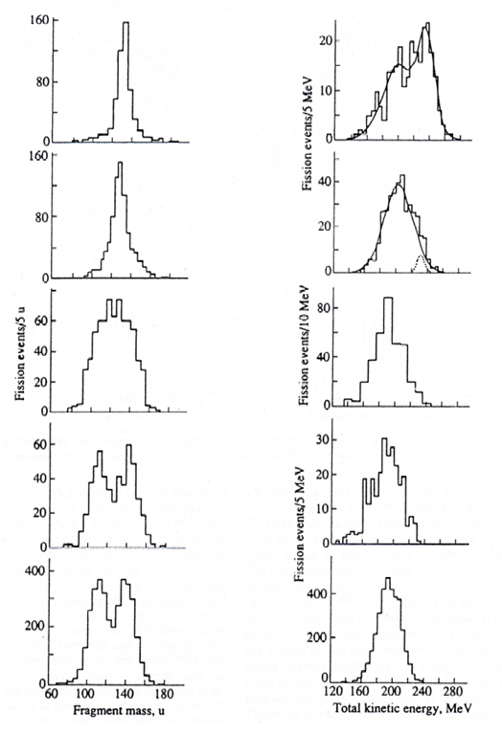
Spontaneous fission of No
²⁶²No
²⁵⁸No
²⁵⁶No
²⁵⁴No
²⁵²No
E.K. Hulet, Phys. Atom. Nucl. 57 (1994) 1165-1173.

Slide 12
Bimodal fission of ²⁵⁶No*
E* = 17.2 MeV
~1.7%
~2.5%
E.V. Prokhorova et al., Nucl. Phys. A 802 (2008) 45
Notes:
It is clearly seen that MDs at these low excitation energies are far from being a Gaussian in shape.
Thus a strong deviation of the mass distribution from the LDM shape was observed. Such a behavior of fragments in MEDs is determined by the shell effects in the low-energy fission of 256No.
The total and differential mass distributions for TKE > 201 MeV and TKE < 201 MeV are presented for the projectile energy E lab = 211.
In the case of TKE > 201 MeV a narrow two-humped structure is distinctly seen in the region of heavy masses MH ≈ 131–135 u. Fig. at TKE < 201 MeV - a wide flat MD in the region of heavy fragment masses MH ≈ 140–150 u. Thus, one can see that the 256No mass distribution at E∗ = 17.2 consists of at least two components (modes).
at the lowest projectile energies Elab = 218 and 211 MeV two components in the the TKE distribution appear in the region of symmetric masses, i.e., a low-energy one with TKElow ≈ 200 MeV, and a high energy one with TKEhigh ≈ 233 MeV.
These TKE values as well as mass yields are typical of the standard and SS modes in the spontaneous fission of
superheavy nuclei. Thus, we observed here both in the mass and energy distributions the
presence of SS-mode in the 256No induced fission, although on the whole the contribution of the SS-mode is quite small

Slide 13
Bimodal fission of ²⁶⁰No*
E.K. Hulet, Phys. Atom. Nucl. 57 (1994) 1165-1173.
~54%
~14%
~7%

Slide 14
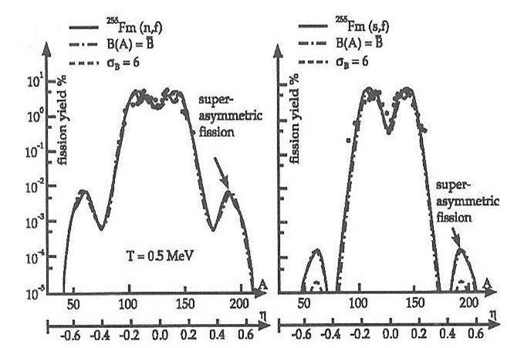
Superasymmetric fission
W. Greiner (International Workshop on Fusion Dynamics at the Extremes, May 25-27, 2000)
The potential between the two fragments V(R, η) depends for given distance between the two nuclear centers R on the mass asymmetry η. The collective wave-function Ψ(R, η) will show maxima where the potential has minima and vice versa. The probability distribution will show pronounced maxima for symmetric and asymmetric fission.
If the potential has several minima, due to shell structure, symmetric, asymmetric and superasymmetric fission will occur.

Slide 15
Superasymmetric fission of ²⁶⁰No*
Notes:
The mass and energy distributions of fragments obtained in the reaction ²²Ne + ²³⁸U are shown
The mass distribution of the symmetric fragments has a nearly Gaussian shape and the average TKE shows a parabolic dependence on fragment mass typical for fission of excited compound nuclei as established by the LDM
whereas in the mass region around 52/208 u that corresponds to the formation of fissioning pair of two magic nuclei Ca/Pb, an increase of fragment yields was observed.
Moreover the total kinetic energy for these fragments is found to be about ~25 MeV higher than predicted by the LDM. The higher TKE indicates that the asymmetric fragments originate from more compact scission configuration as compared to normal fission

Slide 16
Superasymmetric fission
of ²⁵⁴Fm* and ²⁶⁰No*

Slide 17
Superasymmetric fission
Fission of nuclei
with A≈200 u
A_{H}/A_{L} ∼ 4.3!
Neutron induced
fission of actinides
Fission of ²⁶⁰No*
A_{H}/A_{L}~2
A_{H}/A_{L}~2.5
Z_{L}=28 and Z_{H}=50, N_{H}=82
M.G.Itkis, Z.Phys.A320(1985)433
Z_{L}=28
D.Rochmann, Nucl.Phys.A735(2004)3
Z_{L}=20, N_{L}=28 and
Z_{H}=82, N_{H}=126
I.M.Itkis,J.Phys.Conf.Ser.515(2014)012008
Notes:
For the first time the superasymmetric mode was observed in the compound nuclei fission in Pb region [1]. The enhancement of the mass yield in the region 65-75 u for the light fragment in the fission of ²¹³At and ²¹⁰Po compound nuclei is connected with the influence of double magic Ni (Z = 28, N = 50) and double magic Sn (Z = 50, N = 82). Notice that in this case the ratio A_{H}/A_{L} ≈ 2, and the yield is around 0.01%. The superasymmetric fission mode with mass ratio of A_{H}/A_{L} ≈ 2.5, caused by the closed shells Z = 28 and N = 50, was also found in thermal-neutron-induced fission of actinides nuclei [2]. In this case only the light fragment is close to the double magic Ni and the yield of superasymmetric mode does not exceed 10⁻⁴%.
, whereas in the mass region around 52/208 u (A_{H}/A_{L} ≈ 4.3), that corresponds to the formation of fissioning pair of two magic nuclei Ca/Pb, an increase of fragment yields was observed. Moreover the total kinetic energy for these fragments is found to be about ~30 MeV higher than predicted by the LDM. The higher TKE indicates that the asymmetric fragments originate from more compact scission configuration as compared to normal fission. In the low panel of figure 6 the experimental mass distribution together with the prediction of W. Greiner for thermal neutrons induced fission of ²⁵⁵Fm is presented. According to this calculation the yield of about 0.01% is expected due to the influence of the closed shells, while for spontaneous fission of ²⁵⁵Fm the yield of 10⁻⁴% is expected for this superasymmetric mode [15]

Slide 18
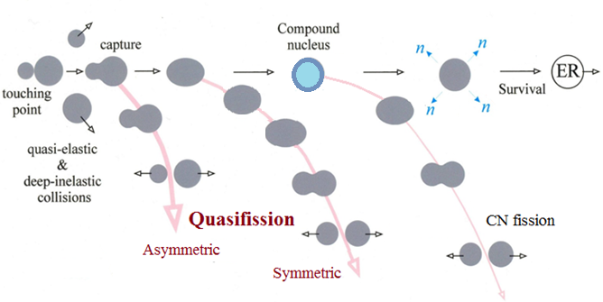
Reaction channels in the collisions of heavy ions
Notes:
at energies around the Coulomb barrier the complete fusion of two massive nuclei is suppressed by competing binary process, the quasifission (QF), in which the composite system separates in two main fragments without forming a CN.
QF happens to be the most important mechanism that prevents the formation of SHE in the fusion of heavy nuclei.

Slide 19
Fusion-Fission vs Quasifission
Properties of QF
Large width of mass distribution
Asymmetry in mass–angle correlations
Large angular anisotropy
W. Q. Shen, J. Albinski, A. Gobbi et al., Phys.Rev.C 36, 115 (1987)
Criteria to identify reaction mechanism
Coulomb factor Z₁Z₂
Entrance channel mass asymmetry α₀
Mean fissility parameter x_{m}
Z₁Z₂ > 1600
α₀ < 0.9 (α_{BG})
x_{m} > 0.765
x_{m} > 0.68
Notes:
W. Q. Shen, J. Albinski, A. Gobbi et al., Phys. Rev. C 36, 115 1987
Since CN fission and QF are both binary decay channels characterized by large nucleon exchange and energy dissipation,
it is difficult to make the experimental separation between QF and CN fission.
Three criteria are widely used to identify the reaction mechanism (fusion or QF).
1. The reaction Coulomb factor Z₁Z₂ (charge product of reaction partners). This parameter relates to the Coulomb energy in the entrance channel. According to the calculations in the frame of macroscopic-microscopic model of Swiacteki the threshold value of Z₁Z₂ for the appearance of QF is 1600.
2. Entrance channel mass asymmetry α₀ = (A_{projectile} - A_{target})/(A_{projectile} + A_{target}). Unexpected fusion suppression observed in quite asymmetric combinations of colliding nuclei can be qualitatively explained in the framework of the liquid drop Businaro-Gallone picture, i.e., by an effect of the conditional barrier arising along the mass asymmetry coordinate on a path to the formation of a spherical CN. The fusion probability P_{CN}, as a measure of the fusion suppression effect, correlates with the entrance-channel mass asymmetry. According to this criterion QF appears for systems with entrance channel mass asymmetry lower than the Businaro-Gallone mass asymmetry
3. Effective fissility parameter x_{eff} connected with repulsive and attractive forces in the entrance channel
Recently, mean fissility parameter was proposed x_{m}=0.75 x_{eff} + 0.25 x_{CN}
From the analysis of a large data set of mass-angle distributions of fission-like fragments obtained in the reaction with heavy ions it has been found that the QF takes place for reactions with x_{m} > 0.68 and becomes dominant at x_{m} > 0.765.
These criteria, however, are not universal. For instance, they do not take into account the shapes of the interacting nuclei. The relative orientation of deformed nuclei changes the Coulomb barrier and the distance between the centres of the colliding nuclei and this leads to a change in the balance between repulsive and attractive forces. When two interacting nuclei touch each other by their lateral surfaces (near-side collisions), a high formation probability of a spherical CN is expected, whereas in the elongated conﬁguration, when nuclei touch each other by their poles (near-tip collisions), a high QF probability is expected.
The interaction energy is also a very important parameter for QF. The relative contribution of QF process decreases when the interaction energy increases.

Slide 20
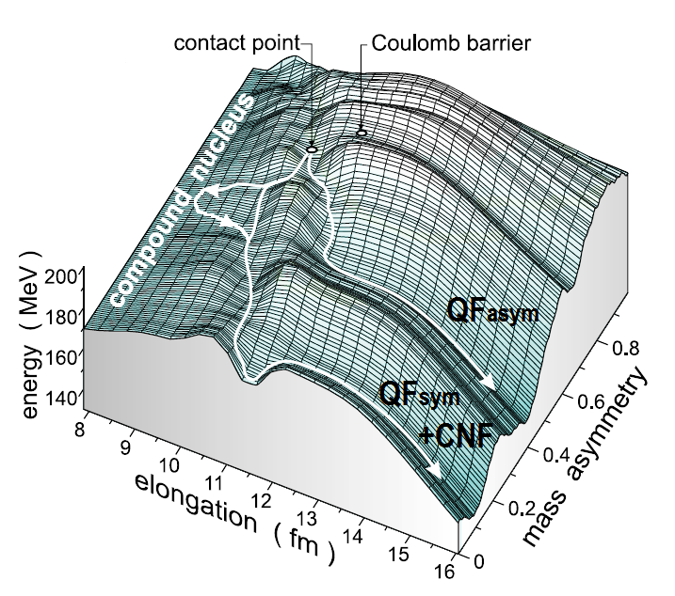
Fusion-fission vs Quasifission
For superheavy composite systems the relative contribution of quasifission to the capture cross section becomes dominant and mainly leads to the formation of asymmetric fragments.
This asymmetric QF is characterized by asymmetric angular distributions in the center-of-mass system and thus fast reaction times. The TKE for these fragments is higher than that for compound nucleus fission. Hence, this process is colder than CNF and shell effects are more pronounced.
~10⁻²¹ s
~10⁻²⁰ s
What process the symmetric fragments originate from?
The calculations of potential energy surfaces show that one of the possible reaction channels for such systems is a process occurring without a CN stage, but with fragment properties close to those known from CNF. This process, so-called symmetric quasifission, is characterized by long reaction times sufficient for mass equilibration and resulting in the formation of symmetric fragments.
Notes:
To clarify the question about the origin of symmetric fragments we investigated the mass-energy distributions of binary reaction fragments for four different ion-target combinations, leading to the formation of Hs, at energies close and below the Coulomb barrier.

Slide 21
Fission and Quasifission of Hs*
Z_{t} Z_{p} 980 1152 1472 2132
Notes:
На рис. Показаны массово-энергетические распределения делительно-подобных осколков, полученных в результате измерений и обработки данных в реакциях …
Выше и ниже барьера
Продукты реакций вблизи масс налетающего иона и мишени идентифицировались как события упругого и квазиупругого рассеяния и в данном анализе не рассматривались.
Видно, что даже при близких энергиях возбуждения массово-энергетические распределения для этих реакций резко отличаются. В случае реакций 2Ne+249Cf и 26Mg+248Cm массовые распределения имеют треуг. форму, характерную для процесса деления, в соответствии с предсказаниями жидкокапельной модели для случая относительно нагретых ядер.
Массово-энергетическое распределение для Fe+Pb реакции имеет широкую двугорбую форму даже для энергии возбуждения 48 МэВ (довольно высоко 25 МэВ над барьером). Для этой реакции процесс квазиделения доминирует при энергиях как выше, так и ниже барьера.
Для реакции ³⁶S+²³⁸U массовые распределения делительно-подобных осколков заметно отличаются. При низких энергиях возбуждения распределения имеют преимущественно асимметричную форму. С ростом энергии возбуждения проявляется Симметричный пик. При высоких энергиях возбуждения массовое распределение становится симметричным как в случае реакции ²⁶Mg+²⁴⁸Cm, но более широким.
Дать хар-ку распределений – зависимость от энергии и масс –асим
Деление составного ядра характеризуется следующими свойствами:
Массовые распределения имеют гауссову форму. Дисперсия зависит от энергии возбуждения и углового момента.
Симметричные угловые распределения осколков в с.ц.м. Распределения ТКЕ близки к гауссиану со средним значением, зависящим от кулоновского параметра Z²/A^{1/3} .
Квазиделение – процесс, идущий без образования составного ядра
Для сверхтяжелых систем процесс квазиделения приводит в основном к формированию асимметричных фрагментов с масс-асимметрией ~0.4 (долина свинца) Такое квазиделение характеризуется асимметричными угловыми распределениями фрагментов → коротким временем реакции
Однако одним из возможных каналов реакции для сверхтяжелых систем является процесс симметричного квазиделения (долина олова), - свойства, как у деления - симметричное угловое распределение, и характеризующийся большим временем реакции, достаточным для формирования симметричных осколков. Возникает вопрос о происхождении симметричных фрагментов.

Slide 22
Properties of TKE Distributions
A_{CN} /2±20 u
Viola et al.
0.1071 Z²/A^{1/3}+ 22.2
V. E. Viola et al., Phys.Rev.C 31,1550 (1985)
M.G. Itkis and A. Ya. Rusanov, Phys.Part.Nucl. 29, 160 (1998)
Notes:
Показаны <ТКЕ > и среднеквадр. Откл в завис. от Е*
NeCf - <ТКЕ>, дисперсия соотв систематикам для деления нагр ядер и MgCm – при высокой энергии ----
FePb – <ТКЕ> растет с энергией, дисперсия TKE меньше чем предсказания МЖК для деления
SU - <ТКЕ> ниже, дисперсия НИЖЕ при низкой енергии, Выше при высокой (два процесса с соизмеримым вкладом)

Slide 23
TKE deconvolution
CNF
QF_{asym}
QF_{sym}
A_{CN} /2±20 u
Notes:
It is clearly seen that the TKE distributions change markedly showing nearly Gaussian shape in the case of ³⁶S and ⁴⁸Ca ions and two-humped shape for the reactions with ⁴⁸Ti and ⁶⁴Ni.
One may speculate about the presence of other processes together with the CN fission in the symmetric mass region for ³⁶S, ⁴⁸Ca, ⁴⁸Ti, ⁶⁴Ni + ²³⁸U reactions.
We assume that the mass-symmetric fragments may be formed by three different modes: CN fission, symmetric QF (QFsym) and a tail of asymmetric QF process.
To evaluate the contribution of the CN-fission process in the symmetric mass region we decomposed the TKE distributions as a sum of three Gaussians. One of them is associated with the CN-fission process (filled region). We fix mean value and variance of this component to the values obtained from the systematics
The low energy component is attributed to QFasym while the high energy one is connected with QFsym.

Slide 24
Analysis of TKE Distributions
σ_{TKE}
σ_{TKE}
σ_{TKE}
σ_{TKE}
21.3 MeV
21.4 MeV
21.4 MeV
21.5 MeV
CNF
CNF
CNF
CNF
QF_{sym}
QF_{sym}
QF_{asym}
QF_{asym}
21.7 MeV
21.6 MeV
CNF
21.5 MeV
CNF
23.5 MeV
CNF
CNF
QF_{sym}
QF_{asym}
QF_{sym}
QF_{asym}
CNF
22.5 MeV
CNF
22.4 MeV
CNF
24.1 MeV
A_{CN} /2±20 u
QF_{sym}
QF_{asym}
QF_{sym}
QF_{asym}
<TKE>
215 MeV
Notes:
Предположили, что сим фр-ты из 3 мод (сим/асим квази и деление) Вписывали 3 гаусса, для деления зафиксировали среднее и дисперсию в соотв с систематиками для деления нагр ядер (МЖК) низко-эн -> асим квази, высокоэнерг – сим квази
Голубая область – деление
Вклад дел компоненты - Растет с ростом энергии
Для железа – сложно – слишком малый вклад процесса деления
Для неона при энергии под барьером – слишком низкая статистика, но дисп больше чем мжк
NeCf - преобладает классическое деление сост ядра (и MgCm)
FePb - доминирует асим квази
SU - получили вклады деления и квазиделения в сим области -> Помогло определить вклад деления и квазиделения в симметричной области

Slide 25
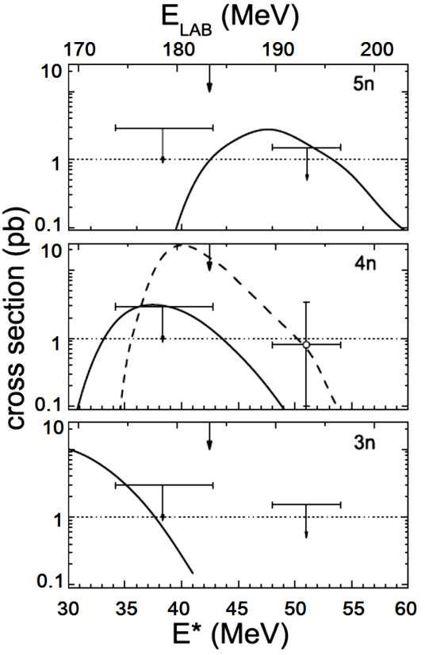
²⁷⁴Hs* ER cross sections and Fusion
Probability
²⁶Mg + ²⁴⁸Cm
³⁶S + ²³⁸U
~70%
~17%
J. Dvorak et al.,
Phys. Rev. Lett.100, 132503 (2008)
R. Graeger et al.,
Phys. Rev. C 81, 061601(R) (2010)
Notes:
The ER cross sections for the reactions 26Mg+248Cm and 36S+238U were reported in Refs. [J. Dvorak et al., Phys. Rev. Lett. 100, 132503 (2008)] and [R. Graeger et al., Phys. Rev. C 81, 061601(R) (2010)].
The enhancement of sub-barrier fusion for the reaction 26Mg+248Cm was observed in experiment
The measured ER cross sections in the reaction 36S+238U are lower than those of the 26Mg+248Cm reaction. The reduction of the ER cross section for the reaction 36S+238U may be explained by suppression of fusion due to the dominance of the QF process as opposed to the more asymmetric 26Mg+248Cm reaction.
Thus, as follows from the ER cross-section measurements, the fusion probability for the two reactions depends mainly on the asymmetry of the projectile-target combination.

Slide 26
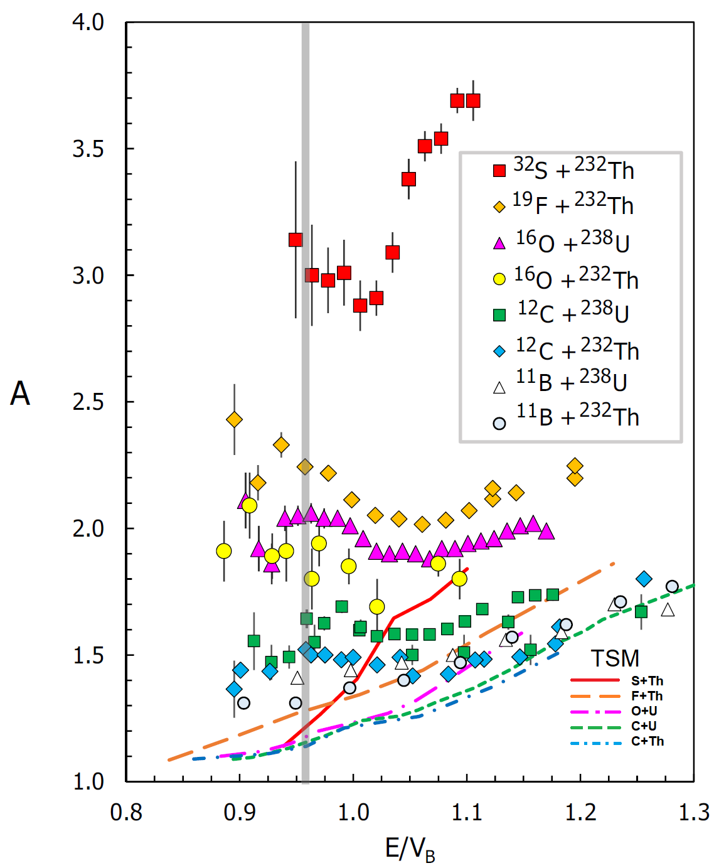
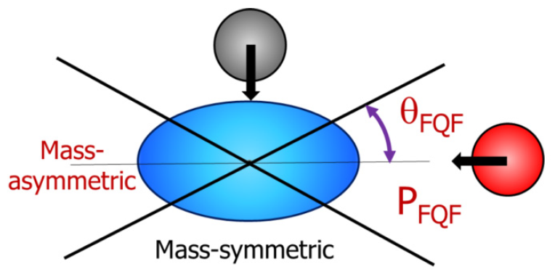
Light projectiles and deformed targets
FF or QF?
Simple ansatz used to modelthe ratio between fast mass-asymmetric quasifission and symmetric-peaked fission. Axial collisions up to a limiting angle θ_{FQF} are assumed to result in fast quasifission with probability P_{FQF}
Other collisions are taken to result in symmetric-peaked fissionlike events.
Collisions with the tips of statically deformed prolate actinide nuclei show evidence for two distinct quasifission processes of different time scales: Fast (asymmetric) and Slow (symmetric)
For mass-symmetric fission events, deviations of
angular anisotropies from expectations for fusion-fission, indicating a component of slower quasifission even in the reactions with light projectiles like C and O.
D.J.Hinde et al., Phys.Rev.C 97, 024616 (2018)
Large angular anisotropy at sub-barrier energies.
Notes:
K. Banerjee PHYSICAL REVIEW C 83, 024605 (2011)
A sudden change in the fragment mass width, observed in the present measurement, confirmed the transition to quasifission at below-barrier energies; the same was indicated earlier from the study of fission fragment angular anisotropy. However, the present measurement of prescission neutron
multiplicity as well as the earlier measurement of evaporation residue yield did not indicate any significant departure from the respective statistical model predictions throughout the energy range.
The transition-state model is conventionally used in theoretical analysis of the data on the angular distribution of fission fragments. The essence of this model consists of the assumption that there is a certain chosen (transition) configuration of a fissioning system that determines the angular distribution of fission fragments. Thus, there are two limiting assumptions on the position of the transition state and, correspondingly, two variants of the transition-state model: the saddle-point transition-state (SPTS) model and the scission-point transition-state (SCTS) model. The SPTS model gives a reasonably exact reproduction of the experimental data on the anisotropy of the fission fragment angular distributions for reactions in which neutrons, 3He, and α particles were used as projectiles. The compound nuclei formed in such reactions have a temperature of about 1 MeV and low angular momenta. For reactions with more massive ions of carbon, oxygen and heavier, standard SPTS model regularly predicted low values of angular anisotropy, and the experimental data are closer to the values obtained according to the SCTS model. The experimentally observed angular distribution anisotropy cannot be described by either the SPTS or SCTS models. Therefore, it was assumed, in the general case, that the transition state determining the angular distribution of fission fragments is located somewhere between the saddle point and the scission point.

Slide 27
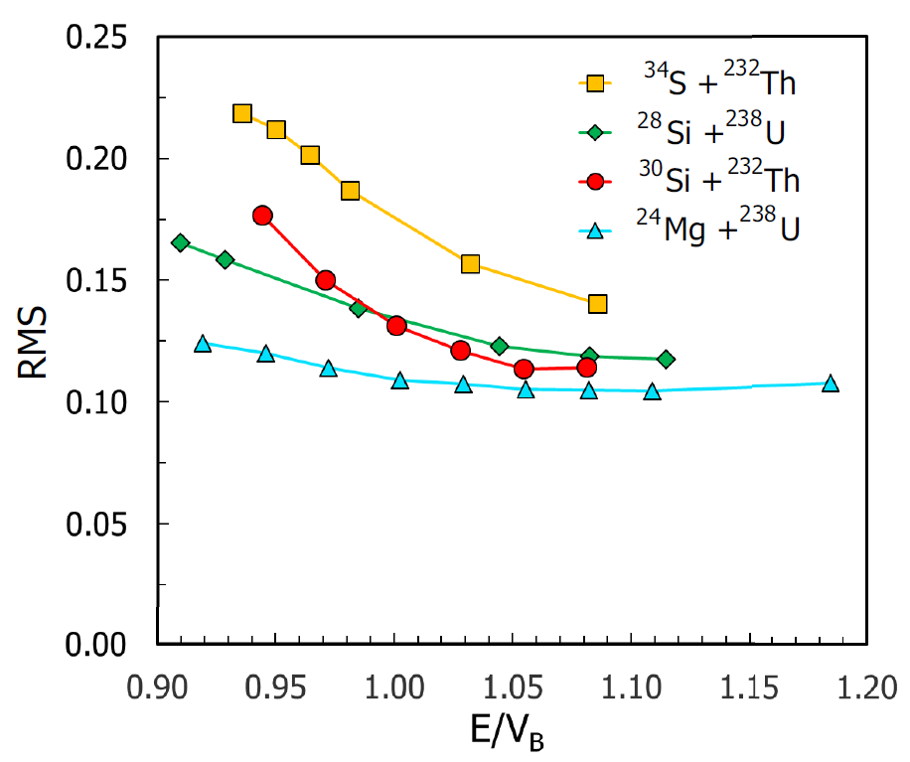
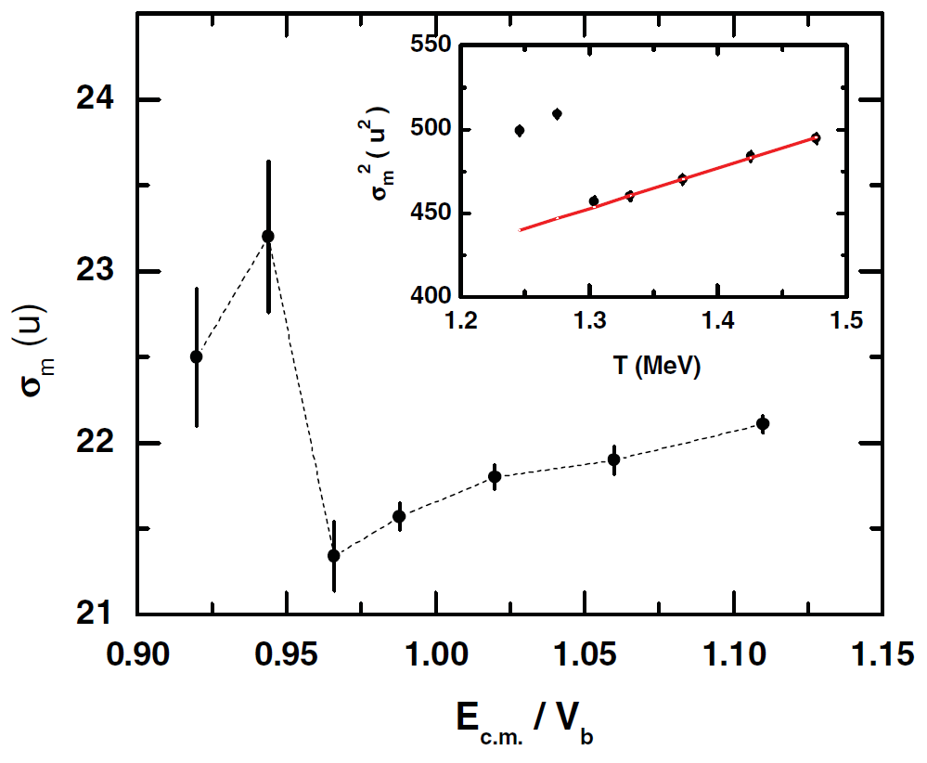
Light projectiles and deformed targets
FF or QF?
¹⁶O + ²³⁸U
The expectation for fusion-fission
K. Banerjee et al., Phys.Rev.C 83, 024605 (2011)
D.J.Hinde et al., Phys.Rev.C 97, 024616 (2018)
A sudden change in the fragment mass width was observed at sub-barrier energies. However, the measurement of prescission neutron multiplicity did not indicate any significant departure from the respective statistical model predictions throughout the energy range.
Root-mean-square (RMS) deviation of the fissionlike events as a function of beam energy with respect to the capture barrier.
Notes:
K. Banerjee PHYSICAL REVIEW C 83, 024605 (2011)
A sudden change in the fragment mass width, observed in the present measurement, confirmed the transition to quasifission at below-barrier energies; the same was indicated earlier from the study of fission fragment angular anisotropy. However, the present measurement of prescission neutron
multiplicity as well as the earlier measurement of evaporation residue yield did not indicate any significant departure from the respective statistical model predictions throughout the energy range.
The transition-state model is conventionally used in theoretical analysis of the data on the angular distribution of fission fragments. The essence of this model consists of the assumption that there is a certain chosen (transition) configuration of a fissioning system that determines the angular distribution of fission fragments. Thus, there are two limiting assumptions on the position of the transition state and, correspondingly, two variants of the transition-state model: the saddle-point transition-state (SPTS) model and the scission-point transition-state (SCTS) model. The SPTS model gives a reasonably exact reproduction of the experimental data on the anisotropy of the fission fragment angular distributions for reactions in which neutrons, 3He, and α particles were used as projectiles. The compound nuclei formed in such reactions have a temperature of about 1 MeV and low angular momenta. For reactions with more massive ions of carbon, oxygen and heavier, standard SPTS model regularly predicted low values of angular anisotropy, and the experimental data are closer to the values obtained according to the SCTS model. The experimentally observed angular distribution anisotropy cannot be described by either the SPTS or SCTS models. Therefore, it was assumed, in the general case, that the transition state determining the angular distribution of fission fragments is located somewhere between the saddle point and the scission point.

Slide 28
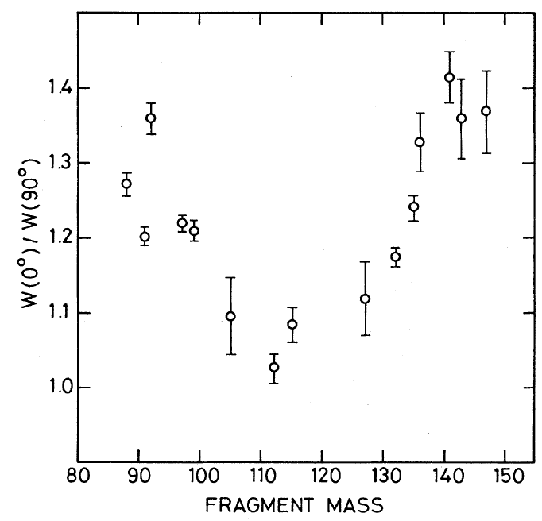
Angular Anisotropy
15 MeV proton-induced fission of Th
The angular anisotropies of symmetrically divided fission fragments were smaller than those of asymmetrically divided
fragments.
With the assumption of two kinds of saddle points, one leading to a symmetric mass division and the other to an asymmetric division, the observed angular anisotropies could be well reproduced.
H. Kudo et al., Phys.Rev.C 25, 909 (1982)
Notes:
H.Kudo et al. PRC 25 (1982) 909
The angular distributions of 15 fission fragments were radiochemically measured in the 15 MeV proton-induced fission of Th.
It was found that the angular anisotropies of symmetrically divided fission fragments were smaller than those of asymmetrically divided
fragments. With the assumption of two kinds of saddle points, one leading to a symmetric mass division and the other to an asymmetric division, the observed angular anisotropies could be well reproduced.

Slide 29
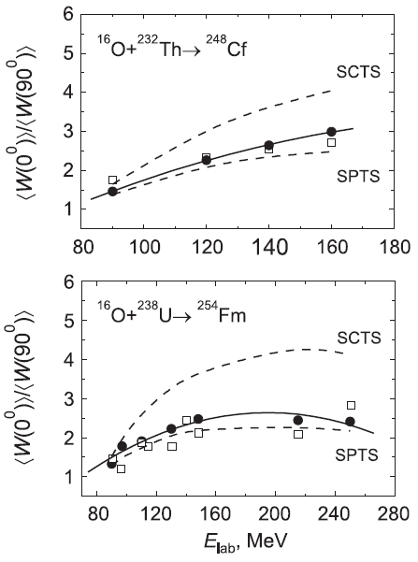
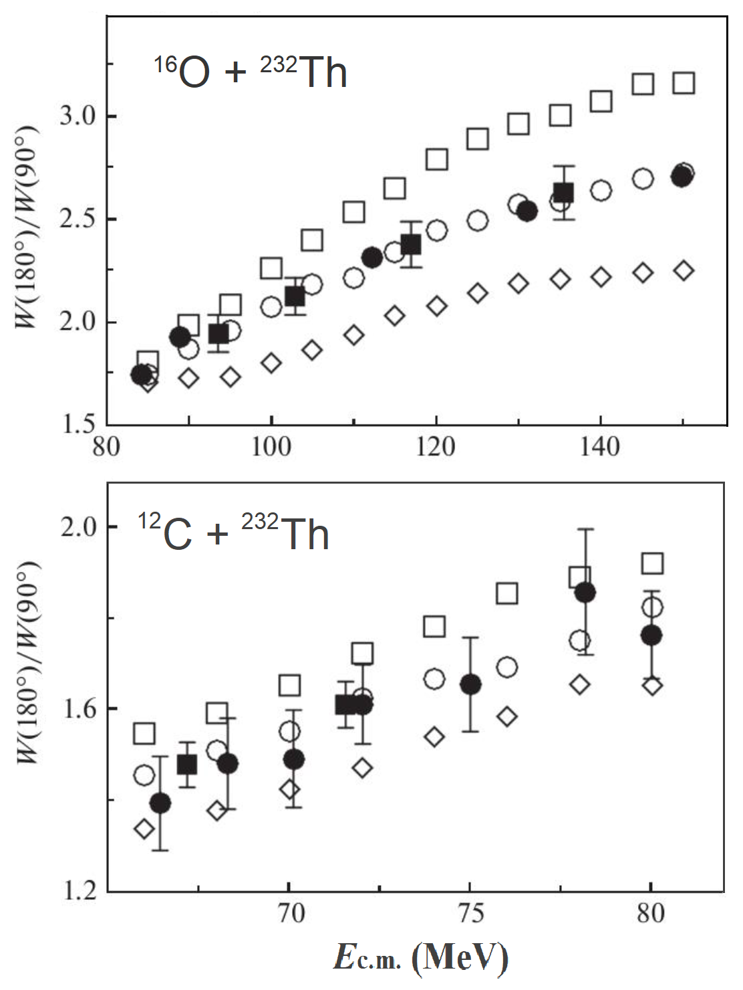
Angular Anisotropy
The experimentally observed angular distribution anisotropy cannot be described by either the saddle-point (SPTS) or scission-point (SCTS) transition-state models!
The anisotropies of the fission fragments angular distributions, obtained within a dynamical approach based on the combining of three-dimensional Langevin dynamics for collective shape coordinates with the stochastic dynamics of the tilting mode of fission, agree well with the experimental data.
A.V.Karpov et al.,
J.Phys.G 34, 255 (2007)
D.O.Eremenko et al., Bull.Russ.Acad.Sci.Phys. 81, 800 (2017)
Notes:
Karpov
Exp data from:
Back B B, 1985 Phys. Rev. C 32 195; Vaz L C, 1984 Z. Phys. A 315 169; Gavron A, 1984 Phys. Rev. Lett. 52 589; Karamyan S A, 1967 Yad. Fiz. 6 494; Toke J et al 1984 Phys. Lett. B 142 258
The transition-state model is conventionally used in theoretical analysis of the data on the angular distribution of fission fragments. The essence of this model consists of the assumption that there is a certain chosen (transition) configuration of a fissioning system that determines the angular distribution of fission fragments. Thus, there are two limiting assumptions on the position of the transition state and, correspondingly, two variants of the transition-state model: the saddle-point transition-state (SPTS) model and the scission-point transition-state (SCTS) model. The SPTS model gives a reasonably exact reproduction of the experimental data on the anisotropy of the fission fragment angular distributions for reactions in which neutrons, 3He, and α particles were used as projectiles. The compound nuclei formed in such reactions have a temperature of about 1 MeV and low angular momenta. For reactions with more massive ions of carbon, oxygen and heavier, standard SPTS model regularly predicted low values of angular anisotropy, and the experimental data are closer to the values obtained according to the SCTS model. The experimentally observed angular distribution anisotropy cannot be described by either the SPTS or SCTS models. Therefore, it was assumed, in the general case, that the transition state determining the angular distribution of fission fragments is located somewhere between the saddle point and the scission point.
A dynamical approach to the treatment of fission fragment angular distribution is developed. The approach is based on the combining of three-dimensional Langevin dynamics for collective shape coordinates with the stochastic dynamics of the tilting mode of fission.
The anisotropies of the fission fragment angular distributions obtained with τK = 4 × 10−21 s agree well with the experimental data

Slide 30
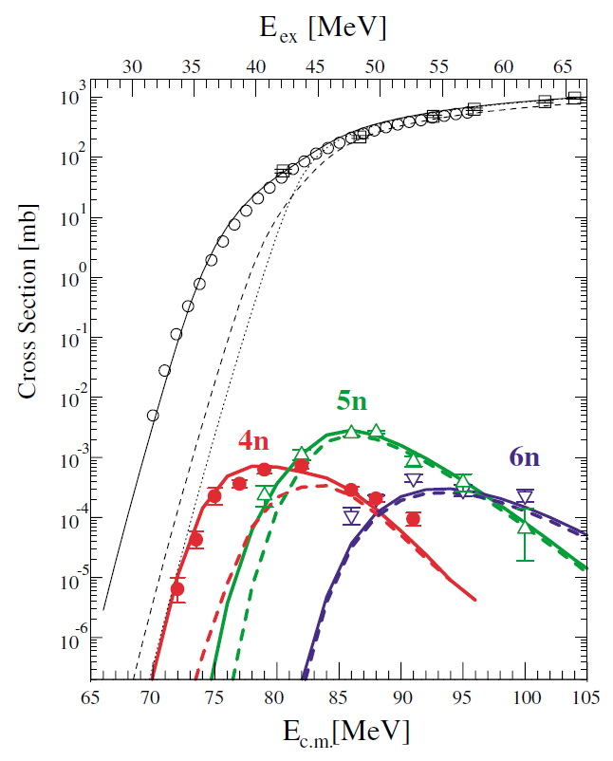
¹⁶O+²³⁸U ER cross sections
Evidence of Complete Fusion in the Sub-Barrier ¹⁶O+²³⁸U Reaction
Evaporation residue cross sections in the ¹⁶O+²³⁸U reaction were measured for the energy range from above- to extreme sub-barrier.
The cross sections are reproduced by a statistical model calculation, for which partial cross sections are calculated by a coupled-channel model taking into account the prolate deformation of ²³⁸U.
Complete fusion was observed in the collision of the projectile with the tips of the ²³⁸U target, in the same way as the side collision.
The presence (or absence) of complete fusion is unambiguously determined by measuring the ER cross section!
K.Nishio et al.,
Phy.Lett.B 93, 162701(2004)
Notes:
The presence (or absence) of complete fusion is unambiguously determined by measuring the ER cross section.
because of the observation that the angular anisotropies [A =W180/W90] in the sub-barrier region show much larger values than the prediction of the standard transition state model (TSM). In order to explain the anomalous behavior, two models are proposed. One is the fission before the K equilibrium and the other is the orientation-dependent quasifission model.
Hishio et.al [] conclude that in the sub-barrier region, complete fusion is the main process after the projectile is captured to the target, and the orientation dependent quasifission is not the reason for the anomalously large fission fragment angular anisotropy. The fission events in the sub-barrier region are ascribed to fusion-fission rather than quasifission.
In order to consider the fusion process in the subbarrier energy region, a statistical model calculation was carried out by using the code HIVAP.
The calculation needs the partial wave cross section for angular momentum for the fusion process, which varies largely from that of the one-dimensional model at and below the Coulomb barrier as the results of coupling between the relative motion and several nuclear collective motions. The L and fusion cross section are calculated by the coupled-channel code CCDEGEN which is based on a version of the CCFULL

Slide 31
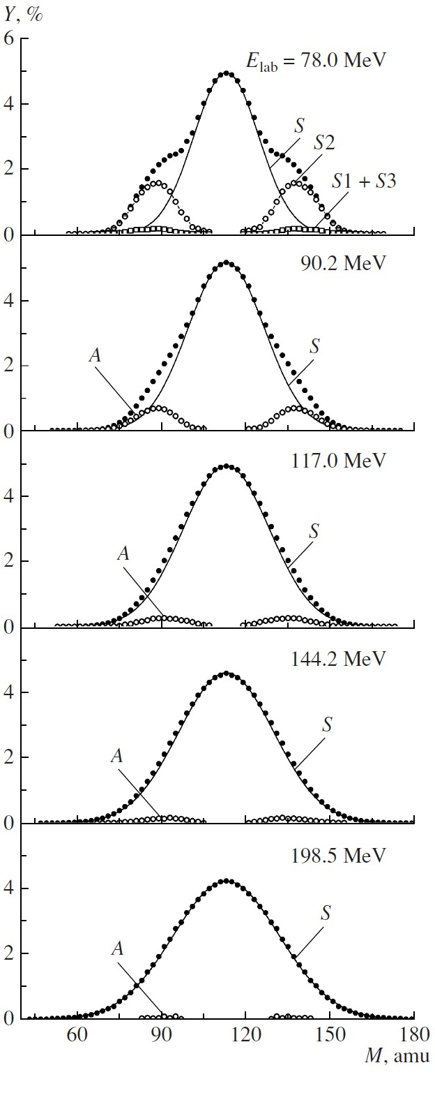
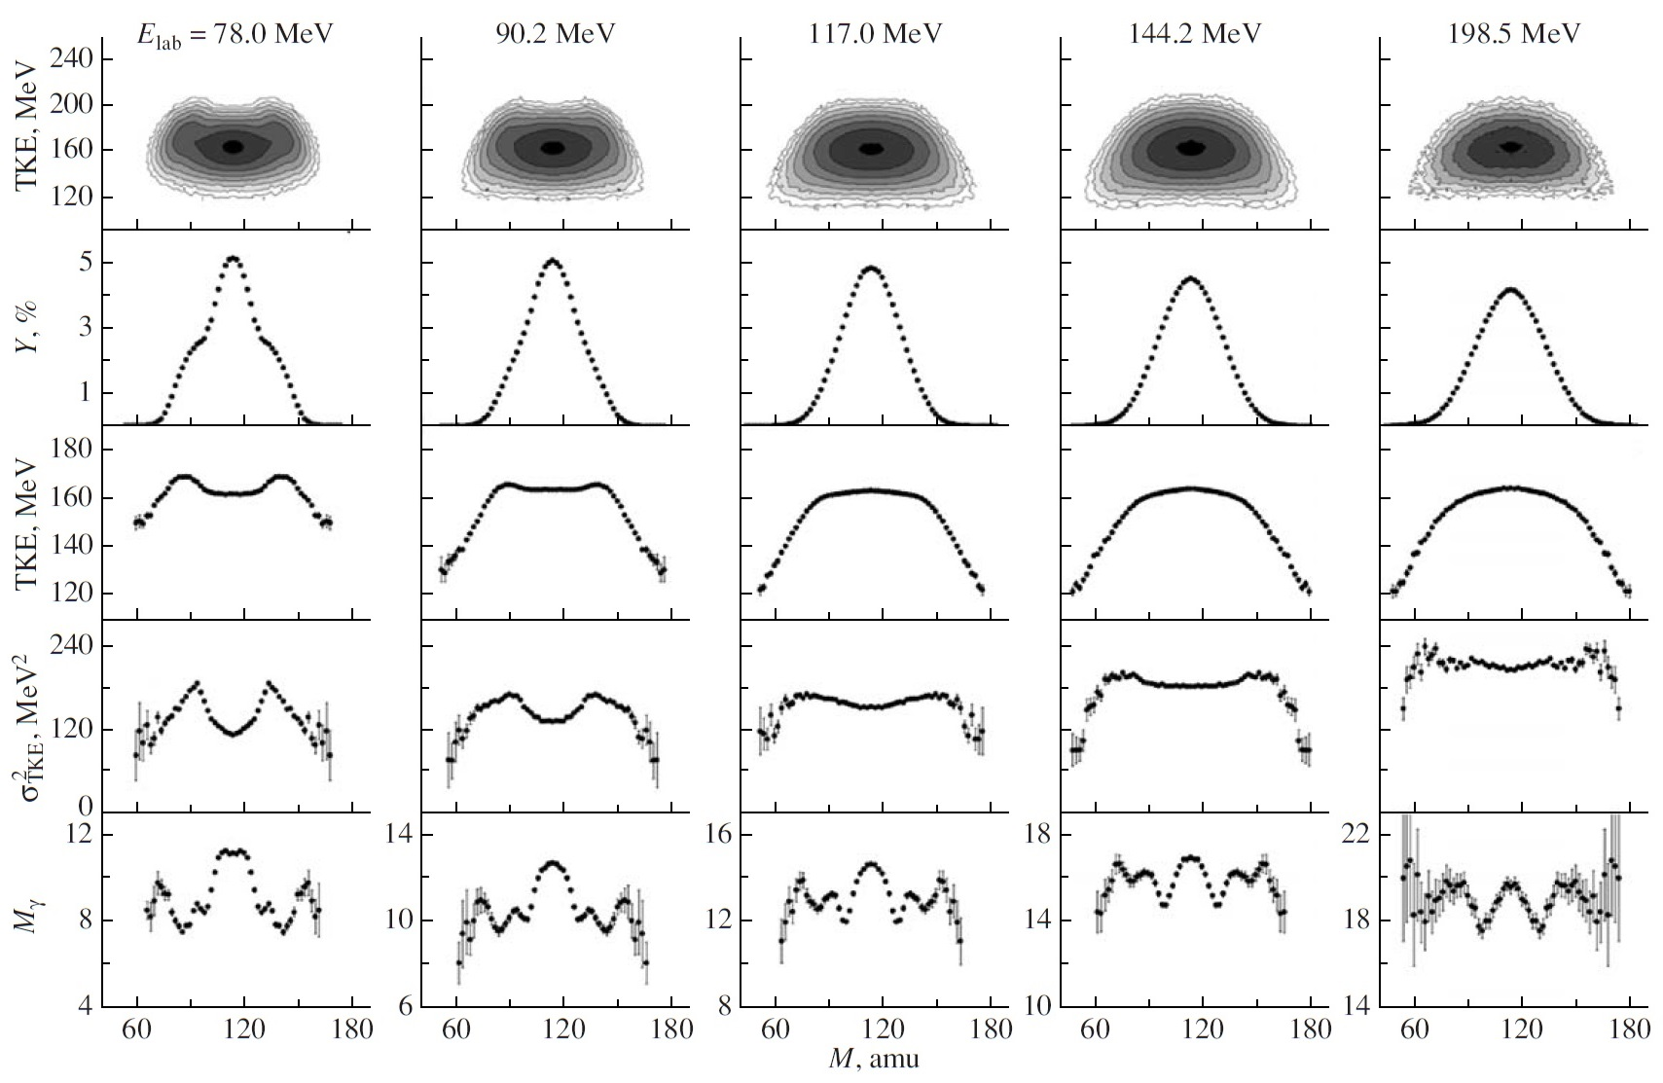
Multimodal fission of ²²⁶Th
²⁰⁸Pb(¹⁸O, f)
E*= 26 MeV 37 MeV 62 MeV 87 MeV 137 MeV
A.Ya. Rusanov et al., Phys. Atom. Nucl. 71 (2008) 984
Notes:
The mass–energy distributions of fragments originating from the fission of the compound nucleus 226Th and their correlations with the multiplicity of gamma rays emitted from these fragments are measured and analyzed in 18O + 208Pb interaction induced by projectile oxygen ions of energy in the
range Elab = 78−198.5MeV. Manifestations of an asymmetric fission mode, which is damped exponentially with increasing Elab, are demonstrated. Theoretical calculations of fission valleys reveal that only two independent valleys, symmetric and asymmetric, exist in the vicinity of the scission point. The dependence of the multiplicity of gamma rays emitted from both fission fragments on their mass, Мγ(М), has a complicated structure and is highly sensitive to shell effects in both primary and final fragments.
note that at Elab = 144.2 MeV, the mass distribution of fission fragments has a nearly Gaussian shape;
however, there is a slight growth at the edges in the dependence σ2TKE(M),
and the dependence Mγ(M) features a significant minimum at MH2 ≈ 143 amu. In other words, there is a small admixture of asymmetric fission in this case at the initial compound-nucleus excitation energy of E*ini=87 MeV, and Mγ(M) exhibits a high sensitivity to manifestations of fission asymmetry
The minimum in the dependence Mγ(M) for MH1 = 127–129 amu survives at all energies, having approximately the same depth in relation to the value of Mγ for symmetric fission around M ≈ A/2.

Slide 32
Multimodal fission in p-induced reactions
Notes:
At the proton energy E_{p}=13 MeV one can observe two-humped mass distribution with small appearance of symmetric peak. For all proton energies two fission modes are quite clearly seen in Mass-TKE distributions: symmetric and asymmetric ones. The symmetric contribution grows up with increasing proton incident energy, even at 55 MeV of proton energy the shoulders in the mass energy distribution demonstrate clearly the asymmetric fission peaks.
the thorium is a boundary nucleus between mainly asymmetric to mainly symmetric fission. There are two fission possibilities, resulting in symmetric fission mode. First, the symmetric fission mode is pronounced even at low excitation energies of the compound nucleus, and its yield grows up with increasing of the proron incident energy. Second, the pre-equilibrium and pre-scission neutrons, which can be evaporated even at the proton incident energy of already 20 MeV, reduce the mass of the fissioning nucleus. In the work [K.-H. Schmidt et al., Nucl. Phys. A665 (2000), 221-267] it is shown, that the more neutron deficient transactinide nucleus is, the more symmetrical is its mass-distribution of fission fragments. This also may enhance the yield of fission fragments in the symmetrical region.
The TKE for the symmetric mode is lower at all proton energies than that for the asymmetric one. In first approximation the TKE is interpreted as the Coulomb energy of the two fragments at the contact point at scission. Taking this assumption into account, we may conclude that the system is more compact when the compound nucleus fission is asymmetric, and the system is more elongated in the case of the symmetric fission.

Slide 33
Multimodal fission in p-induced reactions

Slide 34
Fission of ²⁴⁸Cf*

Slide 35
Fission of Fm*

Slide 36
Conclusion
For the compound nucleus ²⁷⁴Hs* formed in the reaction ²⁶Mg + ²⁴⁸Cm at the initial excitation energy E*=35 MeV and ²⁷¹Hs* formed in the reaction ²²Ne + ²⁴⁹Cf at the initial excitation energy E*=29 MeV the phenomenon of bimodal fission was observed.
For the compound nucleus ²⁶⁰No* formed in the reaction ²²Ne + ²³⁸U at the initial excitation energy E*=41 MeV the bimodal fission as well as superasymmetric fission (A_{H}/A_{L}≈ 4.3) were observed
For the compound nuclei ²⁴⁸Cf*, ^{254,256}Fm* formed in the reactions ^{16,18}O + ²³²Th,²³⁸U, and ²²Ne + ²³²Th,²³⁸U an increase of fragment yields in the mass region ~70 u, connected with the influence of closed shells Z = 28 and N = 50, was observed.

Slide 37
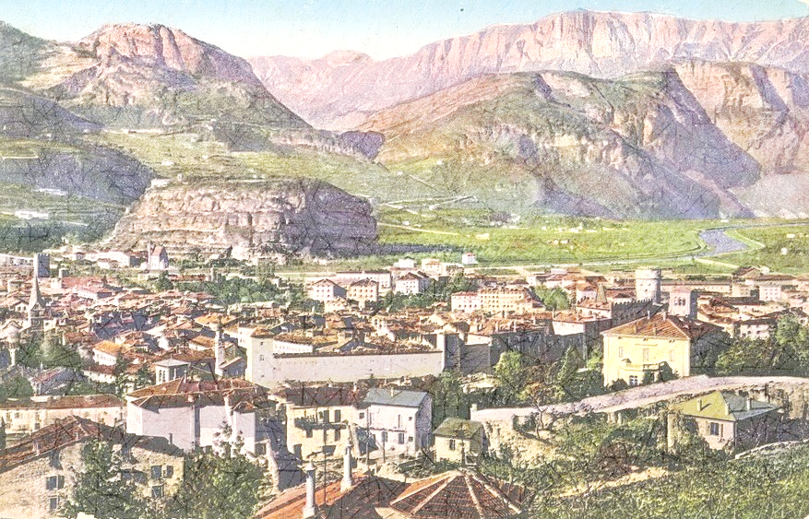
Thank you for attention!

Slide 38
Proj |  | Targ |  | CN |  | E_{lab} | E_{cm} | E* | E_{Coul} | E_{Bass} | E_{cm}/E_{B} | E-E_{C} | Z²/A | x_{CN} | x_{eff} | x_{m} | TKE_{Viola}
O | 18 | Pb | 208 | Th | 226 | 78 | 72 | 26 | 78.4 | 74.5 | 0.964 | -7 | 35.8 | 0.761 | 0.420 | 0.50 | 165
O | 18 | Pb | 208 | Th | 226 | 90 | 83 | 37 | 78.4 | 74.5 | 1.112 | 5 | 35.8 | 0.761 | 0.420 | 0.50 | 165
O | 18 | Pb | 208 | Th | 226 | 117 | 108 | 62 | 78.4 | 74.5 | 1.446 | 32 | 35.8 | 0.761 | 0.420 | 0.50 | 165
O | 18 | Pb | 208 | Th | 226 | 144 | 133 | 87 | 78.4 | 74.5 | 1.779 | 59 | 35.8 | 0.761 | 0.420 | 0.50 | 165
O | 18 | Pb | 208 | Th | 226 | 199 | 183 | 137 | 78.4 | 74.5 | 2.453 | 113 | 35.8 | 0.761 | 0.420 | 0.50 | 165
O | 18 | U | 238 | Fm | 256 | 85 | 79 | 40 | 85.7 | 82.0 | 0.964 | -7 | 39.1 | 0.839 | 0.442 | 0.54 | 191
O | 16 | U | 238 | Fm | 254 | 89 | 83 | 45 | 86.6 | 82.9 | 1.006 | -3 | 39.4 | 0.842 | 0.462 | 0.56 | 191
O | 16 | U | 238 | Fm | 254 | 101 | 95 | 56 | 86.6 | 82.9 | 1.141 | 9 | 39.4 | 0.842 | 0.462 | 0.56 | 191
Ne | 22 | U | 238 | No | 260 | 107 | 98 | 41 | 105.2 | 101.9 | 0.962 | -8 | 40.0 | 0.857 | 0.505 | 0.59 | 197
Ca | 44 | Pb | 206 | No | 250 | 227 | 187 | 40 | 179.7 | 178.1 | 1.050 | 9 | 41.6 | 0.870 | 0.697 | 0.74 | 199
Ni | 64 | W | 186 | No | 250 | 311 | 231 | 40 | 221.4 | 221.2 | 1.046 | 13 | 41.6 | 0.870 | 0.782 | 0.80 | 199
O | 16 | Th | 232 | Cf | 248 | 84 | 79 | 42 | 85.1 | 81.4 | 0.965 | -7 | 38.7 | 0.826 | 0.458 | 0.55 | 186
O | 16 | Th | 232 | Cf | 248 | 96 | 90 | 53 | 85.1 | 81.4 | 1.103 | 5 | 38.7 | 0.826 | 0.458 | 0.55 | 186

Slide 39
Fission of ²⁴⁸Cf*

Slide 40
Fission of ²⁵⁴Fm* and ²⁵⁶Fm*

Slide 41
Fission of ²⁵⁴Fm*

Slide 42
Notes:
This slide shows the trends of the average light and heavy fragment masses in spontaneous and low energy fission of nuclei from Th isotopes up to superheavy elements. As established since a long time, for nuclei with A < 250 the heavy fragment masses are peaking around mass 140, a fact traced to the influence of spherical and deformed shells near 132Sn. For the region of very heavy nuclei with compound masses from A ≈ 256 to A ≈ 280 the fragment mass distributions are in most cases symmetric. When both fragments are close to either Z = 50 or N= 82 bimodal fission shows up. In the case of fission of superheavy nuclei the light fragments with mass 132-134 u play the stabilizing role. Hence, shell effects are everywhere present and determine the basic characteristics of fragment mass distributions.

Slide 43
Nuclear Deformation, Cluster-Structure, Fission and Cluster Radioactivity
The basic idea was that the essential coordinates of a fissioning nucleus are the distance between the two nuclear centers and the mass asymmetry
The potential between the two fragments V(R, η) depends for given R on the mass asymmetry η. The collective wave-function Ψ(R, η) will show maxima where the potential has minima and vice versa. The probability distribution will show pronounced maxima for symmetric and asymmetric fission. If the potential has several minima, due to shell structure, symmetric, asymmetric and superasymmetric fission will occur.
A simple theoretical idea was proven by experiment done independently of the theory.

Slide 44
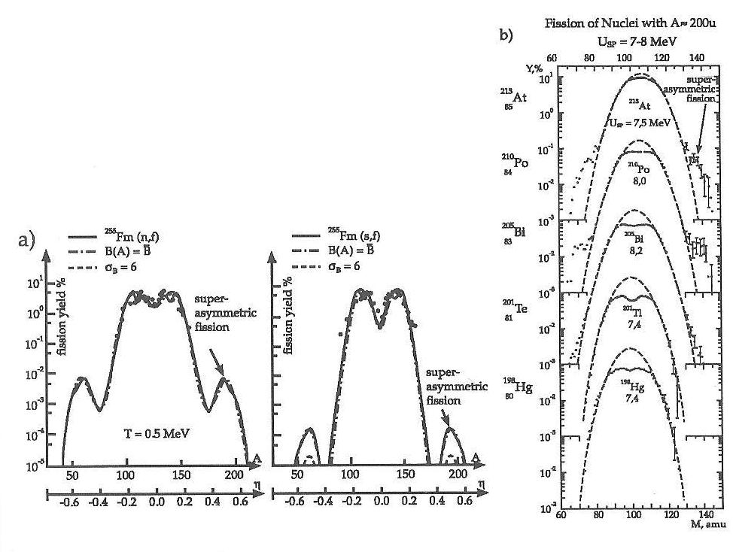
Superasymmetric fission of heavy nuclei
W. Greiner (International Workshop on Fusion Dynamics at the Extremes, 25-27 May 2000)
Superasymmetric fission of nuclei with A~200 u

Slide 45
Fission and Quasifission of ²⁵⁰No*

Slide 46
Bimodal Fission of ²⁷⁴Hs*
Z₁ = Z₂ ≈ 50
N₁ = N₂ ≈ 82
²⁷⁴Hs
108 protons
166 neutrons
$ν_{pre}^{syst}$≈ 1.1
E.K. Hulet et al., Phys. Rev. Lett. 56, 313 (1986)
Notes:
На рис приведено распределение ТКЕ для области симметричных масс А/2 ± 20. Хорошо видно, это распределение имеет ярко выраженную высокоэнергетическую компоненту, а само распределение по форме очень похоже на распределение ТКЕ осколков спонтанного деления например, ²⁵⁸Fm или ²⁶²No.
Сравнили с серой – то же ядро.
НО <ТКЕ> выше и дисперсия больше – отличаются -> это не связано с квази как для серы - > особенности самого деления
Поэтому мы приходим к заключению, что в нашем случае реализуется бимодальное деление Hs*, образованного в реакции Mg+Cm при начальной энергии возбуждения 35 МэВ
(для Ne+Cf при энергии ниже барьера тоже дисперсияя ТКЕ больше, -> бимодальность, но статистика слишком мала)

Slide 47
TKE Distributions

Slide 48
M.G. Itkis and A. Ya. Russanov, Fiz. Elem. Chastits At. Yadra 29, 389 (1998)
J. R. Nix and W. J. Swiatecki, Nucl. Phys. 71, 1 (1965)
M. G. Itkis, V. N. Okolovich, A.Ya. Rusanov, and G. N. Smirenkin, Z. Phys. A320, 433 (1985)

Slide 49
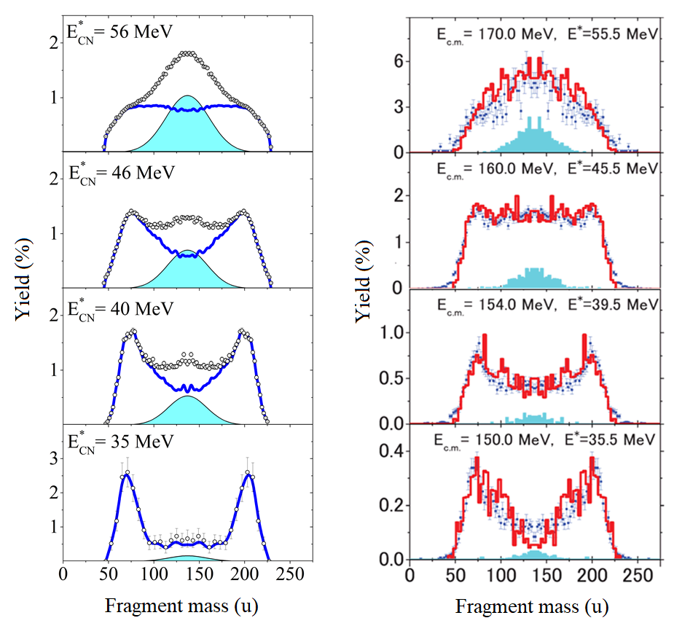
³⁶S + ²³⁸U
Aritomo et al. proposed a model which combines the coupled-channels approach and a fluctuation-dissipation model for
dynamical calculations.
I.M. Itkis et al.,
Phys. Rev. C 83 (2011) 064613
Y. Aritomo et al.,
Phys. Rev. C 85 (2012) 044614
Notes:
In order to describe heavy-ion fusion reactions around the Coulomb barrier with an actinide target nucleus,
Aritomo et al propose a model which combines the coupled-channels approach and a fluctuation-dissipation model for
dynamical calculations. This model takes into account couplings to the collective states of the interacting nuclei
in the penetration of the Coulomb barrier and the subsequent dynamical evolution of a nuclear shape from
the contact configuration. In the fluctuation-dissipation model with a Langevin equation, the effect of nuclear
orientation at the initial impact on the prolately deformed target nucleus is considered. Fusion-fission, quasifission,
and deep quasifission are separated as different Langevin trajectories on the potential energy surface.

Slide 50
Reaction | A_{CN} | η | Z₁Z₂ | β |  | B_{Bass} (MeV) | B_{tip} (MeV) | B_{side} (MeV)
 |  |  |  | ion | target
²²Ne + ²⁴⁹Cf | 271 | 0.838 | 980 | 0.562 | 0.299⁺ | 109.0 | 94.7 | 119.0
²⁶Mg + ²⁴⁸Cm | 274 | 0.810 | 1152 | 0.482 | 0.297 | 126.8 | 111.6 | 138.8
³⁶S + ²³⁸U | 274 | 0.737 | 1472 | 0.168 | 0.286 | 159.1 | 147.5 | 170.8
⁵⁸Fe + ²⁰⁸Pb | 266 | 0.564 | 2132 | 0.259 | 0 | 227.2 | 224.4 | 240.7

Slide 51
E_{lab} (MeV) | E_{c.m.} (MeV) | E_{c.m.} /E_{B} | E* (MeV) | <l> (ħ) | T_{saddle} (MeV) | σ_{M} (u) | σ_{TKE} (MeV)
²²Ne + ²⁴⁹Cf
102 | 93.7 | 0.868 | 29 | 7 | 0.98 | 19.5 | 21.3
127 | 116.7 | 1.081 | 52 | 22 | 1.13 | 22.1 | 21.7
²⁶Mg + ²⁴⁸Cm
125 | 113.1 | 0.899 | 32 | 8 | 1.01 | 20.1 | 21.3
129 | 116.8 | 0.927 | 35 | 9 | 1.03 | 20.3 | 21.4
143 | 129.4 | 1.028 | 48 | 19 | 1.11 | 21.8 | 21.6
160 | 144.8 | 1.150 | 64 | 35 | 1.18 | 24.4 | 22.5
³⁶S + ²³⁸U
168 | 145.9 | 0.921 | 31 | 9 | 1.00 | 20.0 | 21.3
173 | 150.3 | 0.948 | 35 | 11 | 1.03 | 20.4 | 21.4
179 | 155.5 | 0.981 | 40 | 15 | 1.06 | 21.0 | 21.5
186 | 161.6 | 1.019 | 46 | 22 | 1.10 | 22.0 | 21.7
198 | 172.0 | 1.085 | 56 | 33 | 1.15 | 24.0 | 22.4
⁵⁸Fe + ²⁰⁸Pb
289 | 226.0 | 0.999 | 21 | 16 | 0.93 | 19.3 | 21.5
297 | 232.2 | 1.027 | 27 | 26 | 0.99 | 20.1 | 21.9
305 | 238.5 | 1.055 | 33 | 37 | 1.04 | 23.2 | 22.7
315 | 246.3 | 1.089 | 41 | 47 | 1.09 | 25.6 | 23.5
324 | 253.3 | 1.120 | 48 | 54 | 1.14 | 27.4 | 24.1
Notes:
Барьер
NeCf 109 -13 (*29) +8 (*52)
MgCm 127 -14 (*32) -10 (*35) +2 (*48) +18 (*64)
SU 159 -13 (*31) -9 (*35) -3 (*40) +3 (*46) +13 (*56)
FePb 227 -1 (*21) +5 (*27) +11 (*33) +19 (*41) +26 (*48)

Slide 52
(MeV) | (MeV) |  | (u) | (u) | (MeV) | (MeV) | (MeV)
²²Ne + ²⁴⁹Cf
102 | 29 | 0.86 | 20.2±0.8 | 19.5 | 214±2 | 23.2±1.4 | 21.3
127 | 52 | 1.07 | 22.0±0.1 | 22.1 | 215±1 | 21.5±0.1 | 21.7
²⁶Mg + ²⁴⁸Cm
129 | 35 | 0.92 | 32.1±0.3 | 20.3 | 218±1 | 22.6±0.6 | 21.4
143 | 48 | 1.02 | 27.8±0.1 | 21.8 | 215±1 | 22.6±0.1 | 21.6
160 | 64 | 1.14 | 24.4±0.1 | 24.4 | 215±1 | 22.5±0.1 | 22.5

Slide 53
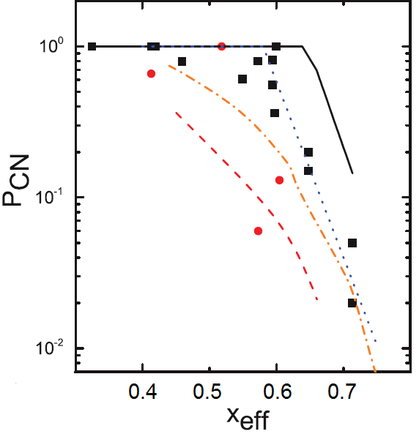
Fusion Probability
σ_{ER} = σ_{capture} × P_{CN} × W_{survival}
σ_{capture} = σ_{QF} + σ_{CNF} + σ_{ER}
R. Yanez et al.,
Phys. Rev. C 88, 014606 (2013)
Fusion vs Quasifission
Coulomb factor Z₁Z₂
Entrance channel mass asymmetry α
Mean fissility parameter x_{m}
Z₁Z₂ > 1600
x_{m} > 0.68
x_{m} > 0.765
Notes:
Formally the cross section for producing a heavy evaporation residue, σ_{ER}, in a fusion reaction can be written as
σ_{ER} = σ_{capture} × P_{CN} × W_{survival} where
σ_{capture} is the capture cross section,
P_{CN} is the probability that after overcame the Coulomb barrier the interacting nuclear system reaches a compact CN configuration
W_{survival} is the probability that CN survives against fission (CN fission)
Experimentally, the capture cross section is defined as the sum of the QF, CN-fission and ER cross sections.
The main uncertainty in the determination of σ_{ER} gives the value of the fusion probability P_{CN}.
Not only is the numerical value of PCN uncertain, but the dependence of PCN on excitation energy and the reaction entrance channel is not well established
The experimental measurements of fusion probability show the general dependence of P_{CN} upon fissility.
But they strongly vary from each other as well as the predictions of different theoretical models applied to describe the whole evolution of low-energy nucleus-nucleus collisions at strong channel coupling of deep-inelastic scattering, CN formation, and QF
It is important to determine P_{CN} experimentally to improve the understanding of reaction mechanisms taking place in the reactions with heavy ions.
To define P_{CN} experimentally the information about relative contributions of QF, CN fission and ER components into the capture cross sections is needed.
In the case of reactions leading to the formation of SHE the ER cross section in negligibly small compare with CN-fission and QF processes.
Since CN fission and QF are both binary decay channels characterized by large nucleon exchange and energy dissipation,
it is difficult to make the experimental separation between QF and CN fission.
Three criteria are widely used to identify the reaction mechanism (fusion or QF).
1. The reaction Coulomb factor Z₁Z₂ (charge product of reaction partners). This parameter relates to the Coulomb energy in the entrance channel. According to the calculations in the frame of macroscopic-microscopic model of Swiacteki the threshold value of Z₁Z₂ for the appearance of QF is 1600.
2. Entrance channel mass asymmetry α₀ = (A_{projectile} - A_{target})/(A_{projectile} + A_{target}). Unexpected fusion suppression observed in quite asymmetric combinations of colliding nuclei can be qualitatively explained in the framework of the liquid drop Businaro-Gallone picture, i.e., by an effect of the conditional barrier arising along the mass asymmetry coordinate on a path to the formation of a spherical CN. The fusion probability P_{CN}, as a measure of the fusion suppression effect, correlates with the entrance-channel mass asymmetry. According to this criterion QF appears for systems with entrance channel mass asymmetry lower than the Businaro-Gallone mass asymmetry
3. Effective fissility parameter x_{eff} connected with repulsive and attractive forces in the entrance channel
Recently, mean fissility parameter was proposed x_{m}=0.75 x_{eff} + 0.25 x_{CN}
From the analysis of a large data set of mass-angle distributions of fission-like fragments obtained in the reaction with heavy ions it has been found that the QF takes place for reactions with x_{m} > 0.68 and becomes dominant at x_{m} > 0.765.
These criteria, however, are not universal. For instance, they do not take into account the shapes of the interacting nuclei. The relative orientation of deformed nuclei changes the Coulomb barrier and the distance between the centres of the colliding nuclei and this leads to a change in the balance between repulsive and attractive forces. When two interacting nuclei touch each other by their lateral surfaces (near-side collisions), a high formation probability of a spherical CN is expected, whereas in the elongated conﬁguration, when nuclei touch each other by their poles (near-tip collisions), a high QF probability is expected.
The interaction energy is also a very important parameter for QF. The relative contribution of QF process decreases when the interaction energy increases.

Slide 54
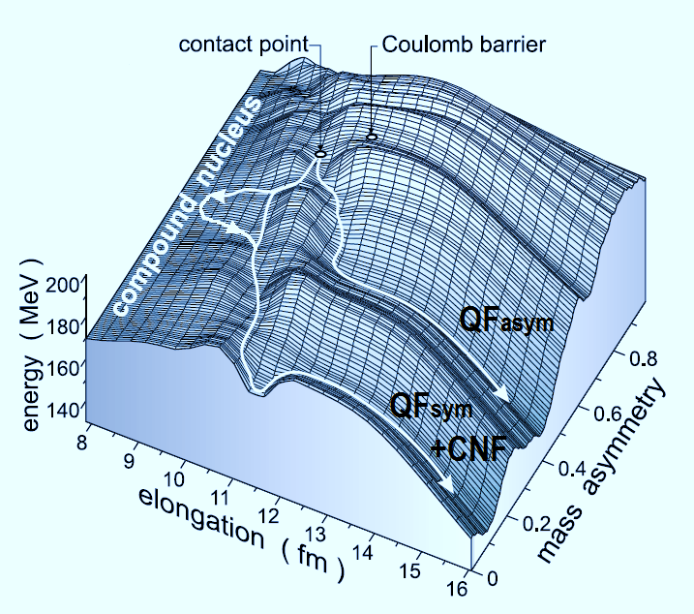
Characteristics of FF and QF
Fission of heated nuclei
Mass distribution has a typical Gaussian shape with the dispersion depending on excitation energy and angular momentum of compound nucleus
Symmetric angular distributions of fragments with respect to 90◦ in the center-of-mass system
Kinetic energy distribution of fragments has a nearly Gaussian shape with mean value depending on Z²/A^{1/3} (Viola systematics)
Takes time!
Quasifission
Wide mass distribution
Asymmetric angular distribution of fragments with respect to 90◦ in the center-of-mass system
Higher kinetic energies than for compound nucleus fission
Notes:
It is known that in superheavy composite systems QF mainly leads to the formation of asymmetric fragments. This type of QF process, so-called asymmetric quasifission, is characterized by asymmetric angular distributions in the center-of-mass system and thus fast reaction times (~10⁻²¹ s) The TKE for these fragments is observed to be higher than that for CN fission and hence this process is colder than CNF. Due to this reason shell effects in QF are more pronounced.
Besides the asymmetric component, also the symmetric component may be affected by the presence of the QF process On the one hand, the angular distribution for all these mass-symmetric fragments is symmetric with respect to 90° in the center-of-mass system and the estimated reaction time is ~10⁻²⁰ s, typical for CNF processes. On the other hand, the calculations of potential energy surfaces show that one of the possible reaction channels for such systems is a process occurring without a CN stage, but with fragment properties close to those known from CNF. This process is characterized by long reaction times sufficient for mass equilibration and resulting in the formation of symmetric fragments.
Consequently, the question of whether the symmetric fragments originate from CNF or QF processes arises.

Slide 55
Collaboration
I.M. Itkis, M.G. Itkis, G.N. Knyazheva, E.M. Kozulin, K.V. Novikov
Flerov Laboratory of Nuclear Reactions, Joint Institute for Nuclear Research, Dubna, Russia
E. Vardaci
Dipartimento di Fisica dell’Università di Napoli “Federico II” and Istituto Nazionale di Fisica Nucleare, Napoli, Italy
W.H.Trzaska
Department of Physics, University of Jyväskylä, Finland
Thank you for attention!

Slide 56
Superasymmetric fission
← ²⁶⁰No*→
Bimodal
fission

Slide 57
Properties of TKE Distributions
A_{CN} /2±20 u
Viola et al.
0.1071 Z²/A^{1/3}+ 22.2
V. E. Viola et al., Phys.Rev.C 31,1550 (1985)
M.G. Itkis and A. Ya. Rusanov, Phys.Part.Nucl. 29, 160 (1998)
Notes:
Показаны <ТКЕ > и среднеквадр. Откл в завис. от Е*
NeCf - <ТКЕ>, дисперсия соотв систематикам для деления нагр ядер и MgCm – при высокой энергии ----
FePb – <ТКЕ> растет с энергией, дисперсия TKE меньше чем предсказания МЖК для деления
SU - <ТКЕ> ниже, дисперсия НИЖЕ при низкой енергии, Выше при высокой (два процесса с соизмеримым вкладом)

Slide 58
σ_{ER} = σ_{capture} × P_{CN} × W_{survival}
P_{CN} = (1 - P_{FQF} ) (1 - P_{SQF} )

