Slide 1
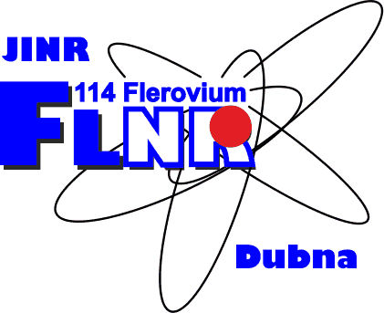
Production of neutron-rich heavy and superheavy nuclei in multinucleon transfer reactions
Alexander Karpov
Flerov Laboratory of Nuclear Reactions, JINR, Dubna, Russia
9-13 April 2018, Trento, Italy

Slide 2
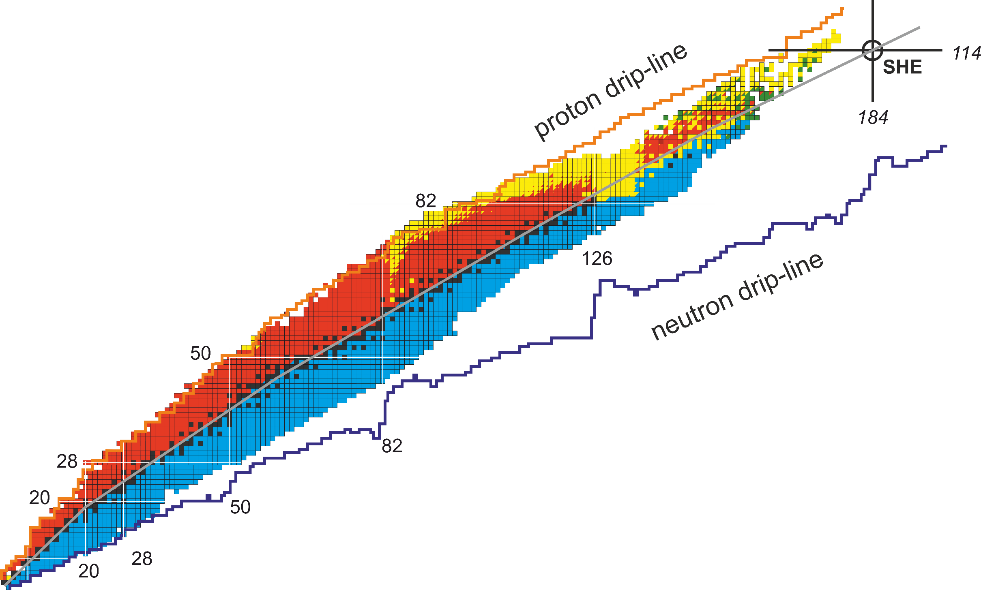
Motivation
3-4 neutron-rich nuclei were added during last years based on the fragmentation reactions
Cross section is 4.4±2.0 pb for ²⁰²Os J. Kurcewicz et al., PLB (2012)
Only lower limit of half-life values were identified
Other efficient methods of production of these nuclei are still of great value
Multi-nucleon transfer reactions are thought to be an efficient method of synthesis of new neutron-rich heavy and superheavy nuclei

Slide 3
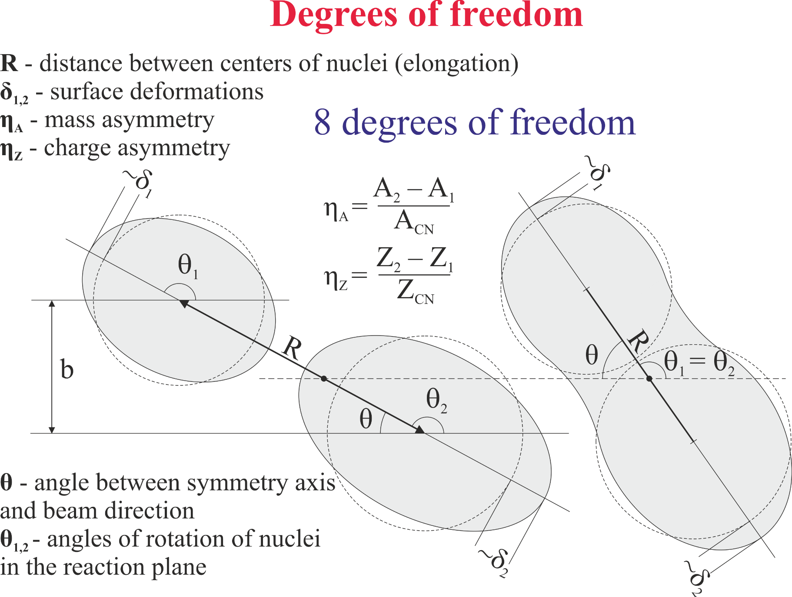
Model
A.V. Karpov and V.V. Saiko, Phys. Rev. C 96, 024618 (2017)

Slide 4
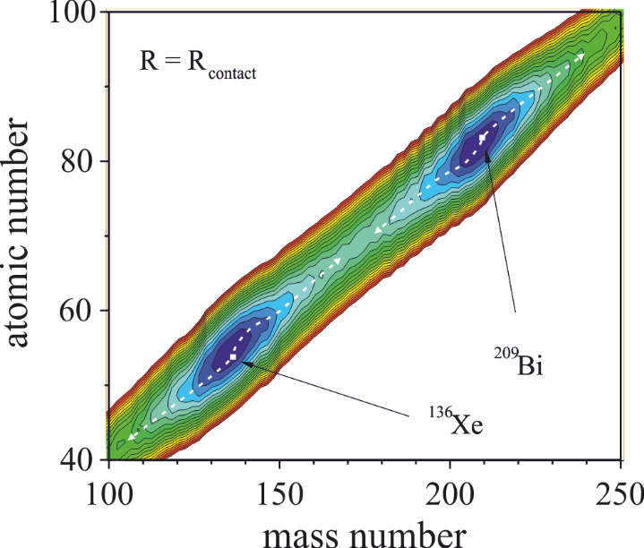
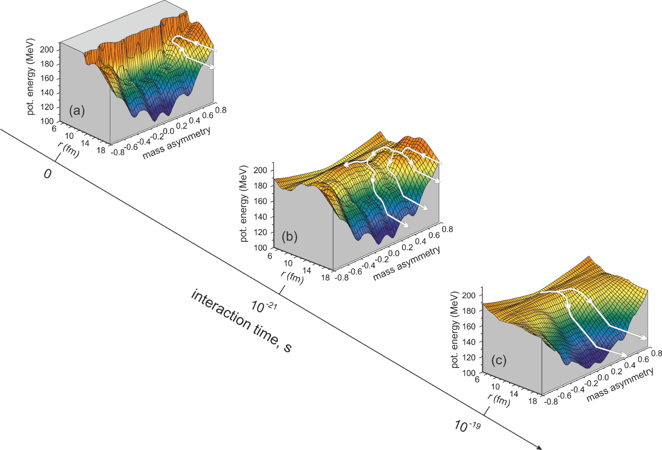
Potential energy
A.V. Karpov, EXON (2006)
V.I. Zagrebaev, A.V. Karpov, et al. PEPAN (2007)
Double-folding potential with Migdal forces
Two-center shell model

Slide 6
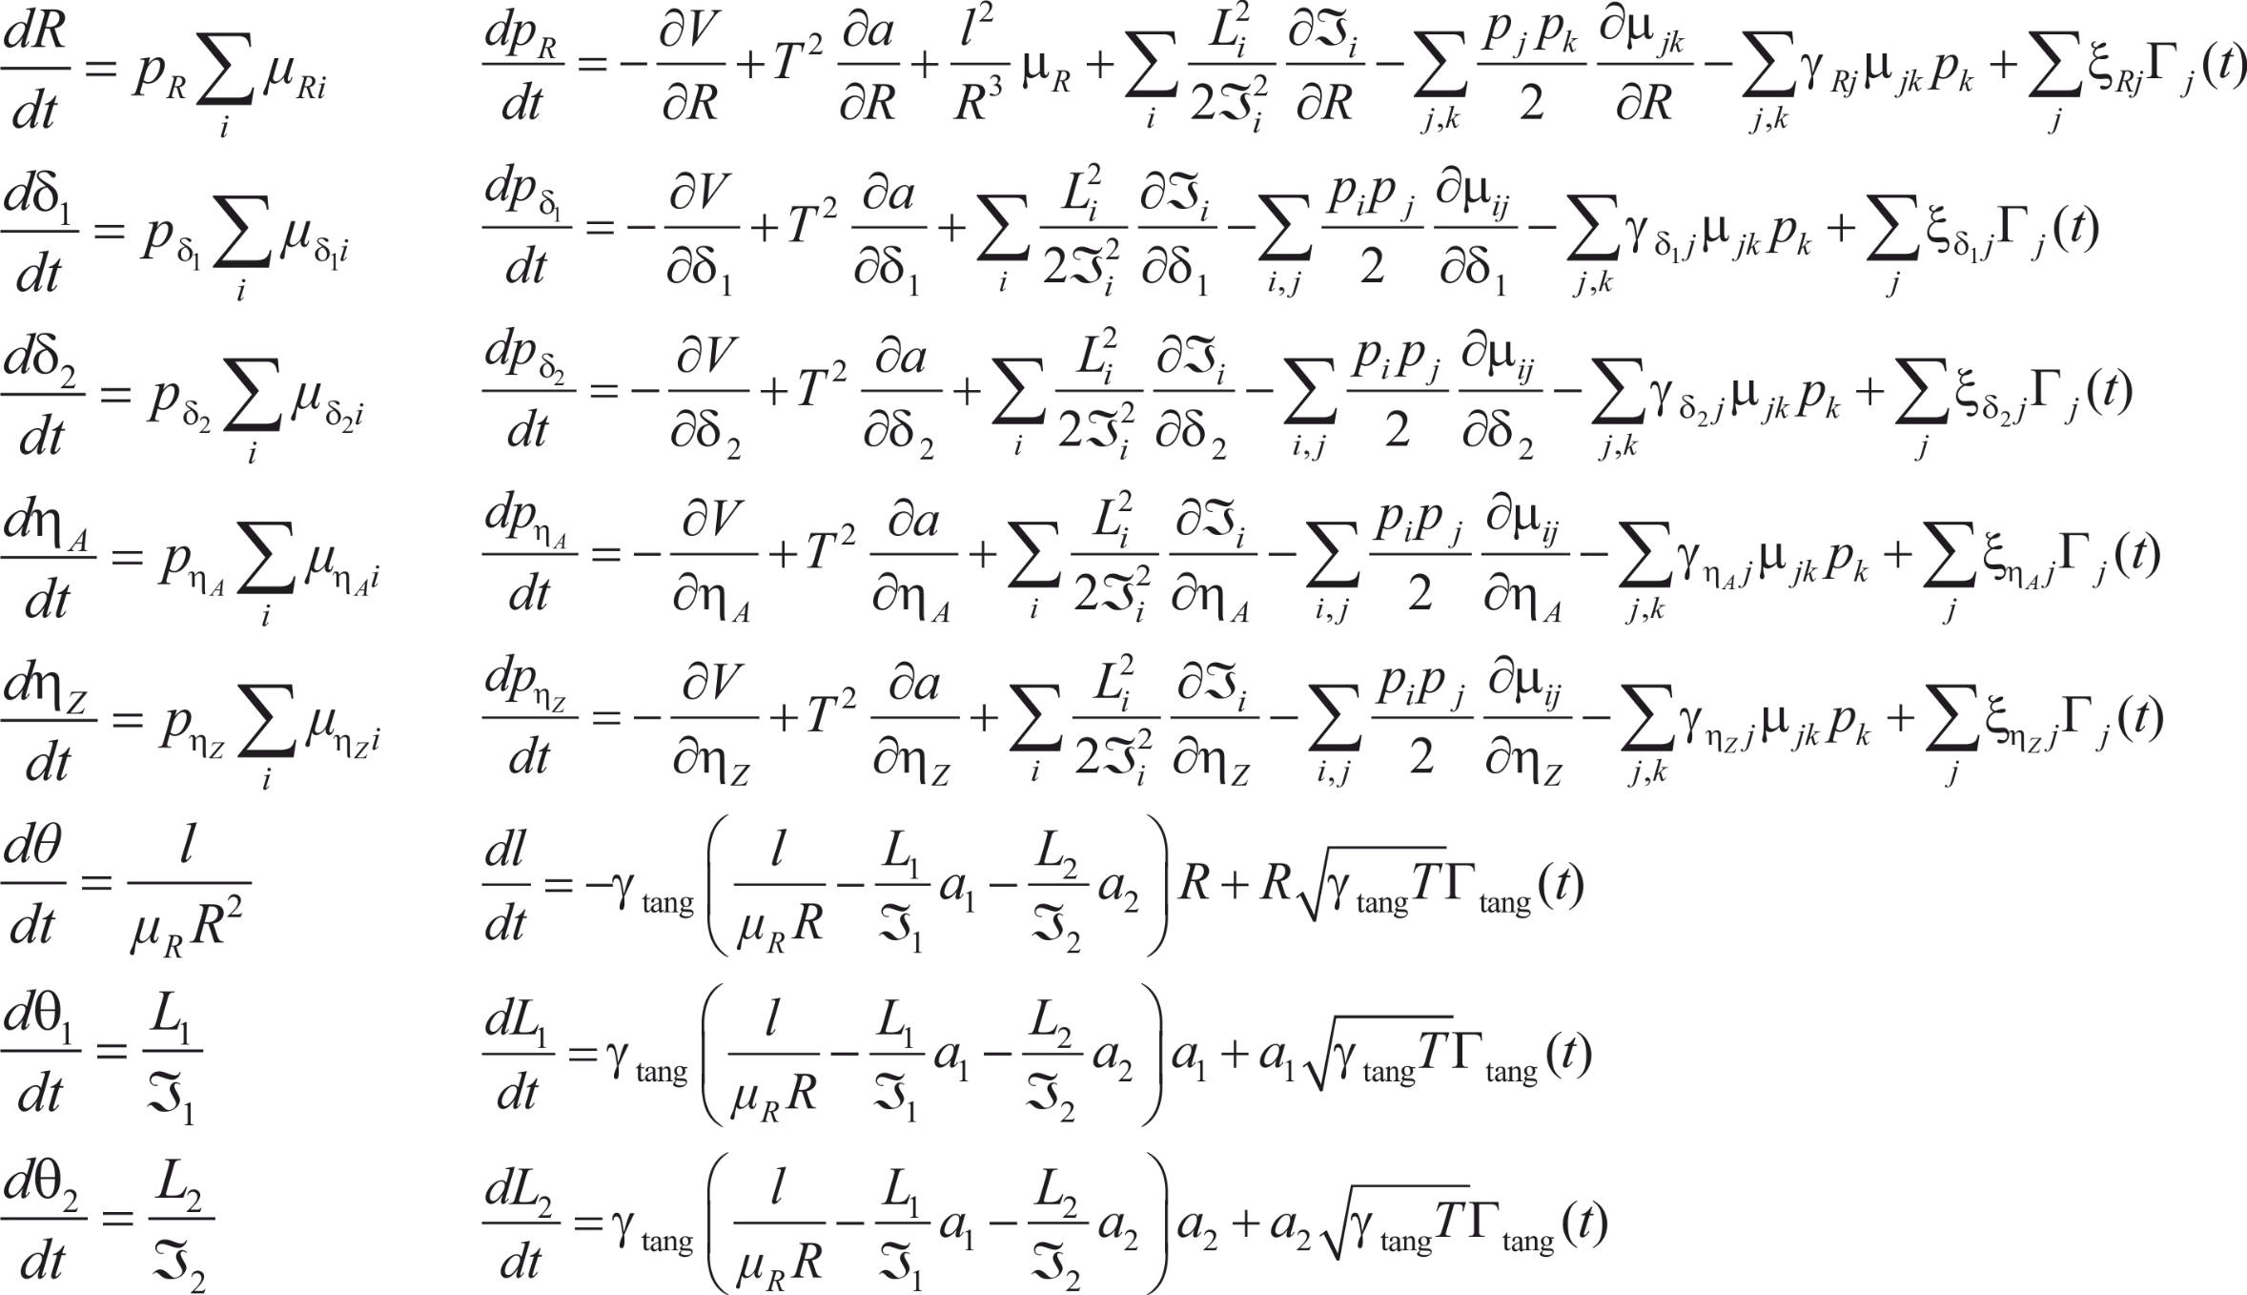
Equations of motion (R, δ₁, δ₂, η_{A}, η_{Z}, θ₁, θ₂, θ)

Slide 8
http://nrv.jinr.ru

Slide 9
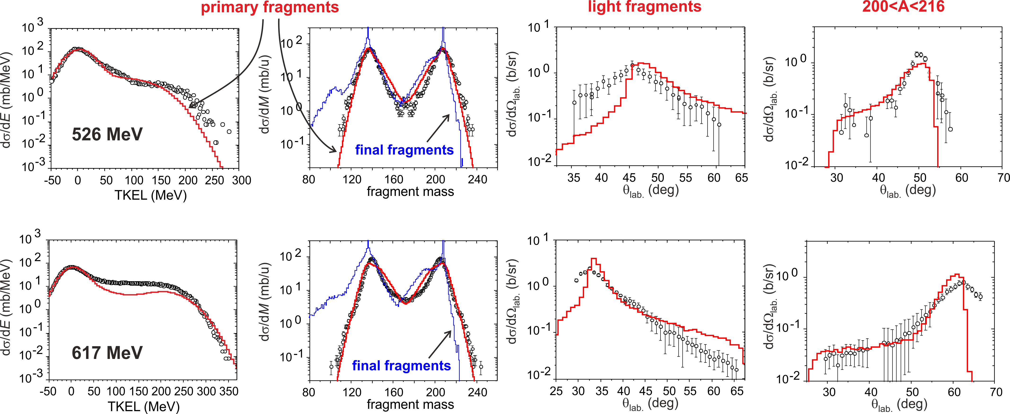
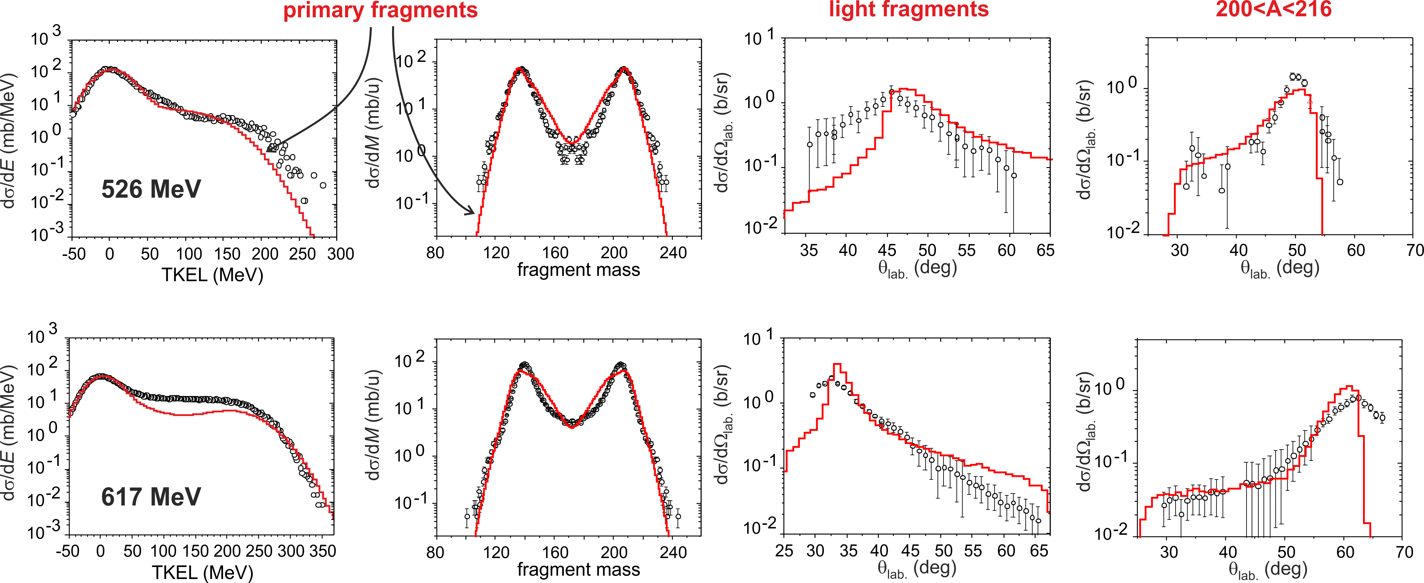
¹³⁶Xe+²⁰⁸Pb
experiment: E.M. Kozulin, et al., PRC (2012)

Slide 10
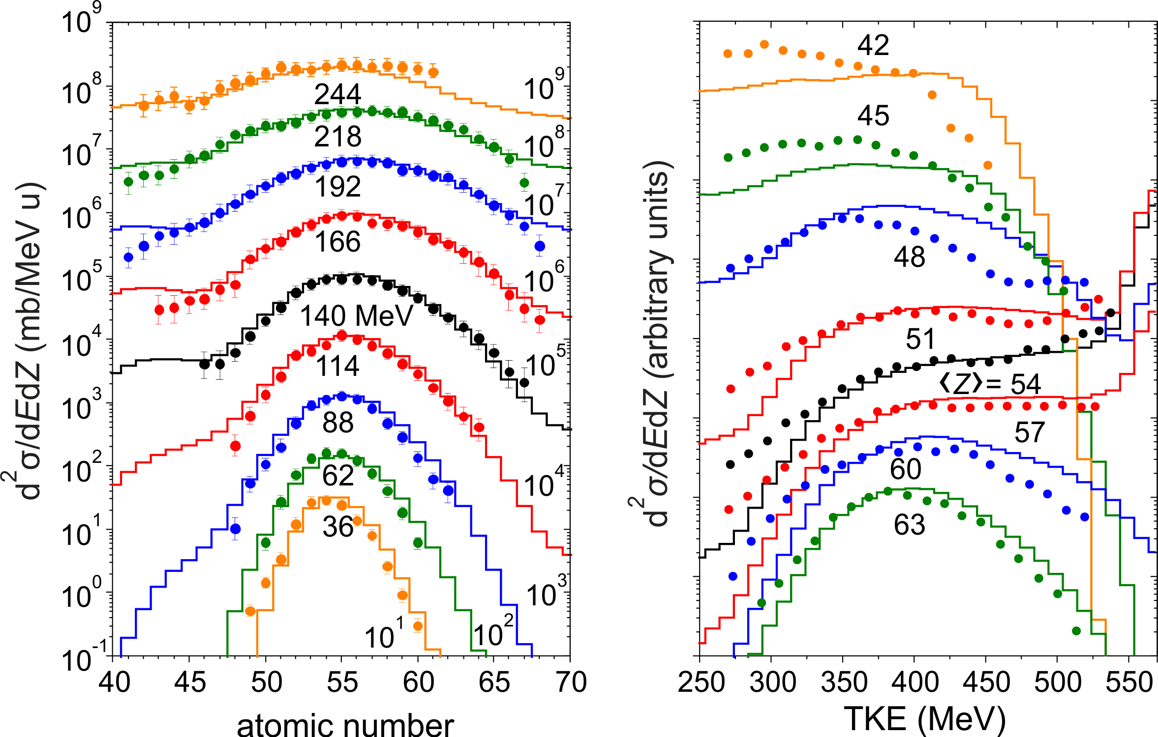
¹³⁶Xe+²⁰⁹Bi @ 569 MeV
experiment: W. W. Wilcke, et al., PRC (1980)

Slide 11
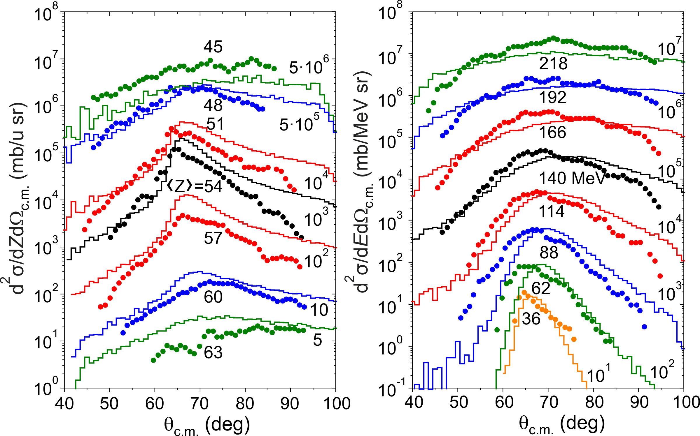
¹³⁶Xe+²⁰⁹Bi @ 569 MeV
experiment: W. W. Wilcke, et al., PRC (1980)

Slide 12
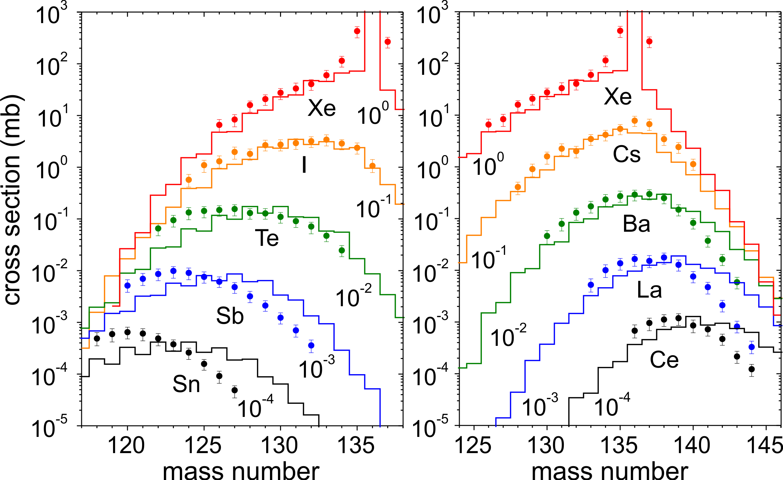
¹³⁶Xe+¹⁹⁸Pt @ 643 MeV
experiment: Y. X. Watanabe, et al., PRL (2015)

Slide 13
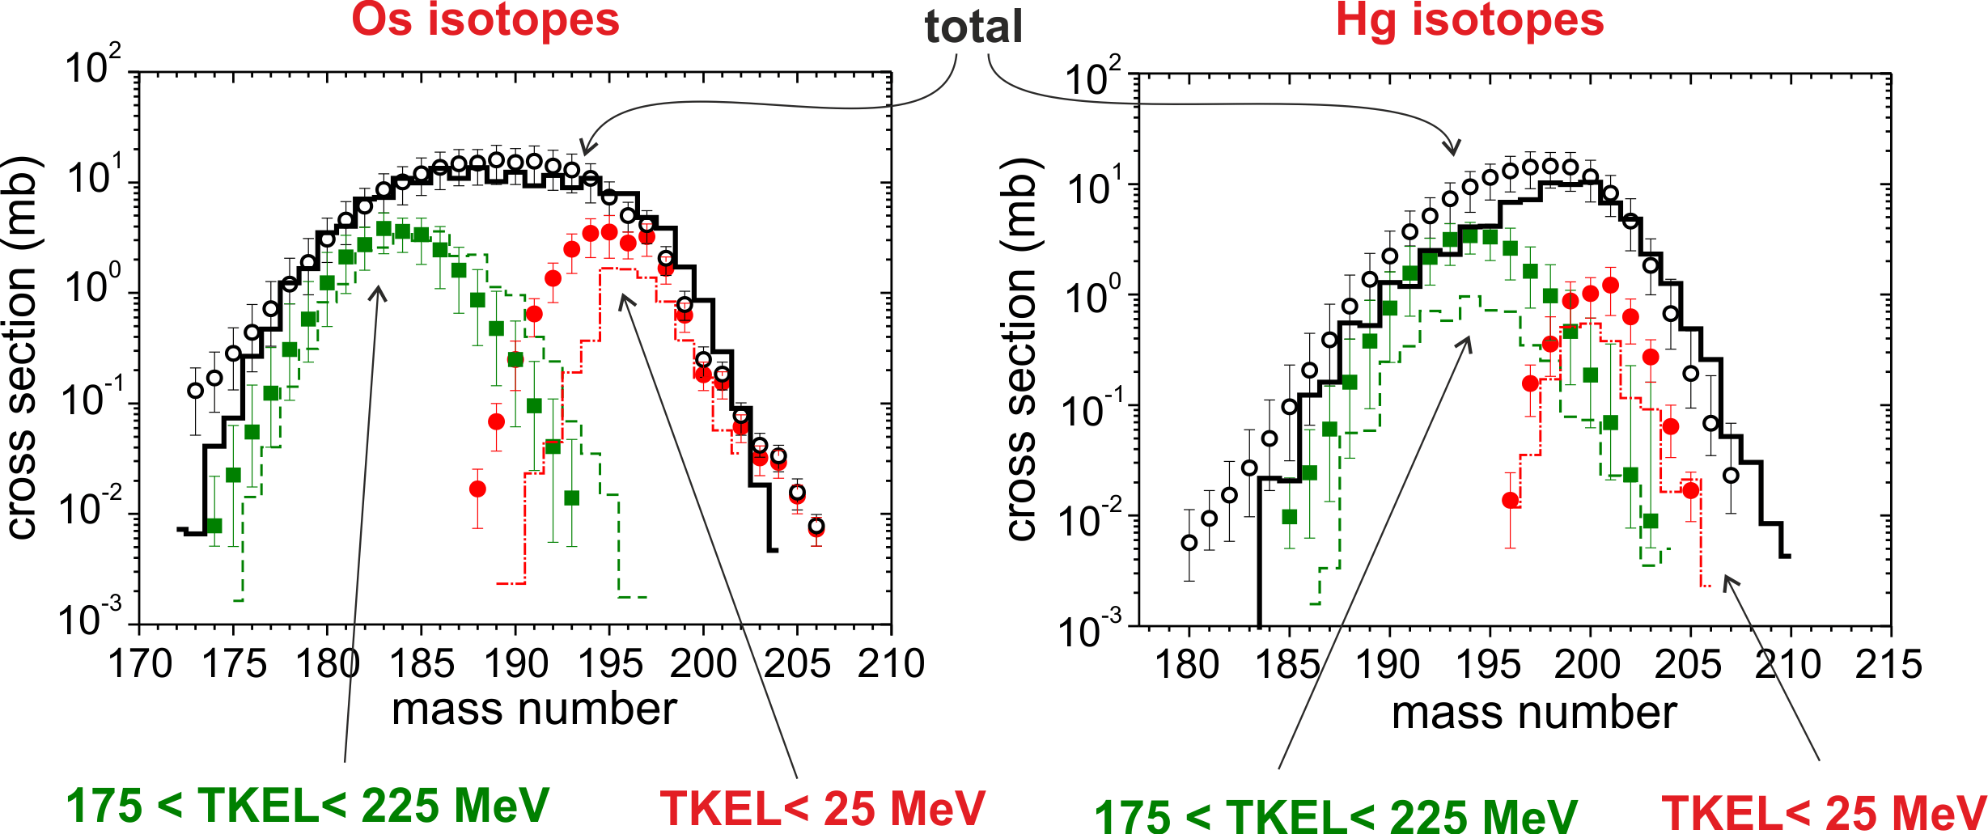
¹³⁶Xe+¹⁹⁸Pt @ 643 MeV
experiment: Y. X. Watanabe, et al., PRL (2015)

Slide 14
Production of neutron-rich Os-isotopes
10²
10¹
N=126
10⁰
last stable
¹³⁶Xe + ¹⁹⁸Pt
massive transfer
10⁻¹
last studied
10⁻²
Cross section, mb
10⁻³
last known
fragmentation of ²⁰⁸Pb
10⁻⁴
T. Kurtukian-Nieto et.al (2014)
10⁷
10⁻⁵
10⁻⁶
10⁻⁷
fragmentation of ²³⁸U
10⁻⁸
J. Kurcewicz et al.,(2012)
10⁻⁹
185
190
195
200
205
210
Mass number

Slide 15
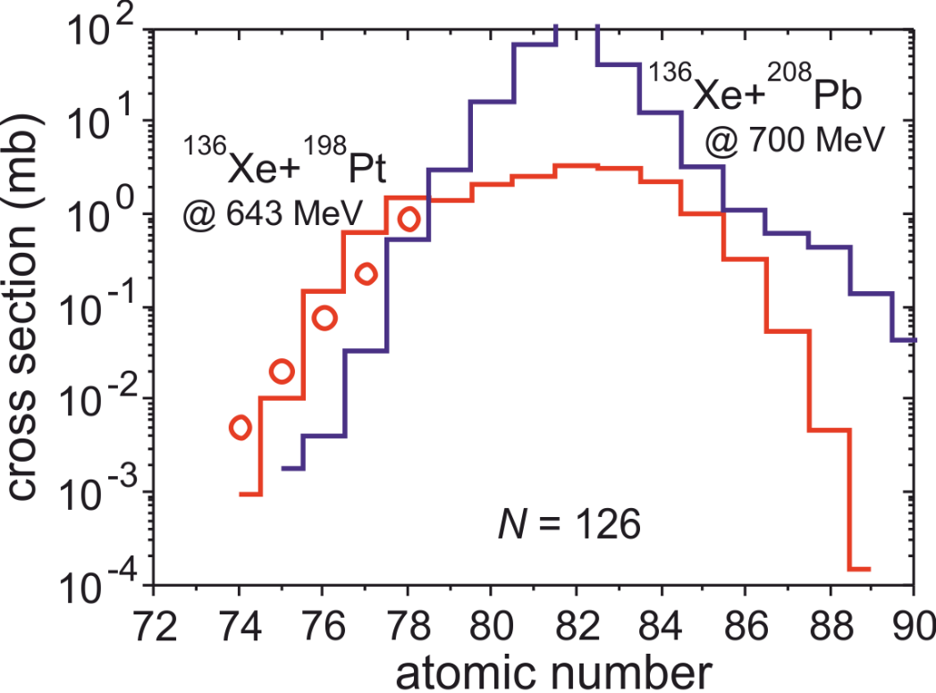
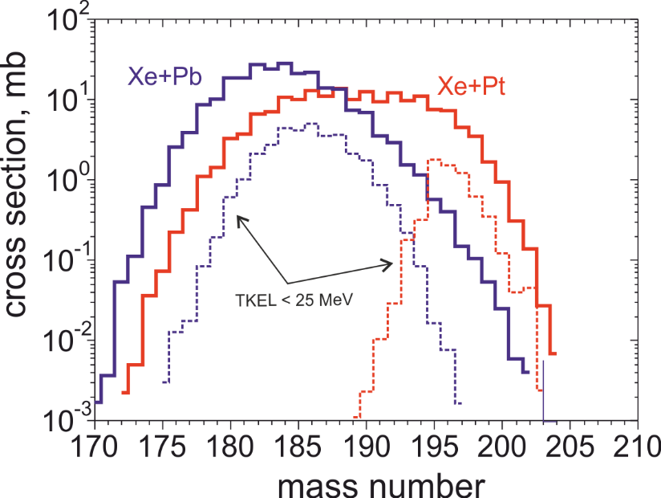
Production of N=126 nuclides
Optimal reaction
Os isotopes
experiment: Y. X. Watanabe, et al., PRL (2015)

Slide 16
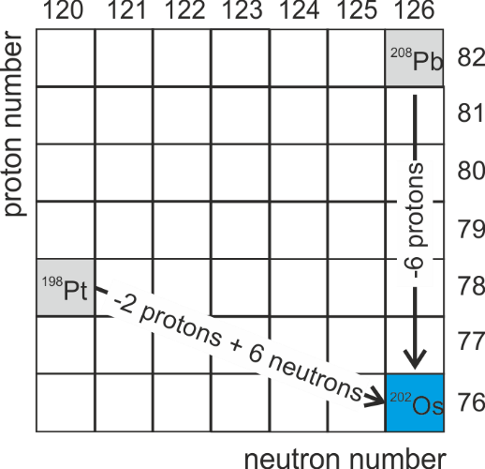
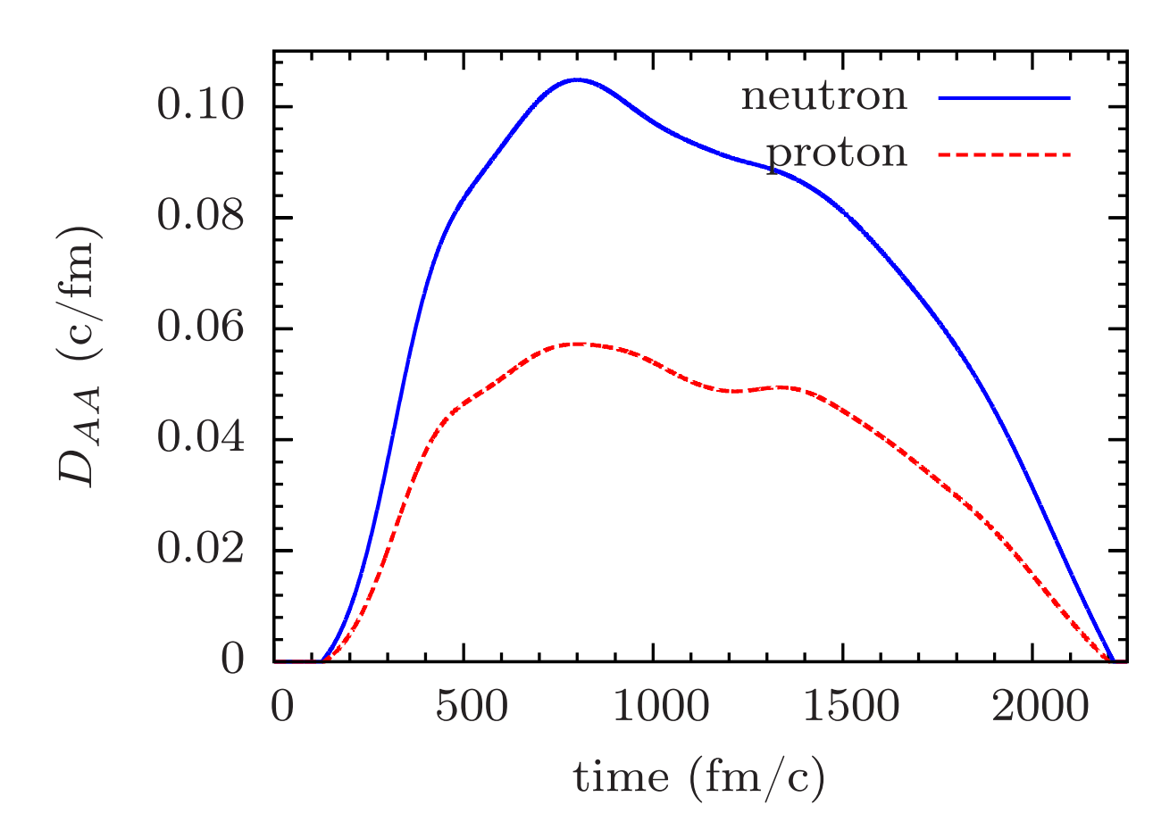
Production of N=126 nuclides
Optimal reaction
⁴⁸Ca+²³⁸U
¹³⁶Xe+²⁰⁸Pb: Q_{202Os}=-9.1 MeV
¹³⁶Xe+¹⁹⁸Pt: Q_{202Os}=-14.8 MeV
S. Ayik, B. Yilmaz, O. Yilmaz, A. S. Umar,
arXiv (2018)

Slide 17
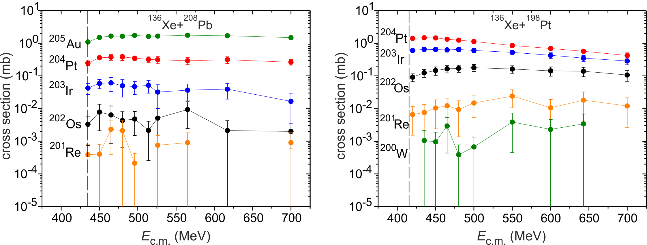
Production of N=126 nuclides
Optimal energy

Slide 18
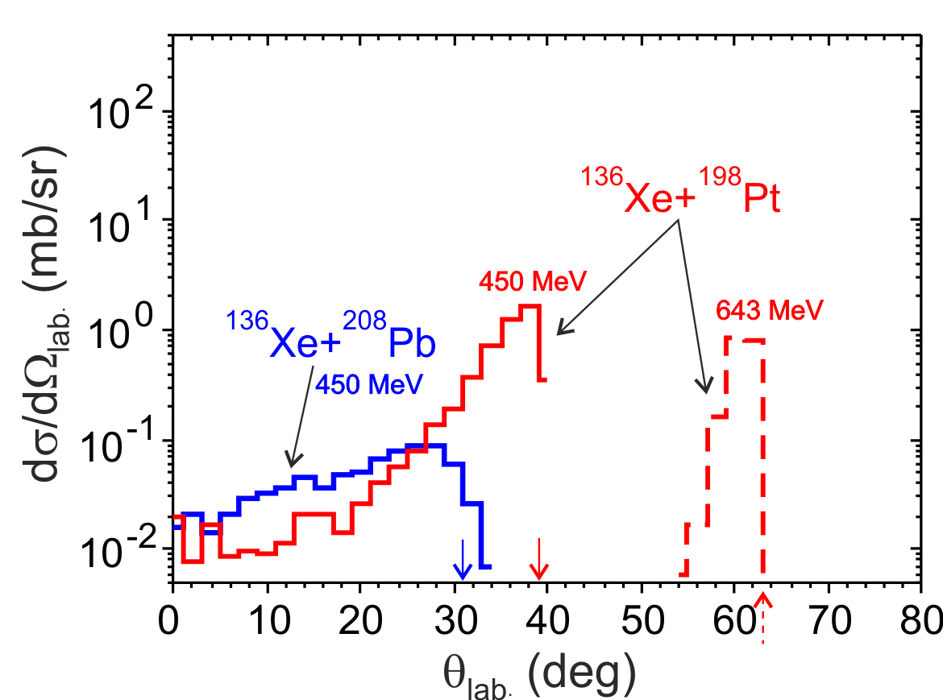
Production of N=126 nuclides
Detection angles

Slide 19
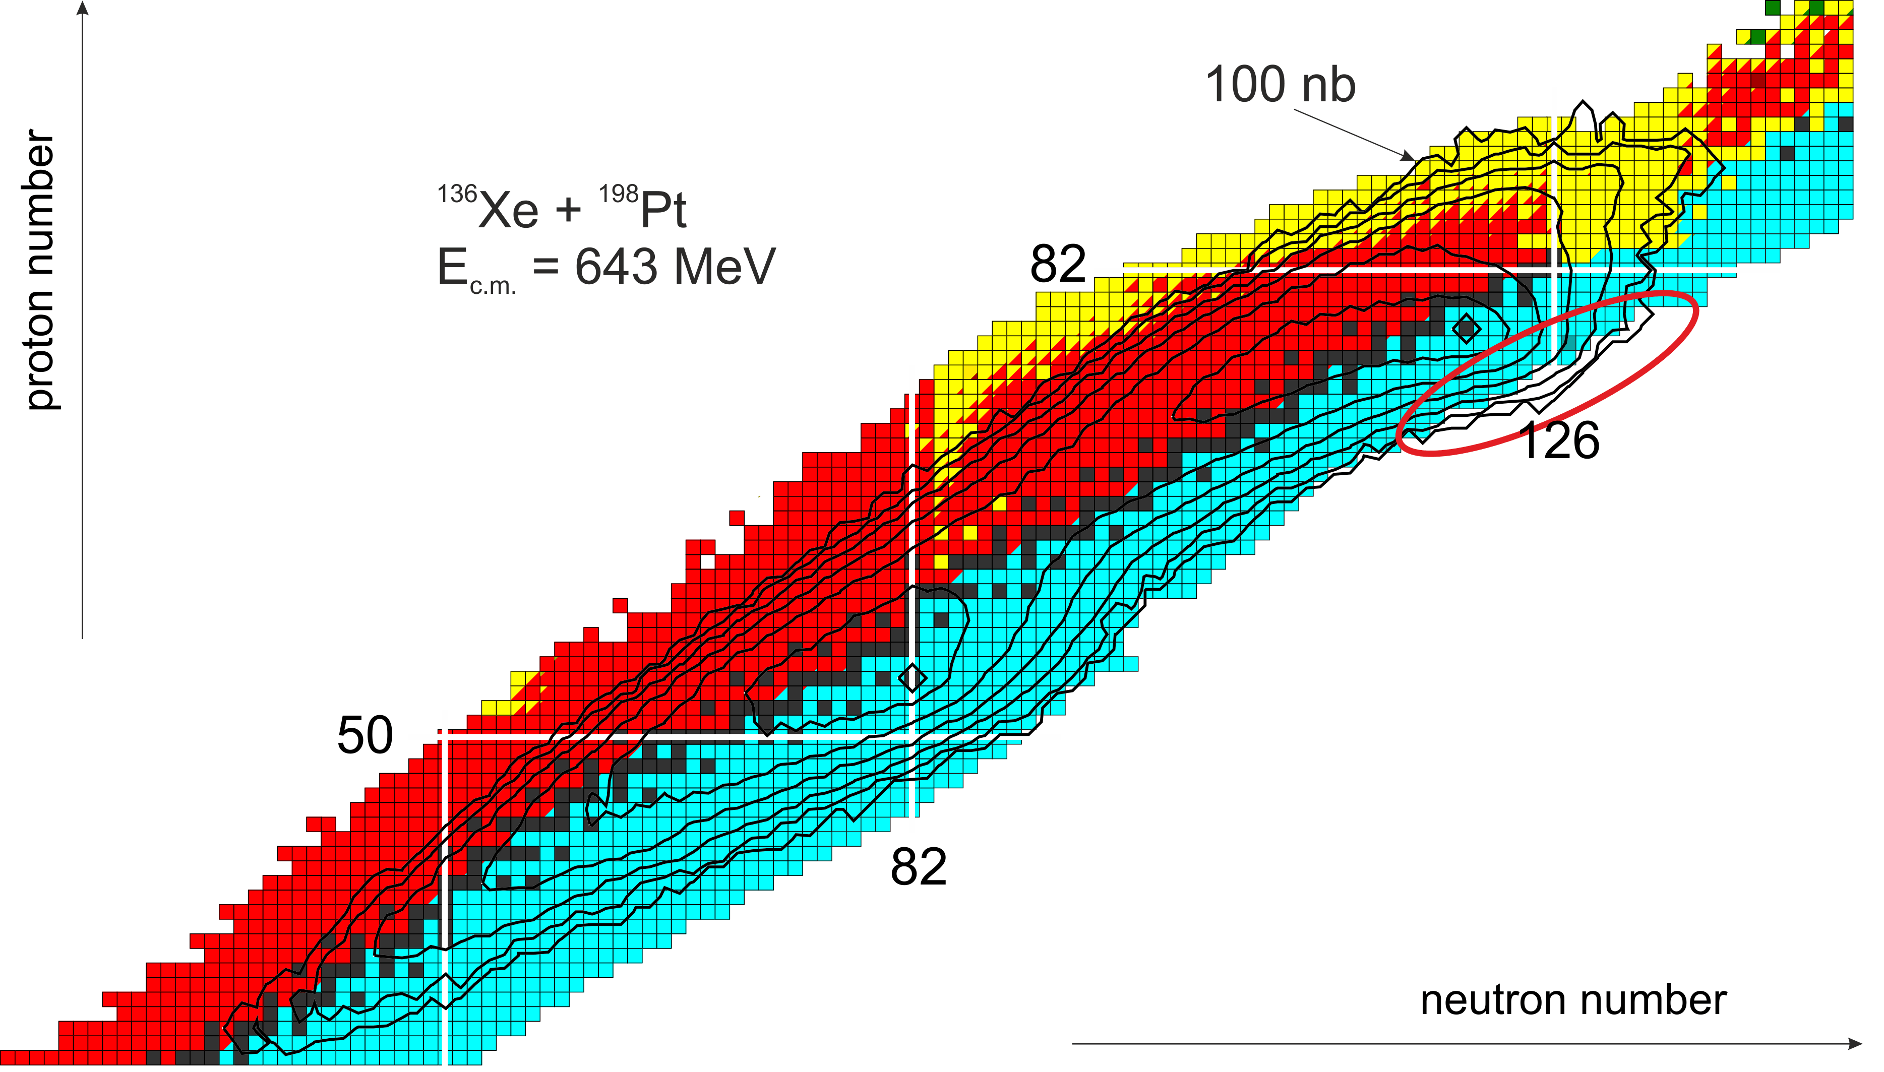
Production cross section

Slide 20
Production of neutron-rich heavy and SH nuclei in actinide-actinide collisions (U+smth.)
e.g. U+Cm→Pb*+Sg*
Strong shell effects may lead to increased cross sections for formation of a Pb-like fragment as one of the reaction products and a heavy or SH fragment as another one

Slide 21
spherical nuclei at g.s.
Orientation effects in nucleus-nucleus collisions
statically deformed nuclei

Slide 22
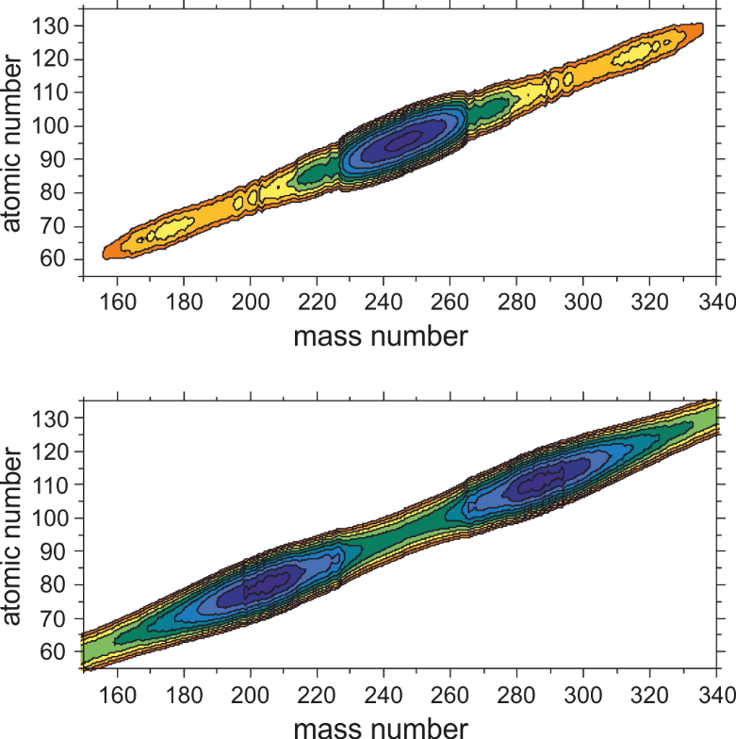
Collisions of actinides. Potential energy @ contact point: ²³⁸U+²⁵⁴Es case
²⁵⁴Es
²³⁸U
²⁰⁸Pb
A₁
A₂
²⁸⁶Mt
A₁
A₂

Slide 23
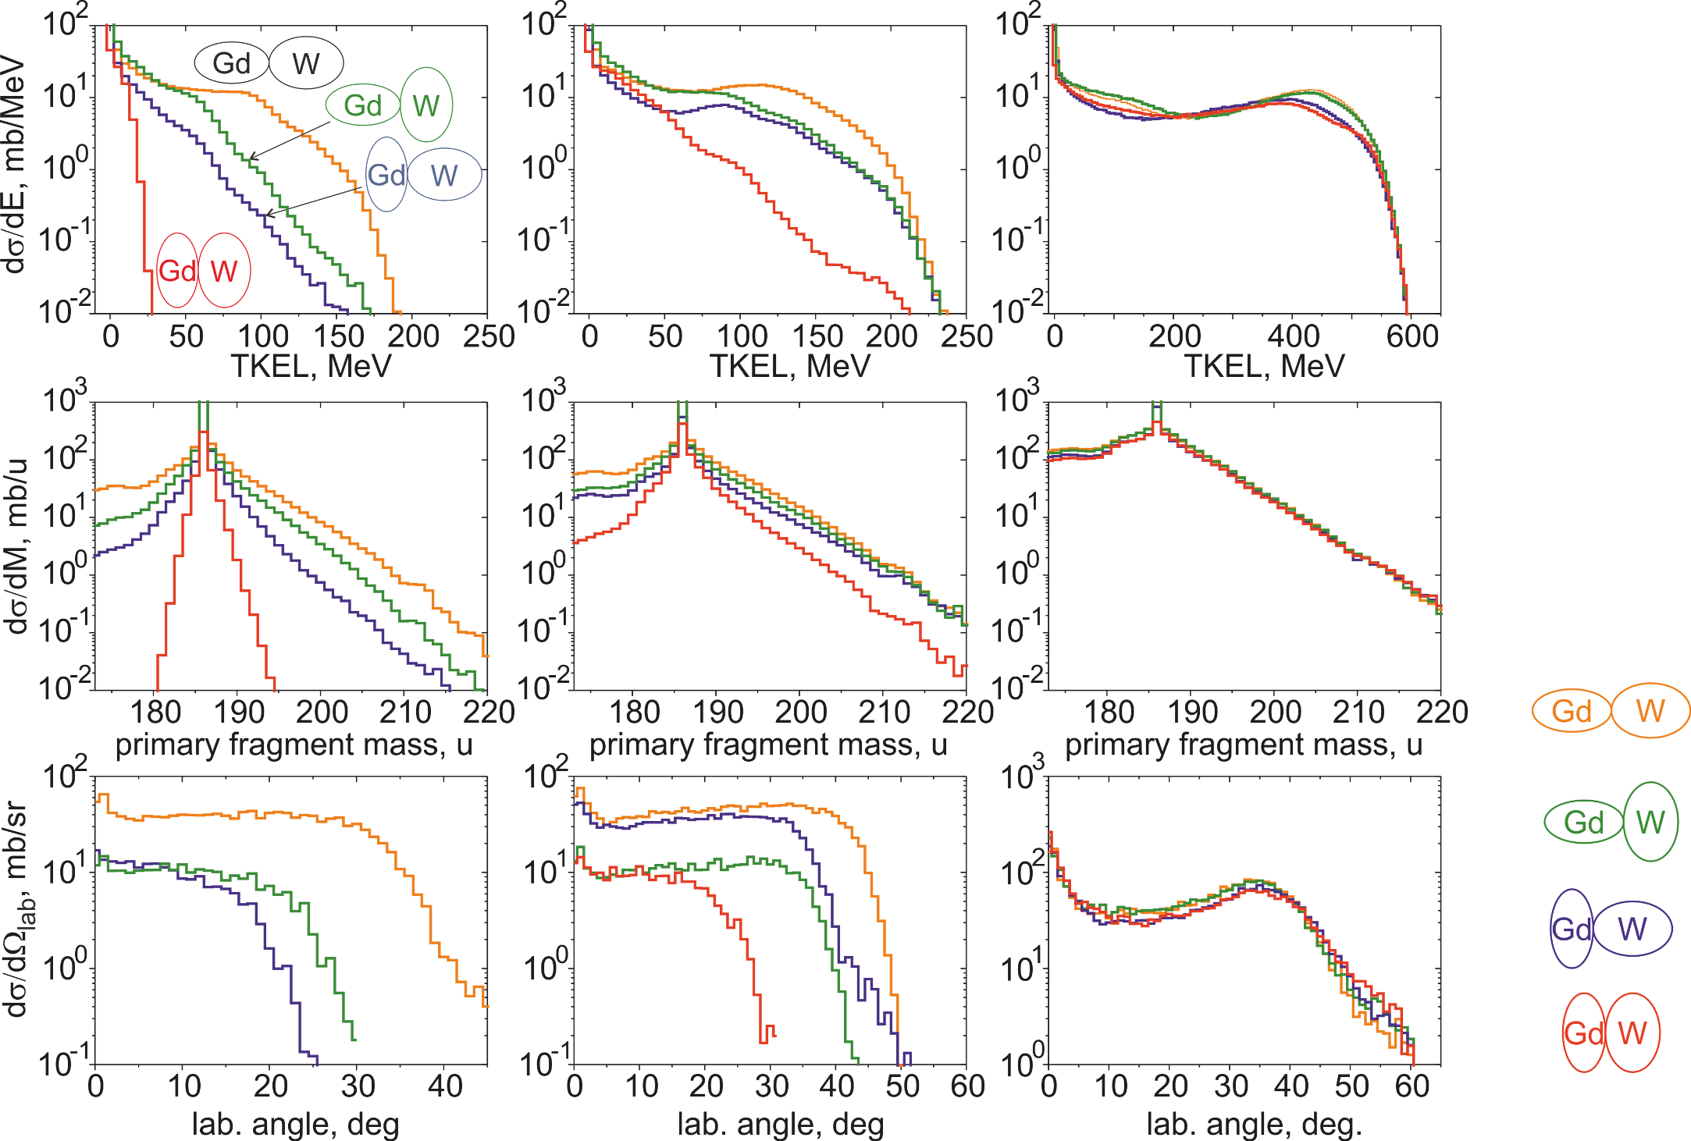
¹⁶⁰Gd + ¹⁸⁶W (β₂=0.22) (β₂=0.28)
Orientation effects in nucleus-nucleus collisions
462 MeV
502 MeV
860 MeV
412 MeV
447 MeV
454 MeV
492 MeV
exp
exp
A>200
A>200
A>200

Slide 24
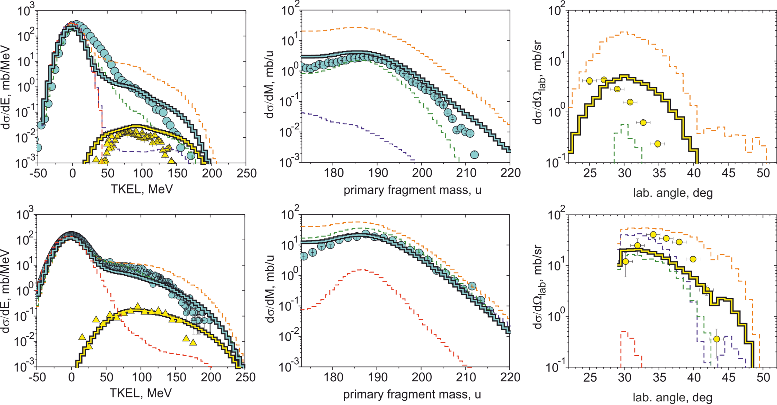
¹⁶⁰Gd + ¹⁸⁶W
Orientation effects
exp: E.M. Kozulin, et al., PRC (2017)
E_{c.m.}=462 MeV
A>200
A>200
E_{c.m.}=502 MeV
A>200
A>200

Slide 25
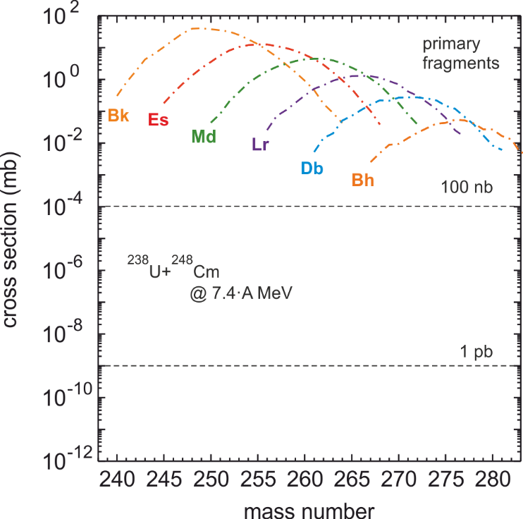
Collisions of actinides. A way to superheavies?
large production cross sections for primary reaction products
²⁹⁸114* (double magic) can be produced with the cross section ~10-100 nb

Slide 26
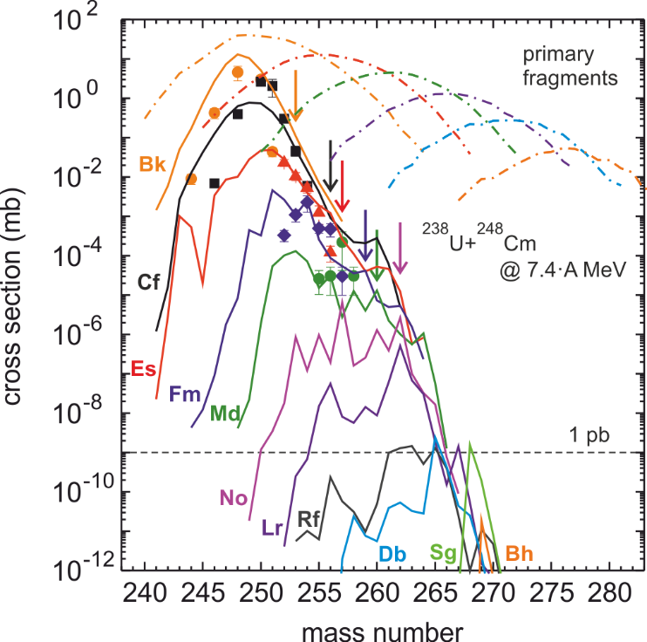
Collisions of actinides. Comparison with existing data: U+Cm
cross sections for Z>103 are below 1 pb
but…
new isotopes of elements with Z<103 can be produced with sufficiently large cross sections
exp: M. Schädel et al., PRL (1982)

Slide 27
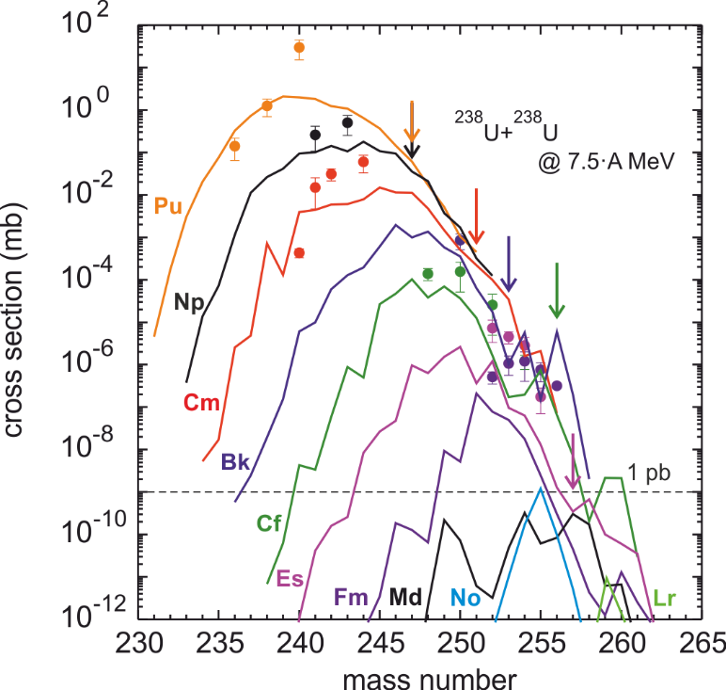
Collisions of actinides. Comparison with existing data: U+U
exp: M. Schädel et al., PRL (1978)
cross sections for heavy products are lower than in the U+Cm case
no significant influence of shell effects (parabola-like shapes)
one should use the heaviest available target (²⁵⁴Es)

Slide 28
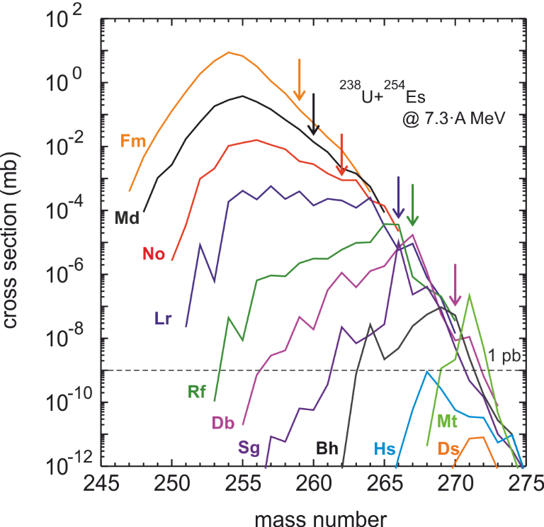
Collisions of actinides: U+Es
SH nuclei up to isotopes of Mt can be produced with cross sections larger than 1pb
pronounced influence of shell effects on the production cross sections

Slide 29
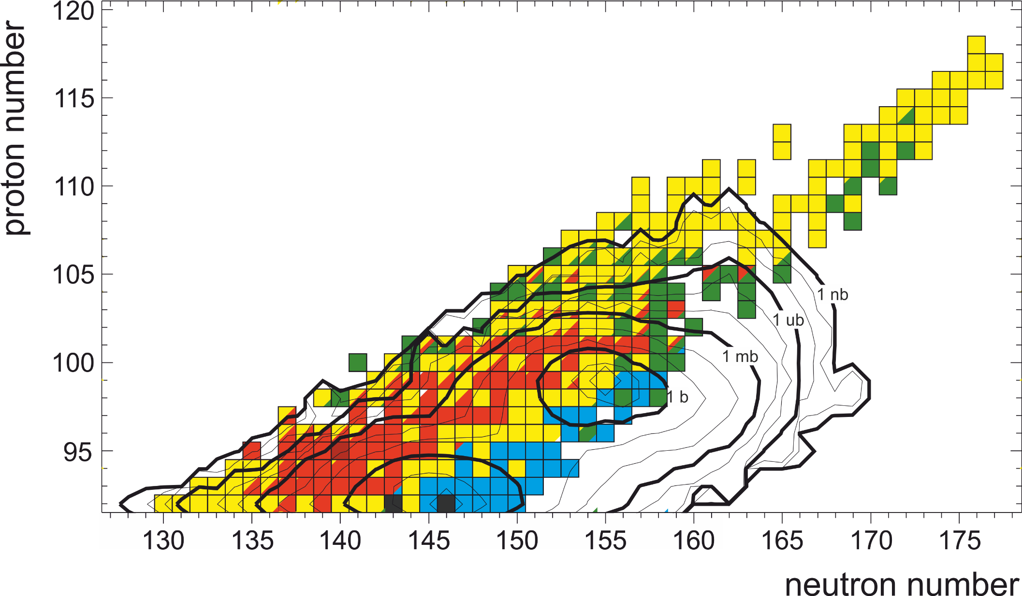
Collisions of actinides: U+Es
²³⁸U+²⁵⁴Es @ 7.3 A∙MeV

Slide 30
Conclusions and Outlook
Co-author: Vyacheslav Saiko
PRODUCTION OF NEUTRON-RICH HEAVY NUCLEI (N=126)
Large cross sections (>100 nb) for yet-unknown nuclei. Weak energy dependence of the production cross sections of neutron-rich nuclei, but strong sensitivity of the angular distributions to the collision energy. (collisions of spherical nuclei)
ORIENTATION EFFECTS IN NUCLEUS-NUCLEUS COLLISIONS
Strong influence on the production cross sections as well as on the angular and energy distributions.
PRODUCTION OF SH NUCLEI IN COLLISIONS OF ACTINIDES
Production cross sections drop down very quickly with increasing nucleon transfer due to small survival probabilities. One should use the heaviest available target (²⁵⁴Es) to increase the production cross section of heaviest nuclei. Strong shell effects may give a real chance to produce new isotopes of heavy actinides.
In spite of a long history of studies of heavy-ion nucleus-nucleus collisions, systematic high-quality experiments are of great demand.
A.V. Karpov and V.V. Saiko, Phys. Rev. C 96, 024618 (2017)

