Slide 1
Impact of Quasifission on SHE Production
M. G. Itkis
Joint Institute for Nuclear Research, Dubna, Russia
Sportaneous and induced fission of very heavy and super-heavy nuclei
April 9-13, 2018, Trento, Italy

Slide 2
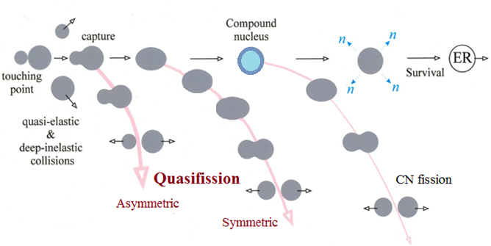
Reaction channels in the collisions of heavy ions
Notes:
at energies around the Coulomb barrier the complete fusion of two massive nuclei is suppressed by competing binary process, the quasifission (QF), in which the composite system separates in two main fragments without forming a CN.
QF happens to be the most important mechanism that prevents the formation of SHE in the fusion of heavy nuclei.

Slide 3
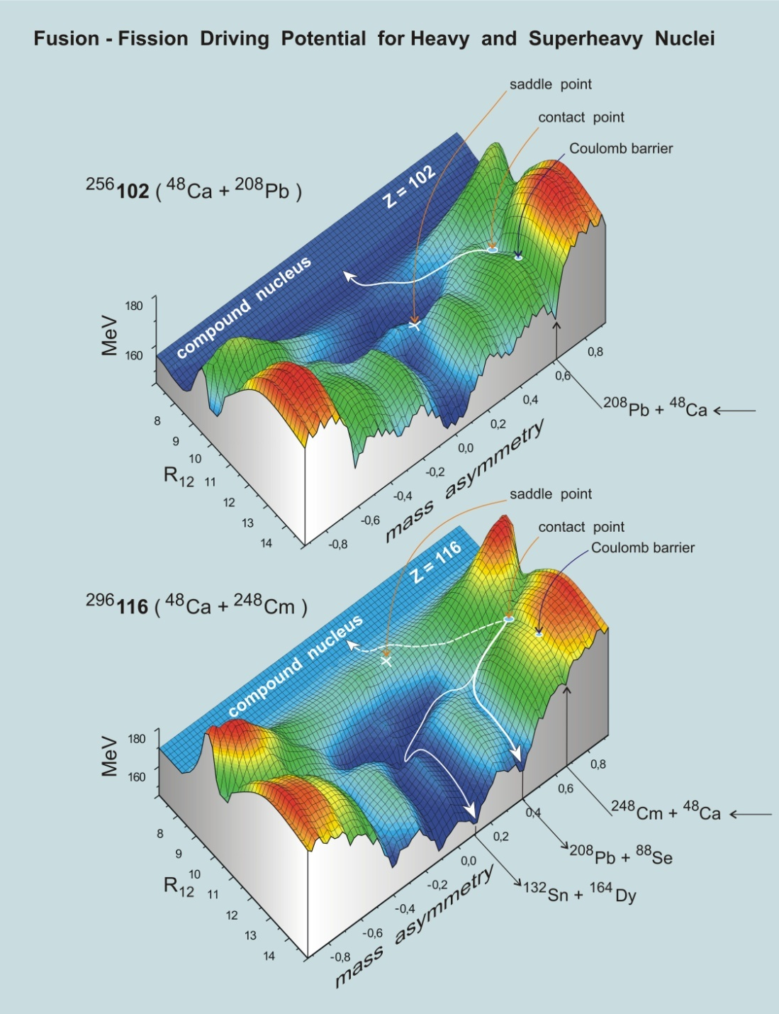
Calculated by
V.A. Zagrebaev

Slide 4
Reactions with ⁴⁸Ca
E*≈ 33 MeV
The sharp change of the MED triangular shape for the reaction ⁴⁸Ca + ²⁰⁸Pb, where Fusion-Fission process dominates, to the Quasifission shape of MED for the ²⁸⁶112-²⁹⁶116 nuclei.
The wide two-humped mass distribution with high peak of heavy fragment near double magic lead (M_{H}≈208) for the Quasifission process.
In spite of the dominating role of the Quasifission process for these reactions we assume that in the symmetric region of the fragment masses (A/2±20) FF process coexists with QF.
The Fusion-Fission mass distribution is asymmetric in shape with mass of the light fragment M_{L}≈132-134 amu (see on the framings)
Double-magic nucleus ⁴⁸Ca allows one to obtain the low excitation energy of compound nucleus (E* ≈ 30-36 MeV) at the Coulomb barrier
Neutron excess leads to N_{CN} = 170-180 in the reaction with actinide targets in differ from cold fusion reaction, where N_{CN} ≈ 150-160
The heaviest element, which can be obtained with the reactions with ⁴⁸Ca-projectiles, is 118 nucleus.
Yield,%
Fragment mass (u)

Slide 5
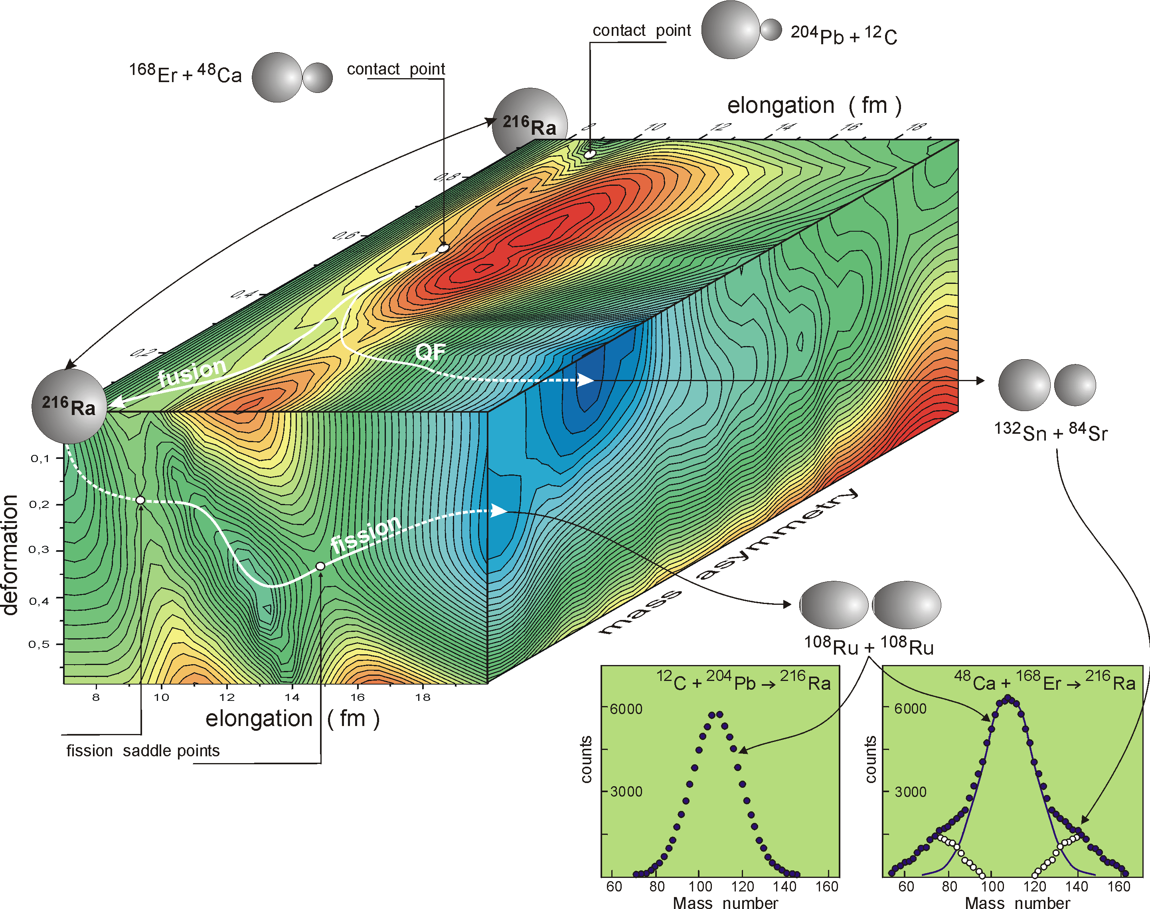
Entrance channel influence on fusion-fission dynamics of heavy nuclei
Potential energy surface as a function of mass-asymmetry of the entrance channels, elongation and deformation for ²¹⁶Ra
Two-dimensional TKE-Mass matrixes, Mass yields, ⟨TKE⟩(M), σ²_{TKE} (M) for ²¹⁶Ra, produced in the reactions with ¹²C and ⁴⁸Ca ions

Slide 6
Entrance channel influence on fusion-fission dynamics of heavy nuclei
Z_{t} Z_{p} 980 1472 2132 2660

Slide 7
⁸⁸Sr + ¹⁷⁶Yb : shell effects in damped collisions

Slide 8
Influence of entrance-channel magicity on fusion-fission and quasifission
Spherical target
Deformed target
Z₁Z₂=1240
Z₁Z₂=1240
QF
N_{m}=3
N_{m}=2
Z₁Z₂=1840
Z₁Z₂=1640
N_{m}=4

Slide 9
Mass and Energy distributions in the Ca-induced reactions

Slide 10
Cold fusion reactions
Hot fusion reactions
Notes:
Cold and hot fusion reactions are characterized by a strongly different entrance channel. Cold fusion reactions involve ²⁰⁸Pb or ²⁰⁸Bi target nuclei and ER with an excitation energy of about 10-15 MeV which leads to a high survival against fission. Hot fusion reactions involve actinide target nuclei and lead to ER with excitation energy between 30 and 60 MeV, which results in higher neutron evaporation and lower survival against fission.
It is readily seen that in the transition from ⁵⁰Ti to ⁸⁶Kr the shape of mass-energy distributions of binary reaction fragments changes strongly due to the QF and deep-inelastic processes. For the ⁵⁰Ti ion the contribution of symmetric fragments into the capture cross-section is around 60%; in the case of ⁸⁶Kr QF and deep-inelastic scattering are dominant processes.
For the heaviest system ¹³⁶Xe + ²⁰⁸Pb the main process is deep-inelastic scattering
For the hot reactions induced by ⁴⁸Ca ions the mass-energy distributions are similar for all the reactions: a pronounced asymmetric QF with heavy fragments near the double magic lead is observed.
The red rectangles show the regions of masses and TKE’s where the main part of CN-ﬁssion fragments is expected.
The comparison between the two sets of mass-TKE matrices shows convincingly that hot fusion reactions are more suitable for producing SHE.

Slide 11
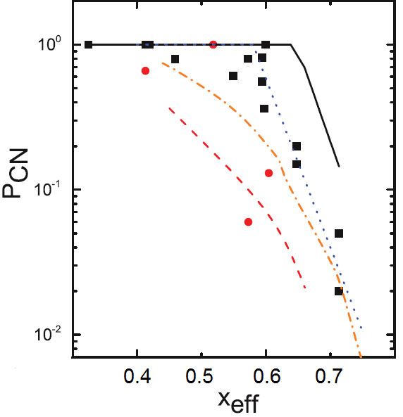
Fusion Probability
σ_{ER} = σ_{capture} × P_{CN} × W_{survival}
σ_{capture} = σ_{QF} + σ_{CNF} + σ_{ER}
Strongly vary
from each other!
The experimental measurements of fusion probability show the general dependence of P_{CN} upon fissility.
Mass-energy distributions of binary fragments formed in the reactions ⁴⁸Ti+²³⁸U, ⁵²Cr+²³²Th, ^{84,86}Kr+¹⁹⁸Pt leading to the formation of composite systems with Z=114 at energies near the Coulomb barrier have been studied to estimate the decrease rate of fusion probability at the transition from the reactions with ⁴⁸Ca to Ti and Cr ions.
Theory
Experiment
R. Yanez et al.,
Phys. Rev. C 88, 014606 (2013)
Notes:
Formally the cross section for producing a heavy evaporation residue, σ_{ER}, in a fusion reaction can be written as
σ_{ER} = σ_{capture} × P_{CN} × W_{survival} where
σ_{capture} is the capture cross section,
P_{CN} is the probability that after overcame the Coulomb barrier the interacting nuclear system reaches a compact CN configuration
W_{survival} is the probability that CN survives against fission (CN fission)
Experimentally, the capture cross section is defined as the sum of the QF, CN-fission and ER cross sections.
The main uncertainty in the determination of σ_{ER} gives the value of the fusion probability P_{CN}.
Not only is the numerical value of PCN uncertain, but the dependence of PCN on excitation energy and the reaction entrance channel is not well established
The experimental measurements of fusion probability show the general dependence of P_{CN} upon fissility.
But they strongly vary from each other as well as the predictions of different theoretical models applied to describe the whole evolution of low-energy nucleus-nucleus collisions at strong channel coupling of deep-inelastic scattering, CN formation, and QF
It is important to determine P_{CN} experimentally to improve the understanding of reaction mechanisms taking place in the reactions with heavy ions.
To define P_{CN} experimentally the information about relative contributions of QF, CN fission and ER components into the capture cross sections is needed.
In the case of reactions leading to the formation of SHE the ER cross section is negligibly small compared to CN-fission and QF processes.
Since CN fission and QF are both binary decay channels characterized by large nucleon exchange and energy dissipation,
it is difficult to make the experimental separation between QF and CN fission.
Three criteria are widely used to identify the reaction mechanism (fusion-fission or quasifission).
1. The reaction Coulomb factor Z₁Z₂ (charge product of reaction partners). This parameter relates to the Coulomb energy in the entrance channel. According to the calculations in the frame of macroscopic-microscopic model of Swiatecki the threshold value of Z₁Z₂ for the appearance of QF is 1600.
2. Entrance channel mass asymmetry α₀ = (A_{projectile} - A_{target})/(A_{projectile} + A_{target}). Unexpected fusion suppression observed in quite asymmetric combinations of colliding nuclei can be qualitatively explained in the framework of the liquid drop Businaro-Gallone picture, i.e., by an effect of the conditional barrier arising along the mass asymmetry coordinate on a path to the formation of a spherical CN. The fusion probability P_{CN}, as a measure of the fusion suppression effect, correlates with the entrance-channel mass asymmetry. According to this criterion QF appears for systems with entrance channel mass asymmetry lower than the Businaro-Gallone mass asymmetry
3. Effective fissility parameter x_{eff} connected with repulsive and attractive forces in the entrance channel
Recently, mean fissility parameter was proposed x_{m}=0.75 x_{eff} + 0.25 x_{CN}
From the analysis of a large data set of mass-angle distributions of fission-like fragments obtained in the reaction with heavy ions it has been found that the QF takes place for reactions with x_{m} > 0.68 and becomes dominant at x_{m} > 0.765.
These criteria, however, are not universal. For instance, they do not take into account the shapes of the interacting nuclei. The relative orientation of deformed nuclei changes the Coulomb barrier and the distance between the centres of the colliding nuclei and this leads to a change in the balance between repulsive and attractive forces. When two interacting nuclei touch each other by their lateral surfaces (near-side collisions), a high formation probability of a spherical CN is expected, whereas in the elongated conﬁguration, when nuclei touch each other by their poles (near-tip collisions), a high QF probability is expected.
The interaction energy is also a very important parameter for QF. The relative contribution of QF process decreases when the interaction energy increases.

Slide 12
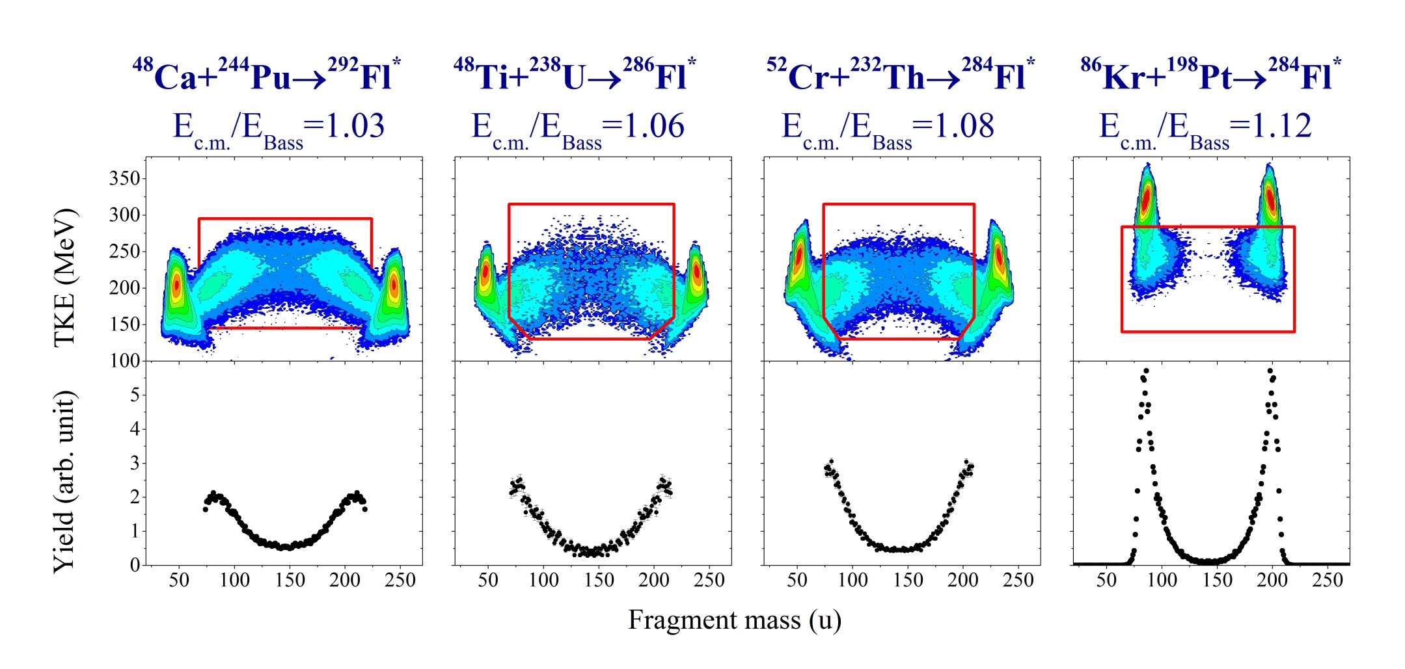
Mass and Energy distributions in the reactions leading to the formation of Z=114
QF+CNF
QF+CNF?
QF+CNF?
QF
QF increases
CNF decreases
Z_{t}Z_{p}=1880
X_{m}=0.721
Z_{t}Z_{p}=2024
X_{m}=0.776
Z_{t}Z_{p}=2160
X_{m}=0.806
Z_{t}Z_{p}=2808
X_{m}=0.917

Slide 13
Capture cross section
E_{c.m.}/E_{Bass}
1.1÷1.2
²³⁸U
β₂ = 0.286
Notes:
The capture cross section as a function of the effective fissility parameter for the reactions with ²⁰⁸Pb and ²³⁸U nuclei at interaction energies E_{c.m.}/E_{Bass} = 1.1-1.2.
the measured capture cross sections as a function of effective fissility parameter x_{eff} are shown together with the data obtained for the reactions with ²⁰⁸Pb [R. Bock et al., Nucl. Phys. A 388, 334 (1982)] and ²³⁸U [J. Toke et al., Nucl. Phys. A 440, 327 (1985)] beams.
For x_{eff} ≤ 0.75 capture cross sections virtually do not change. For the x_{eff} larger than 0.75 the capture cross sections decrease exponentially with increasing effective fissility parameter.
Apparently for such systems due to the large values of Z₁Z₂ leading to the strong Coulomb repulsion between the interacting nuclei the formation of dinuclear system is inhibited. In this case the main reaction channel is a few-nucleon transfer process.
For example, for ⁶⁴Ni + ²³⁸U reaction at an energy 13% above the barrier the capture cross section is 5.5 times lower than the total transfer cross section measured in [L. Corradi et al., Phys. Rev. C 59, 261 (1999)].
However, as followed from the trend in σ_{capture} behavior, the orientation effect increases the probability to form dinuclear system by several orders of magnitude for the reactions with large values of Z₁Z₂ that results in slower decrease of the capture cross section in the reactions with U nucleus as compared to the reactions with Pb.

Slide 14
Contribution of symmetric component into all fissionlike fragments

Slide 15
Contribution of symmetric component into all fissionlike fragments

Slide 16
CS of symmetric fragment formations
At energies above the barrier the CS for symmetric fragments formations decreases 2 times for the reaction ⁴⁸Ti+²³⁸U and 4 times for the ⁵²Cr+²³²Th compare with the ⁴⁸Ca+²³⁸U.
Note that a significant part of symmetric fragments may be connected with QF process. It is only upper limit for fission cross section!

Slide 17
Cross sections of symmetric fragment formations
For 4n channel (E*=40÷50MeV):
⁴⁸Ca+²³⁸U→⁴⁸Ca+²⁴⁴Pu
σ(A_{CN}/2±20) drops ∼2 times
⁴⁸Ca+²³⁸U→⁴⁸Ti+²³⁸U
σ(A_{CN}/2±20) drops ∼10 times
For 3n channel (E*=30÷40MeV):
⁴⁸Ca+²³⁸U→⁴⁸Ca+²⁴⁴Pu
σ(A_{CN}/2±20) drops ∼10 times
⁴⁸Ca+²³⁸U→⁴⁸Ti+²³⁸U
σ(A_{CN}/2±20) drops ∼100 times
4n
3n
For the studied reactions the excitation energies at the barrier energy vary strongly ( 36MeV for the Ca+Pu, 44MeV for the Ti+U and 41MeV for the Cr+Th). It leads to decreasing the CS for the Ti+U and Cr+Th for 3n ER channel.

Slide 18
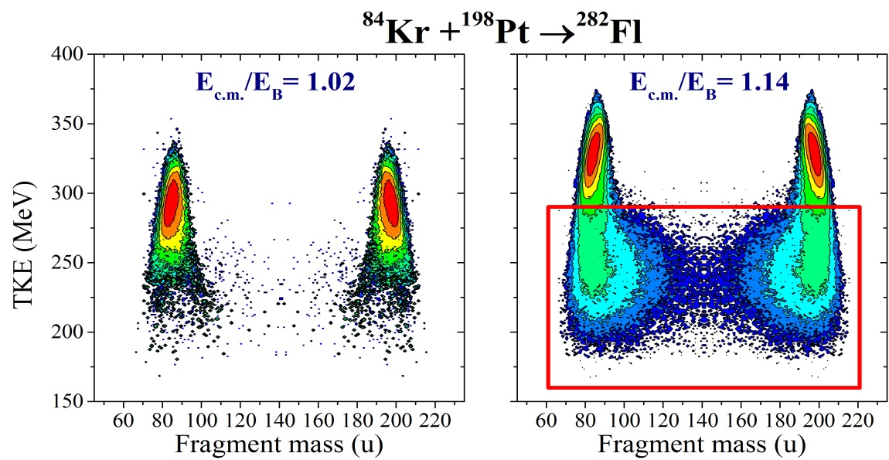
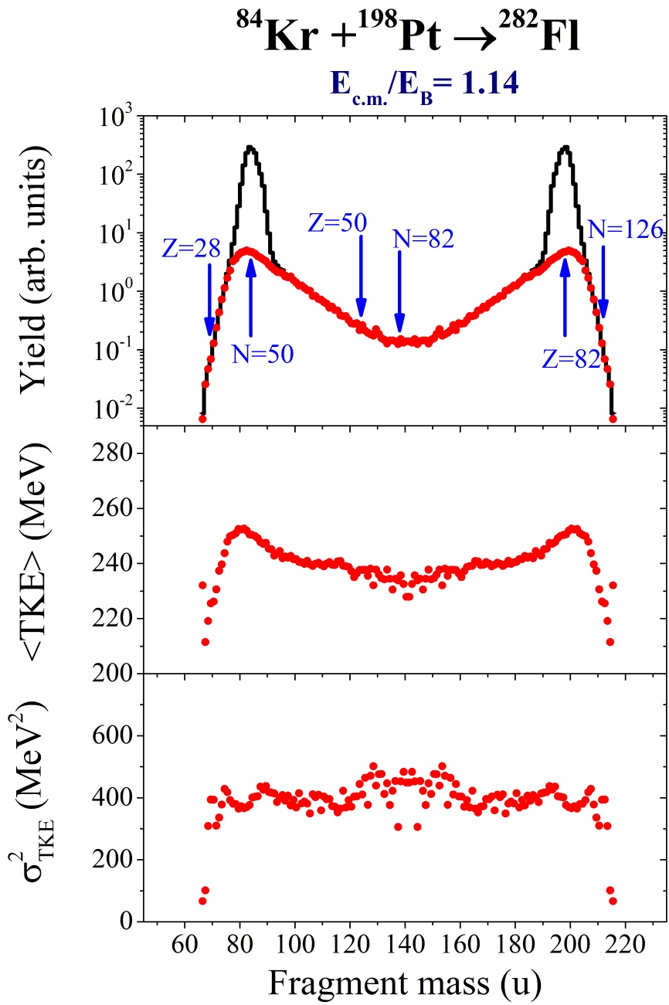
The reaction ⁸⁴Kr+¹⁹⁸Pt
The CN-formation cross section in this reaction is extremely small due to large Coulomb repulsion in the entrance channel (Z₁Z₂=2808). The contribution of symmetric fragments is about 3.6% at E/E_{B}=1.14. These fragments are formed in QF process. The average TKE and its dispersion virtually do not depend on the fragments mass. The dispersion of TKE is about 400 MeV². This value is lower than in the case of the T + U and Cr + Th.
TKE can be used as additional parameter (together with fragment mass) to estimate the contribution of CN-fission component in capture cross section.

Slide 19
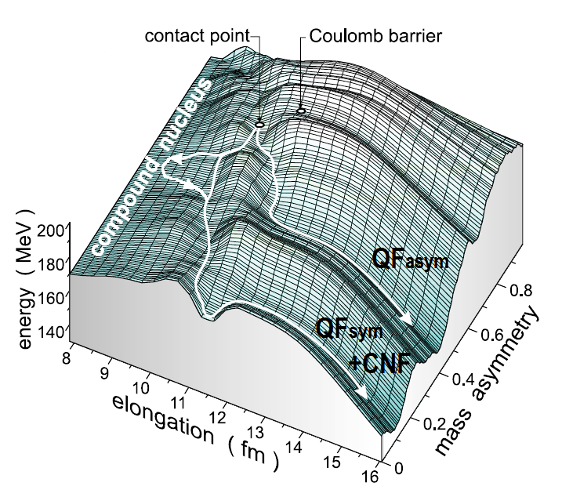
TKE distributions
CNF
QF_{asym}
QF_{sym}
A_{CN} /2±20 u
Notes:
It is clearly seen that the TKE distributions change markedly showing nearly Gaussian shape in the case of ³⁶S and ⁴⁸Ca ions and two-humped shape for the reactions with ⁴⁸Ti and ⁶⁴Ni.
One may speculate about the presence of other processes together with the CN fission in the symmetric mass region for ³⁶S, ⁴⁸Ca, ⁴⁸Ti, ⁶⁴Ni + ²³⁸U reactions.
We assume that the mass-symmetric fragments may be formed by three different modes: CN fission, symmetric QF (QFsym) and a tail of asymmetric QF process.
To evaluate the contribution of the CN-fission process in the symmetric mass region we decomposed the TKE distributions as a sum of three Gaussians. One of them is associated with the CN-fission process (filled region). We fix mean value and variance of this component to the values obtained from the systematics
The low energy component is attributed to QFasym while the high energy one is connected with QFsym.

Slide 20
TKE distributions
A_{CN} /2±20 u
According to this decomposition of TKE distribution for the reaction ⁵²Cr+²³²Th on QF_{sym} (assuming the same distribution as for the Kr+Pt), QF_{asym} and CNF (Viola systematics), the contribution of CNF is about 4% for fragments with mass A_{CN}/2±20u.
QF_{asym}
QF_{sym}
CNF
The upper limit for CNF for the reaction ⁵²Cr+²³²Th at energies 1.15E_{B} is only 0.4% from capture CS. The estimated CNF cross section for the reaction ⁴⁸Ca+²³⁸U is about 15% from capture cross section.
⁴⁸Ca+²³⁸U→ ⁵²Cr+²³²Th CNF CS drops more than 40 times!
Notes:
It is clearly seen that the TKE distributions change markedly showing nearly Gaussian shape in the case of ³⁶S and ⁴⁸Ca ions and two-humped shape for the reactions with ⁴⁸Ti and ⁶⁴Ni.
One may speculate about the presence of other processes together with the CN fission in the symmetric mass region for ³⁶S, ⁴⁸Ca, ⁴⁸Ti, ⁶⁴Ni + ²³⁸U reactions.
We assume that the mass-symmetric fragments may be formed by three different modes: CN fission, symmetric QF (QFsym) and a tail of asymmetric QF process.
To evaluate the contribution of the CN-fission process in the symmetric mass region we decomposed the TKE distributions as a sum of three Gaussians. One of them is associated with the CN-fission process (filled region). We fix mean value and variance of this component to the values obtained from the systematics
The low energy component is attributed to QFasym while the high energy one is connected with QFsym.

Slide 21
Fusion Probability in Cold and Hot fusion reactions
Notes:
Fusion probability in cold (spherical target nuclei) and hot fusion (strongly deformed target nuclei) reactions at energies above the Coulomb barrier in dependence on the mean fissility parameter of the reaction, deduced from the present analysis of mass-energy distributions, is shown.
The solid and dashed lines are the descriptions of P ⁰_{CN} for hot and cold fusion reactions with an equation proposed by Zagrebaev
The fusion probabilities decrease exponentially with increasing mean fissility parameter both for cold and hot fusion reactions but with different rate.
In the interactions of deformed nuclei the orientation effect plays an important role in the evolution of dinuclear system.
Such different behavior of the P ⁰_{CN} dependence on mean fissility parameter for the reactions with spherical and strongly deformed target nuclei may be explained by the orientation effect.
In the case of spherical target nuclei the fusion probability is higher up to the values of mean fissility parameter x_{m} ≈ 0.8, for the larger values of x_{m} the fusion probability sharply decreases as compared to the reactions with strongly deformed target nuclei.
In the reactions with strongly deformed nuclei, QF starts to suppress CN formation at the lower values of x_{m} (~0.7) as compared to the reactions with spherical targets due to the contribution of near-tip collisions, while for x_{m} > 0.8 the near-side collisions give a gain in fusion probabilities even at large values of Z₁Z₂.
Notice that the fusion probabilities obtained from the analysis of mass-energy distributions of fissionlike fragments refer only to the upper limit
In estimating the fusion probability it is important to take into account the ang distr. But there is no model for QF and no detailed exp data

Slide 22
Mass and Energy distributions in the reactions with U target
200 u
208 u
210 u
215 u
Notes:
the mass and energy distributions of binary fragments at energies near the Coulomb barrier
The reaction products having masses close to those of projectile and target are identified as quasielastic and deep-inelastic events in the total kinetic energy-mass (TKE, M) matrix, and we will not consider them. Reaction products lying between elastic peaks can be identified as totally relaxed events, i.e., as fission (or fissionlike) fragments. We have outlined them by solid lines in the panels. Henceforth we consider the properties of these events only.
At first sight the distributions for the reaction ⁴⁸Ti + ²³⁸U are similar to those for the reactions with ⁴⁸Ca ions: the wide two-humped shape with large QF component peaked around the mass 208-210 u. In the case of ³⁶S + ²³⁸U reaction the asymmetric QF (QFasym) peaks around masses 200 u, and for the ⁶⁴Ni + ²³⁸U shifts to the heavier mass 215 u.
Generally, in heavy-ion-induced reactions the formation of QFasym fragments is connected with the strong influence of the nuclear shell at Z = 82 and N = 126 (doubly magic lead)
the deviation the QF fragment masses from 208 u is due to the influence of the shells in light fragment Z = 28 and N = 50.

Slide 23
Mass distributions
Z_{t} Z_{p}
1472
³⁶S+²³⁸U
⁴⁸Ca+²³²Th,²³⁸U, ²⁴⁴Pu, ²⁴⁸Cm
27 u
1840
⁶⁴Ni+²³⁸U
38 u
25 u
2024
G.N. Knyazheva, I.M. Itkis, E.M.Kozulin
J. Phys. Conf. Series 515 (2014) 012009
12 u
2576
Driving potentials are calculated
Using NRV(nrv.jinr.ru)
Notes:
the mass distributions of fissionlike fragments for the ³⁶S, ⁴⁸Ca, ⁴⁸Ti, ⁶⁴Ni + ²³⁸U reactions at energies near and above the Coulomb barrier are shown together with The driving potentials calculated at contact configuration in the diabatic approximation using the proximity model with the help of Nuclear Reaction Vision project (NRV)
For the ³⁶S -ions-induced reaction the positions of minima of the driving potential agree with the positions of peaks in the experimental asymmetric QF mass distribution, while for the reactions with ⁴⁸Ti and ⁶⁴Ni the QFasym peak is shifted to the more asymmetric masses compare to the minimum of the driving potential.
It is clearly seen that in the case of the reactions with ³⁶S and ⁴⁸Ca ions the width of asymmetric QF peak increases with increasing interaction energy, while the mass distributions of fissionlike fragments formed in the reactions with ⁴⁸Ti and ⁶⁴Ni ions virtually do not change with the growing interaction energy.
Recently the time scale for QFasym process have been estimated [G.N. Knyazheva, I.M. Itkis, E.M.Kozulin, J. Phys. Conf. Series 515 (2014) 01] From the analysis of QF mass distributions for the systems ³⁶S, ⁴⁸Ca, ⁶⁴Ni + ²³⁸U it was found that the interaction time decreases exponentially with increasing Z₁Z₂ of the system
The shift of QFasym peak in mass distribution to more asymmetric masses as well as the narrowing of its’ width for the reactions with ⁴⁸Ti and ⁶⁴Ni ions as compared to the reactions with ³⁶S and ⁴⁸Ca ions may be explained by the shorter interaction time for the ⁴⁸Ti and ⁶⁴Ni ions induced reactions due to the larger Coulomb repulsion in the reaction entrance channel.

Slide 24
Symmetric fragments cross sections
A_{CN} /2±20 u
Notes:
As a first step to evaluate the CN-fission cross section the contribution of fragments with masses A_{CN}/2±20 u can be considered.
We may expect that the mass distributions of the CN-fission fragments can have the symmetric Gaussian shape with the standard deviation of about 20 u ( as Hs) as predicted by the liquid drop model, or asymmetric shape caused by the influence of the closed shells with Z = 50 and N = 82 as in the case of low energy fission of actinides But in both cases the width of CN-fission fragment mass distributions does not exceed 40 u and the choice of the mass range of A_{CN}/2±20 u is reasonable.
The relative contributions of the symmetric fragments with masses A_{CN}/2±20 u into the capture cross section (fragments inside the rectangles in the (TKE, M) distributions) for the reactions of ²³⁸U with ³⁶S, ⁴⁸Ca, ⁴⁸Ti and ⁶⁴Ni ions as a function of energy above the barrier are shown
For the reactions under study the barrier for tip collisions is about 0.94 of the Coulomb barrier value and for the side collisions is about 1.03
At energies below the barrier for the side collisions the contribution of symmetric fragments increases with increasing collision energy, while above the barrier the yield of symmetric fragments increases with increasing collision energy for the reactions with ³⁶S and ⁴⁸Ca, and does not change virtually for the reactions with ⁴⁸Ti and ⁶⁴Ni.

Slide 25
Fusion probability in the reactions with strongly deformed nuclei
P_{CN} ( E_{c.m.}) = P₀ / {1 + exp [ α ( β – E_{c.m.}/E_{Bass} ) ] }
Notes:
P_{CN} is defined as the probability for CN formation from the configuration of two nuclei in contact. As it was mentioned above, the cross section of the evaporation residues is approximately a few picobarns for these reactions.
Thus we deduced the fusion probability using the measured mass-energy distributions as the ratio between the number of events attributed to CN fission in the framework of the present analysis and all fissionlike fragments
The fusion probabilities obtained from the analysis of mass-energy distributions of fissionlike fragments for the reactions with strongly deformed target nuclei: ⁴⁸Ca + ¹⁵⁴Sm, ³⁶S + ²³⁸U, ⁴⁸Ca + ²³⁸U, ²⁴⁴Pu, ²⁴⁸Cm, and ⁴⁸Ti + ²³⁸U in dependence on the energy above the Bass barrier
The deduced values of P_{CN} in dependence on the interaction energy may be approximated by the simple formula proposed by Zagrebaev for fusion probability of cold fusion reactions
P₀, α and β are empirical constants
The differences between the estimated values of P_{CN} and the results of the fitting procedure are typically 2–5% and do not exceed 10%.

Slide 26
Capture and fission cross sections
Notes:
The absolute differential cross sections for all fissionlike events observed in the reactions ³⁶S, ⁴⁸Ca, ⁴⁸Ti, ⁶⁴Ni + ²³⁸U were measured at an angle θ_{c.m.} ≈ 90° at energies near the Coulomb barrier.
Capture cross sections σ_{capture} for all fissionlike events were estimated assuming that the angular distribution is proportional to sin⁻¹θ_{c.m.} This procedure seemed the most reasonable since detailed angular distributions are not available at present, as well as any model (theory) for the angular distribution of fragments produced in the QF process
The cross sections for the formation of symmetric fragments with masses A_{CN}/2±20 u as well as CN-fission cross section σ_{ff} deduced from the obtained fusion probabilities and capture cross sections are also presented (dashed-dotted lines)
The capture cross sections decrease at the transition from ³⁶S ions to ⁶⁴Ni.
At energies above the barrier the capture cross sections for the reactions ³⁶S + ²³⁸U and ⁴⁸Ca + ²³⁸U are close to the geometrical cross sections, while for the ⁴⁸Ti + ²³⁸U reaction it is about 60% of geometrical cross section and about 15% in the case of the ⁶⁴Ni ions.

Slide 27
Capture and upper limit for fusion-fission cross sections
⁴⁸Ca → ⁴⁸Ti
Factor ~7
Notes:
The CN-fission cross section decreases with increasing effective fissility parameter of the system more crucial than the capture cross section.
CN-fission cross section decreases by several orders of magnitude at the transition from ⁴⁸Ca to ⁶⁴Ni ions, and at energies above the barrier it decreases from tens of millibarns to hundreds of microbarns.
In the reaction ⁴⁸Ti + ²³⁸U → ²⁸⁶Fl* the CN-fission cross section is about 7 times lower
as compared to the reaction ⁴⁸Ca + ²⁴⁴Pu → ²⁹²Fl*

Slide 28
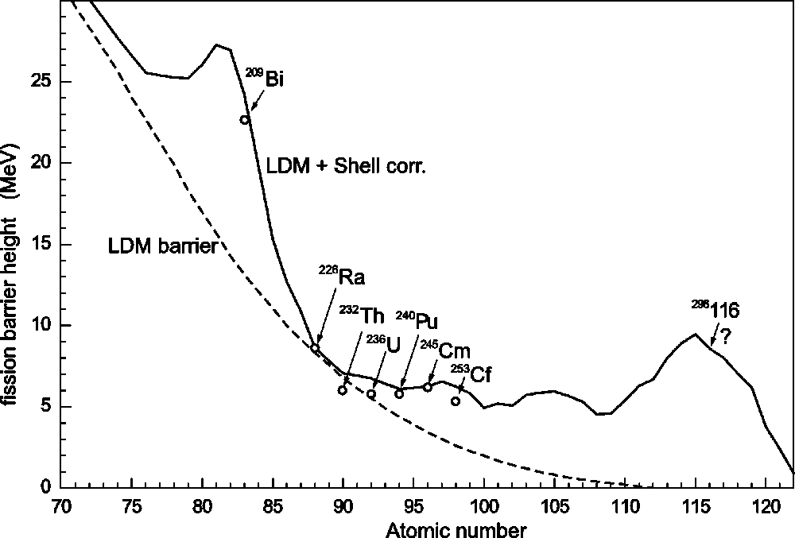
Fission barrier for heavy and superheavy nuclei

Slide 29
Fission barrier of superheavy nuclei
Theory
114 element | Barrier
P. Moller et al. | 8.6 MeV
A. Sobitczewski et al. | 5.3 MeV
A. Mamdouh et al. | 6.6 MeV
Frankfurt (RMF, NL-Z2) | 3.7 MeV
Frankfurt (SHF, Skl3) | 8.2 MeV
V. Zagrebaev | 6.4 MeV
Experiment
Nucleus | E* MeV | σ^{fus} mb | σ^{ER} pb | B^{fis} MeV
²⁸³⁻²⁸⁶112 | 33.0 | <5 | 3.4 | 5.5
²⁸⁸⁻²⁹²114 | 36.5 | <4 | 0.5 | 6.7
²⁹²⁻²⁹⁶116 | 34.8 | <2 | 0.5 | 6.4
The fission barriers of superheavy nuclei with Z=112-116 and N~180 are really quite high, which results in their relative high stability.

Slide 30
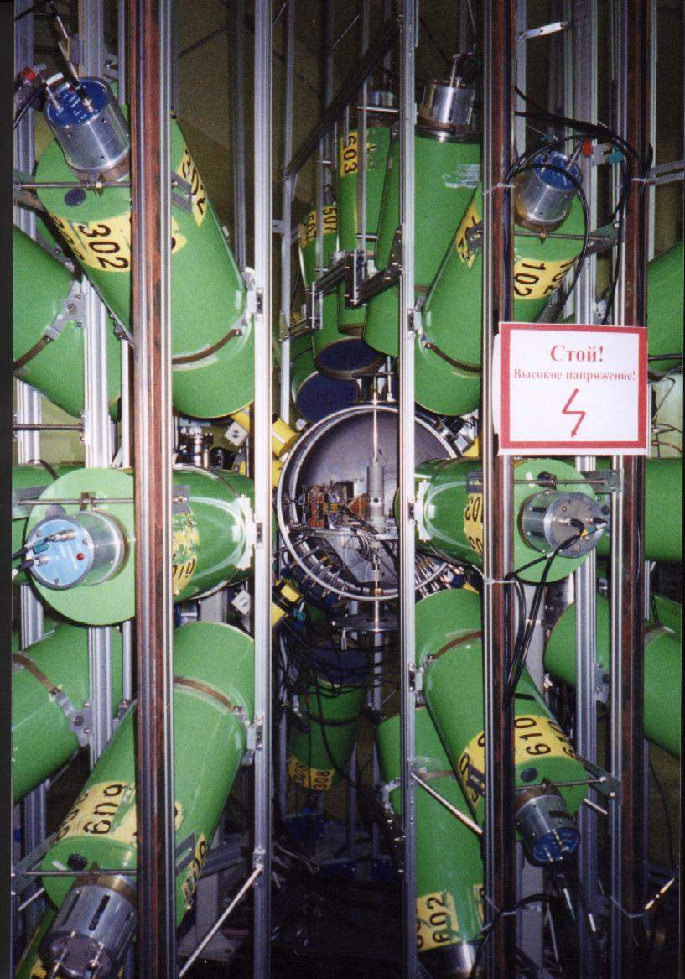
Neutron and γ-emission as probe FF/QF
Total neutron multiplicities as function of atomic number of compound nuclei produced in the reaction with ²⁶Mg, ⁴⁸Ca and ⁵⁸Fe-projectiles
Neutron multi-detectors “DEMON” with trigger of fission fragments “CORSET”

Slide 31
Shell effects manifestation

Slide 32
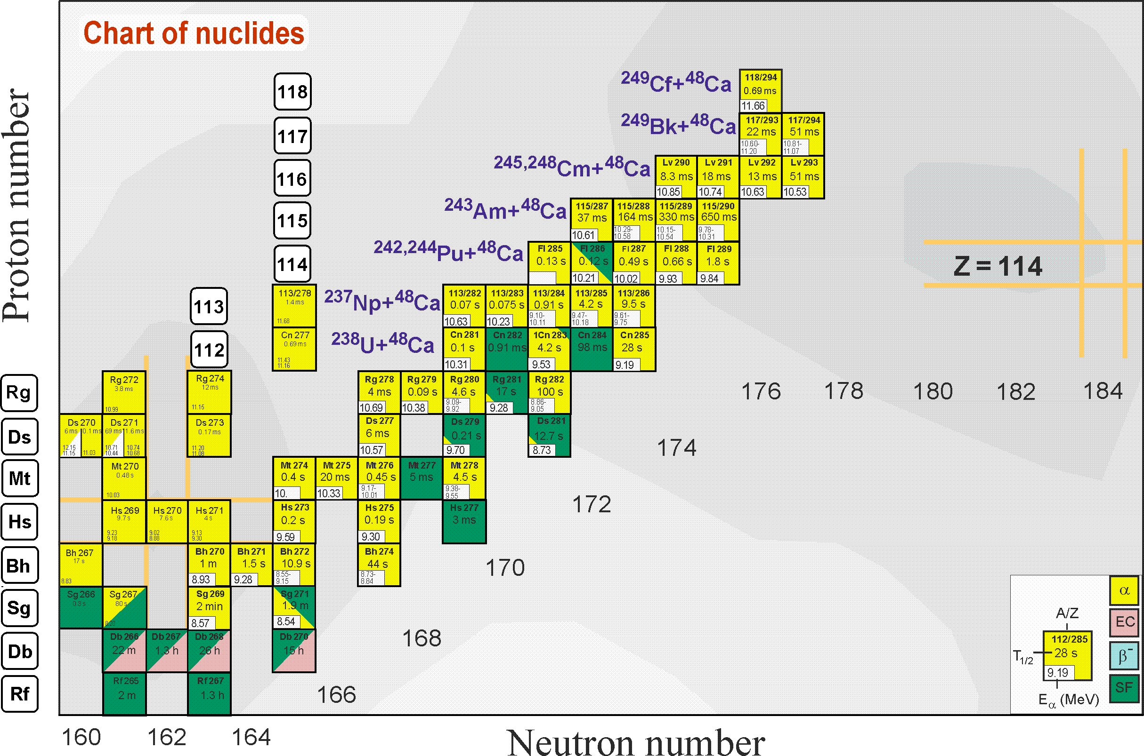
Search for superheavies
Ti, Ni, Fe
Notes:
50 years ago The existence of island of stability in the region of nuclei with Z = 114 and N = 184 was predicted theoretically [A. Sobiczewski, F. A. Gareev, and B. N. Kalinkin, Phys. Lett. 22, 500 (1966)]
That caused the experimental investigations in the field of the superheavy element (SHE) synthesis.
Nowadays more than 30 isotopes of superheavy elements with Z = 108-118 have been synthesized both in cold an hot fusion reactions
In the Flerov Laboratory of Nuclear Reactions a great success was achieved in the synthesis of superheavy elements in hot fusion reactions of ⁴⁸Ca ions with actinide target nuclei.
One of the possible pathways to synthesize new isotopes of superheavy elements with Z = 118-126 is the reactions of actinide targets with Ti, Fe and Ni ions.

Slide 33
SHE in the reactions with Fe and Ni ions
Z_{t} Z_{p}
1840
2444
2576
E*_{CN} ≈ 45 MeV
A_{CN}/2±20
Y(A_{CN}/2±20)=12%
70%
~1-2 pb
34 u
Y(A_{CN}/2±20)=8%
≤2%
22 u
Y(A_{CN}/2±20)=4%
≤0.2%
11 u

Slide 34
Inverse Quasifission
‘Normal’ QF
‘Inverse’ QF
~10 µb
E_{c.m.}-TKE >50MeV
V. Zagrebaev and W. Greiner, J.Phys.G 34, 2265 (2007)
Notes:
The interest in damped collisions of heavy nuclei is conditioned by a search for new ways of production of neutron-rich superheavy nuclei. The inverse (antisymmetrizing) quasifission process was proposed to produce SHE in collisions of transactinides [V.I. Zagrebaev et al., Phys.Rev.C 73, 031602 (2006)]. The role of shell effects in inverse QF can be studied in the experiments with less heavy nuclei [V. Zagrebaev and W. Greiner, J.Phys.G 34, 2265 (2007)].
The binary reaction channels in the reactions ^{156,160}Gd+¹⁸⁶W at the Coulomb barrier energy have been investigated. In these reactions projectile nucleus has to transfer about 22 nucleons to the target to form the fragment with mass around 208 u (double magic lead)
The enhanced yield of products with masses 200-215 u (mass transfer of 20-25 nucleons) was observed for both reactions 156,160Gd +186W. The enhancement found in the yield of products with masses heavier than the target mass conﬁrms the important role of the double magic Pb shell in inverse quasifission process in low-energy damped collisions

Slide 35
Summary
Fusion probabilities P_{CN} have been estimated for the reactions with actinide nuclei.
At subbarrier energies P_{CN} is strongly suppressed for these reactions. This suppression is the larger the heavier a system. At above-barrier energies P_{CN} decreases exponentially when the mean fissility parameter x_{m} increases.
It was found that the fusion probability in the reactions with actinide target nuclei (strongly deformed) is several orders of magnitude higher than in the case of cold fusion reactions at the same value of mean fissility parameter for the systems with x_{m} > 0.8.
The capture cross section decreases with increasing effective fissility parameter for the systems with x_{eff} > 0.75 due to the large Coulomb repulsion in the entrance channel. The transfer process becomes dominant for the systems with x_{eff} > 0.8. Besides, the capture cross section decreases more slowly for the reactions with U target nucleus compared with Pb nucleus.

Slide 36
Thank you for attention!

Slide 37
Projectile | Elab | Ec.m. | Ebass | Ec.m./Ebass
64Ni |  |  | 266.4
 | 328 | 258.5 |  | 0.97
 | 343 | 270.3 |  | 1.01
 | 358 | 282.1 |  | 1.06
 | 382 | 301 |  | 1.13
36S |  |  | 159.08
 | 168 | 145.9 |  | 0.92
 | 173 | 150.3 |  | 0.94
 | 179 | 155.5 |  | 0.98
 | 186 | 161.6 |  | 1.02
 | 198 | 172 |  | 1.08
48Ca |  |  | 193.84
 | 214 | 178.1 |  | 0.92
 | 224 | 186.4 |  | 0.96
 | 234 | 194.7 |  | 1
 | 246 | 204.7 |  | 1.06
 | 260 | 216.4 |  | 1.12
48Ti |  |  | 214.75
 | 247 | 205.5 |  | 0.96
 | 256 | 213 |  | 0.99
 | 271 | 225.5 |  | 1.05
+ ²³⁸U

Slide 38
²⁰⁸Pb [R. Bock et al., Nucl. Phys. A 388, 334 (1982)]
²³⁸U [J. Toke et al., Nucl. Phys. A 440, 327 (1985)]
L. Corradi et al., Phys. Rev. C 59, 261 (1999).
Multinucleon transfer processes in 64Ni+238U Elab=390 MeV
total transfer cross sections, amounting to sigma_tr=670 mb

