Slide 1
Spontaneous and induced fission of very heavy and super-heavy nuclei
ECT Trento, April 9-13, 2018
SHE-Factory:
New facility for super heavy element research
Sergey Dmitriev
Flerov Laboratory of Nuclear Reactions, JINR
Dubna

Slide 2
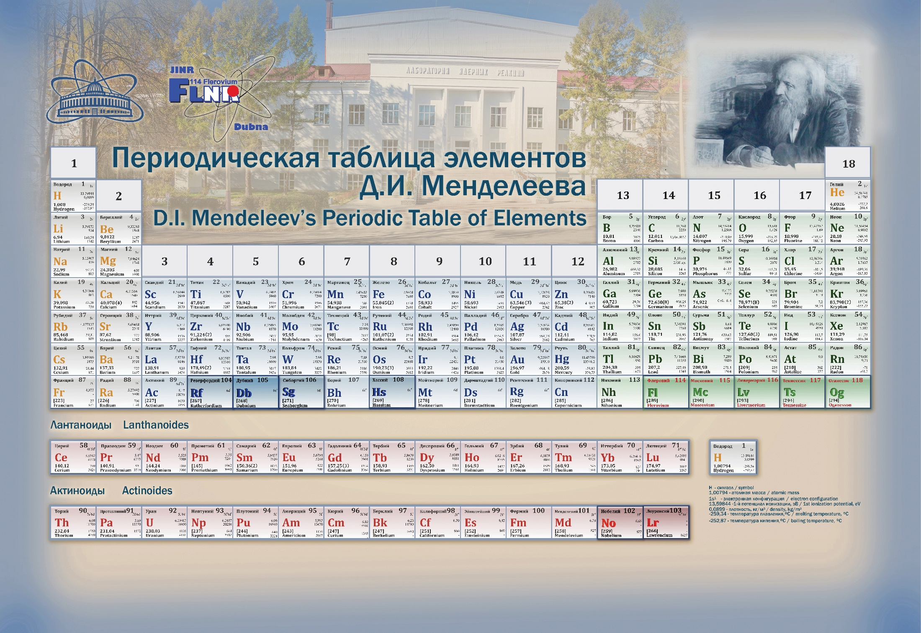

Slide 3
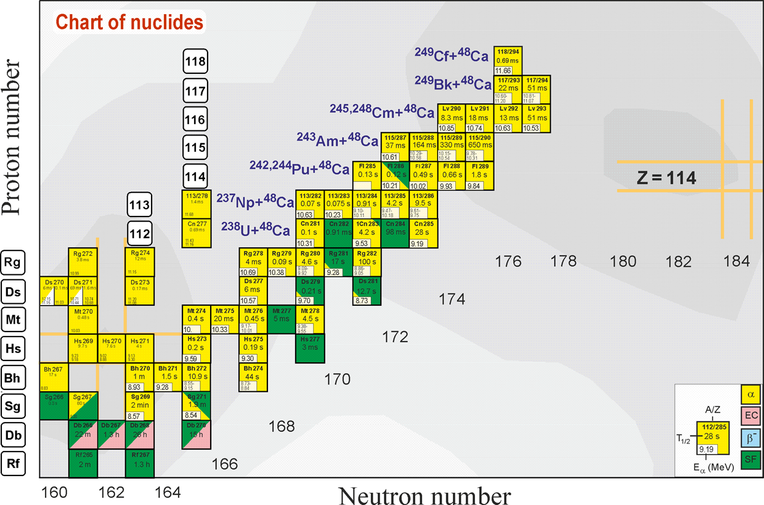
Region of superheavy nuclei

Slide 4
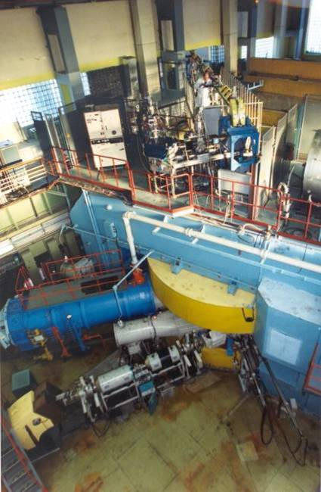
U400 CYCLOTRON
stand-alone & post-accelerator
Ion | Ion energy [MeV/A] | Output intensity
⁴ He ¹⁺ | - | -
⁶ He ¹⁺ | 11 | 3⋅10⁷ pps
⁸ He ¹⁺ | 7.9 | -
¹⁶ O ²⁺ | 5.7; 7.9 | 5 pμA
¹⁸O³⁺ | 7.8; 10.5; 15.8 | 4.4 pμA
⁴⁰ Ar ⁴⁺ | 3.8; 5.1 * | 1.7 pμA
⁴⁸ Ca ⁵⁺ | 3.7; 5.3 * | 1.2 pμA
⁴⁸Ca⁹⁺ | 8.9; 11; 17.7 * | 1 pμA
⁵⁰ Ti ⁵⁺ | 3.6; 5.1 * | 0.4 pμA
⁵⁸ Fe ⁶⁺ | 3.8; 5.4 * | 0.7 pμA
⁸⁴Kr⁸⁺ | 3.1; 4.4 * | 0.3 pμA
¹³⁶Xe¹⁴⁺ | 3.3; 4.6; 6.9 * | 0.08 pμA
¹⁶⁰Gd¹⁹⁺ | 5.5 | 0.01 pμA
²⁰⁹Bi¹⁹⁺ | 3.4 | 0.01 pμA
New heavy isotopes
Fusion-fission
Nuclear spectroscopy
SHE chemistry
Multi nucleon transfer reactions;
Reactions with exotic nuclei
Structure of light exotic nuclei;

Slide 5
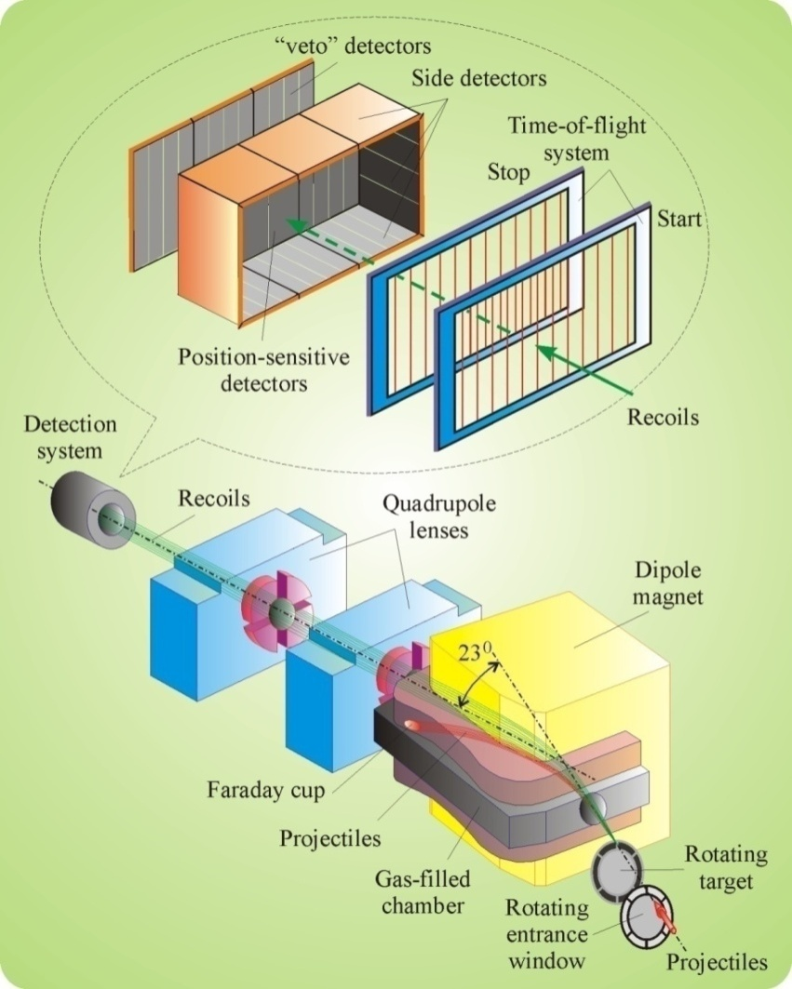
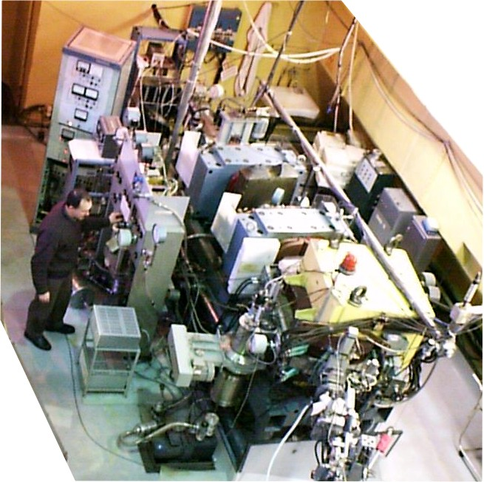
Dubna gas-filled recoil separator

Slide 6
What is beyond 118 element?
Heaviest target: ²⁴⁹Cf → Z_{max}= 118
↓
Heavier projectiles (⁵⁰Ti, ⁵⁴Cr, ⁵⁸Fe, ⁶⁴Ni)
Sufficient increasing of overall experiment efficiency is needed!

Slide 7
SHE-Factory:
New facility for super heavy element research

Slide 8
Superheavy Elements (SHE) Factory – the Goals
Experiments at the extremely low (σ<100 fb) cross sections:
Synthesis of new SHE in reactions with ⁵⁰Ti, ⁵⁴Cr ...;
Synthesis of new isotopes of SHE;
Study of decay properties of SHE;
Study of excitation functions.
Experiments requiring high statistics:
Nuclear spectroscopy of SHE;
Study of chemical properties of SHE.

Slide 9
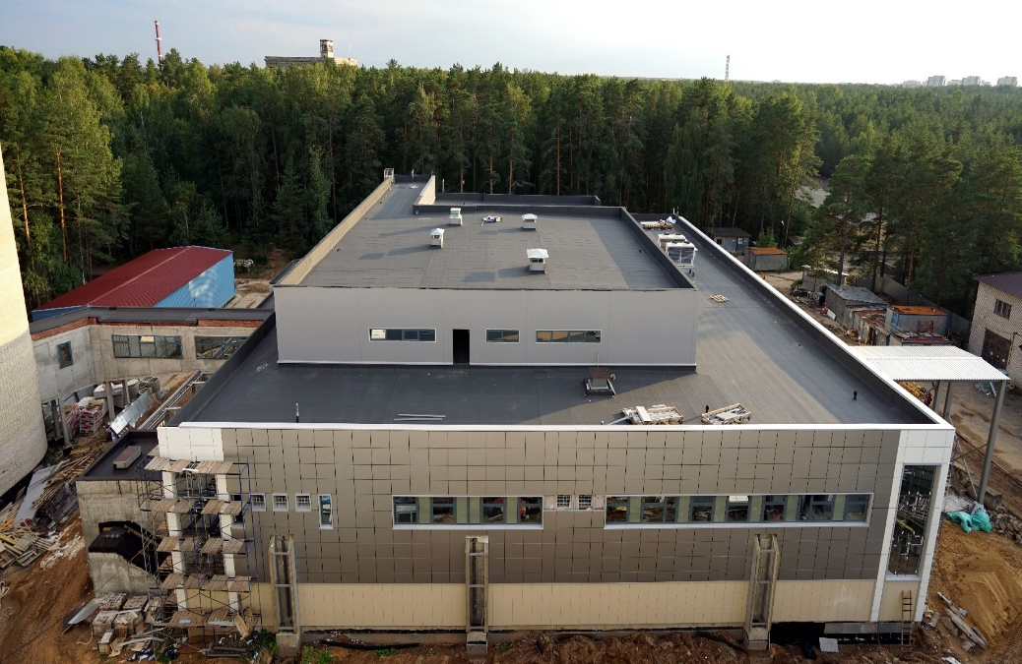
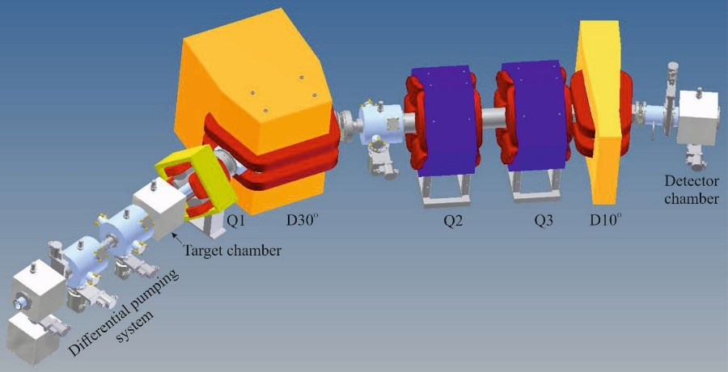
SHE Factory
SHE Factory Building
High-current cyclotron DC-280
New facilities:
New gas-filled separator
Preseparator
SHELS
Etc.
Notes:
The project of the SHE factory includes three principal components: i) high current accelerator, ii) new experimental hall and iii) a number of the next generation facilities.

Slide 10
DC-280 cyclotron – stand-alone SHE factory
DC280 (expected) E=4÷8 MeV/A
Ion | Ion energy [MeV/A] | Output intensity
⁷Li | 4 | 1×10¹⁴
¹⁸O | 8 | 1×10¹⁴
⁴⁰Ar | 5 | 6×10¹³
⁴⁸Ca | 5 | 0,6-1,2×10¹⁴
⁵⁴Cr | 5 | 2×10¹³
⁵⁸Fe | 5 | 1×10¹³
¹²⁴Sn | 5 | 2×10¹²
¹³⁶Xe | 5 | 1×10¹⁴
²³⁸U | 7 | 5×10¹⁰
Synthesis and study of properties of superheavy elements.
Search for new reactions for SHE-synthesis.
Chemistry of new elements.

Slide 11
DC-280
Main Parameters
Ion source | DECRIS-4 - 14 GHz DECRIS-SC3 - 18 GHz
Injecting beam potential | Up to 100 kV
A/Z range | 4÷7
Energy | 4÷8 MeV/n
Magnetic field level | 0.6÷1.35 T
K factor | 280
Gap between plugs | 400 mm
Valley/hill gap | 500/208 mm/mm
Magnet weight | 1000 t
Magnet power | 300 kW
Dee voltage | 2x130 kV
RF power consumption | 2x30 kW
Flat-top dee voltage | 2x14 kV

Slide 12
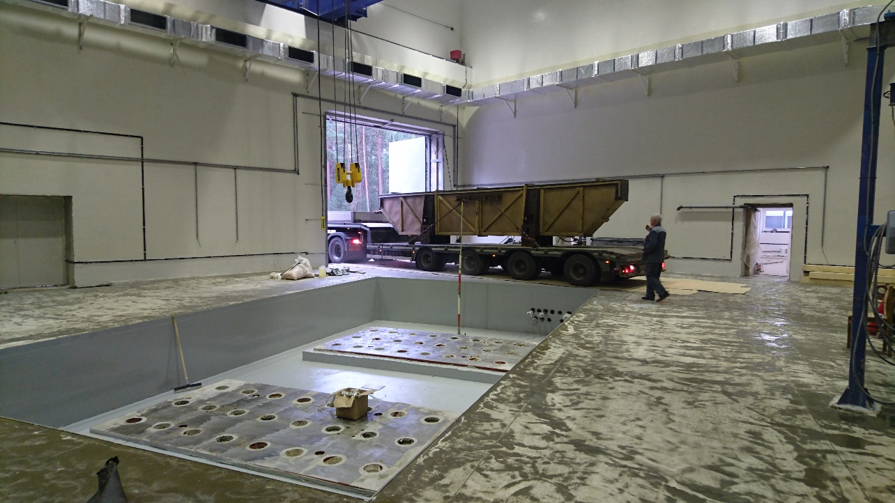
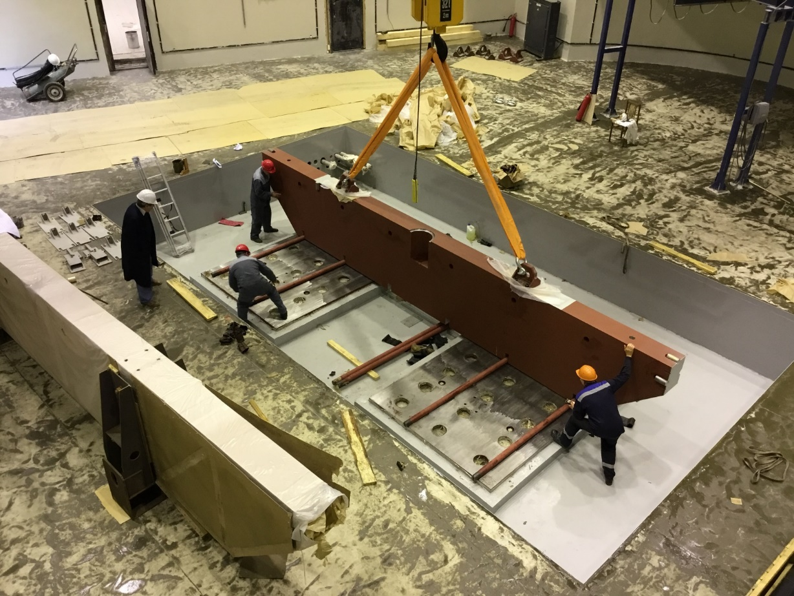
Assembling of the DC280 main magnet
15/09/2016, 9:00
Same day, 14:35

Slide 13
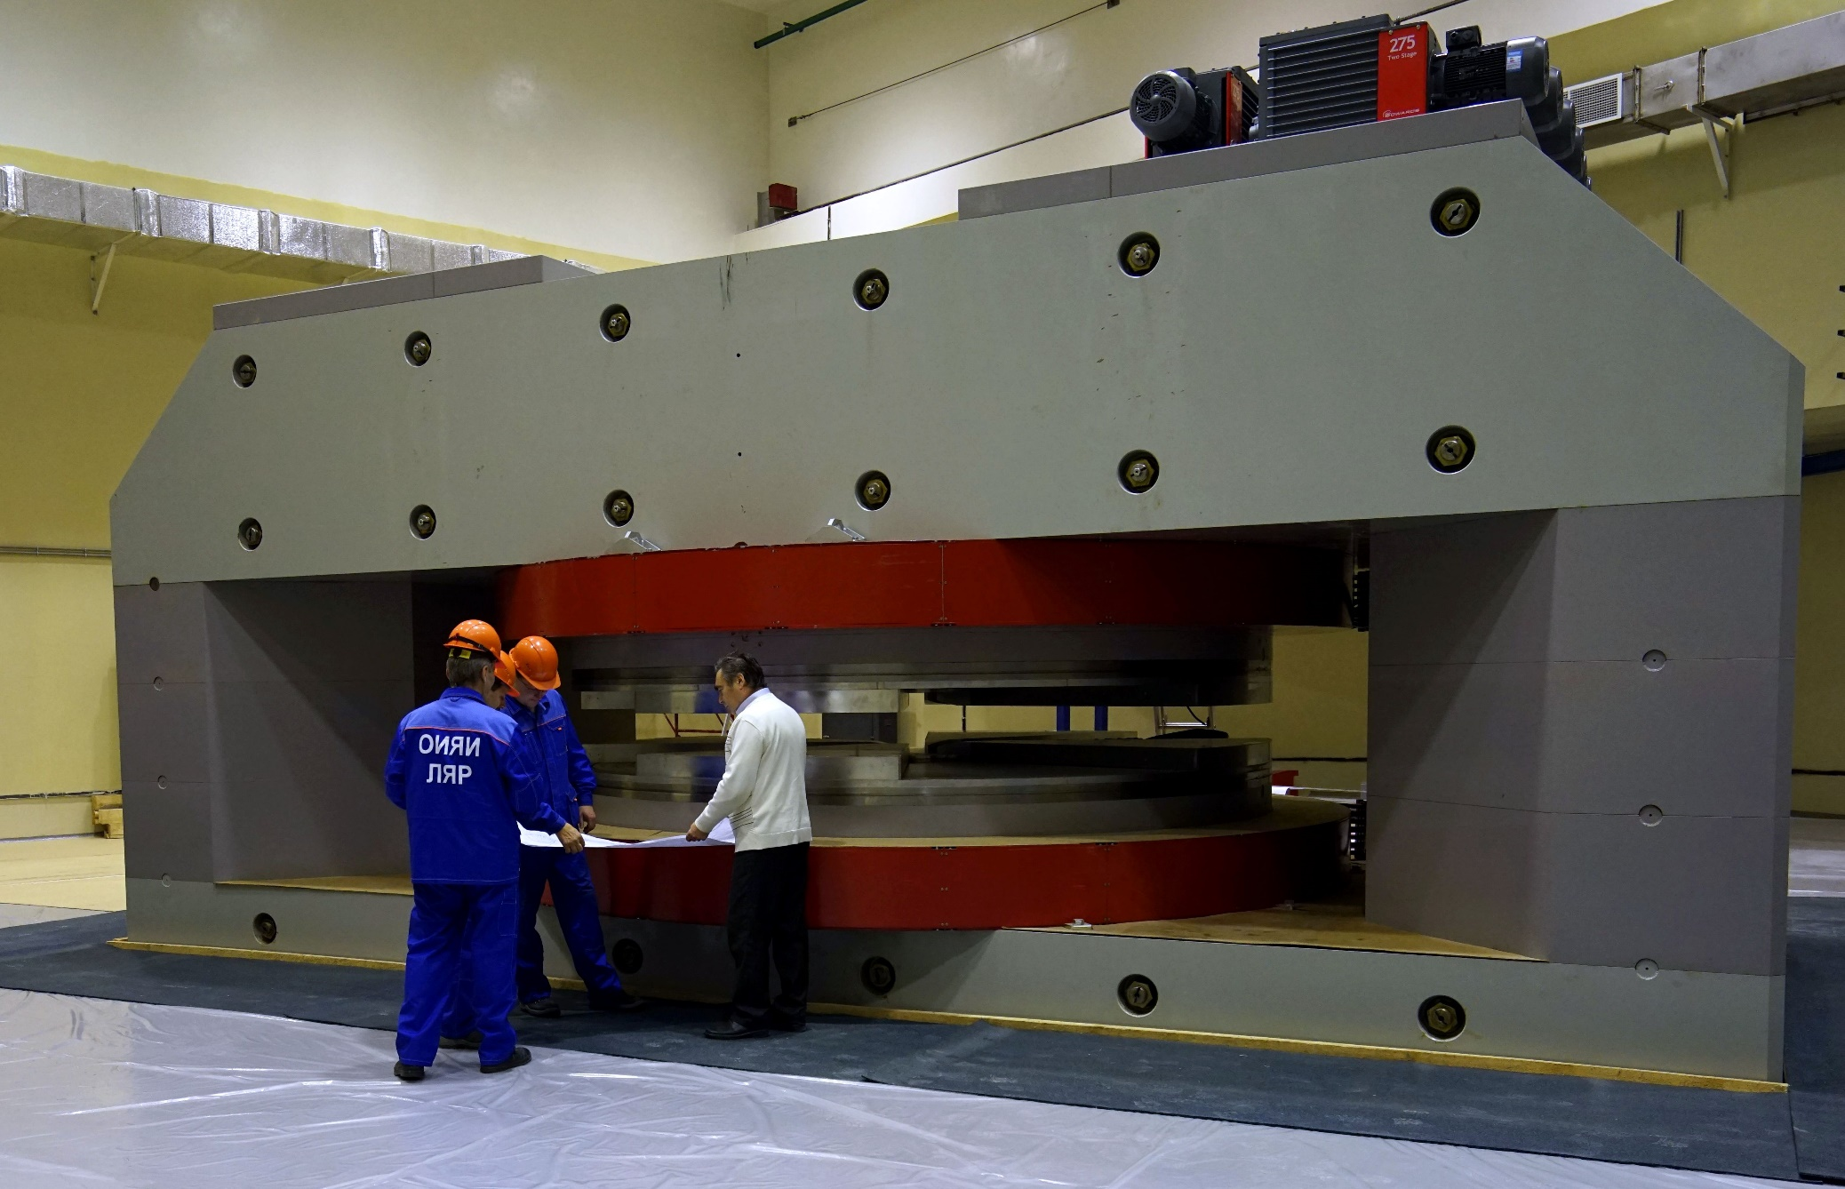
Magnet of DC280 cyclotron – ready for testing
18.01.2017 http://lideo.ru/embed/4655

Slide 14
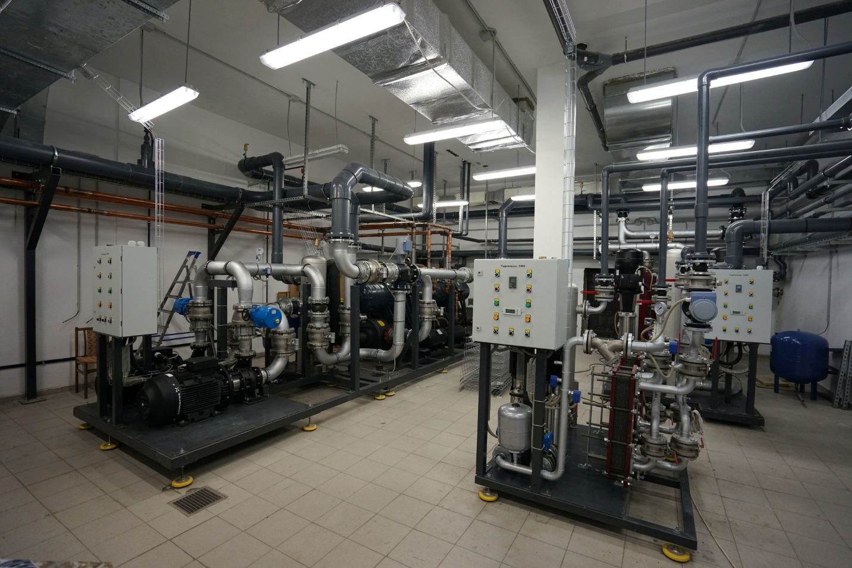
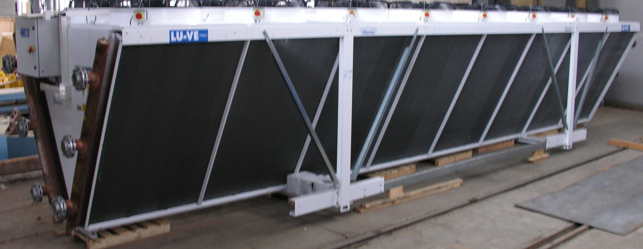
Water cooling system
The water cooling system was developed at the FLNR (equipment suppliers: Russia, Italy, Germany)

Slide 15
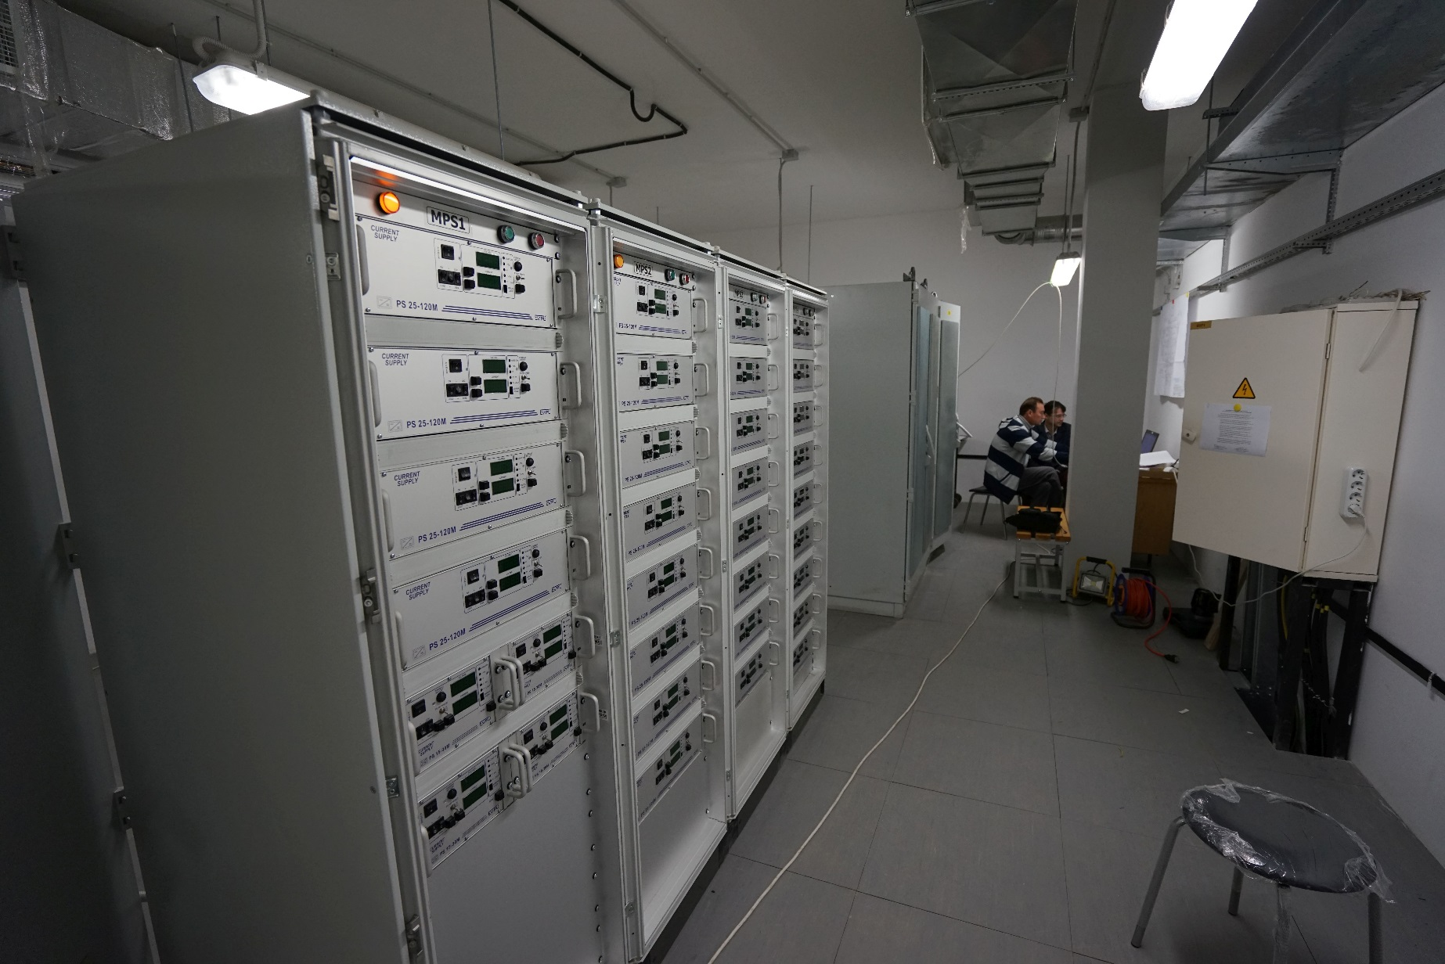
Control system
The control system based on FLNR developments and LabVIEW

Slide 16
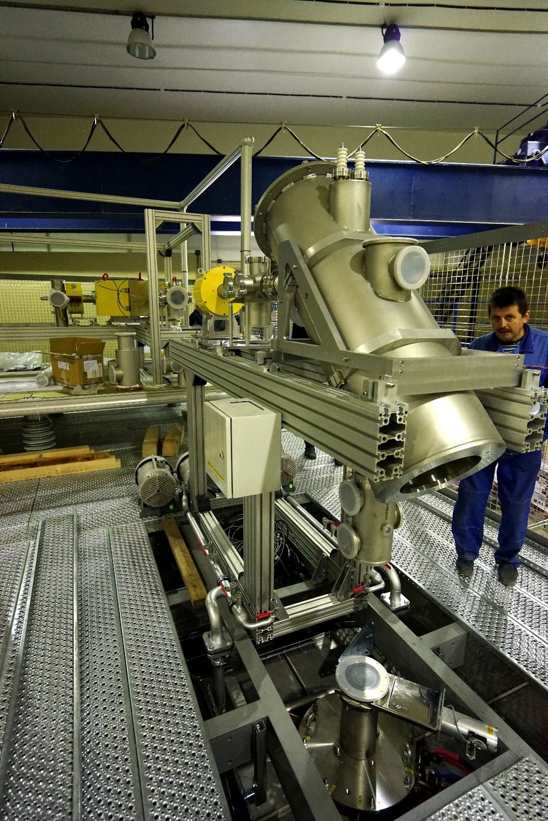

Slide 17
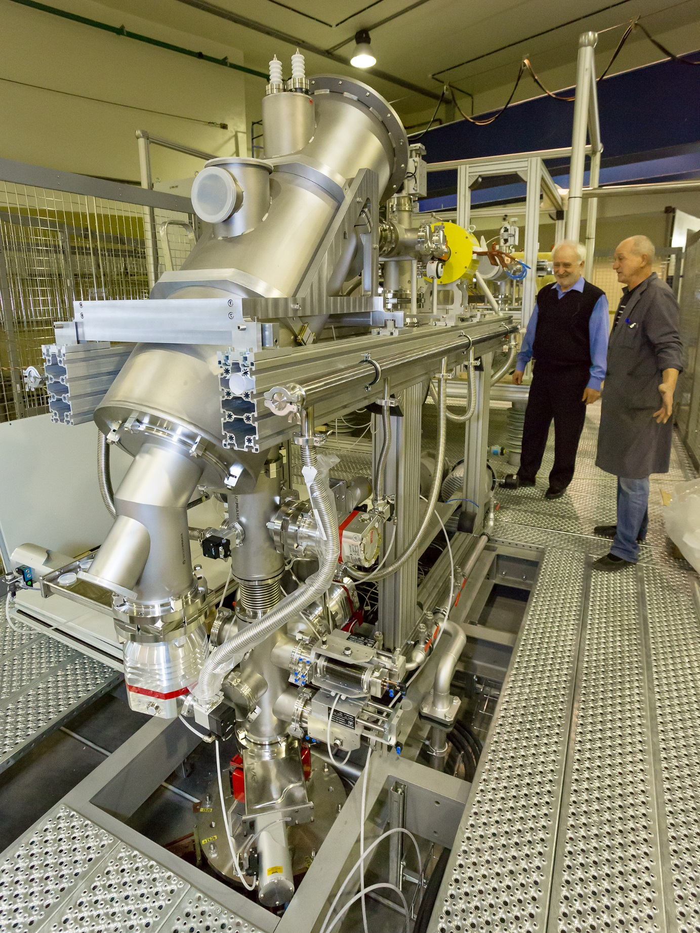

Slide 18
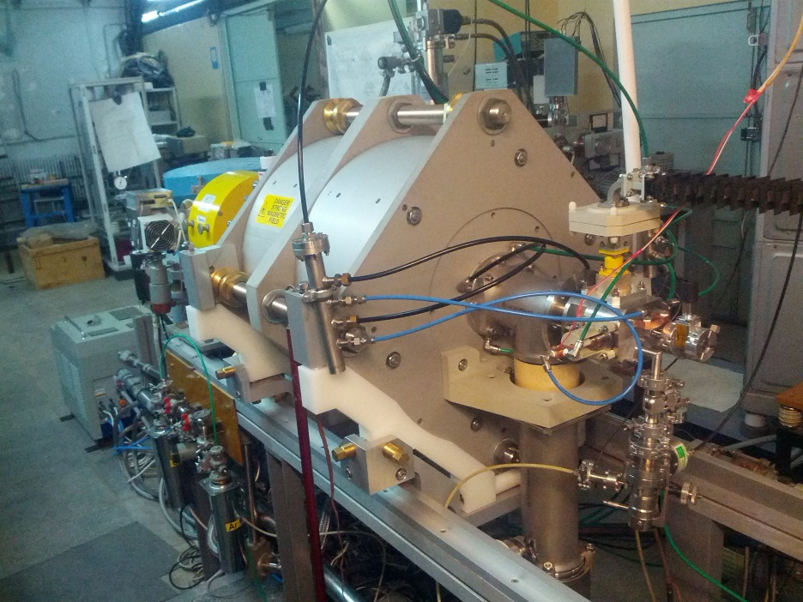
DECRIS-PM at the test bench

Slide 19
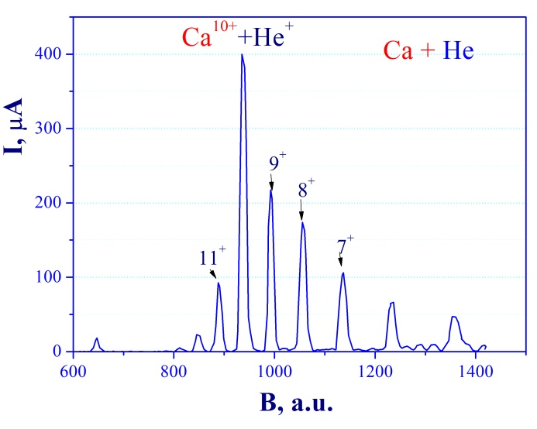
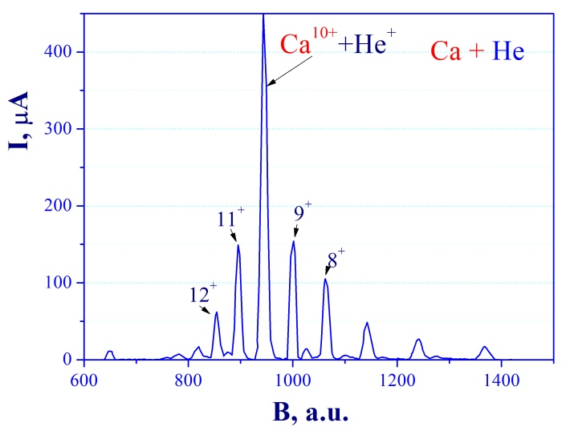
Ca charge state spectra
Ca⁹⁺ =210 µA
Ca¹¹⁺ =150 µA

Slide 20
Expected beam parameters of the DC-280
ION | Z | Beam Intensity from ECR |  | HV platform N | Efficiency of acceleration | Expected beam intensities of (4÷8) MeV/n ions on targets pps
 |  | eμA | pps
20Ne | 3 | 150 | 3.10¹⁴ | 1 | 50% | 1.5·10¹⁴
40Ar | 7 | 300 | 3.10¹⁴ | 1 | 50% | 1.5·10¹⁴
48Са | 7/8 | 160 | 1.10¹⁴ | 1 | 50% | 6.2·10¹³
⁵⁰Ti | 8/9 | 75 | 5.10¹³ | 1 | 50% | 3.1.10¹³
⁵⁴Cr | 9 | 125 | 8.10¹³ | 1 | 50% | 4.10¹³
58Fe | 9/10 | 125 | 8.10¹³ | 1 | 50% | 4·10¹³
64Ni | 10/11 | 125 | 8.10¹³ | 1 | 50% | 4·10¹³
70Zn | 11/12 | 100 | 5.10¹³ | 1 | 50% | 2,5.10¹³
136Хе | 22/23 | 150 | 4.10¹³ | 1 | 50% | 2·10¹³

Slide 21
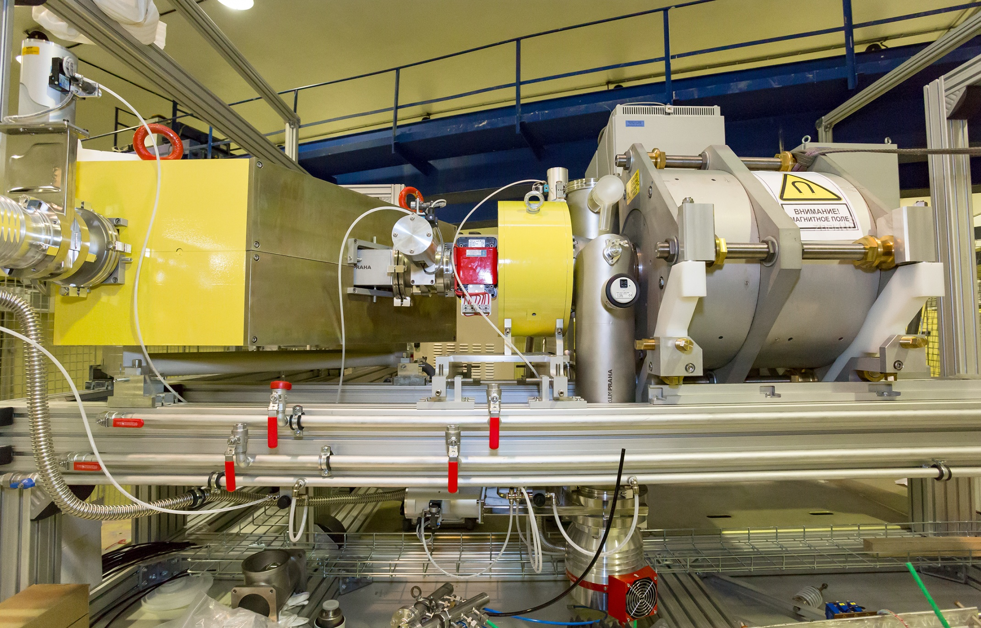

Slide 22
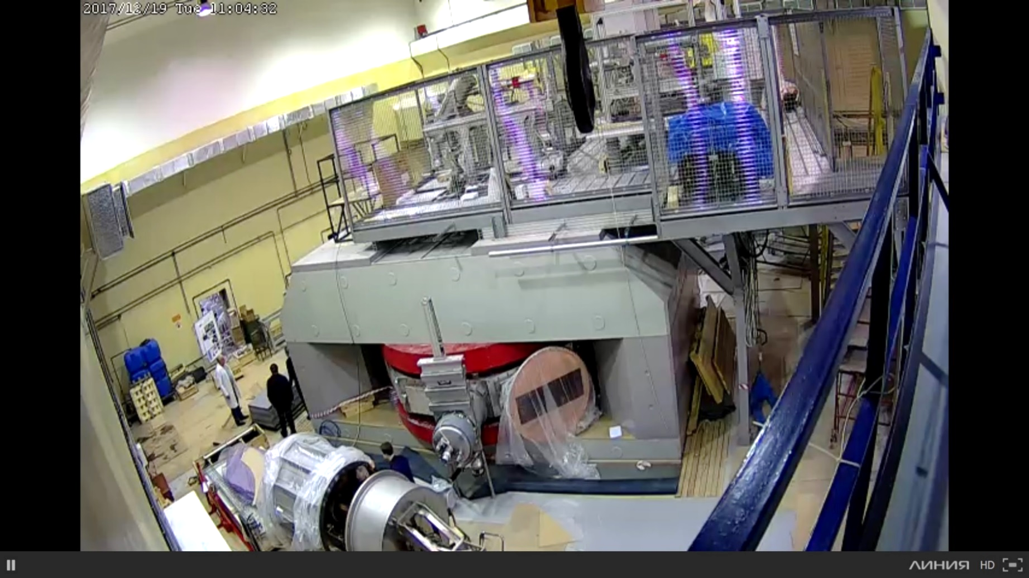

Slide 23
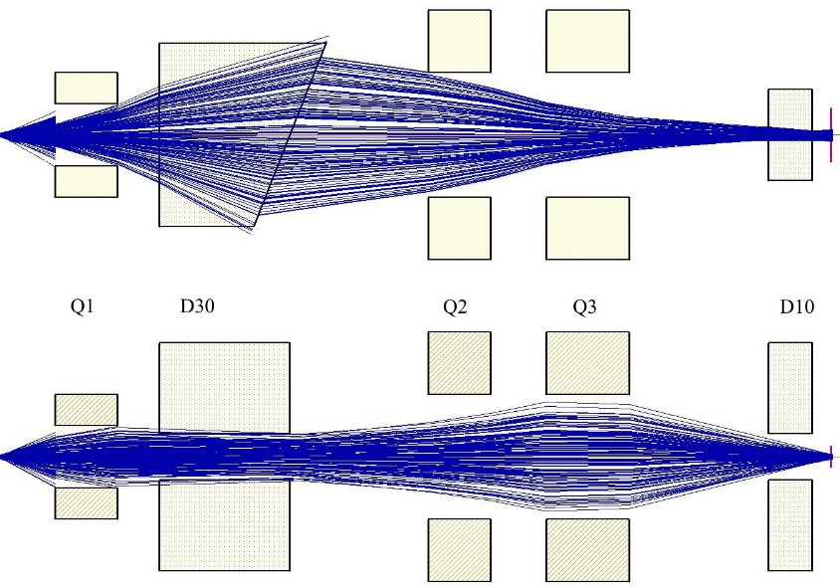
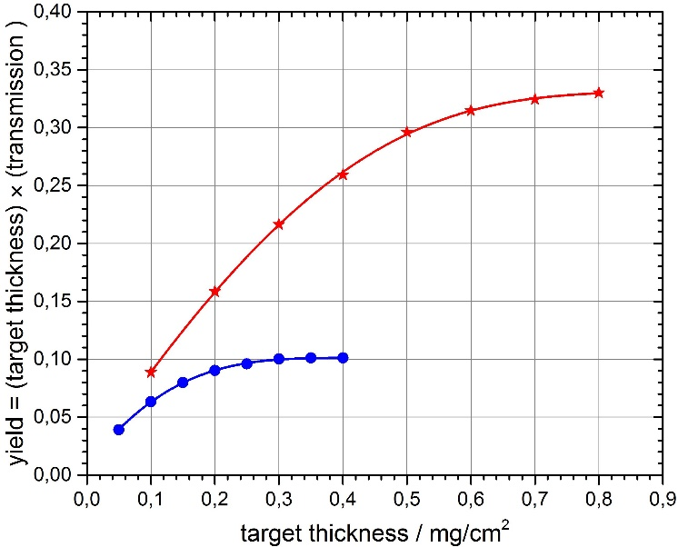
New FLNR gas-filled separator (contracted)
Technical Design
Report No 412923
Reaction | Transmission
²⁴⁴Pu(⁴⁸Ca,3n)²⁸⁹114 | 60 %
²⁴⁴Pu(⁵⁸Fe,4n)²⁹⁸120 | 75 %

Slide 24
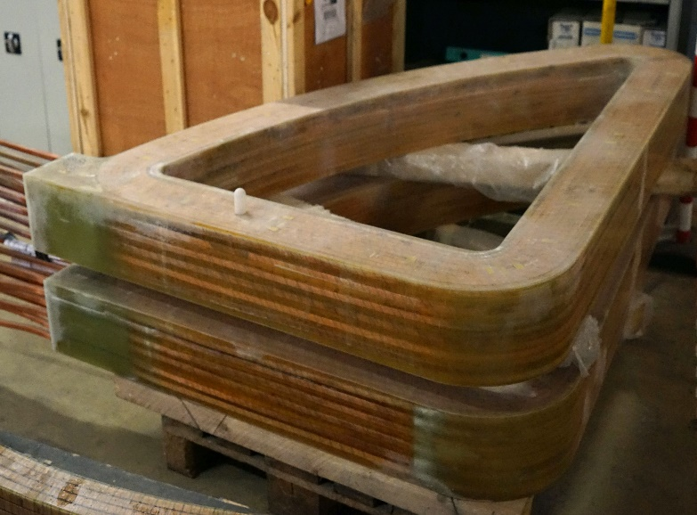
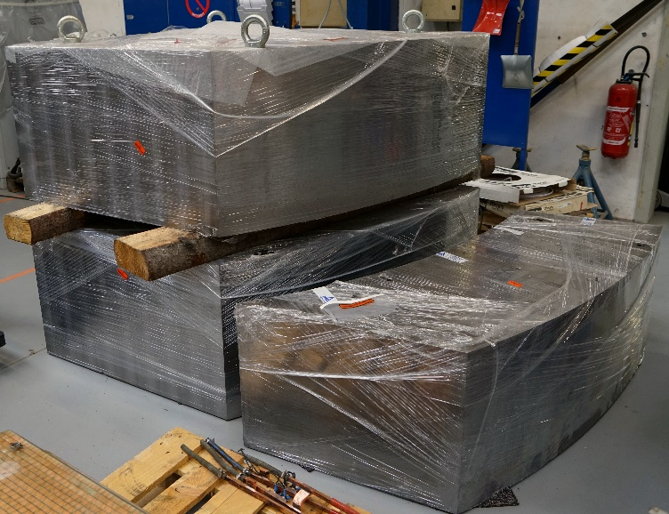
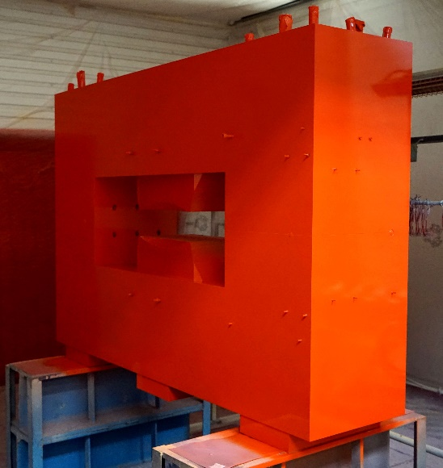
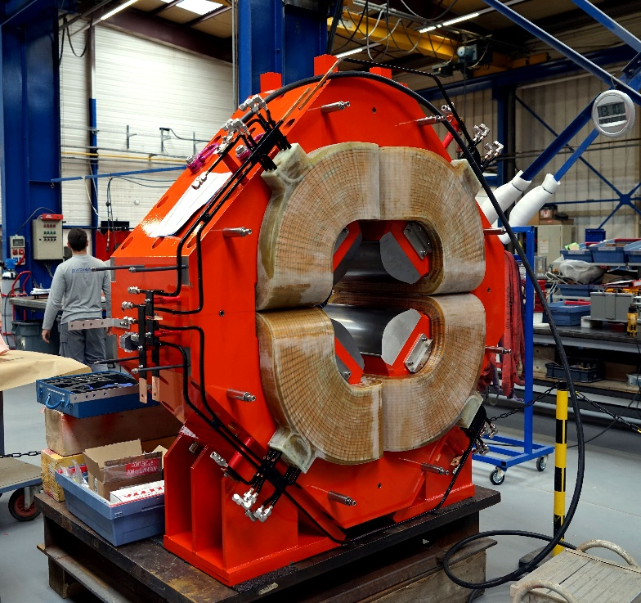
Gas-Filled Separator GFS-2
DC-280
Parts of the main analyzing 30º magnet
Additional 10º magnet
All parts have been manufactured;
Delivery – November , 2017;
Installation Dec. 2017 - Jan 2018
commissioning – Jan –June/ July 2018
Onset of first-day experiments ⁴⁸Ca+ ²⁴³Am –
- Sept.-Nov. 2018;
Focusing quadrupole

Slide 25
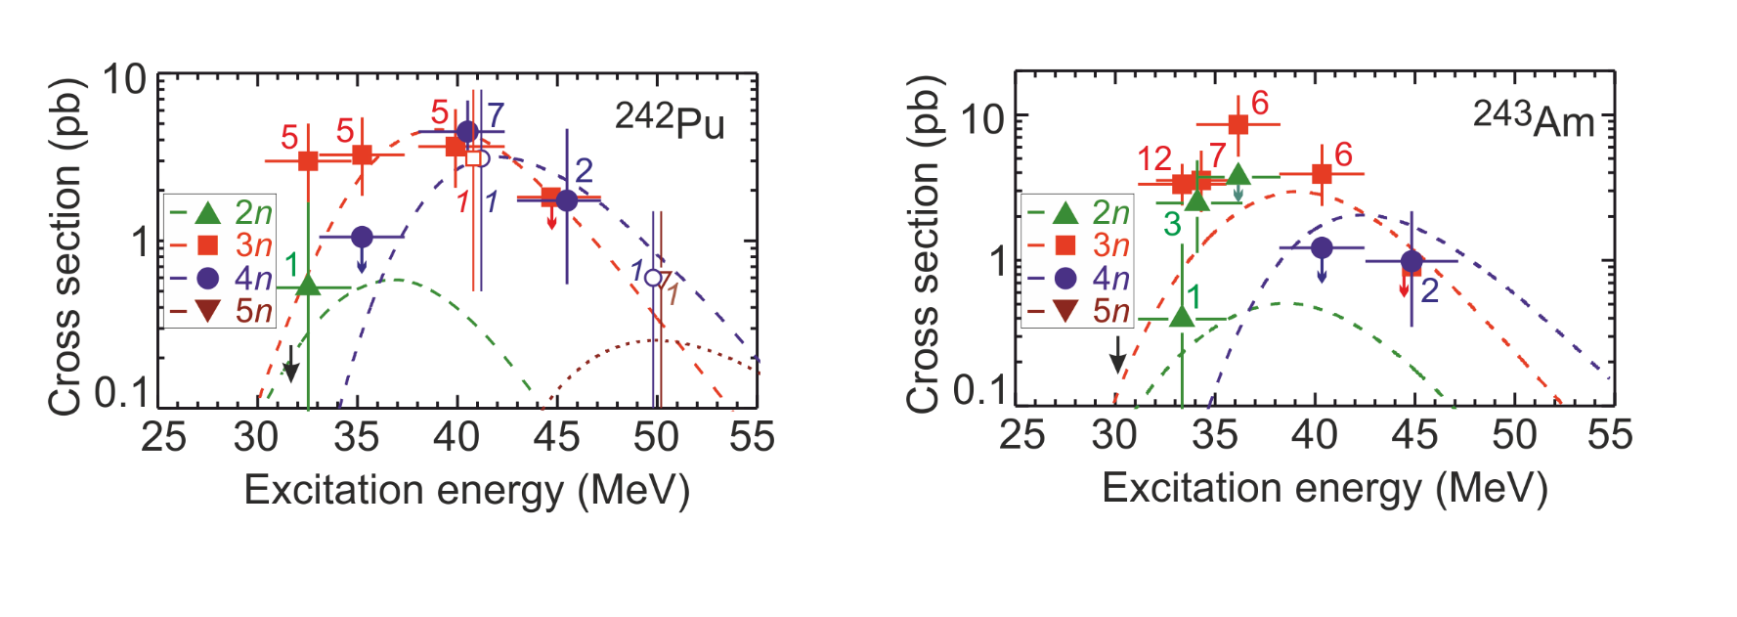
First-day experiments at SHE Factory
Aims of the experiments:
Test of functionalities of all the systems of new accelerator and new gas-filled recoil separator
Accumulate additional statistics for the chosen reactions
Chosen reactions: ⁴⁸Ca+²⁴³Am and ⁴⁸Ca+²⁴²Pu
Enough material to prepare the targets
Relatively large cross sections and, thus, optimum candidates for spectroscopic experiments
Well-studied in previous experiments. Good for testing of the accelerator complex
⁴⁸Ca+²⁴²Pu
Existing experimental data
⁴⁸Ca+²⁴³Am

Slide 26
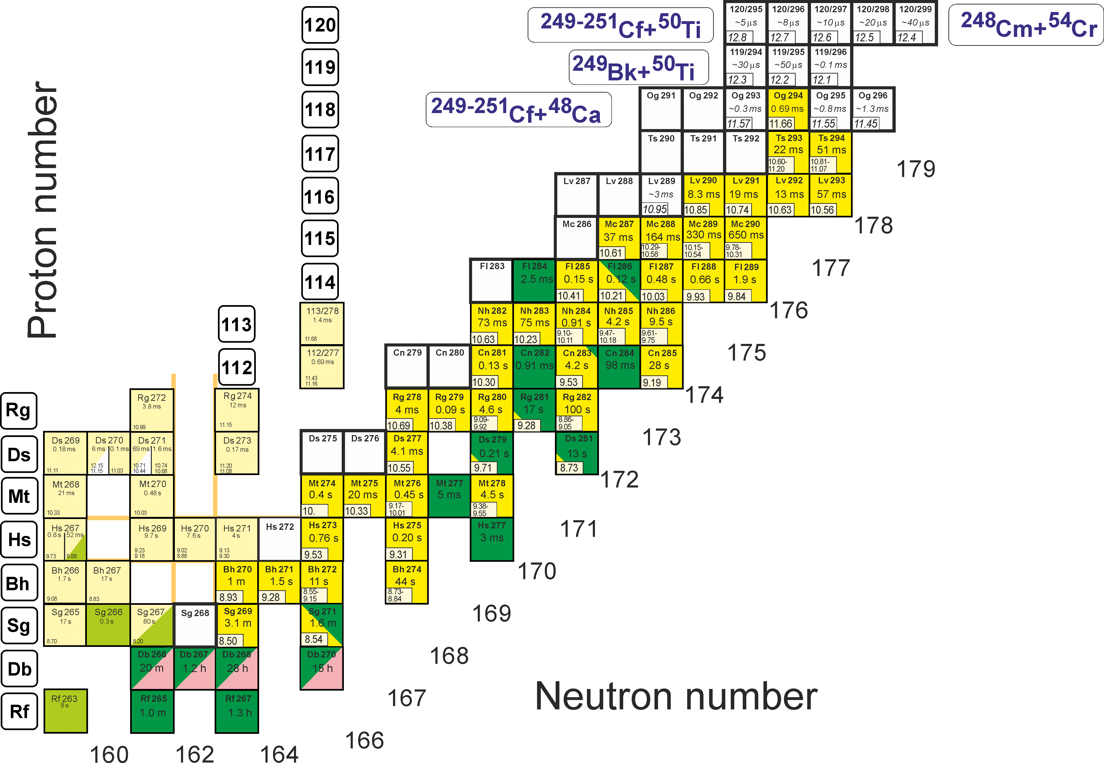
First experiments at SHE Factory
Synthesis of new elements 119 and 120

Slide 27
Reactions of Synthesis
Act. + ⁴⁸Ca
Target
materials
Producer
Isotope
enrichment (%)
²³⁷Np IAR 99.3
²³⁹Pu RFNC ---
²⁴⁰Pu IAR/ORNL 99.98
²⁴²Pu RFNC/ORNL 99.98
²⁴⁴Pu ORNL 98.6
²⁴³Am IAR / ORNL 99.9
²⁴⁵Cm IAR 98.7
²⁴⁸Cm IAR /ORNL 97.4
²⁴⁹Bk ORNL ≥ 95
²⁴⁹Cf IAR/ORNL 97.3
^{249,250,251}Cf ORNL (50+14+36)%
0,35-0,40 mg /cm2 - ≈ 12 mg
Projectiles ⁴⁸Ca produced by
Heavy Ion Accelerator U400;
Energy: 235-250 MeV
(v ≈ 0.1 c);
Intensity: 1.0-1.5 pμA
(n×10¹² ÷ 10¹³ 1/s);
Consumption: 0.5-0.8 mg/h
Beam dose: (0.3-3.0)∙10¹⁹
Notes:
27

Slide 28
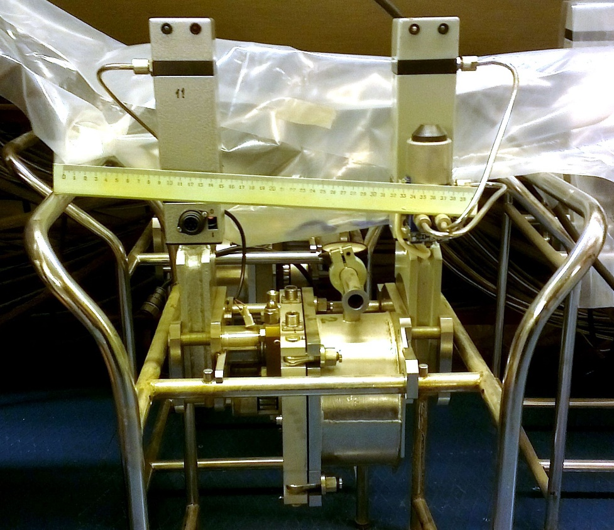
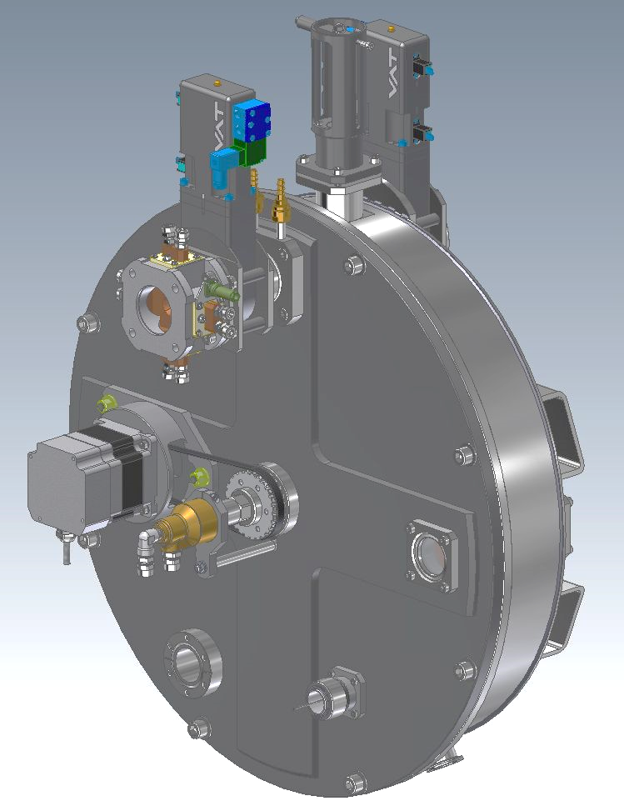
Target block design
old
new
Ø = 120 mm, 1500 r.p.m. synchronous
Beam wobbler or scanner,
Segmented beam diafragm
Is in use at GFS, SHELS, MASHA
Ø = 150mm, 1500 r.p.m. synchronous,
e-beam & optical diagnostic,
water cooling

Slide 29
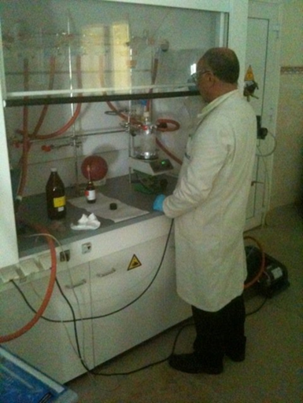
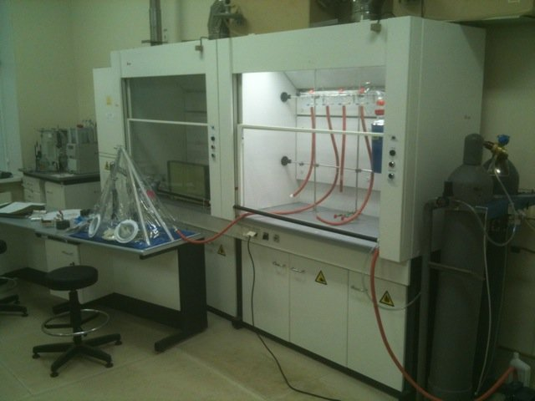
Development of ⁵⁰Ti beam using MIVOC method
Synthesis of (trimethyl)pentamethyl-cyclopentadienyl titanium
TiCl₄ + (CH₃)₅C₅Si(CH₃)₃ Cp*TiCl₃ + 3CH₃Li Cp*Ti(CH₃)₃
Benoit Gall, Zouhair Asfari
Institut Pluridisciplinaire Hubert Curien, IN2P3-CNRS, Université of Strasbourg, France
The first step of synthesis was performed at IPHC, the final step at FLNR.
Chemistry laboratory

Slide 30
Superheavy Elements (SHE) Factory – the Goals
Experiments at the extremely low (σ<100 fb) cross sections:
Synthesis of new SHE in reactions with ⁵⁰Ti, ⁵⁴Cr ...;
Synthesis of new isotopes of SHE;
Study of decay properties of SHE;
Study of excitation functions.
Experiments requiring high statistics:
Nuclear spectroscopy of SHE;
Study of chemical properties of SHE.

Slide 31
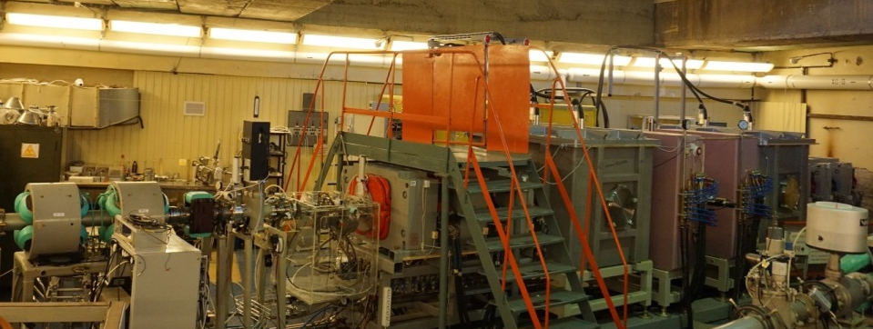
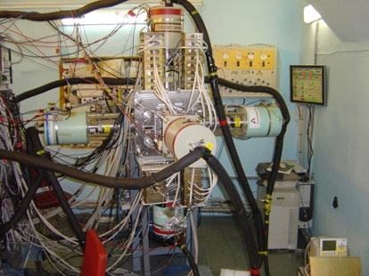
α-, β-, and γ-spectroscopy of heavy nuclei at FLNR
Present status of research (January 2018)
SHELS separator (velocity filter)
U400 heavy ion cyclotron
²²Ne ~ 2 pμA
⁴⁸Ca ~ 1 pμA
⁵⁰Ti ~ 0.5 pμA,
Heavy (Z>100) nuclei
of interest
GABRIELA detector set up (α,β,γ and SF)
Detailed spectroscopy studies of the transfermium isotopes
^{244,246,147,249,251}Fm, ^{249,251}Md, ^{250,251,252,253,254,255}No, ^{253,255}Lr,
^{254,255,256,257}Rf, ²⁵⁷Db

Slide 32
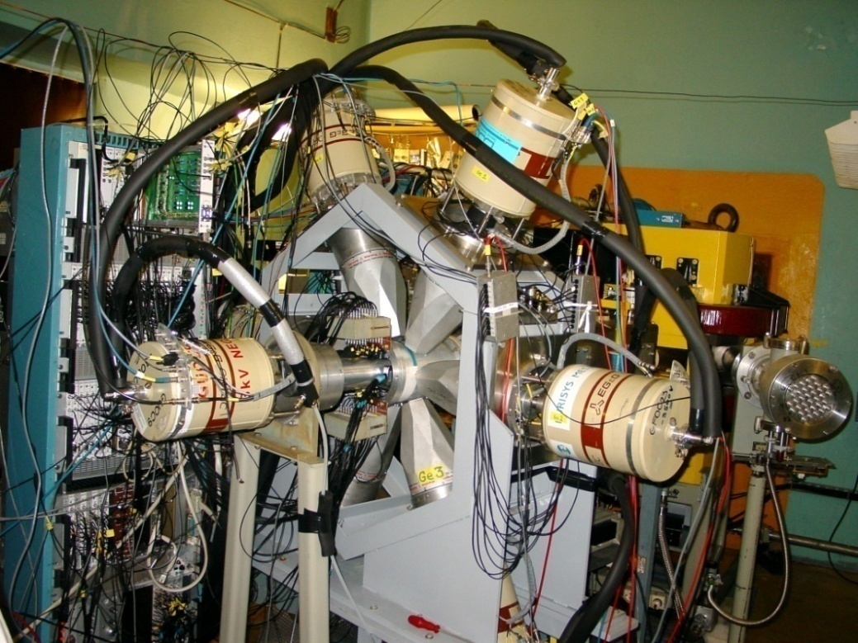

Modernization of the detector
set up
GABRIELA 2016/17
4 single crystal Ge detectors +
1 Clover Ge detector
GABRIELA 2018/2019
5 Clover Ge detectors

Slide 33
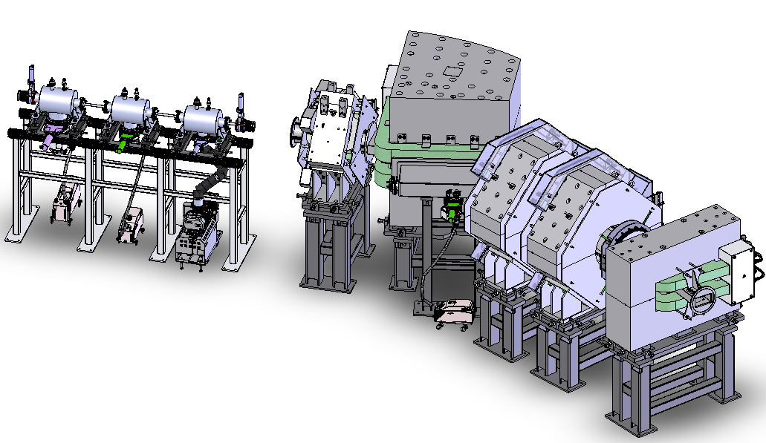
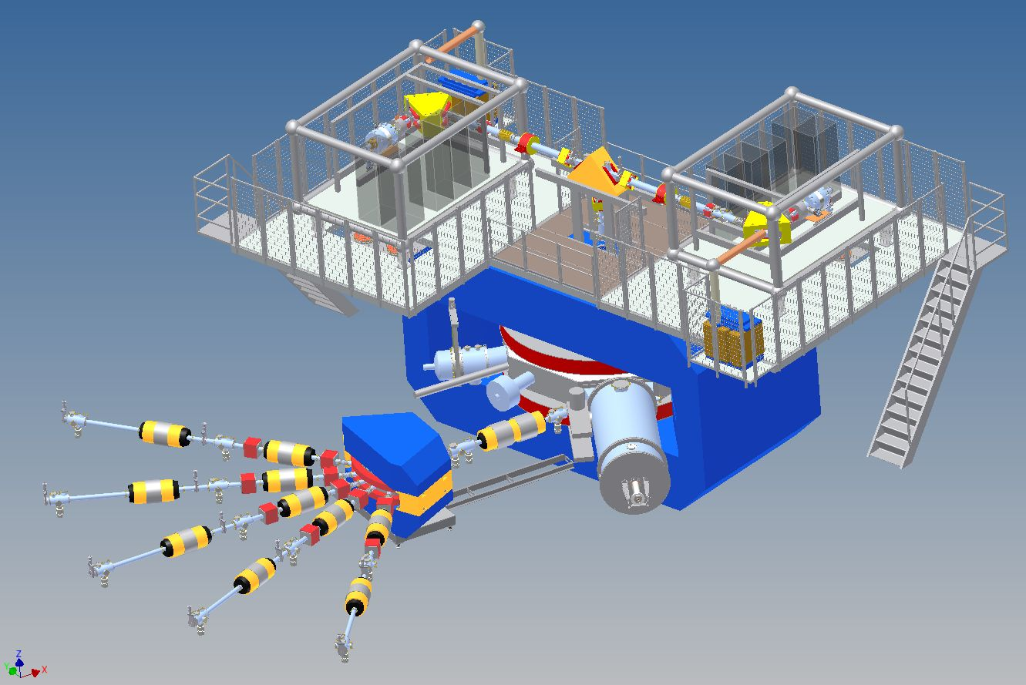
α-, β-, and γ-spectroscopy of heavy nuclei at FLNR
Future perspectives of research
Gas filled separator
DC280 heavy ion cyclotron
²²Ne ~ 20 pμA
⁴⁸Ca ~ 10 pμA
⁵⁰Ti ~ 5 pμA,
Heavy (Z>100) nuclei
of interest
GABRIELA detector set up (α,β,γ and SF)
Detailed spectroscopy studies of the SHE isotopes
^{287,289}Fl, ^{287,288}Mc, ²⁹³Lv

Slide 34
Gas-phase chemistry with elements
112, 113 and 114
Are elements 112, 113 and 114 volatile metals?
How do relativistic effects influence the chemistry of E112, E113 and of E114?
Chemistry of elements 115-118 ?

Slide 35
How to experimentally determine a metallic character of a volatile element at a single atom level?
→ Determine interaction energy (adsorption
enthalpy) with noble metals (e.g. Au)
→ If metallic: strong interaction (adsorption
enthalpy) if non-metallic (noble gas like):
weak interaction

Slide 36
Compound Hg(Au)
and 112(Au)
Reaction:
²⁴²Pu⁽⁴⁸Ca,3n)²⁸⁷114[0.5s]→α→²⁸³112[3.6s]

Slide 37
Laboratory for Radiochemistry and Environmental Chemistry
Result from the ⁴⁸Ca + ²⁴²Pu experiment
Reported at DGFRS:
Oganessian et al. 2004
Observed in Chemistry:
11.05.2006
2:40 (moscow time)
25.05.2006
8:37 (moscow time)
²⁸⁷114
0.51 s
10.02 MeV
²⁸⁷114
²⁸⁷114
²⁸³112
4 s
9.54 MeV
²⁸³112
9.37 MeV
²⁸³112
9.48 MeV
²⁷⁹Ds
0.18 s
SF(>90%)
205 MeV
²⁷⁹Ds
τ: 0.592 s
SF
108+123 MeV
²⁷⁹Ds
τ: 0.536 s
SF
127+105 MeV
Three week bombardment with 3.1x10¹⁸ ⁴⁸Ca ions at 236 ± 3 MeV

Slide 38
All ²⁸³Cn events from FLNR experiments using the reaction ⁴⁸Ca+²⁴²Pu on Au under approx. identical condition
(Data from 2006/2007/2009/2013)
T_{1/2} ²⁸³Cn= 3 s
ΔH_{ads}= -52⁺⁴₋₂ kJ/mol
4 atoms
1 atom
1 atom

Slide 39
Element 112 is a noble metal – like Hg
room temperature

Slide 40
Laboratory for Radiochemistry and Environmental Chemistry
Result from the ⁴⁸Ca + ²⁴²Pu experiment
²⁸⁷114
Observed in chemistry
5.04.2007
21:47:46 (moscow time)
Deposition Temp.: -72 °C
²⁸⁷114
0.51 s
10.02 MeV
²⁸⁷114
10.04 MeV
DGFRS
²⁸³112
4.0 s
9.54 MeV
²⁸³112
10.9 s
9.53 MeV
²⁷⁹Ds
0.18 s
SF
²⁷⁹Ds
0.24 s
SF
103+114

Slide 41
Laboratory for Radiochemistry and Environmental Chemistry
Result from the ⁴⁸Ca + ²⁴⁴Pu experiment
²⁸⁸114
6.5. 2007
08:49:26 (moscow time)
Observed in chemistry
Deposition Temp.: -85 °C
²⁸⁸114
0.8 s
9.95 MeV
²⁸⁸114
9.95 MeV
DGFRS
²⁸⁴112
101 ms
SF
²⁸⁴112
109 ms
SF
62+nd
nd not detected

Slide 42
Laboratory for Radiochemistry and Environmental Chemistry
Result from the ⁴⁸Ca + ²⁴⁴Pu experiment
²⁸⁹114
Observed in chemistry
28.4.2007
22:49:22 (moscow time)
DGFRS
²⁸⁹114
2.7 s
9.82 MeV
²⁸⁹114
9.70 MeV
Deposition Temp.: -128 °C
(ice !)
²⁸⁵112
34 s
9.16 MeV
²⁸⁵112
6 s
9.0 MeV
²⁸¹Ds
9.6
SF
²⁸¹Ds
17 s
SF
123+nd

Slide 43

All Flerovium atoms found at FLNR in ⁴⁸Ca induced fusion reactions with ^{242,244}Pu targets
−ΔH_{a}^{ice}(Rn) = 19 kJ/mol
−ΔH_{a}^{Au}(Hg) ≥ 50 kJ/mol
²⁴²Pu
T_{1/2} ²⁸³Cn= 3 s
−ΔH_{a}^{Au}(Cn) = 52⁺⁴₋₃ kJ/mol
(68 % c.i.)
T_{1/2} ²⁸⁷Fl=0.5 s
−ΔH_{a}^{Au}(Fl) = 34⁺²⁰₋₃ kJ/mol
(68 % c.i.)
decay in flight?
T_{1/2} ²⁸⁸Fl=0.8 s
Volatility
Rn>Fl≈Cn>Hg
R. Eichler et al., Radiochim. Acta 98, 133 (2010)

Slide 45
How volatile is Oganesson?
Predicted melting point: ≈150 °C
( P. Schwerdtfeger)

Slide 46
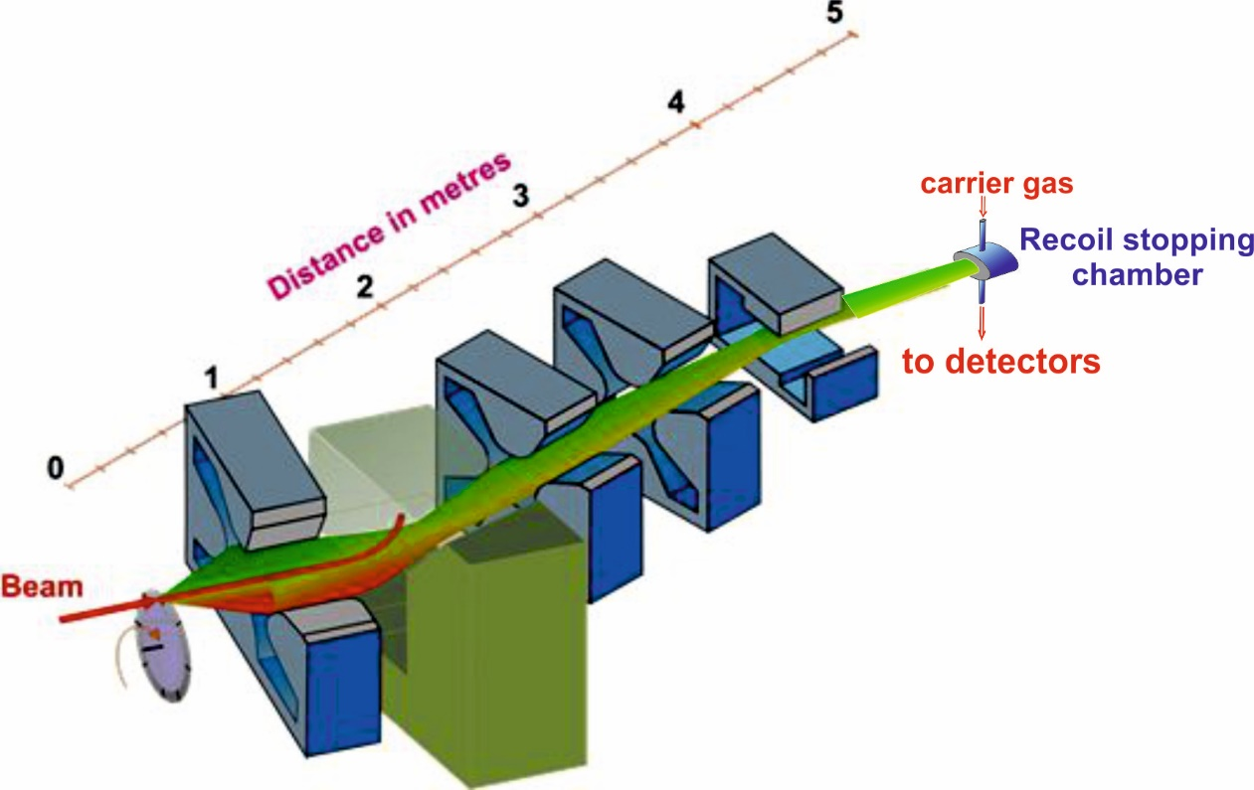
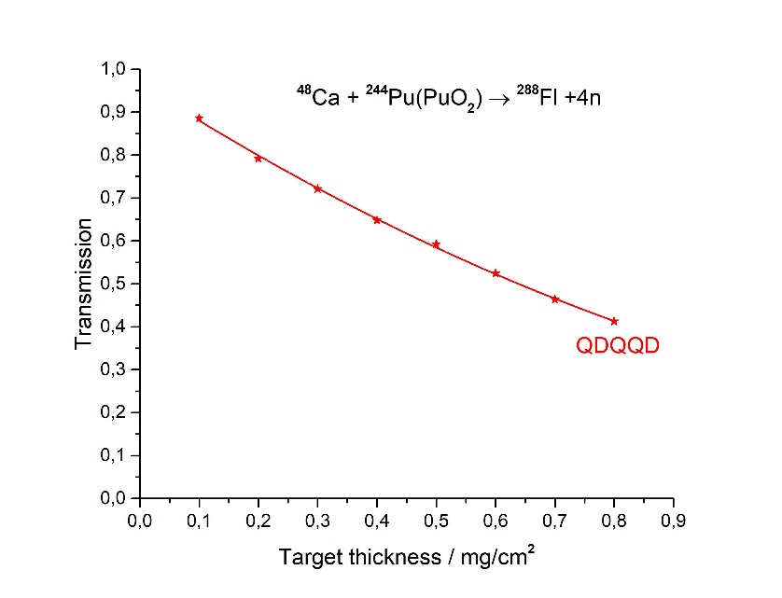
Gas-filled pre-separator GFS-3
(Q_{V}D_{H}Q_{H}Q_{V}D)
Reaction | Transmission
²⁴⁴Pu(⁴⁸Ca,4n)²⁸⁹114 | 60 %
²⁴⁴Pu(⁵⁸Fe,4n)²⁹⁸120 | 75 %

Slide 47
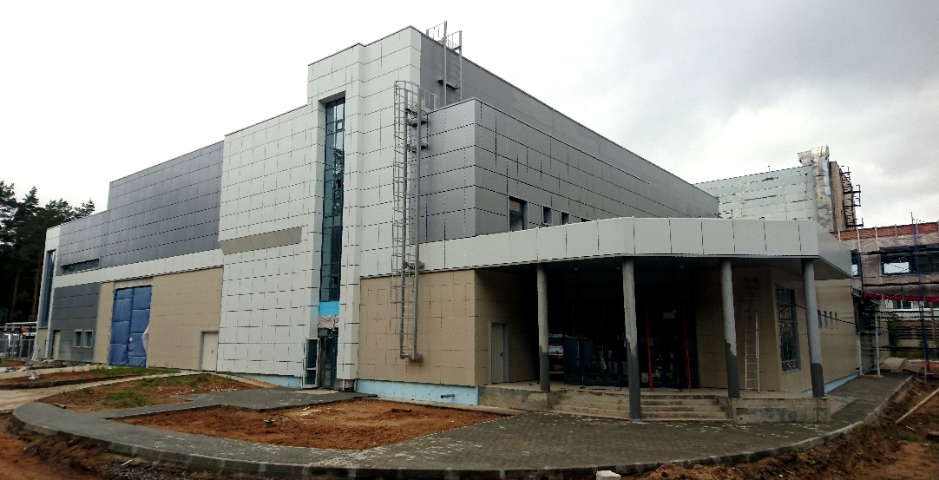
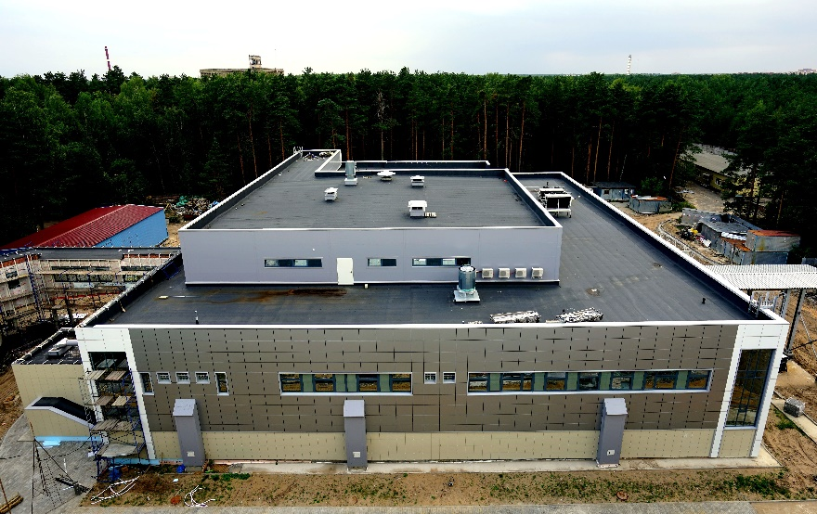
Superheavy Element Factory
time schedule
DC-280
SHE Factory Building: Completion - Dec 2017; commissioning - Jan – April 2018
DC-280 cyclotron: Assembling – Dec 2017; commissioning – Jan - April 2018
Gas-Filled Separator: Installation – Dec 2017; commissioning – Jan - July 2018
Onset of first-day experiments – Sept-Nov 2018

Slide 48
U400R CYCLOTRON
stand-alone & post-accelerator
U400R (expected)
Ion | Ion energy [MeV/A] | Output intensity
⁶He | 2.8 ÷ 14 | 10⁸
⁸He | 1.6 ÷ 8 | 10⁵
⁷Li | 2-17 | 1×10¹⁴
¹⁶O | 6,4 -27 | 1×10¹⁴
⁴⁰Ar | 1-5,1 | 6×10¹³
⁴⁸Ca | 1,6-11 | 1.5×10¹³
⁵⁰Ti | 4,1-21 | 6×10¹²
⁵⁸Fe | 1,2-7,5 | 6×10¹²
⁸⁴Kr | 0,8-3,5 | 2×10¹²
¹³²Xe | 0,8-3,5 | 3×10¹²
²³⁸U | 1,5- 8 | 5×10¹¹
Fusion-fission;
Quasi-fission;
Nuclear spectroscopy;
New heavy isotopes;
Multi nucleon transfer reactions;
SHE chemistry;
Reactions with exotic nuclei;
Structure of light exotic nuclei;

Slide 49
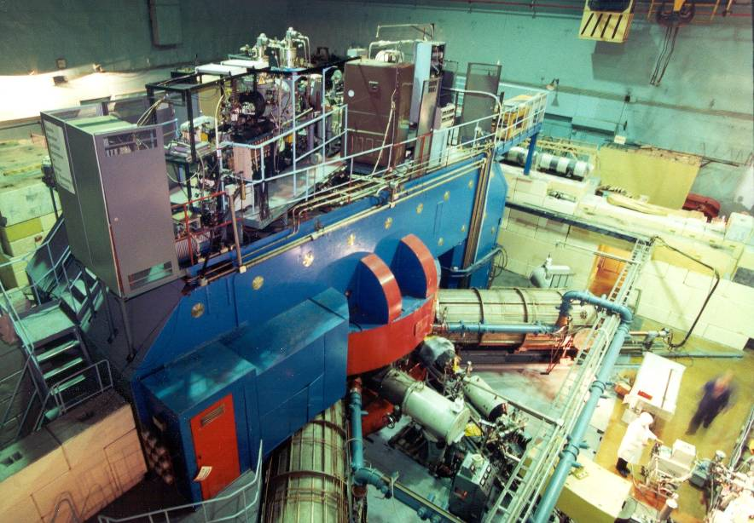
U400M CYCLOTRON
stand-alone & driving accelerator
U400M E=30 ÷ 50 MeV/A E=4.5 ÷ 9 MeV/A
Ion | Ion energy [MeV/A] | Output intensity
⁷Li | 35 | 6×10¹³
¹⁸O | 33 | 1×10¹³
⁴⁰Ar | 40 | 1×10¹²
⁴⁸Ca | 5 | 6×10¹²
⁵⁴Cr | 5 | 3×10¹²
⁵⁸Fe | 5 | 3×10¹²
¹²⁴Sn | 5 | 2×10¹¹
¹³⁶Xe | 5 | 4×10¹¹
²³⁸U | 7 | 2×10¹⁰
Properties and structure of light exotic nuclei;
Astrophysics;
Reactions with exotic nuclei;
Light neutron-rich nuclei;
Deep inelastic scattering;
Producing of RIBs.
Notes:
49

Slide 50
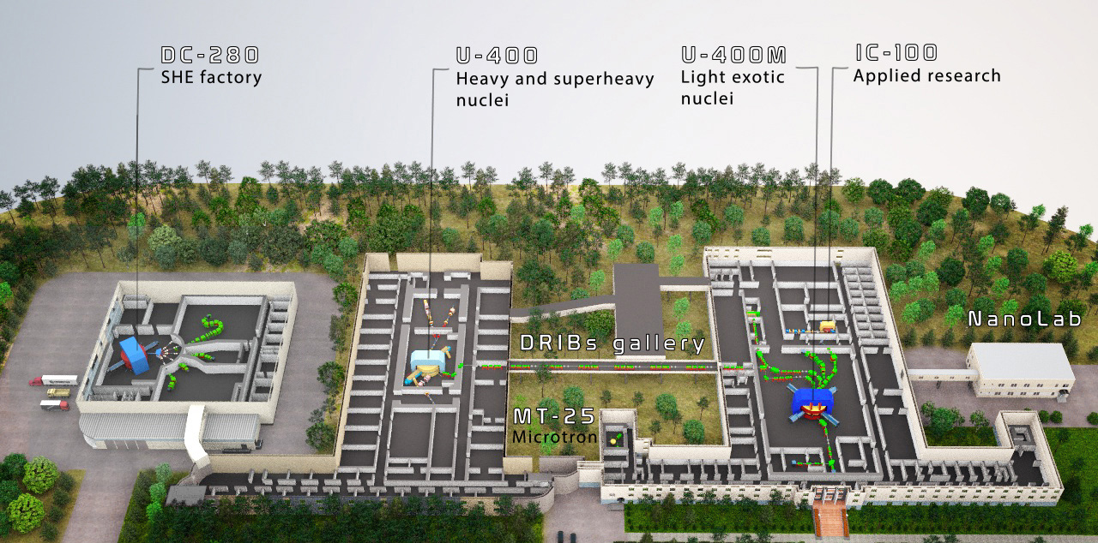

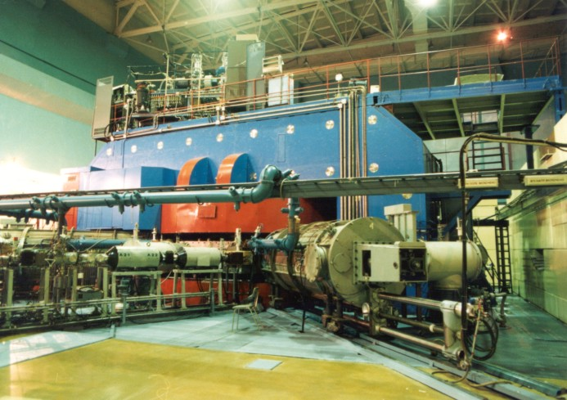

Slide 51
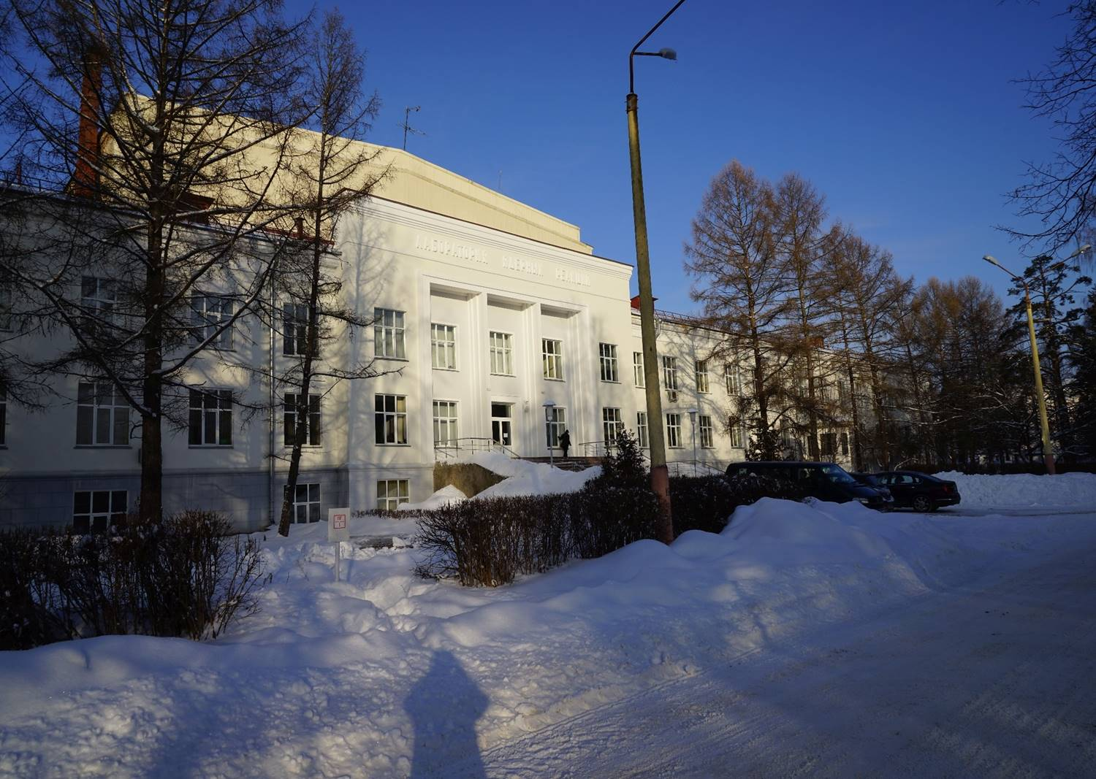
THANK YOU
FOR YOUR
ATTENTION !
Flerov Laboratory of Nuclear Reactions (JINR)

Slide 52
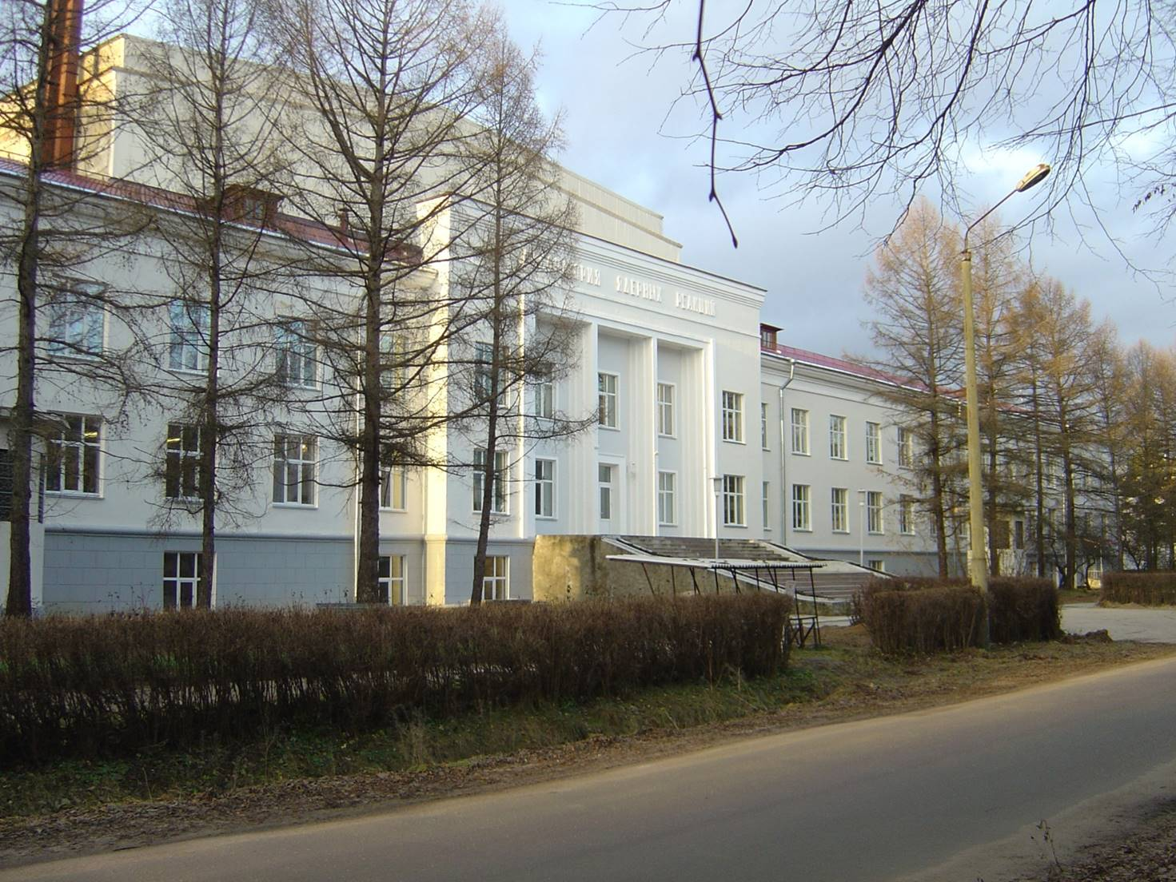
THANK YOU
FOR YOUR
ATTENTION !
Flerov Laboratory of Nuclear Reactions (JINR)

