Slide 1
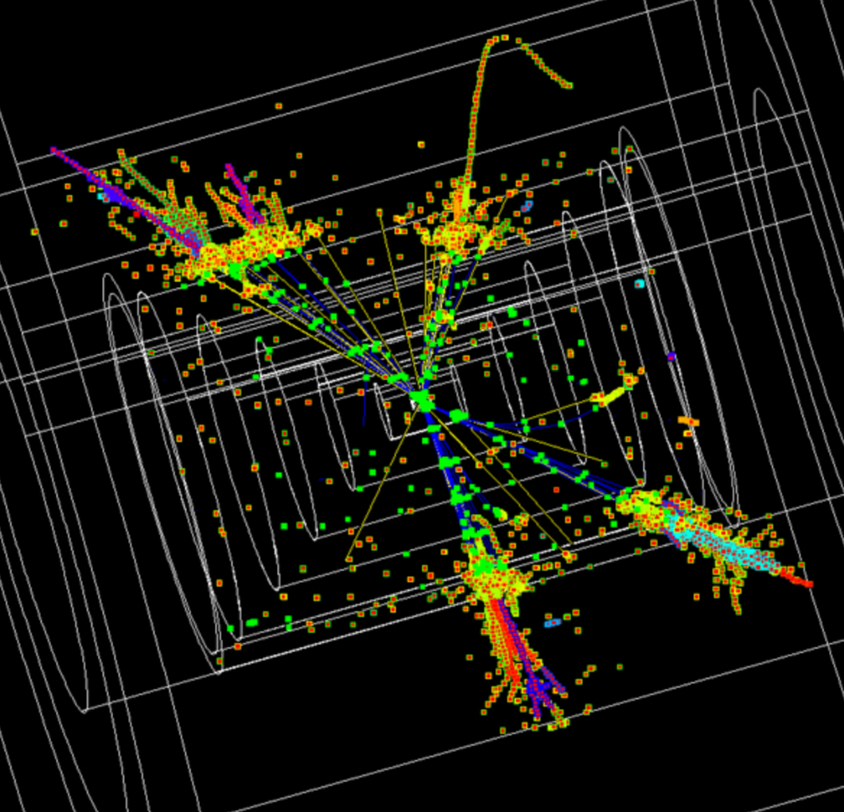

QCD challenges at present and future colliders
Andrea
Banfi
LFC19 Workshop - 9 September 2019 – Trento

Slide 2
Outline
Personal selection of intriguing theoretical problems, relevant to the physics of present and future colliders
Inclusive cross sections (N³LO)
Differential distributions (NNLO and resummations)
Hadronisation at future electron-positron colliders
Important left-over topics, that however share some similarities with the above
Monte-Carlo event generators
Top cross sections (see Wednesday’s talks)
Boosted object searches

Slide 3
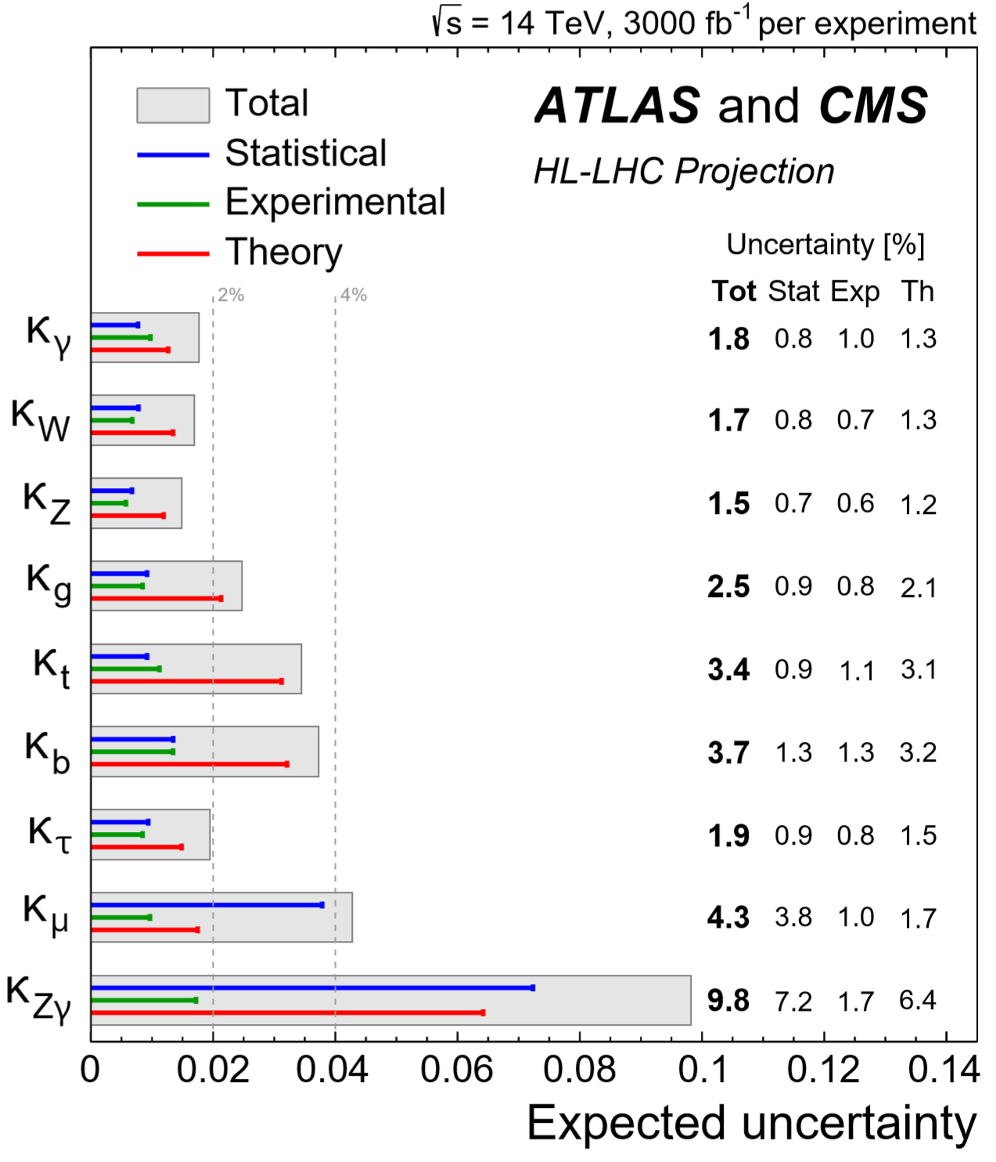
Discovery through precision
Higgs couplings after HL-LHC
In the absence of striking new physics signals, we can still grasp the scale of new physics by looking at deviations from SM expectations
After HL-LHC, uncertainties will be largely dominated by theory
Precision is the key: can theory accuracy be pushed at the % level?
[HL-LHC W2 report 1902.00134]

Slide 4
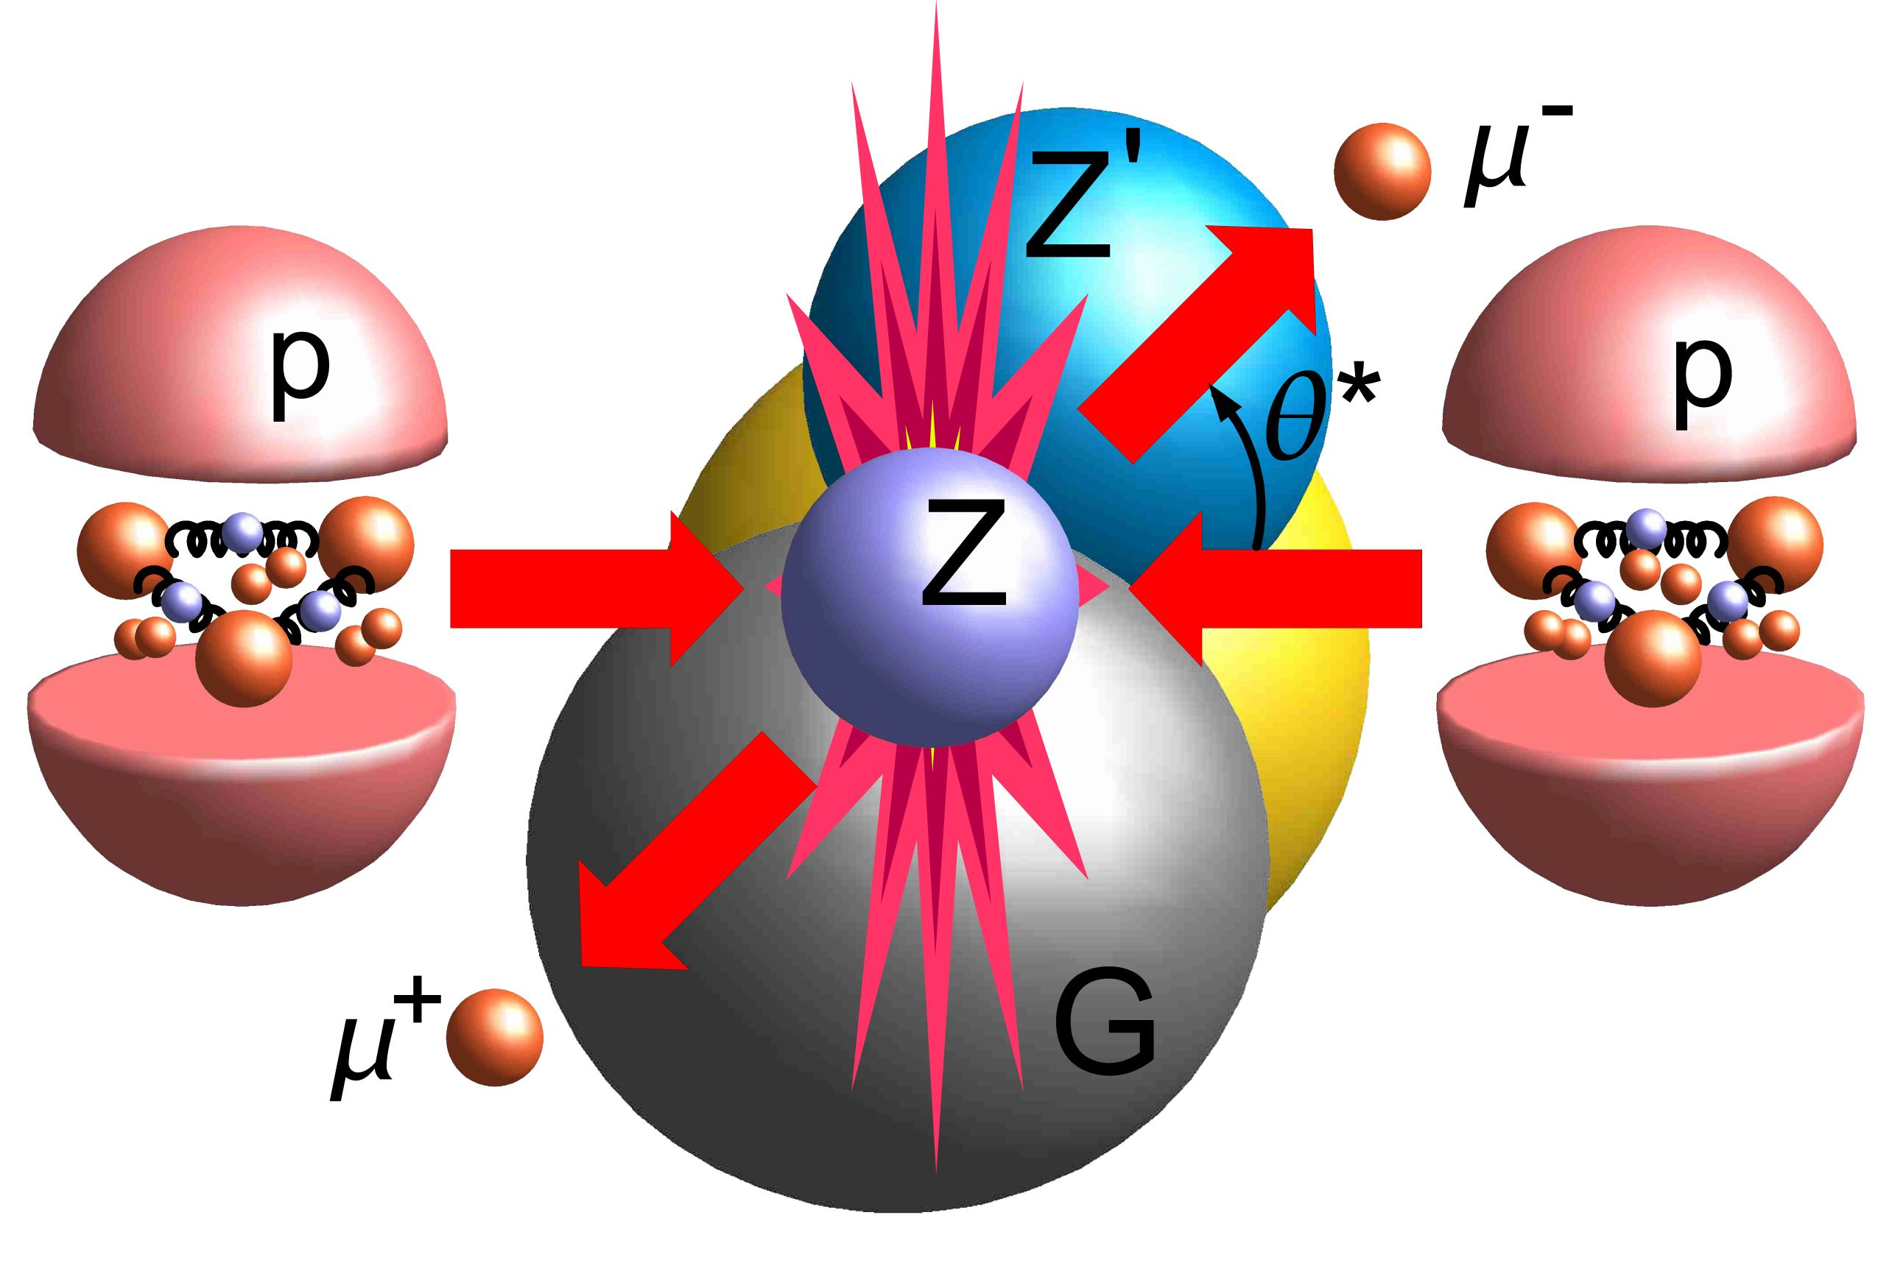
Precision through PT QCD
Cross sections are computed in QCD via a factorisation formula
[http://cms.web.cern.ch/news/weak-mixing-light-and-heavy]
PDFs: extracted from data
evolution is perturbative
Partonic cross section:
expansion in the QCD coupling

Slide 5

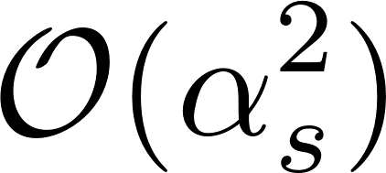
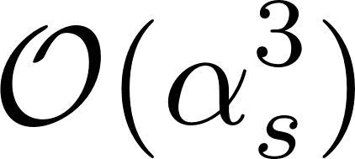
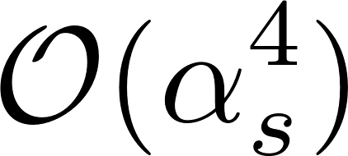
Perturbative QCD
LO
NLO
NNLO
Production of numerically stable results requires also clever methods to achieve cancellation of infrared singularities between real and virtual corrections

Slide 6
Inclusive cross sections

Slide 7

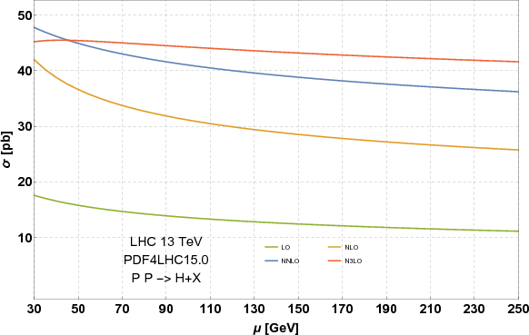
QCD is strong interactions
QCD cross sections converge slowly need to go to high perturbative order to have satisfactory theoretical control
[Mistlberger 1802.00833]
New state of the art for inclusive cross sections: N³LO

Slide 8
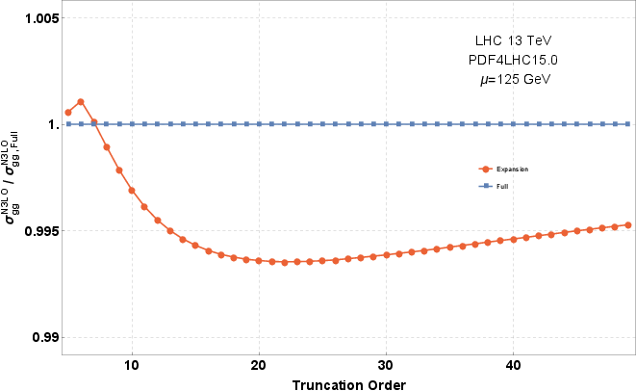
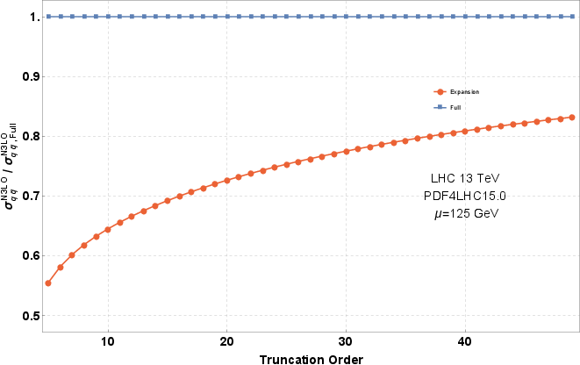
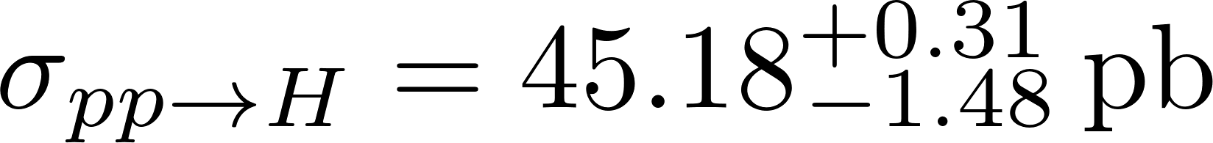
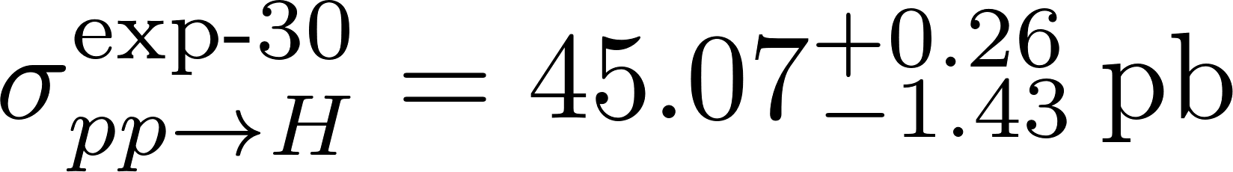
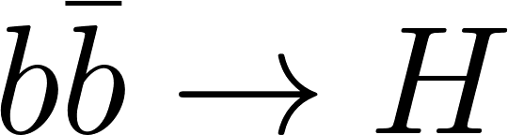
Higgs total cross section
Exact calculation in the limit of infinite top mass (HEFT)
Threshold expansion used in gluon-fusion calculation converges slowly for quark channels
[Anastasiou et al. 1602.00695]
[Mistlberger 1802.00833]
All relevant massless integrals for 2→1 processes at N³LO known
New N³LO calculation for
possibility of achieving 0.1% accuracy in DY total cross section
[Duhr Dulat Mistlberger 1904.09990]

Slide 9
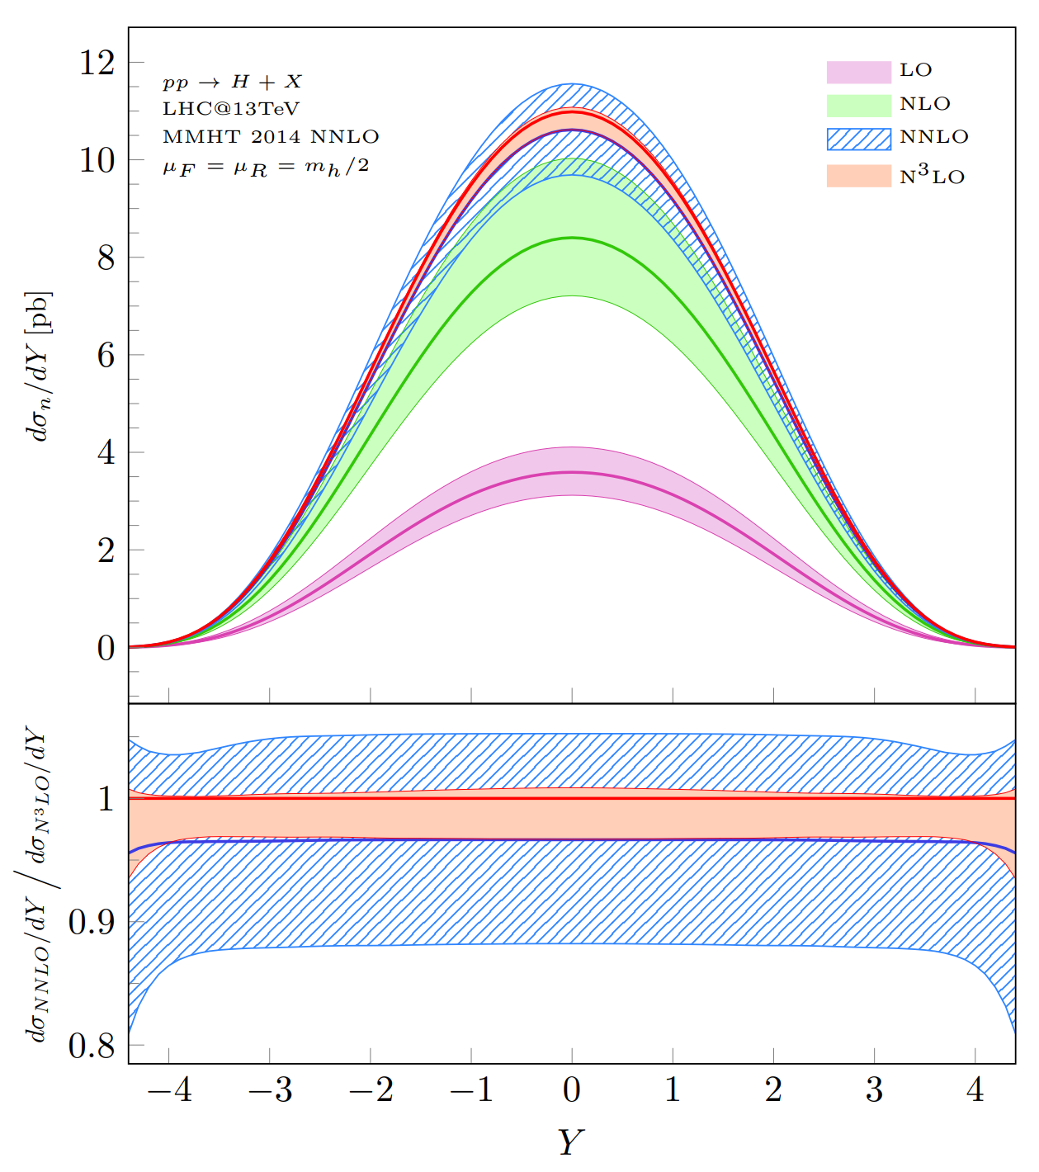
Higgs rapidity distribution
The Higgs boson rapidity distribution in gluon fusion (HEFT) can also be computed at N³LO using a threshold expansion
Note the remarkable convergence of the perturbative QCD expansion
[Dulat Mistlberger Pelloni 1810.09462]

Slide 10
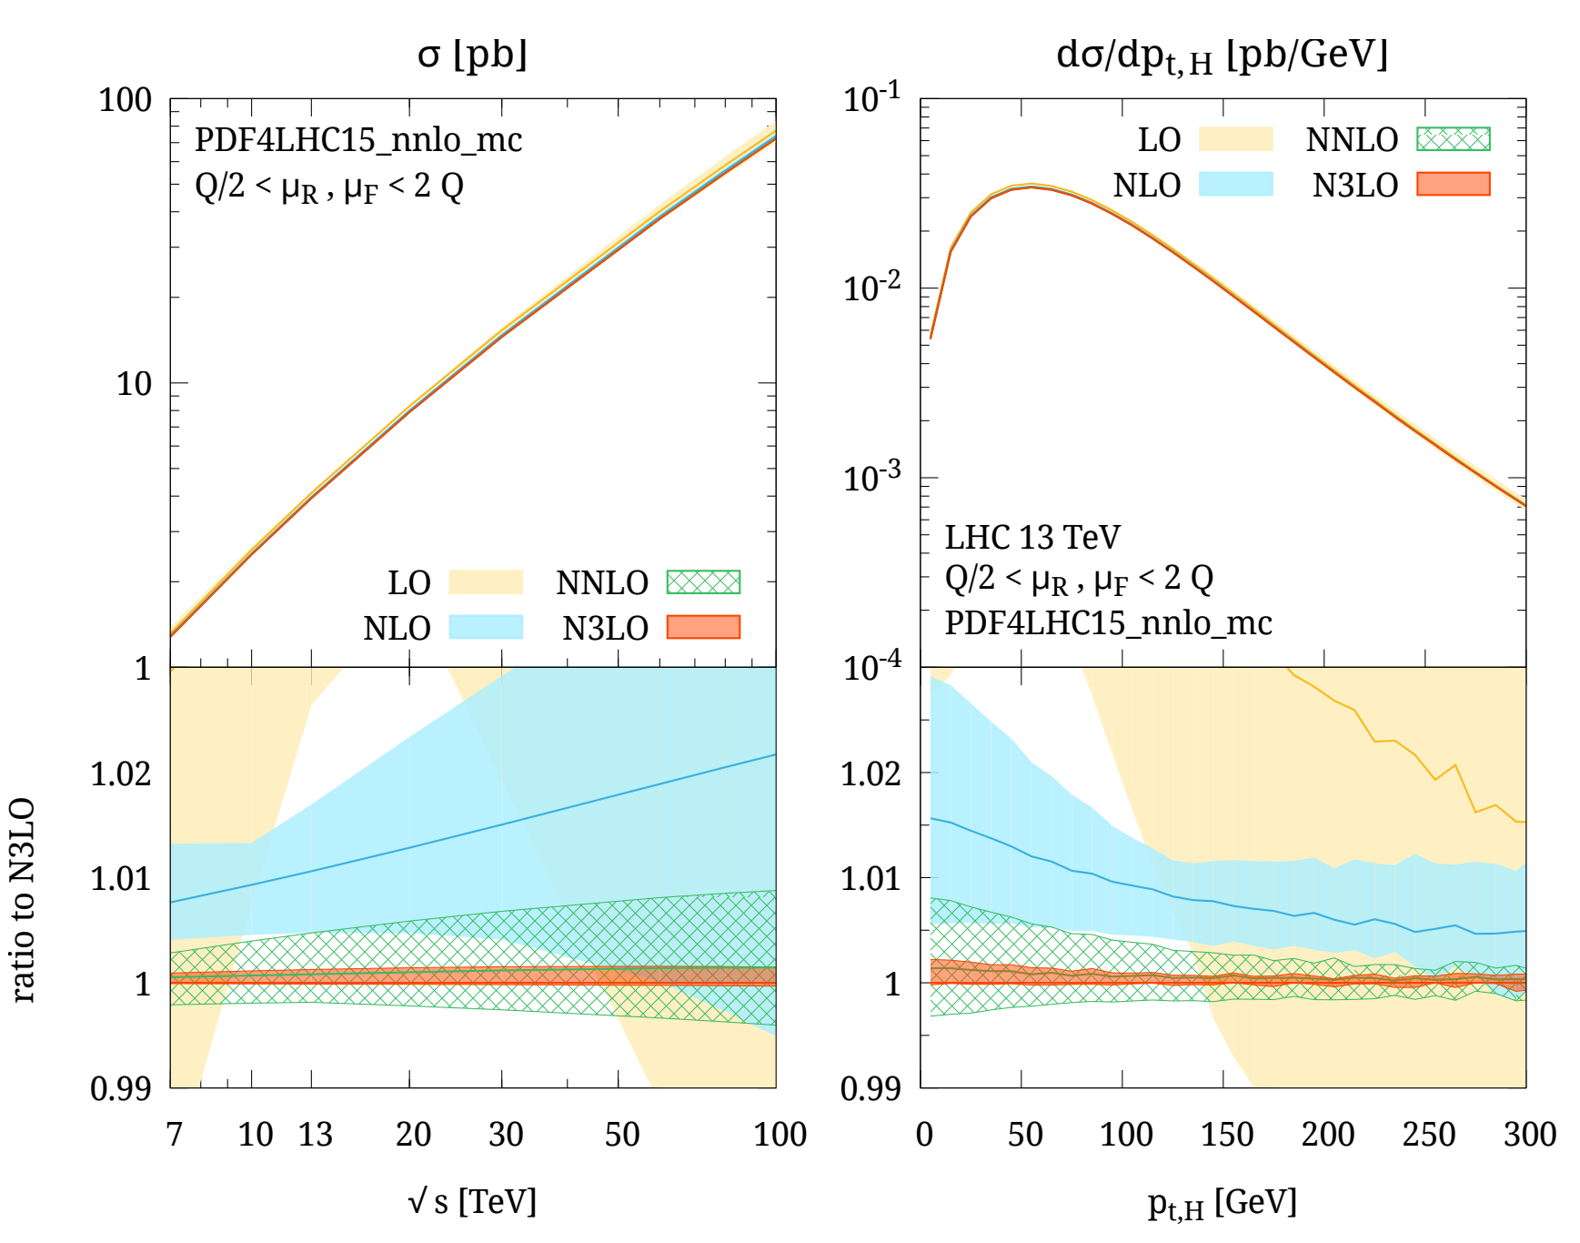
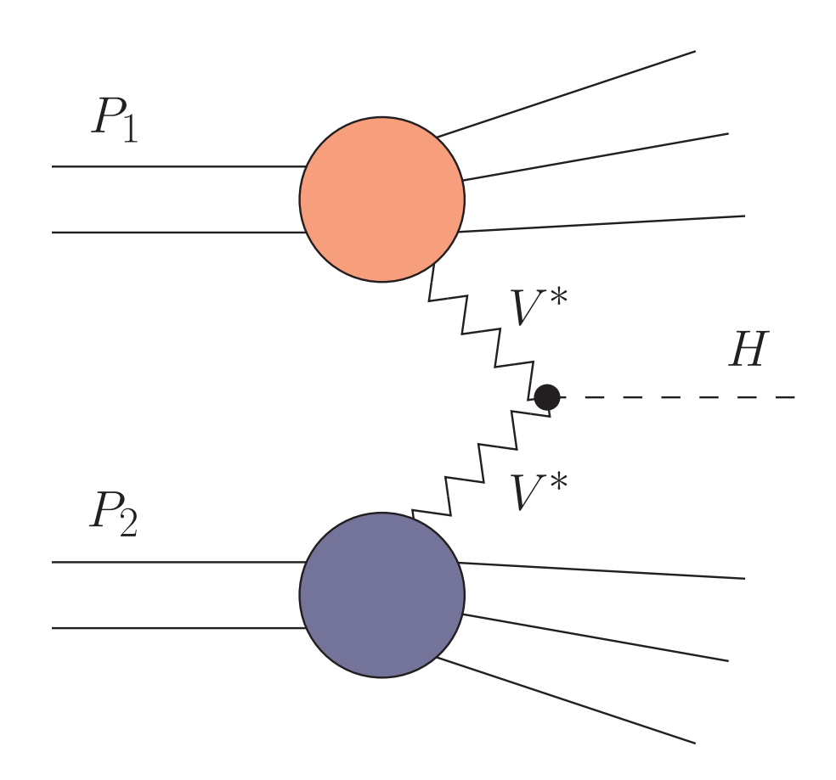
Inclusive vector-boson fusion
Vector boson fusion is known at N³LO in the DIS-approximation
[Dreyer Karlberg 1606.00840]
Non-factorisable NNLO corrections contribute at the sub-percent level
[Liu Melnikov Penin 1906.10899]

Slide 11
Differential distributions

Slide 12
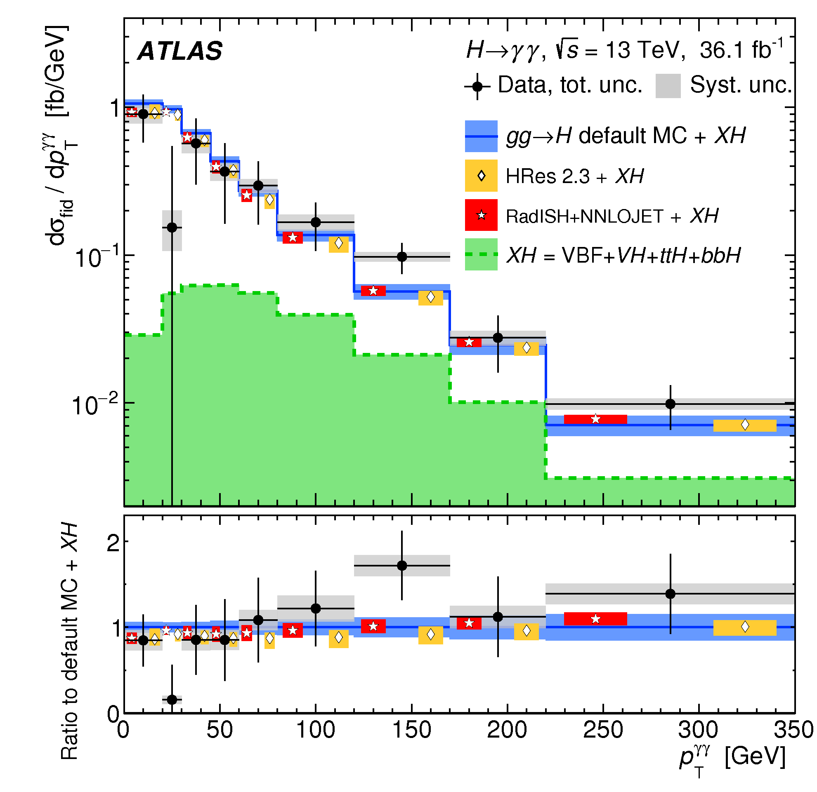
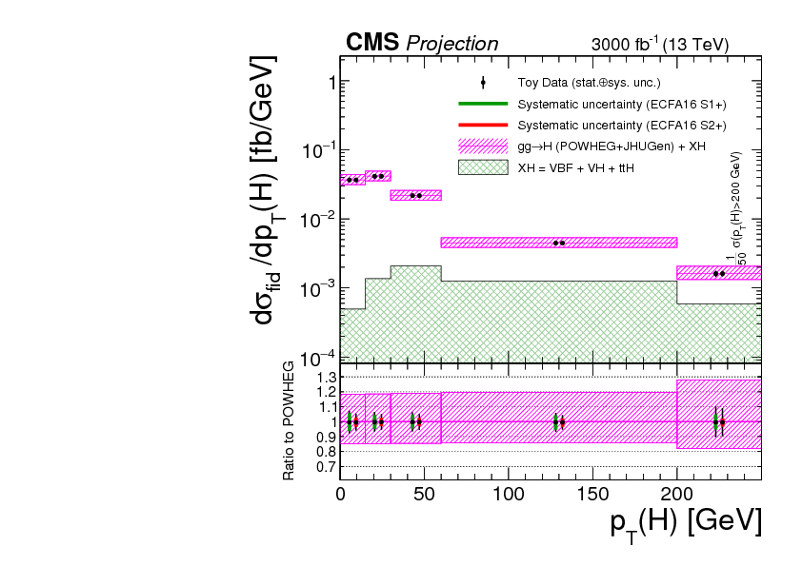
Differential cross sections
In differential cross sections, experimental error is close to theory error
Experimental error will shrink with higher luminosity and energy
[1802.04146]
[CMS-PAS-FTR-16-002]
high-p_{T} region, sensitive to new physics

Slide 13
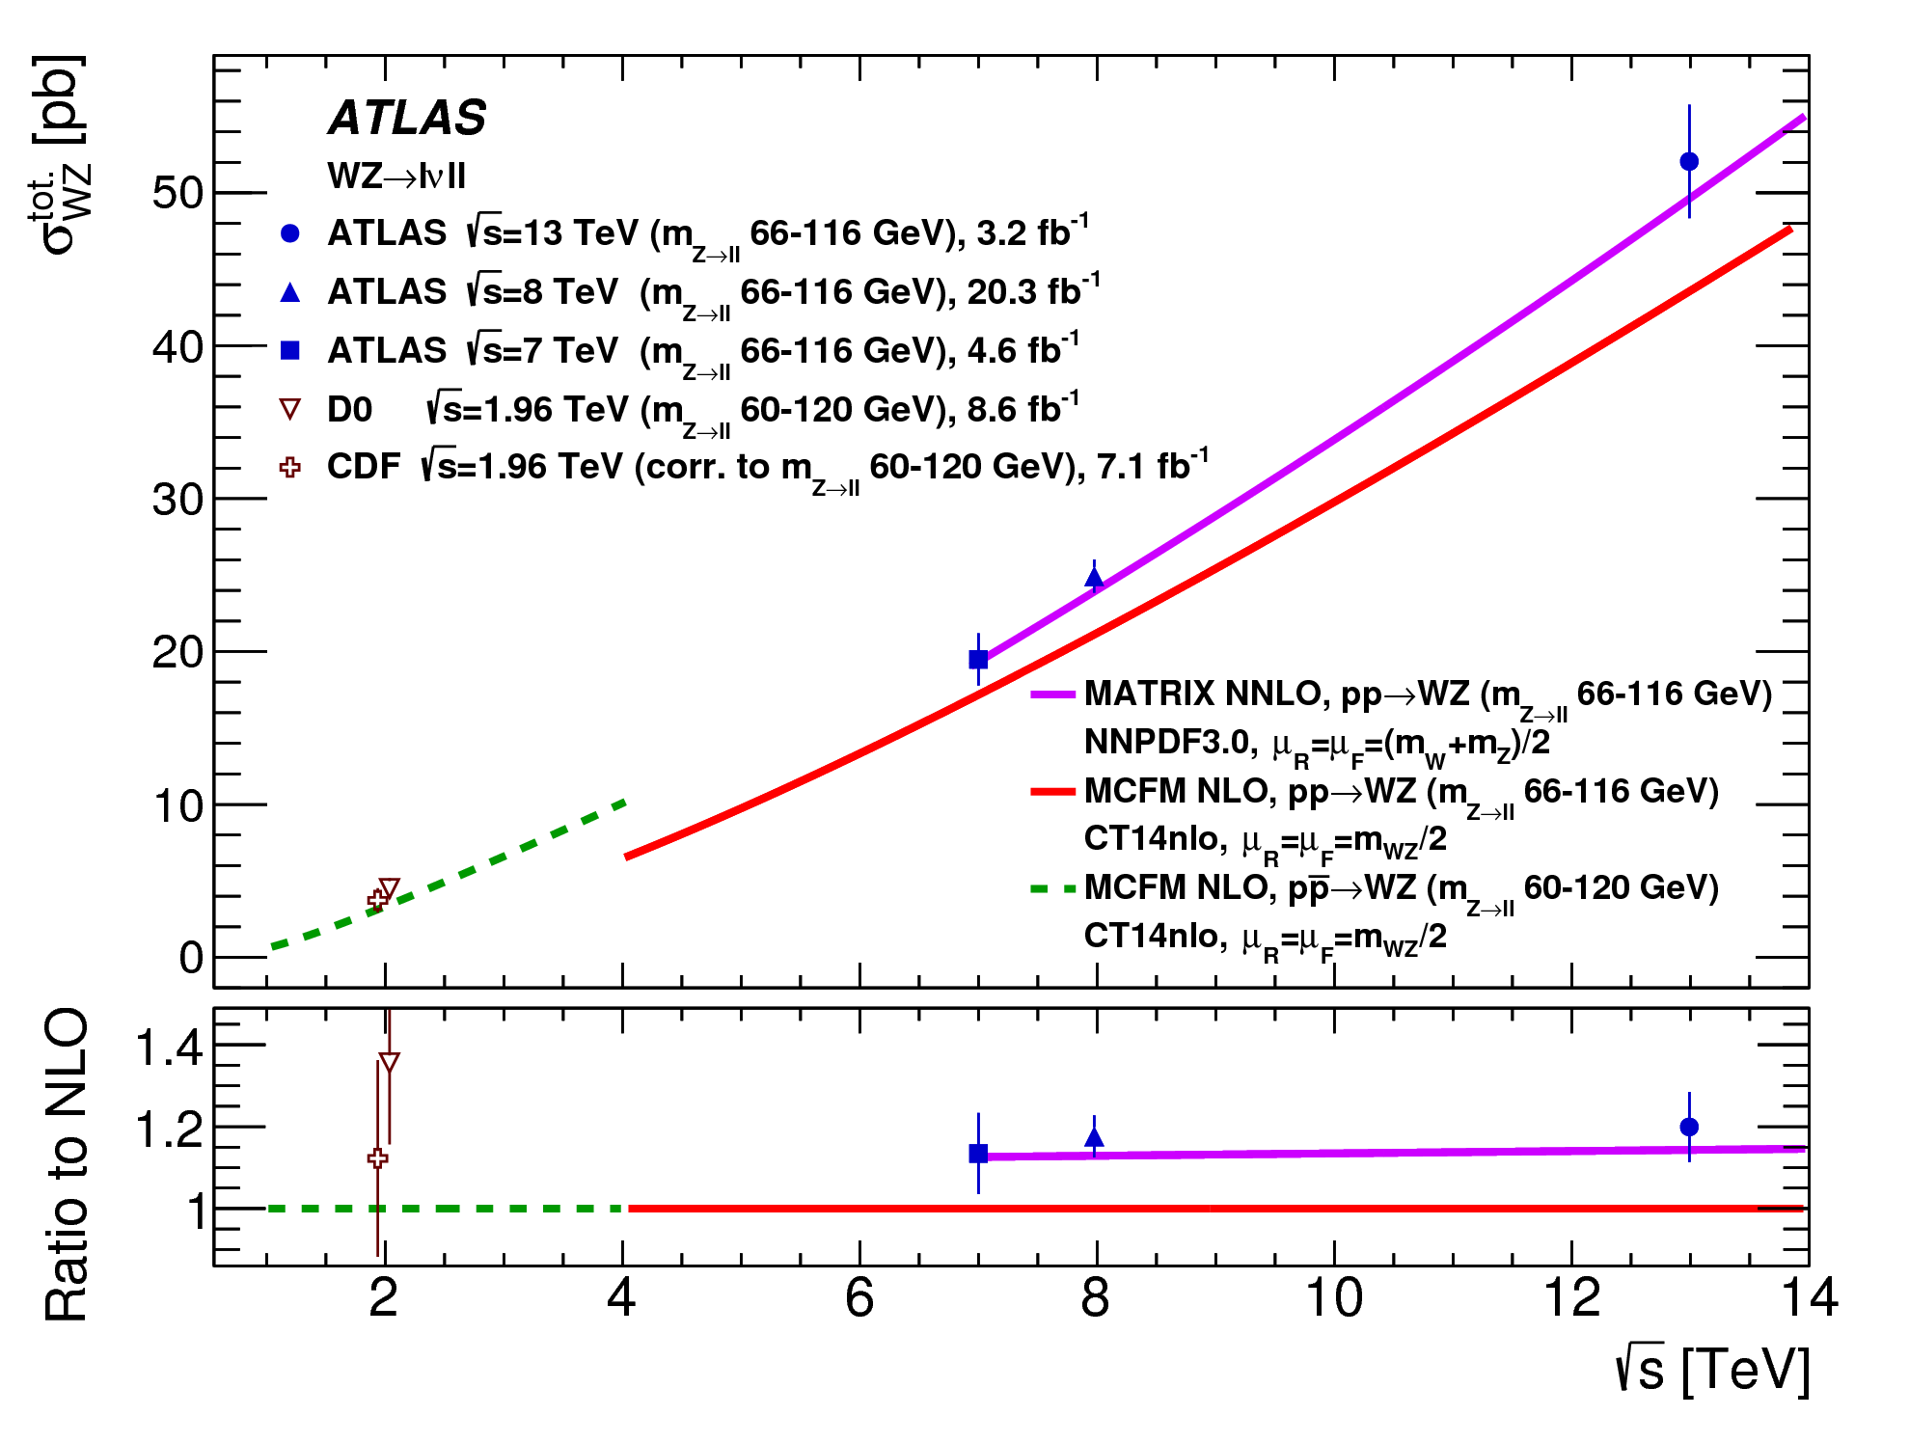
NNLO is needed and works
In many SM model process, NNLO is needed for a satisfactory description of LHC data
[1606.04017]

Slide 14
NNLO for 2→2 processes
All SM 2→2 processes are known at NNLO
Impressive progress in the developments of methods for the cancellation of infrared divergences between real and virtual corrections
“Antenna” subtraction [Gehrmann-De Ridder Gehrmann Glover hep-ph/0505111]
q_{T} slicing [Catani Grazzini hep-ph/0703012]
“Sector decomposition and FKS” subtraction [Czakon 1101.0642]
“Jettiness” slicing [Boughezal Liu Petriello 1504.02540]
“Projection to Born [Cacciari Dreyer Karlberg Salam Zanderighi 1506.02660]
“Colorful NNLO [Del Duca Duhr Kardos Somogyi Trocsanyi 1603.08927]
Novel more efficient subtraction methods are being developed
Fully differential predictions available fiducial cuts!
“Nested soft-collinear” subtraction [Caola Melnikov Rontsch 1702.01352]
“Local analytic sector” subtraction [Magnea Maina Pelliccioli Signorile-Signorile Torrielli Uccirati 1806.09570]

Slide 15
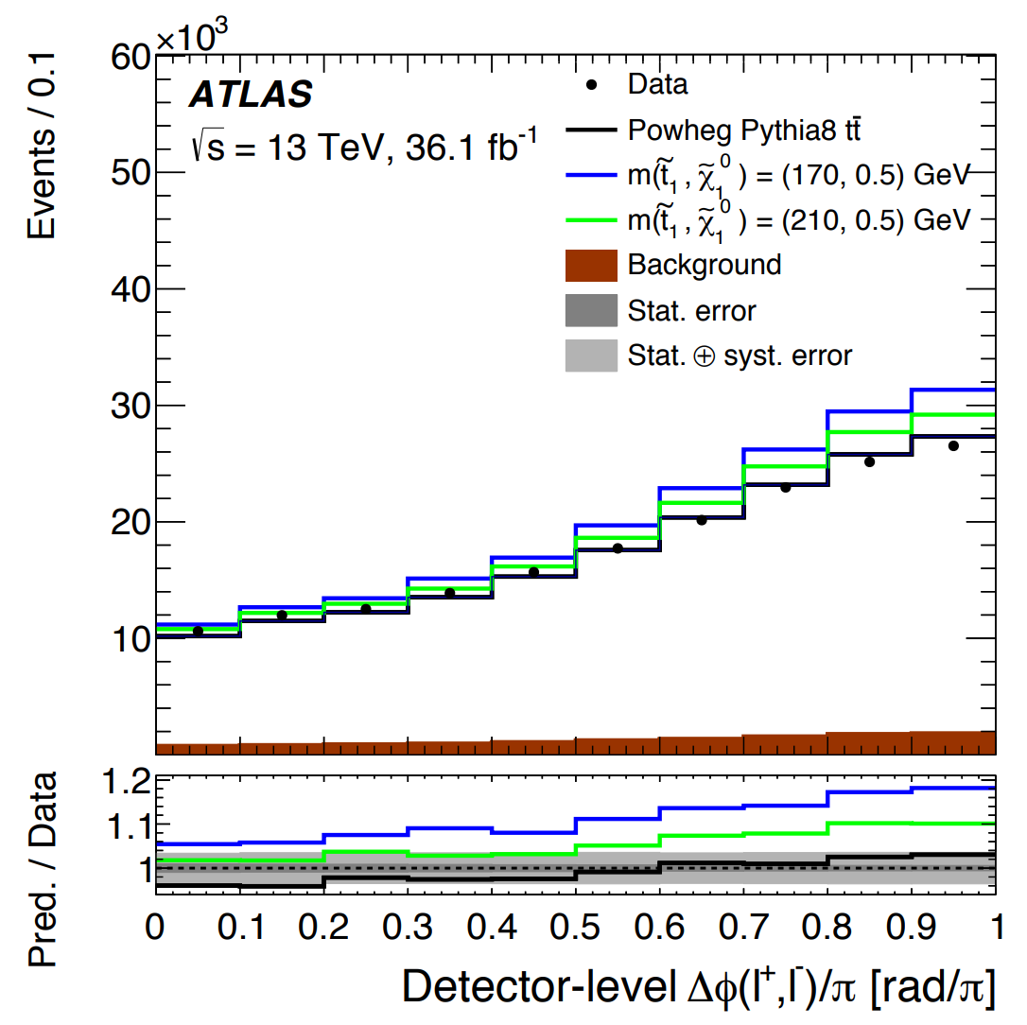
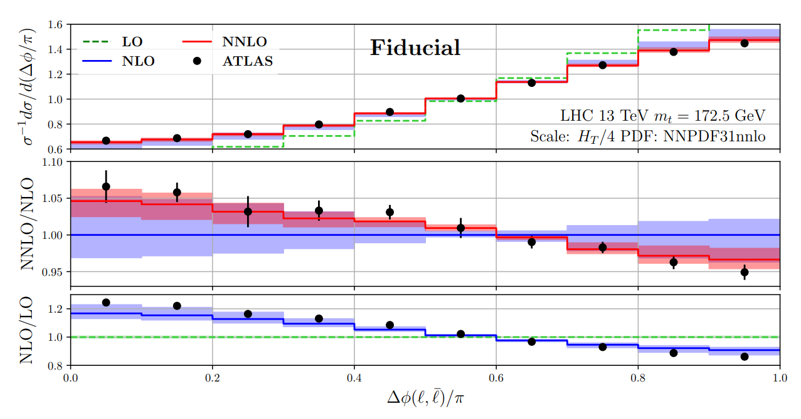
NNLO with fiducial cuts
Example: dilepton azimuthal correlation in top production sensitive to spin correlations between initial and final state probe stops
[Behring Czakon Mitov Papanastasiou Poncelet 1901.05407]
NNLO top production with fiducial cuts is able to correctly describe the dilepton azimuthal decorrelation, unlike the NLO central value
The size of NNLO corrections is around 5%, and within the NLO band

Slide 16
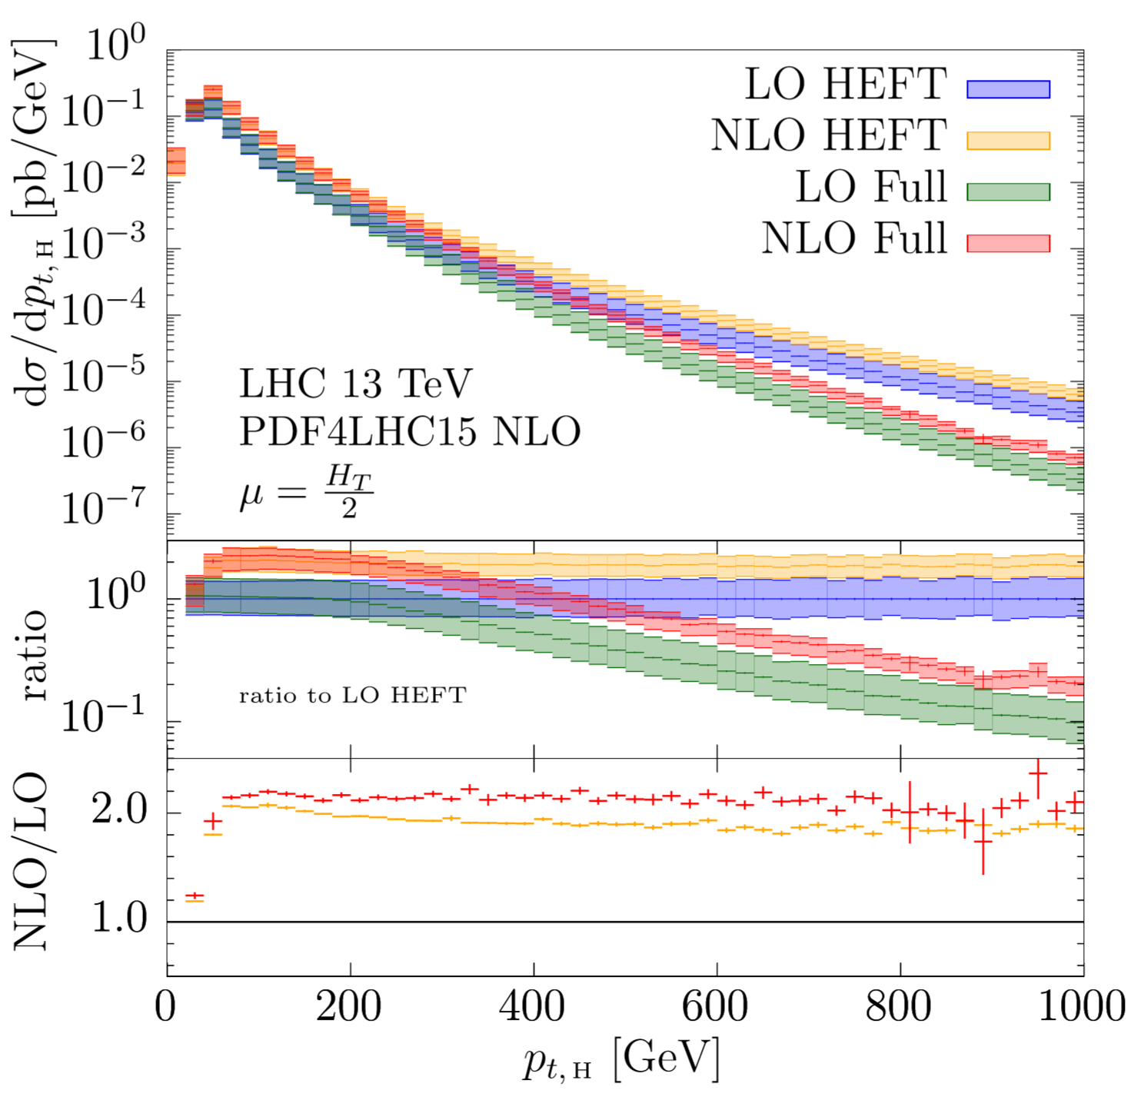
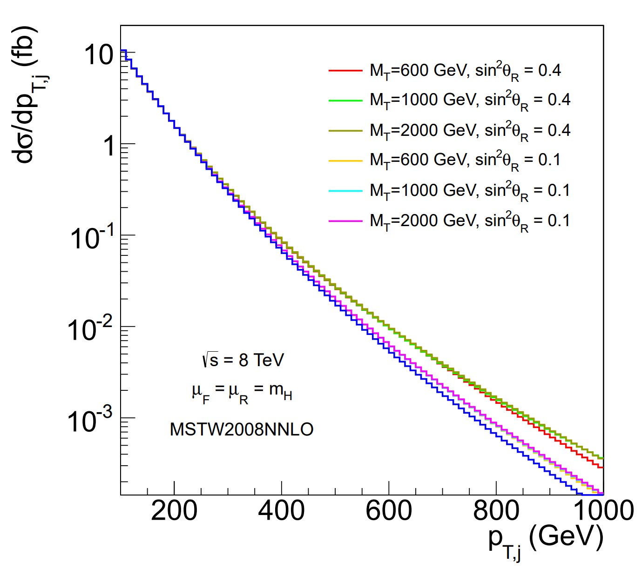
Higgs+1jet@NLO
The tail of the Higgs p_{T} spectrum is sensitive to the presence of BSM physics (e.g. top partners or stops)
[AB Martin Sanz 1308.4771]
No analytical calculation: two-loop integrals with full top-mass dependence from numerical evaluation of two-loop integrals with sector decomposition
[Jones Kerner Luisoni 1802.00349]

Slide 17
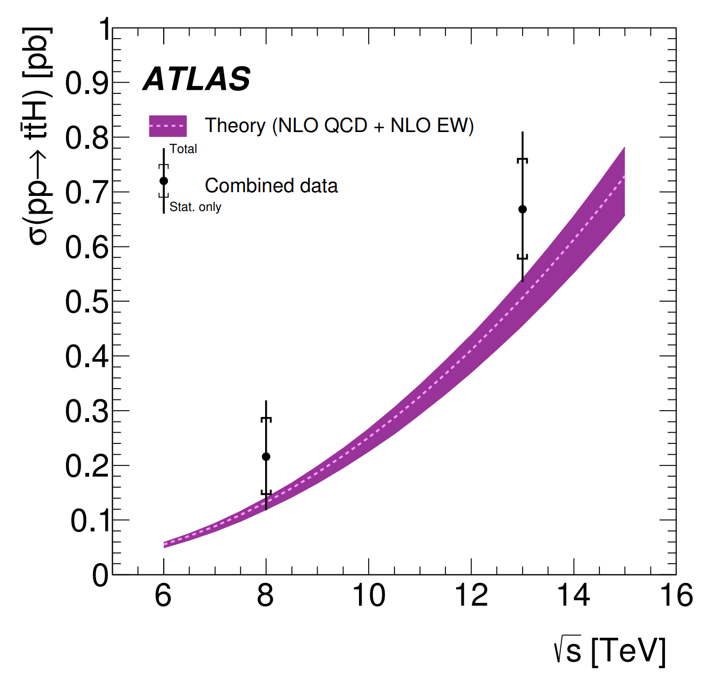
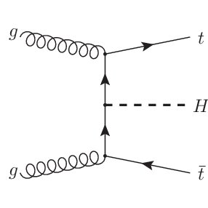
NNLO for 2→3 processes
Important 2→3 processes (e.g. ttH for direct access to the top Yukawa) will be measured with experimental accuracy at the percent level NNLO needed to make best use of this data
[1806.00425]
No 2→3 process has been computed at NNLO yet
Full-colour five-gluon all-plus helicity amplitude is the first-ever analytic two-loop 2→3 amplitude
[Badger Chicherin Gehrmann Heinrich Henn Peraro Wasser Zhang Zoia 1806.00425]

Slide 18
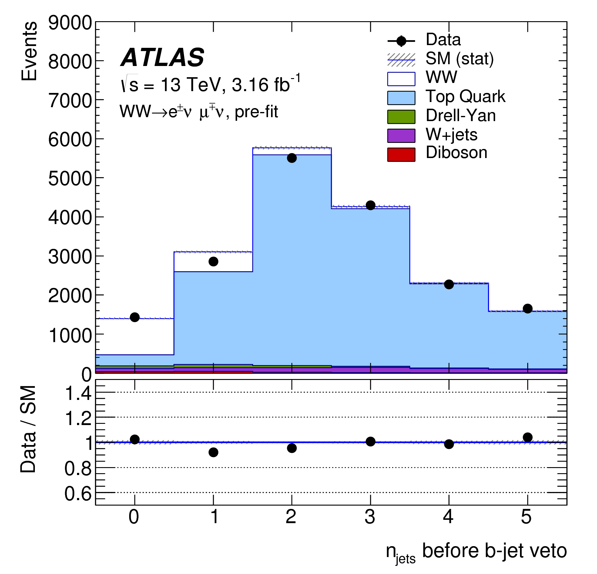
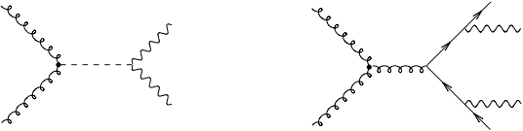

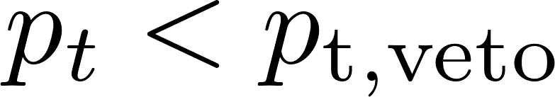
Jet vetoes
In many processes (e.g. WW production), one puts a jet-veto to separate signal from background (typically from tops)
[1706.01702]
The main object of study is the zero-jet cross section , obtained by imposing that all jets have

Slide 19
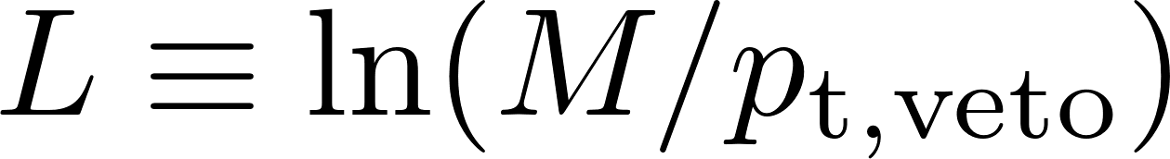


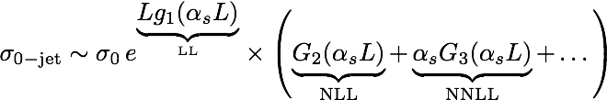
Jet-veto resummations
The zero-jet cross section is an example of a two-scale observable, affected by logarithms that need to be resummed at all orders

Slide 20
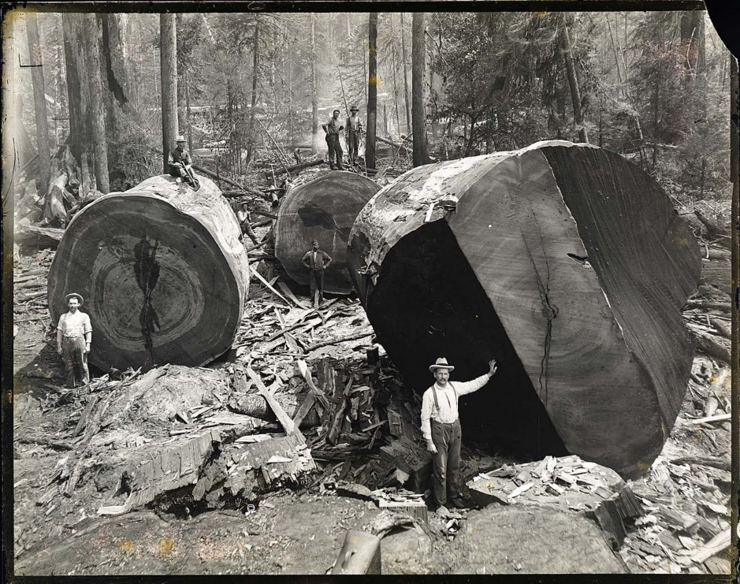
Jet-veto resummations
The zero-jet cross section is an example of a two-scale observable, affected by logarithms that need to be resummed at all orders

Slide 21
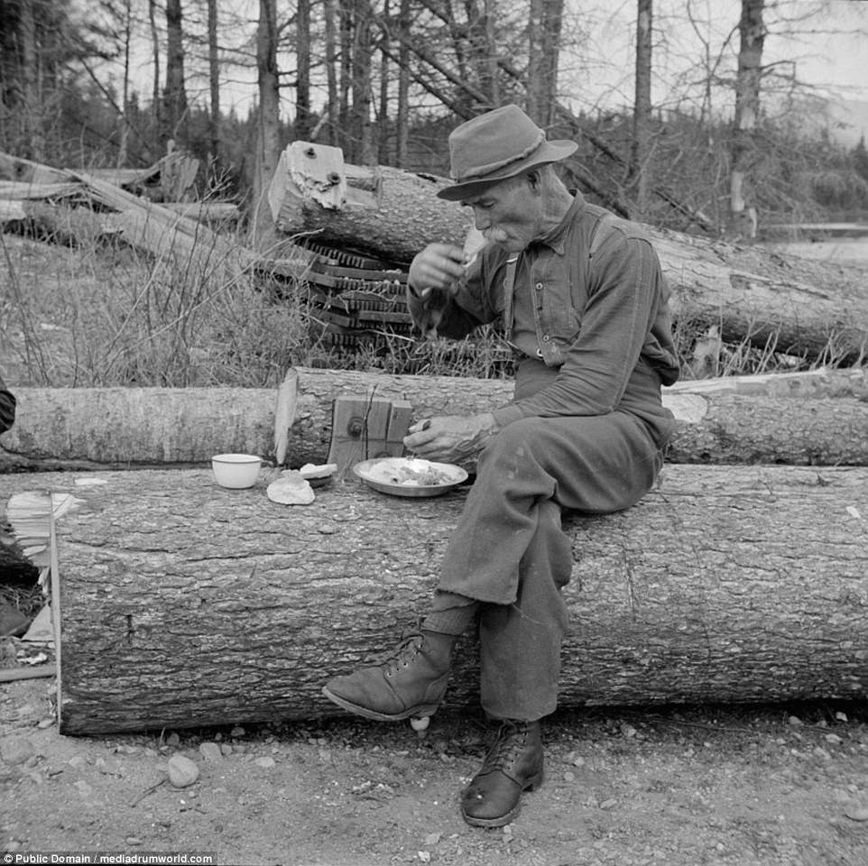
Jet-veto resummations
The zero-jet cross section is an example of a two-scale observable, affected by logarithms that need to be resummed at all orders

Slide 22

Jet-veto resummations
The zero-jet cross section is an example of a two-scale observable, affected by logarithms that need to be resummed at all orders

Slide 23
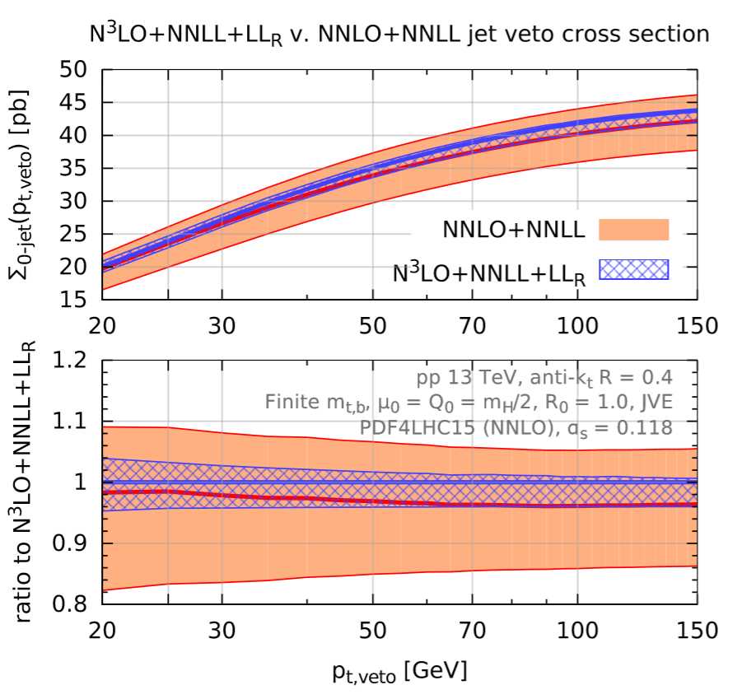
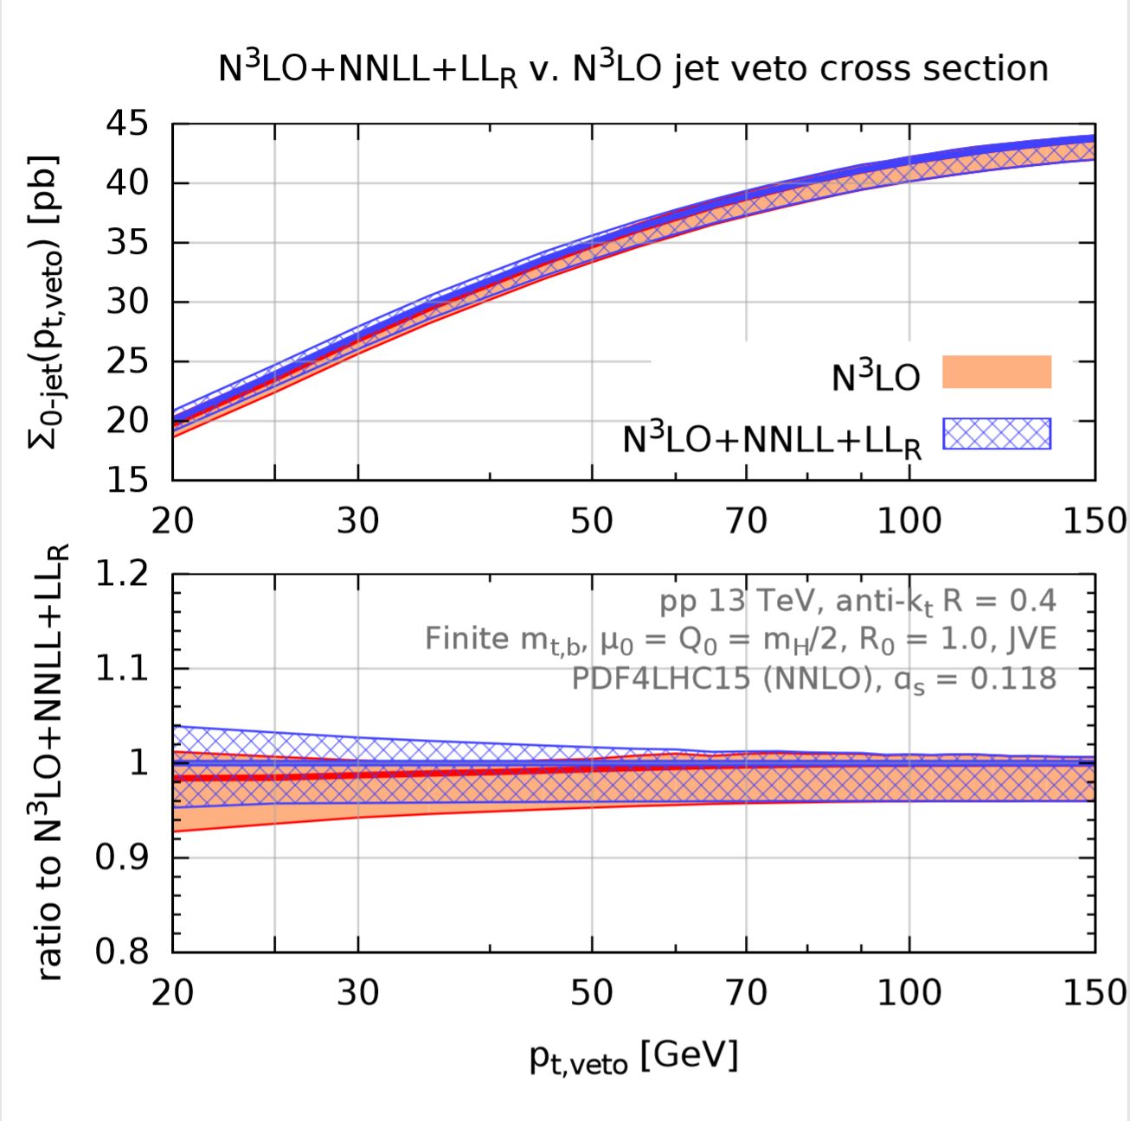
Jet-veto: NNLL vs NNLO
Jet-veto resummations have reached a very high accuracy (NNLL+N³LO)
[AB Caola Dreyer Monni Salam Zanderighi Dulat 1511.02886]
Reduction of uncertainty mainly due to H+1jet@NNLO NNLO predictions work down to remarkably low transverse momenta!
NNLO calculations now fully differential, what about resummations?

Slide 24
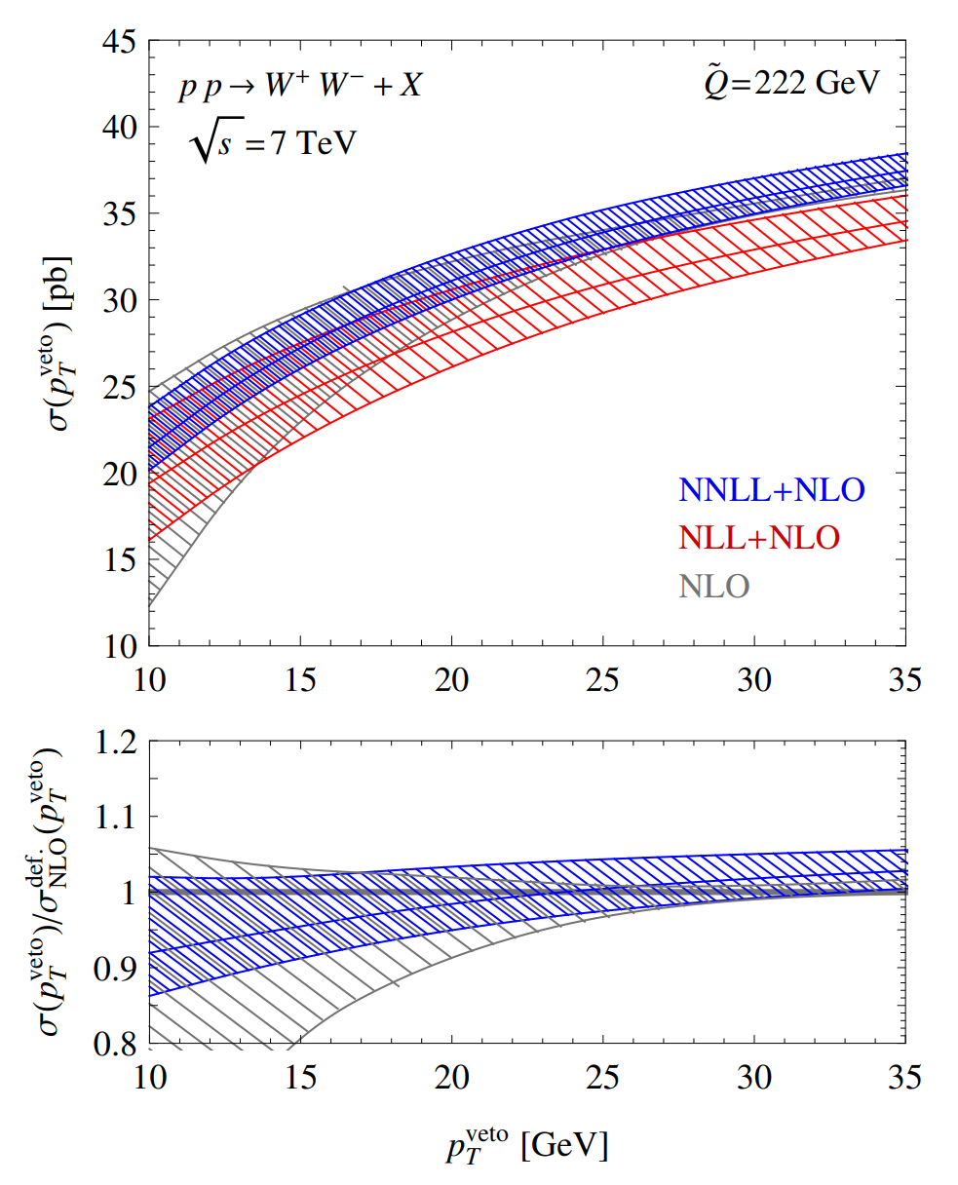
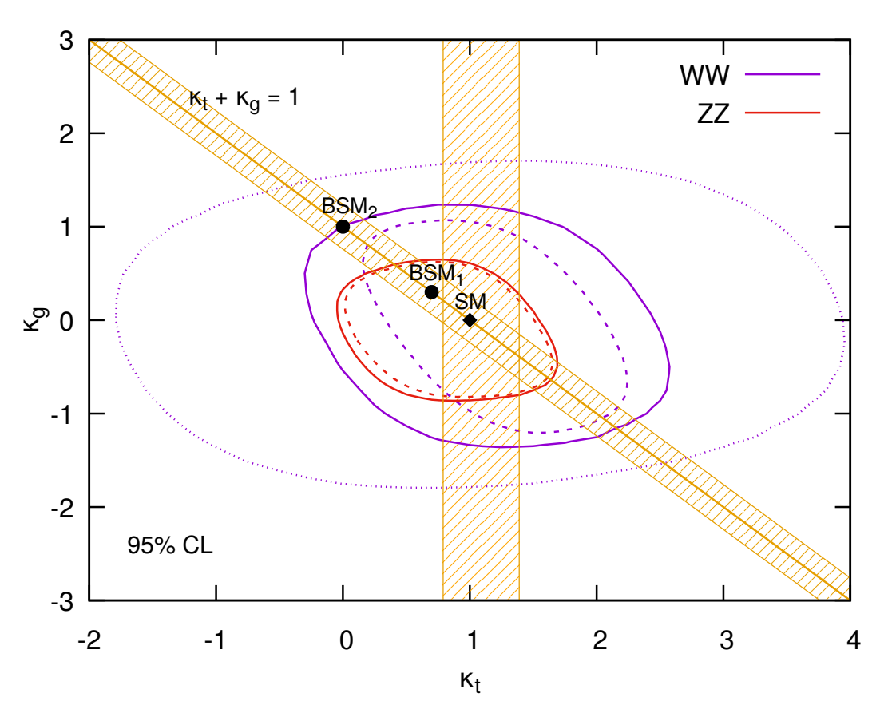
Resummations with fiducial cuts
Resummations live in the Born phase space leptonic cuts with minor modifications of fixed-order codes, and at the cost of a LO calculation
Fiducial NNLL jet-veto resummations for colour singlets both in SCET (MADGRAPH_MC@NLO_SCET) and in QCD (MFCM-RE)
no uncertainties
HL-LHC 3 ab⁻¹
scale uncertainties
[Becher Frederix Neubert 1412.8408]
[Arpino AB Kauer Jaeger 1905.06646]
Implementations of analytic resummations within fixed-order codes allow separate access to interference between BSM and SM

Slide 25
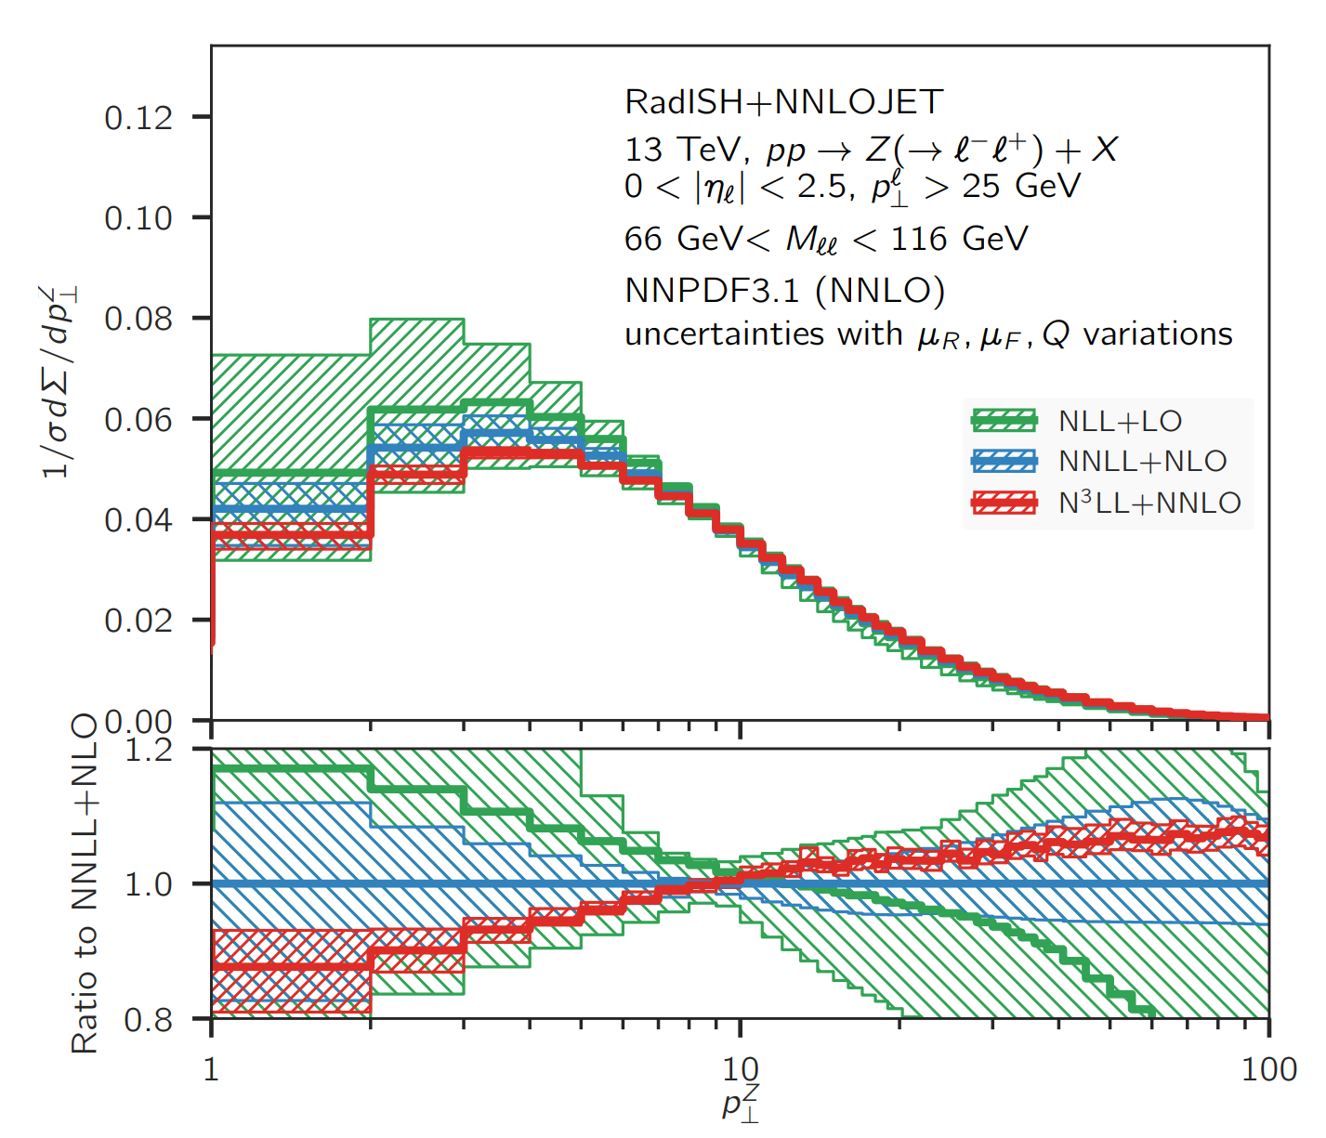
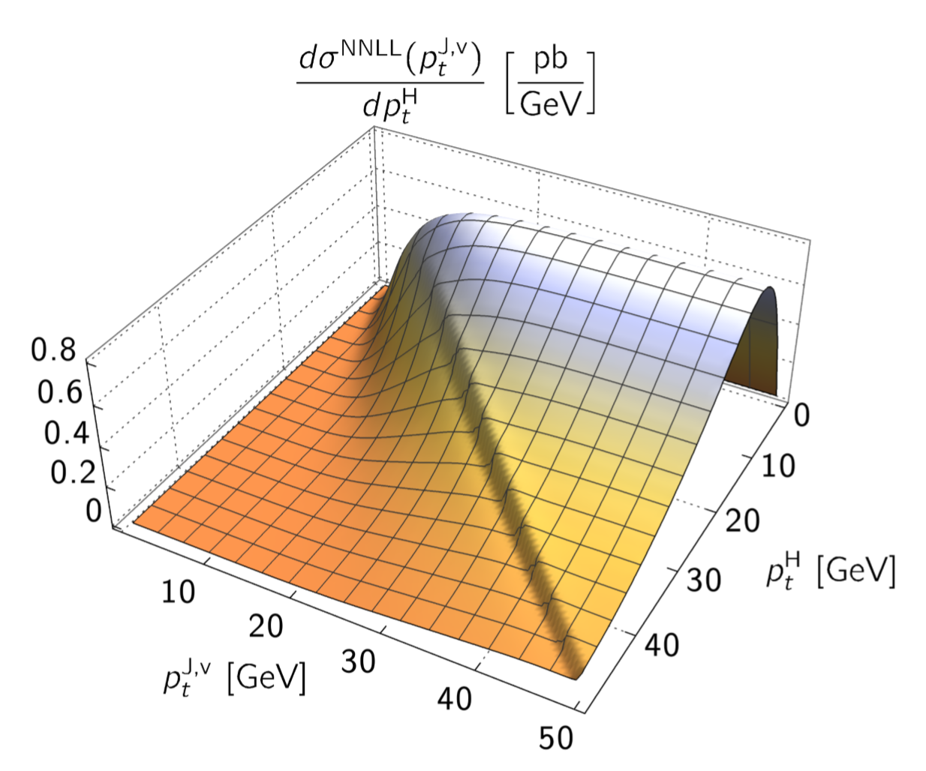
Double differential resummations
For transverse momentum distributions of colour singlets, resummations are available at the highest accuracy (N³LL)
[Bizon et al 1905.05171]
[Monni Rottoli Torrielli 1909.xxxxx]
The RadISH formalism allows also for the joint resummation of transverse momentum distribution with a veto on additional jets
The RadISH program is an event generator fully differential in the decay products of the colour singlet

Slide 26
Hadronisation

Slide 27
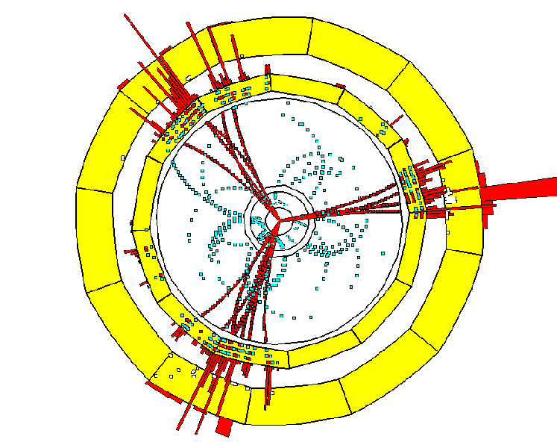
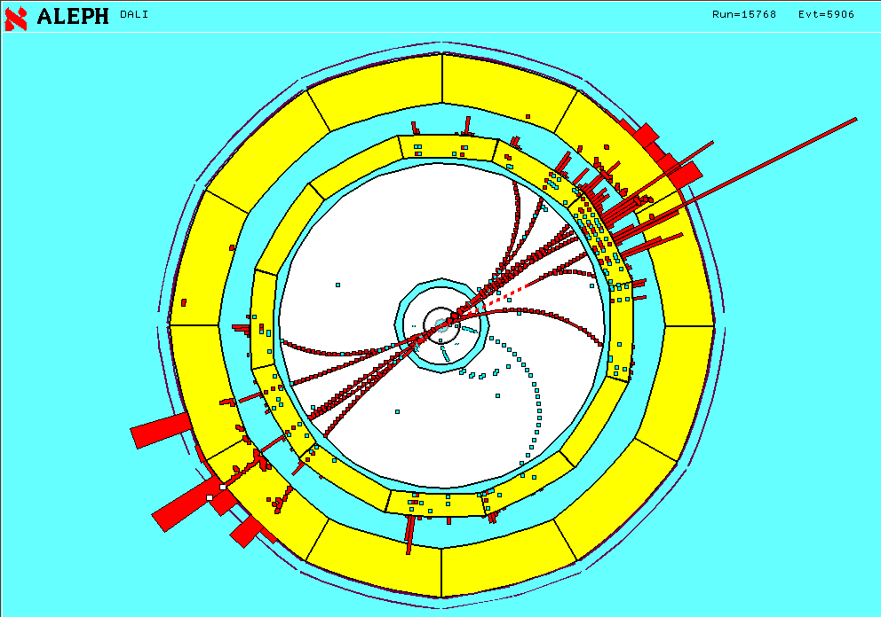
Jet observables in e+e-
Jet observables (e.g. event-shape distributions and jet rates) are powerful probes of QCD dynamics from high to low scales

Slide 28
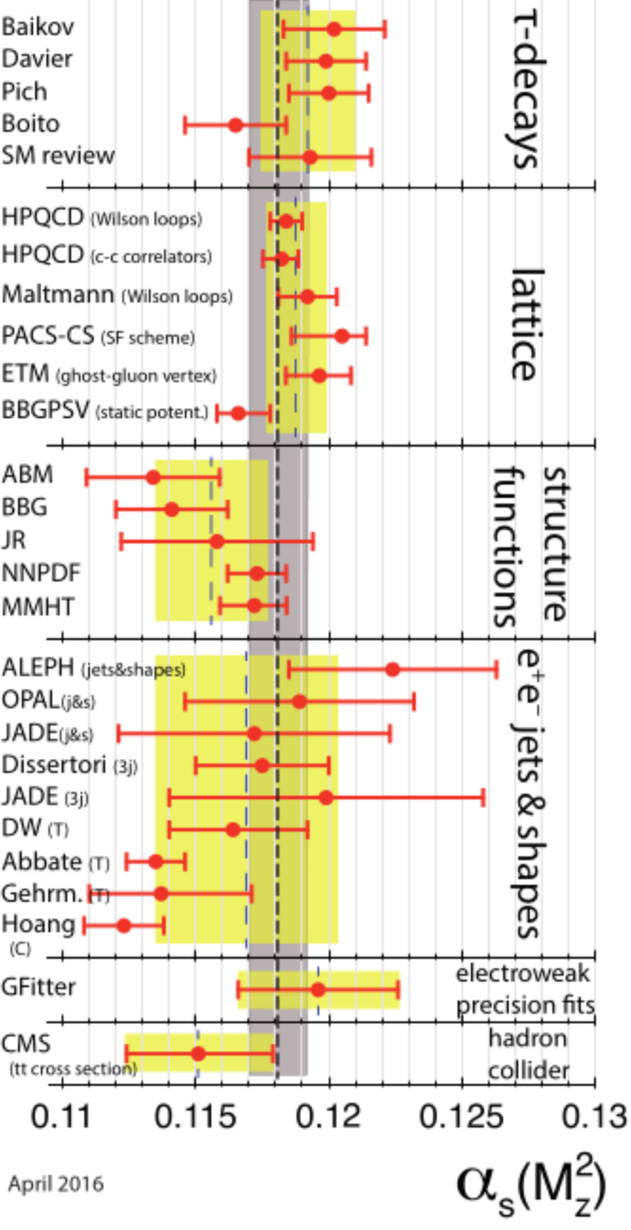
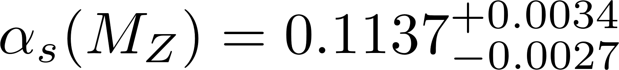
Strong coupling with jets
Jet observables constitute an important means of determination of the strong coupling
Currently, tension between determinations with different jet observables
What is the main difference between various approaches?
Event shapes and jet-rates (NLL+NNLO)
Thrust and C-parameter ((N)NNLL+NNLO)
[PDG 2019]

Slide 29
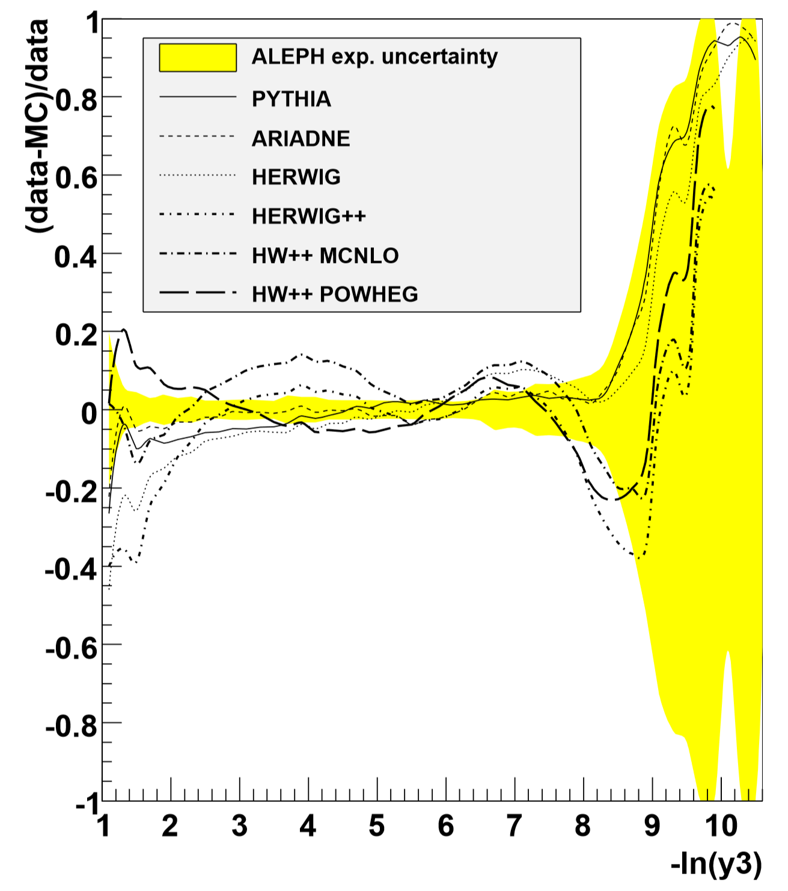
Hadronisation corrections
Most analyses determine hadronisation corrections using Monte Carlo event generators, as the ratio between hadron- and parton-level results
[Dissertori et al 0906.3436]
Hadronisation uncertainty
Perturbative QCD uncertainty
This approach is sensible as long as perturbative QCD uncertainties dominate
Recent calculations have pushed to accuracy of QCD calculations to NNLL hadronisation main source of uncertainty!
[Verbytskyi et al 1902.08158]

Slide 30


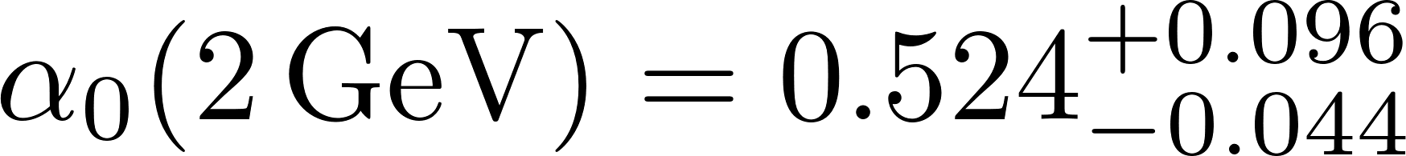

Analytic PT-NP fits
Most accurate determinations of from thrust and C-parameter from simultaneous fits of analytical models of leading hadronisation corrections
Such fits give values of the strong coupling below the world average
Thrust (NNLL+NNLO)
C-parameter (N³LL+NNLO)
[Gehrmann Luisoni Monni 1210.6945]
[Hoang Kolodubrez Mateu Stewart 1501.04111]
Both Monte-Carlo and analytic determinations of hadronisation corrections are challenged by the precision of perturbative QCD calculations
Monte Carlo event generators have the correct kinematics, but predictions are very dependent on the hadronisation model
Using just leading hadronisation corrections might be an oversimplification in the fit region, what is the impact of neglected effects?

Slide 31
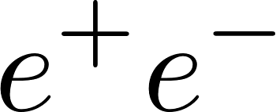
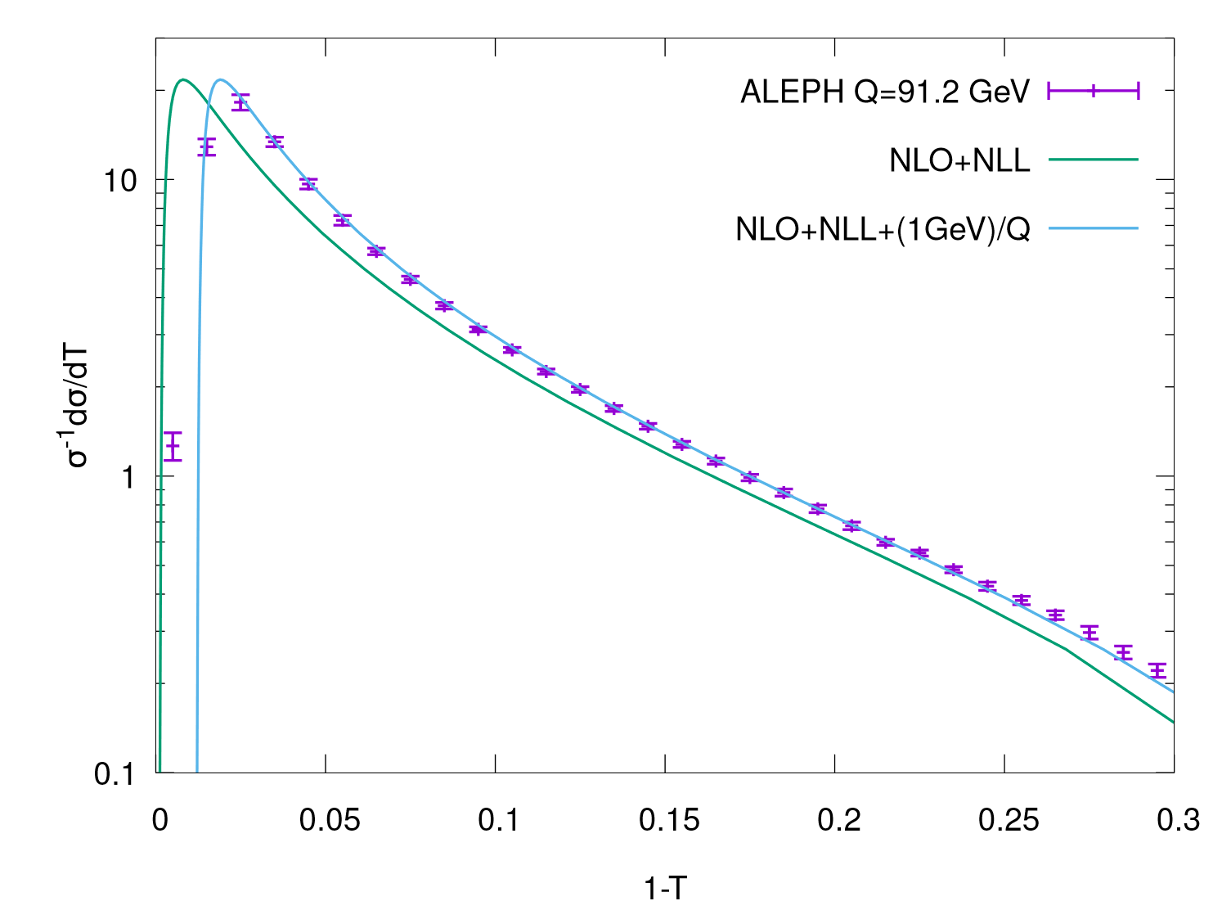
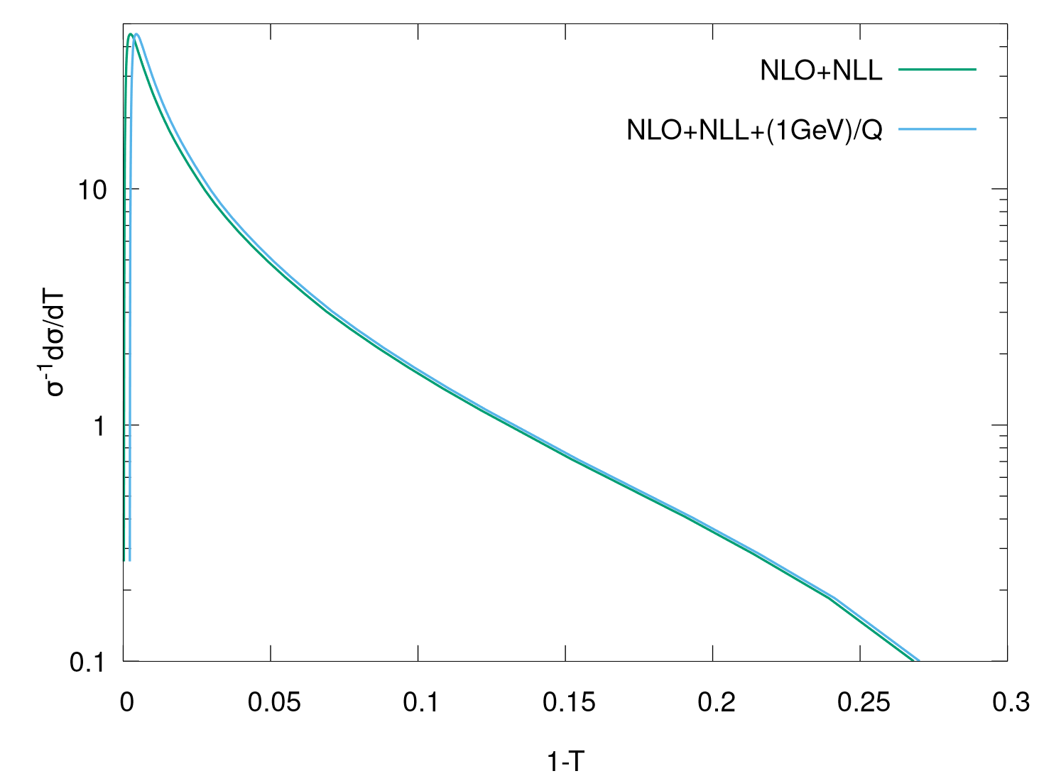


Hadronisation at future colliders
At future colliders, hadronisation corrections to two-jet observables are smaller than at LEP1 1 jet ~ 1 parton
Two-fold advantage for fits of the strong coupling
Monte-Carlo hadronisation corrections will have a reduced impact in the error on perturbative uncertainties (now ~0.1%) dominant
Negligible impact of subleading hadronisation corrections more reliable determination of NP parameter(s) of leading 1/Q corrections

Slide 32
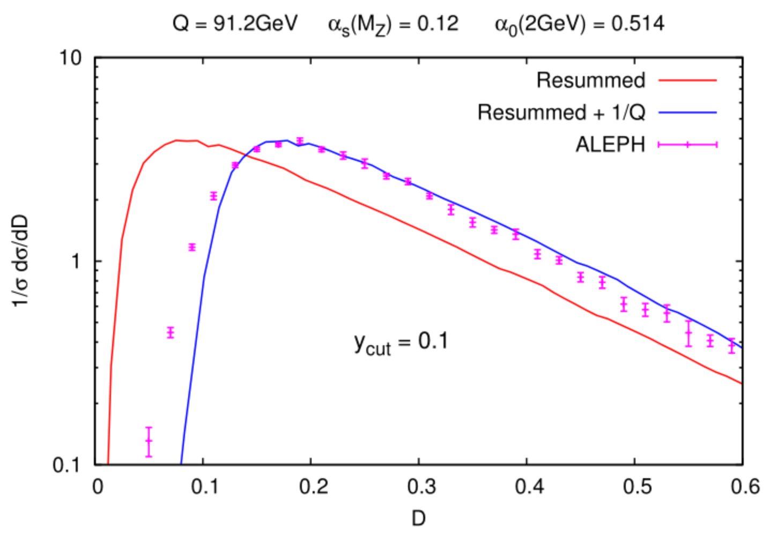
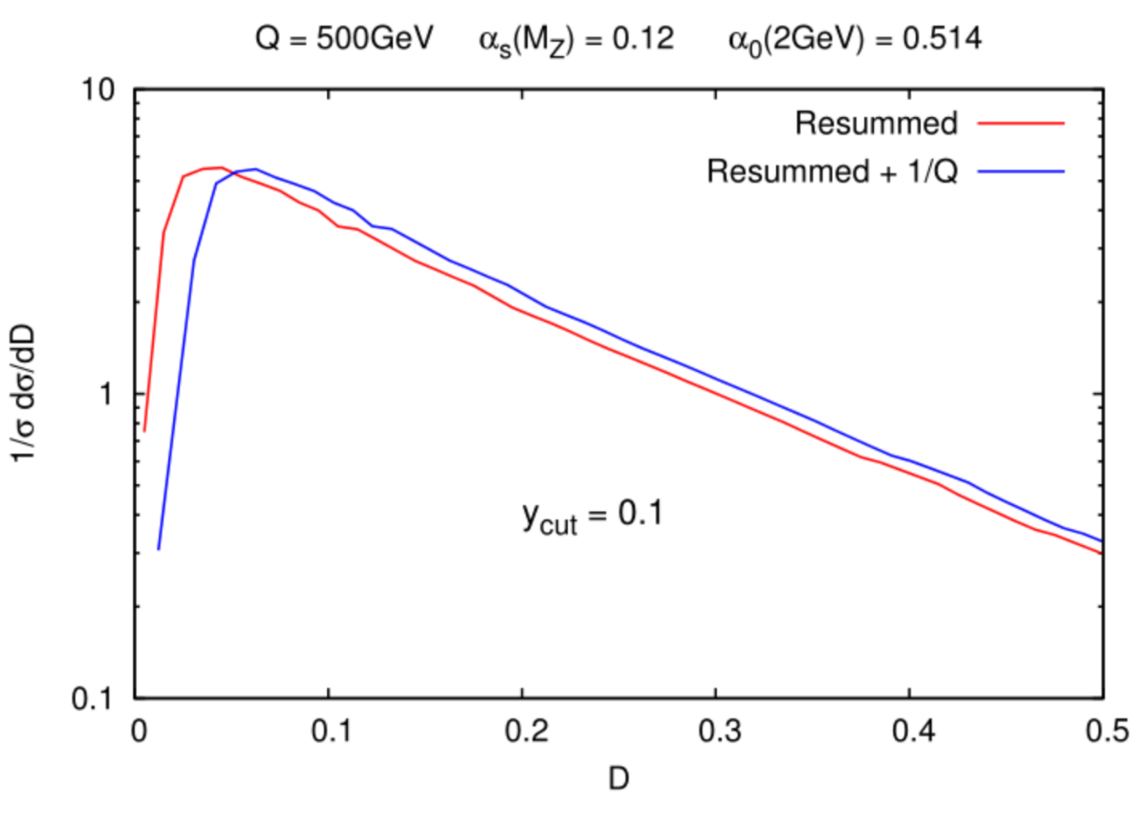
multi-jet opportunities
Near-to-planar three-jet event shapes (e.g. D-parameter) could be used to probe hadronisation effects in gluon jets
Hadronisation corrections in three-jet events are very large at LEP (twice as large as in two-jet events due to radiating gluon) fits of leading hadronisation corrections problematic
Hadronisation effects in three-jet observables at future colliders are as large as those for two-jet event shapes at LEP new tests of leading hadronisation corrections
[AB Dokshitzer Marchesini Zanderighi hep/ph 0104162]
[AB 0706.2722]

Slide 33
Concluding remarks
Future electron-positron colliders offer the possibility to answer a number of general theoretical questions
Inclusive cross sections have reached an impressive N³LO accuracy
Fully differential NNLO calculations for 2→2 processes is becoming the state of the art for differential distributions
Work in progress towards NNLO for 2→3 processes (e.g. ttH)
There is no conceptual problem in making resummations fully differential in the (leptonic) decay products of a colour singlet
First differential resummations in two jet observables
Future electron-positron colliders offer exciting opportunities to understand the physics of leading hadronisation corrections

Slide 34
Concluding remarks
Future electron-positron colliders offer the possibility to answer a number of general theoretical questions
Inclusive cross sections have reached an impressive N³LO accuracy
Fully differential NNLO calculations for 2→2 processes is becoming the state of the art for differential distributions
Work in progress towards NNLO for 2→3 processes (e.g. ttH)
There is no conceptual problem in making resummations fully differential in the (leptonic) decay products of a colour singlet
First differential resummations in two jet observables
Future electron-positron colliders offer exciting opportunities to understand the physics of leading hadronisation corrections
Thank you for your attention!

Slide 35
Extra

Slide 36
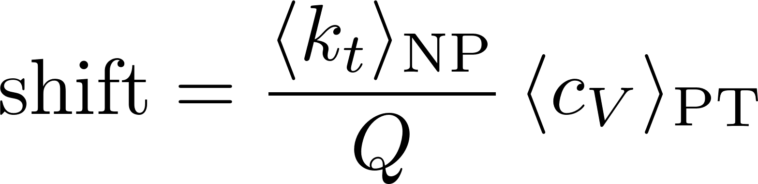
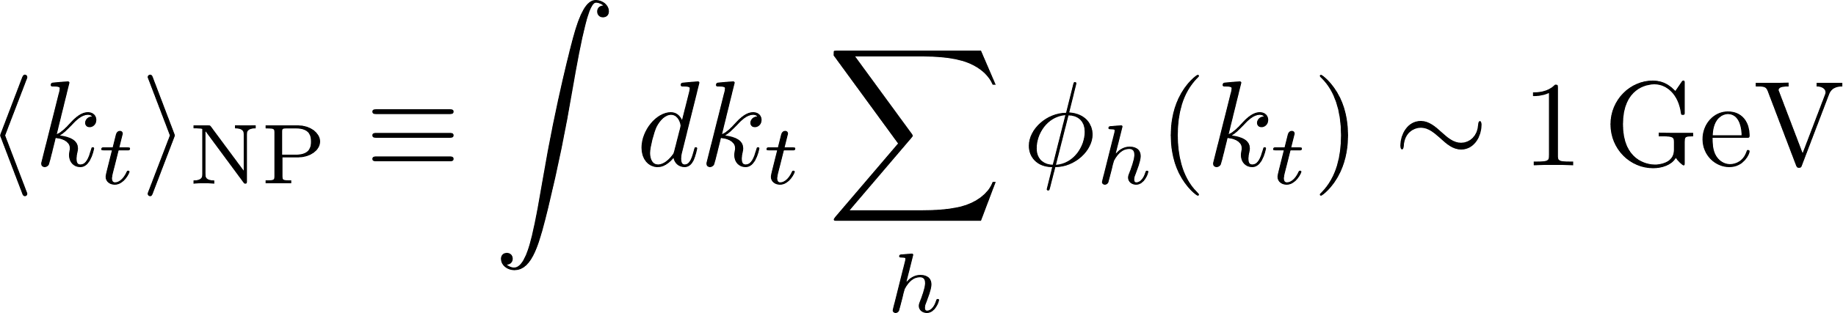


Leading hadronisation effects
Central hadrons with momenta ~1GeV give rise to shift of perturbative distributions of jet observables
[Dokshitzer Webber hep-ph/9704298]
Average over PT configurations
Universal (?) NP parameter
Observable dependent but calculable

Slide 37



Leading hadronisation effects
Leading hadronisation corrections are triggered by central hadrons ( ) distributed uniformly in rapidity

Slide 38

Higgs+1jet@NLO
The K-factor for Higgs+1jet is large (about 2), of the same order as that for the Higgs total cross section could things stabilise at NNLO?
Such large K-factors plague ggH irrespective of whether full mass dependence is kept theoretical understanding needed here
HEFT
[Boughezal Caola Melnikov Petriello Schulze 1504.07922]
[Jones Kerner Luisoni 1802.00349]

Slide 39





Jet-vetoes and BSM probes
New physics (e.g. contact interactions) can modify the shape of distributions in WW production at high invariant mass large logs in the tails of distributions
At large invariant masses, pure NNLL resummation dominates over non-logarithmic terms (remainder)

Slide 40

PT calculations for e+e-
The past ten years have been characterised by an impressive progress in perturbative calculations for jet observables
NNLO calculation of
NNLL resummation of factorisable observables (e.g. thrust, broadening) in SCET
General NNLL resummation of event shapes in annihilation with the ARES method
First-ever NNLL resummation of a jet-rate with ARES
[Gehrmann-De Ridder Gehrmann Glover Heinrich 0711.4711]
[Becher Schwartz 0803.0342]
[Becher Bell 1210.0580]
[AB Monni McAslan Zanderighi 1412.2126]
[AB Monni McAslan Zanderighi 1607.03111]

