Slide 1

Disorder and “Equilibration” in SYK model
Trento 19’

Slide 2
Outline
Motivation
SYK Model
Mesoscopy
RMT/viscid fluid
BH/Chaos
Spectrum/Hydro
Summary

Slide 3
Motivation
Holography:
Mesoscopy:

Slide 4
Holography
Duality:
Symmetry:
Organize:

Slide 5
Mesoscopy
Hierarchy:
RMT:
Chaos:

Slide 6
SYK Model

Slide 7
SYK model

Slide 8
Mapping on Clifford

Slide 9
Spectrum :

Slide 10
Mesoscopy

Slide 11
Spectral form factor

Slide 12
Return probability

Slide 13
Diffuson

Slide 14
Slope, ramp, plateau

Slide 15
Mesoscopic times

Slide 16
RMT

Slide 17
Characteristic determinant :

Slide 18
Fierzing: N=2n

Slide 19
Ergodic evolution : Burgers equation for SYK

Slide 20
Semi-circle

Slide 21
Black-hole and Chaos

Slide 22
Edge universality : Airy

Slide 23
Entropy at the edge and black-hole

Slide 24
Entropy increase in SYK

Slide 25
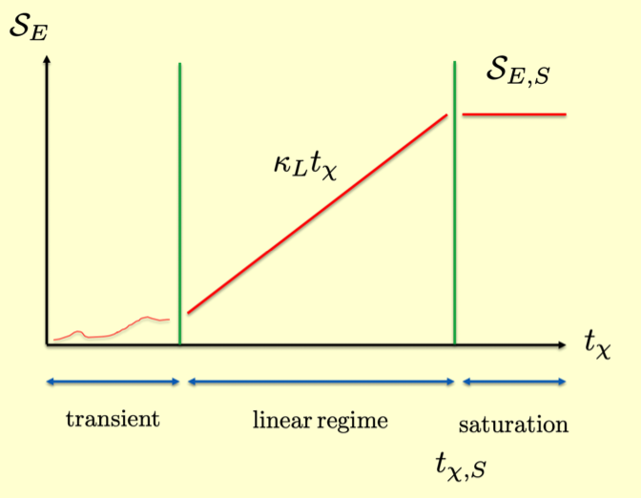
Entropy increase from chaotic maps

Slide 26
Spectral Hydro

Slide 27
SYK in “chiral limit”

Slide 28
Hydrodynamics

Slide 29
Hydrostatics

Slide 30
Sound waves

Slide 31
Spectral relaxation time : SYK

Slide 32
Summary
edge-RMT
all-RMT
Mesoscopy
RMT/BH
Spectral/hydro

