Slide 1
Chaotic Scattering in Normal- and Superconducting Microwave Billiards,
Induced Time- Reversal Violation and the VWZ Approach
ECT* 2019
Classical-, quantum- and microwave billiards
Billiards as a model for the compound nucleus
Induced violation of T invariance in billiards
RMT description for chaotic scattering systems with T violation
Experimental test of RMT results on fluctuation properties of
S-matrix elements with normal and superconducting microwave billiards
Supported by DFG within SFB 1245
B. Dietz, T. Klaus, M. Miski-Oglu, A. Richter, M. Wunderle
Notes:
I will speak about old and new results obtained based on random matrix theory and the supersymmetry method for S-matrix correlation functions and the distributions of S-matrix elements for systems with and without time reversal invariance violation. Although widely used to discover signatures of T-violation in compound nucleus reactions the random matrix theory results were tested if at all only in very few experiments. We tested these both with RMT simulations and with experimental data. The experiments were performed with chaotic microwave billiards. I will first shortly outline how the experimental data may be used to test analytic results obtained for the S-matrix correlations in compound nucleus reactions.

Slide 2
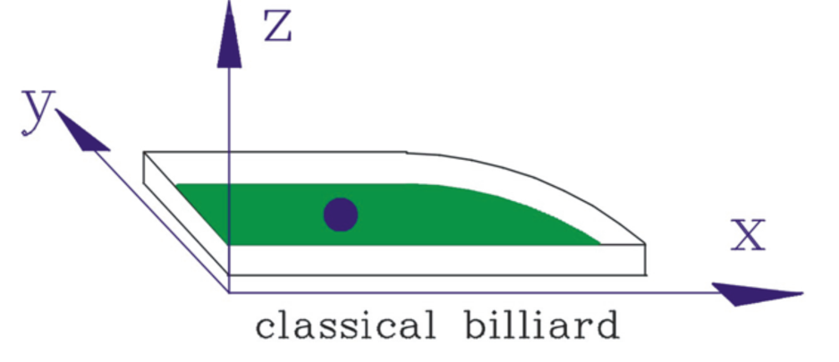
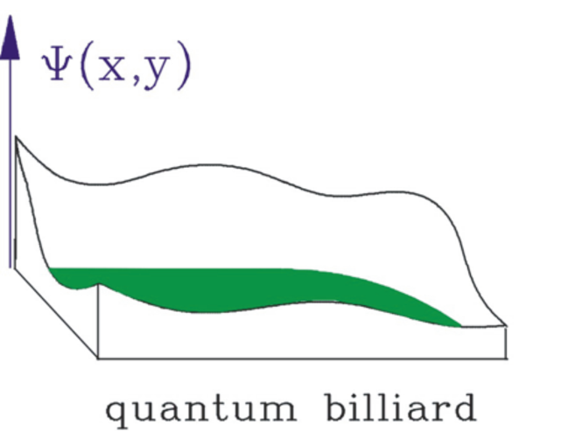
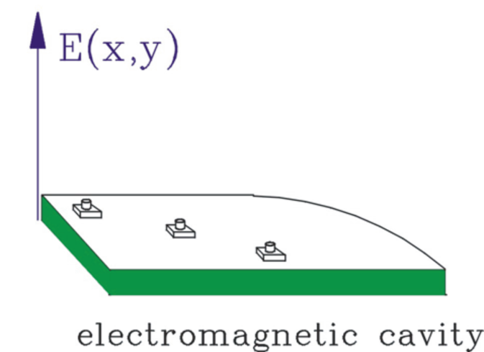
Classical-, Quantum- and Microwave Billiards

Slide 3
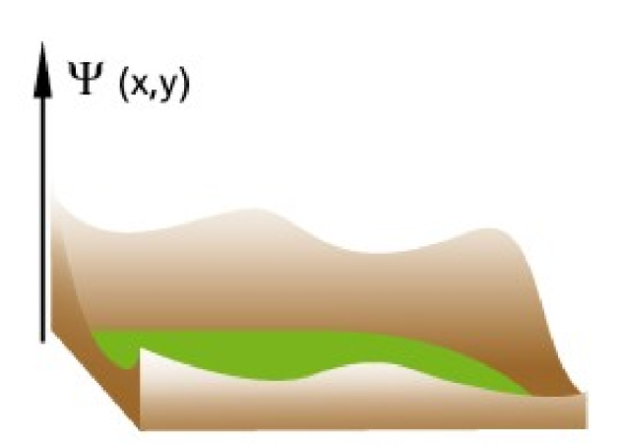
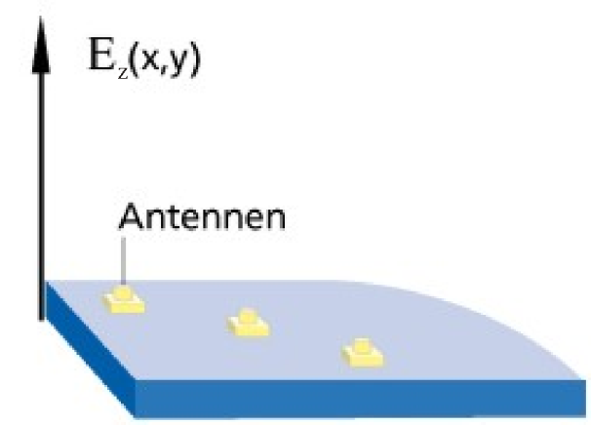

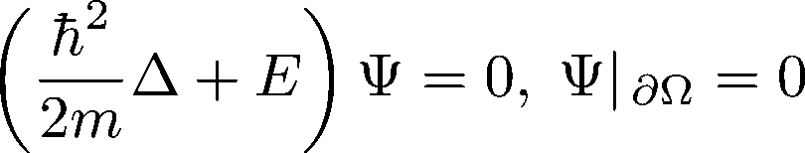

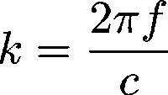
Schrödinger- and Microwave Billards
Quantum billiard
Microwave billiard
d
Analogy
eigenvalue E ↔ wave number
eigenfunction Ψ ↔ electric field strength E_{z}
Notes:
3
Part of the subproject C4 focuses on the spectral properties of classically regular or fully chaotic systems and of systems with mixed regular and chaotic dynamics. Billiards are well suited for such studies as their classical dynamics is solely determined by their shape. The eigenvalues and eigenfunctions of these so-called quantum billiards are determined experimentally by using the analogy between them and flat microwave resonators. Below a certain frequency, that is, for wave lengths larger than double the height of the resonator, the electric field strength is perpendicular to the top and bottom of the resonator. There the underlying Helmholtz equation is mathematically equivalent to the Schrödinger equation of the quantum billiard of corresponding shape. In both systems the solutions of the wave equation fulfill Dirichlet boundary conditions along the wall of the billiard. Accordingly the eigenvalues of the quantum billiard are directly related to the resonance frequencies, the eigenfunctions to the electric field strengths of the microwave resonator, which is also called microwave billiard. The eigenvalues are obtained in superconducting measurements of resonance spectra.

Slide 4
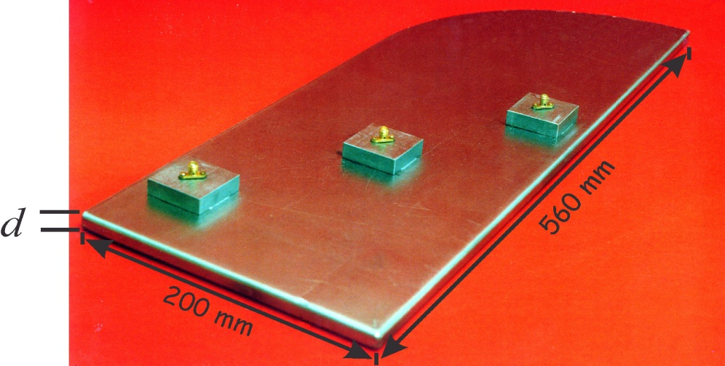
Microwave Resonator as a Model
for the Compound Nucleus
rf power
in
rf power
out
C+c
D+d
Compound
Nucleus
②
A+a
B+b
d
①
Microwave power is emitted into the resonator by antenna ①
and the output signal is received by antenna ② → Open scattering system
The antennas act as single scattering channels
Absorption at the walls is modeled by additive channels
Manufactured at CERN from surplus Nb metal sheets of sc LEP cavities

Slide 5
Typical Transmission Spectrum
Transmission measurements: relative power from antenna a → b

Slide 6
Scattering Matrix Description within the
“Heidelberg Approach“
Nucleus
Microwave billiard
energy E
nuclear Hamiltonian
coupling of quasi-bound
states to channel states
← E, f→
frequency f
resonator Hamiltonian
coupling of resonator
states to antenna states
and to absorptive channels
← H →
← W →
Experiment measures complex S-matrix elements
GOE
T-inv
RMT description: replace H by a matrix for systems
GUE
T-noninv
Notes:
Both scattering processes are described by a scattering matrix, which was derived by Mahaux and Weidenmüller in the context of compound-nucleus reaction theory. Here, f is the excitation frequency and 1I is the unit matrix. For compound nucleus reactions H is the nuclear Hamiltonian, for a microwave resonator it is the Hamiltonian of the resonator. Likewise for compound nucleus reactions the matrix W couples the quasi-bound states of the compound nucleus to the open channels, and in the microwave billiard the resonator modes to the antenna channels. While in nuclear physics one can only measure cross sections we have access to the full scattering matrix in microwave experiments. For a statistical description of properties of the S-matrix the matrix H is replaced by a random matrix from a suitable ensemble. In case of time-reversal invariance this ensemble is the GOE, in case of complete T violation it is the GUE..

Slide 7
Resonance Parameters
Use eigenrepresentation of
and obtain for a scattering system with isolated resonances
a → resonator → b
Here: of eigenvalues of
Partial widths fluctuate and total widths also
real part
imaginary part

Slide 8
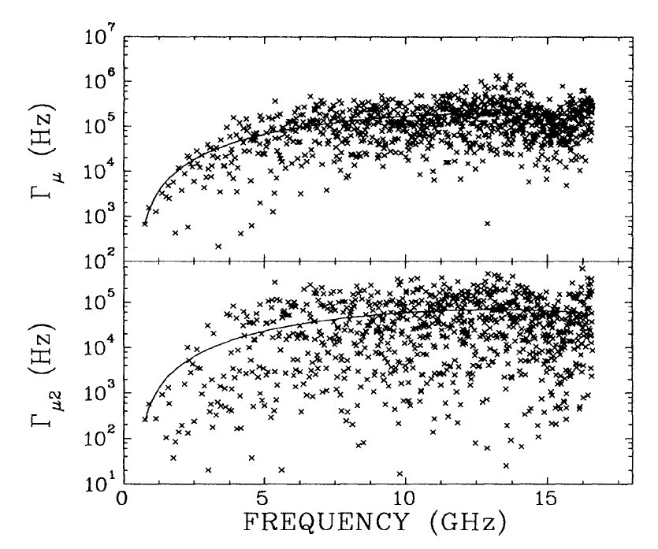
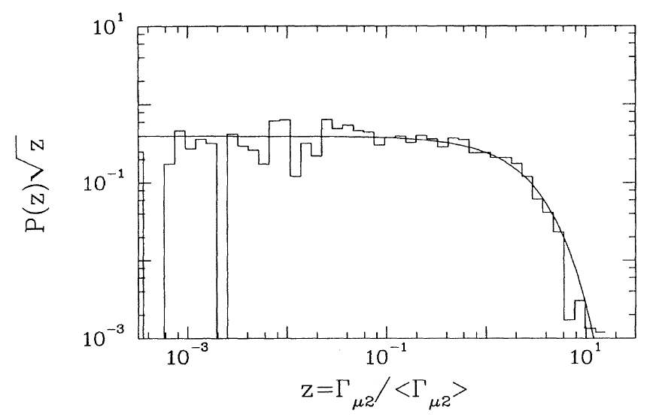
Fluctuations of Total Widths and Partial Widths
Both quantities fluctuate randomly about a slow secular variation of the mean.
The partial widths obey a Porter-Thomas distribution.
There is a lack of correlations among partial widths and also a lack of correlations between total widths and resonance energies. Finally, we observed a nonexponential decay of the system.
…“one of the strongest tests ever for the assertion that upon quantization a classically chaotic system respecting T-invariance attains GOE fluctuation properties“.
(Alt, Gräf, Harney Lengeler, Richter, Schardt and Weidenmüller, 1995)

Slide 9
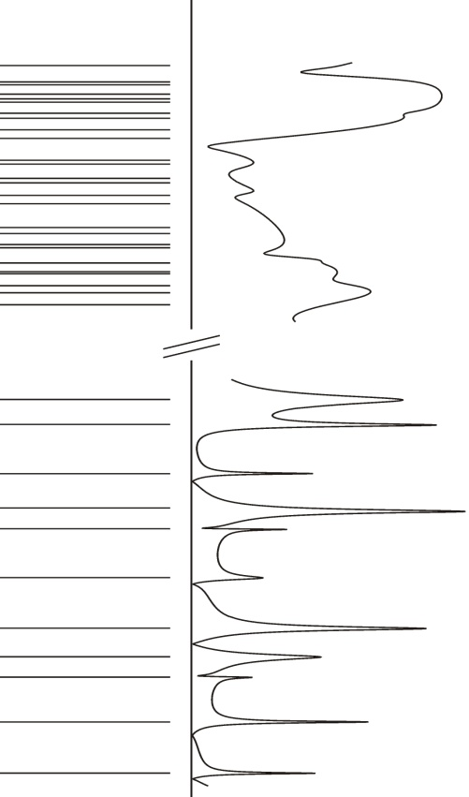

Excitation Spectra
atomic nucleus
microwave cavity
overlapping resonances
for Γ/d > 1
Ericson fluctuations
weakly overlapping resonances for Γ/d ≲ 1
isolated resonances
for Γ/d << 1
ρ ~ exp
ρ ~ f
Universal description of spectra and fluctuations:
Verbaarschot, Weidenmüller and Zirnbauer (1984)

Slide 10
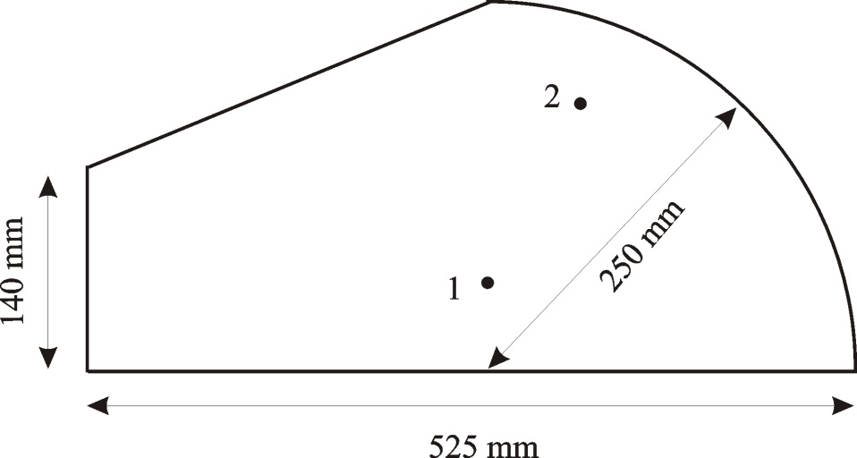
Fully Chaotic Microwave Billiard
Tilted stadium (Primack+Smilansky, 1994)
Only vertical TM₀ mode is excited in resonator → simulates a quantum
billiard with dissipation
Additional scatterer → improves statistical significance of the data sample
Measure complex S-matrix for two antennas 1 and 2: S₁₁, S₂₂, S₁₂, S₂₁
2
1
(Dietz, Friedrich, Harney, Miski-Oglu, Richter, Schäfer and Weidenmüller, 2008)
Notes:
We use a microwave cavity made of Copper coupled to two antennas and measure the response to an external field as a function of radiofrequency f. The microwave cavity has the shape of a tilted stadium billiard. The dynamics of the corresponding classical billiard is
chaotic. The tilted shape was used in order to avoid bouncing--ball orbits between parallel walls. The experiment is performed at room temperature, with Ohmic losses at the walls of the cavity.
The range of the excitation frequency is chosen such, that only a single vertical mode in the microwave cavity is excited. Then, the cavity simulates a two-dimensional chaotic quantum system and is a microwave billiard. An additional scatterer was inserted in the resonances and spectra were measured for six different positions of it to improve the statistical significance of the data. A vector network analyzer couples microwave power in and out of the resonator via either one or both antennas and yields the complex elements S_{ab}(f) of the scattering matrix, where a, b = 1, 2. The range 1GHz ≤f≤25GHz was covered in steps of Δ=100kHz in reflection and transmission measurements (yielding S₁₂(f), S₂₁(f)).

Slide 11
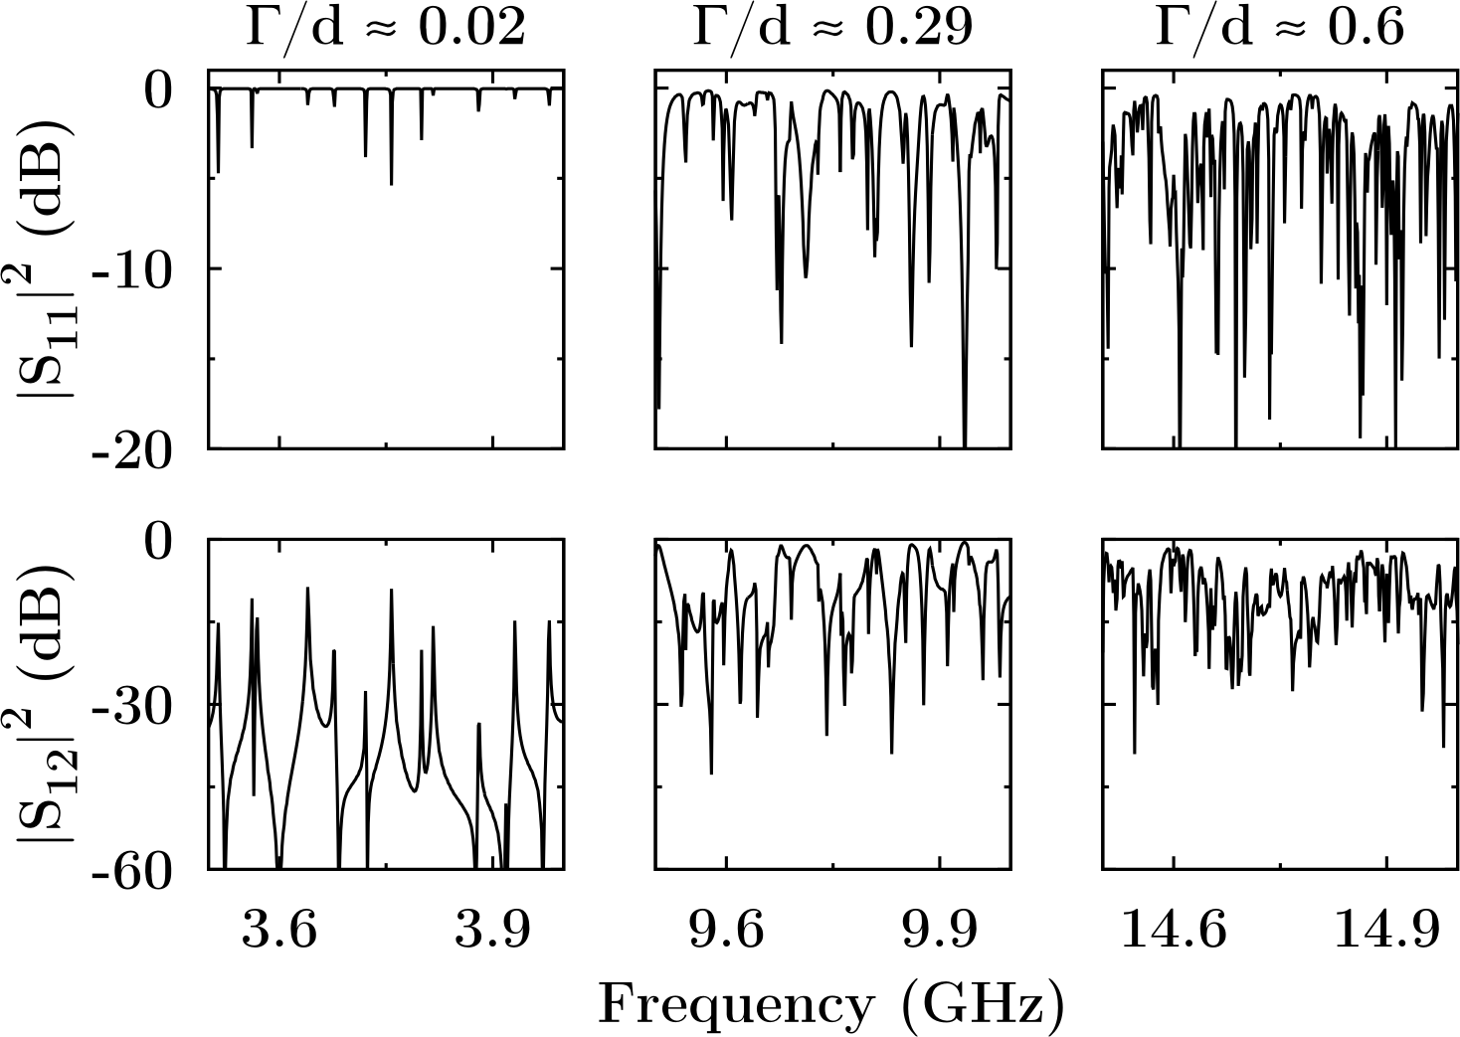
Spectra and Correlations of
S-Matrix Elements
Γ/d <<1: isolated resonances → eigenvalues, partial and total widths
Г/d ≲ 1: weakly overlapping resonances and strongly overlapping resonances (Г/d >1) → investigate S-matrix fluctuation properties with the autocorrelation function and its Fourier transform

Slide 12
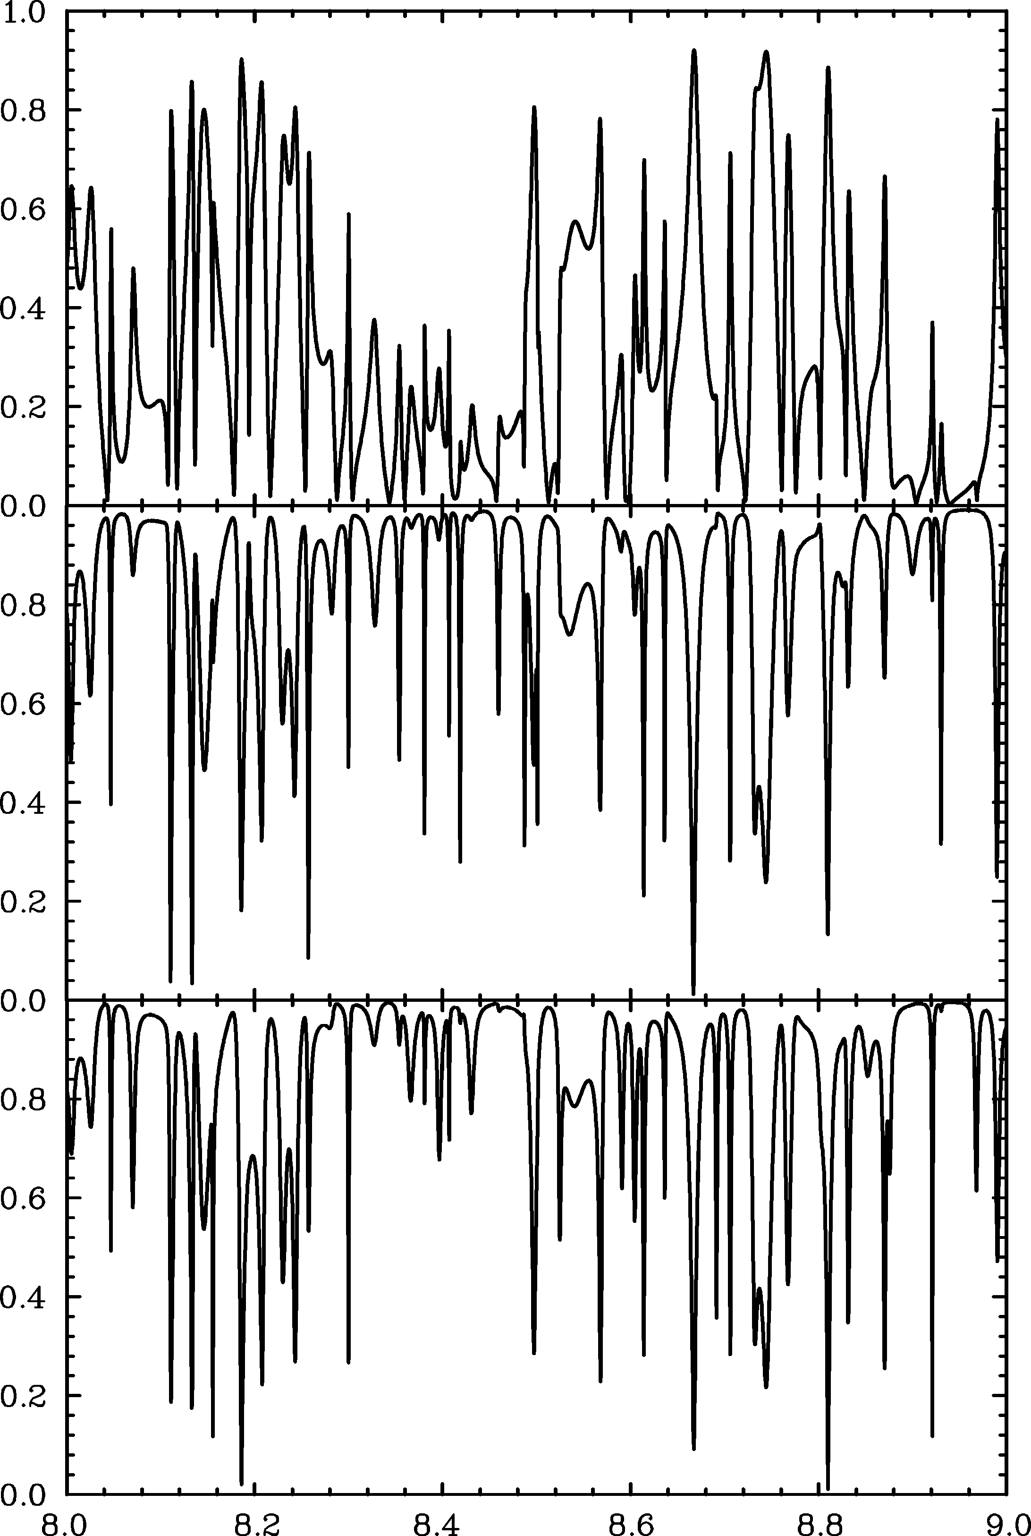
Spectra of S-Matrix Elements in the Regime Γ/d ≲ 1
Example: 8-9 GHz
|S₁₂|
|S₁₁|
|S₂₂|
How does the system decay?
Frequency (GHz)

Slide 13
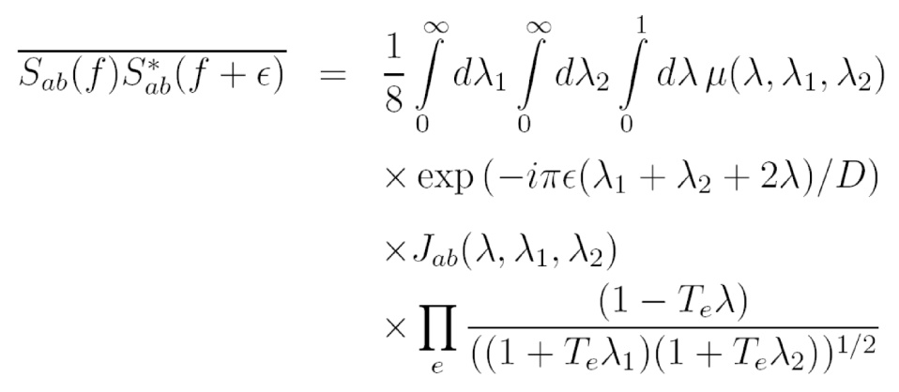
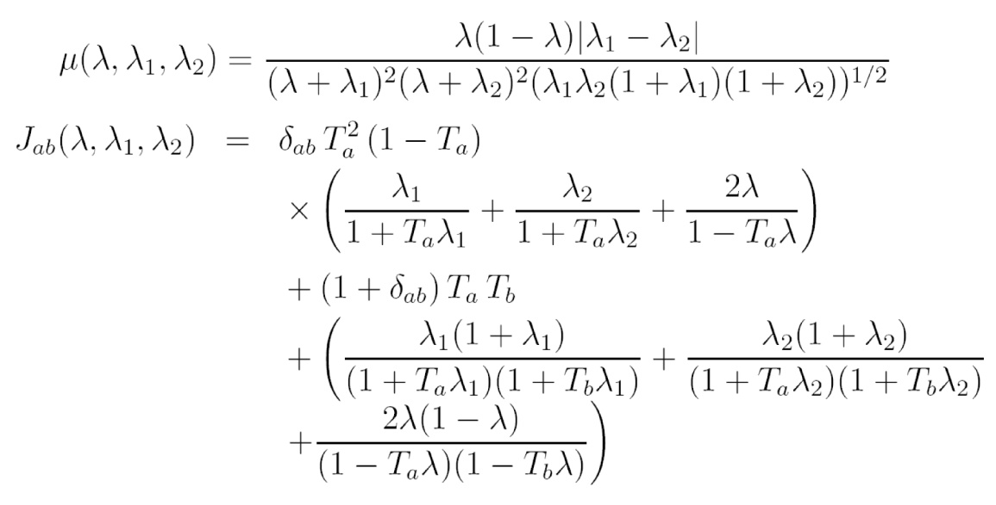

Exact RMT Result for GOE Systems
Verbaarschot, Weidenmüller and Zirnbauer (VWZ) 1984 for arbitrary Г/d
VWZ-Integral
C = C(T_{i}, d ; ε)
Transmission coefficients
Average level distance
Rigorous test of VWZ: isolated resonances, i.e. Г ≪ d
First test of VWZ in the intermediate regime, i.e. Г/d ≈ 1, with high statistical significance only achievable with microwave billiards
Note: nuclear cross section fluctuation experiments yield only |S|²

Slide 14
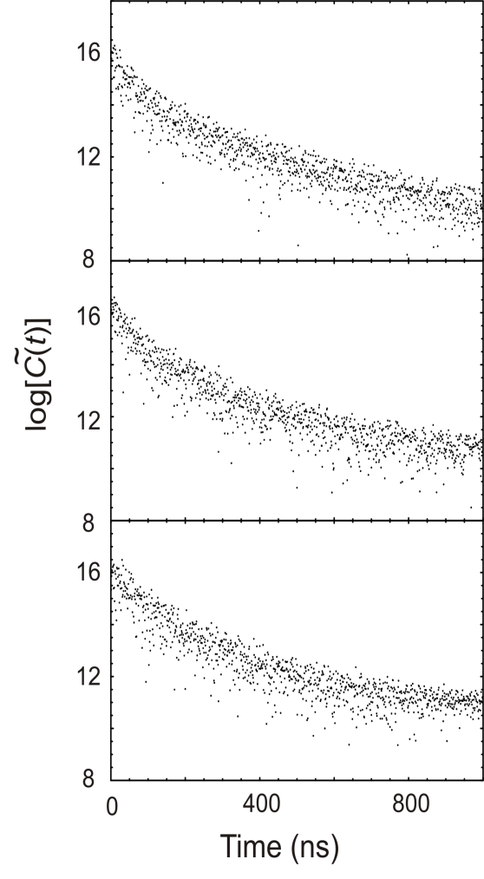
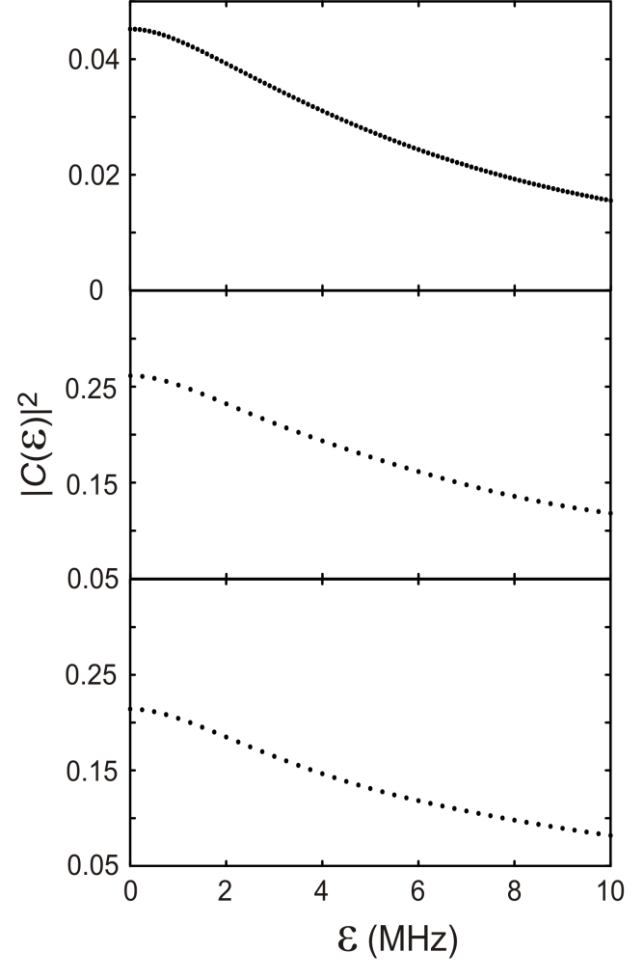
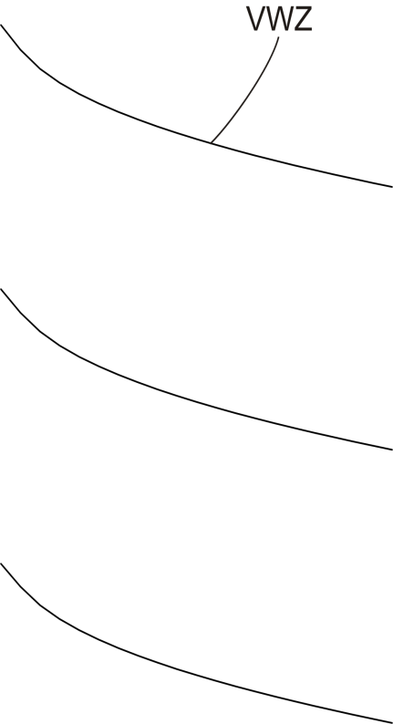
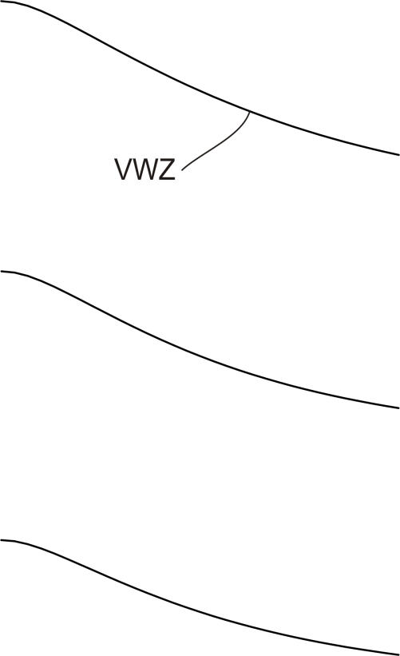
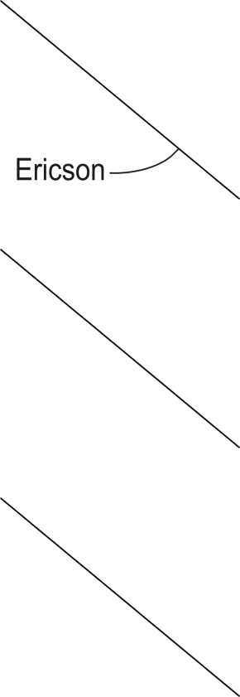
Fourier Transform vs.
Autocorrelation Function
Time domain
Example 8-9 GHz
Frequency domain
← S₁₂ →
← S₁₁ →
← S₂₂ →

Slide 15
Corollary
Present work:
S-matrix → Fourier transform → decay time (indirectly measured)
Future work at short-pulse high-power laser facilities:
Direct measurement of the decay time of an excited nucleus might become possible by exciting all nuclear resonances (or a subset of them) simultaneously by a short laser pulse.

Slide 16
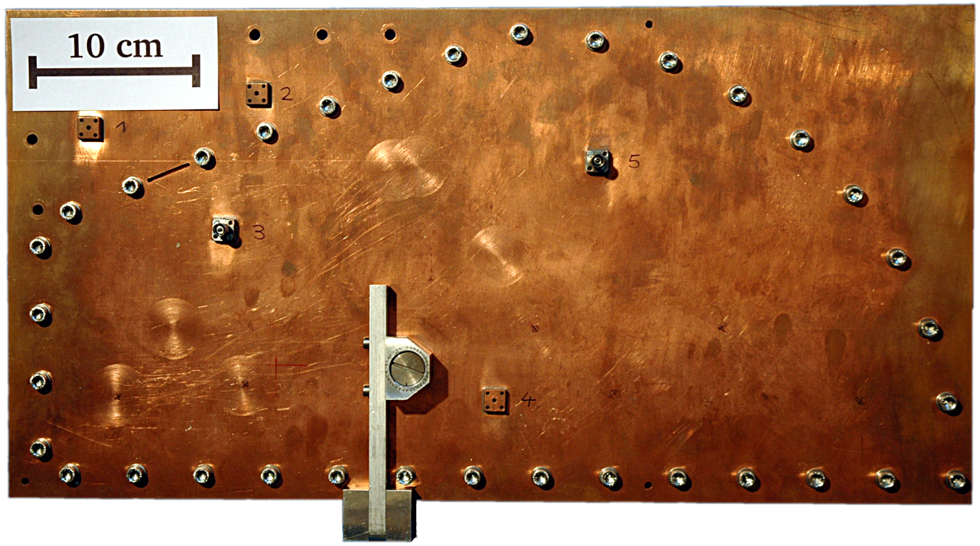
Fully Chaotic Microwave Billiard and the Study of Induced T Violation
N
S
N
S
A cylindrical ferrite is placed in the resonator
An external magnetic field is applied perpendicular to the billiard plane
The strength of the magnetic field is varied by changing the distance
between the magnets
Notes:
In the experiment a cylindrical ferrite is placed in the resonator and an external magnetic field is applied perpendicular to the billiard plane. The magnetic field is generated by two permanent magnets which are placed above the top and below the bottom plate of the resonator. The magnetic field is varied by changing the distance between the magnets.
Field strengths up to 390 mT could be attained. Here we focus on the results for B=190 mT as there the effects are most clearly visible.

Slide 17
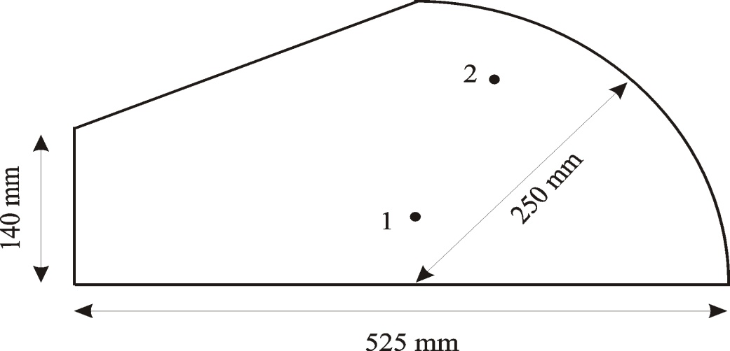
Induced Violation of T Invariance
with Ferrite
Spins of magnetized ferrite precess collectively with their Larmor frequency about the external magnetic field
Coupling of rf magnetic field to the ferromagnetic resonance depends on the direction a b
S_{ab}
F
b
a
S_{ba}
T-invariant system → reciprocity
→ detailed balance
T-noninvariant system
S_{ab} = S_{ba}
|S_{ab}|² = |S_{ba}|²

Slide 18
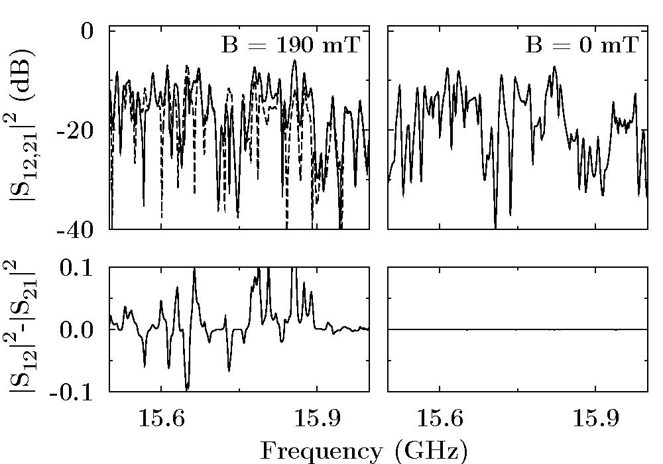
Detailed Balance in the Microwave Billiard
S₁₂
S₂₁
Clear violation of principle of detailed balance for nonzero magnetic field B
→ How can we determine the strength of T violation?
Notes:
This figure compares measured intensities of the transmission from antenna 1 to 2 and vice versa for an experiment with and one without magnetization of the ferrite. It clearly demonstrates the violation of the principle of detailed balance for nonzero magnetic field.

Slide 19
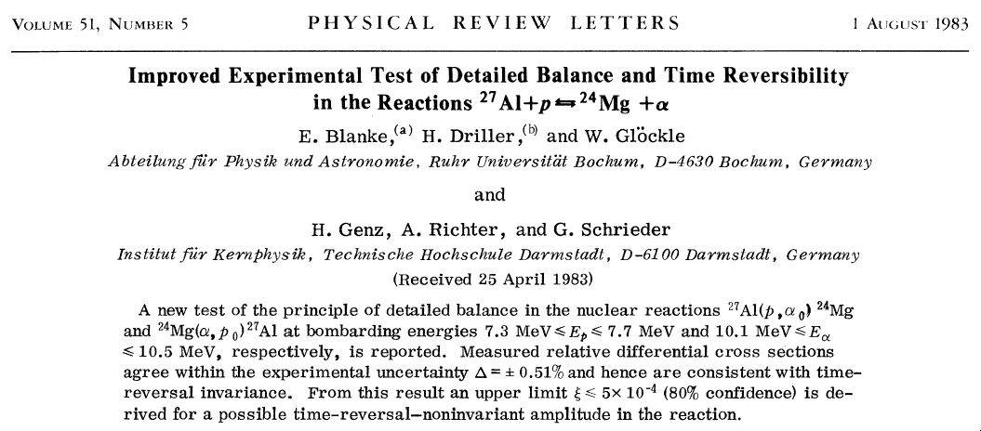
Search for TRSB in Nuclei:
Ericson Regime

Slide 20
Analysis of T violation with a
Crosscorrelation Function
Crosscorrelation function
Special interest in crosscorrelation coefficient C_{cross}(ε = 0)
if T-invariance holds
if T-invariance is violated

Slide 21
S-Matrix Correlation Functions and RMT
Pure GOE → VWZ 1984
Pure GUE → FSS (Fyodorov, Savin, Sommers) 2005
Partial T violation → Pluhař, Weidenmüller, Zuk, Lewenkopf + Wegner
derived analytical expression for C⁽²⁾ (ε=0) in 1995
RMT →
GOE: 0
GUE: 1
Complete T-invariance violation sets in already for ξ ≃1
Based on Efetov´s supersymmetry method we derived analytical
expressions for C ⁽²⁾ (ε) and C_{cross}(ε=0) → valid for all values of ξ

Slide 22
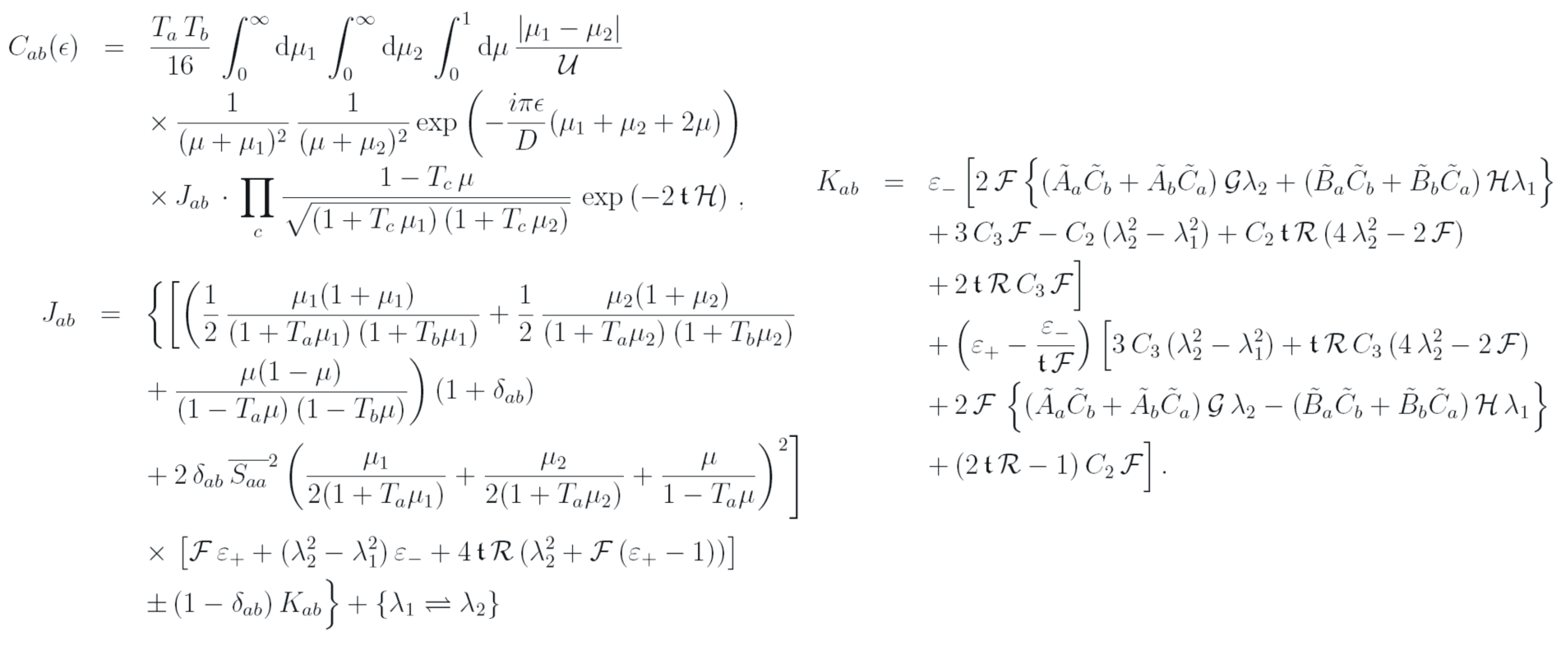
RMT Result for Partial T Violation
(Phys. Rev. Lett. 103, 064101 (2009))
RMT analysis based on Pluhař, Weidenmüller, Zuk, Lewenkopf and Wegner (1995)
mean resonance spacing
→ from Weyl‘s formula
(2)
d
parameter for strength of T violation
→ from crosscorrelation coefficient
transmission coefficients
→ from autocorrelation function

Slide 23
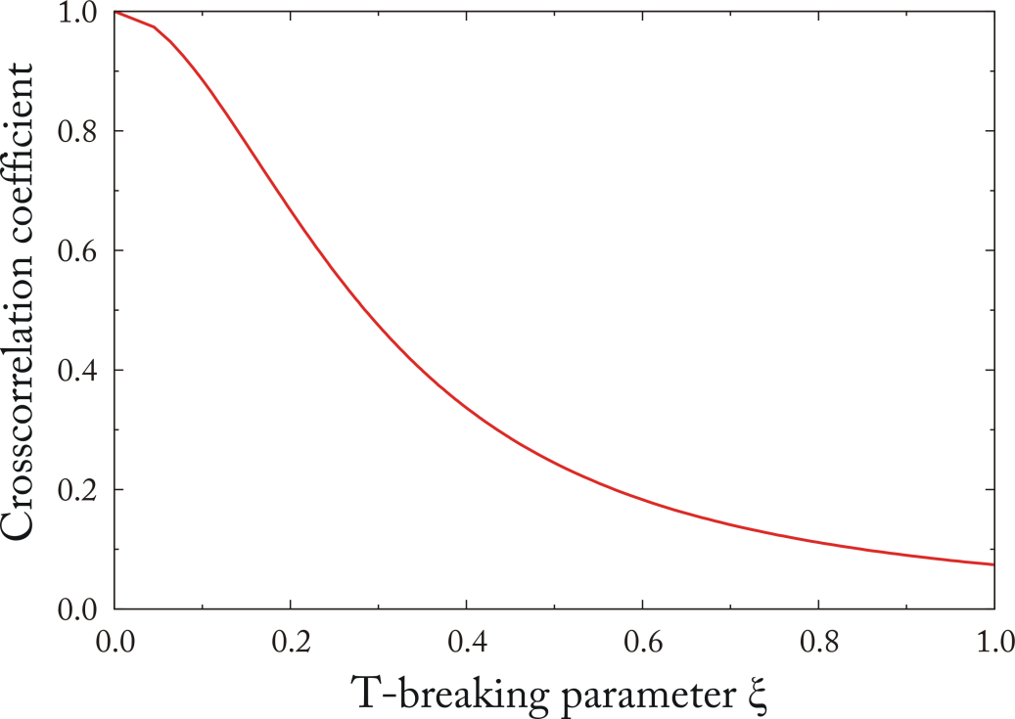
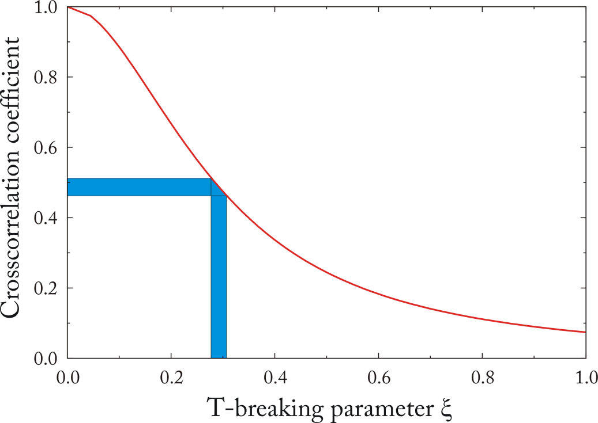
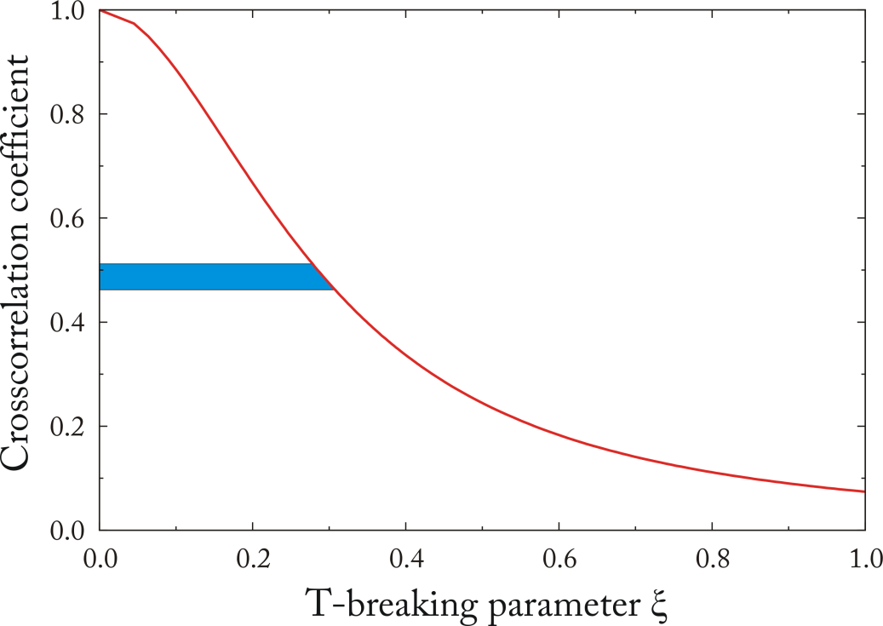
Exact RMT Result for Partial T Breaking
RMT analysis based on Pluhař, Weidenmüller, Zuk, Lewenkopf and Wegner (1995)
for GOE
RMT →
for GUE

Slide 24
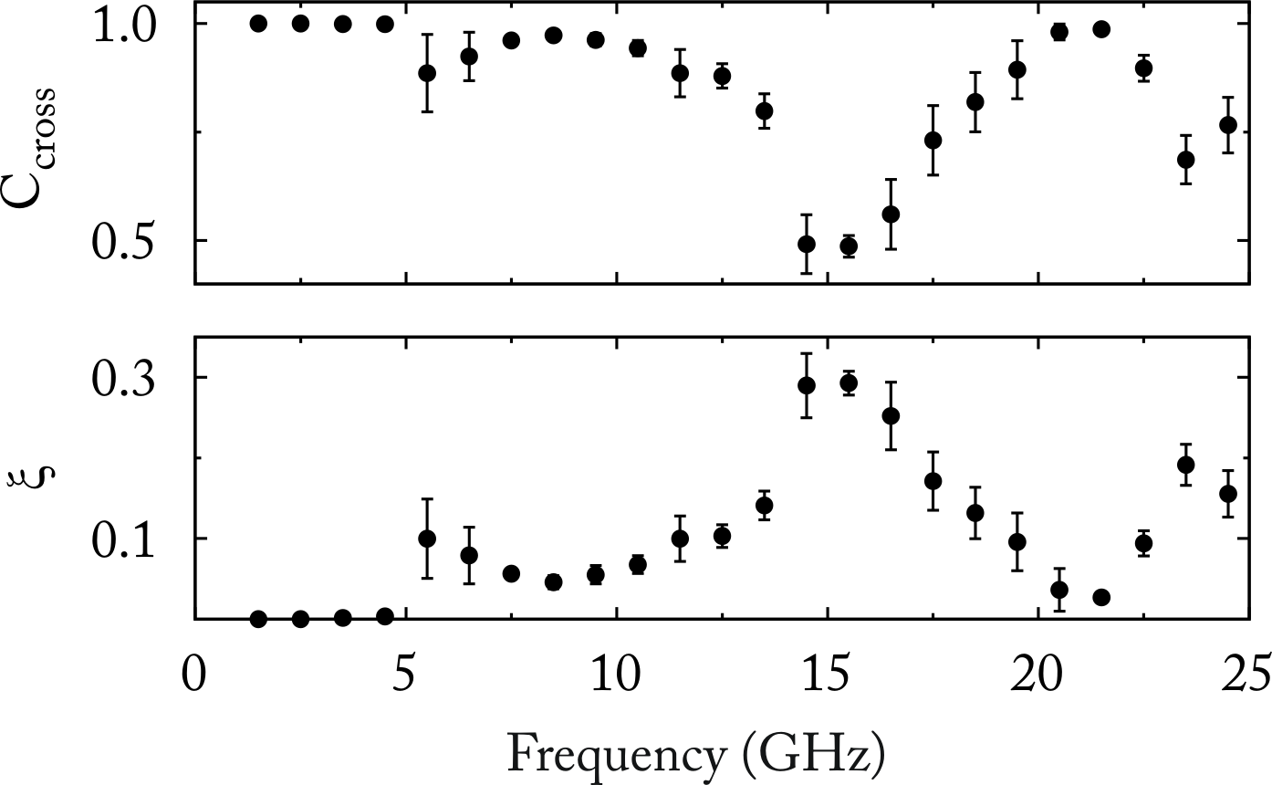
T-Violation Parameter ξ
cross-correlation
coefficient
Largest value of T-violation parameter achieved is ξ ≃ 0.3
(Dietz, Friedrich, Harney, Miski-Oglu, Richter, Schäfer, Verbaarschot and Weidenmüller, 2009)
Notes:
Here are shown again the experimental values of the cross-correlation coefficient and the parameter ξ for the T-violation deduced from these. The error bars indicate the r.m.s. variation of C_{cross}(0) over the 6 realizations.

Slide 25
Induced Time Reversal Symmetry Breaking in a Superconducting
Microwave Billiard
In room- temperature experiments T invariance violation was induced by inserting a ferrit into the billiard resonator and magnetizing it with an external B-field
Due to the Meissner- Ochsenfeld effect this is, however, no longer possible in case of superconducting cavities constructed from lead-coated copper or brass since below a critical temperature T_{C} the field is expelled from the superconductor
We thus used a billiard cavity made out of niobium – a type II superconductor – for magnetic fields between two critical values,
B_{c1} = 153 mT and B_{c2} = 268 mT
Between these two critical values magnetic flux starts to penetrate the superconductor via so called vortices or flux tubes

Slide 26
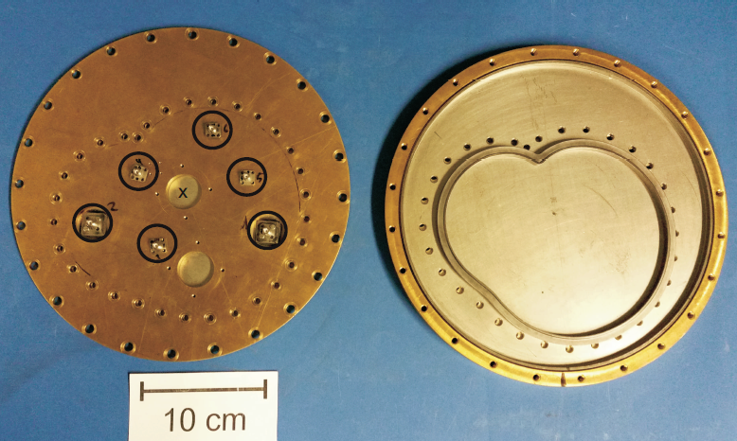
Billiard Cavity Made out of Niobium
The top plate (left) is removed from the bottom plate (right)
A lead-coated brass frame (right) with the shape if the African continent ("Africa billiard", Berry and Robnik (1986)) was inserted into the circular niobium cavity
The circles indicate the 6 antenna positions for in- and outputting rf power
The ferrite position at the center is marked by a cross

Slide 27
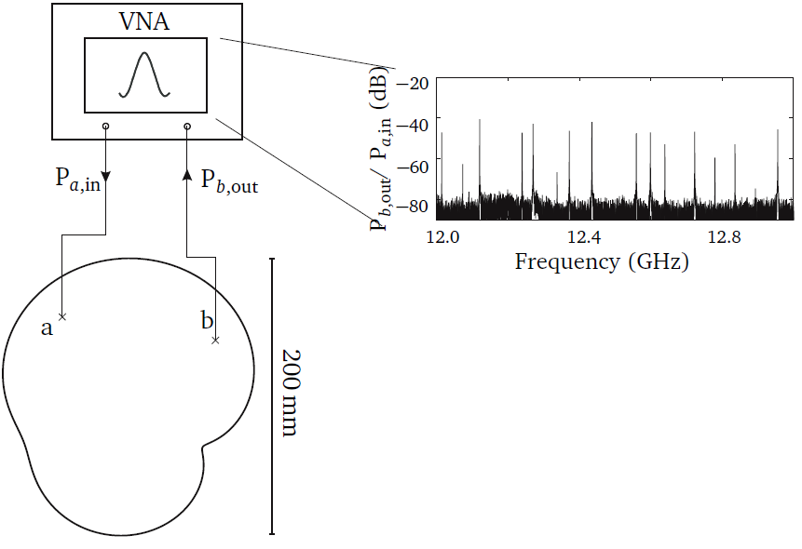
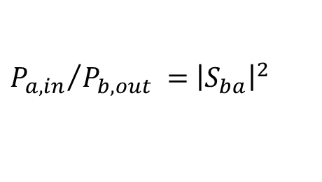
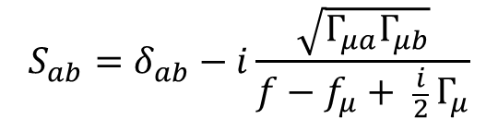
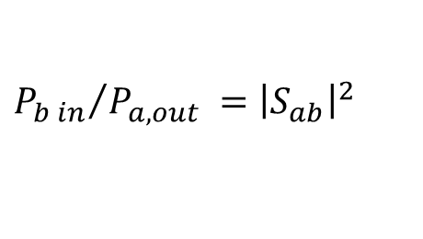
Principle of the Measurement
Ratio is measured for B = 0 and B ≠ 0
Quality factor Q = f_{μ} / Γ_{μ} > 10⁵ → all resonances are detected
${P_{a, in}}/{P_{b, out} }=$ ${\left|S_{ba}\right|}^{2}$
${P_{b in}}/{P_{a, out} }=$ ${\left|S_{ab}\right|}^{2}$
and
$$S_{ab}=δ_{ab}−i\frac{\sqrt{Γ_{μa}Γ_{μb}}}{f−f_{μ}+ \frac{i}{2} Γ_{μ}}$$
From the measured S-matrix the resonance
strength Γ_{μa}∙ Γ_{μb} is determined and compared to RMT predictions

Slide 28
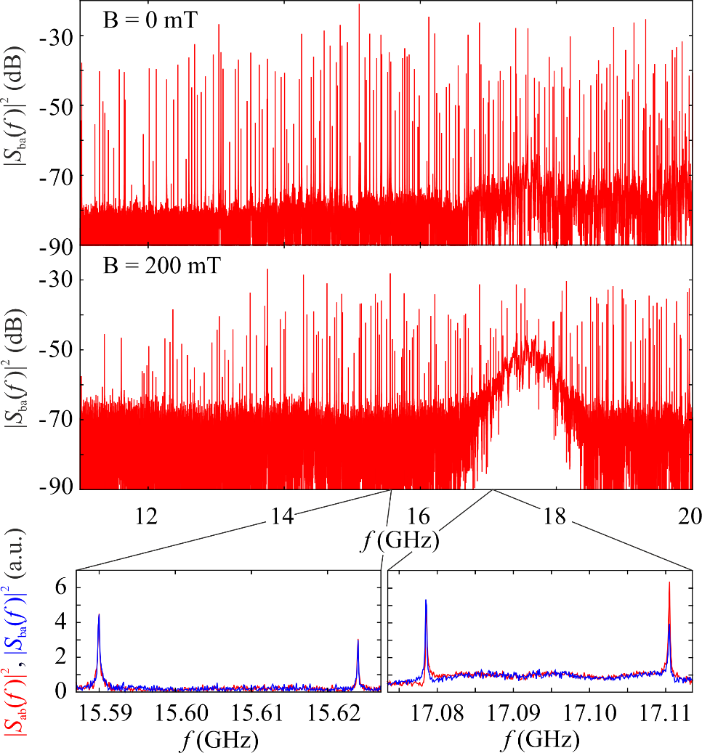
Measured Transmission Spectra
About 150 resonances (all resonances)
Spectra at B = 200 mT exhibit a broad peak between 16.5 and 18 GHz which may be attributed to electric field modes trapped inside the ferrit ("FMR")
For B = 0 mT and also below and above the FMR the principle of reciprocity holds, i.e. S_{ab}(f ) = S_{ba}(f ), but it is clearly violated within it. This is shown in the zoom for two pairs of resonances at 15.59 and 15.62 GHz and at 17.08 and 17.11 GHz, respectively.

Slide 29

Fluctuations in the Transmission Spectra
We model the Hamiltonian of the fully chaotic Africa billiard by an ensemble of N×N-dimensional random matrices with entries
$$H_{μν}=H_{μν}^{s}+i({πξ}/{\sqrt{N}) H_{μν}^{a}}$$
H^{s} being a real-symmetric and Hª a real-antisymmetric matrix with uncorrelated Gaussian-distributed matrix elements. The parameter ξ determines the magnitude of T violation.
The strength distribution is derived from that of the partial widths:
Best fitting analytical curve yields ξ.
with conserved T invariance (ξ = 0): Porter-Thomas
for chaotic systems
with fully violated (ξ > 1): exponential

Slide 30
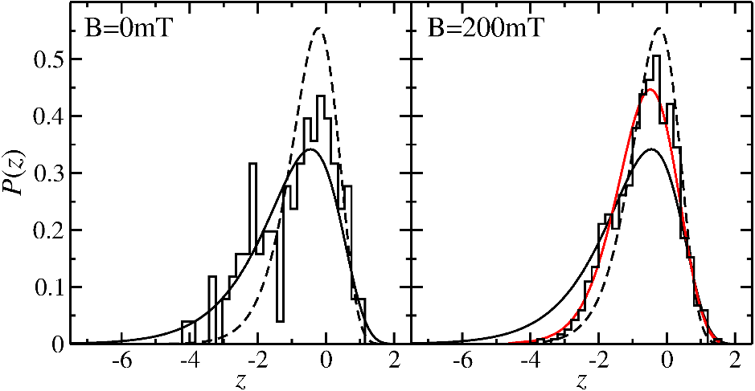
Experimental and Theoretical Strength Distributions
Experiment: histogramm
GOE: solid line
GUE: dashed line
Best fitting analytical curve (red) yielding: ξ = 0.2

Slide 31
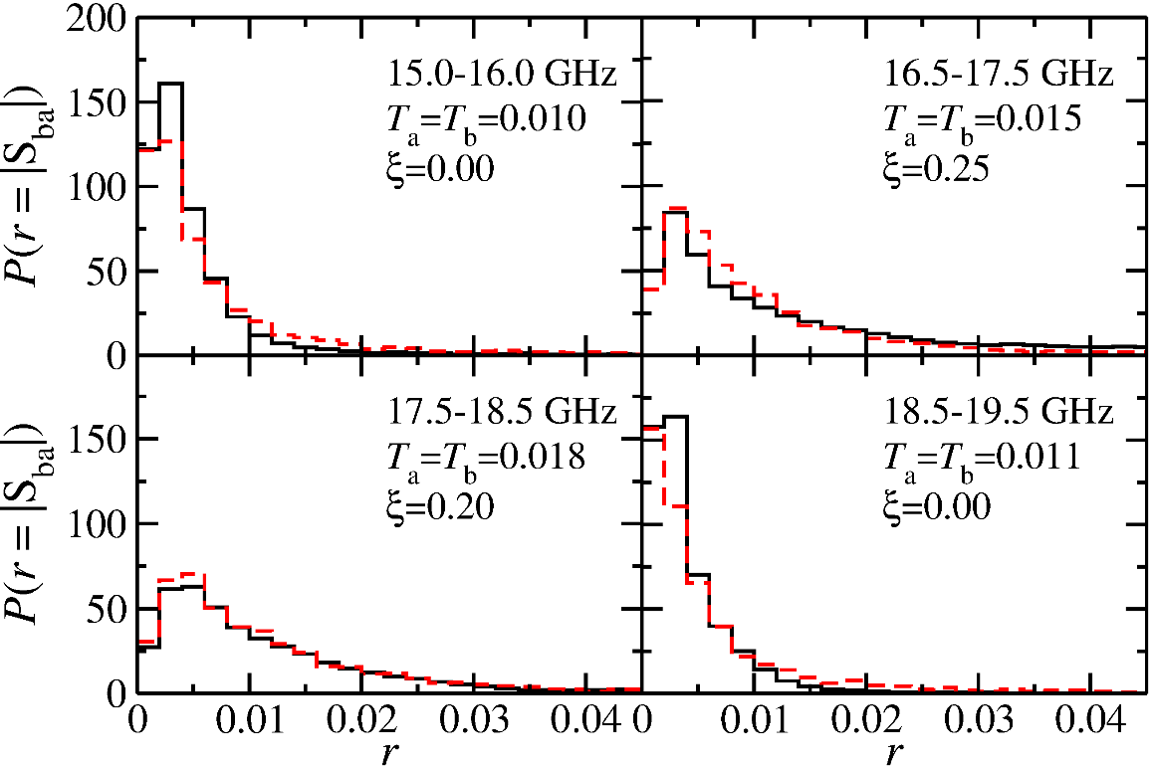
Distribution of the Modulus of the Measured off-diagonal S-Matrix Elements
In order to obtain the transmission coefficients T_{a,b} and τ_{abs} ensembles of 500 random S matrices were generated. Their distribution (red dashed lines) is compared to the measured one (black solid lines) in 4 different frequency intervals.
Note that the distribution clearly reflects the existance of T breaking (ξ ≠ 0) at the position if the FMR where T_{a} and T_{b} are larger than outside of it.

Slide 32
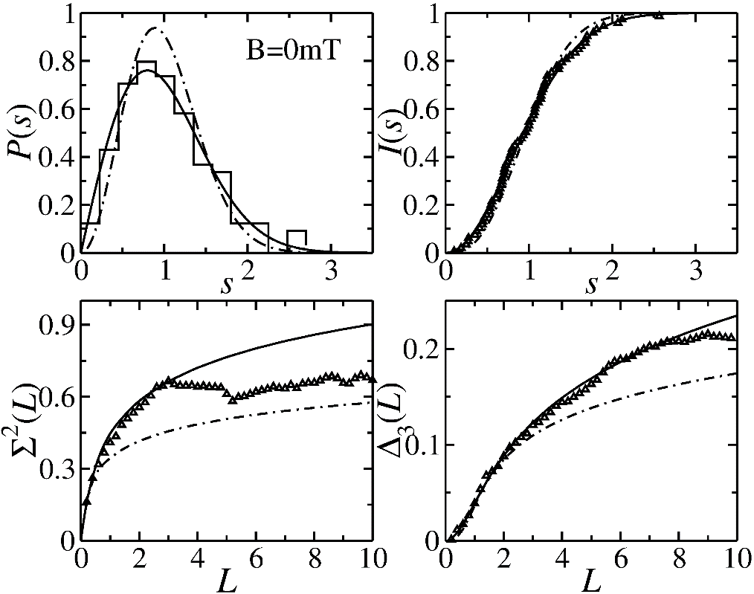
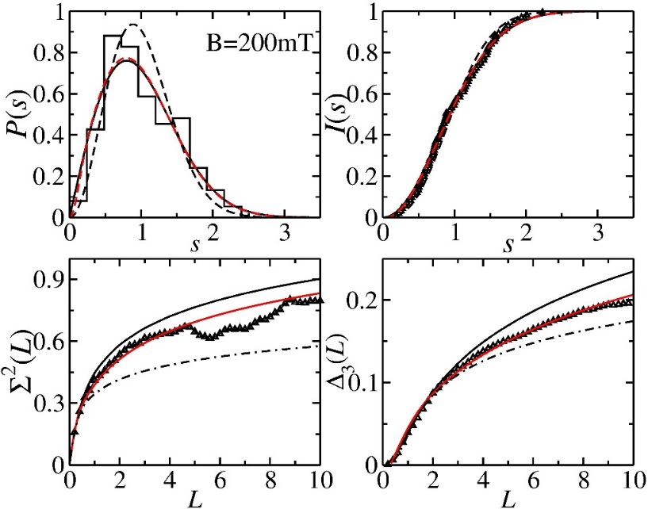
Fluctuation Properties of the Resonance Frequencies
Spectral properties (NNSD P(s) and the cummulative one I(s), the variance Σ₂(L) and the Dyson-Metha statistic Δ₃(L)) for external magnetic fields B = 0 mT (left) and B = 200 mT (right).
Experimental data (histograms and triangles) are compared to GOE predictions (solid lines) and GUE predictions (dash-dotted lines).
The red solid lines show the corresponding best fitting curves yielding ξ = 0.2 and thus verify the value derived from the transition strength distribution.

Slide 33
Summary
We experimentally realized for the first time a superconducting microwave billiard with partially violated T invariance. In order to obtain longer and complete sequences of eigenvalues and to realize a stronger violation of T invariance the area of the cavity, i.e., the billiard needs to be increased and a few more ferrites must be added. Yet, care has to be taken that additional absorption leaves the resonances isolated in order to ensure complete level sequences.

Slide 34
Perspectives and Thanks
I spoke here about the last experiment preformed in "our" billiard group at the Institut of Nuclear Physics at the TU Darmstadt. The group was founded in 1992 so to say as an offspring from our experience in rf superconductivity from developing and building the S-DALINAC and our research in nuclear physics.
During the almost 30 years the billiard group has existed we had many collaborators from the outside, some of them are here at the meeting – Thomas Guhr, Thomas Seligman, Jac Verbaarschot, Jochen Wambach and Hans Weidenmüller. This gives me pleasure to thank all of them.
Finally I am very pleased that the work with superconducting billiards is now being continued at Lanzhou University in China. My long time collaborator at Darmstadt Barbara Dietz is the prime investigator there, and I wish you, Barbara, great success in your endeavours.

