Slide 1
Few-body systems using pionless effective field theory
Hilla De-Leon, Lucas Platter (UTK)
and Doron Gazit (HUJI)
Neutrini and nuclei, challenges and opportunities for nuclear theory
29.05.2019

Slide 2
Outline
Calculation of $A=3$ bound state matrix element in pionless effective field theory
Low energy magnetic reactions in $A≤3$ nuclear systems and uncertainty estimation.

Slide 3
Calculation of $A=3$ bound state matrix element in pionless effective field theory
De-Leon, Platter, Gazit (2019)

Slide 4
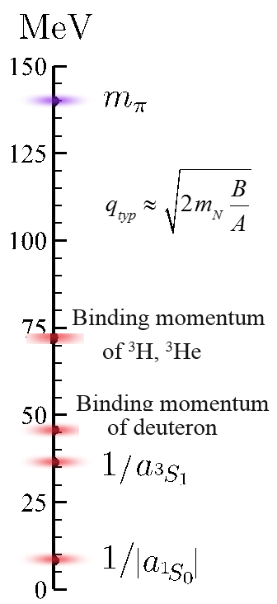
Effective Field Theory
The fundamental theory is QCD, which is non-perturbative in the low-energy regime.
If the momentum scale, $q,$ is small compared to the physical cutoff, $Λ_{cut}$, a physical process can be described using Effective Field Theory.
For low energies $\left(q<Λ_{cut}=m_{π}\right),$ pion can be integrated out and only nucleons are left as effective degrees of freedom.
$$\text{QCD}\text{→}$$
$ℒ_{effective}=\underset{LO}{\underbrace{𝒪(1)}}+\underset{NLO}{\underbrace{𝒪\left(\frac{q}{Λ_{cut}},\frac{r}{a}\right)}}+…+$
Kaplan, Savage ,Wise, (1998-1999)
Bedaque, Hammer, van Kolck (1999)

Slide 5
Building $π$EFT Lagrangian
Scale separation:
$a∼\frac{1}{q}$ $ρ∼\frac{1}{Λ_{cut}}$
Parameter | Value | Parameter | Value
$$γ_{t}$$ | 45.701 MeV | $$ρ_{t}$$ | 1.765 fm
$$a_{s}$$ | -23.714 fm | $$ρ_{s}$$ | 2.73 fm
$$a_{p}$$ | -7.8063 fm | $$ρ_{p}$$ | 2.794 fm
$\underset{LO}{\underbrace{ }}$
$\underset{NLO}{\underbrace{ }}$

Slide 6
Building $π$EFT Lagrangian
L${=N}^{T}\left(iD_{0}+\frac{D^{2}}{2M_{N}}\right)N$
$${−t}^{i†}\left(σ_{t}+iD_{0}+\frac{D^{2}}{4M_{N}} \right)t^{i}−s^{A†}\left(σ_{s}+iD_{0}+\frac{D^{2}}{4M_{N}}\right)s^{A}$$
$${ y}_{t}\text{[}t^{i†}\left({N^{T}P}_{t}^{i}N\right)+h.c]+{ y}_{s}\text{[}s^{A†}\left({N^{T}P}_{s}^{A}N\right)+h.c]$$
$$+{\text{L}}_{3}+ℒ_{photon}+ {\text{L}}_{weak}+ℒ_{magnetic}$$
Where:
$$y_{t,s}^{2}=\frac{8π}{M_{N}^{2}ρ_{t,s}}, σ_{t,s}=\frac{2}{M_{N}ρ_{t,s}}\left(\frac{1}{a_{t,s }}−μ\right)$$
$μ$ is the renormalization scale introduced through the PDS scheme
$$t^{i}\left(3S_{1},I=0\right), s^{A}\left(1S_{0}, I=1\right)$$
$$P_{t}^{i}=\frac{1}{\sqrt{8}}σ^{2}σ^{i}τ^{2} ,P_{s}^{A}=\frac{1}{\sqrt{8}}σ^{2}τ^{2}τ^{A}$$
$$D_{μ}=∂_{μ}+iA_{μ}\hat{Q}$$
Beane and Savage, (2001(,
Bedaque et al. (1999)

Slide 7
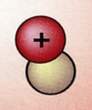
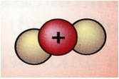
$π$EFT:$1+2≠3$
For πEFT there is a big difference between nuclear systems with 2 particles and 3 particles
Deuteron: $ψ_{d}\left(k\right)=\frac{\sqrt{8πγ_{t}}}{k^{2}+γ_{t}^{2}}$
Triton: $T\left(E,k,p\right)=\int_{0}^{Λ}{\frac{d^{3}p′}{{\left(2π\right)}^{3}}T\left(E,k,p′\right)𝒟\left(E,p′\right)𝒦\left(E,p′,p\right)}$
Summing over all possible amplitudes (Faddeev equation)
Bedaque, Hammer, van Kolck (1999)
König and Hammer (2011), König et al (2014)

Slide 8
πEFT: $A=3$scattering amplitude
For bound state:$T\left(E_{B},k,p\right)=\frac{ℬ{\left(k\right)}^{†}ℬ\left(p\right)}{E−E_{B}}+ℛ$
Triton, $J=\frac{1}{2}$ , coupled channels Faddeev equation:
$$a_{tt}=\frac{4}{3}\left[{\left(σ^{i} \right)}_{β}^{α}{\left(P_{t}^{i}\right)}_{γδ}^{† }{\left(P_{t}^{j}\right)}^{δβ}{\left(σ^{i}\right)}_{γ}^{χ}\right]=−1$$
$$ℬ\left(p\right)=\int_{0}^{Λ}{\frac{d^{3}p′}{{\left(2π\right)}^{3}}ℬ\left(p′\right)𝒟\left(E_{B},p′\right)𝒦\left(E_{B},p′,p\right)}$$
$$ℬ\left(p\right)=\left(\begin{aligned}Γ_{t}\left(p\right) \\ Γ_{s}\left(p\right)\end{aligned}\right), Γ_{μ}(p)=M_{N}\sum_{ν=t,s}{\int{\frac{d^{3}p}{{\left(2π\right)}^{3}}y_{μ}y_{ν}a_{μν}K_{0}(E,p,p^{′}) D_{ν}(E,p′)Γ_{ν}(p′)}}$$
Bedaque, Hammer, van Kolck (1999),
König and Hammer (2011)
König et al (2014)

Slide 9
πEFT: $A=3$scattering amplitude
Triton, $J=\frac{1}{2}$ , coupled channels Faddeev equation:
$$\vec{ℬ}=\overset{⃡}{M} ×\vec{ℬ}$$
Eigenvalue problem
$\vec{ℬ}=\left(\begin{aligned}Γ_{t} \\ Γ_{s}\end{aligned}\right)$, $M_{μ,ν}=M_{N}y_{μ}y_{ν}a_{μν}K_{0}(E,p,p^{′})D_{ν}(E,p′)$
Bedaque, Hammer, van Kolck (1999),
König and Hammer (2011)
König et al (2014)

Slide 10
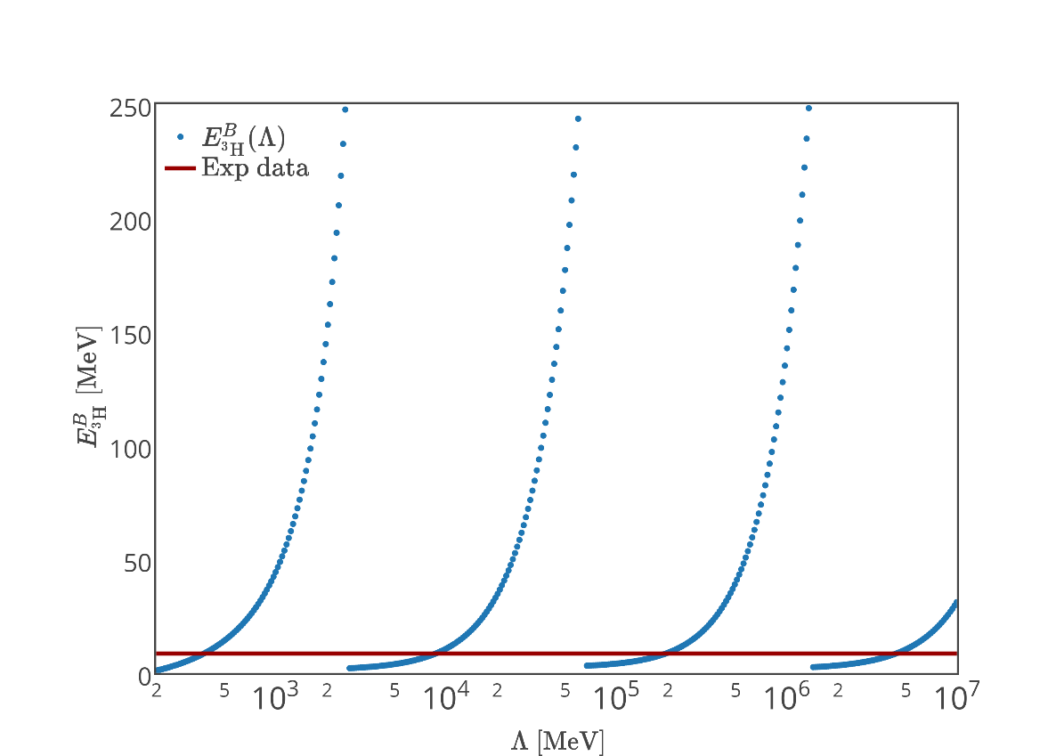
$$\text{Binding} \text{energy}\text{:}$$
Deuteron: $E_{B}=−\frac{γ_{t}^{2}}{M_{N}}$
Triton:
$$Γ_{μ}\left(p\right)=$$
$$M_{N}\sum_{ν=t,s}{\int_{0}^{Λ}{\frac{d^{3}p}{{\left(2π\right)}^{3}}y_{μ}y_{ν}a_{μν}D_{ν}\left(E,p^{′}\right)K_{0}\left(E,p,p^{′}\right)Γ_{ν}\left(p^{′}\right)}}$$
$E_{B}=E_{B}\left(Λ\right),$ Efimov effect
3-body system has strong cutoff dependence
$→$add 3-body force at LO.
$$Γ_{μ}(p)=M_{N}\sum_{ν=t,s}{\int{\frac{d^{3}p}{{\left(2π\right)}^{3}}y_{μ}y_{ν}a_{μν}\left[K_{0}\left(E,p,p^{′}\right)+\frac{2H\left(Λ\right)}{Λ^{2}} \right]D_{ν}(E,p′)Γ_{ν}(p^{′})}}$$
$$\left|E_{B}^{3H}\left(Λ\right)\right|$$
$$\left|E_{B}^{3H}\left(Λ\right)\right| \left[MeV\right]$$
$Λ [MeV$]
Bedaque, Hammer, van Kolck (1999)

Slide 11
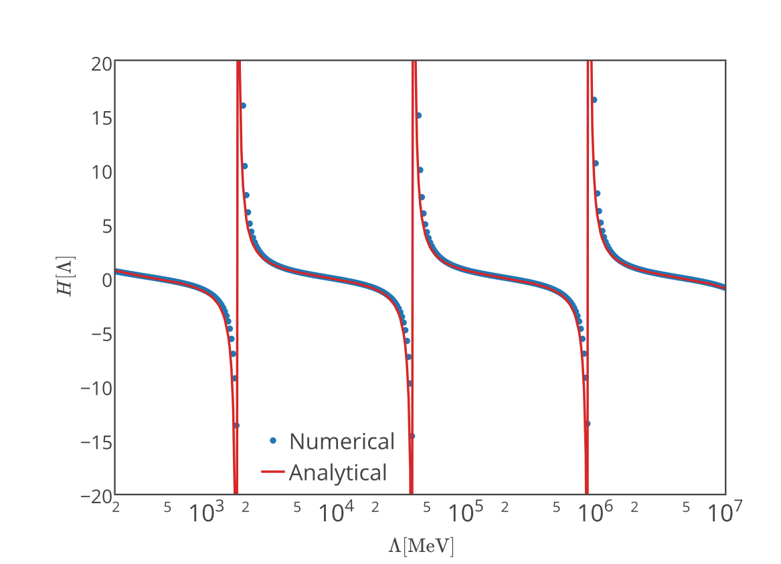
$$\text{Binding} \text{energy}\text{:}$$
Deuteron: $E_{B}=−\frac{γ_{t}^{2}}{M_{N}}$
Triton:
$$Γ_{μ}\left(p\right)=$$
$$M_{N}\sum_{ν=t,s}{\begin{aligned} \\ \int{\frac{d^{3}p}{{\left(2π\right)}^{3}}y_{μ}y_{ν}a_{μν}D_{ν}\left(E,p^{′}\right)K_{0}\left(E,p,p^{′}\right)Γ_{ν}\left(p^{′}\right)}\end{aligned}}$$
$E_{B}=E_{B}\left(Λ\right),$ Efimov effect
3-body system has strong cutoff dependence
$→$add 3-body force at LO.
$$Γ_{μ}(p)=M_{N}\sum_{ν=t,s}{\int{\frac{d^{3}p}{{\left(2π\right)}^{3}}y_{μ}y_{ν}\left[a_{μν}K_{0}\left(E,p,p^{′}\right)+b_{μν}\frac{H\left(Λ\right)}{Λ^{2}} \right]D_{ν}(E,p′)Γ_{ν}(p^{′})}}$$
$$\left|E_{B}^{3H}\left(Λ\right)\right| \left[MeV\right]$$
$Λ [MeV$]
Bedaque, Hammer, van Kolck (1999)

Slide 12
Normalization of the A=3 wave-function
Non relativistic Bethe-Salpeter equation (for a bound state):
$\left|Γ\right\rangle =−VG_{BS}|Γ⟩$
Bethe-Salpeter (B.S.) normalization condition:
$$1=⟨Γ|G_{BS}\frac{∂}{∂E}\left(−G_{BS}^{−1}−V\right)G_{BS}|Γ⟩$$
Triton scattering amplitude: $\left|ℬ\right\rangle =\hat{D}\hat{K}\left|ℬ\right\rangle$
$$Γ_{μ}(p)=M_{N}\sum_{ν=t,s}{\int{\frac{d^{3}p}{{\left(2π\right)}^{3}}y_{μ}y_{ν}\left[a_{μν}K_{0}\left(E,p,p^{′}\right)+b_{μν}\frac{H\left(Λ\right)}{Λ^{2}} \right]D_{ν}(E,p′)Γ_{ν}(p^{′})}}$$
$$\left\langle \hat{1}\right\rangle =\sum_{μ,ν=t,s}{\left\langle Γ_{μ}\left|D_{μ}\left\{\frac{∂}{∂E}\left[D_{μ}^{−1}\left(E\right)δ_{μ,ν }−a_{μν}K_{0}\left(E\right)\right]{\left.​\right|}_{E=E_{B}}\right\}D_{ν}\right|Γ_{ν}\right\rangle }$$
König and Hammer (2011)
De-Leon, Platter and Gazit (2019)

Slide 13
Normalization of the A=3 wave-function
Non relativistic Bethe-Salpeter equation (for a bound state):
$\left|Γ\right\rangle =−VG_{BS}|Γ⟩$
Bethe-Salpeter (B.S.) normalization condition:
$$1=⟨Γ|G_{BS}\frac{∂}{∂E}\left(−G_{BS}^{−1}−V\right)G_{BS}|Γ⟩$$
Triton scattering amplitude:
$$Γ_{μ}(p)=M_{N}\sum_{ν=t,s}{\int{\frac{d^{3}p}{{\left(2π\right)}^{3}}y_{μ}y_{ν}\left[a_{μν}K_{0}\left(E,p,p^{′}\right)+b_{μν}\frac{H\left(Λ\right)}{Λ^{2}} \right]D_{ν}(E,p′)Γ_{ν}(p^{′})}}$$
$$\left\langle \hat{1}\right\rangle =\sum_{μ,ν=t,s}{\left\langle Γ_{μ}\left|D_{μ}\left\{\frac{∂}{∂E}\left[D_{μ}^{−1}\left(E\right)δ_{μ,ν }−a_{μν}K_{0}\left(E\right)\right]{\left.​\right|}_{E=E_{B}}\right\}D_{ν}\right|Γ_{ν}\right\rangle }$$
König and Hammer (2011)
De-Leon, Platter and Gazit (2019)

Slide 14
Normalization of the A=3 wave-function
Non relativistic Bethe-Salpeter equation (for a bound state):
$\left|Γ\right\rangle =−VG_{BS}|Γ⟩$
Bethe-Salpeter (B.S.) normalization condition:
$$1=⟨Γ|G_{BS}\frac{∂}{∂E}\left(−G_{BS}^{−1}−V\right)G_{BS}|Γ⟩$$
Triton scattering amplitude:
$$Γ_{μ}(p)=M_{N}\sum_{ν=t,s}{\int{\frac{d^{3}p}{{\left(2π\right)}^{3}}y_{μ}y_{ν}\left[a_{μν}K_{0}\left(E,p,p^{′}\right)+b_{μν}\frac{H\left(Λ\right)}{Λ^{2}} \right]D_{ν}(E,p′)Γ_{ν}(p^{′})}}$$
$$\left\langle \hat{1}\right\rangle =\sum_{μ,ν=t,s}{\left\langle Γ_{μ}\left|D_{μ}\left\{\frac{∂}{∂E}\left[D_{μ}^{−1}\left(E\right)δ_{μ,ν }−a_{μν}K_{0}\left(E\right)\right]{\left.​\right|}_{E=E_{B}}\right\}D_{ν}\right|Γ_{ν}\right\rangle }$$
König and Hammer (2011)
De-Leon, Platter and Gazit (2019)

Slide 15
Normalization of the A=3 wave-function
Triton scattering amplitude:
$$Γ_{μ}(p)=M_{N}\sum_{ν=t,s}{\int{\frac{d^{3}p}{{\left(2π\right)}^{3}}y_{μ}y_{ν}\left[a_{μν}K_{0}\left(E,p,p^{′}\right)+b_{μν}\frac{H\left(Λ\right)}{Λ^{2}} \right]D_{ν}(E,p′)Γ_{ν}(p^{′})}}$$
$$\left\langle \hat{1}\right\rangle =\sum_{μ,ν=t,s}{\left\langle Γ_{μ}D_{μ}\left|\left\{\frac{∂}{∂E}\left[D_{μ}^{−1}\left(E\right)δ_{μ,ν }−a_{μν}K_{0}\left(E\right)\right]{\left.​\right|}_{E=E_{B}}\right\}\right|{D_{ν}Γ}_{ν}\right\rangle }$$
$\left\langle \hat{1}\right\rangle$= $\sum_{μ,ν=t,s}{\left\langle ψ_{μ}\left|{\hat{𝓞}}_{μν}^{norm}\right|ψ_{ν}\right\rangle }$
Matrix element!
König and Hammer (2011)
De-Leon, Platter and Gazit (2019)

Slide 16
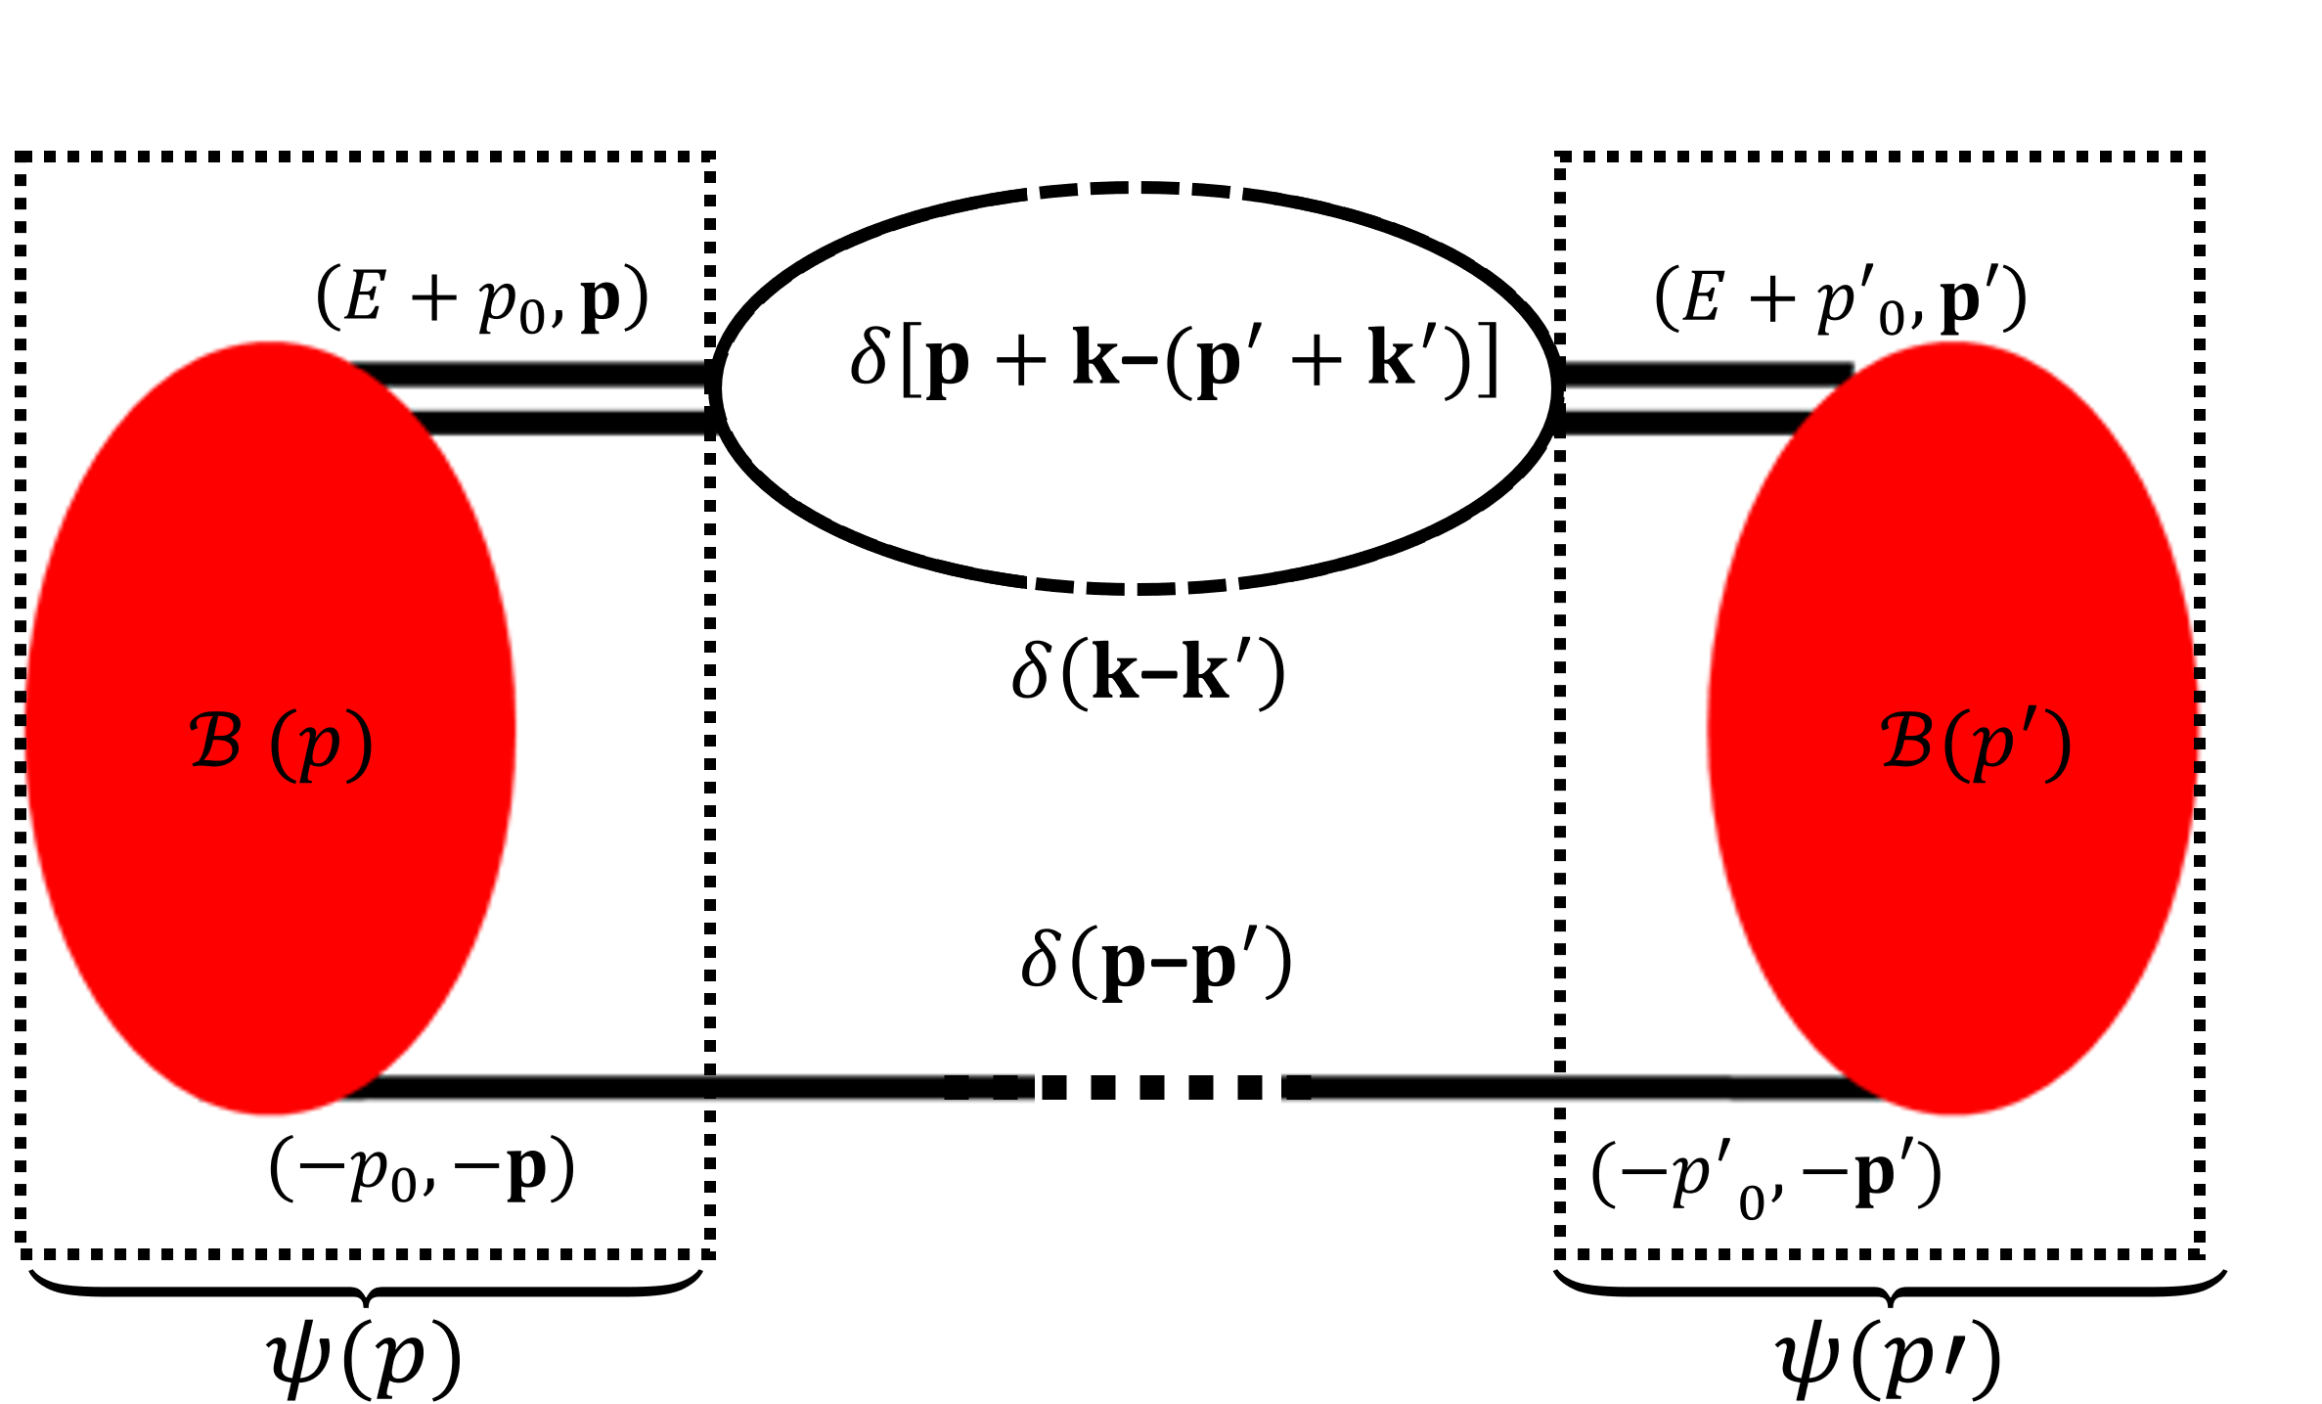
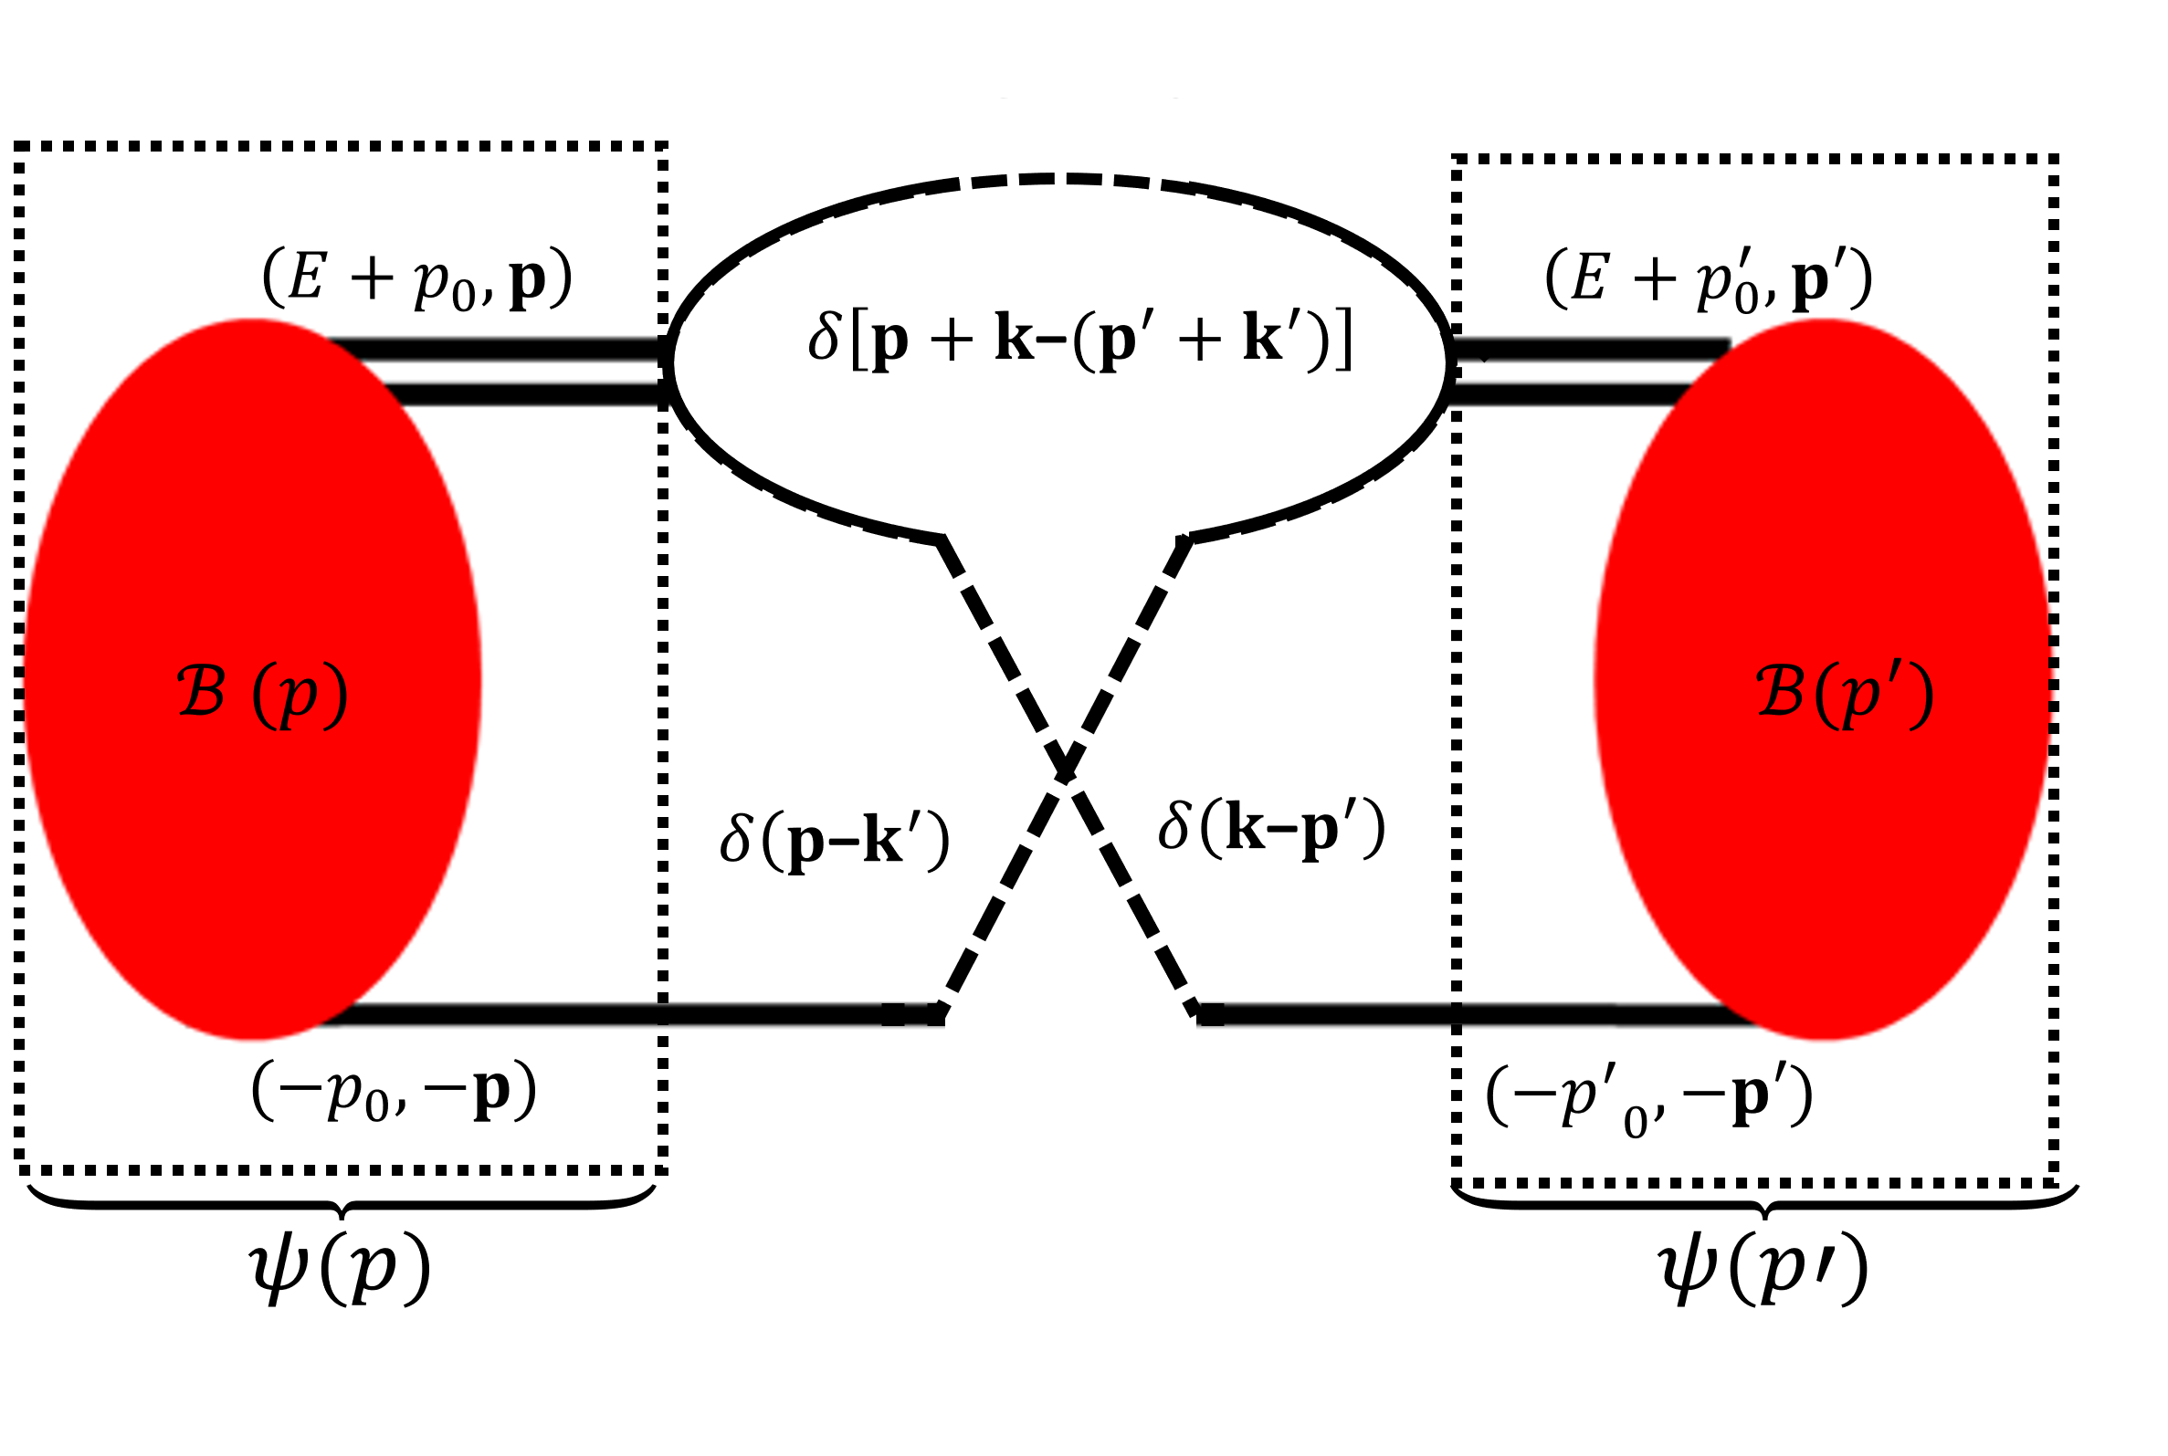
Normalization of the A=3 wave-function:
$$1=\sum_{μ,ν}{\left\langle ψ_{μ}\left|\frac{∂}{∂E}\left[D_{μ}^{−1}\left(E\right)δ_{μ,ν}−a_{μν}K_{0}\left(E \right)\right]{\left.​\right|}_{E=E_{B}}\right|ψ_{ν}\right\rangle }$$
$$\frac{∂S\left(E,p\right)}{∂E}=\int{\frac{d^{3}p′}{{\left(2π\right)}^{3}}S\left(E,p\right)S\left(E,p^{′}\right)\frac{2π^{2}}{p^{′2}}δ(p−p^{′}) }$$
The normalization is equivalent to
all possible connections between two identical bubbles:
$$\left[−\frac{∂}{∂E}𝒦\right]$$
$$\left[\frac{∂}{∂E}𝒟^{−1}\right]$$
De-Leon, Platter and Gazit (2019)

Slide 17
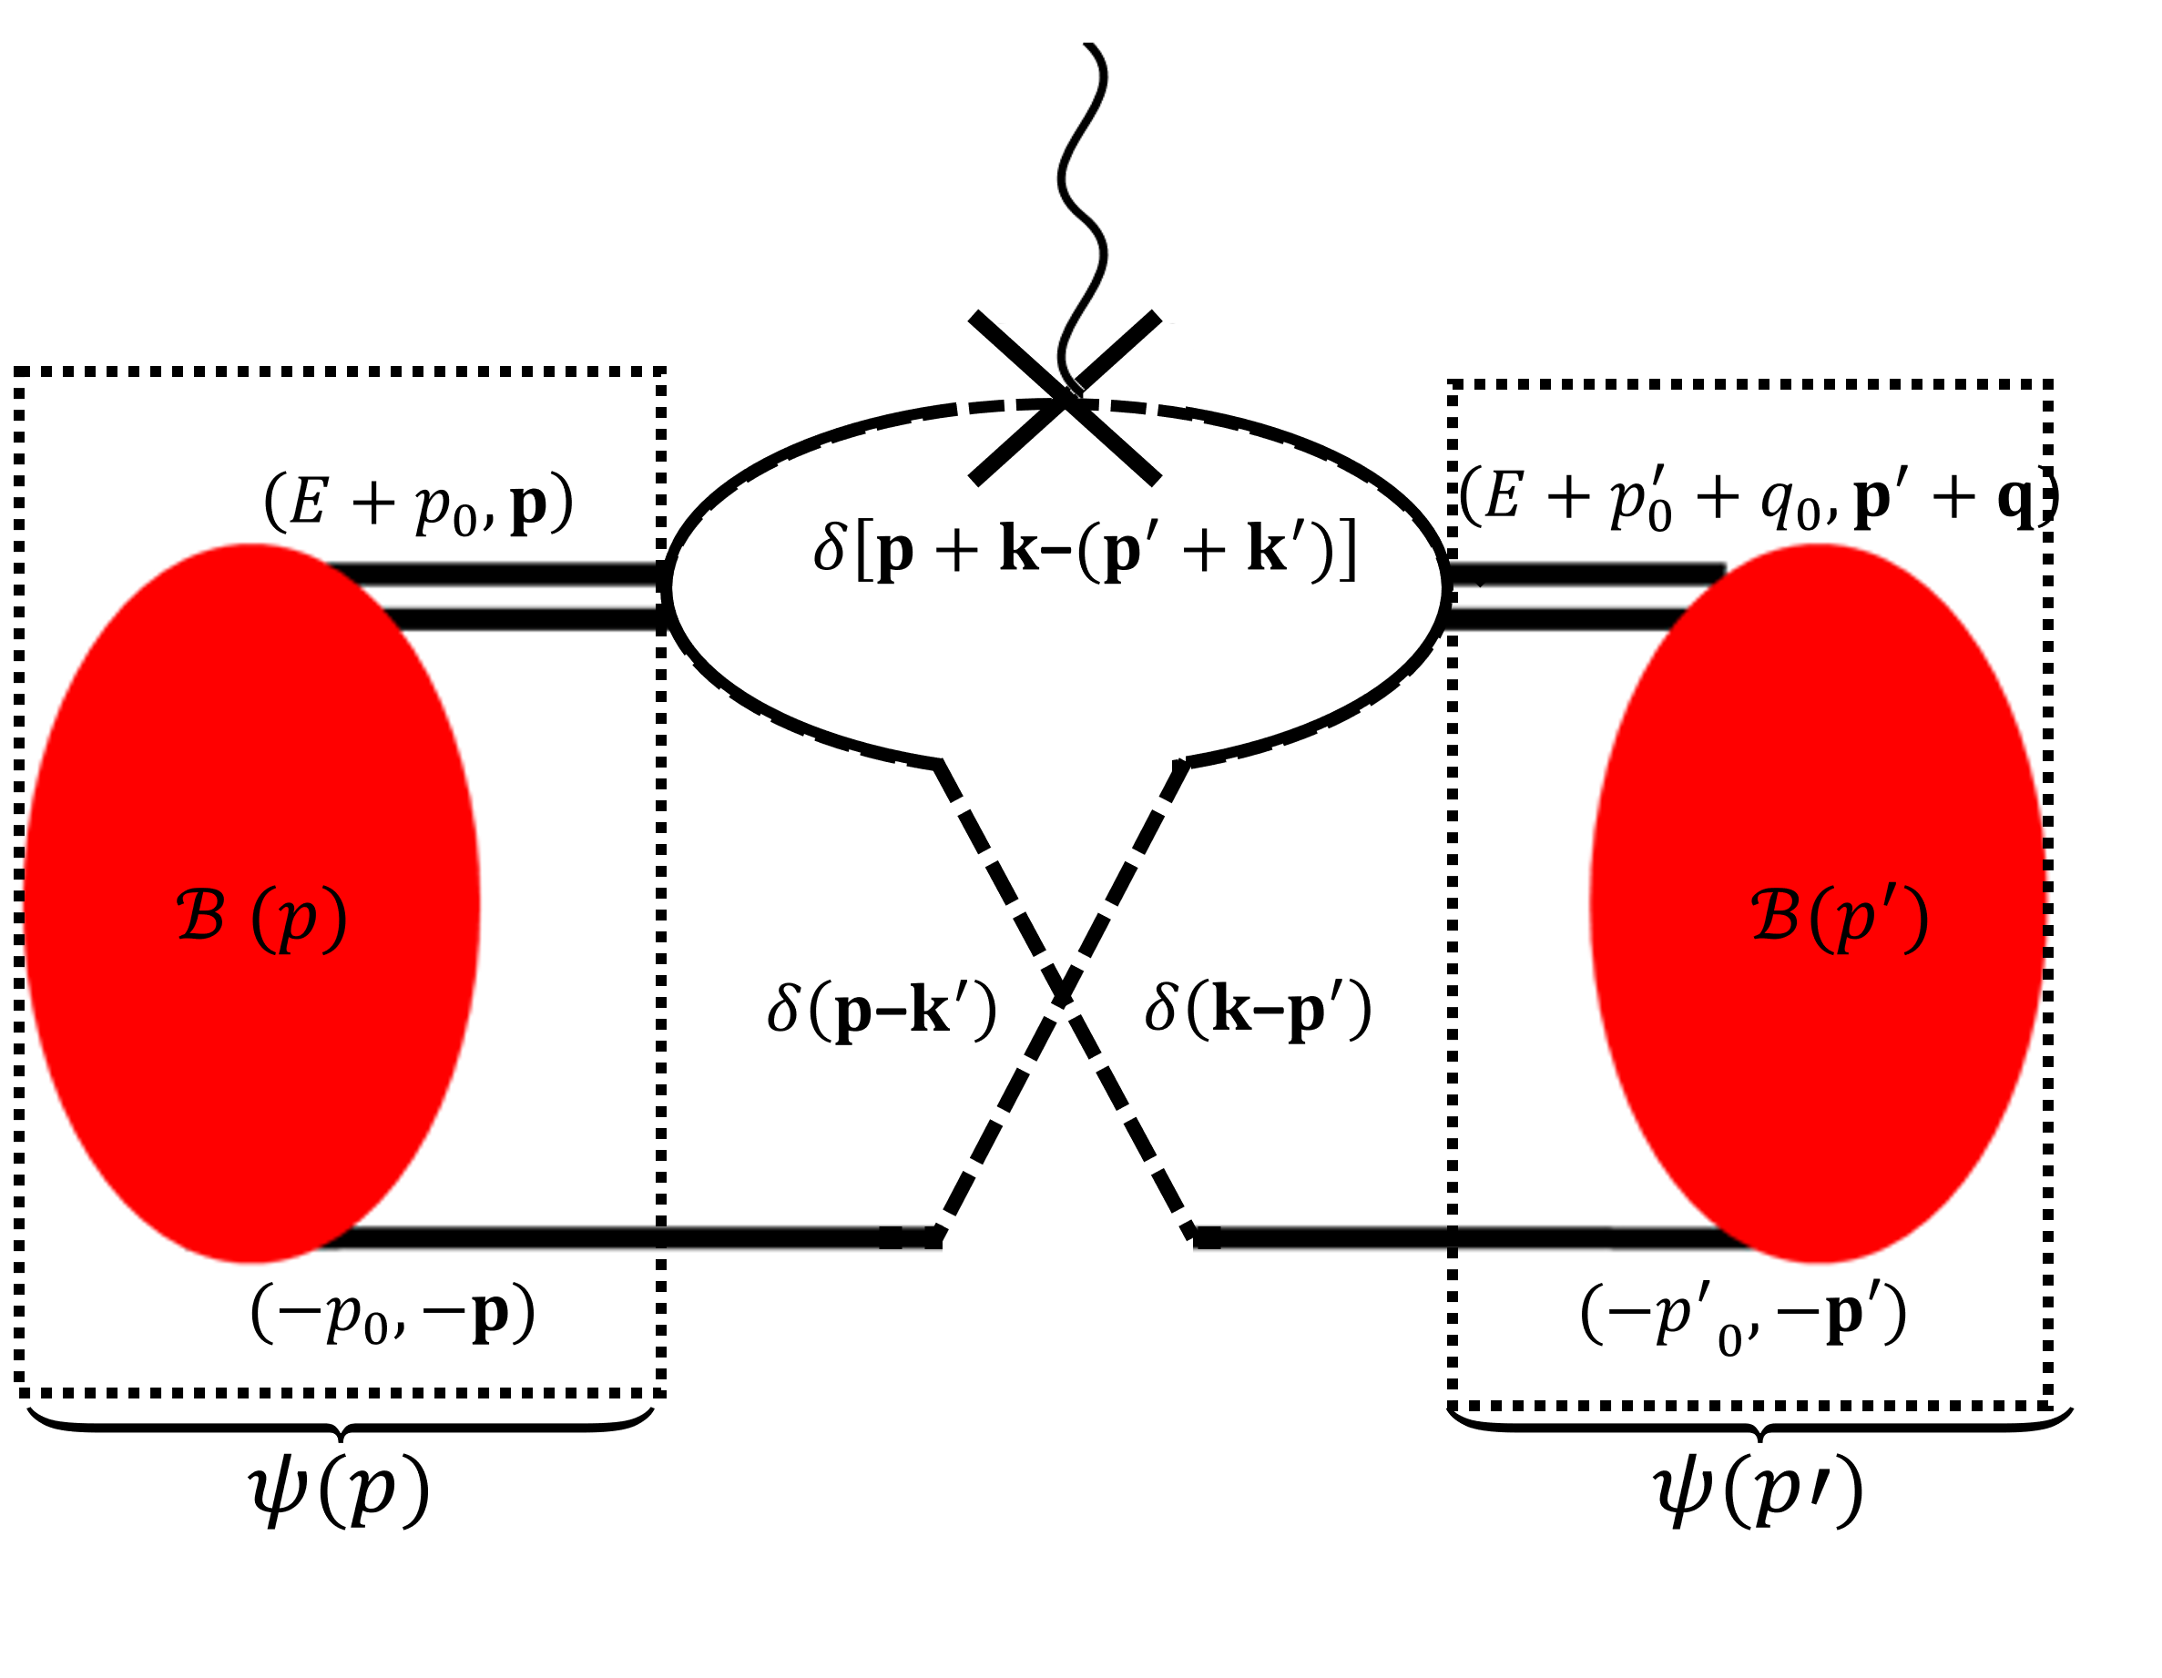
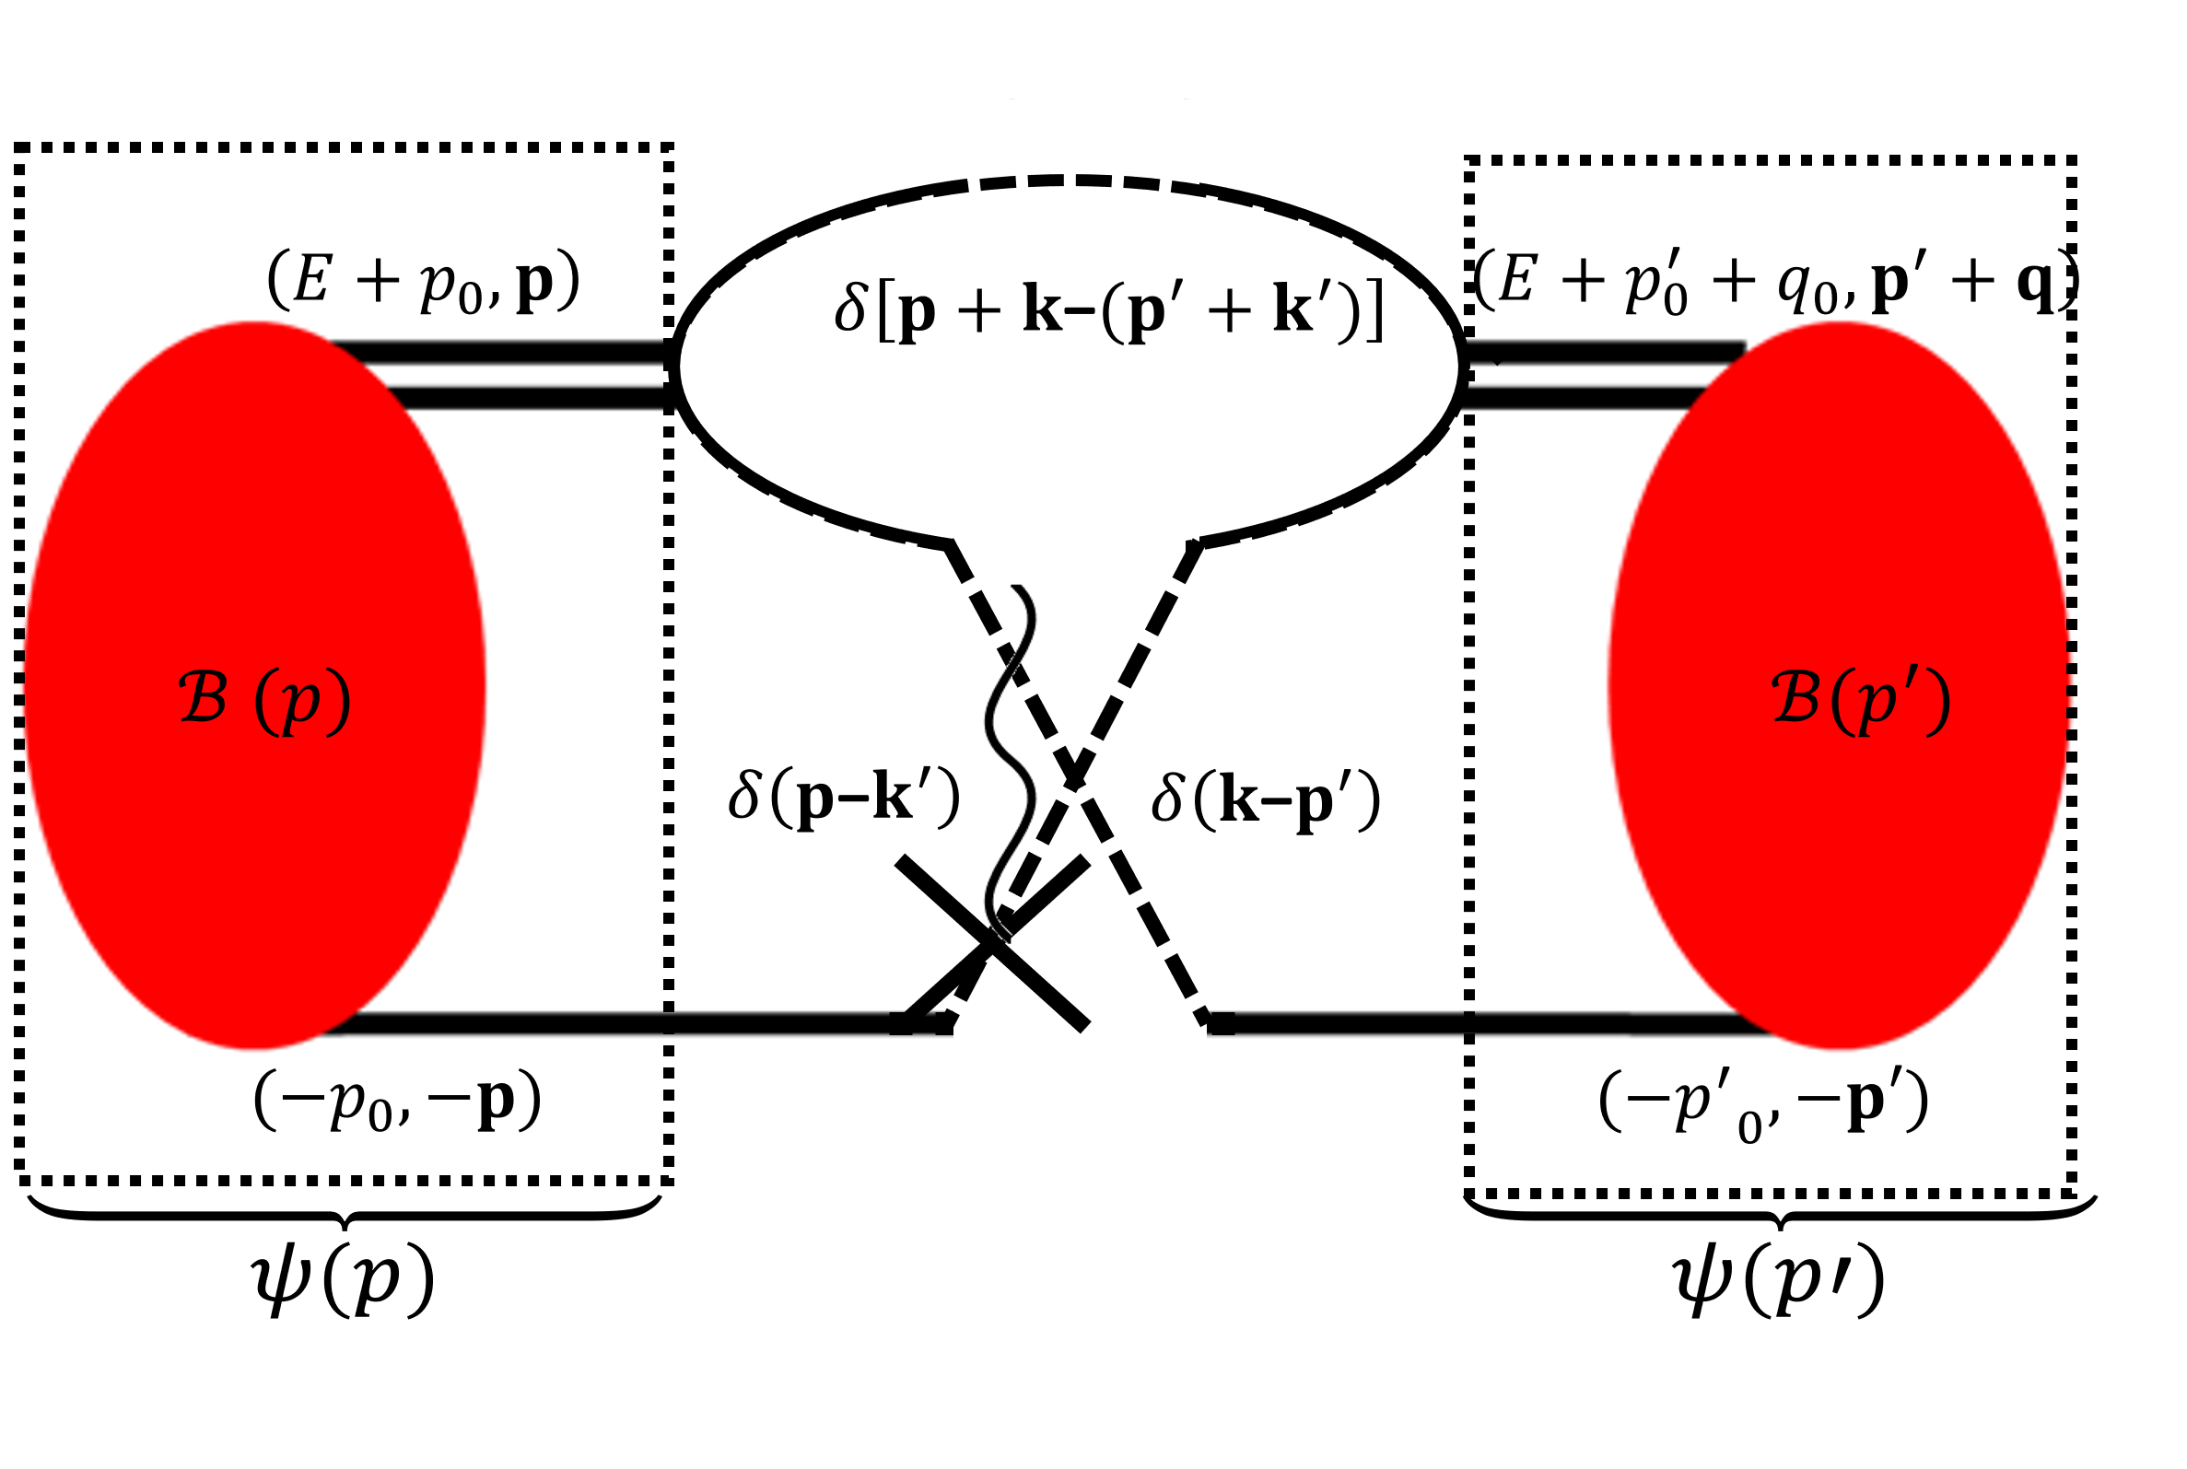
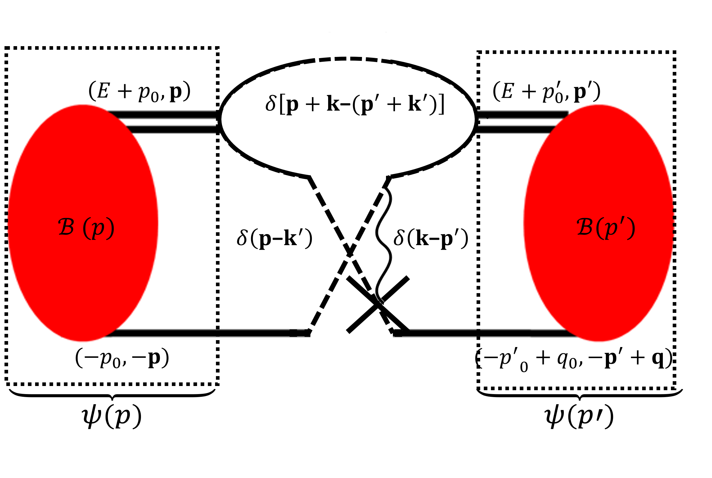
Reduced matrix element
A matrix element is equivalent to all possible connections, with B.S. bound states:
Reduced matrix element:
For the case where $i=j$: $a_{μν}^{i,j}$=$a_{μν}$, $d_{μν}^{i,j}$=$δ_{μ,ν}$
$$⟨𝒪⟩=a^{J}\left\langle \frac{1}{2}\left\|𝒪^{J}\right\|\frac{1}{2}\right\rangle \left\langle \frac{1}{2} | 𝒪^{I} | \frac{1}{2}\right\rangle \sum_{μ,ν}{\left\langle ψ_{ν}^{j} | a_{μν}^{i,j}\hat{𝒦}(q_{0},q)+d_{μν}^{i,j}\hat{ℐ }(q_{0},q) | ψ_{μ}^{i}\right\rangle }$$
De-Leon, Platter and Gazit (2019)

Slide 18
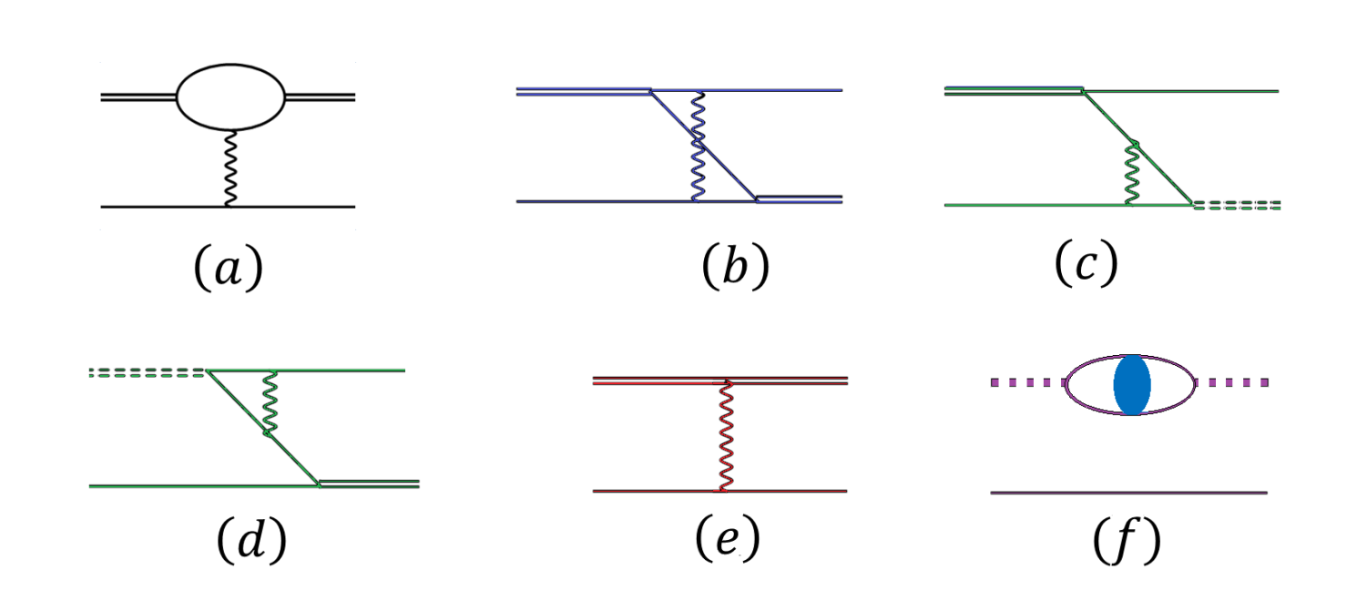
Adding photons – perturbative and non perturbative approaches:
For the bound state, the typical momentum $Q≥\sqrt{M_{N}E_{3He}}∼85MeV$, so: $η=\frac{αM_{N}}{Q}≪1→\text{one} \text{photon} \text{exchange}$
The Coulomb interactions:
Diagrams a-d: $∼𝒪\left(𝒦\right)⋅\frac{αM_{N}}{Q},$diagram e$∼𝒪\left(a\right)⋅\frac{Q}{Λ}$ which is of NLO, diagram f: $pp$propagator.
König, Hammer (2011)
Vannase et al (2015), König et al (2014-2016)

Slide 19
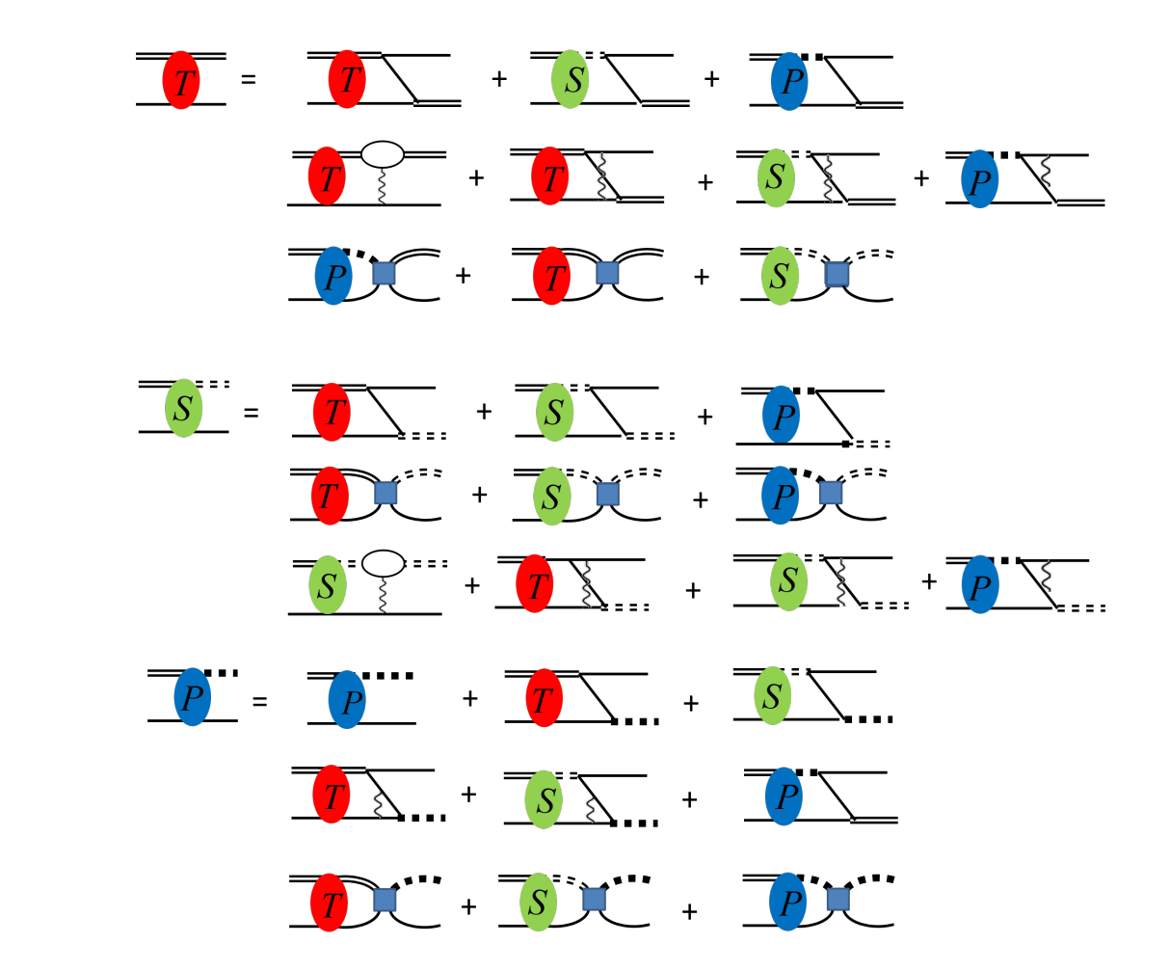
³He – non perturbative photons:
$$Γ_{μ}^{3He}(p)=M_{N}\sum_{ν=t,np,pp}{\int{{\frac{d^{3}p}{{\left(2π\right)}^{3}}y}_{μ}y_{ν}\left\{{a′}_{μν}[K_{0}\left(E_{3He},p,p^{′}\right)+K_{μν}^{C}\left(E_{3He},p,p^{′}\right)]+{b′}_{μν}\frac{H\left(Λ\right)}{Λ^{2}}\right\}D_{ν}(E,p′)Γ_{ν}^{3He}(p^{′})}}$$
König, Hammer (2011)
Vannase et al (2015), König et al (2014-2016)

Slide 20
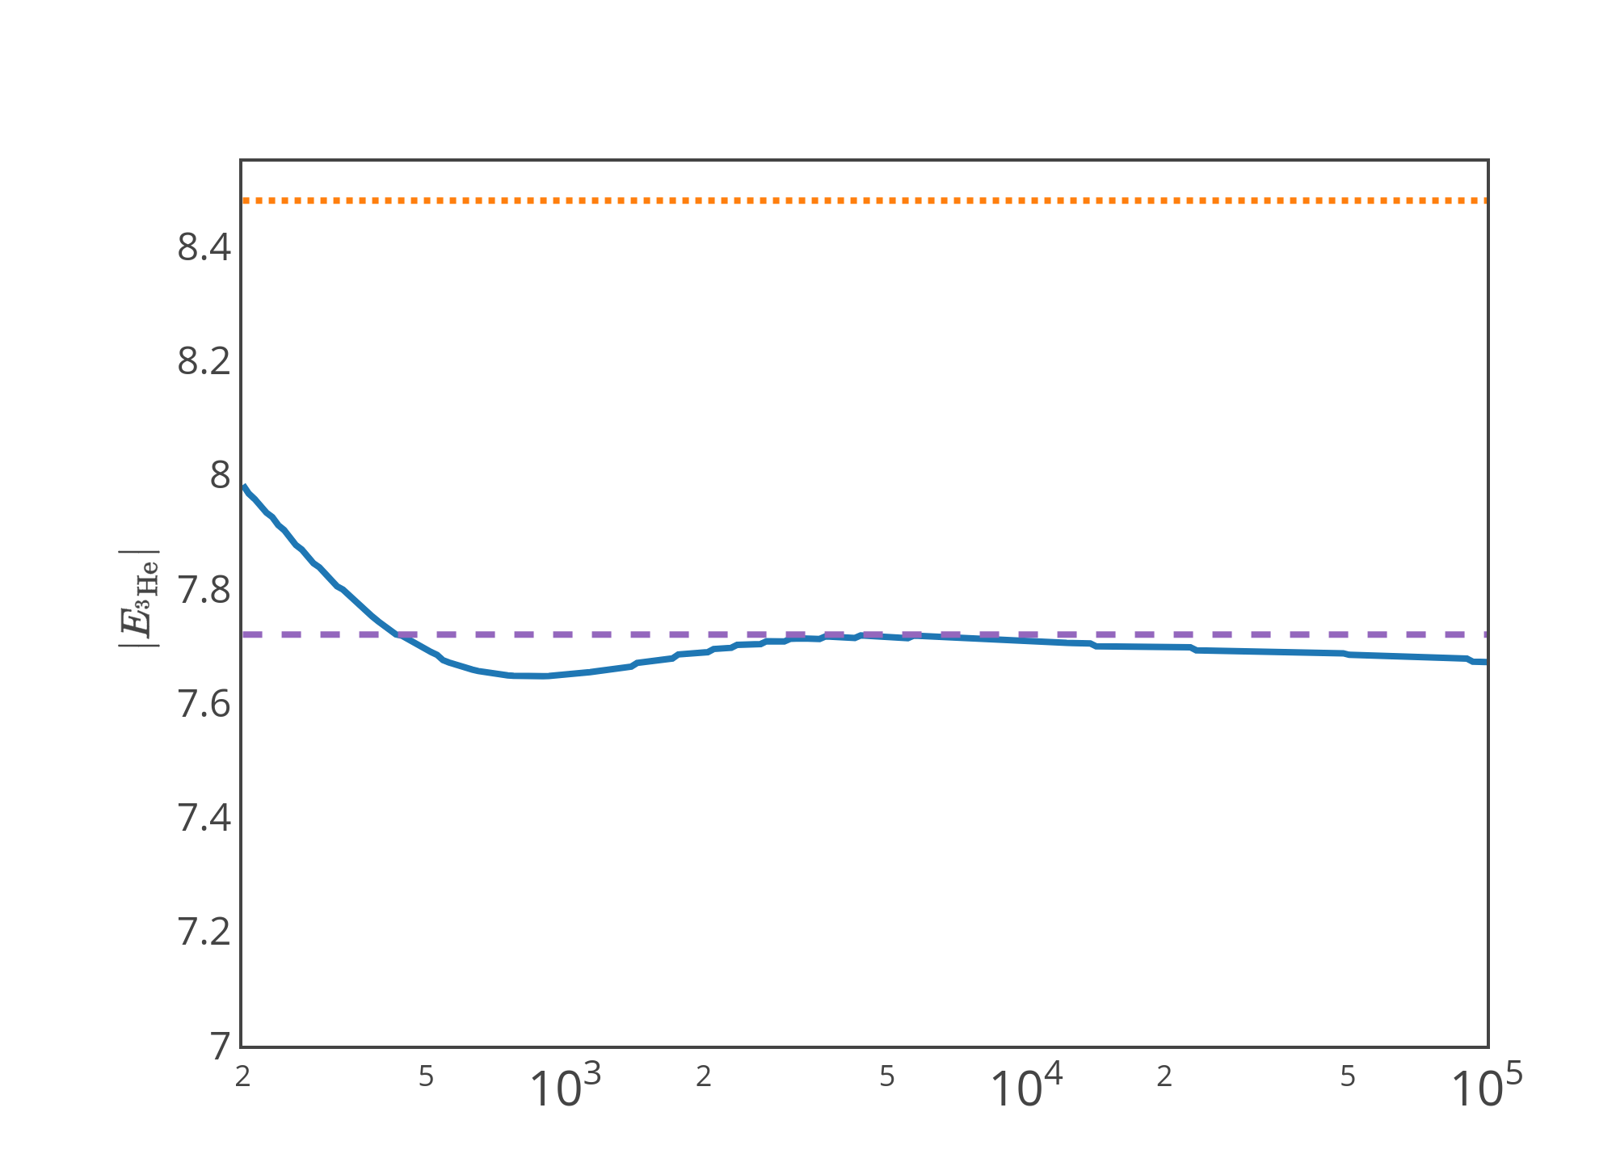
³He – non perturbative photons:
Binding energy:
Two ways to find ³He binding energy difference:
Find the pole of the non-perturbative solution of the homogenous Faddeev equation with Coulomb interaction.
From ³He wave function
³H exp data
³He exp data
$$Γ_{μ}^{3He}(p)=M_{N}\sum_{ν=t,np,pp}{\int{{\frac{d^{3}p}{{\left(2π\right)}^{3}}y}_{μ}y_{ν}\left\{{a′}_{μν}[K_{0}\left(E_{3He},p,p^{′}\right)+K_{μν}^{C}\left(E_{3He},p,p^{′}\right)]+{b′}_{μν}\frac{H\left(Λ\right)}{Λ^{2}}\right\}D_{ν}(E,p′)Γ_{ν}^{3He}(p^{′})}}$$
$Λ [MeV$]
König et al (2014-2016)

Slide 21
³He perturbative photons:
Binding energy:
Two ways to find ³He binding energy difference:
Find the pole of the non-perturbative solution of the homogenous Faddeev equation with Coulomb interaction.
Since Coulomb interaction is perturbative in ³He, one can calculate the energy shift in the one-photon approximations as a matrix element.
$$ΔE=\sum_{μ=t,s}{\left\langle ψ_{μ}^{3H}\left(p\right)\right|𝒪_{μ,ν}^{\left(1B\right)}\left(q_{0},q_{0}\right)+𝒪_{μ,ν}^{\left(2B\right)}\left(q_{0},q_{0}\right)\left|ψ_{ν}^{3H}\left(p\right)\right\rangle }$$
$$𝒪_{μ,ν}^{\left(1B\right)}\left(q_{0},q_{0}\right)=c_{μν}K_{μν}^{C}\left(p,p^{′},E\right)δ(q−p+p^{′})$$
$$𝒪_{μ,ν}^{\left(2B\right)}\left(q_{0},q_{0}\right)=\left[\frac{{D_{pp}\left(E,p\right)−D}_{s}\left(E,p\right)}{D_{s}{\left(E,p\right)}^{2}}\right]\frac{δ\left(p−p^{′}\right)}{p^{′2}}2π^{2}δ_{μ,s }δ_{ν,s }$$
König et al (2014-2016)
De-Leon, Platter and Gazit (2019)

Slide 22
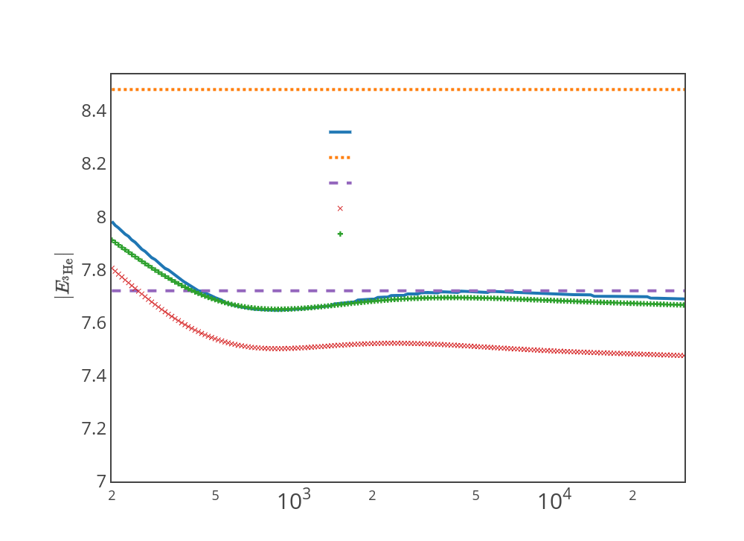
³He perturbative photons:
Binding energy:
Two ways to find ³He binding energy difference:
Find the pole of the non-perturbative solution of the homogenous Faddeev equation with Coulomb interaction.
Since Coulomb interaction is perturbative in ³He, one can calculate the energy shift in the one-photon approximation as a matrix element.
From ³He wave function
³H exp data
³He exp data
Perturbative, one-body
Perturbative, one-body + two-body
$Λ [MeV$]
König et al (2014-2016)
De-Leon, Platter and Gazit (2019)

Slide 23
Low energy electroweak (EW) reactions in $A≤3$ nuclear systems and uncertainty estimation.
De-Leon and Gazit (2019) in submission.
De-Leon, Platter and Gazit (2019).
Pionless: Kirscher et al. (2017), Vanasse (2017) chiral: Pastore et al (2013), Bacca and Pastore (2014)

Slide 24
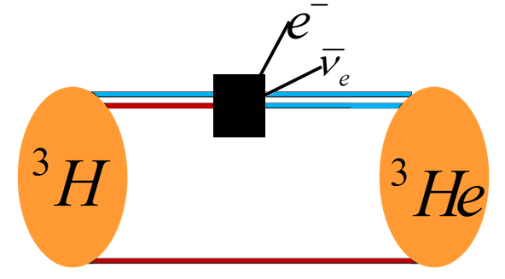
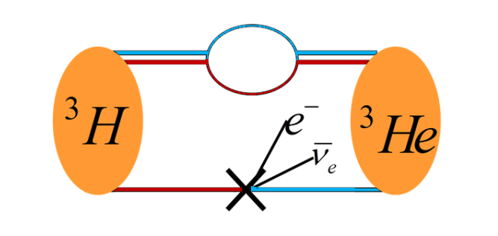
πEFT: Adding EW interaction
The effective Lagrangian coefficients are called low-energy constants (LECs), encode all fundamental theory
The one-body LECs are calibrated from one-body interactions
The two-body LEC can be calibrated from A>1 interactions

Slide 25
EW matrix element, Power counting
$$\left\langle \left|\left|𝒪^{1B}\right|\right|\right\rangle =ψ^{2}𝒪\left[y^{2}S^{3}\left(q_{0},q\right)d^{3}qdq_{0}\right]=ψ^{2}𝒪\left(\frac{8πΛ}{M_{N}^{2}}\frac{1}{\frac{q^{6}}{M_{N}^{3}}}\frac{{ q}^{5}}{4πM_{N}}\right)=ψ^{2}𝒪\left(\frac{Λ}{q}\right)=𝒪\left(1\right)$$
$$\left\langle \left|\left|𝒪^{2B}\right|\right|\right\rangle =ψ^{2}𝒪\left(1\right)=𝒪\left(\frac{q}{Λ}\right)$$
De-Leon, Platter and Gazit (2019)

Slide 26
EW matrix element, Power counting
$$\left\langle \left|\left|𝒪^{1B}\right|\right|\right\rangle =𝒪\left(1\right)$$
$$\left\langle \left|\left|𝒪^{2B}\right|\right|\right\rangle =𝒪\left(\frac{q}{Λ}\right)$$
To keep consistency:
Up to NLO, the one-body diagrams must have one NLO insertion.
The two-body LEC is of $𝒪\left(1\right)$
De-Leon, Platter and Gazit (2019)

Slide 27
NLO A=3, general EW matrix element
$${\left\langle 𝓞_{EW}^{}\right\rangle }_{LO}+{\left\langle 𝓞_{EW}^{}\right\rangle }_{NLO}=$$
$$〈ψ^{LO}\left|𝓞_{EW}^{LO}\right|ψ^{LO}〉+〈ψ^{NLO}\left|𝓞_{EW}^{LO}\right|ψ^{LO}〉\text{+}〈ψ^{LO}\left|𝓞_{EW}^{NLO}\right|ψ^{LO}〉\text{+}〈ψ^{LO}\left|𝓞_{EW}^{LO}\right|ψ^{NLO}〉$$
One-body NLO corrections:
$ψ_{μ}^{NLO}\left(E, p\right)=Z^{NLO}\left[D_{μ}^{NLO}\left(E, p\right)Γ_{μ}^{LO} \left(E, p\right)+D_{μ}^{LO}\left(E, p\right)Γ_{μ}^{NLO} \left(E, p\right)\right]$
NLO operator (two-body): $t^{†}t,s^{†}s,\left(t^{†}s+h.c\right)$
$ψ_{μ}^{NLO}$ is determined by the $A=3$ charge:
$$F_{C}^{LO}\left(0\right)+F_{C}^{NLO}\left(0\right){=F}_{C}^{LO}\left(0\right)\text{=}\text{1}$$
$\sum_{μ,ν=t,s }{\left\langle ψ_{μ}^{NLO}\left|{\hat{𝓞}}_{μν}^{norm}\right|ψ_{ν}^{LO}\right\rangle +\left\langle ψ_{μ}^{LO}\left|{\hat{𝓞}}_{μν}^{norm}\right|ψ_{ν}^{NLO}\right\rangle −\frac{2}{3}}$ $\left\langle ψ_{t}^{LO}|ψ_{t}^{LO}\right\rangle =0$
Vanasse et al (2014-2018)
De-Leon, Platter and Gazit (2019)

Slide 28
Two-body LEC in the dibaryon formalism
In the original Lagrangian:
$$ℒ^{2B}=L_{tt}\left[{\left(N^{T}P_{t}^{i}N\right)}^{†} {(N}^{T}P_{t}^{j}N)+h.c\right]$$
+ $L_{ts}\left[{\left(N^{T}P_{t}^{i}N\right)}^{†} \text{(}N^{T}P_{S}^{A}N)+h.c\right]$+ $L_{ss}\left[{\left(N^{T}P_{s}^{A}N\right)}^{†} {(N}^{T}P_{S}^{B}N+h.c\right]$
In the dibaryon formalism :
$$ℒ^{2B}=\frac{1}{2πρ_{t}}L_{tt}{\left(μ−\frac{1}{a_{t}^{}}\right)}^{2}+\frac{1}{2π{\sqrt{ρ_{t}ρ_{s}}}_{ }}L_{ts}\left(μ−\frac{1}{a_{t}^{}}\right) {\left(μ−\frac{1}{a_{t}^{}}\right)}^{}+\frac{1}{2πρ_{s}}L_{ss}{\left(μ−\frac{1}{a_{s}^{}}\right)}^{2}$$
+terms originating from the effective range corrections
Kong and Ravnda 2000 De-Leon, Platter and Gazit (2019)

Slide 29
Two-body LEC in the dibaryon formalism
Is there a difference between A=2,3 matrix elements?
Can describe simultaneously $A=2$ and $A=3$systems?
De-Leon, Gazit (2019) in submission

Slide 30
Electroweak analogues:
low energy observables $A<4$
To examine the consistency of $πEFT$ we need to find a set of $A<4$reactions all well measured.

Slide 31
Electroweak analogues:
low energy observables $A<4$
To examine the consistency of $πEFT$ we need to find a set of $A<4$reactions all well measured.
All the Electromagnetic interactions for $A<4$ are well measured.
 | Weak | Electromagnetic ( EM)
A=2 | Proton-proton fusion: $p+p→d+ν_{e}+e^{+}$ | Radiative capture: $$n+p→d+γ$$ | Deuteron magnetic moment: $$⟨μ_{d}⟩$$
A=3 | $3H β$decay: $$3H→\overline{ν_{e}}+e^{−}+3He$$ | $3H$ magnetic moment: $$⟨μ_{3H}⟩$$ | $3H$e magnetic moment: $$⟨μ_{3He}⟩$$

Slide 32
Electroweak analogues:
low energy observables $A<4$
To examine the consistency of $πEFT$ we need to find a set of $A<4$reactions all well measured.
All the Electromagnetic interactions for $A<4$ are well measured.
 | EM | Weak
1-body LEC | $$κ_{0},κ_{1}$$ | $$g_{A}$$
1-body operator | $$σ, στ^{0}$$ | $$τ^{+,−}, στ^{+,−}$$
2-body operator | $s^{†}t, t^{†}t$ | $$s^{†}t$$
$A=2, q≈0$obs. | $$σ_{np}, 〈μ_{d}〉$$ | $$Λ_{pp}$$
$A=3, q≈0$obs. | $$〈μ_{3H}〉, 〈μ_{3He}〉$$ | $3H β$ decay
Asymptomatic cutoff dependence | $$L_{1},L_{2}∼μ^{−2}$$ | $$L_{1,A}∼μ^{−2}$$

Slide 33
Magnetic interaction in πEFT :
4 well-measured $A<4$magnetic, $M_{1}$ observables:
$M_{1}=\left\langle μ_{d}\right\rangle ,\left\langle μ_{3H}\right\rangle$, $\left\langle μ_{3He}\right\rangle$ and $σ_{np}∝ κ_{1}^{2}{\left(Y′_{np}\right)}^{2}$
All calculations were done up to NLO:
$\left\langle M_{1}\right\rangle =\left\langle M_{1}\right\rangle ={\left\langle M_{1}\right\rangle }_{LO}^{}\left(1+δ{\left\langle M_{1}\right\rangle }_{NLO}^{}\right)={⟨M_{1}⟩}_{LO}^{1B}\left(1+\underset{ERE corrections }{\underbrace{δ{⟨M_{1}⟩}_{NLO}^{ERE}}}+\underset{LECs contributions}{\underbrace{{δ⟨M_{1}⟩}_{NLO}^{LEC}}}\right)$
$\underset{LECs contributions}{\underbrace{{δ⟨M_{1}⟩}_{NLO}^{LEC}}}=a_{M_{1}}\underset{l_{1}^{′}(μ)}{\underbrace{L_{1}\left(μ−\frac{1}{a_{t}}\right)\left(μ−\frac{1}{a_{s}}\right)}}+b_{M_{1}}{\underset{l_{2}^{′} (μ)}{\underbrace{{L_{2}\left(μ−\frac{1}{a_{t}}\right)}^{2}}}}_{}$
Both $l_{2}^{′}(μ), l_{1}^{′}(μ)$ should be RG invariant

Slide 34
Magnetic interaction in πEFT :
All calculations were done up to NLO:
$\left\langle M_{1}\right\rangle =\left\langle M_{1}\right\rangle ={\left\langle M_{1}\right\rangle }_{LO}^{}\left(1+δ{\left\langle M_{1}\right\rangle }_{NLO}^{}\right)={⟨M_{1}⟩}_{LO}^{1B}\left(1+\underset{ERE corrections }{\underbrace{δ{⟨M_{1}⟩}_{NLO}^{ERE}}}+\underset{LECs contributions}{\underbrace{{δ⟨M_{1}⟩}_{NLO}^{LEC}}}\right)$
$\underset{LECs contributions}{\underbrace{{δ⟨M_{1}⟩}_{NLO}^{LEC}}}=a_{M_{1}}\underset{l_{1}^{′}(μ)}{\underbrace{L_{1}\left(μ−\frac{1}{a_{t}}\right)\left(μ−\frac{1}{a_{s}}\right)}}+b_{M_{1}}{\underset{l_{2}^{′} (μ)}{\underbrace{{L_{2}\left(μ−\frac{1}{a_{t}}\right)}^{2}}}}_{}$
Both $l_{2}^{′}(μ), l_{1}^{′}(μ)$ should be RG invariant
We extract the two-body LECs from two observables and use them to predict the remaining two (6 combinations).
De-Leon and Gazit (2019) in submission

Slide 35
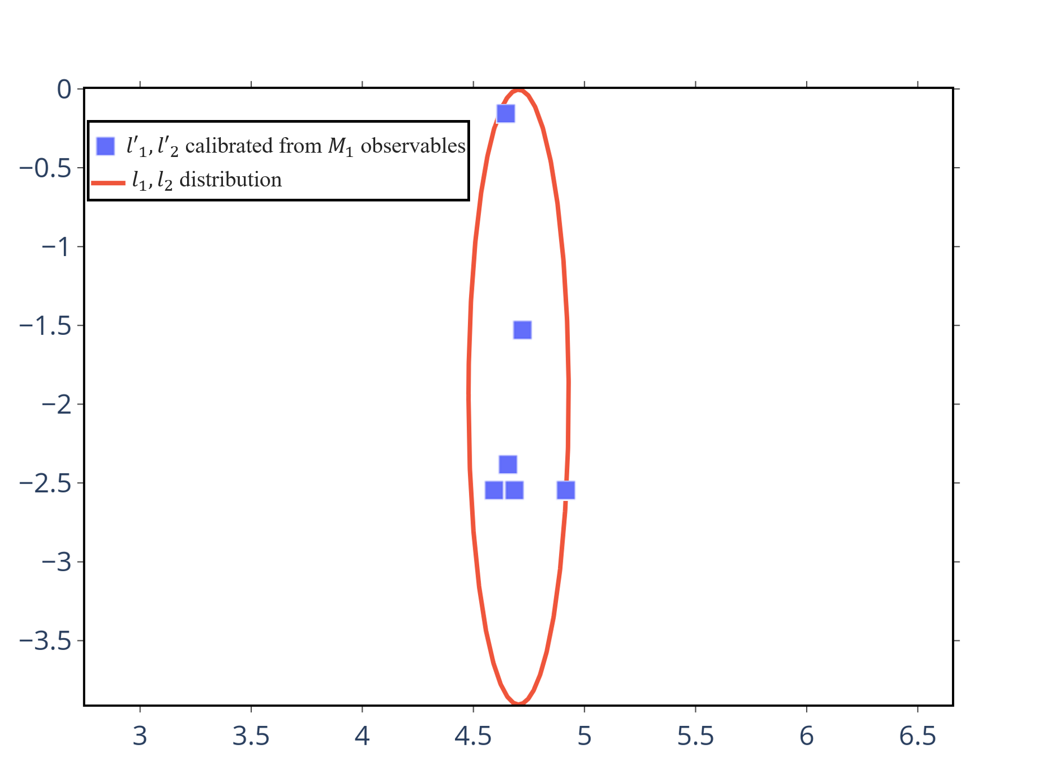
Numerical results
For $⟨{\hat{μ}}_{d}⟩$: $a_{M_{1}}=0,b_{M_{1}}=1$
For $Y_{np}^{′}$:$a_{M_{1}}=1,b_{M_{1}}=0$
$$\left\langle M_{1}\right\rangle ={⟨M_{1}⟩}_{LO}^{1B}\left(1+\underset{ERE corrections }{\underbrace{δ{⟨M_{1}⟩}_{NLO}^{ERE}}}+\underset{LECs contributions}{\underbrace{a_{M_{1}}l_{1}^{′}\left(μ\right)+b_{M_{1}}l_{2}^{′}\left(μ\right)}}\right)$$
$$l_{1}^{′}=\left(4.7±0.2\right)⋅{10}^{−2} l_{2}^{′}=\left(−1.6±1.1\right)⋅{10}^{−2}$$
$l_{2}^{′}$is consistent with 0!!
In $χEFT:$
Two-body iso-vector
current ($l_{1}^{′})$ is of NLO
Two-body iso-scalar
current ($l_{2}^{′})$is of N³LO
$$\frac{l_{2}^{′}(μ)}{{10}^{−2}} [a.u]$$
$$\frac{l_{1}^{′}\left(μ\right)}{{10}^{−2}} [a.u]$$
De-Leon and Gazit (2019) in submission
S. Pastore, R. Schiavilla, J.L. Goity(2008)...

Slide 36
Error estimation, $l_{2}^{′}=0$
 | $$l_{1}^{′^{∞}}/10^{−2}$$ | $$\left\langle μ_{3H}\right\rangle [nMN]$$ | $$\left\langle μ_{3He}\right\rangle [nMN]$$ | $$Y’_{np}$$
Mean | 4.7 | 2.99 | -2.11 | 1.253
$$Δ$$ | 0.6 | 0.01 | 0.01 | 0.005
% NLO/LO |  | 7% | 13% | 5%
Exp data |  | 2.979 | -2.128 | 1.253
$$\left\langle M_{1}\right\rangle ={\left\langle M_{1}\right\rangle }_{LO}^{1B}\left(1+α_{1}δ⟨M_{1}⟩ +α_{2}{δ⟨M_{1}⟩}^{2}\right)$$
$${δ\left\langle μ\right\rangle =10\%, α}_{1}=0.9±0.4$$
with 70% degree of belief:
$α_{2}<\max\left\{1,α_{1}\right\}$ > 1
The theoretical uncertainty for our theory is $\sim ε^{2}= 1\%$
Greisshammer, McGovern and Phillps (2016)
De-Leon and Gazit (2019) in submission

Slide 37
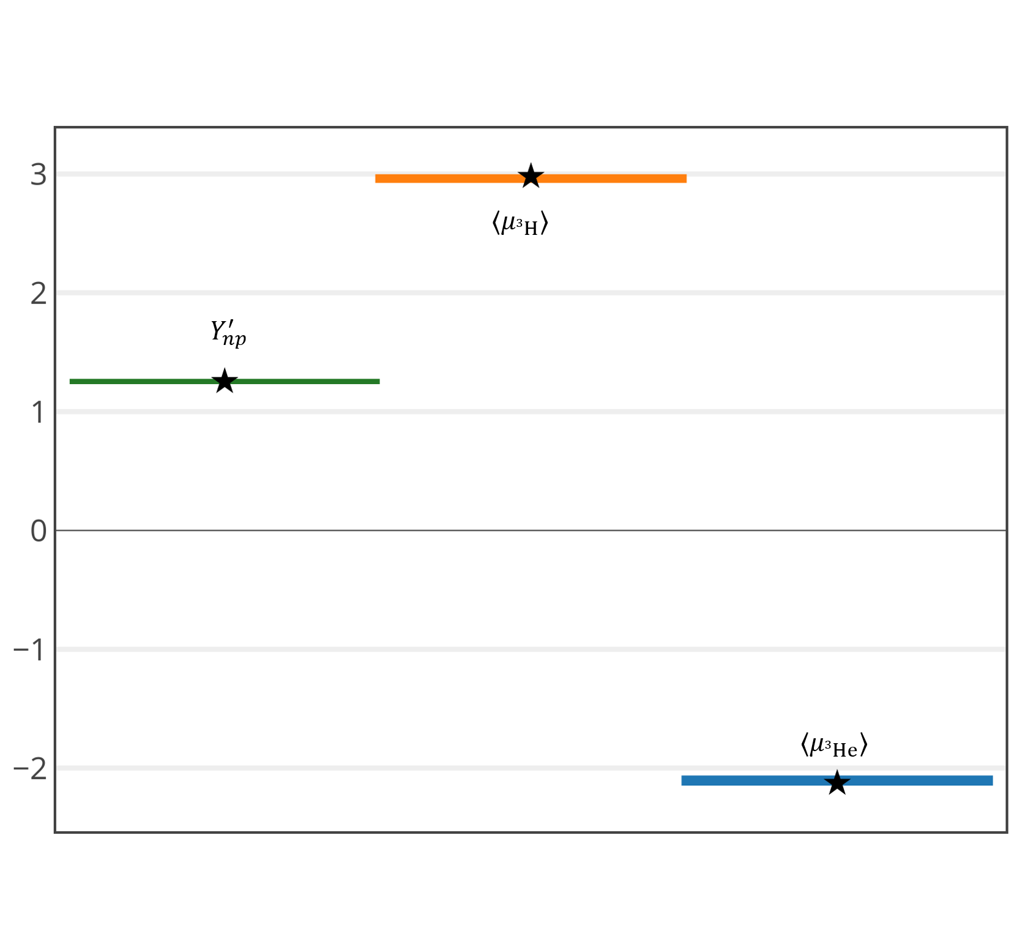
EM Final results, $l_{2}^{′}=0$
M1 strength
The theoretical uncertainty for our theory is $\sim 1\%$
De-Leon and Gazit (2019) in submission

Slide 38
Triton β-decay matrix elements
The triton comparative half-life:
$$fT_{1/2}=\frac{K/G_{V}}{{\left\langle \left|\left|F\right|\right|\right\rangle }^{2}+\frac{f_{A}}{f_{V}}{\left\langle \left|\left|GT\right|\right|\right\rangle }^{2}}$$
$$\left\langle \left|\left|GT(μ)\right|\right|\right\rangle =\left\langle ψ^{3He}\left|\left|A^{+}\right|\right|ψ^{3H} \right\rangle ={\left\langle \left|\left|GT\left(μ\right)\right|\right|\right\rangle }_{LO}\left(1+{\left\langle \left|\left|GT\left(μ\right)\right|\right|\right\rangle }_{ERE}^{NLO}+{\left\langle \left|\left|GT\left(μ\right)\right|\right|\right\rangle }_{l_{1A}^{′}}^{NLO}\right)$$
$$\left\langle \left|\left|F\right|\right|\right\rangle =1−ε, { \left\langle \left|\left|GT\right|\right|\right\rangle }^{exp}=\sqrt{3}×\left(0.953±0.002±0.002\right) , {\left\langle \left|\left|GT\right|\right|\right\rangle }_{α=0}=\sqrt{3}$$

Slide 39
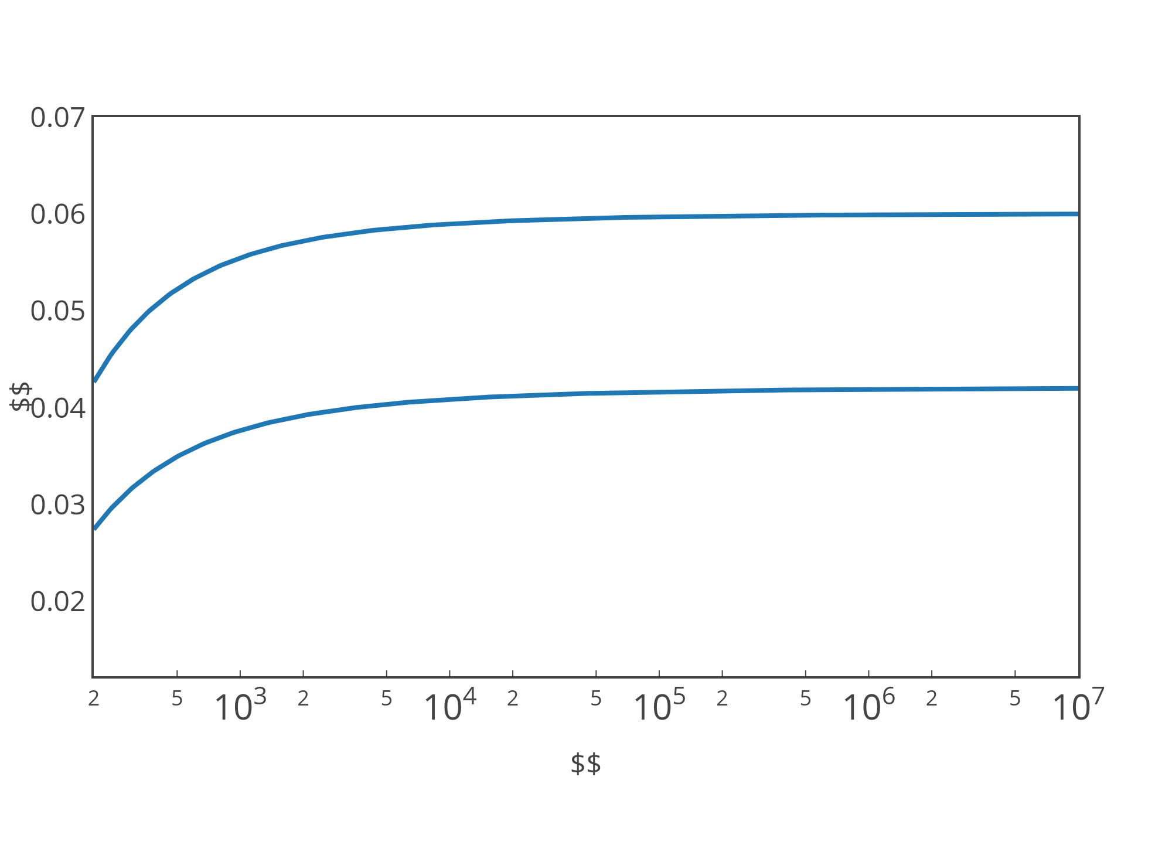
$3H β$-decay: $L_{1,A}$ calibration
$${l′}_{1,A}\left(Λ\right) [a.u]$$
$$μ=Λ→∞$$
${{l′}_{1,A}\left(Λ\right)∝L}_{1,A}\left(Λ−\frac{1}{a_{t}}\right)\left(Λ−\frac{1}{a_{s}}\right)$ is RG invariant!!
$$Λ [MeV]$$
$${ l′}_{1,A}\left(Λ\right)=\frac{{\left\langle ||GT||\right\rangle }^{exp}−{\left\langle ||GT||\right\rangle }_{ERE}^{NLO}}{{\left\langle ||GT||\right\rangle }_{l_{1.A}^{′}}^{NLO}}$$
De-Leon, Platter and Gazit (2019)

Slide 40
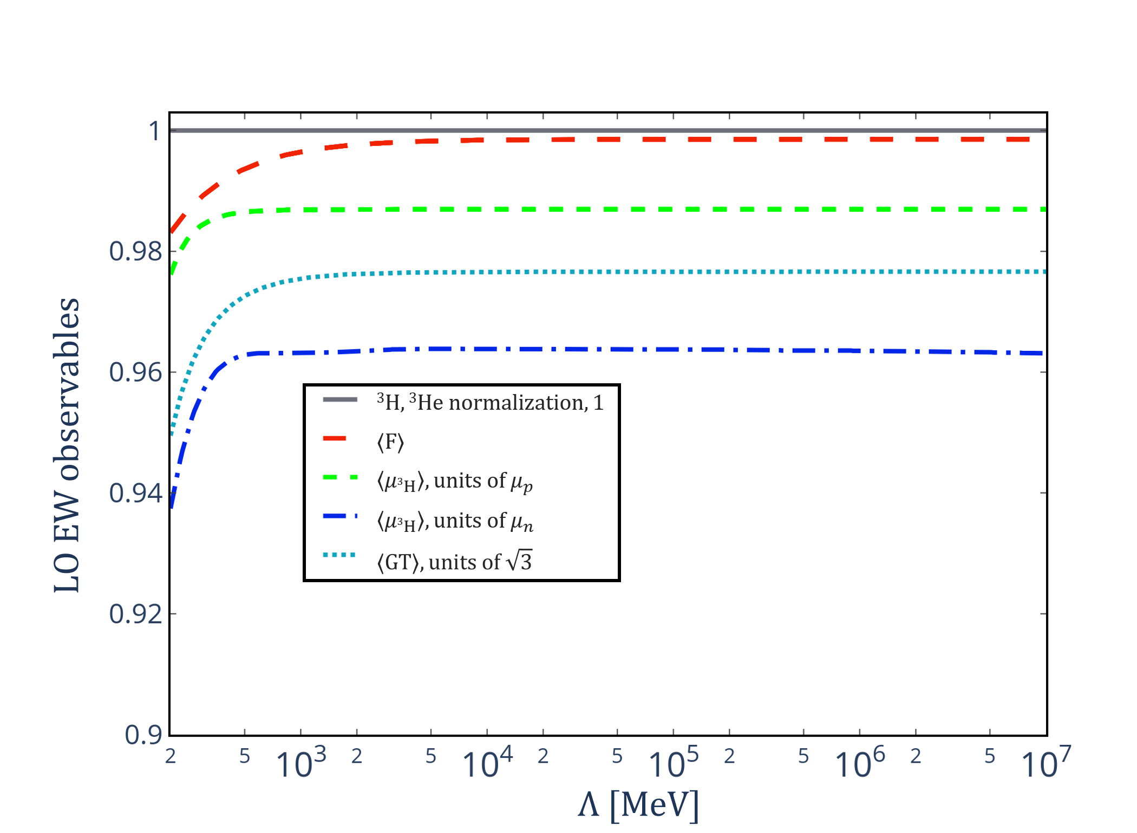
EW interaction: Quantitative analogy
$$\left\langle F\right\rangle ≈1−ε,$$
$\left\langle μ_{3H}\right\rangle ≈0.985$,
$\left\langle μ_{3He}\right\rangle ≈0.965$,
$$\left\langle GT\right\rangle ≈0.975$$
Vanasse (2017)
De-Leon and Gazit (2019) in submission

Slide 41
EW interaction: Quantitative analogy
 | $$⟨||GT|⟩$$ | $$\left\langle μ_{3H}\right\rangle [nMN]$$ | $$\left\langle μ_{3He}\right\rangle [nMN]$$ | $$Y’_{np}$$
Mean |  | 2.99 | -2.11 | 1.253
$$Δ$$ |  | 0.01 | 0.01 | 0.005
% NLO/LO | 3% | 7% | 13% | 5%
Exp data | 0.955 | 2.979 | -2.128 | 1.253
$$\left\langle M_{1}\right\rangle ={\left\langle M_{1}\right\rangle }_{LO}^{1B}\left(1+α_{1}δ⟨M_{1}⟩ +α_{2}{δ⟨M_{1}⟩}^{2}\right)$$
$${δ\left\langle M_{1}\right\rangle =10\%, α}_{1}=0.9±0.4$$
For GT, $α_{1}=0.3$ not an outlier! (Grubbs’ test for outliers)
The theoretical uncertainty for our theory is $\sim ε^{2}= 1\%$
De-Leon and Gazit (2019) in submission

Slide 42
$pp$fusion
$$Λ\left(0\right)=\underset{𝓞\left(\frac{q}{Λ}\right)}{\underbrace{\sqrt{Z_{d}^{NLO}}}}\left[e^{χ}−M_{N}αa_{p}I\left(χ\right)\right]+\sqrt{Z_{d}^{LO}}\frac{a_{p}γ_{t}}{2}\underset{𝓞\left(\frac{q}{Λ}\right)}{\underbrace{γ_{t }\sqrt{ρ_{t}ρ_{s}}}}\left[\underset{𝒪(1)}{\underbrace{\frac{ρ_{t}+ρ_{s}}{2\sqrt{ρ_{t}ρ_{s}}}−l_{1,A}^{′}}}\right]$$
$$Λ\left(0\right)=2.66+0.6×l_{1.A}^{′}$$
$$S\left(0\right)=\frac{4.01{\left(\frac{g_{A}}{1.2695}\right)}^{2}Λ{\left(0\right)}^{2}}{7.035}$$
De-Leon and Gazit (2019) in submission

Slide 43
$pp$fusion – theory
Year | Model | S(0) [${10}^{−25}MeV b$]
2011 | potential model EFT pionless EFT | $$\left.\begin{matrix}4.01\left(1±0.009\right) \\ 4.01\left(1±0.009\right) \\ 3.99\left(1±0.030\right)\end{matrix}\right\}4.01\left(1±0.009\right)$$
2013 | Modern χEFT calculation | $$4.030±0.006$$
2016 | χEFT up to NNLO | $$4.081_{−0.032}^{+0.024}$$
2017 | NPLQCD | $$4.049±0.006$$
Our result:
$S(0)$= $4.16±_{g_{A}}0.02±_{ }{0.01}_{3H half life}+0.08_{theory}±_{ }⋅{10}^{−25}MeV⋅b$
SFII – Adelberger et al., 2011
Marcucci et al., 2013
Acharya et al., 2016
NPLQCD 2017

Slide 44
Summary and outlook
B.S. normalization is equivalent to all possible connections between two amplitudes with identity insertion.
Summing over all the one- and two-body photon exchange diagrams perturbatively yields the energy difference between ³He and ³H. This implies that the Coulomb interaction can be treated perturbatively.
At NLO, we proved that a consistent diagrammatic expansion is just the sum of all possible diagrams with a single NLO perturbation insertion, where charge conservation puts strong constraints on the NLO normalization.

Slide 45
Summary and outlook
We show that the predicts well the A=3 EW observables.
Similar small NLO contributions for $\left\langle μ_{3H}\right\rangle , \left\langle μ_{3He}\right\rangle ,{ Y}_{np}^{′}$ .
We found that the iso-scalar two-body coupling constant is consistent with 0, in contrast to the naïve dimensional analysis of .
We can estimate the theoretical uncertainty by $\sim 1\%$.
There is a strong qualitative analogue between the weak and electrometric operators. We can assume the same error estimation for the weak interactions: ³H$β$ decay and the pp fusion.

Slide 46
What’s next?
Nuclear structure corrections include, to first order in the momentum transfer, weak magnetism and axial charge ($J=1$) multipoles.
We can extend this method for 𝑞>0 weak interactions such as neutrino scattering.
This method can be also extended for heavier nuclei such as halo nuclei.

Slide 47
_{Thank you!}

Slide 48
Weak interaction in πEFT, $q>0$
Multipole decomposition of the nuclear current:
$${\hat{C}}_{JM}\left(q\right)=∫d\vec{r}j_{J}\left(qr\right)Y_{JM}\left(\hat{r}\right){\hat{𝒥 }}_{0}\left(\vec{r}\right)$$
$${\hat{E}}_{JM}\left(q\right)=\frac{1}{q}∫d\vec{r}\vec{∇}×\left[j_{J}\left(qr\right){\vec{Y}}_{JJM}\left(\hat{r}\right)\right]⋅\hat{\vec{𝒥}}\left(\vec{r}\right)$$
$${\hat{M}}_{JM}\left(q\right)=∫d\vec{r}j_{J}\left(qr\right){\vec{Y}}_{JJM}\left(\hat{r}\right)⋅\hat{\vec{𝒥}}\left(\vec{r}\right)$$
$${\hat{L}}_{JM}\left(q\right)=\frac{1}{q}∫d\vec{r}{\vec{∇}[j}_{J}\left(qr\right)Y_{JM}\left(\hat{r}\right)]⋅\hat{\vec{𝒥}}\left(\vec{r}\right)$$
For $q→0$ (LWA), we find that :
$${{\hat{C}}^{±}}_{00}\left(0\right)=\frac{1}{\sqrt{4π}}\sum_{i}{{τ^{i}}^{±}} {{\hat{L}}^{±}}_{1M}\left(0\right)=i\sqrt{\frac{1}{12π}}g_{A}\sum_{i}{σ^{i}{τ^{i}}^{±} }$$

Slide 49
Single Nucleon Currents
$${\hat{𝒥}}_{μ}={\hat{J}}_{μ}^{V}+{\hat{J}}_{μ}^{A}$$
$${\hat{J}}_{μ}^{V}=\overline{u}\left(p^{′}\right)\left[F_{V}\left(q^{2}\right)γ_{μ}+\frac{i}{2M_{N}}F_{M}\left(q^{2}\right)σ_{μν}q^{ν}+…\right]u(p)$$
Vector
Magnetic
Second class currents
$${\hat{J}}_{μ}^{A}=−\overline{u}\left(p^{′}\right)\left[G_{A}\left(q^{2}\right)γ_{μ}γ^{5}+\frac{\left.G_{p}(q^{2}\right)}{m_{μ}}γ^{5}q_{μ}+…\right]u(p)$$
Axial
Induced Pseudo-Scalar
This method can be applied to $q>0$ weak interactions such as $μ^{−}$ capture and $ν$ scattering.
Weinberg PR, 112, 1375 (1958)

Slide 50
Summary and outlook
De-Leon and Gazit (2019) in submission

Slide 51
Single Nucleon Currents
$${\hat{𝒥}}_{μ}={\hat{J}}_{μ}^{V}+{\hat{J}}_{μ}^{A}$$
$${\hat{J}}_{μ}^{V}=\overline{u}\left(p^{′}\right)\left[F_{V}\left(q^{2}\right)γ_{μ}+\frac{i}{2M_{N}}F_{M}\left(q^{2}\right)σ_{μν}q^{ν}+…\right]u(p)$$
Vector
Magnetic
Second class currents
$${\hat{J}}_{μ}^{A}=−\overline{u}\left(p^{′}\right)\left[G_{A}\left(q^{2}\right)γ_{μ}γ^{5}+\frac{\left.G_{p}(q^{2}\right)}{m_{μ}}γ^{5}q_{μ}+…\right]u(p)$$
Axial
Induced Pseudo-Scalar
Weinberg PR, 112, 1375 (1958)

Slide 52
EW matrix element, Power counting
$$\left\langle \left|\left|𝒪^{1B}\right|\right|\right\rangle =ψ^{2}𝒪\left[y^{2}S^{3}\left(q_{0},q\right)d^{3}qdq_{0}\right]=ψ^{2}𝒪\left(\frac{8πΛ}{M_{N}^{2}}\frac{1}{\frac{q^{6}}{M_{N}^{3}}}\frac{{ q}^{5}}{4πM_{N}}\right)=ψ^{2}𝒪\left(\frac{Λ}{q}\right)=𝒪\left(1\right)$$
$$\left\langle \left|\left|𝒪^{2B}\right|\right|\right\rangle =ψ^{2}𝒪\left(1\right)=𝒪\left(\frac{q}{Λ}\right)$$
De-Leon, Platter and Gazit (2019)

Slide 53
Weak matrix element, Power counting
$${L′}_{1,A}$$
$${ g}_{A}$$
$$\left\langle \left|\left|𝒪^{1B}\right|\right|\right\rangle =𝒪\left(1\right)$$
$$\left\langle \left|\left|𝒪^{2B}\right|\right|\right\rangle =𝒪\left(\frac{q}{Λ}\right)$$
$L_{1,A}^{′}=−\frac{ρ_{t}+ρ_{s}}{\sqrt{ρ_{t}ρ_{s}}}+l_{1,A}\left(μ\right)→𝒪\left(L_{1,A}^{′}\right)=𝒪\left(1\right)$
Up to NLO, the one-body diagrams must have one NLO insertion
De-Leon, Platter and Gazit (2019)

Slide 54
Triton β-decay matrix elements
The triton comparative half-life:
$$fT_{1/2}=\frac{K/G_{V}}{{\left\langle \left|\left|F\right|\right|\right\rangle }^{2}+\frac{f_{A}}{f_{V}}{\left\langle \left|\left|GT\right|\right|\right\rangle }^{2}}$$
$$\left\langle \left|\left|GT(Λ)\right|\right|\right\rangle =\left\langle ψ^{3He}\left|\left|A^{+}\right|\right|ψ^{3H} \right\rangle =g_{A}^{}{\left\langle \frac{1}{2}\left|\left|σ\right|\right|\frac{1}{2}\right\rangle ×\left\langle \frac{1}{2}\left|τ\right|\frac{1}{2}\right\rangle }_{}^{}×\int_{0}^{Λ}{\frac{d^{3}p}{{\left(2π\right)}^{3}}}\int_{0}^{Λ}{\frac{d^{3}p^{′}}{{\left(2π\right)}^{3}}ψ^{3H}\left(p\right)𝒪^{GT}\left(p,p^{′},q,q_{0}\right) ψ^{3He}\left(p′\right)}$$
$$\left\langle \left|\left|F\right|\right|\right\rangle =\left\langle ψ^{3He}\left|\left|V^{+}\right|\right|ψ^{3H}\right\rangle ={\left\langle \frac{1}{2}\left|τ\right|\frac{1}{2}\right\rangle }_{}^{}×\int_{0}^{Λ}{\frac{d^{3}p}{{\left(2π\right)}^{3}}}\int_{0}^{Λ}{\frac{d^{3}p^{′}}{{\left(2π\right)}^{3}}ψ^{3H}\left(p\right)𝒪^{F}\left(p,p^{′},q,q_{0}\right) ψ^{3He}\left(p′\right)}$$
$$\left\langle \left|\left|F\right|\right|\right\rangle =1−ε, { \left\langle \left|\left|GT\right|\right|\right\rangle }^{exp}=\sqrt{3}×\left(0.953±0.002±0.02\right) , {\left\langle \left|\left|GT\right|\right|\right\rangle }_{α=0}=\sqrt{3}$$

Slide 55
Weak interaction in πEFT, $q→0$
The Lagrangian of the weak interaction for low energies $\left(E≪W,Z\right)$ is given by:
$ℒ_{weak}=−\frac{G_{F}}{\sqrt{2}}l_{+}^{μ}J_{μ}^{−}+h.c$
$l_{+}^{μ}$ is the leptonic current and $j_{μ}^{−}$ is the hadronic current.
$$J_{μ}^{±}=V_{μ}^{±}−A_{μ}^{±}=\frac{N^{†}τ^{±}N}{2}−\left[\frac{g_{A}}{2}{N^{†}τ}^{±}N+{L′}_{1,A}{\left(t^{†}s+h.c\right)}^{}\right]$$
${ g}_{A}$: axial coupling constant, known from neutron $β$-decay.
$L_{1,A}^{′}=−\frac{ρ_{t}+ρ_{s}}{\sqrt{ρ_{t}ρ_{s}}}+l_{1,A}\left(μ\right)$
$l_{1,A}\left(μ\right)$ is an RG invariant combination of the unknown two-body $L_{1,A}$.
$l_{1,A}\left(μ\right)$ can be calibrated from: $3H→\overline{ν_{e}}+e^{−}+3He$
$${ g}_{A}$$
$${L′}_{1,A}$$

Slide 56
Weak interaction in πEFT, $q→0$
The Lagrangian of the weak interaction for low energies $\left(E≪W,Z\right)$ is given by:
$ℒ_{weak}=−\frac{G_{F}}{\sqrt{2}}l_{+}^{μ}J_{μ}^{−}+h.c$
$l_{+}^{μ}$ is the leptonic current and $j_{μ}^{−}$ is the hadronic current.
$$J_{μ}^{±}=V_{μ}^{±}−A_{μ}^{±}=\frac{N^{†}τ^{±}N}{2}−\left[\frac{g_{A}}{2}{N^{†}τ}^{±}N+{L′}_{1,A}{\left(t^{†}s+h.c\right)}^{}\right]$$
${ g}_{A}$: axial coupling constant, known from neutron $β$-decay.
$L_{1,A}^{′}=−\frac{ρ_{t}+ρ_{s}}{\sqrt{ρ_{t}ρ_{s}}}+l_{1,A}\left(μ\right)$
$l_{1,A}\left(μ\right)$ is an RG invariant combination of the unknown two-body $L_{1,A}$.
$l_{1,A}\left(μ\right)$ can be calibrated from: $3H→\overline{ν_{e}}+e^{−}+3He$
$${ g}_{A}$$
$${L′}_{1,A}$$

