Slide 1
Entanglement measure for the characterisation of Hawking emission
Maxime Jacquet
Walther Group, University of Vienna
Work done with Friedrich König, University of St Andrews, UK
ECT* workshop July 2019

Slide 2
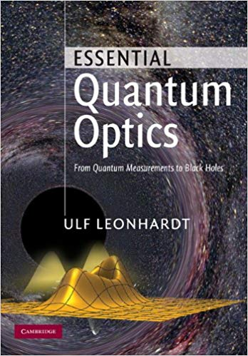
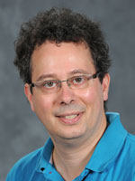
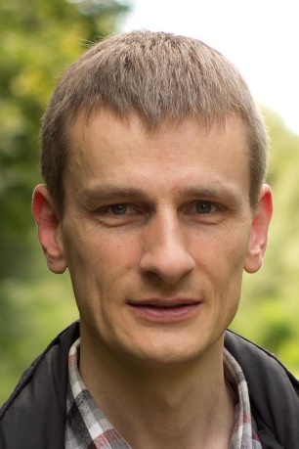
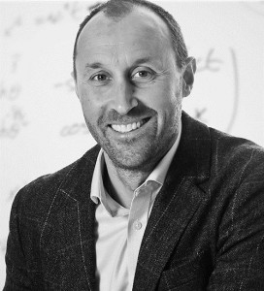
Optical analogues (main experiments)
Robertson, König, Leonhardt et al Science 319, 2008
Belgiorno, Faccio et al PRL 105, 2010
Choudhary and König Opt. Exp. 20, 2012
König, Leonhardt, Faccio et al PRL 108, 2012
  Tartara, JOSA-B 32, 2015
  Jacquet and König, in prep, see eg my PhD Thesis 10.1007/978-3-319-91071-0 (2018)
Bermudez, Leonhardt et al PRL 122 2019

Slide 3
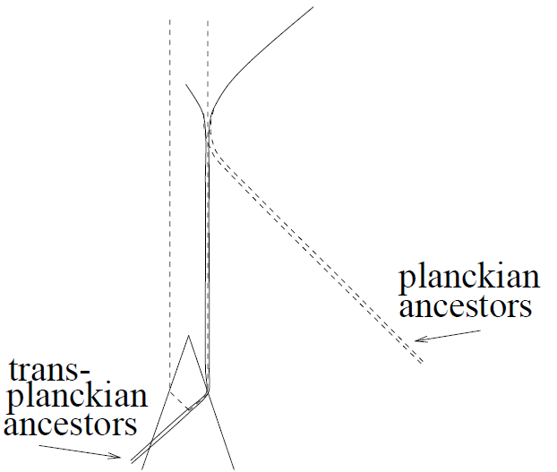



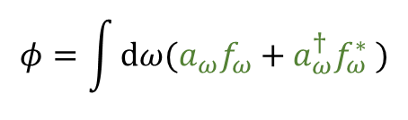
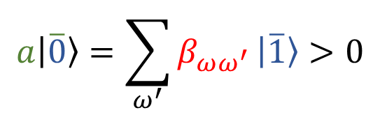
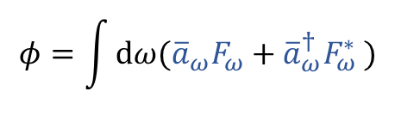
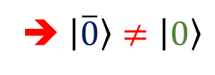
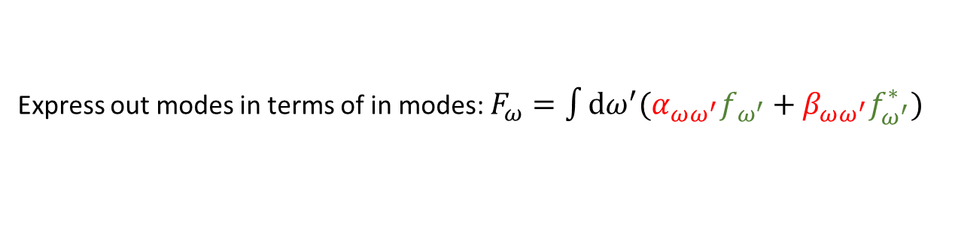
Spontaneous emission from the vacuum
out
in:
$$φ=\int{dω(a_{ω}f_{ω}+a_{ω}^{†}f_{ω}^{∗} )}$$
$$a\left|0\right\rangle =0$$
out:
$$φ=\int{dω({\overline{a}}_{ω}F_{ω}+{\overline{a}}_{ω}^{†}F_{ω}^{∗} )}$$
$$\overline{a}\left|\overline{0}\right\rangle =0$$
Express out modes in terms of in modes: $F_{ω}=\int{dω^{′}(α_{ωω^{′}}f_{ω^{′}}+β_{ωω^{′}}f_{ω^{′}}^{∗})}$
➔ $\left|\overline{0}\right\rangle ≠\left|0\right\rangle$
$$a\left|\overline{0}\right\rangle =\sum_{ω^{′}}{β_{ωω^{′}}}\left|\overline{1}\right\rangle >0$$
Spontaneous emission from the vacuum!
Black hole ➔ Hawking radiation
in
There exist other regimes of spacetime curvature, eg, in analogue gravity!
$$ω_{in}∼e^{κt}ω_{out}$$
Universality of the Hawking effect, Unruh and Schützhold (2005)?
surface gravity of the black hole

Slide 4
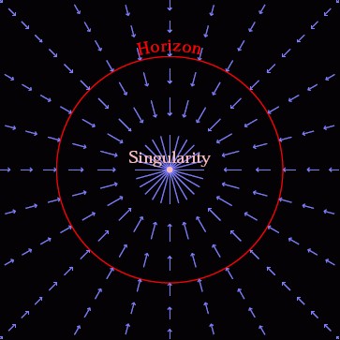
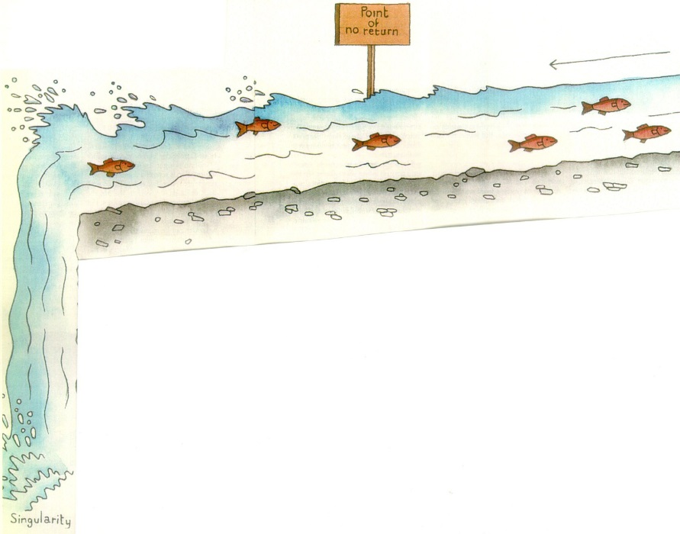
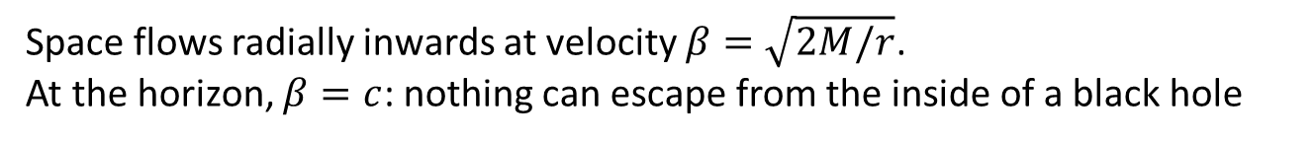
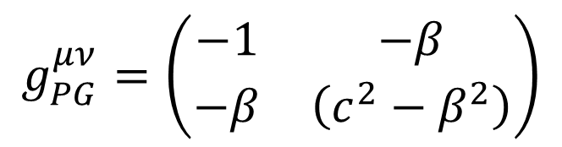
Space flow at the horizon
Inverse metric tensor of Painlevé-Gullstrand metric in 1+1D
$$g_{PG}^{μν}=\left(\begin{matrix}−1 & −β \\ −β & \left(c^{2}−β^{2}\right)\end{matrix}\right)$$
Space flows radially inwards at velocity $β=\sqrt{2M/r}$.
At the horizon, $β=c$: nothing can escape from the inside of a black hole
Superluminal flow of space
Subluminal flow of space
Gif by Hamilton https://jila.colorado.edu/~ajsh/insidebh/waterfall.html
Event horizon separates regions of sub and superluminal flow
⬄
Event horizon separates regions of one-way and two-way motion

Slide 5
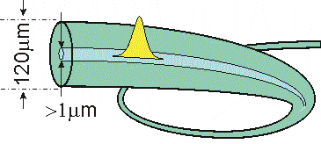
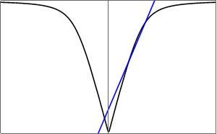
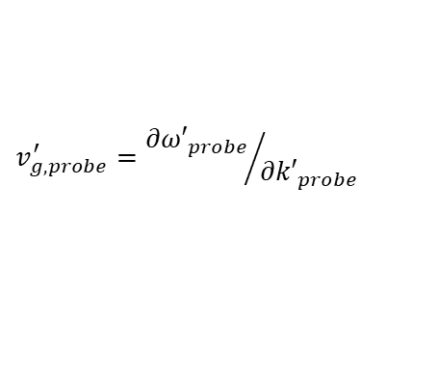

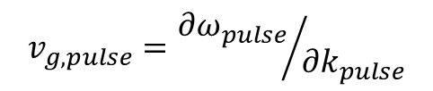

Optical Horizon
Philbin, Kuklewic, Robertson, Hill, König, Leonhardt in Science 319, 2008
Laboratory frame: moving pulse in fibre
Moving frame: stationary pulse
Weak probe wave
co-propagating with the pulse
Weak probe wave
$$v_{g,pulse}={{∂ω}_{pulse}}/{{∂k}_{pulse}}$$
$$ω$$
$$ω′$$
$$v_{g,probe}^{′}={{∂ω′}_{probe}}/{{∂k′}_{probe}}$$
k
k'
Medium dispersion relation
Medium dispersion relation

Slide 6
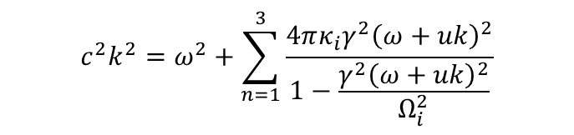
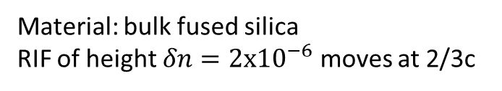
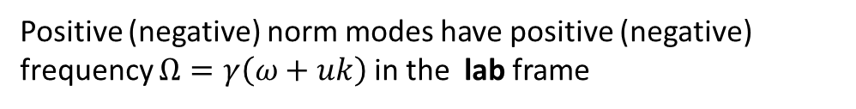
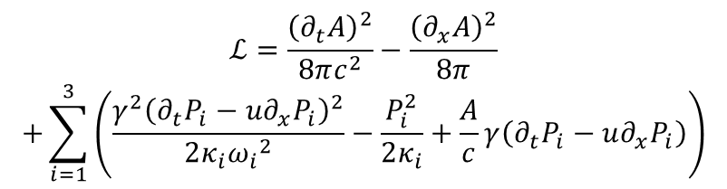
Analytical description of quantum emission in optical analogues
Stationary Refractive Index Front (RIF)
in the moving frame
Lagrangian (MF) from Finazzi and Carusotto, PRA 87 2013
$$ℒ=\frac{{\left(∂_{t}A\right)}^{2}}{8πc^{2}}−\frac{{\left(∂_{x}A\right)}^{2}}{8π}$$
$$+\sum_{i=1}^{3}{\left(\frac{{γ^{2}\left(∂_{t}P_{i}−u∂_{x}P_{i}\right)}^{2}}{2κ_{i}{ω_{i}}^{2}}−\frac{P_{i}^{2}}{2κ_{i}}+\frac{A}{c}γ\left(∂_{t}P_{i}−u∂_{x}P_{i}\right)\right)}$$
n (ζ)-n_{R}
δn
0
0
ζ
$$c^{2}k^{2}=ω^{2}+\sum_{n=1}^{3}{\frac{4πκ_{i}γ^{2}{\left(ω+uk\right)}^{2}}{1−\frac{γ^{2}{\left(ω+uk\right)}^{2}}{Ω_{i}^{2}}}}$$
Moving frame dispersion relation
Sellmeier dispersion relation:
Positive (negative) norm modes have positive (negative) frequency $Ω=γ\left(ω+uk\right)$ in the lab frame
ω
Kinematics of light modes at the RIF: there are frequency intervals with one-way and two-way motion (superluminal and subluminal analogue space flow, respectively)
k
See also Finazzi and Carusotto, EPJP 127 2012
Material: bulk fused silica
RIF of height $δn={2x10}^{−6}$ moves at 2/3c

Slide 7
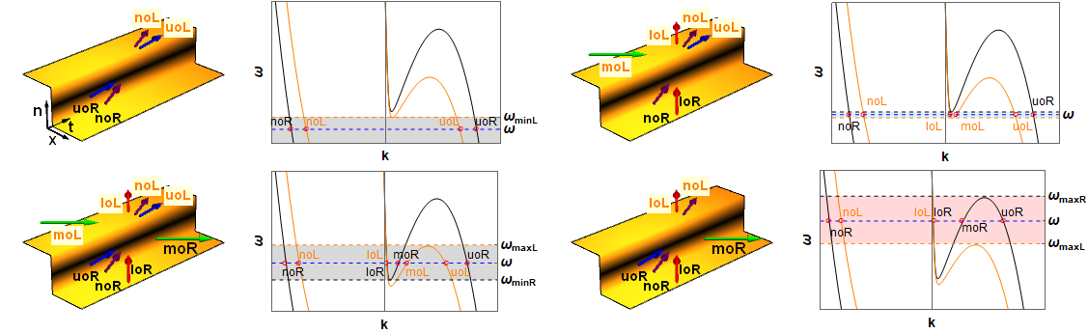
Kinematics of light waves
  Jacquet and König, PRA 92 (2015)
  Jacquet and König, 1709.03100 (2019)
  Jacquet and König, in prep (2019)
  Jacquet, PhD Thesis 10.1007/978-3-319-91071-0 (2018)
The dispersion sets the kinematics scenario ($≡$spacetime curvature). 4 kinematics scenarios are realised simultaneously.
➔spontaneous emission is not only due to the horizon!
Robertson PhD Thesis 2011, Bermudez and Leonhardt PRA 93 2015?,
Robertson et al PRA 99 2019?, Bermudez, Leonhardt et al PRL 122 2019?
In each kinematics scenario, different modes will mix at the horizon, yielding spontaneous emission

Slide 8
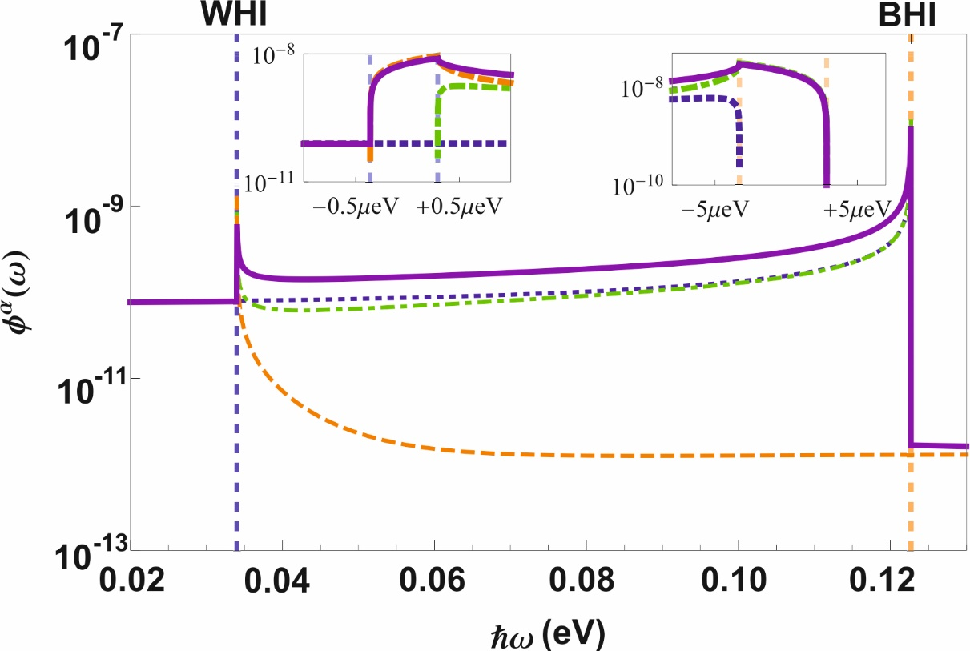
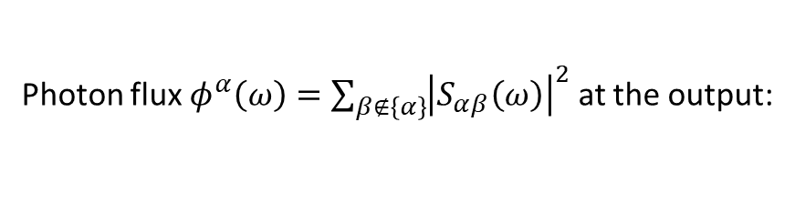
Quantum emission in optics
Jacquet and König (1709.03100): „Due to dispersion, the spacetime curvature varies as a function of frequency and we use this to demonstrate its influence on the emission“
Photon flux $φ^{α}\left(ω\right)=\sum_{β∉\left\{α\right\}}{{\left|S_{αβ}\left(ω\right)\right|}^{2}}$ at the output:
The dispersion sets the kinematics scenario. 4 kinematics scenarios are realised simultaneously.
In each kinematics scenario, different modes will mix at the horizon, yielding spontaneous emission

Slide 9
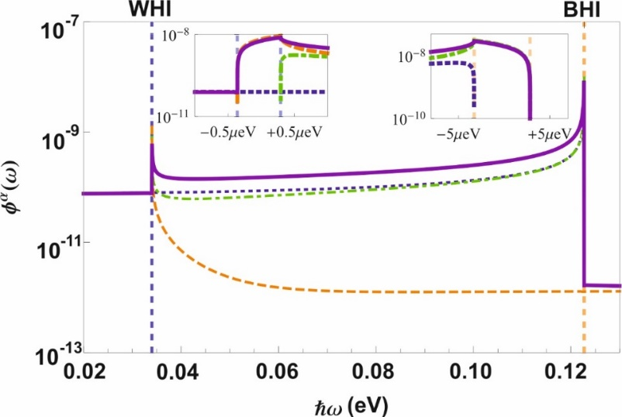
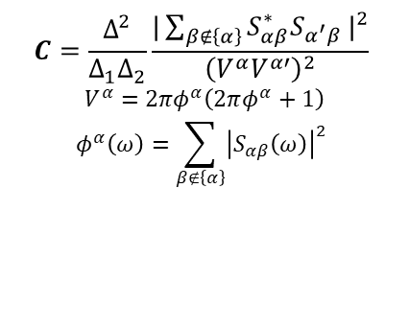
Quantum emission in optics
Jacquet and König (1709.03100): „Due to dispersion, the spacetime curvature varies as a function of frequency and we use this to demonstrate its influence on the emission“
$$C=\frac{Δ^{2}}{Δ_{1}Δ_{2}}\frac{{|\sum_{β∉\left\{α\right\}}{S_{αβ}^{∗}S_{α^{′}β}}|}^{2}}{{\left(V^{α}V^{α′}\right)}^{2}}$$
$V^{α}=2πφ^{α}\left(2πφ^{α}+1\right)$
$$φ^{α}\left(ω\right)=\sum_{β∉\left\{α\right\}}{{\left|S_{αβ}\left(ω\right)\right|}^{2}}$$
Photon number correlations C for typifying frequencies:
WHI
BHI
C

Slide 10
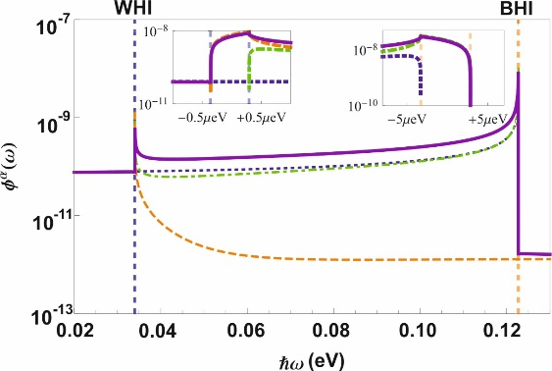
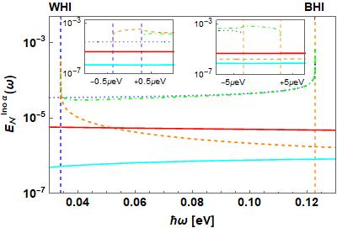

Entanglement measure
Jacquet and König (1709.03100): „Due to dispersion, the spacetime curvature varies as a function of frequency and we use this to demonstrate its influence on the emission“
WHI
BHI
C
Entanglement measure (Logarithmic Negativity versus the energy of corresponding pure state)
WHI
BHI
$${E_{N}}^{αβ}/E_{EPR}^{αβ}$$
In `fluid‘ systems, one measures the nonseparability via the Cauchy-Schwarz ineq., see Steinhauer Nat Phys 2016, Pavloff SPP 7 2018, Coutant and Weinfurtner PRD 97 2018, Steinhauer Nat 2019 (?), or Perez-Horodecki criterion, see Bush and Parentani PRD 89 2014, but don‘t contrast horizon and horizon-less emission

Slide 11
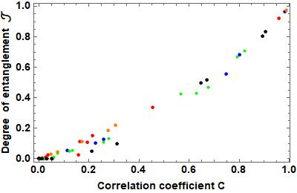
Entanglement measure
Jacquet and König (1709.03100): „Due to dispersion, the spacetime curvature varies as a function of frequency and we use this to demonstrate its influence on the emission“
WHI
BHI
C
Compare degree of entanglement with correlation coefficient
WHI
BHI
$${E_{N}}^{αβ}/E_{EPR}^{αβ}$$
Max entanglement in BHI is 98.6%

Slide 12
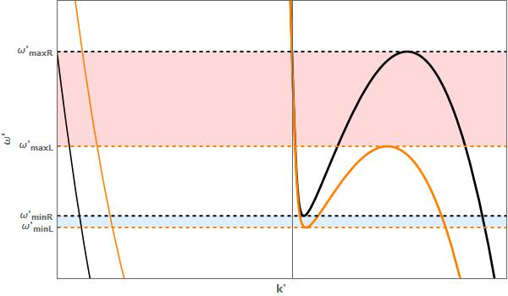
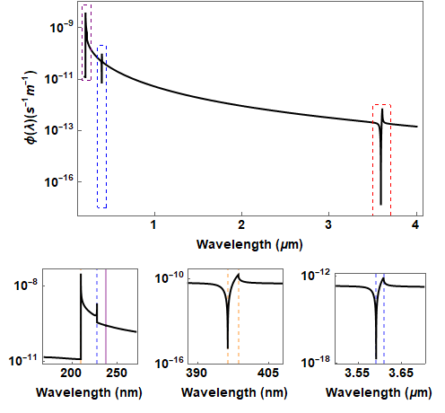
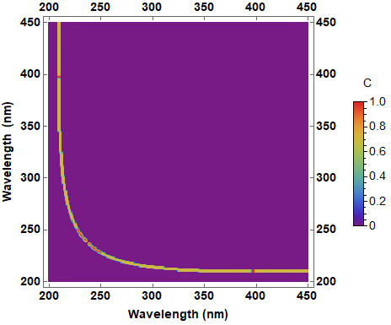
Spacetime curvature and quantum emission
Kinematic configurations analogous to wave motion in different regimes of spacetime curvature
Influence of spacetime curvature on quantum emission:
  Horizon emission has a characteristic shape
  Horizons lead to an order of magnitude increase in pair production
  Horizons lead to purification and increase in quantum correlations
  Horizon emission is not TMSV – can be measured by Logarithmic negativity
  Jacquet and König, PRA 92 (2015)
  Jacquet and König, 1709.03100 (2019)
  Jacquet and König, in prep (2019)
  Jacquet, PhD Thesis 10.1007/978-3-319-91071-0 (2018)
To be compared with Robertson and Parentani PRA 2019 and Bermudez and Leonhardt PRA 2016

Slide 13
