Slide 1
Trento- May 20-24, 2019
Stochastic Mean-Field Approach
(Dynamics of HIC Beyond Mean-Field)
Sakir Ayik
Tennessee Tech University
Brief Description of the SMF approach
Quantal Diffusion Description of Multi-Nucleon Exchange
Early Development of Spinodal Instabilities in Nuclear Matter
  Recent collaborators:
  B. Yilmaz, O. Yilmaz,
  D. Lacroix, S. Umar

Slide 2
Standard Mean-Field Approach
Standard Mean-Field approximation, many-body wave function
is a single Slater Determinant constructed from single-particle
wave functions determined by TDHF equations
At low energies, E/A < 10 MeV, Pauli blocking is very important.
With effective interactions mean-field provides good description
for average dynamics including one-body dissipation. However→
Collective motions is treated in deterministic manner nearly
classical approximation! Fluctuations in collective motion are
severely underestimated, and Initial Symmetries are preserved.
Task: Improve transport approach beyond the mean-field
by incorporating dynamics of fluctuation and spontaneous
symmetry breaking mechanisms.

Slide 3
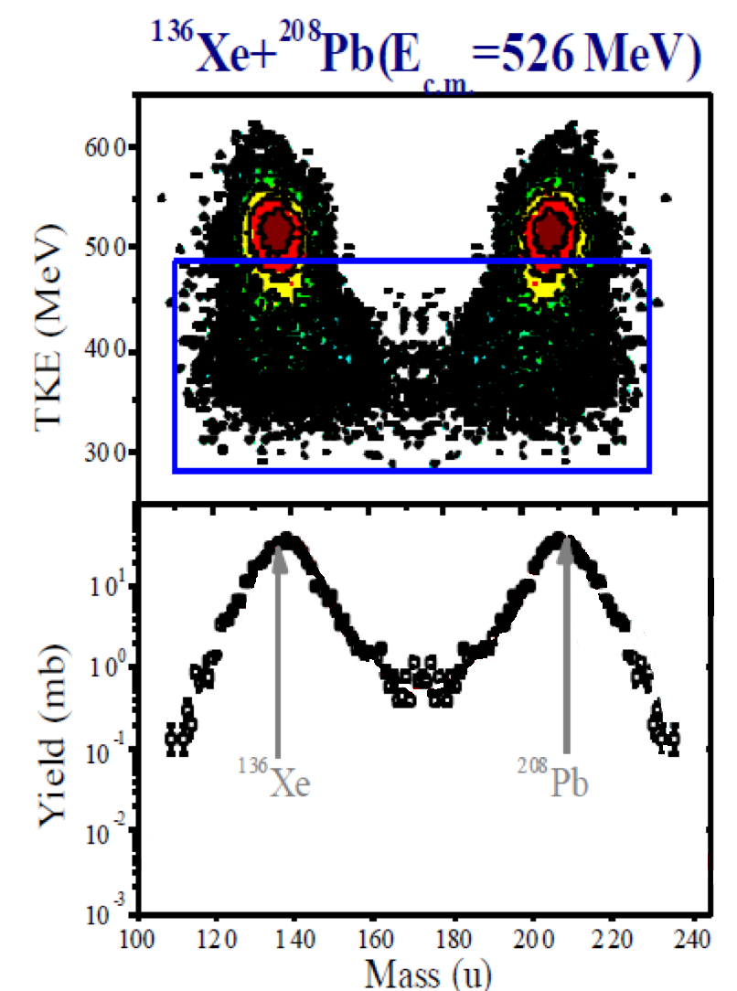

Slide 4
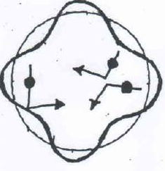
Two different mechanisms for fluctuations:
Fluctuations induced by two-body collisions : collisional
mechanism can be incorporated into equation of
motion in similar manner to Langevin description
of Brownian particle→ Semi-classical limit:
Stochastic Boltzmann-Langevin Approach
[Ayik and Gregoire , PL B212 (1988)174]
Mean-Field Fluctuations: originating from quantal and thermal
fluctuations in the initial state . Dominant mechanism
for fluctuations in collective motion at low energies.
→Stochastic Mean-Field Approach
[Ayik, PLB 658 (2008) 174]

Slide 5
Stochastic Mean-Field →(Quantal Corrections)
Generate an ensemble of s.p. density matrices by incorporating
density fluctuations (quantal or thermal) in the initial state:
Each matrix elements is a Gaussian random number with:
Single-particle wave functions are determined
by the self-consistent mean-field of each event
Observables are calculated as averages over the ensemble.

Slide 6
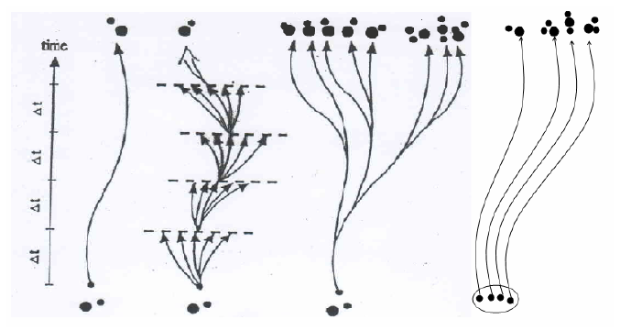
MF BUU BL SMF

Slide 7
Multi-Nucleon Transfers in dissipative collisions between massive nuclei → Production of heavy trans-uranium and heavy neutron rich elements
SMF approach→Quantal Nucleon Diffusion Description of multi-nucleon transfer mechanism

Slide 8
Central Collisions (Di-Nuclear Structure)
Macroscopic Variables→
Mass and Charge Asymmetry,
Relative Distance-Relative
momentum…
Macro variables can be
defined with help of window.
Nucleon number of projectile-
like fragments→
Notes:
8
8

Slide 9
SMF → Langevin description macro variables:
Fluctuating neutron and proton current densities
Two sources for fluctuations :
from the state dependence →
from the initial conditions →

Slide 10
Small fluctuations around the mean→
Fluctuating drift coefficient
Multiplying both side by , and ensemble
averaging, we obtain coupled diff equations for co-variances

Slide 11
S.Ayik, B.Yilmaz, O.Yilmaz, S. Umar, PRC 97 (2018)
Diff equations for co-variances

Slide 12
Primary fragment mass and charge distribution is
specified by a correlated Gaussian distribution→
Langevin Description is equivalent to the Fokker-Planck Description for the primary fragment distribution →

Slide 13
Quantal Nucleon Diffusion Coefficients
Involves complete set of particle- hole states. For small time intervals, introduce a diabatic shift
Employing the closure relation, can eliminate particle states
Required only occupied single-particle states of TDHF equations
No adjustable parameters, Geometry is taken into account
Fully microscopic, Quantal effects, Shell structure, Memory Effect, Barrier penetration of nucleon across the window are included. Pauli blocking is exactly taken into account
(Ayik et al. PRC 94 (2016))
(Skyrme SLy4d Bonch et al. and Umar et al.)

Slide 14
Analogy to random walk : sum of current densities forward and backward direction, second term represents Pauli Blocking
Wigner transform →In semi-classical limit, gives diffusion
coefficients familiar from nucleon-exchange model

Slide 15
Mean drift paths calculated by TDHF:
After a fast charge equilibration, in both systems, the mean drift occurs toward symmetry with
Iso-vector
Iso-scalar

Slide 16
Derivatives of drift coefficients → use Einstein
relations, which relate drifts to the diffusion and
the potential energy surface in N-Z plane:

Slide 17
Multi-nucleon transfer in
collisions with finite impact parameters
Window plane →

Slide 18
Neutron and proton drift and diffusion coefficients at impact parameter b = 2.8 fm

Slide 19
Co-variances for impact parameter b = 2.8 fm:

Slide 20
Mass distribution of Primary fragments in
Data:Kozulin et al.
JP 515(2014)
S.Ayik,B.Yilmaz,
O.Yilmaz, S.Umar
PRC 97 (2018)

Slide 21
Cross-section of primary heavy fragment production in
(milli barn)

Slide 22
Multi-nucleon transfer in collisions at
Closed neutron shells
with N=82 and N=126
Negative values for transfers toward symmetry and asymmetry
Identity of projectile and target is maintained but data shows broad mass distributions.

Slide 23
Proton and neutron diffusion coefficients

Slide 24
TDHF for mean values
Q-value distribution

Slide 25
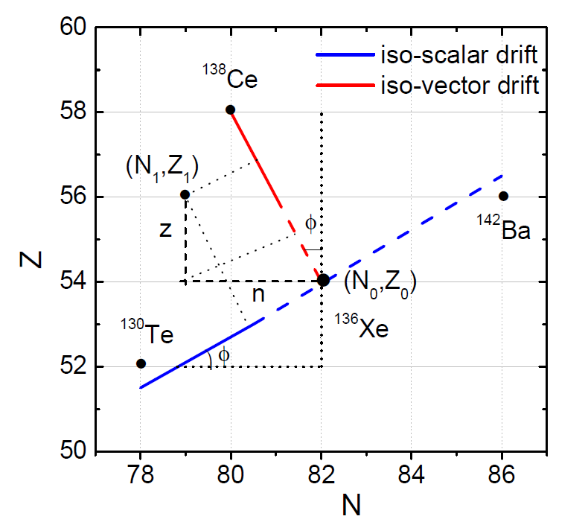
Potential energy surface
Asymmetric parabolic form in iso-scalar direction

Slide 26
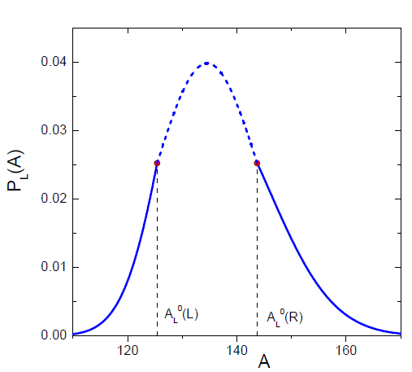

Slide 27
Kozulin et al., PRC 86 (2012)

Slide 28
Density profiles in central tip-tip collision at time 0, 200, 700 and 800 fm/c from top to bottom at
Ecm=1050 MeV.
Ayik et al. PRC 96 (2017)

Slide 29
Density profiles in central side-side collision at time 0, 400, 800 and 1000 fm/c from top to bottom at Ecm=900 MeV
(SLy4d code of Umar et al.)

Slide 30
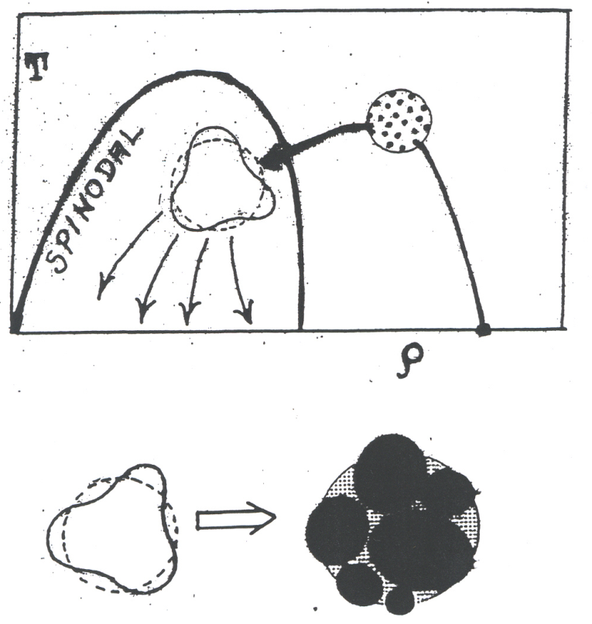
Early Development of Spinodal Instabilities in SMF
Heated and compressed matter expands, cools down and
may enter into spinodal region. Uniform matter unstable,
small density fluctuations grow rapidly leading the
system to break-up into clusters→ Dynamical mechanism
for liquid-gas phase transformation.

Slide 31
Early development of density fluctuations :
Linear response treatment an initial state
Nuclear Matter: Collective modes are plane waves
Using method of one-sided Fourier transform (Landau),
we carry out nearly analytical quantal treatment of
“dispersion relation of unstable collective modes” and
“Equal Time Correlation Functions” of density fluctuations.
(Relativistic description based on Walecka-type model
including non-linear coupling of scalar and rho mesons)
Notes:
31

Slide 32
Equal time correlation function of density fluctuations→
Fourier transform of local
density fluctuations→
Susceptibility
Pole+Cut singularities
Bozek, PLB 383 (1996)

Slide 33
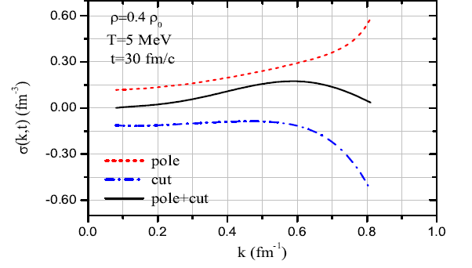
Spectral intensity of correlation function
Cut + Pole contributions is well behaved as a function of wave number

Slide 34
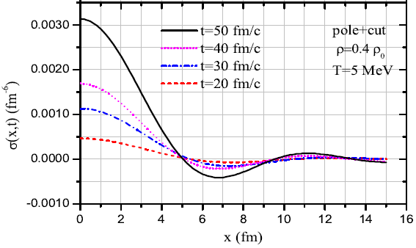
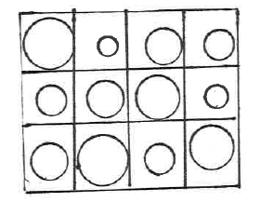
correlation function of
density fluctuations
Correlation length
provides a measure
for size of primary
condensation regions
Dynamics of
liquid-gas phase
transformation.
Acar et al., PRC 92 (2015)

Slide 35
CONCLUSIONS
Need tools for investigations of reactions mechanism with
radioactive beams in upgraded heavy-ion facilities at FRIB -MSU,
GSI-Darmstadt, SPIRAL2 -GANIL, RIKEN-Japan .
Development of quantal transport models (such as SMF)→
powerful tools for describing gross properties nuclear dynamics
  Dissipation and fluctuation mechanisms in HIC
  Dynamical description of phase transformations
  Fusion and induced fission dynamics
  Lacroix and Ayik, EPJ-A (review section) 50 (2014)

