Slide 1

Mechanisms of fragment emission in heavy ion collisions and spallation
Jun Su
Sino-French Institure of Nuclear Engineering & Technology,
Sun Yat-sen University, Zhuhai 519082, China.
E-mail: sujun3@mail.sysu.edu.cn
2019

Slide 2
Outline
Introduction
Theoretical framework
Results

Slide 3
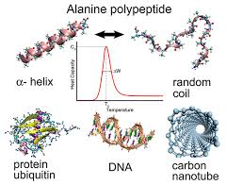
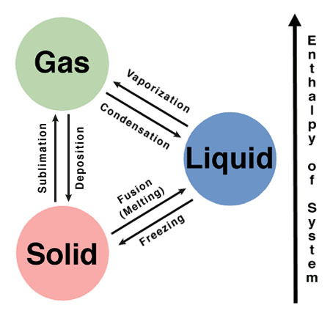
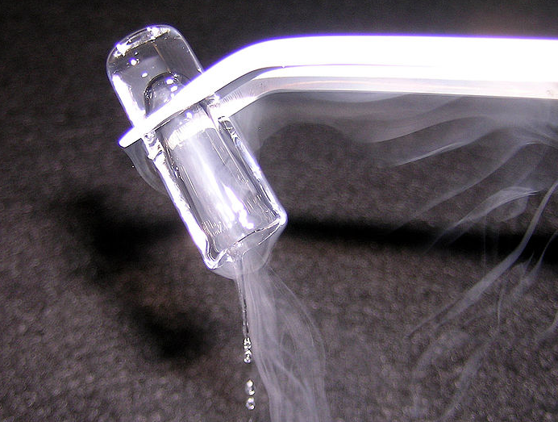
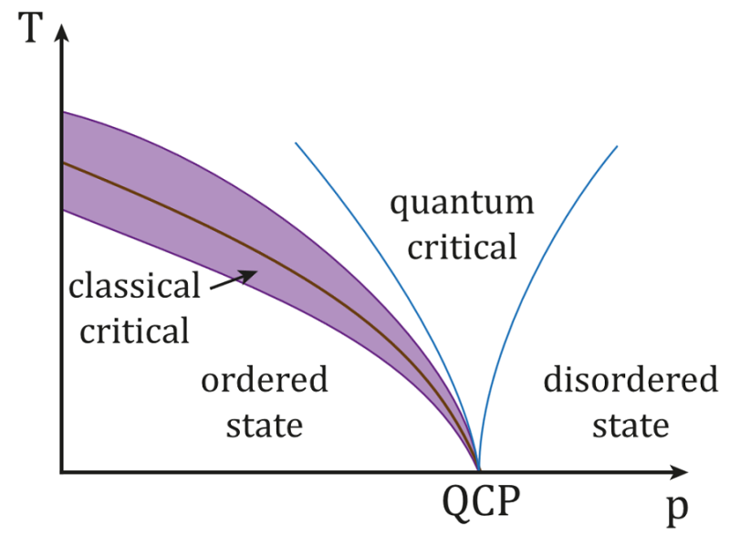
Phase Transition
Nuclear
Classics,
Quantum
Materials
Atomic
Polymer
Phase transitions in finite systems have attracted much attention in many different fields of physics.

Slide 4
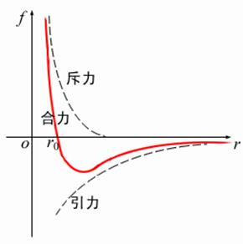
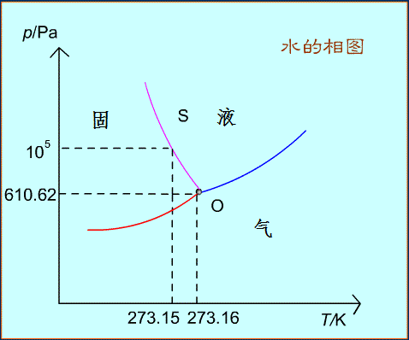
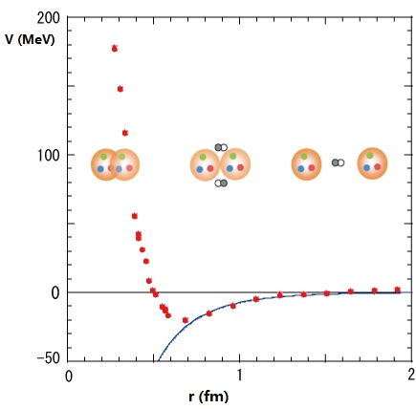
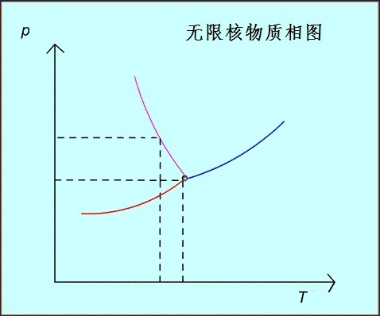
Phase Transition in nuclear matter
molecular force：Van-der-Waals type, attraction but repulsive core
nuclear force：attraction but repulsive core
？
The liquid-gas phase transition is expected to occur in the highly excited nuclei, due to the Van-der-Waals type of the nuclear force.

Slide 5
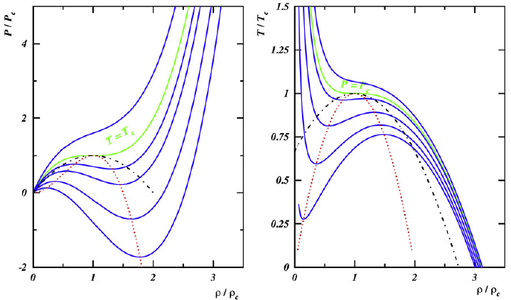
Phase Transition in finite nuclei and its relation to fragmentation
phase diagram
Caloric curve
Power law
Bimodality
Campi scatter
…
Many efforts have been devoted to explore the signals of the phase transition in the nuclear fragmentation.
B. Borderie and M.F. Rivet , Prog. Part. Nucl. Phys. 61 (2008) 551
J. Su, et al., Physics Letters B 782 (2018) 682–687

Slide 6
Fragmentation modes
A large diversity of fragmentation modes has been observed in several types of nuclear reactions
Fragmentation
Central HICs
near Fermi energy
Peripheral HIC
at hundreds of MeV/nucl.
Spallation
at GeV
…
Same:
Intermediate-mass fragments
Deference:
Dissipation of incident kinetic energy
Temperature of the fragmenting source
Breakup mechanisms
Isospin dynamics
Physical Review Letters 75 (6) (1995) 1040
Physical Review C 67 (6) (2003) 064613
Physical Review C 70 (5) (2004) 054607

Slide 7
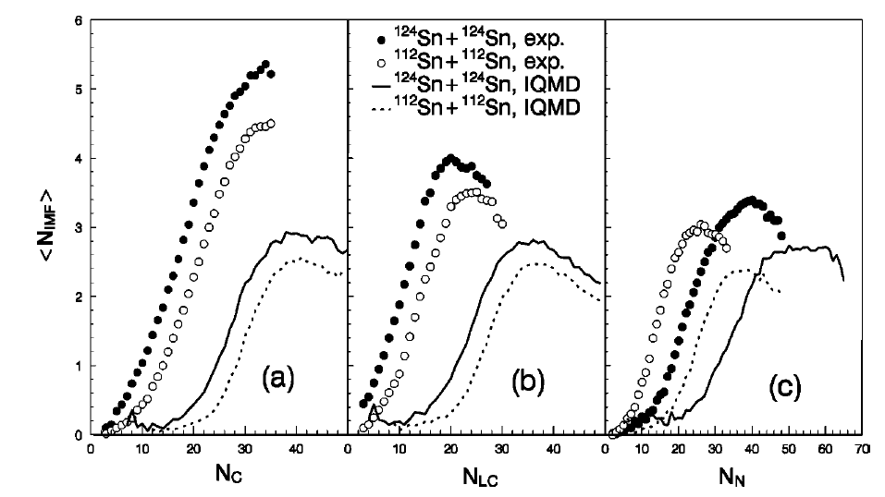
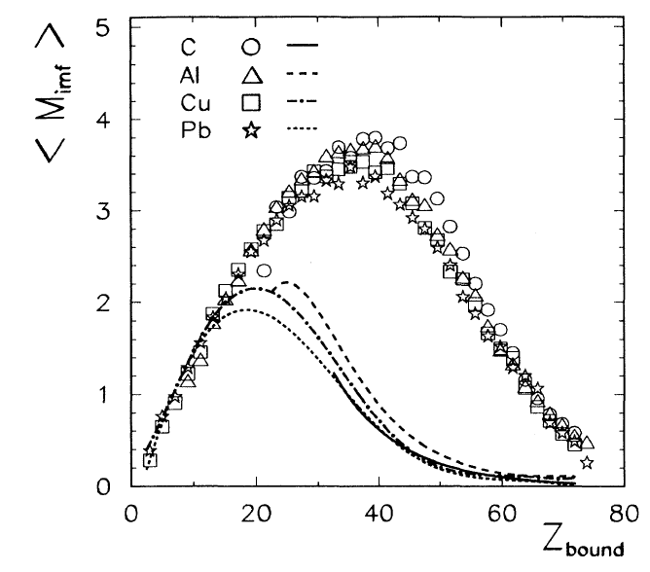
Puzzle
The dynamics transport models (QMD-type or BUU-type) have been very successful in describing fragmentations.
underestimate
Begemann-Blaich et al. concluded in 1993 that “it is not possible to reproduce the fragment distributions” in the fragmentation of ¹⁹⁷Au nuclei at 600 MeV/nucleon measured by the ALADIN Collaboration [Phys. Rev. C, 48 (1993) 610].
F.S. Zhang, PRC 60(1999) 064604

Slide 8

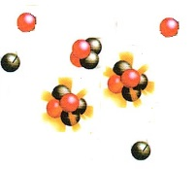


IMF in Spallation
The International Atomic Energy Agency (IAEA) have organized an expert meeting on model codes for spallation reactions.
Two-step models in the IAEA benchmark
Dynamics model
statistical decay model
Impact
Hot and equilibrium system
excited pre-fragments
final products
Multifragmentation
de-excitation
t
IMF in spallation
Coulomb-hole mode
multifragmentation mode
J. Phys. G: 38 (2011) 115006

Slide 9
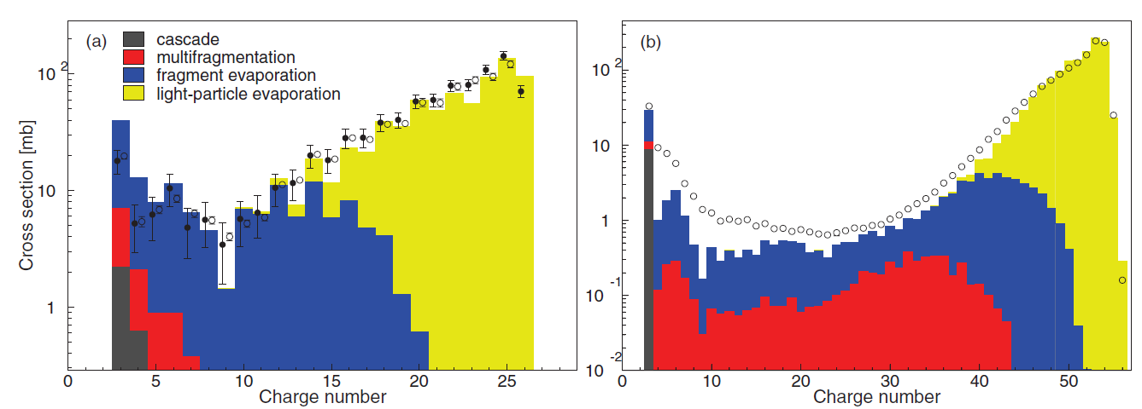
IMF in Spallation
p+⁵⁶Fe@1GeV
p+¹³⁶Xe@1GeV
PhysRevLett.100(2009).022701; PhysRevC.84(2011).064615
A small fraction of the total cross section which feeds multifragmentation
The upper limits for the multifragmentation cross section, are 146.0mb (⁵⁶Fe) and 137.7mb (¹³⁶Xe), which correspond to 18.7% and 10.0% of the respective reaction cross sections.

Slide 10
Goal
Uniform dynamical description of the fragments emission
Spallation
Central HIC
Peripheral HIC
A dynamics model
Study the fragmenting mechanisms

Slide 11
phase transition in projectile fragmentation and spallation ?
Many researches focus on the study of thermodynamic observables from the projectile fragmentation and spallation [25, 26]. However, the signals of phase transition in those reactions is amphibolous, because the expansion phase is absent in those reactions while the spinodal region is considered in the subnormal density region.
B. Borderie and M.F. Rivet , Prog. Part. Nucl. Phys. 61 (2008) 551
J. Su, et al., Physics Letters B 782 (2018) 682–687

Slide 12
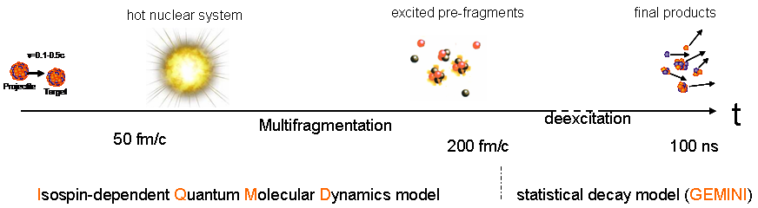
Theoretical framework
IQMD: describe formation of the hot fragments.
GEMINI: simulate the light-particle evaporation of the hot fragments

Slide 13
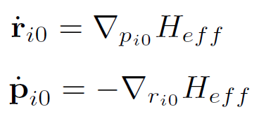

IQMD model
Density in phase space
time evolution
Hamiltonian
Nucleon-nucleon collisions
Pauli blocking
Minimum Spanning Tree to identify the fragments
Code version: IQMD-BNU (Beijing Normal University)

Slide 14
What is more comparing to the standard IQMD-BNU
Second decay by GEMINI
Only light-particle evaporation
Switching time between IQMD and GEMINI depends on the excitation energy of the largest fragment.
Phase-space density constraint

Slide 15
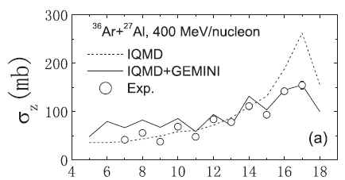
Second decay by GEMINI
Primary fragments
by IQMD
Second decay
Final
fragments
Comparable
Incomparable
Fragments
in experiment
J. Su, et al., PRC.83(2011).014608
The fragment conditions after IQMD can not correspond to the conditions for GEMINI application. By applying GEMINI for de-excitation of primary IQMD fragments we assume that the density and structure of such fragments is close to the normal nuclei ones. As well as we assume that properties of such fragments, in particular, the symmetry energy, level densities and others, correspond to the properties of normal nuclei which are adopted in the GEMINI code.

Slide 16
Switching time between IQMD and GEMINI
Stop IQMD evolution until the excitation energy is less than the threshold of the fragmentation E_{stop}.
Two-step models in the IAEA benchmark
Dynamics model
statistical decay model
Impact
Hot and equilibrium system
excited pre-fragments
final products
Multifragmentation
de-excitation
t
Isospin-dependent Quantum Molecular Dynamics model
statistical decay model (GEMINI)
Describe the emission of IMFs dynamically
Secondary decay of IMFs statistically
Switching time depends on the excitation energy lower than Estop ~ 2 MeV/u
IQMD + GEMINI model used in this work
We have proved the effectiveness for spallation [PRC 97(2018), 054604] and projectile fragmentations [PRC 98(2018), 014610]

Slide 17
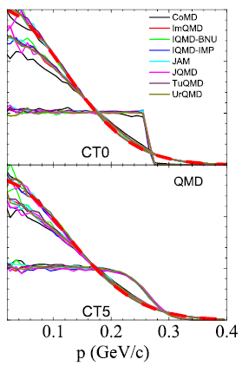
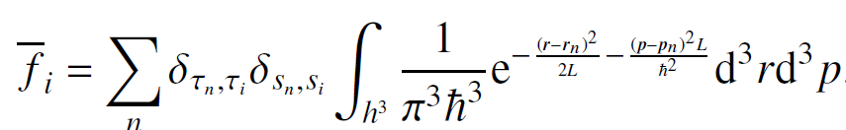
Phase-space density constraint
If phase-space occupation f i has a value greater than 1, the momentum of the ith nucleon is changed randomly by many-body elastic scattering.
The PSDC method is a phenomenological prescription to treat some features of fermionic motion, since the full quantum mechanical description is not possible in this case

Slide 18
Results
Role of the phase-space density constraint
Different break-up mechanism in
Central HICs near Fermi energy,
Peripheral HIC at hundreds of MeV/nucl.,
Spallation at GeV

Slide 19
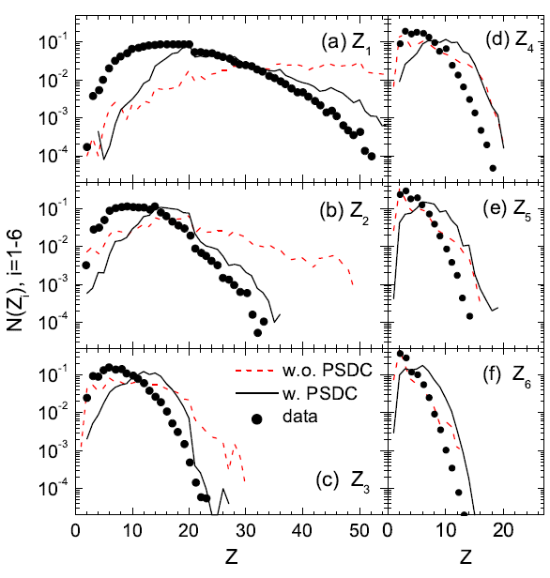
Charge distribution of the six heaviest fragments in central ¹⁹⁷Au + ¹⁹⁷Au collisions at 35 MeV/nucleon.

Slide 20
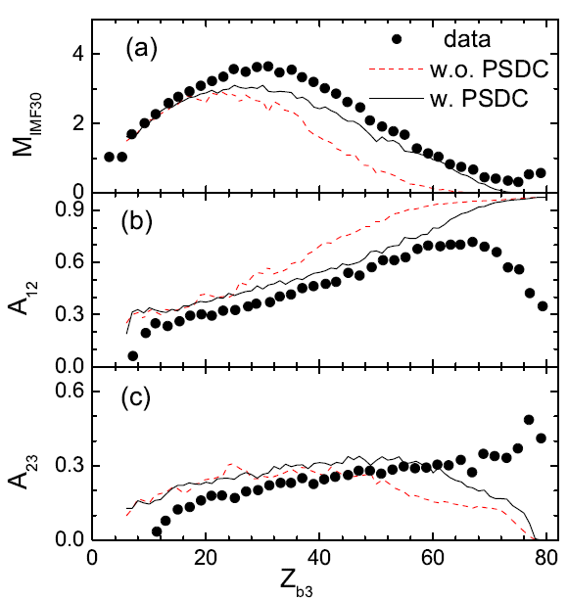
IMF, the first and second fragment asymmetries A12 and A23 versus the bound charge Zb in projectile fragmentation ¹⁹⁷Au + ⁶³Cu at 600 MeV/nucleon.

Slide 21
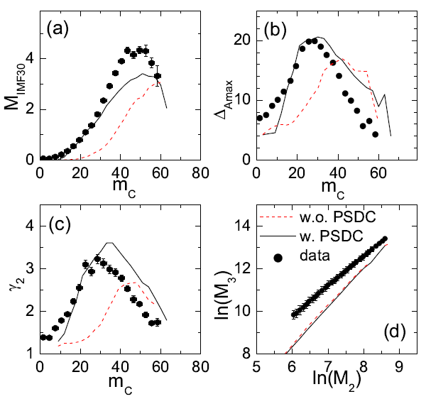
MIMF, Fluctuations of the largest fragment, and moments analysis in projectile fragmentation ¹⁹⁷Au + ¹²C at 1000
MeV/nucleon.

Slide 22
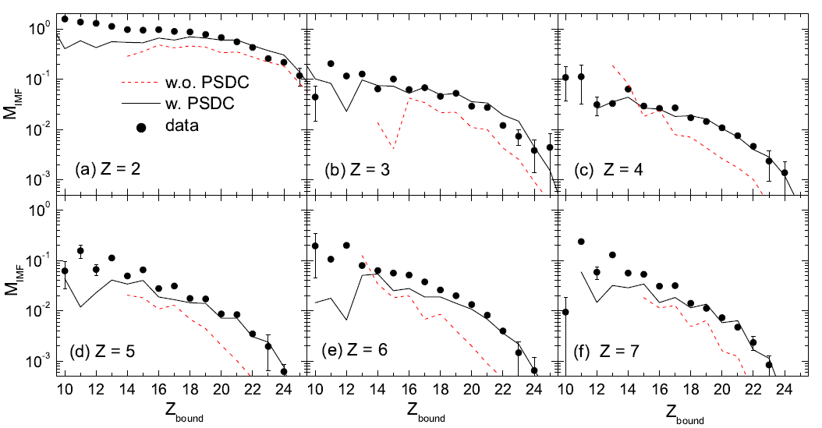
MIMF v.s. Zbound in ⁵⁶Fe + p spallations at 1000 MeV/nucleon

Slide 23
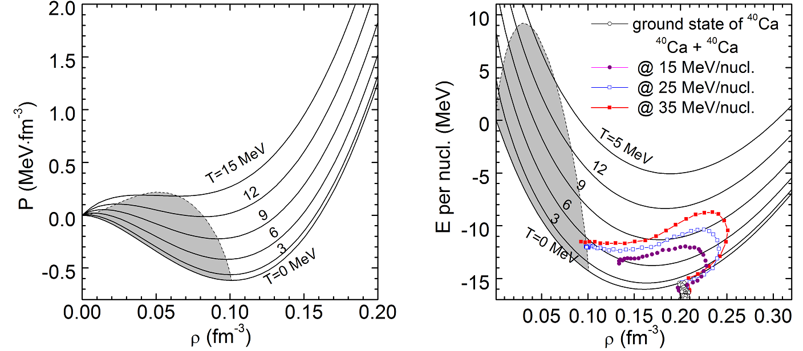
Break-up mechanism central HICs near Fermi energy
undergoes successively the compression and expansion;
decays via multi-fragmentation, i.e., splits into clusters and unbound nucleons in a short time span.;
Physics Reports 389 (5-6) (2004) 263
J. Su, et al., Physics Letters B 782 (2018) 682–687

Slide 24
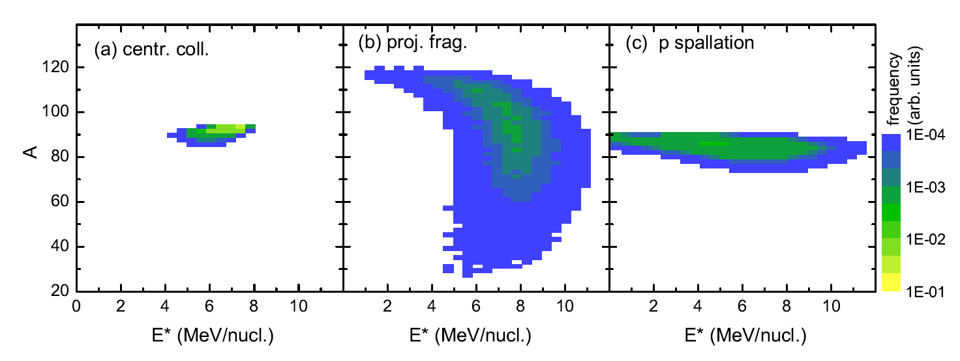
Break-up mechanism
Central HICs
near Fermi energy
Peripheral HIC
Spallation
⁴⁸Ti+⁴⁸Ti@30MeV/nucl.
b = 0 fm
¹²⁰Sn+¹²⁰Sn@600MeV/nucl.
b = 8 fm
⁹⁰Zr+p@2000MeV/nucl.
b = 0 fm

Slide 25
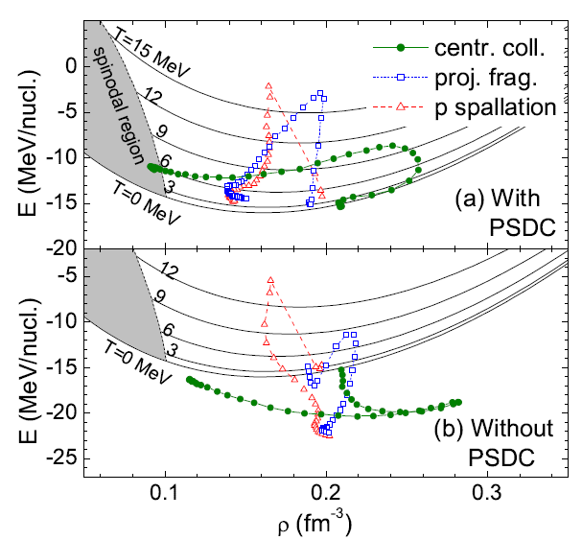
The dynamics track in E-ρ diagram of the projectile center
Central collision: compression and heating at the beginning of the collision, and then the expansion and cooling by the light particle emission.
Projectile fragmentation: The cooling stage accompanies with the expansion, but the ending is far from the spinodal region.
Spallation: heating and cooling

Slide 26
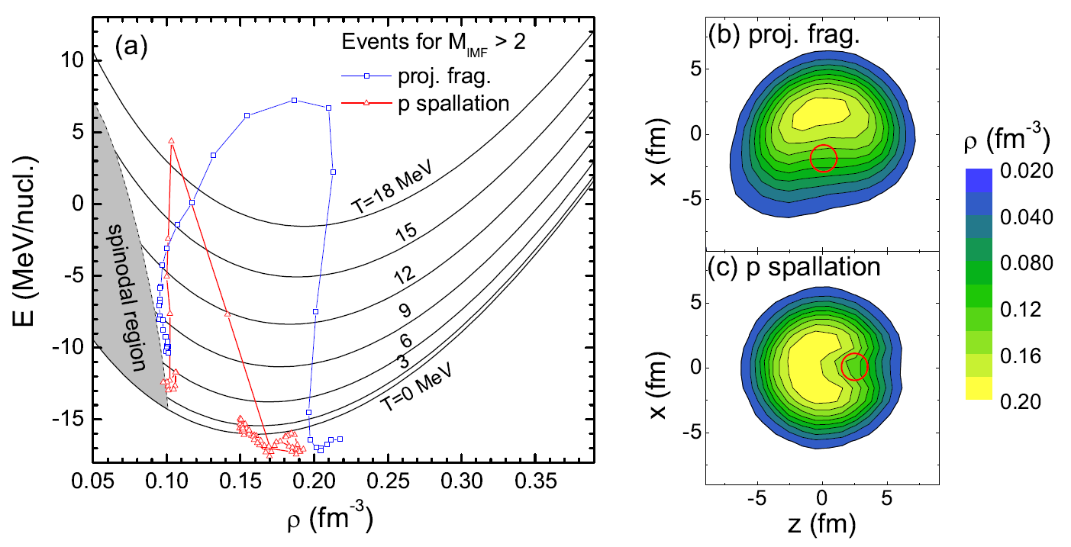
The dynamics E-ρ trajectory of the fragmenting area is different to that of the center.

Slide 27
Conclusions
The application of the PSDC method avoids the evolution of the momentum distribution from the initial Fermi-Dirac type to the Gaussian type, and hence eliminates the over-binding (larger density and smaller kinetic energy) in the center of the nucleus.
The latter suppresses the fragment emission and enhance the nucleon evaporation.
The comparison between the calculations with and without the PSDC method suggests that missing the fermionic feature in the transport model is responsible for the observed underestimation of the fragment yields in the projectile fragmentation [41].

Slide 28
Cooperators
W. Trautmann， GSI
Feng-Shou Zhang， BNU
Wen-Jie Xie，Yuncheng U
Long Zhu， SYSU
Chenchen Guo

Slide 29
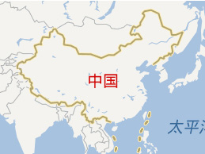
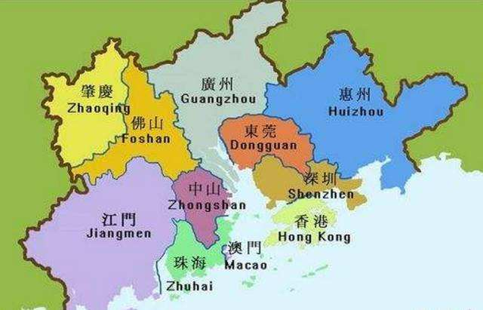
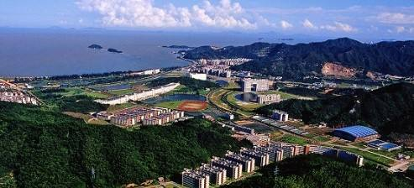
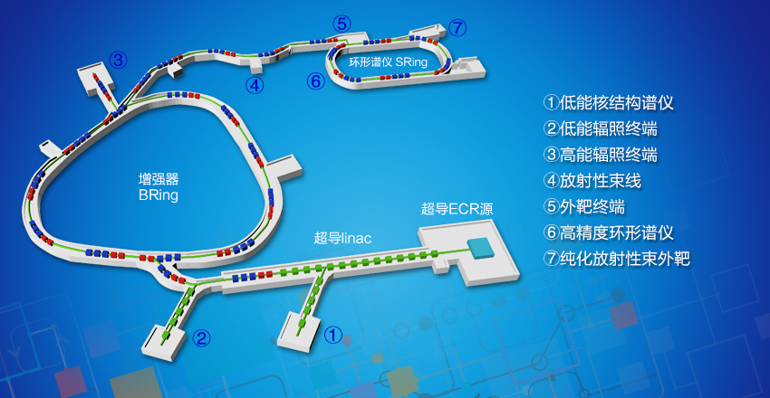
Welcome to Zhuhai
Nuclear physics at SYSU
HIAF@Huizhou

