Slide 1
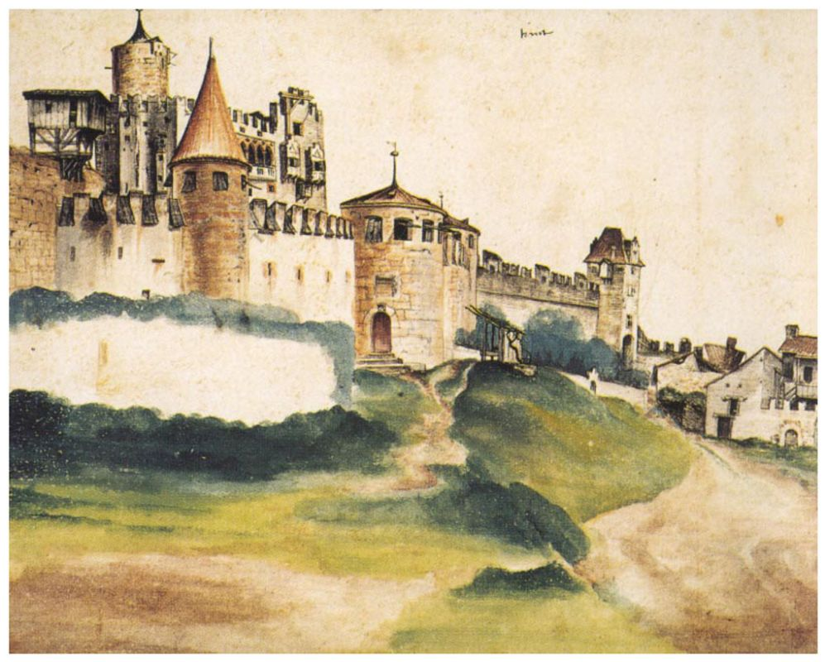
ECT* workshop on Indirect Methods in Nuclear Astrophysics
Trento, Italy, Nov. 5-9, 2018.
Coulomb dissociation of ¹⁷Ne
L.V. Chulkov

Slide 2
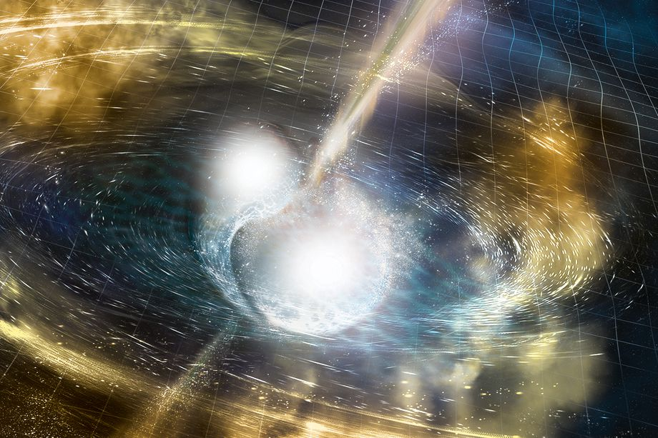
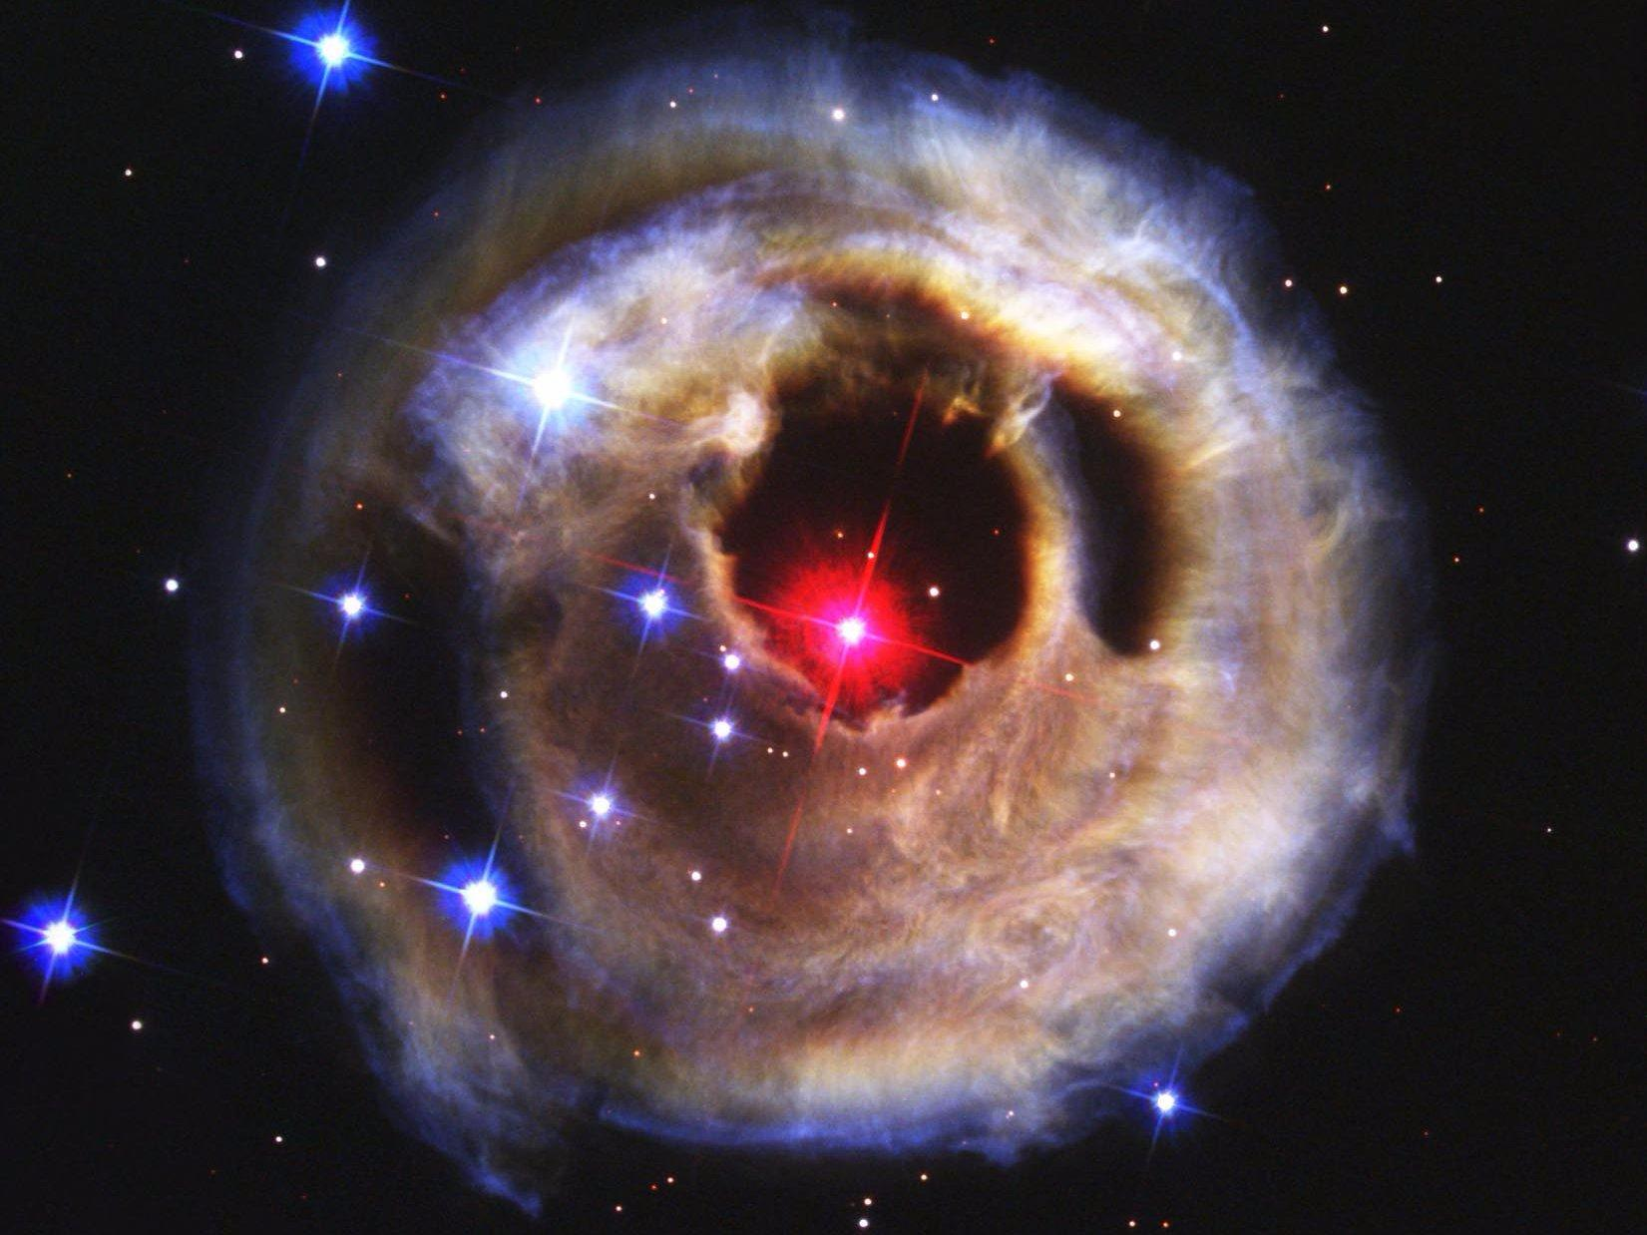
X-ray bursts are thought to be the most frequent thermonuclar explosions in the universe and occur on the surface of accreting neutron stars.
One of the best-studied red novas happened in 2008. The object, called V1309 Scorpii, was a double-star system measured for over 6 years before it merged and erupted.

Slide 3
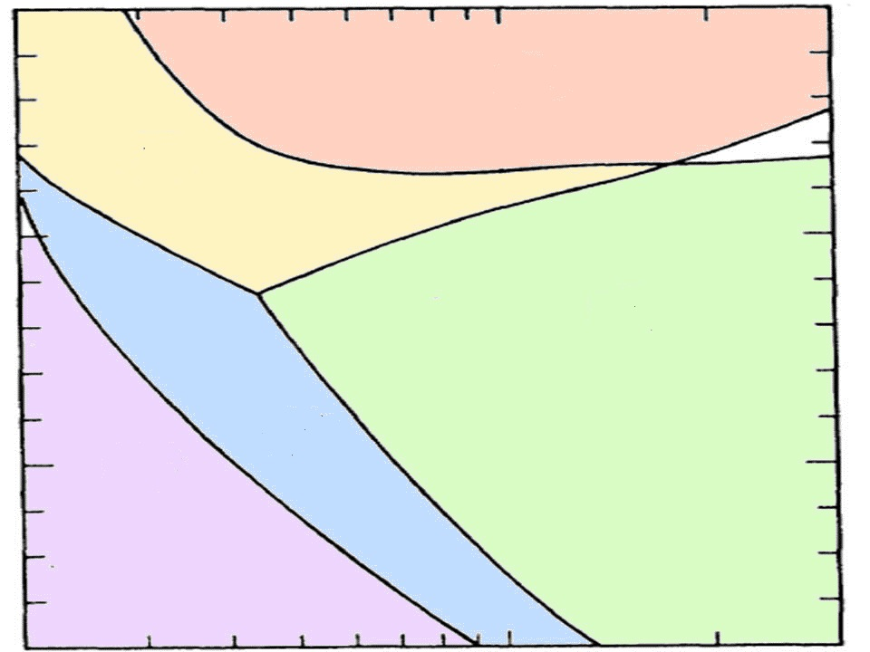
The role of two-proton capture reactions.
The rapid-proton capture are the dominant nucleosynthesis processes in explosive hydrogen burning, which takes place most notably in cataclysmic binary systems, such as novae and x-ray bursts.
¹⁵O(2p,γ)¹⁷Ne
β⁺ β⁺
τ1/2= 123 s τ1/2= 109 ms
two successive proton captures!
10¹⁵
Temperature and density conditions for two-proton capture as well as (α, p) reactions on oxygen and neon.
J. Görres, M. Wiescher
Phys. Rev. C 51, 392 (1995)
¹⁵O(2p,γ)¹⁷Ne (β⁺) ¹⁷F(2p,γ)¹⁸Ne(2p,γ)²⁰Mg
¹⁶O(p,γ)¹⁷F (p,γ)¹⁸Ne(2p,γ)²⁰Mg
10¹⁰
Density [g/cm3]
¹⁶O(p,γ)¹⁷F (p,γ)¹⁸Ne(β⁺)
¹⁶O(p,γ)¹⁷F (p,γ)¹⁸Ne(α,p)²¹Na
¹⁵O(α,γ)¹⁹Ne(p,γ)²⁰Na
10⁵
¹⁸F(p,α)¹⁵O (α,γ)¹⁹Ne(p,γ) ²⁰Na
¹⁶O(p,γ)¹⁷F (p,γ)¹⁸Ne (β⁺)
0.5 1 2 [GK]
temperature

Slide 4
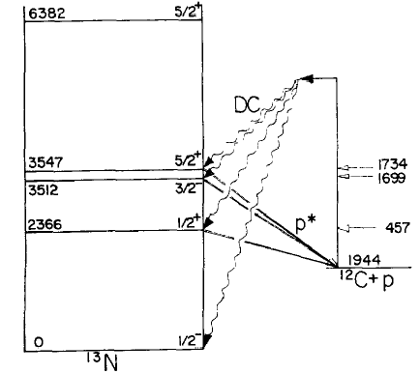
J. Görres, M. Wiescher, F-K. Thielemann
Phys. Rev. C 51, 392 (1995)
The two-proton capture reactions are characterized by two successive proton captures, where the first reaction product is unstable against proton emission, but the second reaction results in a particle stable nucleus.
¹⁵O(p,γ)¹⁶F(p,γ)¹⁷Ne ?
Direct capture to unbound states,
C. Rolfs, R.E. Azuma,
Nucl. Phys. A 227, 291 (1974)

Slide 5
¹⁷Ne structure from analyses of experimental data
Reaction | E, MeV/u | σ_{I} mb | P_{II} MeV/c | R_{m}/R_{ch} _{fm} | P(s²) % | P(d²) % | Reference
C(¹⁷Ne,¹⁷Ne) | 620 | 1044(31) |  | 2.75(7)/ 2.90(7) | 100 |  | A.Ozawa et al., PL B 34 (1999) 18
Be(¹⁷Ne,¹⁷Ne) Be(¹⁷Ne,¹⁵O) | 66 | 1065(32) 191(48) | 168(17) | 2.75(3) | 65 | 35 | R.Kanungo et al.,, PL B 571 (2003) 21
Be(¹⁷Ne,¹⁷Ne) | 64 | 1215(14) |  | 1.68(6) | 100 |  | K. Tanaka et al., PR C 82 (2010) 044309
Collinear laser spectroscopy |  |  |  | 2.75/ 3.04(2) | 42(4) |  | W. Geithner et al., PRL 101 (2008) 252502
Magnetic dipole momentum μ=0.78773(14) μN |  |  |  |  | 24 | 76 | W. Geithner et al., PR C 71(2005) 064319
First forbidden β decay |  |  |  |  | 10 | 50 | M.J.G. Borge et al., PL B 317 (1993) 25
First forbidden β decay ¹⁷Ne - ¹⁷N |  |  |  |  | 13(3) | 60(4) | N. Michel et al., NP A 703 (2002) 202
Coulomb energy for A=17, T=3/2 isoquartet. |  |  |  |  | 100 |  | S. Nakamura et al., PL B 416 (1998) 1
Mirror energy difference as function of P(s2) |  |  |  |  | 24 |  | H.T. Fortune PL B 718 (2013) 1342
Coulomb energy for A=17, T=3/2 isoquartet. |  |  |  |  | 22 | 78 | H.T. Fortune PLB 503 (2001) 70

Slide 6
Three body ¹⁵O+p+p models
Model, p-¹⁵O potential | P_{II} MeV/c | R_{m}/R_{ch} fm | P(s²) % | P(d²) % | P(p²) % | Reference
WS potential increase by 2..4% increased by 0.5% | 165 | 2.77/ 2.88 | 26.2 | 70.1 |  | M.V. Zukov et al., PR C 52 (1995) 3505
 | 140 | 2.81/2.94 | 47.4 | 47.9
generator coordinate 3 clusters |  | 2.56/2.70 | 100 |  |  | N.K. Timofeyuk et al., NP A 600(1996) 1
WS and fine tuning 3B potentials |  | 2.69/3.53 | 39.8 | 55.8 | 4.5 | L. V. Grigorenko et al., NP A 713(2003) 372
WS, and fine tuning 3B potentials |  | 2.8 | 38.9 | 54.4 | 6.7 | E. Garrido et al., NP A 733 (2004) 85
WS potentials , 1s_{1/2} 1p_{3/2} 1p_{1/2} conf. were explicitly excluded. |  | 2.62/2.75 | 16 | 76 |  | T. Oishi et al., PR C 82 (2010) 024315
Relativistic mean field theory, |  |  | 20 | 40 |  | S.S.Zhang et al., EPJ A 49 (2013) 77

Slide 7
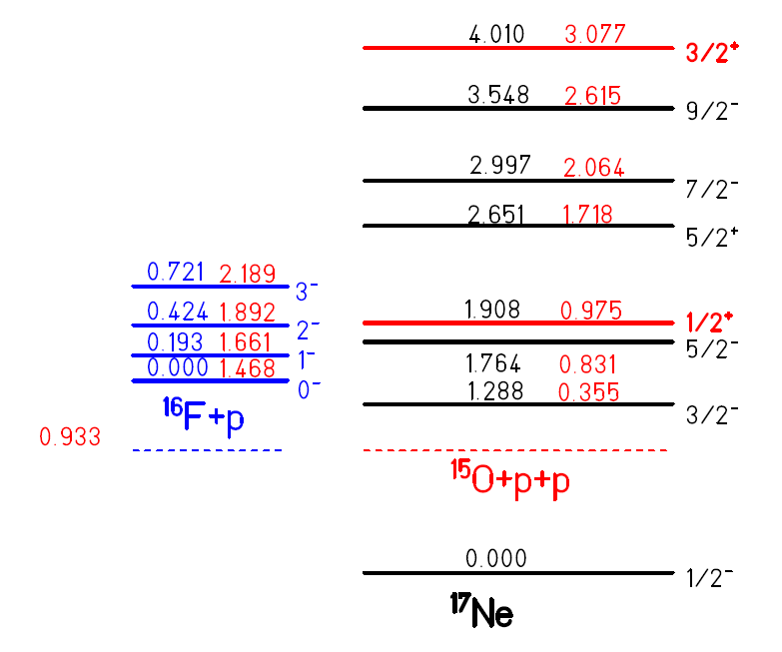
Energy levels of ¹⁷Ne and ¹⁶F
E_{x} , keV | I^{π} | Γ , keV
0 | 0⁻ | 25.6
193 | 1⁻ | 76
424 | 2⁻ | 5.0
721 | 3⁻ | 15.1
¹⁵O+1d_{5/2}
¹⁵O+2s_{1/2}
States in ¹⁷Ne which can be excited by E1 are marked by red.

Slide 8
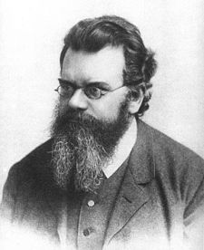
From Coulomb dissociation to absorption.
The absorption and dissociation cross sections are related to each other by the detailed balance:
The principle of detailed balance was explicitly introduced for collisions by Ludwig Boltzmann
in 1872,
However, this equation is valid only for binary reactions.

Slide 9
From Coulomb dissociation to absorption.
The cross section for Coulomb excitation of a narrow resonance related to the transition probability B(πλ) as:
N(πλ) - the number of virtual photons at excitation energy E∗. σ^{πλ} _{C}(E∗) -. the measured cross section (in fm²)
B(πλ) - the transition probability based on the measured cross. Similar expression can be used for the non-resonant cross section and the strength function. dB(πλ) /dE.
π – E (electric), M (magnetic) λ – 1 (dipole), 2 (quadrupole)…..

Slide 10
From Coulomb dissociation to absorption.
With dB(E1)/dE for the non-resonant E1 contribution, the reaction rate at a temperature T is defined as:
This equation is generally applied to successive two proton captures..
Why the life-time of the intermediate resonance is not present in this equation?

Slide 11
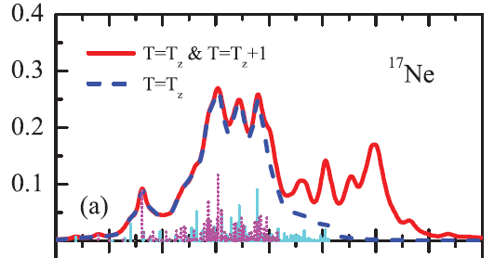
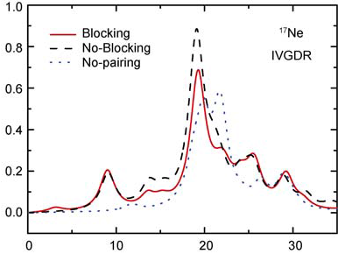
Mean-field models. Large inconsistency of results.
The shell model with the self-consistent Skyrme-Hartree-Fock wave functions.
Hai-Liang Ma et al.,
Phys.Rev. C 85, 044307 (2012)
dB(E1)/dE_{fpp} (e²fm²/MeV)
proton pygmy resonance
The self-consistent relativistic Hartree Bogoliubov model.
Ma Zhong Yu, Tian Yuan, Sci.China Phys, 54,49 (2011)..
dB(E1)/dE_{fpp} (e²fm²/MeV)
E_{fpp} (MeV)

Slide 12
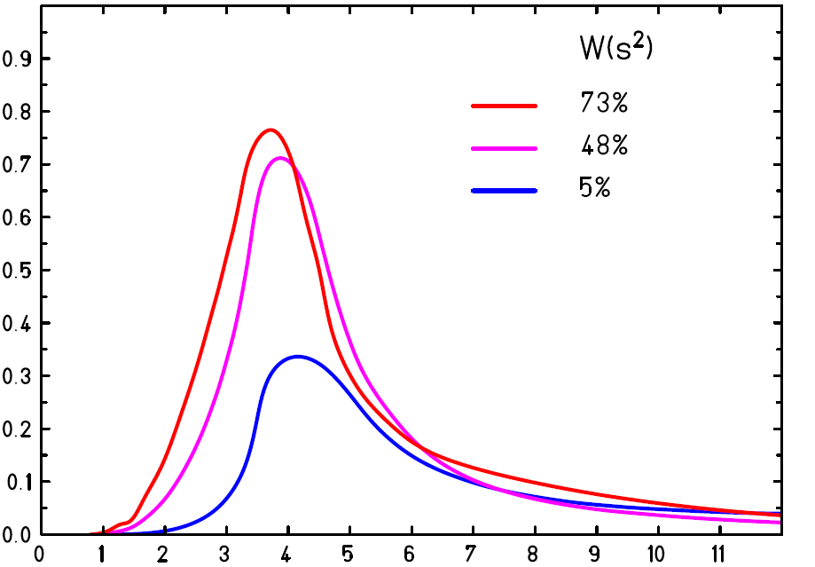
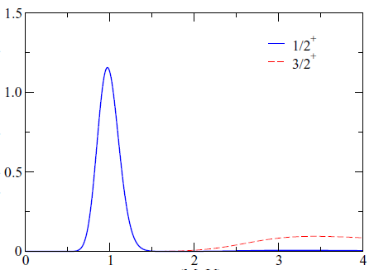
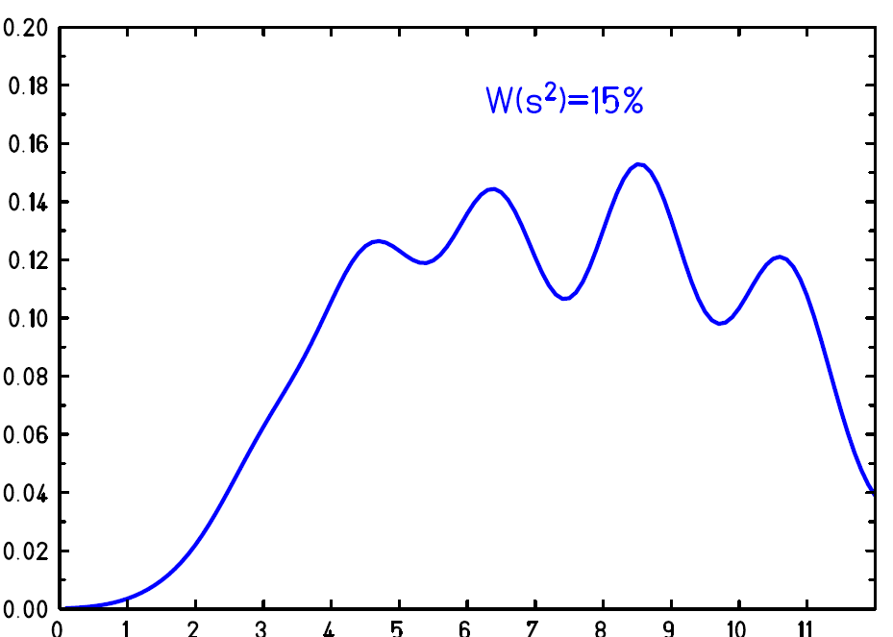
[s²] to [sp] and [d²] to [dp]
were considered [L.V. Grigorenko et al. PL B 641 (2006) 254]
Three-body models.
Large inconsistency of results.
dB(E1)/dE_{fpp} (e²fm²/MeV)
dB(E1)/dE_{fpp} (e²fm²/MeV)
E_{fpp} (MeV)
E_{fpp} (MeV)
Significant part of the E1 strength goes to the 1/2⁺ resonance at 0.975 MeV
[J. Casal et al., Phys.Rev.C 94, 054622 (2016)].
dB(E1)/dE_{fpp} (e²fm²/MeV)
The two valence protons are excited from the 0⁺ ground state configuration to 1⁻ continuum states
[T. Oishi et al., Phys. Rev. C 84, 057301 (2011) ]
E_{fpp} (MeV)

Slide 13
Experimental data are
highly required
to clarify inconsistency between
theoretical calculations.

Slide 14
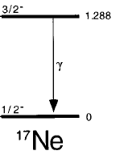
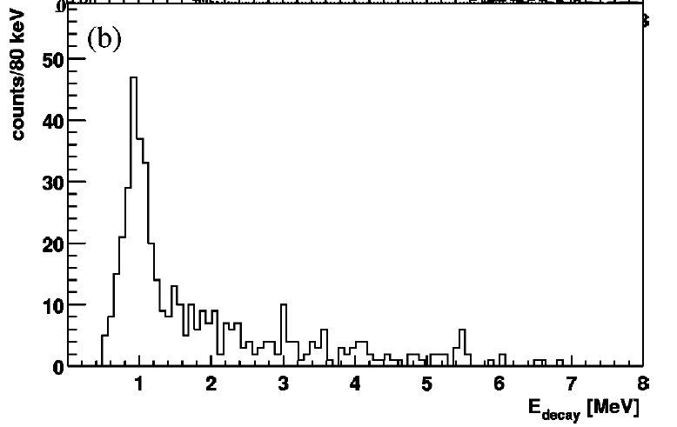
Excitation of ¹⁷Ne on ¹⁹⁷Au at MSU
e²
M. J. Chromik et al., C 55, 1676 (1997)
B(E2, ¹⁷Ne,1/2⁻ → 3/2⁻) = 153(15) e² fm⁴
66(20)
fm⁴
1/2+ Er =0.97 MeV
5/2⁻ Er =0.83 MeV
Geometrical
acceptance?
M. J. Chromik et al., C 66, 024313 (2002)
B(E2, ¹⁷Ne,1/2⁻ → 3/2⁻) = 66(20) e² fm⁴
B(E2, ¹⁷Ne,1/2⁻ → 5/2⁻) = 124 (18) e² fm⁴
fm⁴
fm⁴
Why excitation of 1/ 2⁺ was not considered?

Slide 15
Confusion in units of B(E2)
Larry Zamick
Department of Physics and Astronomy Rutgers, The State University of New Jersey
Research group: Theoretical nuclear physics
On Units for B(E2)'s
arXiv: 0905.29v6[nucl-ex]
Abstract:
We discuss different conventions used for defining B(E2)'s.
First version was published November 17, 2009
Last changes were made in October 22, 2018

Slide 16
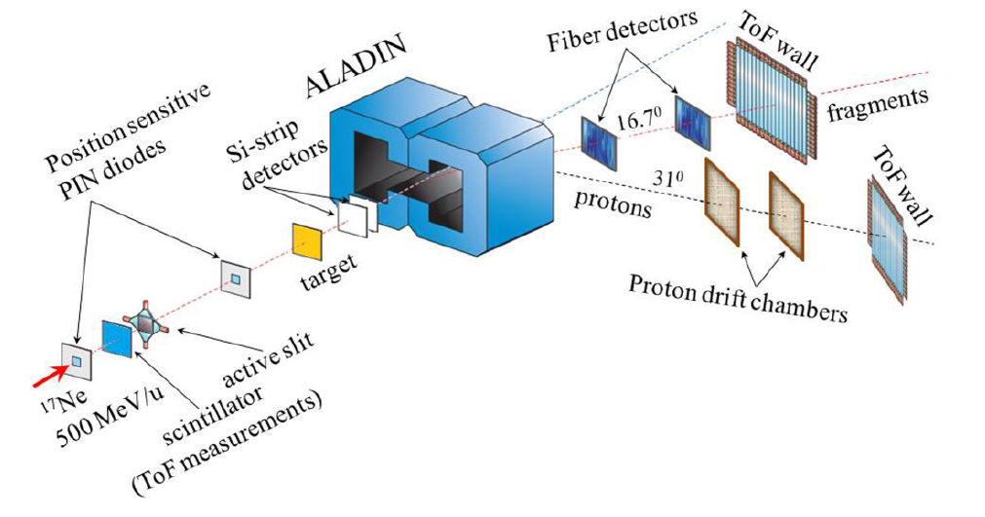
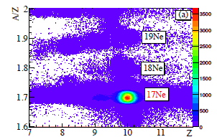
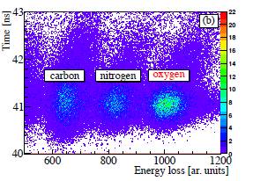
Schematic outline of the experimental setup.
Identification of beam nuclei
Identification of outgoing fragments

Slide 17
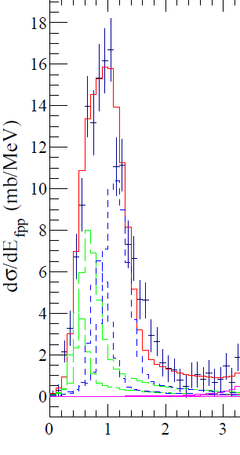
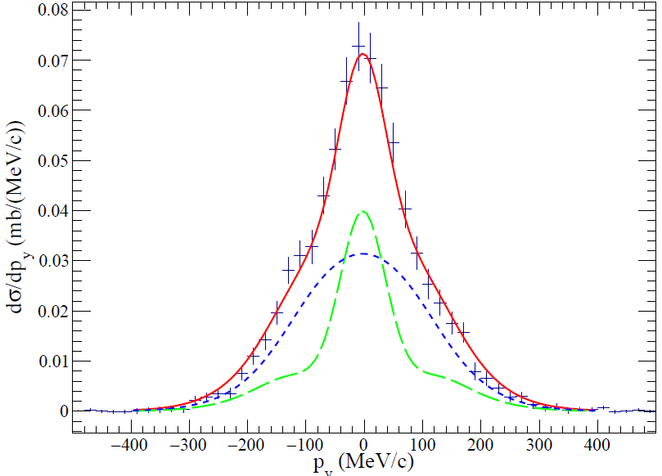
Quasi-free scattering ¹H(¹⁷Ne, p ¹⁵O)
C. A. Bertulani, A.Gade, CPhC 175 (2006) 372.
T.Aumann, C.A.Bertulani, J.Ryckebusch , PR C 88, 064610 (2013)
Very Preliminary
E_{fp} (MeV)
Christopher Lehr, P(s²) = 31(9)%
About 85(15)% of the ¹⁷Ne(g.s.) can be described
as ¹⁵O plus either s² or d² protons.

Slide 18
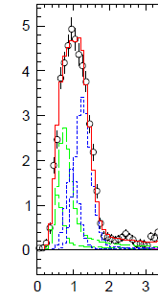
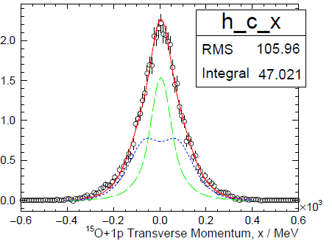
Quasi-free scattering ¹²C(¹⁷Ne, p ¹⁵O)
dσ/dE_{fp} (mb/MeV)
Very Preliminary
E_{fp} (MeV)
Felix Wamers, P(s²) = 21(2)%
Only about 65(3)% of the ¹⁷Ne(g.s.) can be described
as ¹⁵O plus either s² or d² protons.

Slide 19
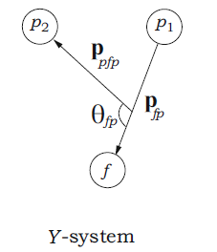
Fractional-energy distribution
Fractional energy
ε_{fp} = E_{fp}/E_{fpp}

Slide 20
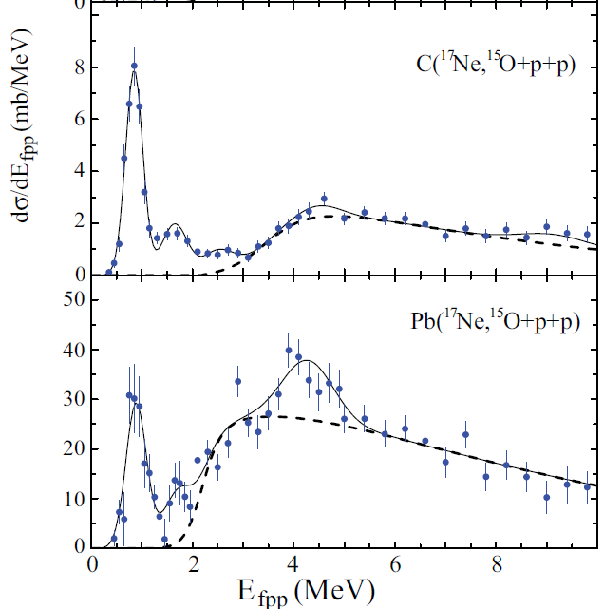
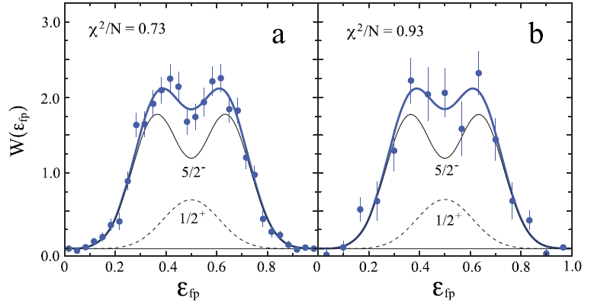
Fragmentation of ¹⁷Ne to ¹⁵O+2p on light and heavy targets
00
5/2⁻+1/2⁺
carbon
lead
5/2⁺+3/2⁻
(3/2⁺)?
5/2−
3/2⁺ strongly excited
with the lead target
Disentanglement of unresolved peaks. Fractional energy spectra W(fp)in the Y-system for the region of ¹⁵O +p +p internal energy 0.5 ≤Ef_{pp}≤1.4MeV. ε_{fp}=E_{fp}/E_{fpp}.
J^{π} identification was based on:
●V. Guimarães, et al., Phys. Rev. C 58 (1998) 116.
● Isobaric multiplet mass equation for A =17, T=3/2 states in ¹⁷N, ¹⁷O and ¹⁷F .
● fractional energy spectra.
5/2⁻ is strongly excited by quadruple transition in the Coulomb field. Collective excitation (?)
J. Marganiec et al. PL B 759 , 200 (2016)

Slide 21
Characteristics of resolved resonances in ¹⁷Ne
I^{π} | E* | C | Pb | EMD | πλ | N(πλ) | B(πλ)
5/2⁻ | 1.764(12)* | 2.44(18) | 11.6(1.5) | 7.1(1.5) | E2 | 11868 | 90(18)
1/2⁺ | 1.908(15)* | 0.81(15) | 2.5(1.2) | <2.4 | E1 | 121.43 | <0.007
5/2⁺ | 2.614(20) | 1.14(10) | −
(3/2₂⁻) | 2.692(21) | <0.3 | −
(5/2₂⁻) | 3.415(38) | 0.62(10) | −
(3/2⁺) | 5.210(79) | 0.46(19) | 14.4(1.7) | 13.6(1.7) | E1 | 68.68 | 0.0071(9)
Excitation energies and errors are from V. Guimarães, et al., Phys. Rev. C 58 (1998) 116.

Slide 22
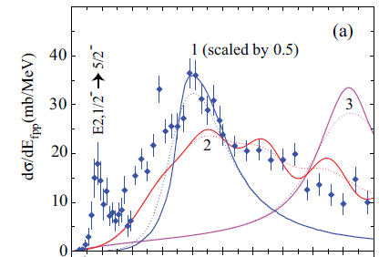
Quadrupole
excitation
1. L. V. Grigorenko et al.,
Phys. Lett. B 641, 254 (2006)
2. T. Oishi et al.,
Phys. Rev. C 84, 057301 (2011).
3. Z. Y. Ma et al.,
SCPhys., Astron. 54, 49 (2011).
Experimental data from
F. Wamers et al.,
Phys Rev. C 97, (2018) 034612.
1 2 3 4 5 6 7 8 9
E_{fpp} (MeV)

Slide 23
Why ¹⁵O +p+ p models gave so different results?
T. Oishi et al., PR C 84, 057301 (2011)
Woods-Saxon potential together with the Coulomb interaction between a proton and the core nucleus. Fit to states in ¹⁶F .
The 1s_{1/2}, 1p_{3/2}, and 1p_{1/2} states, were explicitly excluded.
4 parameters
L.V. Grigorenko et al., PL B 641 (2006) 254
Woods-Saxon pot . includes central, ls and ss terms (l = 0, 2)
three-body potentials, which depends only on hyperradius.
p – wave potential
17 parameters
Three-body potential – V(ρ), ρ -hyper-radius
Notes:
esd

Slide 24
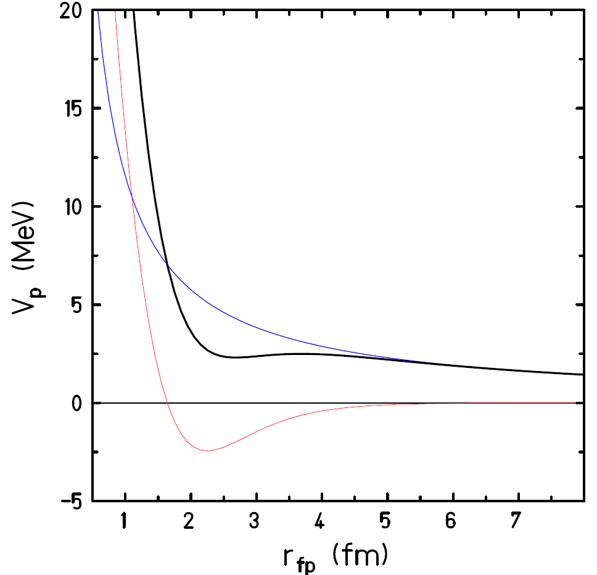
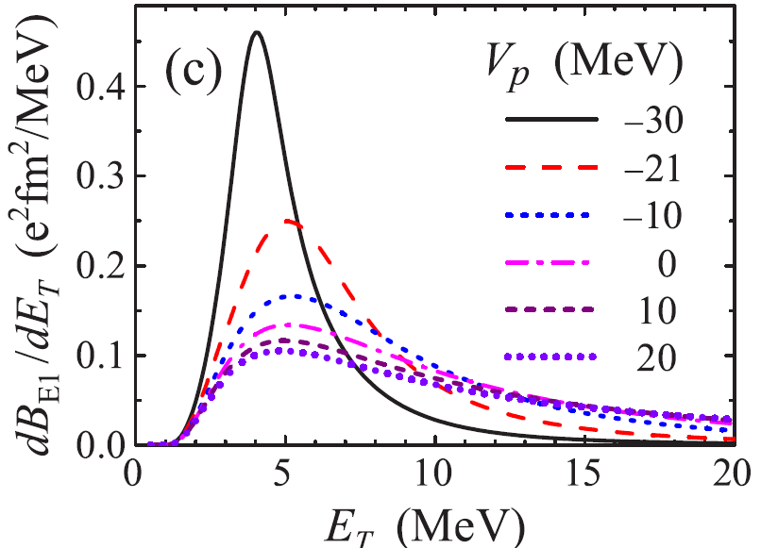
Sensitivity of the E1 strength function to
the p-wave interaction in the ¹⁵O+p channel.
p-wave potential
V_{p} =-30 MeV
Coulomb
Nuclear
Yu. Parfenova et al.,
PR C 98 (2018) 034608.

Slide 25
Why ¹⁵O +p+ p models gave different results?
The two valence protons are excited from the 0⁺ ground state configuration to 1⁻ continuum states
[T. Oishi et al., Phys. Rev. C 84, 057301 (2011) ]
[s²] → [sp] and [d²] → [dp] were considered by
L.V. Grigorenko et al., PL B 641 (2006) 254.
Thus transitions necessary go in a successive way though unbound states in ¹⁶F
[d²] → [df] was ignored.

Slide 26
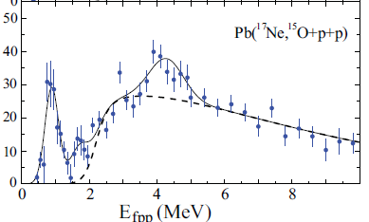
Looking at the structures in
fractional-energy distributions
Fractional-energy distributions were obtained in 4 energy regions of the ¹⁵O+p+p internal energy .

Slide 27
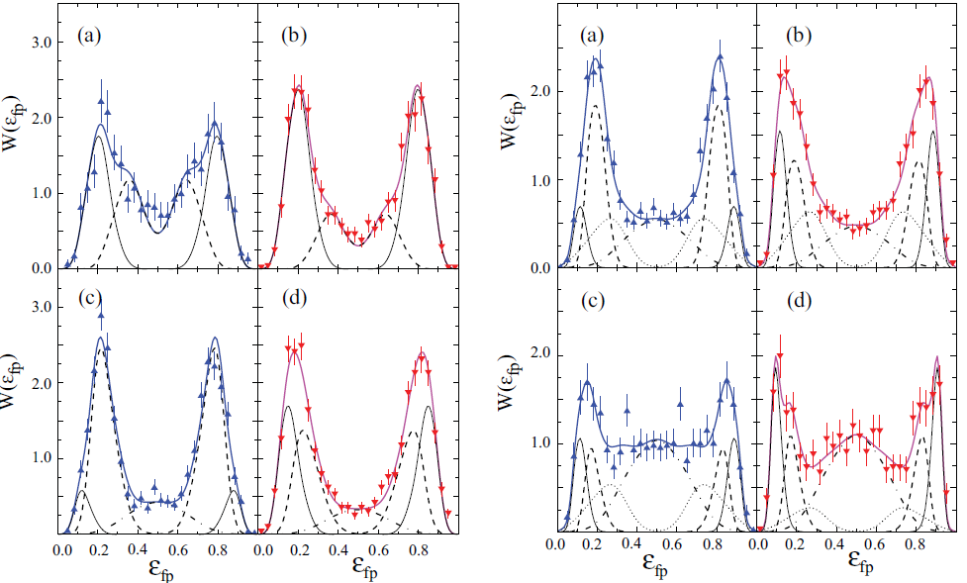
Role of sequential ¹⁵O(p, γ)¹⁶F(p,γ)¹⁷Ne proton absorption
in ¹⁵O(2p, γ)¹⁷Ne) reaction.
3.0 <E_{fpp} <3.8 MeV in (a) and (b) 5.0 <E_{fpp} <6.5 MeV in (a) and (b)
3.8 <E_{fpp} 5.0 MeV [(c), (d)] 6.5 <E_{fpp} <8.0 MeV [(c), (d)]
CH₂ [(a), (c)] and Pb [(b), (d)]. The least-square fits assuming population of ¹⁶F(0⁻ ,1⁻) states (thin solid lines), ¹⁶F(2⁻,3⁻) (dashed lines), ¹⁶F(I⁺) states (dotted lines) and a genuine three-body decay (dashed-dotted lines), are shown.

Slide 28
Role of sequential ¹⁵O(p, γ)¹⁶F(p,γ)¹⁷Ne proton absorption
Decay branches (%) in the fragmentation of ¹⁷Ne on CH₂ and Pb targets. ¹⁶F(I⁺) denotes positive parity states in ¹⁶F at excitation energies 3.7 < E∗< 4.4MeV. The indicated uncertainties are statistical.
ΔE | ¹⁶F(0-) & (1-) | ¹⁶F(2-) & (3-) | ¹⁶F(I+) | 3 body
3.0-3.8 | 53(6)/68(5) | 47(6)/32(4) |  | <5/<5
3.8-5.0 | 22(3)/45(4) | 63(5)/42(4) |  | 15(1)/13(1)
5.0-6.5 | 12(2) /25(3) | 39(94)/27(4) | 29(3)/30(4) | 20(2)/18(2)
6.5-8.0 | 9(3)/20(4) | 29(4)/24(5) | 32(3)/14(3) | 30(3)/42(3)
8.0-10 | 7(4)/12(5) | 35(5)/24(5) |  | 58(7)/64(8)

Slide 29
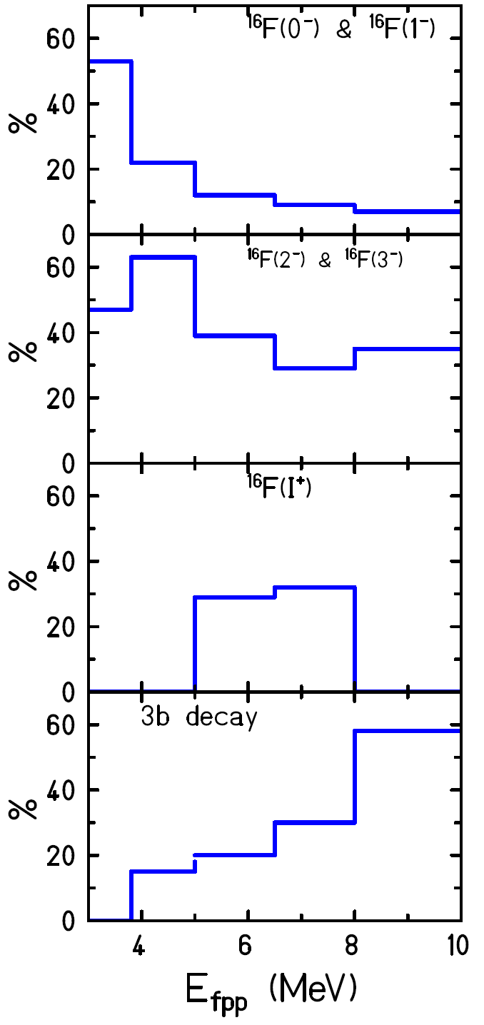
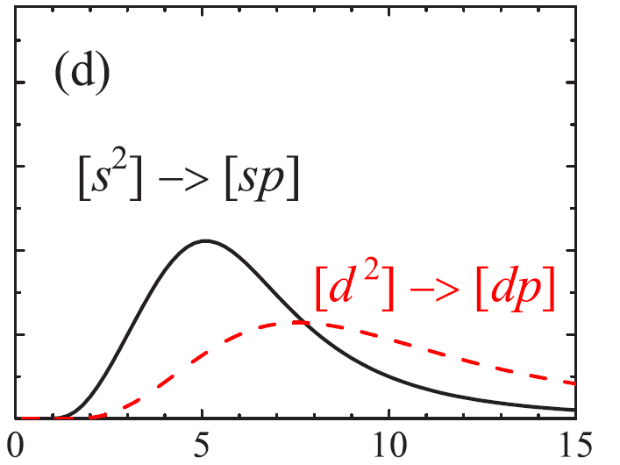
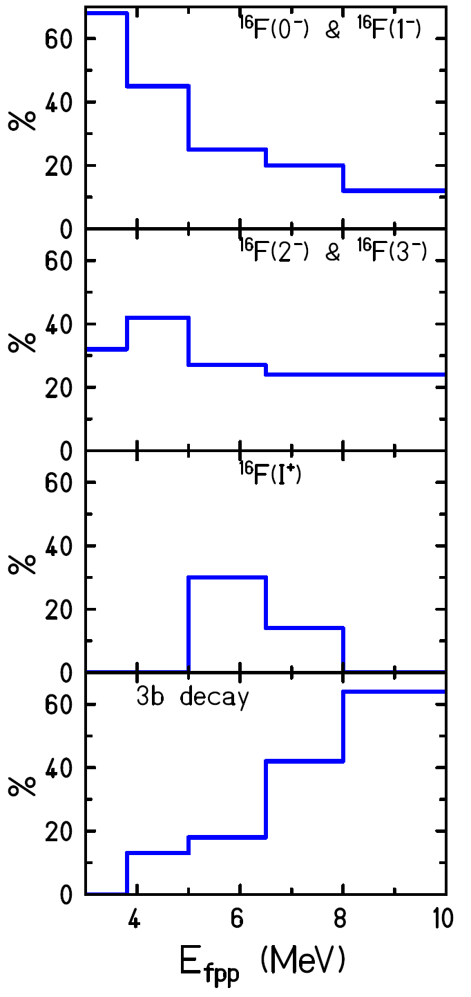
Role of sequential ¹⁵O(p, γ)¹⁶F(p,γ)¹⁷Ne proton absorption
Decay branches (%) in the fragmentation of ¹⁷Ne on CH₂ and Pb targets. ¹⁶F(I⁺) denotes positive parity states in ¹⁶F at excitation energies 3.7 < E∗< 4.4MeV.
CH₂ target
Lead target
[s²] → [sp]
[s²] → [sp]
[d²] → [dp]
[d²] → [dp]
E1 strength function
WF:
100% of [s2] vs. 100% of [d2]
Yu.Parfenova et al.,
PR C 98, 034608 (2018).

Slide 30
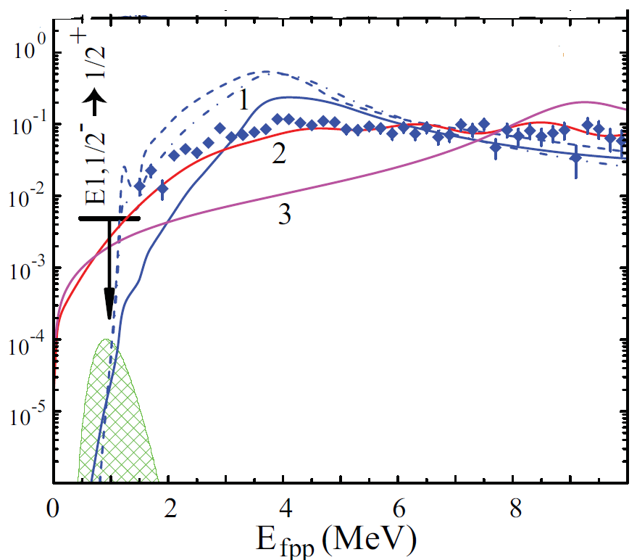
1. L. V. Grigorenko et al.,
Phys. Lett. B 641, 254 (2006)
2. T. Oishi et al.,
Phys. Rev. C 84, 057301 (2011).
3. Z. Y. Ma et al.,
SCPhys., Astron. 54, 49 (2011).
Experimental data from
F. Wamers et al.,
Phys Rev. C 97, (2018) 034612.
Dipole strength function dB(E1)/dE_{fpp}. The hatched zone shows the position of the Gamow window for ¹⁵O(2p,γ )¹⁷Ne as a function of E_{fp} at 1 GK temperature

Slide 31
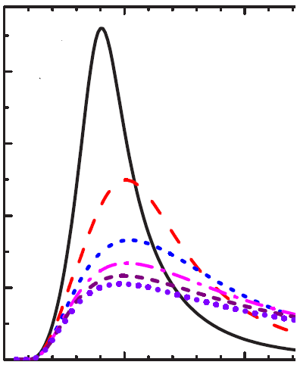
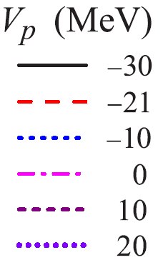
Comparison of theoretical calculations made before and after the GSI experiment
The binding energy variation for ¹⁷Ne is provided by artificial variation of the three-body potential depending on hyper radius.
The variation of the p-wave interaction leads to drastic modification of the E1 strength function in the energy range from 1 to 20 MeV.
L.V. Grigorenko et al.
P L B 641 (2006) 254
Yu. Parfenova et al.,
PR C 98 (2018) 034608.
0.4
0.2
W(s2)=50%
dB(E1)/dE_{fpp} (e²fm²/MeV)
2 4 6 8 10
E_{fpp} (MeV)
E_{fpp} (MeV)

Slide 32
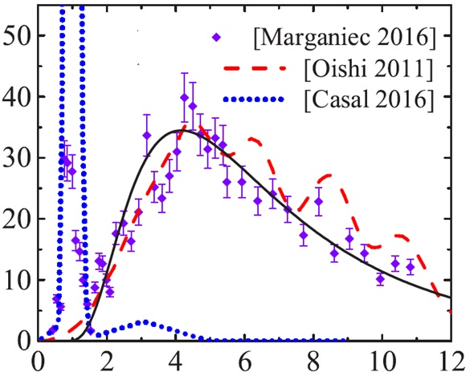
Fit to the experimental relative energy spectrum,
Yu. Parfenova et al., PR C 98 (2018) 034608.
The analysis of the relative energy spectrum allow to constrain the structure of ¹⁷Ne
to 15–65% of the [s2] configuration.
Solid black line -Vp = -10 MeV
dσ/dE_{fpp} (mb/MeV)
E_{fpp} (MeV)

Slide 33
Summary
Dissociation on ¹⁷Ne on light and heavy targets were investigated.
The statement made by J. Casal et al., Phys.Rev.C 94, 054622 (2016) that a significant part of the E1 strength goes to the ¹⁷Ne(1/2⁺) resonance was not confirmed. However, an indication was obtained on excitation of ¹⁷Ne(3/2⁺) by E1 transition.
A comparatively large cross section was measured for population of ¹⁷Ne(5/2⁺) state by E2 collective transition. This might be an evidence of non-negligible contribution of a quadruple electromagnetic dissociation, opposite to the general statement that a dipole transition is the dominant.
It is shown that at low internal energy fragmentation goes through sequential proton emission with population of four lowest states in ¹⁶F with negative parity. At higher energy three-body decay without essential features of final state interactions dominates.
Theoretical analysis of newly available experimental data made by Yu. Parfenova et al., PR C 98 (2018) 034608 revealed a large ambiguities in parameters of interaction potentials. This eventually led to the unreliability in the description of the ¹⁷Ne (g.s.) in the three-body ¹⁵O+p+p model. Earlier this ambiguities were not discussed.

Slide 34
Thank you for attention.
There are still many questions
left unanswered.

