Slide 1
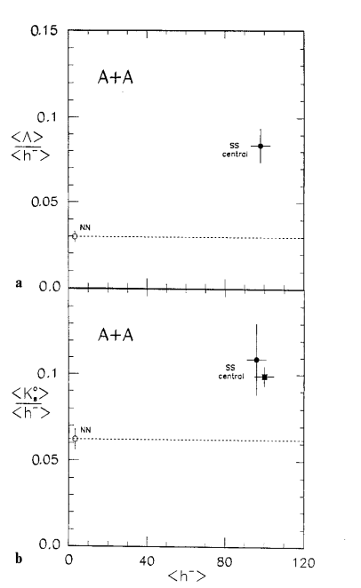
Particle Production: a random collection of observations from LHC data
S+S SPS
NA35
PbPb LHC
A. Andronic et al 1611.01347
  The safest prediction for LHC:
  particle ratios will be trivial (μ_{B} = 0)

Slide 2

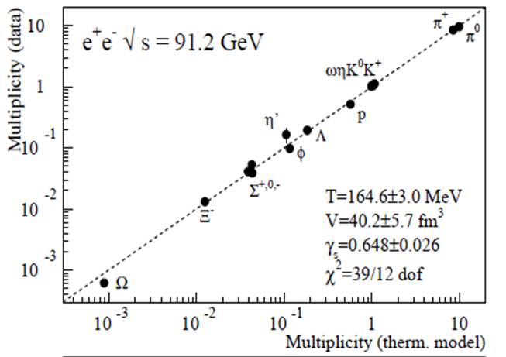
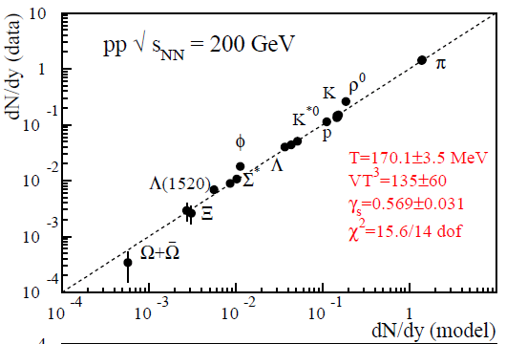
The unreasonably successful Thermal Model
Dozens of particle ratios with very few parameters (T_{chem}, μ_{B}, γ_{s}, γ_{c}.)
  e⁺e⁻, pp, pA, AA : very ‘intuitive’ physics
  very efficient and fairly accurate description (compared to everything else, eg MC)
.. not sure how and why this works so well !
  ‘evolving into equilibrium’ A + B ⬄ C + D (hadronic or partonic ‘pressure cooker’ + detailed balance)
  ‘born into equilibrium’ A + B => C + D (Fermi’s Golden Rule & phase space dominance)
    both plausible ideas, but little (no?) experimental proof
.. not sure how or if this is connected to the QGP (partonic) phase
  (vacuum) hadron masses enter the PS formula, not parton masses (ex γ_{s}, γ_{c}.)
  Connection to QGP either conspiracy (of fugacities) or conjecture
Blessing & Curse of Equilibrium: No memory of past ! No need for Dynamics
e⁺e⁻ LEP
pp RHIC
If Equilibrium is the Problem,
Out-of-Equilibrium may be a Solution:
Study out-of-equilibrium signals => test ‘Dynamics at work’
Fluctuations around Equilibrium
Onset/Approach to (or sequential freeze-out from) Equilibrium

Slide 3
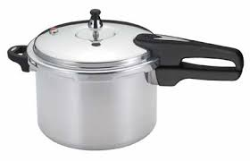
Size/Volume Dependence (the onset?)
Smooth Evolution from MinBias pp to central AA (~ dN/dη, ε, 1/S dN/dy, .. ?)
I) No obvious mechanism for
‘Born into Phase Space’
  w/o IS or FS Interaction =>
  Phase Space = linear superposition
  Change PS via string fusion, a la Dipsy ?
  see also H Satz (change string tension)
    needs interactions
    => ‘born’ evolves towards ‘evolving’
Strangeness Enhancement pp pA AA
Κ₀
Λ
Ξ
PbPb
pp, pPb
Ω
Alice 1606.07424

Slide 4
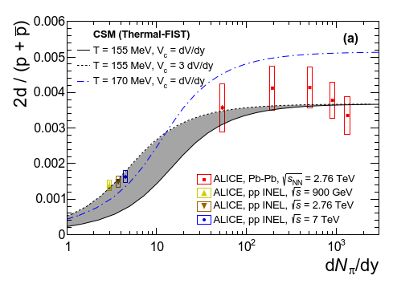
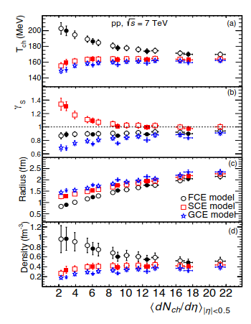
Size/Volume Dependence (the onset?)
II) Exact strangeness conservation => sCanonical
  pretty good for open strangeness, also for light nuclei (incl. baryon conservation)
  fails utterly for the φ
  fails dramatically for p/π
pp, pA, AA: Normalized particle ratios vs N_{ch}
1808.05245
1803.05409
Priv. Comm.
1610.03001

Slide 5
Size/Volume Dependence (the onset?)
III) Core(equil)+ Corona (non-equil):
  many parameters (free fit to Corona fraction) => modest accuracy
  Core/Corona definition in pA questionable
  Does NOT address pp (e⁺e⁻) ratios
Priv. Comm.
1610.03001

Slide 6
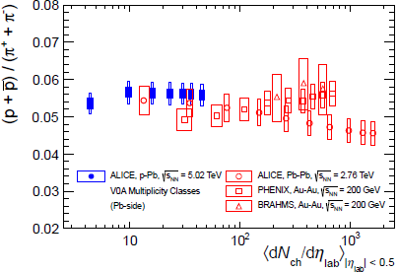
II) Non-equilibrium ratios (sequential FO)?
Different particles -> different x-sections (σ, τ_{r}) -> differential freeze-out T_{chem}
  Smoking gun of chemical dynamics, we should look for it !
K
Alice Phys. Lett. B 728 (2014) 25-38
K*
p/π
π
π
K*
K
Alice Phys. Rev. C 91 024609 (2015)
weak indication of FS chemistry (‘baryon annihilation’)
- Reproduced by transport MC (URQMD, EPOS)
(model dependence, parameters, detailed balance,..)
- Needs better data O(5%) accuracy to firmly establish
√s (RHIC-BES -> LHC), dN/dy(pp -> AA)
- Other large x-section particles ?
Could make, not brake, the case for hadro-chemistry
φ/Κ
Not chemistry, but kinetics
(decay + re-scattering)
Proof & nontrivial test of kinetic phase !
Incompatible with single FO (T_{chem}=T_{kin}) !
=> Transport & Dynamics in HRG
ρ(~1fm) < K*(~4fm) < Λ*(~13fm) < Ξ*(<22fm)< φ(~45fm)

Slide 7
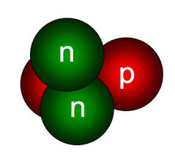
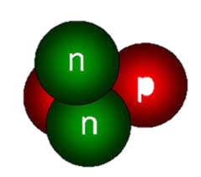
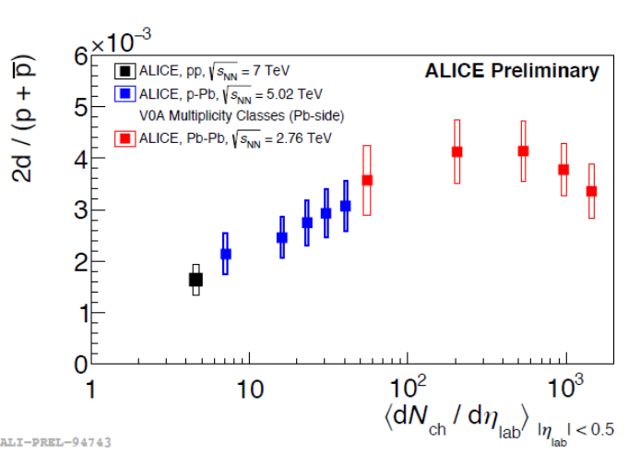
II) Light Nuclei: Return of the old Enigma
Thermal: T_{chem} (d, ³H_{Λ}, ³He) = 156±4 MeV (strongly disfavors non-equil. γ_{s}, γ_{q} ≠1)
  Survive T_{kin} expansion ?: ΔE(³H_{Λ}) ≈ 100 KeV, σ dissociation huge(π+d 10’s mb, PRL 48, 577)
    Isentropic => Entropy/Baryon = c = d/p. True (at Bevalac). But what keeps E/B ↑ ?
  ‘Chemical’ equilibrium may be (part of) the answer
    IFF the equilibrium value does NOT depend on the (decreasing) T
    See eg 1809.04024 (Dmytro, Volker, ..), Ulli, ..
    Arrhenius equitation k = exp(-ΔE/T), ΔE/T << 1
T_{chem}(π, K, p, Λ, ..) = 156±2 MeV
Thermal Model
ALICE PRC 93 (2015) 024917
d, ³H_{Λ}, ³He dN/dy
_{Pb-Pb 0-10%}
pPb: d/p rises while p/π = c
Data/TH model

Slide 8
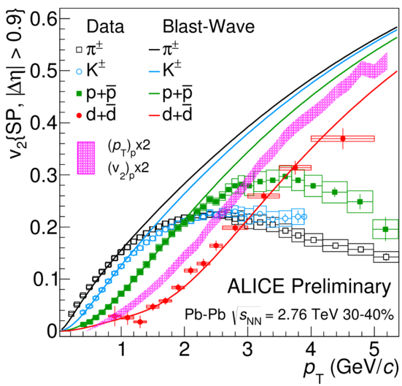
II) Light Nuclei: Return of the old Enigma
Coalesence@T_{kin}:
  Simple models fix ratios to data => get kinetic (p_{T}, v₂) distributions (approx.) right
    Kinetic distributions (flow) better described using Hydro + Coalesence 1807.02813
  Ab Initio Wigner yield calculations are typically off by factors O(>2-8) 1607.0226, 1512.00692
  Compare similar mass, different size nuclei (³He/³_{Λ}H)
  Thermal Model (T, m) ≠ Coalescence (Ψ(r), ρ(x,t))
Little Bang Nucleosynthesis
progress
but not quite solved yet
Thermal + Kinetic :
yields & kinematics ✔
survival ?(✔) pA ? (λ > R ??)
Coalescence:
Survival ✔ kinematics ✔
Yield = T_{chem} by accident ?
Deuteron v₂(p_{T})
Naive Coalesence
BlastWave
T_{chem} -> T_{kin}

Slide 9
Hadronisation
How: ‘macroscopic’/statistical/thermal Model: elegant/simple/efficient
Why:
Hadronisation: Several Promising Leads
but no coherent & complete picture pp→pA→AA
Data plenty, smaller errors may help
may want confirmation from RHIC (BES and pp, pA)
- Ball now with Theory/new Ideas
Color Ropes (Dipsy/1412.6259), ‘thermal’ string decay (1610.09818), Unruh radiation(0704.1426), string fusion(hep-ph/0103060), flavor differential FO(1305.6297), missing resonances (1701.07346), …..
- Significant recent progress
helped by new high quality data and small systems
  The safest prediction for LHC: particle ratios will be trivial (μ_{B} = 0)

Slide 10
π + d −> π + n + p
σ_{Inelastic}
1702.00486
π + d −> π + d
σ_{Elastic}
π⁻ + d −> π⁰ + n + n
σ_{ChargeEx}
σ(inel+CEX) >> σ(elastic)
=> τ_{chem} << τ_{kin}
Why T_{chem} >> T_{kin} ??

Slide 11
S-Canonical & Core Corona Fits
f = optimal Core Fraction
for each particle individually

