Slide 1
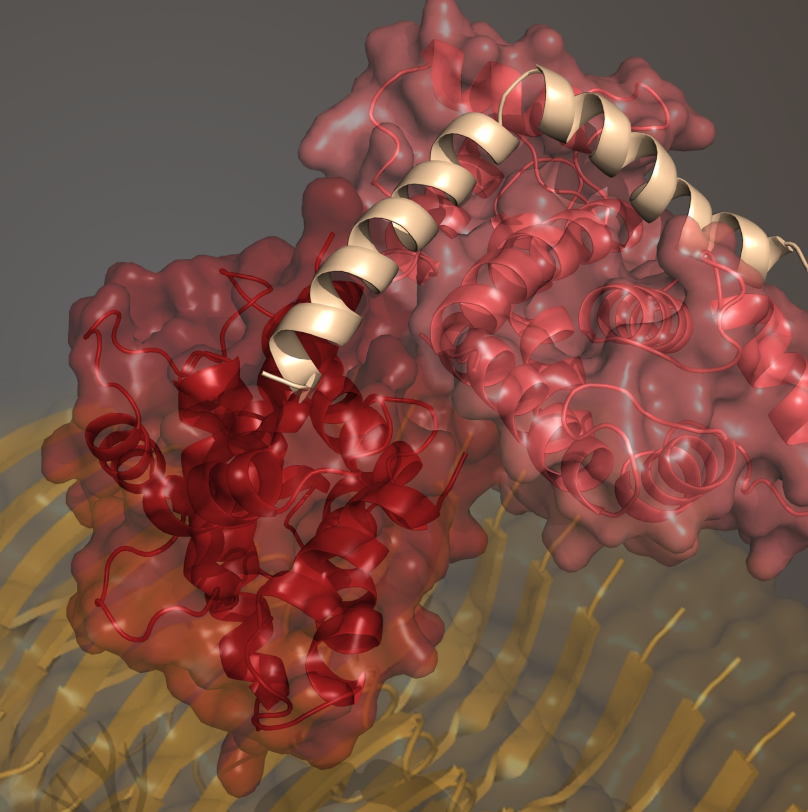
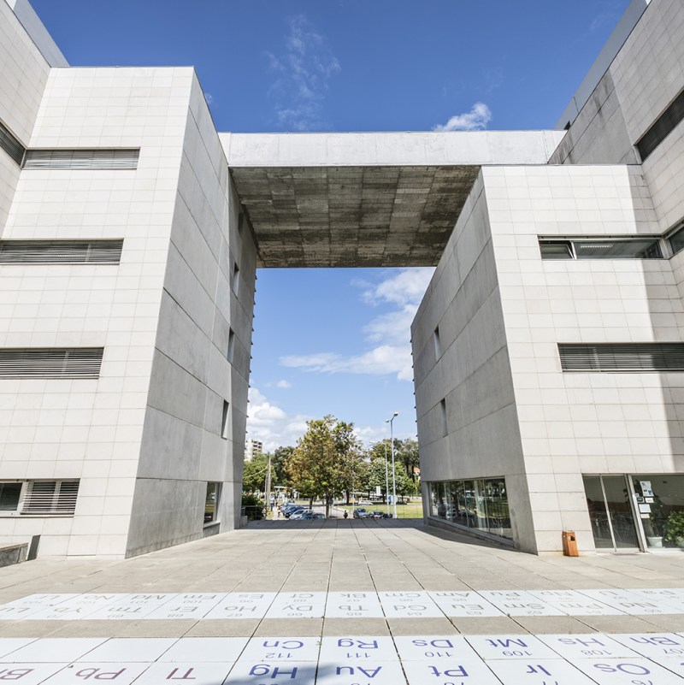
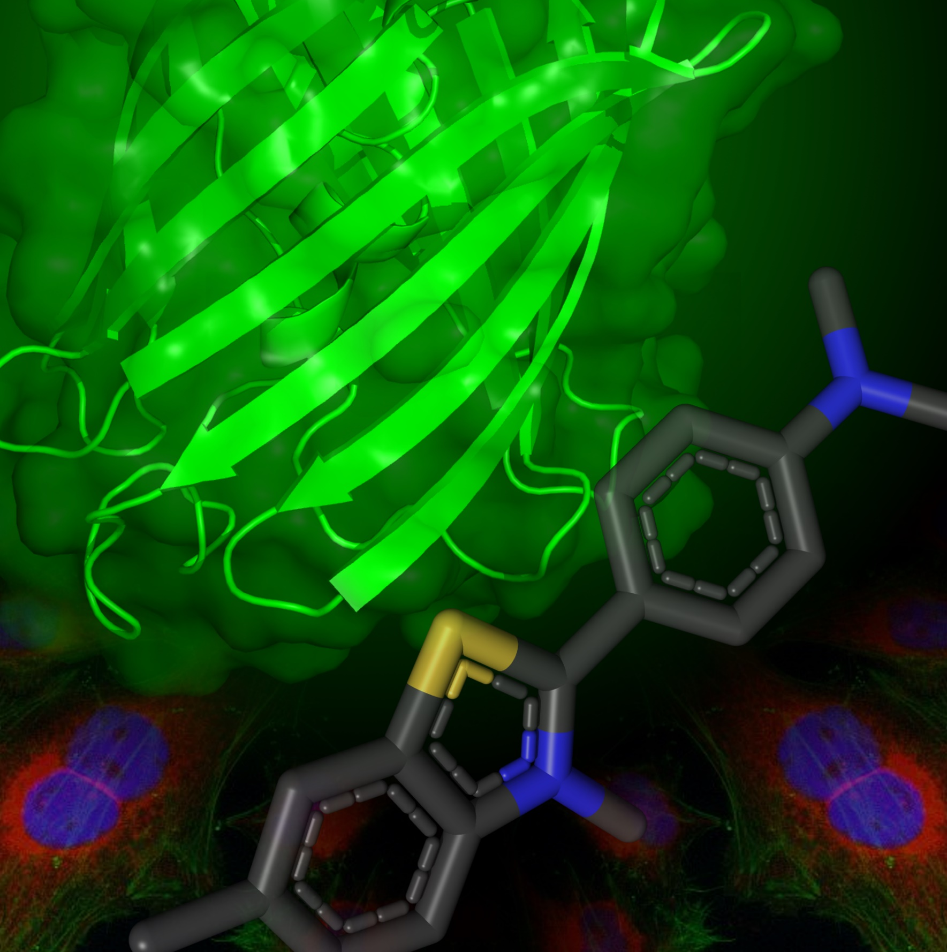



S100B multimers inhibit Aβ42 fibrils and oligomers involved in Alzheimer´s disease
António J. Figueira
PhD student in Biochemistry (Supervisor: Cláudio M. Gomes)
Protein Misfolding and Amyloids in Biomedicine Laboratory (BioISI)
Faculdade de Ciências | Universidade de Lisboa | Departamento de Química e Bioquímica

Slide 2
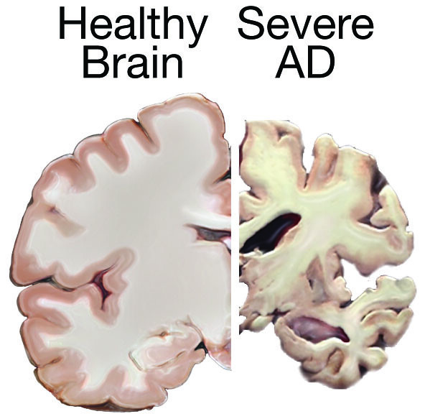
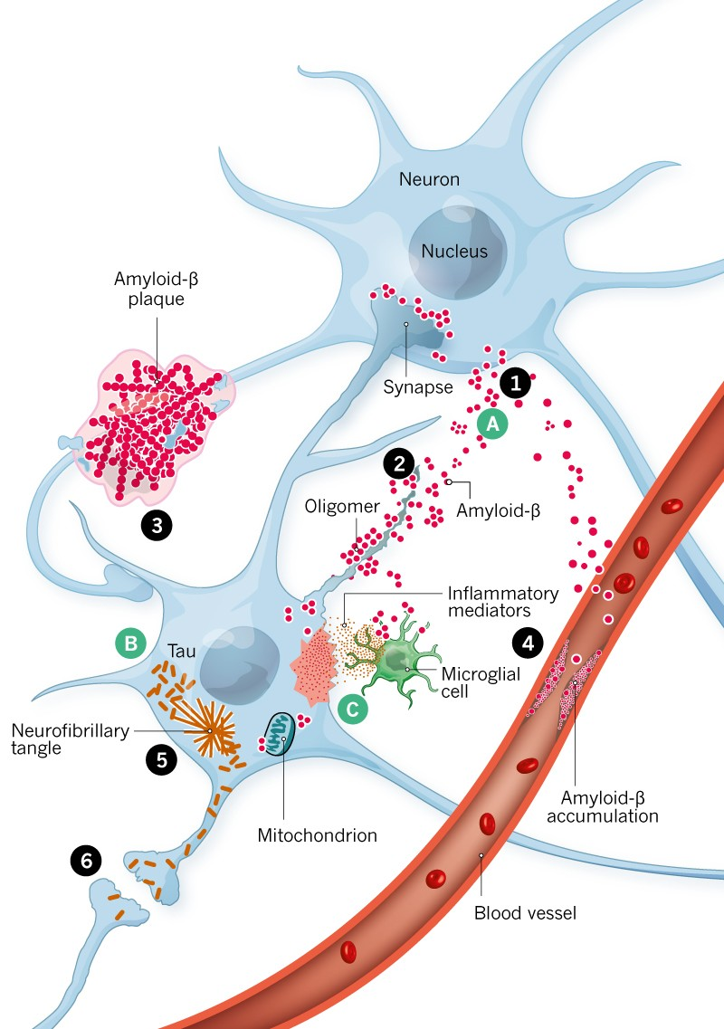
Alzheimer´s disease neurodegeneration

Slide 3
Alzheimer´s disease neurodegeneration
Drew L. An age-old story of dementia. Nature. 2018

Slide 4
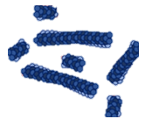
Alzheimer´s disease neurodegeneration
Amyloid-β (Aβ) aggregation
Drew L. An age-old story of dementia. Nature. 2018

Slide 5
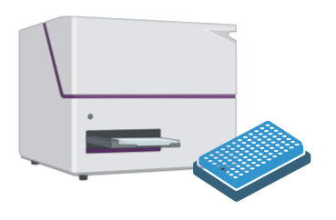
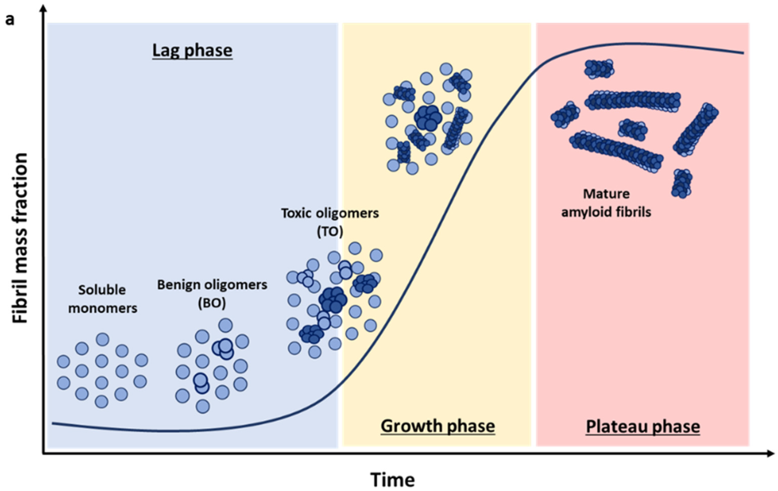
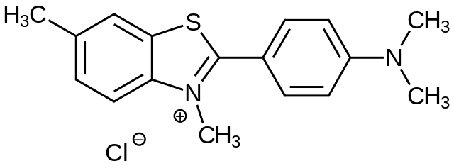


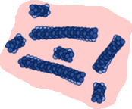

In vitro monitorization of amyloid-β (Aβ) aggregation
Amyloid fibrils can be monitored by the fluorescent dye Thioflavin-T (ThT)
Polanco D et al.. IJMS. (2022)

Slide 6

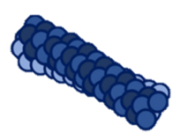


In vitro monitorization of amyloid-β (Aβ) aggregation
Amyloid fibrils can be monitored by the fluorescent dye Thioflavin-T (ThT)
Polanco D et al.. IJMS. (2022)

Slide 7
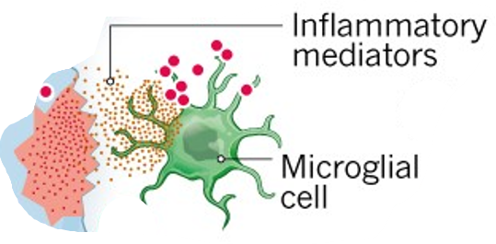
Alzheimer´s disease neurodegeneration
Drew L. An age-old story of dementia. Nature. 2018

Slide 8
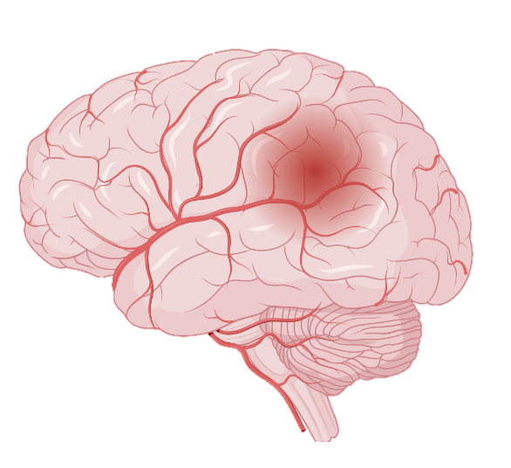
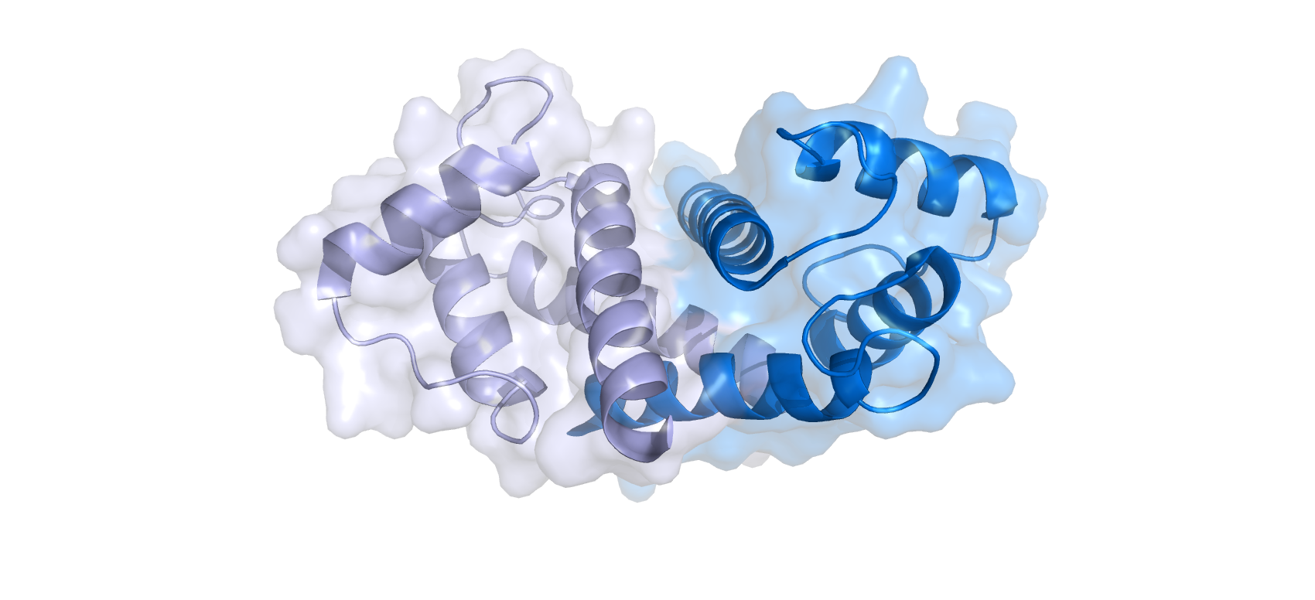
Alzheimer´s disease neurodegeneration
Neuroinflammatory response
Drew L. An age-old story of dementia. Nature. 2018

Slide 9
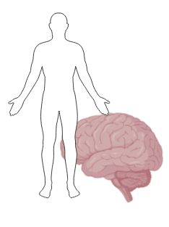
S100B protein
EF-hand Ca²⁺ binding protein
Dimeric protein (10.7 kDa per monomer)
Brain abundant (0.5%).
Multifunctional protein (intra and extracellular roles)
Aβ S100B Merge
Hagmeyer S, et al. Front Neurosci. (2019)

Slide 10
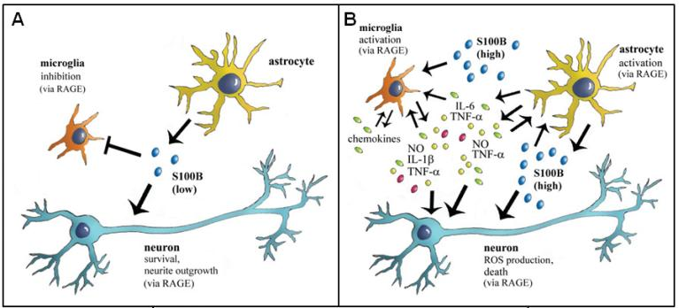
S100B neuroprotective and deleterious functions
S100B level
Aβ42 S100B Merge
Neurotrophic and neuroprotective functions
Pro-inflamatory mediator
Donato R, et al. Curr. Mol. Med. (2012)

Slide 11
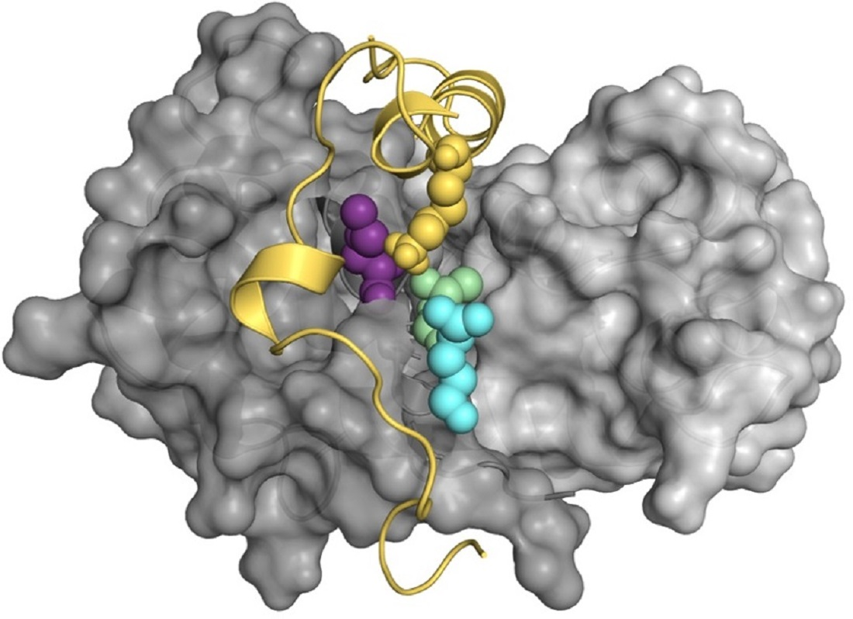
S100B-Ca²⁺ dimer inhibits Aβ42 aggregation
S100B delays Aβ42 aggregation
Aβ42 binding cleft exposed upon Ca²⁺ binding
Ca²⁺-S100B
Aβ42
S100B concentration
(super-stoichiometric)
Cristóvão JS et al. Sci Adv. (2018)
Rodrigues F et al. IJMS (2021)
Figueira, AJ et al. J. Mol. Biol. (2022)

Slide 12
S100B protein
EF-hand Ca²⁺ binding protein
Dimeric protein (10.7 kDa per monomer)
Brain abundant (0.5%).
Multifunctional protein (intra and extracellular roles)
Hagmeyer S, et al. Front Neurosci. (2019)

Slide 13
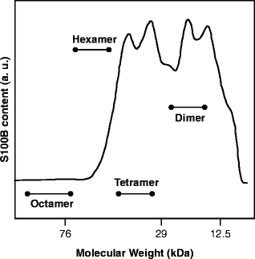
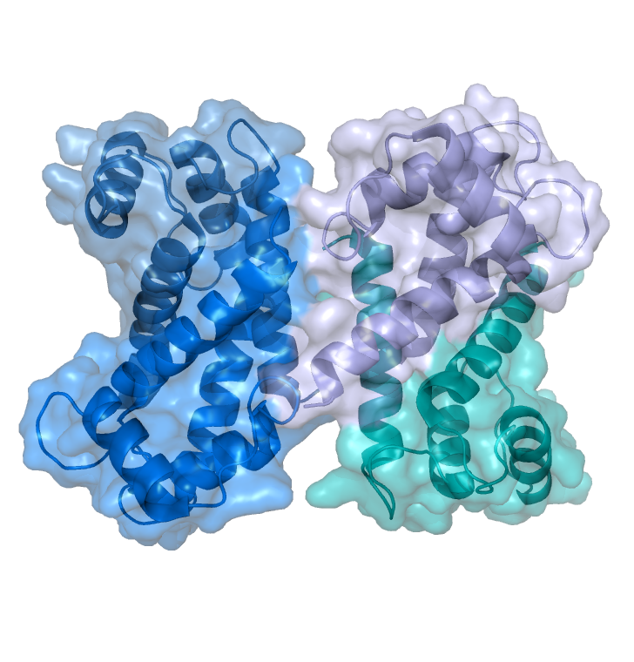
S100B multimers in the human brain
S100B forms non-covalent multimers in the human brain, mainly dimers and tetramers
S100B 2mer
S100B 4mer
Ostendorp T, et al. EMBO J. (2007)

Slide 14


S100B 2mer
S100B 4mer
Does tetrameric S100B inhibit Aβ42 aggregation?
Anti-Aβ42 aggregation?
Ca²⁺ dependent?
Ostendorp T, et al. EMBO J. (2007)

Slide 15
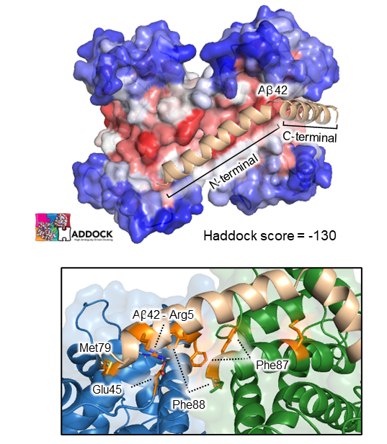
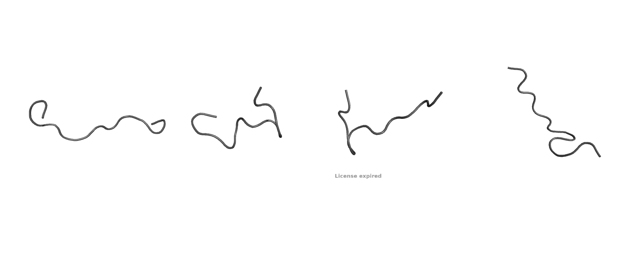
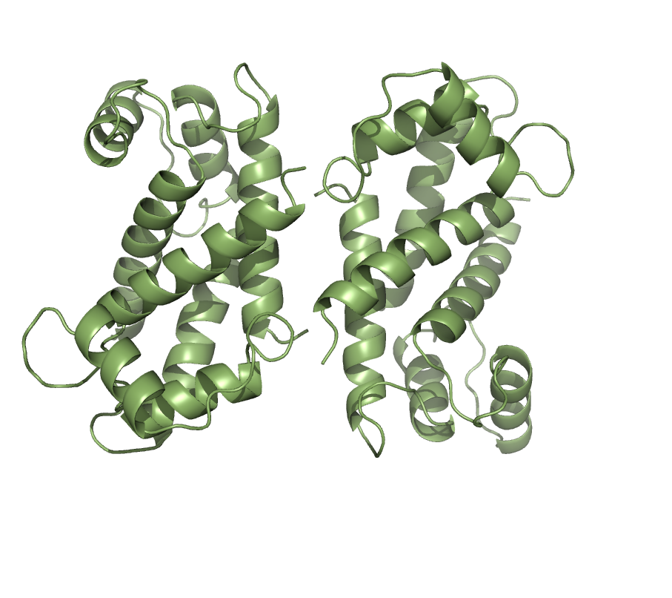
Tetrameric Apo-S100B interacts with Aβ42 via a secondary hydrophobic cleft
Soluble residues
  Far UV Circular Dichroism spectroscopy
Aβ42
Disordered Aβ42
S100B tetramer
Hydrophobic residues
S100B tetramer
Figueira, AJ et al. J. Mol. Biol. (2022)

Slide 16
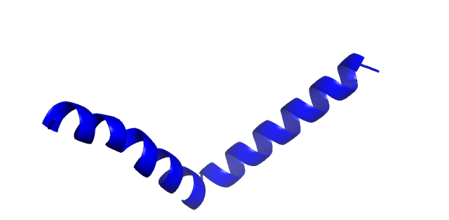
Tetrameric Apo-S100B interacts with Aβ42 via a secondary hydrophobic cleft
Soluble residues
  Far UV Circular Dichroism spectroscopy
Aβ42
Disordered Aβ42
S100B tetramer
Hydrophobic residues
S100B tetramer
Aβ42 + S100B tetramer
Helical Aβ42
Figueira, AJ et al. J. Mol. Biol. (2022)

Slide 17
Tetrameric Apo-S100B interacts with Aβ42 via a secondary hydrophobic cleft
and blocks its aggregation
Apo-S100B tetramer
Soluble residues
apo-S100B:Aβ42 ratio
Hydrophobic residues
Ca²⁺ independent effect
Figueira, AJ et al. J. Mol. Biol. (2022)

Slide 18
Tetrameric Apo-S100B interacts with Aβ42 via a secondary hydrophobic cleft
and blocks its aggregation
Apo-S100B tetramer
Apo-S100B dimer
apo-S100B:Aβ42 ratio
apo-S100B dimer
Figueira, AJ et al. J. Mol. Biol. (2022)

Slide 19
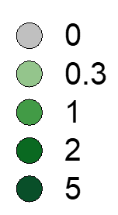
Apo-S100B vs Ca²⁺-S100B tetramer
anti-Aβ42 activity
Apo-S100B tetramer
Ca²⁺-S100B tetramer
apo-S100B:Aβ42 ratio
Ca²⁺-S100B:Aβ42 ratio
Figueira, AJ et al. J. Mol. Biol. (2022)

Slide 20
Apo-S100B vs Ca²⁺-S100B tetramer
anti-Aβ42 activity
Apo-S100B tetramer
Ca²⁺-S100B tetramer
Aβ42
apo-S100B:Aβ42 ratio
Ca²⁺-S100B:Aβ42 ratio
200 nm
Aβ42 + 5x. Ca²⁺-S100B tet.
100 nm
Figueira, AJ et al. J. Mol. Biol. (2022)

Slide 21
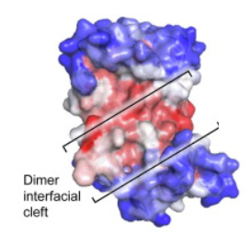
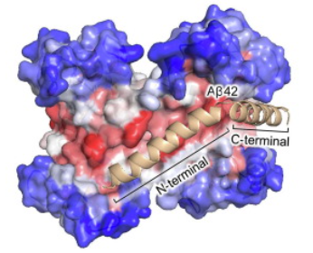
S100B 2mer
Ca²⁺ dependent activity
Effective but ‘lazy’ chaperone
(excess required)
Cristóvão JS et al. (2018) Science Advances
Do dimeric and tetrameric S100B block Aβ42 oligomers?
?
S100B 2mer
S100B 4mer
S100B 4mer
Combines Ca²⁺ dependent and independent activity
Highly efficient chaperone in the apo state at substoichiometric levels
Polanco D et al.. IJMS. (2022)
Figueira et al. (2022) J. Mol. Biol.

Slide 22
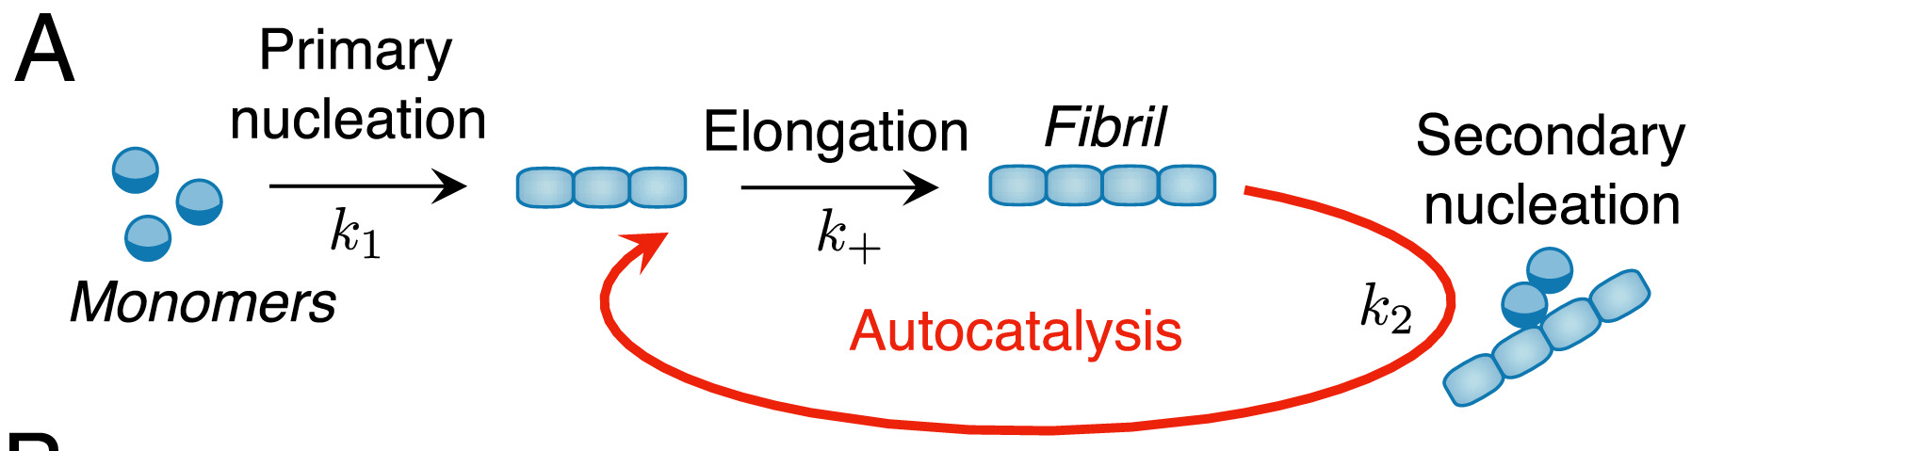
Aβ42 oligomer detection by kinetics analysis
Oligomer
Tornquist M et al. ChemComm. (2018)

Slide 23
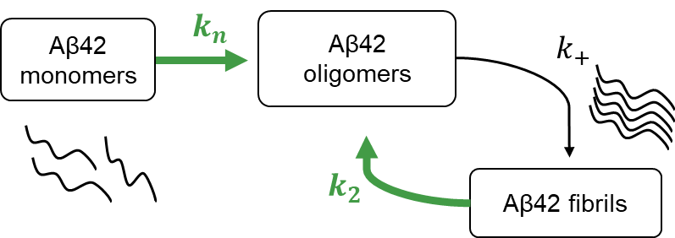
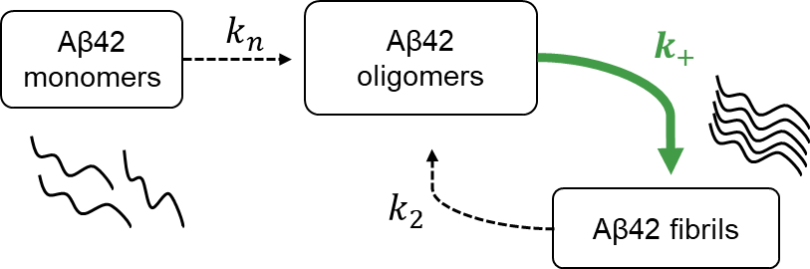
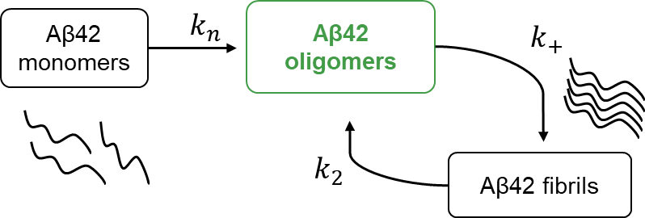
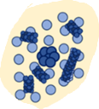
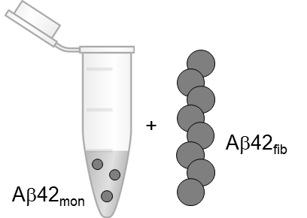
Aβ42 oligomer detection by kinetics analysis: S100B-Ca²⁺ dimer
Unseeded aggregation
Seeded aggregation
Reactive flux towards Aβ42 oligomers
Aβ42
Aβ42
+ S100B-Ca²⁺ dim.
Aβ42
+ S100B-Ca²⁺ dim.
+ S100B-Ca²⁺ dimer
Figueira, AJ et al. Front. Neurosci. (2023)

Slide 24
Aβ42 oligomer detection by kinetics analysis: Apo-S100B tetramer
Unseeded aggregation
Seeded aggregation
Reactive flux towards Aβ42 oligomers
Aβ42
Aβ42
+ Apo-S100B tetramer
Aβ42
+ Apo-S100B tetramer
+ Apo-S100B tetramer
Figueira, AJ et al. Front. Neurosci. (2023)

Slide 25
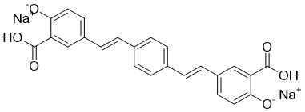
Aβ42 oligomer detection by fluoresence analysis
X-34 fluorophore
ThT fluorophore Detects fibrils
Oligomer
Figueira, AJ et al. Front. Neurosci. (2023)
Polanco D et al.. IJMS. (2022)

Slide 26
Aβ42 oligomer detection by fluoresence analysis
X-34 fluorophore
Detects fibrils
ThT fluorophore Detects fibrils
Oligomer
Figueira, AJ et al. Front. Neurosci. (2023)
Polanco D et al.. IJMS. (2022)

Slide 27
Aβ42 oligomer detection by fluoresence analysis
X-34 fluorophore
Detects fibrils + oligomers
ThT fluorophore Detects fibrils
Oligomer
Figueira, AJ et al. Front. Neurosci. (2023)
Polanco D et al.. IJMS. (2022)

Slide 28

Aβ42 oligomer detection by fluoresence analysis
X-34 fluorophore
X-34 $−$ ThT fluorescence
Detects fibrils + oligomers
X-34
ThT
Oligomer
Figueira, AJ et al. Front. Neurosci. (2023)
Polanco D et al.. IJMS. (2022)

Slide 29
Aβ42 oligomer detection by fluoresence analysis
X-34 fluorophore
X-34 $−$ ThT fluorescence
Kinetic analysis
Detects fibrils + oligomers
X-34
ThT
Oligomer
X-34 positive oligomers are correlated with kinetic analysis
Figueira, AJ et al. Front. Neurosci. (2023)
Polanco D et al.. IJMS. (2022)

Slide 30
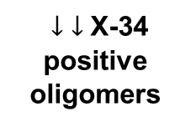
Aβ42 oligomer detection by fluoresence analysis
ThT
Apo-S100B tetramer
Aβ42
Aβ42
+ Apo-S100B tetramer
+ Apo-S100B tetramer
Aβ42
+ Apo-S100B tetramer
$↓$ $↓$X-34 positive
oligomers
X-34
Figueira, AJ et al. Front. Neurosci. (2023)

Slide 31
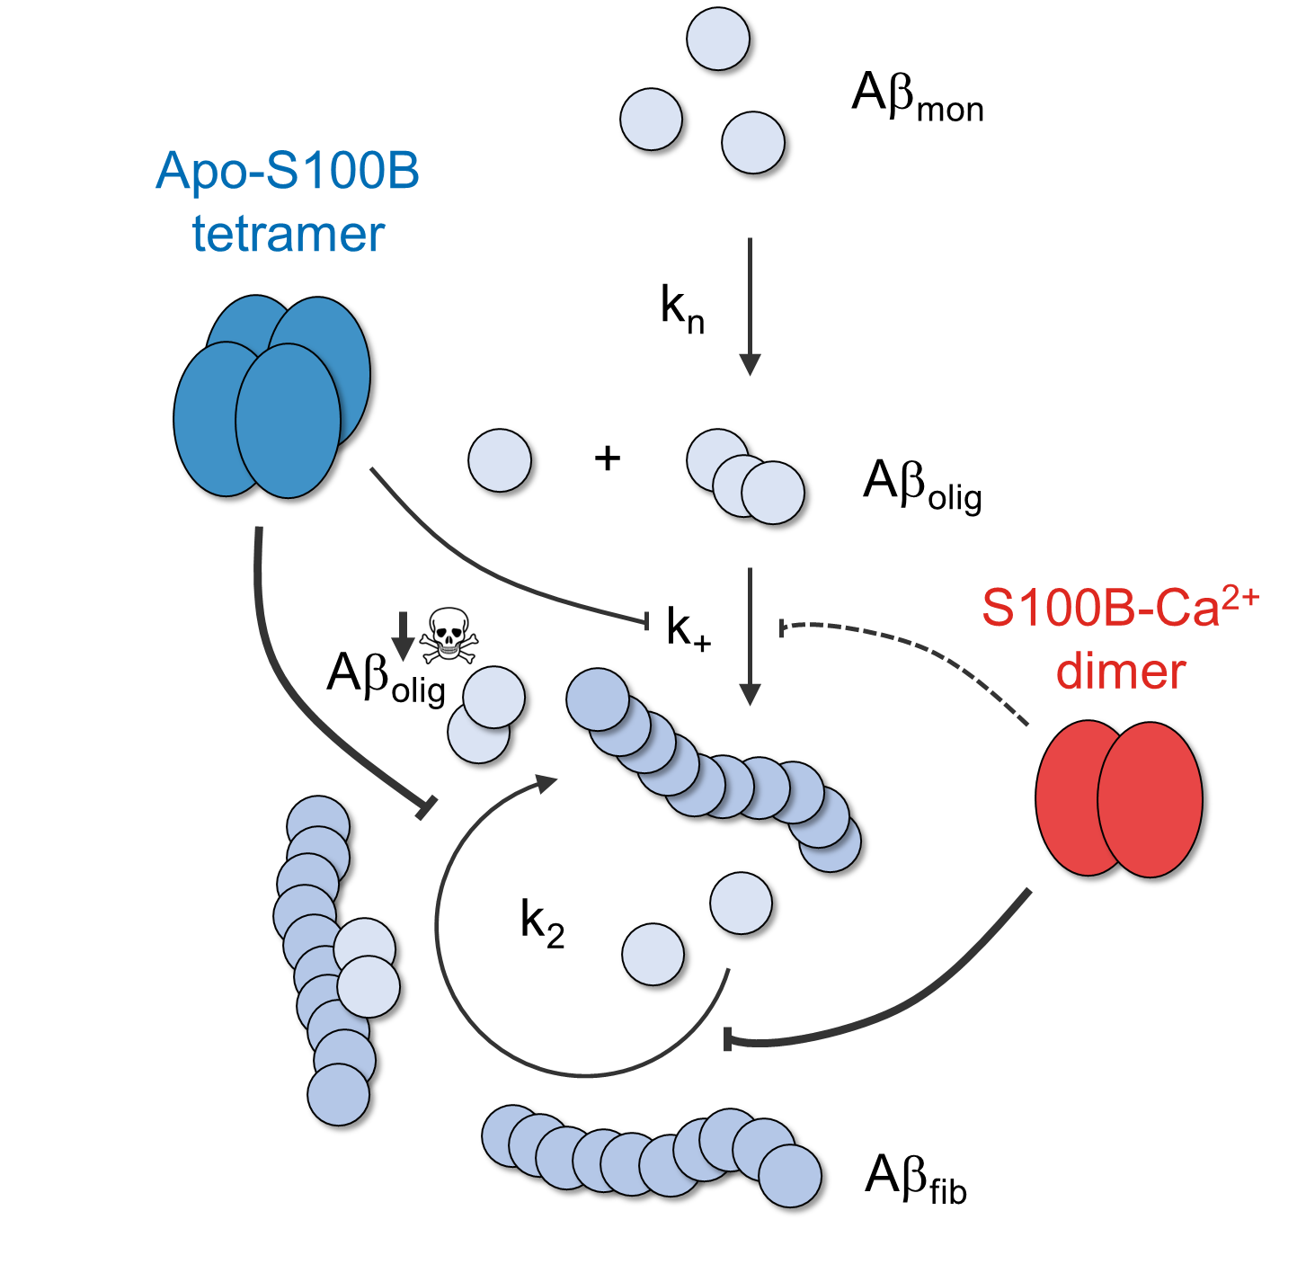




S100B tetramer binds Aβ42 and blocks its aggregation (Ca²⁺ independent + dependent effects)
S100B dimer and tetramer block Aβ42 neurotoxic oligomerization.
Figueira, AJ et al. Front. Neurosci. (2023)
Figueira, AJ et al. J. Mol. Biol. (2022)

Slide 32
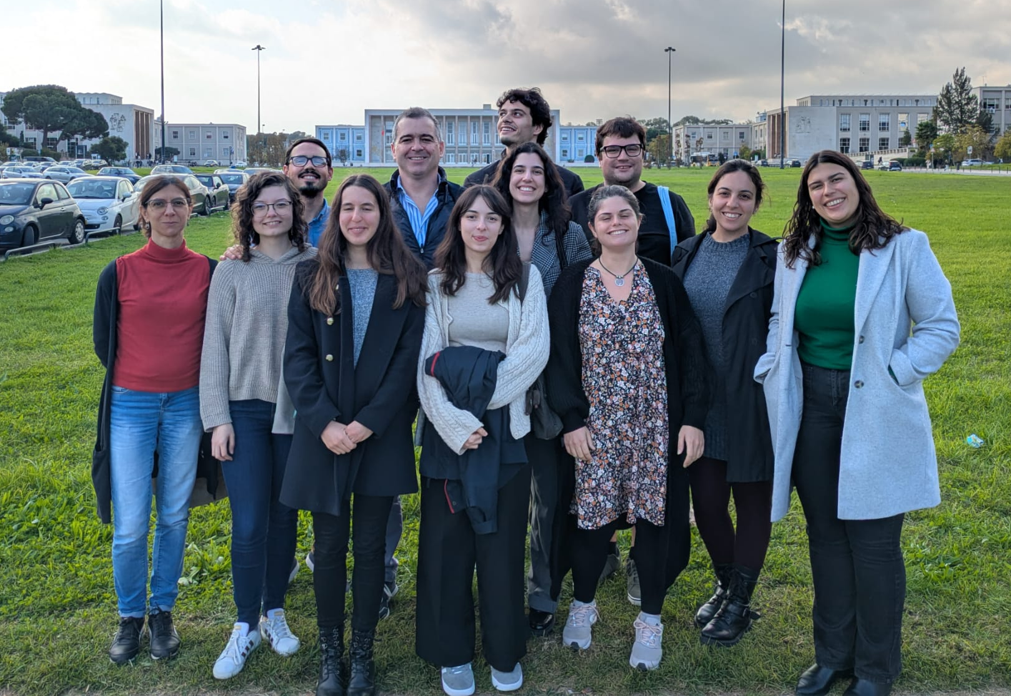


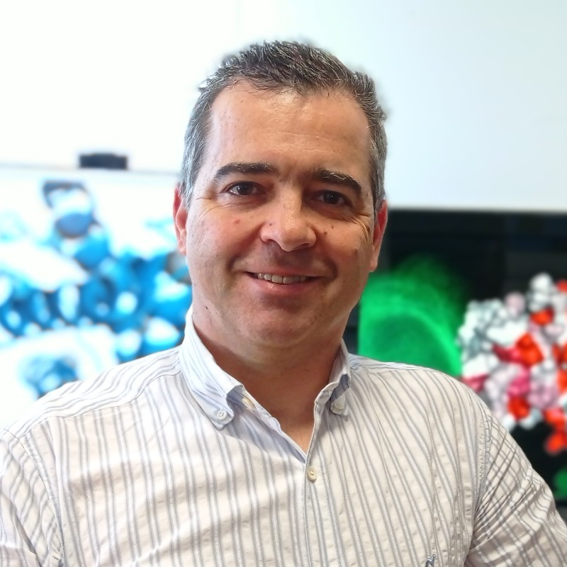


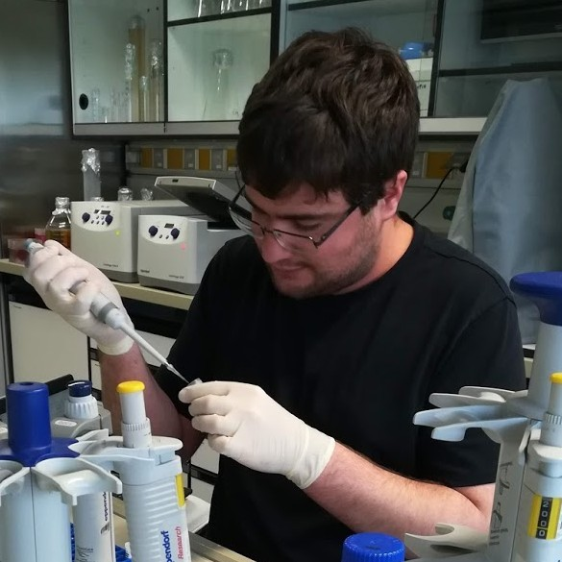












Acknowledgements
Protein Misfolding and Amyloids in Biomedicine Laboratory
Cláudio M. Gomes, Group leader and Supervisor
Bárbara Henriques, Principal investigator
Guilherme G. Moreira, PhD student
António J. Figueira, PhD student
Margarida C. Simões, PhD student
Joana Ribeiro, PhD student
Inês Ventura, PhD student
Daniela P. Freitas, PhD student
Mariana Santos, MSc intern
Ruy Domingos, MSc student
Carolina Silva, MSc student
Molecular Neurobiology Laboratory (UPorto)
Thesis committee
Isabel Cardoso, Associate researcher
Joana Saavedra, PhD student
Michele Vendruscolo, University of Cambridge
Miguel Machuqueiro, FCiências Universidade de Lisboa

