Slide 1


Gaussian Expansion Method for Few-Body States in 2D Materials
Pan-American Few-Body Physics Boot Camp: Fostering Collaboration
Presenter: Luiz Tenorio (PhD Student)
Advisors:
Emiko Hiyama (Tohoku University / Riken)
Tobias Frederico (ITA)
Emails:
luiztenorio@fisica.ufmt.br
mendonca.tenorio.luiz.gustavo.p5@dc.tohoku.ac.jp

Slide 2
Objectives:
To give a small introduction to two- and three- systems in the field of semiconductor physics;
Discuss some of the unique stuff that arises from the fact that we are dealing with 2D materials;
Propose some problems to generate some discussions;

Slide 3
Introduction

Slide 4
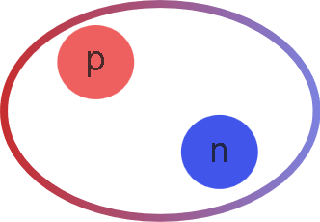
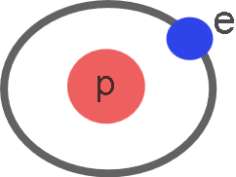
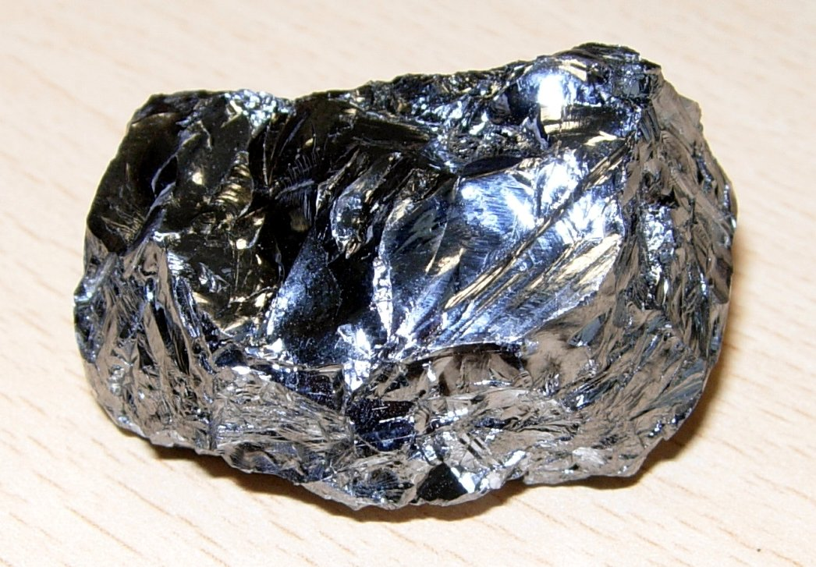
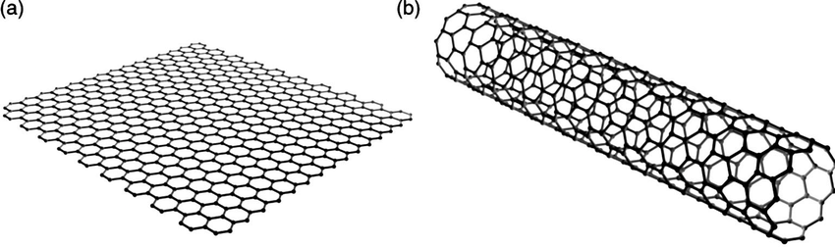
Why 2D?
Historically, we were mainly thinking about 3D systems;
Deuteron
Hydrogen Atom
Silicon Crystal
However, there has been a surge of interest in low dimensional quantum problems in condensed matter physics due to the discovery of graphene;

Slide 5
Electrons and Holes
Here, we will discuss few-body correlations formed in semiconductors due to processes involving external light beams;
These correlations are composed of electrons and holes;
The electron is already very familiar to most people; however, holes is a different matter.

Slide 6
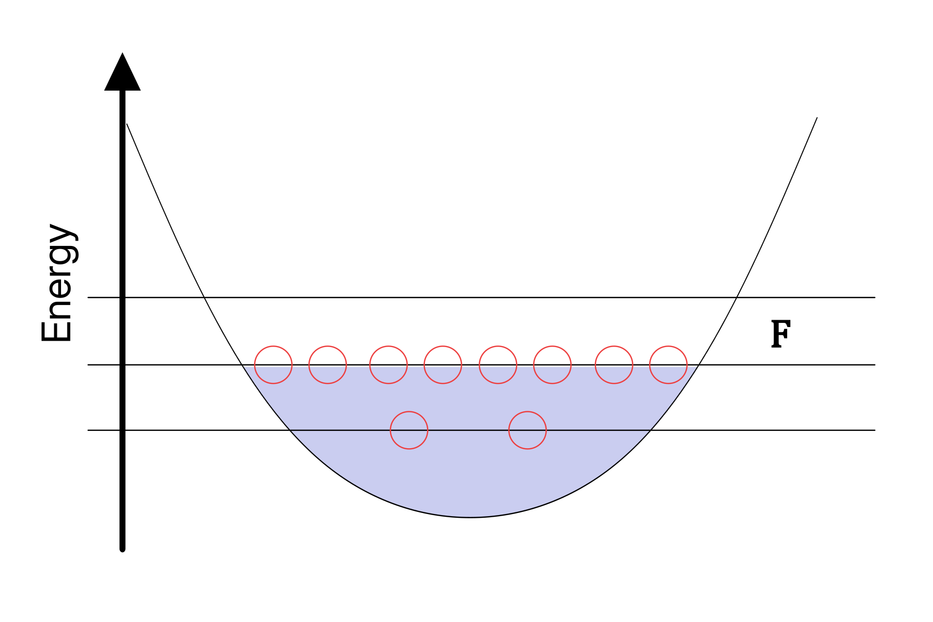
Electrons and Holes
Here, we will discuss few-body correlations formed in semiconductors due to processes involving external light beams;
These correlations are composed of electrons and holes;
The electron is already very familiar to most people; however, holes is a different matter.
To aid our understanding, consider an analogy with the Shell Model. In the shell model, a stable nuclei has nucleons occupying states up to some energy level F.

Slide 7
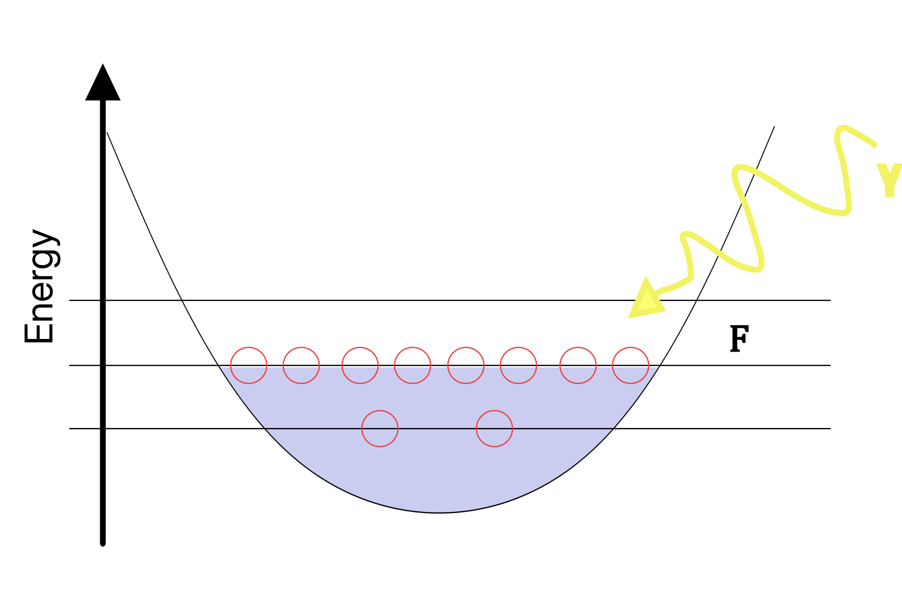
Electrons and Holes
Here, we will discuss few-body correlations formed in semiconductors due to processes involving external light beams;
These correlations are composed of electrons and holes;
The electron is already very familiar to most people; however, holes is a different matter.
Suppose now we excite the nuclei with some gamma radiation;

Slide 8
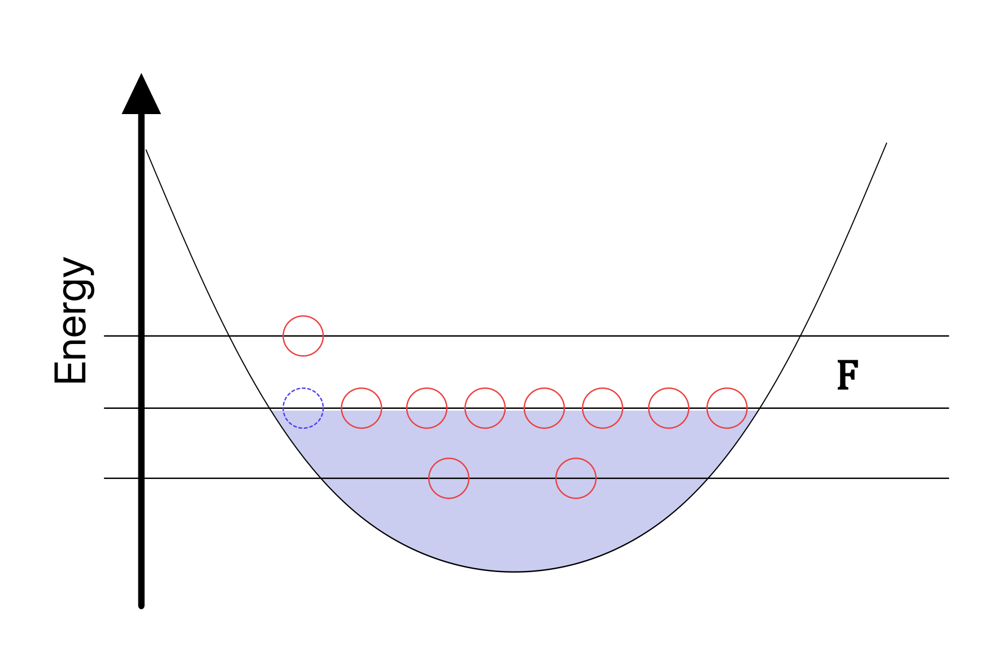
Electrons and Holes
Here, we will discuss few-body correlations formed in semiconductors due to processes involving external light beams;
These correlations are composed of electrons and holes;
The electron is already very familiar to most people; however, holes is a different matter.
The gamma radiation will push a nucleon into the other level. This leaves a vacancy which we call a hole which has residual interaction with the remained of the system;
Holes in semiconductors, behave very differently!
It’s a positively charged quasiparticle;
It propagates throughout the semiconductor and is experimentally manipulable;
It interacts with electrons by coulomb interaction
hole

Slide 9
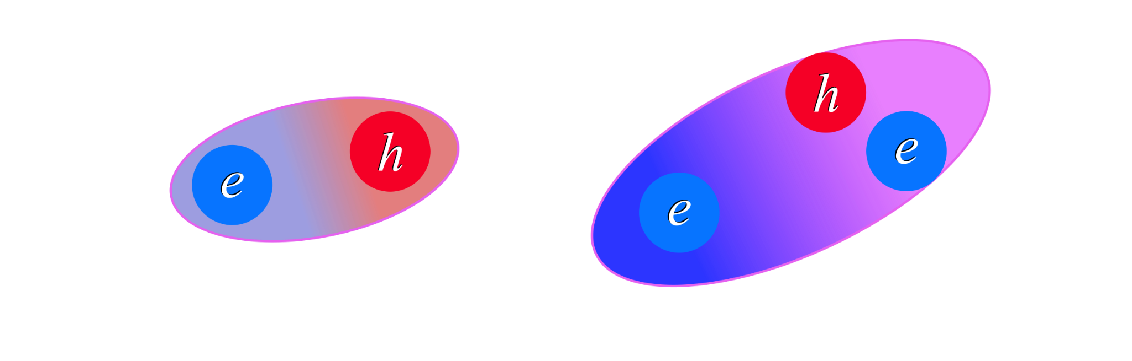
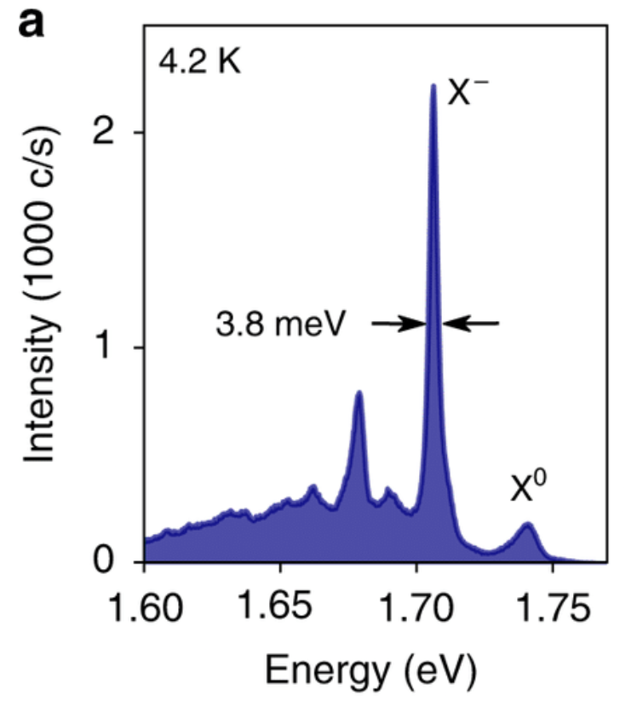
Electrons and Holes
MoS₂
Exciton, X⁰
Trion, X⁻
Electron and holes interacts and form bound-state with electrons in the material, through coulomb interactions;
The exciton and trion are very relevant for the description of how light interacts with semiconductors;
Takeaway
Future optoelectronics relies on understanding the spectrum of few-body correlations in 2D materials;

Slide 10
Excitons and Trions in a Single Layer

Slide 11
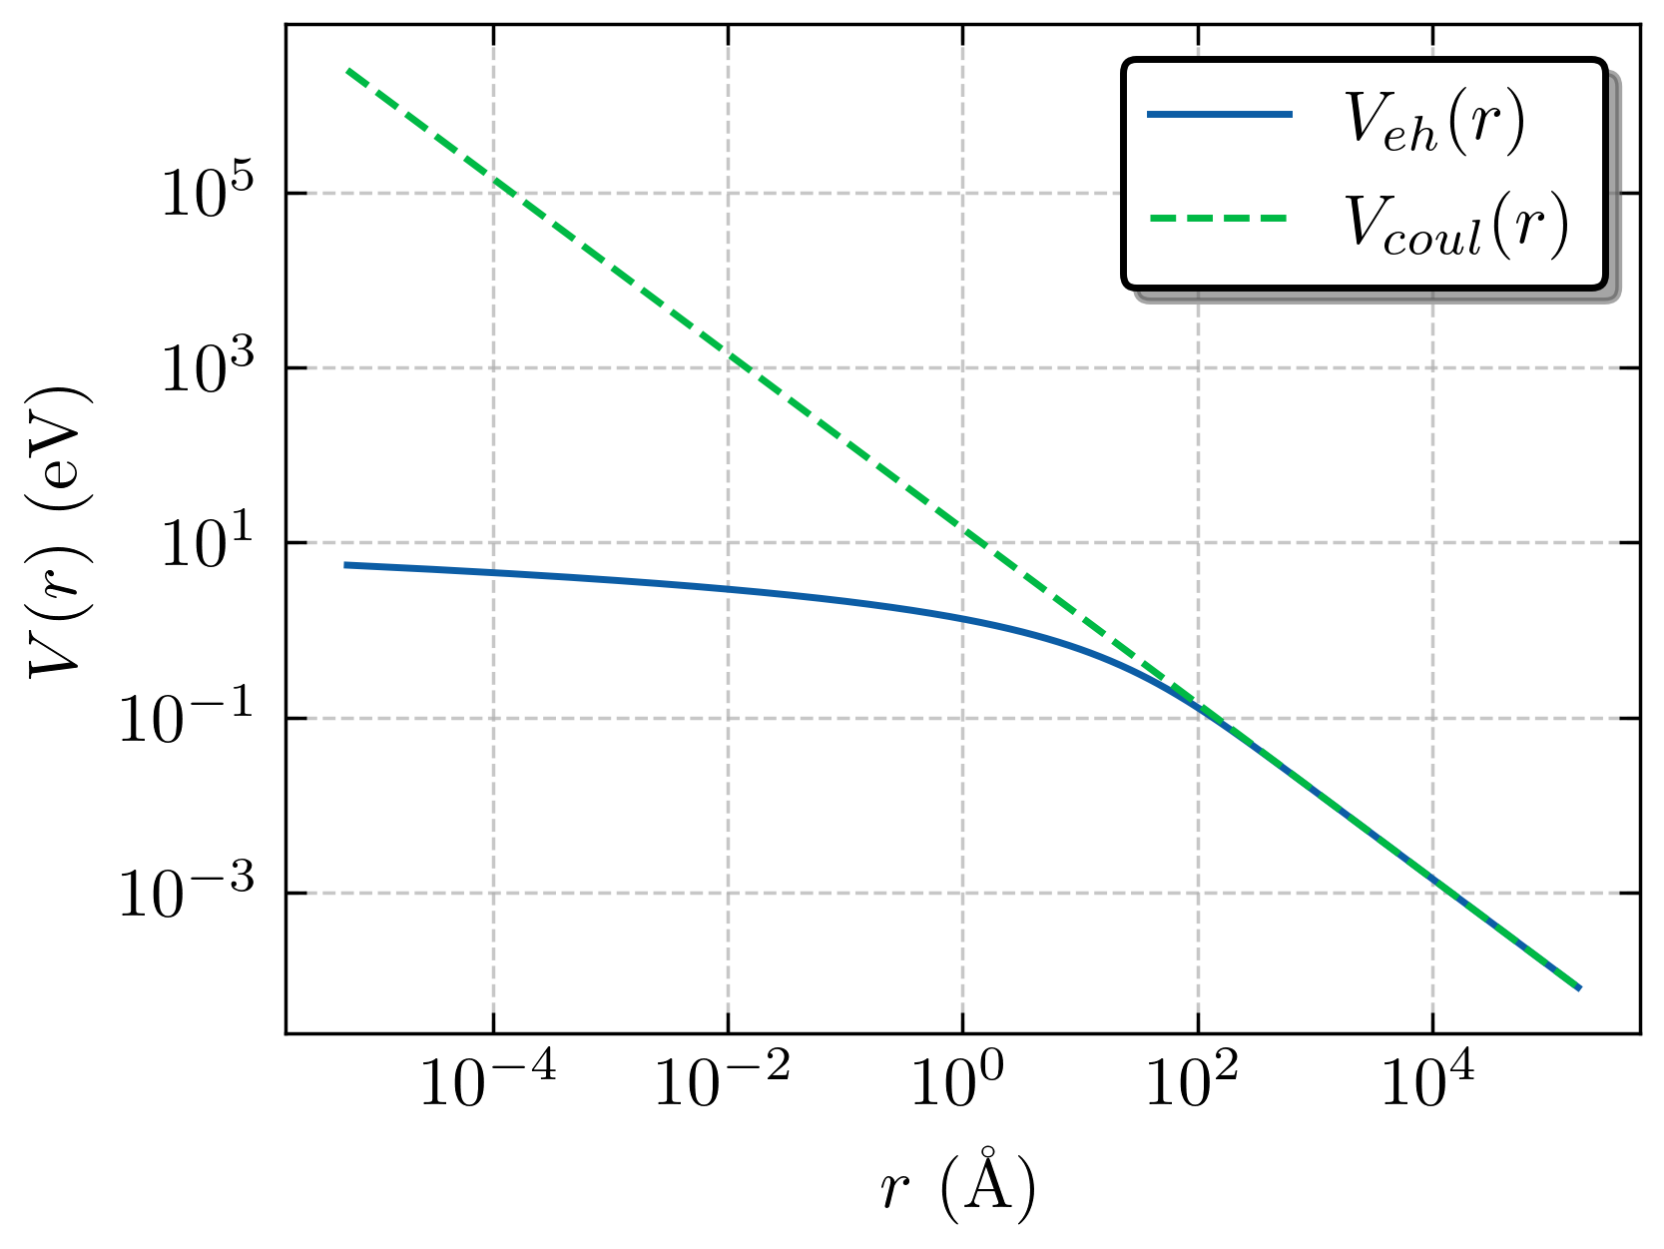
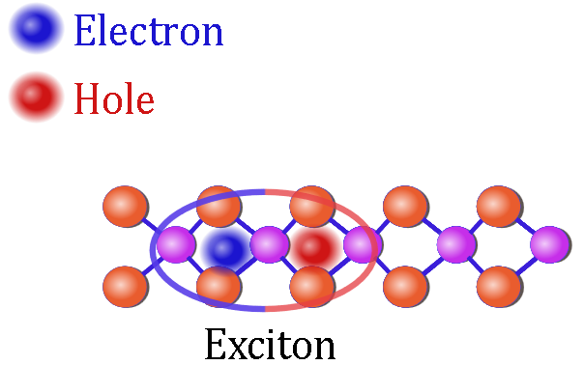
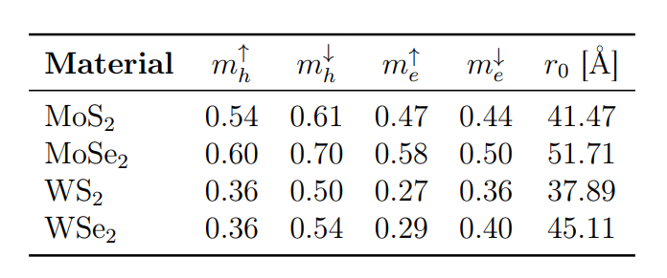
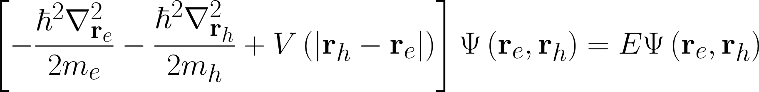
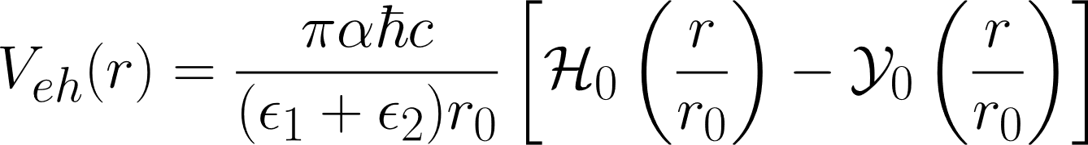
The Exciton (Effective Mass Approach)

Slide 12
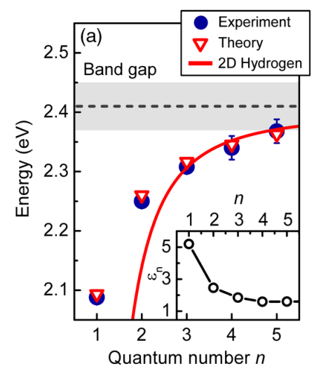
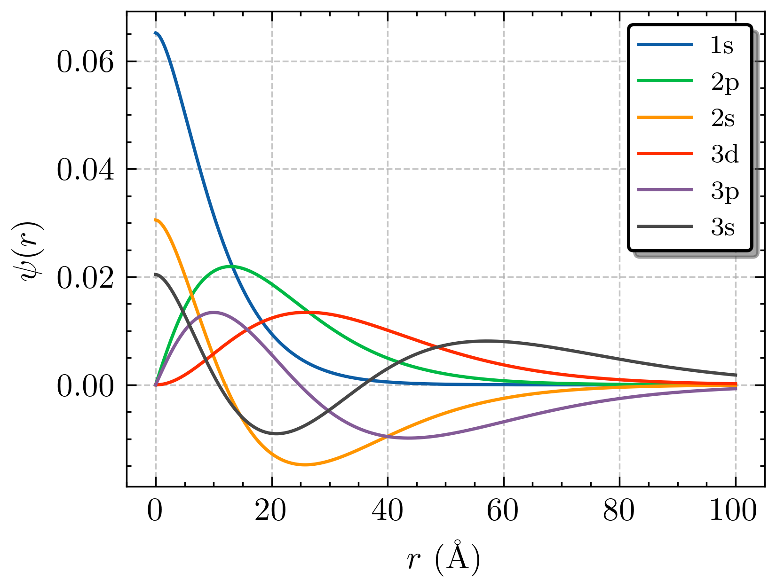
The Exciton (Effective Mass Approach)
Our calc. | Ref.
2.091 eV | 2.09 eV
2.258 eV | 2.25 eV
2.315 eV | 2.31 eV
2.344 eV | 2.34 eV
2.363 eV | 2.37 eV
Ref: PRL 113, 076802 (2014)

Slide 13
The Exciton (Effective Mass Approach)
Our calc. | Ref.
2.091 eV | 2.09 eV
2.258 eV | 2.25 eV
2.315 eV | 2.31 eV
2.344 eV | 2.34 eV
2.363 eV | 2.37 eV
Typical wavefunction structure of the hydrogen atom, with the size modulated by the parameter r₀ ;
For low quantum numbers, the spectrum of absorption shows a nonhydrogenic Rydberg series;
The clear message for this situation is that we have some coulomb-like system which has some different behavior at short-range which in turn is commanded by the r₀ parameter that is related to the polarizability of the medium;
Ref: PRL 113, 076802 (2014)

Slide 14
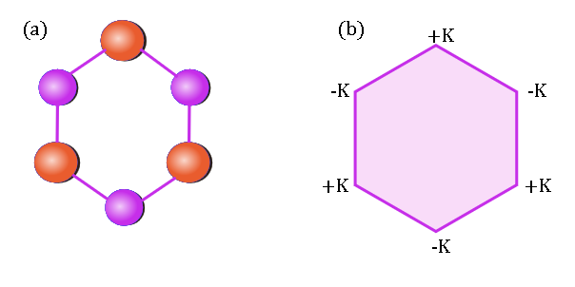
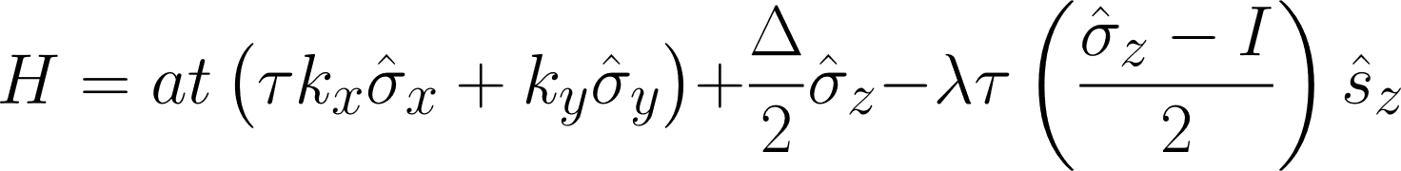
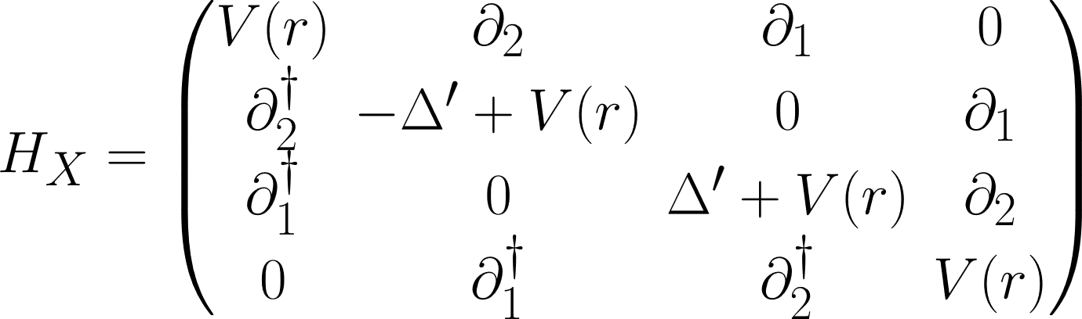

The Exciton (The “Dirac” Equation)
Due to the non-equivalent high symmetry points +K and –K, a new quantum label called “valley” arises;
Effectively, it is a pseudospin which assume +1 and -1 states;
However, here we will simply treat it as +1,-1 parameter to simplify things;
One of the neat things is that due to selection rules (different light polarization will select different valleys), the spins are “locked” by the valley degrees of freedom, and the exciton is formed by a pair of equal spin configuration of particles;
An interesting challenge Is trying to think how one can self-consistently separate the COM from the relative motion (this is open);
What are the difficulties to do so?
Foldy-Wouthuysen expansions have already been applied in this context;
Also, if you are brave enough, think about the three-body problem in this context;

Slide 15
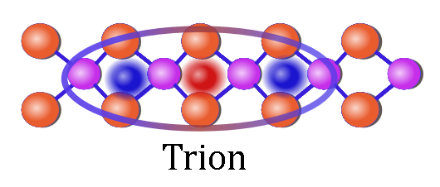
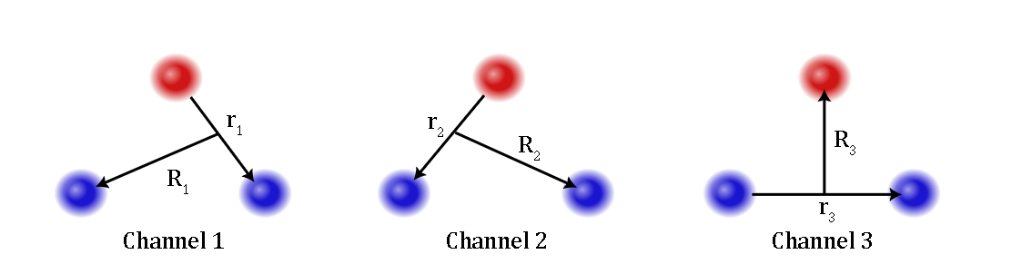
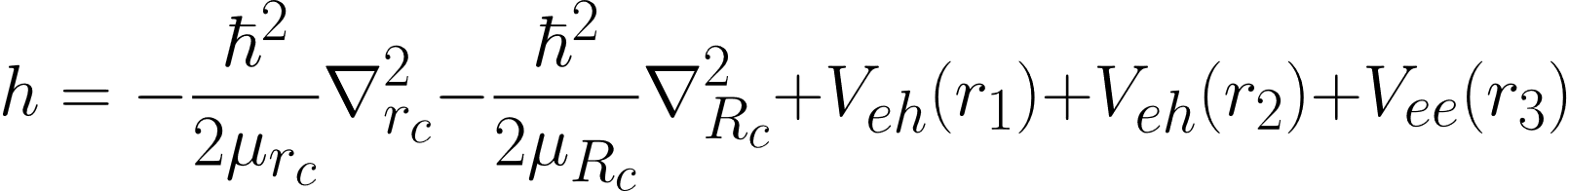

The Trion
It is a three-body problem;
Two attractive and one repulsive interaction;
If you want an atomic physics analogue, thing about the positronium ion;
Now we must solve this problem. To explain the solution approach that I have been using, we will make a small detour;

Slide 16
Interlude: The Gaussian Expansion Method

Slide 17
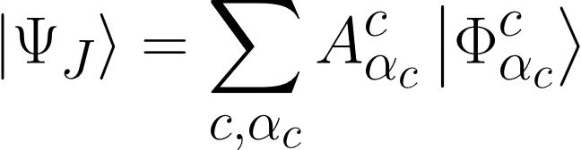
The Basics of the Method

Slide 18
The Basics of the Method

Slide 19
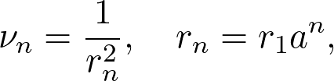
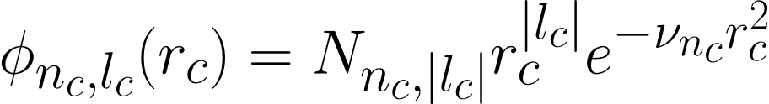
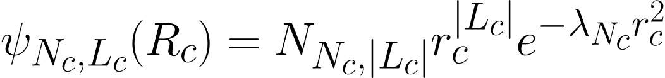
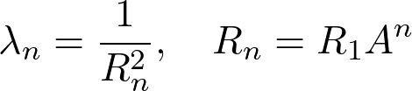
The Basics of the Method

Slide 20
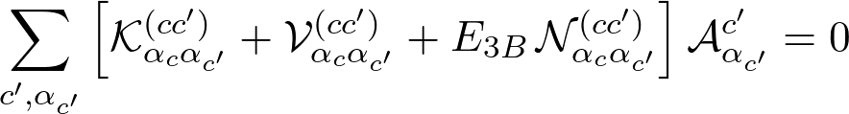
The Basics of the Method

Slide 21
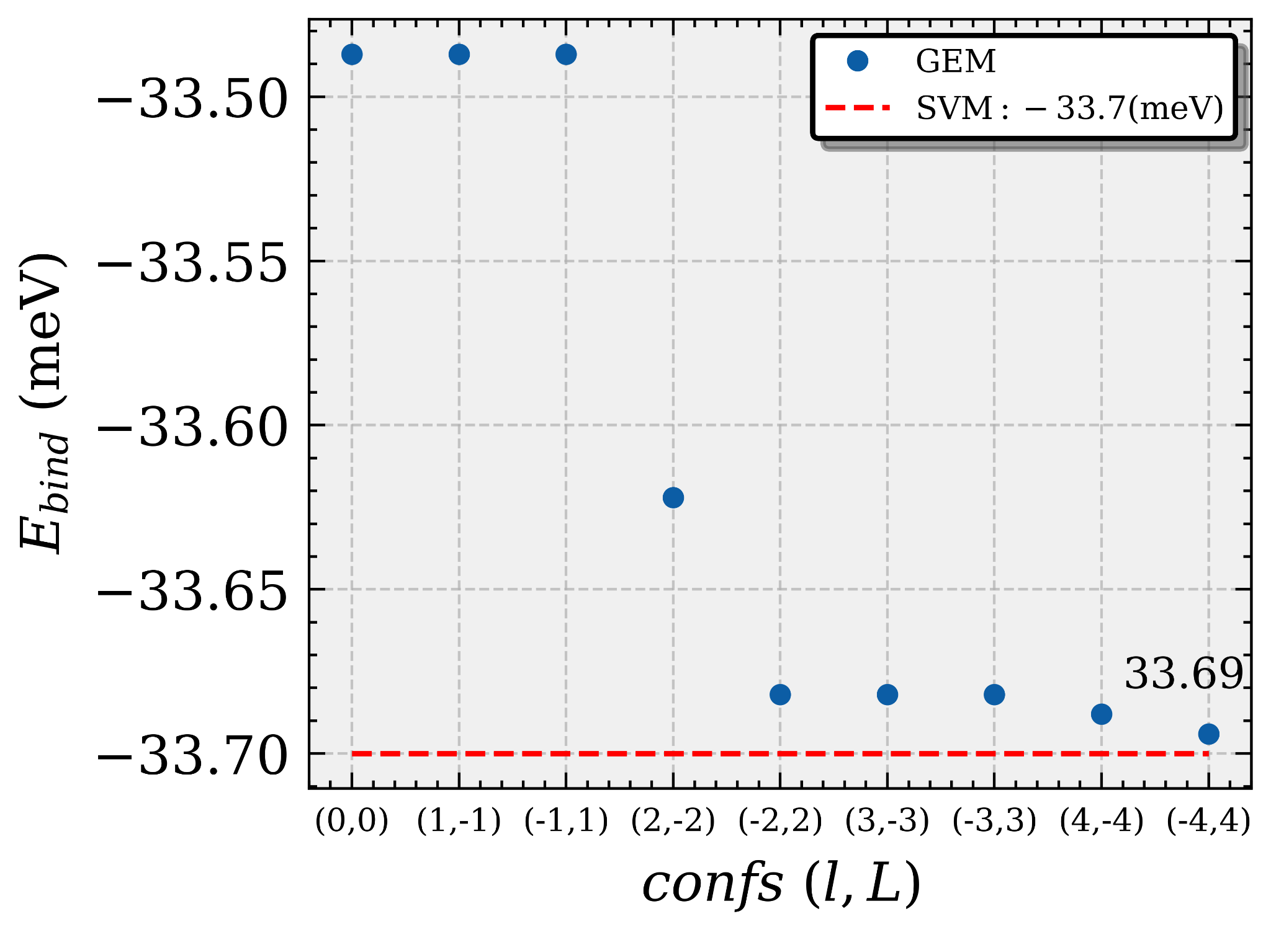
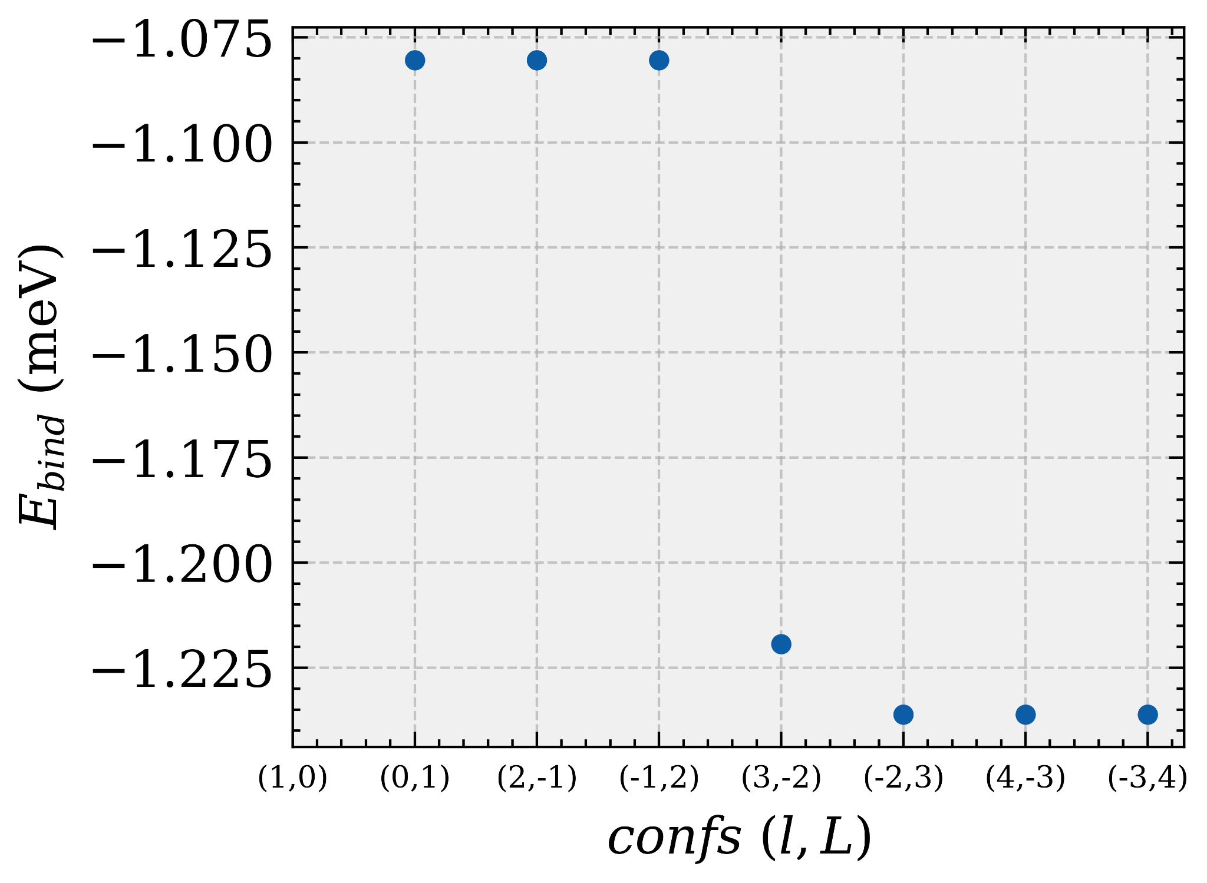
Some convergence of the Three-body Binding Energy;
E_{bind} = E_{3B} - E_{2B}

Slide 22
Back to the Main Event

Slide 23
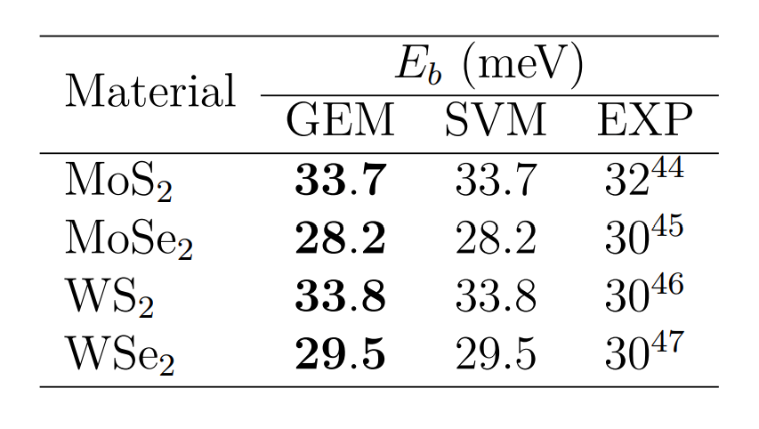
Trion Results
J = 0 (One bound state)

Slide 24
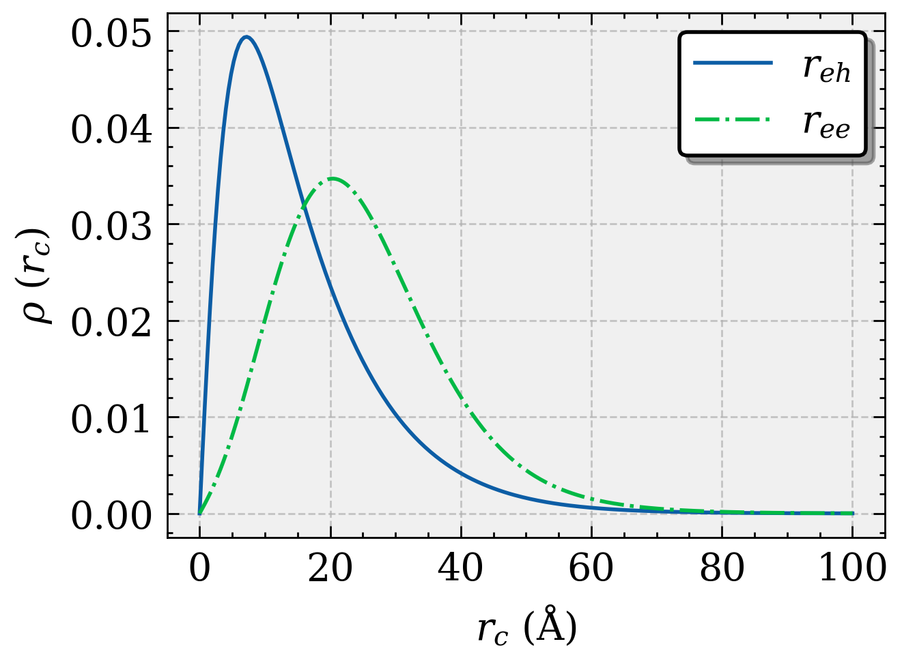
Trion Results
J = 0 (One bound state)

Slide 25
Trion Results
J = 0 (One bound state)
In principle, not too eventful;
We have a single J=0 bound-state which agrees with other methods;
The density distribution has the features;
  The electron-hole pair is close together;
  The other electron is spectating the pair;
  The hole acts as the binding vessel of the two electrons

Slide 26
Trion Results
J = 0 (One bound state)
In principle, not too eventful;
We have a single J=0 bound-state which agrees with other methods;
The density distribution has the features;
  The electron-hole pair is close together;
  The other electron is spectating the pair;
  The hole acts as the binding vessel of the two electrons
We can further examine its structure by looking at its geometry!

Slide 27
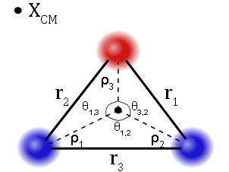
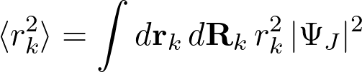
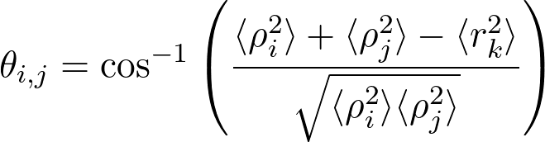
Trion Geometry
To study its geometry, we will employ some basic geometry and use the following equations;

Slide 28
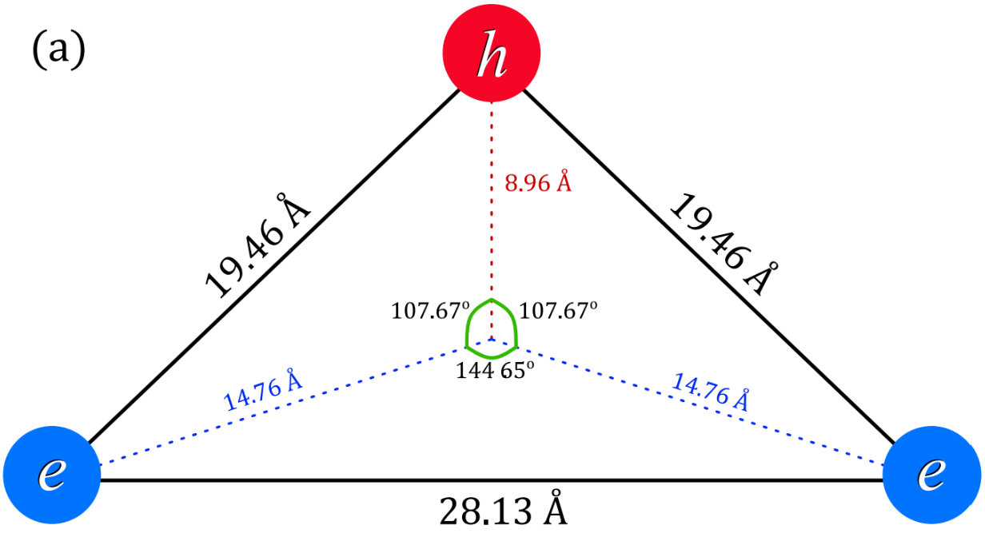
Trion Geometry

Slide 29
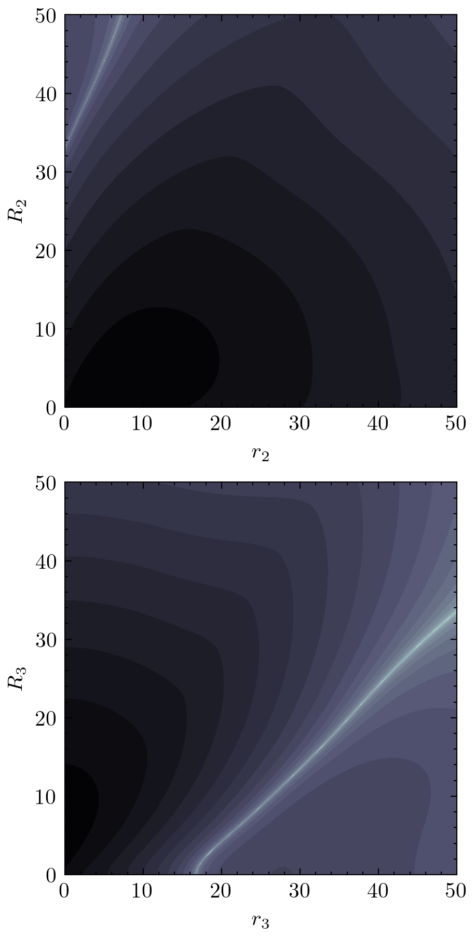
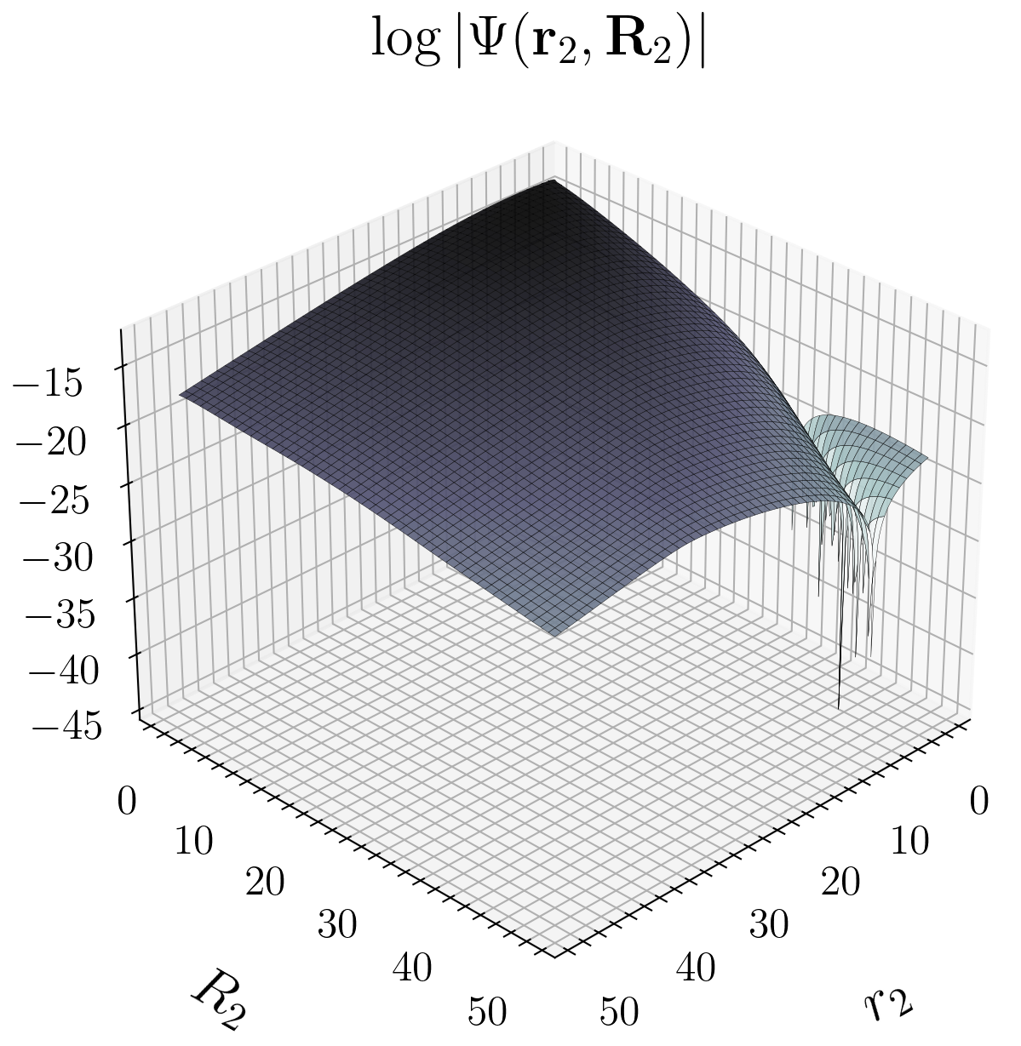
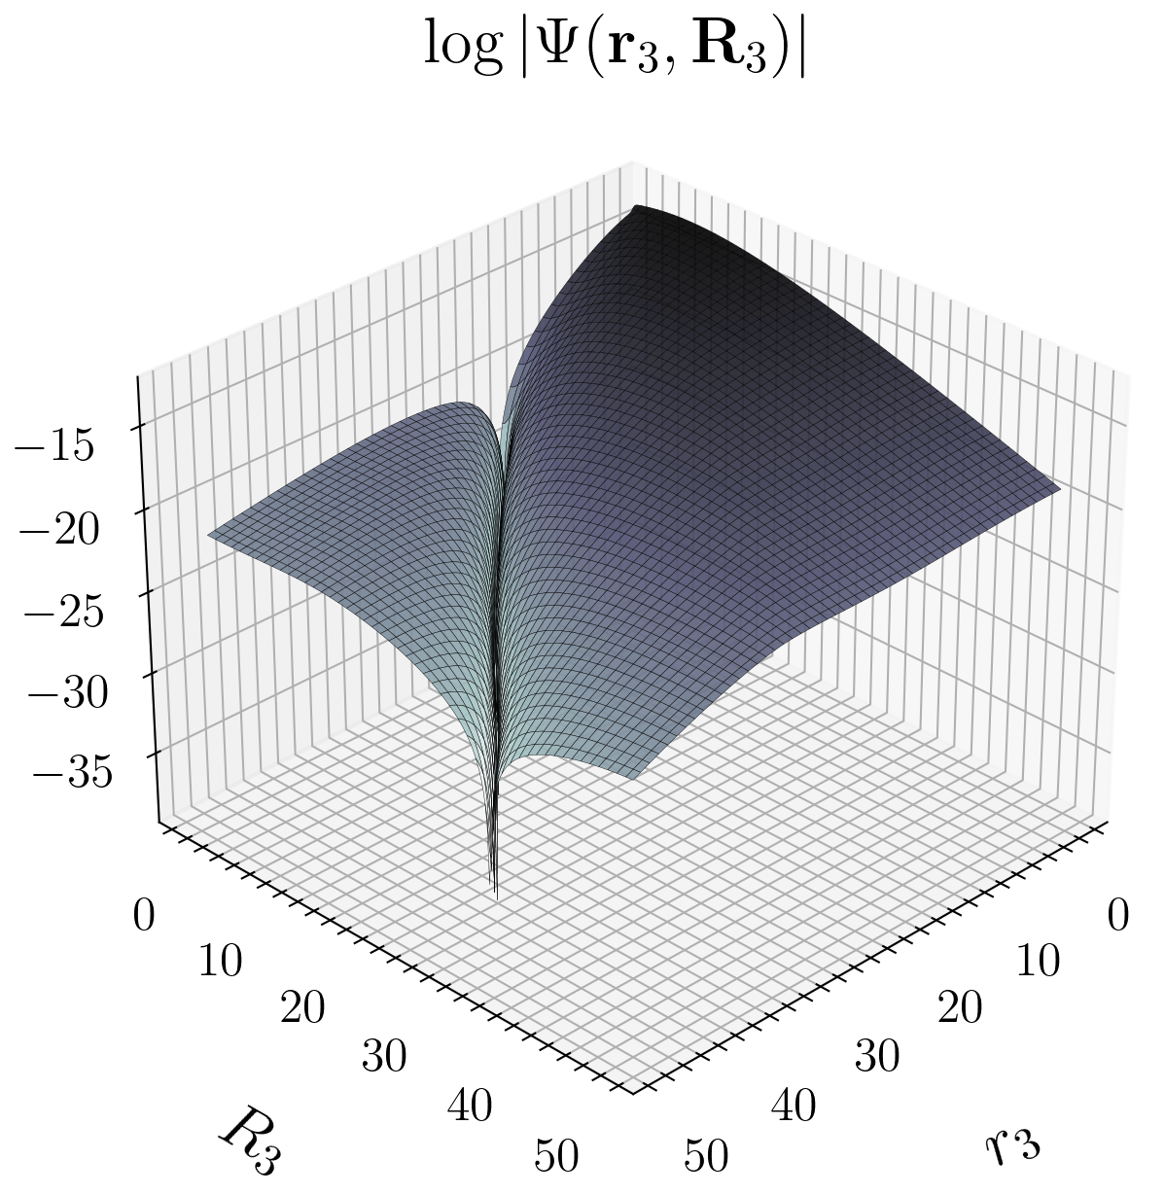
The Wave-Function
Having drawn the physical picture discussed, let us take a look at the J= 0 ground-state wave function;

Slide 30

The Wave-Function
Having drawn the physical picture discussed, let us look at the J= 0 ground-state wave function;

Slide 31
The Wave-Function
Having drawn the physical picture discussed, let us look at the J= 0 ground-state wave function;
This is surprising! There should be NO NODES in the ground-state!

Slide 32
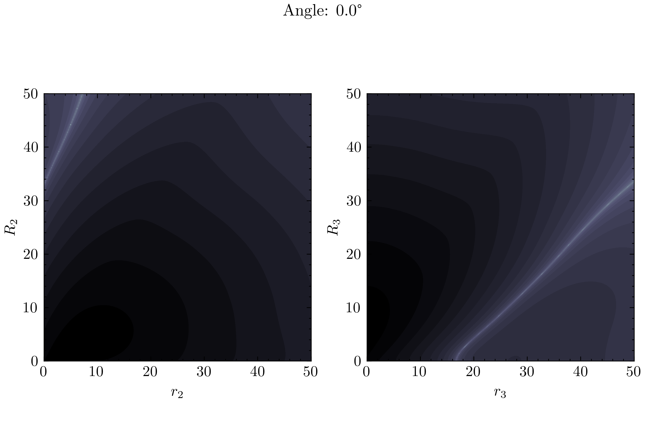
The Wave-Function

Slide 33
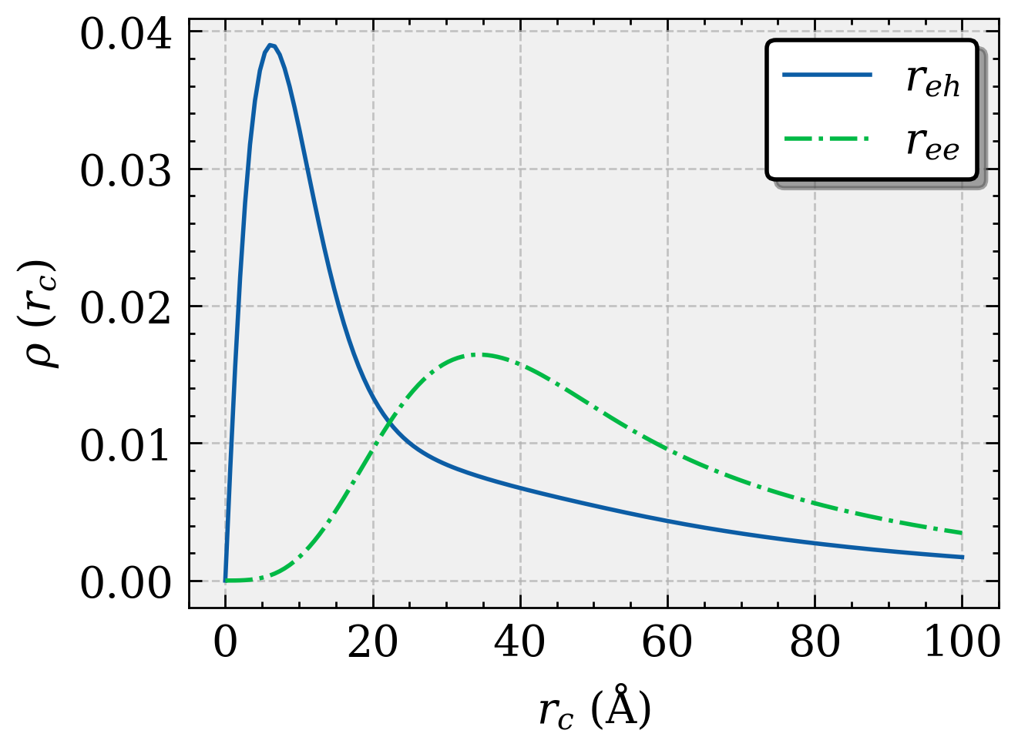
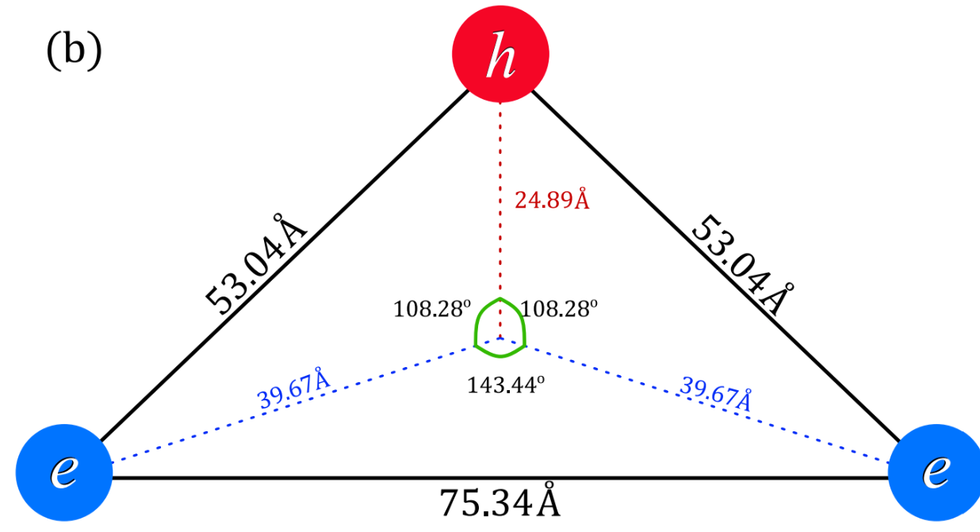
Further Results
We have also a very weakly bound J = 1 state, with energies around 1 meV;
From the distribution, we see that the state has a p-wave component stemming from the electron-electron interaction;

Slide 34
Conclusion and Extra Challenges
We briefly discussed the exciton in the Schrodinger Equation approach and the Dirac Equation approach;
Then, we investigated the three-body and saw that there is one J = 0 State and a J = 1 State;
Furthermore, we saw a Node in the three-body wave function in the ground-state;
Recently there some calculations of the three-body system under some external magnetic field but there are many challenges for the double layer system in the context of structural response to external field;

Slide 35
Extra– Excitons and Trions in Bilayers

Slide 36
Heterostructures, layers and all that Jazz

Slide 37
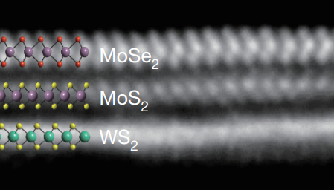
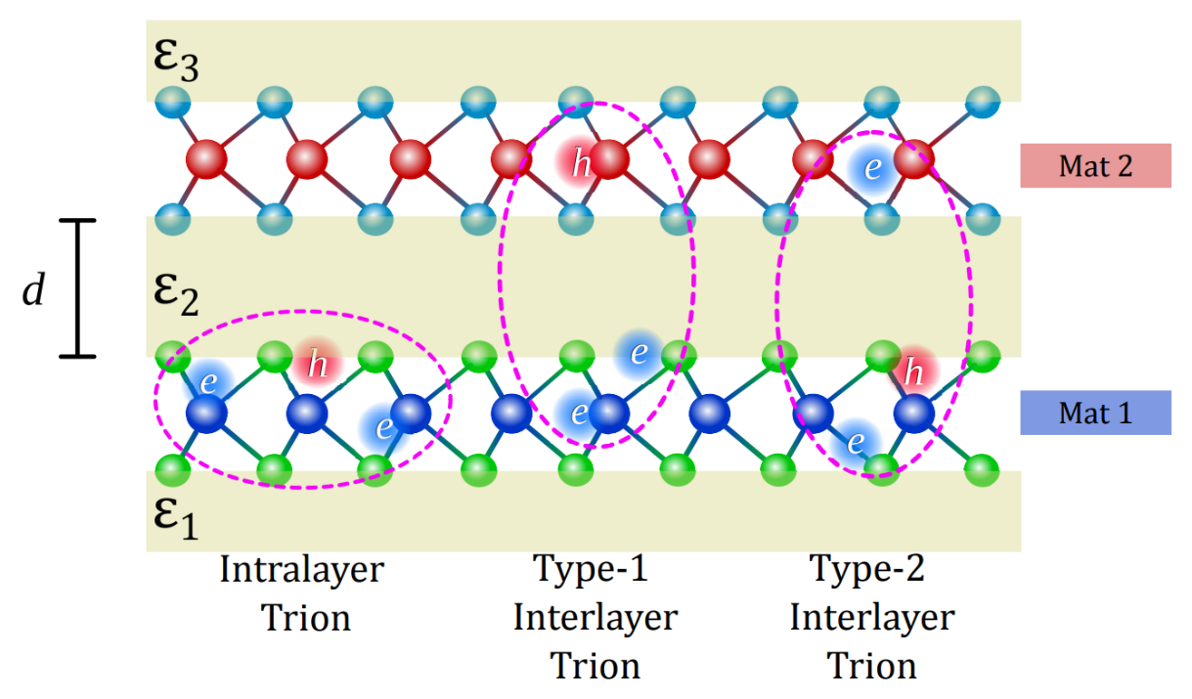
Heterostructures, layers and all that Jazz
Due to the 2D nature of this class of materials, it is a nature thought to just pile them up;
In this way, we can control its properties and have some new formation of excitons and trions;
“What could we do with layered structures with just the right layers? What would the properties of materials be if we could really arrange the atoms the way we want them? “ Richard P. Feynman

Slide 38
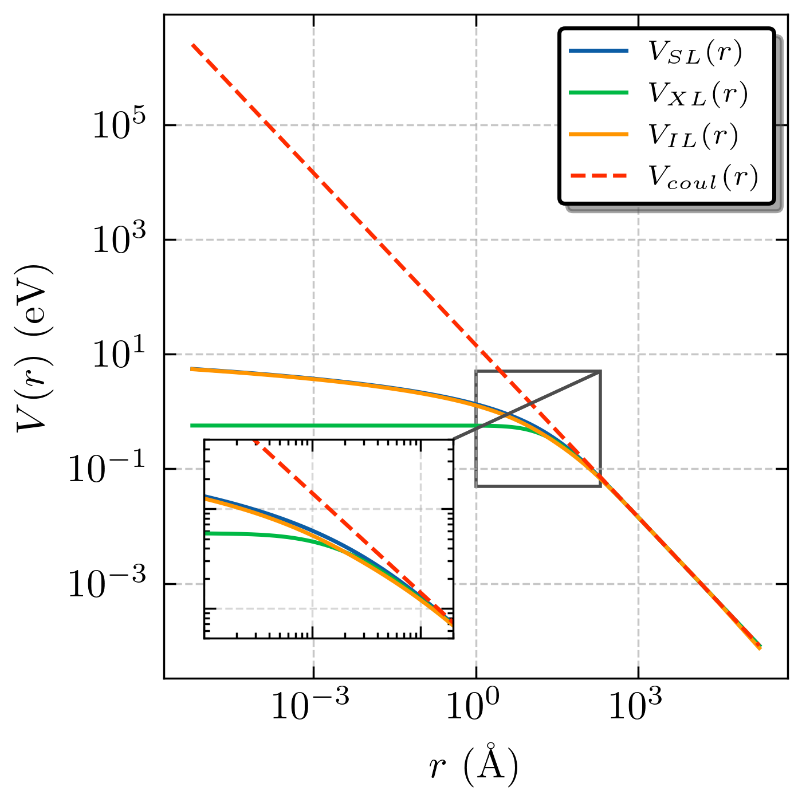
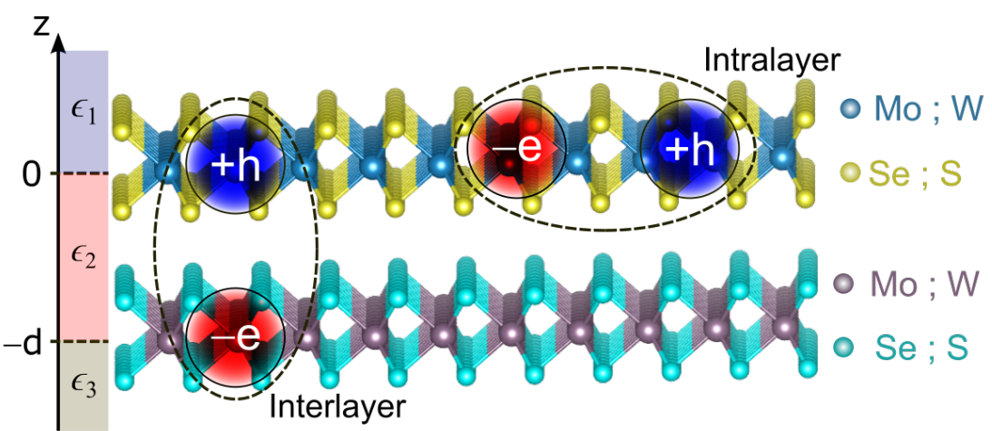
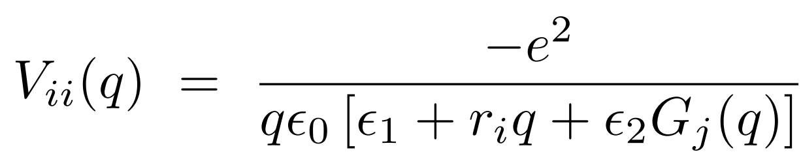
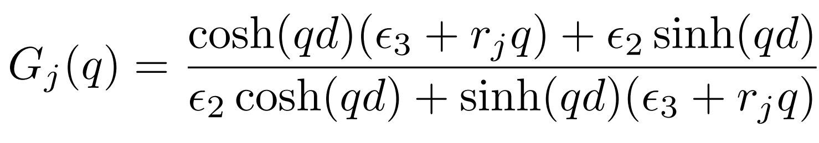
Inter- and Intra-layer interactions

Slide 39
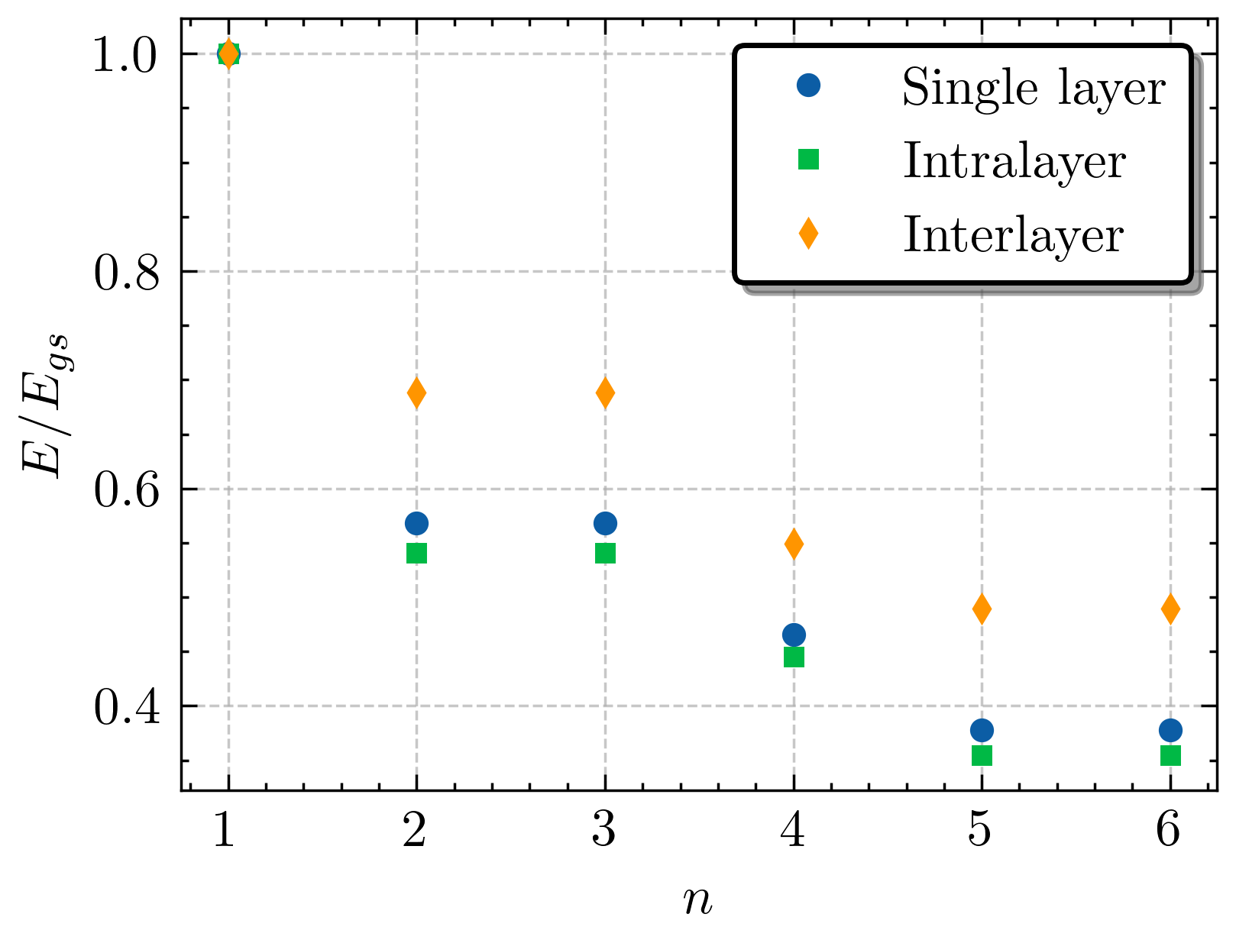
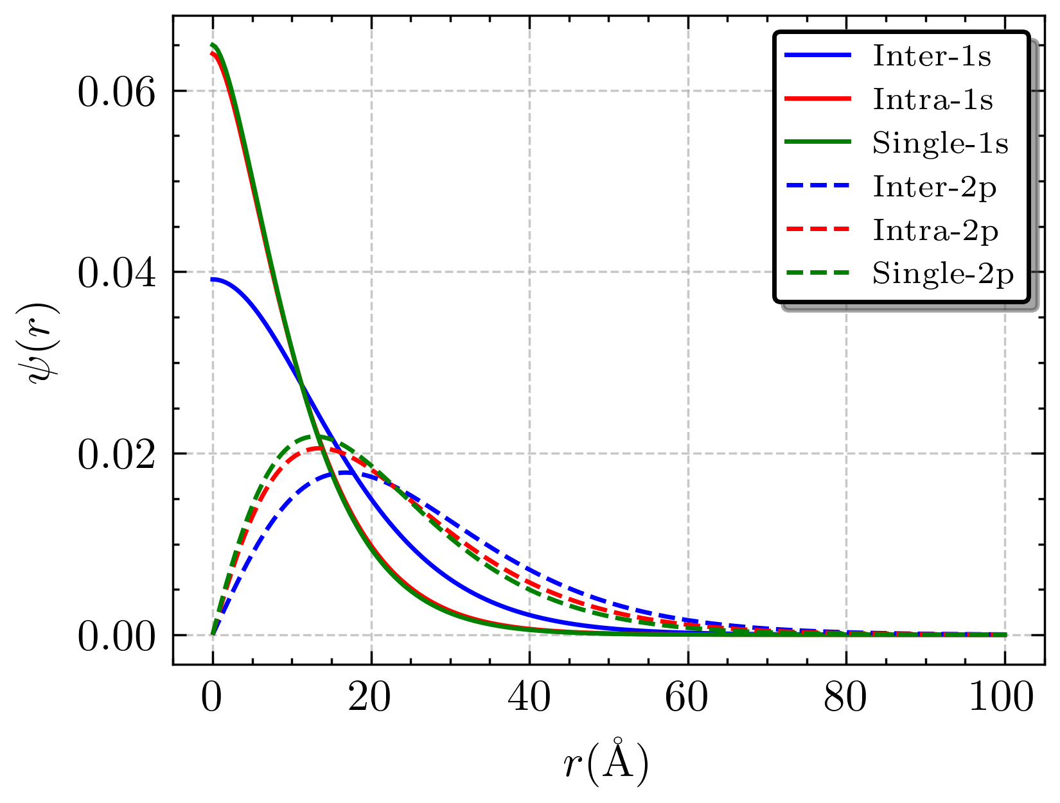
Inter- and Intra- layer Excitons (d = 5)

Slide 40


Inter- and Intra- layer Excitons (d = 50)
Thus, increasing the distance between layers strengthens the intralayer exciton towards the single layer value while weakening the interlayer exciton;

Slide 41

The Trion Zoo
Just to organize ourselves:
Intralayer trions have all interactions as the intralayer potential;
Type-1 has two attractive interlayer interactions and 1 intralayer repulsive interaction;
Type-2 has an attractive intralayer interaction, an attractive interlayer interaction and a repulsive interlayer interaction;
The Intralayer is rather boring, it is just a renormalized state due to the presence of the second layer;
All energy units are in meV;

Slide 42
The Trion Zoo
Just to organize ourselves:
Intralayer trions have all interactions as the intralayer potential;
Type-1 has two attractive interlayer interactions and 1 intralayer repulsive interaction;
Type-2 has an attractive intralayer interaction, an attractive interlayer interaction and a repulsive interlayer interaction;
The Intralayer is rather boring, it is just a renormalized state due to the presence of the second layer;
All energy units are in meV;
J = 0
J = 1
J = 2
Type-1 | Type-2
32.84 | 1.33
3.06 | XXX
0.12 | XXX
Type-1 | Type-2
21.02 | XXX
1.63 | XXX
XXX | XXX
Type-1 | Type-2
1.97 | XXX
XXX | XXX
XXX | XXX

Slide 43


J = 0, Ground-State
J = 0, 1st Excited State

Slide 44

J = 0, 2nd Excited State
J = 1, Ground State

Slide 45


J = 1, Excited State
J = 2, Ground State

Slide 46
Type-1 Interlayer Trion Mass Dependence
In modern semiconductor experiments, the effective mass of the electrons (or holes) may be tuned by introducing doping into the system;
So, with that in mind, let us experiment a little bit by playing around with the masses of one of the electrons and see how it affects the geometry of the Type-1 Trion;
The general procedure is, we will make the electron 1 mass larger and watch how the geometry and clustering responds to this change;

Slide 47


J = 0, Ground-state

Slide 48


J = 0, 1st Excited State
R1
R2

Slide 49


J = 0, 1st Excited State
Region 1
Region 2

Slide 50


J = 0, 2nd Excited State
R2
R3
R1
R4

Slide 51




J = 0, 2nd Excited State
R1
R2
R3
R4

Slide 52
Conclusion
We have introduced the idea of heterostructures and discussed the trion in this context;
Several bound states arose due to the competition of intralayer and interlayer interactions;
We could exam the mass dependence of the bound-state, which yield some interesting results where the clustering may be tuned;

