Slide 1
Structure of light hypernuclei from view point of few-body problem
Emiko Hiyama (Tohoku Univ./RIKEN)

Slide 2
Major goals of hypernuclear physics
To understand baryon-baryon interactions
Fundamental and important for the study
of nuclear physics
Total number of
Nucleon (N) -Nucleon (N) data: 4,000
YN and YY potential models so far proposed
(ex. Chiral, Nijmegen,
Kyoto-Niigata) have large ambiguity.
・ Total number of differential cross section
Hyperon (Y) -Nucleon (N) data: ～ 40- 50
・ NO YY scattering data

Slide 3
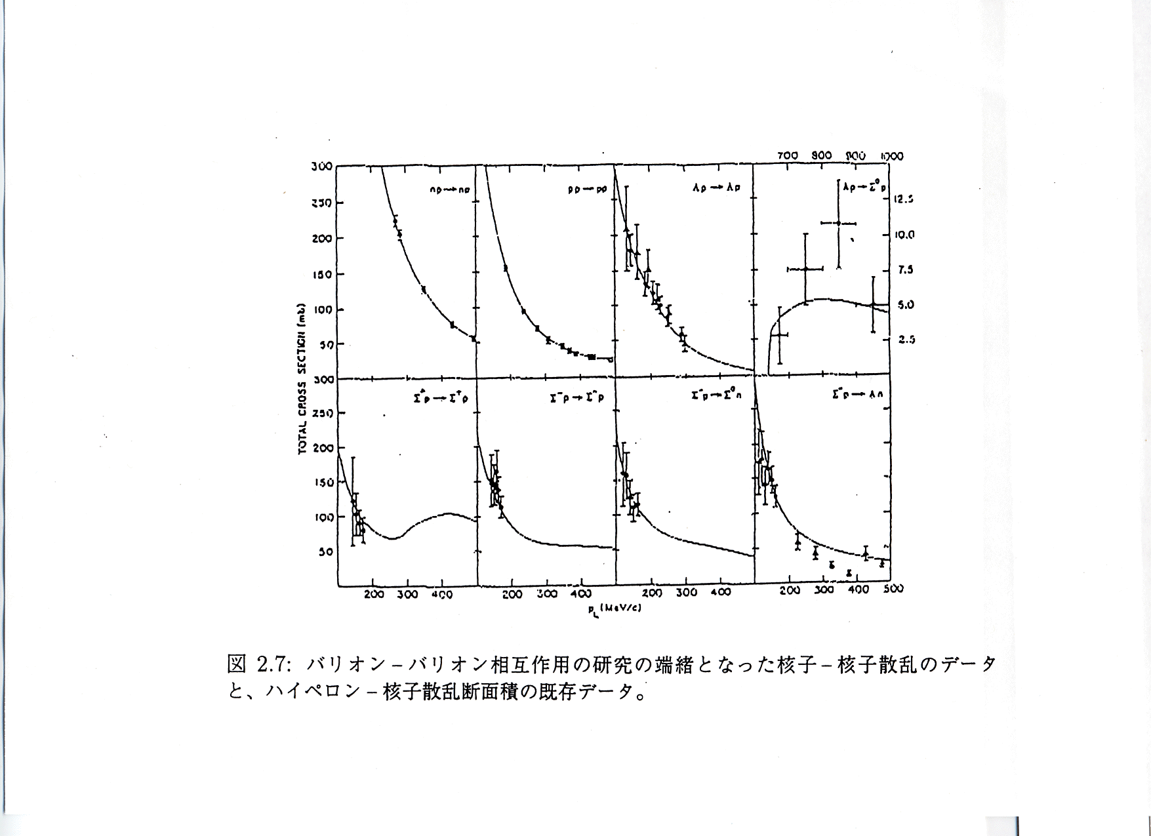
YN scattering data: about 40 events

Slide 4
Therefore, for the study of YN and YY interactions,
the systematic investigation of the
structure of light hypernuclei is one of the important
way.
(Some YN scattering experiments have been done
and further experiment is planned at J-PARC.)
Once YN and YY interactions are determined, we can
predict interesting phenomena which cannot be imagined so far.
In addition, we could study inner part of neutron stars which
have been observed.

Slide 5
Strategy to determine Hyperon-Nucleon and Hyperon-Hyperon interactions from the studies of light Hypernuclear structure
Hyperon-Nucleon interaction
Hyperon-Hyperon interaction
using a
few-body method
My role
①
Use
③
judge
Accurate calculation of hypernuclear structure
Few-body, cluster model, shell model, …..
X
No direct information
②
Compare theoretical results
with experimental data
spin-orbit force of Λ-nucleon interaction
and structure of Λ hypernuclei
Spectroscopy experiments
・ High-resolution γ-ray spectroscopy experiment
by Tamura and his collaborators
・ Emulsion experiment
by Nakazawa and his collaborators

Slide 6
One of the most important subjects in strangeness nuclear physics
“ How large is desirable strength of spin-orbit force in
Λ-N interaction? “
Λ
N
Normal
Nuclear
physics
It is well known that spin-orbit force of nucleon-nucleon
interaction is very large and this force make a great contribution
to the magic number and shell-structure of nuclei.
2 kinds of potential models proposed by the following theory:
Strangeness
Nuclear
physics
1) Meson based V_{meson}
: Nijmegen group
2) Quark based V_{quark}
: Kyoto-Niigata group
V_{meson} ≫ V_{quark}
Very different from each other
Which is preferable?

Slide 7
BNL-E930
BNL-E929
(0p)
1/2⁻
Λ
Λ
(0s)
ΔE
3/2⁺
ΔE
LS splitting
3/2⁻
γ
γ
2⁺
5/2⁺
γ
γ
0⁺
0⁺
1/2⁺
1/2⁺
¹²C
⁸Be
⁹Be
¹³C
Λ
Λ
3- and 4-body calculations:
E. Hiyama, M. Kamimura, T. Motoba, T. Yamada and Y. Yamamoto
Phys. Rev. Lett. 85 (2000) 270.
Λ
Λ
α
⁹Be
¹³C
α
α
Λ
Λ
α
α
YN LS force
1) Meson theory : Nijmegen Model D, F, soft core’97 a – f.
2) Qurak model : Kyoto-Niigata, FSS
Notes:
Microscopic α-cluster model + Λ

Slide 8
ΛN LS force and ⁹Be and ¹³C
H. Akikawa et al.
Phys. Rev. Lett. 88 (2002)
082501; H. Tamura et al.
Nucl. Phys. A754 (2005) 58c
Λ
Λ
⁹Be
Λ
BNL-E930
3/2⁺
80
200
keV
35
40
keV
3/2⁺
3/2⁺
～
～
5/2⁺
5/2⁺
5/2⁺
Quark
Exp.
43±5
keV
Meson
Nijmegen model D,F
Soft core ’97a-f
¹³C
Λ
BNL-E929
1/2⁻
360
960
keV
150
200
keV
1/2⁻
1/2⁻
～
～
3/2⁻
3/2⁻
3/2⁻
Exp.
152
54
36 keV
Quark
±
±
Meson
S.Ajimura et al.
Phys. Rev. Lett. 86,(2001) 4255

Slide 9
Strategy to determine Hyperon-Nucleon and Hyperon-Hyperon interactions from the studies of light Hypernuclear structure
ΛN spin-orbit potentials
Meson based :Nijmegen
Quark based :Kyoto-Niigata
・Quark based interaction gives desirable spin-orbit strength
・suggest to Nijmegen group
to improve the spin-orbit
strength
①
Use
③
Accurate calculation of energy splitting (⁹Be and ¹³C)
using the spin-orbit potentials
Λ
Λ
②
comparison
Spectroscopy experiments
High-resolution γ-ray spectroscopy experiment in ⁹Be and ¹³C
by Tamura and his collaborators
by Kishimoto and his collaborators
Λ
Λ

Slide 10
LS splitting in ⁹Be
Λ
Recently, a new spin-orbit ΛN interaction based on meson theory, extended soft core potential 06 (ESC06) by Nijmegen group
⁹Be
Λ
BNL-E930
(reduced)
3/2⁺
3/2⁺
39 keV
5/2⁺
5/2⁺
43±5
keV
Exp.
ESC06
Good agreement
H. Akikawa et al.
Phys. Rev. Lett. 88,(2002)82501;
H. Tamura et al.
Nucl. Phys. A754,58c(2005)
Hiyama (2007)
Desirable strength of ΛN spin-orbit force
was determined.
Notes:
4-body calculation (2007)

Slide 11
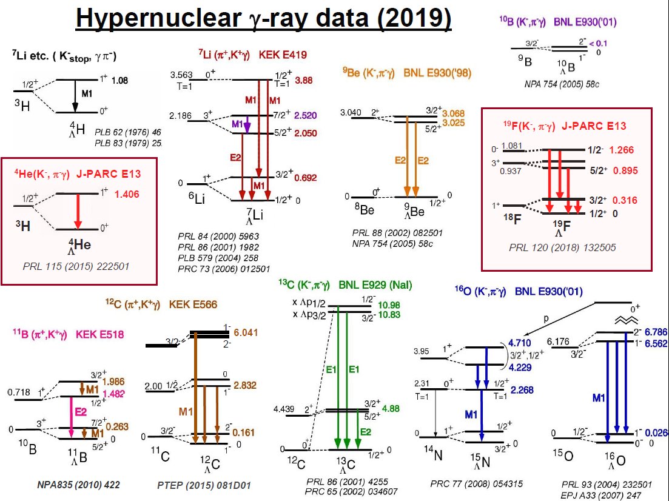
Since 1998
n
n
p
n
p
Λ
Ab-initio calculation
Shell model calculation
+
High-resolution experiments
N
Λ
We have been obtaining
information on ΛN
two-body interaction.

Slide 12
2021
Mass-Radius Relation of Neutron Stars
ΛN interaction updated by
structure study of Λ hypernuclei
+ EoS by coupled-cluster
variational calculation done
by Togashi
Still, the maximum mass of
neutron star is less than twice
of solar mass.
J1614-2230: Nature 467 (2010) 1081, APJ 832 (2016) 167
J0348+0432: Science 340 (2013) 1233232
J0740+6620: Nat. Astron. (2019)
GW170817: PRL 121 (2018) 161101
Hyperon puzzle
missing part of YN interaction: ΛN-ΣN coupling
Notes:
Observationaly Suggested region

Slide 13
S=-1
Mass is smaller.
It is expected that
Λ-Σ conversion
might affect
in structure of
Λ hypernuclei.
ΛN－ΣN coupling
Σ
Non-strangeness sector
80 MeV
N
Δ
Λ
ΛN-ΣN coupling is key issue to
construct YN two-body interaction
completely.
N
N
Δ
300MeV
N
Probability of Δ in nuclei is
not large.

Slide 14
Role of the ΛN-ΣN interaction
・ Three-body effect
N₁
Λ
N₂
N₃
N₁
Λ
N₂
N₃
①
②
Σ
Σ
N₁
Λ
N₂
N₃
N₁
Λ
N₂
N₃
Effective two-body force
Three-body force
In the neutron matter or neutron star, three-body force
might play important role.
・Charge symmetry breaking effect

Slide 15
Charge Symmetry breaking
In S=0 sector
Energy difference comes from
dominantly Coulomb force
between 2 protons.
Charge symmetry breaking
(n-n,p-p) effect is small.
Exp.
N+N+N
0 MeV
- 7.72 MeV
0.76 MeV
1/2⁺
- 8.48 MeV
³He
1/2⁺
³H
n
p
p
n
n
p

Slide 16
In S= -1 sector
Exp.
0 MeV
³He+Λ
0 MeV
³H+Λ
-1.00
-1.24
1⁺
1⁺
0.24 MeV
-2.04
-2.39
0⁺
0⁺
0.35 MeV
p
n
n
n
p
Λ
p
Λ
⁴H
⁴He
Λ
Λ

Slide 17
n
p
n
n
p
Λ
p
Λ
⁴He
⁴H
Λ
Λ
However, Λ particle has no charge.
⁴He
⁴H
Λ
Λ
p
n
n
p
p
n
p
p
+
+
p
Λ
Σ-
p
Λ
Σ-
p
n
+
+
+
+
p
n
n
n
p
n
n
n
+
+
p
Σ0
Σ+
n
Σ0
n
Σ+
p
Notes:
So, charge symmetry breaking effect is considered to come from interaction between Sigma and nucleon.Then, in order to CSB effect, these Σ coupling effect should be taken into account.

Slide 18
In order to explain the energy difference, 0.35 MeV,
N
N
N
N
+
N
Λ
N
Σ
(3N+Λ）
(3N+Σ）
・E. Hiyama, M. Kamimura, T. Motoba, T. Yamada and Y. Yamamoto,
Phys. Rev. C65, 011301(R) (2001).
・A. Nogga, H. Kamada and W. Gloeckle,
Phys. Rev. Lett. 88, 172501 (2002)
・H. Nemura. Y. Akaishi and Y. Suzuki,
Phys. Rev. Lett.89, 142504 (2002).
Coulomb potentials between charged particles (p, Σ±) are included.

Slide 19
0 MeV
³He+Λ
0 MeV
³H+Λ
-1.00
-1.24
1⁺
1⁺
(Exp: 0.24 MeV)
(cal: -0.01 MeV(NSC97e))
-2.04
-2.39
0⁺
0⁺
(Exp: 0.35 MeV)
(cal. 0.07 MeV(NSC97e))
n
n
n
p
p
Λ
p
Λ
・A. Nogga, H. Kamada and W. Gloeckle,
Phys. Rev. Lett. 88, 172501 (2002)
⁴H
⁴He
Λ
Λ
・E. Hiyama, M. Kamimura, T. Motoba, T. Yamada and Y. Yamamoto,
Phys. Rev. C65, 011301(R) (2001).
・H. Nemura. Y. Akaishi and Y. Suzuki,
Phys. Rev. Lett.89, 142504 (2002).
N
N
N
N
+
N
Λ
N
Σ
Notes:
Among these calculation, Nogga and his collaborators investigated the charge symmetry breaking effect by sophisticated 4-body calculation using modern realistic YN and NN interactions. These are results using Nijmegen soft core ’97e model. The calculated energy difference in the ground state is 0.07 MeV. And this value in the excited state is -0.01 MeV. Both of energy difference in the ground state and the excited state are inconsistent with the data. At the present, there exist no YN interaction to reproduce the charge symmetry breaking effect.

Slide 20
0 MeV
³He+Λ
0 MeV
³H+Λ
-1.00
-1.24
1⁺
1⁺
(Exp: 0.24 MeV)
(cal: -0.01 MeV(NSC97e))
-2.04
-2.39
0⁺
0⁺
(Exp: 0.35 MeV)
(cal. 0.07 MeV(NSC97e))
n
n
n
p
p
Λ
p
Λ
⁴H
⁴He
Λ
Λ
There has been exist NO YN interaction to reproduce the data.

Slide 21
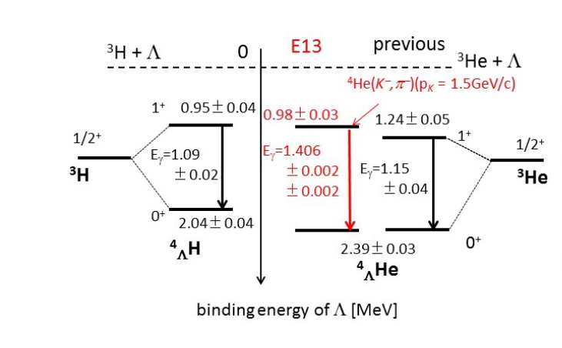
New data
Old data
T. O. Yamamoto, Phys. Rev. Lett.115, 2225 (2015).
M. Schafer et al., PRC106, L031001(2022)
Still it is difficult to reproduce the data for the study of CSB which is related to
ΛN-ΣN coupling. We need more data related to ΛN-ΣN coupling of A=4 Λ
hypernuclei.

Slide 22
0 MeV
³He+Λ
0 MeV
³H+Λ
-1.00??
1⁺
1⁺
1.406 MeV
-2.04
0⁺
0⁺
-2.39??
n
n
n
p
Red-colored states are
confirmed.
However, bule-colored states
have not be confirmed yet!
p
Λ
p
Λ
⁴H
⁴He
Λ
Λ
Once the bule-colored states are confirmed, we could get information on
charge-symmetry breaking interaction.
How do we observe these states?

Slide 23
Spin 1/2
0 MeV
³He+Λ
1⁺
S=1
n
p
Λ
1.406 MeV
p
0⁺
-2.39??
³He
p
Spin 1/2
n
p
Λ
S=0
n
p
Λ
⁴He
p
Λ
³He
If the energy of 0⁺ state energy of ⁴_{Λ}He would be observed at STAR,
it is important to extract information on CSB effect of YN interaction.
Is it possible to observe ³He-Λ correlation?

Slide 24
0 MeV
³H+Λ
-1.00??
1⁺
-2.04
0⁺
Λ
S=1
n
n
p
Λ
n
n
p
⁴H
Along the same line,
1⁺ state of ⁴_{Λ}H should
should be observed.
Λ
³H
Is it possible to observe ³H-Λ correlation?
This experiment has been done by STAR collaboration. However, I have no detail information
on it.

Slide 25
S=-2 hypernuclei
and
YY interaction

Slide 26
Ξ⁻
core
nucleus
For the study of ΞN interaction, it is important to study
the structure of Ξ hypernuclei.
However, so far there was no observed Ξ hypernucleus.
Therefore, we do not know that ΞN interaction is attractive or repulsive.
If we observe Ξ hypernuclei as bound states, we understand ΞN interaction should be attractive. Thus, we have been searching bound Ξ hypernclei experimentally.

Slide 27
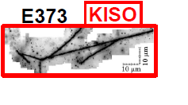
The first measurement of bound Ξ hypernucleus,
¹⁴N-Ξ.
¹⁴N-Ξ-
0 MeV
-1.03 ± 0.18 MeV
or
-3.87 ± 0.21 MeV
Ξ⁻
¹⁴N
We understood Ξ-nuclear
potential should be attractive.

Slide 28
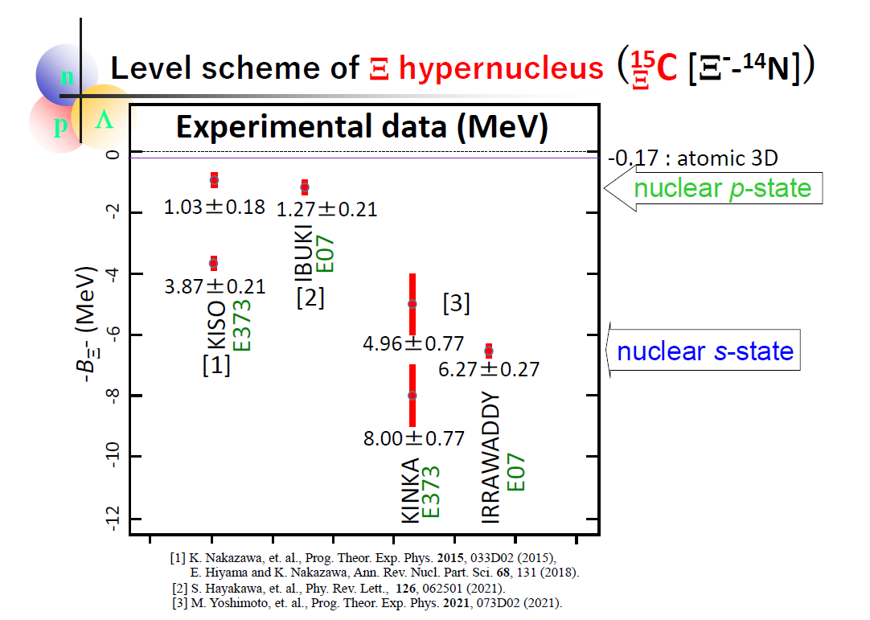
Slide by Nakazawa
After observation of Kiso event, they observed several
events of ¹⁴N-Ξ hypernucleus.
Some are observed as excited state and
some are observed as ground state.

Slide 29
V_{ΞN} = V₀ + σ・σ V_{σ・σ} ＋ τ・τ V_{τ・τ}＋ (σ・σ)(τ・τ) V_{σ・σ τ・τ}
¹⁵_{Ξ}C
By observation of ¹⁵_{Ξ}C(¹⁴N-Ξ), we find that V_{ΞN} itself is attractive.
α
α
Ξ⁻
Because,
All of the terms contribute to binding energy of ¹⁵_{Ξ}C (¹⁴N is not spin-, isospin- saturated).
α
d
Next,
we want to know desirable strength of V_{0,} the spin-,isospin-independent term.

Slide 30
V_{ΞN} = V₀ + σ・σ V_{σ・σ} ＋ τ・τ V_{τ・τ}＋ (σ・σ)(τ・τ) V_{σ・σ τ・τ}
In order to obtain useful information about V₀,
the following systems are suited, because
the (σ・σ), (τ・τ) and
(σ・σ) (τ・τ) terms of
V_{ΞN} vanish
by folding them
into the α-cluster
wave function that are
spin-, isospin-satulated.
Ξ⁻
Ξ⁻
α
α
α
problem : there is NO target to produce them
by the (K⁻, K⁺) experiment .
Because, ・・・

Slide 31
To produce αΞ⁻ and ααΞ⁻ systems by (K⁻, K⁺) reaction,
target
K⁺
K⁻
These systems
are unbound.
Then, we
cannot use them as targets.
p
Ξ⁻
α
α
⁵H
⁵Li
Ξ-
K⁺
K⁻
p
Ξ⁻
α
α
α
α
⁹B
⁹Li
Ξ-

Slide 32
As the second best candidates to extract information about the spin-, isospin-independent term V₀, we propose to perform…
K⁺
K⁻
p
n
Ξ⁻
n
α
n
α
n
⁷Li (T=1/2)
⁷H
(T=3/2)
Ξ⁻
Why they are suited
for investigating V₀?

Slide 33
(more realistic
illustration)
Core nucleus ⁶He is known to be halo
nucleus. Then, valence neutrons are located
far away from α particle.
n
n
α
Ξ⁻
Valence neutrons are located in p-orbit,
whereas Ξparticle is located in 0s-orbit.
Then, distance between Ξ and n
is much larger than the interaction range of
Ξ and n.
n
Ξ⁻
⁷H
(T=3/2)
Ξ⁻
Then, αΞ potential, in which only V₀ term
works, plays a dominant role in the binding
energies of this system.

Slide 34
Before the experiments will be done,
we should predict whether this
hypernucleus will be observed as
bound states or not.
Namely, we calculate the binding energies of this hypernucleus.
Ξ
Ξ⁻
n
α
n
⁷H
(T=3/2)
Ξ⁻

Slide 35
ΞN interaction
・ESC04 (Nijmegen soft core) and ND (Nijmegen Model D)
HAL potential (based on Lattice QCD)
V_{ΞN}=V₀(r)+(σ_{Ξ}・σ_{N})V_{s}(r)+(τ_{Ξ}・τ_{N})V_{t}(r)+（σ_{Ξ}・σ_{N})(τ_{Ξ}・τ_{N})V_{ts}(r)
All terms are central parts only.

Slide 36
Property of the spin- and isospin-components of ESC04, ND,HAL
V(T,S)
ESC04
ND
HAL
T=0, S=1 strongly attractive
T=0, S=0
weakly attractive
T=1, S=1
T=1, S=0
Weakly attractive
(a bound state)
weakly repulsive
Strongly attractive
weakly attractive
Weakly attractive
weakly repulsive
Weakly repulsive
Although the spin- and isospin-components of these models are
very different (due to the different meson contributions),
we find that the spin- and isospin-averaged property,
V₀ = [ V(0,0) + 3V(0,1) + 3V(1,0) + 9V(1,1) ] / 16,
namely, strength of the V₀- term is similar to each other.

Slide 37
4-body calculation of
⁷H
E. Hiyama et al.,
PRC78 (2008) 054316
Ξ⁻
ESC04
MeV
ND
α+ n + n + Ξ⁻
HAL
1.71
MeV
α+ n + n + Ξ⁻
MeV
0.96
α+ n + n + Ξ⁻
0.75
⁶He + Ξ⁻
1.00
0.39
(αΞ⁻ ) + n + n
0.0
0.0
⁶He + Ξ⁻
(αΞ⁻ ) + n + n
⁶He + Ξ⁻
0.04
0.0
(αΞ⁻ ) + n + n
-1.35
1/2⁺
-1.56
1/2⁺
⁷H
-2.80
1/2⁺
⁷H
Ξ⁻
⁷H
Ξ⁻
Ξ⁻
n
Ξ⁻
Similar binding
energies using ND and
ESC04.
In experiments,
we can expect
a bound state.
α
n

Slide 38
Summary of ⁷_{Ξ}H
We understand that ⁷_{Ξ}H should be bound.
This means that αΞ system should be bound.
I have a question. Is it possible to observe αΞ
two-body correlation experiment to make sure
bound state of this system at STAR?

Slide 39
Next, I shall talk about s-shell Ξ hypernuclei
N
N
N
N
Ξ
Ξ
N
No data

Slide 40
T
S
V₀ = [ V(0,0) + 3V(0,1) + 3V(1,0) + 9V(1,1) ] / 16,
which partial contribution makes attractive for V₀ ?
ΞN interaction: T=0, S=0
T=0, S=1
T=1, S=0
T=1, S=1
Ξ
N
t=1/2
S=1/2
t=1/2
S=1/2
we have a two-body bound state for ΞN system?
No idea=>Femtoscopy experiment
at ALICE=>we have no bound ΞN system.
Cf. NN interaction
N
N
T=0, S=0,l=odd
T=0, S=1
T=1, S=0
T=1,S=1,l=odd
strong attraction to have a bound state
as a deuteron

Slide 41
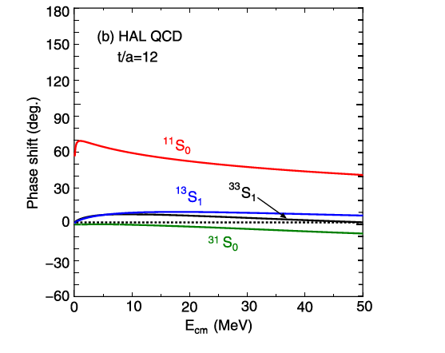
Property of the spin- and isospin-components of HAL
V(T,S)
HAL
T=0, S=1(¹³S₁)
T=0, S=0 (¹¹S₀)
T=1, S=1 (³³S₁)
T=1, S=0(³¹S₀)
Weakly attractive
Strongly attractive
Weakly attractive
Weakly repulsive

Slide 42
To obtain ΞN two-body interaction,
the suited systems to study are s-shell Ξ hypernuclei such as
NNΞ and NNNΞ systems.
E. Hiyama et al., PRL124, 092501 (2020)
N
N
N
N
Ξ
Ξ
N
I show my results of these light systems.
NN interaction: AV8 potential
ΞN interaction :
Nijimegen extended soft core potential (ESC08c)
Realistic potential (only ΞN channel)
ΞN interaction by HAL collaboration (Lattice QCD calculation)
The potential was made by K. Sasaki, Miyamoto, Hatsuda
and Aoki.

Slide 43
N
N
T=1/2, J=1/2⁺ and J=3/2⁺
Ξ
ESC08c
Unbound
0 MeV
d+ Ξ
d+ Ξ
0 MeV
J=1/2+
-2.57 MeV
J=3/2⁺

Slide 44
N
T=1/2, J=1/2⁺ and J=3/2⁺
N
Ξ
HAL potential
0 MeV
d+ Ξ
0 MeV
d+ Ξ
No bound state
J=3/2⁺
J=1/2+

Slide 45
Bound states in A=3 Ξ hypernuclei are dependent on ΞN interaction employed.
If d-Ξ correlation experiment at STAR,
we can check whether or not NNΞ system should be bound.

Slide 46
N
N
N
N
+
Ξ
N
Ξ
N
Total isospin:1/2
Total spin:1/2
Isospin:1/2
Spin:1/2
Total isospin: 0 or 1
Total spin:0 or 1

Slide 47
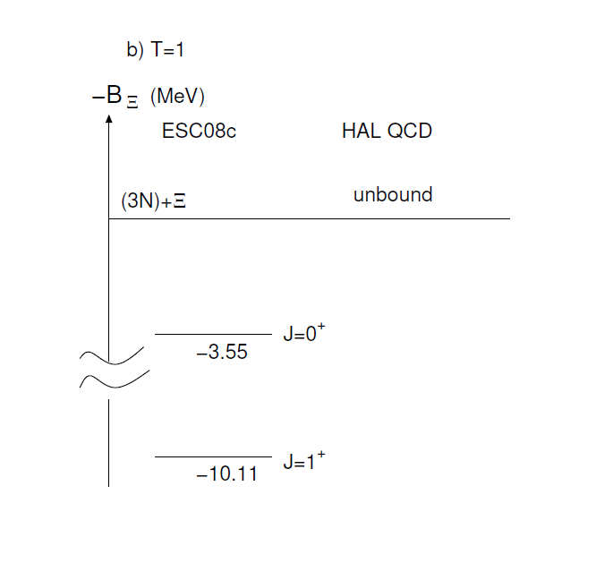
N
N
N
Ξ

Slide 48
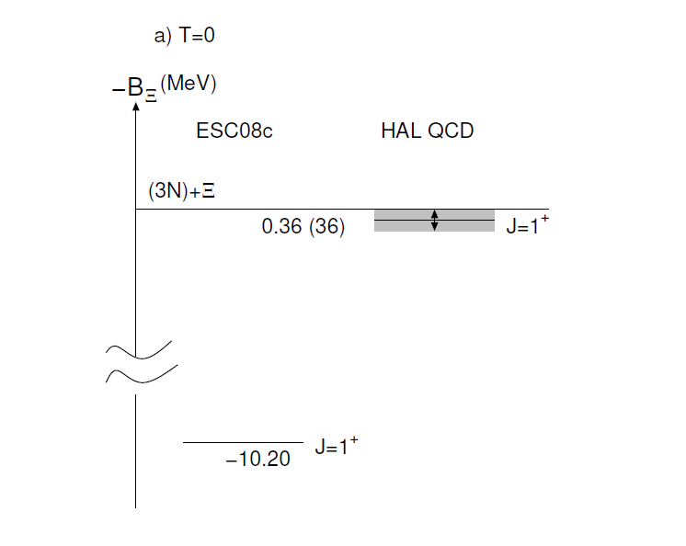
N
N
N
Ξ
H.Le et al., EPJA57, 339 (2021).
NNNΞ

Slide 49
Summary of s-shell Ξ hypernuclei
0 MeV
d+ Ξ
N
N
Ξ
-2.57 MeV
J=3/2⁺
Nijmegen potential
ESC08
Whether or not A=3 Ξ hypernucleus is bound, is dependent on
ΞN potential model.
How do we observe this system?

Slide 50
K ⁺
T=1/2
^{K-}
n
p
n
p
p
Ξ-
³He
One tool: at J-PARC, (K⁻,K⁺) using ³He target
Another tool: d-Ξ femtoscopy experiment?
The experiment can give contribution to the ΞN interaction.

Slide 51
K ⁺
J-PARC
However, the total
Isospin of produced
Ξ hypernucleus is 1,
which is unbound
with HAL potential.
K ⁻
n
n
p
p
n
Ξ
n
p
⁴He
T=1
This state is bound with both of potentials,
Nijmegen and HAL.
However, it is not possible to observe it
by (K⁻,K⁺) reaction.
So, only tool is heavy ion collision.
If it is possible to observe this state at STAR,
this is high impacting! Is it possible or not
at STAR.
n
p
n
Ξ
T=0 J=1⁺

Slide 52
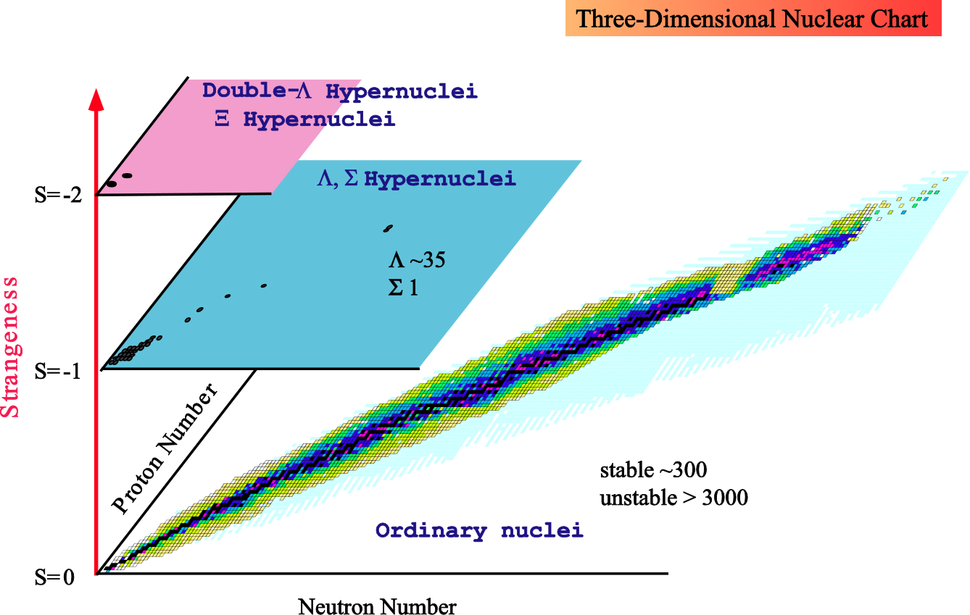
Concluding remark
Multi-strangeness system
such as Neutron star
STAR
J-PARC
ALLICE
STAR
GSI
JLab
J-PARC

Slide 53
Thank you

Slide 54
To investigate bound state of ΞN system, it might be
possible to perform the following experiment:
n
n
T=1, S=0 or S=1
K⁻
K⁺
p
Ξ⁻
It would be difficult to obtain information on ΞN interaction (T=1,S=0 or 1).
Because, there might be no bound state for this system.

