Slide 1


Fusion hindrance in the synthesis of superheavy elements
By Filip Agert
Notes:
Hello, and welcome to my presentation at the few-body workshop here at ECT*.
I am happy to have been invited here and to be able to present my work.
I just started my PhD two weeks ago, and as such I have no work in the area to present so far. Therefore I will be presenting the work I did during my master’s thesis at Lund University and the subsequent internship at GANIL in France.
This presentation will be about the synthesis of superheavy elements, which is out of the theme of this workshop, but I hope that it will still be interesting to some of you here.
Titled is ‘fusion hindrance in the synthesis of superheavy elements’ and my name is Filip Agert

Slide 2
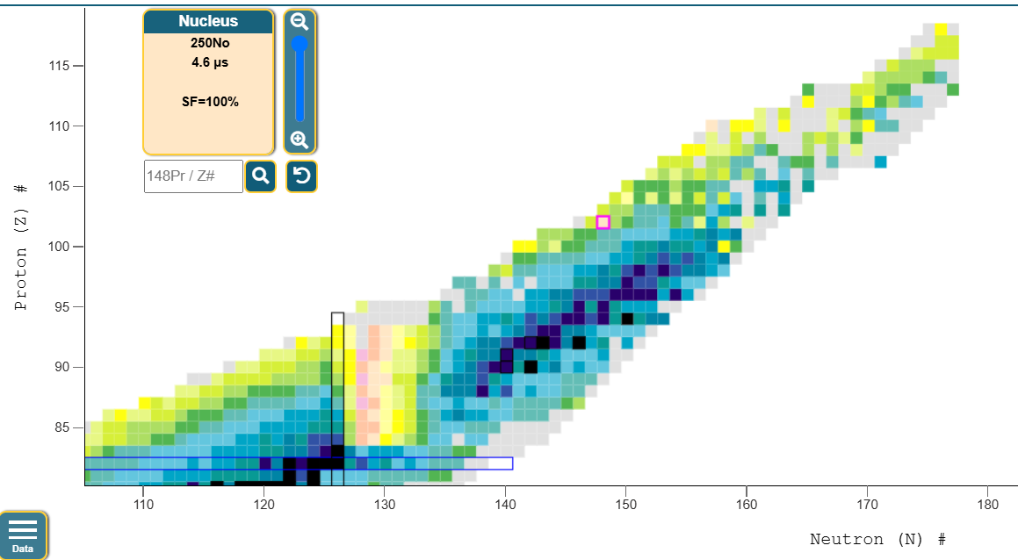
Where are the superheavy nuclei? (SHN)
SHN: Z>102
Pb-208
Chart from: NNDC
Notes:
We start with the definition of superheavy elements, which is that the proton number is greater than 102

Slide 3
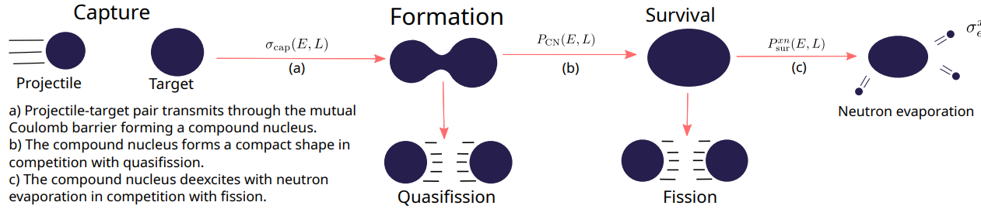



How are superheavy elements synthesised?
3-stages
Notes:
So: How does the synthesis work? We describe this as a three-staged process.
In a particle accelerator, we accelerate ions, Calcium-48, for example onto a target.
If the projectile-target mutual Coulomb repulsion is overcome, which requires energy, we reach the second stage. Formation stage.
Here, we have formed a highly deformed compound nucleus. There are two outcomes from here, either the endparts reseparate into two fragments, which we call quasifission, or the compound nucleus forms a compact shape, reaching the survival stage.
In this stage, we have a highly excited compound nucleus, which needs to deexcite, which it does through two main decay channels. Either it fissions, separating again into two fragments, or neutrons are evaporated from the compound nucleus, taking away the excitation energy as kinetic energy. This is a cascading process where a new nucleus is formed which again needs to de-excite further, repeating until we are at an energy below the fission barrier.
When that is the case, you get an alpha decay chain, which is measurable in a detector.
Each of these processes has an associated cross section or probability to happen. We can multiply these together and sum over the partial waves to get the evaporation residue cross section, which is just the cross section of forming these superheavy elements, as you can see in the formula below.

Slide 4
How are superheavy elements synthesised?
3-stages
Notes:
The first and last stage, capture and survival, are more-or less well described by theory. The formation stage is not. This is what I will focus on in this presentation.

Slide 5
Supervisor:
David Boilley
Thanks to:
Dieter Ackermann

Slide 6
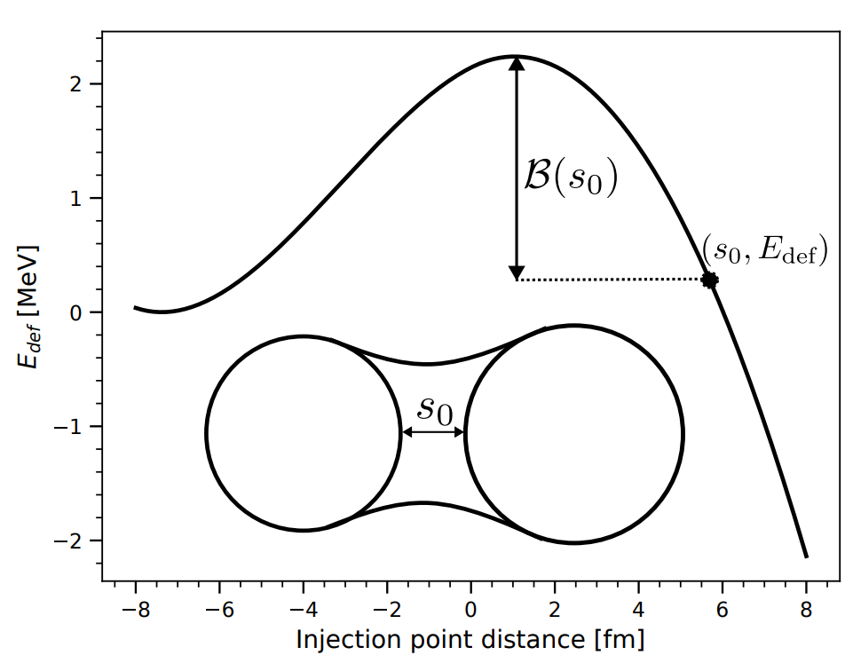
1D potential energy surface
Function of distance between projectile-target.
What is probability of forming a compound nucleus?

Slide 7

Langevin Equation of motion
Langevin EOM is an EOM for a deterministic+random force
s - Separation of target-projectile.
β - Friction.
⍵ - Angular frequency of parabolic barrier.
r(t) - Random force (Gaussian noise).
Simplifies when β≫⍵ in the overdamped limit.

Slide 8
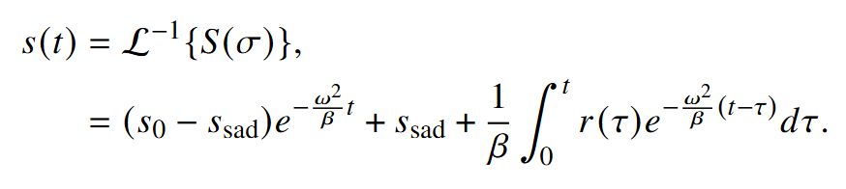
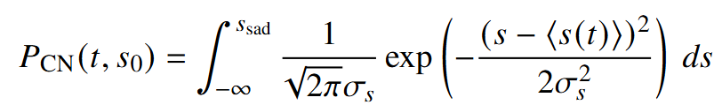
Langevin Equation of motion
Solve for s(t) by applying the Laplace transform.
Formation probability given by integrating a Gaussian up to the saddle point.

Slide 9
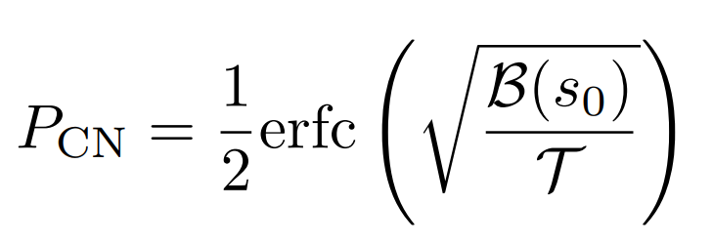
Langevin Equation of motion
Take the limit as t → infinity
With T temperature, dependent on energy,
B barrier height, dependent on potential energy surface.

Slide 10
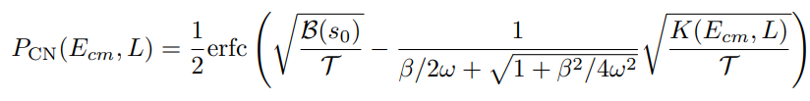
Langevin Equation of motion
Similar derivation even when not overdamped.
K - kinetic energy
Ecm - Center of mass energy
L - Angular momentum for partial wave
Two free parameters of the model to be fit to data:
β – Friction parameter
s₀ – Injection point distance

Slide 11
Fit parameters to data
Cannot fit to formation cross section data due to ambiguous measurement.
Evaporation residue cross section data not ideal
Bad statistics
Little available data
Survival part introduces other sources of uncertainty:
Fission barrier height
Neutron separation energy
σ_{CN}~ mb to μb
σ_{er} ~ nb to fb

Slide 12
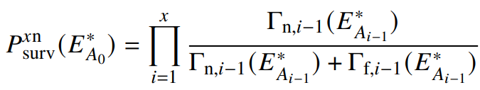
Fit parameters to data
Γ – Decay width for neutron and fission channels, depends on:
Level density parameter, a
Fission friction parameter β
Fission barrier height
Neutron separation energy
Etc…

Slide 13
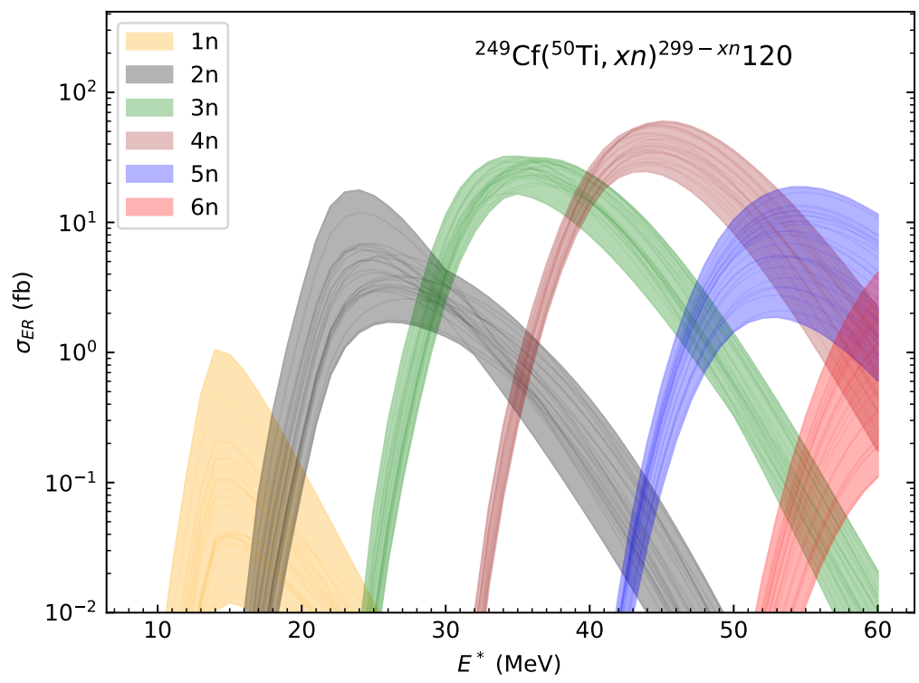
Effect of survival stage parameters on prediction
Refit the formation model parameters to each combination of the survival probability settings. 144 combinations.
Pick the 25 best combinations scoring the lowest loss function.
Predict reaction.
Shaded area is spread in prediction
Factor 3 spread in the 4n channel.

Slide 14
Effect of survival stage parameters on prediction
Refit the formation model parameters to each combination of the survival probability settings. 144 combinations.
Pick the 25 best combinations scoring the lowest loss function.
Predict reaction.
Shaded area is spread in prediction
Factor 3 spread in the 4n channel.
β ~ 0.7 * 10²¹ s⁻¹ in best fit
But varies from 10¹⁷ to 10²¹ in the top 25 combinations.
β model dependent.

Slide 15
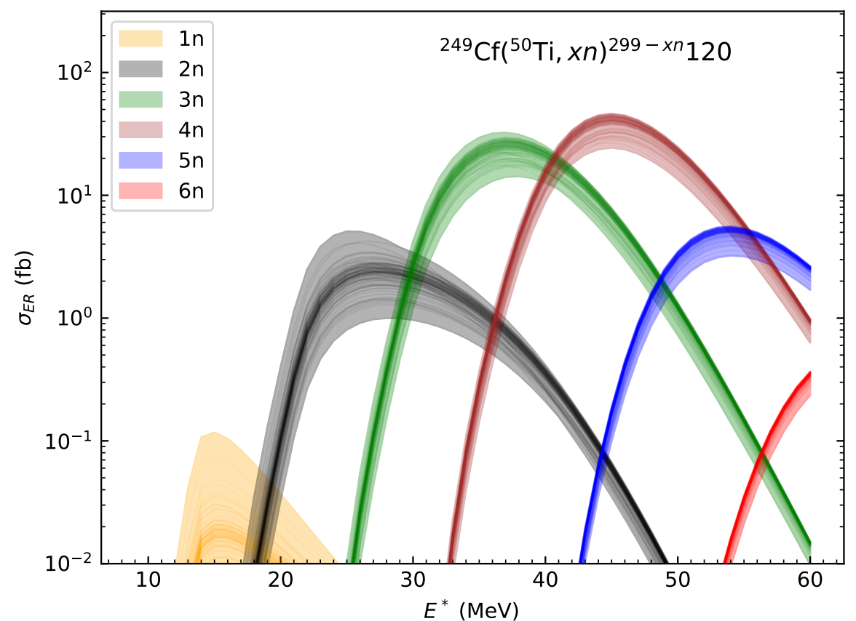
Effect of data bootstrapping
Randomly select 85% of points in full dataset.
Fit the model to these points.
Repeat 100 times.
Figure shows the different predictions this produces.

Slide 16
Outlook for 1D model
Remove model dependence of survival part by using Bohr’s hypothesis
- Survival probability independent of entrance channel.
- Compare two reactions leading to same CN.
Quantify uncertainty in survival part
- Need covariance matrices from Micmac models
Expected 1 order of magnitude uncertainty from uncertainty in
in fission barriers alone.

Slide 17
Supervisors:
G. Carlsson, M. Albertsson, A. Idini

Slide 18
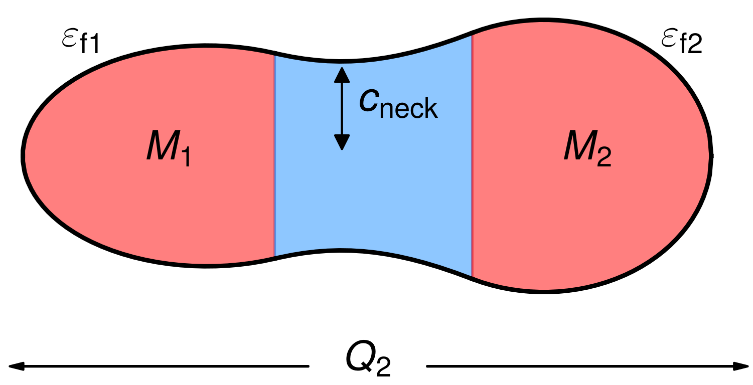
Five dimensional solution
Five shape coordinates define an potential energy surface.
FRLDM potential is used.
α – Mass asymmetry
c_{neck} – Neck radius
Q₂ – Elongation
ε_{l} – Left fragment deformation
ε_{r} – Right fragment deformation
Collectively denoted χ
P. Möller et.al. At. Data Nucl. Data Tables 109–110, 1-204 (2016).
Fig from Martin Albertsson, private communication

Slide 19


Five dimensional solution
How to solve Langevin EOM?
In overdamped limit, motion is approximated by Brownian motion.
Solve by random walk on the potential energy surface.
With probability of moving to a neighbor related to level densities
Fig from Martin Albertsson, private communication

Slide 20

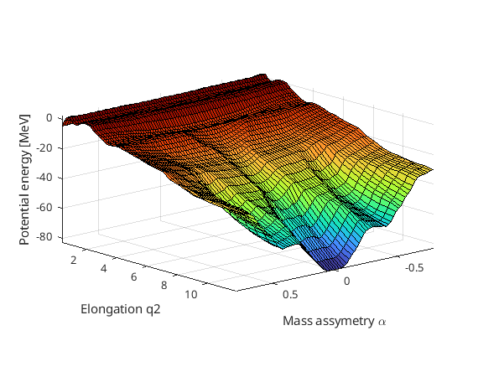



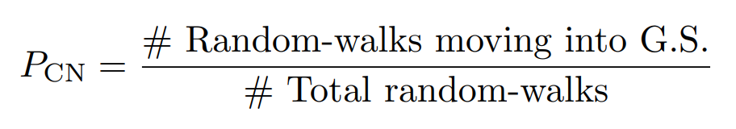
Potential energy landscape
Fusion path
Ground state
Use FRLDM to compute energy of millions of shapes.
Shape changes with a diffusive process on potential surface.
Fusion
Quasifission

Slide 21
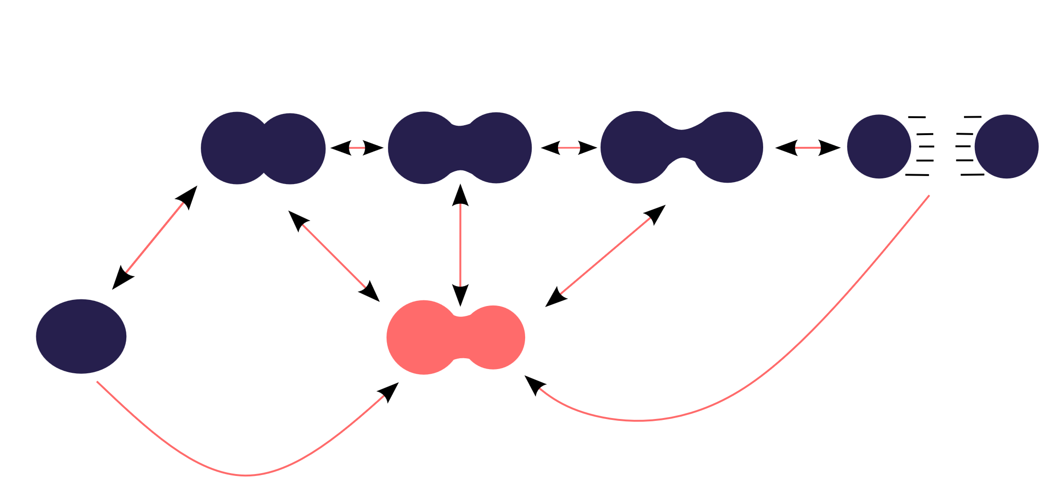
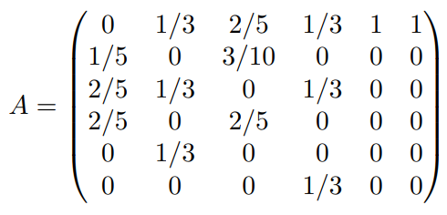
Markov chain
Quasifission
Fusion
A is a ~ 10⁷ × 10⁷ sparse matrix
filling of order ~ 10⁻⁵

Slide 22
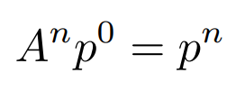
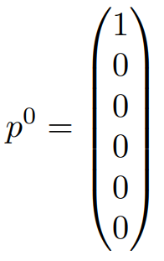
Markov chain
Quasifission
Fusion
P = 1

Slide 23
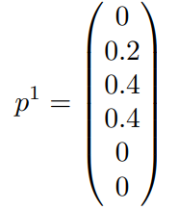
Markov chain
P = 0.2
P = 0.4
P = 0.4
Quasifission
Fusion

Slide 24
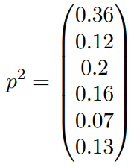

Markov chain
P = 0.12
P = 0.2
P = 0.16
Quasifission
P = 0.13
P = 0.07
Fusion
P = 0.36

Slide 25
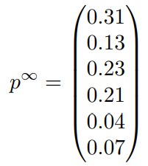

Markov chain
P = 0.13
P = 0.23
P = 0.21
Quasifission
P = 0.07
P = 0.04
Fusion
P = 0.31

Slide 26


Markov chain
Convergence of the vector p means that
Eigenvalue problem with eigenvalue 1.
for all of A’s eigenvalues
Use implicitly restarted Arnoldi method (IRAM) to find eigenvalue and eigenvector of interest.
Implementation: ARPACK-NG (github.com/opencollab/arpack-ng)

Slide 27
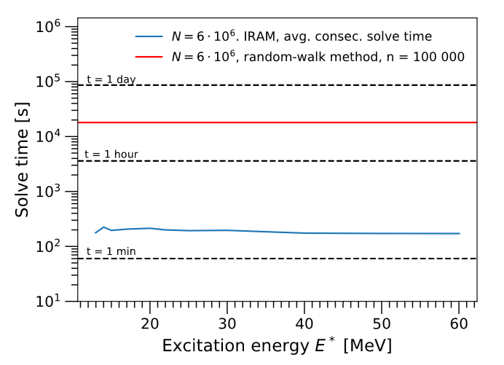
Solve time for one partial wave P_{CN}(E, L)

Slide 28
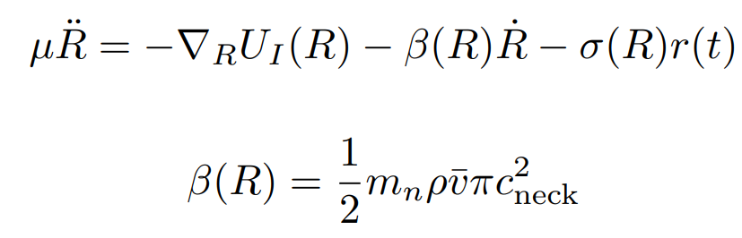
Starting location on PES?
Once nuclei collide, they have radial velocity.
Friction between nucleons converts kinetic energy into excitation energy.
Use Langevin Eq. of motion until radial velocity is small.
`

Slide 29
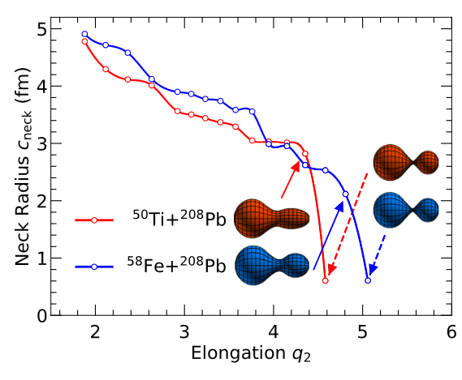
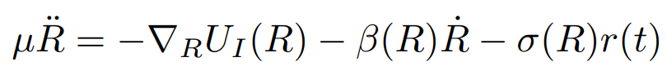
Fusion path
Friction along 1D path in 5D landscape.
Starting condition:
Distance q₂: Large
Neck c_{neck}: Small.
Mass asymmetry α: Projectile & Target
Deformations ε: G.S deformation.
Path defined by following the gradient of PES in the parameters ε_{l}, ε_{r}, c_{neck} to lower elongations.
α frozen to initial value.
Fig. from M. Albertsson, et.al, Phys. Rev. C. 110, (2024)

Slide 30
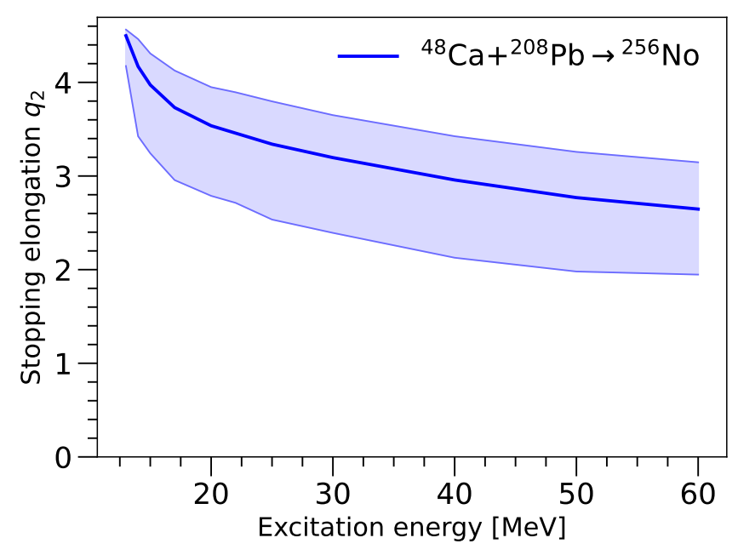
Fusion path
Friction along 1D path in 5D landscape.
Starting condition:
Distance q₂: Large
Neck c_{neck}: Small.
Mass asymmetry α: Projectile & Target
Deformations ε: G.S deformation.
Path defined by following the gradient of PES in the parameters ε_{l}, ε_{r}, c_{neck} to lower elongations.
α frozen to initial value.

Slide 31
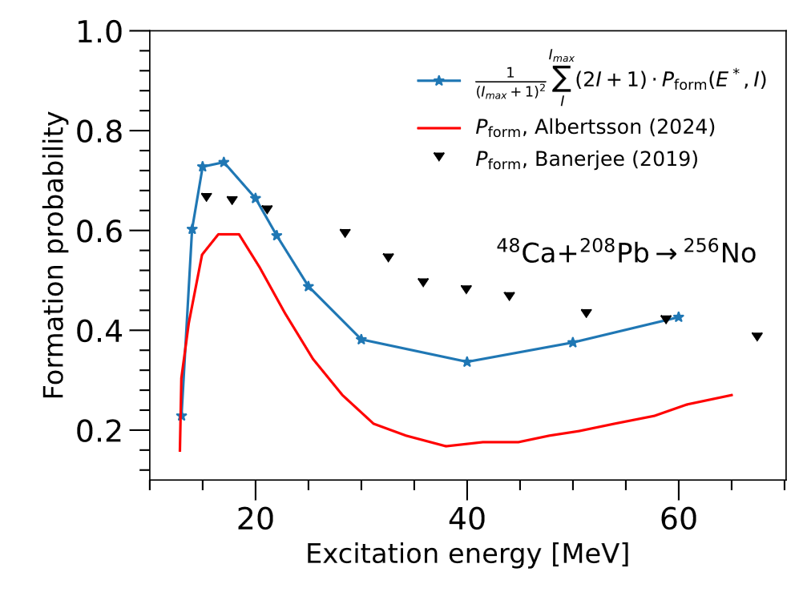
Formation probability
Difference between blue and red calculation is the choice of 1D fusion path to run friction on.
Blue – Follow gradient in
parameters ε_{l}, ε_{r}, c_{neck}
Red – Follow gradient in
parameters ε_{l}, ε_{r}, c_{neck}, α
Sensitive to choice of path.

Slide 32
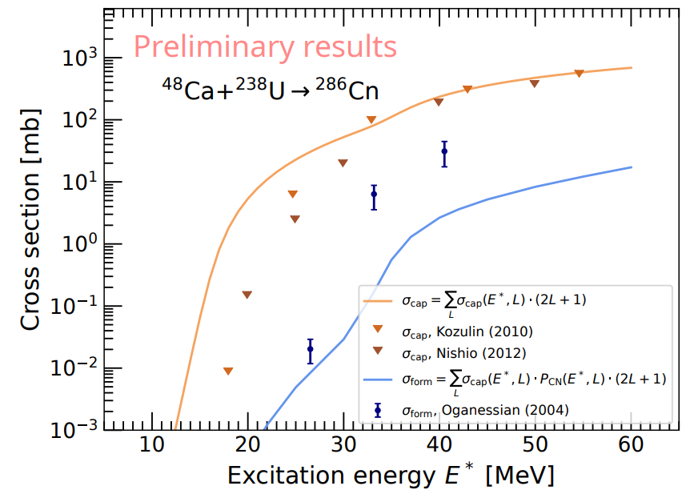

Slide 33
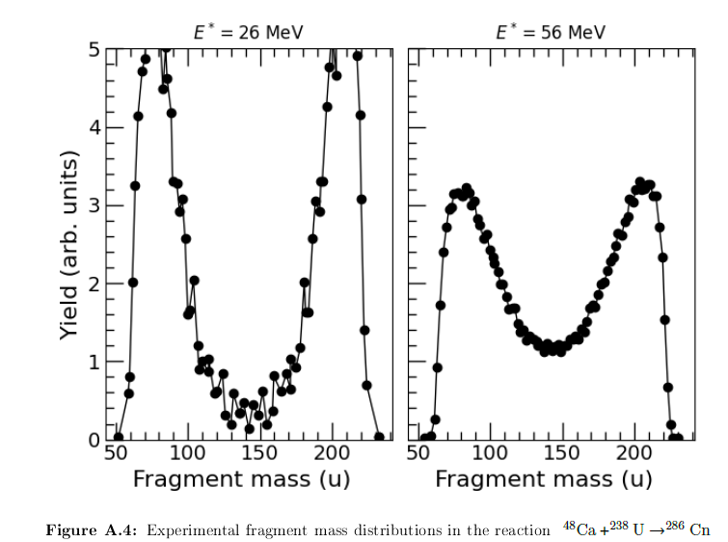

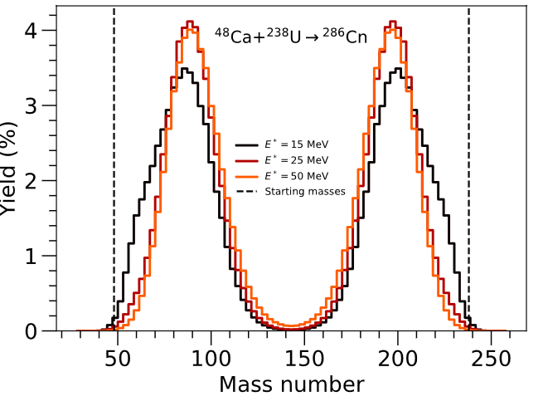
Quasifission fragment mass distribution
M. G. Itkis, et.al, Eur. Phys. J. A 58, 178 (2022).

Slide 34
Outlook for 5D model
Compute survival probability
Extend to odd nuclei
Add degrees of freedom in potential
Z/N degree of freedom in target/projectile
Formation probability sensitive to start location:
Friction in a higher dimensional path.

Slide 35
Thank you for your attention!

Slide 36


Capture
Side collision
Tip collision
More repulsion
Larger Coulomb barrier
Less repulsion
Smaller Coulomb barrier

Slide 37
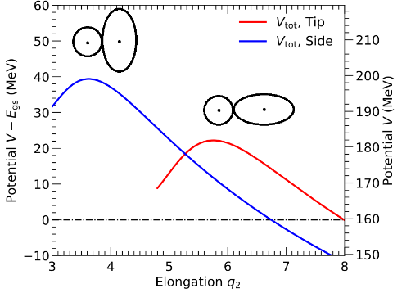
Capture

Slide 38
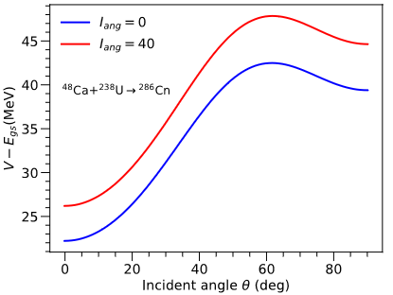



Capture
Incident angle distribution:
0 degrees = tip
90 degrees = side
Side collision more likely

Slide 39
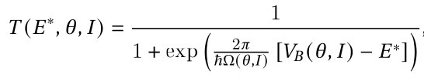
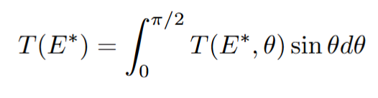
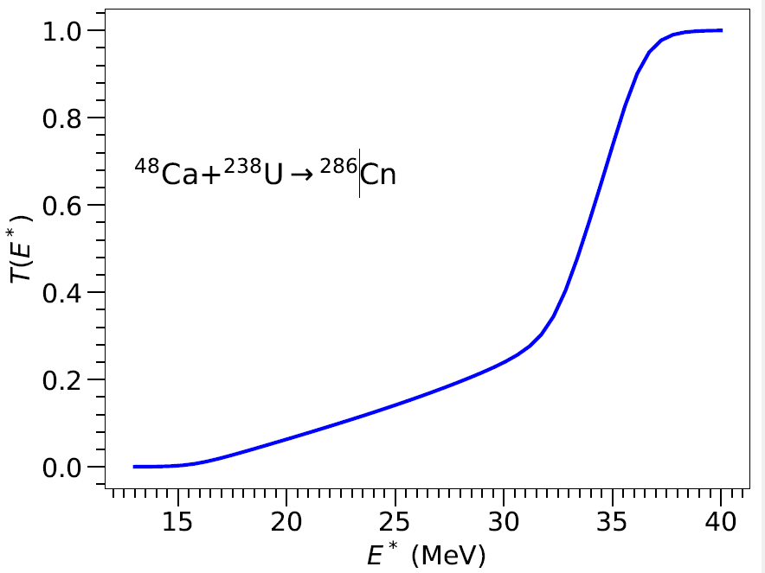
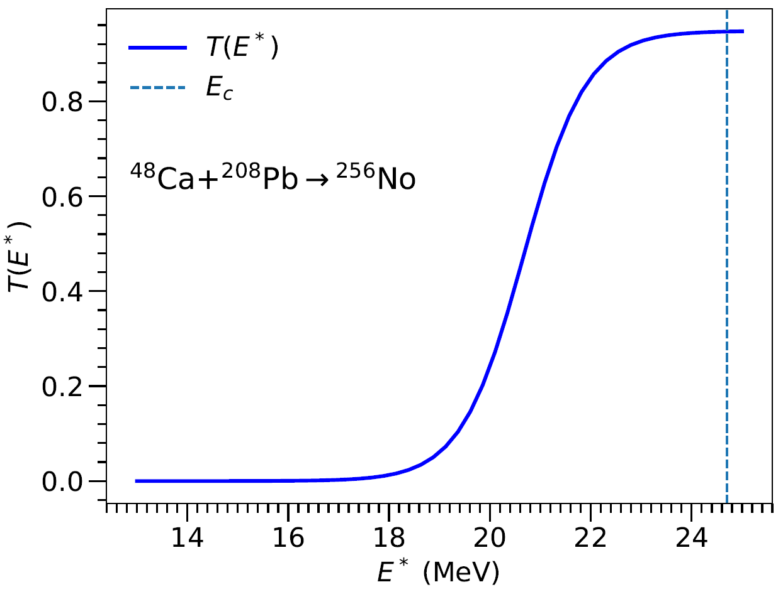
Capture
Integrate transmission prob over all angles

Slide 40
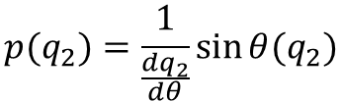
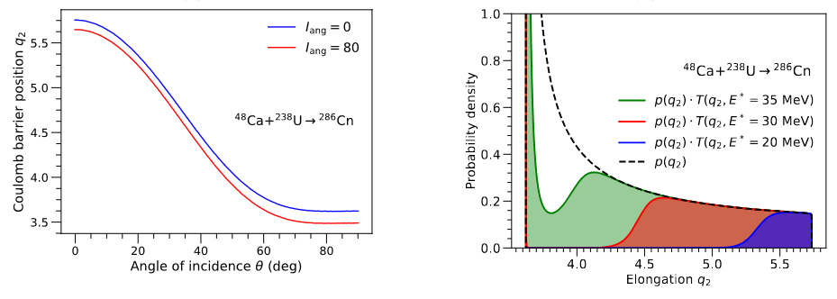
Capture
Variable transform angle into elongation
to get Coulomb barrier position distribution.
Coulomb barrier position determines injection point distance in the formation stage.

Slide 41
Linear systems method
Did not spend too much time on improving the linear systems method as the performance was already two orders of magnitude better
There are methods that can use starting guesses. You could try using them instead. This should improve the performance even further. One idea:
Inverse iteration aka inverse power method.

Slide 42
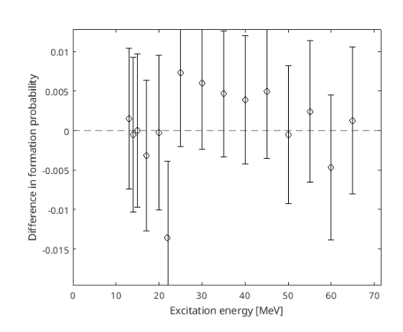


Method validation
Test eigenvector method against random walk algorithm.
15 calculations. 95% error bars
(0.95)^15 = 46% =>
Probability of at least one calculation being outside error bars = 54%

Slide 43
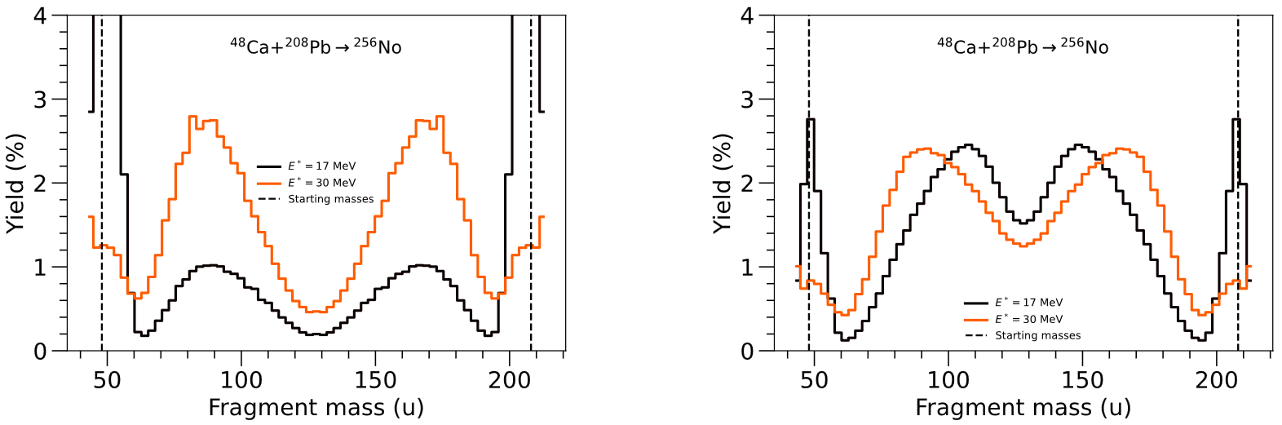
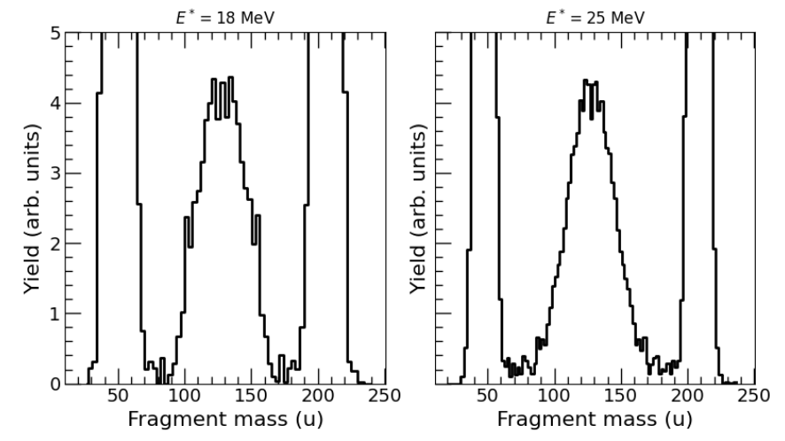
Prediction
Exp data:

Slide 44
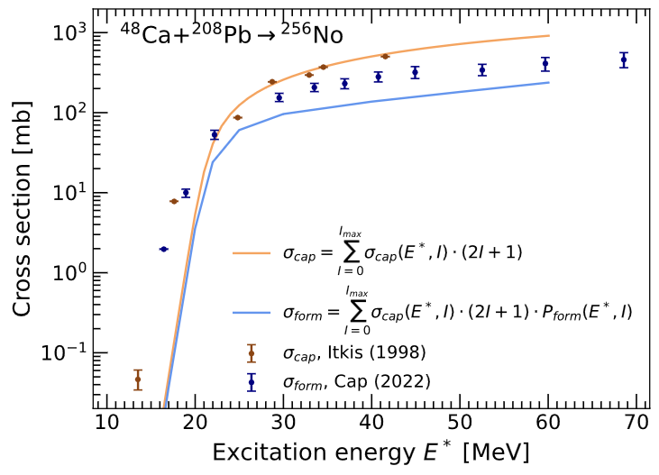
Results

Slide 45
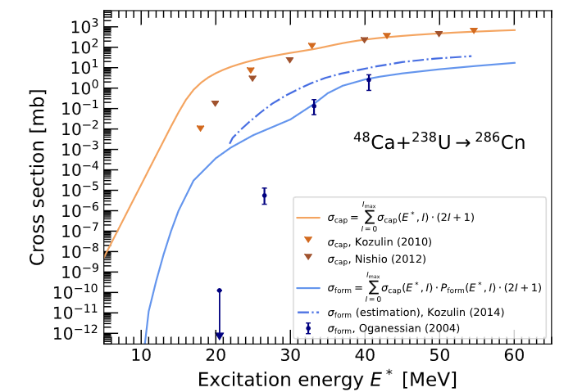

Results
Cn officially named 2010

Slide 46
3. Survival stage

Slide 47
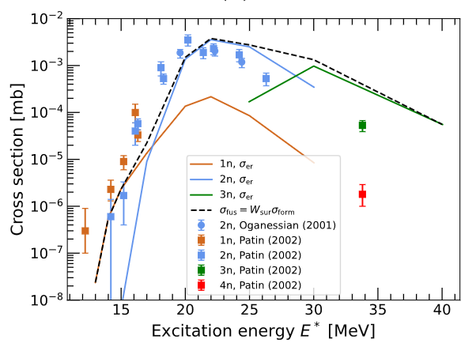
Results
Coulomb barrier position!
No discovered
1950s-1960s (disputed)

Slide 48
Thank you for listening!

Slide 49
Results
Cn officially named 2010

Slide 50
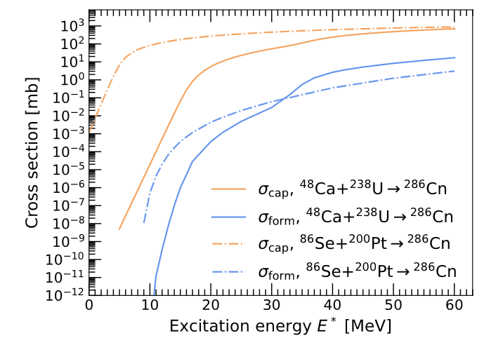
Results
Cn officially named 2010

Slide 51
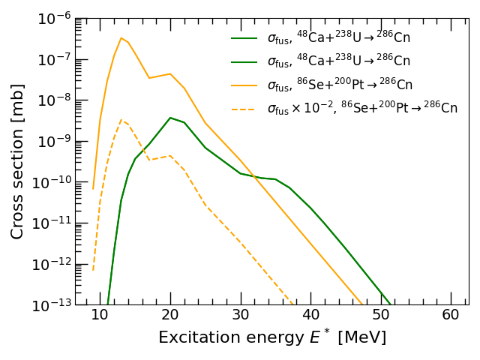
Results
Survival probability from
Kewpie2
Cn officially named 2010

Slide 52
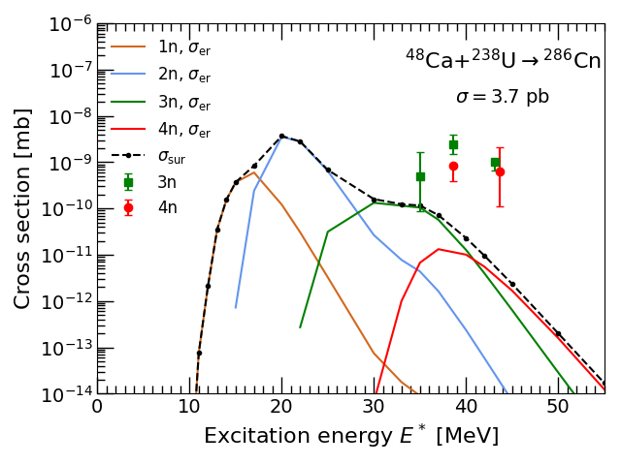
Results

Slide 53
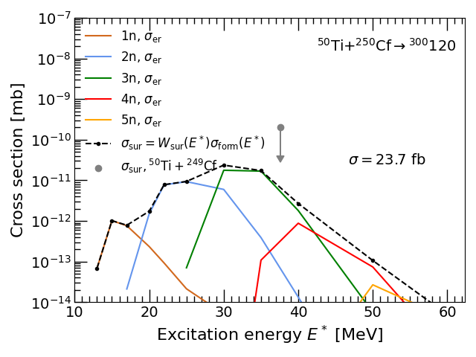

Results
Survival prob from
Kewpie2
Exp. Data for
In figure for
Coulomb barrier
299

Slide 54
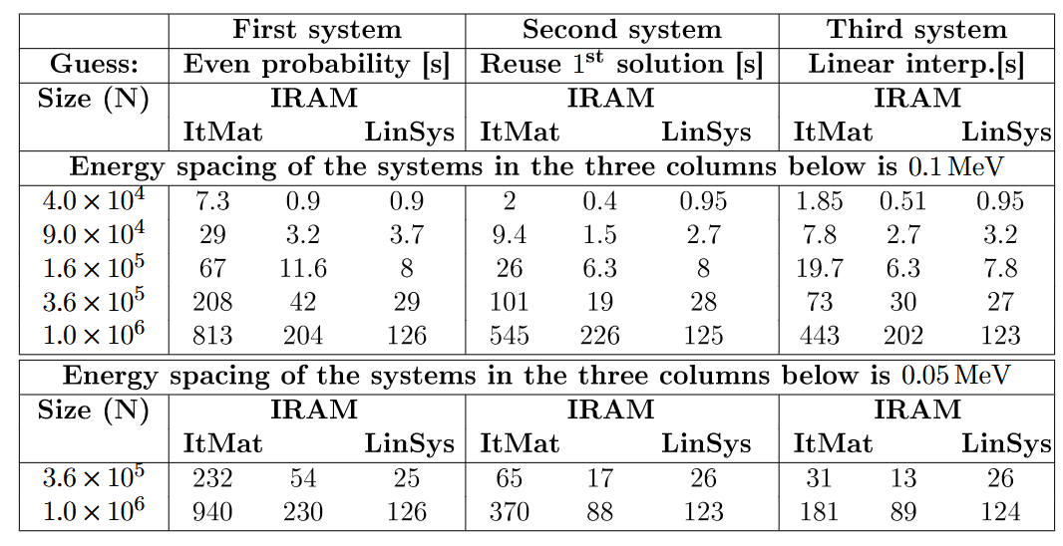
Method results

Slide 55
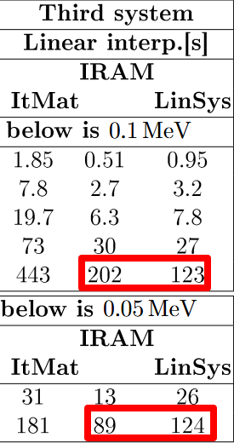
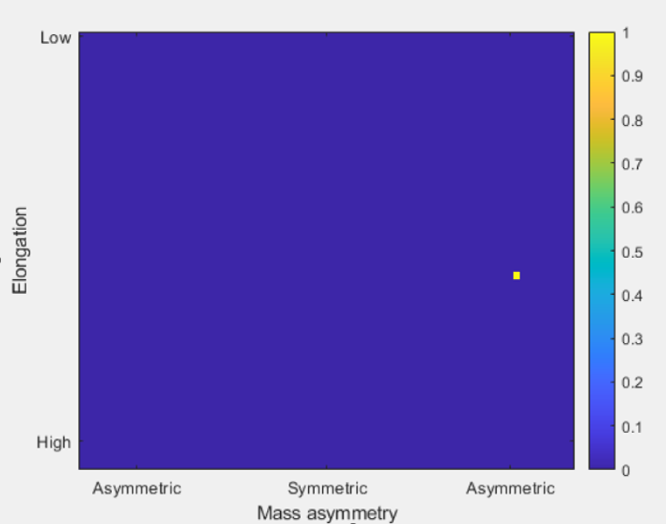
Method results

Slide 56

Ca-48 + U-238 Reaction

Slide 57


Slide 58


Slide 59


Slide 60


Spline

Slide 61




Coulomb barrier position!
Results
=
Survival probability
From (Z=114)
Not (Z=112)
Cn officially named 2010
Fl officially named
2012
Figure from Zagrebaev, Greiner (2015)

