Slide 1




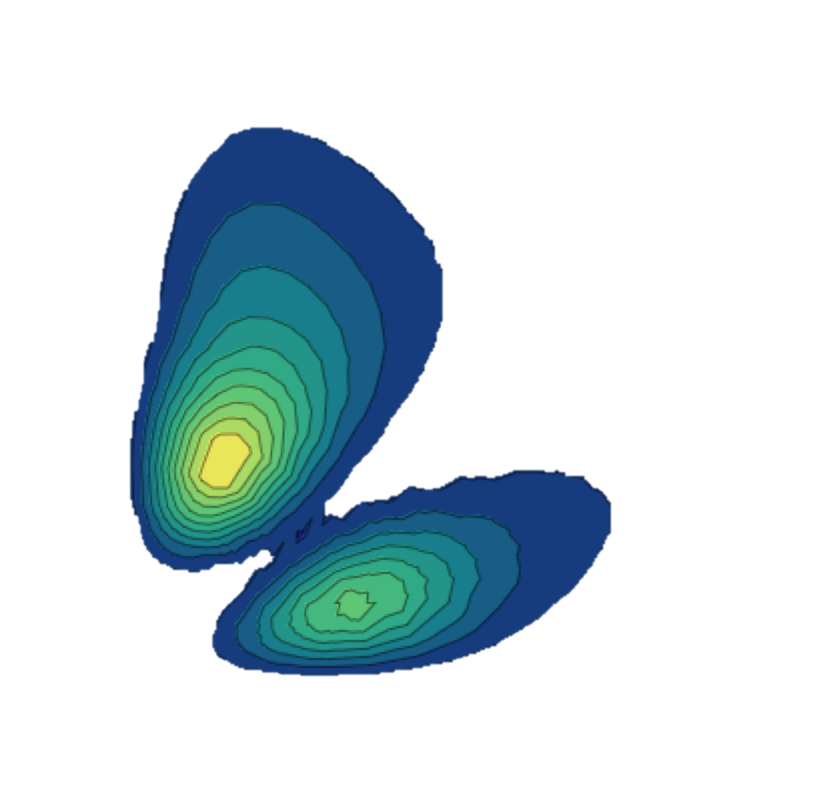

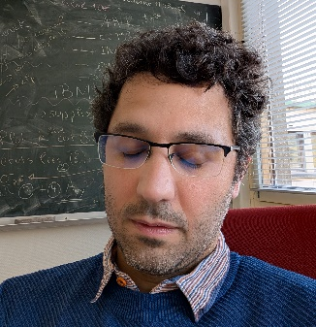


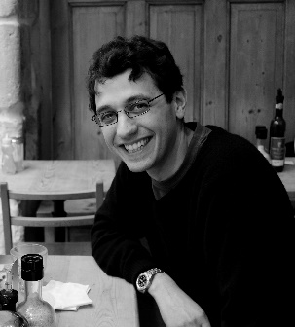



My expertise
Guillaume Hupin, CNRS IJClab
Degree in engineering and physics (condensed matter&radiation)
1st postdoc at LLNL with S. Quaglioni in ab initio reaction
My Phd in nuclear theory at GANIL, CAen
2nd Postdoc at CEA on nuclear structure
Gantt chart discovery
PhD students
Notes:
Good morning, my name is Guillaume Hupin. I am both a nuclear structure and reaction theoretician. Those two facets are necessary to describe exotic nuclei which lie close in energy to the reaction threshold. I seek to come to an understanding of nuclei starting from first principle that is starting from the underlying theory of QCD.

Slide 2
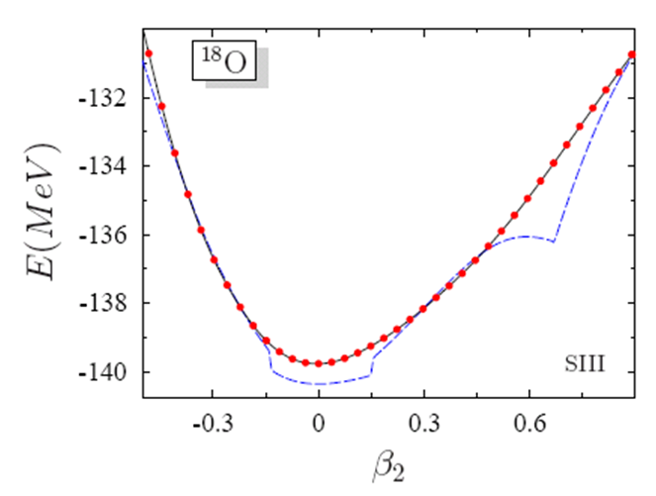
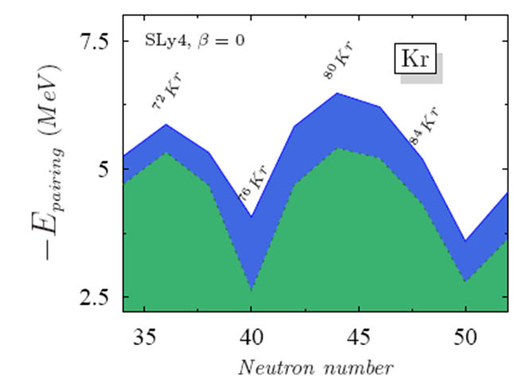
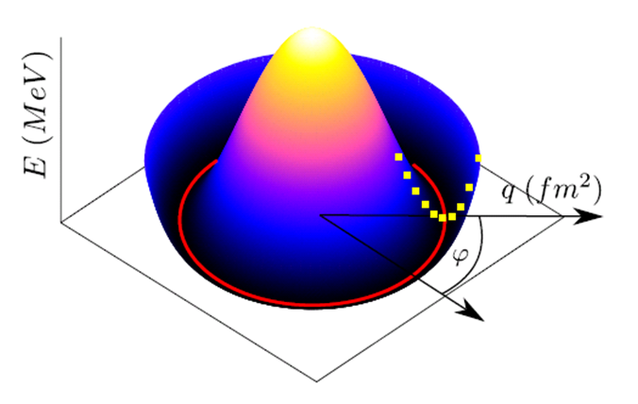
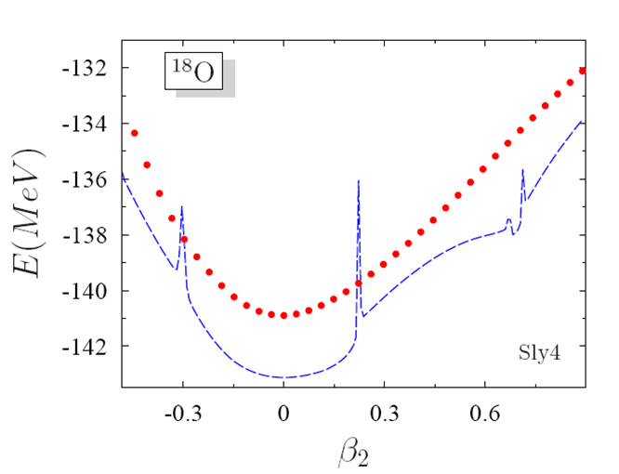
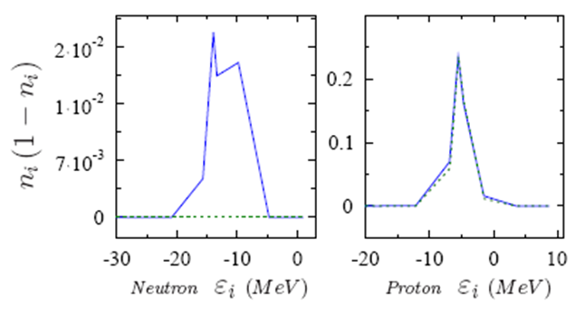
My PhD was initially to develop exact stochastic solutions for EDF fynamics
MR-EDF +regularize
SC-EDF
MR-EDF
non-regularized
VAP
BCS
No regularization
possible
⁷⁶Kr
VAP
BCS
SC-EDF
MR-EDF
non-regularized
I was already able to plot a Mexican hat ! (not in python🤔)
Most of these acronyms do not exist anymore…
So many nucleons at that time !

Slide 3
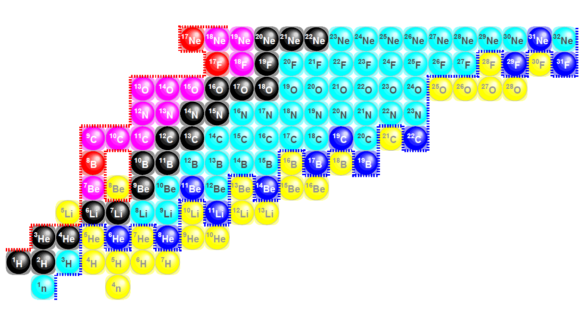

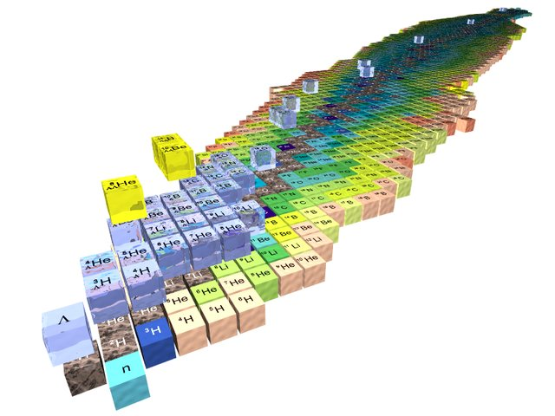
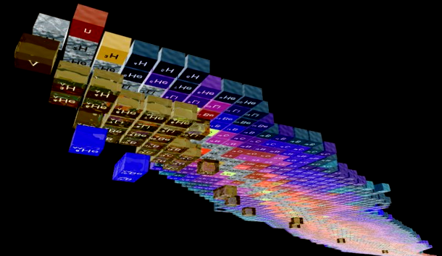

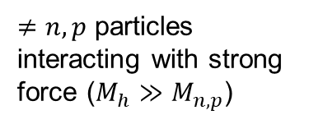
(i) Research directions
Complexity of scattering problem
Complexity of many-body solution
Both
$≠n,p$ particles interacting with strong force ($M_{h}≫M_{n,p}$)
Nuclear theory is data driven.
The lack of accuracy of ab initio structure methods impedes the development of reactions modeling.
$$M_{h}≤M_{n,p}$$
Credits H. Lenske

Slide 4

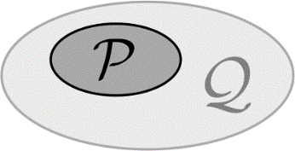
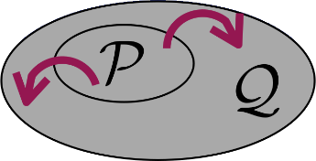
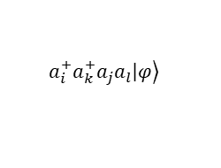

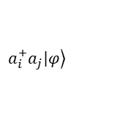
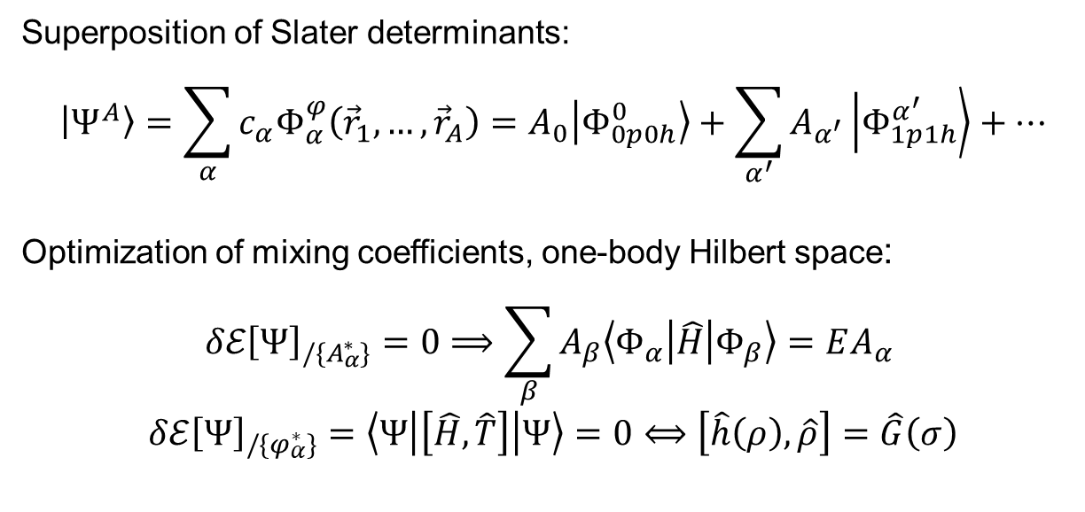
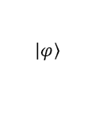
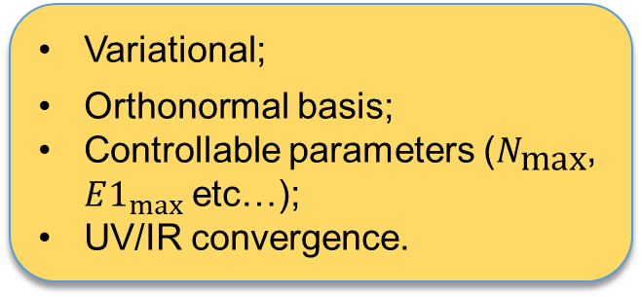

Configuration interaction methods suited for $A≫20$
active domain
Variational;
Orthonormal basis;
Controllable parameters ($N_{\text{max}}$, $E1_{max}⁡$etc…);
UV/IR convergence.
N_{max}
$$ℏΩ$$
$$ℋ$$
Adjustable
No-Core Shell Model
MpMh
Superposition of Slater determinants:
$$\left|\left.Ψ_{ }^{A}\right\rangle \right.=\sum_{α}{c_{α}Φ_{α}^{φ}\left({\vec{r}}_{1},…,{\vec{r}}_{A}\right)}=A_{0}\left|\left.Φ_{0p0h}^{0}\right\rangle \right.+\sum_{α^{′}}{A_{α^{′}}\left|\left.Φ_{1p1h}^{α^{′ }}\right\rangle \right.}+…$$
Optimization of mixing coefficients, one-body Hilbert space:
$$δℰ{\left[Ψ\right]}_{/\{A_{α}^{∗}\}}=0⟹\sum_{β}{A_{β}\left\langle Φ_{α} | \hat{H} | Φ_{β}\right\rangle }=EA_{α}$$
$$δℰ{\left[Ψ\right]}_{/\{φ_{α}^{∗}\}}=\left\langle Ψ | \left[\hat{H},\hat{T}\right] | Ψ\right\rangle =0⟺\left[\hat{h}\left(ρ\right),\hat{ρ}\right]=\hat{G}\left(σ\right)$$
Complexity
$$\left.\left|φ\right.\right\rangle$$
NCSM
IM-SH
MpMh
$$\left.a_{i}^{+}a_{j}\left|φ\right.\right\rangle$$
$$\left.a_{i}^{+}a_{k}^{+}a_{j}a_{l}\left|φ\right.\right\rangle$$
  Collaborators
  N. Pillet (CEA)
  N. Smirnova (IP2IB)
  Collaborator
  P. Arthuis
Generalized Brillouin (GB) equation
“In-Medium” Shell Model

Slide 5
(ii) Research directions
Complexity of scattering problem
Complexity of many-body solution
Both
$≠n,p$ particles interacting with strong force ($M_{h}≫M_{n,p}$)
Nuclear theory is data driven.
Few-body techniques scale very bad with the number of constituents in the continuum.
$$M_{h}≤M_{n,p}$$
Credits H. Lenske
Notes:
The research axis is basically two-fold:
1- More complex reactions
2- Towards heavier mass systems
In higher resolution:
We want to study halo nuclei with full glory NN+3N interaction
Study break up and FSI
Etc…

Slide 6
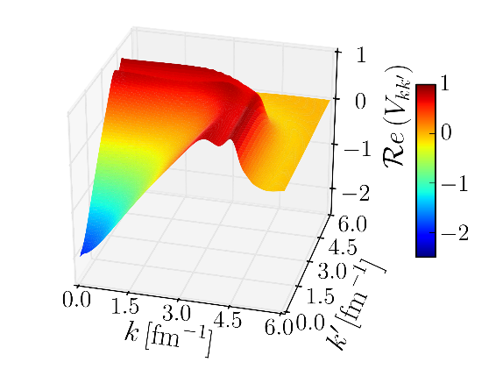
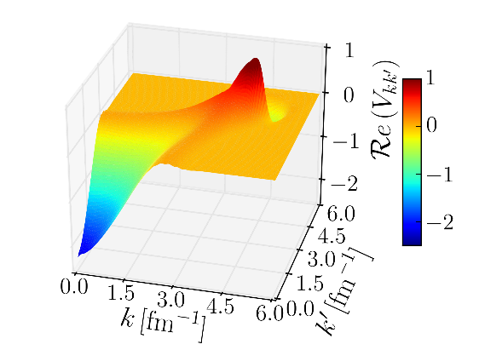
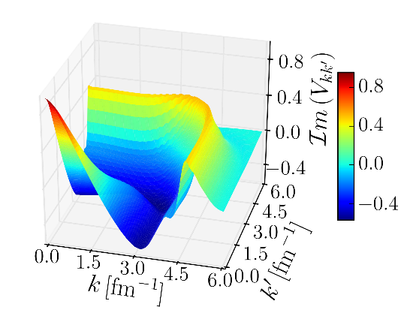
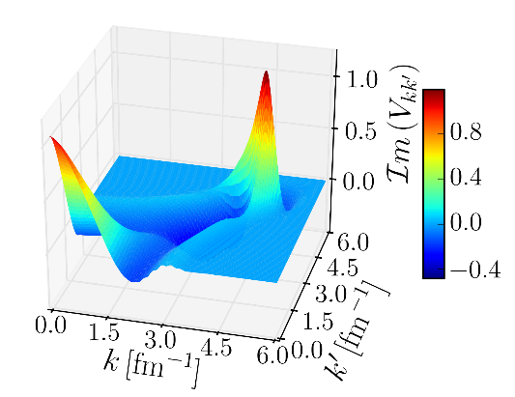
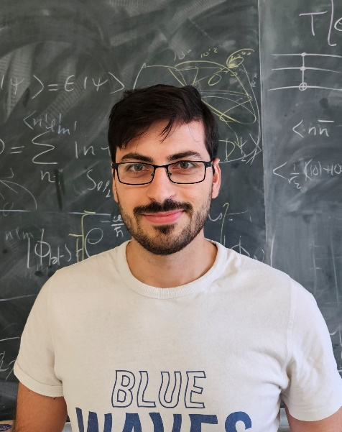
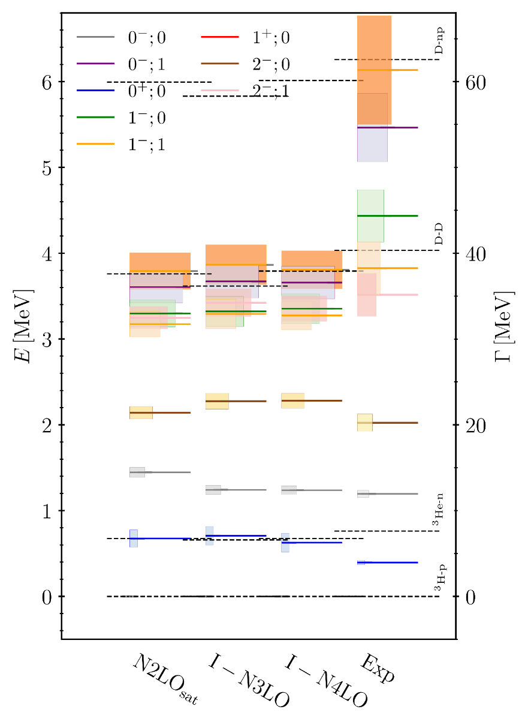
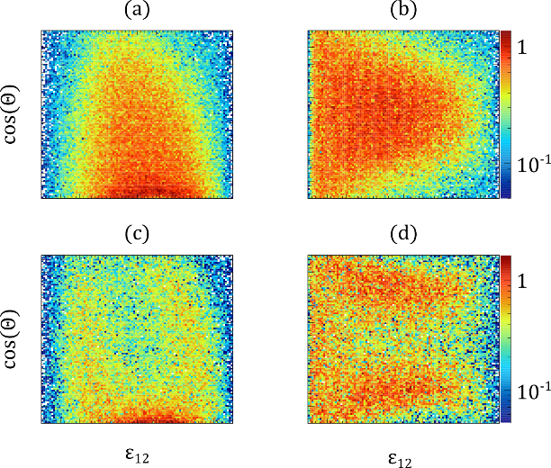
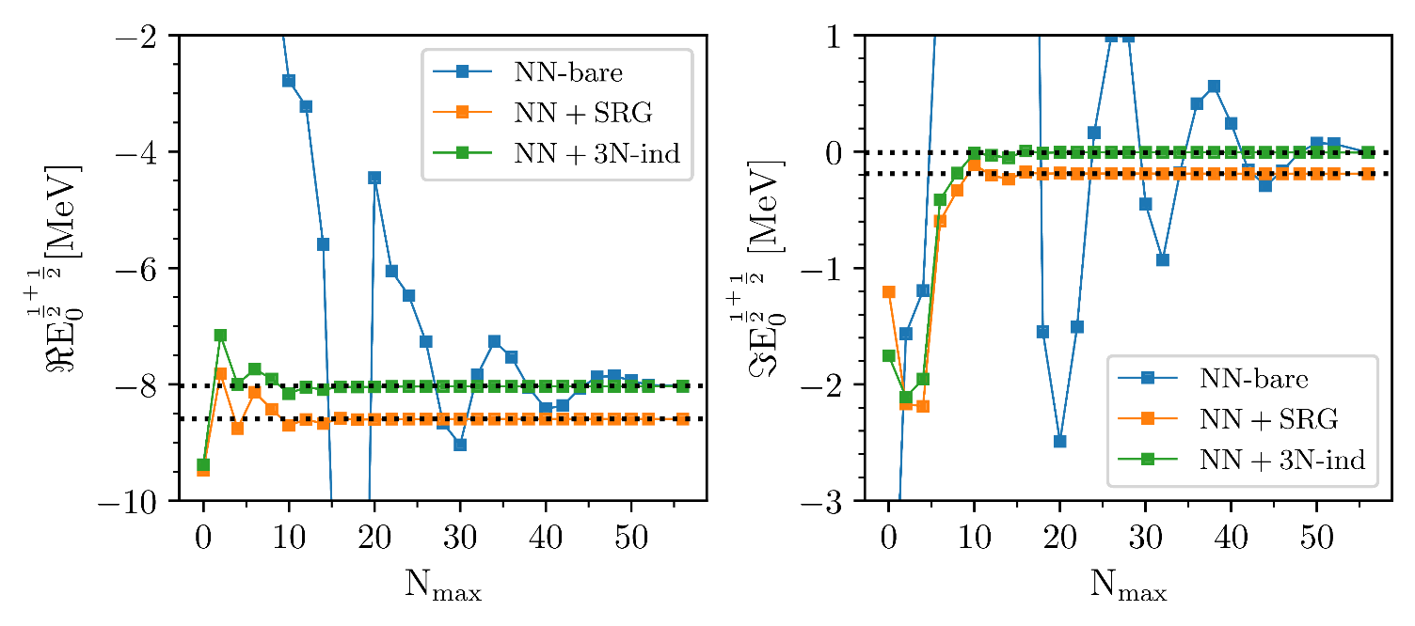
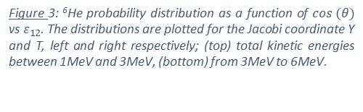
Complex Scaling the FY technique to supplement now established NCSMC
  Collaborators
  O. Yaghi (PhD)
  Collaborators
  R. Lazauskas (CNRS)
  T. Frederico (ITA)
  M. Gattobigio (UCA)
  J. Carbonell (Gif)
  ANR FCUBES
🏖️
Game changer
Figure 3: ⁶He probability distribution as a function of $cos (θ)$ vs $ε_{12}$. The distributions are plotted for the Jacobi coordinate Y and T, left and right respectively; (top) total kinetic energies between 1MeV and 3MeV, (bottom) from 3MeV to 6MeV.
Notes:
Before we get to the actual calculation we have to deal with the so call hard-core problem. That is the fact that the potential will connect states included in the many body calculation to state that are not. For instance in this plot of the two-nucleon force in momentum space …. In this work, we use the SRG method to soften the interaction. It consists in a set of unitary transformation that will drive the Hamiltonian to a prediagonal form suitable for the NCSM.
Important things are that the unitary transformation by design preserve the physics while decoupling low and high momentum however this will induce extra many-body forces.
Once the interaction is evolved we can cut it to the scale of the many-body theory.

Slide 7
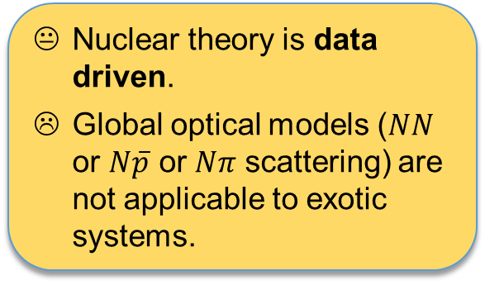
(iii) Research directions
Complexity of scattering problem
Complexity of many-body solution
Both
$≠n,p$ particles interacting with strong force ($M_{h}≫M_{n,p}$)
Nuclear theory is data driven.
Global optical models ($NN$ or $N\overline{p}$ or $Nπ$ scattering) are not applicable to exotic systems.
$$M_{h}≤M_{n,p}$$
Credits H. Lenske
Notes:
The research axis is basically two-fold:
1- More complex reactions
2- Towards heavier mass systems
In higher resolution:
We want to study halo nuclei with full glory NN+3N interaction
Study break up and FSI
Etc…

Slide 8











Building block - Chiral EFTs
Weinberg ‘90’91’92 Ordóñez and vK ’92 etc…
Importance
$$𝒪(1)$$
$$𝒪(Q/M_{hi})$$
A. Tichai, et. al. Front. Phys. 8, 164 (2020)
Friar ’97
High quality nuclear interactions (at N³LO).
Various fits and successes.
Weinberg PC wrong: no renormalizability.
Correct power counting: active research
Development of improved power counting $⟶$ high-precision/high-orders.
Stability of p-shell nuclei.
How does chiral expansion perform under forthcoming LQCD data?
Notes:
Chiral effective field theory was proposed by Weinberg in the 90’ using naive dimensional analysis in the power counting.
In this PC, high-order chiral EFT perform well and allow many-body practitioners to have high-quality nuclear interactions thus to connect to experiments.
For instance, I show the evolution of binding energy of Oxygen and Calcium isotopes using many-body perturbation theory (2nd order +N3LO) from the contributors.
Already, several fitting procedures of LEC exist and produce interaction of various quality.
There is a strong interest in the community to depart from Weinberg PC, which we know to be non-renormalizabled. Others PC are being developed: see the scribble on the slide.
In France, there is a strong research program going forward in that direction, at this stage the goals are:

Slide 9
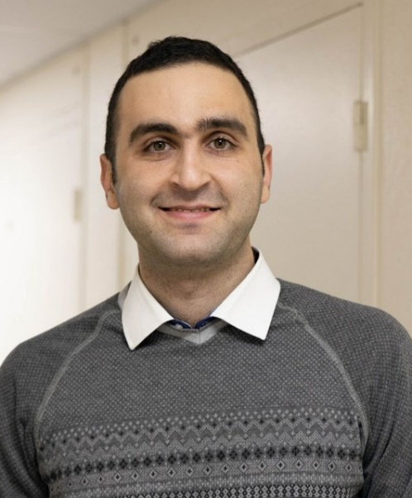

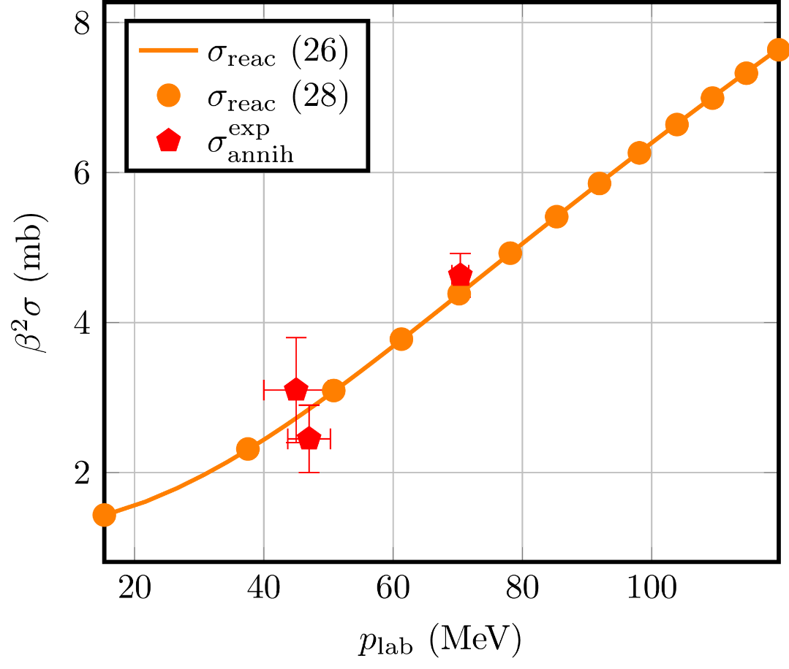

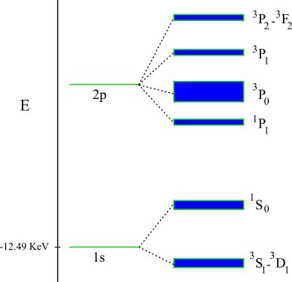
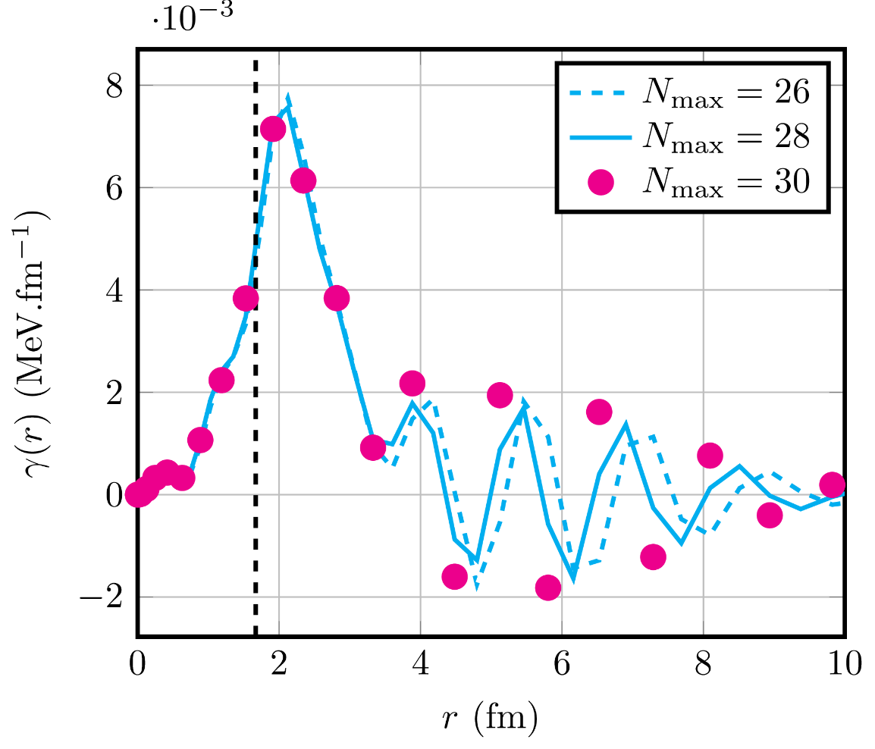
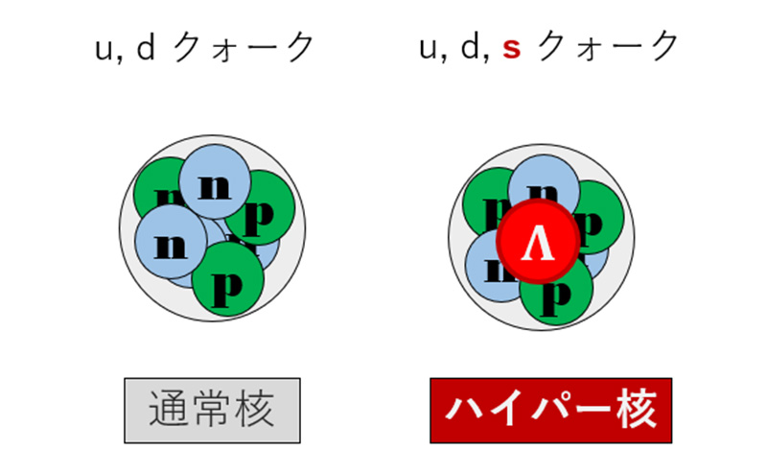
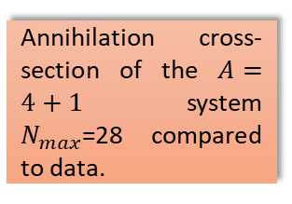


Level shifts and annihilation cross-section
  Collaborators
  Dehghani (PhD)
  F. Wu (PD)
Annihilation cross-section of the $A=4+1$ system $N_{max}\text{=}\text{28}$ compared to data.
$$V\left(r\right)$$
$$r$$
Coulomb
Nuclear
Annihilation
We can do other “exotic” (not neutron) systems
Annihilation density of the antiproton in the helium system.
  Collaborators
  E. Hiyama (RIKEN/UoTohoku)
  Chair d’Alembert

Slide 10

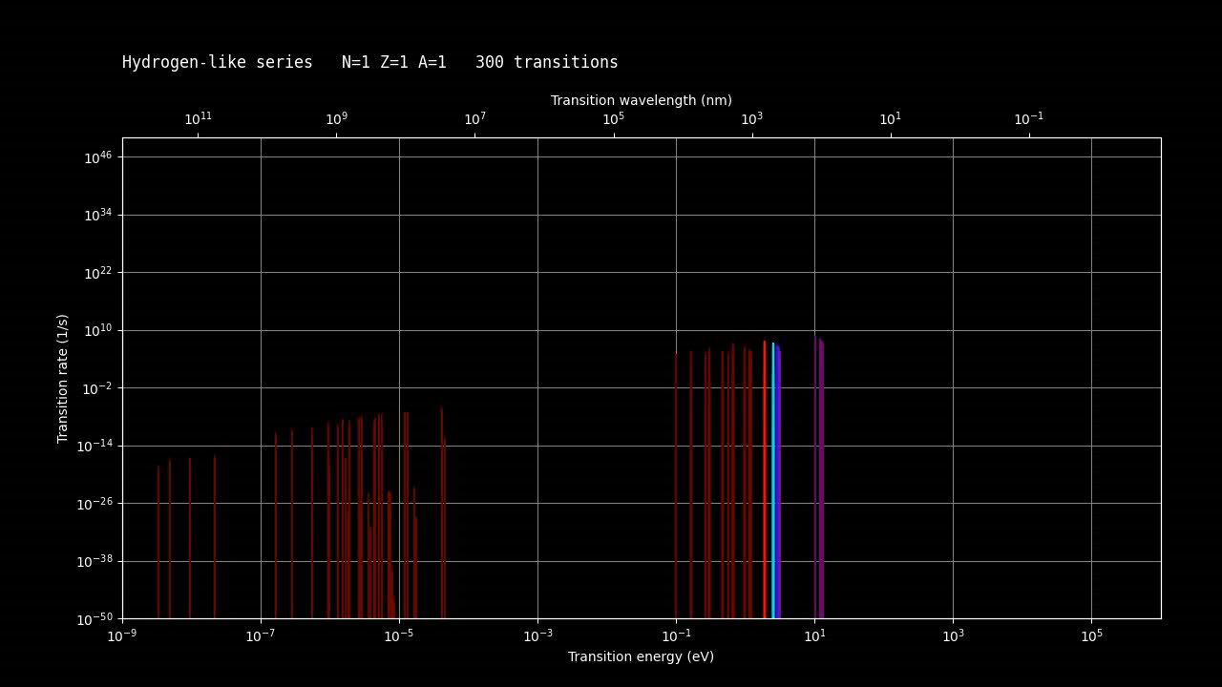
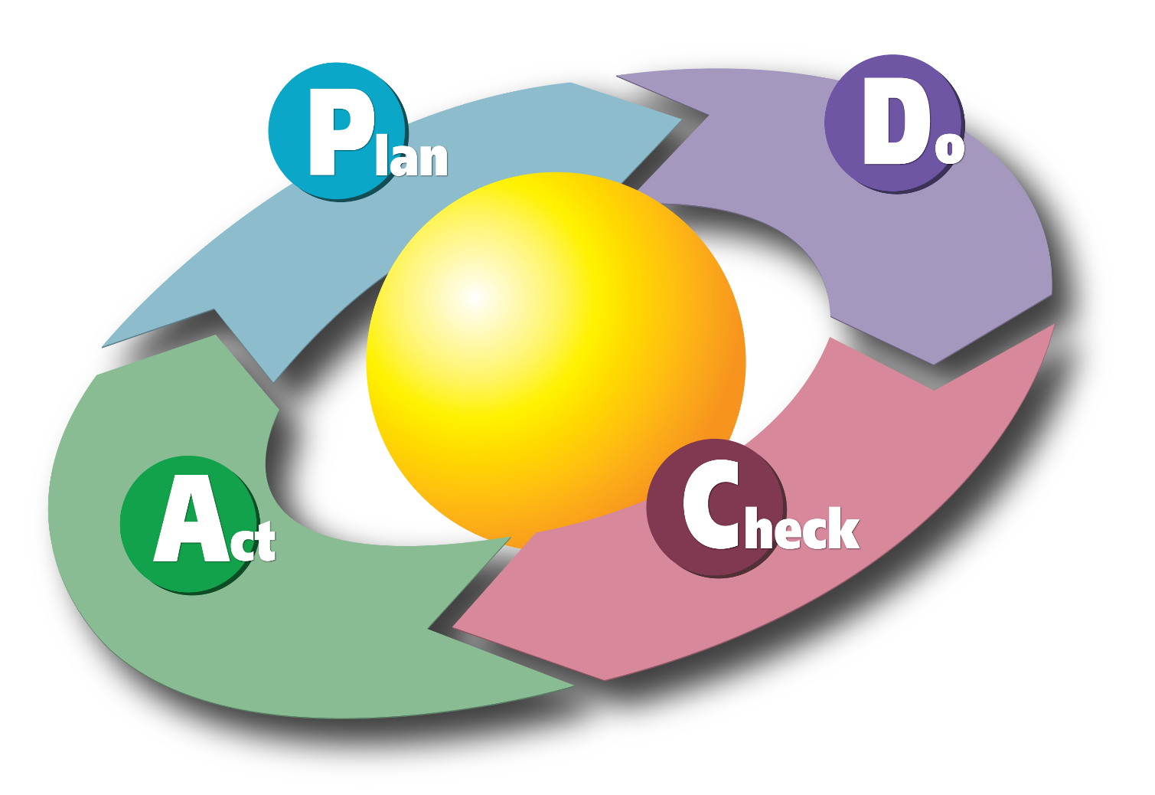
Artificial Intelligence (a.k.a. big fit with lots of parameters)
Dataset to train AI >> NIST repository
(BTW they got fired!)
  Collaborators
  D. Becht (PhD)
  P. Indelicato (LKB)
  N. Pillet (CEA)
Hyperparameters
Run many-body code
Generate DATA
Do the same for nuclear W.F. in CI, i.e. predict subspace of the Hilbert space to perform diagonalization
Train an ANN

