Slide 1
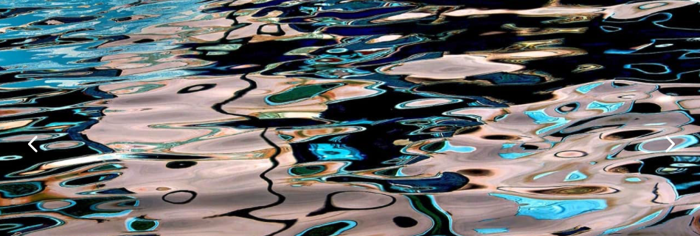
Uncertainty quantification in nuclear reactions
Work supported by NSF-CSSI, DOE-NP and MSU
https://imagesofvenice.com
Filomena Nunes
Michigan State University
Michigan State University occupies the ancestral, traditional, and contemporary Lands of
the Anishinaabeg–Three Fires Confederacy of Ojibwe, Odawa, and Potawatomi peoples.
The University resides on Land ceded in the 1819 Treaty of Saginaw.

Slide 2
Outline
The physical model
  optical potentials in reactions
Prior knowledge
The evidence
The likelihood
Calibration: examples
Conclusions
Color code:
Nuclear physics background
Statistical model

Slide 3
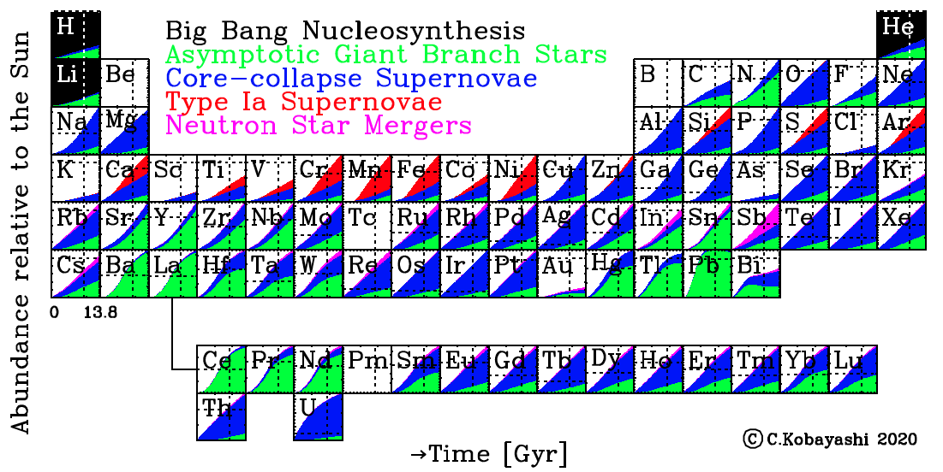
Where did nuclei come from?
How were they produced?
Kobayashi, Karakas, Lugaro, ApJ 2020
Notes:
ApJ The time evolution (in Gyr) of the origin of elements in the periodic table: Big Bang nucleosynthesis (black), AGB stars (green), core-collapse supernovae including SNe II, HNe, ECSNe, and MRSNe (blue), SNe Ia (red), and NSMs (magenta). The amounts returned via stellar mass loss are also included for AGB stars and core-collapse supernovae depending on the progenitor mass. The dotted lines indicate the observed solar values.

Slide 4
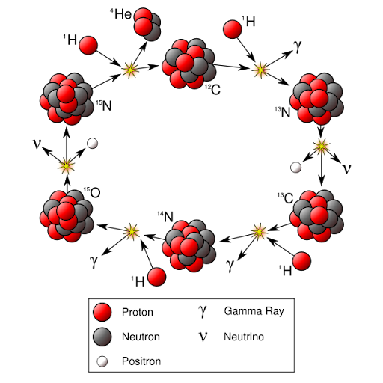
Reactions are key to answering these big science questions
It is through a bunch of reactions that we produce the elements we see on Earth
Example: CNO cycle which takes place in our favorite star
Notes:
ApJ The time evolution (in Gyr) of the origin of elements in the periodic table: Big Bang nucleosynthesis (black), AGB stars (green), core-collapse supernovae including SNe II, HNe, ECSNe, and MRSNe (blue), SNe Ia (red), and NSMs (magenta). The amounts returned via stellar mass loss are also included for AGB stars and core-collapse supernovae depending on the progenitor mass. The dotted lines indicate the observed solar values.

Slide 5
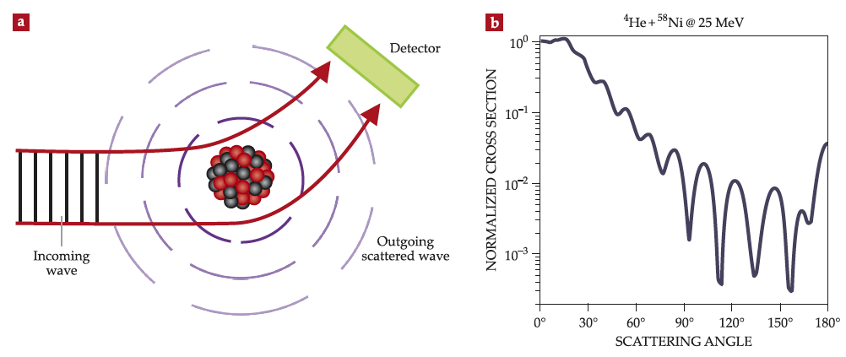
Nuclear reactions offer unique probes to explore our big science questions
We make beams of exotic rare isotopes and smash them onto a target!

Slide 6
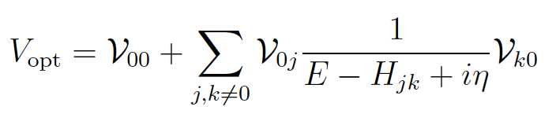
The Optical Potential is an essential ingredient in reaction theory
V_{NN}
U_{opt}
It’s the projection of the many-body scattering problem on the ground state:
End up with a single-channel scattering equation with potential:
Hebborn, Nunes, et al., JPG 50, 060501 (2023)

Slide 7
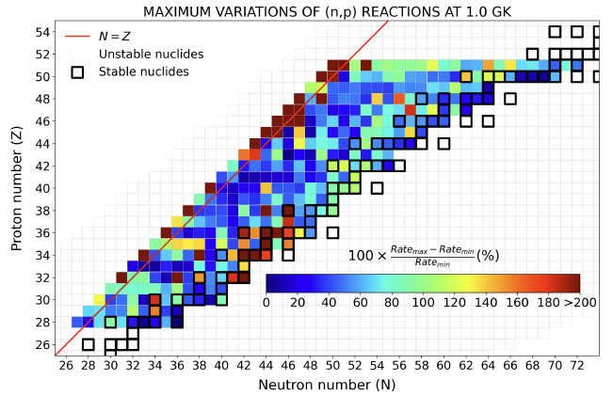
Optical potentials are pervasive in reaction models
Inputs necessary for (n,g); (p,g); (p,n); (n,p); (d,p); (d,n); …
Inputs also for breakup, knockout and transfer on heavier probes
Reaction observables are very sensitive to details of the optical potential.
OP is a main source of uncertainty
Need uncertainty quantification!
Hebborn, Nunes, et al., JPG 50, 060501 (2023)

Slide 8
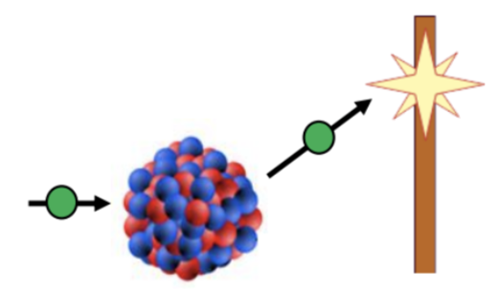
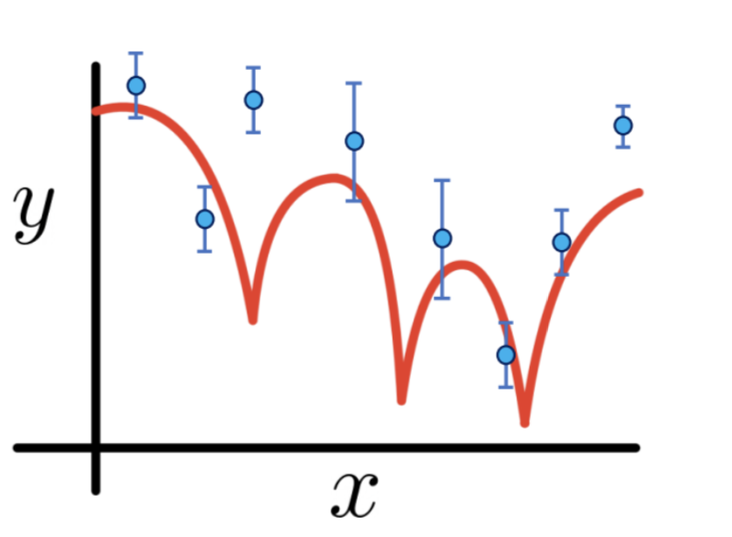

Physical model: optical model
[T+U_{opt}(R)-E]ψ=0
The model has a set of parameters
U_{opt}( R )= V f(R, r, a) + W f(R, r_{w}, a_{w}) + W_{s} f(R, r_{s}, a_{s}) + V_{so} + V_{C}
calibrated with reaction data
(phenomenological optical potentials)
A DEEPER UNDERSTANDING OF THE INPUTS FOR REACTION THEORY THROUGH UNCERTAINTY QUANTIFICATION
Amy Lovell (PhD thesis 2018)

Slide 9
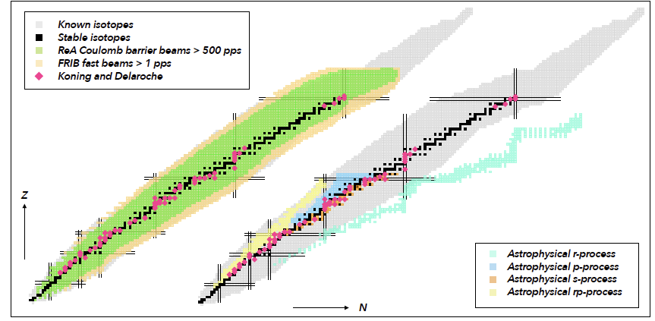
Phenomenological potentials fitted to stable nuclei
I pick one isotope + one reaction
determine local OP
Hebborn, Nunes, et al., JPG 50, 060501 (2023)

Slide 10


Phenomenological potentials fitted to stable nuclei
Kyle Beyer
Global OP calibration (this afternoon)
Sam Sullivan
OP calibration along an isotopic chain (Thu)
Hebborn, Nunes, et al., JPG 50, 060501 (2023)

Slide 11
Outline
The physical model
  optical potentials in reactions
Prior knowledge
The evidence
The likelihood
Calibration: examples
Conclusions
Color code:
Nuclear physics background
Statistical model

Slide 12
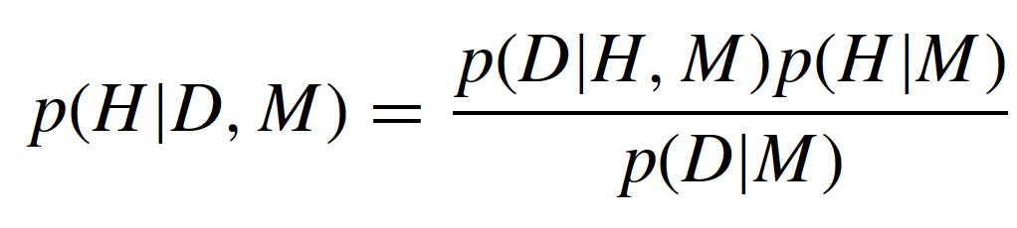
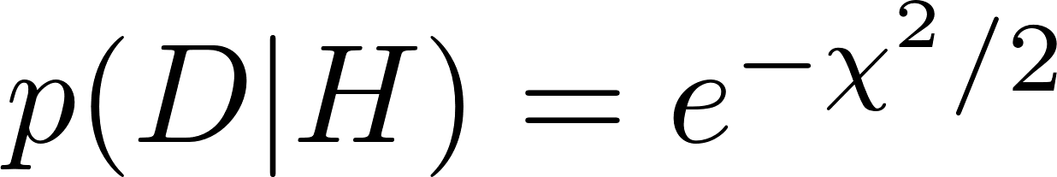
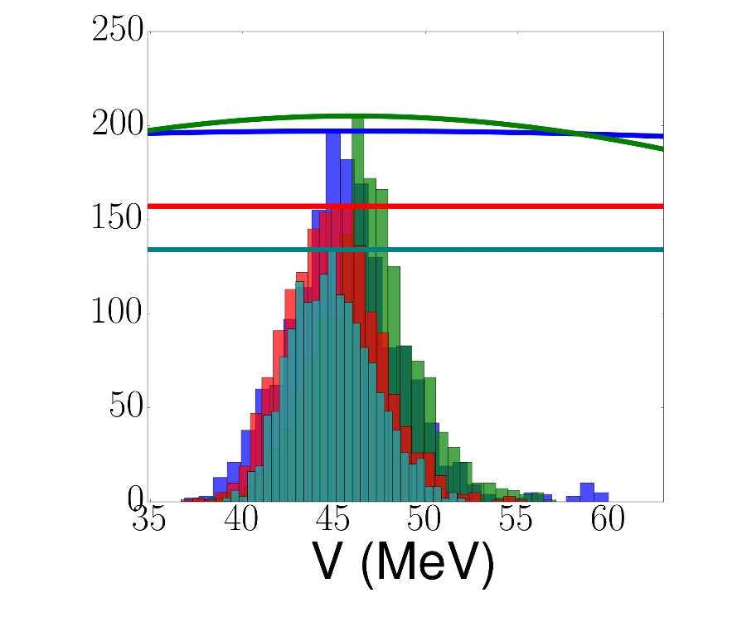
Bayesian analysis: prior knowledge
prior distribution of parameters H given model M
Gaussian distribution:
Mean value: global optical potential from global chi2 fits performed decades ago
(BG, CH, KD)
Width: 20% or 50% depending on the problem
nuclear theory
statistics
nuclear experiment
Optical Potential

Slide 13
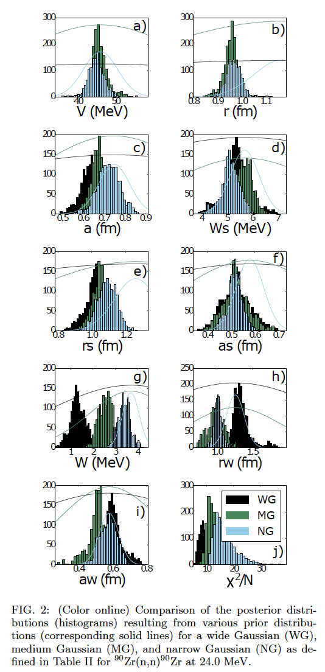
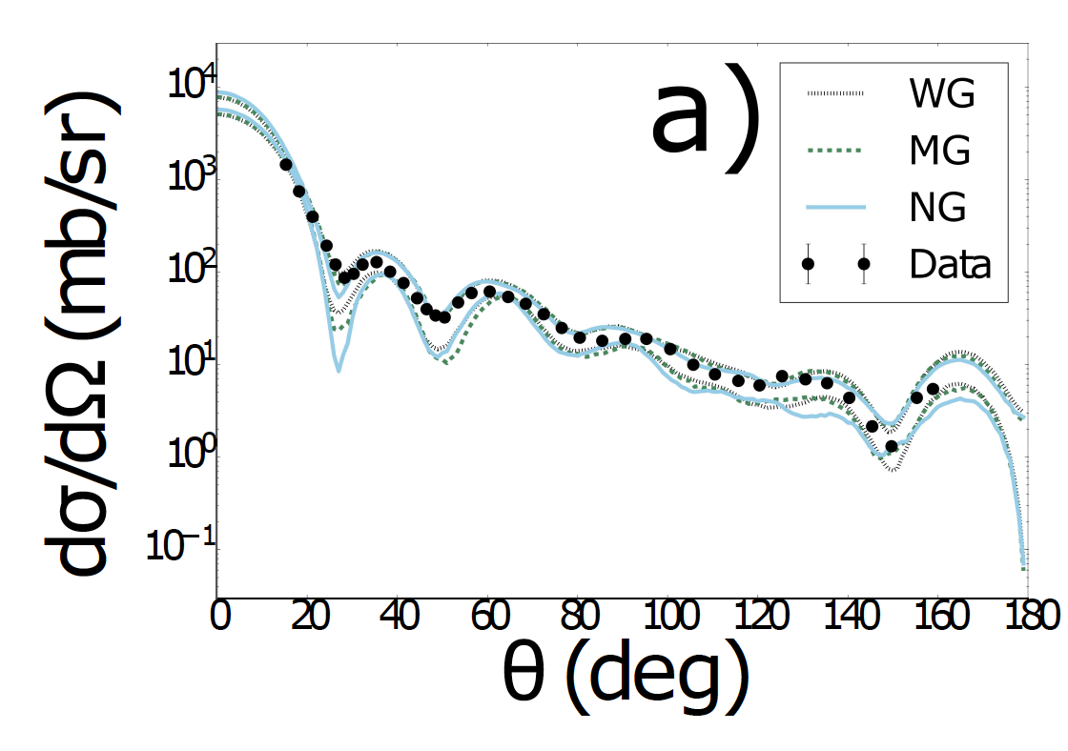
What prior to use?
How confident are you in your prior knowledge?
⁹⁰Zr(n,n) @24 MeV
Lovell and Nunes PRC (2018)

Slide 14
Bayesian analysis: the data
elastic scattering: angular distributions
total cross sections, polarization data, etc
- real exp data with evaluated errors
- mock data using KD with 10% errors
Data constraints
nuclear theory
statistics
nuclear experiment
⁹⁰Zr(n,el)
E=24 MeV
Optical Potential

Slide 15
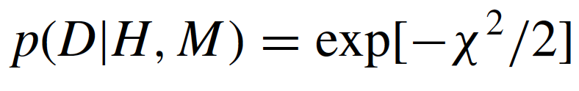
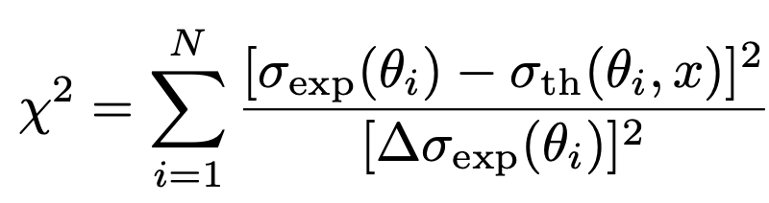

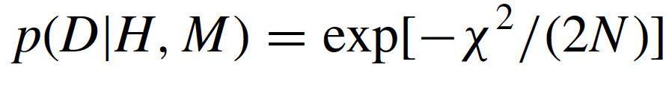
Bayesian analysis: the likelihood
no correlations and errors normally distributed
rescale chi2 by the degrees of freedom
(d=N_{data} - N_{parameters})
If N_{data} >> N_{parameters}

Slide 16
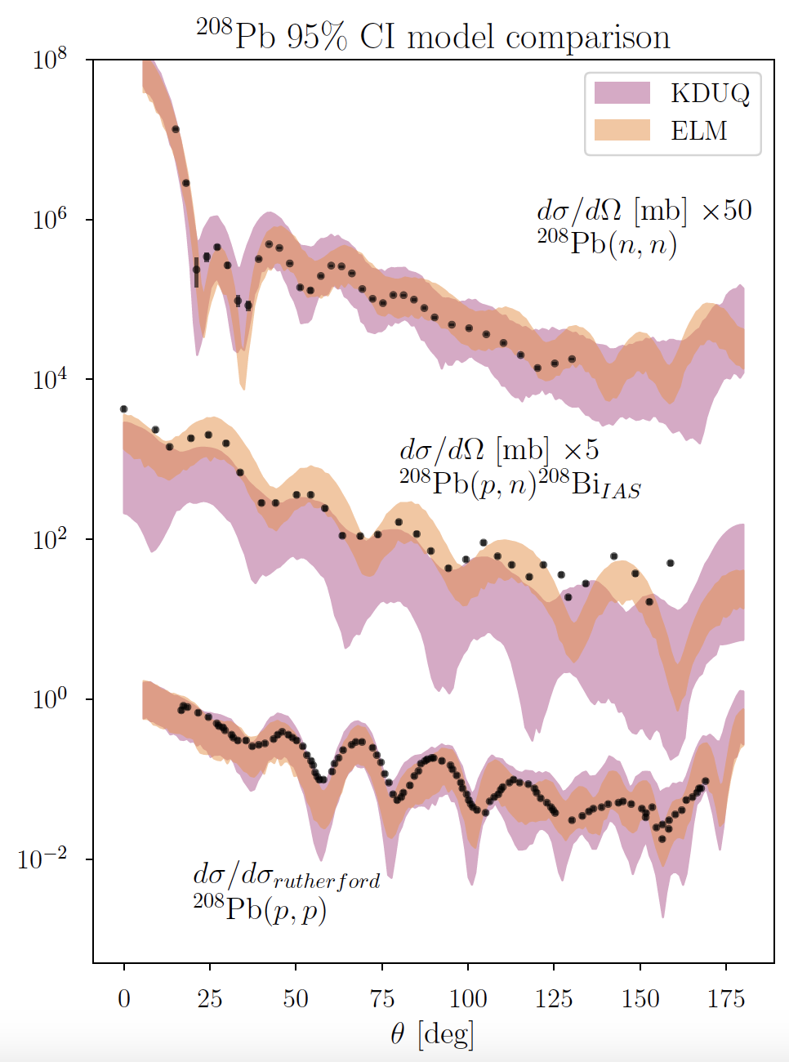
Bayesian analysis: the likelihood with correlations (the real thing)
Including data correlations in likelihood:
typically not used because
covariance is usually not known in reactions experiments
Recognition that doubling the angles in the measurement contains essentially the same information – introduction of 1/N scaling

Slide 17
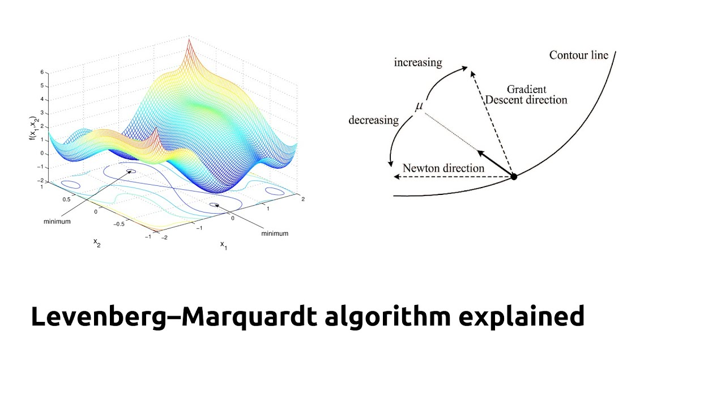
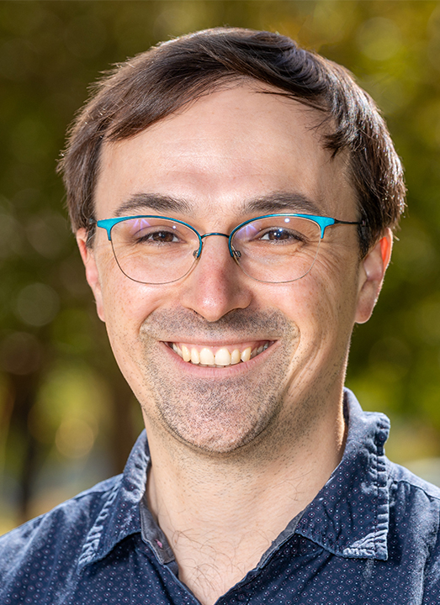
Frequentist versus Bayesian approach
  Frequentist Chi2 minimization
Bayesian MCMC:
emcee - Goodman-Weare stretch-move proposal distribution
affine-invariant (not affected by the scaling or shape of the target distribution)
uses an ensemble of walkers to propose moves
more efficient, especially for highly skewed or badly scaled problems, due to a lower autocorrelation time
Interpolates between Newton and gradient-descent: better numerical stability and converges faster than standard gradient descent.
Study lead by Cole Pruitt in collaboration with
Amy Lovell,
Chloe Hebborn,
Filomena Nunes
PRC (2024)

Slide 18
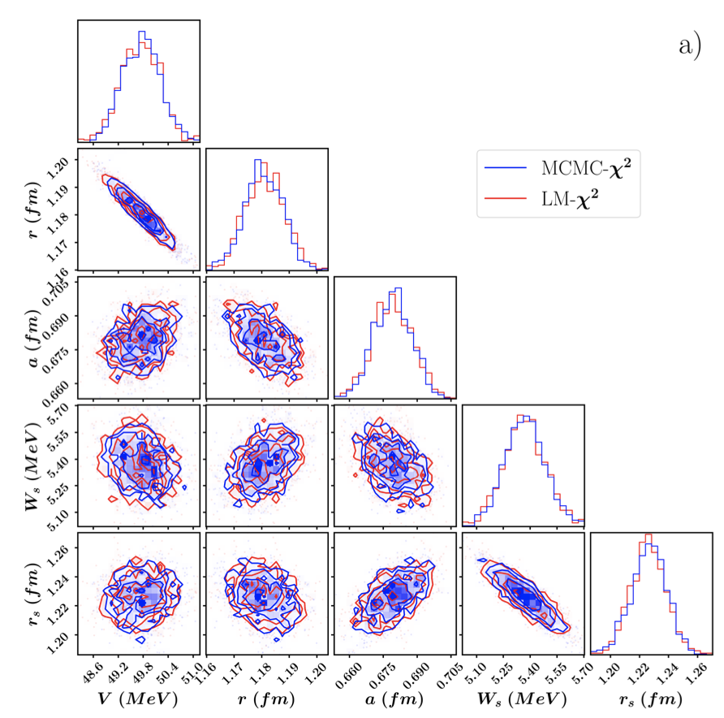
Application: OP with 5 parameters
⁹⁰Zr(n,n) @10 MeV
N_{data}=36
Frequentist (red) Bayesian (blue)
same likelihoods+priors
produce same posteriors
Pruitt, Lovell, Hebborn, Nunes, PRC 110, 064606 (2024)

Slide 19
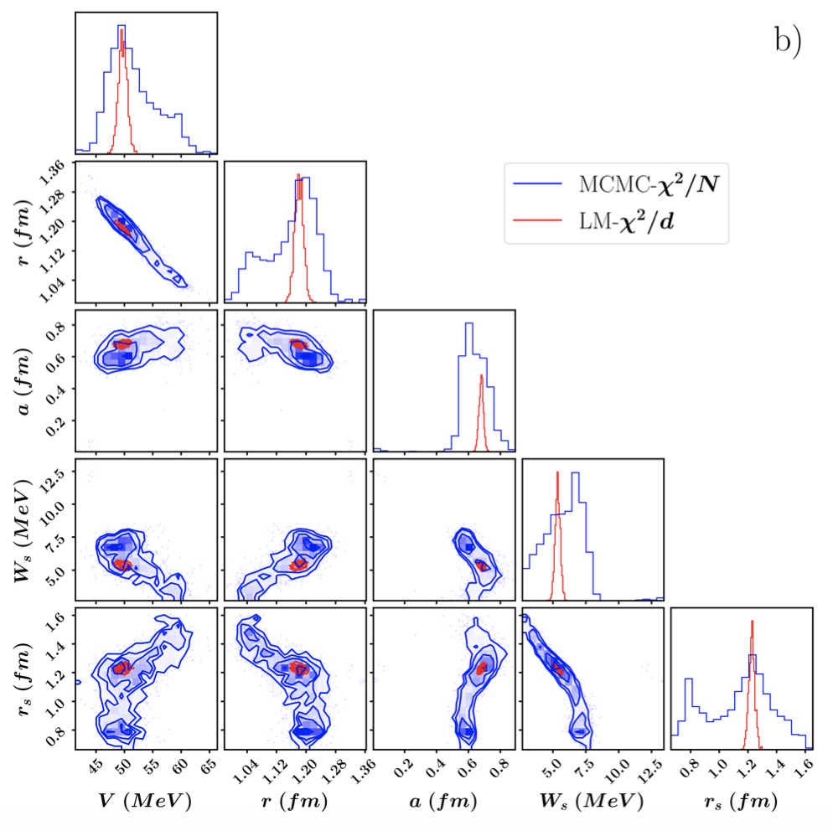
Application: OP with 5 parameters scaled
⁹⁰Zr(n,n) @10 MeV
Frequentist (red) Bayesian (blue)
Different likelihood scaling allows MCMC to sample a wider region of parameters space
And results in different posteriors
Pruitt, Lovell, Hebborn, Nunes, PRC 110, 064606 (2024)

Slide 20
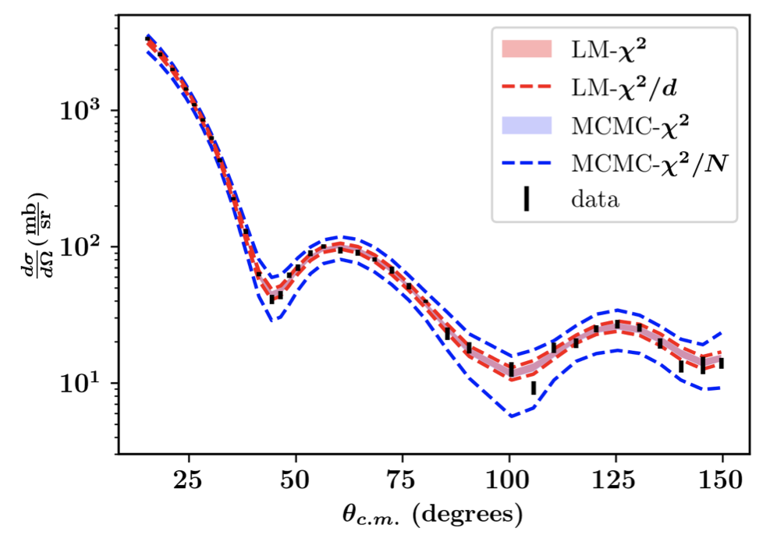
Application: OP with 5 parameters
⁹⁰Zr(n,n) @10 MeV
The scaling effectively inflates the error by sqrt(N)
MCMC with 1/N scaling produces credible intervals roughly sqrt(N) wider
Pruitt, Lovell, Hebborn, Nunes, PRC 110, 064606 (2024)

Slide 21
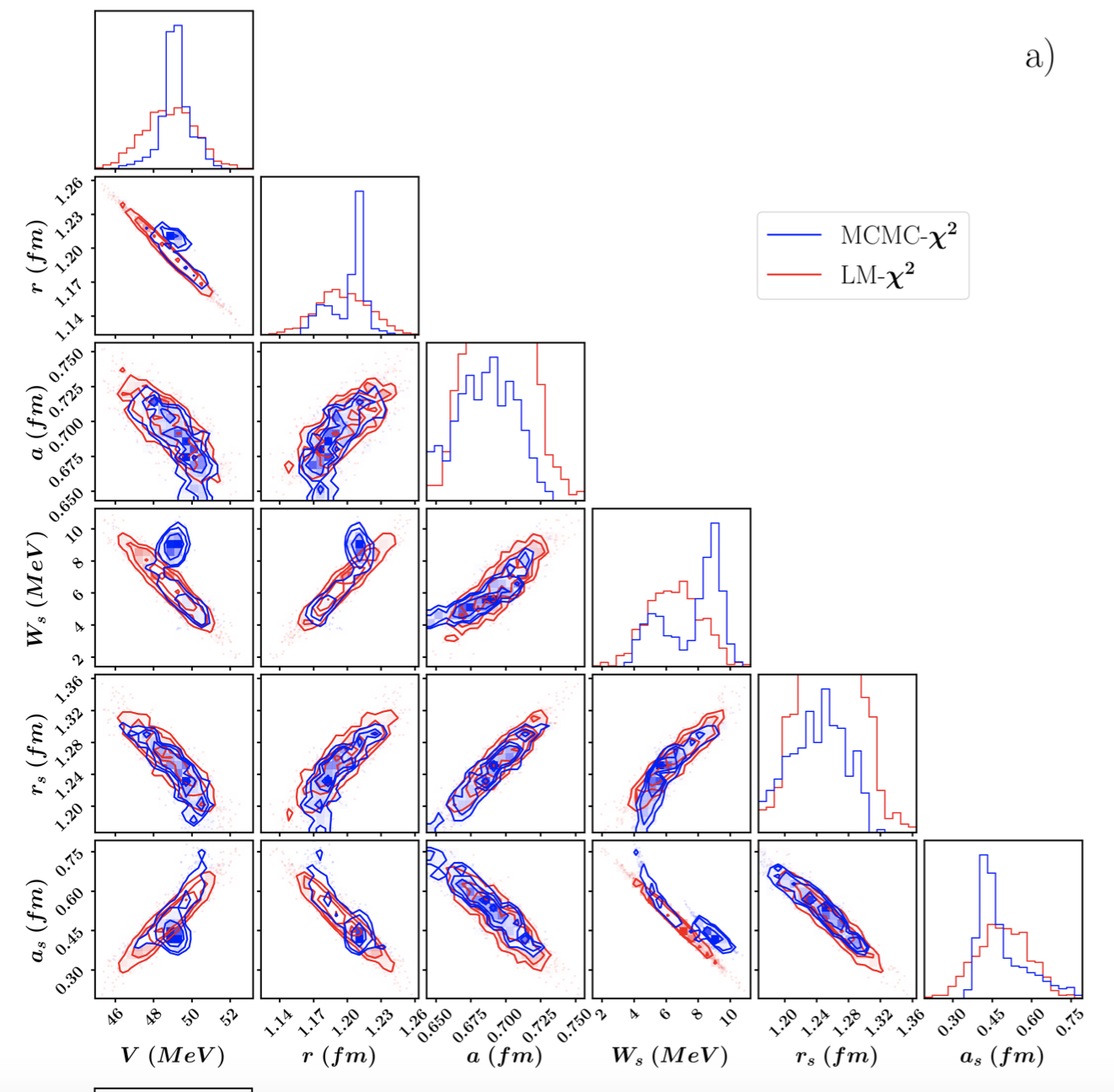
Application: OP with 6 parameters
⁹⁰Zr(n,n) @10 MeV
Frequentist (red) Bayesian (blue)
same likelihoods+priors
different posteriors
frequentist approach is unable to capture the complex parameter dependencies in the model
Pruitt, Lovell, Hebborn, Nunes, PRC 110, 064606 (2024)

Slide 22
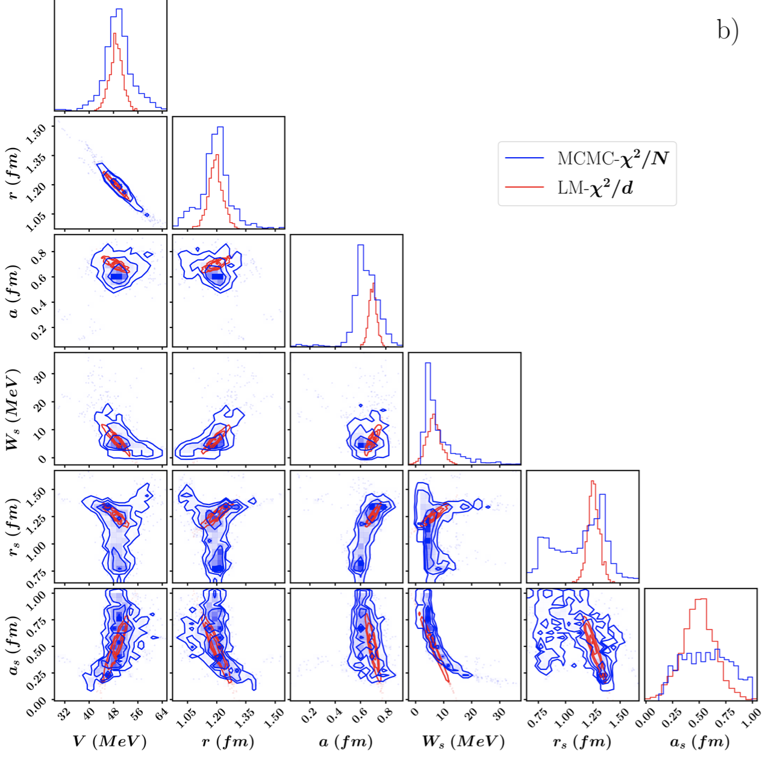
Application: OP with 6 parameters scaled
⁹⁰Zr(n,n) @10 MeV
Frequentist (red) Bayesian (blue)
The different scaling has a more dramatic effect on the posteriors
Pruitt, Lovell, Hebborn, Nunes, PRC 110, 064606 (2024)

Slide 23
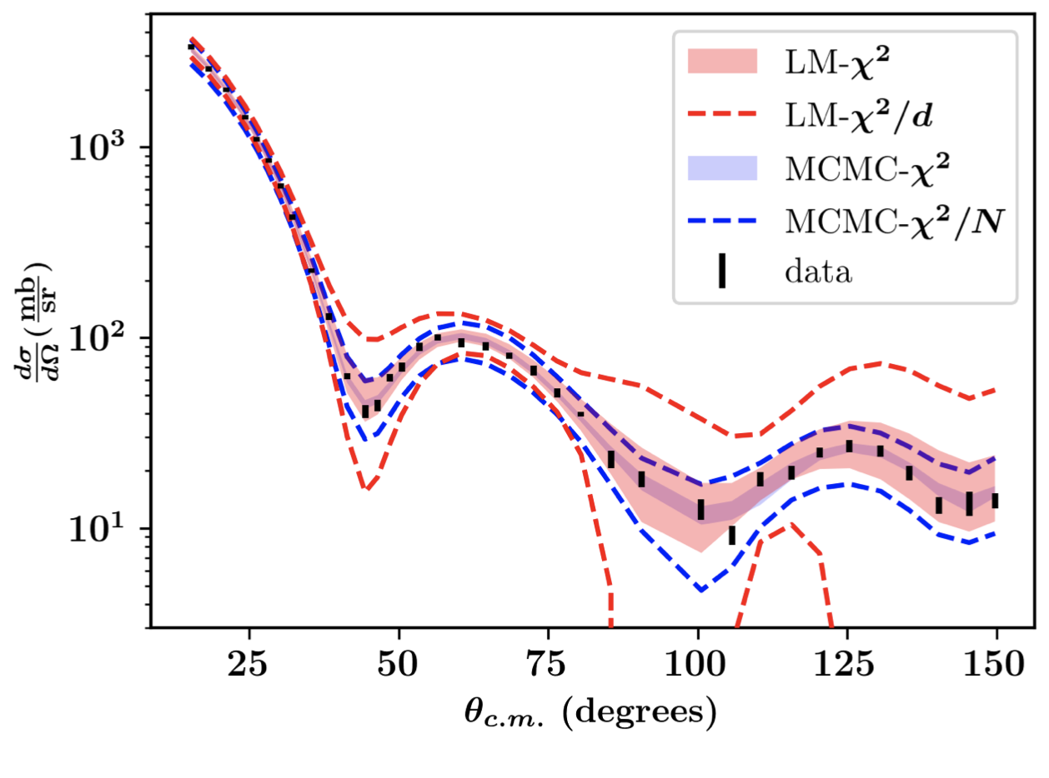
Application: OP with 6 parameters
⁹⁰Zr(n,n) @10 MeV
For this example, frequentist credible intervals are larger than the Bayesian and not a reliable estimate
Many applications have much more than 6 parameters
Pruitt, Lovell, Hebborn, Nunes, PRC 110, 064606 (2024)

Slide 24



Likelihood: how to pick the right one?
Complications:
  data correlations
  systematic errors on data underestimated
  model correlations
  model uncertainties
?
?
How to combine sets of angular distributions?
How to combine different types of reaction data?

Slide 25
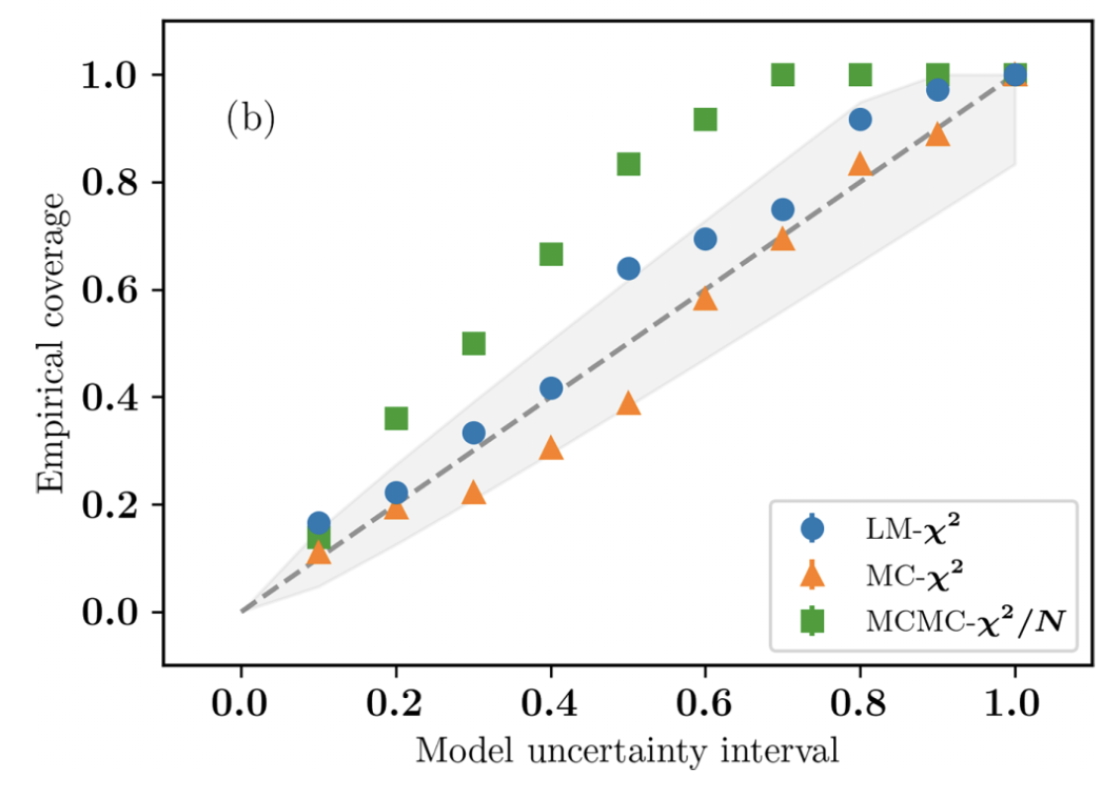

Empirical coverage can discern likelihoods
⁹⁰Zr(n,n) @10 MeV
(6 parameter)
⁹⁰Zr(n,n) @10 MeV
Empirical coverage evaluates the fraction of experimental data that fall within the estimated model uncertainty intervals
added to the model’s parametric uncertainty in quadrature
For this reaction, the the unscaled chi2 has expected coverage
Pruitt, Lovell, Hebborn, Nunes, PRC 110, 064606 (2024)

Slide 26
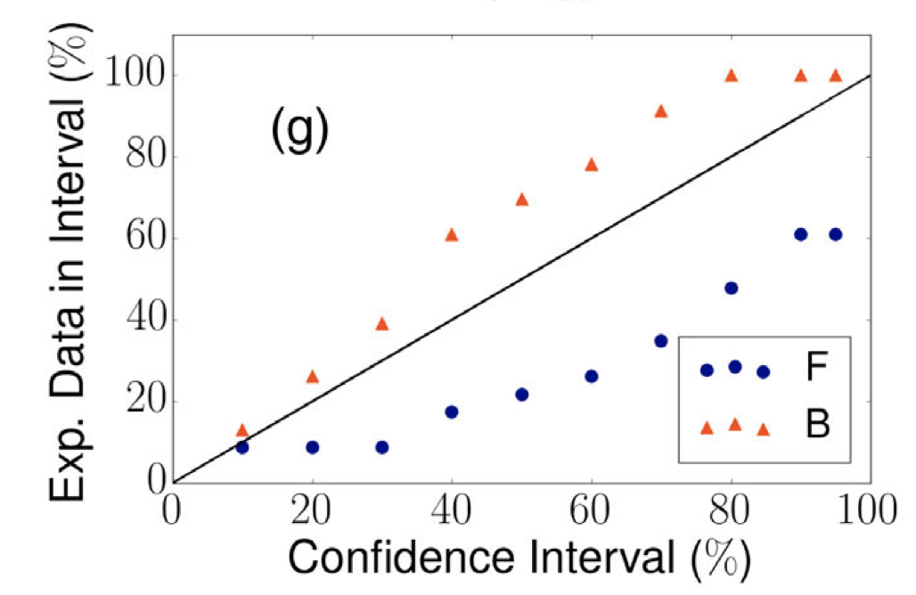
Empirical coverage can discern likelihoods
⁴⁸Ca(n,n) @12 MeV
For this example, the unscaled chi2 underestimates uncertainty for 95% C.I. – an indication that uncertainties
are larger than assumed
LM χ²
MCMC χ²/N
The unaccounted-for uncertainties will contain unreported experimental errors (systematic) and/or model errors
+ Δσ_{UFU}
King et al., PRL 2019

Slide 27
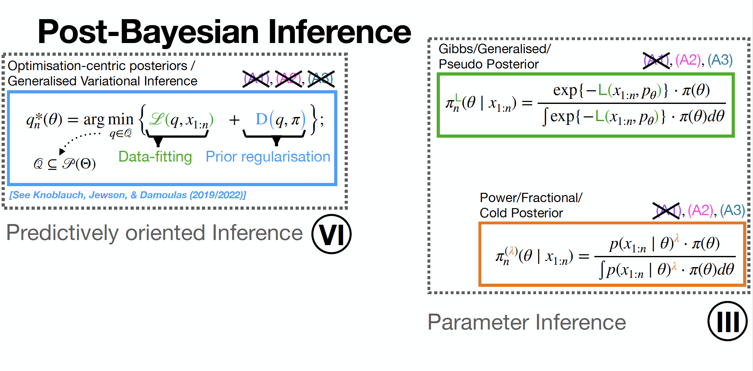
What are the alternatives to these ‘likelihoods’?
Should we be tempering the weight of the data?
See Knoblauch’s talk from Monday

Slide 28
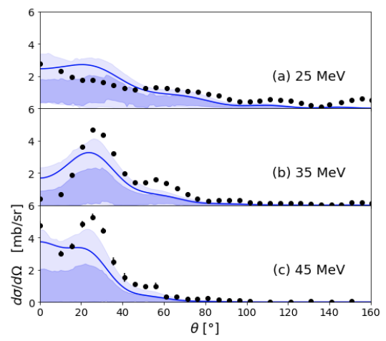
Conclusion
Optical potential calibrations are essential for determining uncertainties in reaction observables
Frequentist approach fails as complexity of parameter space increases
How to account for the complexity in the statistical model with reduced information - choice of likelihood
Empirical coverage is an important validation tool!
Charge exchange
⁴⁸Ca(p,n) ⁴⁸Sc
transfer ^{34,26,46}Ar(p,d)
knockout
^{32,34,46}Ar on ⁹Be @ ~70 MeV A

Slide 29
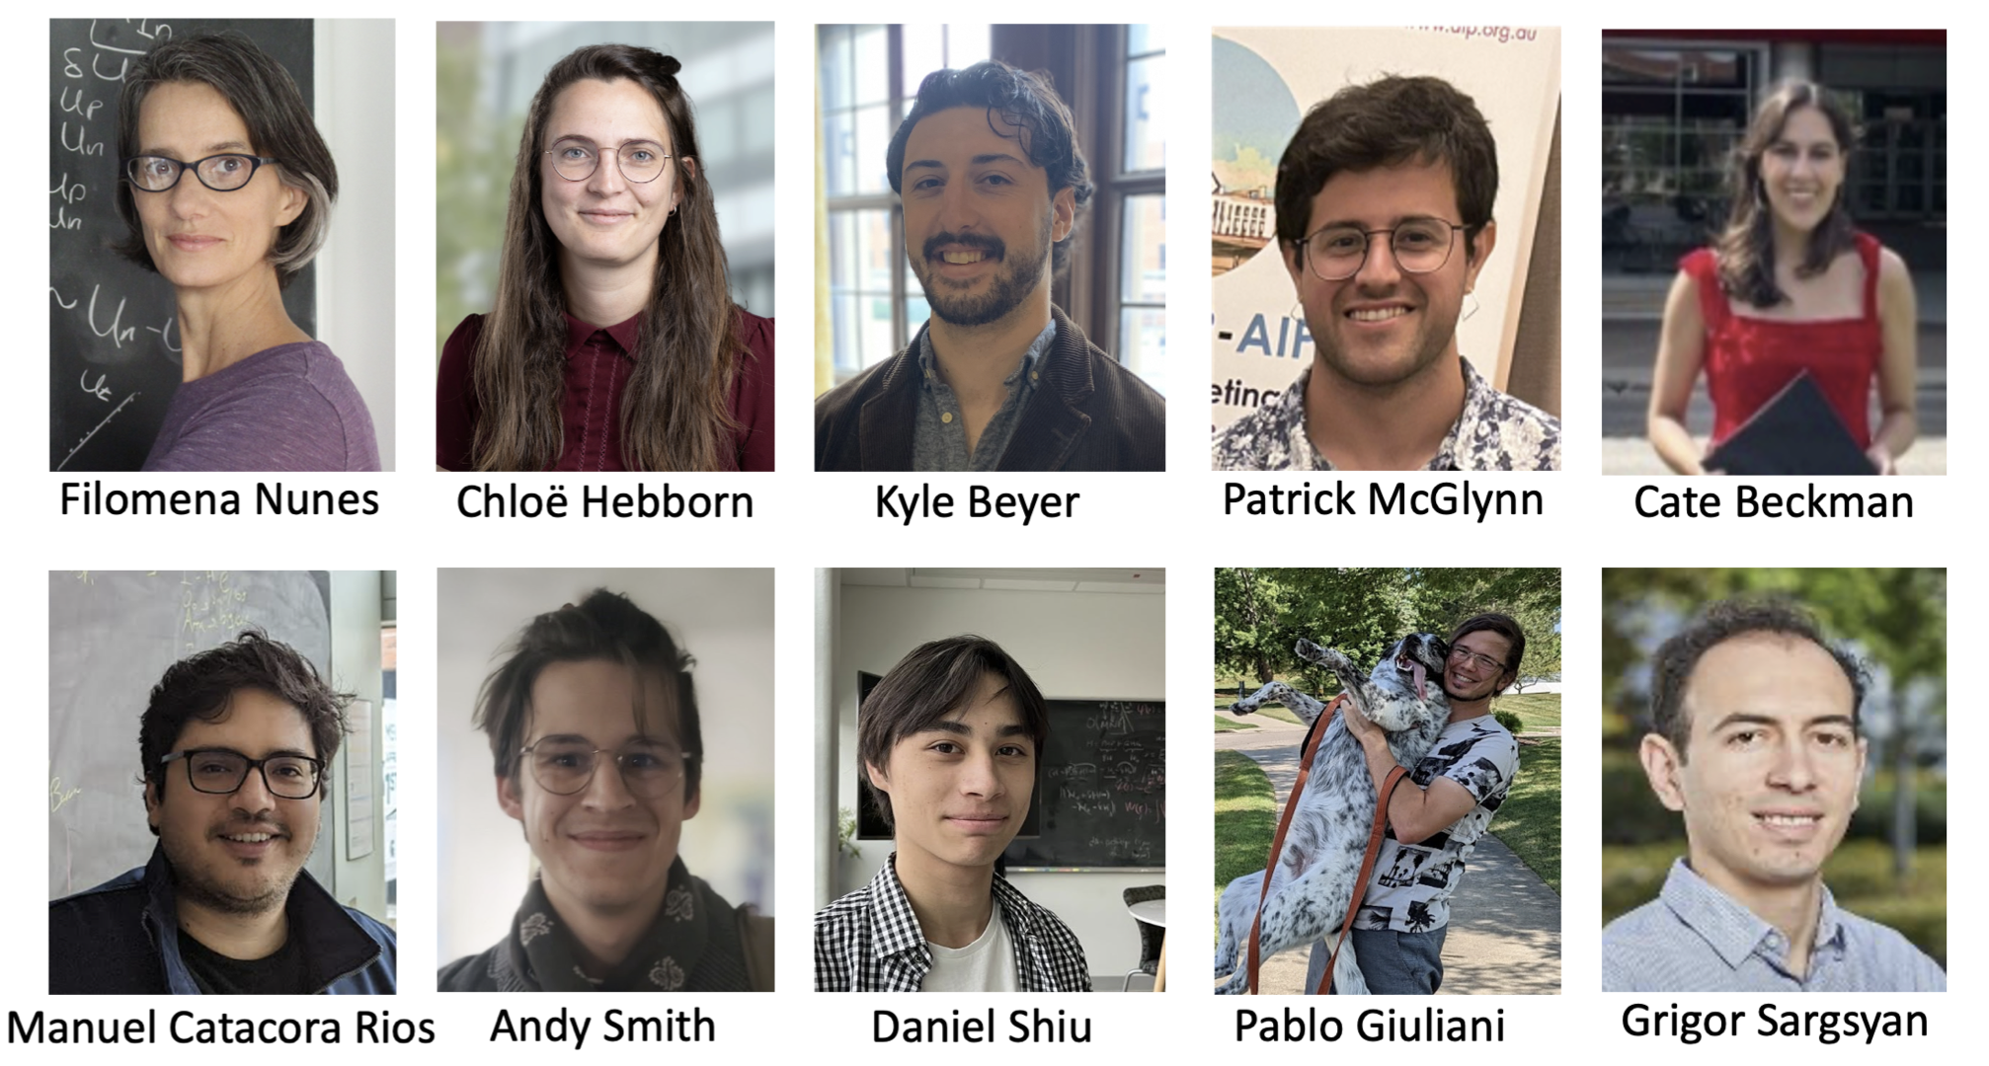

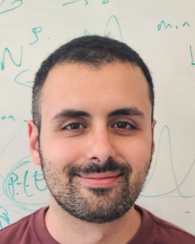

Work supported by NSF-CSSI, DOE-NP and MSU
The future is the young people working in the field
Ibrahim Abdurrahman
Cate Beckman
Zetian Ma
The few-body reactions group at FRIB
Chloe Hebborn@Orsay

Slide 30
BACKUP

Slide 31

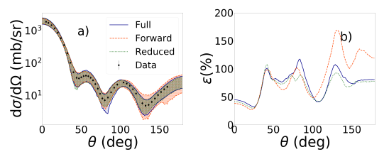
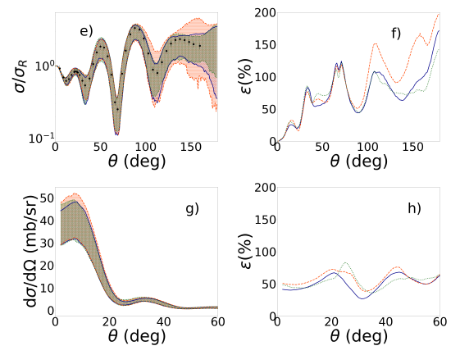
Manuel Catacora-Rios
What angular information needed?
⁴⁸Ca(n,n)⁴⁸Ca at 12 MeV
⁴⁸Ca(p,p)⁴⁸Ca at 21 MeV
Catacora-Rios, King, Lovell and Nunes, PRC (2019)

Slide 32
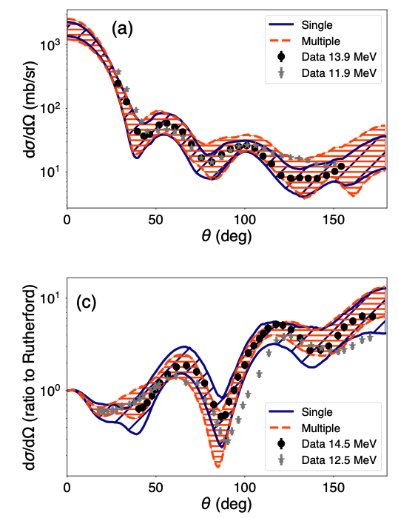
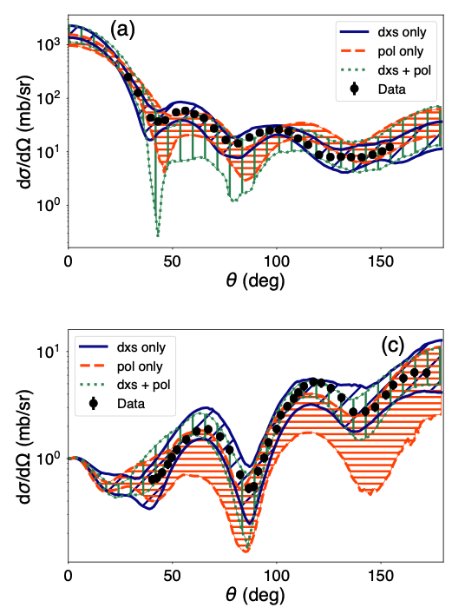
Single energy versus multiple energy sets?
Polarization versus differential cross sections?
⁴⁰Ca(n,n)
@12 MeV
95%
credible
intervals
⁴⁰Ca(p,p)
@ 13 MeV
King, Lovell, Neufcourt, Nunes PRL (2019)
Catacora-Rios et al. PRC 100, 064615 (2019)
Lovell, Nunes, Catacora-Rios, King, JPG (2020)
Catacora-Rios et al. PRC 104, 064611 (2021)

Slide 33
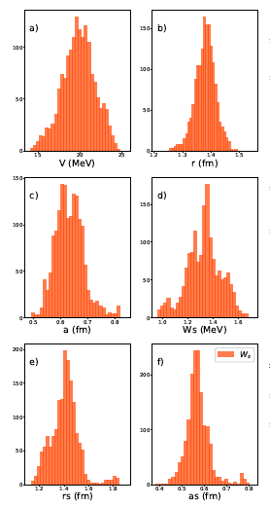
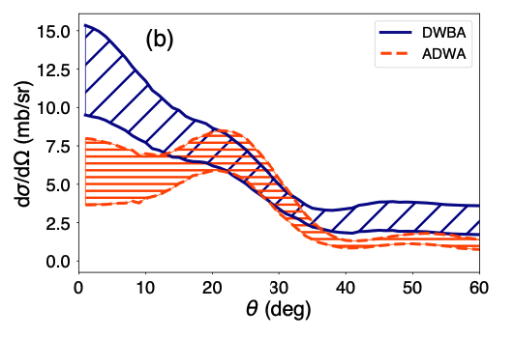
Propagating uncertainties to transfer
OP constrained with elastic scattering to obtain posterior distributions for parameters
Propagate to other reaction observables
⁴⁰Ca(d,p) ⁴¹Ca(g.s.) @ 28.4 MeV
Ekstrom talk:
UQ important for
decision-making and model assessment
Lovell, Nunes, Catacora-Rios, King, JPG (2020)

Slide 34
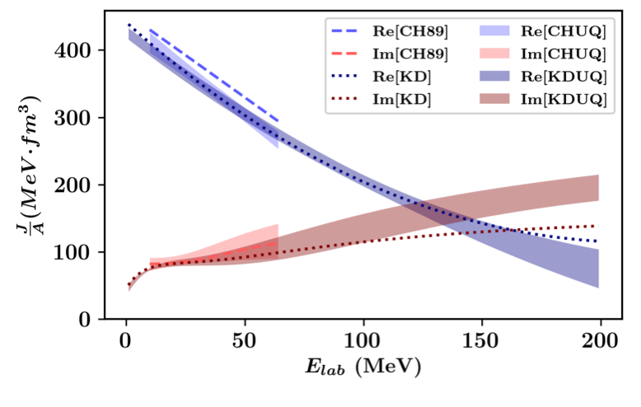
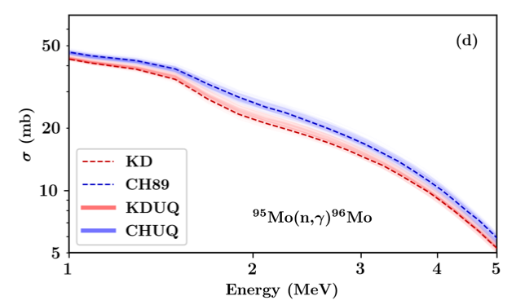
Uncertainty quantified global optical potential (CHUQ and KDUQ)
Bayesian analysis using the same experimental protocol as in the original CH89 and KD2003 parameterizations
Fit on stable nuclei
Bayesian UQ
Pruitt et al., Phys. Rev. C 107, 014602 (2023)

Slide 35

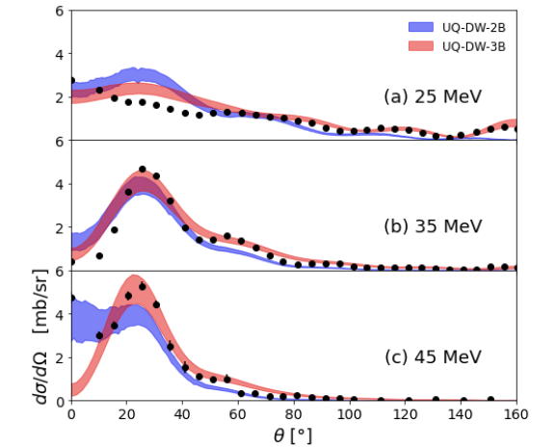
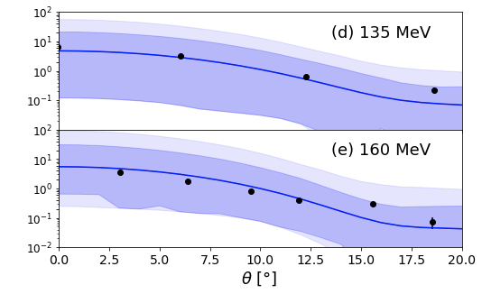
Andy Smith
OP uncertainties in charge exchange to IAS
DWBA formalism
Using parameter posterior from KDUQ
Dark shade (68% ci)
Light shade (95% ci)
⁴⁸Ca(p,n) ⁴⁸Sc
Comparing two-body and three-body models for charge exchange
Smith, Hebborn, Nunes, Zegers, PRC 110, 034602 (2024)

Slide 36
Uncertainty quantified global optical potential (East Lansing Model)
ELM uses a much smaller set of data compared to KDUQ
Includes charge-exchange to IAS for key isotopes
Still under development
Beyer and Nunes, in preparation

Slide 37
Propagating uncertainties to knockout
Eikonal model
Using parameter posterior from KDUQ
compare with a consistent ADWA study of transfer ^{34,26,46}Ar(p,d)
^{32,34,46}Ar on ⁹Be @ ~70 MeV A
dark (light) shade:
68% (95%) credible intervals
Hebborn, Nunes, Lovell, PRL 131, 212503(2023)
Notes:
Parallel-momentum distributions of the remaining (a) 31Ar, (b) 33Ar and (c) 45Ar after the one-neutron knock-out of 32Ar, 34Ar and 46Ar o a 9Be target at 65.1A MeV, 70A MeV and 70A MeV, respectively. The theoretical distributions were folded with the experimental resolution, and their center has been adjusted so that the average distribution reproduces the high-momentum tail of the data. The data and the experimental resolution are from Gade et al. (dark shade 68% ci and light shade 95%)
Transfer Angular distributions for (a) 34Ar(p; d)33Ar(g.s.), (b) 36Ar(p; d)35Ar(g.s.) and (c) 46Ar(p; d)45Ar(g.s.) at 33A MeV.
All theoretical distributions have been scaled to reproduce the data from Lee, Tsang etc.
The scaling factors are the extractedSFs and their uncertainties result from both theoretical and experimental errors.

Slide 38
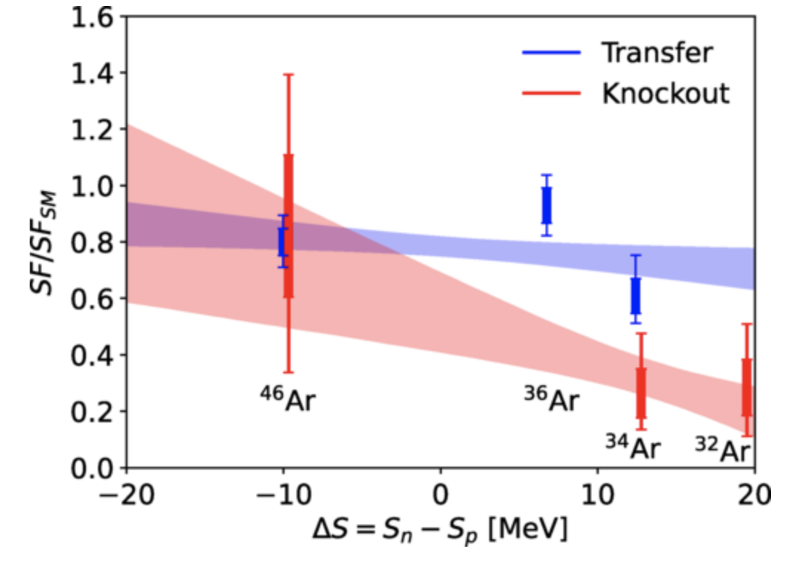
Comparing knockout and transfer: linear fit
68% (95%)
credible
intervals
Hebborn, Nunes, Lovell, PRL 131, 212503(2023)
Notes:
Ratio of the SF extracted from data and the shell-model SF (including the center-of-mass correction) as a function of the asymmetry of the nucleus Delta S = Sn - Sp. The
blue error bars correspond to the SFs extracted from Lee transfer data and the red ones to the SFs extracted from Gade knockout data. Each error bars show the 1 and 2 uncertainties. The shaded area correspond to the 1sigma uncertainties of a linear fit of the transfer (blue) and knockout (red) error bars.

Slide 39
Bird’s eye view of nuclear reactions
Nuclear reactions got us from the lightest elements all the way to the wide range of elements found in our solar system!

Slide 40
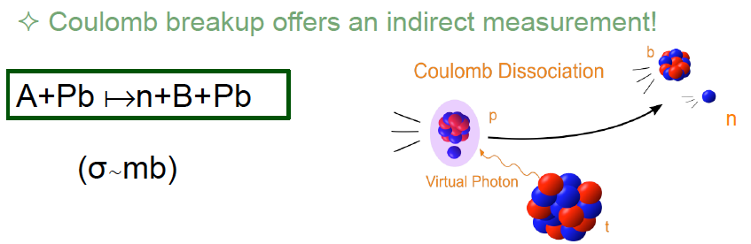
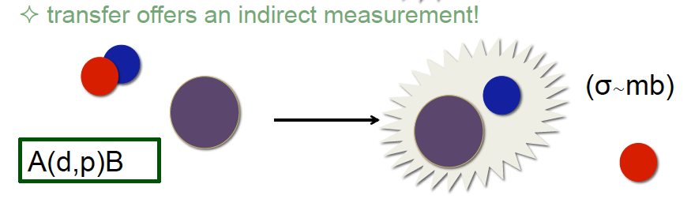
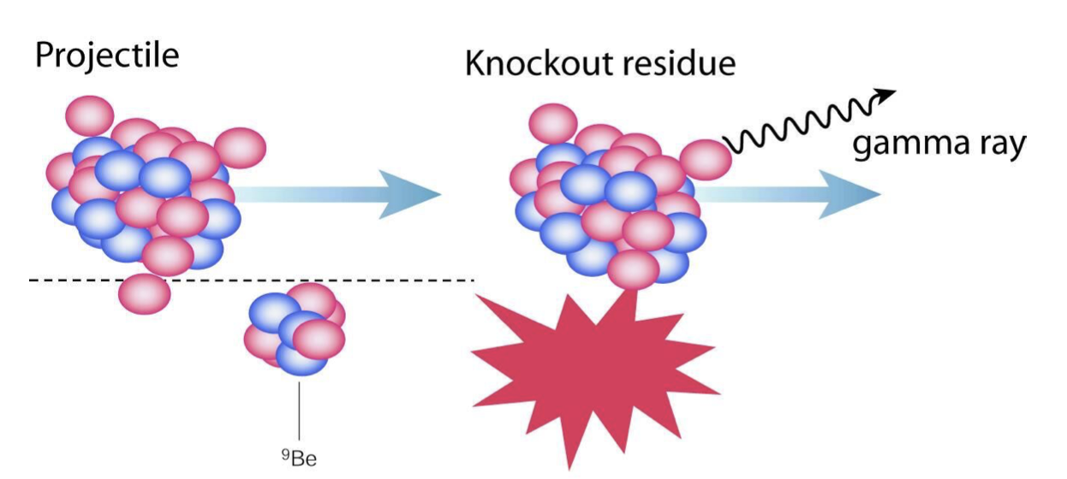
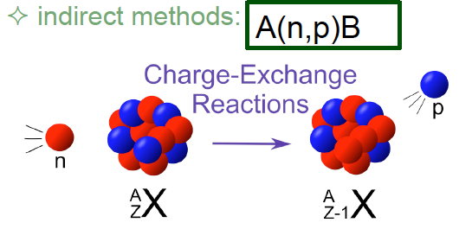
Bird’s eye view of nuclear reactions
Probe of neutron capture: breakup and transfer
Probe of single-particle structure: knockout
Reactions are the most diverse probes to extract astrophysics and structure information, especially for unstable isotopes…
But reaction theory is key for translation!
Probe of electron capture: charge-exchange

Slide 41
Reaction theory maps the many-body into a few-body problem
isolating the important degrees of freedom in a reaction
effective nucleon-nucleus interactions (or nucleus-nucleus) usually referred to as optical potentials
main cause of uncertainty

Slide 42
Landscape of global optical potentials
energy
Koning and Delaroche 2003
E=1 keV – 200 MeV
A=24-209
>100 MeV
Fit on stable nuclei
No UQ
No idea how
good for
unstable
nuclei
Weppner 2009
E=30-160 MeV, A=12-70
Becchetti and Greenlees 1969
E<50 MeV
A>40
CH89
E ~ 10-65 MeV
A=40-209
DISPERSIVE (DOM)
<10 MeV
mass

Slide 43
Optical potentials from theory
Microscopic optical potential:
  Non-local, typically not global, no simple general form
  depends on the EFT: cutoffs, regularizations, etc.
  agreement with data is variable…

Slide 44
Landscape of microscopic optical potentials
energy
AB INITIO
Based on chiral 2b+3b forces
Applied to light nuclei
or closed shell nuclei
MEAN FIELD
Based on density functional fitted to nuclear properties
medium to heavy mass nuclei
NUCLEAR MATTER
Based on NN chiral 2b+3b and MF densities
medium to heavy mass nuclei
>100 MeV
<10 MeV
mass

Slide 45
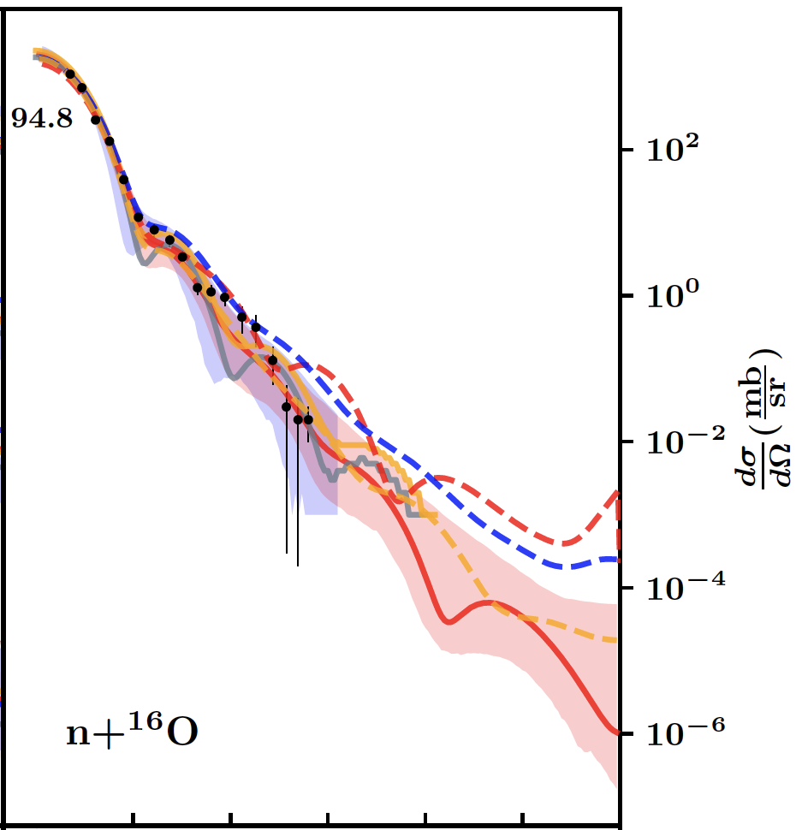
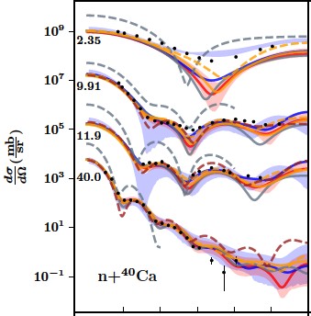
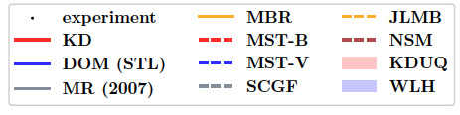
How do optical models compare?
Cross section: Angular distributions
(shaded - 95% credible intervals)
Hebborn, Nunes, et al., JPG 50, 060501 (2023)

Slide 46

How do optical models compare?
95%
credible
intervals
Total cross section as a function of energy
Hebborn, Nunes, et al., JPG 50, 060501 (2023)

Slide 47

How do optical models compare?
Asymmetry of total cross section
95%
credible
intervals
Hebborn, Nunes, et al., JPG 50, 060501 (2023)

