Slide 1


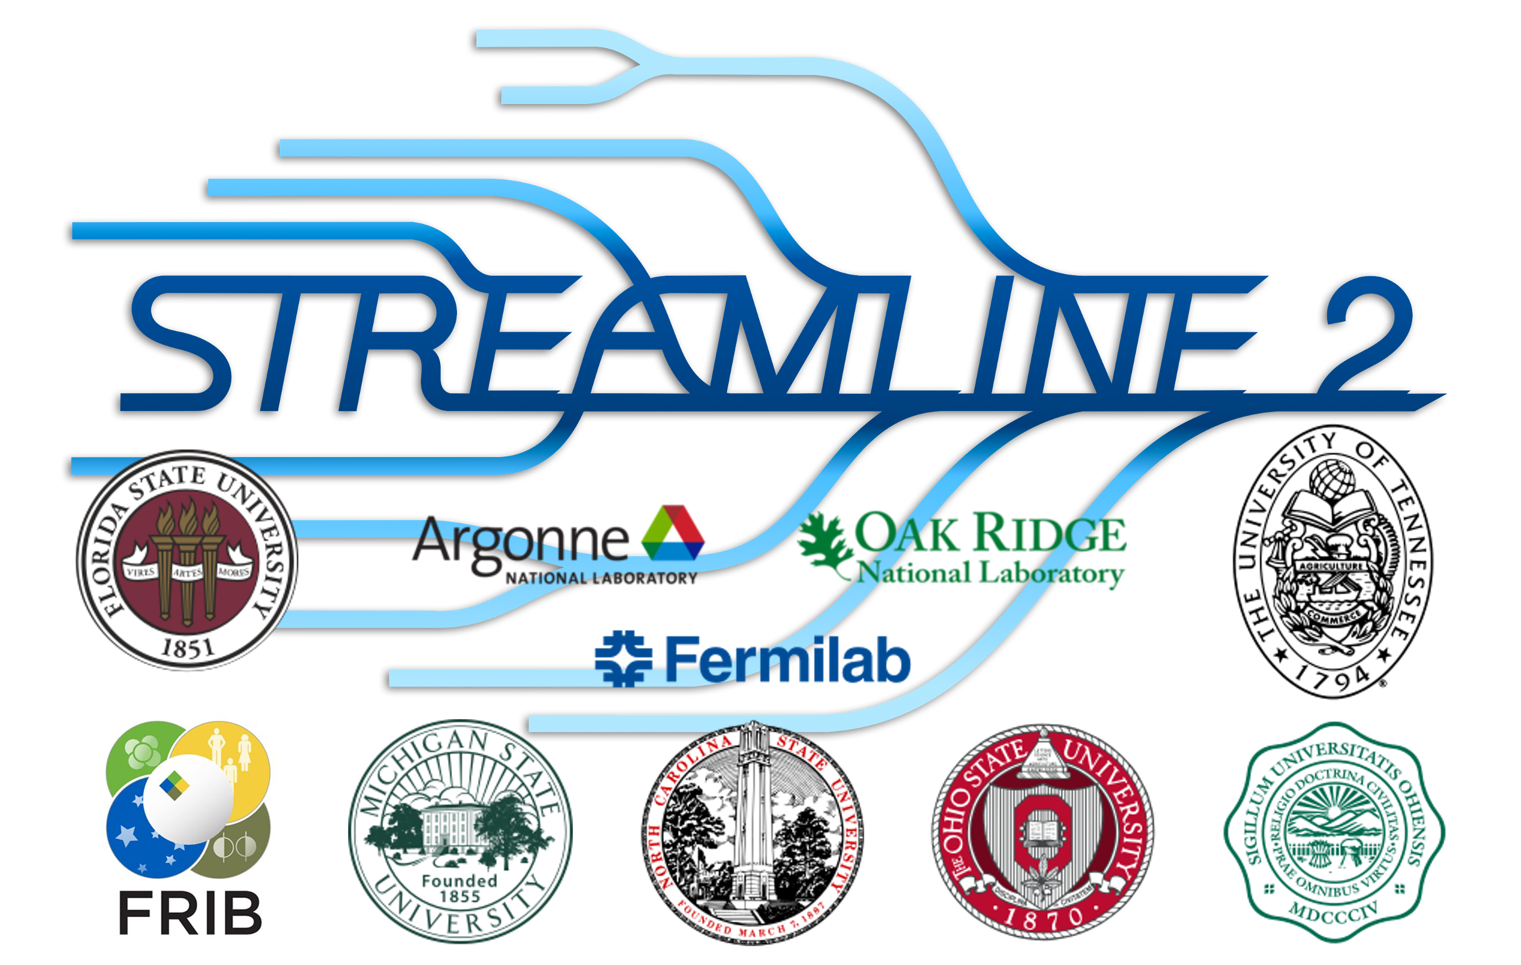

Meeting nuclear challenges with RBM emulators
Dick Furnstahl
ISNET-11, ECT*, November 2025
RBM = Reduced basis method
https://nuclei.mps.ohio-state.edu/
https://buqeye.github.io/
https://www.lenpic.org/
https://bandframework.github.io/

Slide 2
Outline
Overview: RBM emulators for challenges in nuclear physics
More effective RBMs and offline training: 2N and 3N scattering
Non-affine models: optical potentials
Complex energies: extracting and emulating continuum physics
Summary and outlook

Slide 3
Outline
Overview: RBM emulators for challenges in nuclear physics
More effective RBMs and offline training: 2N and 3N scattering
Non-affine models: optical potentials
Complex energies: extracting and emulating continuum physics
Summary and outlook

Slide 4
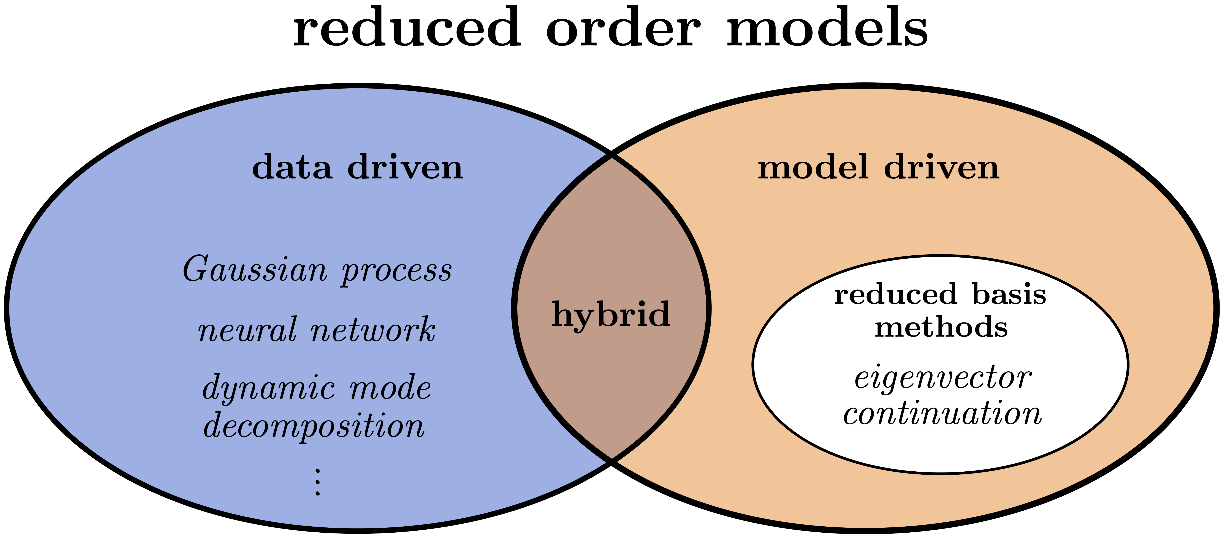
Universe of model reduction methods
UQ need: to vary parameters for calibration, sensitivity analyses, ...
Exploit: much information in high-fidelity models is superfluous.
Solution: reduced-order models → emulators (fast & accurate™).
PMMs
Data driven: interpolate output of high-fidelity model w/o understanding Examples: Gaussian processes; artificial neural networks; dynamic mode decomposition; …
Model driven: derive reduced-order equations from high-fidelity equations Features: physics-based, respects underlying structure → can extrapolate; often uses projection
Hybrid: learn from data but physics-informed. E.g., Parametric Matrix Models (PMMs).
Here: developments with Reduced Basis Models (RBMs)

Slide 5
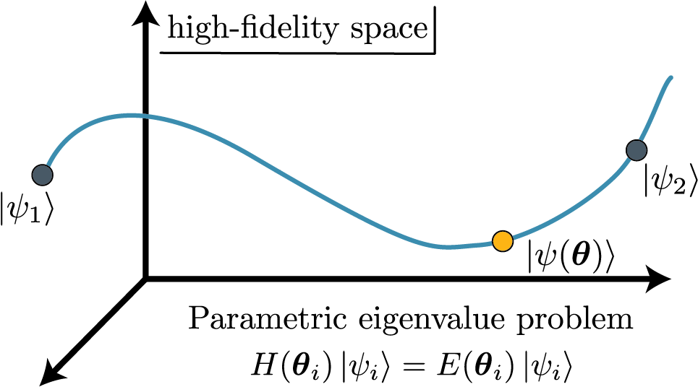
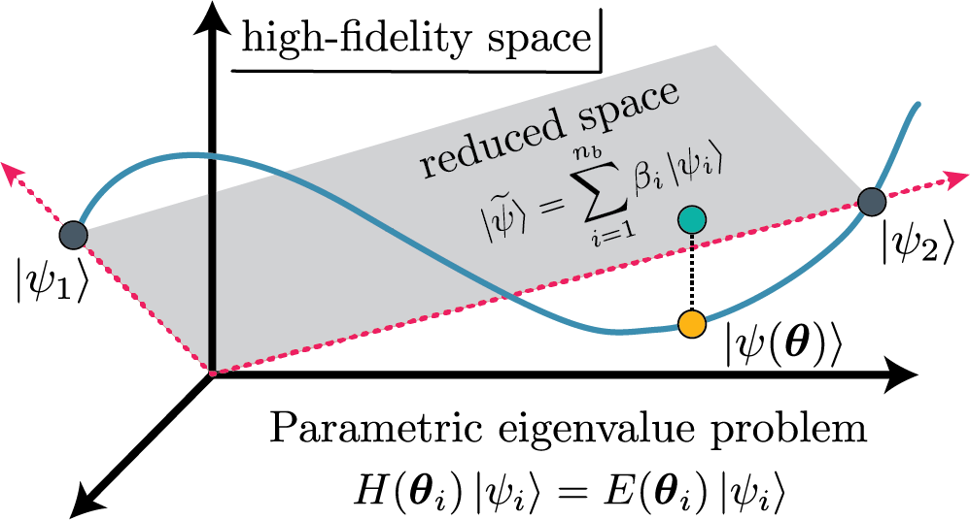
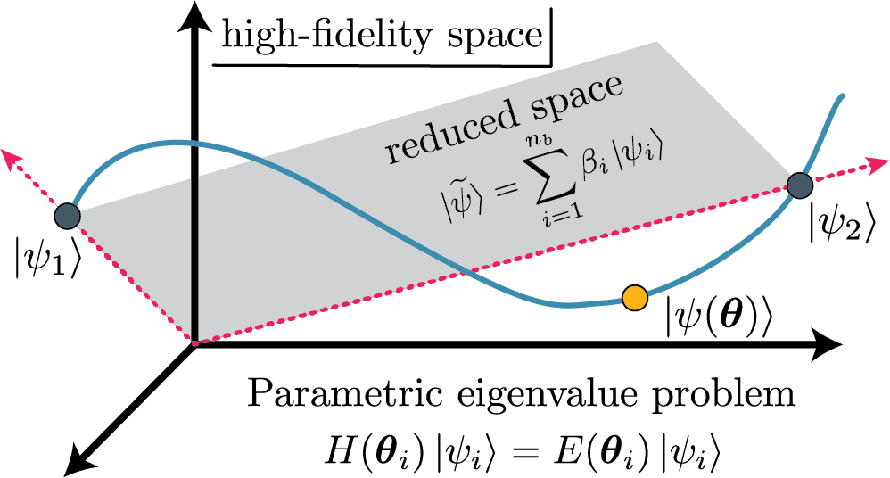
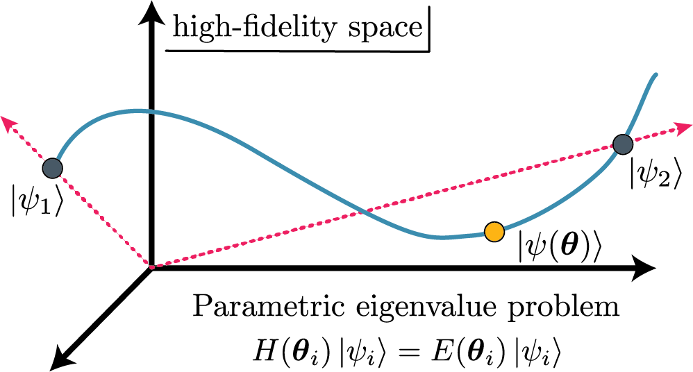
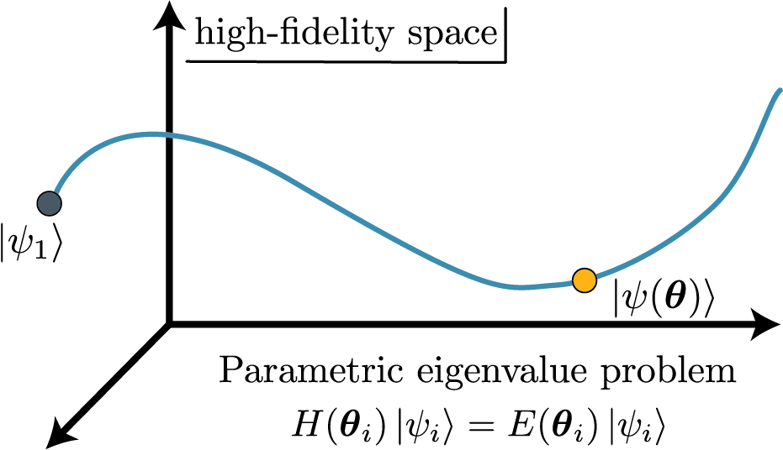
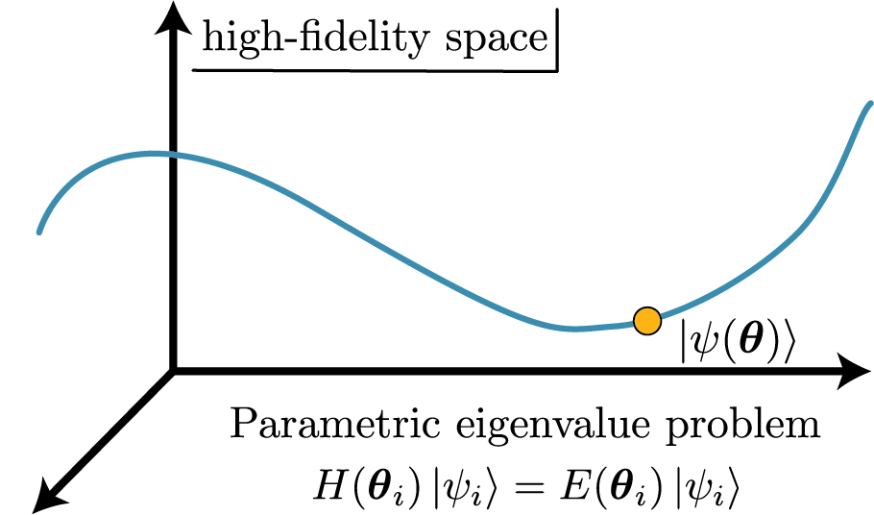







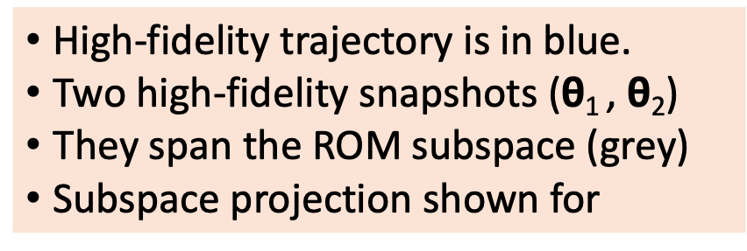
Schematic picture of projection-based emulators
Variational → stationary functional
Use trial and
Solve generalized eigenvalue problem:
Galerkin projection → use weak form
Reduce dimension:
Limit orthogonality:
Choose (Ritz) ≡ variational
More general: (Petrov-Galerkin)
High-fidelity trajectory is in blue.
Two high-fidelity snapshots ($\text{θ}$₁ , $\text{θ}$₂)
They span the ROM subspace (grey)
Subspace projection shown for

Slide 6
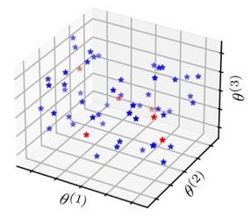
Schematic picture of projection-based emulators
How to choose the snapshot basis?
Space-filling sampling (e.g., LHC) then singular value decomposition (POD)
Develop error estimator and greedy algorithm [E. Bonilla et al. (2022); A. Sarkar et al. (2022)]
High-fidelity trajectory is in blue.
Two high-fidelity snapshots ($\text{θ}$₁ , $\text{θ}$₂)
They span the ROM subspace (grey)
Subspace projection shown for

Slide 7
Snapshot RBM emulators for nuclear observables
Ground-state eigenvectors from a selection of parameter sets is an extremely effective variational basis for other parameter sets. Characteristics: fast & accurate! Scales!
Applied to many different observables:
Ground-state properties (energies, radii)
Transition matrix elements
Excited states
Resonances
Adapted to special situations and methods
Pairing; shell model
Coupled cluster approach; MBPT
Systems in a finite box
Subspace diag. on quantum computers
Extended to non-eigenvalue problems
Reactions and scattering; fission
Quantum spin system phase diagrams
⁴He energy
EC from Frame et al., (2018)
EC as emulator: König et al. (2020)
See Duguet et al., RMP (2024) for more details and refs.

Slide 8
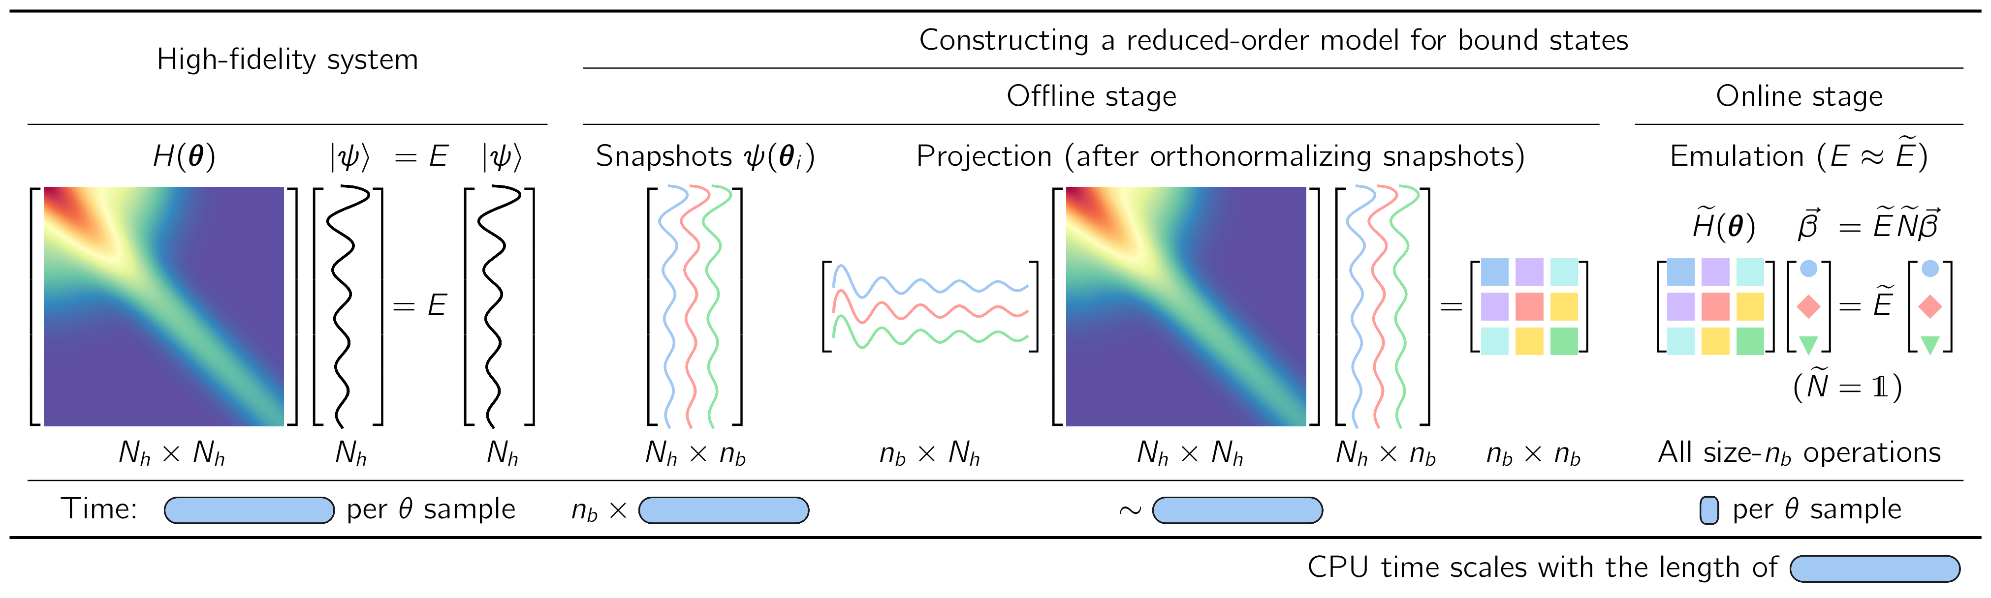
Constructing a reduced-basis model (aka emulator)
J. A. Melendez et al., J. Phys. G 49, 102001 (2022)
E. Bonilla, P. Giuliani et al., Phys. Rev. C 106, 054322 (2022)
P. Giuliani, K. Godbey et al., Front. Phys. 10, 1212 (2022)
C. Drischler et al., Quarto + Front. Phys. 10, 1365 (2022)

Slide 9
Constructing a reduced-basis model (aka emulator)
J. A. Melendez et al., J. Phys. G 49, 102001 (2022)
E. Bonilla, P. Giuliani et al., Phys. Rev. C 106, 054322 (2022)
P. Giuliani, K. Godbey et al., Front. Phys. 10, 1212 (2022)
C. Drischler et al., Quarto + Front. Phys. 10, 1365 (2022)
Offline stage (pre-calculations of size N_{h}):
Construct basis using snapshots from high-fidelity system (simulator)
Project high-fidelity system to small-space using snapshots

Slide 10
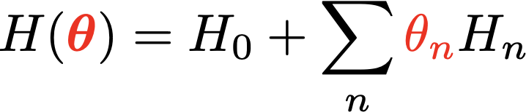
Constructing a reduced-basis model (aka emulator)
For speed: only size-n_{b} operations in online stage → affine structure
← affine in 𝜃_{n}
What if non-affine?
We’ll do that later!
⇒
Notes:
%H({\color{red}\bm\theta}) = H_0 + \sum_n {\color{red}\theta_n} H_n
\langle \psi_i | H({\color{red}\bm\theta}) | \psi_j \rangle = \langle \psi_i | H_0 | \psi_j \rangle + \sum_{n} {\color{red}\bm\theta_n} \langle \psi_i | H_n | \psi_j \rangle \ {\color{blue}\longleftarrow n_b \times n_b\ \mbox{matrices}}

Slide 11
Outline
Overview: RBM emulators for challenges in nuclear physics
More effective RBMs and offline training: 2N and 3N scattering
Non-affine models: optical potentials
Complex energies: extracting and emulating continuum physics
Summary and outlook

Slide 12
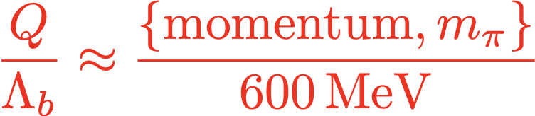
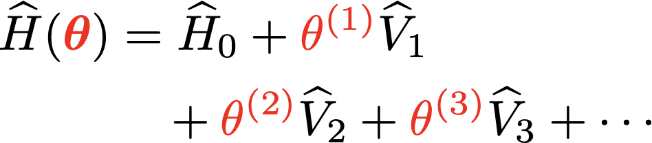
Challenges of χEFT for nuclear many-body theory
Tremendous progress in ab initio calculations with multiple many-body methods
Precision calculations need uncertainty quantification but calculations are expensive
Largest uncertainties from Hamiltonian (2N + 3N forces)
Systematic EFT expansion but many parameters to determine → not best fits but distributions
Constrained by chiral symmetry
Notes:
\newcommand{\param}{\theta}
\newcommand{\params}{\boldsymbol{\theta}}
\newcommand{\red}[1]{{\color{red}#1}}
\red{\frac{Q}{\Lambda_b} \approx \frac{\{{\rm momentum}, m_\pi\}}{600\,{\rm MeV}}}
\wh H(\params) &= \wh H_0 + \red{\param^{(1)}} \wh V_1 \\ & \quad + \red{\param^{(2)}} \wh V_2 + \red{\param^{(3)}} \wh V_3 + \cdots

Slide 13
Reduced order models: (Petrov-)Galerkin projections
scattered wavefunction
Reduction:
Full-Order Model: inhomogeneous RSE
Galerkin (G) ROM
free wavefunction
Snapshot matrix
special second-order ODE
Projection:
High-Fidelity Solver: here, Numerov’s method (iterative)
Reduced matrix
Least-Squares Petrov-Galerkin (LSPG) ROM
The generated sequence has to be matched to an asymptotic limit parametrization
Other methods include RK and leapfrog methods
Reduction: Projection:
Obtain matrix form of ODE solver
In the case of Matrix Numerov: lower triangular, low-bandwidth matrix
Already FAST!
Construct as orthogonal projector onto residuals
Affine decompositions from potential carry over:

Slide 14
Emulator basis construction
Maldonado, Drischler, rjf, Mlinarić., arXiv:2504.06092 (PRC 2025)
FOM trajectory
Snapshot #2
Snapshot #1
Where to place the emulator’s snapshots?
Space-filling sampling combined with a Proper Orthogonal Decomposition (POD)
Active learning approach based on error estimation and a greedy algorithm
The greedy method uses far fewer FOM solutions to construct its basis, iteratively adding snapshots where the (estimated) emulator error is maximum.
See also: Sarkar & Lee, PRR 4, 023214 ; Bonilla et al., PRC 106, 054322

Slide 15
Proper Orthogonal Decomposition (POD)
POD is based on a (truncated) Singular Value Decomposition (SVD) of the snapshot basis:
See also Principal Component Analysis (PCA)
U and V are unitary matrices (e.g., UU† = U†U = 1|) containing the singular vectors
Σ is a diagonal matrix with decreasing, nonnegative diagonal entries (singular values)
Truncating singular vectors corresponding to the r smallest singular values results in the best possible rank-r approximation (in Frobenius norm) to the original M (low-rank approximation)

Slide 16
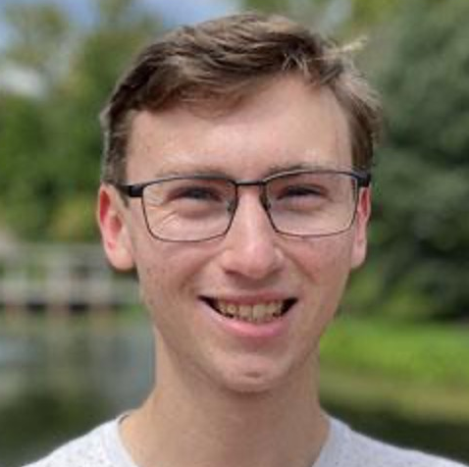
Greedy Algorithm in Action (preview)
start with 2 randomly placed initial snapshots
#0
Maldonado, Drischler, rjf, Mlinarić., arXiv:2504.06092 (PRC 2025)
Estimate the emulator error across the parameter space
#1
Place the next snapshot(s) at the location(s) of maximum estimated error
#2
Iterate until the requested accuracy is obtained
(1D problem for illustration)
Greedy Iteration
increasing accuracy

Slide 17
Emulator error estimation for greedy algorithm
start with 2 randomly placed initial snapshots
Error estimates: residual as a proxy for exact error
exact error
(approximatively proportional to each other)
Estimate the emulator error across the parameter space
Fast & accurate error estimation in the reduced space
Theoretical error bounds
Place the next snapshot(s) at the location(s) of maximum estimated error
Also derived: similar error bounds for phase shifts
Opportunities/challenges:
estimate the extremal singular values using the Successive Constraint Method (SCM)
use the upper bound as a conservative error estimate
Greedy Iteration
increasing accuracy
Iterate until the requested accuracy is obtained

Slide 18
POD vs greedy algorithm
Maldonado, Drischler, rjf et al., arXiv:2504.06092 (PRC 2025)
POD obtains high accuracy as it has access to the most information. But: expensive!
Greedy emulator:
similar accuracy throughout but using far fewer high-fidelity calculations. Much less expensive!
identifies & remedies poor choices of the initial snapshot bases
Finds and removes spurious singularities known as Kohn anomalies (LSPG-ROM is free of such anomalies)
Chiral Potential
Gezerlis et al. (N2LO)
training set: 200 random points, validation set: 10⁴ random points

Slide 19


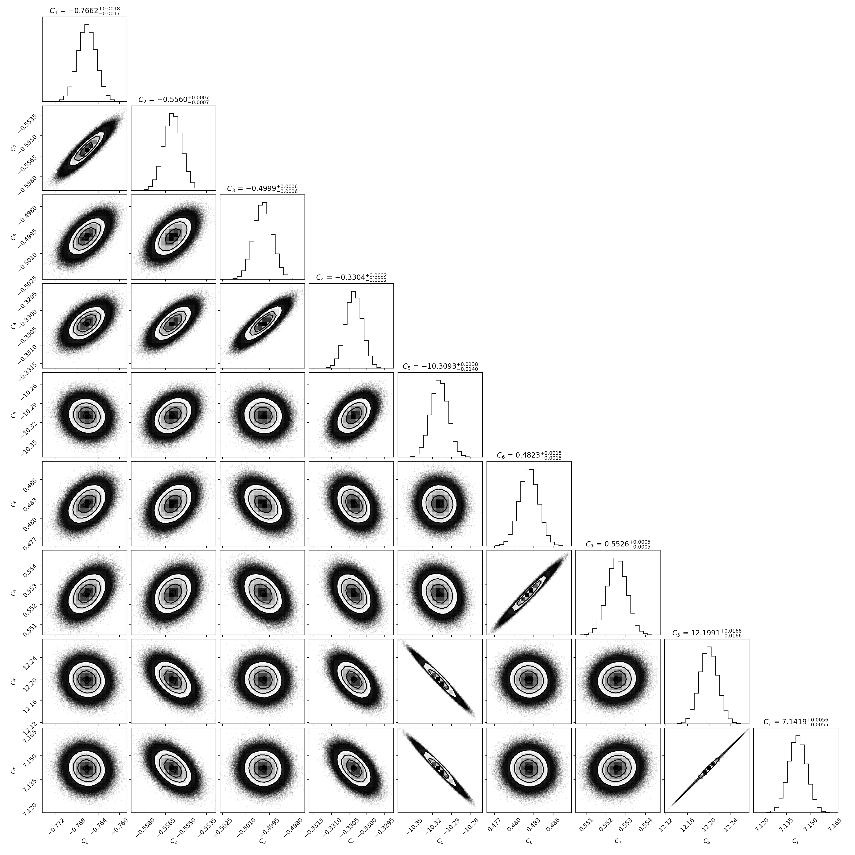
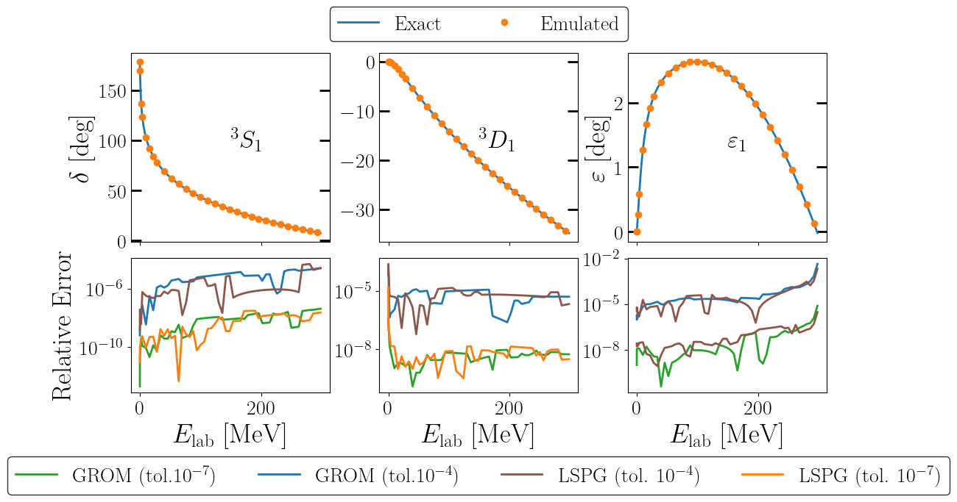
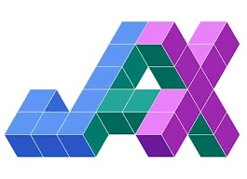
Extension to coupled channels & momentum space
Giri, Kim, Drischler, Elster, rjf et al., in prep.
Lippmann-Schwinger (integral) equation
gives access to a wide range of modern chiral potentials
As before, the greedy algorithm exhibits a fast convergence pattern.
Proof of principle: Bayesian calibration of chiral NN potentials
(including emulator errors)
Emulation of phase shifts
Here: local N²LO GT+ chiral potentials
C_{S}, C_{T},
C₁, C₂, C₃, C₄, C₅, C₆, C₇
HPC:
More rigorous speed-up factors thanks to

Slide 20
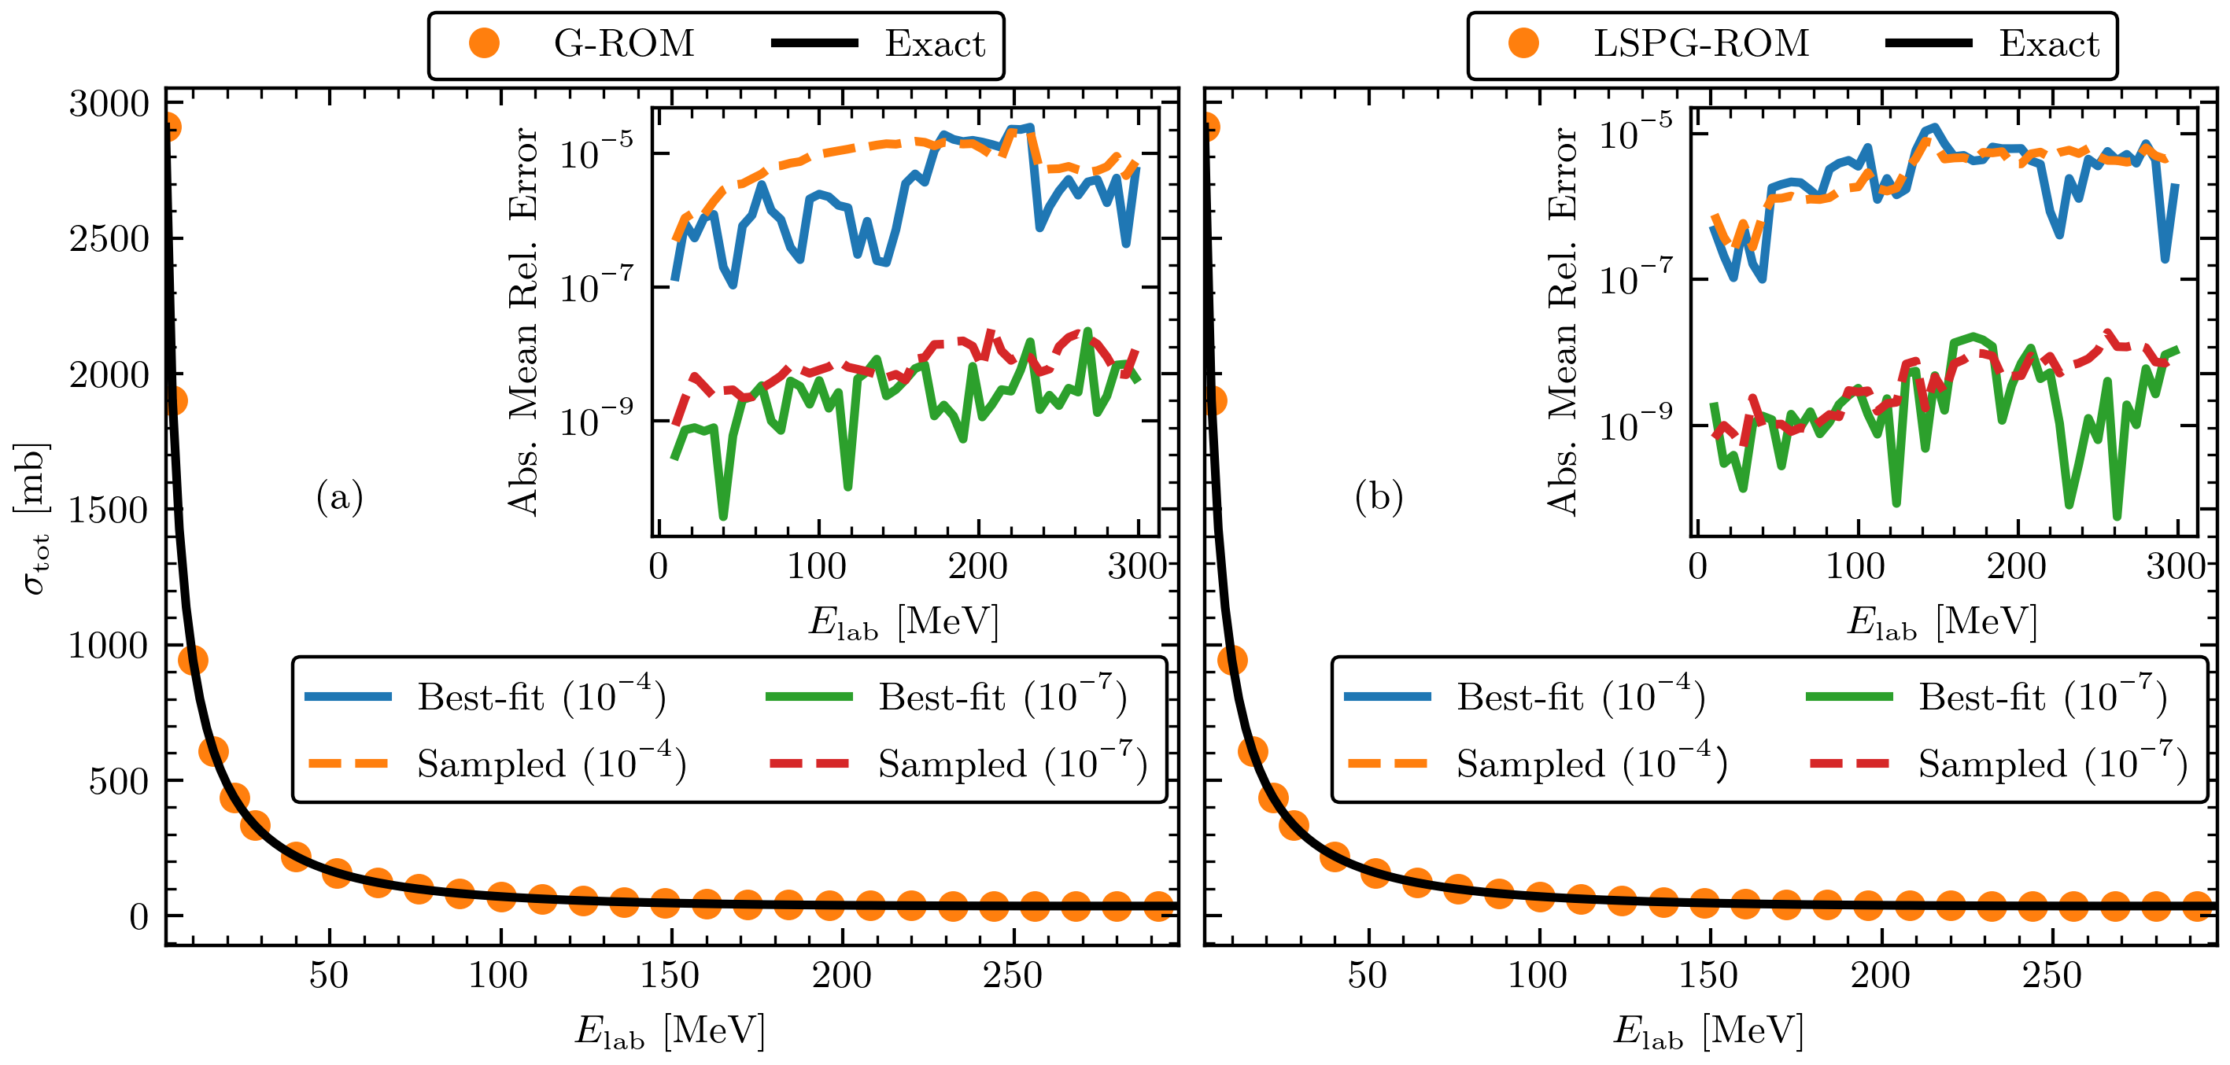
Extension to coupled channels & momentum space
Giri, Kim, Drischler, Elster, rjf et al., in prep.
Lippmann-Schwinger (integral) equation
gives access to a wide range of modern chiral potentials
As before, the greedy algorithm exhibits a fast convergence pattern.
Proof of principle: Bayesian calibration of chiral NN potentials
(including emulator errors)
Emulation of total cross sections
C_{S}, C_{T},
C₁, C₂, C₃, C₄, C₅, C₆, C₇
HPC:
More rigorous speed-up factors thanks to
Here: local N²LO GT+ chiral potentials

Slide 21

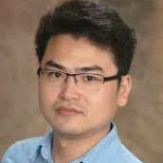
N-d scattering emulator
Gnech, Zhang, Drischler, rjf, Grassi, Kievsky, Marcucci, and Viviani, arXiv:2511.01844, arXiv:2511.10420
Emulate three-body scattering with greedy snapshot selection
FOM: KVP for three-body scattering & hyperspherical harmonics method (linear system)
p-d scattering
Example:
ROM: G-ROM (G) or LSPG-ROM (LS)
So far: N-d scattering below the deuteron break-up threshold with
fixed N³LO NN potential (Norfolk)
N²LO 3N interactions (c_{D}, c_{E})
Greedy algorithm: systematic reduction of emulator errors
Needed: extension to higher energies is critical for Bayesian calibration of chiral 3N interactions
FOM trial wave function

Slide 22
Emulation errors at first and second order
Gnech, Zhang, Drischler, rjf, Grassi, Kievsky, Marcucci, and Viviani, arXiv:2511.01844, arXiv:2511.10420
G-ROM results; similar from LSPG-ROM. Second order gives significant error reduction.

Slide 23
Summary points
Gnech, Zhang, Drischler, rjf, Grassi, Kievsky, Marcucci, and Viviani, arXiv:2511.01844, arXiv:2511.10420
See also:
Witala, Golak, Skibinski,
EPJA 57, 241
p-d scattering
Systematic reduction of the emulator error with increasing number of snapshots (as expected)
G-ROM and LSPG-ROM behave similarly
R₁₁ is much larger than the other two components
½⁻ is less sensitive to 3N forces (= smaller residuals)
Opportunities/challenges:
Emulation of all NN+3N LECs and up to higher E
Computation of scattering observables; requires emulation across partial waves (and energy)
Implementation in Bayesian parameter estimation
Application to four-body scattering?

Slide 24
Outline
Overview: RBM emulators for challenges in nuclear physics
More effective RBMs and offline training: 2N and 3N scattering
Non-affine models: optical potentials
Complex energies: extracting and emulating continuum physics
Summary and outlook

Slide 25
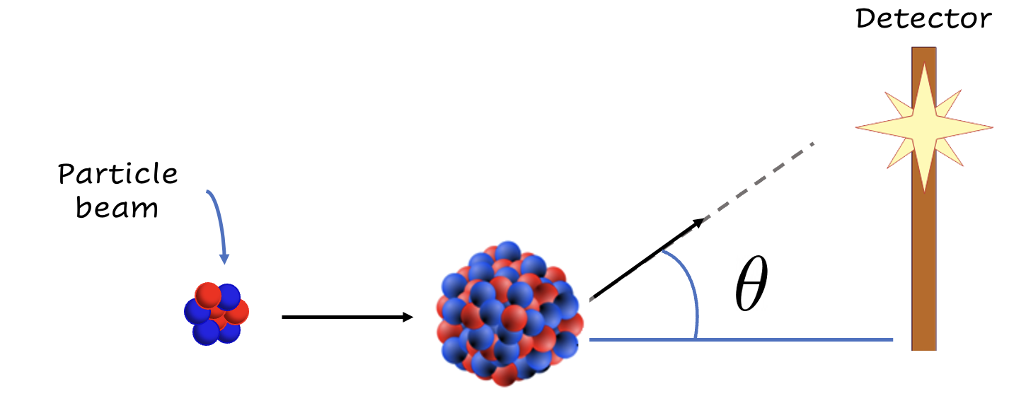

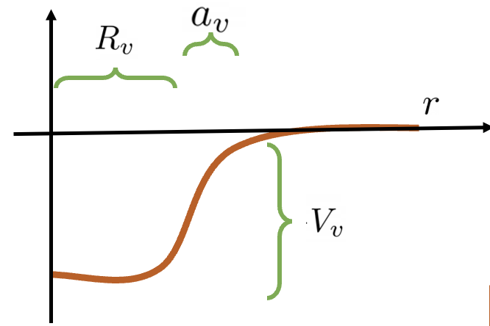

Optical potential motivation
Reaction theory connects experiment to quantities of interest.
(Optical Potentials)
**Effective interaction parameters.

Slide 26

RBM emulators for non-affine scattering problems
Nuclear ROSE in BAND Framework (free software!). Reduced Order Scattering Emulator can handle local, complex, non-affine interactions.
Strategy: convert non-affine to affine → hyper-reduction methods Example: calibrating phenomenological optical potential with EIM
[Odell et al., PRC (2024)]
Scattering → Galerkin projection but potential is non-affine in the parameters to fit ( ):
ROSE Team: Daniel Odell,
Pablo Giuliani, Kyle Beyer,
Manuel Catacora-Rios,
Moses Chan, Edgard Bonilla, rjf, Kyle Godbey,
Filomena Nunes
Problem: U doesn’t factor into products of r and 𝞱 functions, so integrals between test and basis functions have to be calculated every time → no offline-online speed-up!
Notes:
\params = \{V_v, \red{R_v}, \red{a_v}, \ldots\}

Slide 27

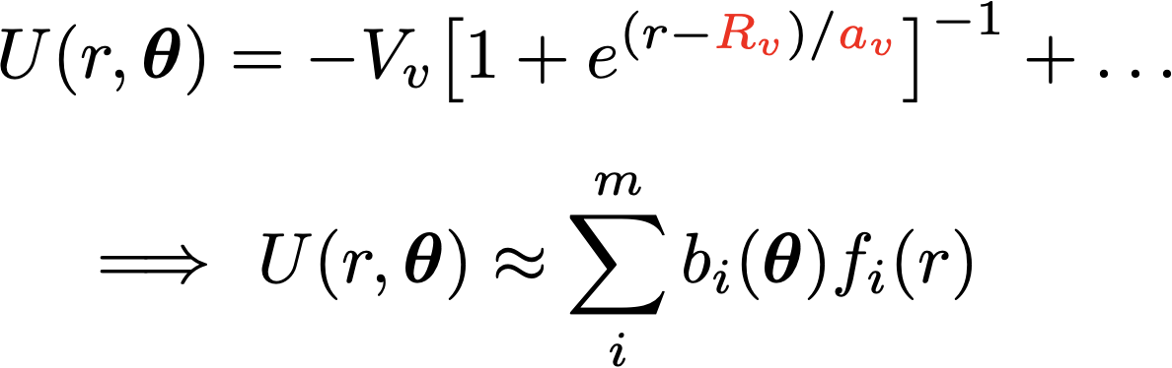
RBM emulators for non-affine scattering problems
Nuclear ROSE in BAND Framework (free software!). Reduced Order Scattering Emulator can handle local, complex, non-affine interactions.
Strategy: convert non-affine to affine → hyper-reduction methods Example: calibrating phenomenological optical potential with EIM
[Odell et al., PRC (2024)]
Scattering → Galerkin projection but potential is non-affine in the parameters to fit:
⇒
Notes:
Developments at top were proof of principle until NVP

Slide 28
RBM emulators for non-affine scattering problems
[Odell et al., PRC (2024)]
Notes:
Developments at top were proof of principle until NVP

Slide 29
RBM emulators for non-affine scattering problems
Nuclear ROSE in BAND Framework (free software!). Reduced Order Scattering Emulator can handle local, complex, non-affine interactions.
[Odell et al., PRC (2024)]
Accurate wave functions from POD (or PCA) applied to snapshots.
Leading principle components.
Accurate potentials from EIM.
Leading PCA basis components.
Notes:
Developments at top were proof of principle until NVP

Slide 30
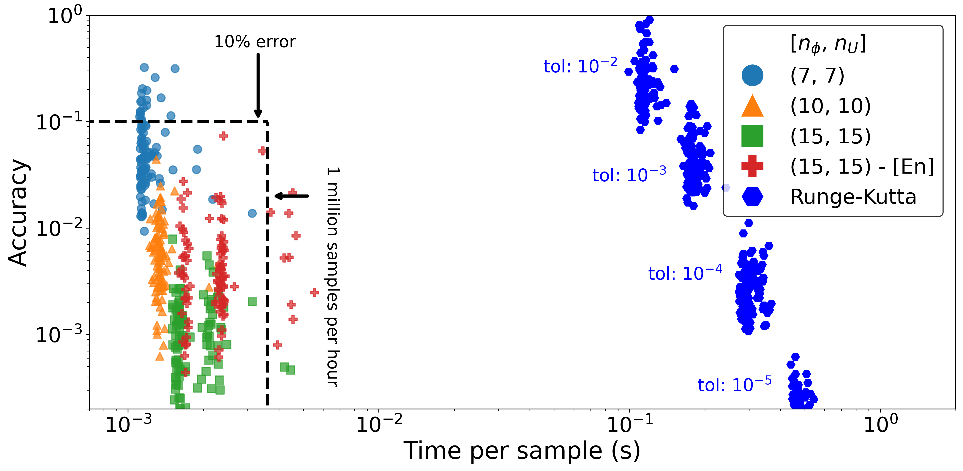
RBM emulators for non-affine scattering problems
Nuclear ROSE in BAND Framework (free software!). Reduced Order Scattering Emulator can handle local, complex, non-affine interactions.
[Odell et al., PRC (2024)]
Notes:
Developments at top were proof of principle until NVP

Slide 31

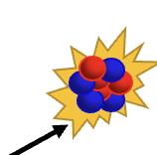
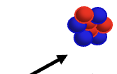
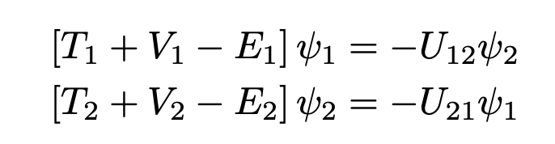
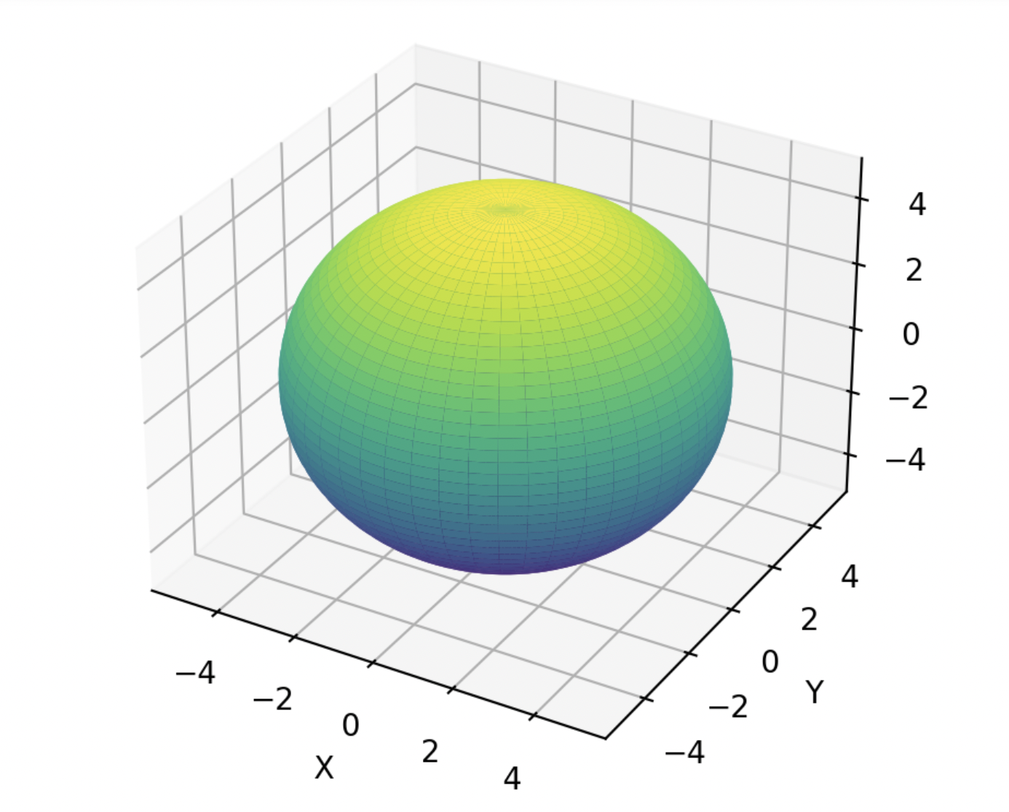
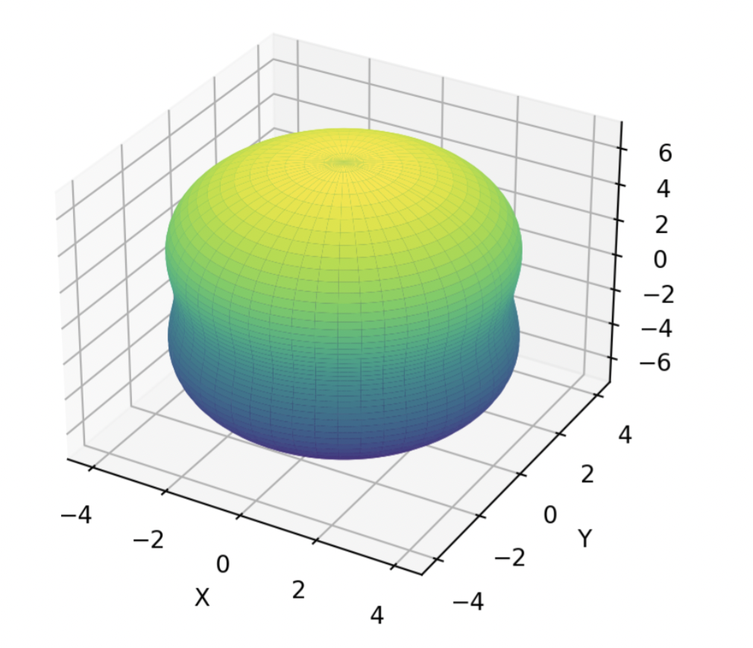

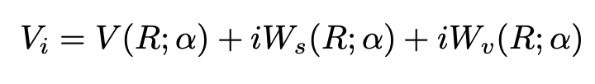
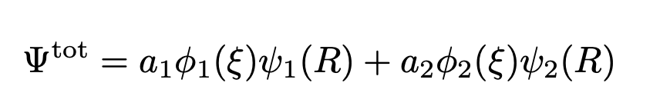
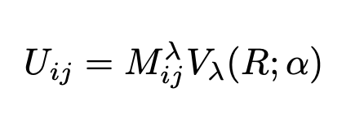



RBM emulator for coupled channels
Example: Inelastic scattering
Coupling term
Radial equations!
M. Catacora-Rios
et al., in prep.
* Single channel operator
Spherical Potentials (Woods-Saxon)
*Elastic channel
Deformed Potentials
*Inelastic channel
*Integrate out the -dependence
Coupling matrix elements (Angular momentum)
Radial and parameter dependence
$$ξ$$

Slide 32
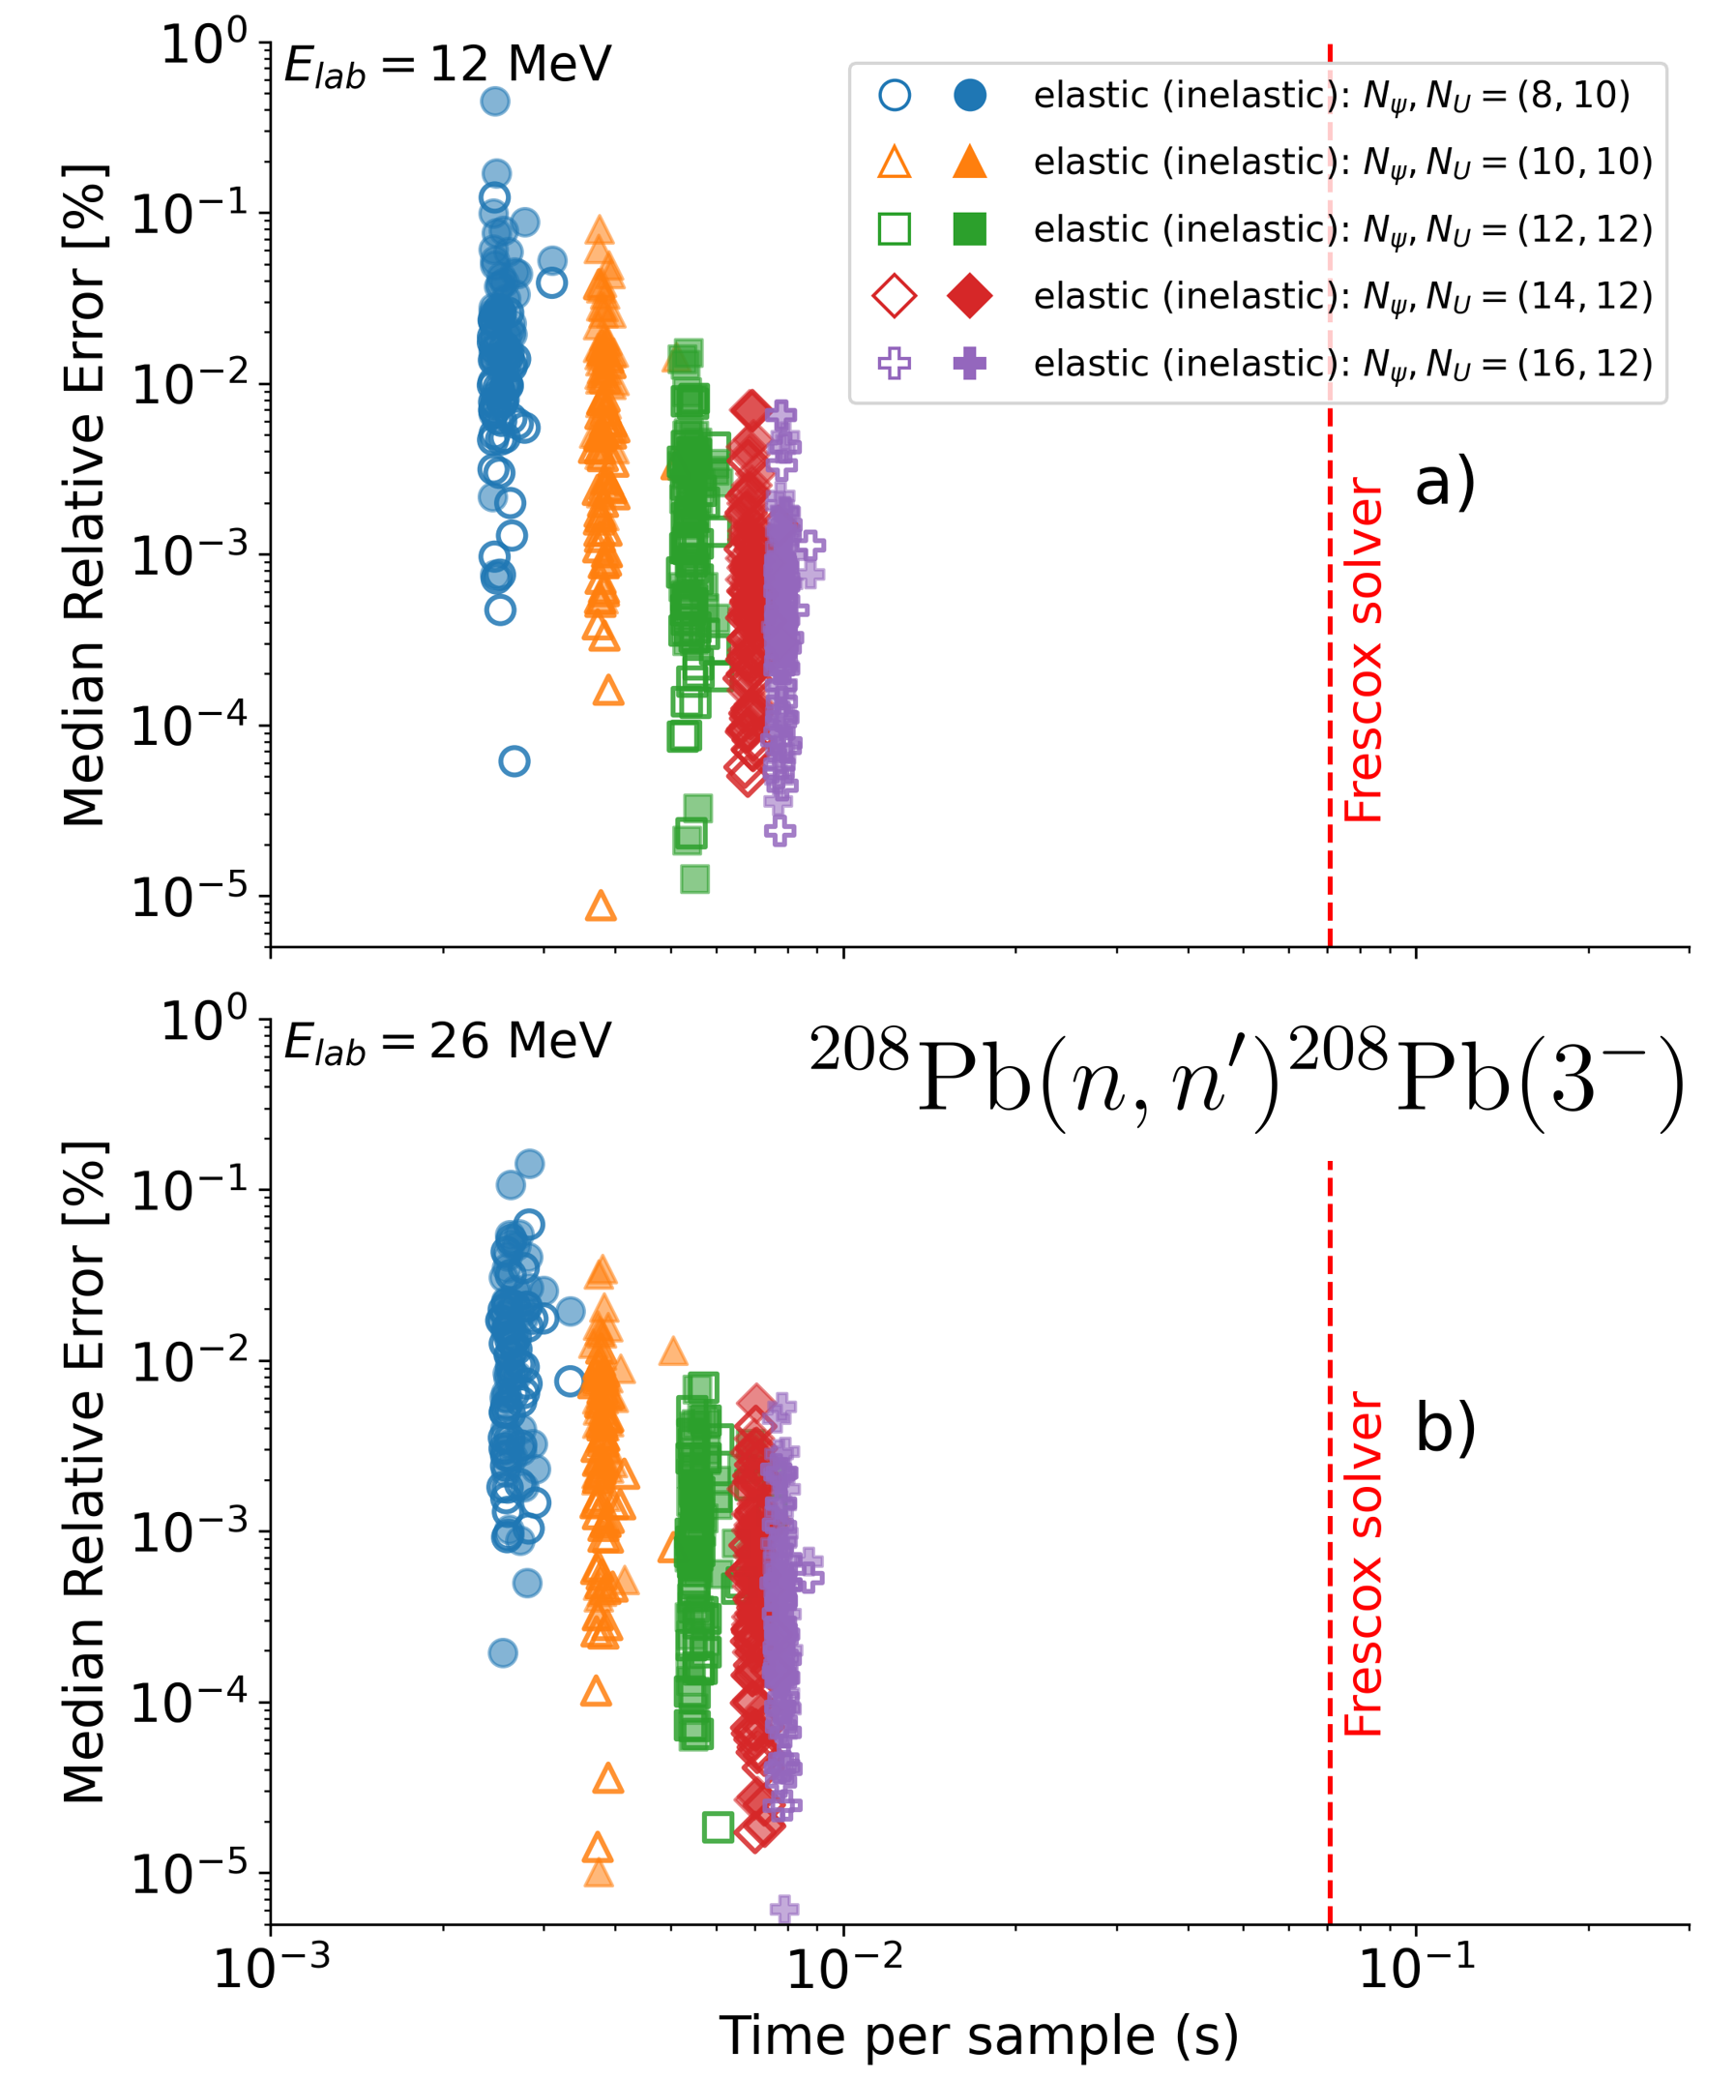
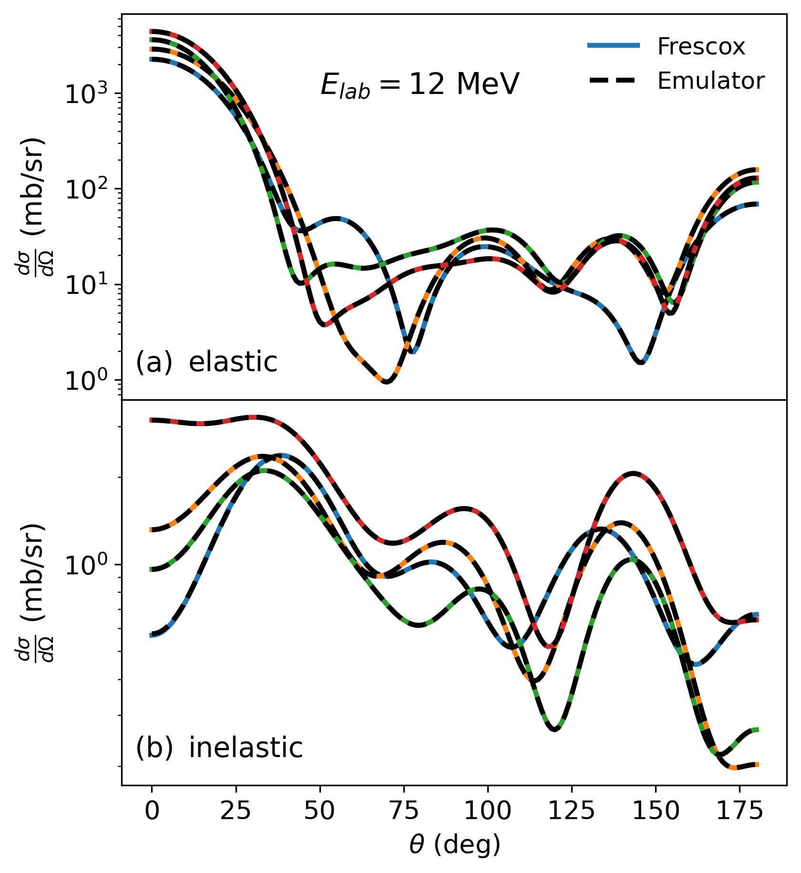
Coupled channel emulator: Fast & Accurate
M. Catacora-Rios
et al., in prep.

Slide 33
Outline
Overview: RBM emulators for challenges in nuclear physics
More effective RBMs and offline training: 2N and 3N scattering
Non-affine models: optical potentials
Complex energies: extracting and emulating continuum physics
Summary and outlook

Slide 34
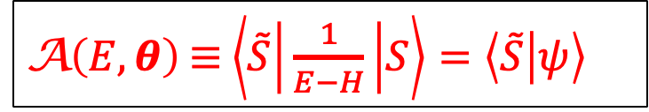
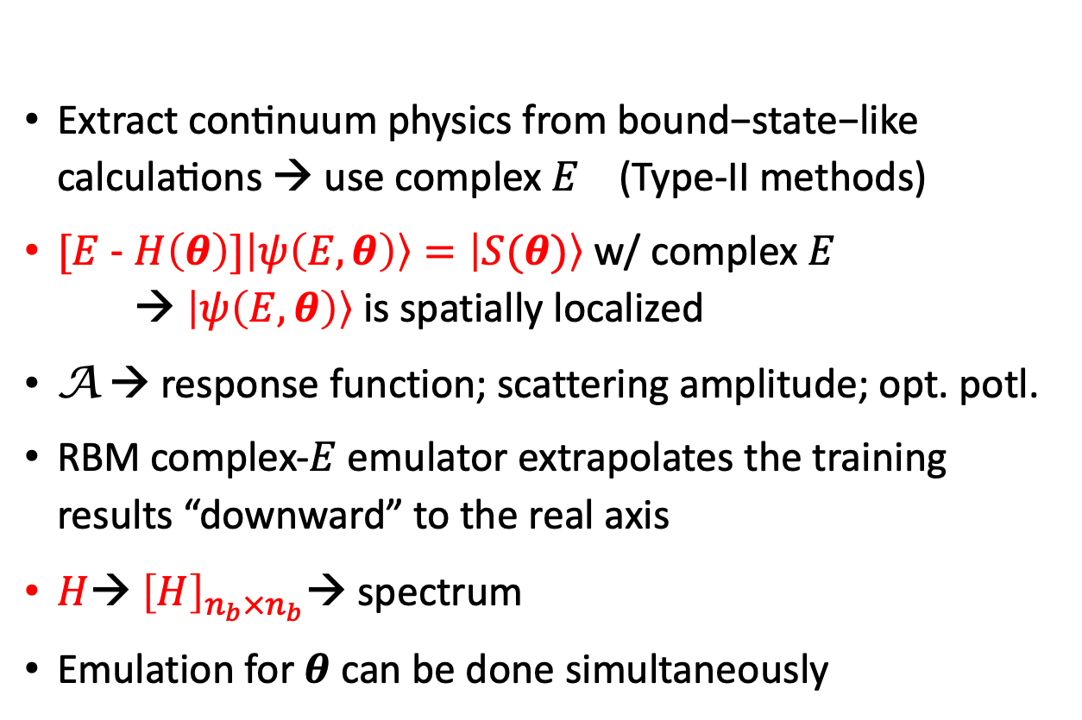




Complex-$E$ emulator for continuum physics
$\text{E}\text{xtract} \text{continuum} \text{physics} \text{from} \text{bound}\text{−}\text{state}\text{−}\text{like} \text{calculations} → \text{use} \text{complex} E$ (Type-II methods)
$[E$- $H\left(θ\right)]\left|ψ\left(E,θ\right)\right\rangle =\left|S(θ)\right\rangle$ w/ complex $E$ → $\left|ψ\left(E,θ\right)\right\rangle$ is spatially localized
A → response function; scattering amplitude; opt. potl.
RBM complex-$E$ emulator extrapolates the training results “downward” to the real axis
$H$→ ${\left[H\right]}_{n_{b}×n_{b}}$→ spectrum
Emulation for $θ$ can be done simultaneously
Challenge: sampling over many parameters when continuum physics is involved
X. Zhang
A$\left(E,θ\right)$ $≡$ $\left\langle \tilde{S} | \frac{1}{E−H} | S\right\rangle =\left\langle \tilde{S} | ψ\right\rangle$
$$Im(E)$$
.
.
.
$$Re(E)$$
$$θ$$
“A non-Hermitian quantum mechanics approach for extracting and emulating continuum physics based on bound-state-like calculations (: technical details)” Xilin Zhang, 2408.03309, 2411.06712 (to appear in PRL and PRC)

Slide 35
Complex-$E$ emulator for continuum physics
Relative errors of emulated resolvent matrix element when varying basis size and training point location in the complex E plane.

Slide 36
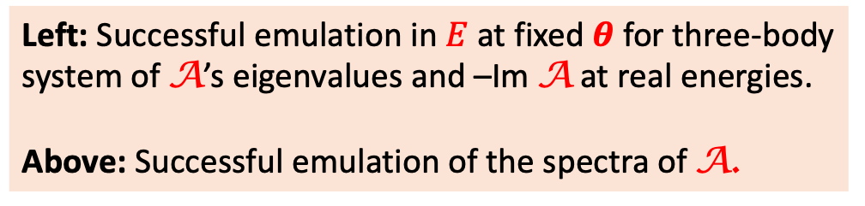

Complex-$E$ emulator for continuum physics
Left: Successful emulation in $E$ at fixed $θ$ for three-body system of A’s eigenvalues and –Im A at real energies.
Above: Successful emulation of the spectra of A.

Slide 37

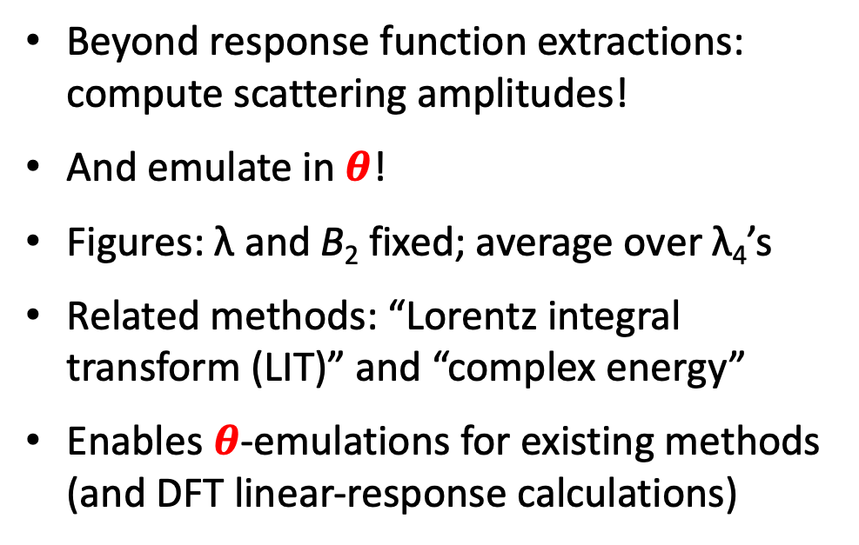
Complex-$E$ emulator for continuum: scattering amplitudes
Particle-dimer scattering
Beyond response function extractions: compute scattering amplitudes!
And emulate in $θ$!
Figures: λ and B₂ fixed; average over λ₄’s
Related methods: “Lorentz integral transform (LIT)” and “complex energy”
Enables $θ$-emulations for existing methods (and DFT linear-response calculations)

Slide 38
Outline
Overview: RBM emulators for challenges in nuclear physics
More effective RBMs and offline training: 2N and 3N scattering
Non-affine models: optical potentials
Complex energies: extracting and emulating continuum physics
Summary and outlook

Slide 39
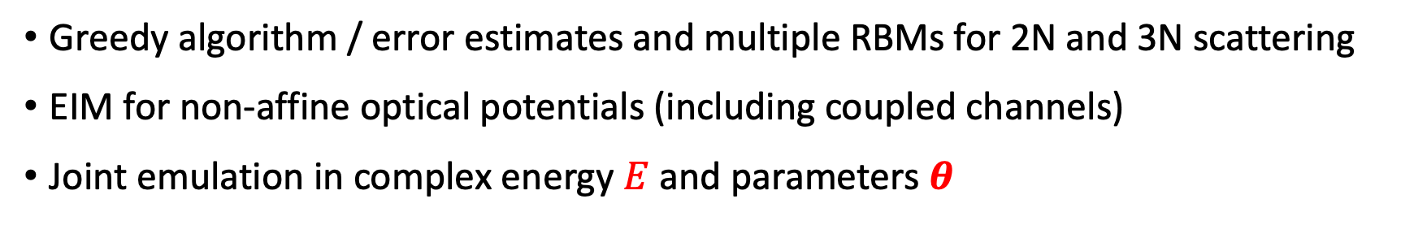
Summary of RBM emulator extensions
Greedy algorithm / error estimates and multiple RBMs for 2N and 3N scattering
EIM for non-affine optical potentials (including coupled channels)
Joint emulation in complex energy $E$ and parameters $θ$
Many opportunities
Extend 3N emulators to full Bayesian calibration and UQ for chiral EFT
Efficient Bayesian calibration for optical potentials (and beyond) → next steps?
Many continuum applications are waiting!
Alternative to RBM?
Parametric matrix models: impose matrix structure but learn from data

Slide 40
Thank you!
Jupyter and Quora books:
Learning from Data for Physicists (Forssén, rjf, Phillips)
BUQEYE Guide to Projection-Based Emulators in Nuclear Physics
Reduced Basis Methods in Nuclear Physics
See Duguet et al., RMP (2024) for more on EC/RBM emulators
Notes:
2013-present: ISNET: Information and Statistics in Nuclear Experiment and Theory

Slide 41
Extra Slides

Slide 42
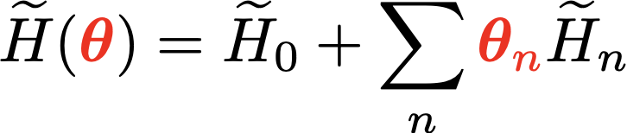
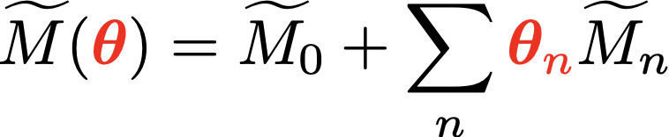
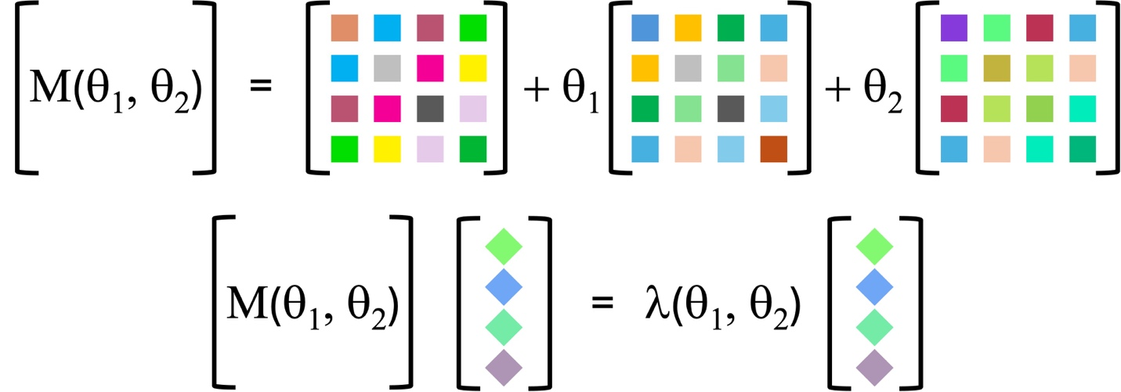
Hybrid approach: Parametric Matrix Models (PMMs)
RBM/EC: matrix elements of eigenvector snapshots → model driven
R. Somasundaram et al., arXiv:2404.11566 (2024)
PMM: learn matrix elem. from data (eigenvalues) → hybrid data driven
Application to emulate noisy AFDMC calculations
P. Cook, D. Jammooa et al., arXiv:2401.11694 (2025)
PMMs capture essential structures such as smooth analytic behavior, symmetries, and conservation laws.
Notes:
%H({\color{red}\bm\theta}) = H_0 + \sum_n {\color{red}\theta_n} H_n
%\langle \psi_i | H({\color{red}\bm\theta}) | \psi_j \rangle = \langle \psi_i | H_0 | \psi_j \rangle + \sum_{n} {\color{red}\bm\theta_n} \langle \psi_i | H_n | \psi_j \rangle \ {\color{blue}\longleftarrow n_b \times n_b\ \mbox{matrices}}
% \widetilde H({\color{red}\bm\theta}) = \widetilde H_0 + \sum_{n} {\color{red}\bm\theta_n} \widetilde H_n
%\ {\color{blue}\longleftarrow n_b \times n_b\ \mbox{symmetric matrices}}
%\widetilde M({\color{red}\bm\theta}) = \widetilde M_0 + \sum_{n} {\color{red}\bm\theta_n} \widetilde M_n
%\ {\color{blue}\longleftarrow \mbox{\textit{learn} symmetric matrices}}
\widetilde H({\color{red}c}) &= \frac{1}{2N}\sum_{i}^{N} (\sigma^z_i + {\color{red}c} \sigma_i^x) \\
\widetilde M({\color{red}c}) &= (\sigma^z + {\color{red}c} \sigma^x)/2

Slide 43


Parametric matrix models bridge physics and machine learning
Objectives
Researchers have introduced a new class of machine learning algorithms called parametric matrix models (PMMs).
Unlike traditional approaches that mimic neurons or optimize generic functions, PMMs are built from matrix equations that resemble the governing equations of physical systems.
By treating inputs as parameters for the matrix elements, PMMs capture essential structures such as smooth analytic behavior, symmetries, and conservation laws.
PMMs are universal function approximators, able to solve general machine learning tasks while retaining strong interpretability.
Impact
Parametric matrix models represent a paradigm shift in scientific machine learning.
By embedding physical and mathematical structure directly into their design, PMMs produce interpretable results that adhere to known constraints, unlike many “black box” neural networks.
This makes them especially powerful for scientific discovery, where extrapolation, efficiency, and interpretability are critical.
PMMs can outperform state-of-the-art methods in scientific computing and compete strongly on broader machine learning tasks.
Accomplishments
“Parametric Matrix Models,” Cook, Jammooa, Hjorth-Jensen, Lee, Lee, Nat. Commun. 16, 5929 (2025).
https://frib.msu.edu/news-center/news/researchers-develop-new-machine-learning-method
Parametric matrix models emulate physical systems through matrix equations, enabling accurate and interpretable predictions with fewer parameters than conventional machine learning methods.

Slide 44
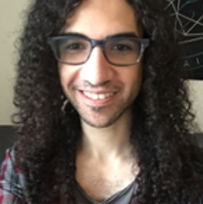

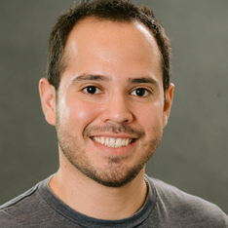
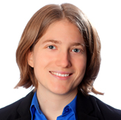
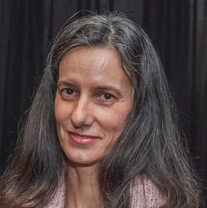
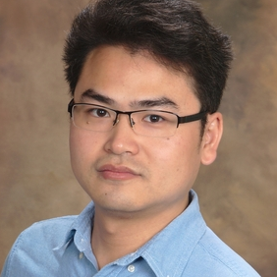
RBM implementation freedom: examples from scattering
Codes (Jupyter notebooks) publicly available!
Wave-function-based emulation for nucleon-nucleon scattering in momentum space (General Kohn & Newton Variational Principle)
Garcia, CD, Furnstahl, Melendez, and Zhang, Phys. Rev. C 107, 054001
2023
Highlight: extends snapshot-based KVP to momentum space & coupled channels
Toward emulating nuclear reactions using eigenvector continuation (General Kohn Variational Principle)
CD, Quinonez, Giuliani, Lovell, and Nunes, Phys. Lett. B 823, 136777
2021
Highlight: Schwartz anomaly mitigation | proof of principle: parameter estimation
Fast & accurate emulation of two-body scattering observables without wave functions (Newton Variational Principle)
Melendez, CD, Garcia, Furnstahl, and Zhang, Phys. Lett. B 821, 136608
2021
Highlight: VP without (trial) wave functions | in momentum space | coupled channels
Efficient emulators for scattering using eigenvector continuation (Kohn Variational Principle for the K-matrix)
progress
Furnstahl, Garcia, Millican, and Zhang, Phys. Lett. B 809, 135719
2020
Highlight: introduces snapshot-based trial wave functions for ROMs
See also: CD, Melendez, Garcia, Furnstahl, and Zhang, Front. Phys. 10, 92931 | see also ROSE in Odell et al., PRC 109, 044612

Slide 45
RBM implementation freedom: examples from scattering
Quantum mechanical two-body scattering problem can be formulated in multiple ways: Schrödinger equation in coordinate or momentum space; variational methods; …
See Drischler et al., (2022) for details and references
Every variational way for scattering has a Galerkin counterpart!
Non-variational, also, e.g., “origin” emulator
What is the best way to implement a 3-body scattering emulator?
E.g, for Bayesian χEFT LEC estimation or nuclear reactions.
X. Zhang, rjf, PRC (2022) gave proof of principle (bosons) using KVP.

Slide 46
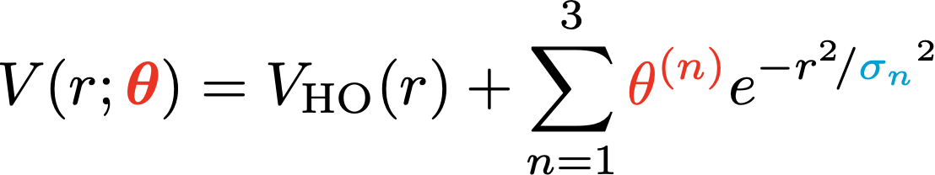

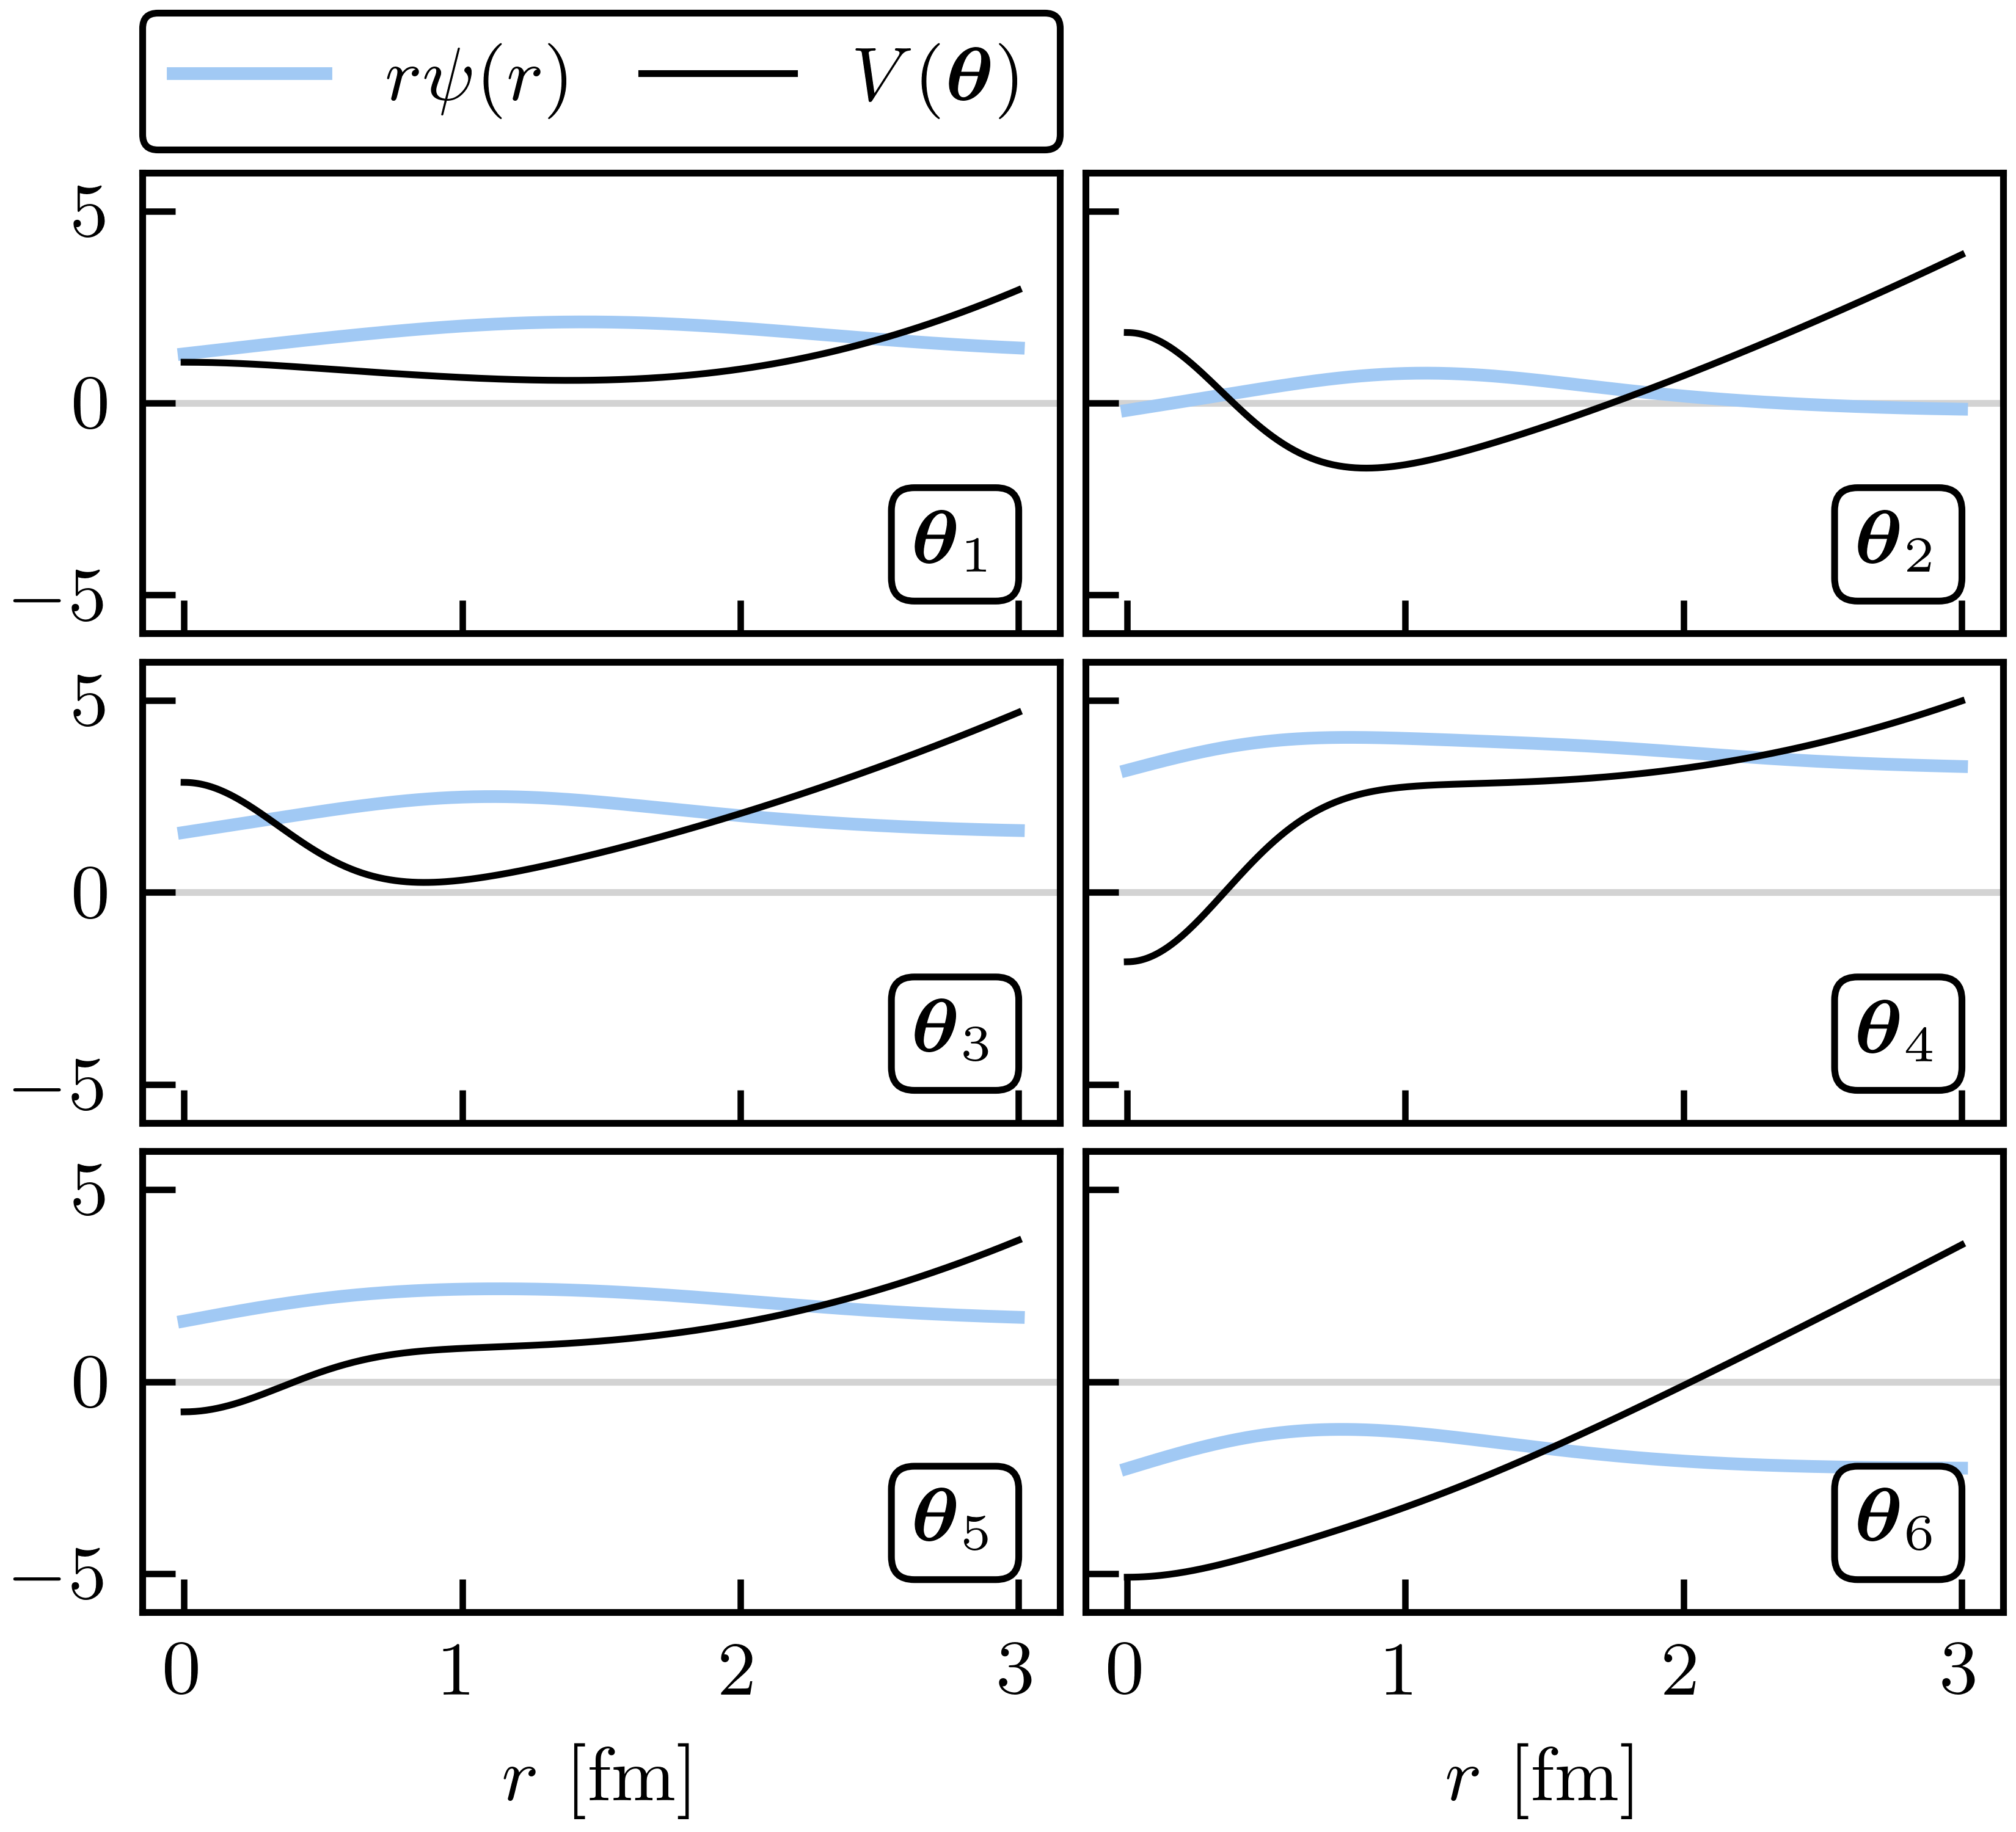
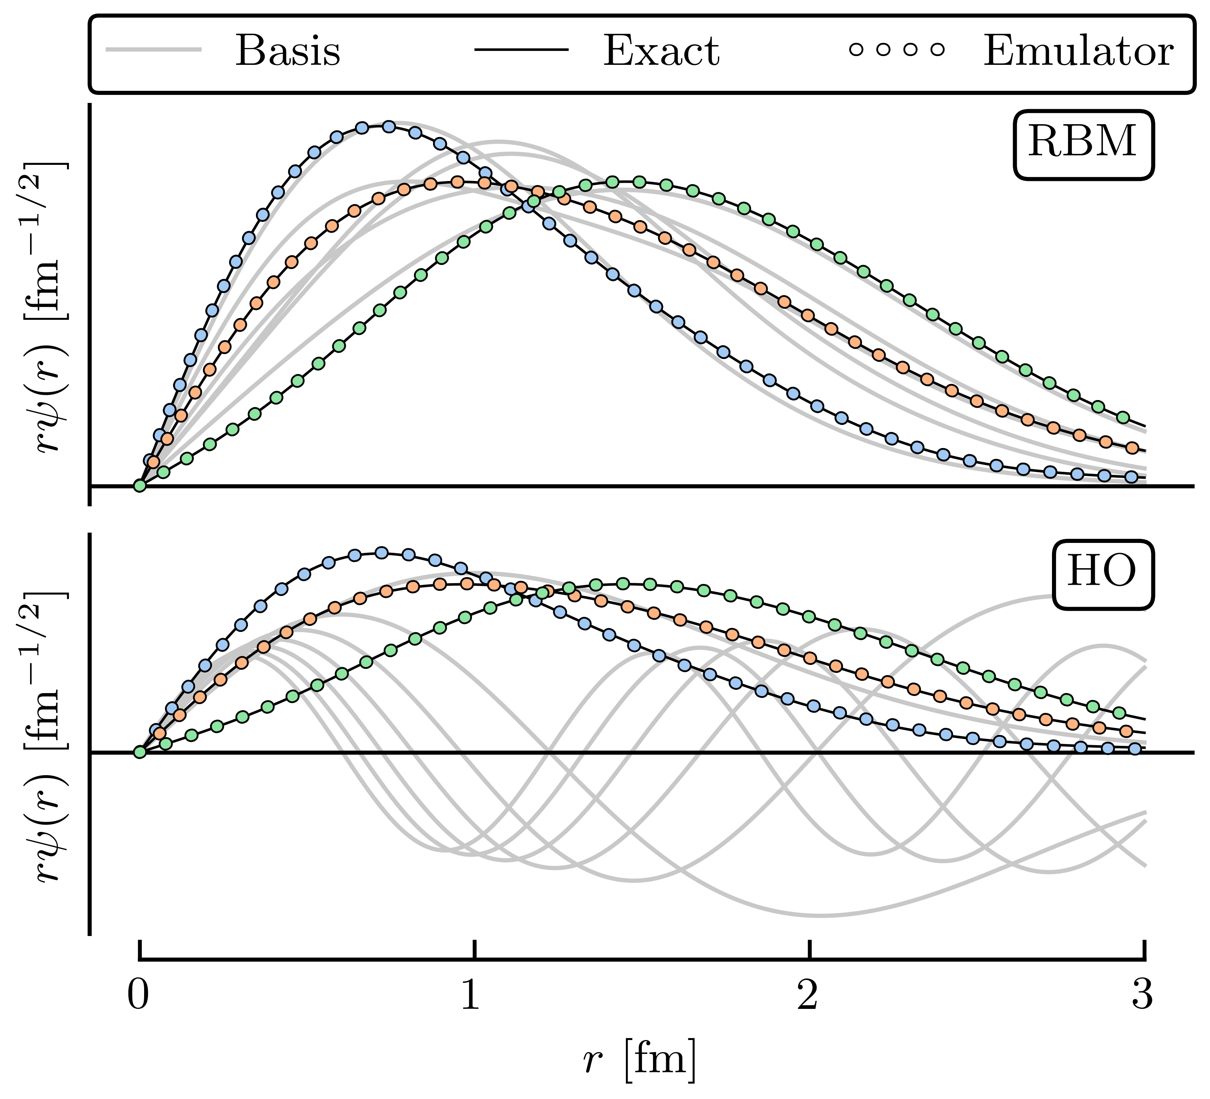


Illustrative example: anharmonic oscillator [Try your own!]
Eigenvalue problem:
← affine!
3 test 𝜃s
6 random 𝜃s
Variational emulator → diagonalize the Hamiltonian in a finite basis:
Notes:
High fidelity solution from TISE with a fine mesh in coordinate space.
Following the MOR paradigm, we take snapshots of the high-fidelity wave function at various training parameters $\{\params_i\}$ and collect them into our basis $X$.
Here, we choose $\nbasis = 6$ training points randomly and uniformly distributed in the range $[-5, 5]$\,MeV for all $\theta_n$; 50 validation parameter sets are chosen within the same range.
For example, we take three of the validation parameter sets we sampled and compare the exact and emulated wave functions for both emulators. Although both the reduced basis and HO basis are rich enough to capture the main effects of varying $\params$, the RBM emulator is much more effective at capturing the fine details of the wave function. [next slide]
\newcommand{\param}{\theta}
\newcommand{\params}{\boldsymbol{\theta}}
\newcommand{\red}[1]{{\color{red}#1}}
V(r; {\red{\params}}) &= V_{\text{HO}}(r) + \sum_{n=1}^3 \red{\param_n} e^{-r^2/\sigma_n^2}
%\exp(-r^2/\sigma_n^2),
%
%
\mbox{ with } \sigma_n = [0.5, 2, 4] \; \mathrm{fm}

Slide 47

Illustrative example: anharmonic oscillator [Try your own!]
Eigenvalue problem:
← affine!
3 test 𝜃s
3 test 𝜃s
Variational emulator → diagonalize the Hamiltonian in a finite basis:
Notes:
\newcommand{\param}{\theta}
\newcommand{\params}{\boldsymbol{\theta}}
\newcommand{\red}[1]{{\color{red}#1}}
V(r; {\red{\params}}) &= V_{\text{HO}}(r) + \sum_{n=1}^3 \red{\param_n} e^{-r^2/\sigma_n^2}
%\exp(-r^2/\sigma_n^2),
%
%
\mbox{ with } \sigma_n = [0.5, 2, 4] \; \mathrm{fm}

Slide 48


Illustrative example: anharmonic oscillator [Try your own!]
← affine!
Summary: GP doesn’t use the structure of the high-fidelity system to its advantage; HO emulator knows the problem to be solved is an eigenvalue problem; RBM (aka EC) training data are curves rather than scalars, takes advantage of system structure.
Notes:
Straightforward to emulate are the eigen-energies $E(\params)$, whose emulated values $\subspace{E}(\params)$ are the result of solving the emulator equation~\eqref{eq:ritz_condition}.
But as discussed in Section~\ref{sec:eigen-emulators_variational}, other observables associated with the operator $O$ can be emulated via $\braket{\psi(\params) | O | \psi(\params)} \approx \braket{\trial\psi(\params) | O | \trial\psi(\params)}$ using the $\trial\psi(\params)$ found from Equation~\eqref{eq:ritz_condition}.
For illustrative purposes, we continue our example using the trained RBM and HO emulators, but add a popular emulation tool to the discussion: Gaussian processes (GPs).
GPs are non-parametric, non-intrusive machine learning models for both regression \& classification tasks~\cite{rasmussen2006gaussian,Mackay:1998introduction,Mackay:2003information}.
Their popularity stems partly from their convenient analytical form and flexibility in effectively modeling various types of functions.
GPs benefit from treating the underlying set of codes as a black box~\cite{ghattas_willcox_2021}; as we will soon see, this is a double-edged sword.
We employ two independent GPs to emulate the ground-state energy and the corresponding radius expectation value.
Each GP uses a Gaussian covariance kernel and is fit to the observable values at the same values of $\params_i$ used to train the RBM emulator.
We use the maximum likelihood values for the hyperparameters.
The absolute residuals at the validation points for each of the RBM, HO, and GP emulators are shown in Figures~\ref{fig:energy-residuals} and~\ref{fig:radius-residuals} for the energy and radius, respectively.
Among these emulators, the GP emulators perform the worst, despite being trained on the values of the energies and radii themselves to perform this very emulation task.
Furthermore, its ability to extrapolate beyond the support of its training data is often poor unless great care is taken in the design of its kernel and mean function \new{(see Figures~1 and~2 in Reference~\cite{Konig:2019adq})}.
The GP suffers from what, in other contexts, could be considered its strength: because it treats the high-fidelity system as a black box (although some information can be conveyed via physics-informed priors for the hyperparameters), it cannot use the structure of the high-fidelity system to its advantage.
Note that the point here is not that it is impossible to find some GP that can be competitive with other RBM emulators after using expert judgment and careful (\ie, physics-informed) hyperparameter tuning.
Rather, we emphasize that with the reduced-order models, remarkably high accuracy is achieved \emph{without} the need for such expertise.
The HO emulator performs better than the GP emulator, but it was not ``trained'' \emph{per~se}, it was merely given a basis of the lowest six HO wave functions as a trial basis, from which a reduced-order model was derived.
However, the HO emulator can still outperform the GP emulator because it takes advantage of the \emph{structure} of the high-fidelity system: it is aware that the problem to be solved is an eigenvalue problem, for this is built into the emulator itself.
This feature permits a single HO emulator to emulate the wave function, energy, and radius simultaneously.
Coming in first in the comparison of the emulators' performances is the RBM emulator, which typically results in higher accuracies than the HO and GP emulators by multiple orders of magnitude.
The RBM emulator combines the best ideas from the other emulators.
Like the GP, the RBM emulator uses evaluations of the eigenvalue problem as training data.
However, its ``training data'' are \emph{curves} (\ie, the wave functions) rather than scalars (\eg, eigen-energies), like the GP is trained upon.
Like the HO emulator, the RBM emulator takes advantage of the structure of the system when projecting the high-fidelity system to create the reduced-order model.
With these strengths, the RBM emulator is highly effective in emulating bound-state systems, even with only a few snapshots \new{and far from the support of the snapshots (see Figures~1 and~2 in Reference~\cite{Konig:2019adq})}.

Slide 49

Role of emulators: new workflows for NP applications
From Xilin Zhang, rjf, Fast emulation of quantum three-body scattering, Phys. Rev. C 105, 064004 (2022).
How can ISNET facilitate these new workflows based on shared emulators?
If you can create fast & accurate™ emulators for observables, you can do calculations without specialized expertise and expensive resources!
Notes:
Emulators run fast, often with a small memory footprint, and can be easily shared. These properties make emulators effective interfaces for large expensive calculations, through which uses can access sophisticated physical models at a minimum cost of computational resources and without specialized expertise, creating a more efficient workflow for nuclear science. As such, emulators can become a collaboration tool that can catalyze new direct and indirect connections between different research areas and enable novel studies

Slide 50



































CC-Emulator Workflow Chart
$${\left\{α_{k}\right\}}_{k=1}^{N_{EIM}}$$
User inputs:
$${\left\{α_{k}\right\}}_{k=1}^{N_{RBM}}$$
After off-line:
$$\text{P}\text{−}\text{T} \text{system}\text{ (}\text{states}\text{, }\text{numerical} \text{details}\text{)}$$
$${\left\{α_{k}\right\}}_{k=1}^{N_{solve}}$$
$$n_{RBM}$$
$$n_{EIM}^{sph}$$
$$n_{EIM}^{def}$$
$$δ\text{−}\text{strength}$$
Offline
Online
Coupling and Free Waves
$$)^{−1}c_{j}^{sph}$$
$$δ\text{−}\text{strength}$$
$$n_{RBM}$$
$${\left\{α_{k}\right\}}_{k=1}^{N_{EIM}}$$
$${\left\{α_{k}\right\}}_{k=1}^{N_{RBM}}$$
$$\text{P}\text{−}\text{T} \text{system}$$
Coupling matrix elements:
$$M_{ij}$$
$$n_{EIM}^{sph}$$
Compute EIM coefficients
$${\left\{α_{k}\right\}}_{k=1}^{N_{solve}}$$
$$φ_{i}^{free}$$
For each $α$ in the set
$\text{Generate} \text{Frescox}$ input file
Free waves:
$$n_{EIM}^{def}$$
$c_{j}^{sph}=V^{sph}(s_{j},α)$,
$c_{j}^{def}=V^{def}(s_{j},α)$
$$δ\text{−}\text{strength}$$
$${b_{k}^{def}=(U}_{kj}^{EIM})^{−1}c_{j}^{def}$$
Empirical Interpolation
${b_{k}^{sph}=(U}_{kj}^{EIM})^{−1}c_{j}^{sph}$,
Frescox
Obtain SVD basis functions
$${\left\{{V(R,α}_{k})\right\}}_{k=1}^{N_{EIM}}$$
$${\left\{{U(R,α}_{k})\right\}}_{k=1}^{N_{EIM}}$$
$${\left\{u_{i}^{sph}(R)\right\}}_{i=1}^{n_{EIM}^{sph}}$$
$${\left\{u_{i}^{def}(R)\right\}}_{i=1}^{n_{EIM}^{def}}$$
Select interpolation locations
$${\left\{ψ_{i}^{ex} (R,α_{k})\right\}}_{k=1}^{N_{RBM}}$$
$${\left\{s_{i}^{sph}(R)\right\}}_{i=1}^{n_{EIM}^{sph}}$$
$${\left\{s_{i}^{def}(R)\right\}}_{i=1}^{n_{EIM}^{def}}$$
SVD Basis
Integrals
Precompute all integrals with affine EIM basis:
SVD basis elements:
$${\hat{A}}_{ijk},{\hat{B}}_{ijk}, c_{i}$$
${{\{ψ}_{i;k}^{SVD}\}}_{k=1}^{n_{RBM}}$= SVD[${\left\{ψ_{i}^{ex} (R,α_{k})\right\}}_{k=1}^{N_{RBM}}]$
$${(U}_{ij}^{EIM})^{−1}$$
Invert EIM matrix:

