Slide 1

Gaussian Processes of Sparse Datasets
Ryan Ferguson
Supervisors: Dave Ireland and Bryan McKinnon
r.ferguson.3@research.gla.ac.uk

Slide 2
Why are we doing this?

Slide 3
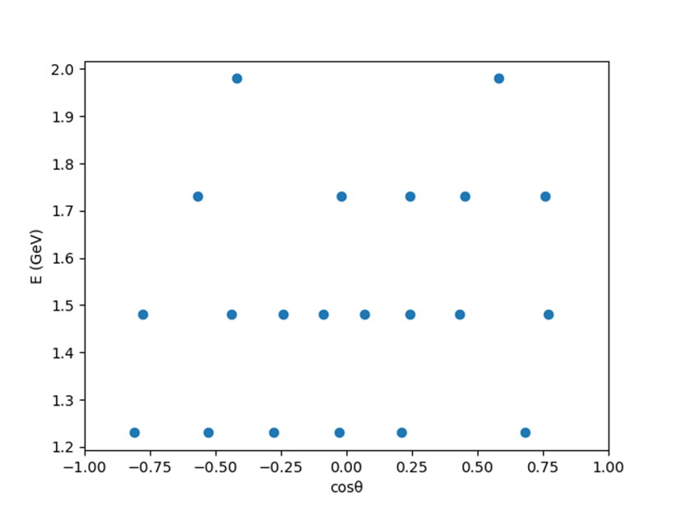
Why?
Information from hadron data is limited by incomplete and potentially inconsistent datasets.
Notes:
Incomplete, inaccurate datasets
Sparsely populated in kinematic regions of interest and extracting useful information challenging.

Slide 4
Current issues?
Current hadron analyses can use data from 40+ years ago, which are unlikely to be taken again.
These coupled channel analyses require data from different experiments which can disagree, leading to arbitrary weighting in χ² minimisation for theoretical modelling.
This produces inconsistencies in the fitting of resonances which are still a matter of debate today, e.g. Λ1405.
Notes:
Check other datasets.
Improve datasets to help theorists, check for areas of divergence.

Slide 5
Specifics of this GP model

Slide 6
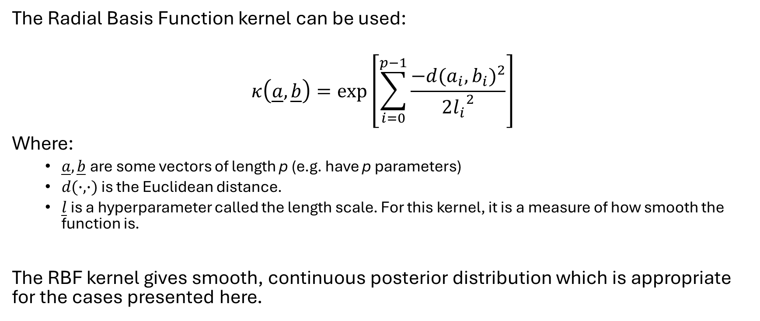
Kernel Choice
The Radial Basis Function kernel can be used:
$$κ\left(\underline{a},\underline{b}\right)=exp⁡\left[\sum_{i=0}^{p−1}{\frac{−{d(a_{i},b_{i})}^{2}}{2{l_{i}}^{2}}}\right]$$
Where:
  $\underline{a},\underline{b}$ are some vectors of length p (e.g. have p parameters)
  $d(∙,∙)$ is the Euclidean distance.
  $\underline{l}$ is a hyperparameter called the length scale. For this kernel, it is a measure of how smooth the function is.
The RBF kernel gives smooth, continuous posterior distribution which is appropriate for the cases presented here.

Slide 7
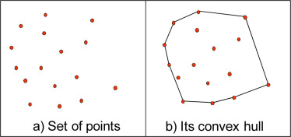
Convex Hull
It was found in testing that the GP performs well at interpolating but not at extrapolating.
As such a set of discrete points of the convex hull¹ of the known datapoints is the space that the GP gives a prediction for (with resolution in each dimension chosen by the user).
Notes:
A convex hull is the minimal convex polygon that encloses all points in the set of known points.

Slide 8
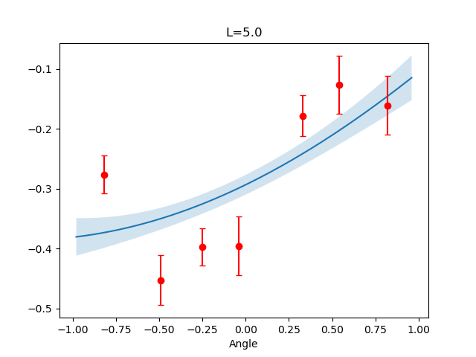
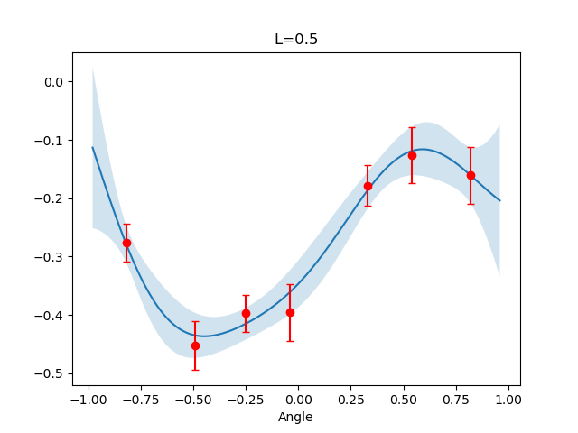
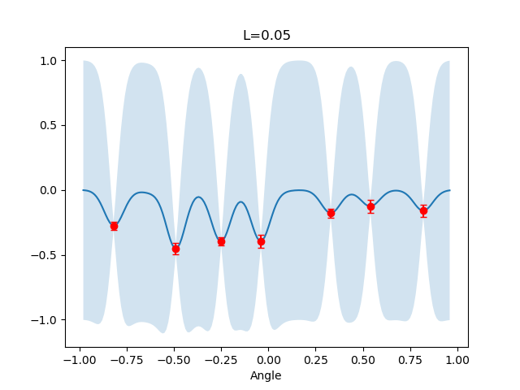
Hyperparameter Choice
The choice of length scale dictates the smoothness of our posterior and how good the overall fit is

Slide 9
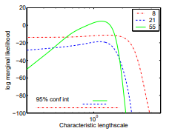

Standard Approach for Hyperparameter Optimisation
The normal approach is to use the marginal likelihood function:
$$\log{p\left(y | X,\vec{l}\right)=−\frac{1}{2}y^{T}{K_{y}}^{−1}y}−\frac{1}{2}\log\left|K_{y}\right|−\frac{n}{2}\log{2π}$$
For low number of datapoints this is not well defined⁶:

Slide 10
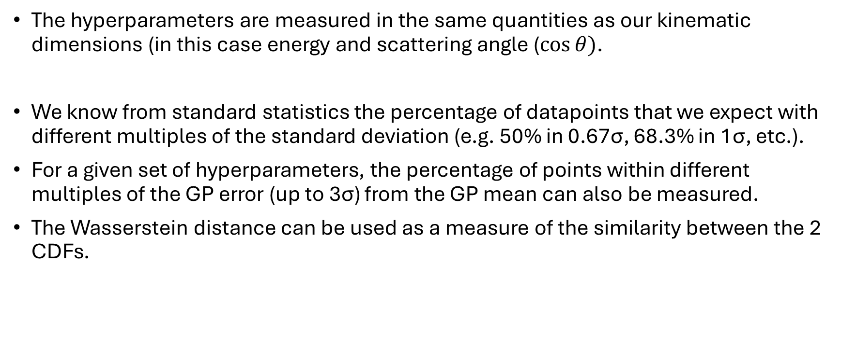
Hyperparameter Search
The hyperparameters are measured in the same quantities as our kinematic dimensions (in this case energy and scattering angle ($\cos{θ})$.
We know from standard statistics the percentage of datapoints that we expect with different multiples of the standard deviation (e.g. 50% in 0.67σ, 68.3% in 1σ, etc.).
For a given set of hyperparameters, the percentage of points within different multiples of the GP error (up to 3σ) from the GP mean can also be measured.
The Wasserstein distance can be used as a measure of the similarity between the 2 CDFs.

Slide 11
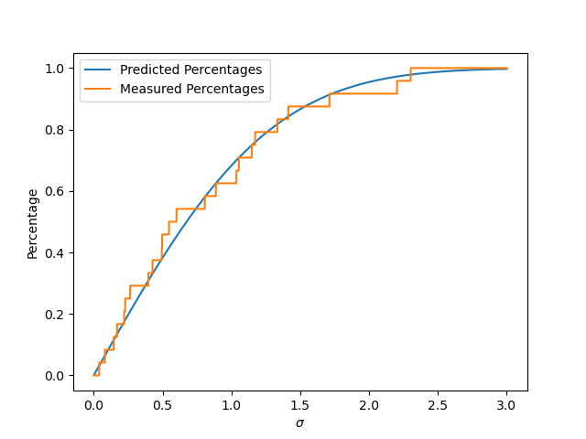
Expected vs Measured Percents

Slide 12
Bounds for Hyperparameter Search
Upper – Full range (per kinematic dimension)
  We know that the GP fails at extrapolation so want to keep within interpolating range
Lower – Minimum distance between (sorted) adjacent datapoints.
  Take for instance the energy hyperparameter
  We know that we cannot infer anything smaller than the smallest distance between adjacent energy levels, (think resolution)

Slide 13
Hyperparameters on boundary
In certain cases, the returned optimal hyperparameters sit on or close to the boundary.
Often these still give good physical results but sometimes can return GP fits showing unphysical behaviour.
The Wasserstein distance (or the Kolmogorov-Smirnov statistic) alone cannot be used as a suitable loss function

Slide 14
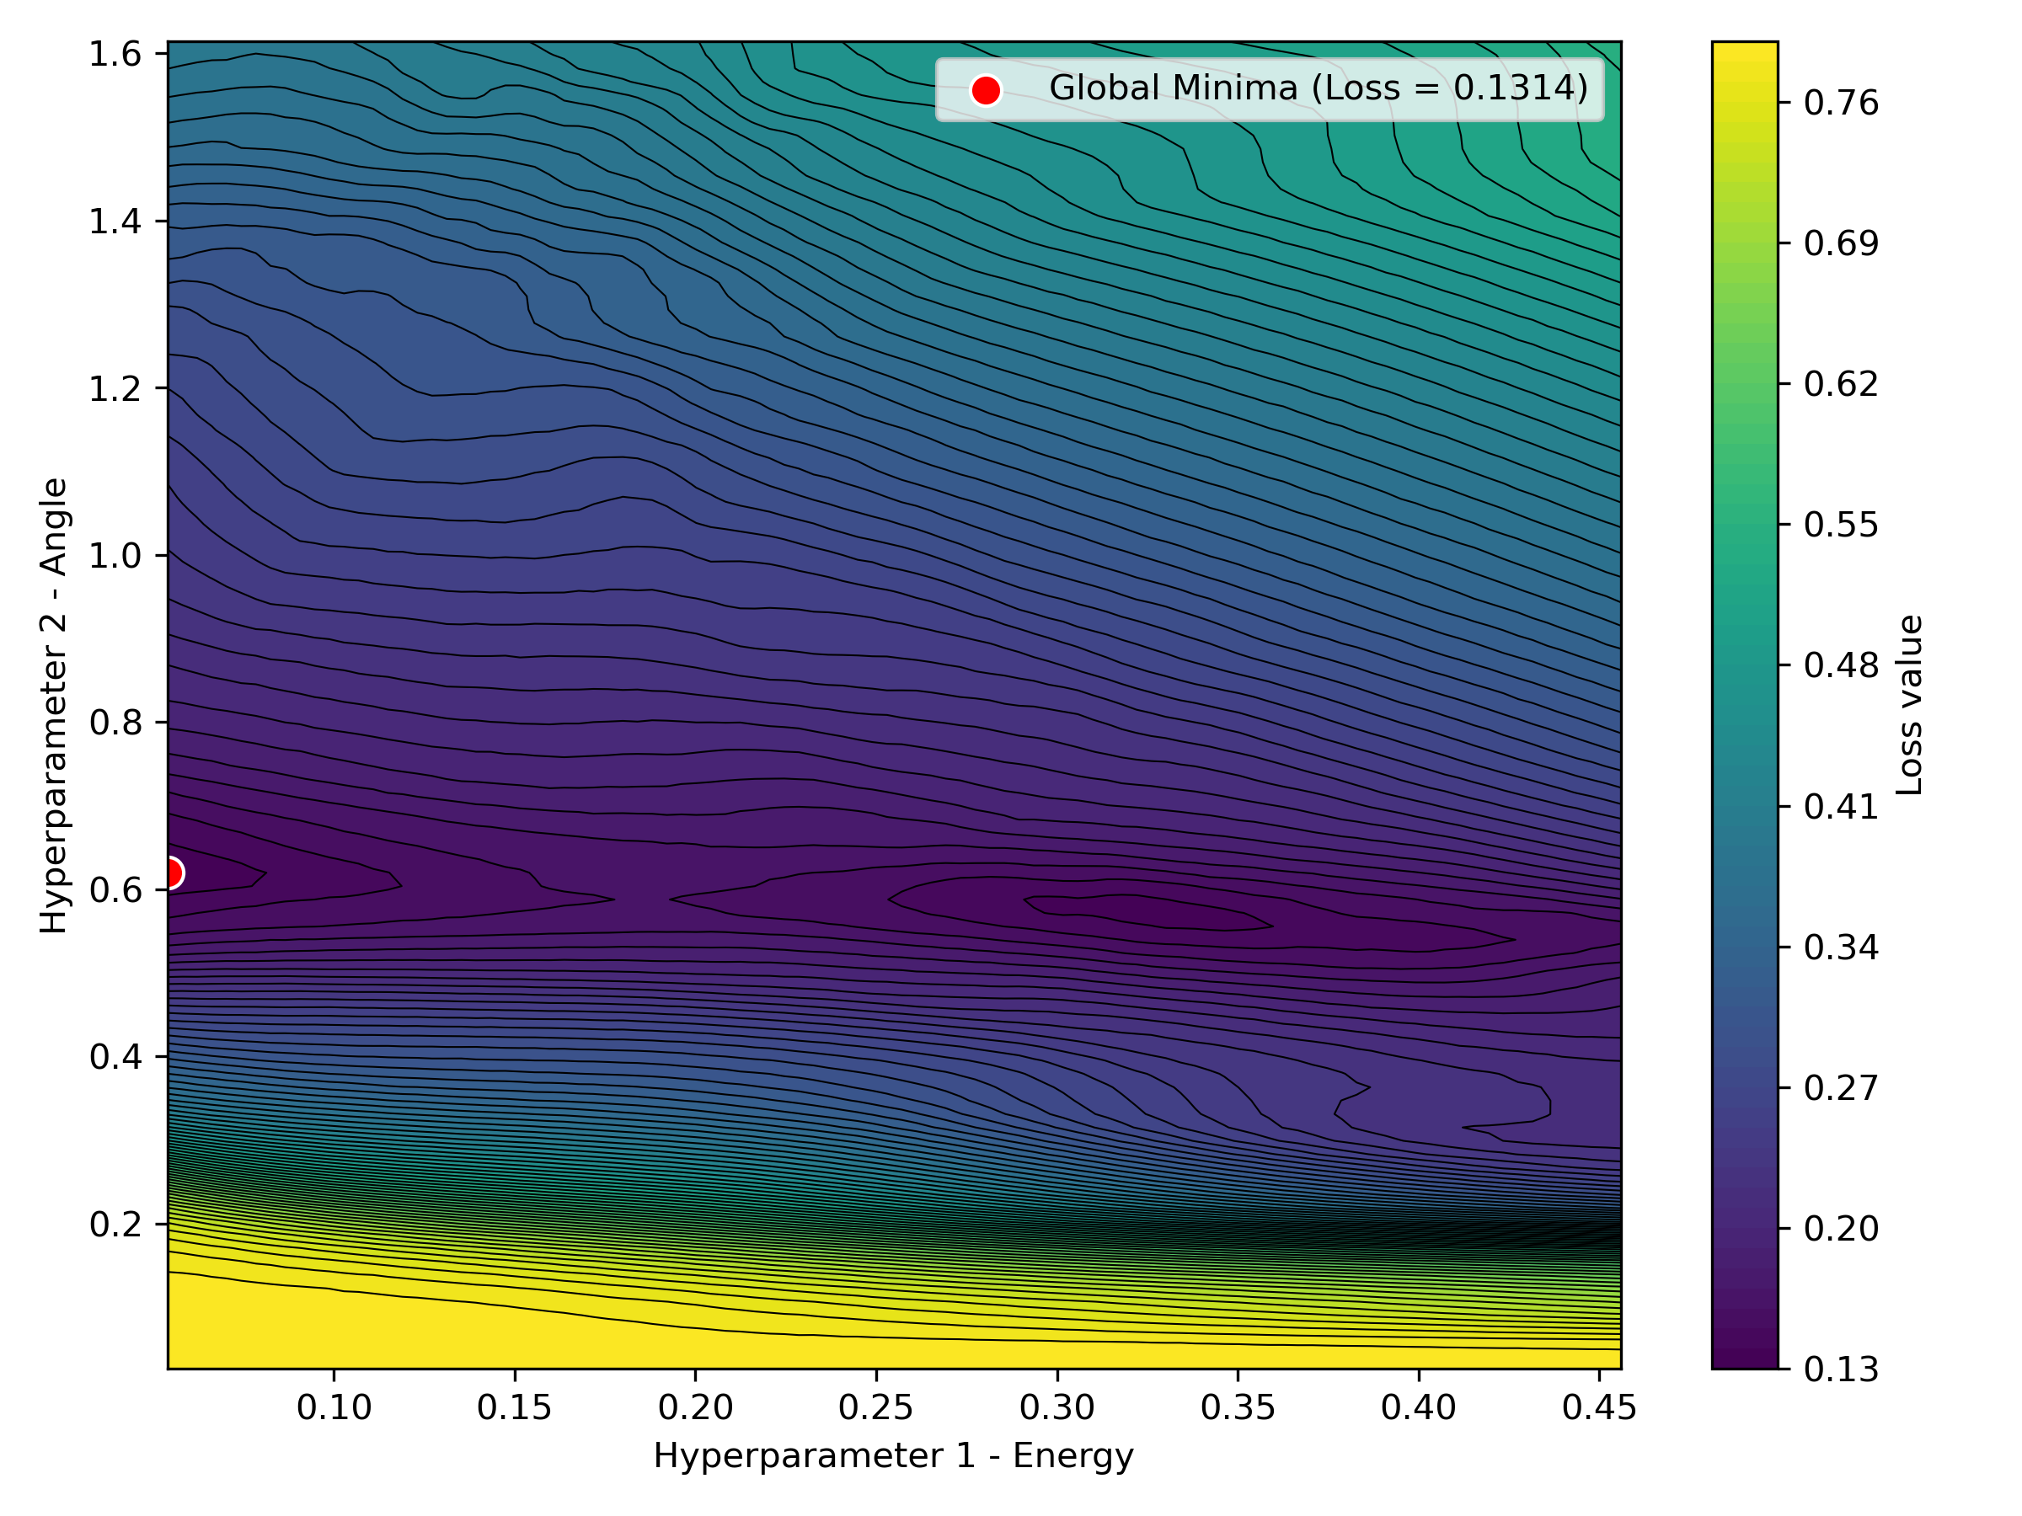
Loss surface – optimum close to boundary

Slide 15
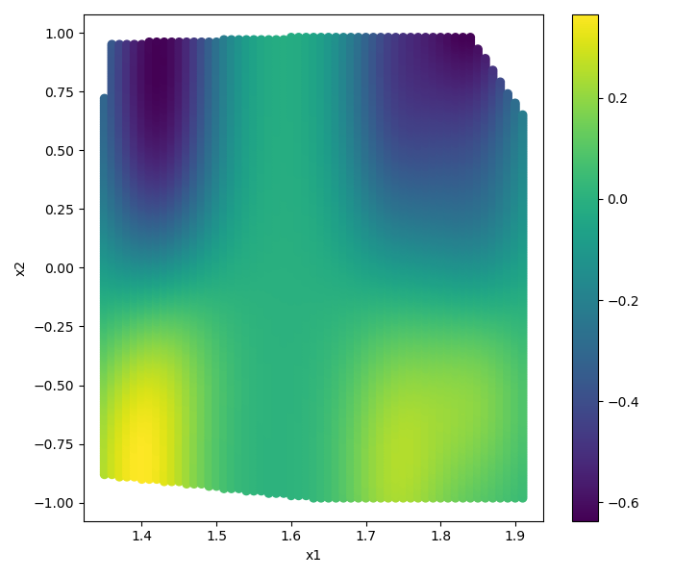
Results not totally physical

Slide 16
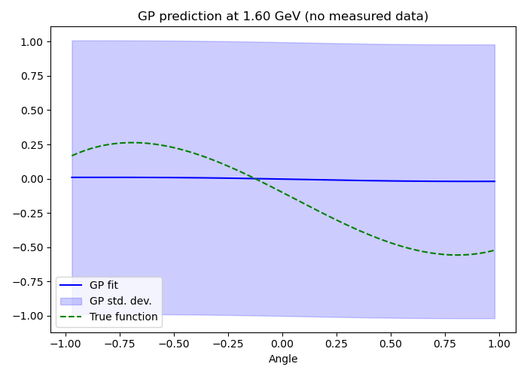
Projection at E=1.6 (no measured data)

Slide 17
Boundary Penalty Term
For each kinematic dim, if the prospective length scale is on any boundary assign it 1, decreasing linearly until the centre is assigned 0.
Weight this to 1% in the final loss.
This ensures that if there are local minima (with a similar loss to the global minima) but far from the boundary then this will be the returned optimum.
By weighting it to only 1% it ensures that if the only viable hyperparameters lie on the boundary then these will still be the returned set.

Slide 18
How do we know it works?

Slide 19
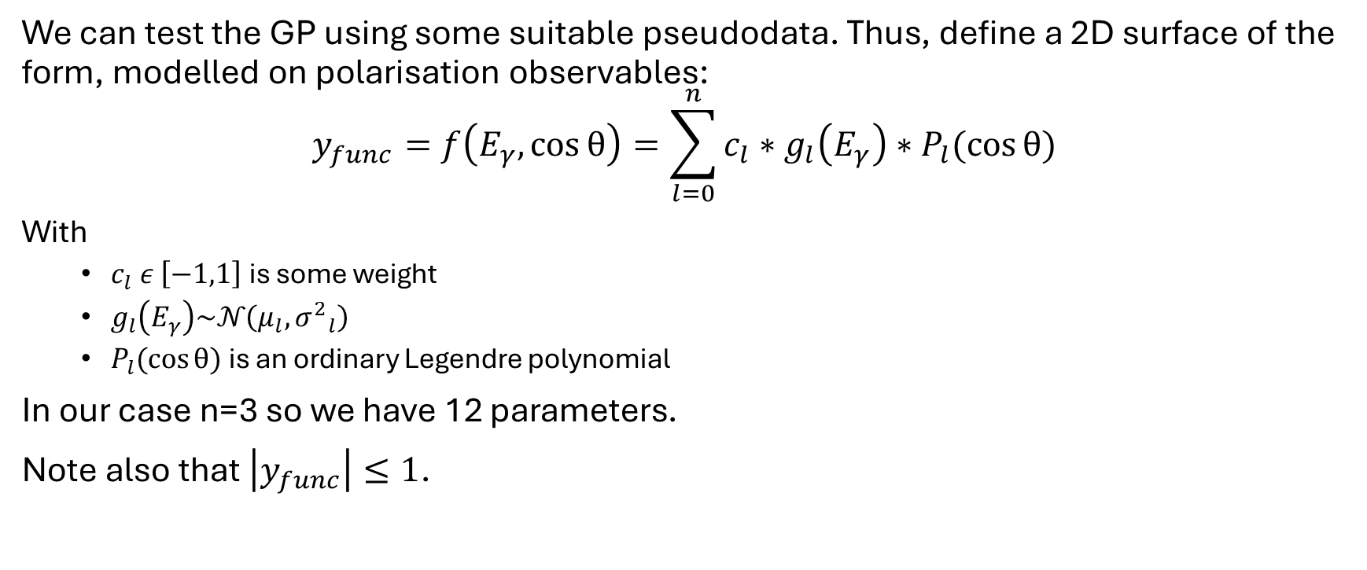
Pseudodata
We can test the GP using some suitable pseudodata. Thus, define a 2D surface of the form, modelled on polarisation observables:
$$y_{func}=f\left(E_{γ},\cos{θ}\right)=\sum_{l=0}^{n}{c_{l}∗g_{l}\left(E_{γ}\right)∗P_{l}(\cos{θ}) }$$
With
  $c_{l} ε \left[−1,1\right]$ is some weight
  $g_{l}\left(E_{γ}\right)\text{∼}𝒩\left(μ_{l},{σ^{2}}_{l}\right)$
  $P_{l}(\cos{θ})$ is an ordinary Legendre polynomial
In our case n=3 so we have 12 parameters.
Note also that $\left|y_{func}\right|≤1$.

Slide 20
2 Tests
A 2D known surface is generated, some points are selected and given appropriate noise and error bars. This is pseudodata which can be used to test the GP is performing as intended.
We can perform 2 tests on this:
Number of points in different confidence intervals
Unbiased Pull of Fitted coefficients

Slide 21
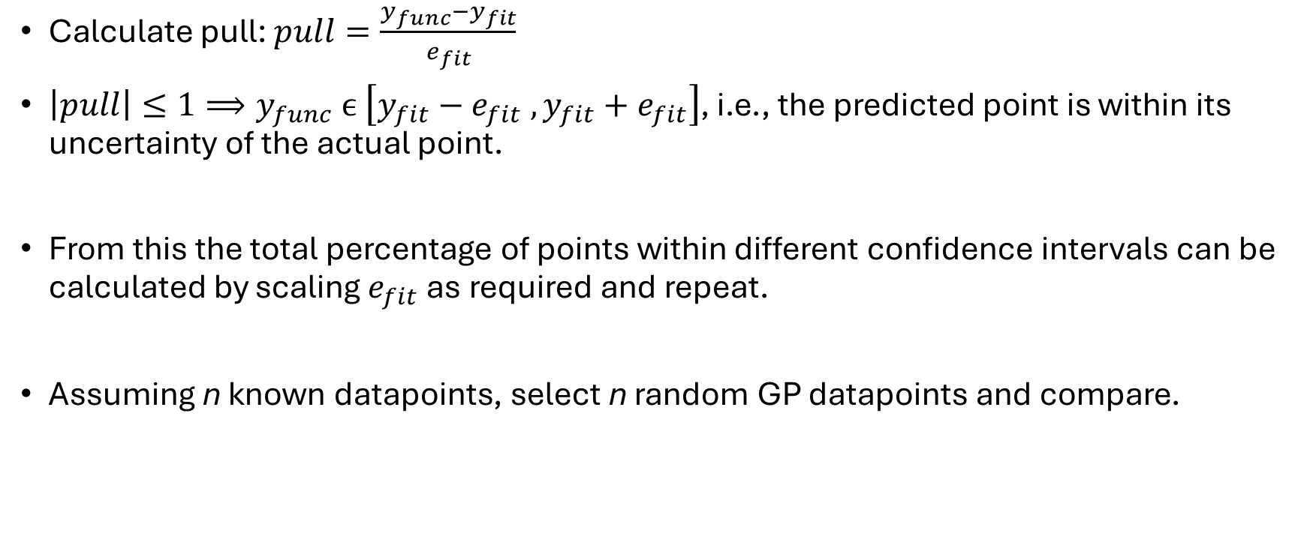
Points within confidence intervals
Calculate pull: $pull=\frac{y_{func}−y_{fit}}{e_{fit}}$
$\left|pull\right|≤1⟹y_{func} ϵ \left[y_{fit}−e_{fit} , y_{fit}+e_{fit}\right]$, i.e., the predicted point is within its uncertainty of the actual point.
From this the total percentage of points within different confidence intervals can be calculated by scaling $e_{fit}$as required and repeat.
Assuming n known datapoints, select n random GP datapoints and compare.

Slide 22
Points within confidence intervals
Confidence interval | Expected percentage of points within confidence interval (%) | Mean percentage of GP points within confidence interval (%)
0.67σ | 50 | 62.6
1σ | 68.3 | 77.0
1.96σ | 95 | 96.4

Slide 23
Fitting Parameters
The functional form of the 2D surface can be fitted using the known datapoints as well as the n random datapoints (to check the GP performs well in all kinematic regions).
The pull of the 12 fitted coefficients compared to the actual coefficients can be calculated for both.
Notes:
As stated previously, most of the information of hadron resonances is obtained from the fitting the theoretical functional form to data. As such is important to check that fits to GP data are appropriate.

Slide 24
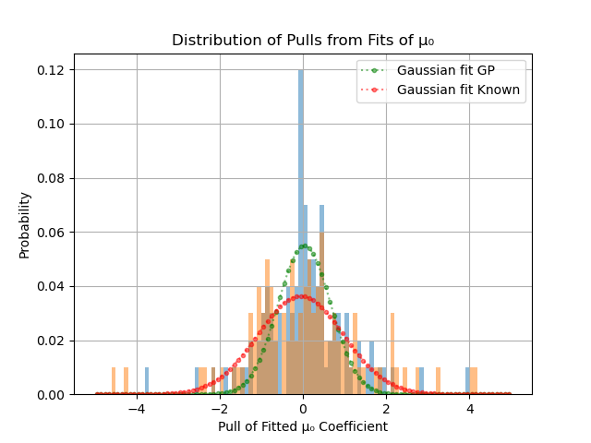
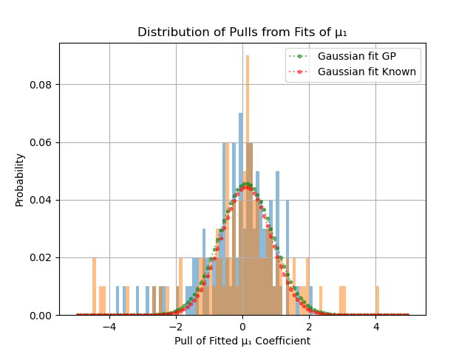
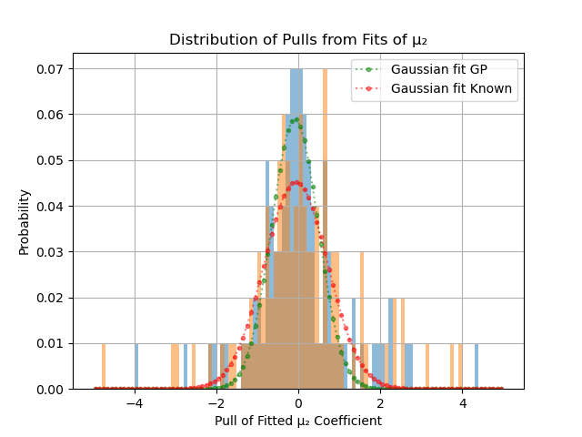
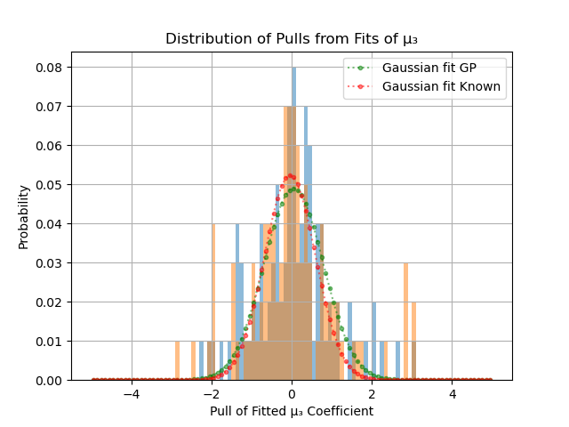
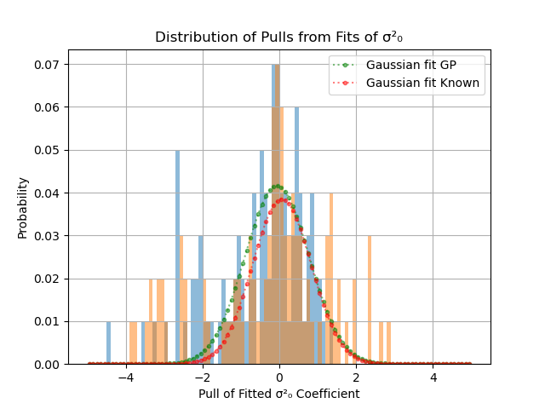
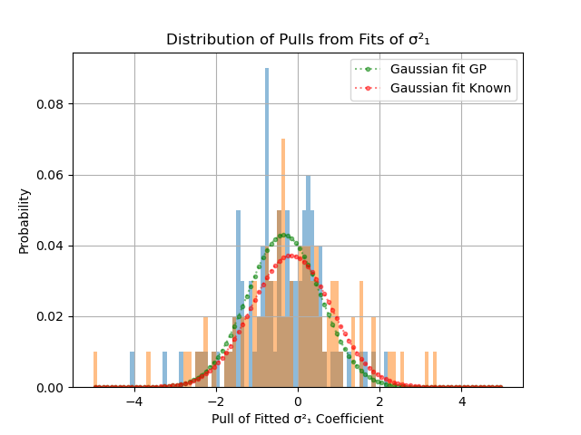
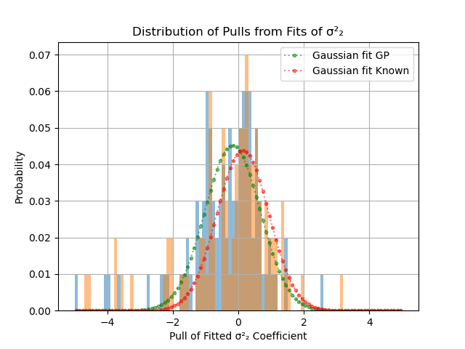
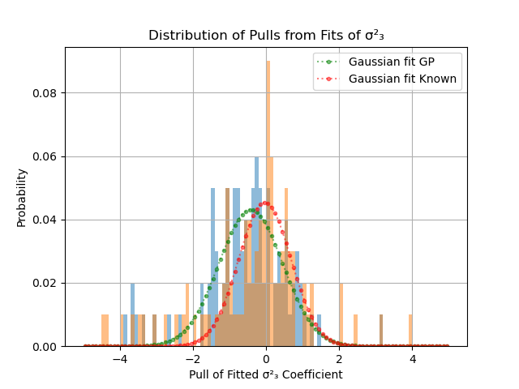
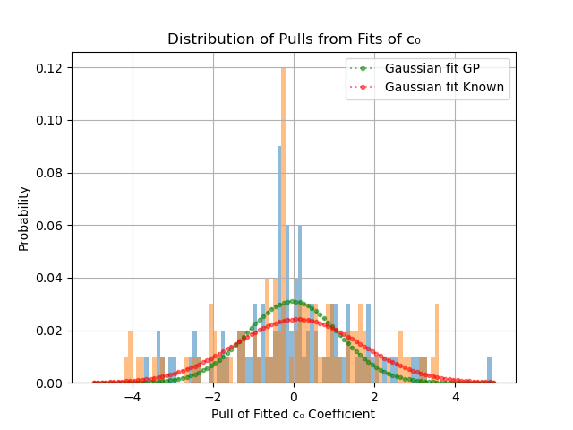
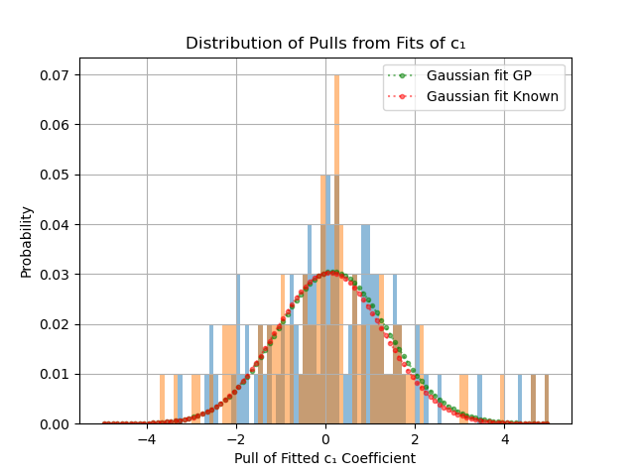
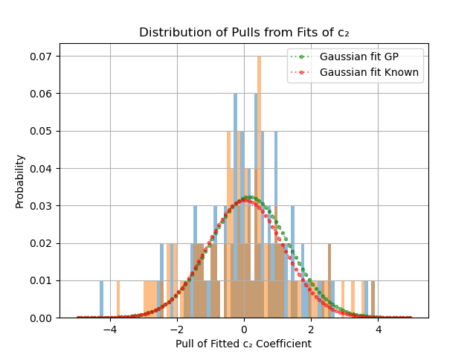
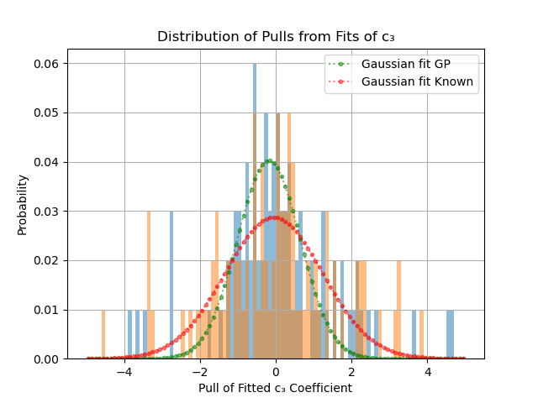

Slide 25
What does real data look like?

Slide 26
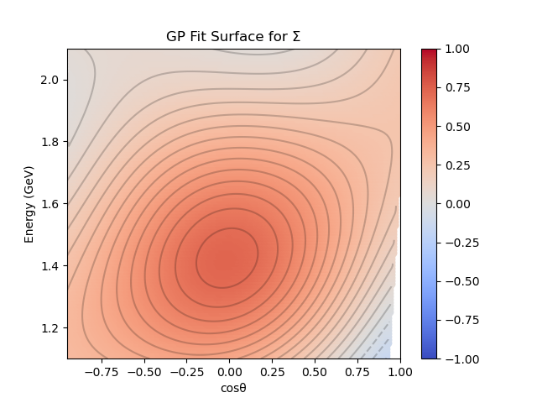
Data from CLAS
The GP has been used on data recently published by the CLAS collaboration at Jefferson Lab, specifically 5 polarisation observables (Σ, P, T, O_{x} and O_{z}) of the K⁰Σ⁺ reaction.² Example plots for Σ:

Slide 27
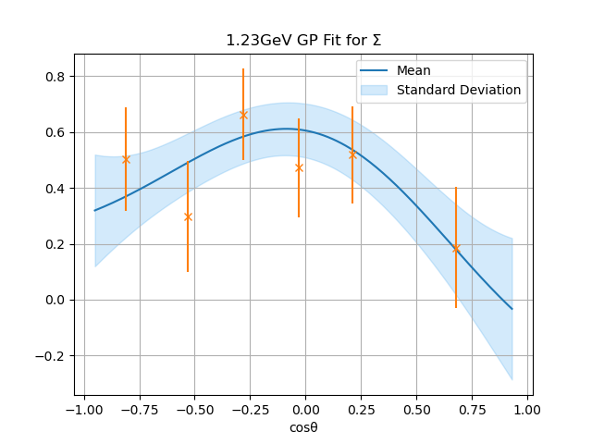
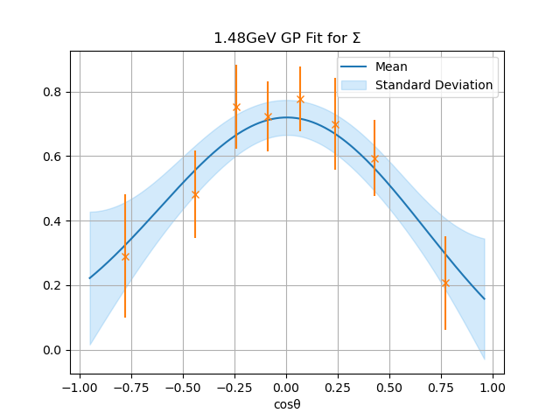
GP 1D Projections for Σ

Slide 28
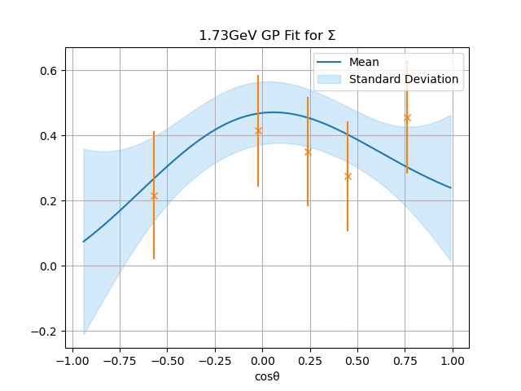
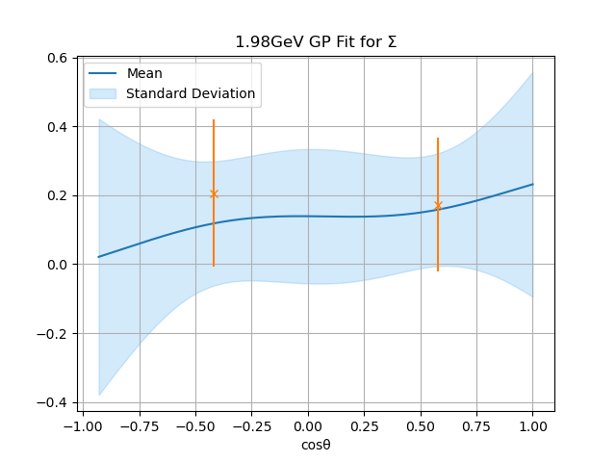
GP 1D Projections for Σ

Slide 29
Inconsistencies across Datasets

Slide 30
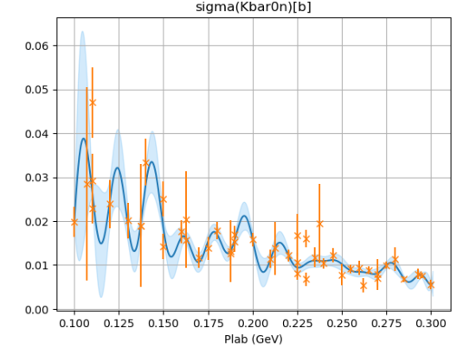

Simple 1D case - KbarN Cross Section
Try to run a GP fit on the world data for $K^{−}p→{\overline{K}}^{0}n$

Slide 31
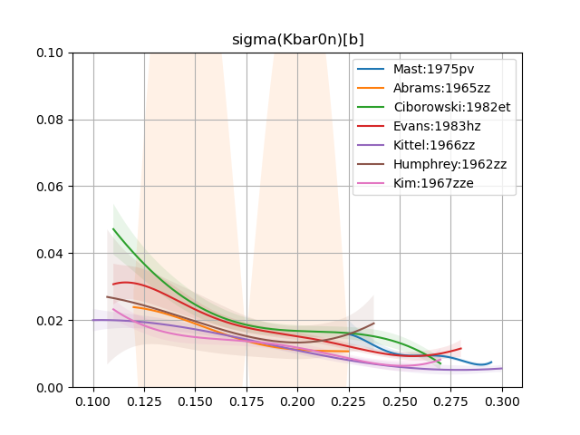
KbarN
Instead running a GP on each individual experiment produces the following:

Slide 32
Probability surface
Taking a 1D projection in energy, each result (from the different GPs) can be assumed to form a normalised gaussian.
This means that results with larger error bars have a lower amplitude and thus contribute less to the 1D projection.

Slide 33
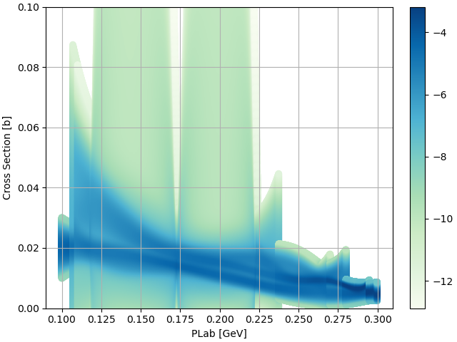
Probability Surface
By normalising each slice, the (log) probability of a cross-section value at a given energy can be found:

Slide 34
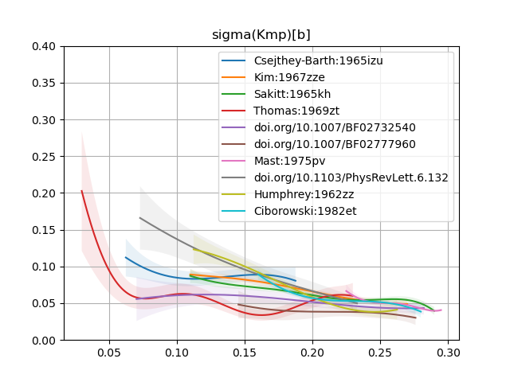
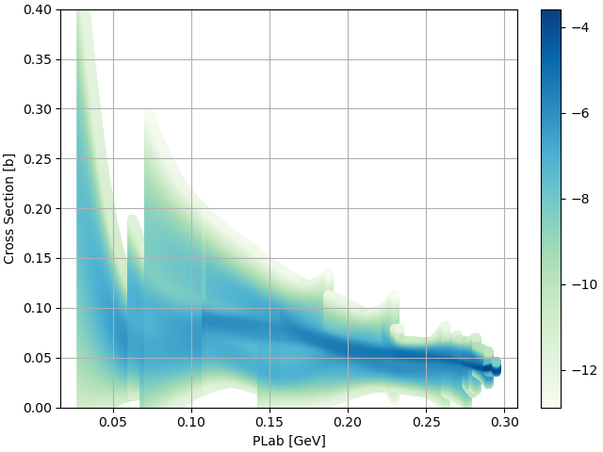

Slide 35
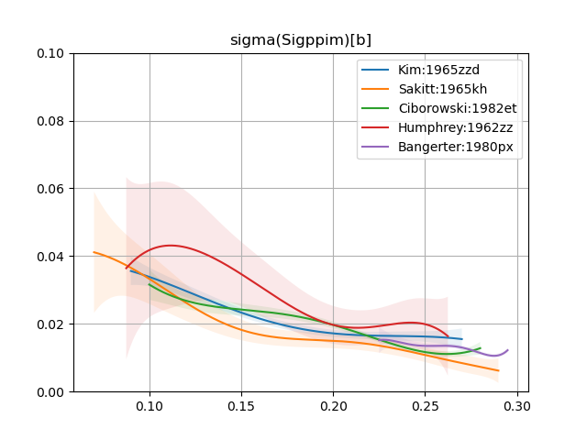
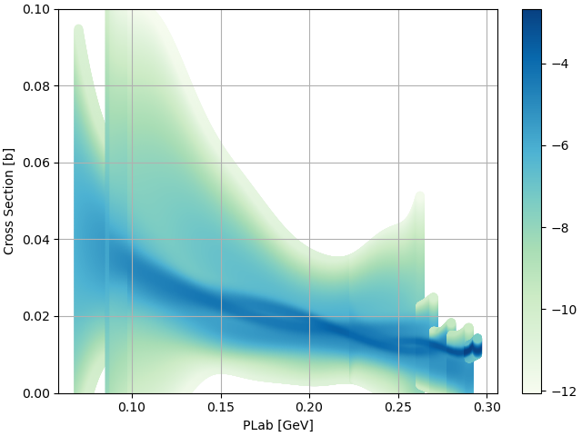

Slide 36
Conclusion
A Gaussian Process is an extremely useful machine learning tool to expand existing, limited datasets.
The methodology presented here has been demonstrated to work on pseudodata, modelled on real-life sparse datasets.
Inconsistencies between experiments can be measured and a probability surface found.
Code to run GP fits and probability surface calculations can be found on the GitHub here, https://github.com/rferguson22/Gaussian-Process

Slide 37
Thanks for listening

Slide 38
References
R. Laurini, Geographic Knowledge Infrastructure, 2017, www.sciencedirect.com/topics/earth-and-planetary-sciences/convex-hull [accessed May 28th 2024]
L. Clark et al, Photoproduction of the Σ+ hyperon using linearly polarized photons with CLAS, 2024, https://arxiv.org/abs/2404.19404 [accessed May 30th 2024]
F. Rieger, HIGH ENERGY ASTROPHYSICS - Lecture 9, 2024, www.mpi-hd.mpg.de/personalhomes/frieger/HEA9.pdf [accessed May 30th 2024]
R. Fiore et al, Kinematically complete analysis of the CLAS data on the proton structure Function F2 in a Regge-Dual model, 2006, https://www.researchgate.net/publication/46776238_Kinematically_complete_analysis_of_the_CLAS_data_on_the_proton_structure_Function_F2_in_a_Regge-Dual_model?_tp=eyJjb250ZXh0Ijp7ImZpcnN0UGFnZSI6Il9kaXJlY3QiLCJwYWdlIjoiX2RpcmVjdCJ9fQ [accessed May 30th 2024]
M. Krasser, Gaussian processes. 2018. URL: krasserm.github.io/2018/03/19/gaussian-processes/ [accessed May 26th 2024]
C. E. Rasmussen and C.K. I. Williams, Gaussian Processes for Machine Learning, MIT Press, 2006, ISBN-13 978-0-262-18253-9.

Slide 39
Back-up Slides

Slide 40
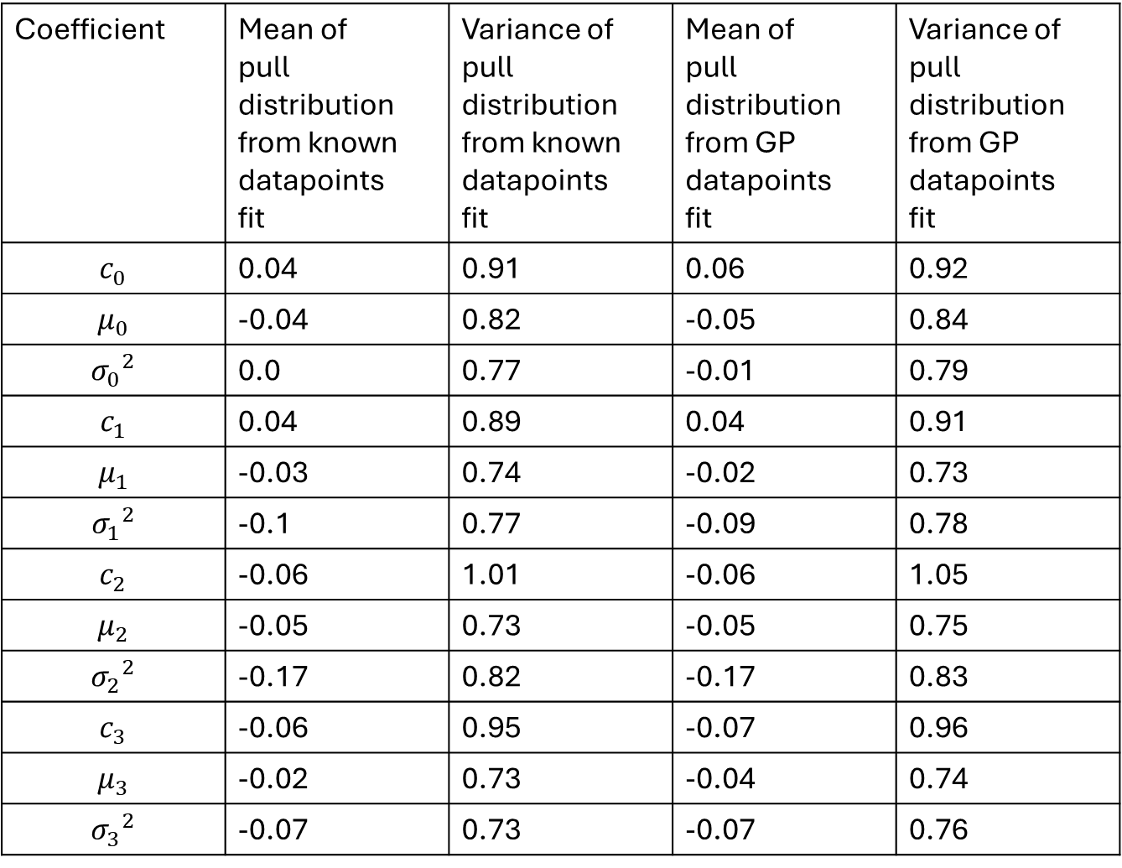
Coefficient | Mean of pull distribution from known datapoints fit | Variance of pull distribution from known datapoints fit | Mean of pull distribution from GP datapoints fit | Variance of pull distribution from GP datapoints fit
$$c_{0}$$ | 0.04 | 0.91 | 0.06 | 0.92
$$μ_{0}$$ | -0.04 | 0.82 | -0.05 | 0.84
$${σ_{0}}^{2}$$ | 0.0 | 0.77 | -0.01 | 0.79
$$c_{1}$$ | 0.04 | 0.89 | 0.04 | 0.91
$$μ_{1}$$ | -0.03 | 0.74 | -0.02 | 0.73
$${σ_{1}}^{2}$$ | -0.1 | 0.77 | -0.09 | 0.78
$$c_{2}$$ | -0.06 | 1.01 | -0.06 | 1.05
$$μ_{2}$$ | -0.05 | 0.73 | -0.05 | 0.75
$${σ_{2}}^{2}$$ | -0.17 | 0.82 | -0.17 | 0.83
$$c_{3}$$ | -0.06 | 0.95 | -0.07 | 0.96
$$μ_{3}$$ | -0.02 | 0.73 | -0.04 | 0.74
$${σ_{3}}^{2}$$ | -0.07 | 0.73 | -0.07 | 0.76

Slide 41
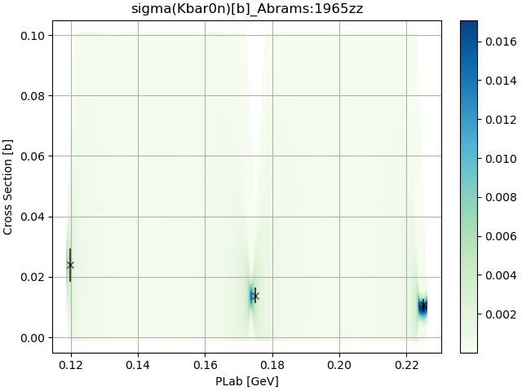
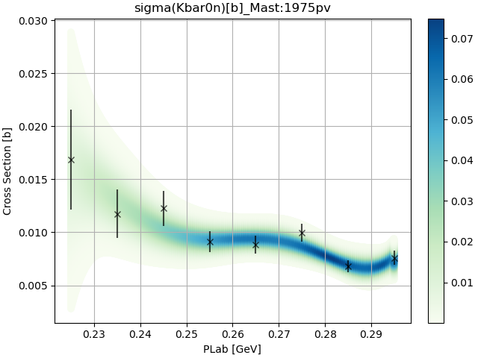
Kbar0n

Slide 42
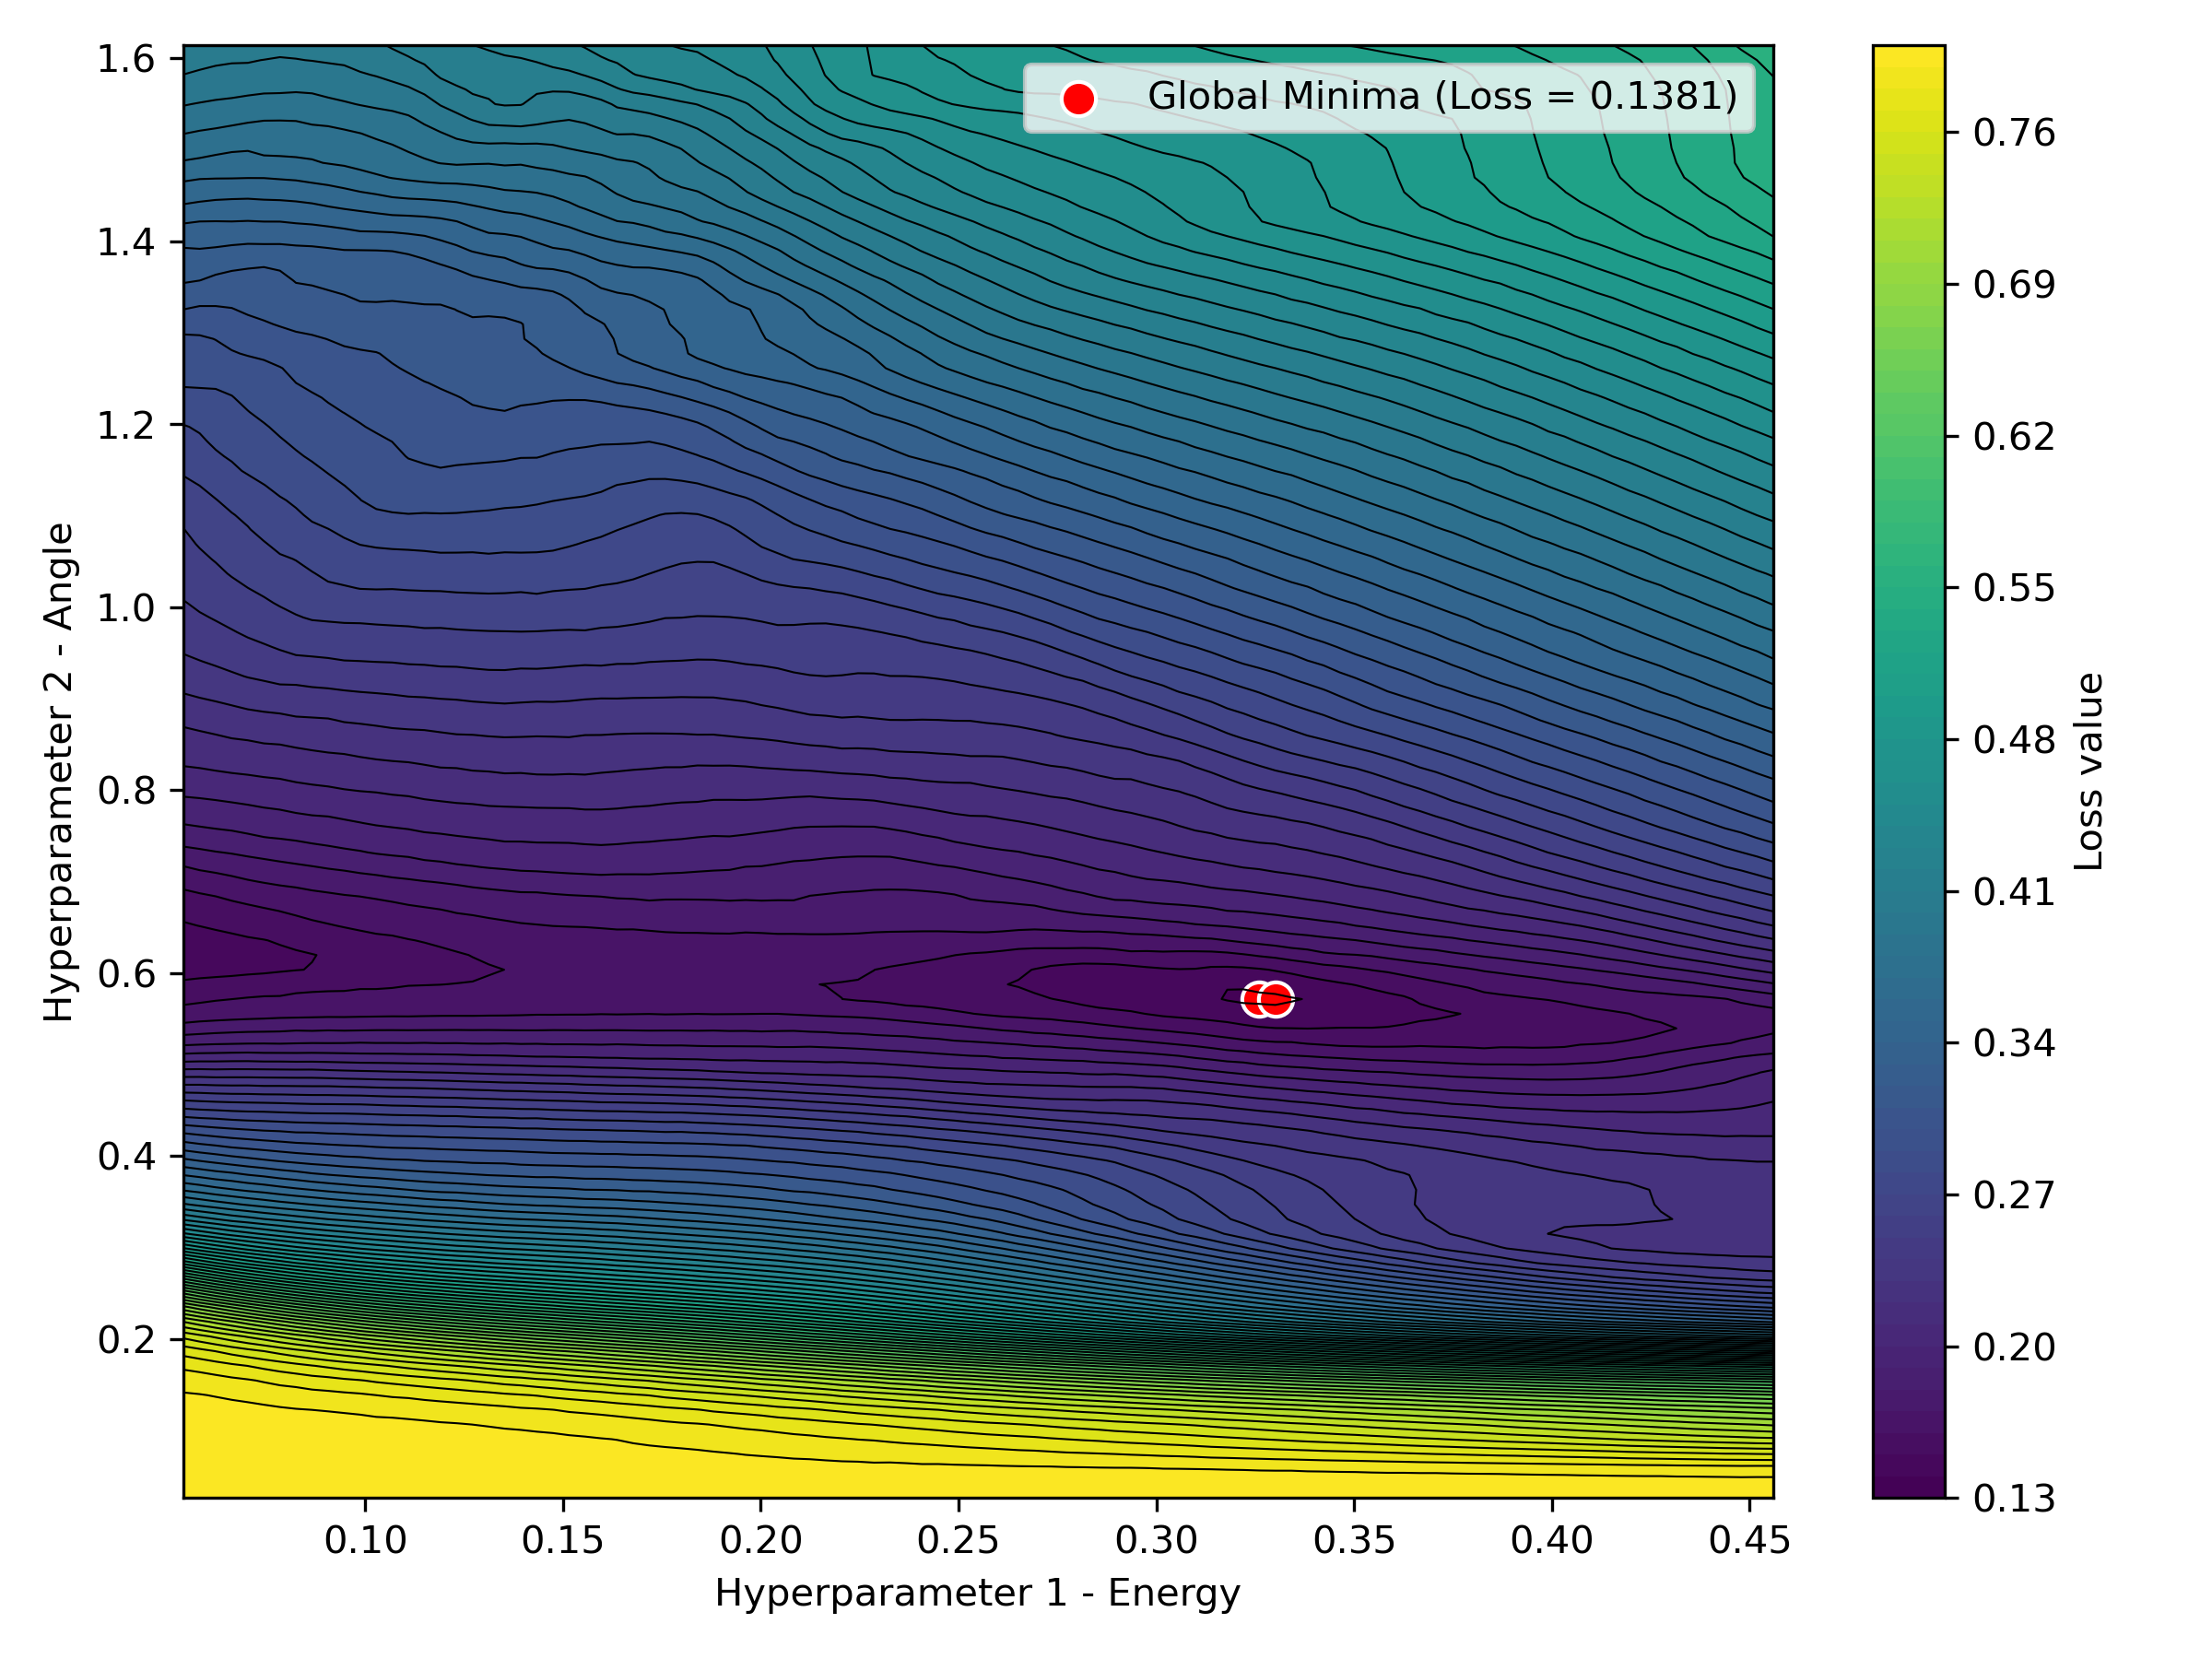
New minima far from boundary

Slide 43
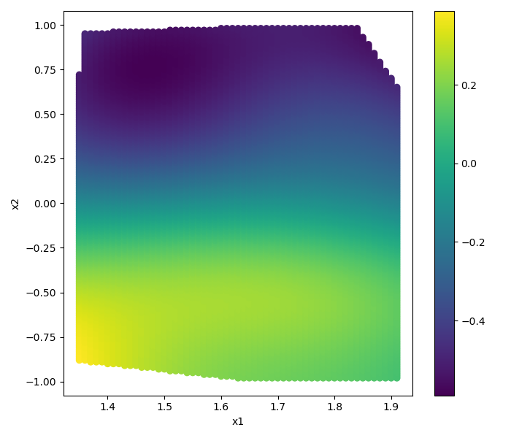
Gives reasonable looking surface

Slide 44
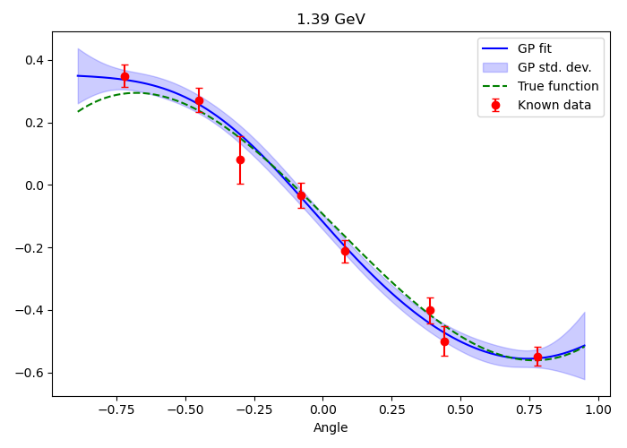
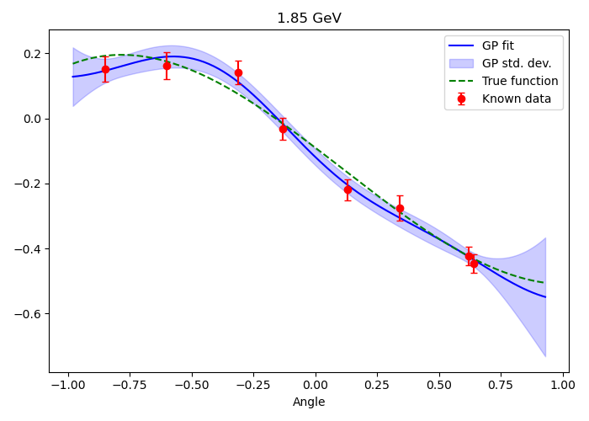
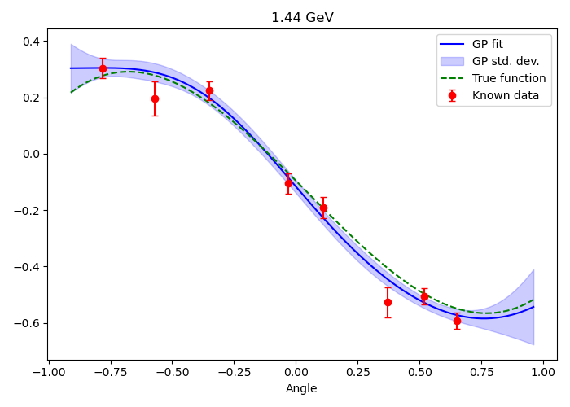
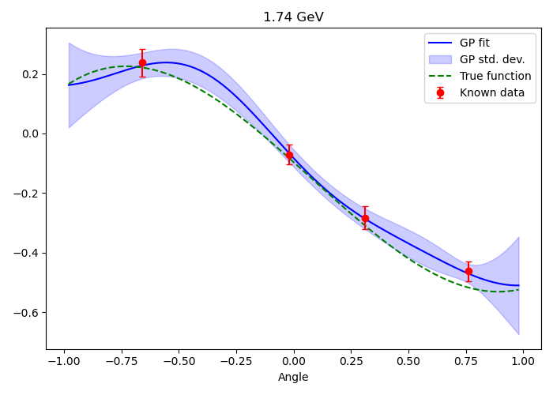

Slide 45
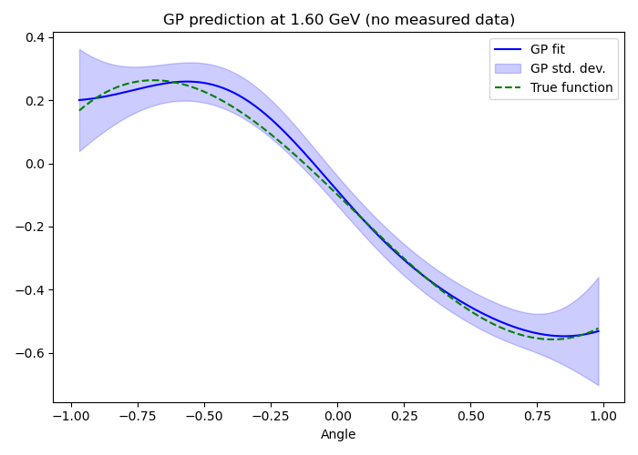
Check at E=1.6 (no measured data)

Slide 46
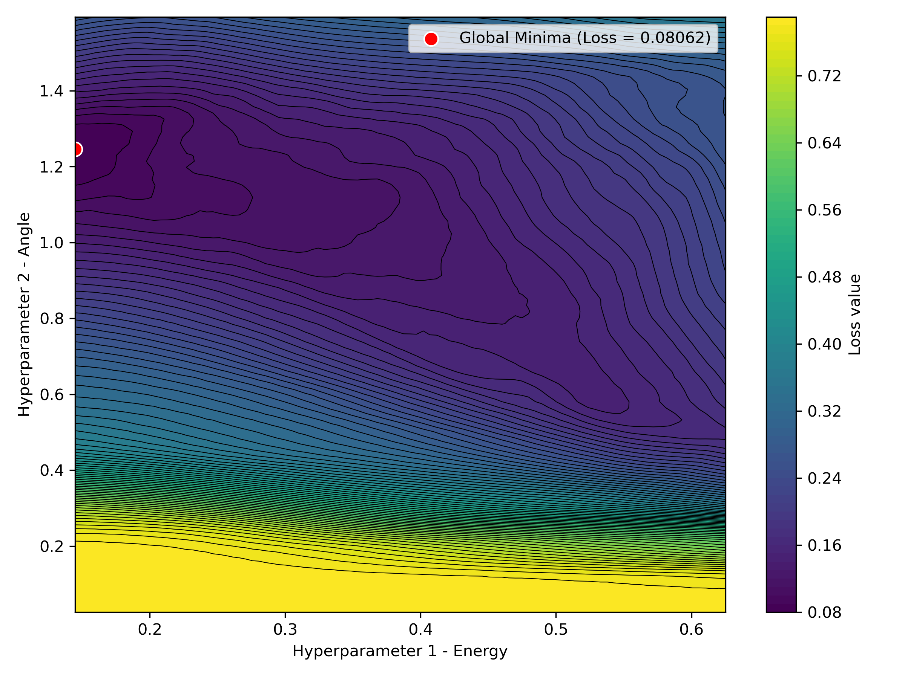
But what about other points still on the boundary?

Slide 47


Slide 48





Slide 49

Check at E=1.6 (no measured data)

Slide 50

Generating Pseudodata I
A generated asymmetry datapoint is based on the effective number of counts measured. This can be expressed as
$$A=\frac{N_{+}−N_{−}}{N_{+}+N_{−}}$$
where $N_{+},N_{−}$ are used to describe the 2 different states which are used to estimate the effective count. These take into account beam polarisation, recoils, target dilution and other such factors. These random variables are generated from “true” values:
$$N\sim \text{Pois}\left(n_{±}\right)$$
where $n_{±}=\frac{1}{2}n_{e}\left[1±f\left(w,\cos{θ}\right)\right]$. Here $n_{e}$ is defined as the effective number of events and is in the range [200,1000] which is estimated based on real data.

Slide 51

Generating Pseudodata II
By using standard propagation of errors, the error on A is given by:
$$δA=\frac{2}{{\left(N_{+}+N_{−}\right)}^{2}}\sqrt{N_{+}N_{−}\left(N_{+}+N_{−}\right)}$$

Slide 52
How does it work?

Slide 53

Mathematical Process
Assume that we have n known datapoints of the form $\left({\vec{x}}_{i},y_{i}\right)$ with known errors $e_{i}$ used to define the expression form $\vec{y}=f\left(X\right)$. Here ${\vec{x}}_{i}$ is a vector of the kinematic variables (e.g. energy, scattering angle, etc.) and $X$ is a matrix whose rows are ${\vec{x}}_{a},{\vec{x}}_{b}$.
e.g. if we have 3 points a,b,c that have some energy E and scattering angle cosθ, then X is
$$X=\left[\begin{matrix}{\vec{x}}_{a} \\ {\vec{x}}_{b} \\ {\vec{x}}_{c}\end{matrix}\right]=\left[\begin{matrix}E_{a} & {\cos{θ}}_{a} \\ E_{b} & {\cos{θ}}_{b} \\ E_{c} & {\cos{θ}}_{c}\end{matrix}\right]$$
i.e. X will always be a 2D matrix, regardless of the number of input dimensions

Slide 54

Mathematical Process
Assume that $\vec{y}$ is drawn from a Multivariate Gaussian of the form $p\left(\vec{y} | X\right)∼𝒩\left(\vec{0},K\right)$ (the zero mean assumption simplifies some maths later but doesn’t impact the prediction), where $K=κ(X,X,\vec{l})+ {\vec{e}}^{2}I_{n}$ is the n x n covariance matrix.
Here κ is some kernel function that is used to measure the covariance and $\vec{l}$ are hyperparameters (more on this later). Here $K_{ab}=κ\left({\vec{x}}_{a},{\vec{x}}_{b} \right)+δ_{ab}{e_{a}}^{2},$ where ${\vec{x}}_{a},{\vec{x}}_{b}$ are rows of the matrix $X$.

Slide 55

Mathematical Process
Assume that there are m known datapoints of the form outlined previously, with known ${\vec{x_{∗}}}_{i}$with unknown scalars ${y_{∗}}_{i}$, which are correlated to the n known datapoints.
A matrix $X_{∗}$ can then be generated whose rows are the vectors $\vec{x_{∗}}$.
As $\vec{y_{∗}}$ is correlated to $\vec{y}$, they are drawn from the same multivariate Gaussian:
$$\left[\begin{matrix}\vec{y} \\ \vec{y_{∗}}\end{matrix}\right]∼𝒩\left(\underline{0}, \left[\begin{matrix}K & K_{∗} \\ {K_{∗}}^{T} & K_{∗∗}\end{matrix}\right]\right)$$
where $K_{∗}=κ\left(X,X_{∗}\right)$, $K_{∗∗}=κ\left(X_{∗},X_{∗}\right)$.
Essentially, our data can be thought of as a single sample drawn from this multivariate Gaussian.

Slide 56


Example Case
Assume we have a single point (1,0.5) and want to get a prediction for $x_{∗}=0.9$.
Plugging the values of $x=1$, $x_{∗}=0.9$ into $K$,$K_{s}$, $K_{ss}$ and plotting the multivariate Gaussian gives the graph below
Note this plot is generated with the specific values $x=1$, $x_{∗}=0.9$ , $l=1$, changing any of these values will result in a different multivariate Gaussian

Slide 57


Example Case
We know that $y=0.5$ so can do a 1D projection to get the value for $y_{∗}$

Slide 58

Mathematical Process III
By using the conditional of a multivariate Gaussian, a prediction for $\vec{y_{∗}}$ can be obtained:
$p\left(\vec{y_{∗}} | X_{∗},X,\vec{y} \right)∼N\left(\vec{μ_{∗}},Σ_{∗}\right)$ where
$\vec{μ_{∗}}={K_{∗}}^{T}K^{−1}\vec{y}$
$Σ_{∗}=K_{∗∗}−{K_{∗}}^{T}K^{−1}K_{∗}$
Thus, the GP now has a prediction for the mean and covariance matrix, and thus the standard deviation, of $\vec{y_{∗}}$. ⁵

Slide 59

Example

Slide 60


Slide 61


Slide 62


Slide 63


