Slide 1


Multi-step and Two-step cascade spectra + Fluctuation properties of MACS
Milan Krtička

Slide 2
MSC & TSC Spectra
“Indirect methods” for testing PSF and NLD models

Slide 3
MSC & TSC Spectra
Based on coincidence measurement (use of events with all deposited E_{γ})
In principle, different particles can be used for inducing radiative capture reactions – (p,γ) used … A. Voinov et al. Phys. Rev. C 81, 024319 (+ K. Malatji talk)
Neutrons are typically used … (n,γ) (reaction important for astrophysics)
“Indirect methods” for testing PSF and NLD models
(Similarly to many other methods) do not allow extraction of absolute PSF/NLD
Sometimes sensitivity to transition type (E1 vs M1)

Slide 4
Multi-Step Cascade Spectra
γ decay (following resonance neutron capture)
Typically used:
for n capture on individual resonances
with array of scintillation detectors

Slide 5
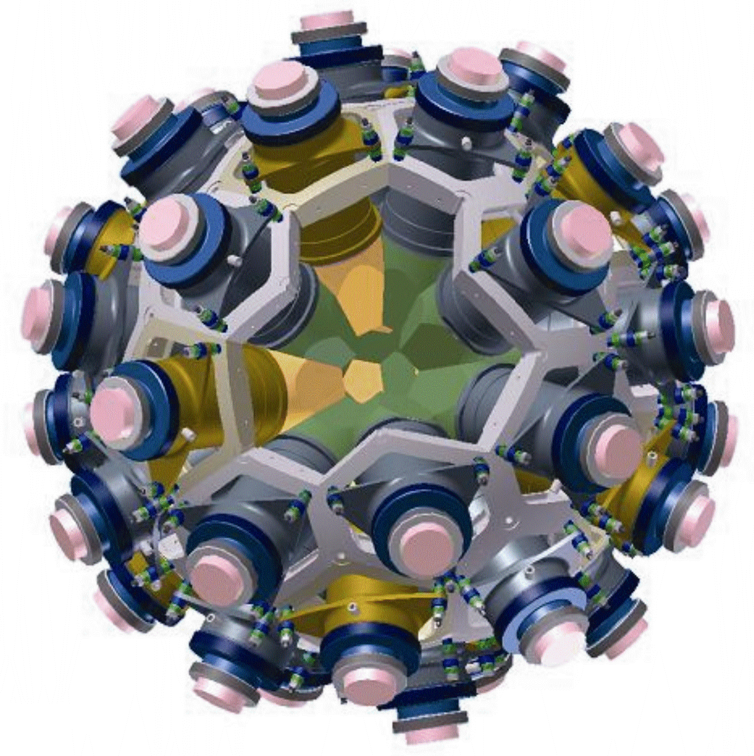
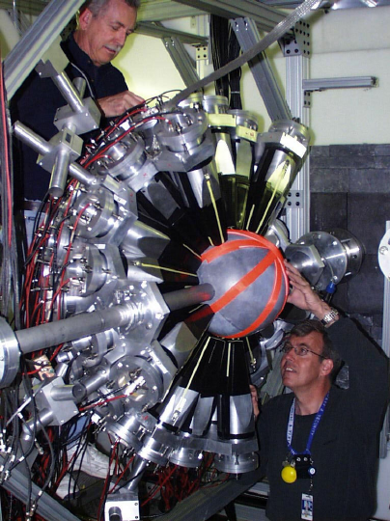
Multi-Step Cascade Spectra
γ decay (following resonance neutron capture)
Emitted γ rays detected via a (complex) detection system
DANCE detector @ LANL (160 BaF₂ crystals)

Slide 6
Multi-Step Cascade Spectra
Total detected energy (ΣE_{γi} ≡E_{Σ}) for individual multiplicities M
γ decay (following resonance neutron capture)
Emitted γ rays detected via a (complex) detection system

Slide 7
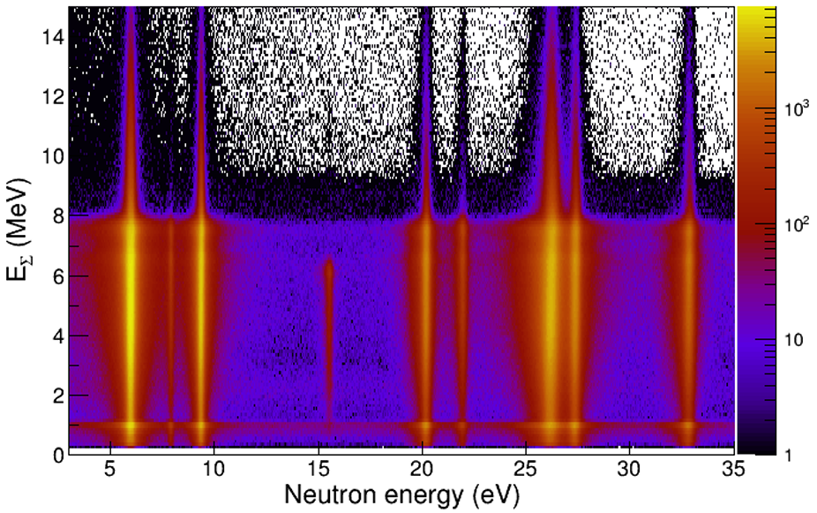
Sum-energy spectra
Using TOF, spectra from individual resonances can be checked
Experimental En vs E_{Σ} spectrum for ¹⁶⁷Er(n,γ)¹⁶⁸Er summed over all M.
Spectra from DANCE detector @ LANL
I. Knapová, PhD thesis (CU 2022)

Slide 8
Multi-Step Cascade Spectra
Using TOF, spectra from individual resonances can be checked
Experimental En vs E_{Σ} spectrum for ¹⁶⁷Er(n,γ)¹⁶⁸Er summed over all M.
Various kinds of spectra can be prepared:
Multiplicity distribution spectra
MSC spectra
…
Spectra from individual resonances can be prepared.

Slide 9
Multi-Step Cascade Spectra
Using TOF, spectra from individual resonances can be checked
Experimental En vs E_{Σ} spectrum for ¹⁶⁷Er(n,γ)¹⁶⁸Er summed over all M.
Various kinds of spectra can be prepared:
Multiplicity distribution spectra
MSC spectra
…
Spectra from individual resonances can be prepared.

Slide 10
Multi-Step Cascade Spectra
γ decay (following resonance neutron capture)
Emitted γ rays detected via a (complex) detection system
E_{γ1}
E_{γ3}
E_{γ2}
E_{γ4}

Slide 11
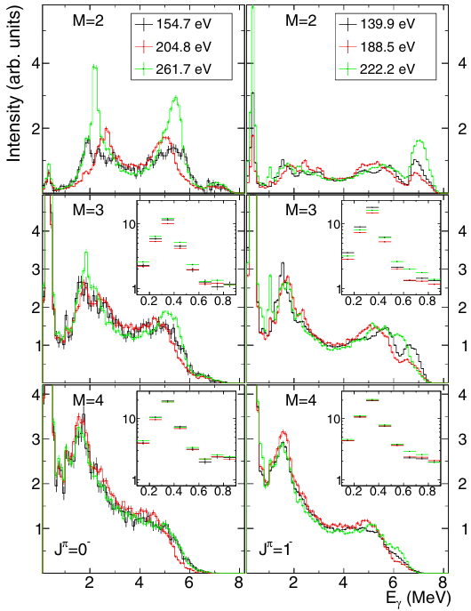
MSC Spectra
Often spectra from resonances with different J
Sometimes even from different π
¹⁹⁵Pt(n,γ)
N. Simbirtseva et al.,PRC 101, 024302 (2020)

Slide 12
MSC Spectra
Often spectra from resonances with different J
Sometimes even from different π
¹⁹⁵Pt(n,γ)
Spectra from individual resonance are not identical
due to Porter-Thomas fluctuations
differences strongly depend on measured isotope
pronounced the most usually for M=2

Slide 13
MSC Spectra
Often spectra from resonances with different J
Sometimes even from different π
¹⁹⁵Pt(n,γ)
Spectra from individual resonance are not identical
due to Porter-Thomas fluctuations
differences strongly depend on measured isotope
pronounced the most usually for M=2
Used in comparison - either
spectra from individual resonances or
(if spectra from “many” resonances available)
“average” spectra

Slide 14
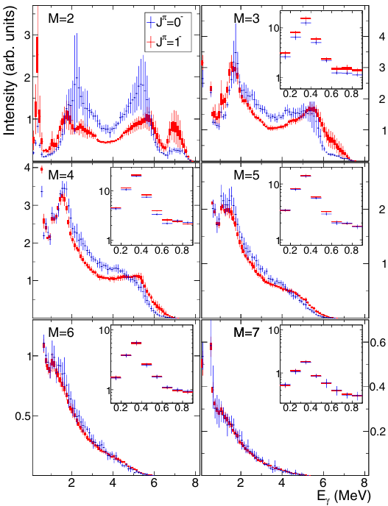
MSC Spectra
¹⁹⁵Pt(n,γ)
“average” from
11 resonances of 1⁻
5 resonances of 0⁻
(one could check also fluctuations)

Slide 15
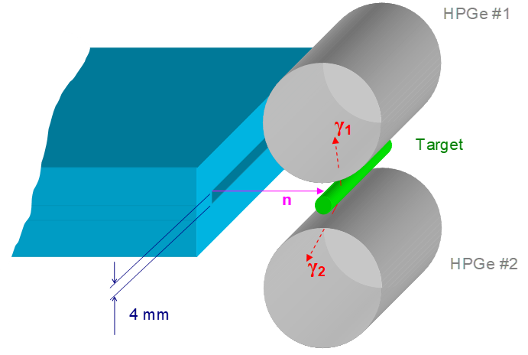
Two-Step Cascade Spectra
Typically used:
for thermal n capture
with HPGe detectors
Řež setup:
neutron guide
Reactor (n source)
HPGe detectors
excellent energy resolution for FEP
low efficiency, especially for detection of full energy (FEP)

Slide 16
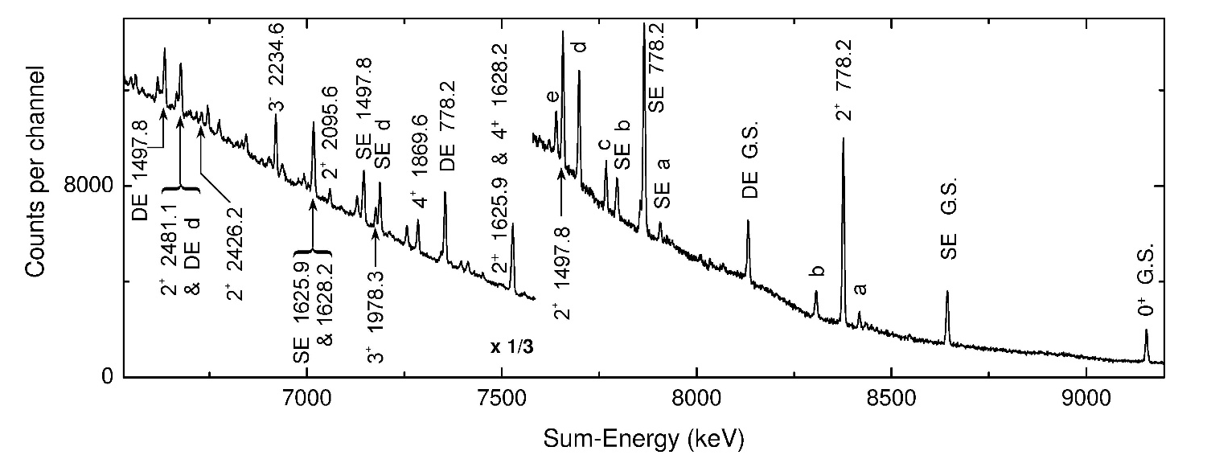
⁹⁵Mo(n,γγ)
Neutron capturing state
S_{n}(+E_{n})
E
γ
1
E
γ
2
Ground state

Slide 17
⁹⁵Mo(n,γγ)
Neutron capturing state
S_{n}(+E_{n})
E
γ
1
E
γ
2
Ground state

Slide 18
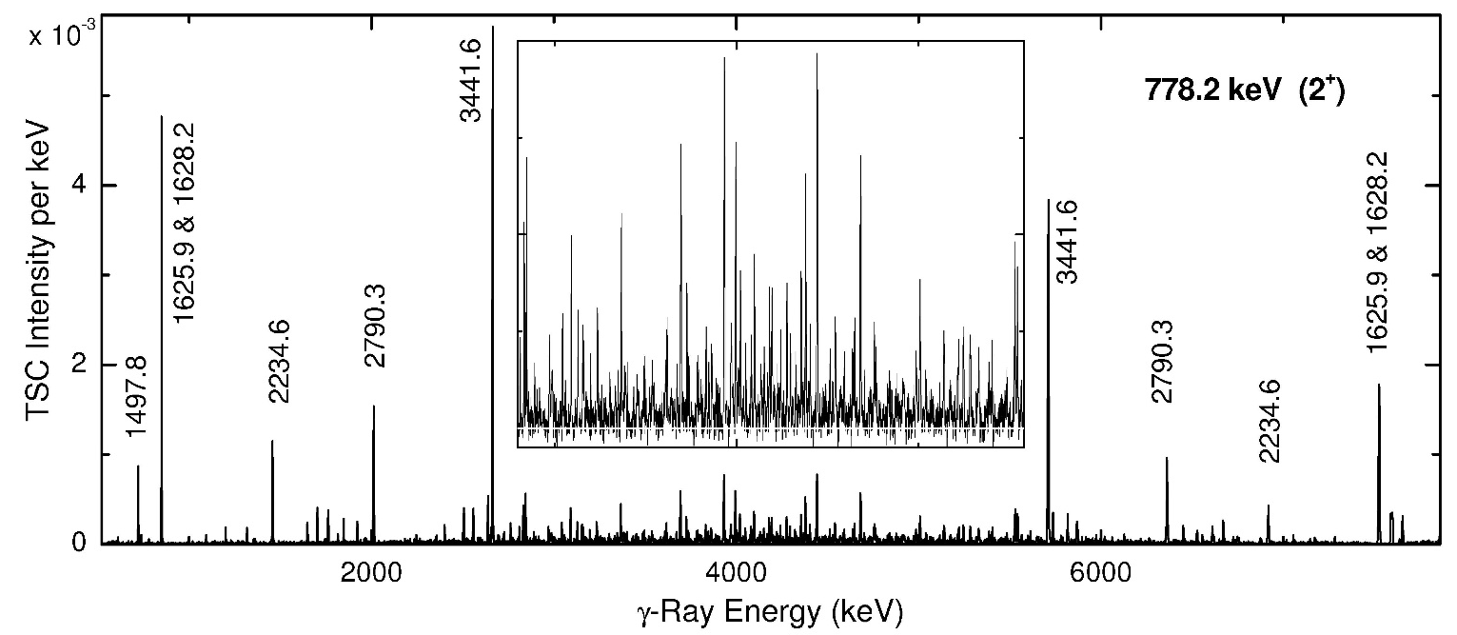
Example of a TSC spectrum
TSC spectrum - taken from only one of the detectors considering fixed sum energy

Slide 19
Example of a TSC spectrum
Very powerful tool for “spectroscopy” (decay of low-lying levels)
Use for “statistical decay”
Spectra to several final levels typically available
Requires use of “integrated” or “wide-bin” spectra to suppress impact of Porter-Thomas fluctuations of individual transitions
PSF/NLD models can be tested

Slide 20
Example of a TSC spectrum
Very powerful tool for “spectroscopy” (decay of low-lying levels)
Use for “statistical decay”
Spectra to several final levels typically available
Requires use of “integrated” or “wide-bin” spectra to suppress impact of Porter-Thomas fluctuations of individual transitions
PSF/NLD models can be tested
Wide-bin TSC spectra
ΔE_{γ} = 4 MeV
ΔE_{γ} = 2 MeV
Integrated TSC spectra

Slide 21
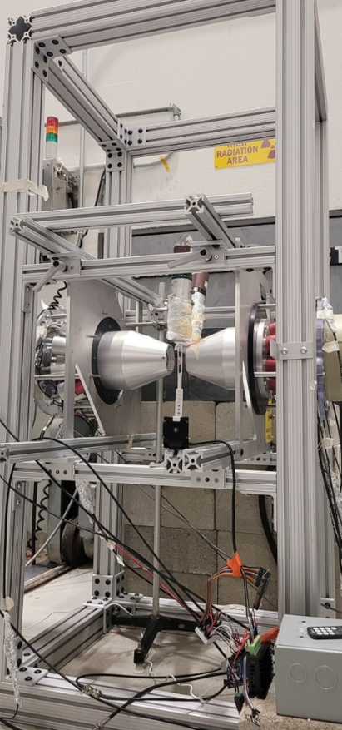
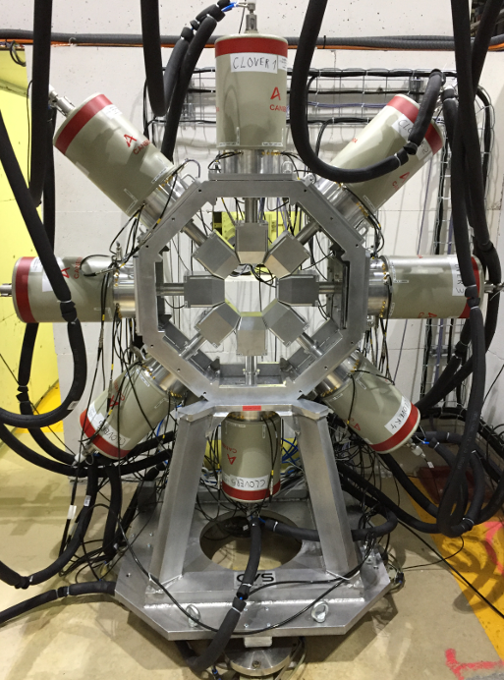
Two-Step Cascade Spectra
Setup at UMass Lowell research reactor
Fission Product Prompt ray Spectrometer (FIPPS) @ ILL
Today’s “alternatives”:
2 or 3 HPGe detectors with anti-Compton shields available – ready for measurements
8 HPGe clovers + segmented anti-Compton shields
… some tests performed (Mo experiment from Rez repeated)
M. Jandel et al., Nucl. Phys. A 1060 (2025) 123116

Slide 22
MSC & TSC Spectra
Experimental spectra come from a complicated interplay between photon strength functions (PSFs) and level density (NLD)
(At least for MSC spectra) Complicated detector response to each cascade
Comparison of predictions based on statistical model simulations with experimental counterparts
Cascades (γ decay) generated using statistical model of γ decay (typically using DICEBOX code)
Detector response (GEANT4) applied to each γ cascade

Slide 23
Some examples (sensitivity of spectra)

Slide 24
TSCs in the ¹⁶²Dy(n,γ)¹⁶³Dy
A simple example (expectation):
If E1~M1 for E_{γ} ~ S_{n}/2: TSC intensity to final levels with both parities (the same spin) expected to be similar
If one type dominates: TSC intensity to negative parity states should be “negligible”
Sensitivity to transition type (E1 vs M1)
1/2 +
M1
-
+
E1
-
+

Slide 25
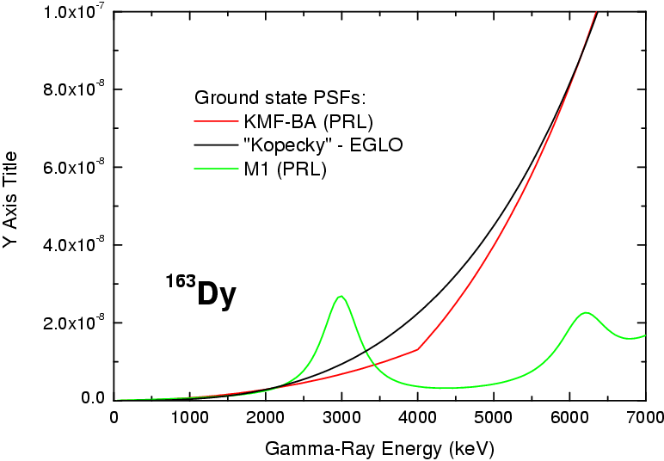
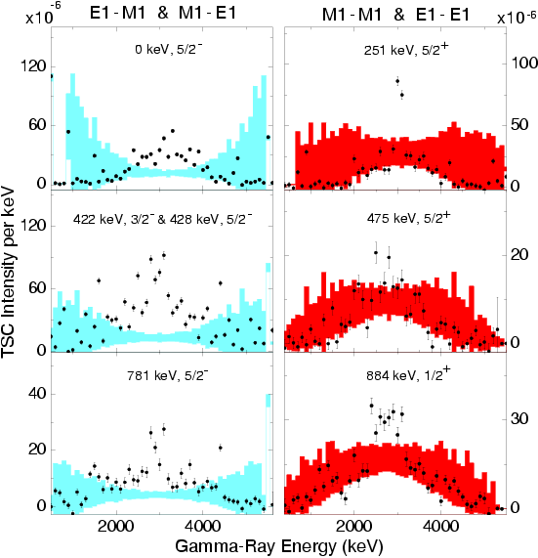
TSCs in the ¹⁶²Dy(n,γ)¹⁶³Dy
The role of E1 transitions
to or from the ground state
is reduced
EGLO (E1)
KMF-BA (E1)
f(E_{γ},T=0) (MeV⁻³)
SR
SF
1/2 +
Entire absence
of SR assumed
M1
-
+
Experimental data
E1
π_{f} = +
DICEBOX Simulations
-
π_{f} = -
+
M. Krtička et al., Phys. Rev. Lett. 92, 172501 (2004)

Slide 26
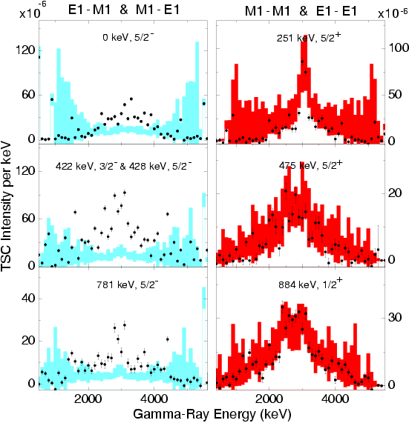
TSCs in the ¹⁶²Dy(n,γ)¹⁶³Dy
The role of E1 transitions
to or from the ground state
is reduced
EGLO (E1)
KMF-BA (E1)
f(E_{γ},T=0) (MeV⁻³)
SR
SF
1/2 +
A “pygmy E1 resonance” with energy of 3 MeV assumed to be built on all levels
M1
-
+
Experimental data
E1
π_{f} = +
DICEBOX Simulations
-
π_{f} = -
+
M. Krtička et al., Phys. Rev. Lett. 92, 172501 (2004)

Slide 27
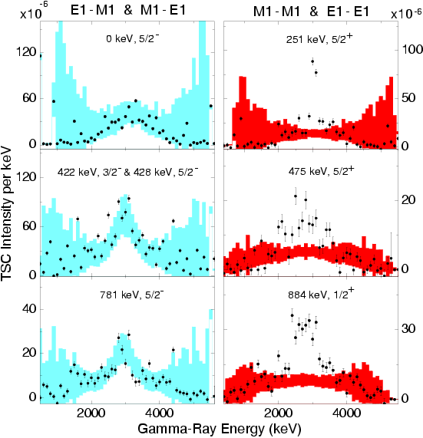
TSCs in the ¹⁶²Dy(n,γ)¹⁶³Dy
The role of E1 transitions
to or from the ground state
is reduced
EGLO (E1)
KMF-BA (E1)
f(E_{γ},T=0) (MeV⁻³)
SR
SF
1/2 +
SR (M1) assumed to be built only on all levels below 2.5 MeV
M1
-
+
Experimental data
E1
π_{f} = +
DICEBOX Simulations
-
π_{f} = -
+
M. Krtička et al., Phys. Rev. Lett. 92, 172501 (2004)

Slide 28
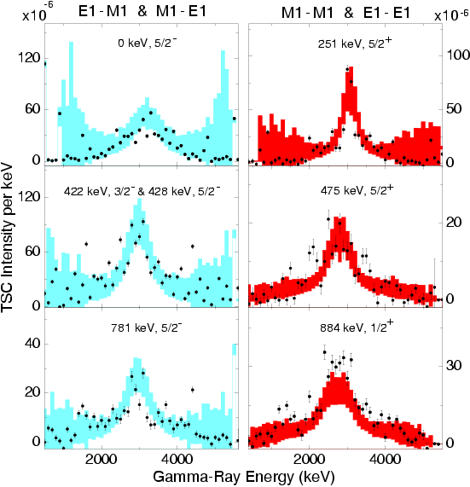
TSCs in the ¹⁶²Dy(n,γ)¹⁶³Dy
The role of E1 transitions
to or from the ground state
is reduced
EGLO (E1)
KMF-BA (E1)
f(E_{γ},T=0) (MeV⁻³)
SR
SF
1/2 +
SR assumed to be built on all ¹⁶³Dy levels
M1
-
+
Experimental data
E1
π_{f} = +
DICEBOX Simulations
-
π_{f} = -
+
M. Krtička et al., Phys. Rev. Lett. 92, 172501 (2004)

Slide 29
MSCs in even-even Dy isotopes
Similar features can be visible (in some cases) also in MSC spectra:

Slide 30
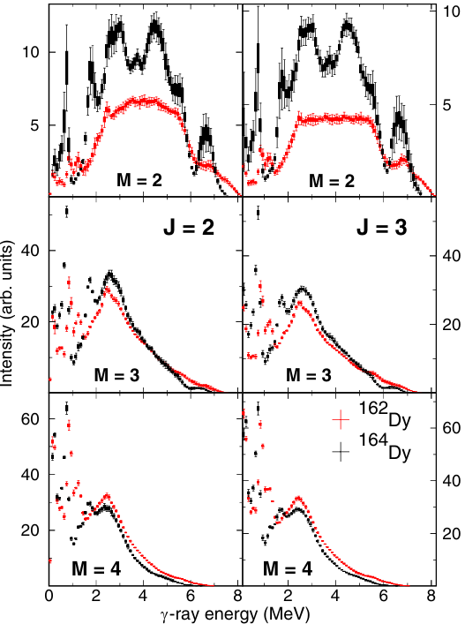
MSCs in even-even Dy isotopes
Similar features can be visible (in some cases) also in MSC spectra:
Example (only averaged experimental spectra):
¹⁶¹Dy(n,γ):
25 resonances of 2+
22 resonances of 3+
¹⁶³Dy(n,γ):
14 resonances of 2−
26 resonances of 3−
M=2:
E1-E1 or M1-M1 for ¹⁶²Dy
E1-M1 or M1-E1 for ¹⁶⁴Dy
Differences due to presence of only positive-parity states at low excitation energies of product nuclei
… a significant impact of the scissors mode

Slide 31
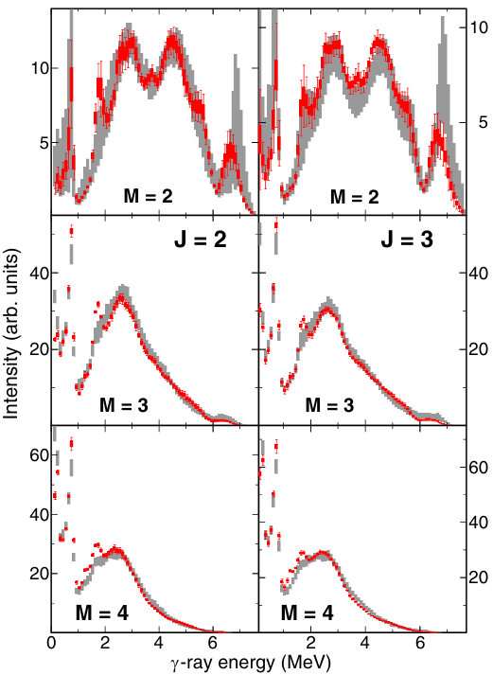
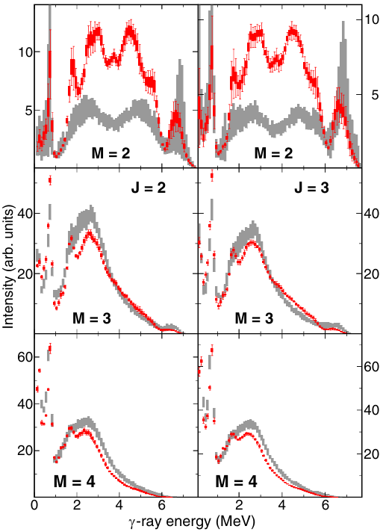
MSCs in even-even Dy isotopes
A bump in PSF near 3 MeV postulated (¹⁶⁴Dy)
M1
E1
¹⁶⁴Dy
¹⁶⁴Dy

Slide 32
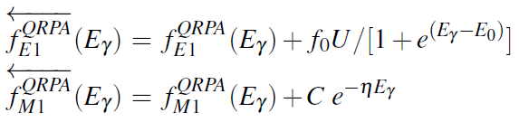
Sensitivity to low-E_{γ} M1 PSF limit
Different tests with the D1M-QRPA model – main aim to learn about possible low-energy PSF enhancement
checked sensitivity to
Low-energy enhancement in M1 PSF (value of C)
Broadening M1 width
Low-energy limit in E1 PSF (value of f₀)
Level density model
Results for the low-energy enhancement adopted in the recommended PSF model from the Coordinated Research Project on PSF
Any model can be tested …
M. Krticka, S. Goriely et al., PRC 99 044308 (2019)
Comparison for 15 isotopes - 2x Mo, 2x Cd, 6x Gd, 2x Dy, 3x U

Slide 33
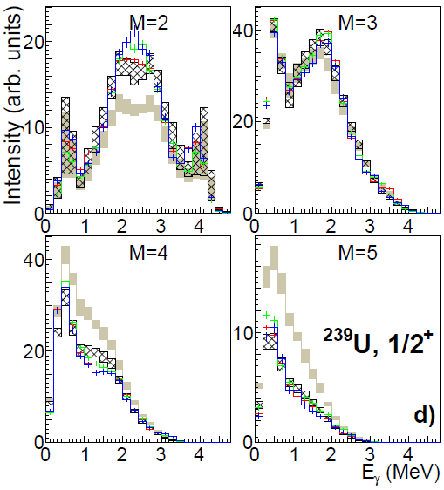
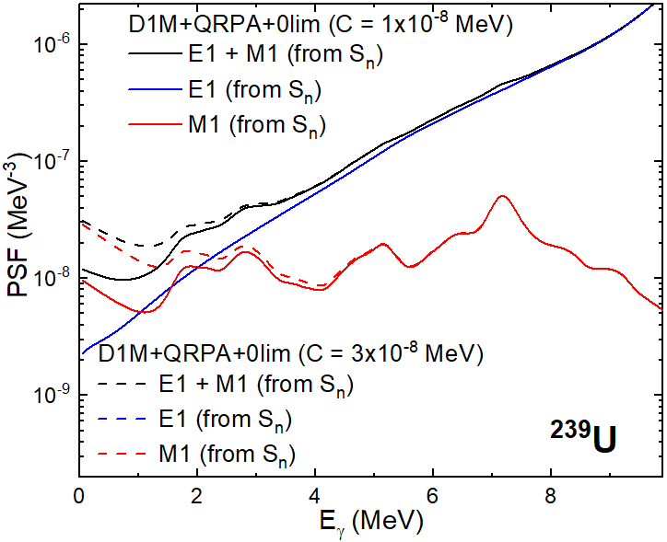

Sensitivity to low-E_{γ} M1 PSF limit
C = 3x10⁻⁸ MeV⁻³, η = 0.8 MeV⁻¹
C = 1x10⁻⁸ MeV⁻³, η = 0.8 MeV⁻¹
M. Krticka, S. Goriely et al., PRC 99 044308 (2019)
Comparison for 15 isotopes - 2x Mo, 2x Cd, 6x Gd, 2x Dy, 3x U

Slide 34
Sensitivity to low-E_{γ} M1 PSF limit
C = 3x10⁻⁸ MeV⁻³, η = 0.8 MeV⁻¹
Clear impact on multiplicity distribution
Only “a weak” low E_{γ} enhancement allowed in U
C = 1x10⁻⁸ MeV⁻³, η = 0.8 MeV⁻¹
M. Krticka, S. Goriely et al., PRC 99 044308 (2019)
Comparison for 15 isotopes - 2x Mo, 2x Cd, 6x Gd, 2x Dy, 3x U

Slide 35
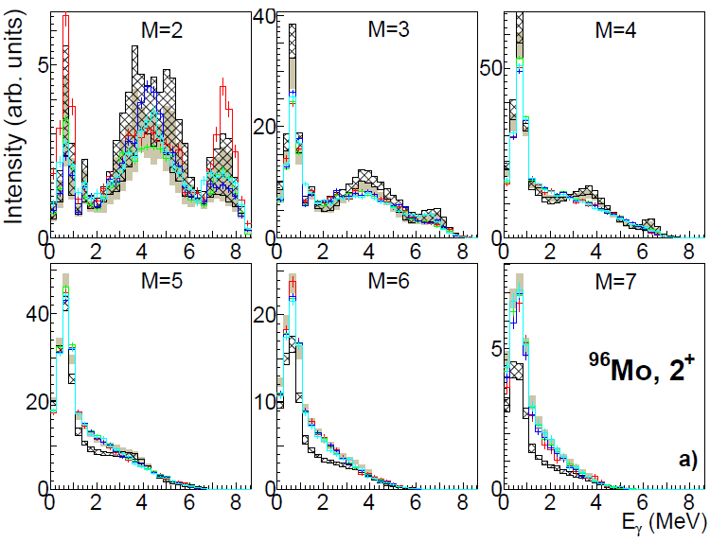
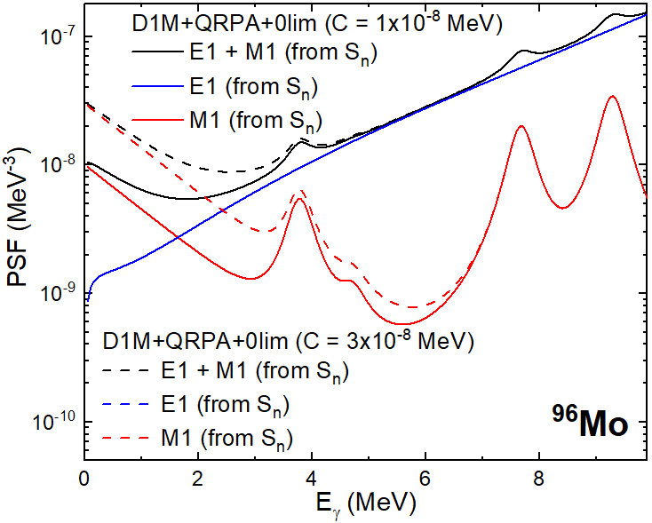
Sensitivity to low-E_{γ} M1 PSF limit
C = 3x10⁻⁸ MeV⁻³, η = 0.8 MeV⁻¹
C = 1x10⁻⁸ MeV⁻³, η = 0.8 MeV⁻¹
M. Krticka, S. Goriely et al., PRC 99 044308 (2019)
Comparison for 15 isotopes - 2x Mo, 2x Cd, 6x Gd, 2x Dy, 3x U

Slide 36
Sensitivity to low-E_{γ} M1 PSF limit
Model based on QRPA requires “relatively strong enhancement” for Mo (the only of tested nuclei)
Seems inconsistent with original analysis of MSC and TSC spectra [Sheets et al., PRC 79 024301 (2009); Krticka et al., PRC 77 054319 (2008)] … but …
C = 3x10⁻⁸ MeV⁻³, η = 0.8 MeV⁻¹
C = 1x10⁻⁸ MeV⁻³, η = 0.8 MeV⁻¹
M. Krticka, S. Goriely et al., PRC 99 044308 (2019)
Comparison for 15 isotopes - 2x Mo, 2x Cd, 6x Gd, 2x Dy, 3x U

Slide 37
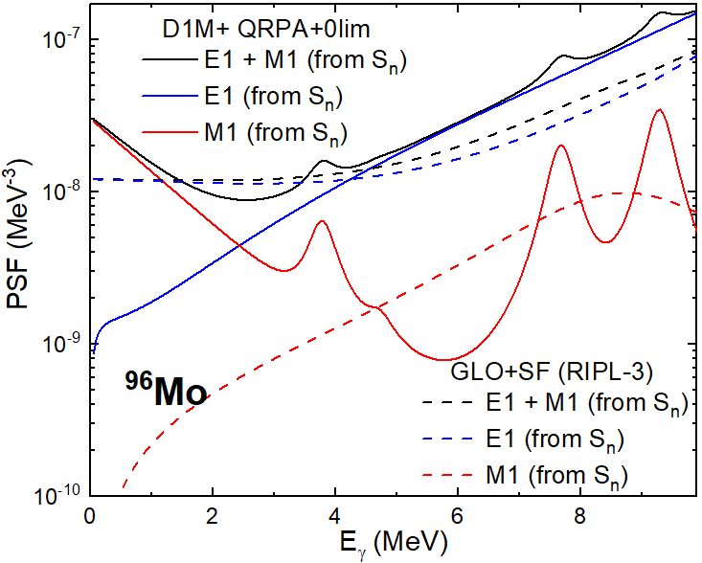
Sensitivity to low-E_{γ} M1 PSF limit
There could be several models yielding similarly good description …
A comparison should be made with a wide range of models (at least GLO E1 model is relevant here)
Model based on QRPA requires “relatively strong enhancement” for Mo (the only of tested nuclei)
Seems inconsistent with original analysis of MSC and TSC spectra [Sheets et al., PRC 79 024301 (2009); Krticka et al., PRC 77 054319 (2008)] … but …
M. Krticka, S. Goriely et al., PRC 99 044308 (2019)
Comparison for 15 isotopes - 2x Mo, 2x Cd, 6x Gd, 2x Dy, 3x U

Slide 38
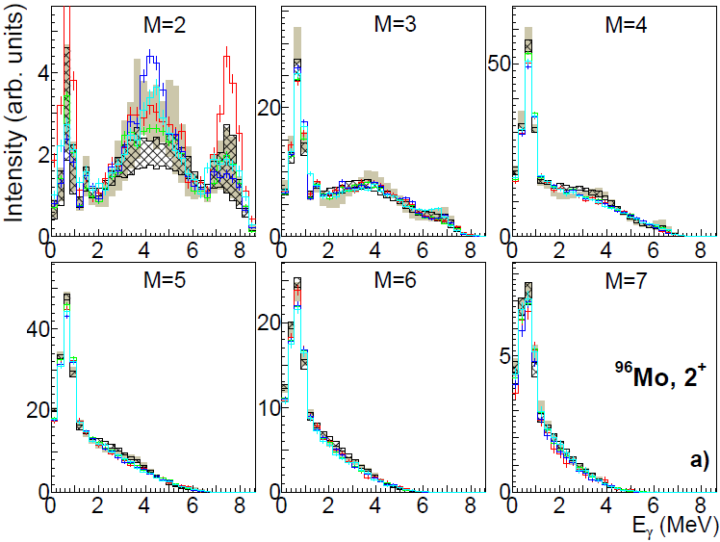
Sensitivity to low-E_{γ} M1 PSF limit
D1M + QRPA + 0lim
GLO + SF
M. Krticka, S. Goriely et al., PRC 99 044308 (2019)
Comparison for 15 isotopes - 2x Mo, 2x Cd, 6x Gd, 2x Dy, 3x U

Slide 39
Sensitivity to low-E_{γ} M1 PSF limit
Similarly good description obtained
E1 limit in GLO (at least partly) mimics the M1 low-energy enhancement in QRPA + 0lim model
Probably even better agreement obtained with GLO + SP model used in original (TSC & MSC) papers
… not a unique answer ☹
D1M + QRPA + 0lim
GLO + SF
M. Krticka, S. Goriely et al., PRC 99 044308 (2019)
Comparison for 15 isotopes - 2x Mo, 2x Cd, 6x Gd, 2x Dy, 3x U

Slide 40
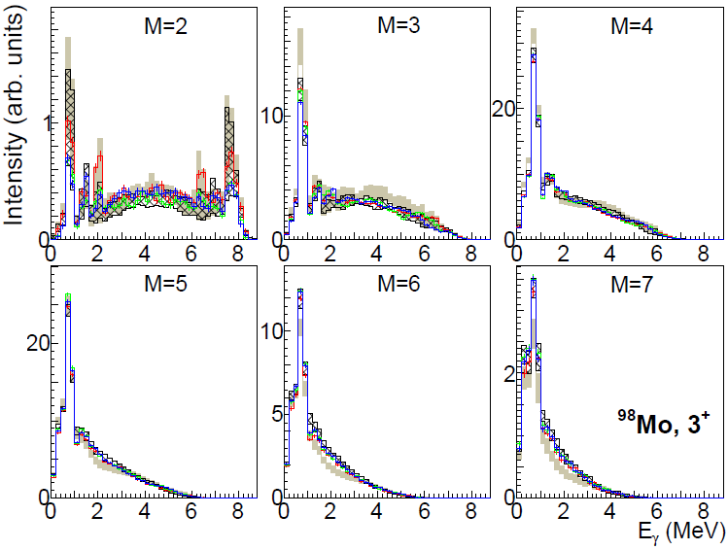
Sensitivity to low-E_{γ} M1 PSF limit
Similarly good description obtained
E1 limit in GLO (at least partly) mimics the M1 low-energy enhancement in QRPA + 0lim model
Probably even better agreement obtained with GLO + SP model used in original (TSC & MSC) papers
… not a unique answer ☹
D1M + QRPA + 0lim
GLO + SF
M. Krticka, S. Goriely et al., PRC 99 044308 (2019)
Comparison for 15 isotopes - 2x Mo, 2x Cd, 6x Gd, 2x Dy, 3x U

Slide 41
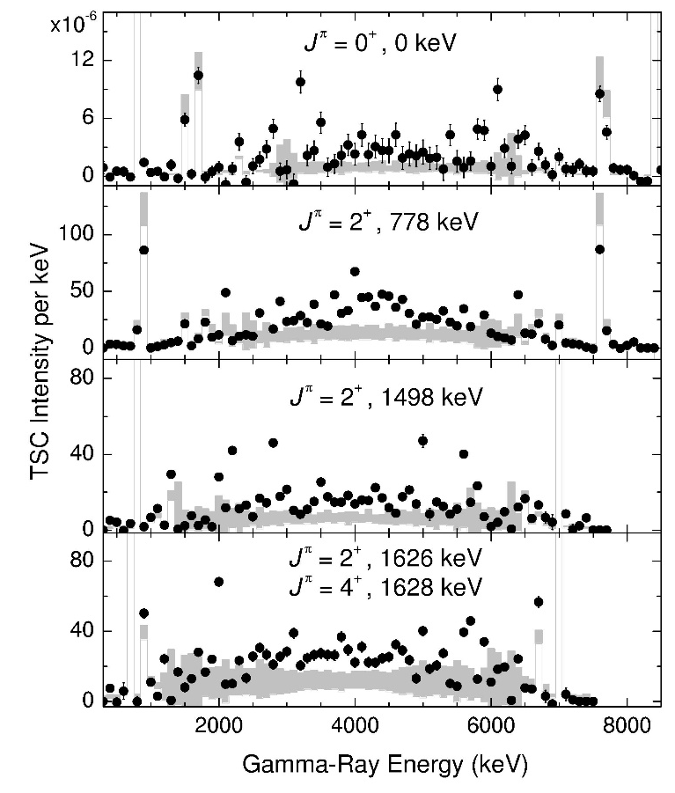
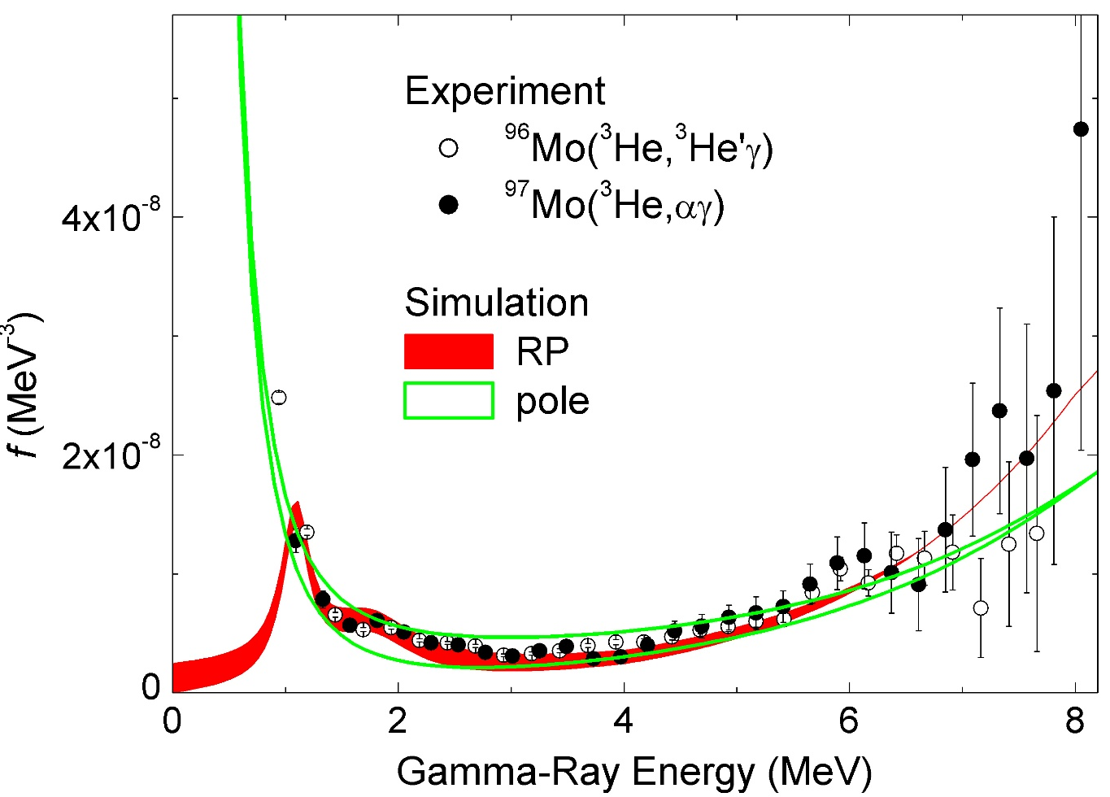
Sensitivity to low-E_{γ} M1 PSF limit – TSC spectra
Models are evidently incorrect …

Slide 42
Comparison … some recent results
In general, D1M-QRPA model gives often “reasonable” predictions
Low-energy enhancement in the proposed model based, at least partly on comparison with MSC spectra.
Spectra are very sensitive to exact position (and strength) of scissors mode, which is not always perfect in this model.

Slide 43
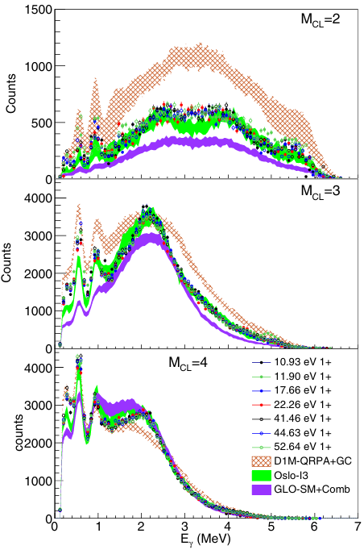
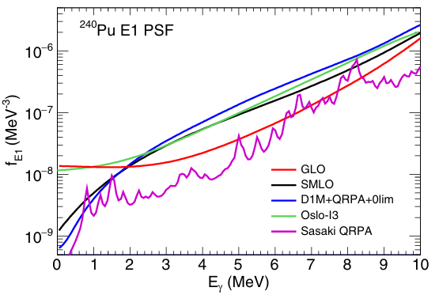
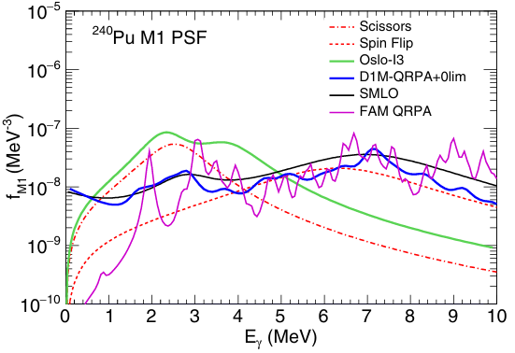
Comparison … some recent results
In general, D1M-QRPA model gives often “reasonable” predictions … but not always
Low-energy enhancement in the proposed model based, at least partly on comparison with MSC spectra.
Spectra are very sensitive to exact position (and strength) of scissors mode, which is not always perfect in this model.
²⁴⁰Pu
Fissile nucleus checked for the first time
J. Ullmann et al., PRC 111 (2025) 024610

Slide 44
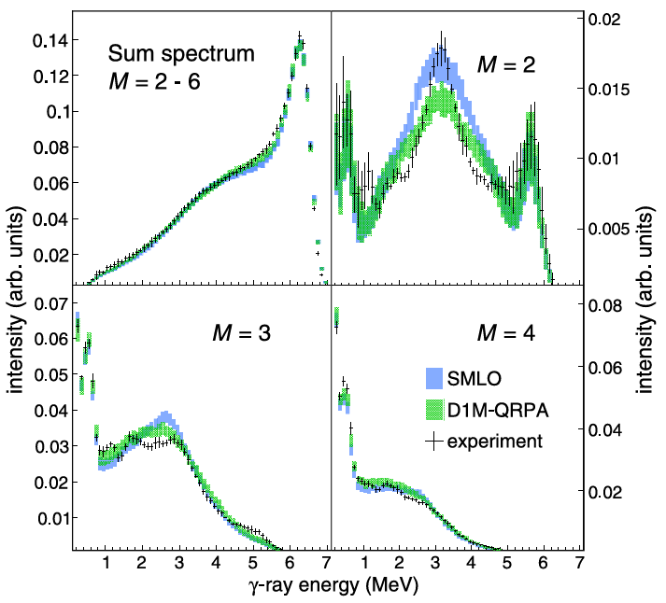
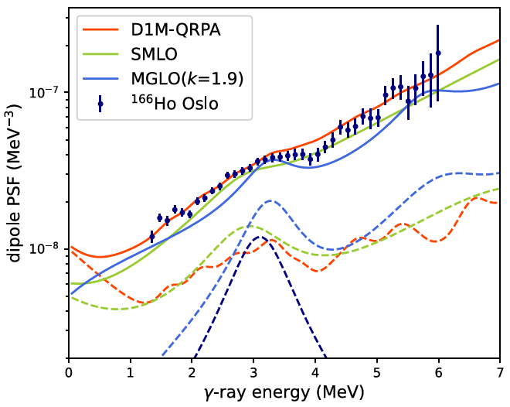
Comparison … some recent results
¹⁷⁰Tm
I. Knapova et al.,PRC112,014612 (2025)

Slide 45
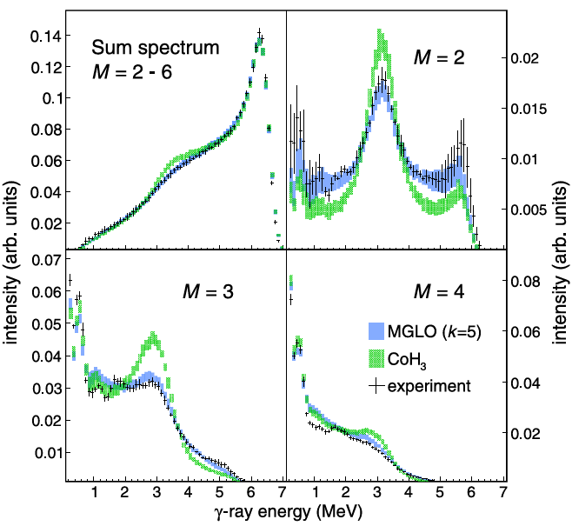
Comparison … some recent results
¹⁷⁰Tm
I. Knapova et al.,PRC112,014612 (2025)

Slide 46
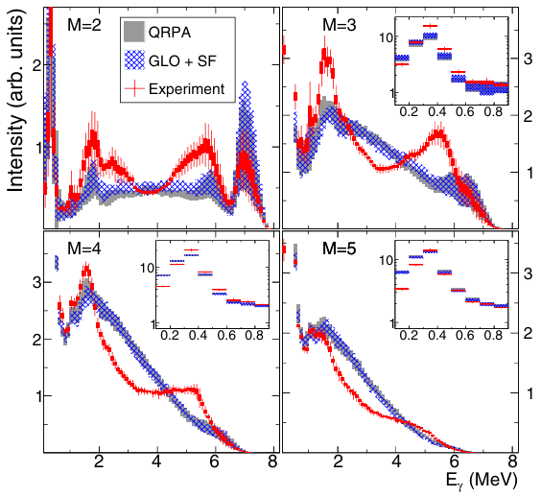
Comparison … models not always perfect
In general, D1M-QRPA model gives “reasonable” predictions.
Low-energy enhancement in the proposed model based, at least partly on comparison with MSC spectra.
Spectra are very sensitive to exact position (and strength) of scissors mode, which is not always perfect in this model.
(Almost) the only nuclei with a significant disagreement with D1M-QRPA predictions are isotopes near Pt …
¹⁹⁶Pt
N. Simbirtseva et al.,PRC 101, 024302 (2020)

Slide 47
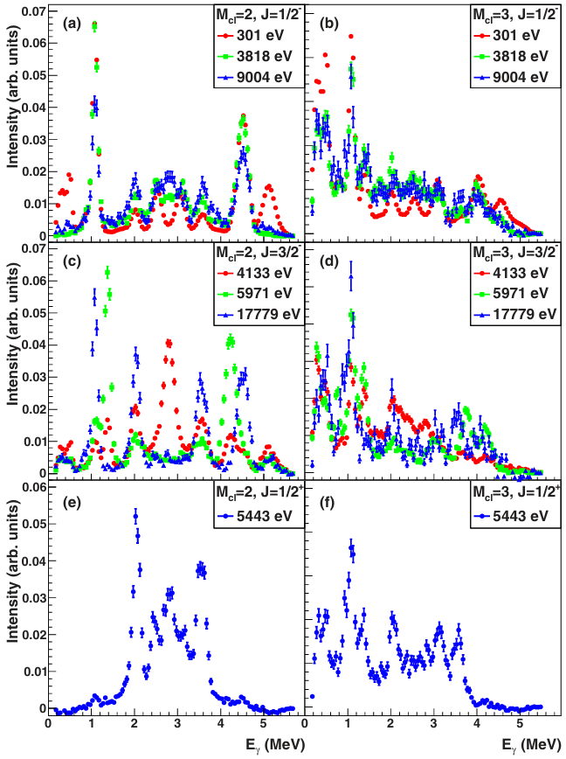
Limits
Fluctuations
due to “statistical character” of individual level positions and their decays
can be significant
typically, present if number of levels is low
“lighter” nuclei
nuclei close to closed shells
⁹³Zr
J.R.Winklbauer et al, Phys. Rev. C99, 024318(2019)

Slide 48
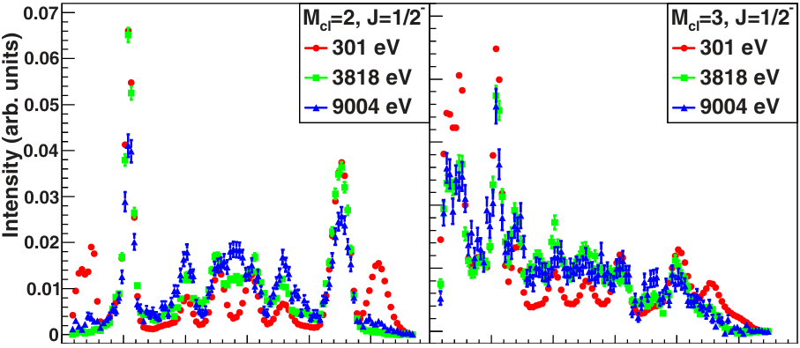
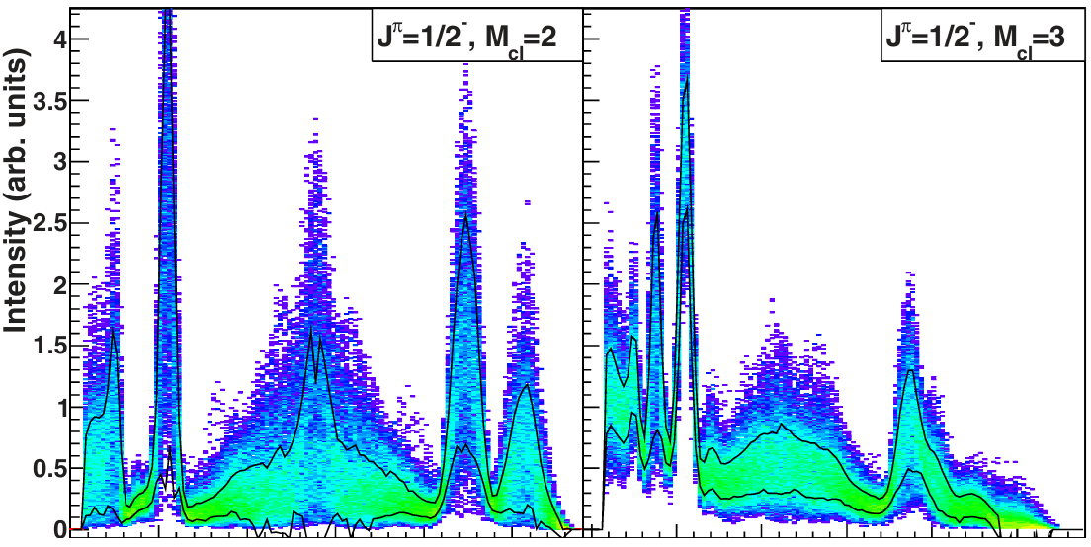
Limits
Experiment
Fluctuations
due to “statistical character” of individual level positions and their decays
can be significant
typically, present if number of levels is low
⁹³Zr
Simulations (average of 3 resonances)
2
4
6
E_{γ}
2
4
6
E_{γ}
J.R.Winklbauer et al, Phys. Rev. C99, 024318(2019)

Slide 49
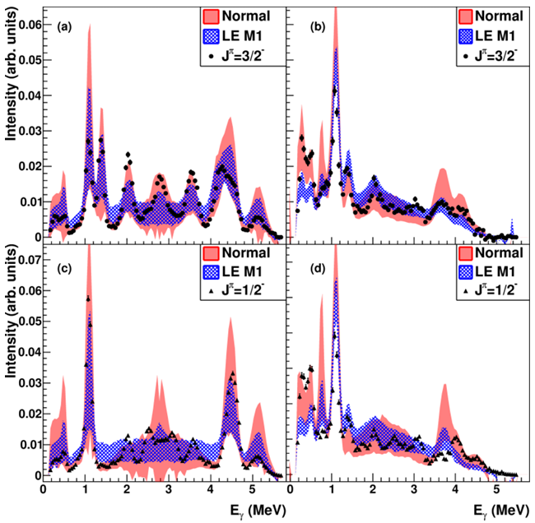
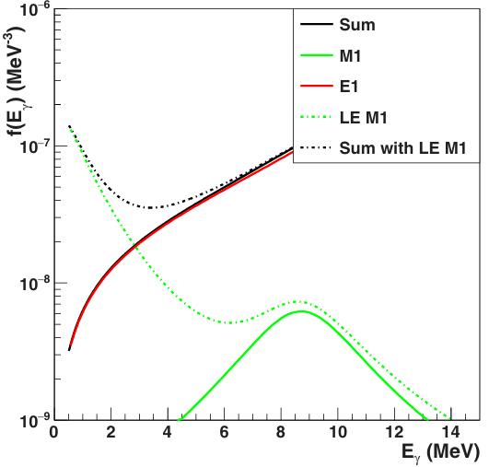
Limits
Fluctuations
due to “statistical character” of individual level positions and their decays
can be significant
typically, present if number of levels is low

Slide 50
Summary – TSC & MSC spectra
Coincidence spectra from (n,γ) reaction are important for verification of PSFs and NLD used in astrophysics calculations
MSC and TSC spectra are typically sensitive to PSF for E_{γ} ≈ 1 ÷ (S_{n}-1) MeV range (sometimes to lower energies)
High-energies limited by number of available final states for decay
Very low E_{γ} limited by a factor of E_{γ}^{2L+1} in Γ_{γ}
Often (not always) sensitivity to transition types (due to selection rules on γ decay)
Decay governed by a highly-nontrivial interplay of PSFs and NLD (not really discussed above)

Slide 51
Fluctuation properties of MACS

Slide 52
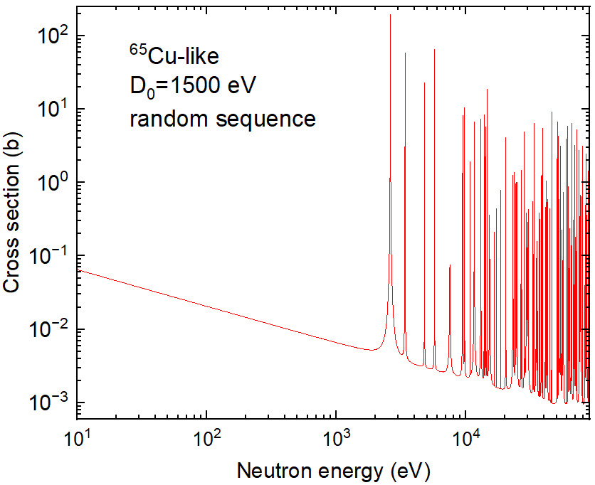
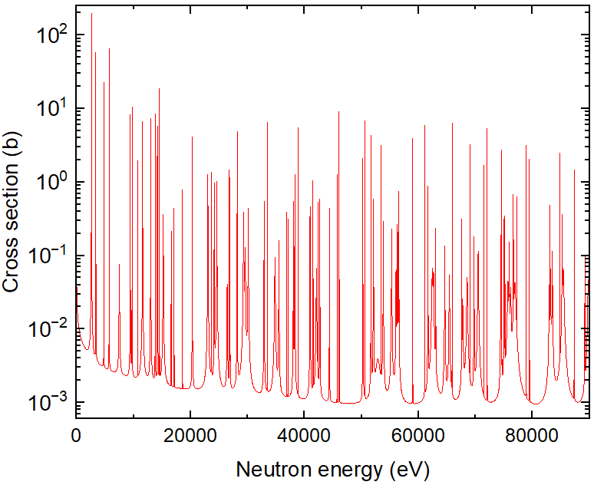
Fluctuation properties of MACS
Let us suppose that we precisely know all “average neutron quantities”
… spacing, neutron strength functions, radiation widths + (inelastic scat. channels,…)
for all neutron orbital momenta
What is the uncertainty in MACS from “random realizations” of individual resonances?

Slide 53

Fluctuation properties of MACS
T. Rauscher, F. K. Thielemann, and K. L. Kratz, Phys.Rev.C 56, 1613 (1997)
Discuss “The criterion for the application of the statistical model”
Provide as a rule of thumb: HF deviation falls below 20% if there are at least 5–10 resonances within the effective energy window (probably 2σ of the distribution).
BTW, we found a different width ☺
What is it “statistical model” (and its validity/applicability)?
For MK: “a reaction via compound nucleus” (often applicable also for low-energy “off resonance” region)
T. Rauscher: (likely) applicability of HF “prediction”
For others … ?

Slide 54
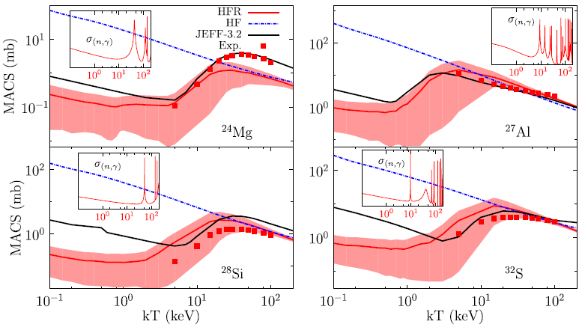
Fluctuation properties of MACS
Addressed with “HFR” (for a few nuclei)
D. Rochman et al., PLB 764 (2017) 109–113
Area given by
MAD = Median Absolute Deviation
D₀ ≈ 53 keV
D₀ ≈ 158 keV
D₀ ≈ 332 keV
D₀ ≈ 179 keV
“when applying the statistical HF model to light nuclei, (integrating over a statistical LD instead of summing up over individual levels), HFR calculations may lead to quite different predictions …”

Slide 55

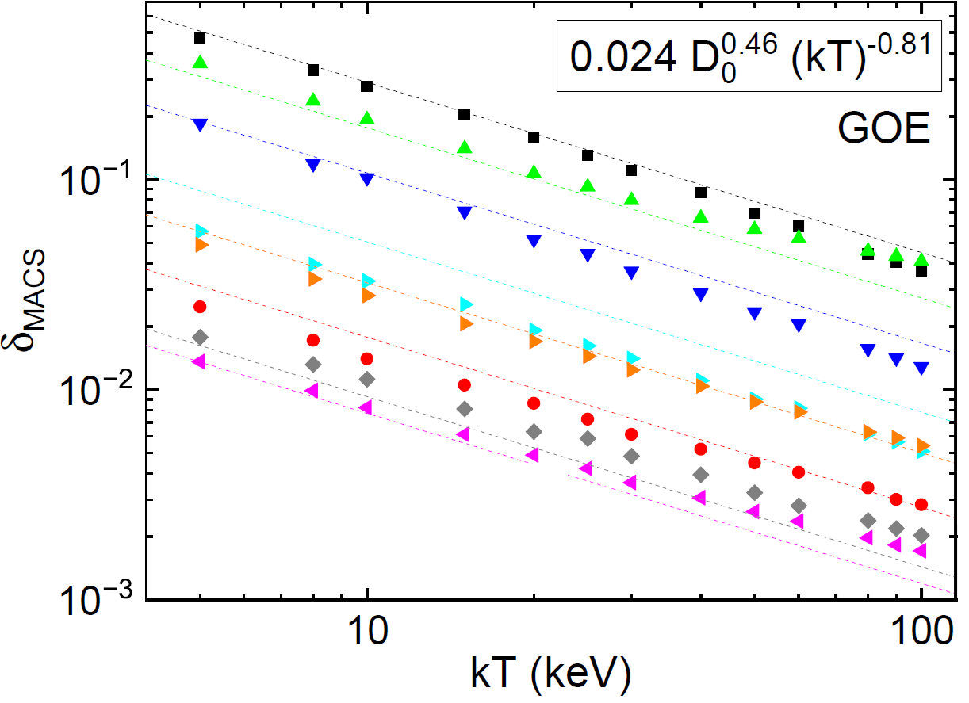
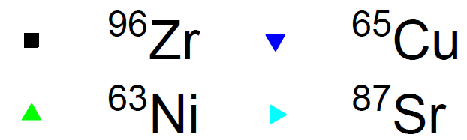
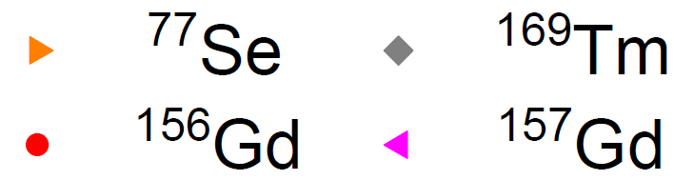
Fluctuation properties of MACS
More systematic study: MK, A. Couture, PRC 112,054601(2025) – no HF calculations, only random resonance sequences, no “direct capture”
Various tests of impact of different quantities (using “an artificial nucleus”)
Relative uncertainty in MACS: with D₀ in eV, kT in keV (if GOE long-range correlations present)
Reasonably works for “real nuclei”
Assumed D₀
⁹⁶Zr: 13000 eV
⁶³Ni: 4400 eV
⁶⁵Cu: 1500 eV
⁸⁷Sr: 290 eV
⁷⁷Se: 110 eV
¹⁵⁶Gd : 30 eV
¹⁶⁹Tm 7.3 eV
¹⁵⁷Gd: 4.9 eV

Slide 56
Fluctuation properties of MACS
More systematic study: MK, A. Couture, PRC 112,054601(2025) – no HF calculations, only random resonance sequences, no “direct capture”
Various tests of impact of different quantities (using “an artificial nucleus”)
Relative uncertainty in MACS: with D₀ in eV, kT in keV (if GOE long-range correlations present)
Reasonably works for “real nuclei”
Assumed D₀
⁹⁶Zr: 13000 eV
⁶³Ni: 4400 eV
⁶⁵Cu: 1500 eV
⁸⁷Sr: 290 eV
⁷⁷Se: 110 eV
¹⁵⁶Gd : 30 eV
¹⁶⁹Tm 7.3 eV
¹⁵⁷Gd: 4.9 eV

Slide 57
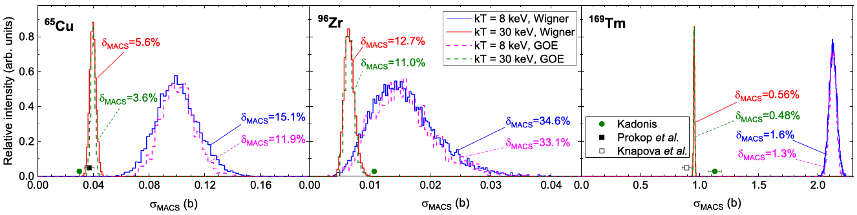
Fluctuation properties of MACS
More systematic study: MK, A. Couture, PRC 112,054601(2025) – no HF calculations, only random resonance sequences, no “direct capture”
Various tests of impact of different quantities (using “an artificial nucleus”)
Relative uncertainty in MACS: with D₀ in eV, kT in keV (if GOE long-range correlations present)
Reasonably works for “real nuclei”
D₀=1.5 keV
D₀=7.3 eV
D₀=13 keV

Slide 58
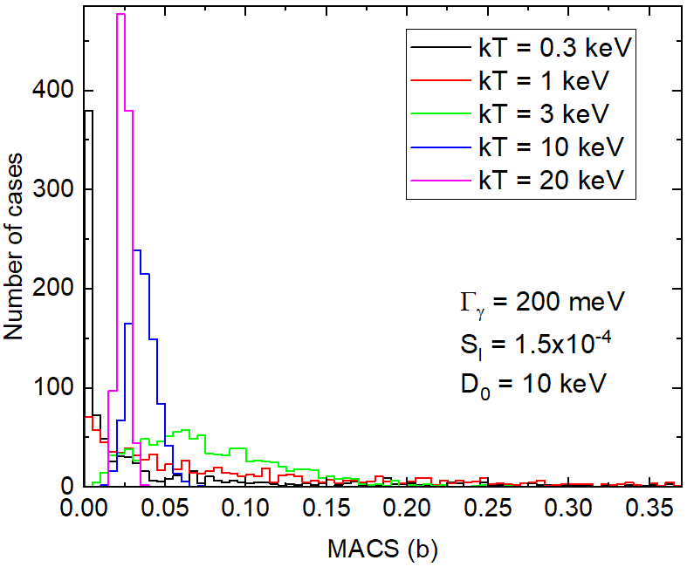
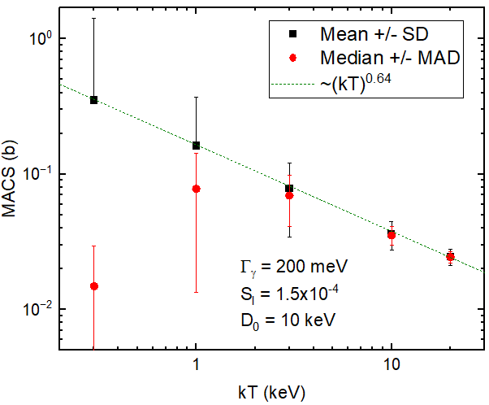
Fluctuation properties of MACS
What does happen if D₀ ≤ kT?
If kT larger than a few keV (relevant for astrophysical processes):
about 10 resonances (of all l) [Rauscher] within Δ appears for D₀ ≈ kT
yields δ_{MACS} ≈ 0.3, 0.2, and 0.13 for kT = 8, 25, and 90 keV
1000 random sequences

Slide 59
Fluctuation properties of MACS
What does happen if D₀ ≤ kT?
If kT larger than a few keV (relevant for astrophysical processes):
about 10 resonances (of all l) [Rauscher] within Δ appears for D₀ ≈ kT
yields δ_{MACS} ≈ 0.3, 0.2, and 0.13 for kT = 8, 25, and 90 keV
1000 random sequences
Max MACS ≈ 10 b

Slide 60
Fluctuation properties of MACS - Conclusions
Be aware if D₀ ≤ kT
A contribution from “direct” processes might be important if D₀ is large …

Slide 61
Thank you for your attention

