Slide 1
ECT* Workshop on Neutron-Capture Reactions for Astrophysical Processes, Trento, 2025
Softness in the scissors motion
and its appearance in the γ-ray strength function
Fang-Qi Chen
Lanzhou University

Slide 2
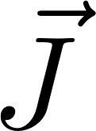

Nuclear scissors motion
Collective picture
Experimental signature
neutrons
3
protons
Scissors excitation
2
centroid
fragmented
…
Excitation energy of scissors oscillation
1
Strong M1 transitions
ground state
oscillation
Oscillation between intrinsic orientations of protons & neutrons
Observed via strong M1 transitions
(in deformed nuclei)

Slide 3
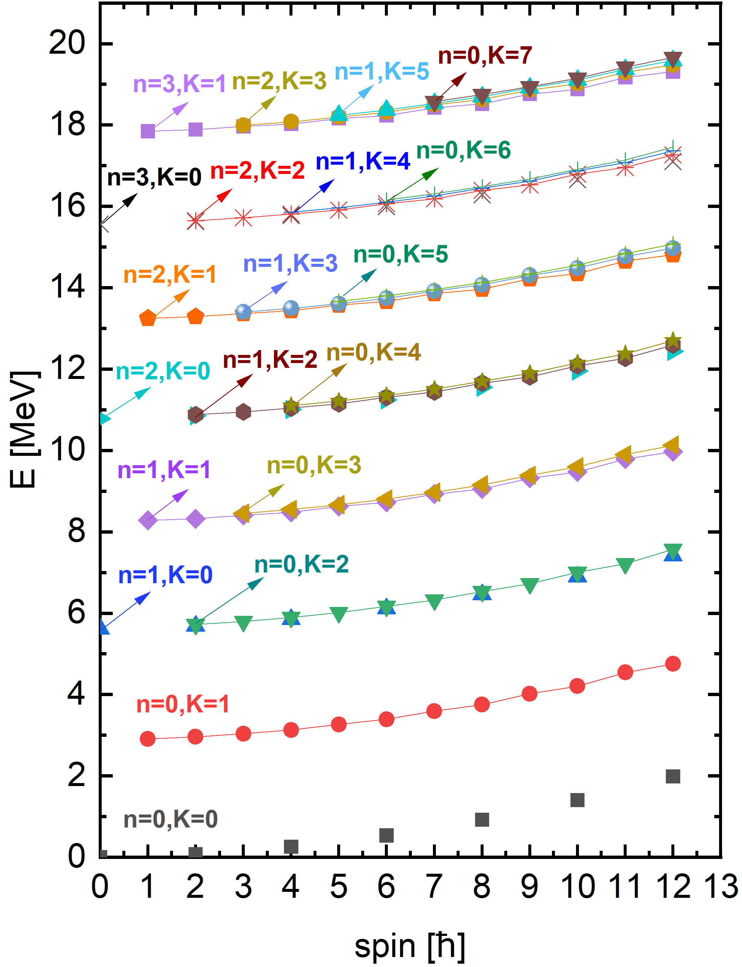
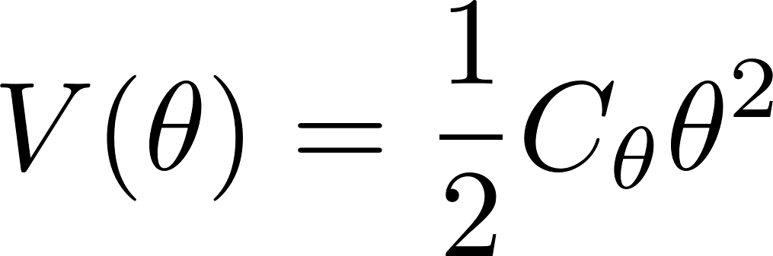

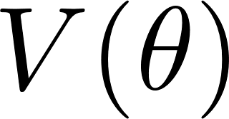
Harmonicity in the scissors oscillation
Theoretically, the scissors motion is often recognized as harmonic oscillation.
Two-Rotor-Model (phenomenological)
Projected Shell Model (microscopic)
Collective potential assumed for interaction between neutron & proton rotors:
With microscopic n-p interaction
Characteristic degeneracy of harmonic oscillator
( : angle between the two symmetry axes)
Intrinsic E. O. M
Harmonic form
Emerges “automatically”
Should be artificial since
must be periodic

Slide 4
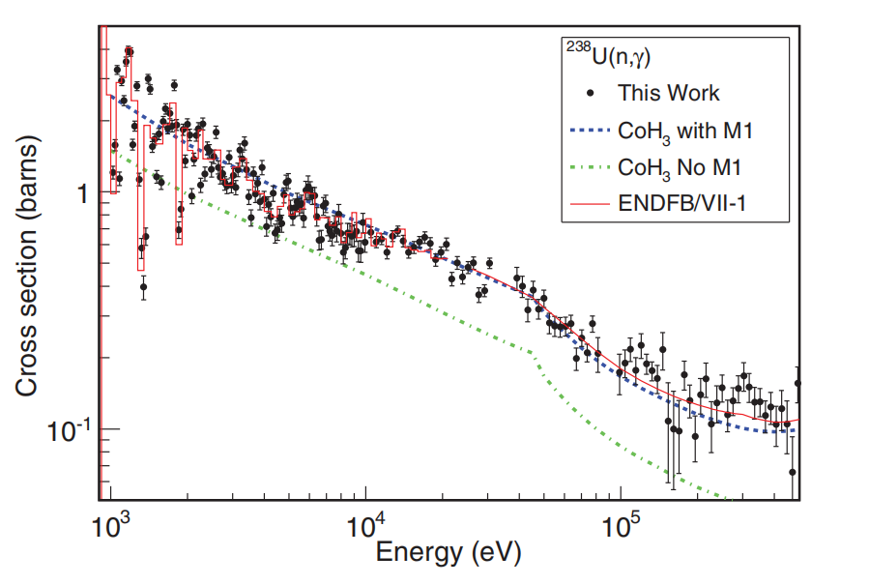

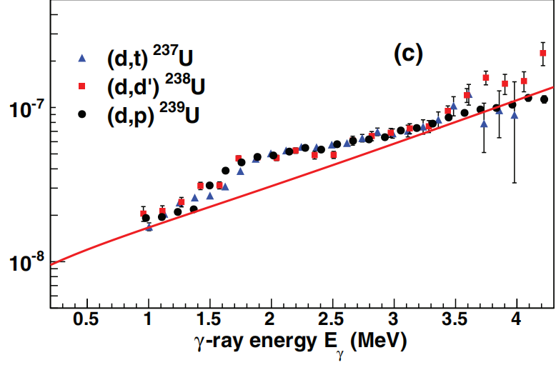
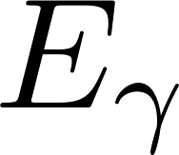
Scissors resonance in the γ-ray strength function
The scissors resonance
Impact on neutron capture cross sections
M. Guttormsen et al, PRC 89, 014302 (2014)
J. L. Ullmann et al, PRC 89, 034603 (2014)
Scissors resonance
Calculation with
scissors resonance
& exp data
Tails of all other resonance
Calculation without scissors resonance
Observed systematically in deformed nuclei
With in accordance with the scissors excitation on the ground state
Neutron capture cross section enhanced with the consideration of scissors resonance

Slide 5
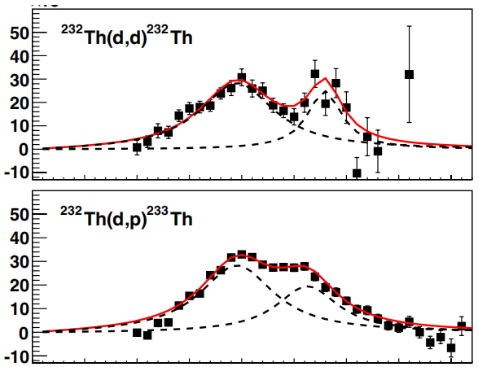


Splitting of the scissors resonance in the actinide region
M. Guttormsen et al, PRL 109, 162503 (2012)
Possible explanation by triaxiality:
different excitation energies between
①
②
neutron axis
proton axis
proton axis
neutron axis
short
short
long
long
Oscillation along
long-axis
Oscillation along
short-axis
larger strength for the higher fragment
Opposite to the exp observation
Unknown mechanism making the scissors resonance softer than expected

Slide 6
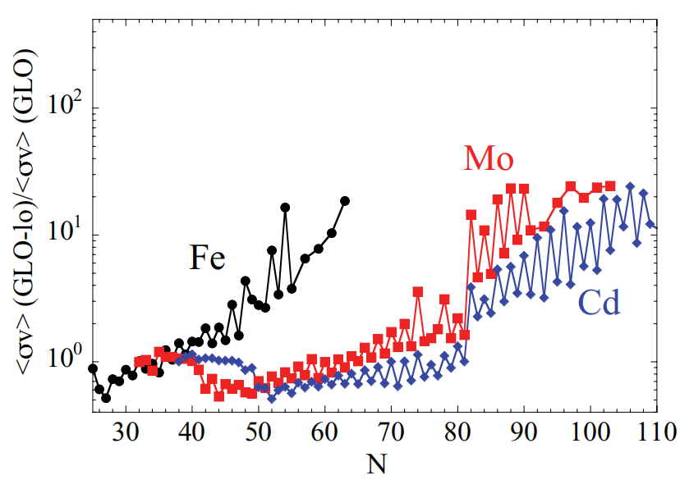
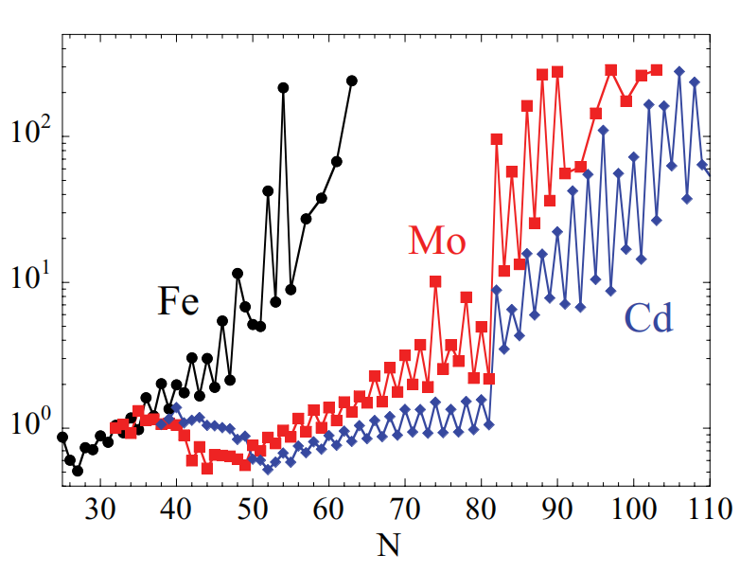
Low-energy-enhancement (LEE) in the γ-ray strength function
The low-energy enhancement
Impact on the neutron capture and r-process
A. Voinov et al, PRL 93 142504 (2004)
A. C. Larsen et al, PRC 82 014318 (2010)
Reaction rates (normalized)
~10 times increase
⁵⁷Fe
⁵⁶Fe
w/o LEE
With LEE
Observed in weakly-deformed nuclei
Neutron capture rate significantly enhanced in the neutron-rich region
With much smaller than the scissors excitation energy
Non-negligible impact on the r-process expected

Slide 7
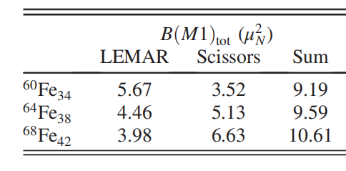
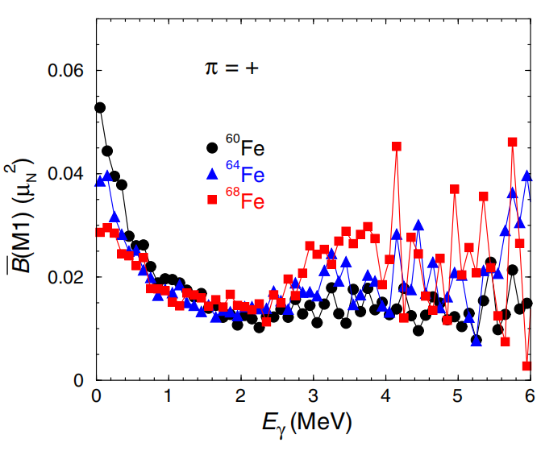
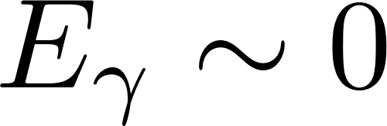
Possible connection between the LEE and the scissors motion
Shell model calculation
R. Schwengner et al, PRL 118 092502 (2017)
scissors resonance
LEE
LEE
towards open shell
decrease
increase
Approximately conserved
The origin of the LEE might be connected to the scissors motion
But
How does the scissors motion become extremely soft (with )?

Slide 8
The aim of this work
To explore the softness in the scissors motion by using the Projected Shell Model
Projected Shell Model for the scissors motion
in the past
in this work
Weakly-deformed nuclei
Quasi-particle configurations
Well-deformed nuclei
With only g.s. configuration
Extremely soft scissors motion
Softened scissors motion
Origin of the LEE?
scissors resonance splitting?
Harmonic scissors oscillation

Slide 9
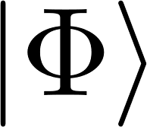
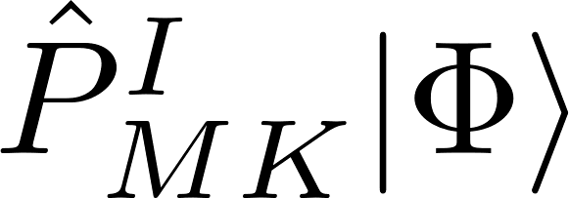
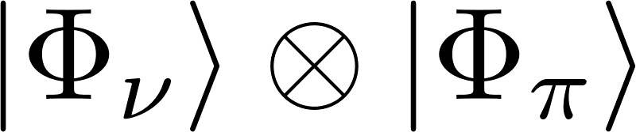
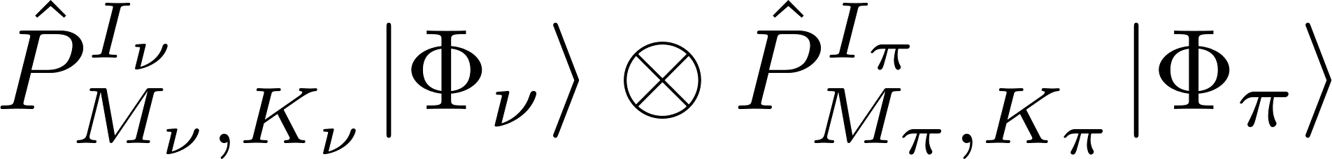
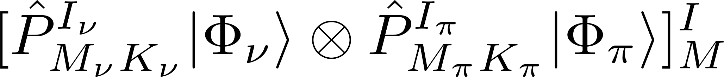
Theoretical description of the scissors motion (I)
Model framework for the scissors motion
The scissors motion can be understood as the motion of two rotors
Description for a single rotor by angular momentum projection:
intrinsic state
laboratory state
basis for
Hamiltonian diagonalization
angular momentum
projection
generalization
Description for a neutron and a proton rotors by angular momentum projection:
intrinsic state
projected state
does not have a good total angular momentum
angular momentum coupling
basis for
Hamiltonian diagonalization
laboratory state

Slide 10
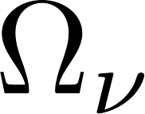
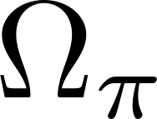
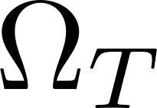
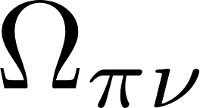
Theoretical description of the scissors motion (II)
Illustration of the scissors motion
Illustration of the scissors motion
Probability distribution of the scissors angle
Wave function in terms of the scissors angle
Laboratory basis constructed above
Orientation of the neutrons
Orientation of the protons
transformation
Relative orientations between neutrons & protons
Orientation of the principle axes for the whole nucleus
(the scissors angle)
Illustration of the collective rotation of the scissors mode
Illustration of the intrinsic motion between protons and neutrons (the scissors motion)

Slide 11
Result & discussions (I):
The Low-Energy-Enhancement in the γ-ray strength function

Slide 12
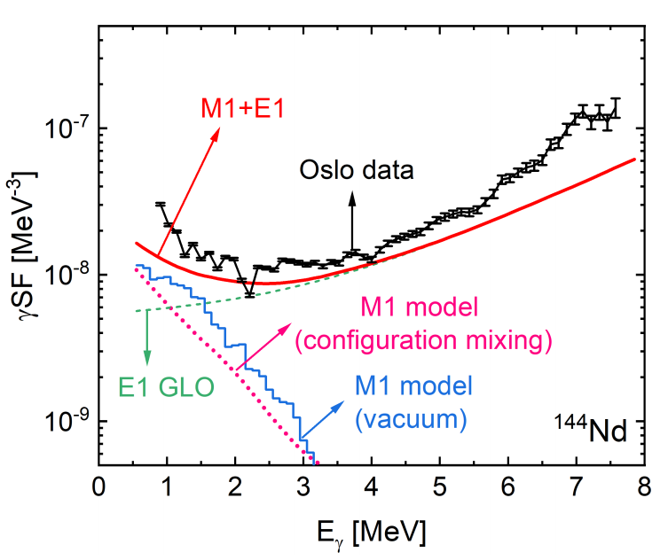
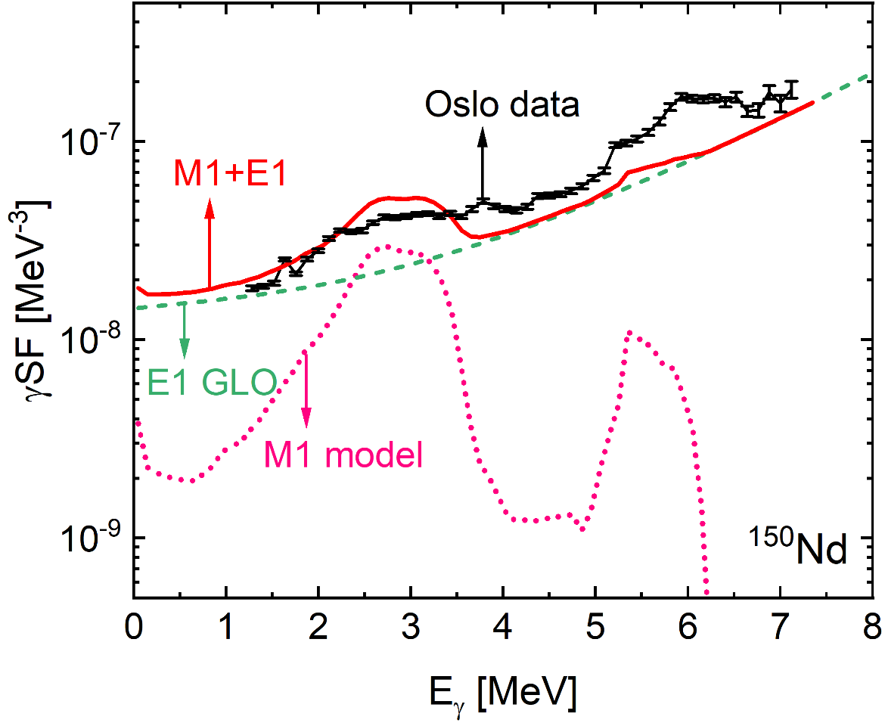
Theoretical results for γ-Strength Function with LEE
Exp reference: M. Guttormsen et al, PRC 106, 034314 (2022)
Exp data: https://www-nds.iaea.org/PSFdatabase
Weakly deformed nucleus
Well-deformed nucleus
¹⁴⁴Nd
(g.s. configuration)
LEE appears as expected
LEE disappears as expected
even with a single intrinsic g.s. configuration
and is replaced by the scissors resonance
Origin of the LEE is embedded in the model, even with the intrinsic g.s. configuration only

Slide 13
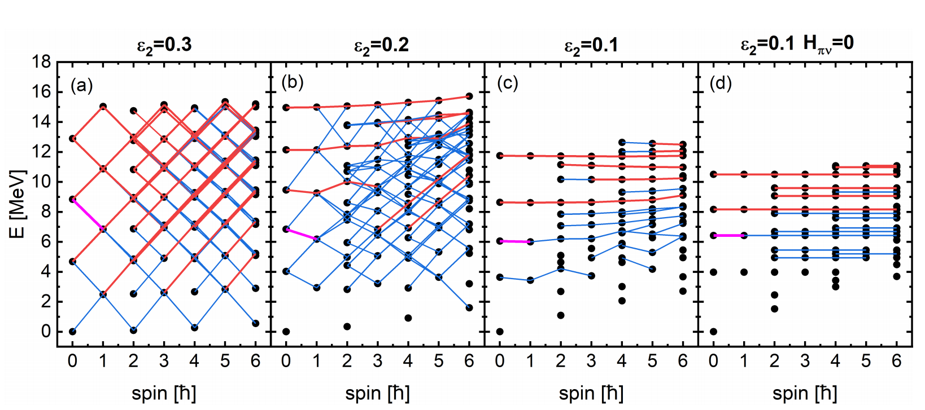
Scissors spectra obtained with the intrinsic g.s. configuration
approximately free?
similarity
free
Rhombus-like regularity
Rhombus faded
Band-like structure
dominates
Band-like structure from free scissors motion
Harmonic oscillation
Band-like structure
(leading to LEE)

Slide 14
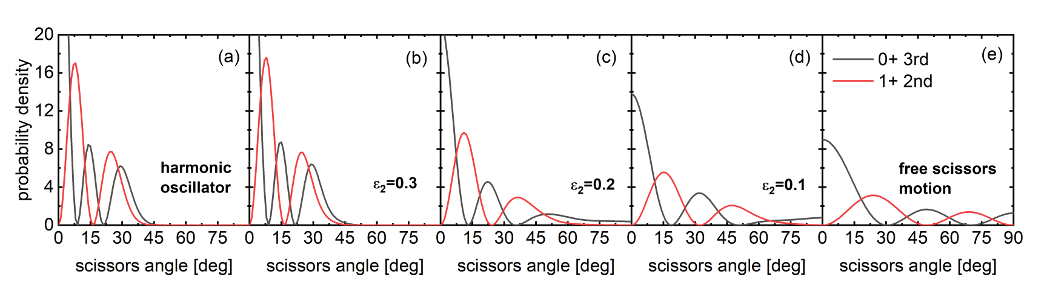
Evolution towards free scissors motion with reduced deformation
Probability distribution of the scissors angle
for representative states:
strong M1 transition
0+ 3rd
1+ 2nd
Harmonic limit
Large deformation
Intermediate deformation
Small deformation
Free limit
Harmonic oscillator
Almost harmonic
Development of
anharmonicity
Closer to free scissors motion
Free scissors motion
Deformation decreases
Harmonic scissors oscillation
Free scissors motion

Slide 15
How does the scissors motion becomes free
Collective motion
The motion of a “particle” in a “collective potential” (≈energy surface)
Emergence of scissors angle with large deformation
Emergence of scissors angle with small deformation
Sharp reduction of n-p overlap
Mild reduction of n-p overlap
Large energy cost
Small energy cost
Steep energy surface
Flat energy surface
Well confined scissors motion
Approximately free
scissors motion
LEE
Approximately free scissors motion
A geometric effect due to weak deformation

Slide 16
Result & discussions (II):
Splitting of the scissors resonance in the actinide region
(Preliminary)

Slide 17
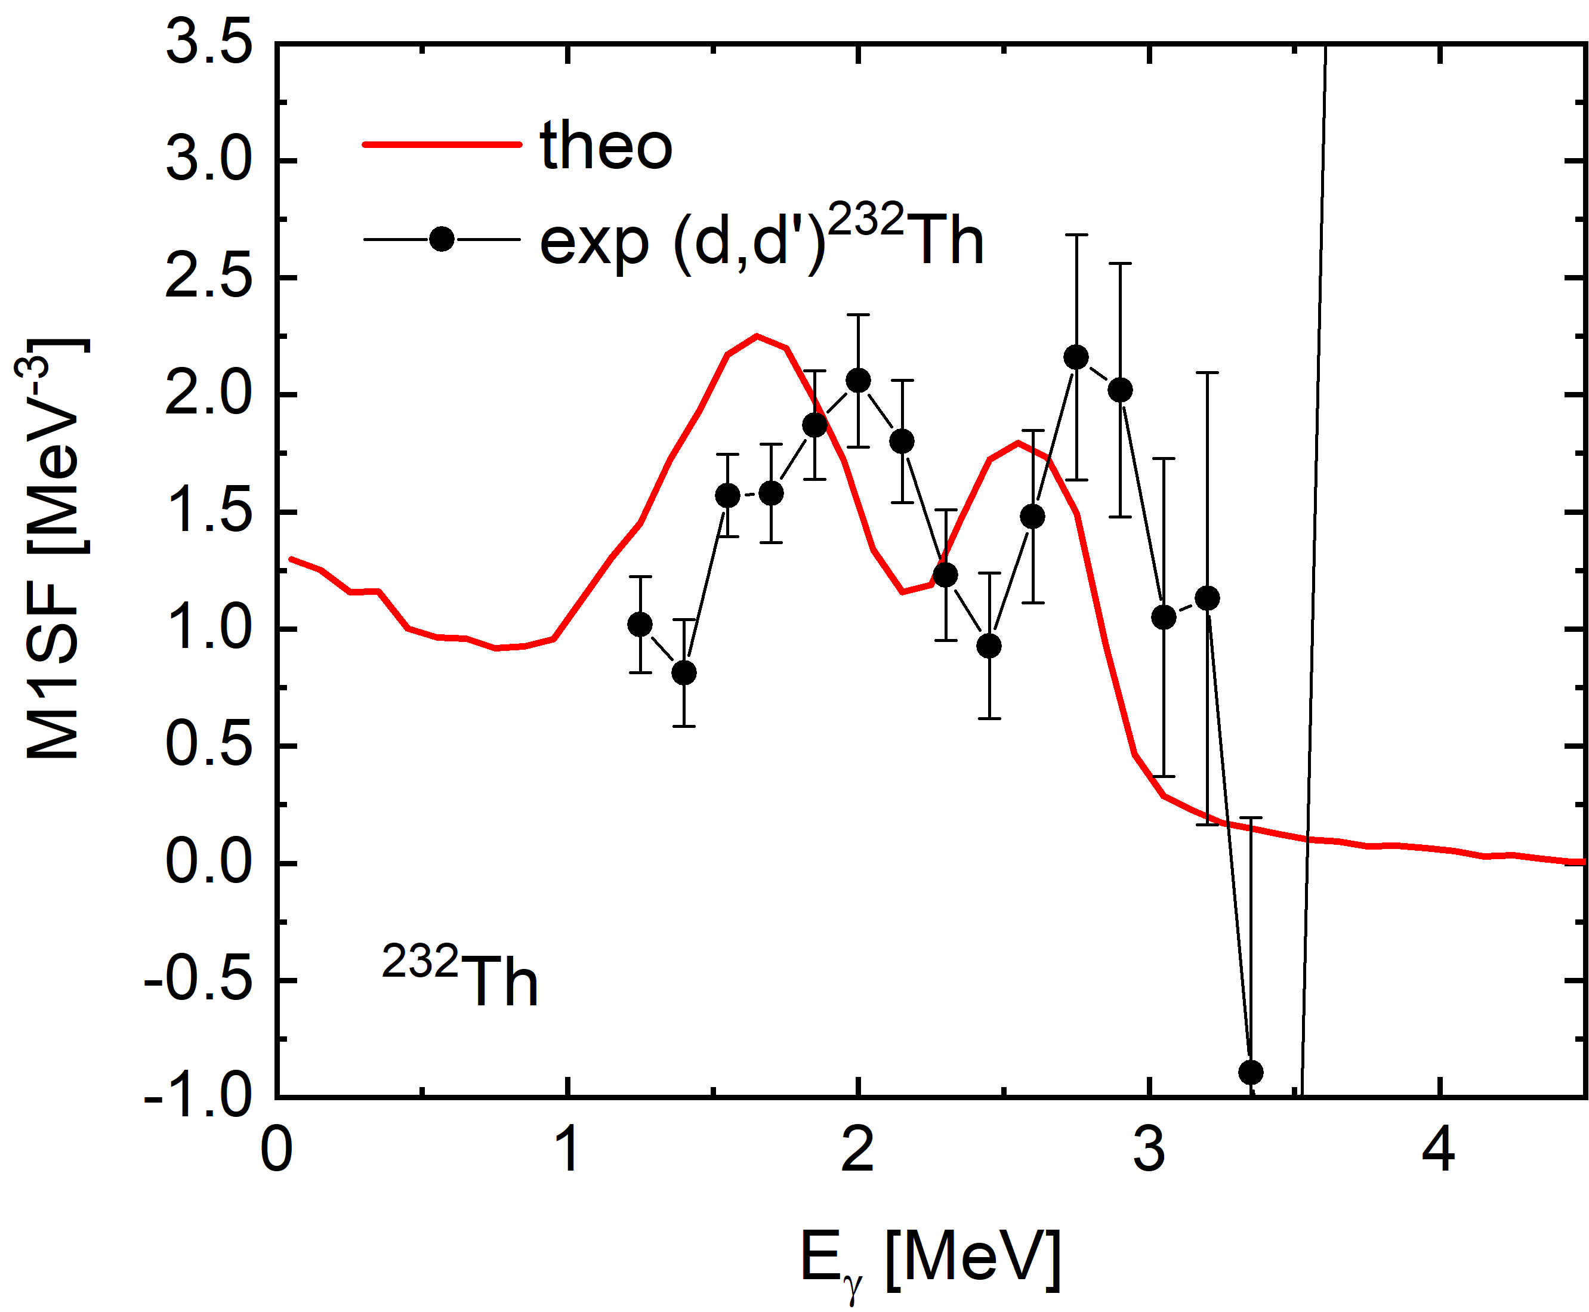
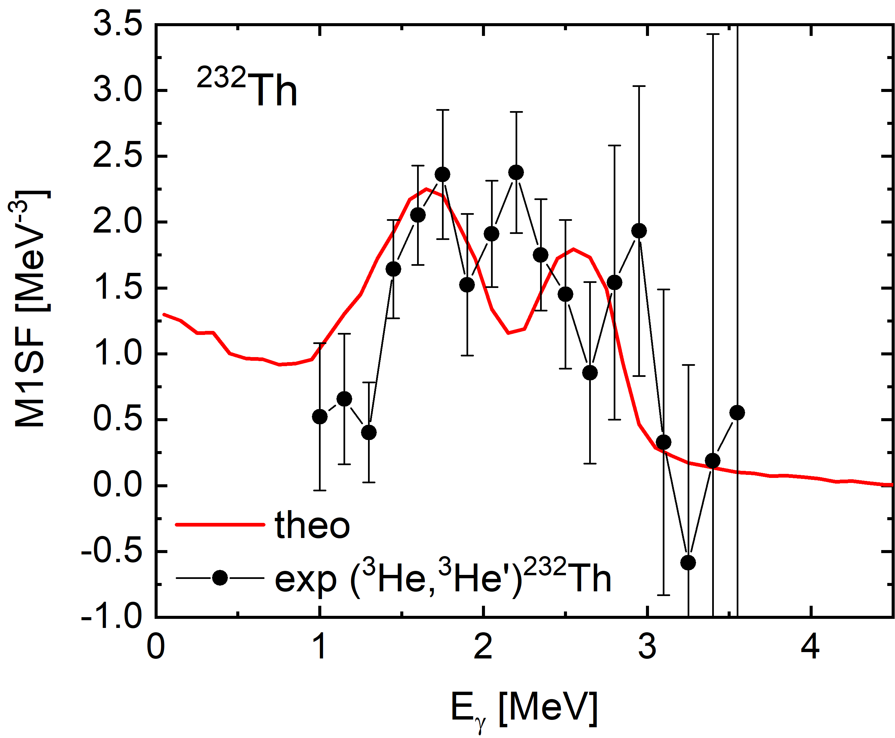
Theoretical result for the scissors resonance splitting
Exp reference: M. Guttormsen et al, PRC 89, 014302 (2014)
Exp data: https://www-nds.iaea.org/PSFdatabase
(Tails of other structures has been removed phenomenologically from the data)
Splitting of the scissors resonance has been reproduced qualitatively

Slide 18
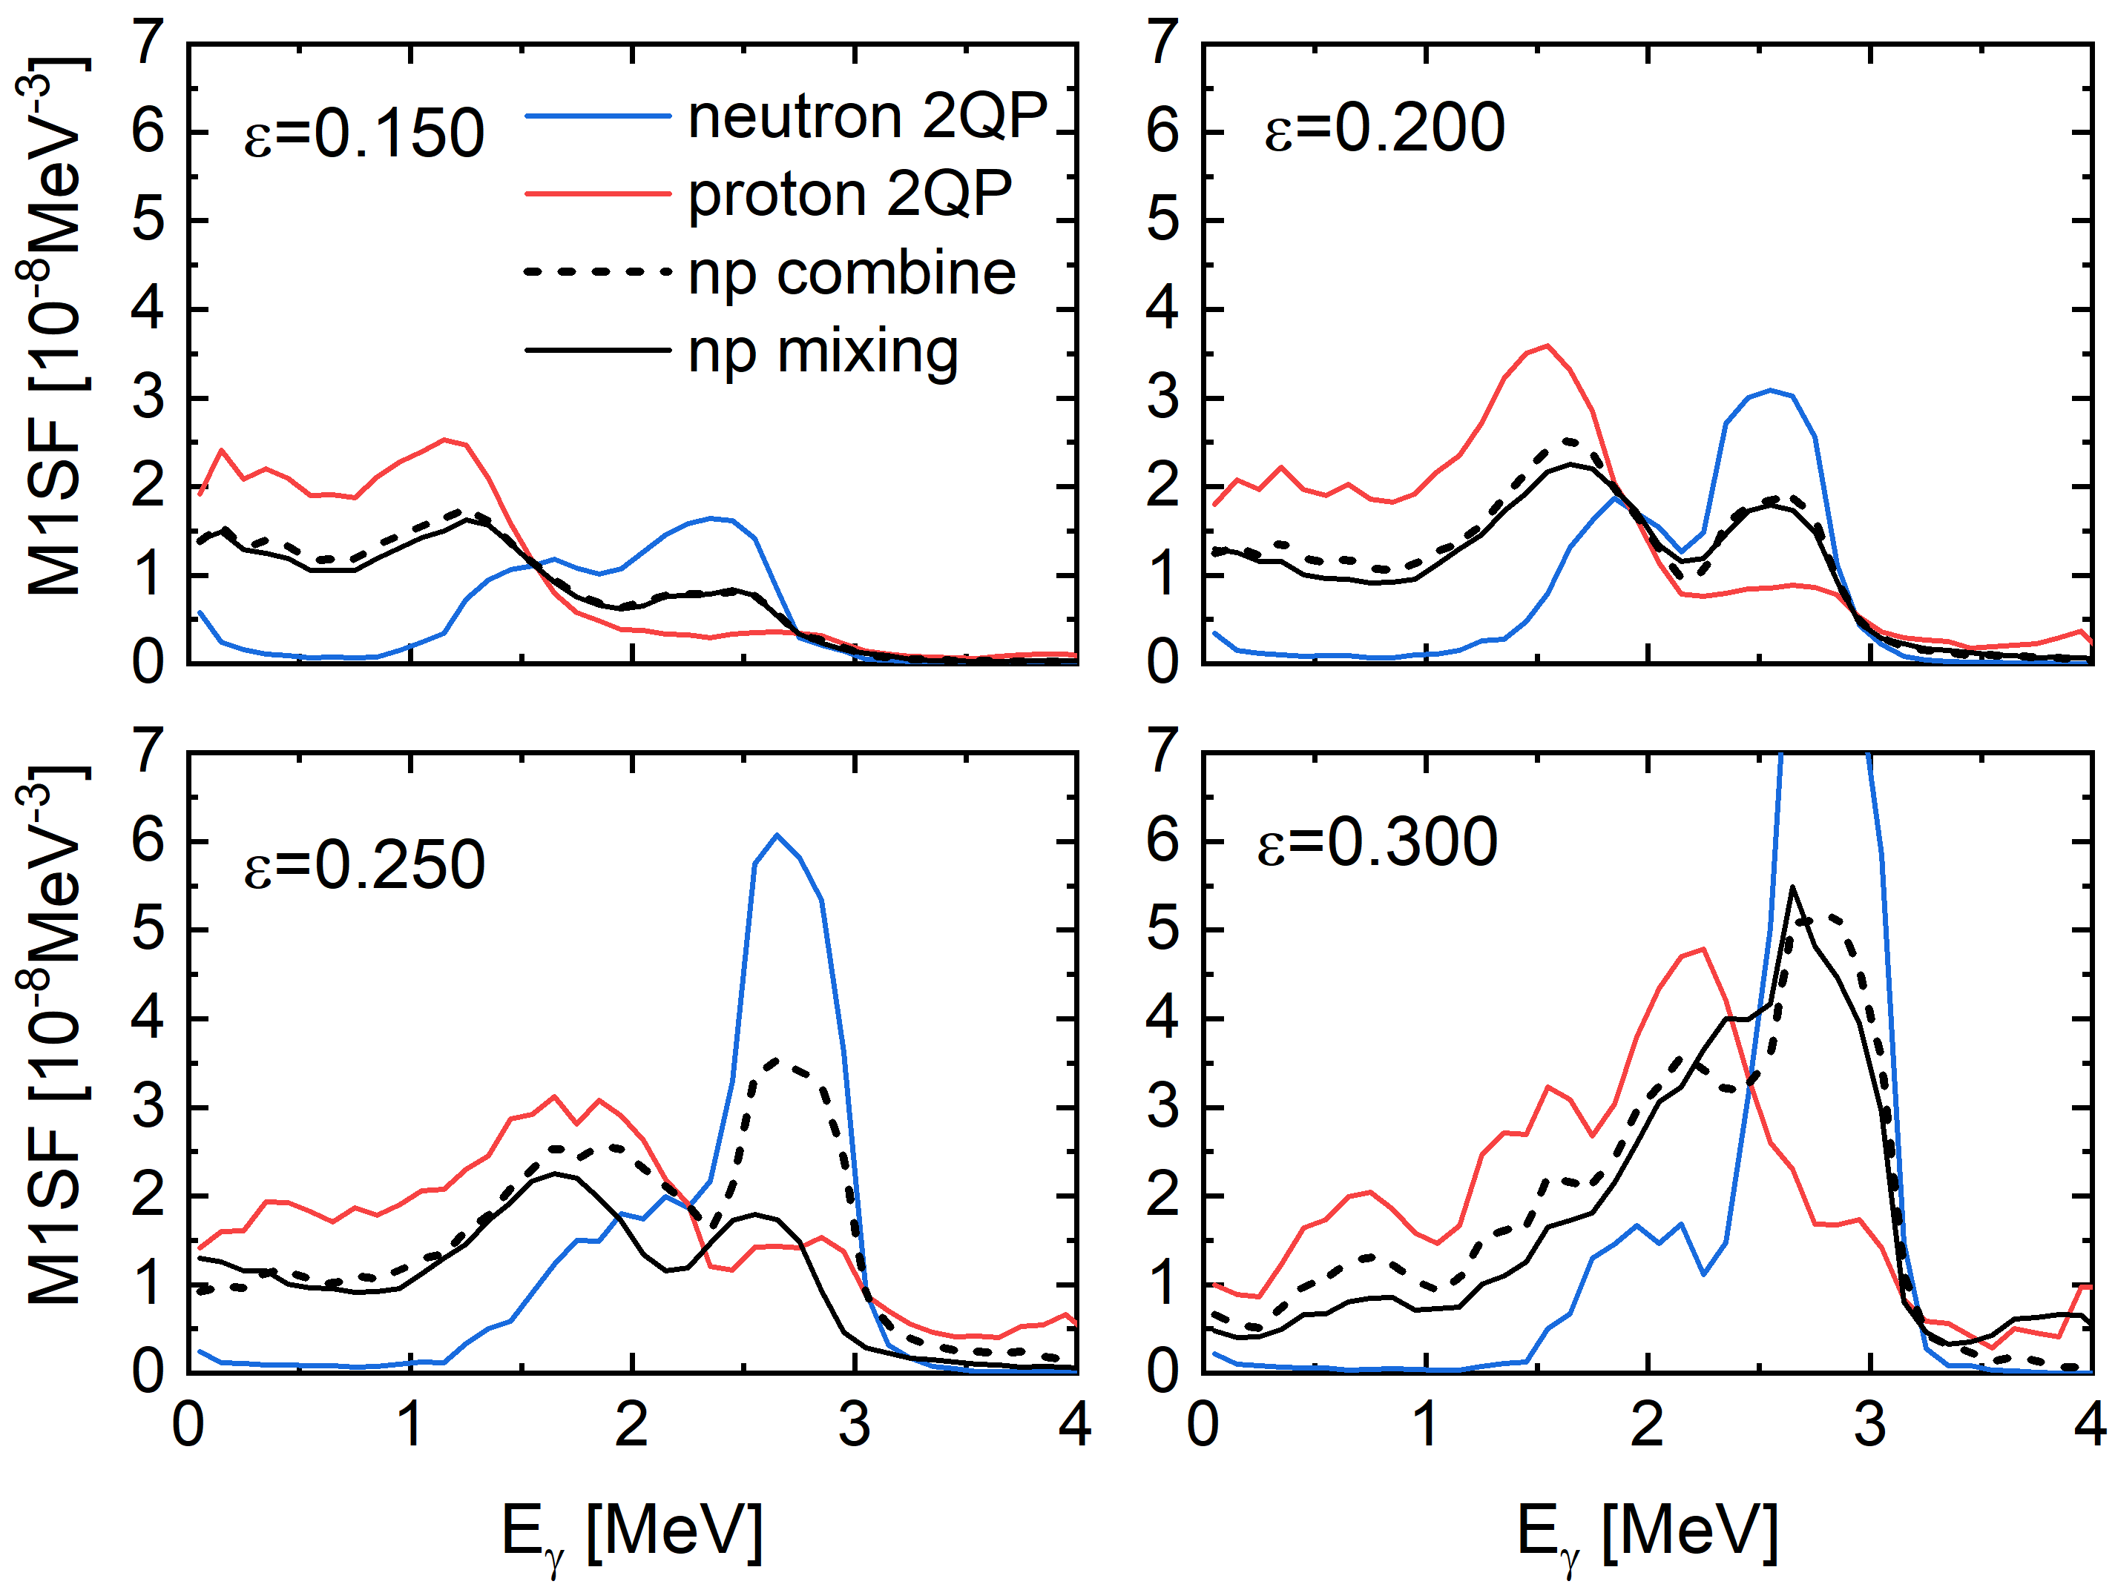
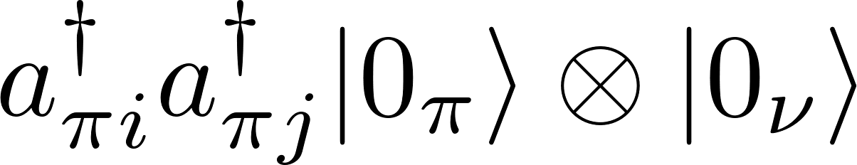
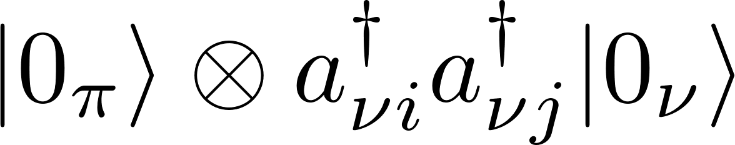
Configurations involved in the lower and higher fragments
Lower fragment:
proton 2QP configuration
Higher fragment:
neutron 2QP configuration
Mixing between proton & neutron configurations:
little effect only
Difference between scissors motion
with neutron & proton 2QP configurations
splitting of scissors resonance

Slide 19
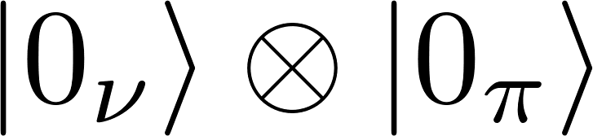
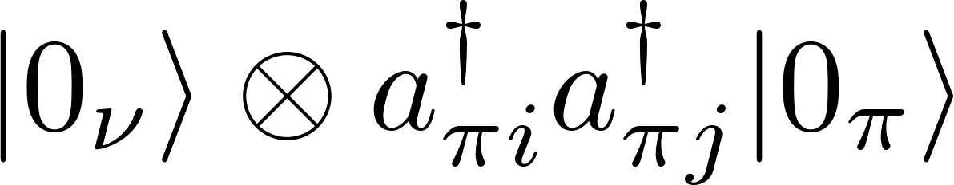
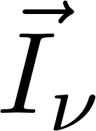
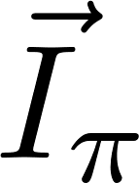
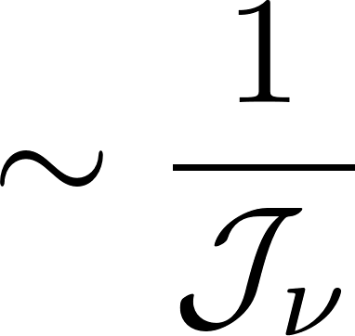
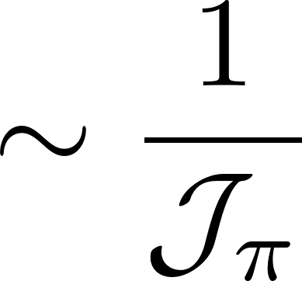

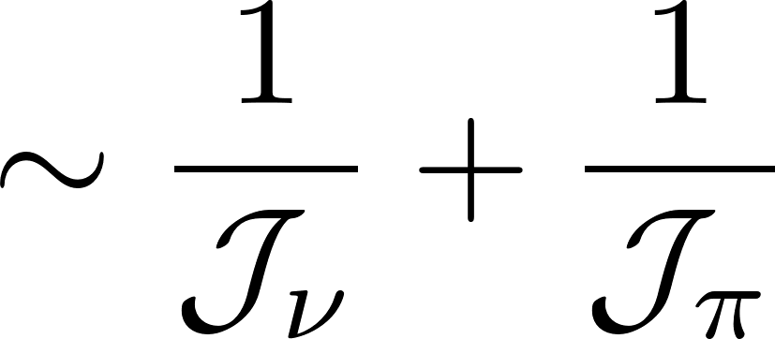
How is scissors motion affected by 2QP excitation
In simplified case:
g.s. configuration
2QP configuration
from rotation
from rotation
from rotation
from 2qp alignment
energy cost
energy cost
energy cost
energy cost
>
Total energy cost:
Total energy cost:
The excitation energy of scissors motion can be reduced by 2QP excitation
due to angular momentum alignment

Slide 20
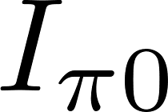
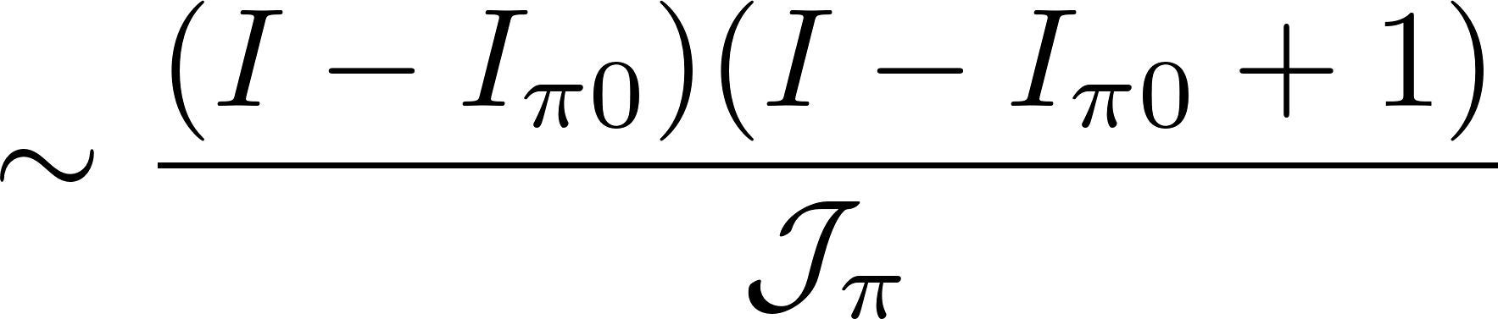
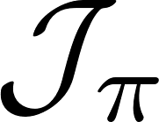
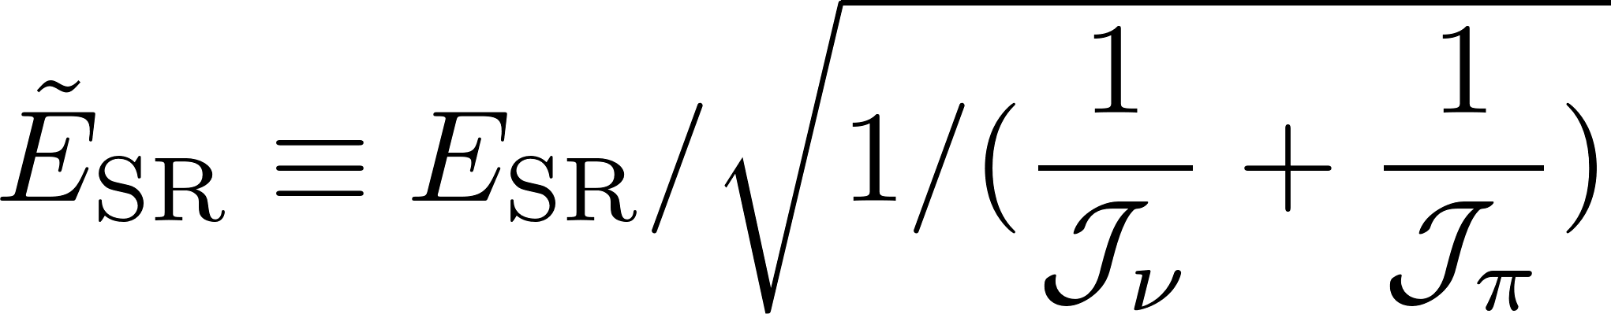

To see the effect of 2QP alignment: Energy scaling with MoI
In realistic case:
from 2qp alignment
energy cost
from rotation
energy cost
from rotation
dependence of the scissors energy on
energy cost
Should be removed when seeking for
dependence of the scissors energy on 2QP alignment
To remove the disturbance of :
scaling
Scissors excitation energy
energy of scissors resonance
Effective mass of scissors oscillator
(given by the Two-Rotor-Model)

Slide 21
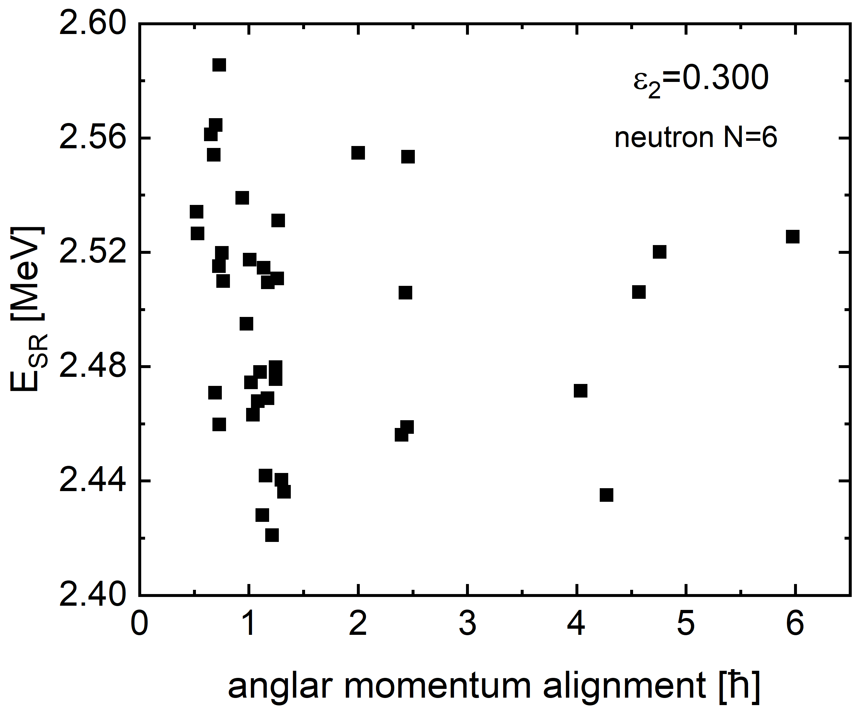
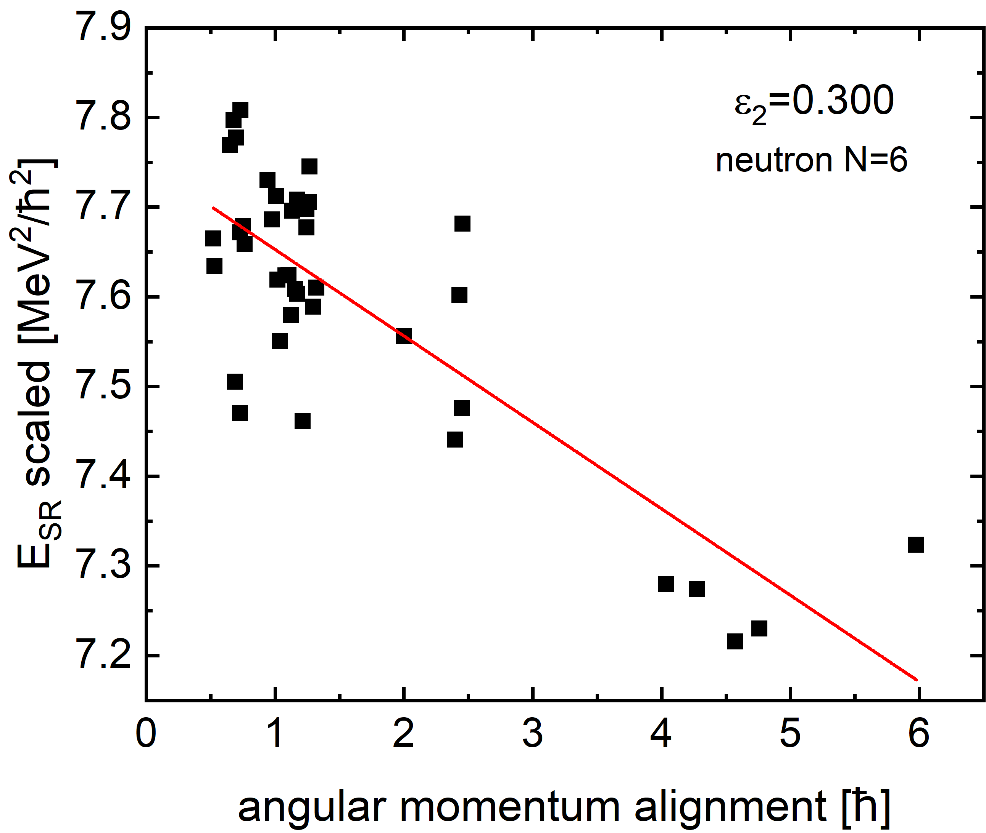
Possible correlations between 2QP alignment and scissors excitation energy
average energy of scissors resonance
(before scaling)
average energy of scissors resonance
(after scaling)
No correlation with 2QP alignment
Significant correlation with 2QP alignment
Softening of the scissors motion due to 2QP alignment is demonstrated

Slide 22
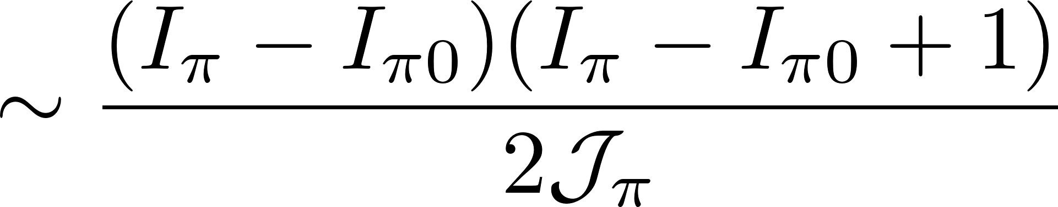
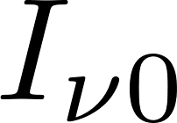

Impact of the difference between proton & neutron 2QP alignments
proton 2QP configuration:
from proton 2QP alignment
energy cost
(large)
rotational
energy cost
from rotation
from rotation
energy cost
(small)
Lower scissors resonance
neutron 2QP configuration:
from neutron 2QP alignment
energy cost
(small)
rotational
energy cost
from rotation
from rotation
energy cost
(large)
Higher scissors resonance
The difference in 2QP alignment
contributes to the splitting in scissors excitation energy

Slide 23
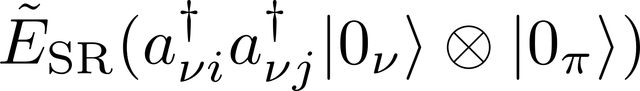
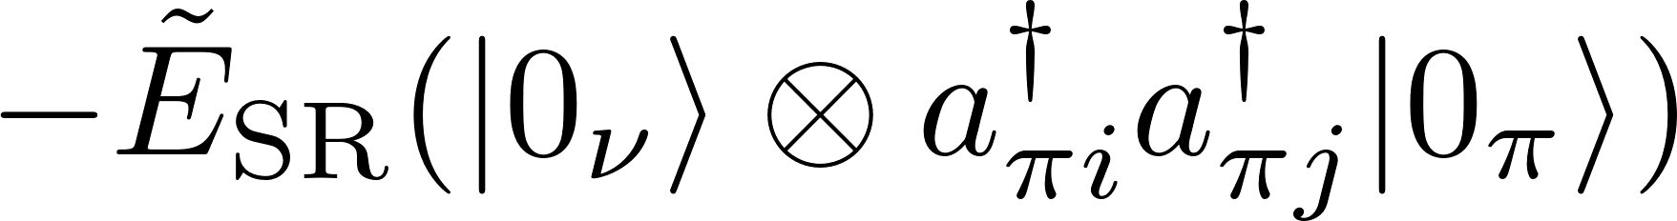
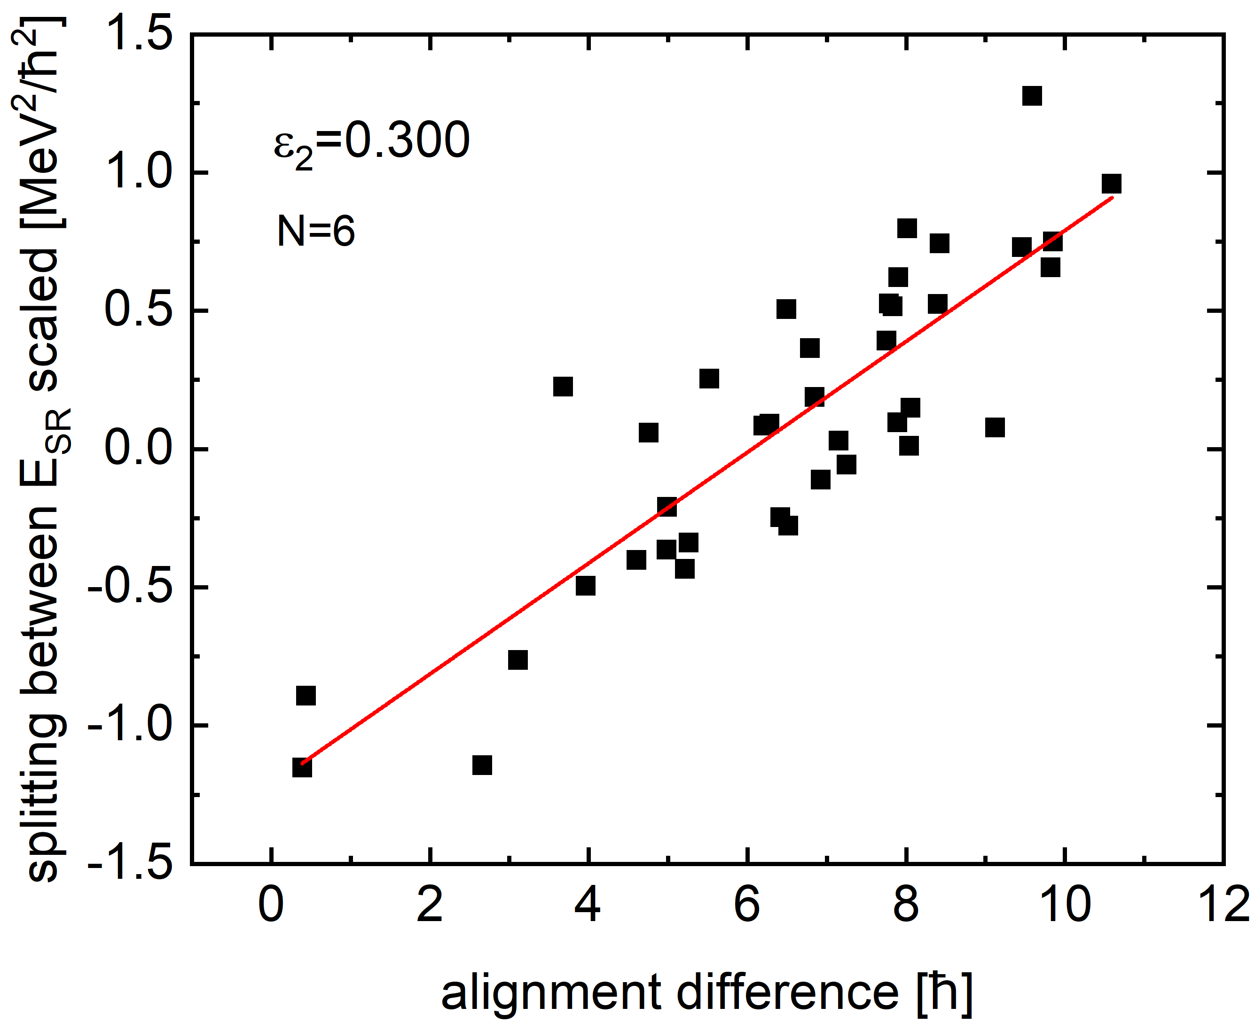
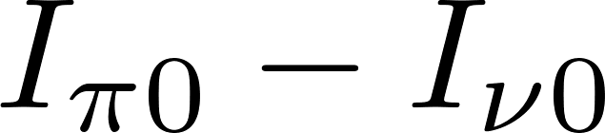
Possible correlation between 2QP alignment and scissors energy splitting
Scissors energy splitting:
neutron 2QP
proton 2QP
scaled
same quasi-particle orbitals
strong correlations found
difference between 2QP alignments
Splitting between scaled scissors energies
difference between proton & neutron 2QP alignment [ħ]

Slide 24
Summary
The low-energy-enhancement and the splitting of the scissors resonance are investigated by the projected shell model allowing scissors motion beyond harmonic oscillation.
The low-energy-enhancement can be understood as the result of an extremely soft, approximately free scissors motion due to weak deformation.
The scissors motion can be softened by the angular momentum alignment of intrinsic quasiparticle excitations, and the difference between neutron and proton alignments contribute to the splitting of the scissors resonance in the actinide region.

Slide 25
Work in collaboration with:
Yi-Fei Niu (Lanzhou University)
Yang Sun (Shanghai Jiao Tong University)
Mathis Wiedeking (LBNL)
Acknowledgment to Zhi-Xiang Huang for the help in preparing some of the figures.
Thank you very much for your attention!

