Slide 1



Renormalized dual basis for scalable simulations of (2+1)D compact quantum electrodynamics
Marc Miranda-Riaza, Pierpaolo Fontana, Alessio Celi
Trento, 4th September 2025

Slide 2
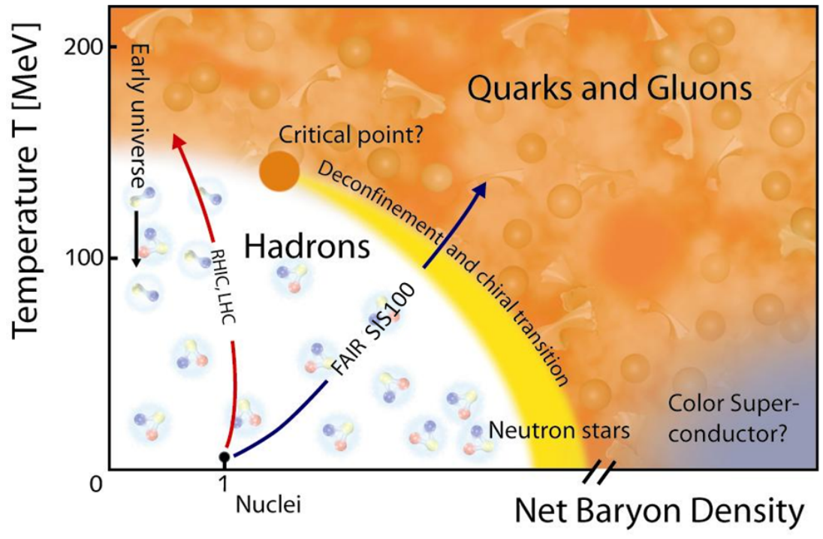
Lagrangian formulation
Studying LGTs with Monte Carlo:
Finite baryon density
Real-time evolution
Sign problem!
[Creutz, Quarks, Gluons and Lattices (1983)]
[Rothe, Lattice Gauge Theories: An Introduction (1992)]
[Durante et al. Phys. Scr. 94 (2019)]

Slide 3





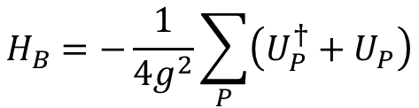






Hamiltonian formulation (U(1))
$$\left[U_{μ}\left(n\right),E_{ν}(m)\right]=−δ_{μν}δ_{mn}U_{μ}(n)$$
Possible gauge groups G: U(1), U(N), SU(N), Sp(N),...
Electric field Hamiltonian:
Magnetic field Hamiltonian
$$A$$
$$B$$
$$H_{E}=\frac{g^{2}}{2}\sum_{n,\hat{μ}}{E_{μ}^{2}\left(n\right)}$$
$$D$$
$$C$$
$$D$$
$$H_{B}=−\frac{1}{{4g}^{2}}\sum_{P}{\left(U_{P}^{†}+U_{P}\right)}$$
Coupling strength
$$A$$
$$B$$
$$A$$
$$g −$$
[Kogut & Susskind, Phys. Rev. D 11 (1975)]

Slide 4
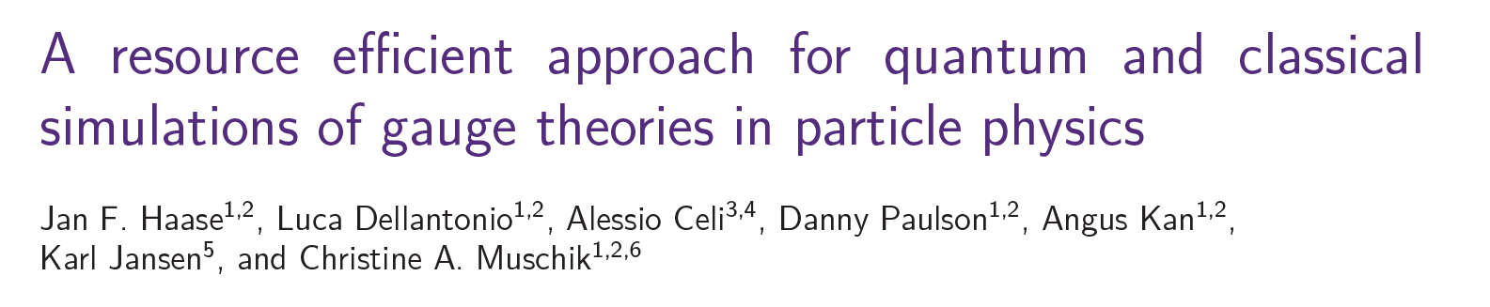
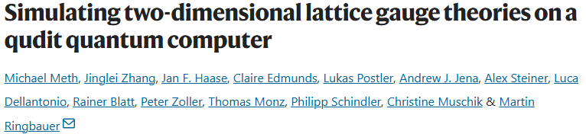
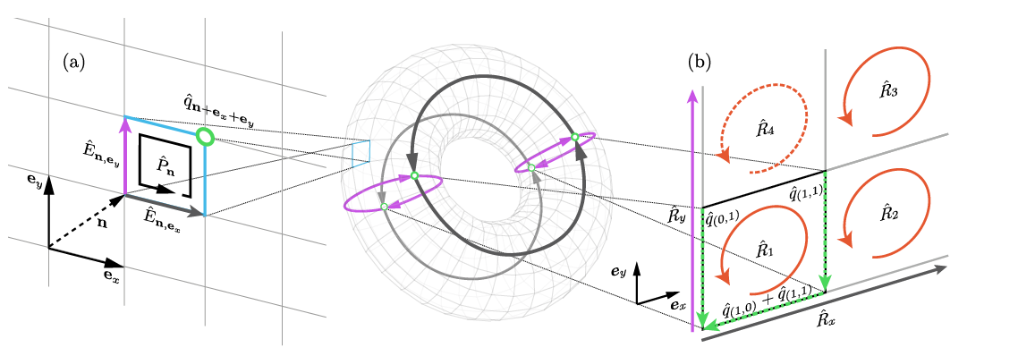










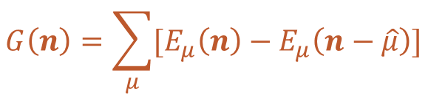






Reformulation
$$ℋ$$
$$ℒ_{\hat{x}}(C)$$
$$ℋ_{G}$$
$$A$$
$$B$$
$$W_{B}$$
$$D$$
$$C$$
$$D$$
Physical states:
$$G\left(n\right)\left|ψ\right\rangle =q|ψ⟩$$
$W_{A}$
$$W_{C}$$
Gauss law:
$$A$$
$$B$$
$$A$$
$$ℒ_{\hat{y}}(A)$$
$$G\left(n\right)=\sum_{μ}{[E_{μ}\left(n\right)−E_{μ}\left(n−\hat{μ}\right)]}$$
8 links $U_{μ}(n)$
3 independent Gauss laws $𝒢(n)$
5 independent physical variables
Resource-efficient simulation
[Haase et al., Quantum 5 (2021)]
[Meth et al., Nat. Phys. 21 (2025)]

Slide 5
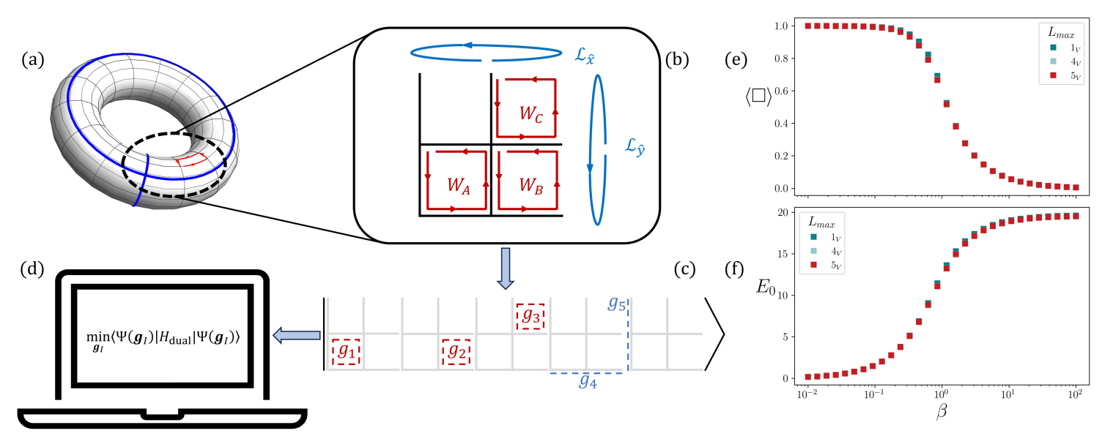
Reformulation for SU(N)
[Fontana, MMR & Celi, Phys. Rev. X (accepted) (2025)]
[Mathur & Rathor, Phys. Rev. D 107 (2023)]

Slide 6
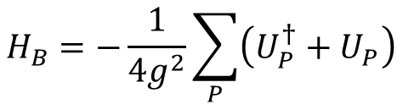
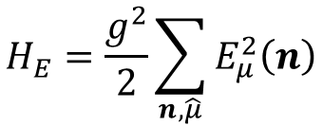
The renormalized dual basis (RDB)
$$H_{E}=\frac{g^{2}}{2}\sum_{n,\hat{μ}}{E_{μ}^{2}\left(n\right)}$$
$$H_{B}=−\frac{1}{{4g}^{2}}\sum_{P}{\left(U_{P}^{†}+U_{P}\right)}$$
Electric basis
Group basis
Peter-Weyl theorem
Truncation of degrees of freedom
Span weak & strong couplings
with the same precision

Slide 7
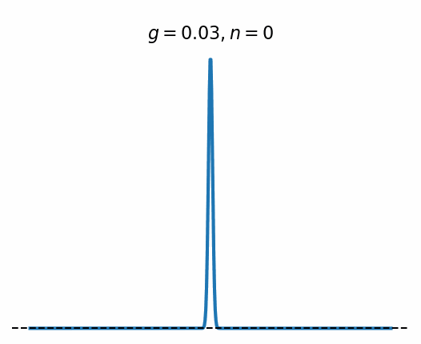
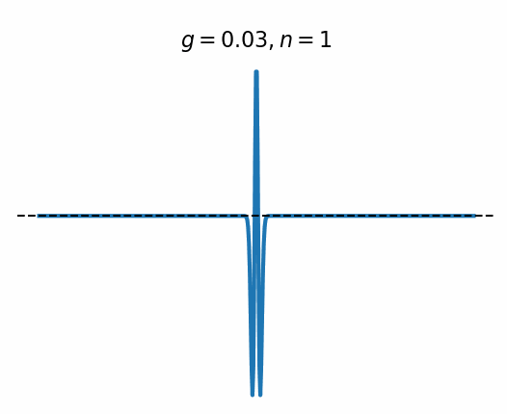
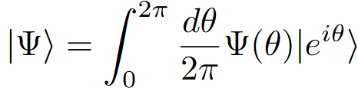
The renormalized dual basis (RDB)
$$H_{E}=\frac{g^{2}}{2}\sum_{n,\hat{μ}}{E_{μ}^{2}\left(n\right)}$$
$$H_{B}=−\frac{1}{{4g}^{2}}\sum_{P}{\left(U_{P}^{†}+U_{P}\right)}$$
Minimal setup for the competition between non-commuting electric and magnetic fields
In coordinate representation
[Fontana, MMR & Celi, Phys. Rev. X (accepted) (2025)]

Slide 8
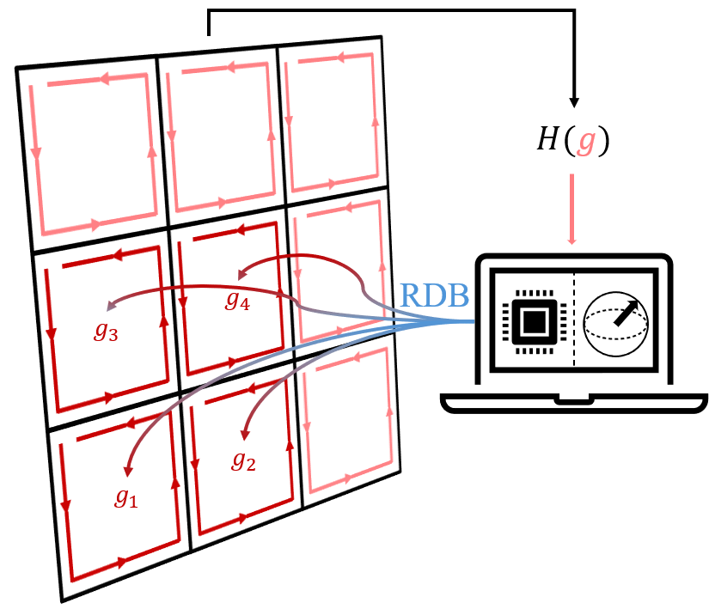
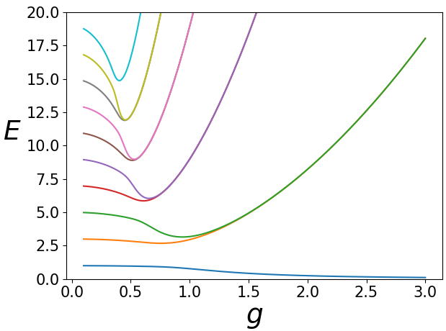
The renormalized dual basis (RDB)
Truncation
[MMR, Fontana & Celi (in preparation)]

Slide 9
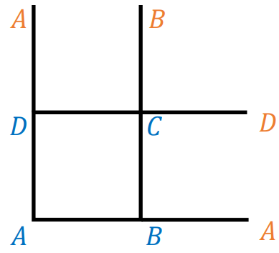
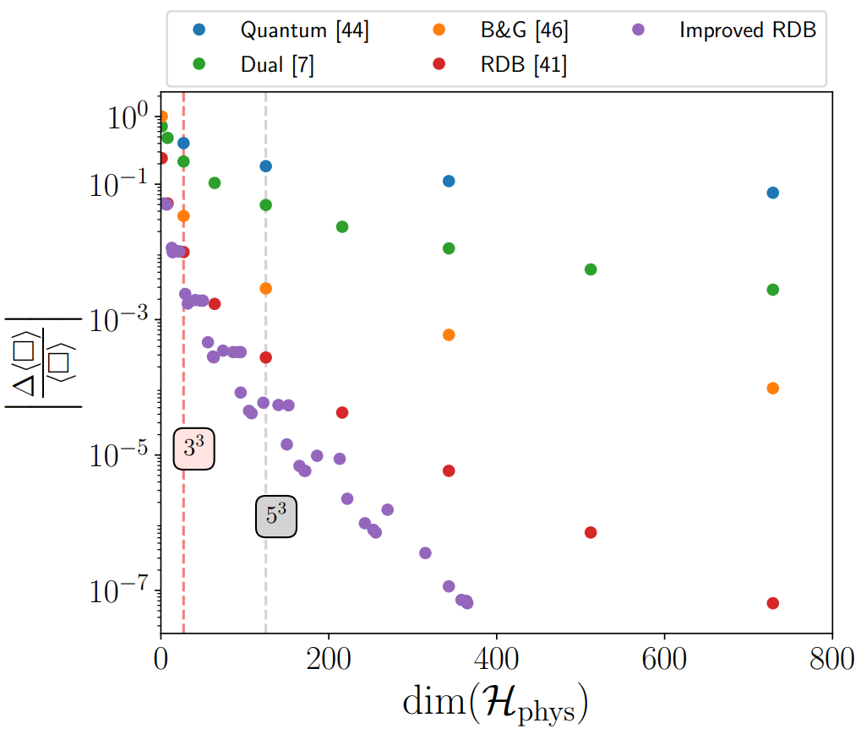
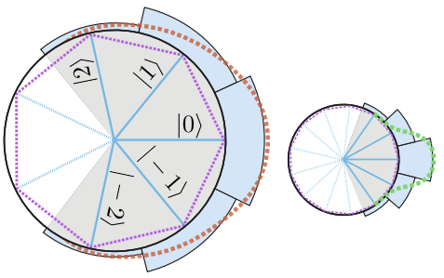
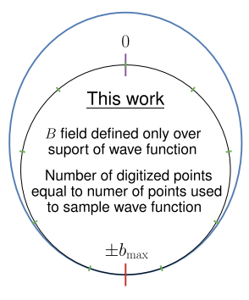

Comparison for U(1)
[44][Adapted from Haase et al., Quantum 5 (2021)]
[46][Adapted from Bauer & Grabowska, Phys. Rev. D 107 (2023)
[7][Ligterink et al., Ann. Phys. 284 (2000)]
[MMR, Fontana & Celi (in preparation)]
[41][Fontana, MMR & Celi, Phys. Rev. X (accepted) (2025)]

Slide 10
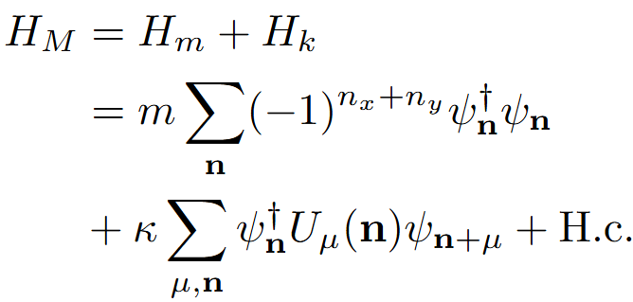
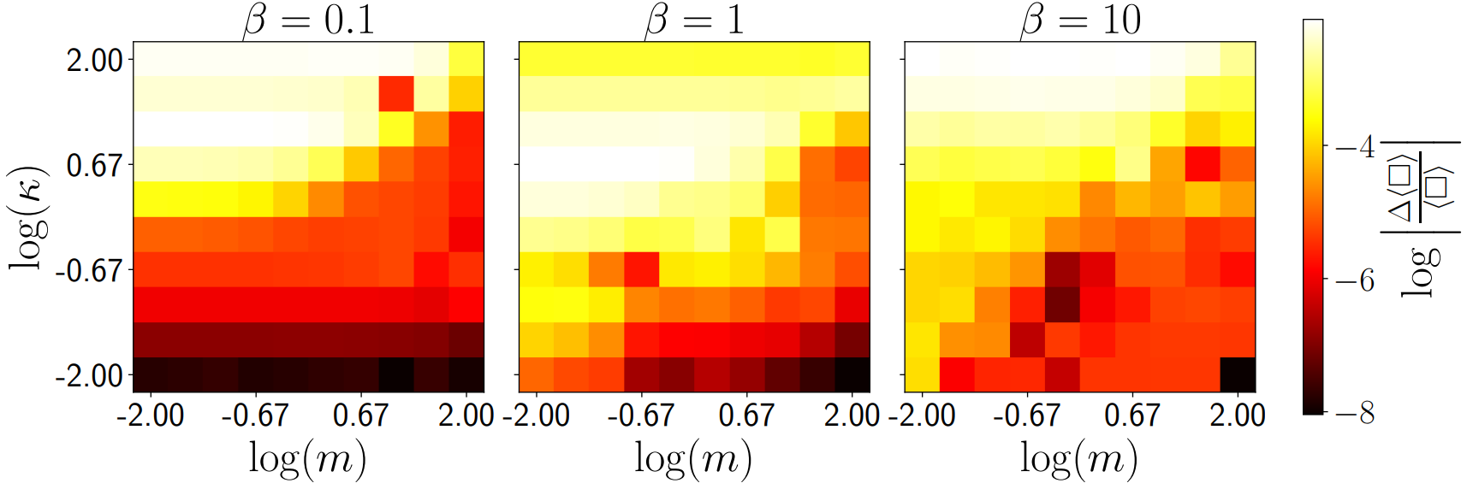

Adding matter [U(1)]
[Haase et al., Quantum 5 (2021)]
[MMR, Fontana & Celi (in preparation)]

Slide 11
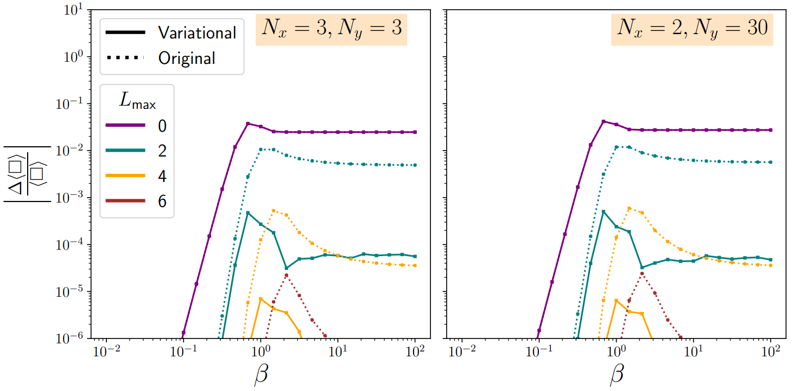
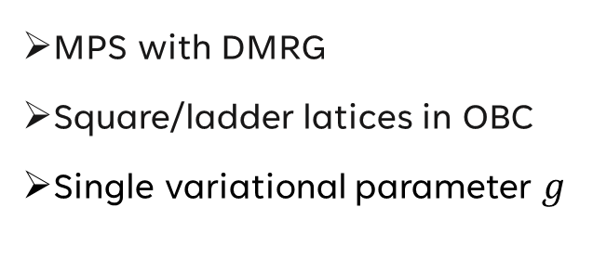
Scaling to larger lattices [U(1)]
MPS with DMRG
Square/ladder latices in OBC
Single variational parameter $g$
[Bender, Zohar, Phys. Rev. D 102 (2020)]
[MMR, Fontana & Celi (in preparation)]

Slide 12
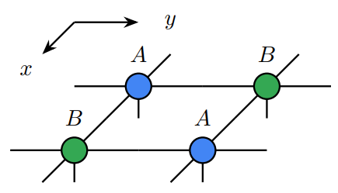
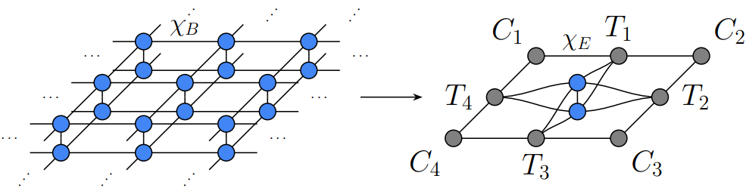
Even larger lattices [U(1)]
(infinite) Projected entangled pair states (iPEPS)
variPEPS library
[Naumann, Weerda et al., SciPost Phys.Lect.Notes 86 (2024)]

Slide 13
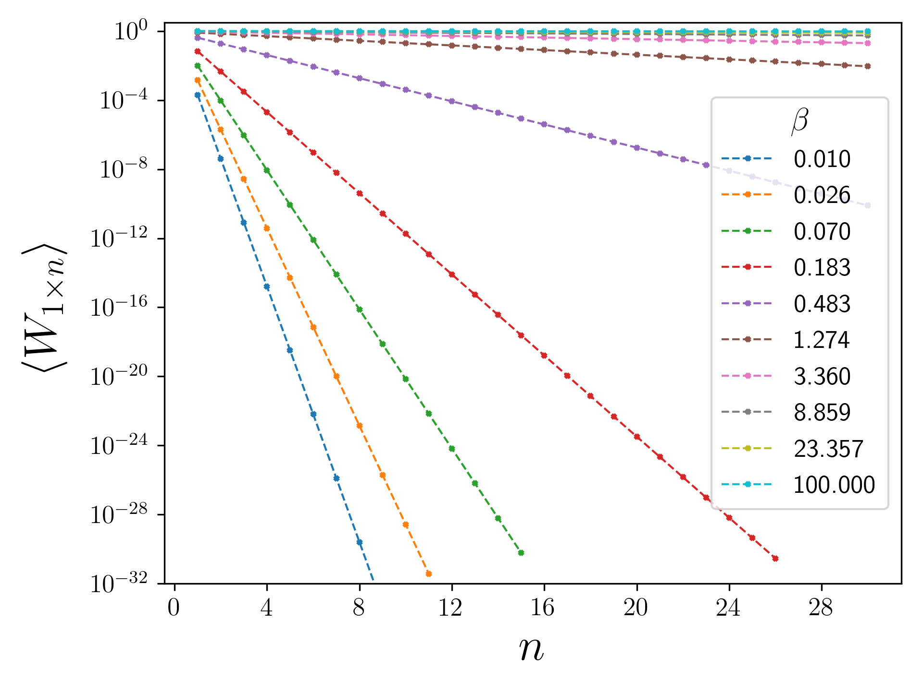
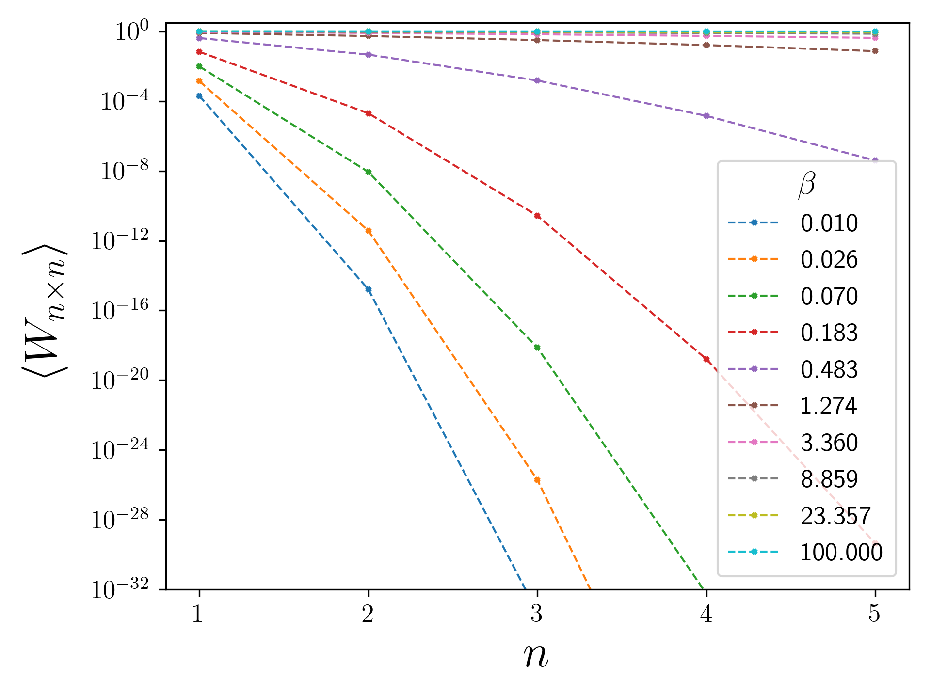


Even larger lattices [U(1)]
iPEPS for infinite 2D (variPEPS)
String tension:
Probe of confinement
Creutz ratio:
$$χ_{i×j}=−\ln{\frac{W_{i×j}W_{i−1×j−1}}{W_{i×j−1}W_{i−1×j}}}$$
[MMR, Fontana & Celi (part 2: in preparation)]
[Wilson, Phys. Rev. D 10 (1974)]
[Zohar, Phys. Rev. Research 3 (2021)]
[Creutz, Phys. Rev. Lett. 45 (1980)]
[Bender, Zohar, Phys. Rev. D 102 (2020)]

Slide 14
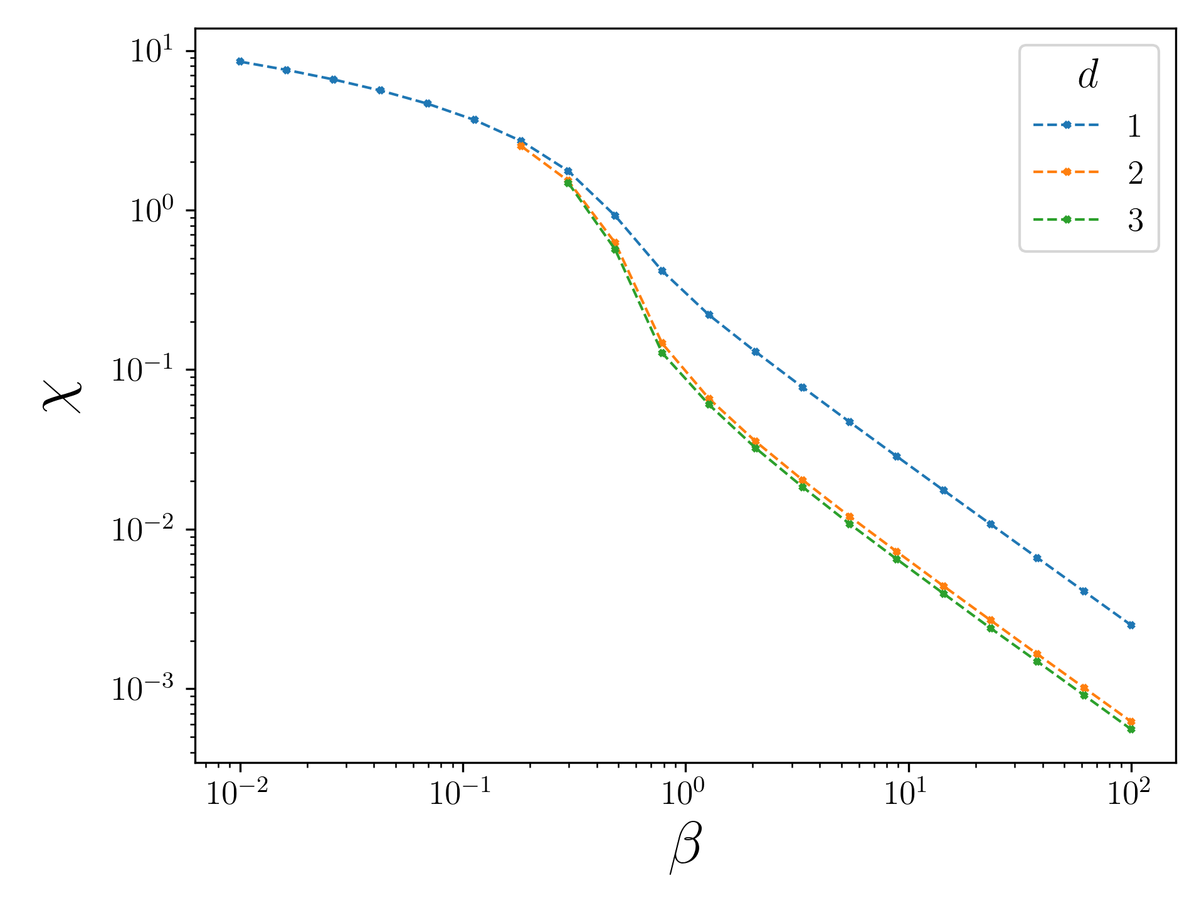

Even larger lattices [U(1)]
iPEPS for infinite 2D (variPEPS)
[MMR, Fontana & Celi (part 2: in preparation)]
$$χ_{i×j}=−\ln{\frac{W_{i×j}W_{i−1×j−1}}{W_{i×j−1}W_{i−1×j}}}$$
Creutz ratio:
[Wilson, Phys. Rev. D 10 (1974)]
[Zohar, Phys. Rev. Research 3 (2021)]
[Creutz, Phys. Rev. Lett. 45 (1980)]
[Bender, Zohar, Phys. Rev. D 102 (2020)]

Slide 15
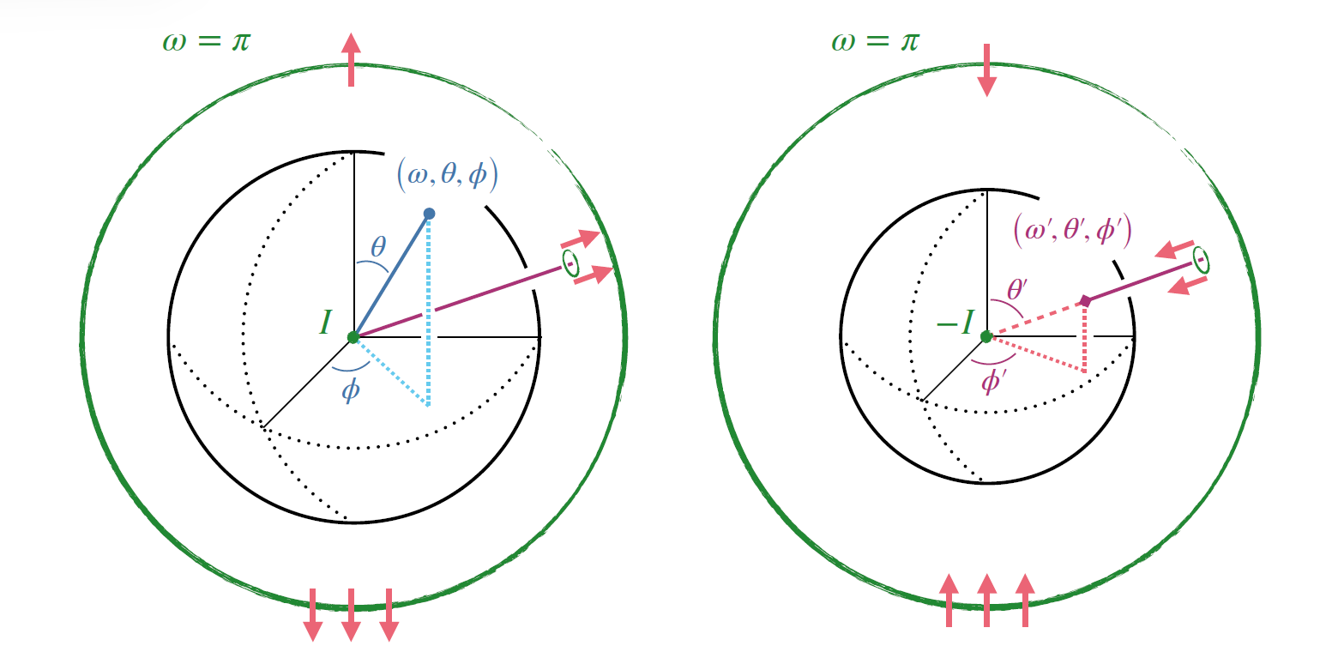
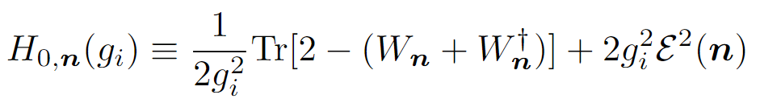








Renormalized dual basis for SU(2)
$$ℒ_{\hat{x}}(C)$$
$$ℒ_{\hat{y}}(A)$$
$$\left(ω,θ,φ\right)↔S^{3}$$
$$W_{B}$$
$W_{A}$
$$W_{C}$$
[Adapted from D’Andrea et al., Phys. Rev. D 109 (2024)]
Single plaquette Hamiltonian for each loop:
[D’Andrea et al., Phys. Rev. D 109 (2024)]

Slide 16
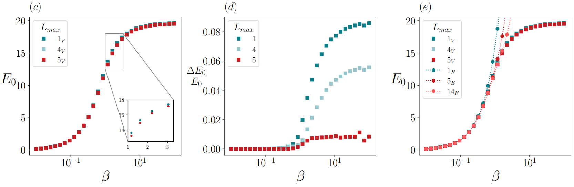
Renormalized dual basis for SU(2)
[Fontana, MMR & Celi, Phys. Rev. X (accepted) (2025)]

Slide 17
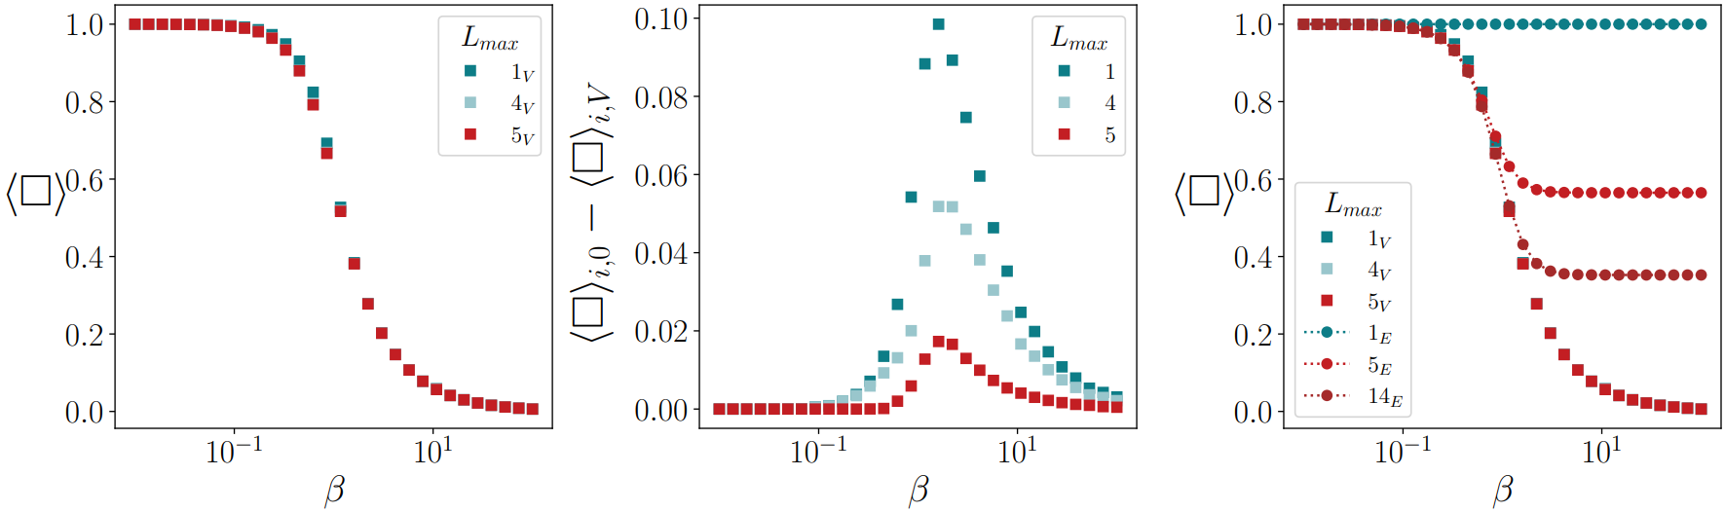
Renormalized dual basis for SU(2)
[Fontana, MMR & Celi, Phys. Rev. X (accepted) (2025)]

Slide 18
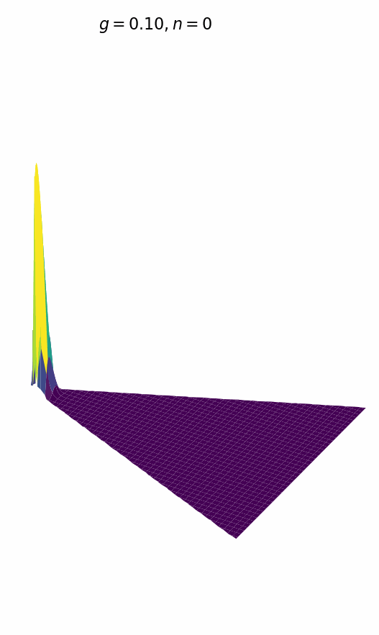
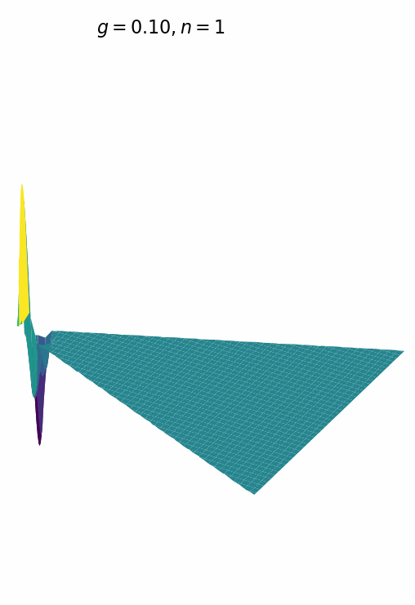
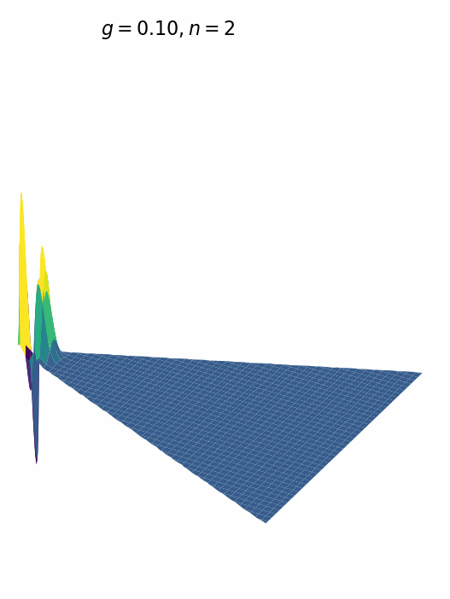
Renormalized dual basis for SU(3)

Slide 19

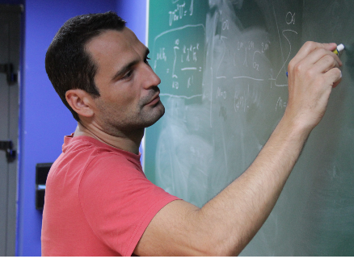
Outlook
Resource-efficiency of the renormalized dual basis (RDB)
For U(1) it enabled large-scale simulations at all values of the coupling
Proof-of-concept demonstration for SU(2)
Outlook
RDB for SU(3) and possibly other compact Lie groups
Inclusion of matter and large-scale non-Abelian LGTs
VQE implementation
Pierpaolo Fontana
Alessio Celi

Slide 20
Back-up slides

Slide 21
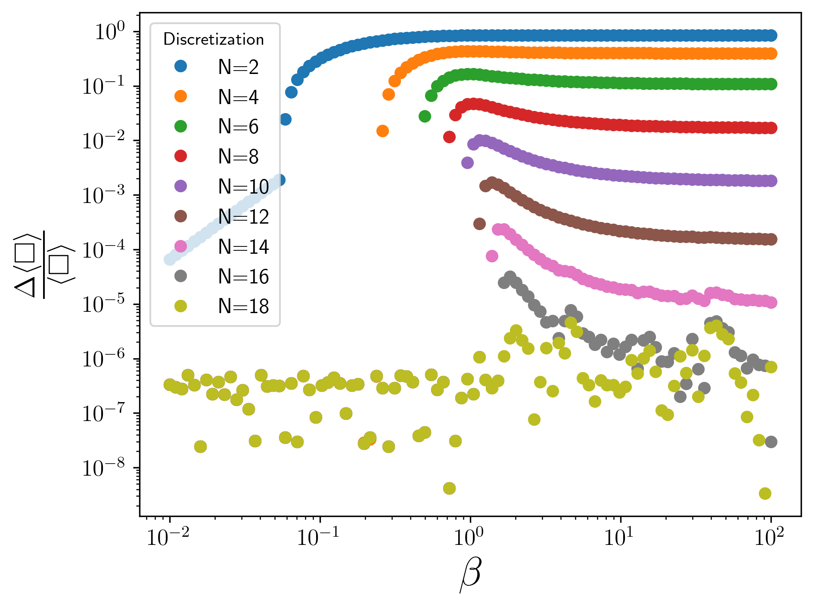
Comparison in SU(2)
Discretization vs RDB

Slide 22
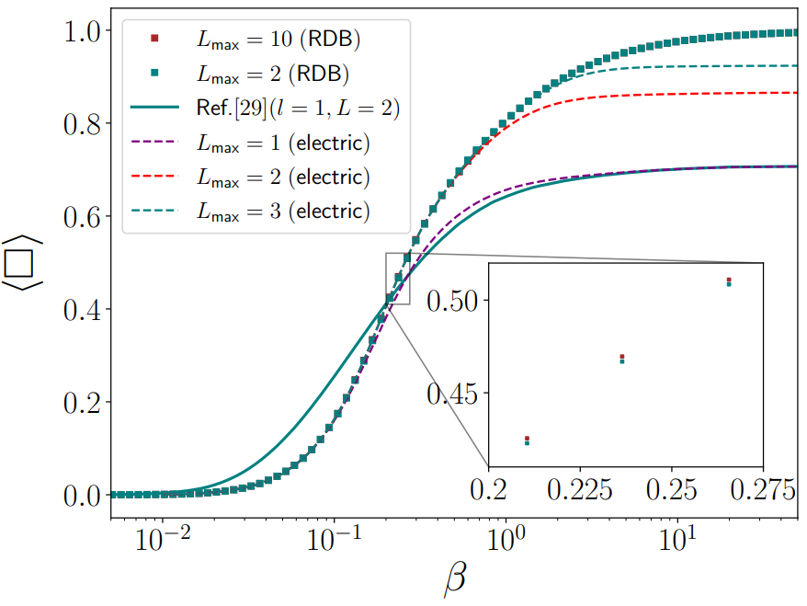
Adding matter [U(1)]
State of the art quantum computation of U(1) LGT
[Meth et al., Nat. Phys. 21 (2025)]
[29][Haase et al., Quantum 5 (2021)]
[MMR, Fontana & Celi (in preparation)]

Slide 23

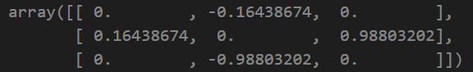

Matrix elements ( U(1) )
Electric squared
Electric
Cosinus

Slide 24
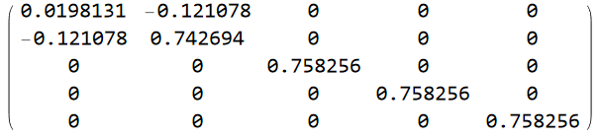
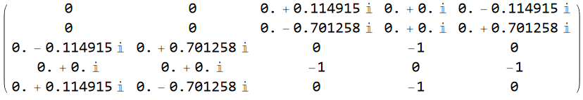
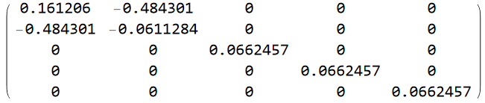
Matrix elements ( SU(2) )
Electric squared
Electric
Cosinus

Slide 25


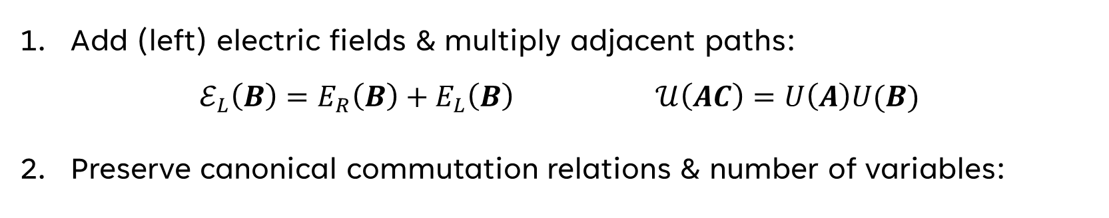









«Fusion rules» for physical variables
Combine links & electric fields:
$$E_{L}(A)$$
$$E_{R}(B)$$
$$E_{L}(B)$$
$$E_{R}(C)$$
$$ℰ_{L}(B)$$
$$ℰ_{L}\left(AC\right)=E_{L}(A)$$
$$=$$
$$U(A)$$
$$U(B)$$
$$𝒰\left(B\right)=U(B)$$
$$𝒰(AC)$$
Add (left) electric fields & multiply adjacent paths:
$ℰ_{L}\left(B\right)=E_{R}\left(B\right)+E_{L}\left(B\right) 𝒰\left(AC\right)=U\left(A\right)U(B)$
Preserve canonical commutation relations & number of variables:
$\left[ℰ_{L},𝒰\right]=−T𝒰,$ $\left[ℰ_{R},𝒰\right]=𝒰T$
[Mathur & Sreeraj (PRD 2015)]
[Mathur & Rathor (PRD 2023)]

Slide 26












Single periodic plaquette
$$A$$
$$B$$
$$W_{B}$$
$$D$$
$$C$$
$$D$$
$$=$$
$W_{A}$
$$W_{C}$$
$$A$$
$$B$$
$$A$$

Slide 27












Single periodic plaquette
$$ℒ_{\hat{x}}(C)$$
$$W_{B}$$
$$W_{B}$$
$$=$$
$${\overline{U}}_{\hat{y}}(A)$$
$${\overline{U}}_{\hat{x}}(C)$$
$W_{A}$
$$W_{C}$$
$W_{A}$
$$W_{C}$$
$$ℒ_{\hat{y}}(A)$$
$$𝒯(B)$$

Slide 28
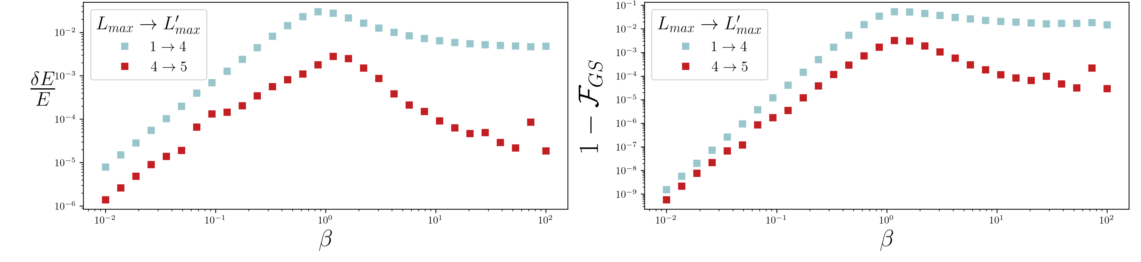
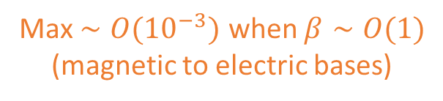
Ground state properties
$$δE=|E_{0,L_{max}}\left(β,g_{i}\right)−E_{0,L_{max}^{′}}\left(β,g_{i}\right)|$$
$$1−ℱ_{GS}=1−{|{⟨ψ}_{0,L_{max}}\left(β,g_{i}\right)|ψ_{0,L_{max}^{′}}\left(β,g_{i}\right)⟩|}^{2}$$
Variational
energy precision
Max $∼O({10}^{−3})$ when $β∼O(1)$
(magnetic to electric bases)

Slide 29
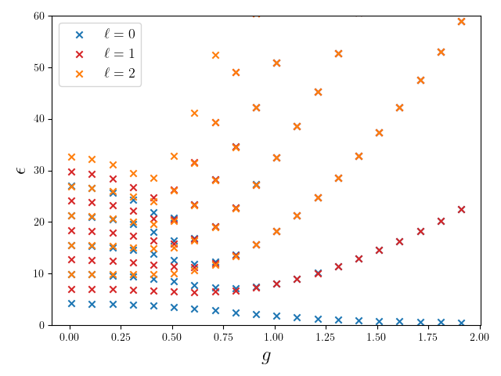
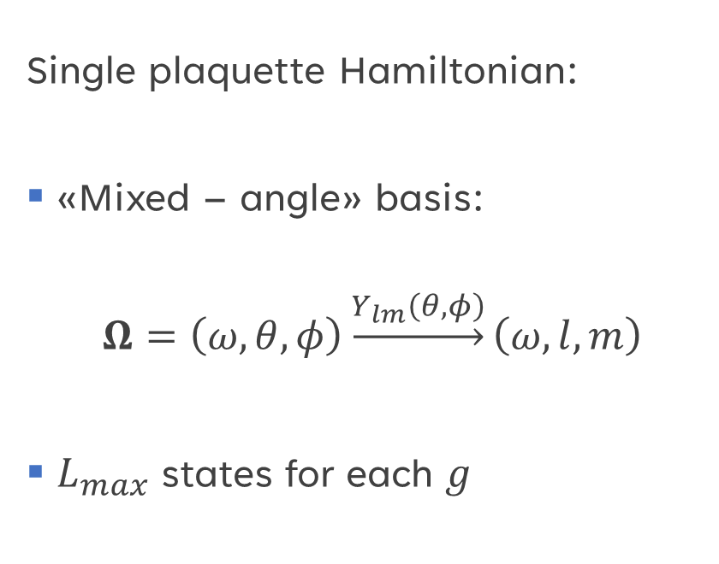
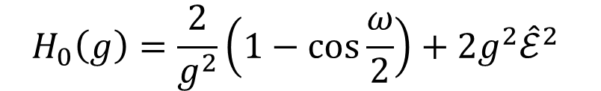

$SU\left(2\right)$ local basis choice
Single plaquette Hamiltonian:
«Mixed – angle» basis:
$$Ω=\left(ω,θ,φ\right)\underset{→}{Y_{lm}\left(θ,φ\right)}\left(ω,l,m\right)$$
$L_{max}$ states for each $g$
$$H_{0}\left(g\right)=\frac{2}{g^{2}}\left(1−cos\frac{ω}{2}\right)+2g^{2}{\hat{ℰ}}^{2}$$

Slide 30
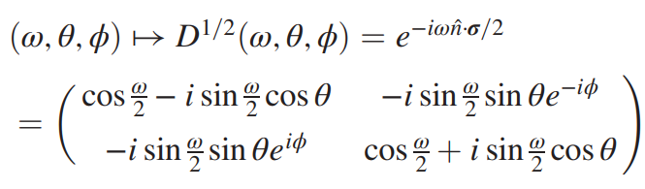










$SU\left(2\right)$local basis choice
Work in the group basis:
$$𝒲≡\{W_{A},W_{B},W_{C},ℒ_{\hat{x}},ℒ_{\hat{y}}\}$$
$$∈SU(2)$$
Local Hamiltonian for $𝒲_{i}∈𝒲$:
$H_{0,𝒲_{i}}\left(g_{i}\right)=V_{B}\left(ω\right)+2g_{i}^{2}{\hat{ℰ}}^{2}$
$$\left(ω,θ,φ\right)↔S^{3}$$
$${\hat{ℰ}}^{2}=\frac{L^{2}}{\sin^{2}{\frac{ω}{2}}}−4[∂_{ω}^{2}+cot\frac{ω}{2}∂_{ω}]$$
Central motion problem on $S^{3}$
$$V_{B}\left(ω\right)≡\frac{2}{g^{2}}\left(1−cos\frac{ω}{2}\right)$$
$L_{max}$ states for each $g$
[Adapted from Bauer & Grabowska (arXiv 2023)]

Slide 31




Dual Hamiltonian
Main message 1: reformulating the theory in terms of physical quantities (gauge-invariant) we get rid of redundancies
$H=H_{E}(ℰ,ℒ,𝒲)+H_{B}(𝒲)$
$H_{B}\left(𝒲\right)=\frac{1}{2g^{2}}\sum_{n}{Tr}[2−\left(W_{n}^{†}+W_{n}\right)]$
$H_{E}\left(ℰ,ℒ,𝒲\right)=H_{E,local}+H_{E,non−local}$
$$H_{E,non−local}∋{ℰ^{a}(n)ℛ_{ab}\left(𝒫\right)ℰ}^{b}(m)$$

Slide 32

Trapped ions QPU: 2D QED

Slide 33

Trapped ions QPU: 2D QED

Slide 34

Plaquette in the electric basis

Slide 35



Another basis for U(1)
[Haase et al., Quantum 5, 393 (2021)]

Slide 36


Strong coupling
Weak coupling

Slide 37

Another basis for U(1)

