Slide 1
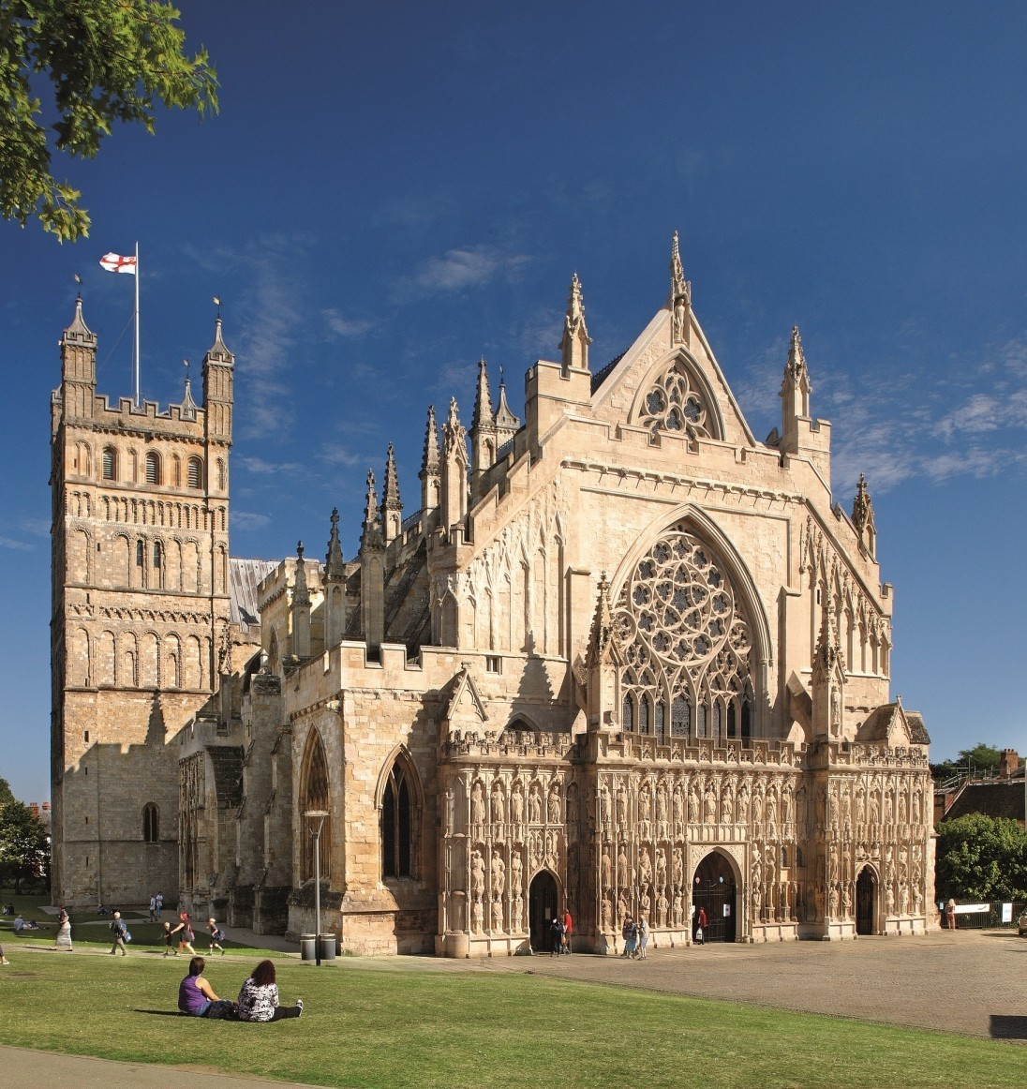
Simplifying quantum simulations (of LGTs)
Many others with some help from Luca Dellantonio
ECT*, Trento, 02/09/2025

Slide 2
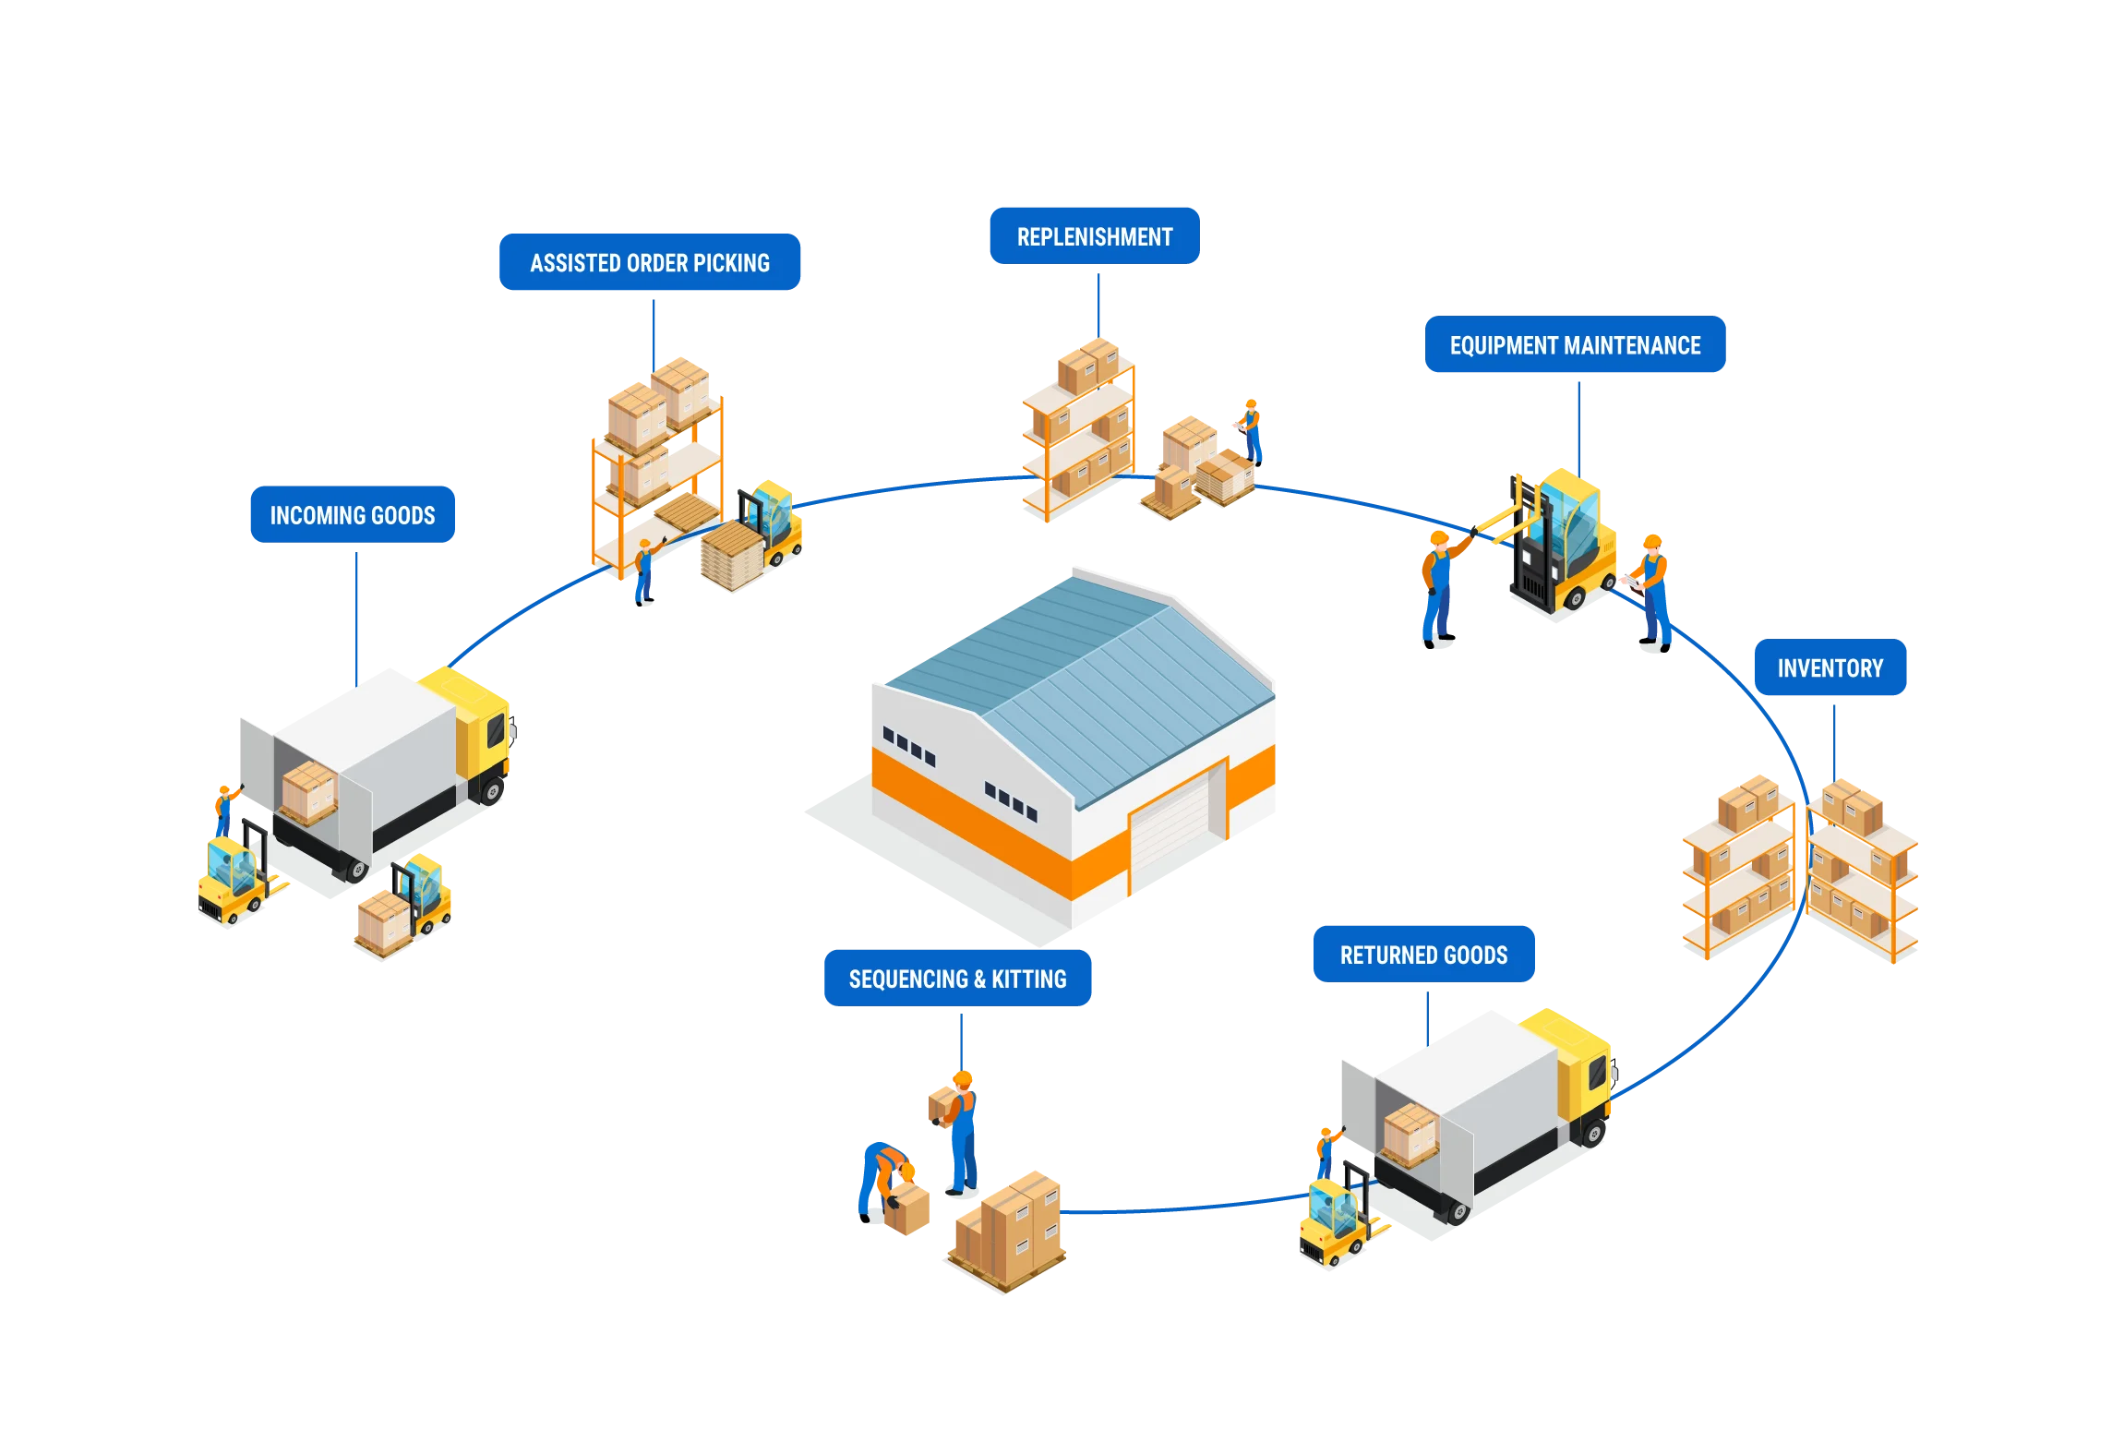
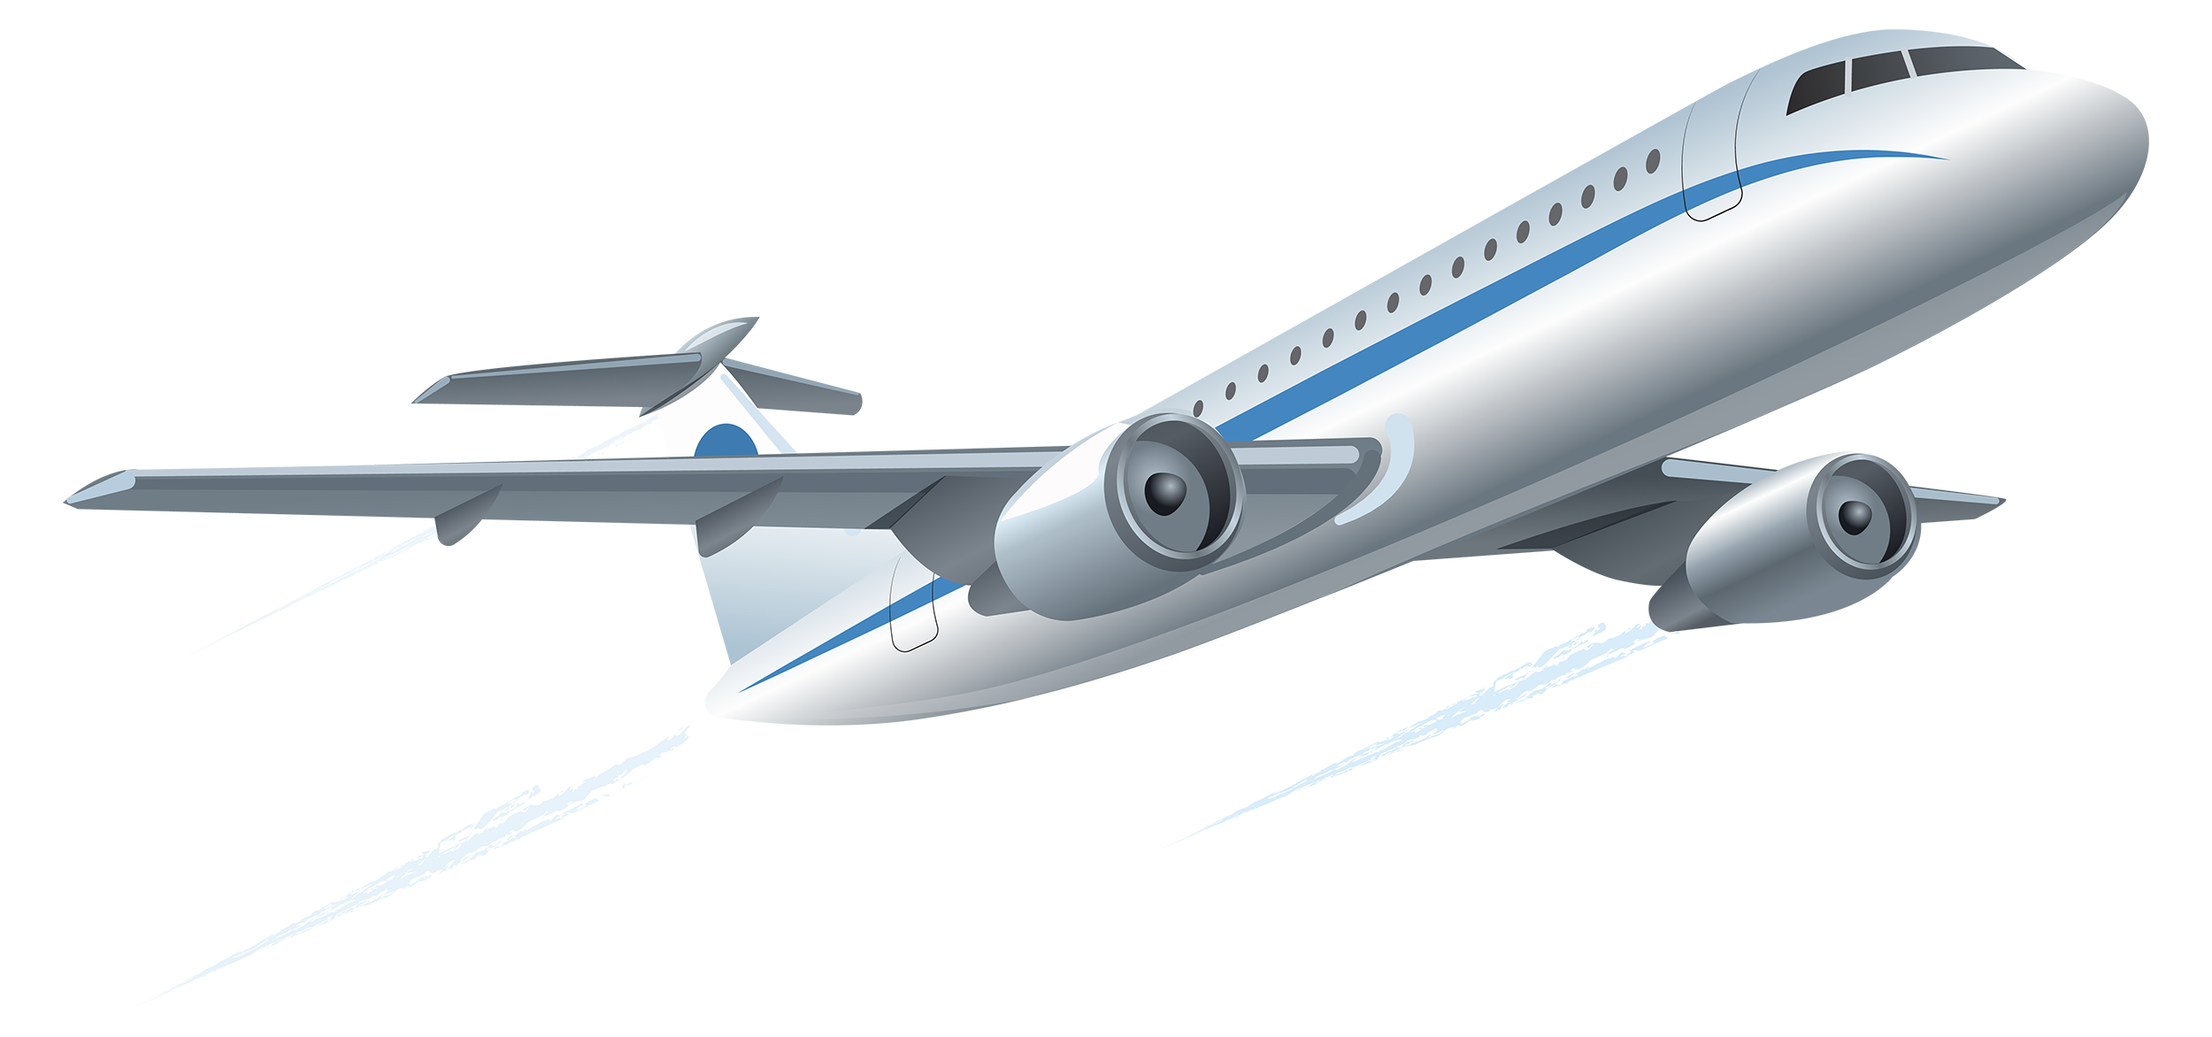

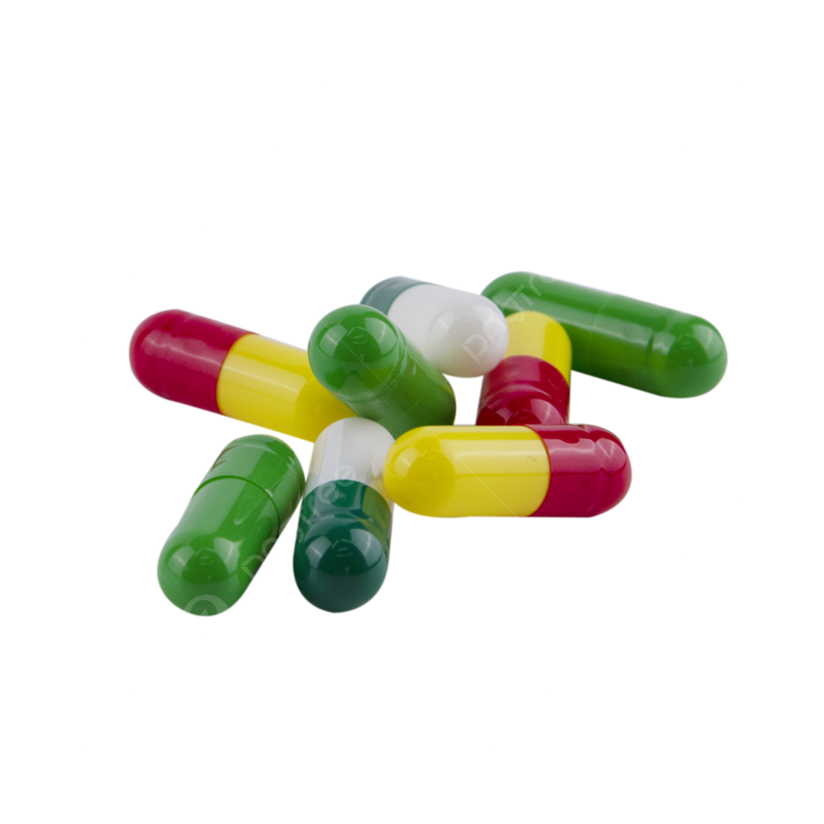


Slide 3
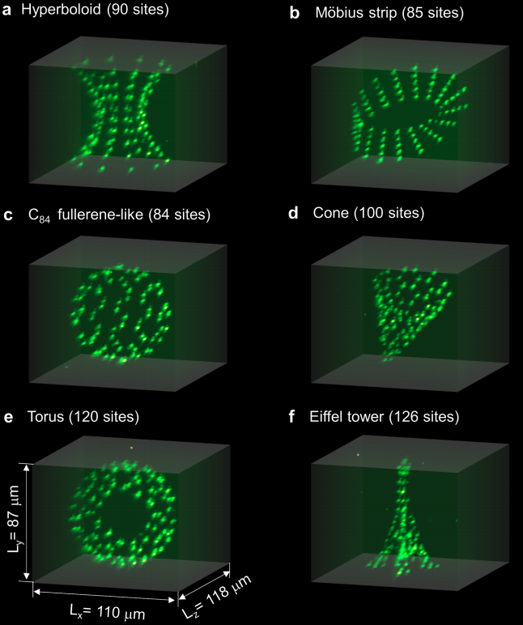
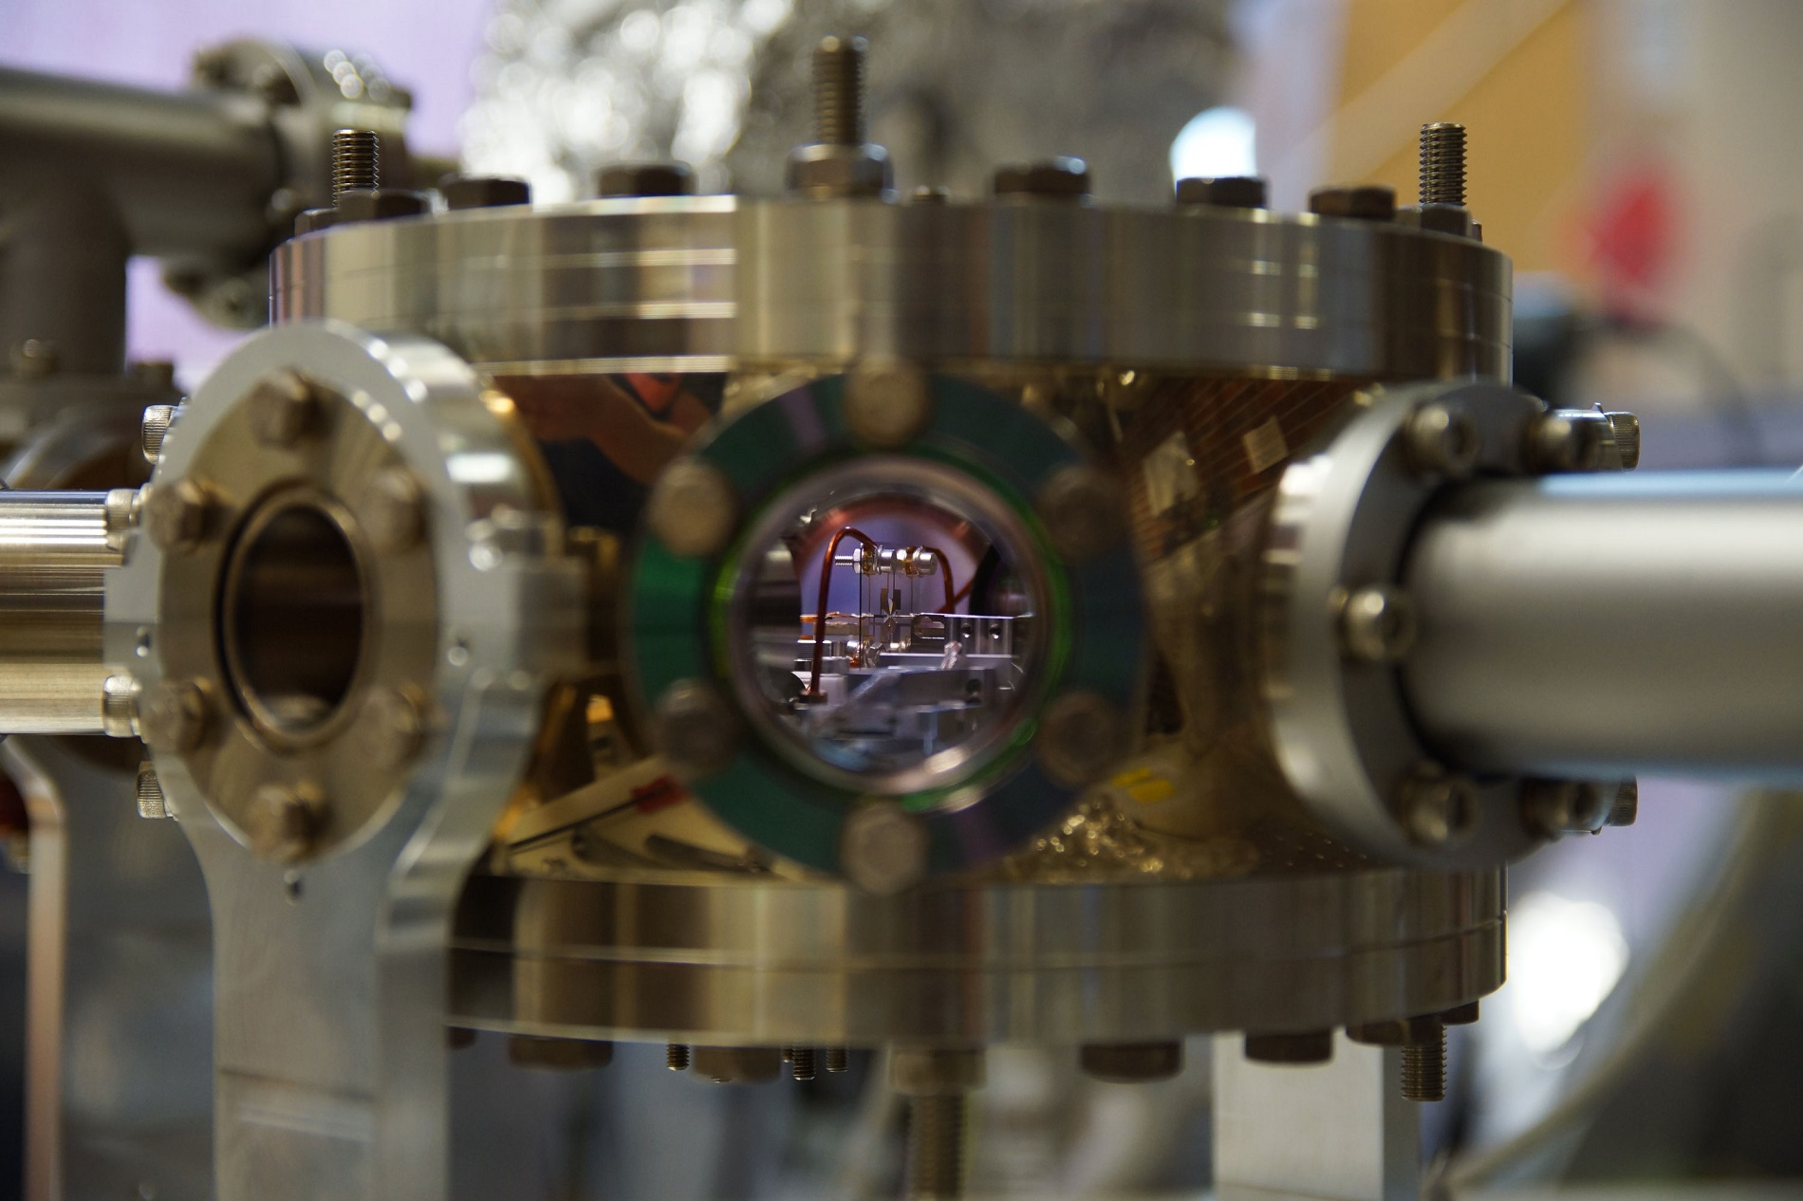
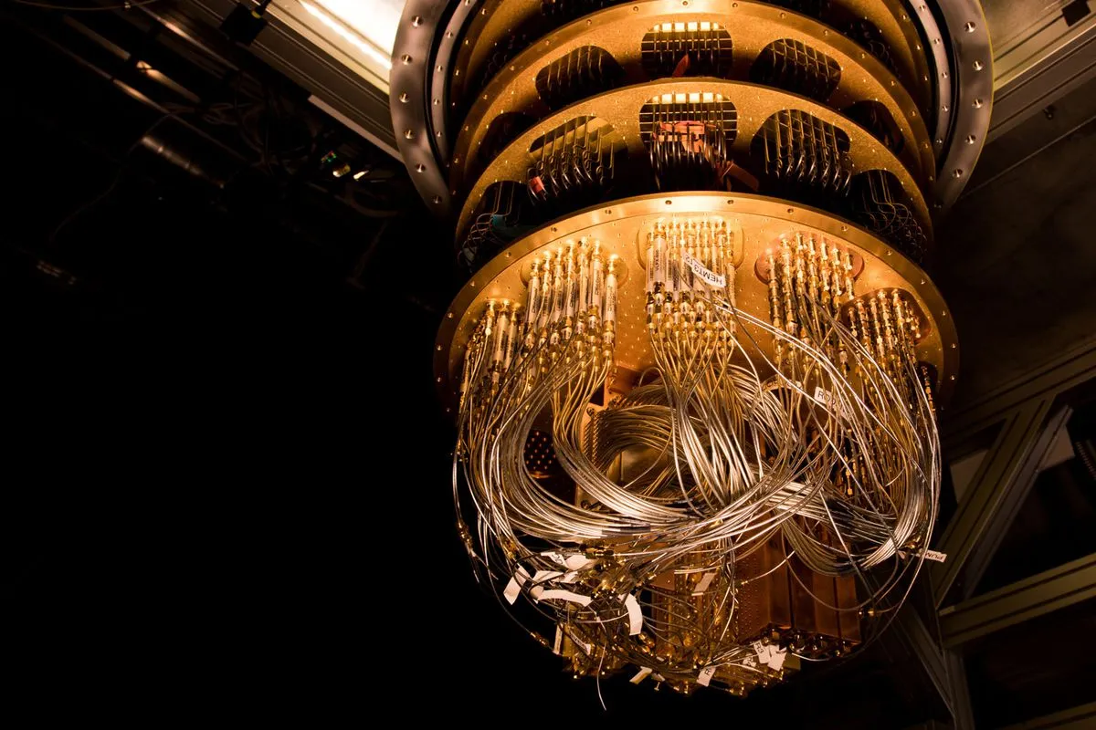
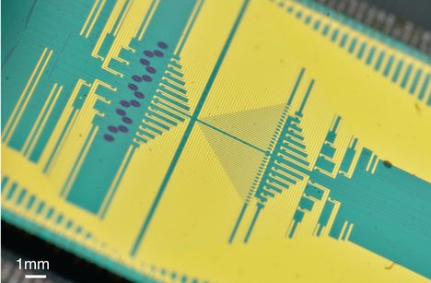
Hardware
University of Innsbruck
Universities of Oxford and Sussex…
IBM
NPL, Google, Righetti, Intel, Alibaba…
University of Bristol,
Niels Bohr Institute…
Pasqal, Harvard

Slide 4
Hardware
Software
Encoding a problem onto a q. comp [1,2,3,4]
Develop better languages [5]
Efficient measurement of q. observables [6,7,8]
[1] J. F. Haase*, LD*, A. Celi*, D. Paulson, A. Kan, K. Jansen and C. A. Muschik, Quantum, 5, 393, 2021
[2] D. Paulson*, LD*, J. F. Haase*, A. Celi*, A. Kan, A. Jena, C. Kokail, R. v. Bijnen, K. Jansen, P. Zoller and C. A. Muschik, PRX Quantum, 2, 030334, 2021
[3] L. Gunderman, A. Jena, LD, and Phys. Rev. A 109, 022618, 2024
[4] C. Nation, R.Simon, LD, et al., in preparation
[5] R. R. Ferguson*, LD*, A. A. Balushi, K. Jansen, W. Dür and C. A. Muschik, PRL, 126, 22, 2021
[6] A. J. Jena, A., Schlosberg P. Mukhopadhyay, J. F. Haase, F. Leditzky and LD, Quantum 7, 903, 2023
[7] R. Simon, Z. Shi, C. Nation, A. Jena, LD, on ArXiv today/tomorrow
[8] R. Simon, M. Meth, A. Jena, F. Martini, M. Ringbauer, LD, in preparation
Notes:
Mention Carsten’s presentation: not going to give “final solutions” to the problems he mentioned, but definitely help ☺

Slide 5
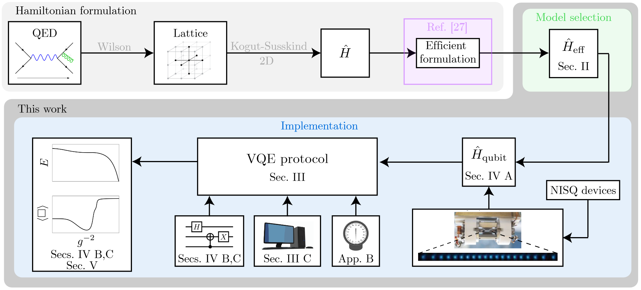
Software
Measurement
Efficient encoding
Image from D. Paulson*, LD*, J. F. Haase*, A. Celi*, A. Kan, A. Jena, C. Kokail, R. v. Bijnen, K. Jansen, P. Zoller and C. A. Muschik, PRX Quantum, 2, 030334, 2021

Slide 6
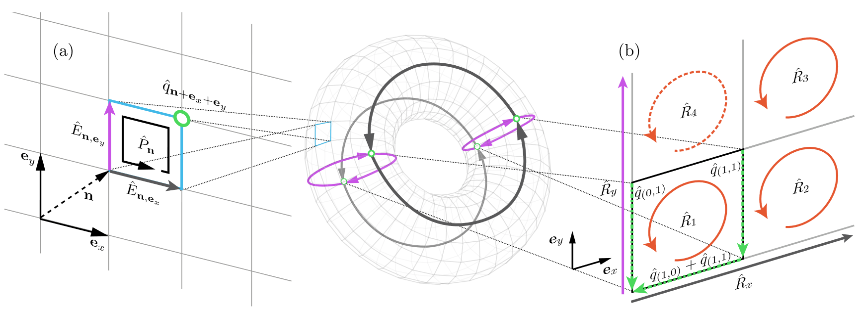
Encoding
Particles ${\hat{q}}_{n}→$ ‘easy’ for q. computer
Fields ${\hat{E}}_{n},{\hat{P}}_{n},{\hat{R}}_{n}→$ hard and expensive for q. computer...
Image from J. F. Haase*, LD*, A. Celi*, D. Paulson, A. Kan, K. Jansen and C. A. Muschik, Quantum, 5, 393, 2021

Slide 7
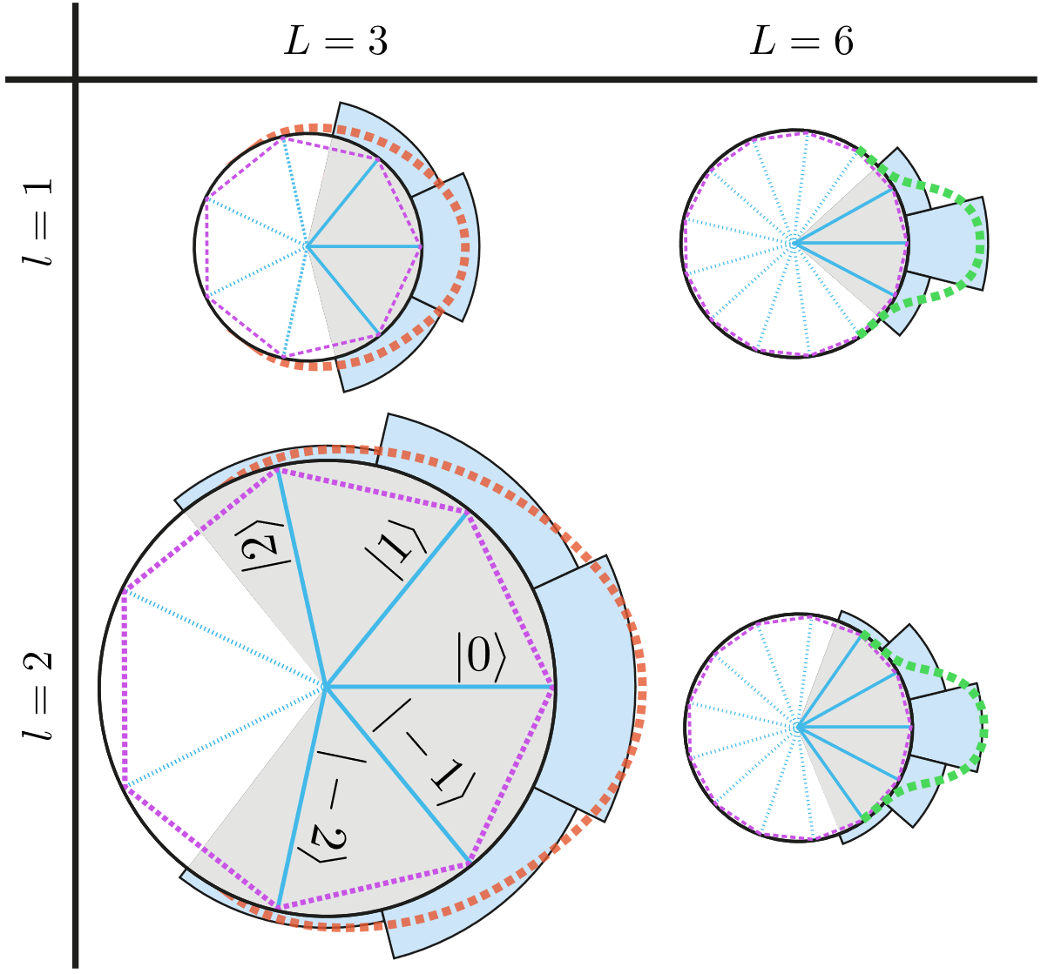
Encoding
Particles ${\hat{q}}_{n}→$ ‘easy’ for q. computer
Fields ${\hat{E}}_{n},{\hat{P}}_{n},{\hat{R}}_{n}→$ hard and expensive for q. computer...
Approximate a circle with a polygon
«Concentrate» the desired state
Truncate the Hilbert space
Convergence to untruncated model
Image from J. F. Haase*, LD*, A. Celi*, D. Paulson, A. Kan, K. Jansen and C. A. Muschik, Quantum, 5, 393, 2021

Slide 8
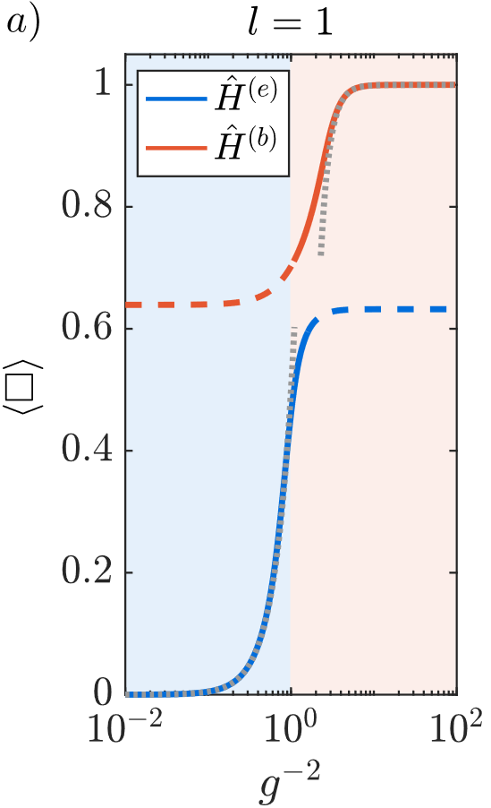
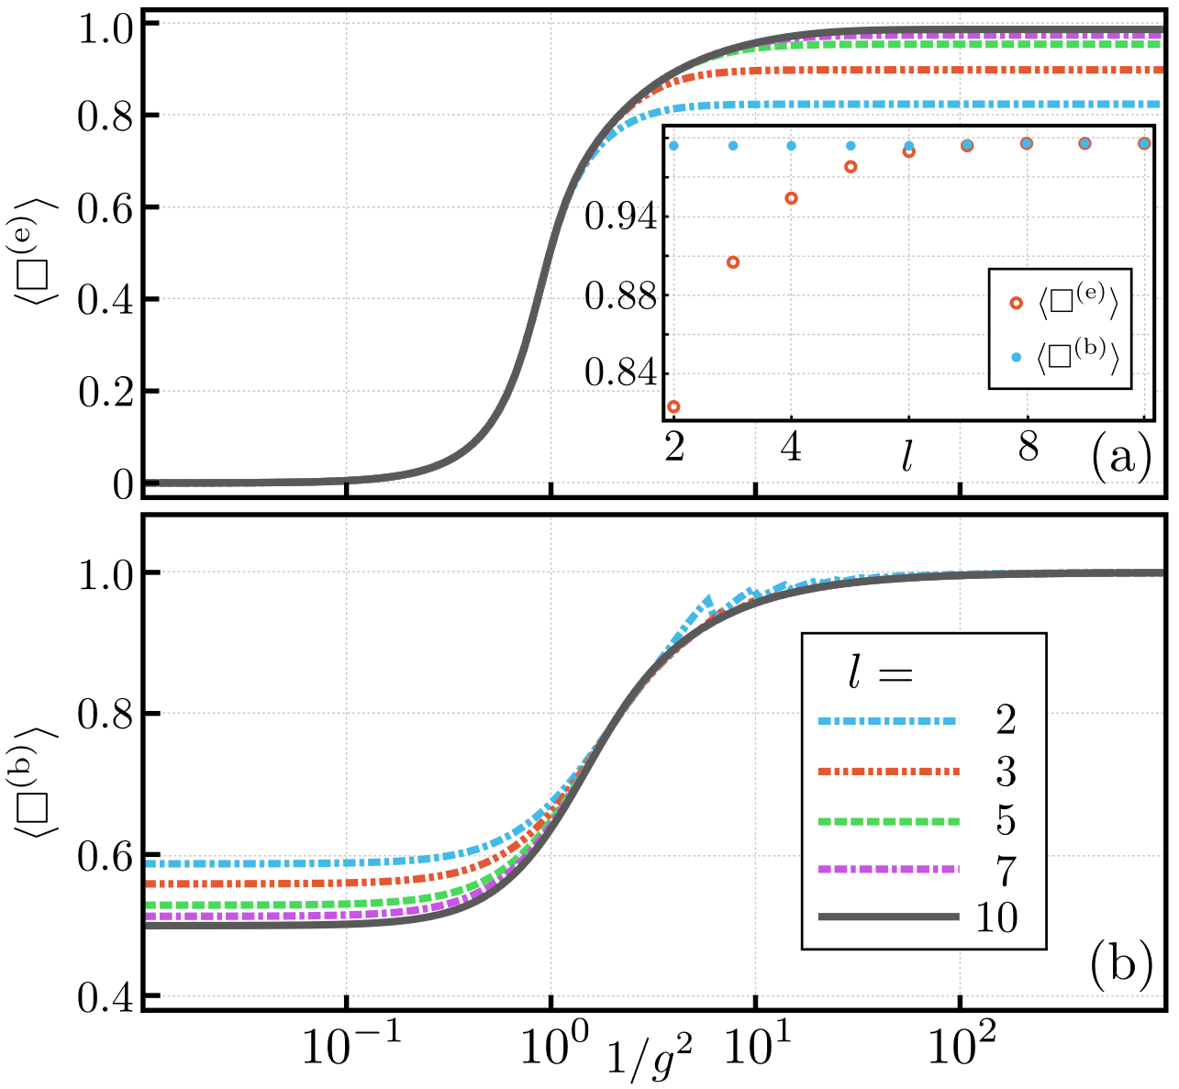
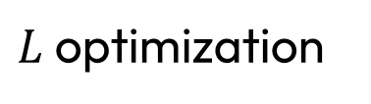
Encoding
Particles ${\hat{q}}_{n}→$ ‘easy’ for q. computer
Fields ${\hat{E}}_{n},{\hat{P}}_{n},{\hat{R}}_{n}→$ hard and expensive for q. computer...
Models convergence
$L$ optimization
J. F. Haase*, LD*, A. Celi*, D. Paulson, A. Kan, K. Jansen and C. A. Muschik, Quantum, 5, 393, 2021
D. Paulson*, LD*, J. F. Haase*, A. Celi*, A. Kan, A. Jena, C. Kokail, R. v. Bijnen, K. Jansen, P. Zoller and C. A. Muschik, PRX Quantum, 2, 030334, 2021

Slide 9
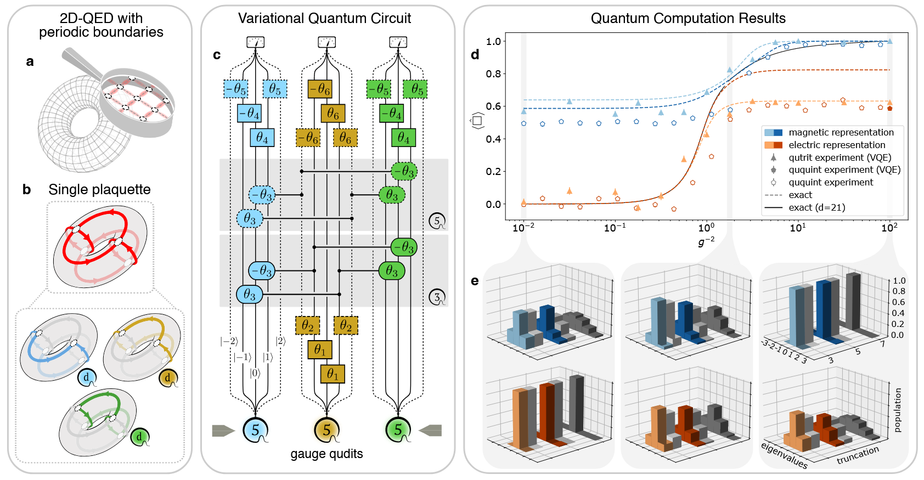
Encoding
Particles ${\hat{q}}_{n}→$ ‘easy’ for q. computer
Fields ${\hat{E}}_{n},{\hat{P}}_{n},{\hat{R}}_{n}→$ hard and expensive for q. computer... Unless it is qudit ready!
Jinglei Zhang
M. Meth et many al. (including LD), Nature Physics 21, 570-576 (2025)

Slide 10
Encoding – can we do better?
Zero charge subsector: many redundant DOFs
[1] S. Bravyi, J. M. Gambetta, A. Mezzacapo, and K. Temme, arXiv:1701.08213, 2017
[2] L. Gunderman, A. Jena, LD, and Phys. Rev. A 109, 022618, 2024
Notes:
Story about me (and Alessio) finding effective Hamiltonians
and next slide present occam

Slide 11
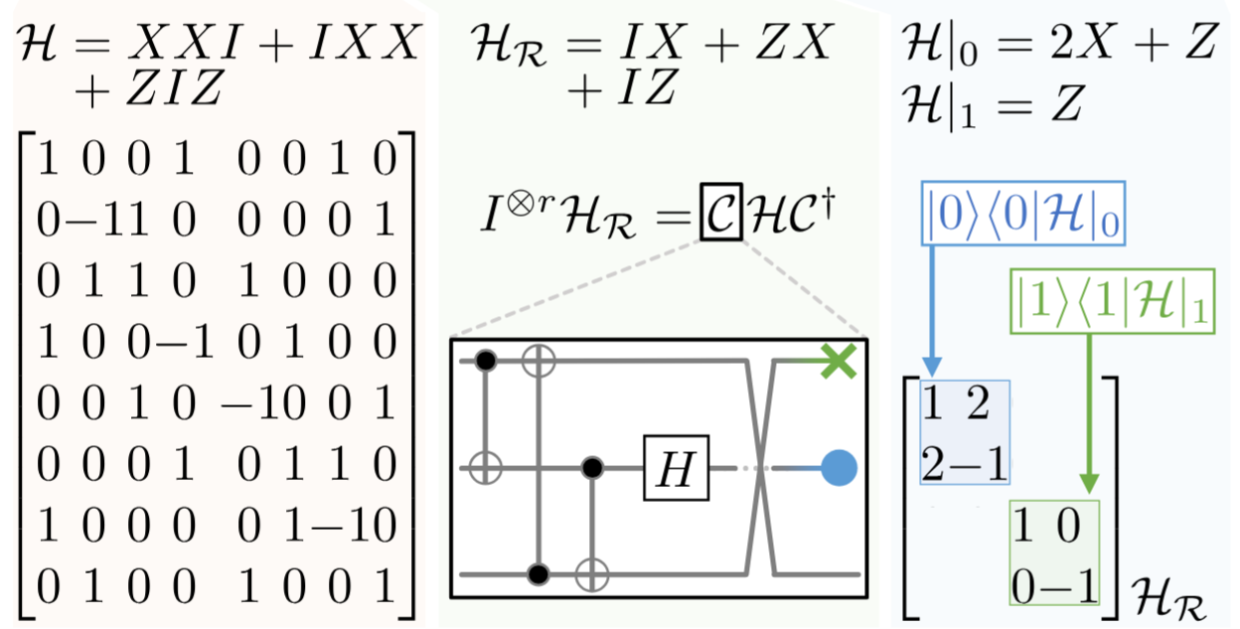
Encoding – can we do better?
Find all qudit Pauli symmetry and only work in the right subsector!
Edoardo Bellini talk
[1] S. Bravyi, J. M. Gambetta, A. Mezzacapo, and K. Temme, arXiv:1701.08213, 2017
[2] L. Gunderman, A. Jena, LD, and Phys. Rev. A 109, 022618, 2024
Notes:
We find all Pauli symmetries deterministically and efficiently
Consider the example; 3 qubit Hamiltonian. Do we need these 3?
We find a Clifford where one is redundant (eliminated)
And the other only has Z -> classically simulable
This can be done with spins and for large Hamiltonians

Slide 12
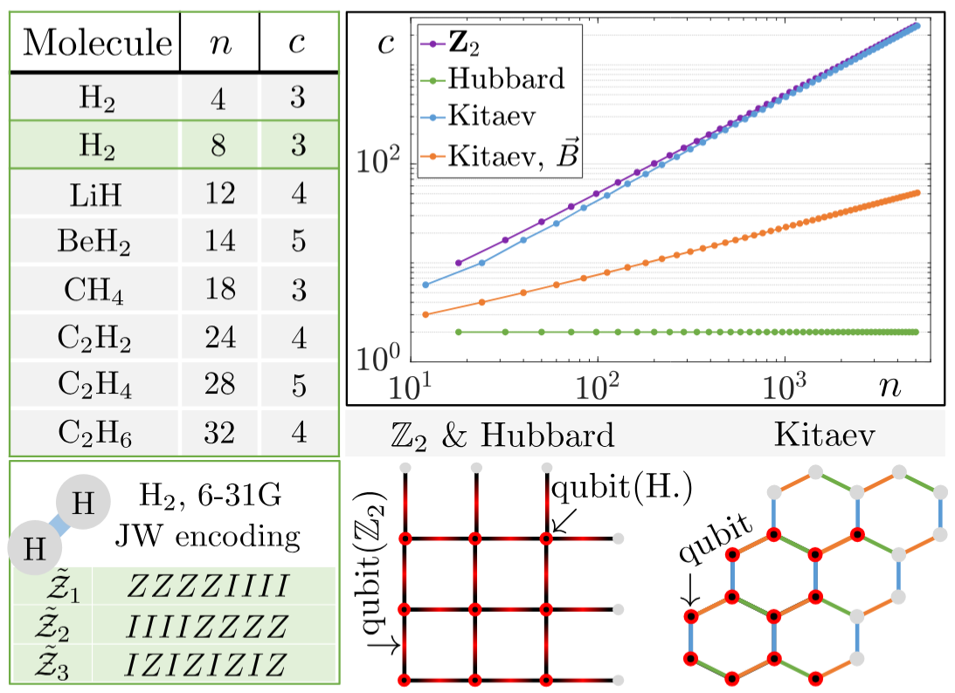

Encoding – can we do better?
5000+ qubits
Generalised to quDits
Any input Hamiltonian
Exponential advantage
(still exponentially hard)
[1] S. Bravyi, J. M. Gambetta, A. Mezzacapo, and K. Temme, arXiv:1701.08213, 2017
[2] Image from L. Gunderman, A. Jena, LD, and Phys. Rev. A 109, 022618, 2024

Slide 13
Encoding – can we do better?
Permutations are Clifford
How to use them?
Hamiltonian dependent
Clifford Symetries
Pauli Symmetries
[3] C. Nation, R.Simon, LD, et al., in preparation

Slide 14
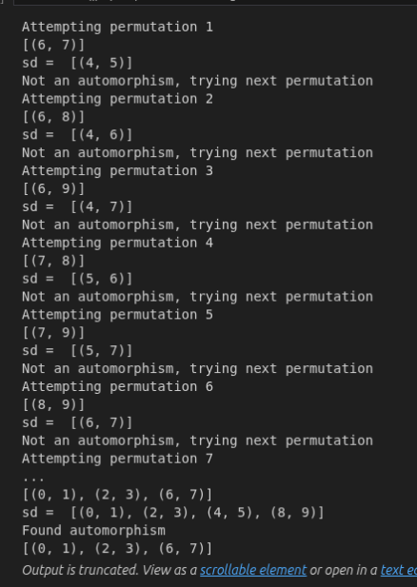
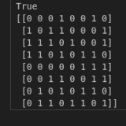
Encoding – can we do better?
Permutations are Clifford
How to use them?
Hamiltonian dependent
[3] C. Nation, R.Simon, LD, et al., in preparation

Slide 15
Software
Measurement
Image from D. Paulson*, LD*, J. F. Haase*, A. Celi*, A. Kan, A. Jena, C. Kokail, R. v. Bijnen, K. Jansen, P. Zoller and C. A. Muschik, PRX Quantum, 2, 030334, 2021

Slide 16
Measurement
Protocol | Overlap | 1/M scaling | Non-bitwise | Single-shot error | Adaptive | Doubling | Noise | qudit
LDF [1] | NO | YES | YES | YES (trivial) | NO | NO | NO | NO
Classical shadow [2] | YES | NO (exp. worse) | NO | NO | NO | NO | NO | NO
APS [3] | YES | NO | NO | NO | NO | NO | NO | NO
Derand [4] | YES | YES | NO | NO | NO | NO | NO | NO
OGM [5] | YES | YES | NO | NO | NO | NO | NO | NO
AEQuO [1] | YES | YES | YES | YES | YES | NO | NO | NO
CBS [6] | YES | YES | YES | NO | NO | NO | NO | NO
AQuIRE [7,8] | YES | YES | YES | YES | YES | YES | YES | YES
[1]: A. J. Jena, A., Schlosberg P. Mukhopadhyay, J. F. Haase, F. Leditzky and LD, Quantum 7, 903, 2023
[2]: H. Y. Huang, R. Kueng, J. Preskill, Nat. Physics, 16, 1050-1057, 2020
[3]: C. Hadfield, S. Bravy, R. Raymond, A. Mezzacapo, arXiv:2006.15788, 2020
[4]: H. Y. Huang, R. Kueng, J. Preskill, PRL, 127, 030503, 2021
[5]: B. Wu, J. Sun, Q. Huang, X. Yuan, arXiv:2105.13091, 2021
[6]: M. Kohda, R. Imai, K. Kanno, K. Mitarai, W. Mizukami, Y. O. Nakagawa, arXiv:2112.07416, 2022
[7] R. Simon, Z. Shi, C. Nation, A. Jena, LD, on ArXiv today/tomorrow
[8] R. Simon, M. Meth, A. Jena, F. Martini, M. Ringbauer, LD, in preparation

Slide 17
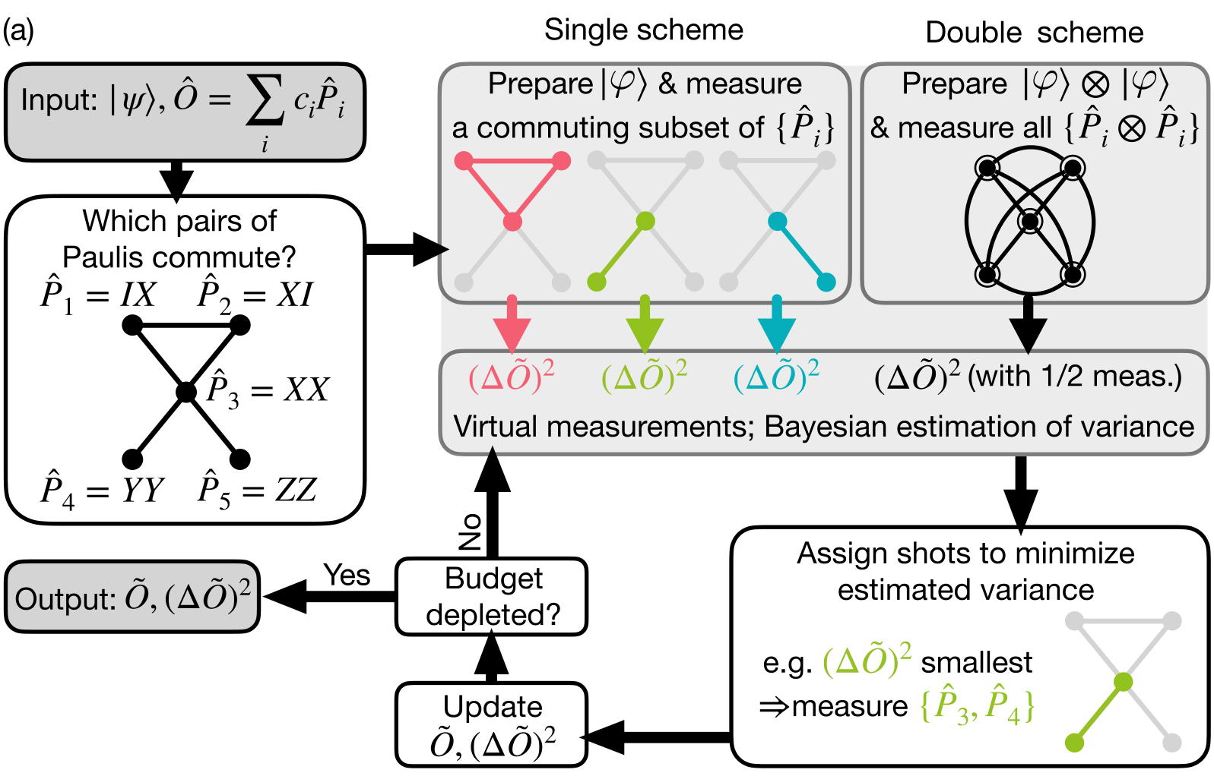
Measurement
Qudit ready
Hardware noise awareness
Not an
Error!
[7] R. Simon, Z. Shi, C. Nation, A. Jena, LD, on ArXiv today/tomorrow
[8] R. Simon, M. Meth, A. Jena, F. Martini, M. Ringbauer, LD, in preparation

Slide 18
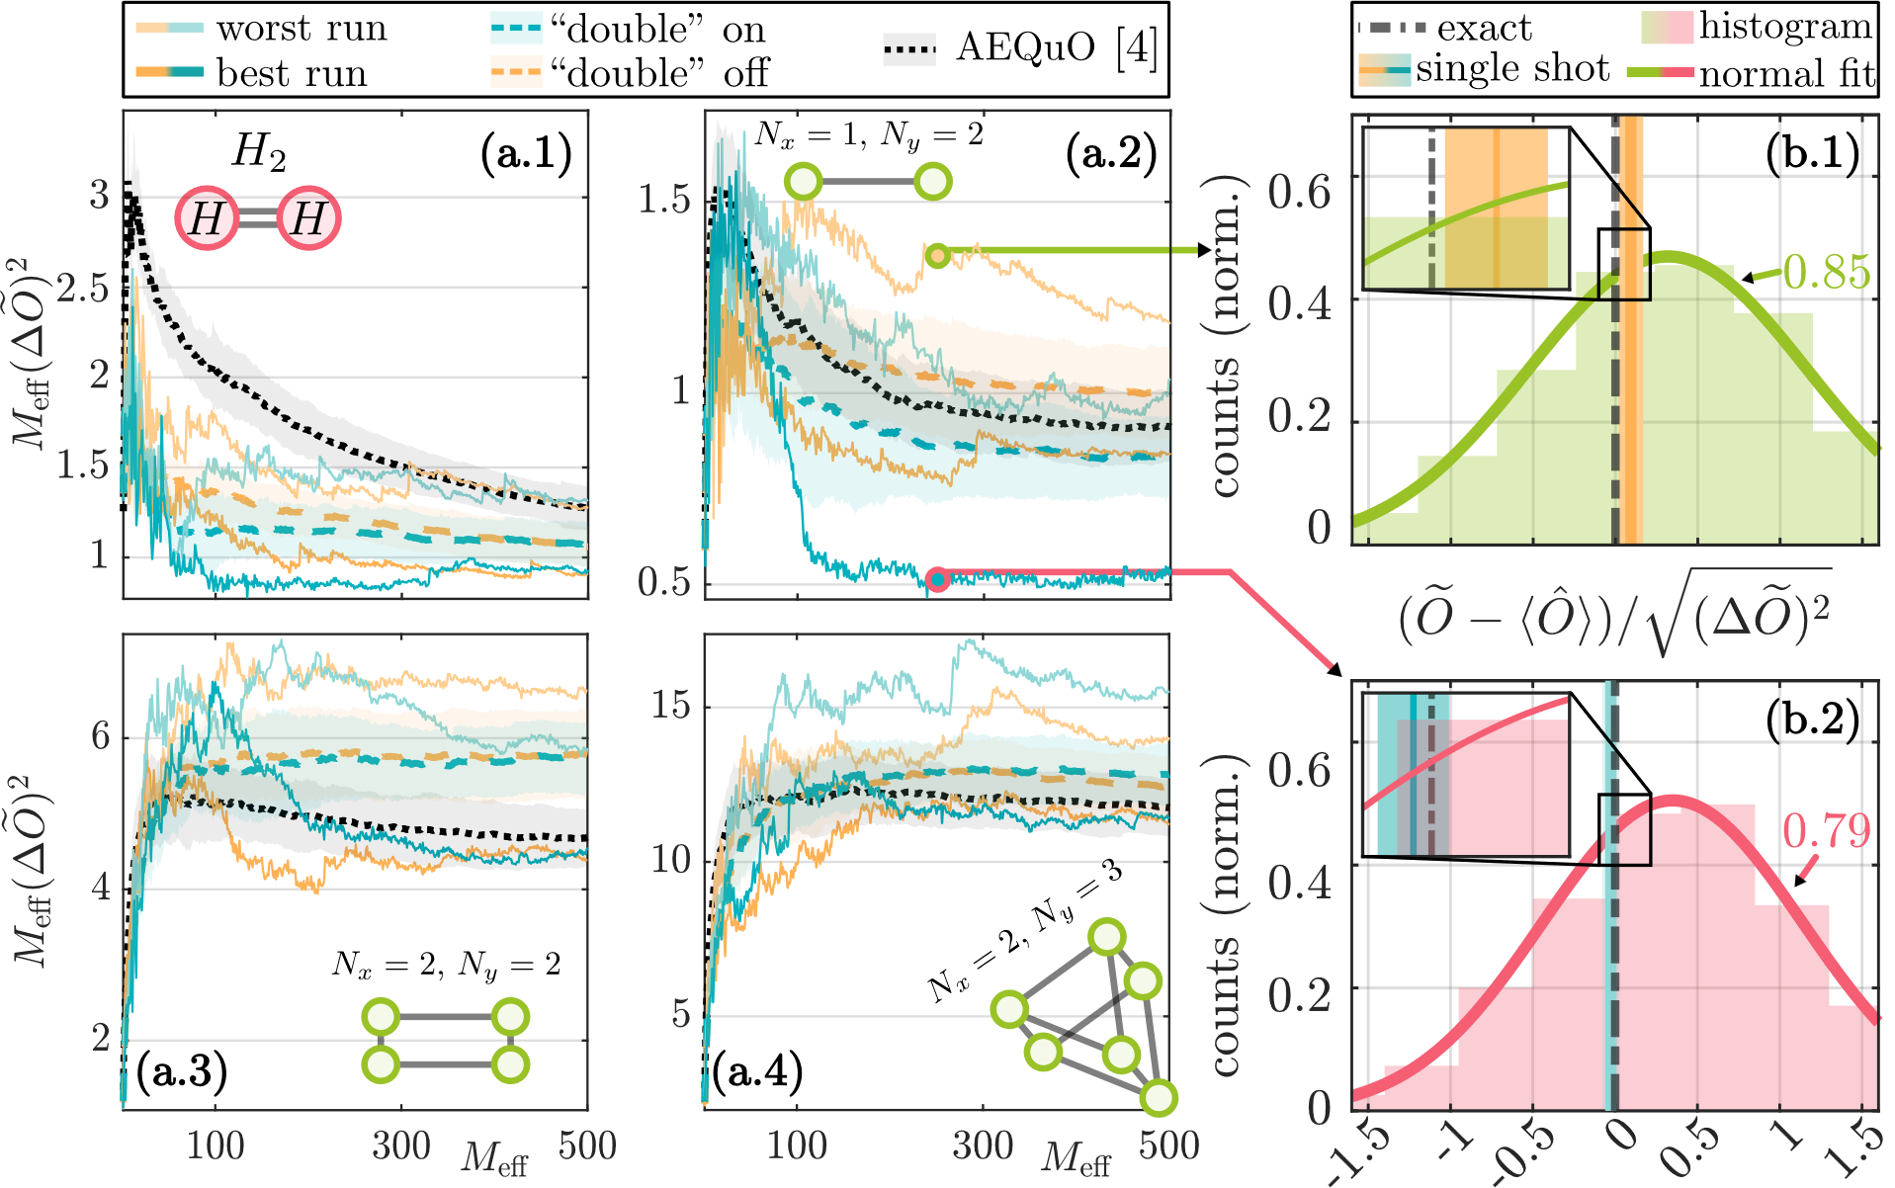
Measurement – double scheme
[7] Image from R. Simon, Z. Shi, C. Nation, A. Jena, LD, on ArXiv today/tomorrow
[8] R. Simon, M. Meth, A. Jena, F. Martini, M. Ringbauer, LD, in preparation

Slide 19
Measurement – qudit observables
Particles $→$ ‘easy’ for q. computer
Gauge fields $→$ hard and expensive for q. computer... Much better if qudit ready!
Jinglei Zhang
M. Meth et many al., Nature Physics 21, 570-576 (2025)

Slide 20
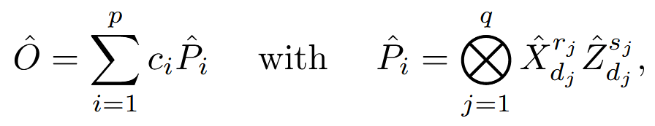
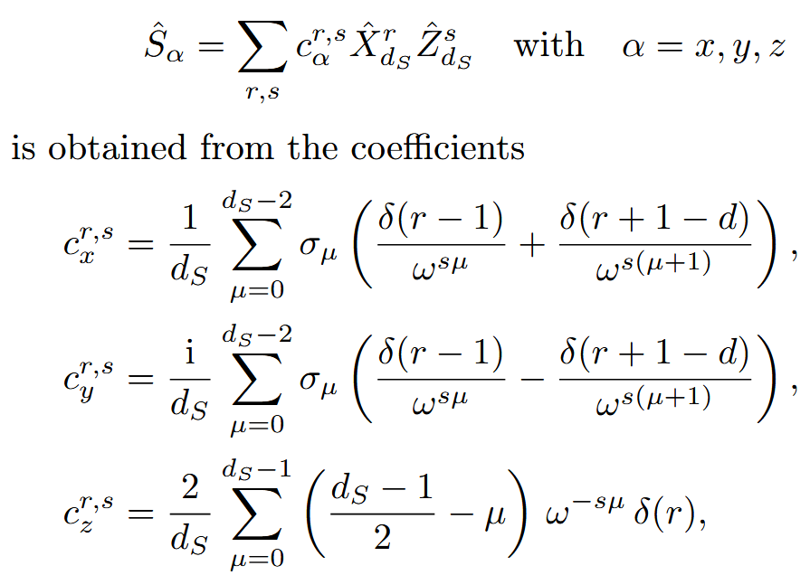

Measurement – qudit observables
Spin Hamiltonian
Classically efficient
Pauli Hamiltonian
[7] R. Simon, Z. Shi, C. Nation, A. Jena, LD, on ArXiv today/tomorrow
[8] R. Simon, M. Meth, A. Jena, F. Martini, M. Ringbauer, LD, in preparation

Slide 21
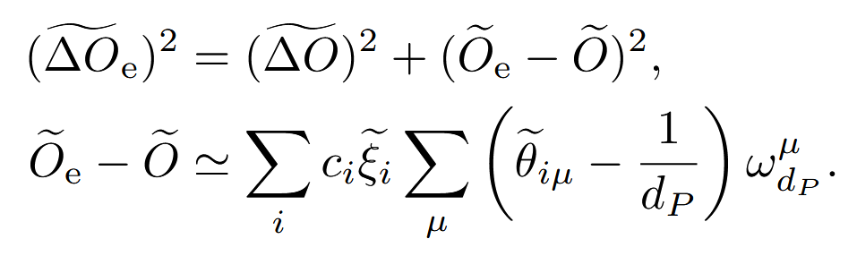
Measurement – error awareness
Cheap
Impact on the specific experiment
[7] R. Simon, Z. Shi, C. Nation, A. Jena, LD, on ArXiv today/tomorrow
[8] R. Simon, M. Meth, A. Jena, F. Martini, M. Ringbauer, LD, in preparation
Notes:
Error awareness (super simple, can get really complicated depended on how accurately you want to estimate error probabilities... )
Efficiency of error awareness
Will lead to error mitigation

Slide 22
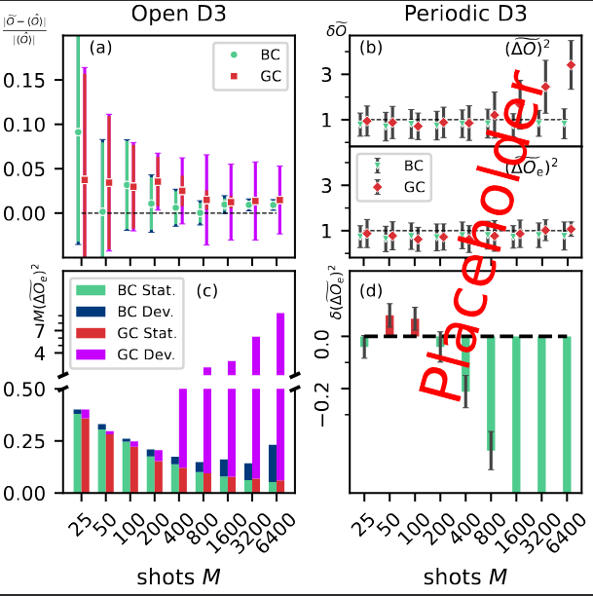
Measurement
# shots
# shots
[7] R. Simon, Z. Shi, C. Nation, A. Jena, LD, on ArXiv today/tomorrow
[8] Image from R. Simon, M. Meth, A. Jena, F. Martini, M. Ringbauer, LD, in preparation

Slide 23
Conclusions and Outlook
Classically efficient (?) approach for symmetry finding
Measurement protocol that will not let you down
Error mitigation within AQuIRE
Better heuristic algorithms for working with Cliffords

Slide 24
Attempt for open questions
Readout mitigation. We have seen amazing results, that I cannot reproduce. While this is mostly my lack of capabilities, I believe that a shared framework would benefit the whole community.
What am I simulating? As an (ignorant) quantum simulation person, I would like a “revised Kogut-Susskind” paper, because I simply do not understand it!

Slide 25
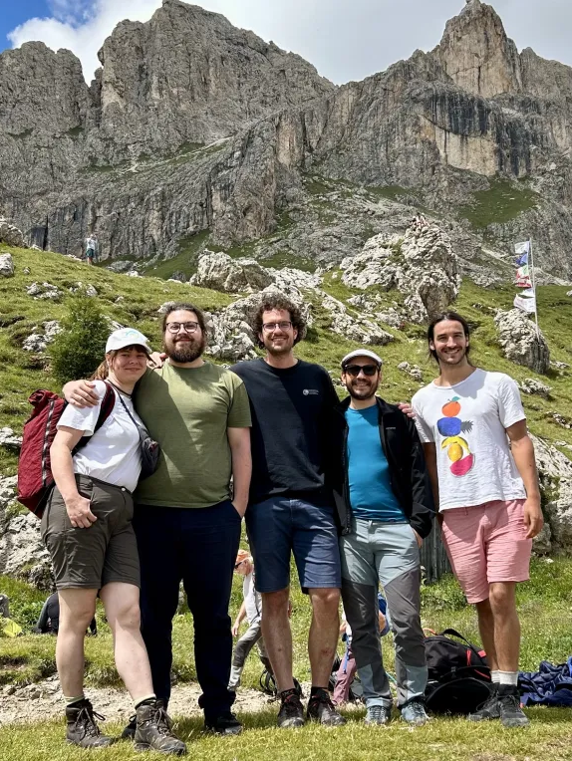
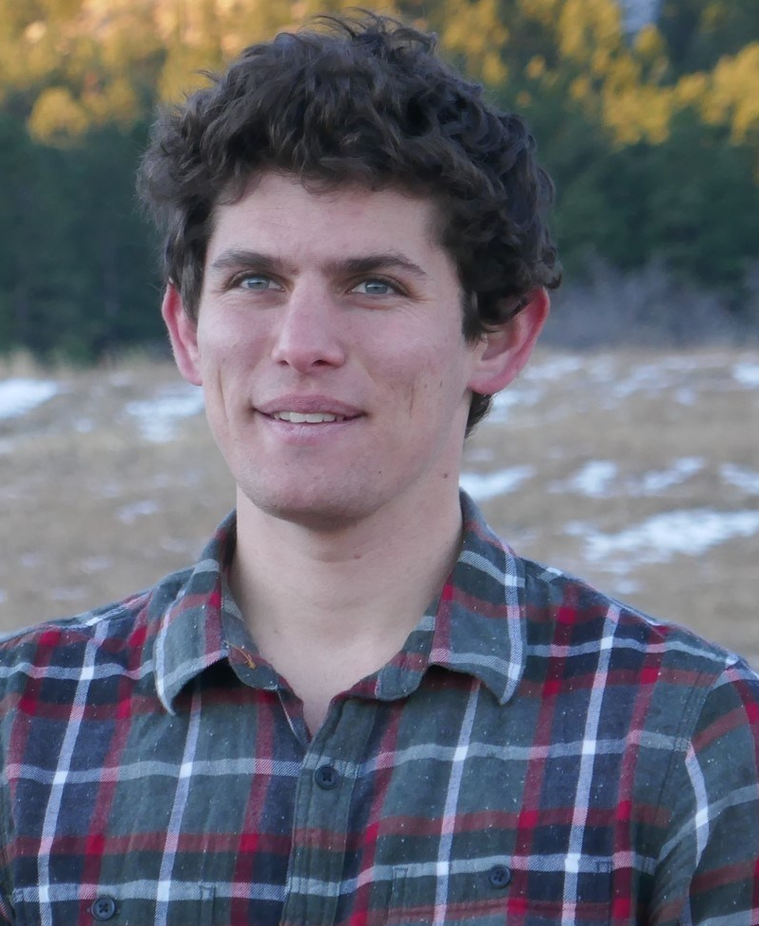
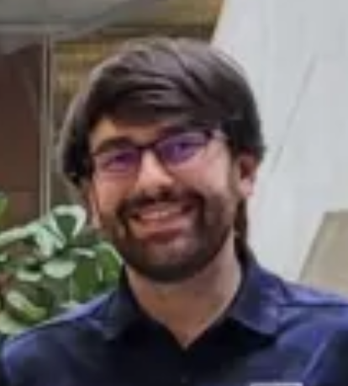

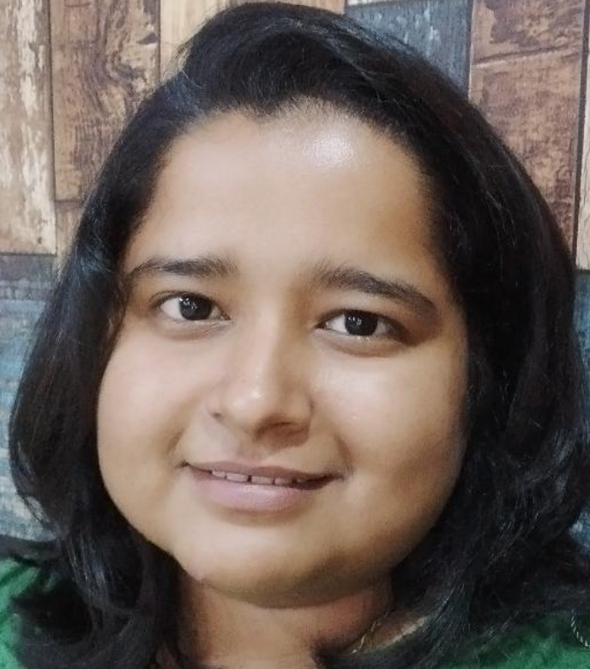

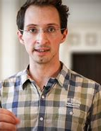
Acknowledgements

