Slide 1


Large N Truncations of LGT
Anthony Ciavarella

Slide 2


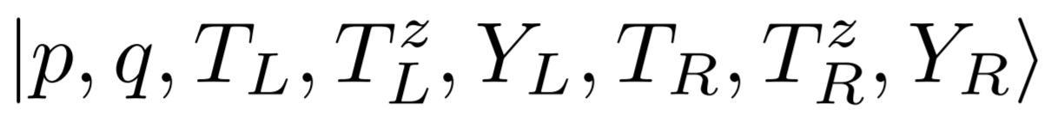
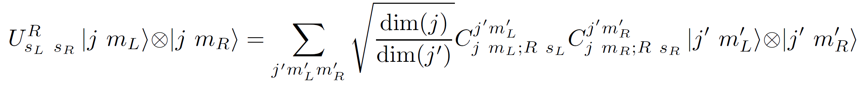
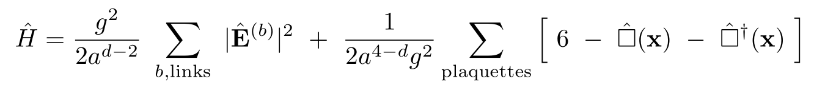
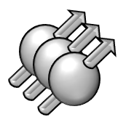
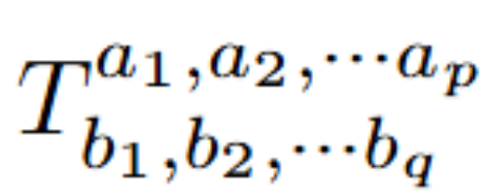
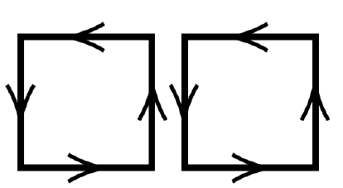
Hamiltonian formulation of lattice Gauge Theory
Kogut and Susskind
Phys. Rev. D 11 (1975) 395
Magnetic Basis
SU(2)
SU(3)
Electric Basis
Gauge invariant electric basis states can be represented graphically by loops
p
q

Slide 3
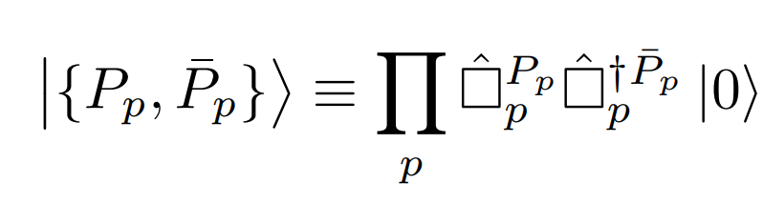
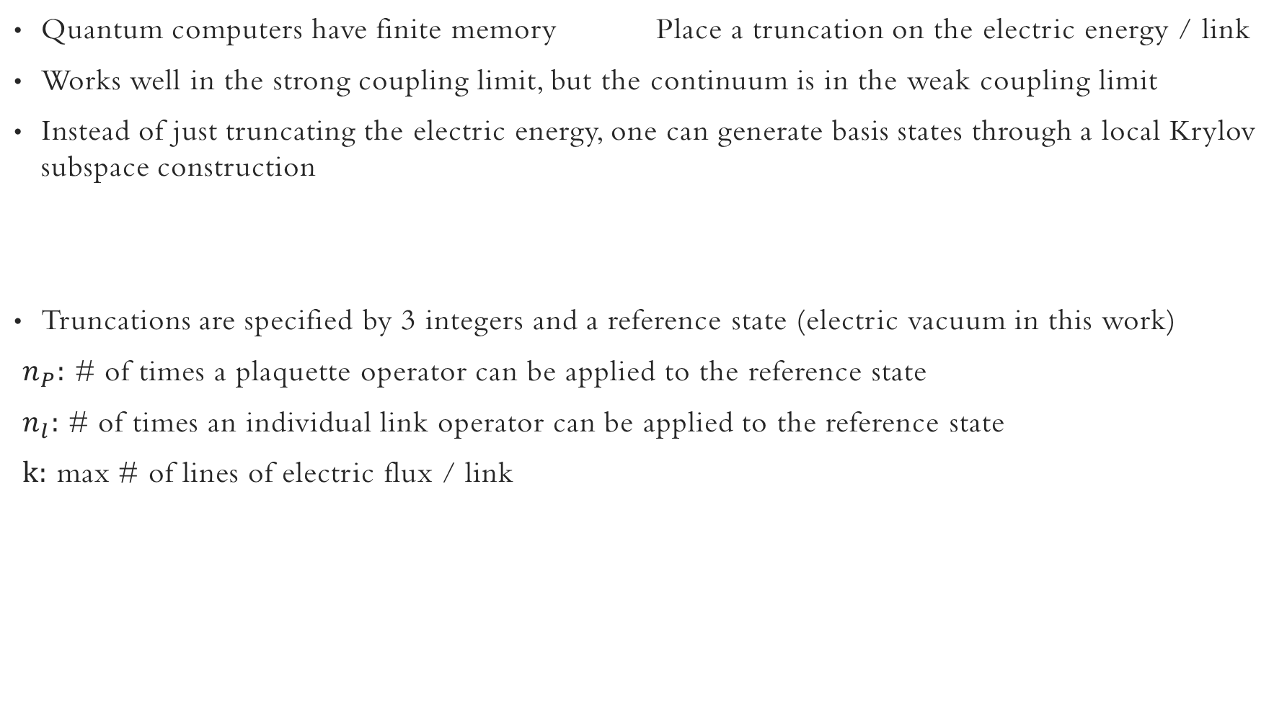
Electric Basis Truncation
Quantum computers have finite memory Place a truncation on the electric energy / link
Works well in the strong coupling limit, but the continuum is in the weak coupling limit
Instead of just truncating the electric energy, one can generate basis states through a local Krylov subspace construction
Truncations are specified by 3 integers and a reference state (electric vacuum in this work)
$n_{P}:$ # of times a plaquette operator can be applied to the reference state
$n_{l}:$ # of times an individual link operator can be applied to the reference state
$k:$ max # of lines of electric flux / link
arXiv:2503.11888

Slide 4

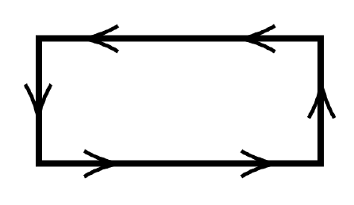
Large N expansion
SU(3)
SU(N), Expand in 1/N
Qualitatively reproduces many aspects of QCD
Provides a starting point for describing interactions between mesons
Used in event generators that simulate collider physics
Expand plaquette operator matrix elements in powers of 1/N
Truncate matrix elements of the plaquette operator based on the large N scaling and use the truncated plaquette operator in the local Krylov subspace construction
The large N scaling of a state is determined by the maximum overlap of the state with
= O(1)
= O(1/N)
Phys. Rev. Lett. 133, 111901

Slide 5


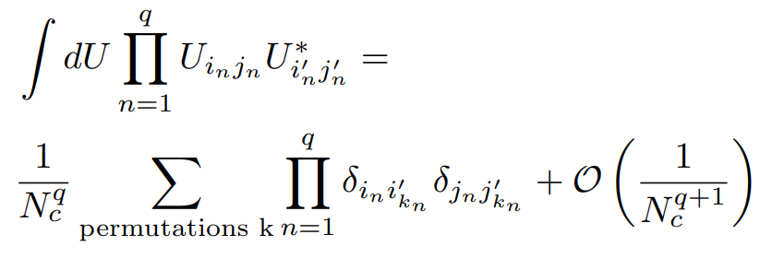
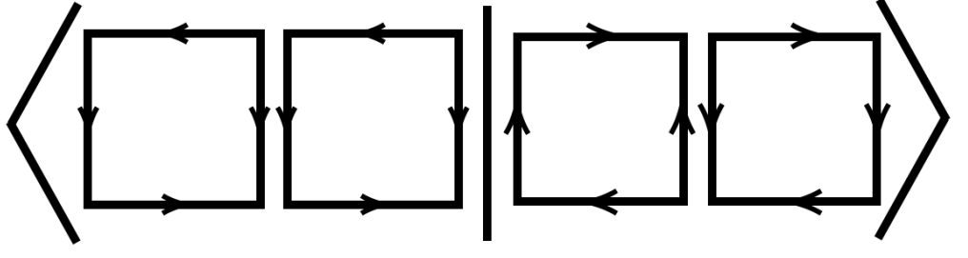
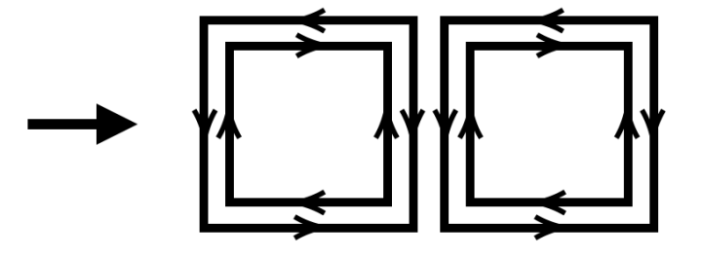
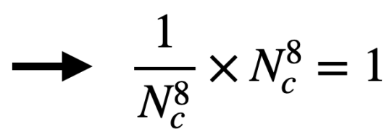
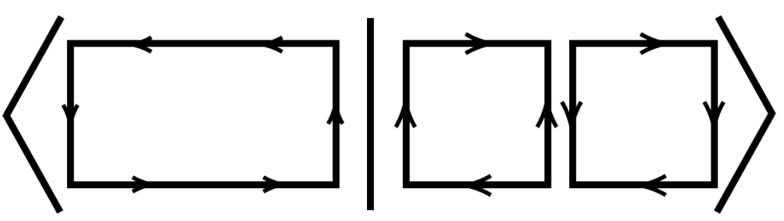
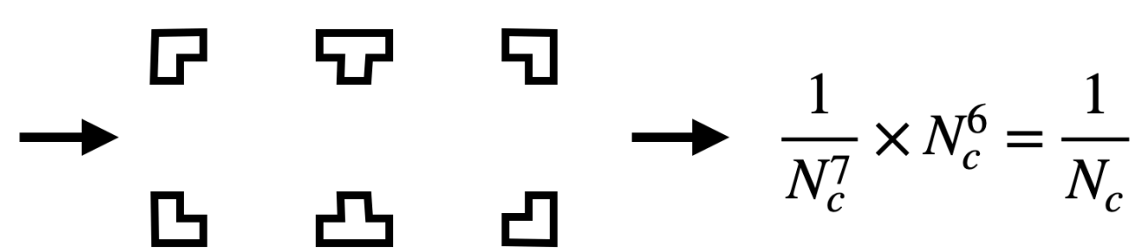


Large N Scaling of States
The Large N scaling is determined by
This can be evaluated in the magnetic basis,
using the identity
Simple Scaling Rule
$m_{i}=$# Plaquettes enclosed by loop i

Slide 6
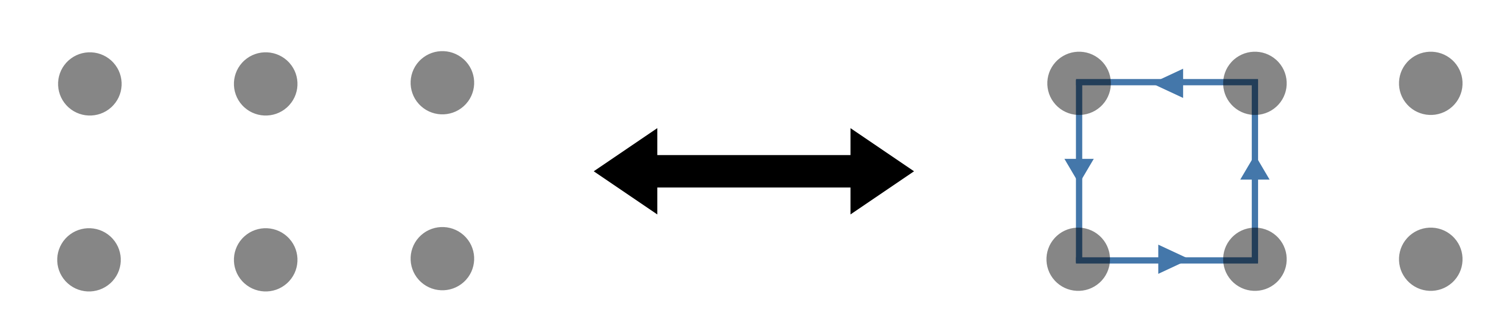
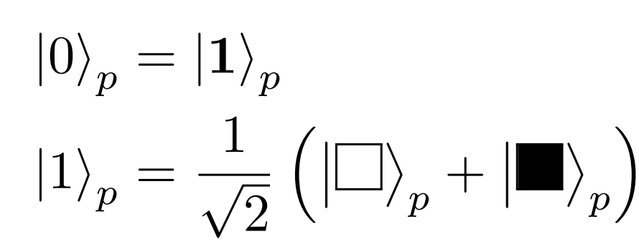
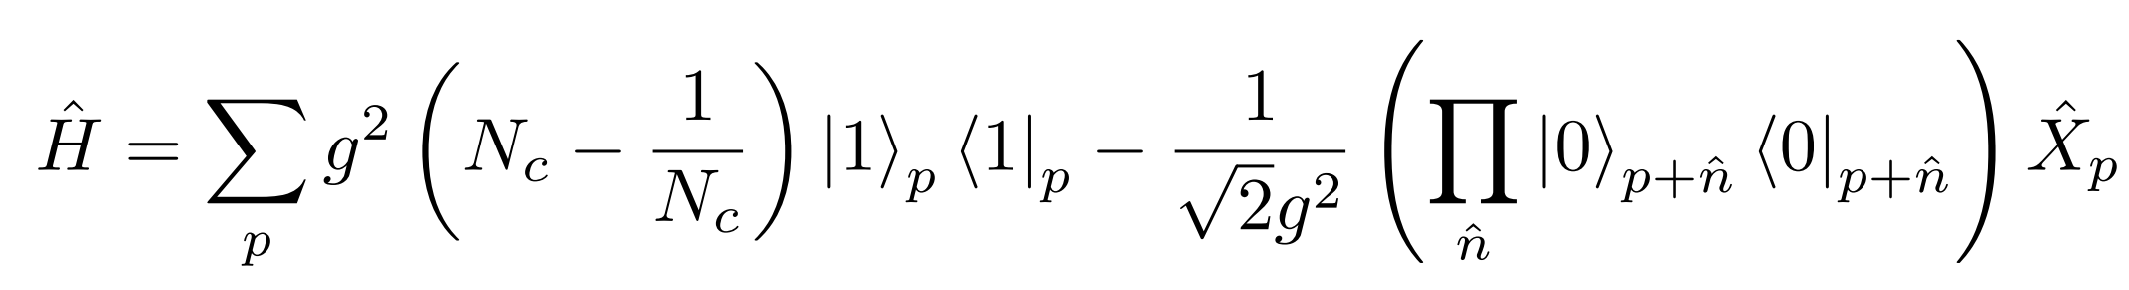
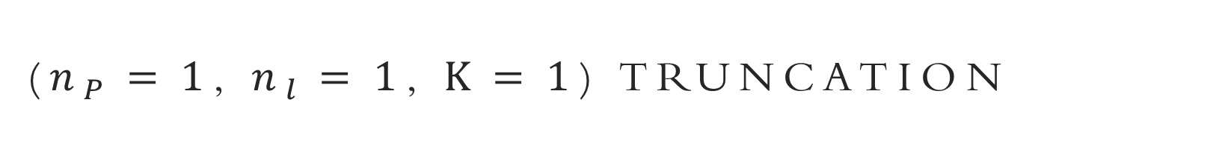
($n_{P}=1$, $n_{l}=1$, $k=1$) truncation
Each plaquette operator can be applied once
Neighboring plaquette operators cannot both be applied
One qutrit per plaquette, specifies if the plaquette is excited and the orientation of electric flux
In the even C sector, only get equal superpositions of each orientation of flux, so only qubits are needed

Slide 7
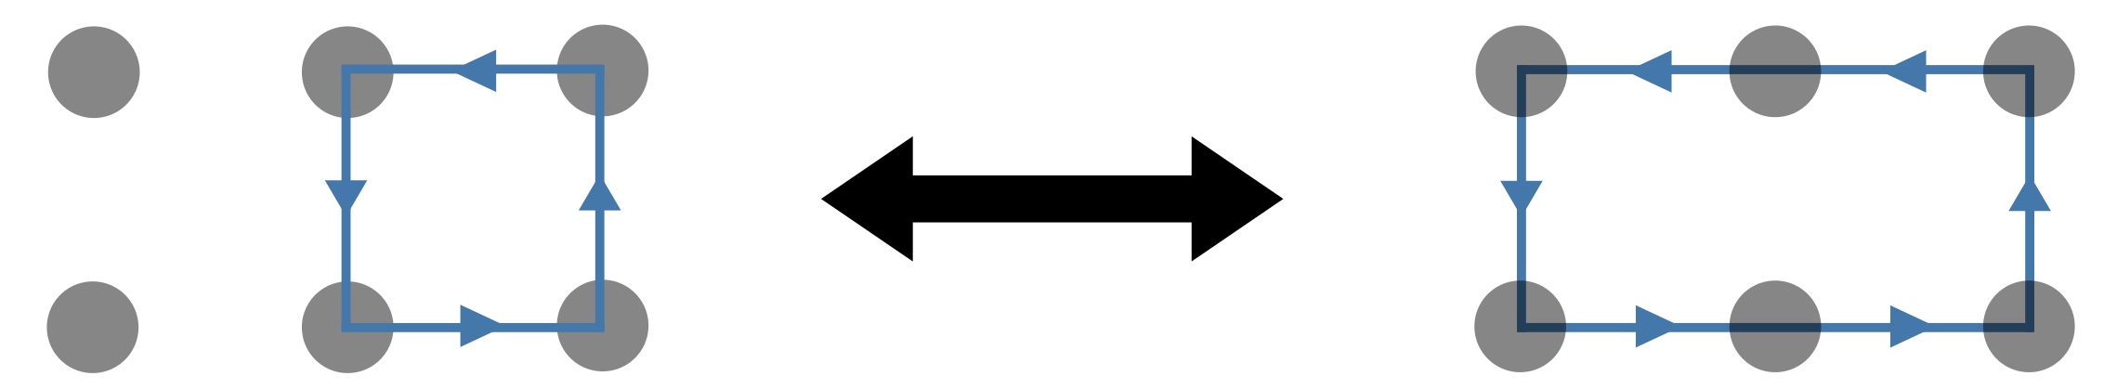
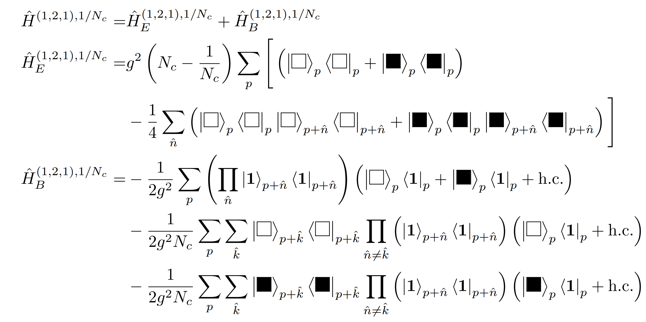
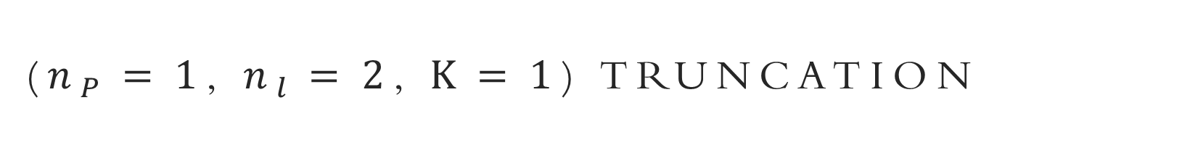
($n_{P}=1$, $n_{l}=2$, $k=1$) truncation
Each individual plaquette operator can be applied once, but neighboring plaquette operators can also be applied
Only keep states where links are in the trivial or fundamental irrep
At large N, identical to the previous truncation, but has a 1/N correction
Still only need a qutrit per plaquette, and can project the even C sector onto a single qubit per plaquette

Slide 8
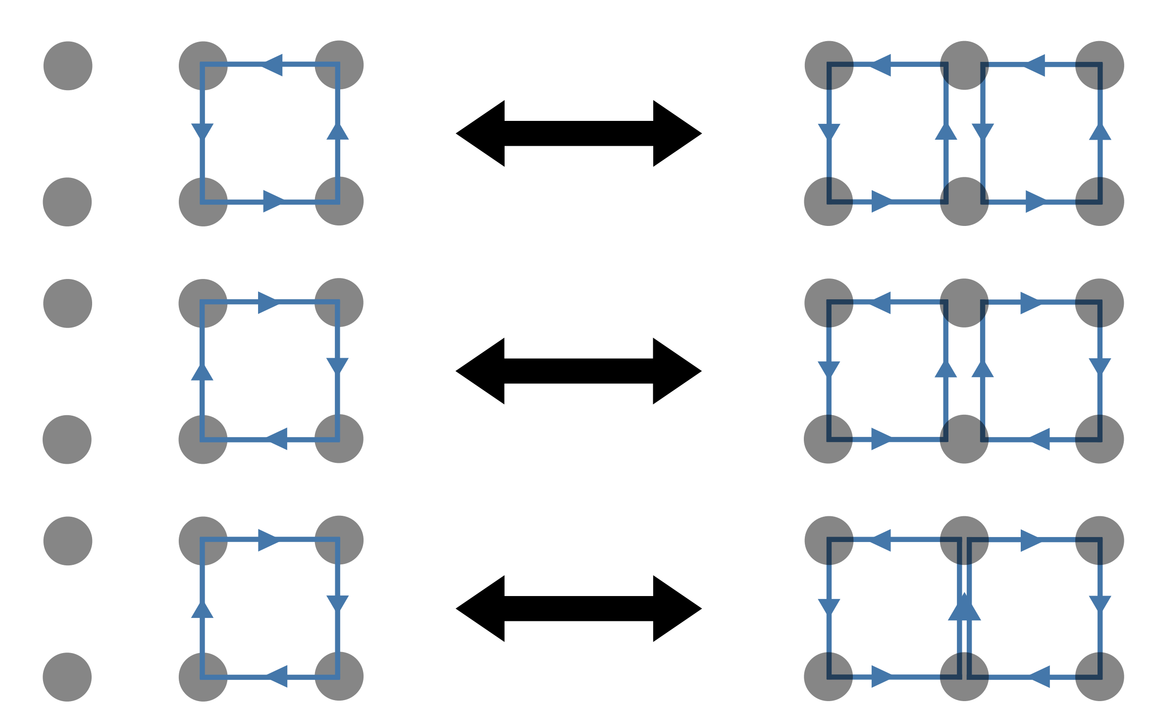
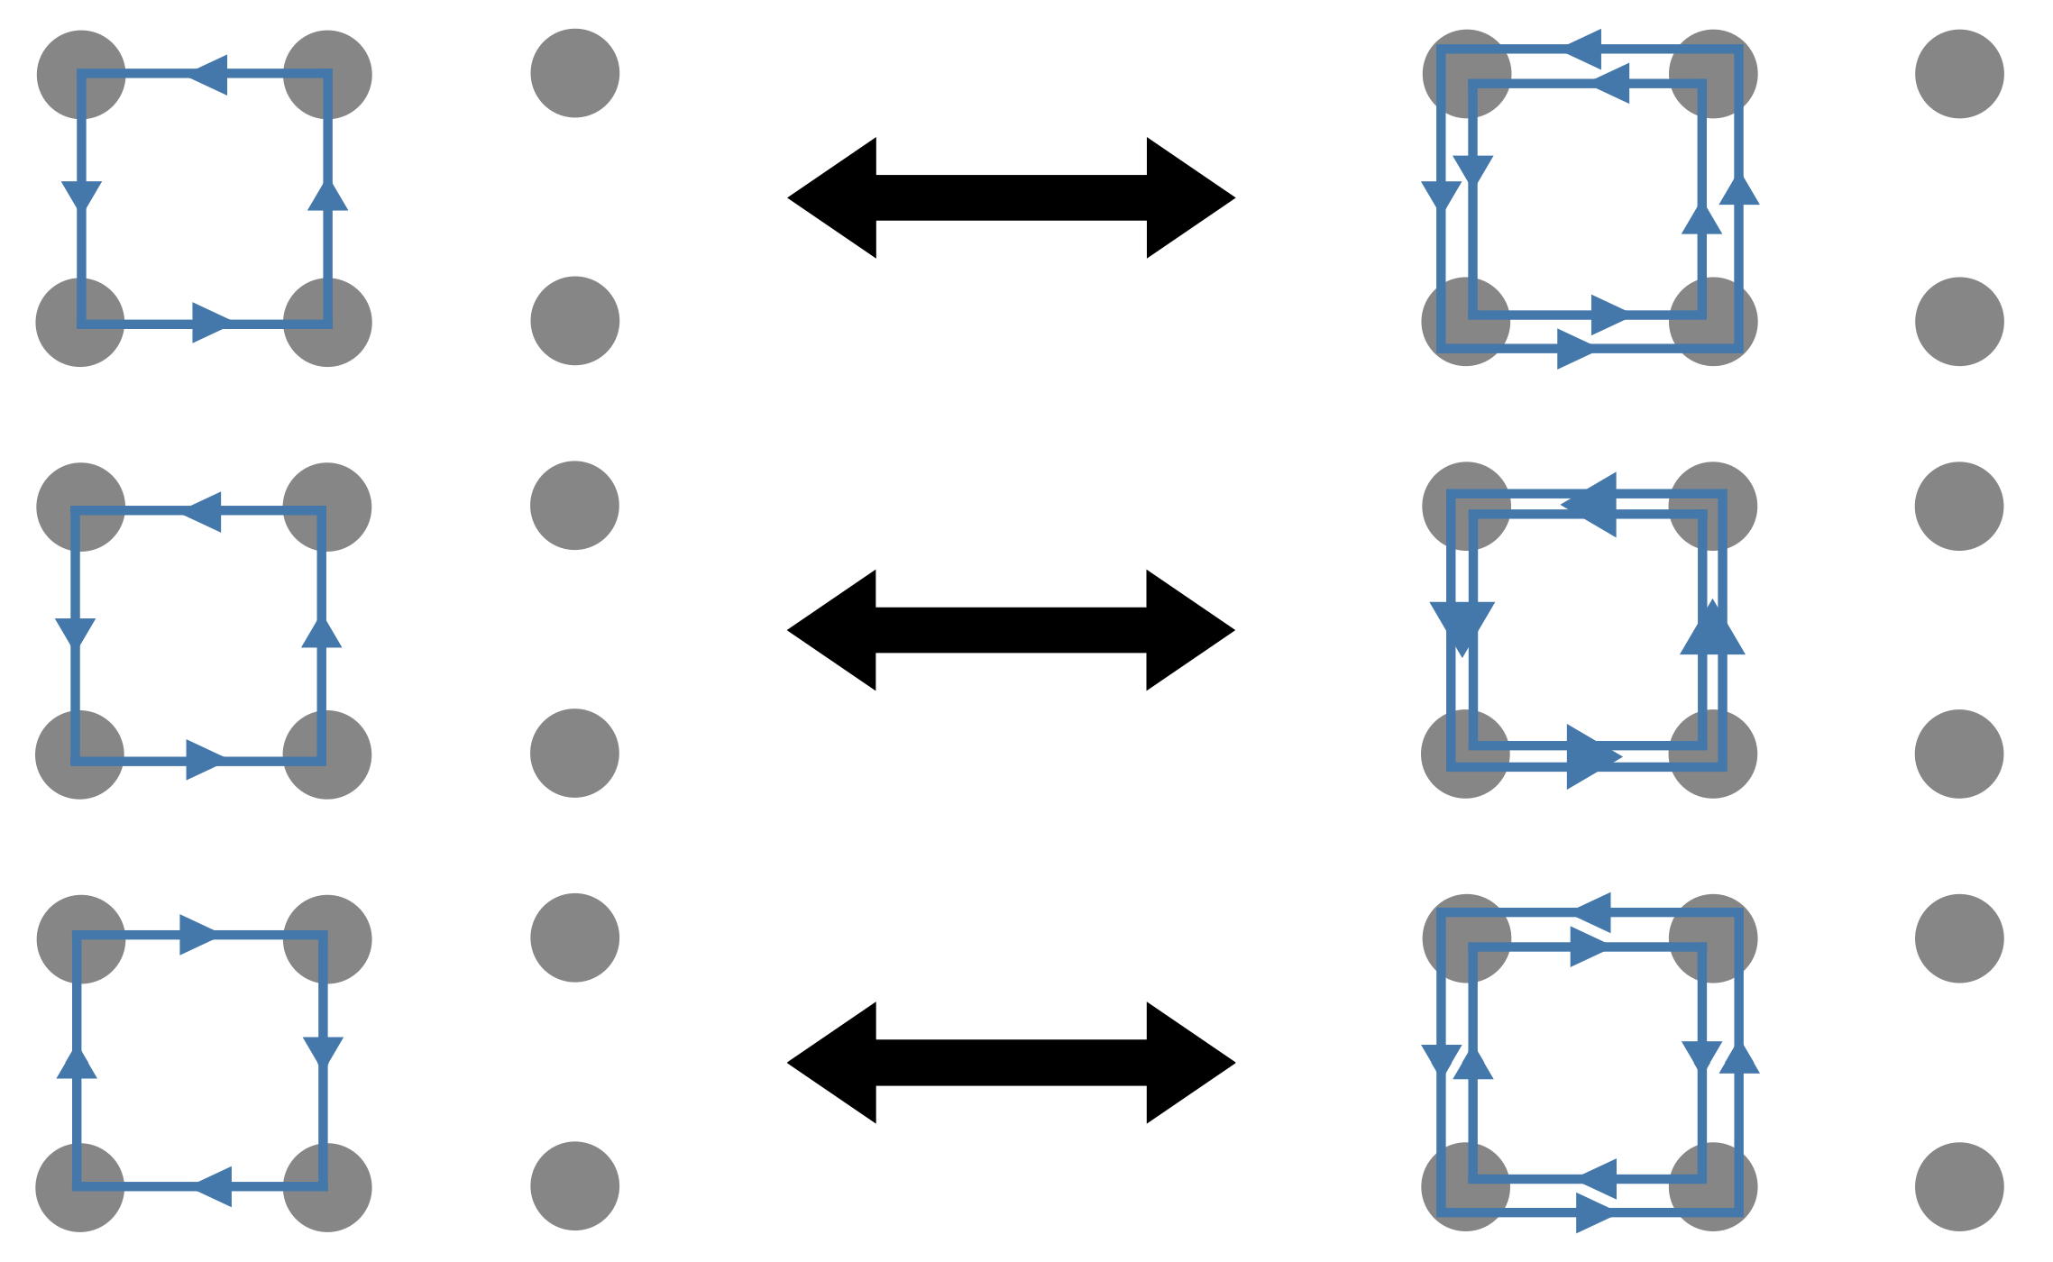
($n_{P}=2$, $n_{l}=2$, $k=2$) truncation
Individual plaquette operators can now be applied twice
Need a qu8 per plaquette to specify the irrep of flux flowing around the plaquette
Also, need a qubit / link to resolve ambiguities

Slide 9
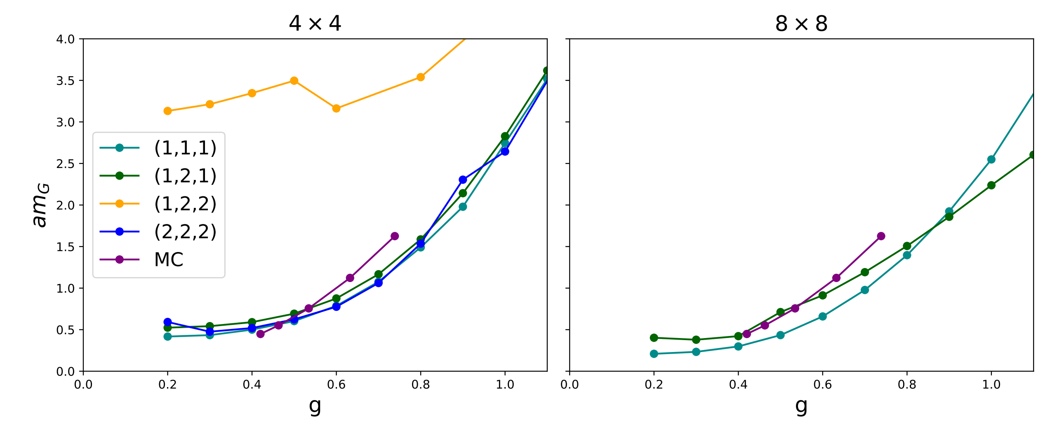
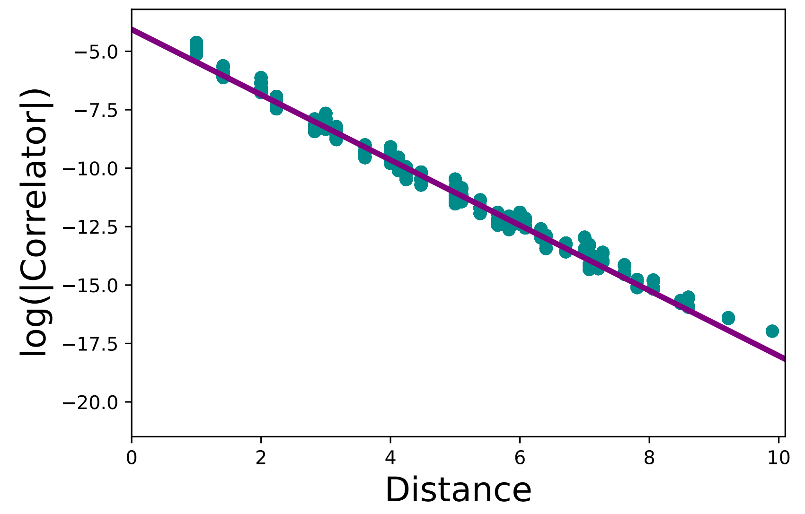
Glueball Mass Calculation
As a test of these truncations, the scalar glueball mass was computed for SU(3) LGT in 2+1D and compared to traditional MC results
This was done by obtaining the vacuum state from DMRG and fitting correlation functions to an exponential
Correlation functions in the (1,1,1) truncation already show signs of the restoration of rotation symmetry at g=0.8 on an 8x8 lattice

Slide 10
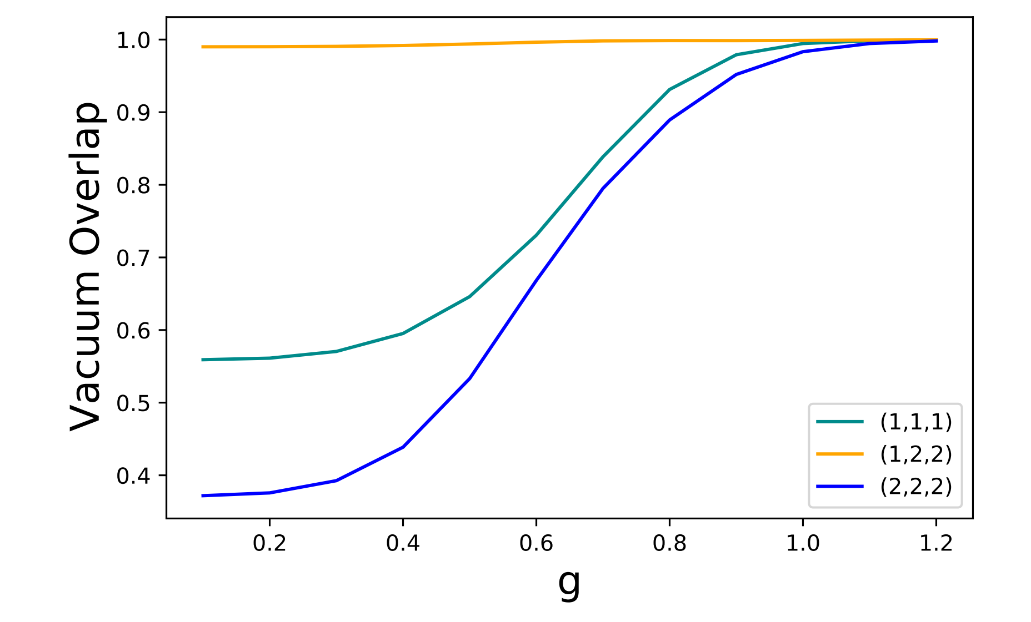
Why does (1,2,2) fail?
All of the truncations except for (1,2,2) look roughly consistent with the untruncated theory.
The (1,2,2) truncation lies close to a point in theory space where the correlation length vanishes for all values of g
The correlation free limit comes from dropping all 1/N dependence in the electric energy and plaquette operator

Slide 11
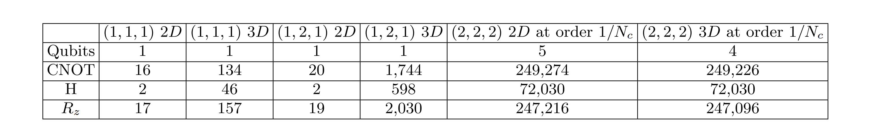
Resources needed for quantum simulation
These low lying truncations can reach non-trivial lattice spacings and can be used for near-term quantum simulations of lattice gauge theories
Time evolution can be performed using Trotterization by breaking the plaquette operator into a sum over generators of gauge invariant basis rotations

Slide 12


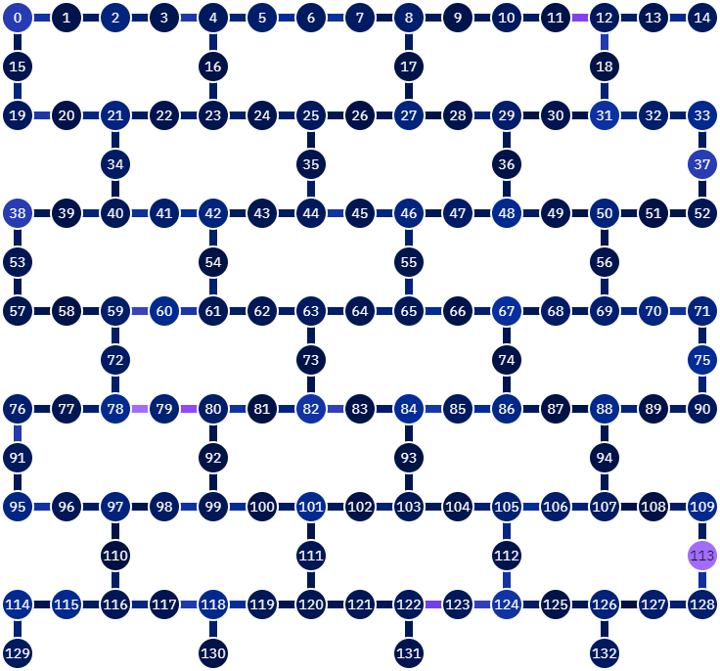


Real time Evolution on IBM’s quantum computers (1,1,1) truncation
Interaction Picture Trotterization
Yellow and blue qubits are used to represent the state of the system
Square qubits are used to enable communication between those used to represent the system
One Trotter step = CNOT depth 45

Slide 13
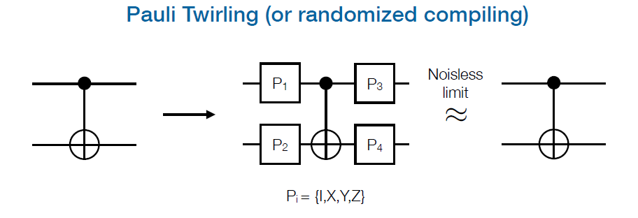
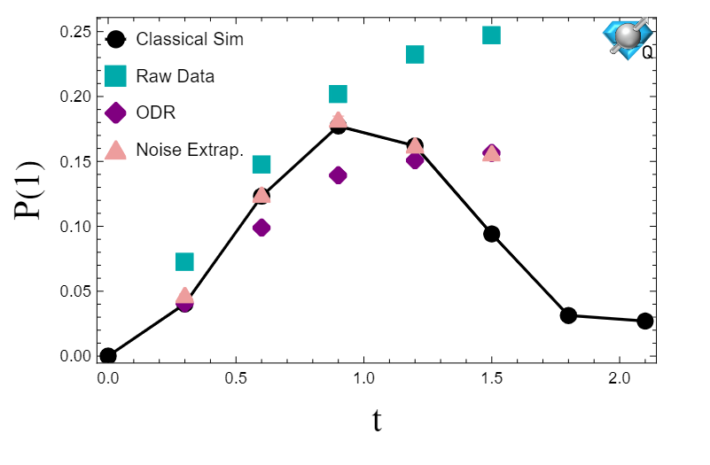
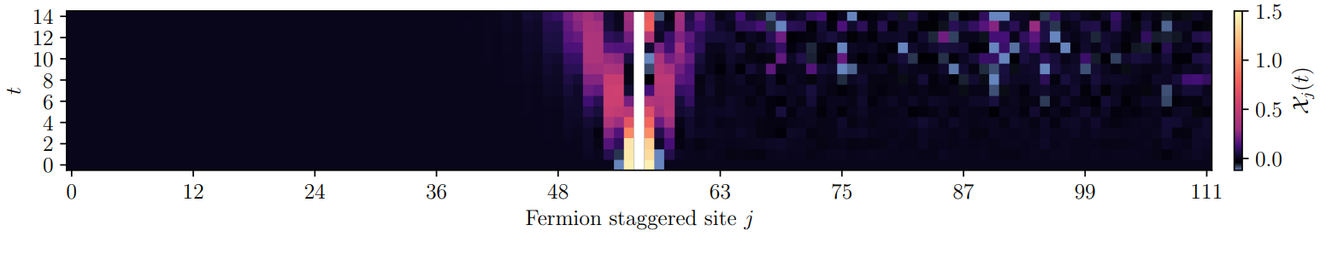

Error mitigation
Quantum simulations have errors coming from inherent hardware errors
Pauli twirling converts coherent errors into a Pauli error channel
Decoherent Pauli noise renormalizes Pauli operators
$\left\langle ψ | \hat{P} | ψ\right\rangle \overset{→}{}η_{P}\left\langle ψ | \hat{P} | ψ\right\rangle$
This can be mitigated by running a circuit with a known answer to determine $η_{P}$
Other sources of hardware error can be mitigated by artificially introducing noise by applying more CNOT gates and extrapolating to zero noise.
5x5
Operator Decoherence Renormalization
Phys. Rev. Lett. 127, 270502
arXiv:2210.11606
PRX Quantum 5, 020315
Phys. Rev. D 109, 114510
112 qubits, CNOT depth 370 (13,858 CNOTs)

Slide 14
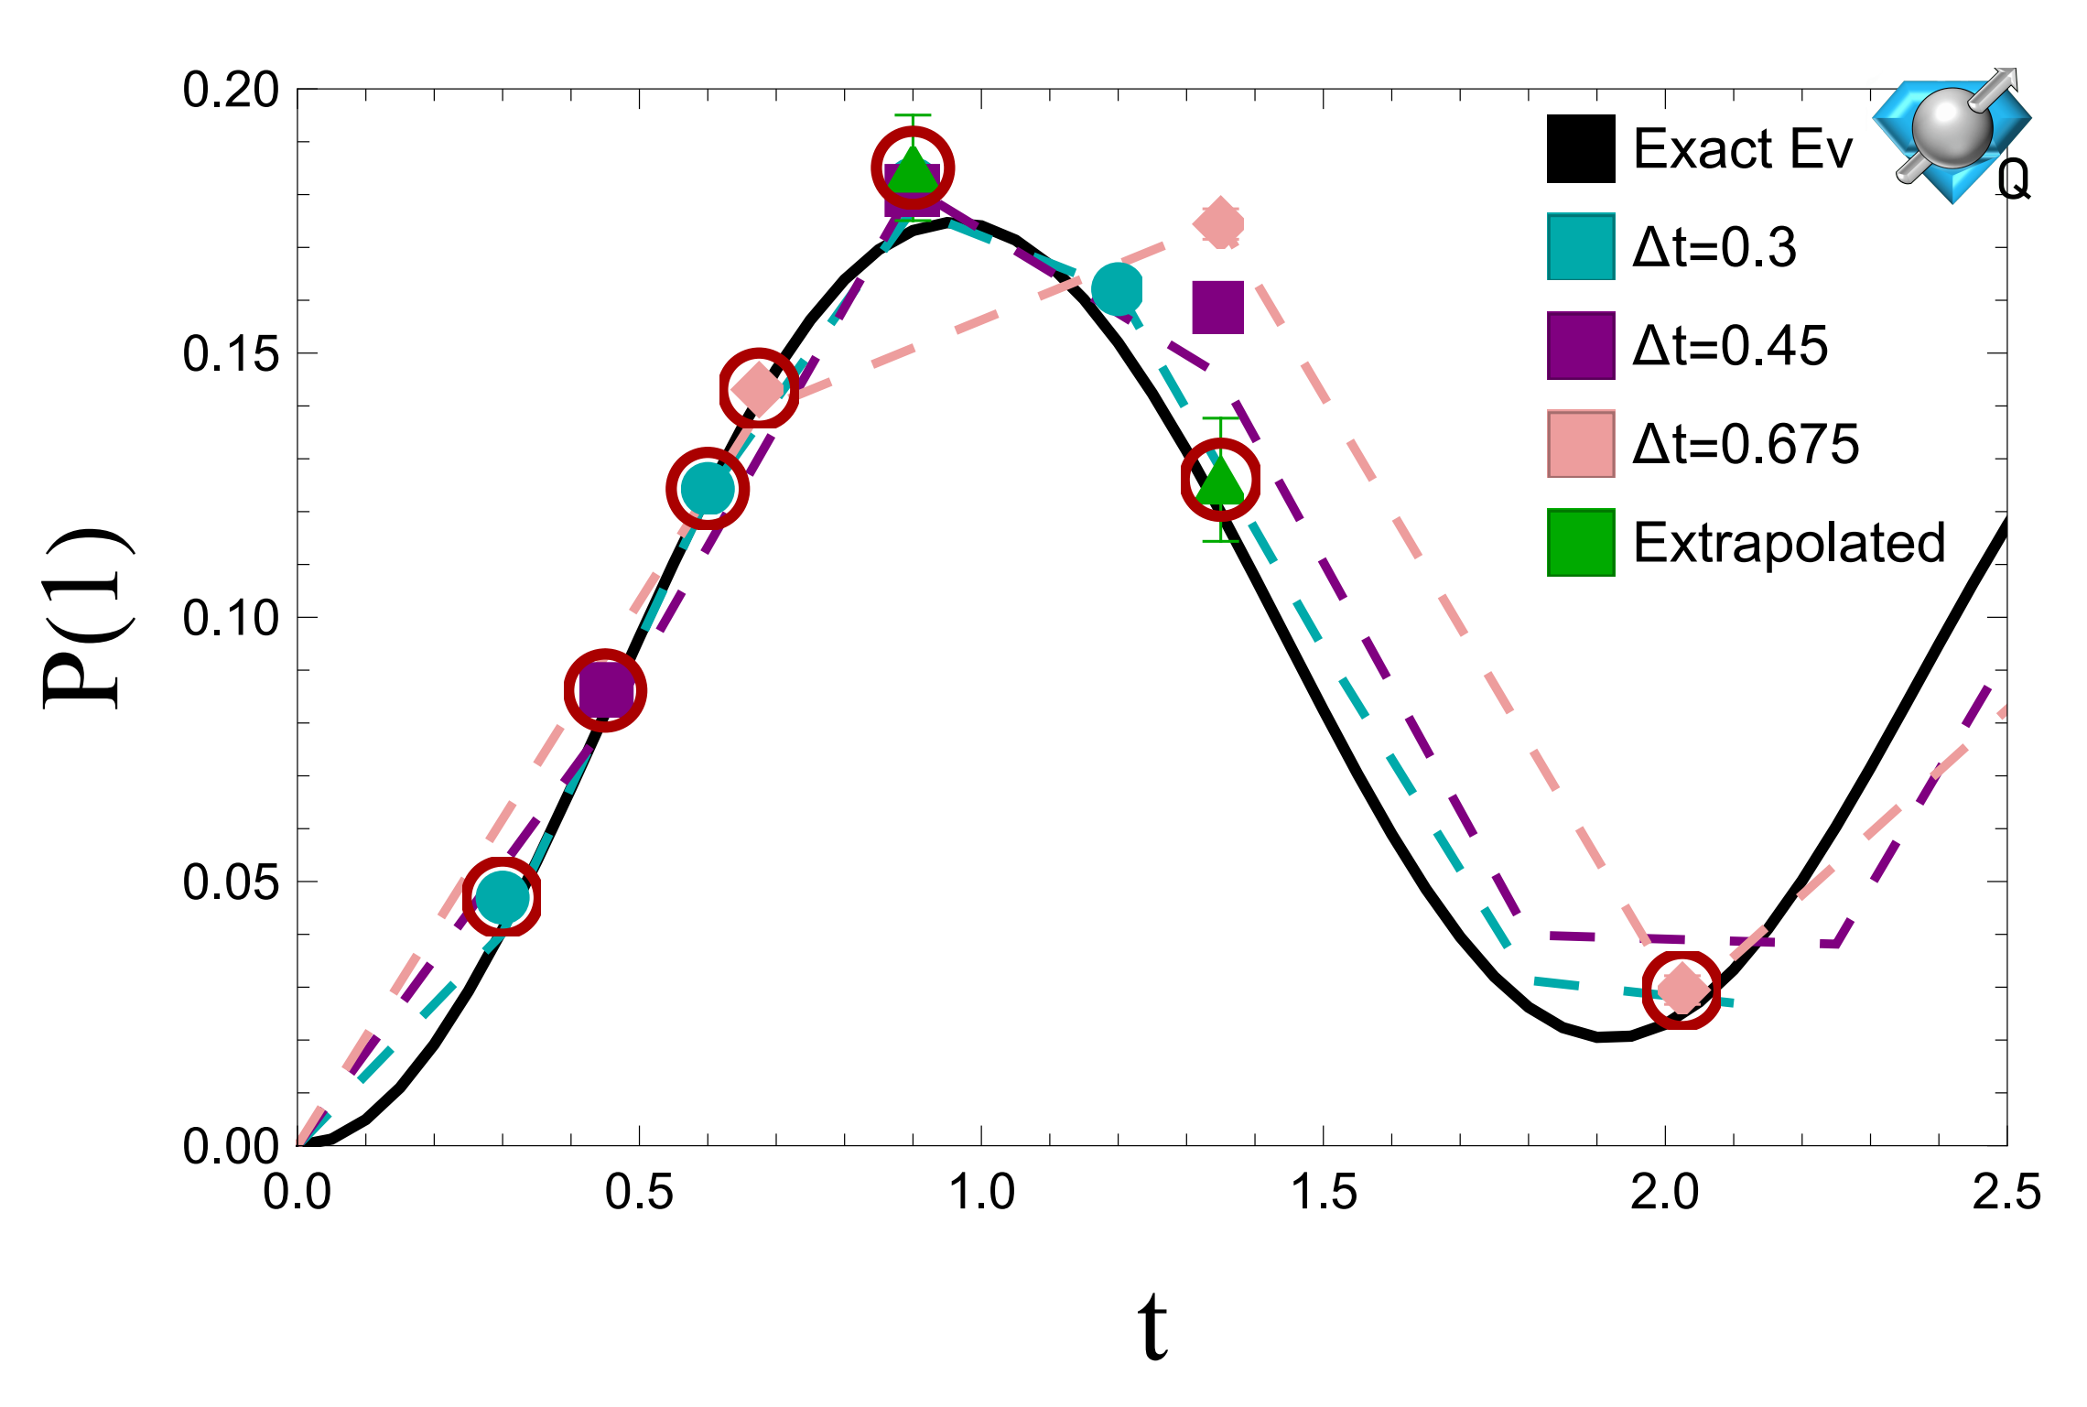
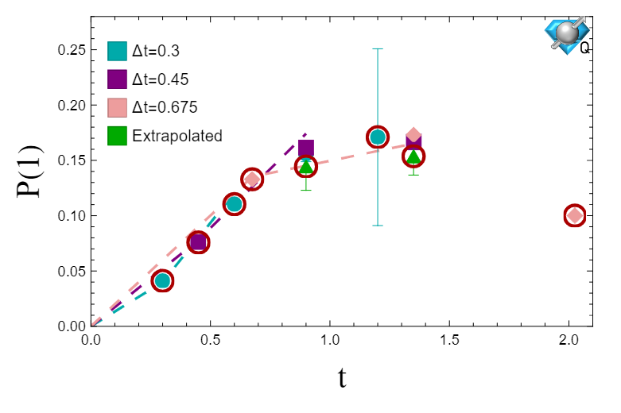
Algorithmic Errors
Errors also come from the Trotterization of the time evolution operator.
This can be mitigated by performing the evolution with multiple step sizes that sample the same points in time and extrapolating.
Noise in circuits scales with circuit depth not system size so small simulations can be used to validate the results of larger ones.
CuQuantum was used to perform a classical simulation for a 8x8 lattice.
5x5
8x8
129 Qubits
CZ Depth 113
1500 CZ Gates
8733 1 Qubit Gates

Slide 15

Summary & Future Goals
Careful construction of electric bases can significantly reduce the gate count for quantum simulation
The large N expansion can be used to reduce the resources needed for simulation further.
Future work will look at including quarks and 1/N corrections.

