Slide 1
ASPECTS OF SUPERCONDUCTING STRINGS
AMEY GAIKWAD
MANI L. BHAUMIK INSTITUTE FOR THEORETICAL PHYSICS
UCLA
w/ THOMAS DUMITRESCU

Slide 2
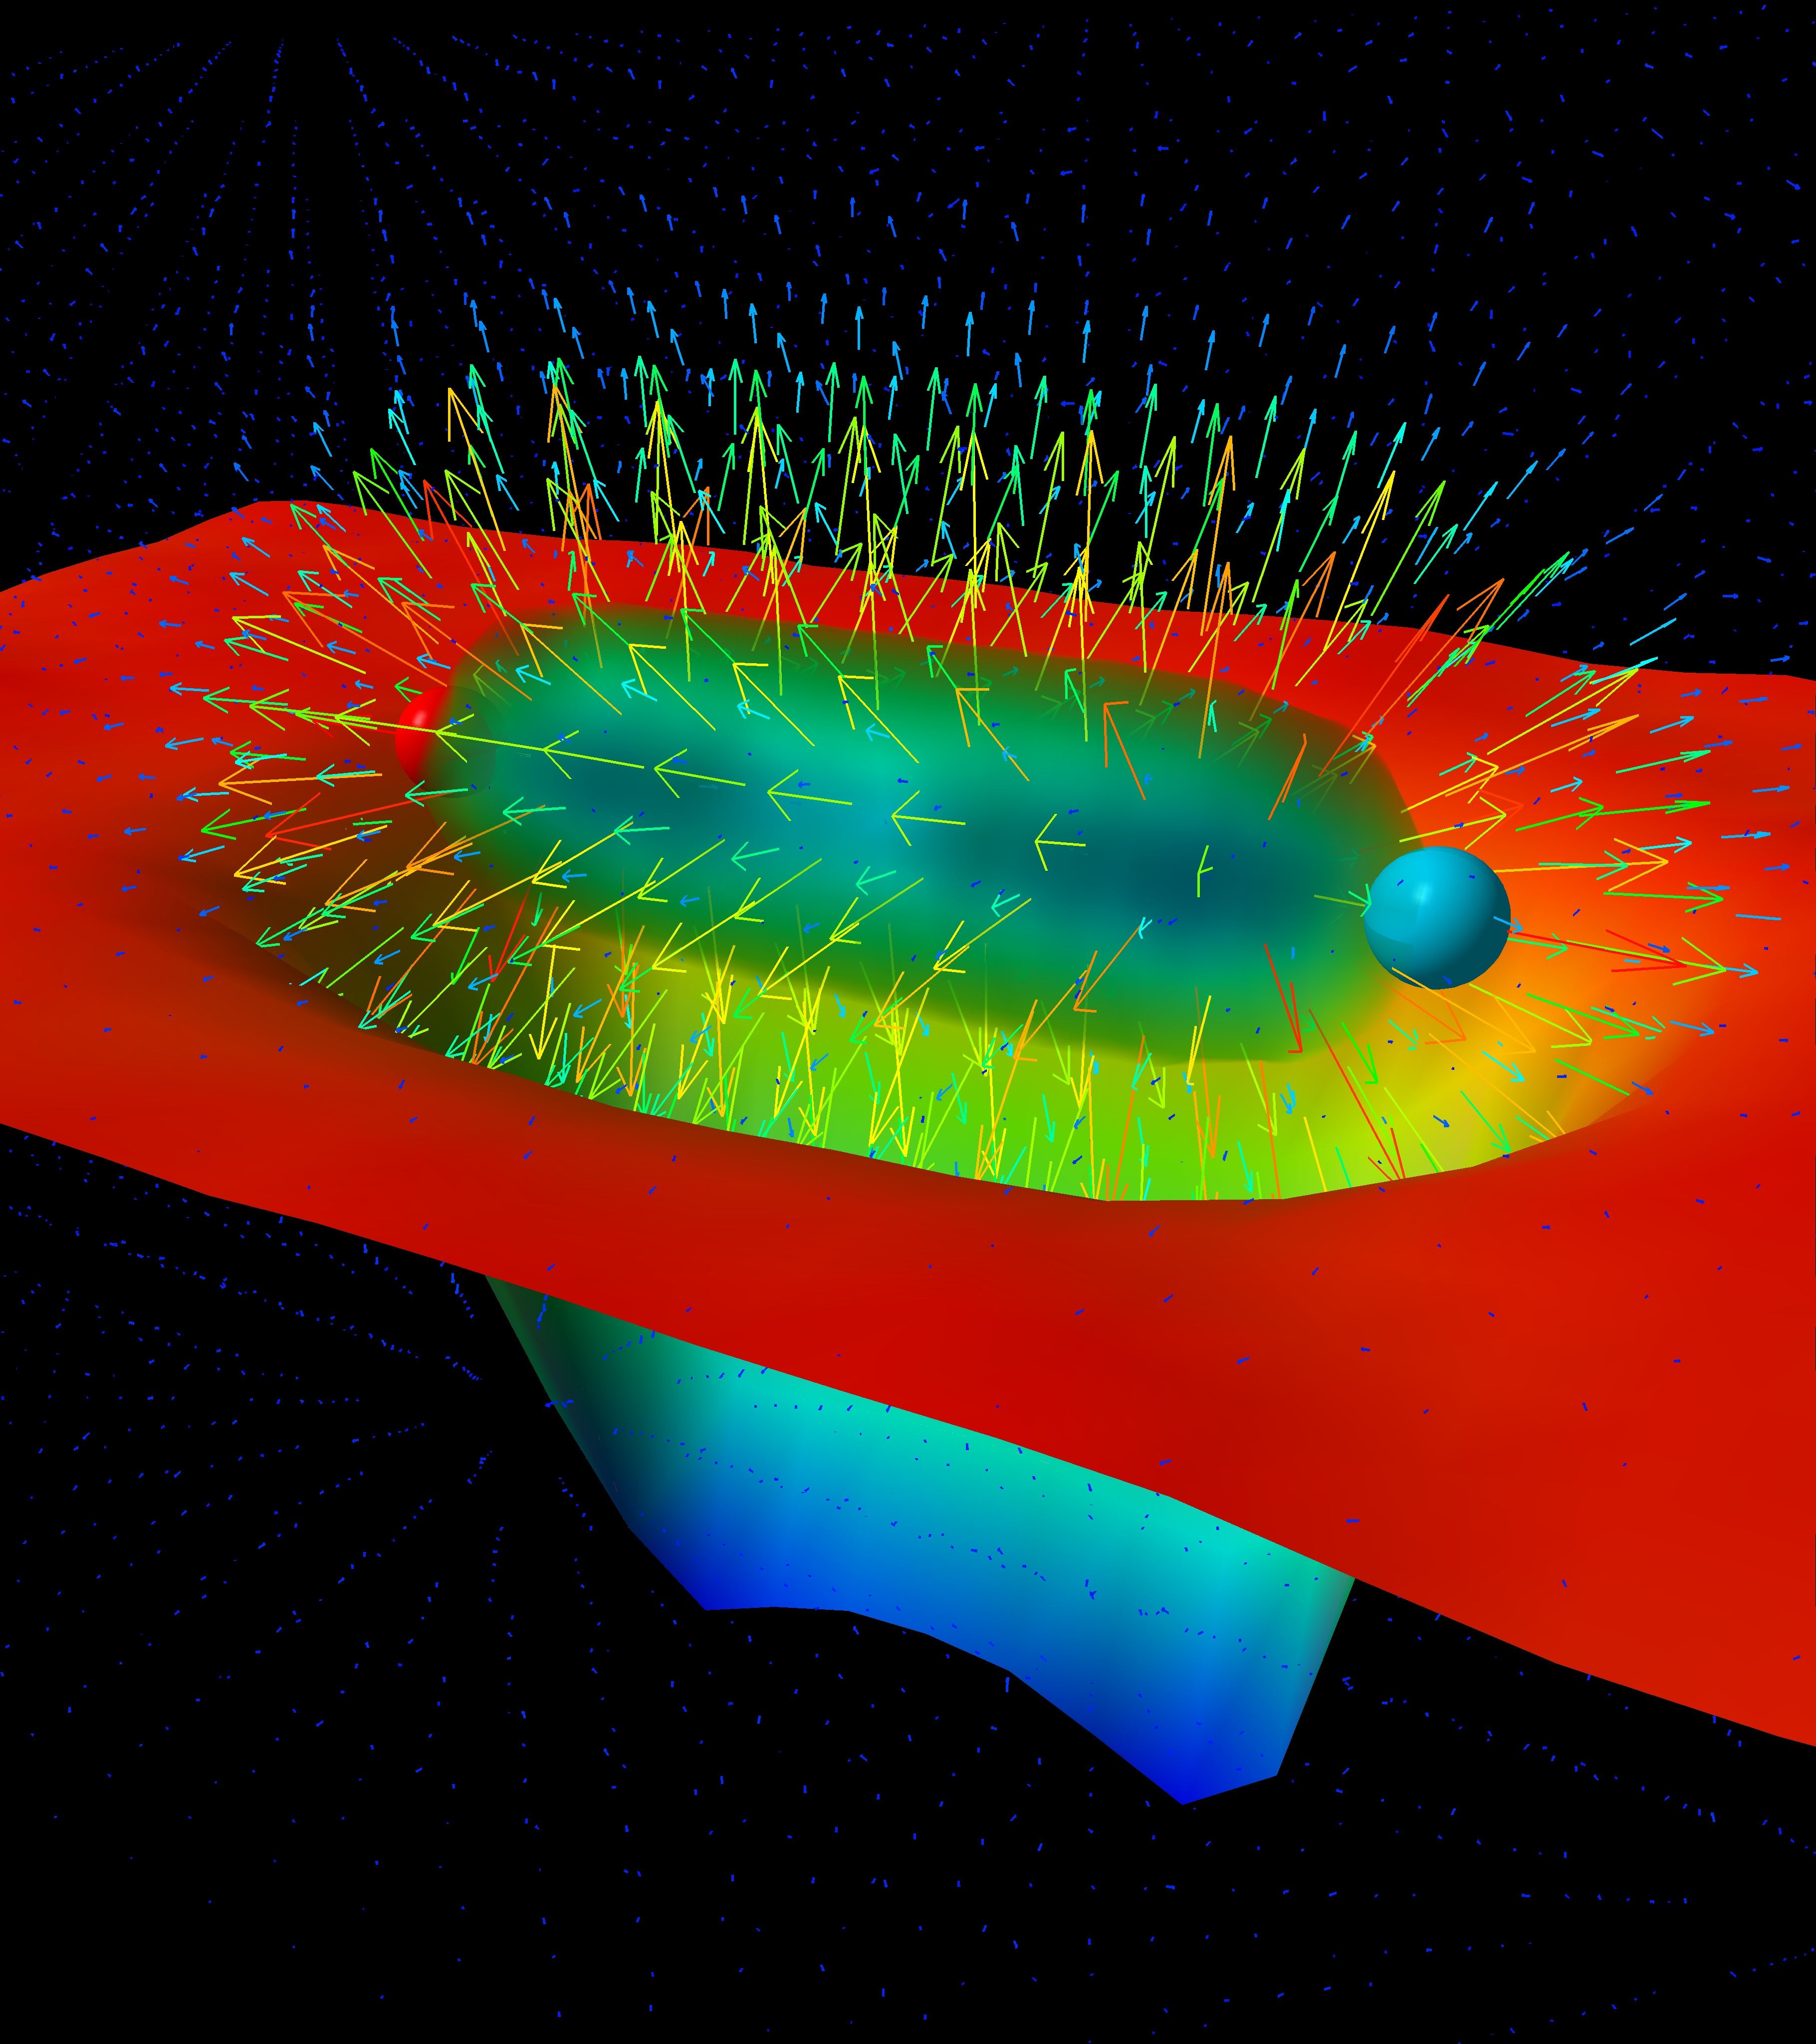
CONFINING STRINGS
Absence of free quarks and gluons
Examples : Yang Mills (YM), QCD
Characteristic feature : chromoelectric flux tubes
Numerical lattice evidence
Study properties of confining strings
Leinweber

Slide 3
WHAT ARE SUPERCONDUCTING STRINGS ?
‘t Hooft - Mandelstam dual superconductivity : Confining strings (electric) EM dual to
superconducting strings (magnetic)
Today : Abrikosov-Nielsen-Oleson (ANO) vortex strings (magnetic flux tubes) in tractable
weakly coupled Abelian Higgs Models (AHMs) 3+1D
Dual superconductivity : made explicit in deformed Seiberg Witten theory – a dual Abelian
Higgs model with electric flux tubes
Simple Abelian models are good laboratories for studying properties of strings
Cosmic Strings
Superconductivity

Slide 4
TWO QUESTIONS
What is the lightest non-trivial fluctuation mode around a string background ?
Do fundamental strings attract or repel ?

Slide 5
YM CONFINING FLUX TUBES
What is the lightest non-trivial fluctuation mode around a string background ?
Do fundamental strings attract or repel ?
Pseudoscalar Axion is the lightest non-trivial fluctuation
Believe that confining strings in YM attract and form bound states
[Dubovsky, Flauger, Gorbenko’ 12 ,Athenodorou, Dubovsky, Luo, Teper ’ 24, ….]
[Athenodorou, Teper ’21, ….]
Axion is the lightest massive excitation in a setting where fundamental confining strings attract !

Slide 6
OUTLINE OF TODAY’S TALK
Properties of Strings
Fluctuations of Strings

Slide 7
PROPERTIES OF STRINGS
String Tension, Phases of giant strings
Do strings attract or repel ?
Do strings form bound states ?
Forthcoming [Dumitrescu, AG ‘25]

Slide 8
UNIVERSAL FEATURES OF AHM VARIANTS
Keep general
gauge theory, single complex scalar of unit charge
Dimensionless gauge coupling
admits one Higgs vacuum
one-form magnetic flux symmetry
requirement

Slide 9
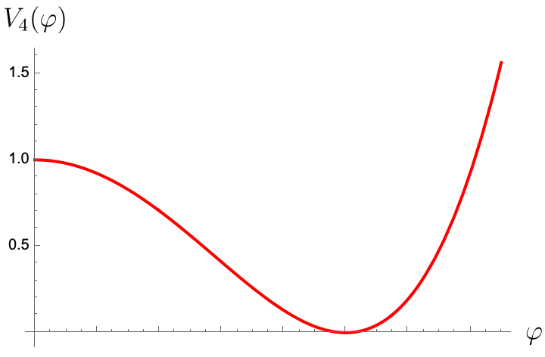
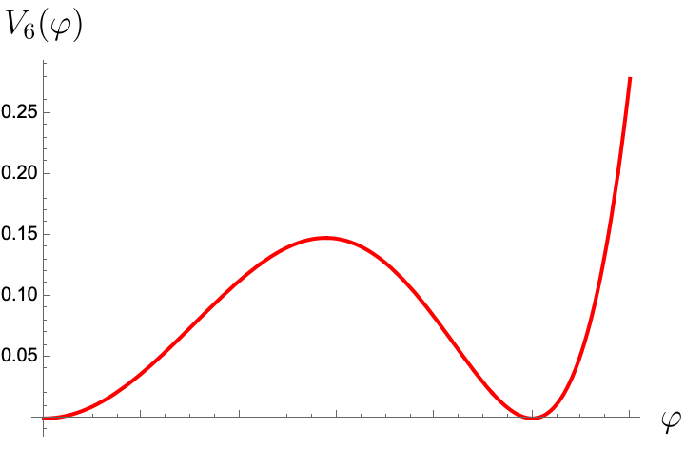
CHOICES OF POTENTIAL
Well studied !
CONVENTIONAL MODEL
DEGENERATE MODEL
The Higgs vacuum is trivial and gapped – massive Higgs boson
and vector boson
Domain Wall
Unique Higgs vacuum
Higgs vacuum + Coulomb vacuum

Slide 10
TYPE - I AND TYPE - II CLASSIFICATION
Type - I
Type – II
conventional AHM - BPS embedding into susy
Ratio controls many, potentially correlated, qualitative properties.
Purely classical analysis
Conventional
Degenerate

Slide 11
ABRIKOSOV-NIELSEN-OLESON (ANO) STRINGS
Magnetic flux tubes. To exist as finite tension excitations, study the Higgs vacuum in which
the one form flux symmetry is unbroken. Charged objects : ANO strings.
For any flux what is the lowest energy - string ?
There can be many strings but in any sector, there would be a ground state or lowest energy
string expected to be the most stable one.
Write down non linear equations of motion of Lagrangian and solve them subject to flux
constraint. Instead solve in analytically tractable regime.
1
1
v/s
2
fundamental

Slide 12
PART I

Slide 13
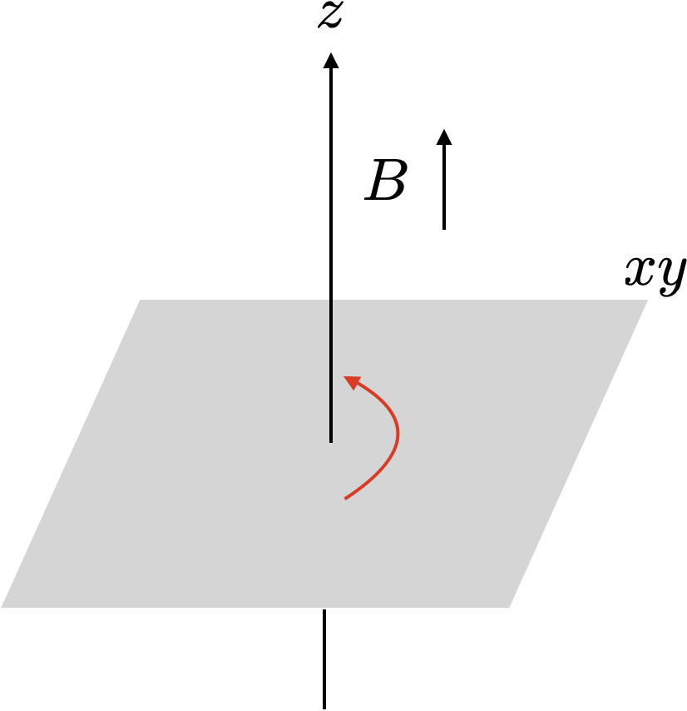
ROTATIONALLY SYMMETRIC STRINGS
Simplifying assumption
Also Static and translationally invariant
These might NOT be the min. energy string configurations
Finite energy requirement
forces the winding to be
equal to the flux
Tension OR Energy per unit length.

Slide 14
STRING EQUATIONS
ODEs instead of PDEs
Rescaled version of the potential
Regularity and finite tension
requirements for the
boundary conditions
(vacuum in degenerate model )
Higgs vacuum
Cannot be solved analytically, but can be numerically – profiles only depend on and
Analytic solution in large flux limit

Slide 15
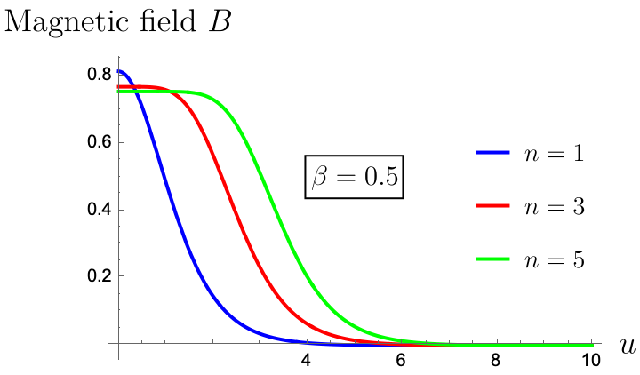
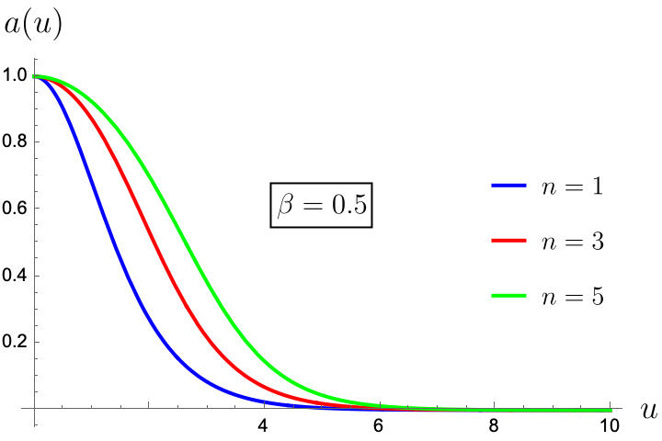
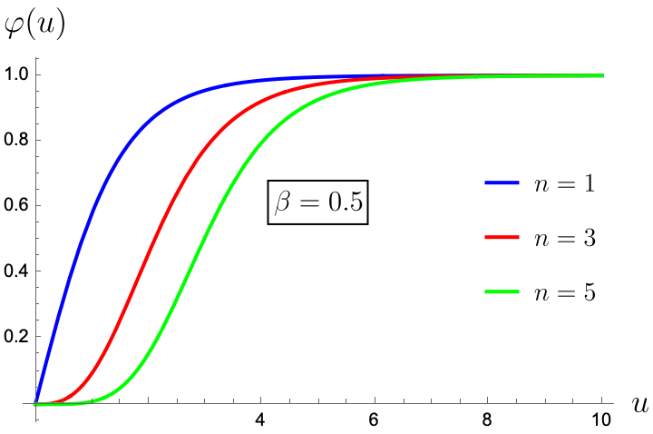
VARIATION WITH
Conventional AHM

Slide 16
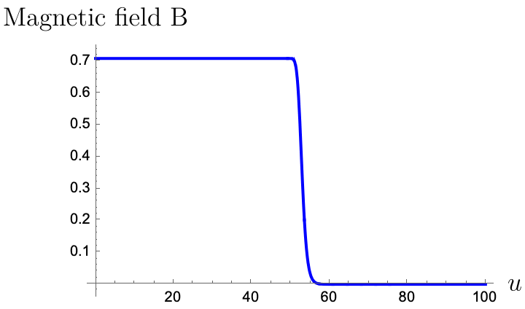
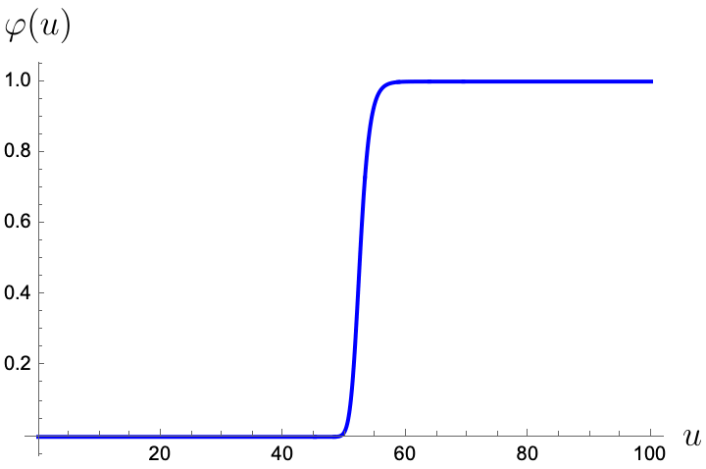
Vortex ‘Core’
(Coulomb region)
(Higgs vacuum)
Vortex ‘Core’
Conventional AHM
BUT THE TREND IS TRUE
EVEN FOR THE DEGENERATE MODEL !
(Coulomb region)
(Higgs vacuum)

Slide 17
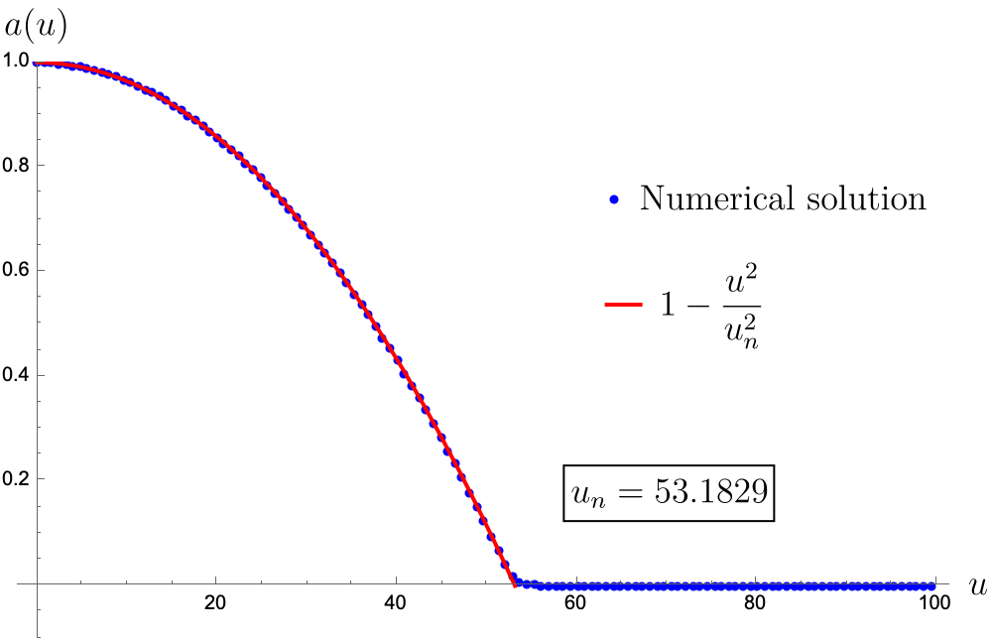
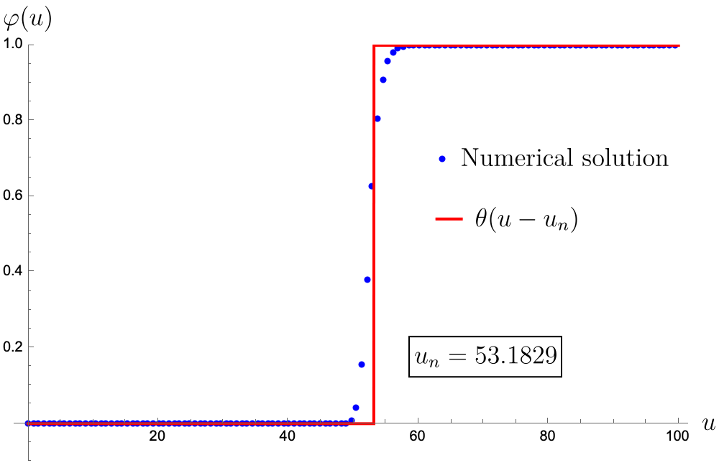
GIANT STRINGS : CONVENTIONAL AHM
JUST COULOMB
REGION AND
HIGGS VACUUM
Quadratic fall off for gauge field translates to constant magnetic field !

Slide 18
STRING TENSION
GUESSTIMATE
Constant energy density proportional
to the area of the string
Not a vacuum ! Hence, there’s a penalty
Flux wants to spread out
Variational minimization sets optimal radius and string tension

Slide 19
LARGE SOLUTION
We need to account for physics from the transition region
By producing large solution everywhere
Surface tension
SUBLEADING TO CORE !
Core
Boundary

Slide 20
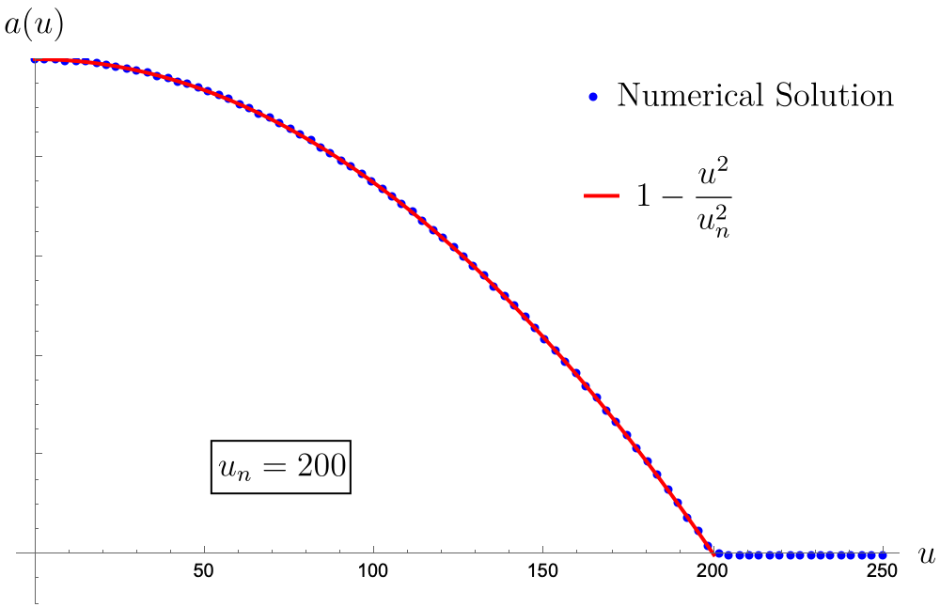
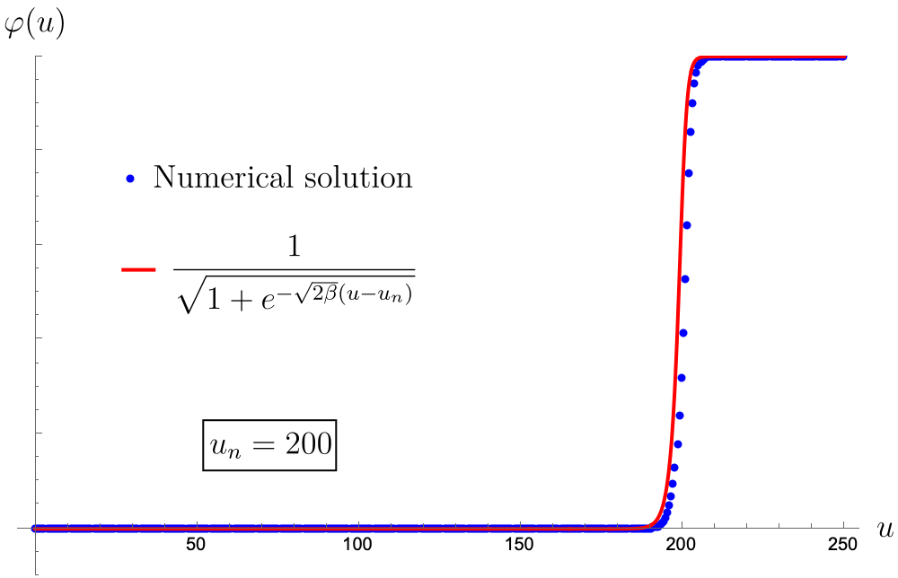
GIANT STRINGS: DEGENERATE MODEL
Domain wall solution connecting the Coulomb and Higgs vacuum
Note the difference in size for the same values of parameters

Slide 21
STRING TENSION
Domain wall tension – Difference in competition, no urgency for the scalar field to leave the Coulomb vacuum !
Flux wants to spread out
Variational minimization sets optimal radius and string tension

Slide 22
PHASES OF GIANT STRINGS
CONVENTIONAL AHM
BULK PHASE
Core radius
String tension
Energy density
DEGENERATE MODEL
DOMAIN WALL PHASE
Core radius
String tension
Energy density
Infinite volume region – large strings have phases !
[Penin, Weller ’21 ,…]
[Bolognesi, Gudnason ’05, … ]

Slide 23
PART II

Slide 24
FORCES BETWEEN SEPARATED STRINGS
Force between two strings separated by a distance
ATTRACT in Type – I ; REPEL in Type – II
Just the Mass Spectrum determines the answer to this question

Slide 25
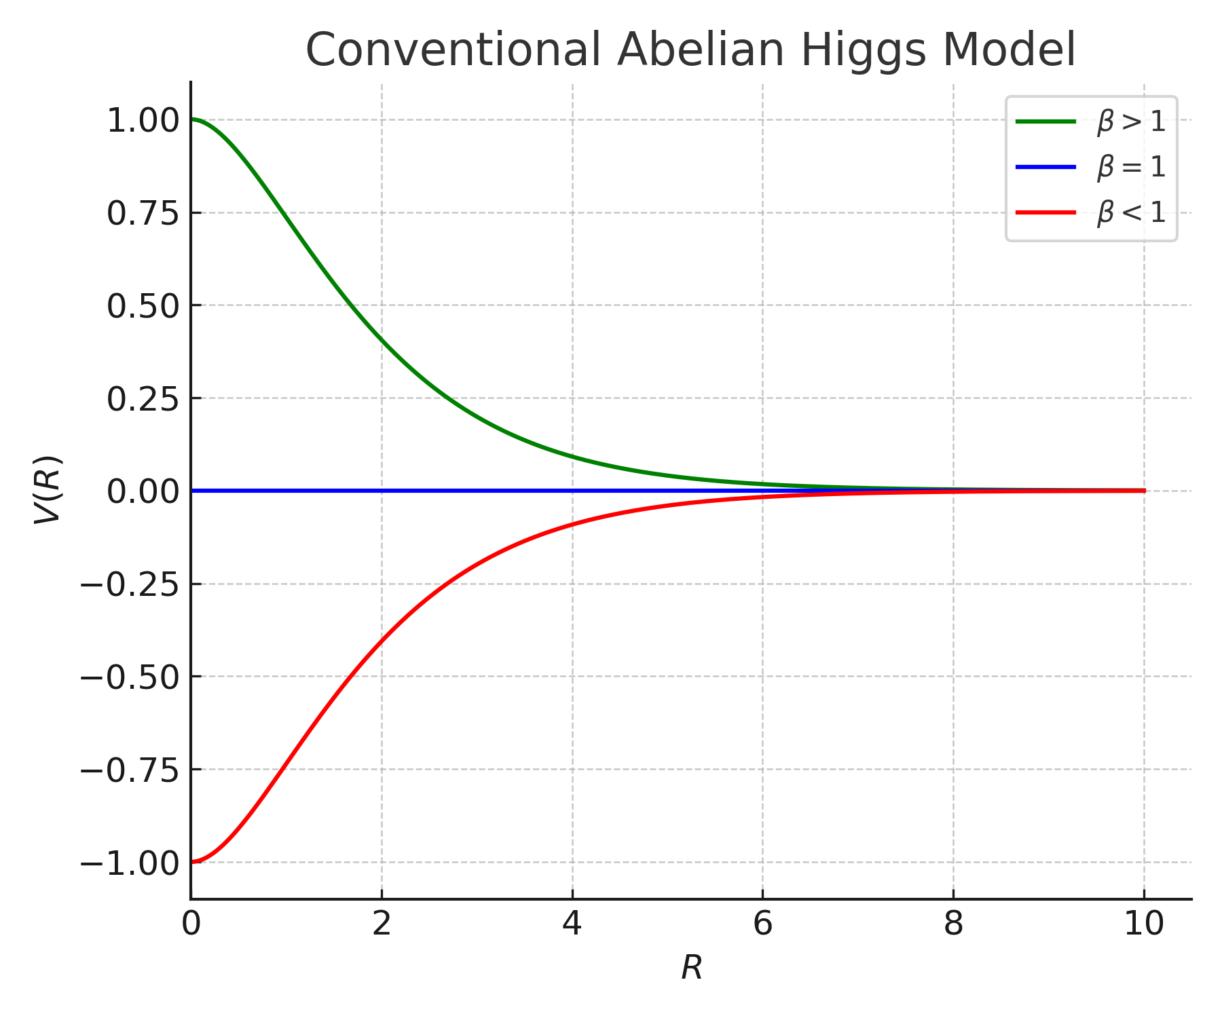
INTERACTION POTENTIAL AS A FUNCTION of
Interaction energy of
superconducting vortices
[Jacobs, Rebbi ‘79, …]
Repel
Neutral
Just knowing the spectrum tells us
something non trivial about the strings themselves. This is generically
not true – DEGENERATE MODEL
Attract
YM BELIEF : Strings attract at infinity and form stable bound states
Binding energy of a 2-string

Slide 26
ROTATIONALLY SYMMETRIC BOUND STATES
Compare with
Numerics at small flux
Stability of giant strings - convexity of tension at large
Unstable bound state
Stable bound state

Slide 27
STABILITY OF GIANT BOUND STATES
CONVENTIONAL AHM
DEGENERATE MODEL
Stability directly correlated w/
Stability of 2-string ; same as above
Stable for all values of
Stability of 2-string – not as straightforward
Stable
Neutral
Unstable

Slide 28
FEATURES
Phases of Giant strings : Scaling of size and tension with
Interacting forces between separated fundamental strings
Stable versus unstable symmetric bound states
These are important data points gathered from simple AHMs

Slide 29
STRING FLUCTUATIONS IN CONVENTIONAL AHM
Forthcoming [Dumitrescu, AG, Li ‘25]

Slide 30
FLUCTUATION PROBLEM AND ZERO MODES
String is an object in 2D space ; Two NGBs – Broken translational symmetry
Additional moduli for BPS at higher flux
Other small fluctuation modes are gapped and extremely rich
Linearize equations and solve linearized problem
For this talk focus on fluctuations of
the fundamental string

Slide 31
MASSIVE MODES
Continuum of scattering states
Bound state excitations
transverse spin – rotates the GBs.
Use this symmetry to organize states
Transverse Parity : GBs transform as a vector
Focus on spin – 0 : Axion and Dilaton
Pseudoscalar
Scalar

Slide 32
MASS HIERARCHY : AXION AND DILATON
Axion is the lightest massive excitation in the type-II regime - a setting where fundamental strings REPEL !
Type – I
Type - II

Slide 33
YM CONFINING FLUX TUBES
Pseudoscalar Axion is the lightest non-trivial fluctuation
Believe that confining strings in YM attract and form bound states
[Dubovsky, Flauger, Gorbenko’ 13, Athenodorou, Dubovsky, Luo, Teper ’ 24, ….]
[Athenodorou, Teper ’21, ….]
Axion is the lightest massive excitation in a setting where fundamental confining strings ATTRACT !

Slide 34
EFFECTIVE ACTION OF LONG STRINGS
Calculate three point couplings of GBs to massive modes
Integrate to calculate backreaction on the GBs. At leading order,
(Suppressed indices)
[Aharony, Komargodski ’13, Dubovsky, Flauger, Gorbenko ‘12…. ]
Interesting characteristic numbers of the string
Extrinsic
curvature
Ricci
scalar

Slide 35
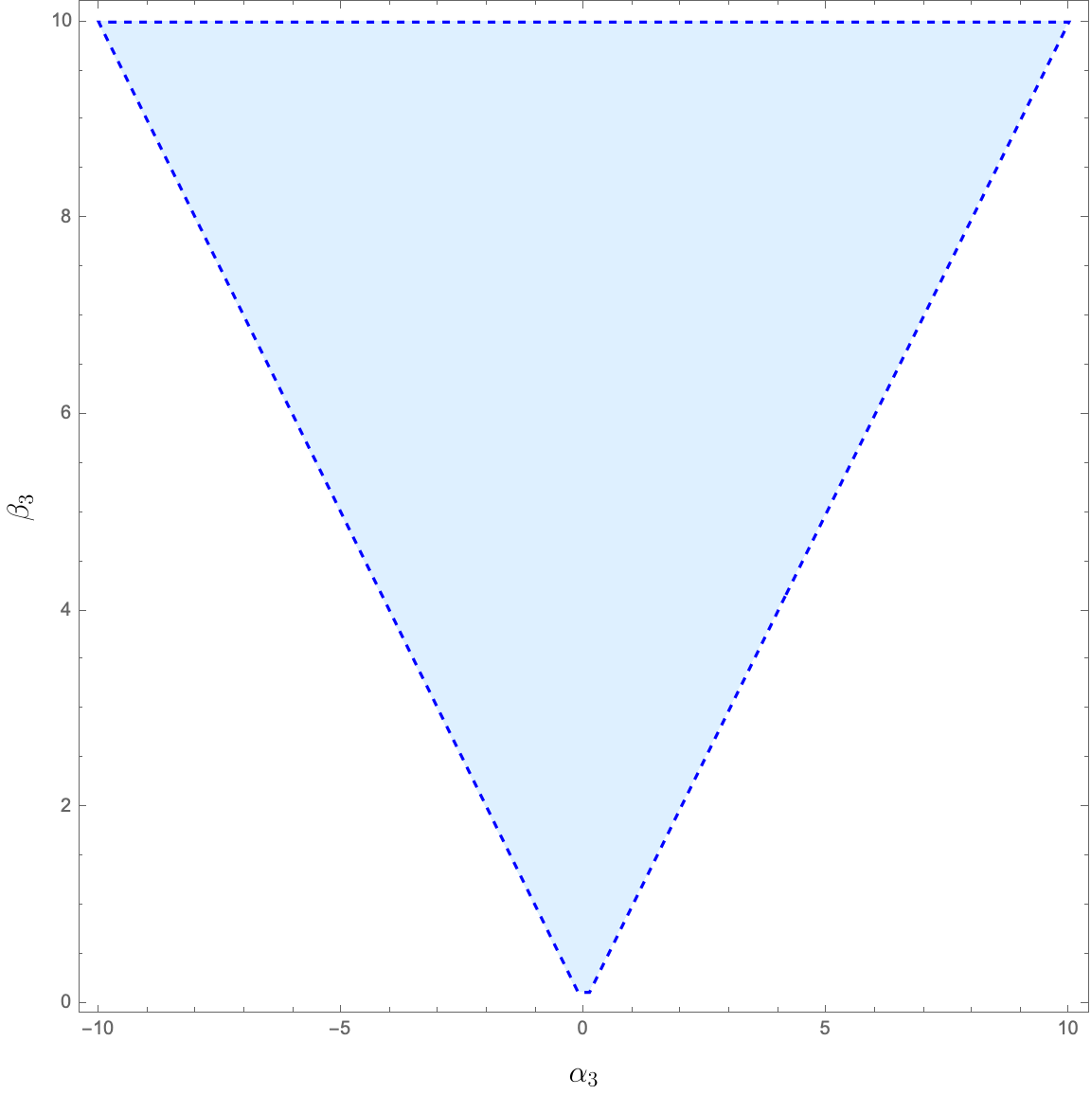
BOOTSTRAP BOUNDS
Requiring a consistent UV completion of the branon S-matrix, put bounds on its low energy expansion and bound the EFT parameters
[Miro, Guerrieri,
Hebbar, Penedones, Vieira ’19]
[Miro, Guerrieri ’21]

Slide 36
YM CONFINING FLUX TUBES
[Miro, Guerrieri,
Hebbar, Penedones, Vieira ’19]
[Dubovsky, Flauger, Gorbenko ’14, Dubovsky, Gorbenko ’15,…]
SU(5) YM
SU(3) YM

Slide 37
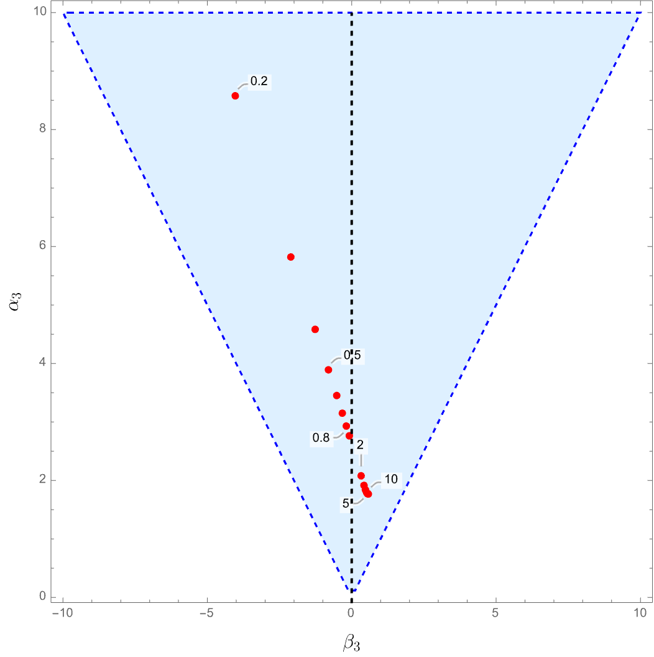
CONVENTIONAL AHM
In red, we plot
the conventional AHM for different values of
TYPE- I
AHM
TYPE-II
AHM

Slide 38
The YM confining flux tubes
lie in the region where Type-II
superconducting strings reside.
This simulates the similar tension as before !
SU(5) YM
SU(3) YM
TYPE- I
AHM
TYPE-II
AHM

Slide 39
MINIMAL AHM IS NOT A COMPELLING DUAL DESCRIPTION FOR YM CONFINING STRINGS !

Slide 40
YET ANOTHER VARIANT !
Deformed SW theory : Abelian model of confinement, MANY more fields : scalars
and fermions
It is known from condensed matter literature that if one has multiple Higgs fields
and you play w/ potentials, one can dramatically change the way in which strings
attract / repel
Study PHASES OF GIANT CONFINING STRINGS in deformed Seiberg Witten theory.
Forthcoming [Dumitrescu, AG ‘25 ]
WALL CROSSING AND EXTREMELY RICH GIANT STRING PHASE DIAGRAMS !

Slide 41
THANK YOU !

Slide 42
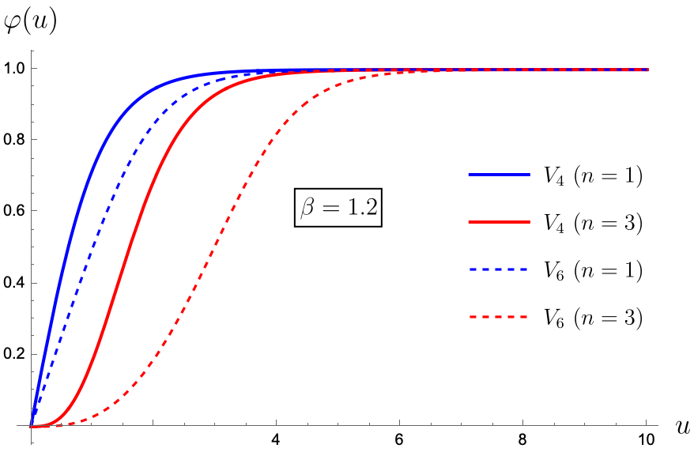
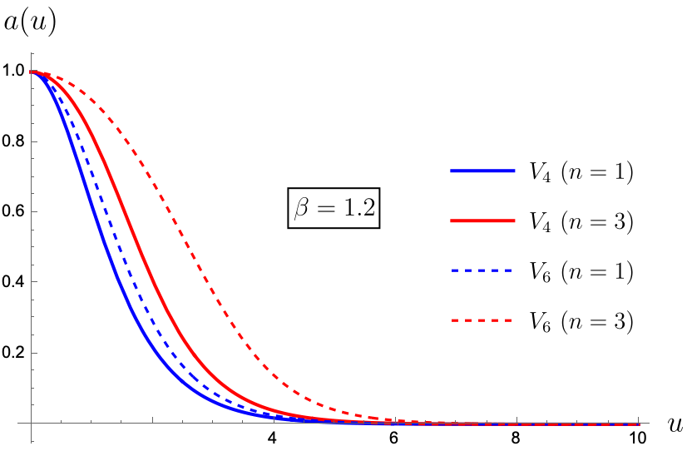
Comparing the conventional AHM and Degenerate models qualitatively
The degenerate model is more dilute for same value of

Slide 43
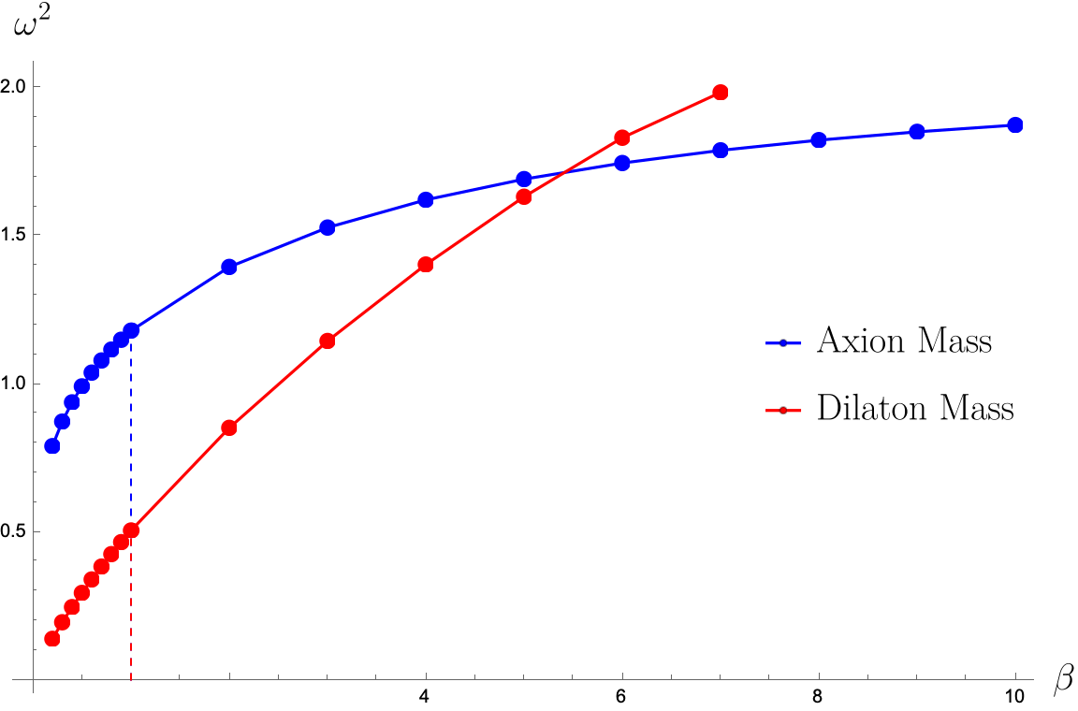
MASS HIERARCHY : DEGENERATE MODEL
Axion is the lightest massive excitation in the type-II regime, where fundamental strings repel !
Type – I
Type - II

Slide 44
LINDE WEINBERG BOUND
If gets very small, then there are quantum effects that become important and completely
destroy the Higgs phase. There is a lower bound on that comes from quantum corrections.
There is no problem in cutting off the analysis at the point where the quantum corrections
become important

Slide 45
WHY IS THE DILATON LIGHTER ?
The region that opens up in the middles is a Coulomb region with a nearly massless photon
and the whole model has a magnetic flux symmetry. The photon that becomes massless
in this large bucket is the GB for that symmetry, Precisely the mode of wiggling the magnetic
field is the Dilaton – it preserves all the symmetries of the string and it is natural that the
mode which is the Goldstone mode of that system should be the lightest modes in this
regime.
Free Maxwell has 2 GBs. In the full AHM, there’s only the mag symmetry. The thing that
breaks the degeneracy b/w them is the interactions w/ the charged Higgs. If one had to
guess, which one survived or which one is lighter, it is maybe more natural to guess the
pseudo GB. This is a-posteriori reasoning !

Slide 46








UNIFORM MAGNETIC FIELD INSIDE CORE

Slide 47
STRING TENSION (CONTINUED)
Fact for all : BPS point
To leading order in marginal BPS-like behavior – we did not
account for physics from the boundary
Break marginality by producing large solution everywhere
Surface tension
Core
Boundary

Slide 48
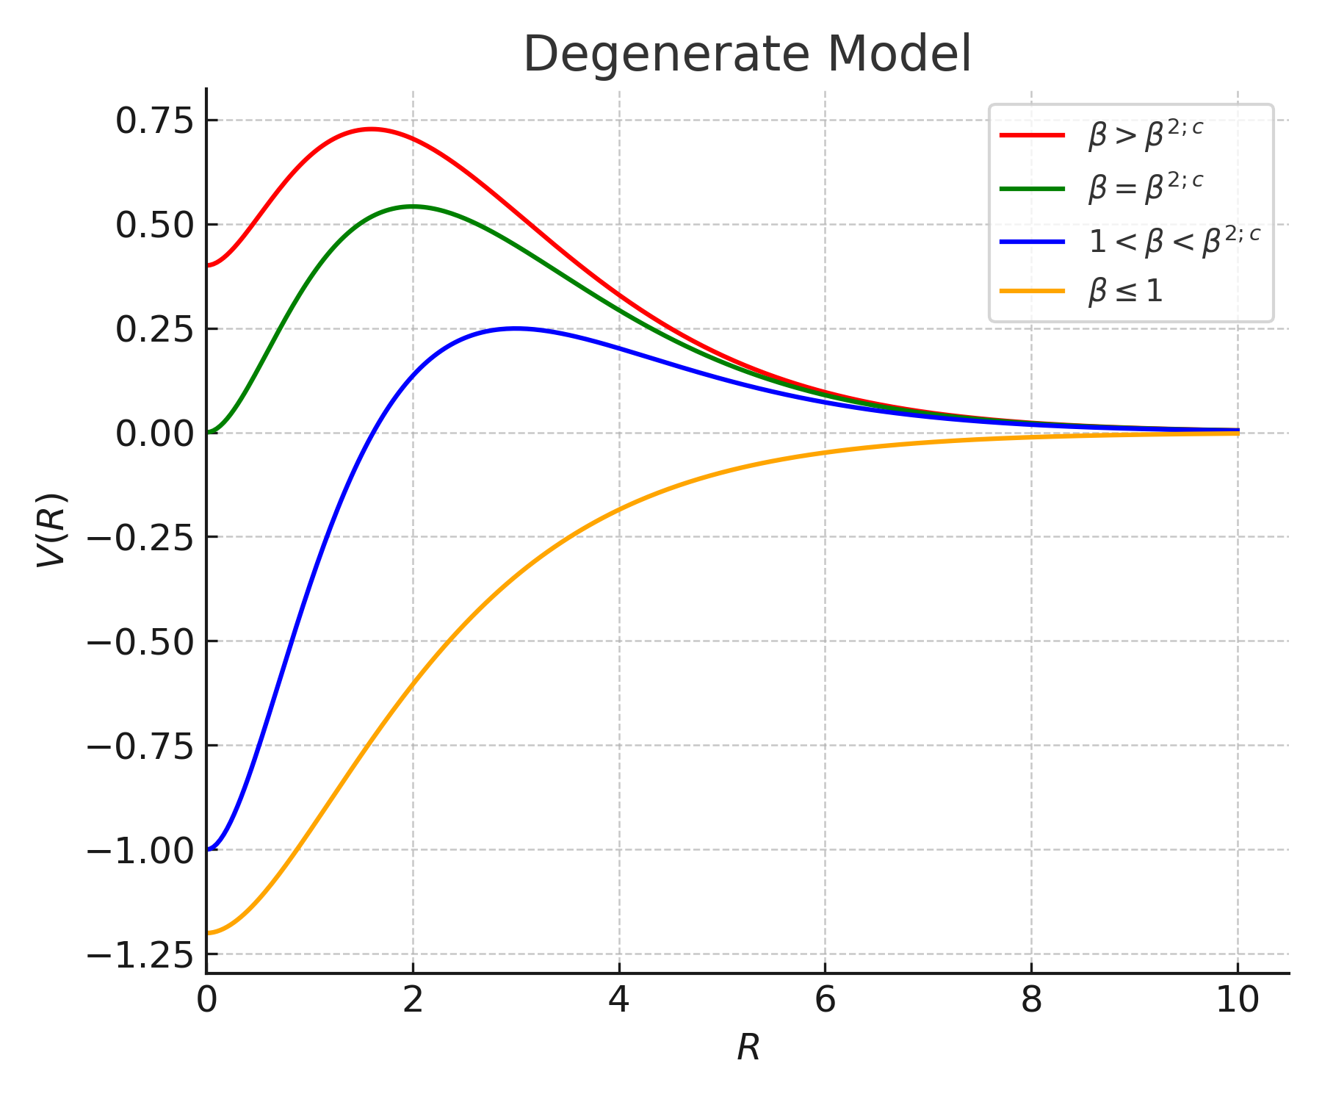
INTERACTION POTENTIAL AS A FUNCTION OF
SCHEMATIC CARTOON PREDICTION
Strings repel at infinity but can form rotationally symmetric bound states
Binding energy of a 2-string

