Slide 1






Isotope-Shift measurements in muonic ${}_{}^{10}B$ and ${}_{}^{11}B$2p/1s transitions with an mmc
César Godinho
ECT* Workshop
2025

Slide 2
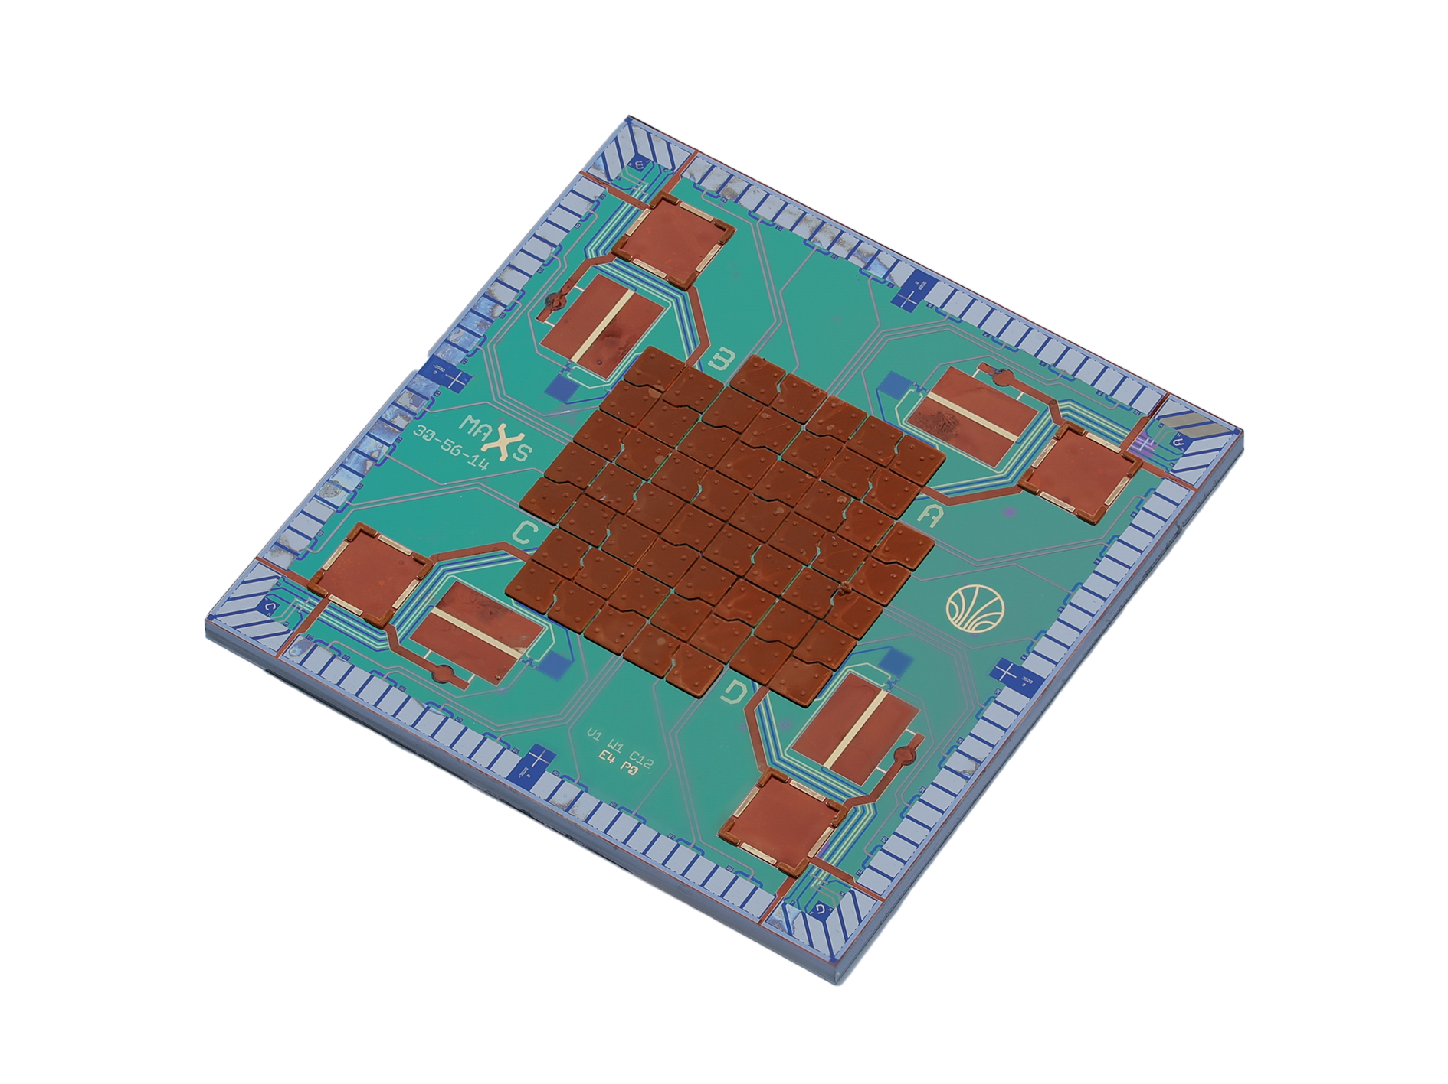
outline
Contextualization
Theoretical Baseline
Experimental Setup
Data Analysis
Future Steps

Slide 3
context
Charge radii of light nuclei

Slide 4
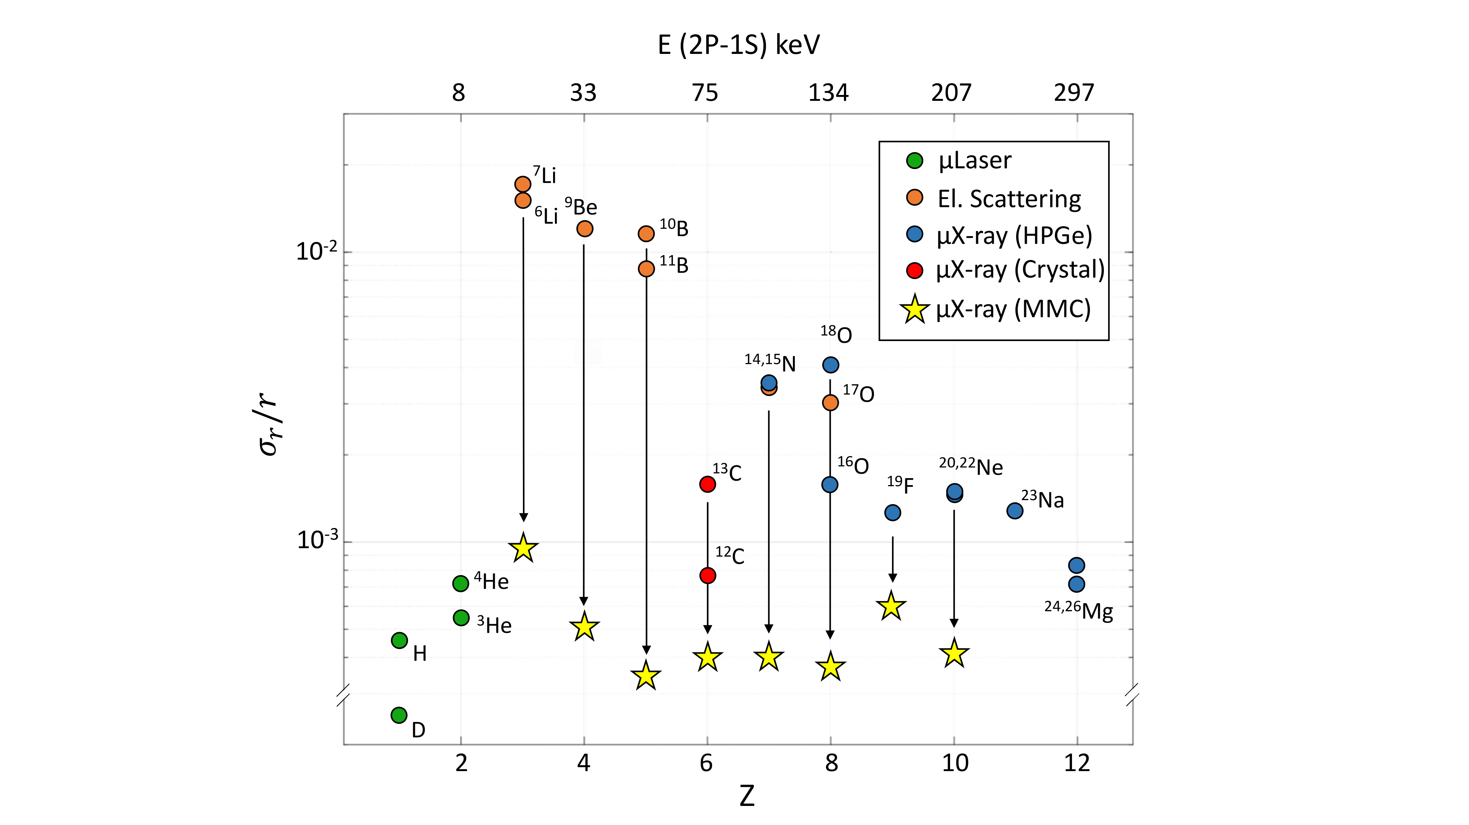
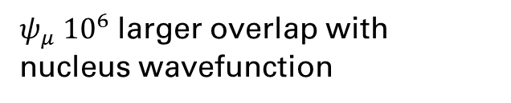

Motivation
$$m_{μ}\sim 200m_{e}$$
${ψ_{μ} 10}^{6}$ larger overlap with nucleus wavefunction
MMC detector with 1/1000 resolving power
Accessible to high-precision ab-initio nuclear theory
Towards Standard Model Fundamental Constants
A. Antognini et al. arXiv 2210.16929 (2022)
Notes:
Light nucliei accessible to nuclear theory calculations.
Shed some light on possible new physics and fundamental constants.

Slide 5
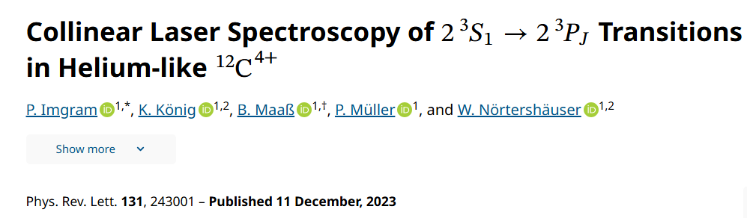
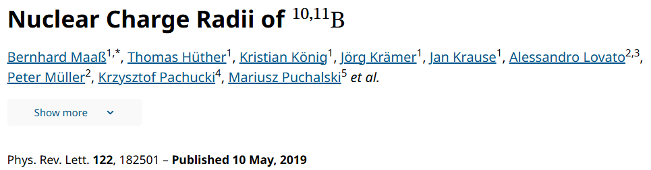
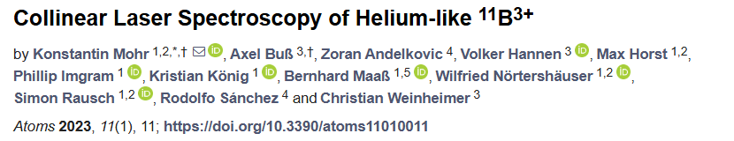
Motivation
Notes:
Light nucliei accessible to nuclear theory calculations.
Shed some light on possible new physics and fundamental constants.

Slide 6
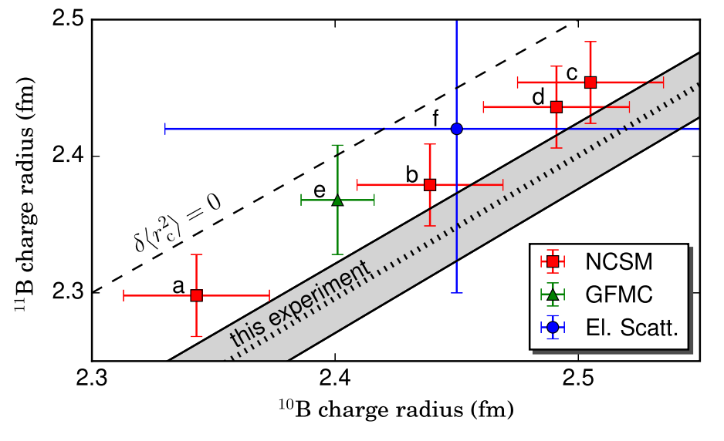
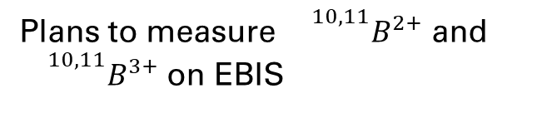
Motivation
Laser spectroscopy
He-like Ions
State-of-the-art calculations
Plans to measure ${}^{10,11}B^{2+}$ and ${}^{10,11}B^{3+}$ on EBIS
B. Maaß et al. Phys. Rev. Letters 122, 182501 (2019)
Notes:
The isotope shift between the stable isotopes of boron 10B and 11B was measured on a collimated atomic beam.
Beams of two lasers crossed the atomic beam in perpendicular alignment to perform resonance ionization mass spectrometry.

Slide 7
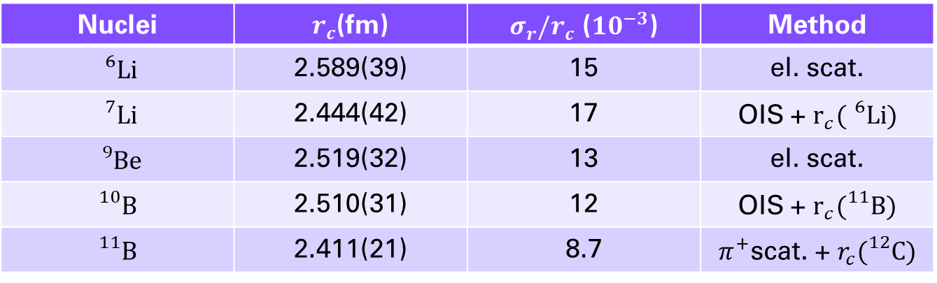
Past Measurements
Nuclei | $r_{c}$(fm) | $σ_{r}/r_{c}$ ($10^{−3}$) | Method
$${}_{}^{6}{\text{Li}}$$ | 2.589(39) | 15 | el. scat.
$${}_{}^{7}{\text{Li}}$$ | 2.444(42) | 17 | OIS + $r_{c}({}_{}^{6}{\text{Li}})$
$${}_{}^{9}{\text{Be}}$$ | 2.519(32) | 13 | el. scat.
$${}_{}^{10}{\text{B}}$$ | 2.510(31) | 12 | OIS + $r_{c}({}_{}^{11}{\text{B}})$
$${}_{}^{11}{\text{B}}$$ | 2.411(21) | 8.7 | $π^{+}$scat. + $r_{c}({}_{}^{12}{\text{C}})$
B. Ohayon et al. Physics 2024, 6, 206-215
Muonic ground state measurements lead to better Lamb shift predictions
X-ray and Laser spectroscopy of muonic species can lead the search for new physics
Compare charge radii to current state-of-the-art theory predictions

Slide 8

Past Measurements
Nuclei | $r_{c}$(fm) | $σ_{r}/r_{c}$ ($10^{−3}$) | Method
$${}_{}^{6}{\text{Li}}$$ | 2.589(39) | 15 | el. scat.
$${}_{}^{7}{\text{Li}}$$ | 2.444(42) | 17 | OIS + $r_{c}({}_{}^{6}{\text{Li}})$
$${}_{}^{9}{\text{Be}}$$ | 2.519(32) | 13 | el. scat.
$${}_{}^{10}{\text{B}}$$ | 2.510(31) | 12 | OIS + $r_{c}({}_{}^{11}{\text{B}})$
$${}_{}^{11}{\text{B}}$$ | 2.411(21) | 8.7 | $π^{+}$scat. + $r_{c}({}_{}^{12}{\text{C}})$
B. Ohayon et al. Physics 2024, 6, 206-215
Muonic ground state measurements lead to better Lamb shift predictions
X-ray and Laser spectroscopy of muonic species can lead the search for new physics
Compare charge radii to current state-of-the-art theory predictions

Slide 9
Past Measurements
Optical isotopic chain charge radii measurements depend on some reference isotope
Hence, they inherit an overpowering uncertainty from their reference
There is a need for high accuracy for a stable isotope of each considered light nuclei
Notes:
Mention QED contributions as a function of Z.

Slide 10
Our Measurements
In 2024 – Measured Be, Li and B
For 2025 – Planned C, N and O
Notes:
Mention QED contributions as a function of Z.

Slide 11
Theoretical baseline

Slide 13
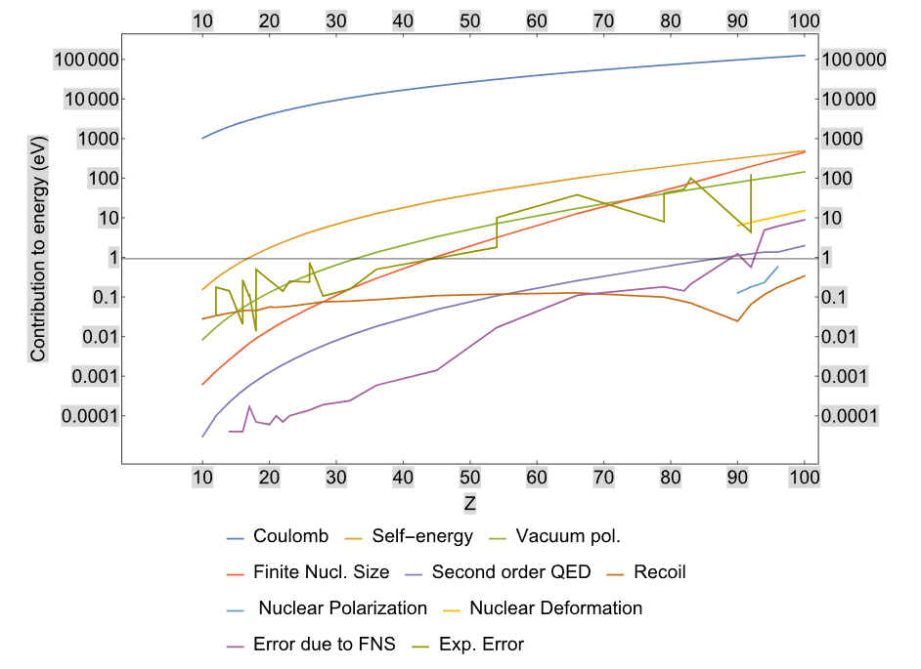
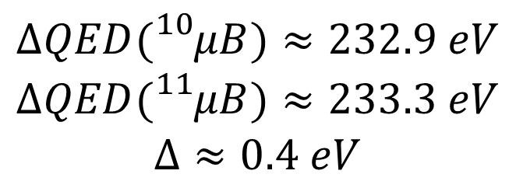
$$ΔQED({}_{}^{10}{μB)≈232.9 eV}$$
$$ΔQED({}_{}^{11}{μB)≈233.3 eV}$$
$$Δ≈0.4 eV$$
P Indelicato 2019 J. Phys. B: At. Mol. Opt. Phys. 52 232001
Notes:
Also mention lamb-Shift contributions.
Simplifying, multiple transitions in here.

Slide 14
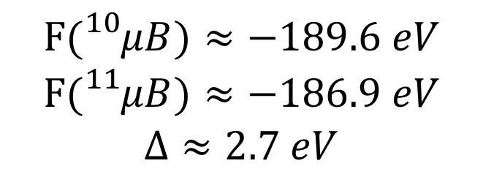
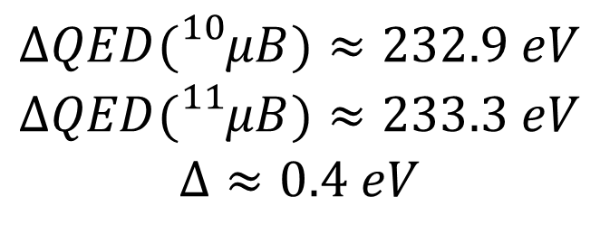
…
$$ΔQED({}_{}^{10}{μB)≈232.9 eV}$$
$$ΔQED({}_{}^{11}{μB)≈233.3 eV}$$
$$Δ≈0.4 eV$$
$$F({}_{}^{10}{μB)≈−189.6 eV}$$
$$F({}_{}^{11}{μB)≈−186.9 eV}$$
$$Δ≈2.7 eV$$
P Indelicato 2019 J. Phys. B: At. Mol. Opt. Phys. 52 232001
Notes:
F -> 7x DeltaQED!
Simplifying, multiple transitions in here
Reference: two-photon Exchange / Nuclear Polarizability

Slide 15
…
Why use muonic atoms?
Enlarged energy contributions
Precise QED corrections
Why use the isotope shift?
Model independent

Slide 16
Experimental setup

Slide 17
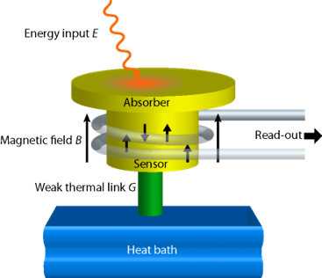
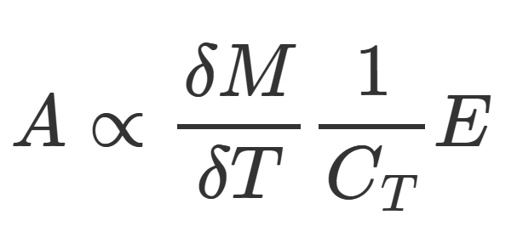
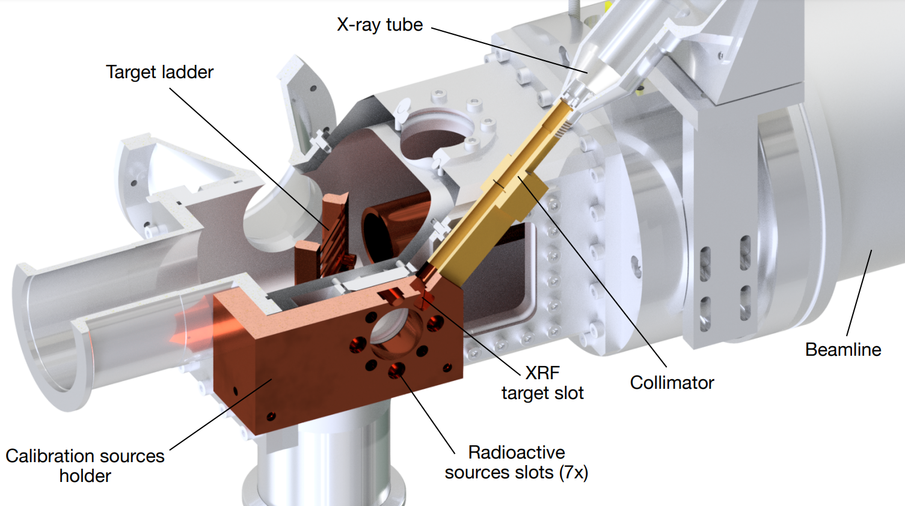
ADC
MMC ARRAY
Data Storage
&
Online Analysis
HPGe & SDD
Notes:
Mention MMC 0.5Hz per pixel
Each pixel is basically a detector
Really, they are linked by pairs
Mention how pixels are tied to the ADC

Slide 18
Data workflow

Slide 19
Raw Waveform
Filter Generation
Temperature Data
Amplitude Determination
Temperature Correction
Goodness of Fit and Holdoff Data Cuts
Spectra
Co-adding
Energy Calibration
Notes:
References + Proton size radius
Scattering
Spectroscopy

Slide 20
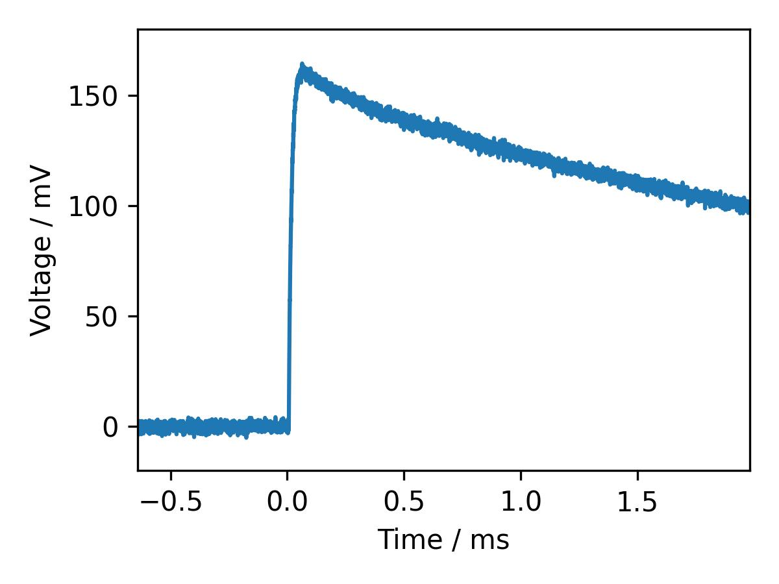
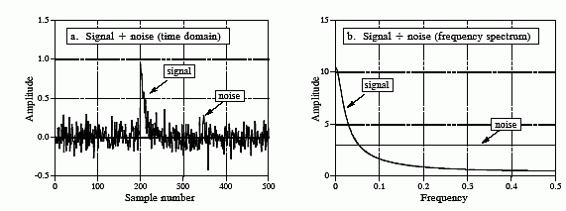

Raw Waveform
Template Or Optimal
Filtering
A
$$φ_{T}$$
The Scientist and Engineer's Guide to Digital Signal Processing, Steven W. Smith, Ch. 17
Notes:
A -> Amplitude for now on
phiT -> Used for temperature sensing on some specific pixels

Slide 21
Data
Analysis

Slide 22
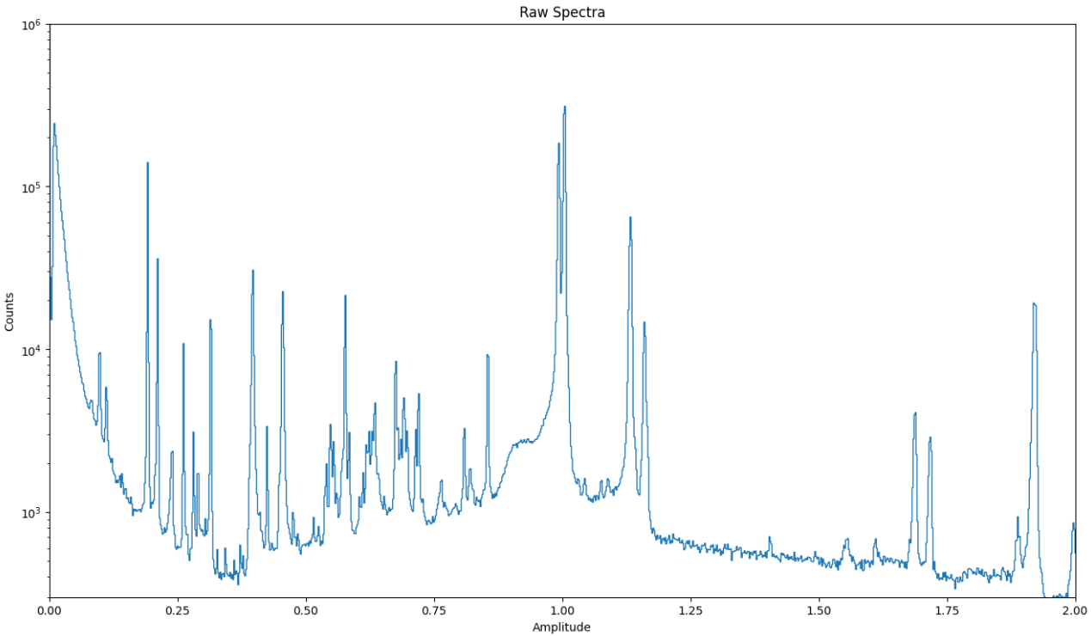






$$Cs$$
$$Mn$$
$$Ba$$
$$Am$$
$μB$ 2p-1s
$$Cs$$
Notes:
A -> Amplitude for now on
phiT -> Used for temperature sensing on some specific pixels

Slide 23
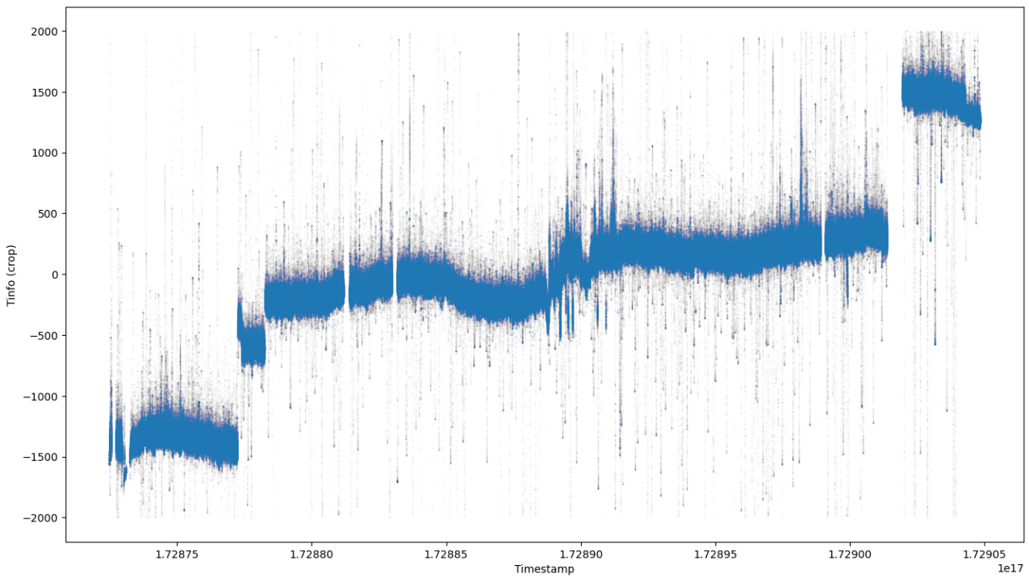
Temperature Data
ADC1
Big temperature variations
Notes:
Mention the temperature units
They are the diff to average temp

Slide 24
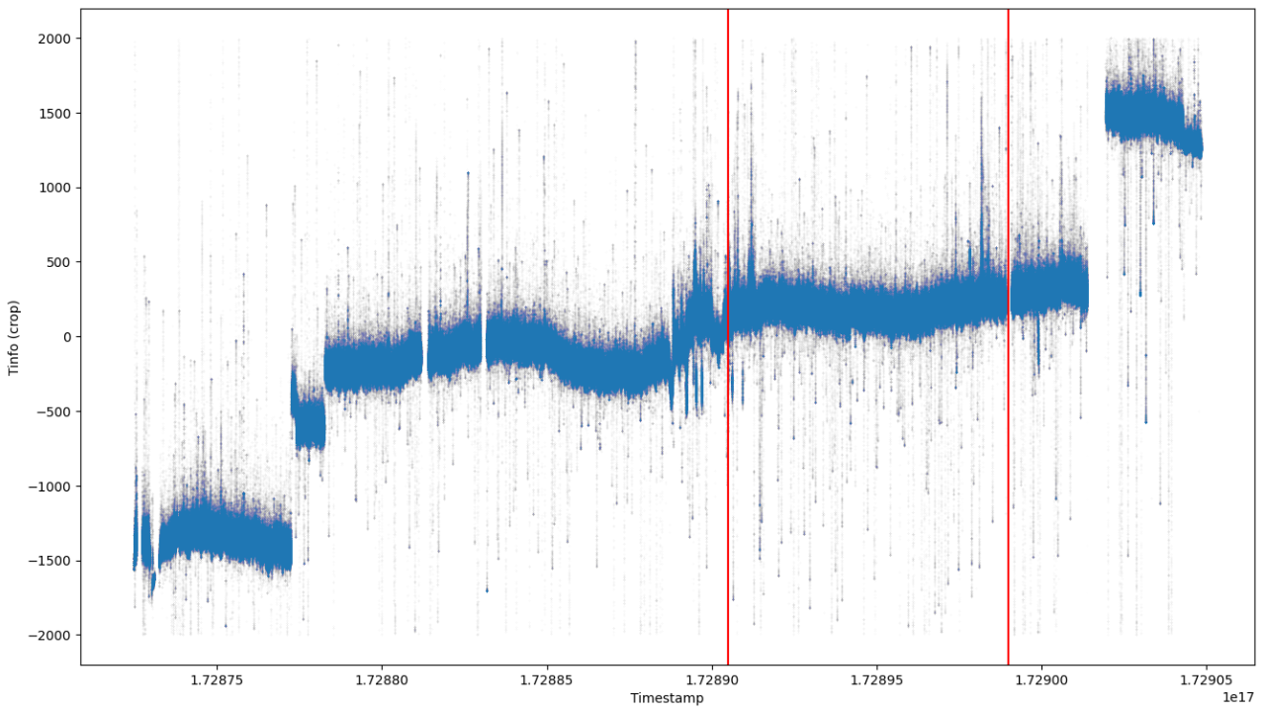
Temperature Data
ADC1
Crop the data to manageable stable region
Notes:
A -> Amplitude for now on
phiT -> Used for temperature sensing on some specific pixels

Slide 25
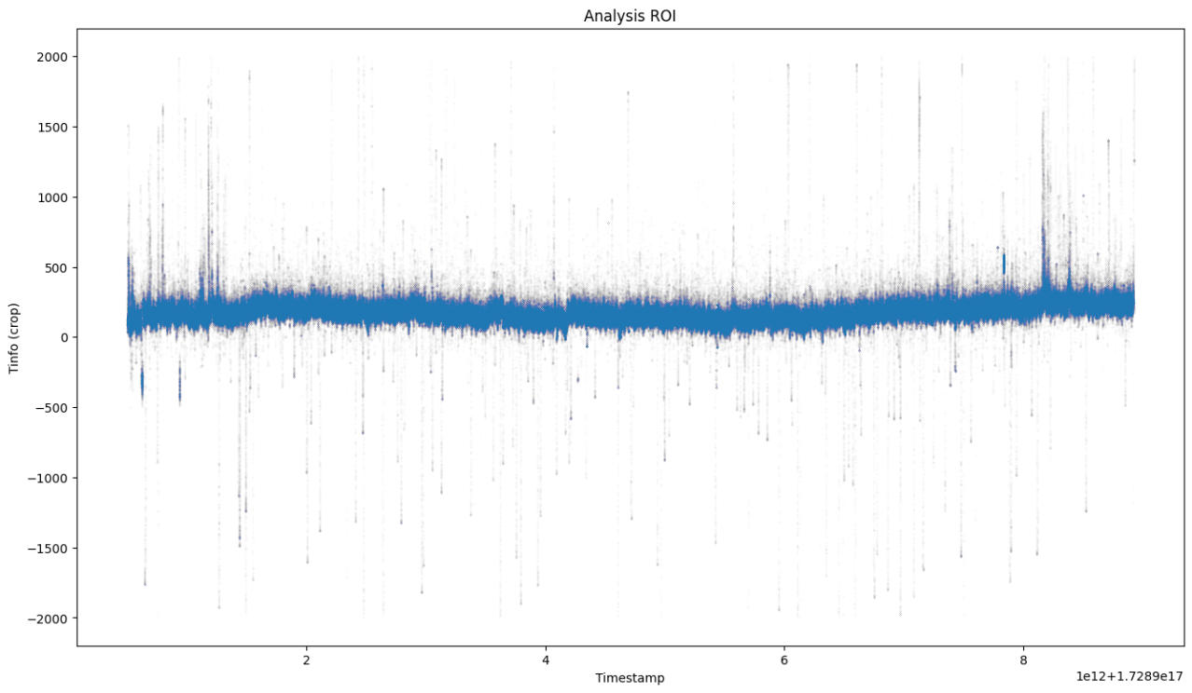
Temperature Data
Signal flux jump affects baseline
Notes:
A -> Amplitude for now on
phiT -> Used for temperature sensing on some specific pixels

Slide 26
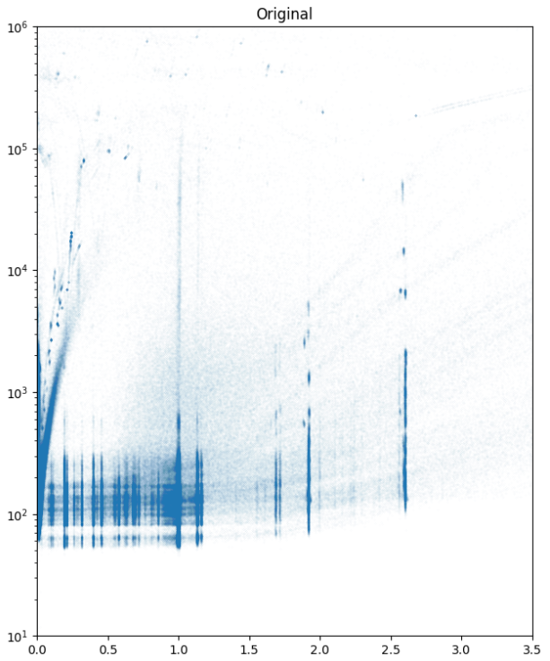

Goodness of Fit and Holdoff Data Cuts
Fit $χ^{2}$
Amplitude

Slide 27
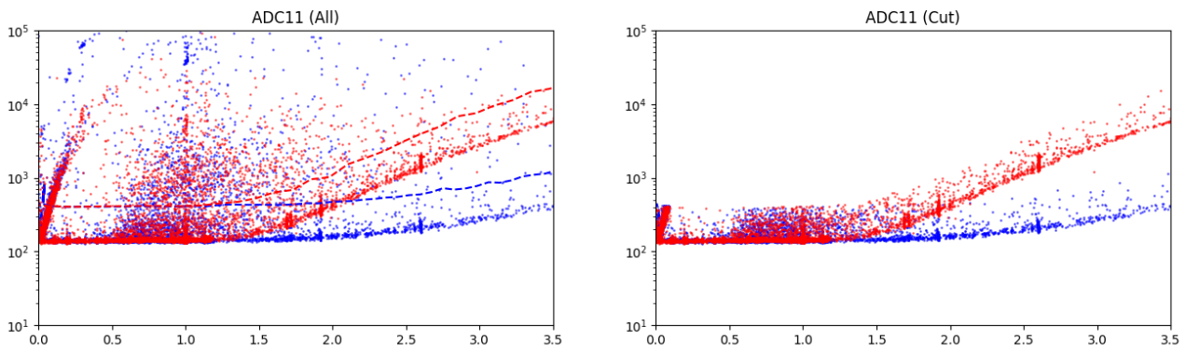


Goodness of Fit and Holdoff Data Cuts
Fit $χ^{2}$
Fit $χ^{2}$
Amplitude
Amplitude
Remove unwanted electron events
Remove unwanted poor fits

Slide 28
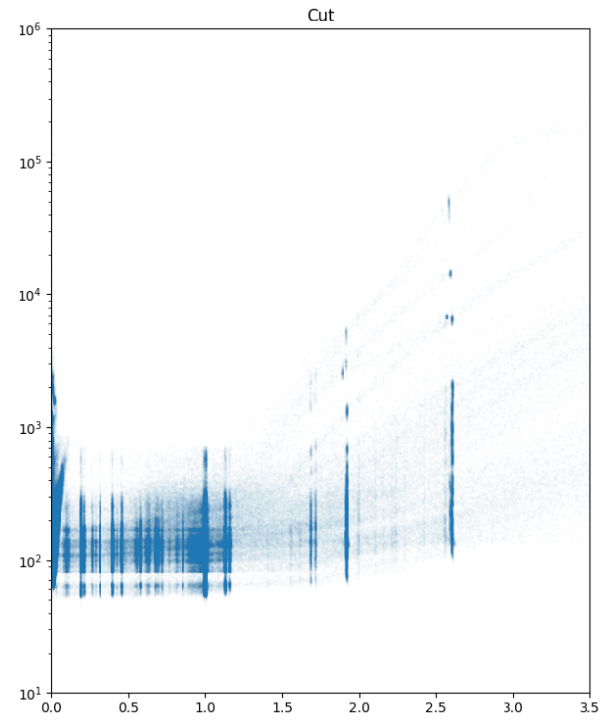

Goodness of Fit and Holdoff Data Cuts
Fit $χ^{2}$
Fit $χ^{2}$
Amplitude
Amplitude

Slide 29
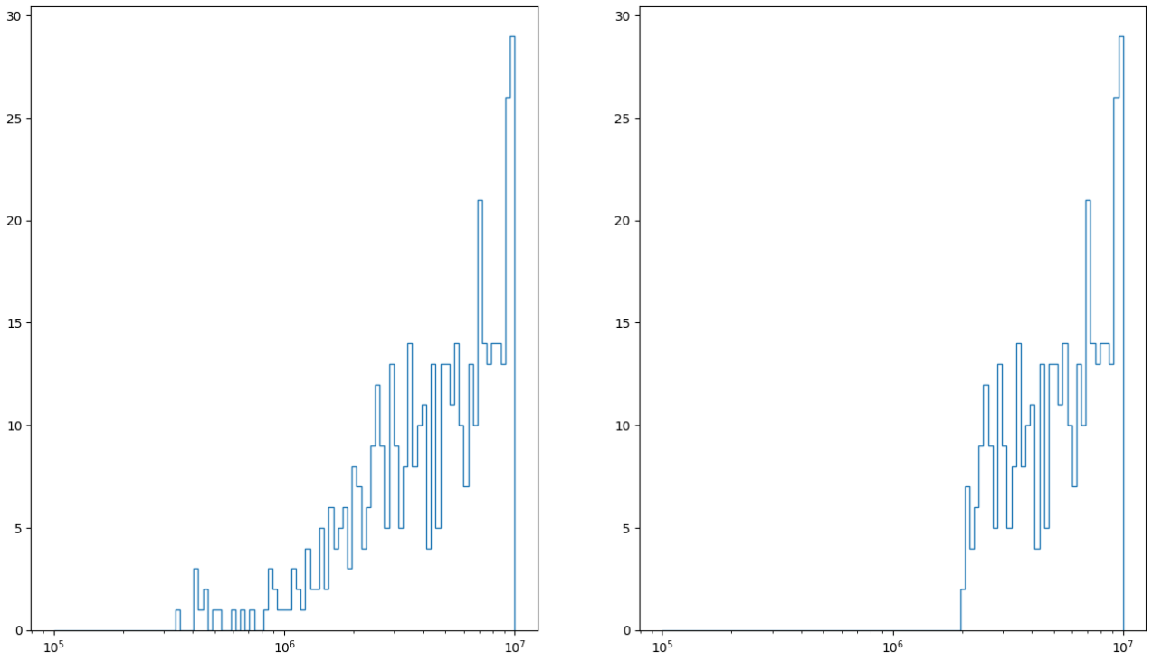
Goodness of Fit and Holdoff Data Cuts
ADC11_NEGP
Counts
Counts
Hit Events Time Delta (ns)
Hit Events Time Delta (ns)

Slide 30
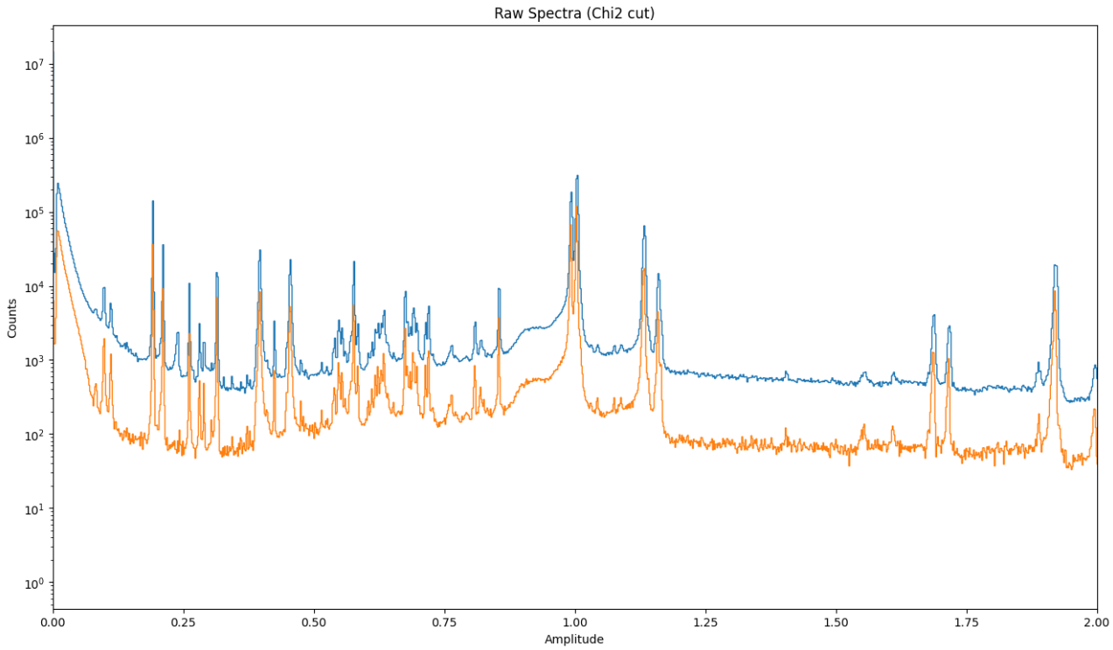
Goodness of Fit and Holdoff Data Cuts

Slide 31
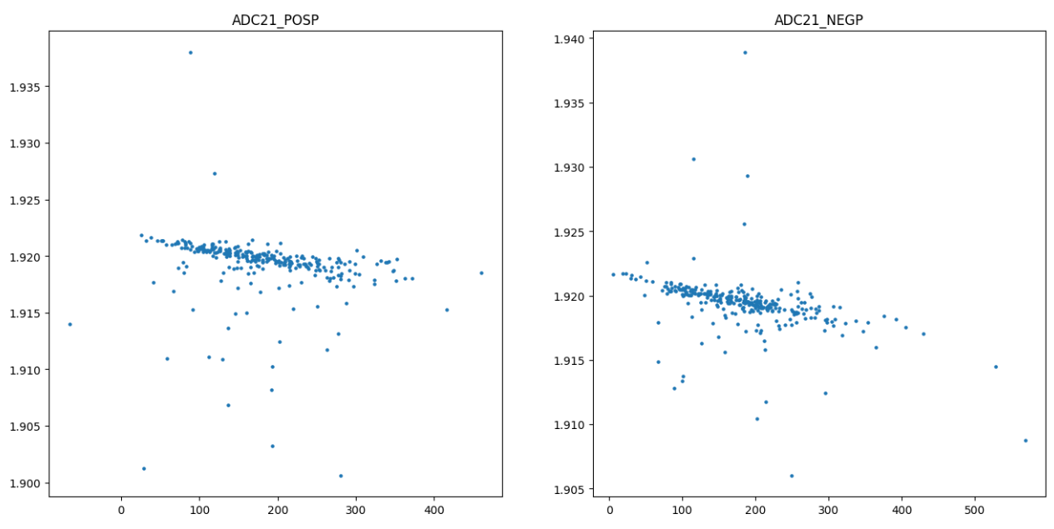
Temperature Correction
Amplitude
Amplitude
Tinfo
Tinfo

Slide 32
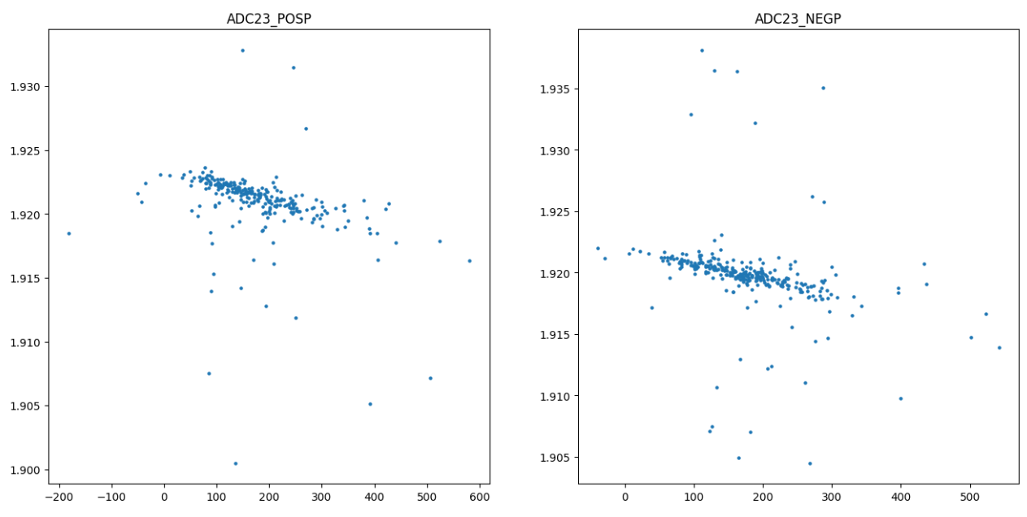
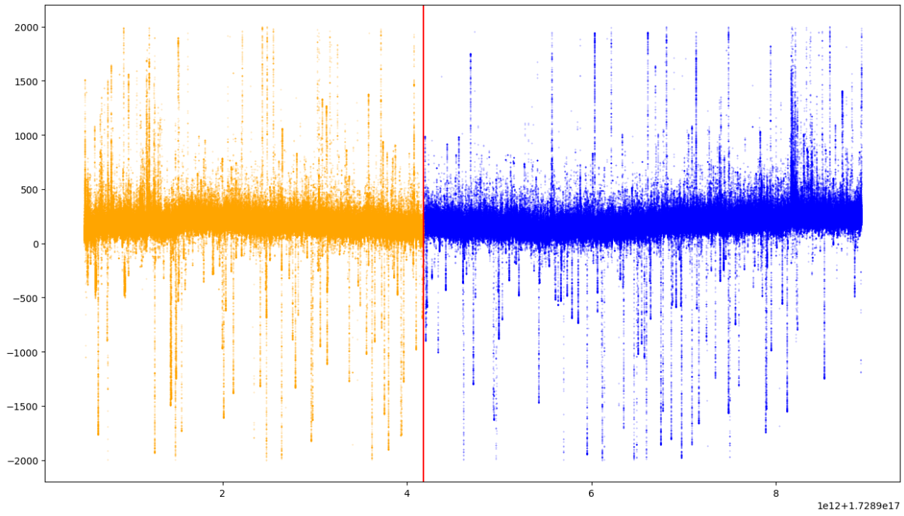
Temperature Correction
Amplitude
Amplitude
Tinfo
Tinfo
Amplitude temperature dependency

Slide 33
Temperature Correction
Tinfo
Timestamp

Slide 34
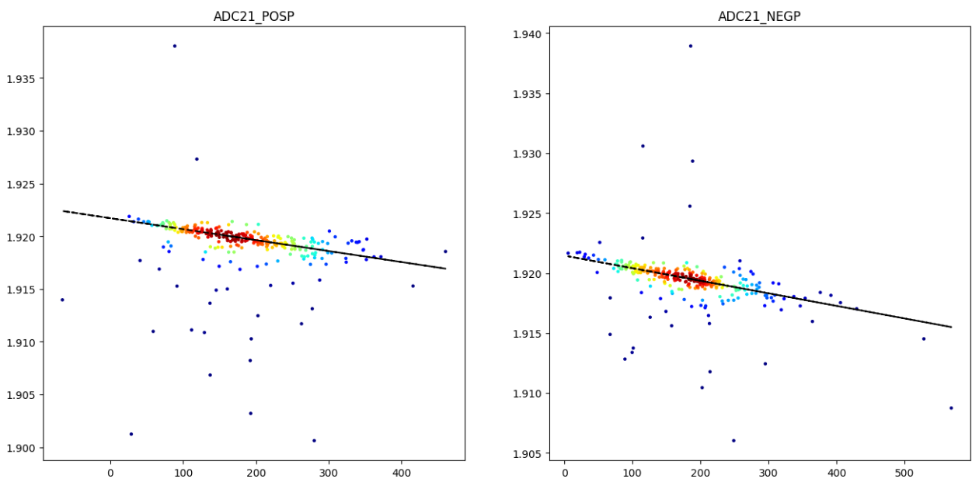
Temperature Correction
Amplitude
Amplitude
Tinfo
Tinfo
Use of Kernel Density Estimator for better fits

Slide 35
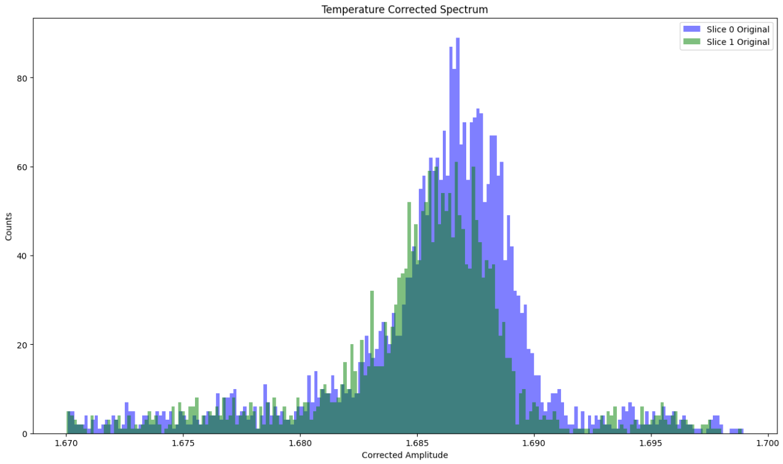
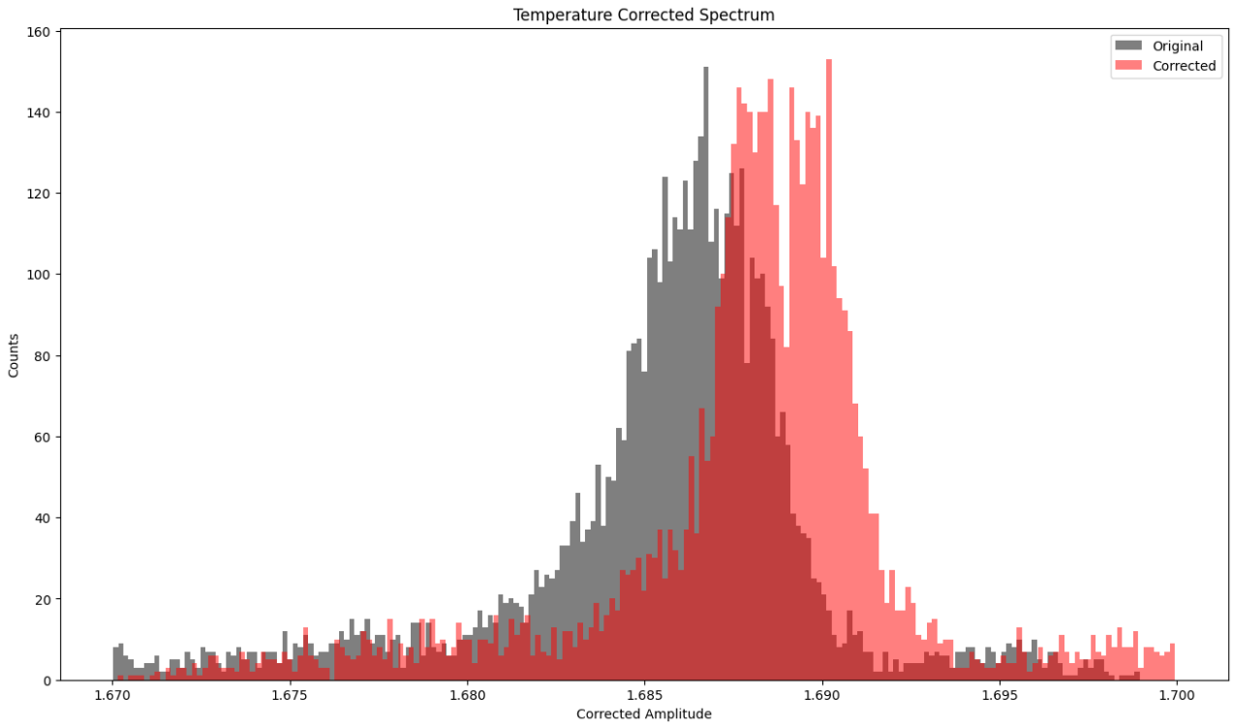

Temperature Correction
$$μB$$

Slide 36
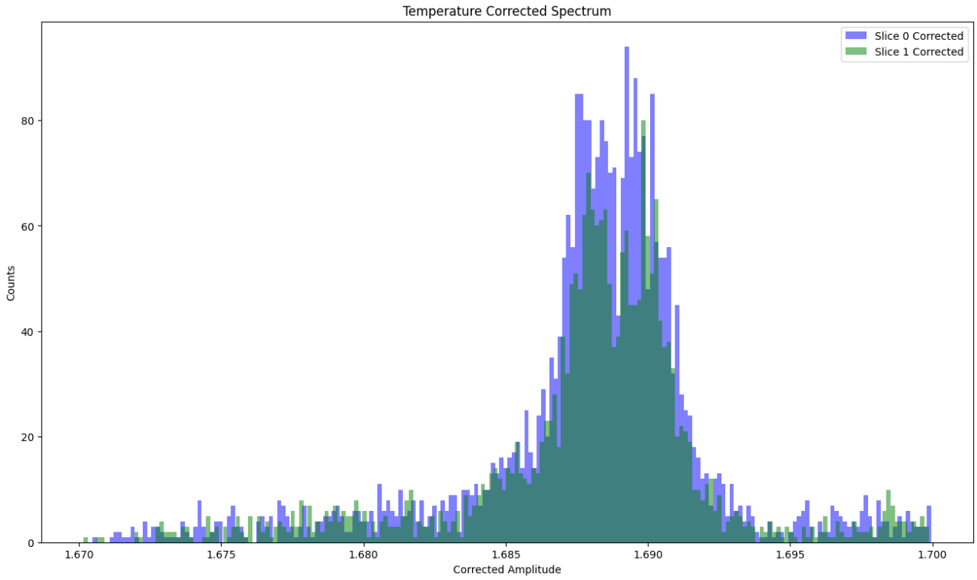
Temperature Correction
$$μB$$

Slide 37
Temperature Correction
$$μB$$

Slide 38
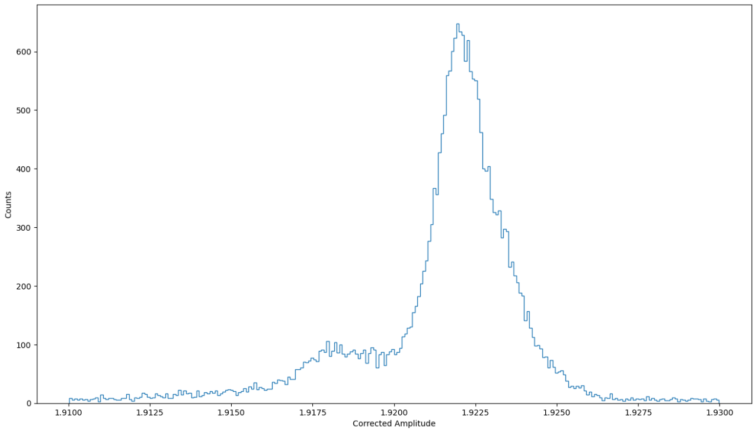

Spectra
Co-adding
$$Am$$

Slide 39
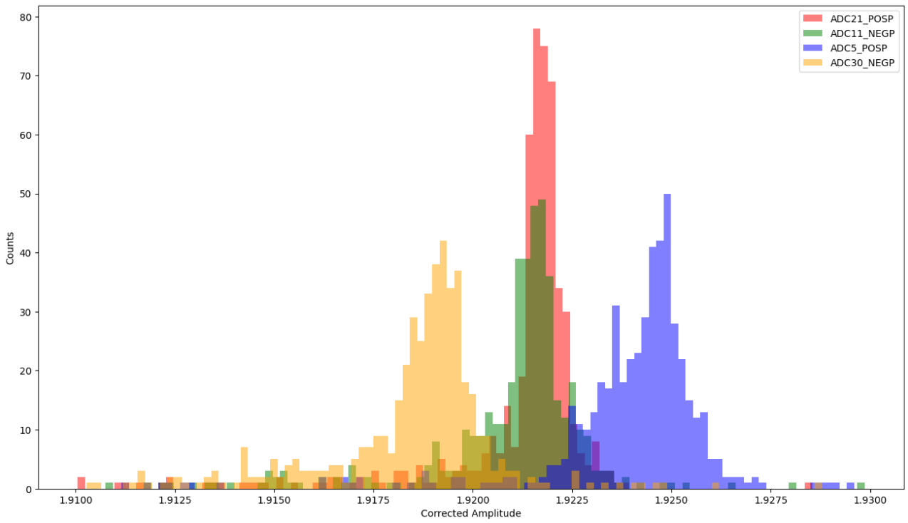

Spectra
Co-adding
$$Am$$

Slide 40


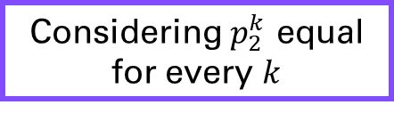

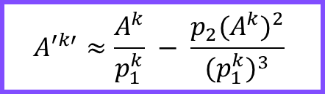


Spectra
Co-adding
$$E\left(A\right)=p_{1}A+p_{2}A^{2}$$
Ref. Non-Linear Folding
Linear Folding
Non-Ref. Non-Linear Folding
$$A′\left(A\right)=p_{1}^{k}A+p_{2}^{k} A^{2}$$
Knowing $p_{2}≪p_{1}$
$${A′}^{k′}={p_{1}^{k}A}^{k}+p_{2}^{k}{{(A}^{k})}^{2}$$
Use literature data and line shapes to “align” pixels
(Ideal if we had many counts across the board)
$${A′}^{k′}≈\frac{A^{k}}{p_{1}^{k}} − \frac{p_{2}({A^{k})}^{2}}{{{(p}_{1}^{k})}^{3}}$$
Use likelihood method to align histograms based on gain expressions
$${A′}^{k′}≈\frac{A^{k}}{G^{k}}$$
Line shape independent
Considering $p_{2}^{k}$ equal for every $k$
Notes:
- Both the linear folding and Non-Ref. Linear Folding are completely line shape independent!

Slide 41


Spectra
Co-adding
Linear Folding
$$Am$$
$$G^{k}$$

Slide 42

Spectra
Co-adding
Linear Folding
Maximal Likelihood Method
We use the nested_fit code package to evaluate the data using nested sampling.​
- Yields a Likelihood value for each model​
- Possible to calculate each Model Probability​
- Accounts for a Prior Probability on the models​
- Yields an Evidence for the Data​
Notes:
Due to fabrication diferences
And also other factors

Slide 43
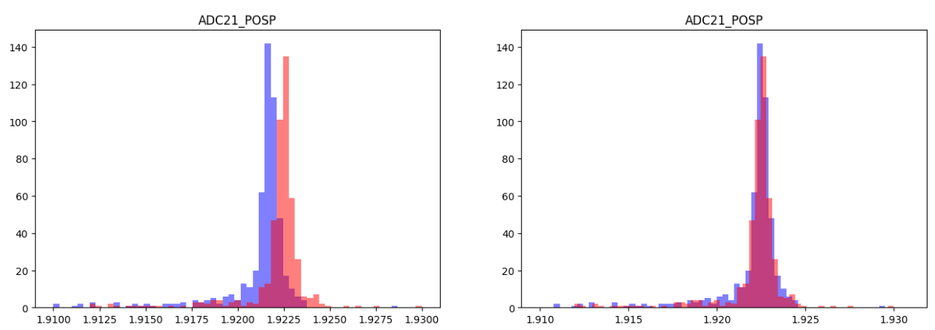
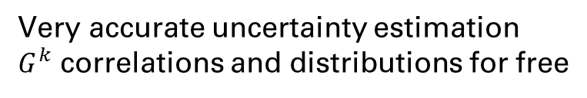
Spectra
Co-adding
Linear Folding
Maximal Likelihood Method
Ground Truth
ADC20_POSP
Counts
Counts
Data to Correct
ADC21_POSP
Corrected Amplitude
Corrected Amplitude
Model Evidence
One can compare between
Linear and Non-linear models
and quantitatively see which one is better
Very accurate uncertainty estimation
$G^{k}$ correlations and distributions for free
Notes:
Due to fabrication diferences
And also other factors

Slide 44
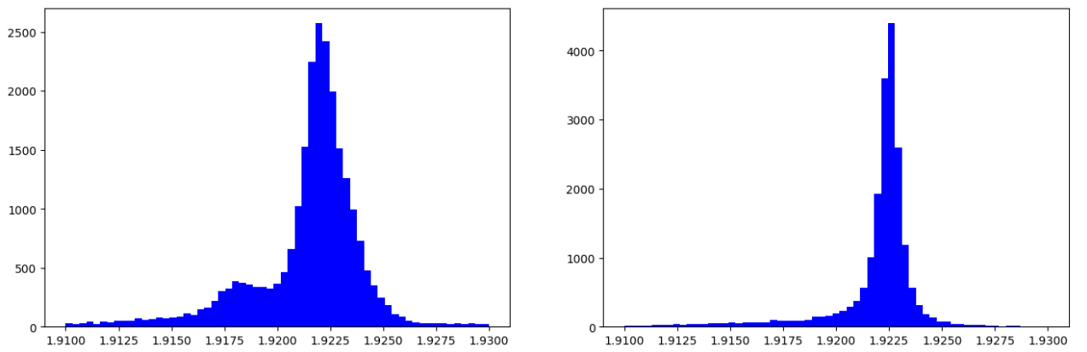


Spectra
Co-adding
Linear Folding
$Am$ (before folding)
$Am$ (after folding)
Counts
Counts
Corrected Amplitude
Corrected Amplitude
Notes:
Due to fabrication diferences
And also other factors

Slide 45
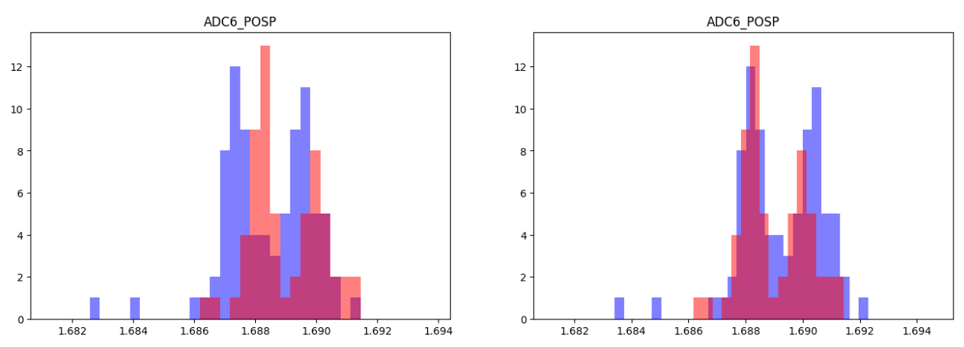

Spectra
Co-adding
Linear Folding
$$μB$$
Counts
Counts
Corrected Amplitude
Corrected Amplitude
Notes:
Due to fabrication diferences
And also other factors

Slide 46
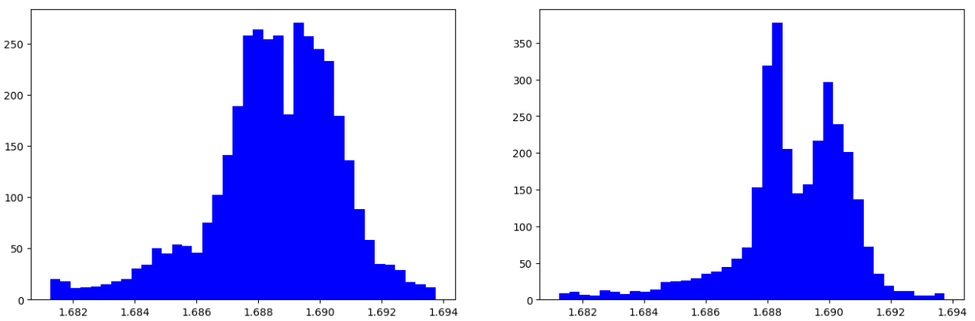


Spectra
Co-adding
Linear Folding
$μB$ (before folding)
$μB$ (after folding)
Counts
Counts
Corrected Amplitude
Corrected Amplitude
Notes:
Due to fabrication diferences
And also other factors

Slide 47
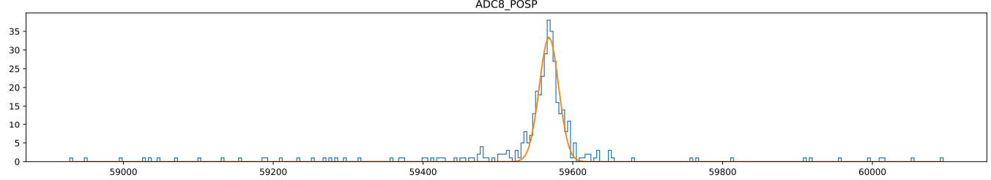
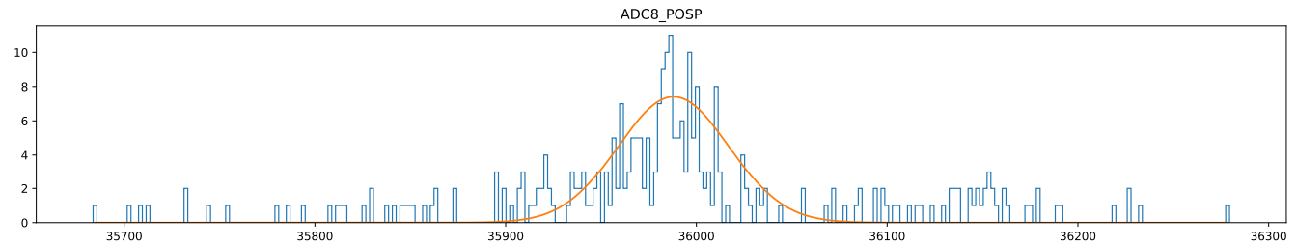
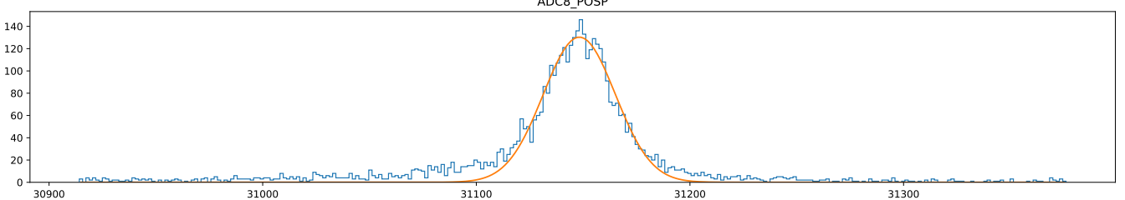
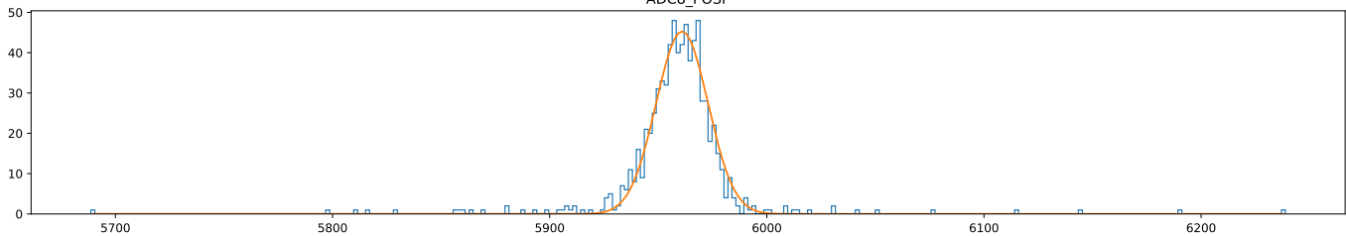




Spectra
Co-adding
Ref. Non-Linear Folding
$$Am$$
Line shape dependency
$$Ba$$
High statistics dependency
Counts
$$Cs−Kα$$
$$Mn$$
Corrected Amplitude (Scaled)
Notes:
Notes on statistics needs
And also on peak locality
If we are far away from the peak of interest

Slide 48
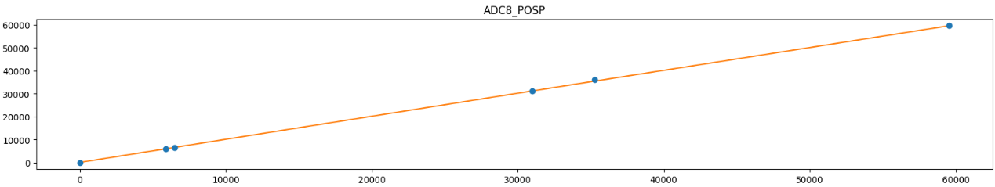
Spectra
Co-adding
Ref. Non-Linear Folding
Literature (eV)
Corrected Amplitude (Scaled)
Physically accurate quadratic correction
Errors not visible at current scale
Notes:
Notes on statistics needs
And also on peak locality
If we are far away from the peak of interest

Slide 49
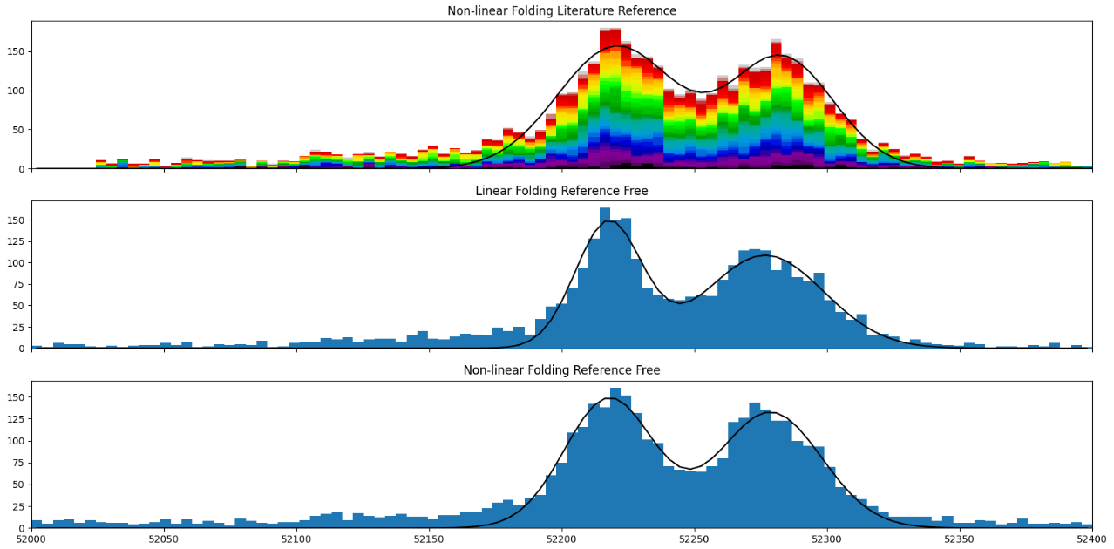




Spectra
Co-adding
Ref. Non-Linear Folding
$$μB$$
$$\sim 50eV FWHM$$
Counts
$$\sim 30eV FWHM$$
$$\sim 40eV FWHM$$
Corrected Amplitude (Scaled)
Notes:
Notes on statistics needs
And also on peak locality
If we are far away from the peak of interest

Slide 50
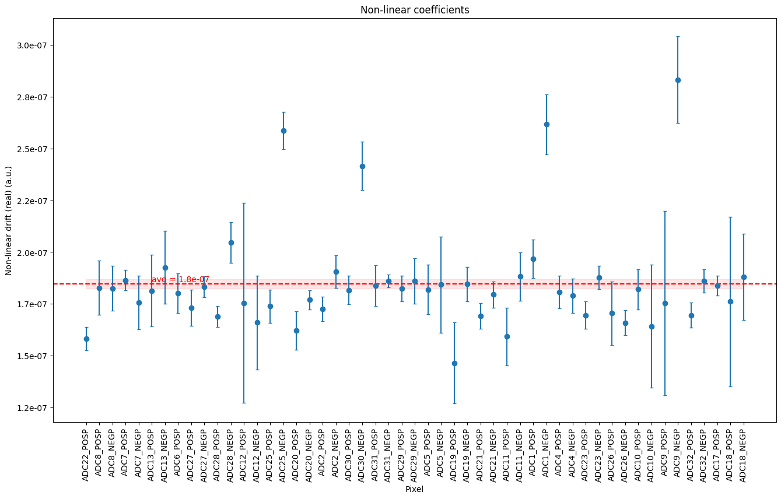
Spectra
Co-adding
Ref. Non-Linear Folding
Require < 1 eV uncertainty
Non-linearity correction plays a big role on this
Non-linear drift (1/eV)
Notes:
Notes on statistics needs
And also on peak locality
If we are far away from the peak of interest

Slide 51



Energy Calibration
Linear Folding
Using coarse model
Preliminary $≈60 eV$ isotope shift
Notes:
Notes on statistics needs
And also on peak locality
If we are far away from the peak of interest

Slide 52
Brief co-adding summary

Slide 53
Linear Folding
Literature reference free
Ref. Non-linear Folding
No “master” pixel required
Non-Ref. Non-linear Folding
Literature reference free
Line shape not required
Assumes constant non-linear gain
Requires “master” pixel
Requires line shape knowledge
More dependent on number of events
Requires literature reference
Basically, a per-pixel “calibration”
Line shape not required
Requires “master” pixel
Folds globally
Only folds locally
Basically, a per-pixel “calibration”
More complex
Simple

Slide 54
Future work

Slide 55
Use Bayesian likelihood methods to analyze which model best co-adds the data
Figure out if it is reasonable to use a global non-linear constant for all the data pixels
Improve ref. non-linear folding by using better line shapes (e.g., recursive approach)
Fit HFS model to data and analyze the Boron line shape and quantify the isotopic shift

Slide 56
Isotope-Shift measurements in muonic ${}_{}^{10}B$ and ${}_{}^{11}B$2p/1s transitions with an mmc
César Godinho
ECT* Workshop
2025

