Slide 1




Magnetic Micro-Calorimeters
for atomic and nuclear physics
Andreas Fleischmann, Loredana Gastaldo, and a large team at
Heidelberg University
New perspectives in the charge radii determination for light nuclei
ECT* Workshop, July 2025, supported by

Slide 2
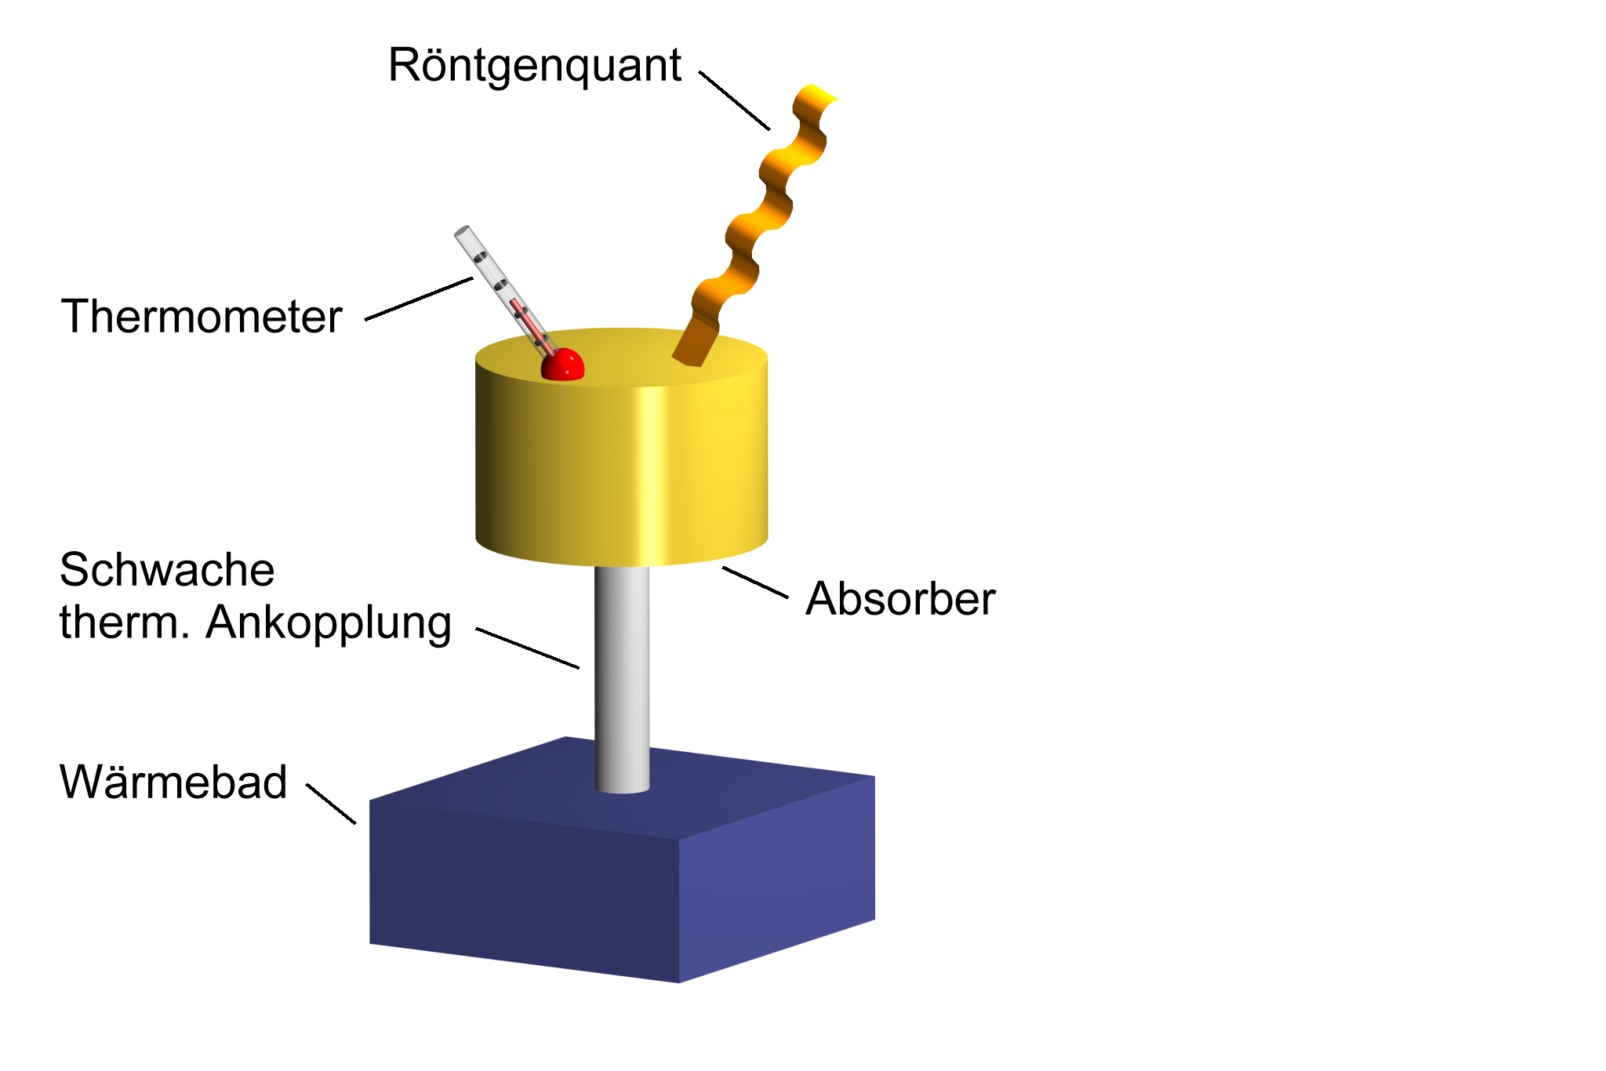
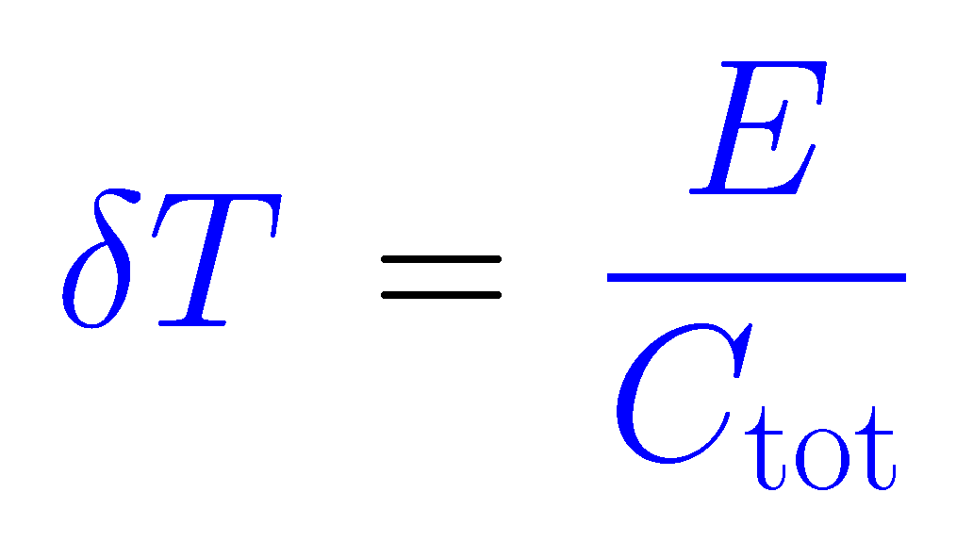
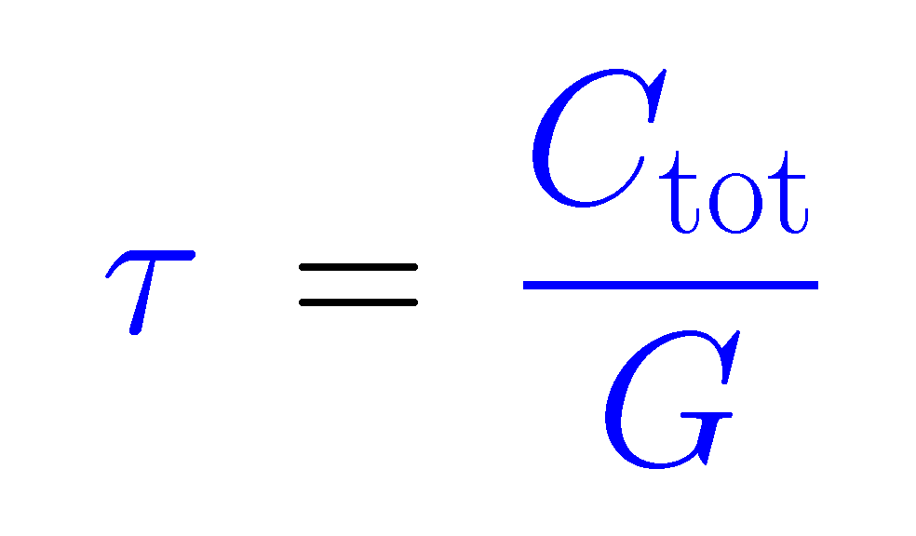
micro-calorimeters
X-ray photon or particle
Thermal detectors !
Somewhat numb:
Convert good form of energy to heat!
Thermometer
Temperature change
Weak thermal link G
Absorber C
Relaxation to bath temperature
Thermal bath
(T < 100mK)
Operation at low temperature (T < 0.1 K):
small specific heat
large temperature change
small thermal noise !

Slide 3
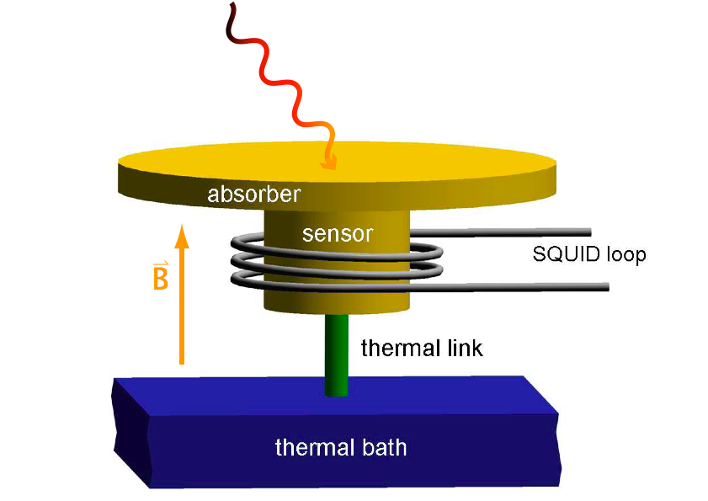
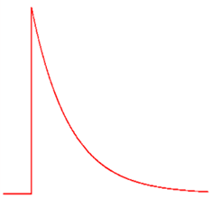
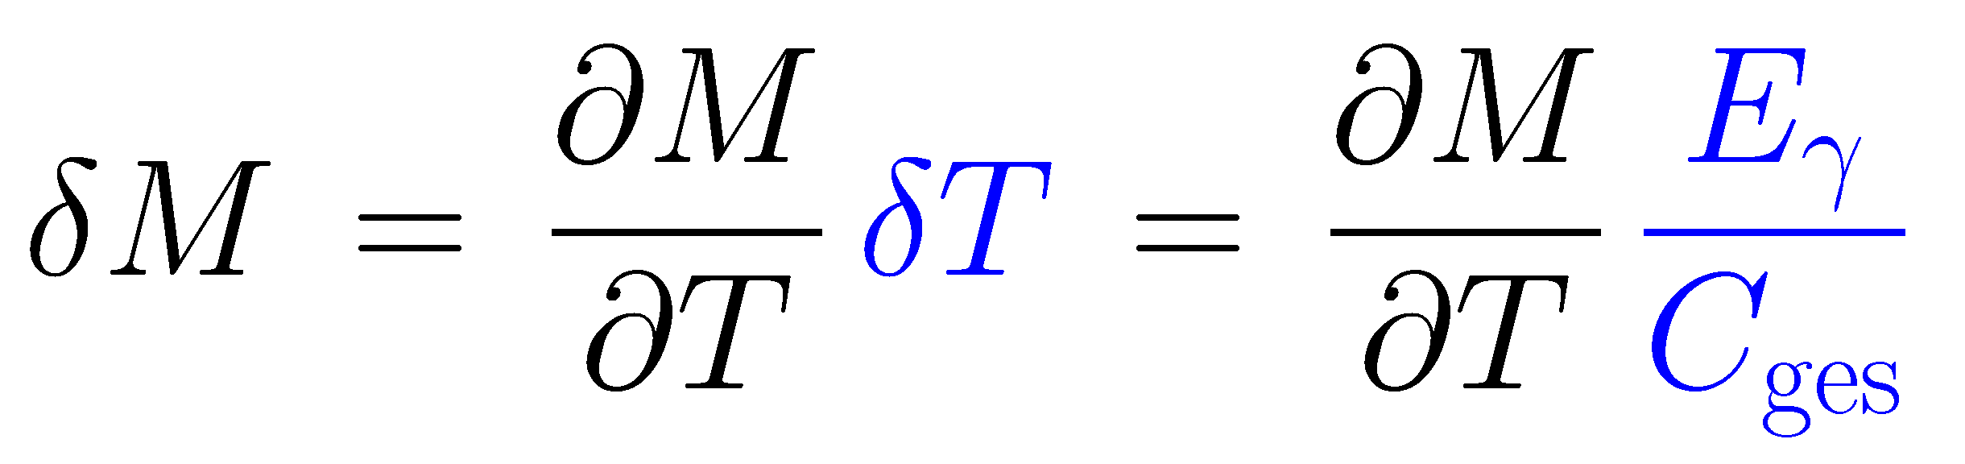
metallic magnetic calorimeters
paramagnetic sensor: Au:Er_{500ppm} , Ag:Er
T
M
T
~1 mK
signal size:
~1 ms
20 mK
t
main differences to resistive sensors like TES and thermistors
no dissipation in the sensor
no galvanic contact to the sensor
M and C of weakly interacting spins well understood
important for large arrays
numerical optimization
non-linearity: small & understood from thermodynamics

Slide 4
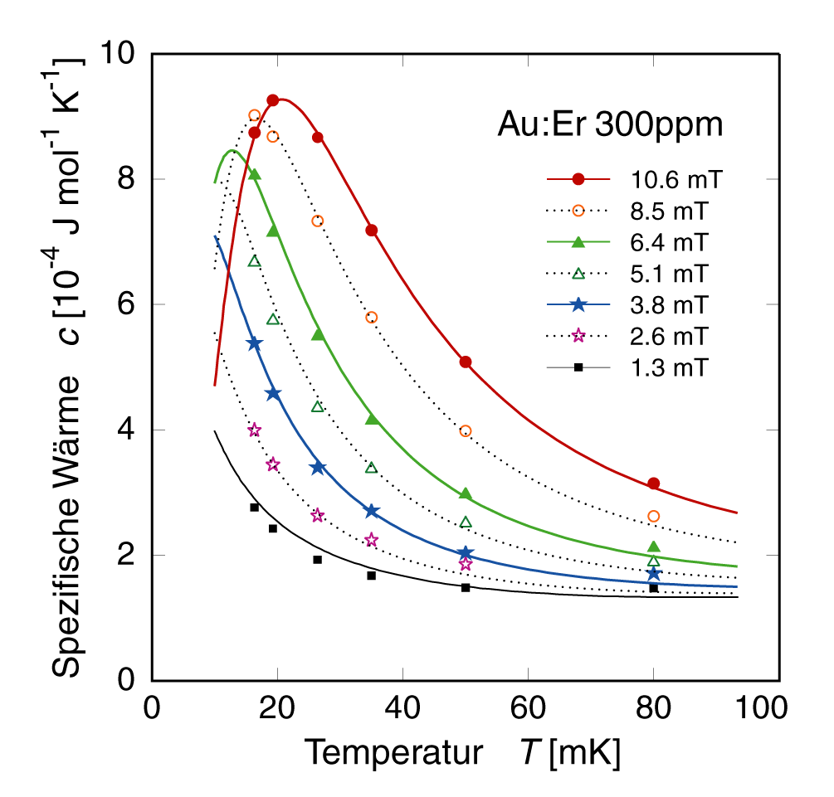
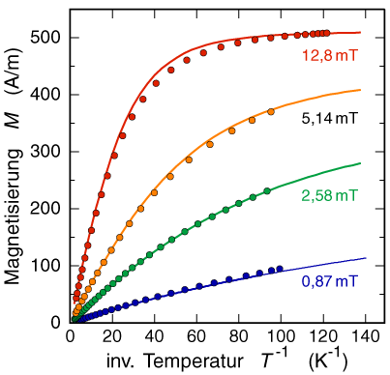
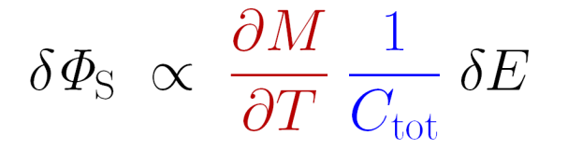
thermodynamical properties of Au:Er, Ag:Er
thermodynamic properties of interacting spins are well understood
Au:Er 300 ppm
Au:Er 300 ppm
Au:Er 300 ppm
typical range
of operation
Specific heat C [10⁻⁴ J mol⁻¹K⁻¹]
Magnetization M [A/m]
electrons
Inverse Temperature T⁻¹ [K ⁻¹]
Temperature T [mK]
signal size can be predicted with confidence
non-linearity as well !
RKKY-interaction between Er-spins ~ 3 times stronger in silver

Slide 5
detector geometries
planar paramagnetic T-sensor
superconducting pickup loop with persistent current to generate bias B-field
meander-shaped pick-up coil
stripline (sandwich) design
250 μm
filling factor ≈ 0.4
filling factor ≈ 0.8

Slide 6
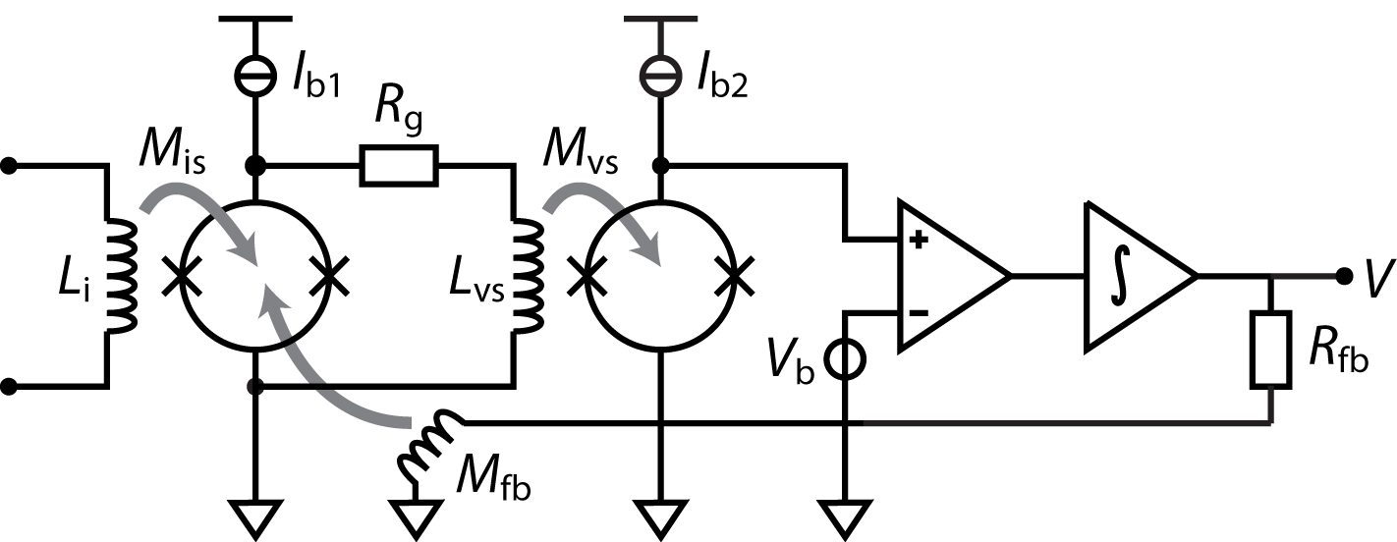
two-stage dc-SQUID setup
< 100 mK
300K
input coil should
match pickup coil
main advantages:
low readout noise
large system bandwidth (several MHz)
low power dissipation (close to the MMC)
linearization by flux locked loop

Slide 7
microwave SQUID multiplexer (µMUX)
readout 100s of pixels with only one HEMT amplifier and two coaxes

Slide 8
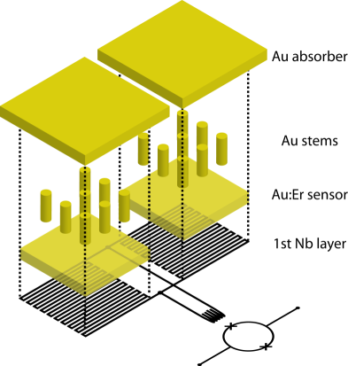
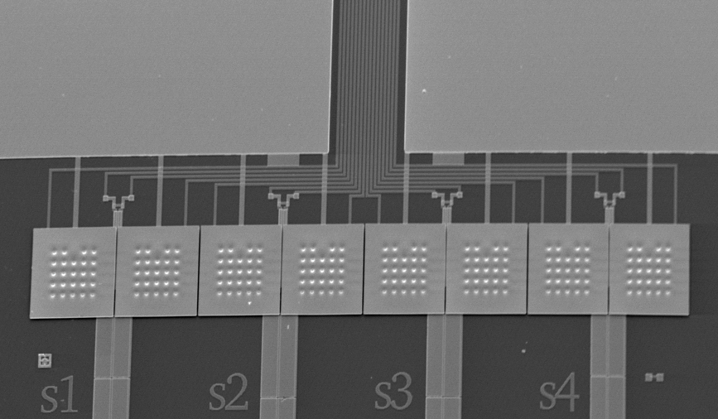
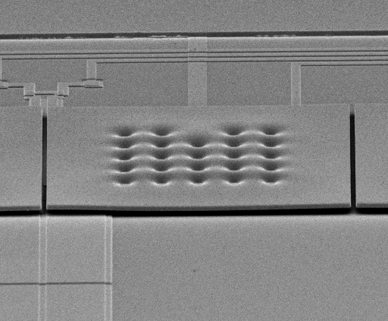
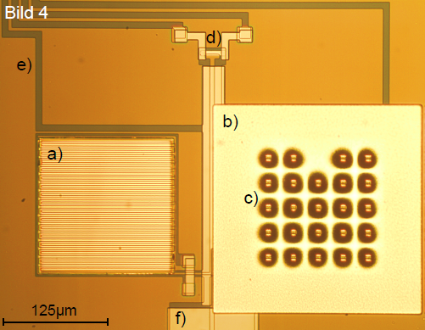
micro-fabricated devices: first 1×8 array for soft x-rays (a decade ago)
1×8 x-ray absorbers
  250μm×250 μm gold, 5 μm thick
  98% qu.-eff. @ 6 keV
  electroplated into photoresist mold
  mech/therm contact to sensor by stems
  to prevent loss of initially hot phonons
Au:¹⁶⁶Er_{300ppm} temperature sensors
Superconducting meander shaped pickup coils
  2.5 μm wide Nb lines
  I_{c} ≈ 100mA
On-chip persistent current switch (AuPd)
Au:Er
on
Nb meander
250 μm

Slide 9
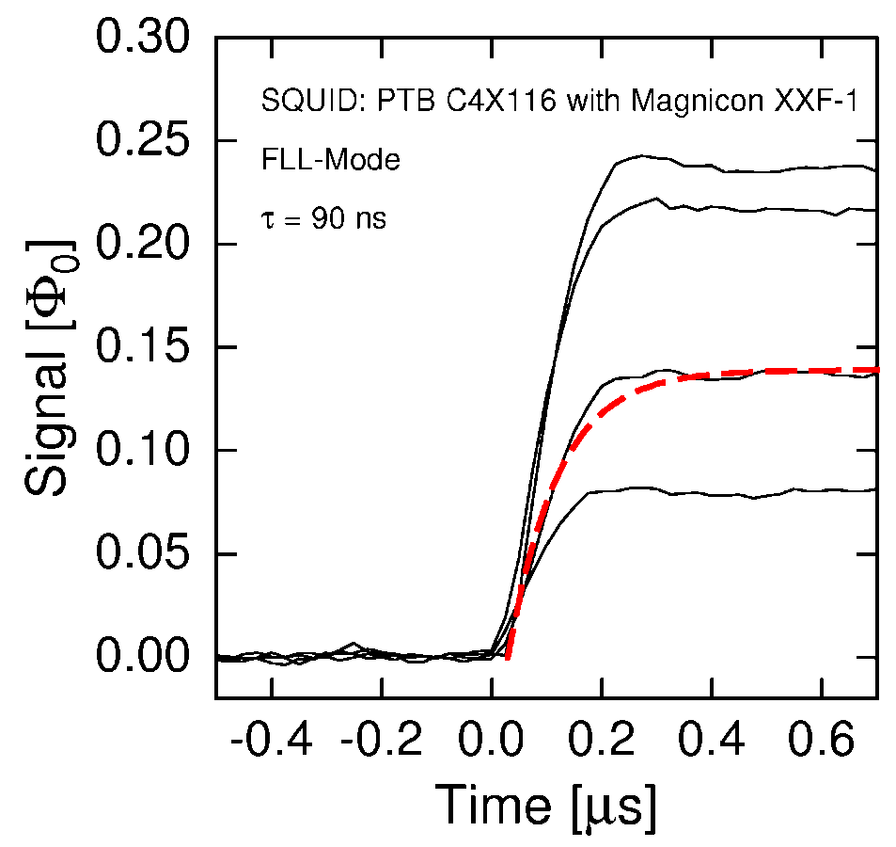
signal rise in compact x-ray detectors
rise time: 90 ns @ 30 mK, as expected for the electron-spin-relaxation of Er in Au

Slide 10
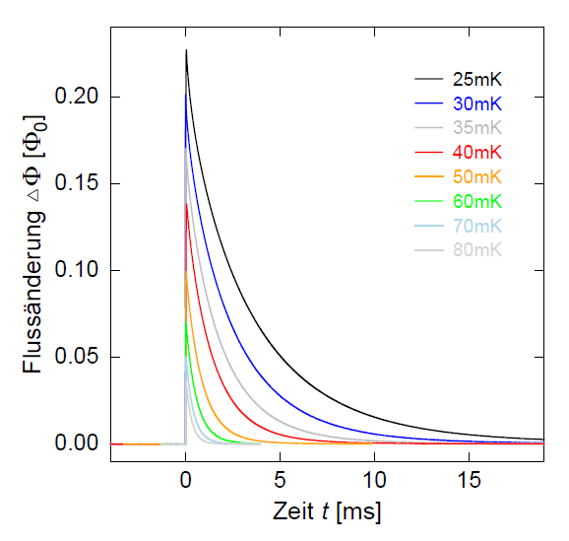
signal decay
decay time
adjusted by metallic thermal link (Au)
here: 3 ms @ 30 mK
On-chip thermal bath
magnetic flux
time

Slide 11
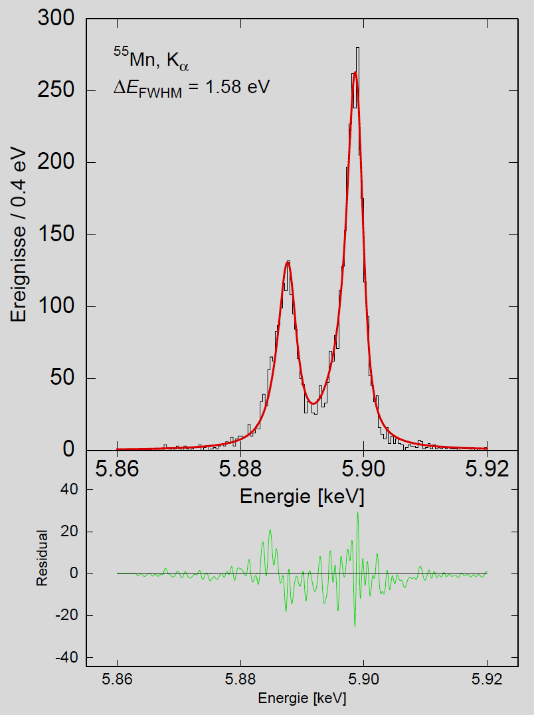
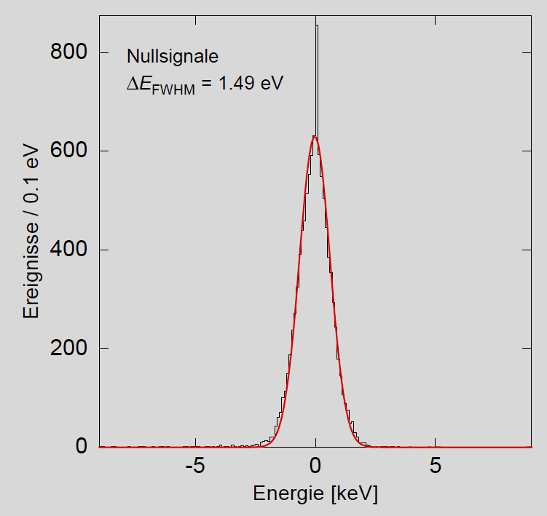
first 1×8 array for soft x-rays
⁵⁵Mn
ΔE_{FWHM} = 1.5 eV @ 0 keV
ΔE_{FWHM} = 1.6 eV @ 6 keV
Defines state-of-the-art together with TES from NIST and NASA

Slide 12
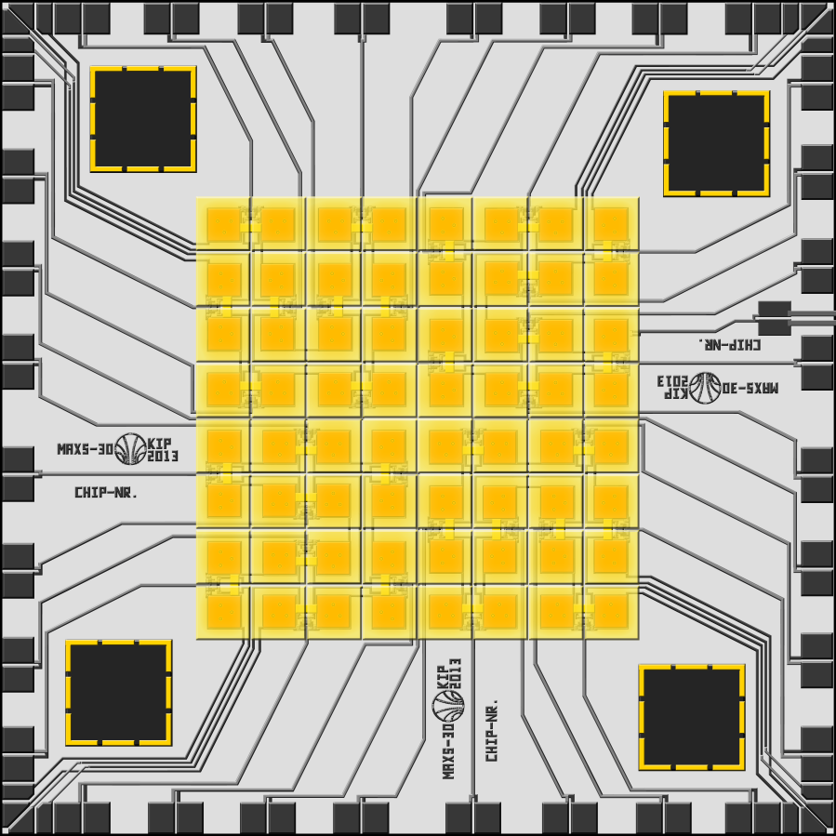
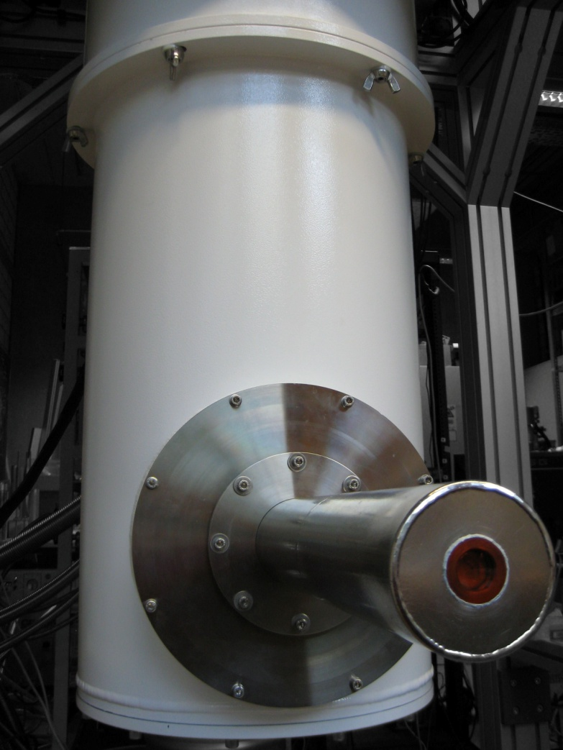
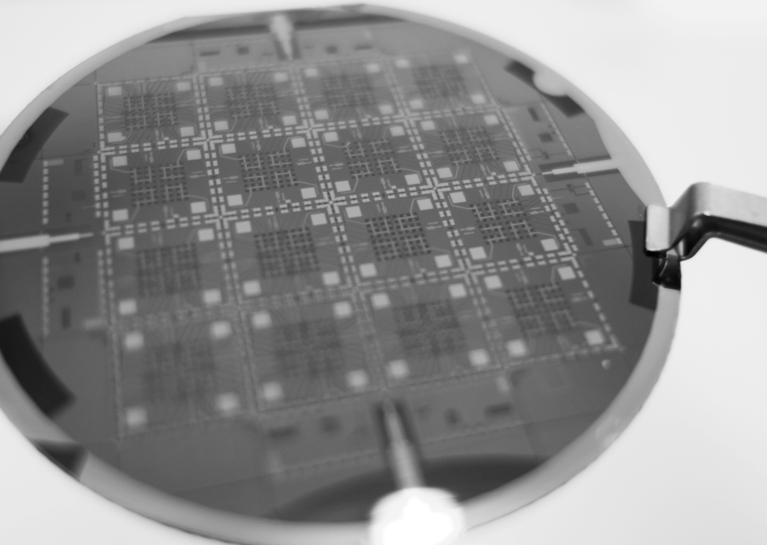
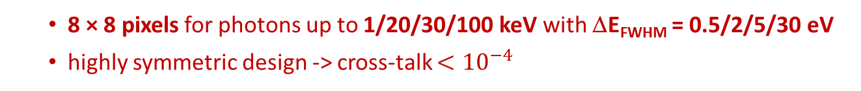
8×8 arrays of maXs-1/20/30/200
8 × 8 pixels for photons up to 1/20/30/100 keV with ΔE_{FWHM} = 0.5/2/5/30 eV
highly symmetric design -> cross-talk $<{10}^{−4}$
1.2/2/4/8 mm
Dry dilution fridge
(Bluefors, FI)

Slide 13
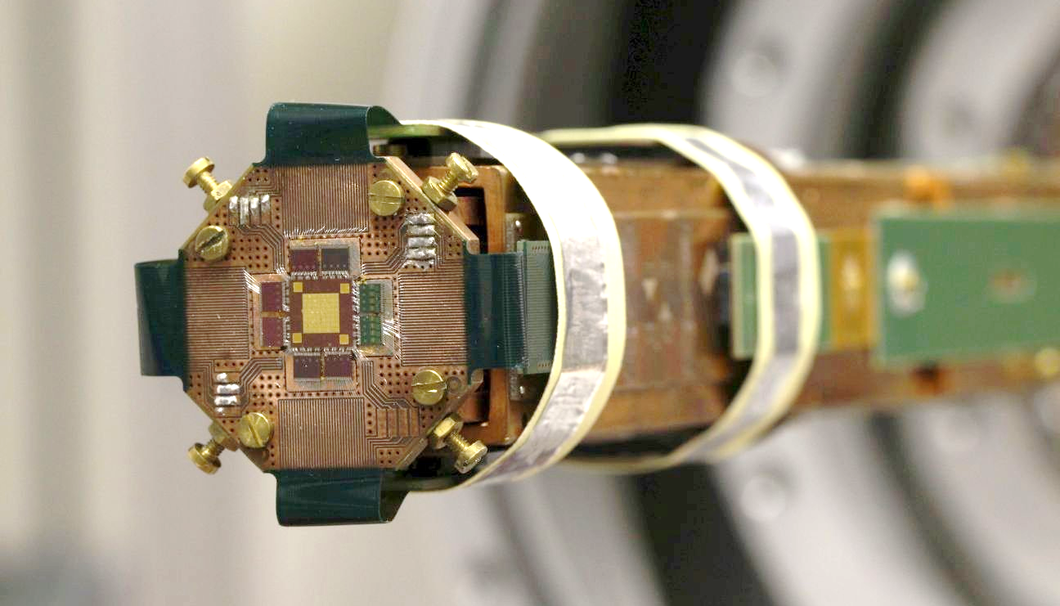
maXs-30
maXs-30 mounted on coldfinger of a dry dilution fridge

Slide 14
maXs-30
T

Slide 15
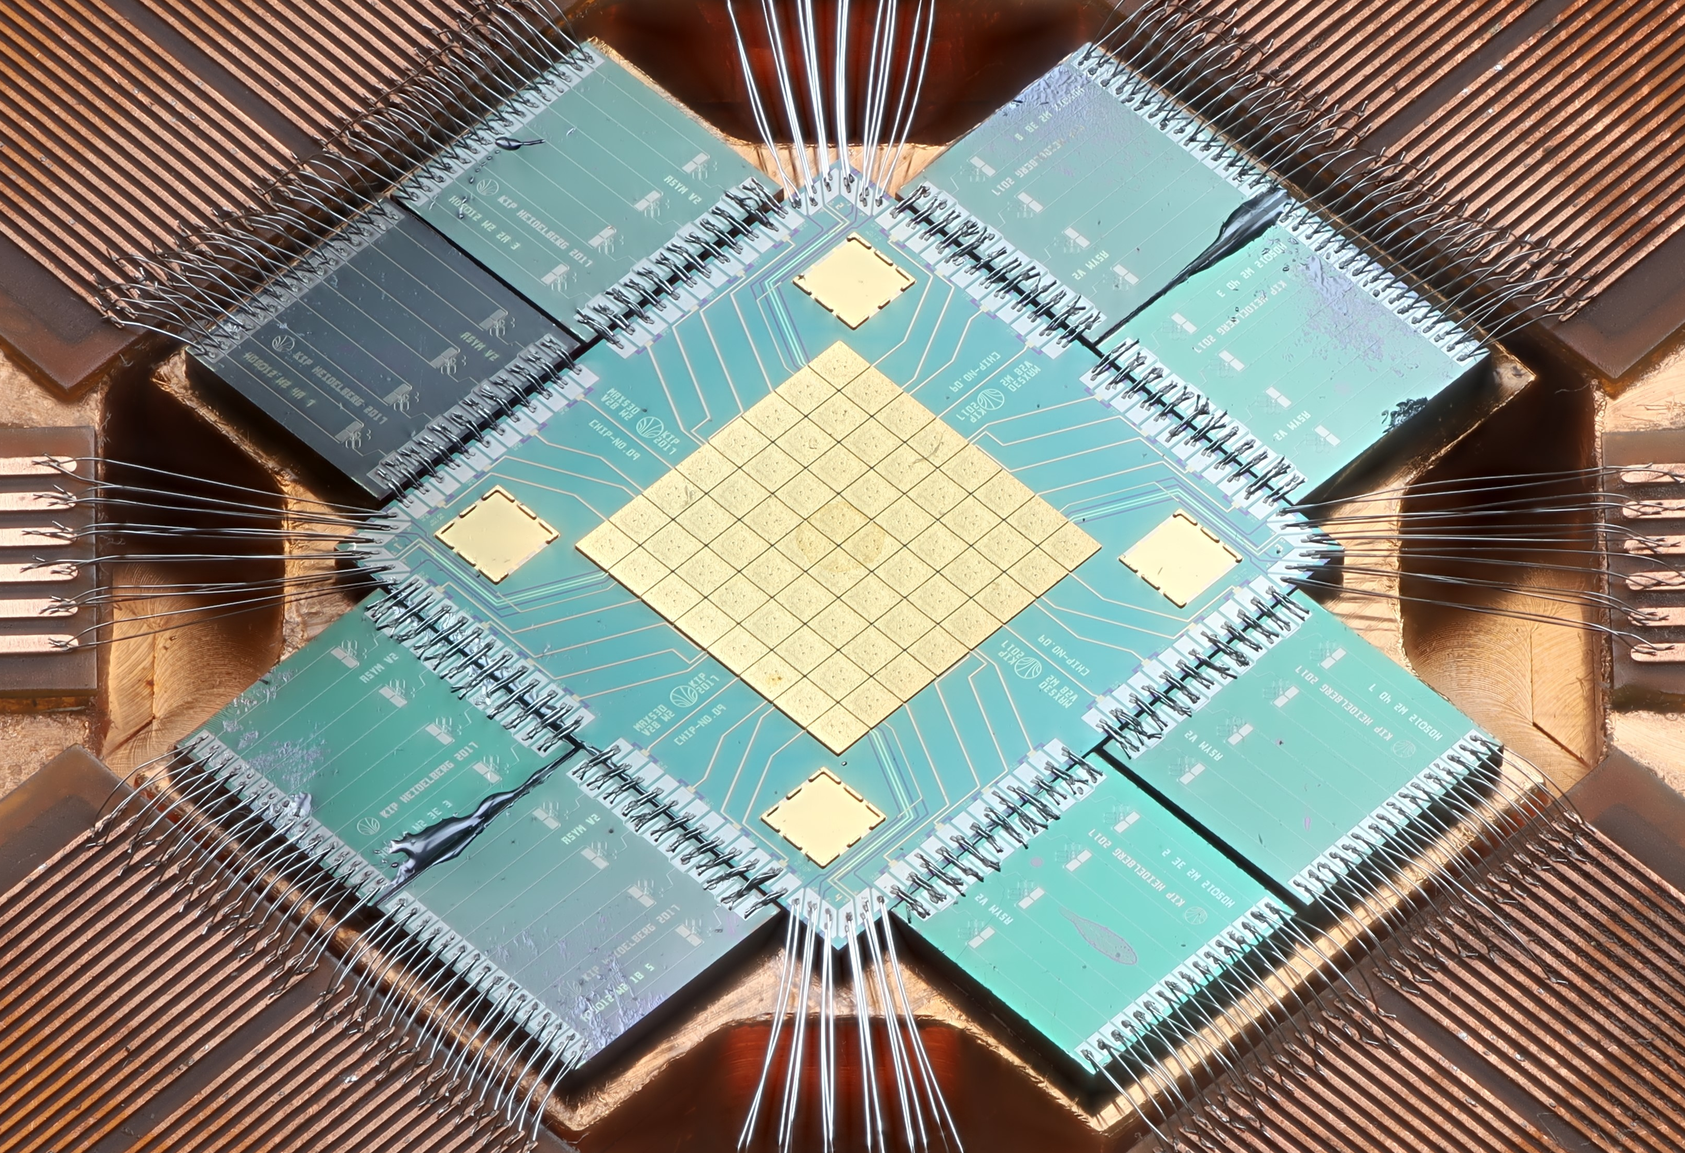
maXs-30 an 8×8 pixel array for x-rays up to 30 keV
Absorbers:
each 0.5mm × 0.5 mm
30-50 μm thick gold
9.8 eV
Energy resolution ΔE_{FWHM} = 9.8 eV @ 59 keV
Resolving power: 6000 (limited by gain drifts)

Slide 16
²³³U + ²⁴¹Am spectrum
Co-added 20 channels, several weeks of data taking
²²⁹Th
²²⁹Th
Many high-statistics lines → Allows broadband calibration
Notes:
I want to start the talk .. Showing our wide-range spectrum of …. From 20 channels

Slide 17
maXs-30: calibration
non-linearity
non-linearity as thermodynamically expected!

Slide 18
maXs-30: present calibration residuals
Most lines from literature have too large uncertainty.

Slide 19
maXs-30: present calibration residuals
Sub-eV agreement for carefully selected calibration lines.
Left-over residuals due to ADCs → sparse set of calib.-lines should allow for ppm-level (FS) calibration

Slide 20
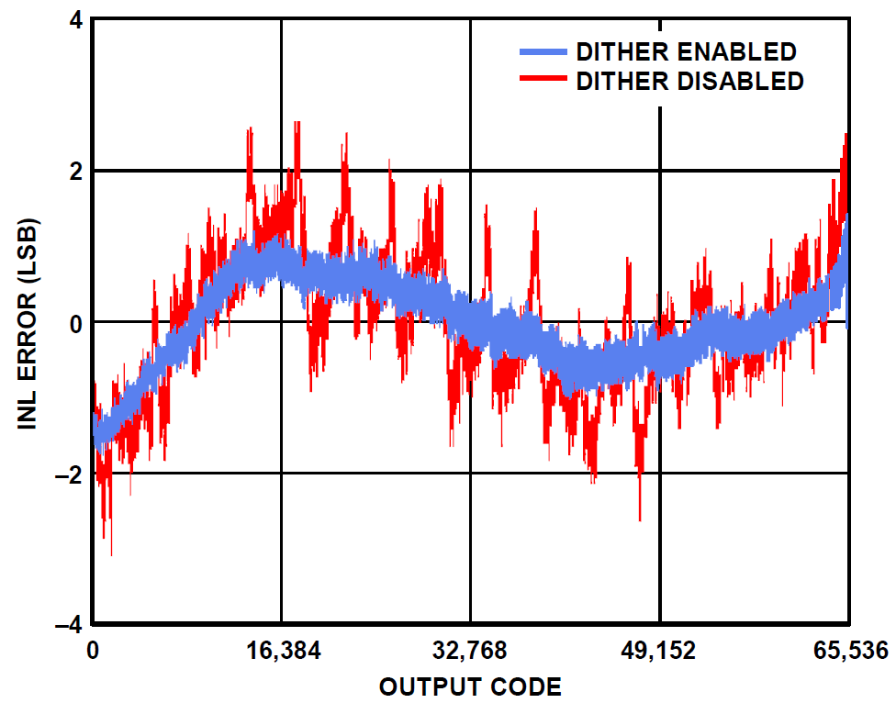
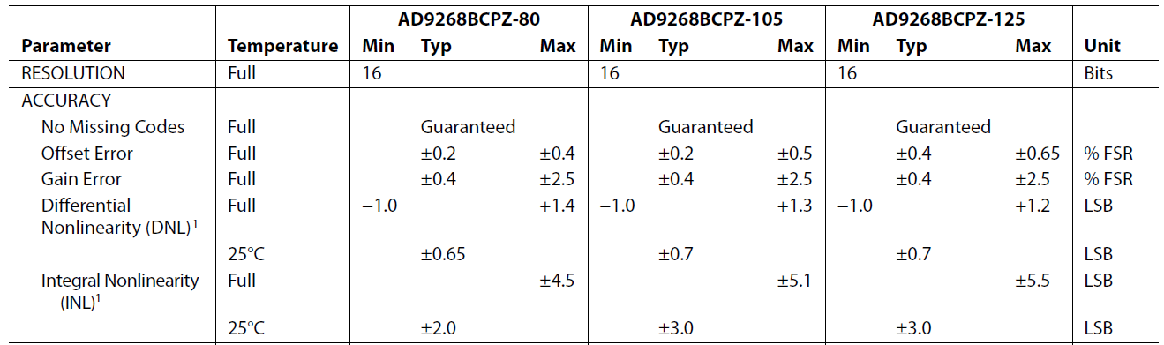
Effects of ADC non-linearity scaled to the Lamb-shift / QUARTET-experiment
(worst case)
Presently used digitizers: Struck SIS3316 (AD9268)
16 bit for +/- 120 keV (1 LSB = 3.7eV)
„no missing codes“, i.e. bits are up to ± 0.5 LSB off: 1 → 0.7
2 → 2.1
4 → 3.6
8 → 8.2
…

Slide 21
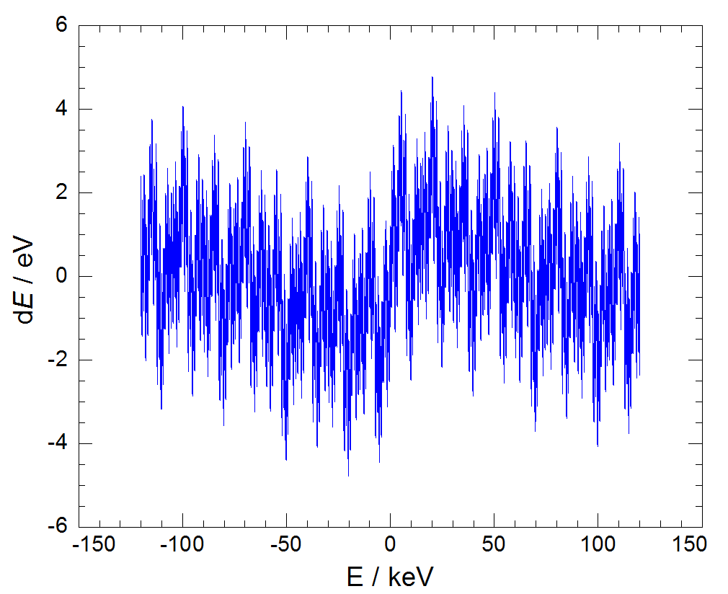
Effects of ADC non-linearity
16 bit for +/- 120 keV
„no missing codes“, i.e. bits are up to ± 0.5 LSB off: 1 → 0.7
2 → 2.1
4 → 3.6
8 → 8.2
…

Slide 22
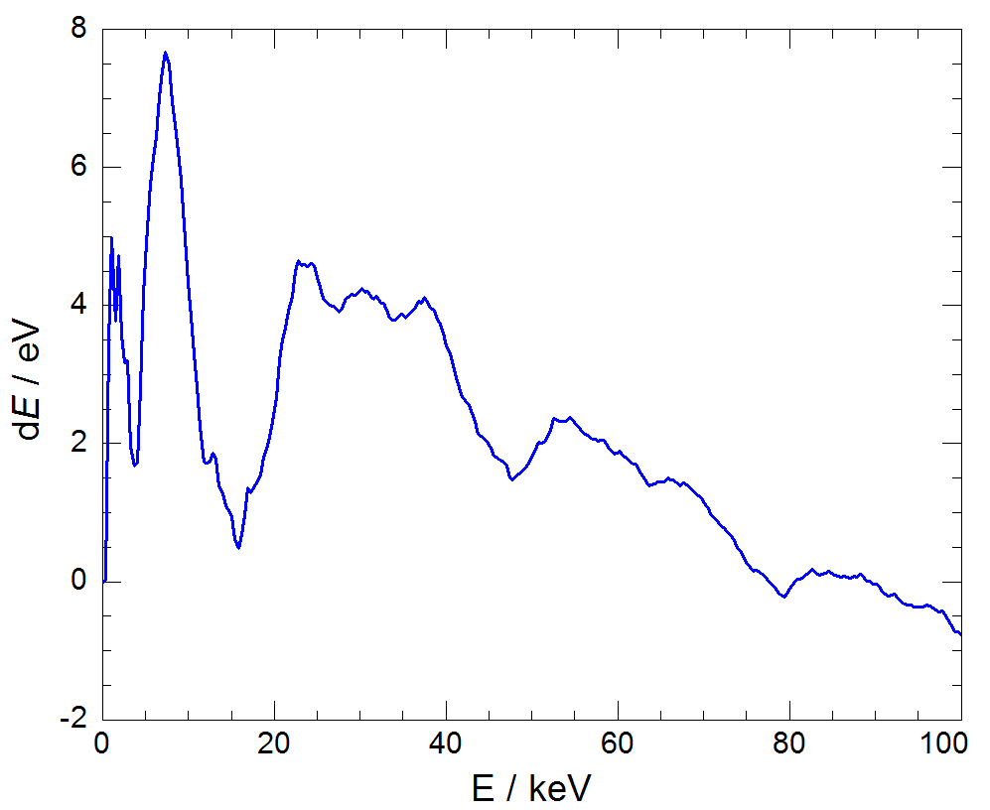
Effects of ADC non-linearity
16 bit for +/- 120 keV
overall nonlinearity for processed, simulated pulses:

Slide 23
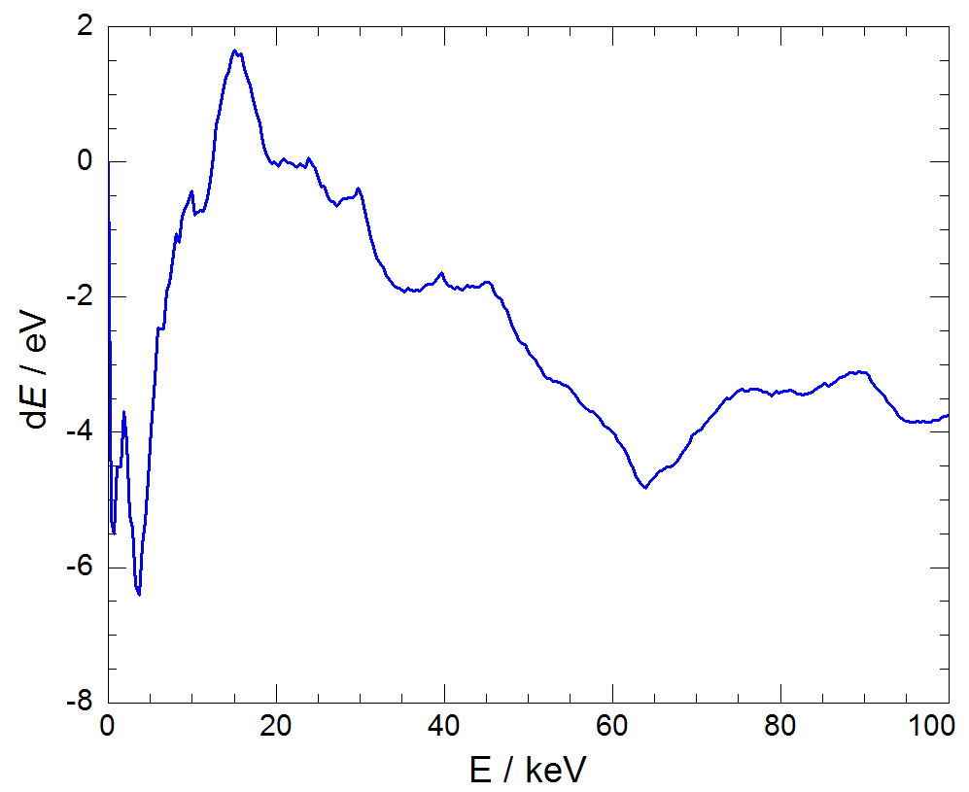
Effects of ADC non-linearity
16 bit for +/- 120 keV
overall nonlinearity for processed, simulated pulses:

Slide 24
Measured ADC non-linearity
16 bit for +/- 60 keV
measured non-linearity of SIS-3316:

Slide 25
Effects of ADC non-linearity on energy calibration
16 bit for +/- 60 keV
based on measured non-linearity of SIS-3316.
pulses average over large voltage ranges removing errors of small bits

Slide 27
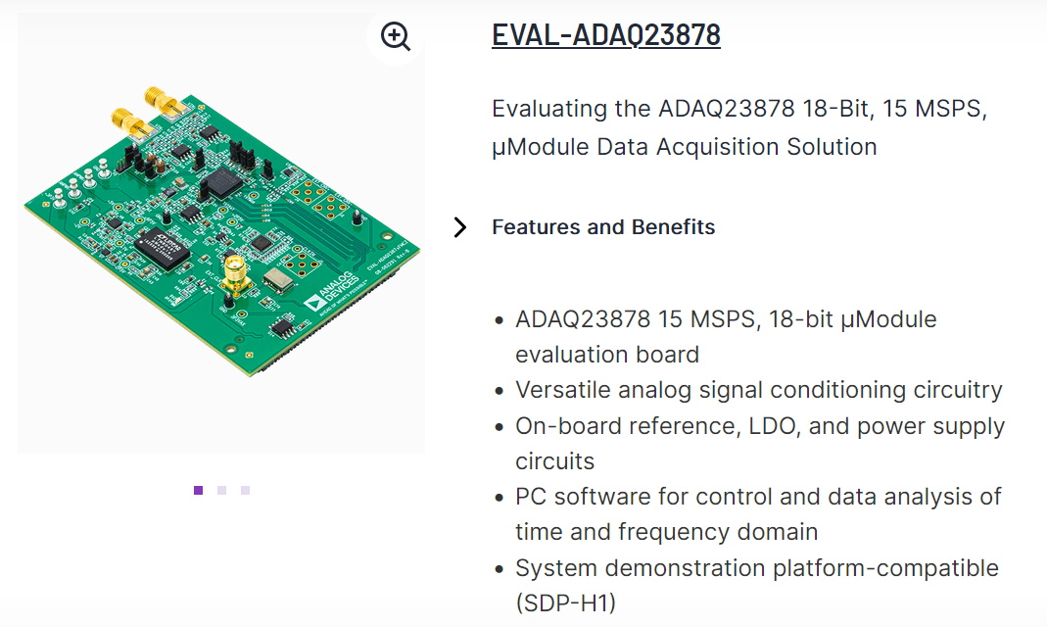

Slide 28
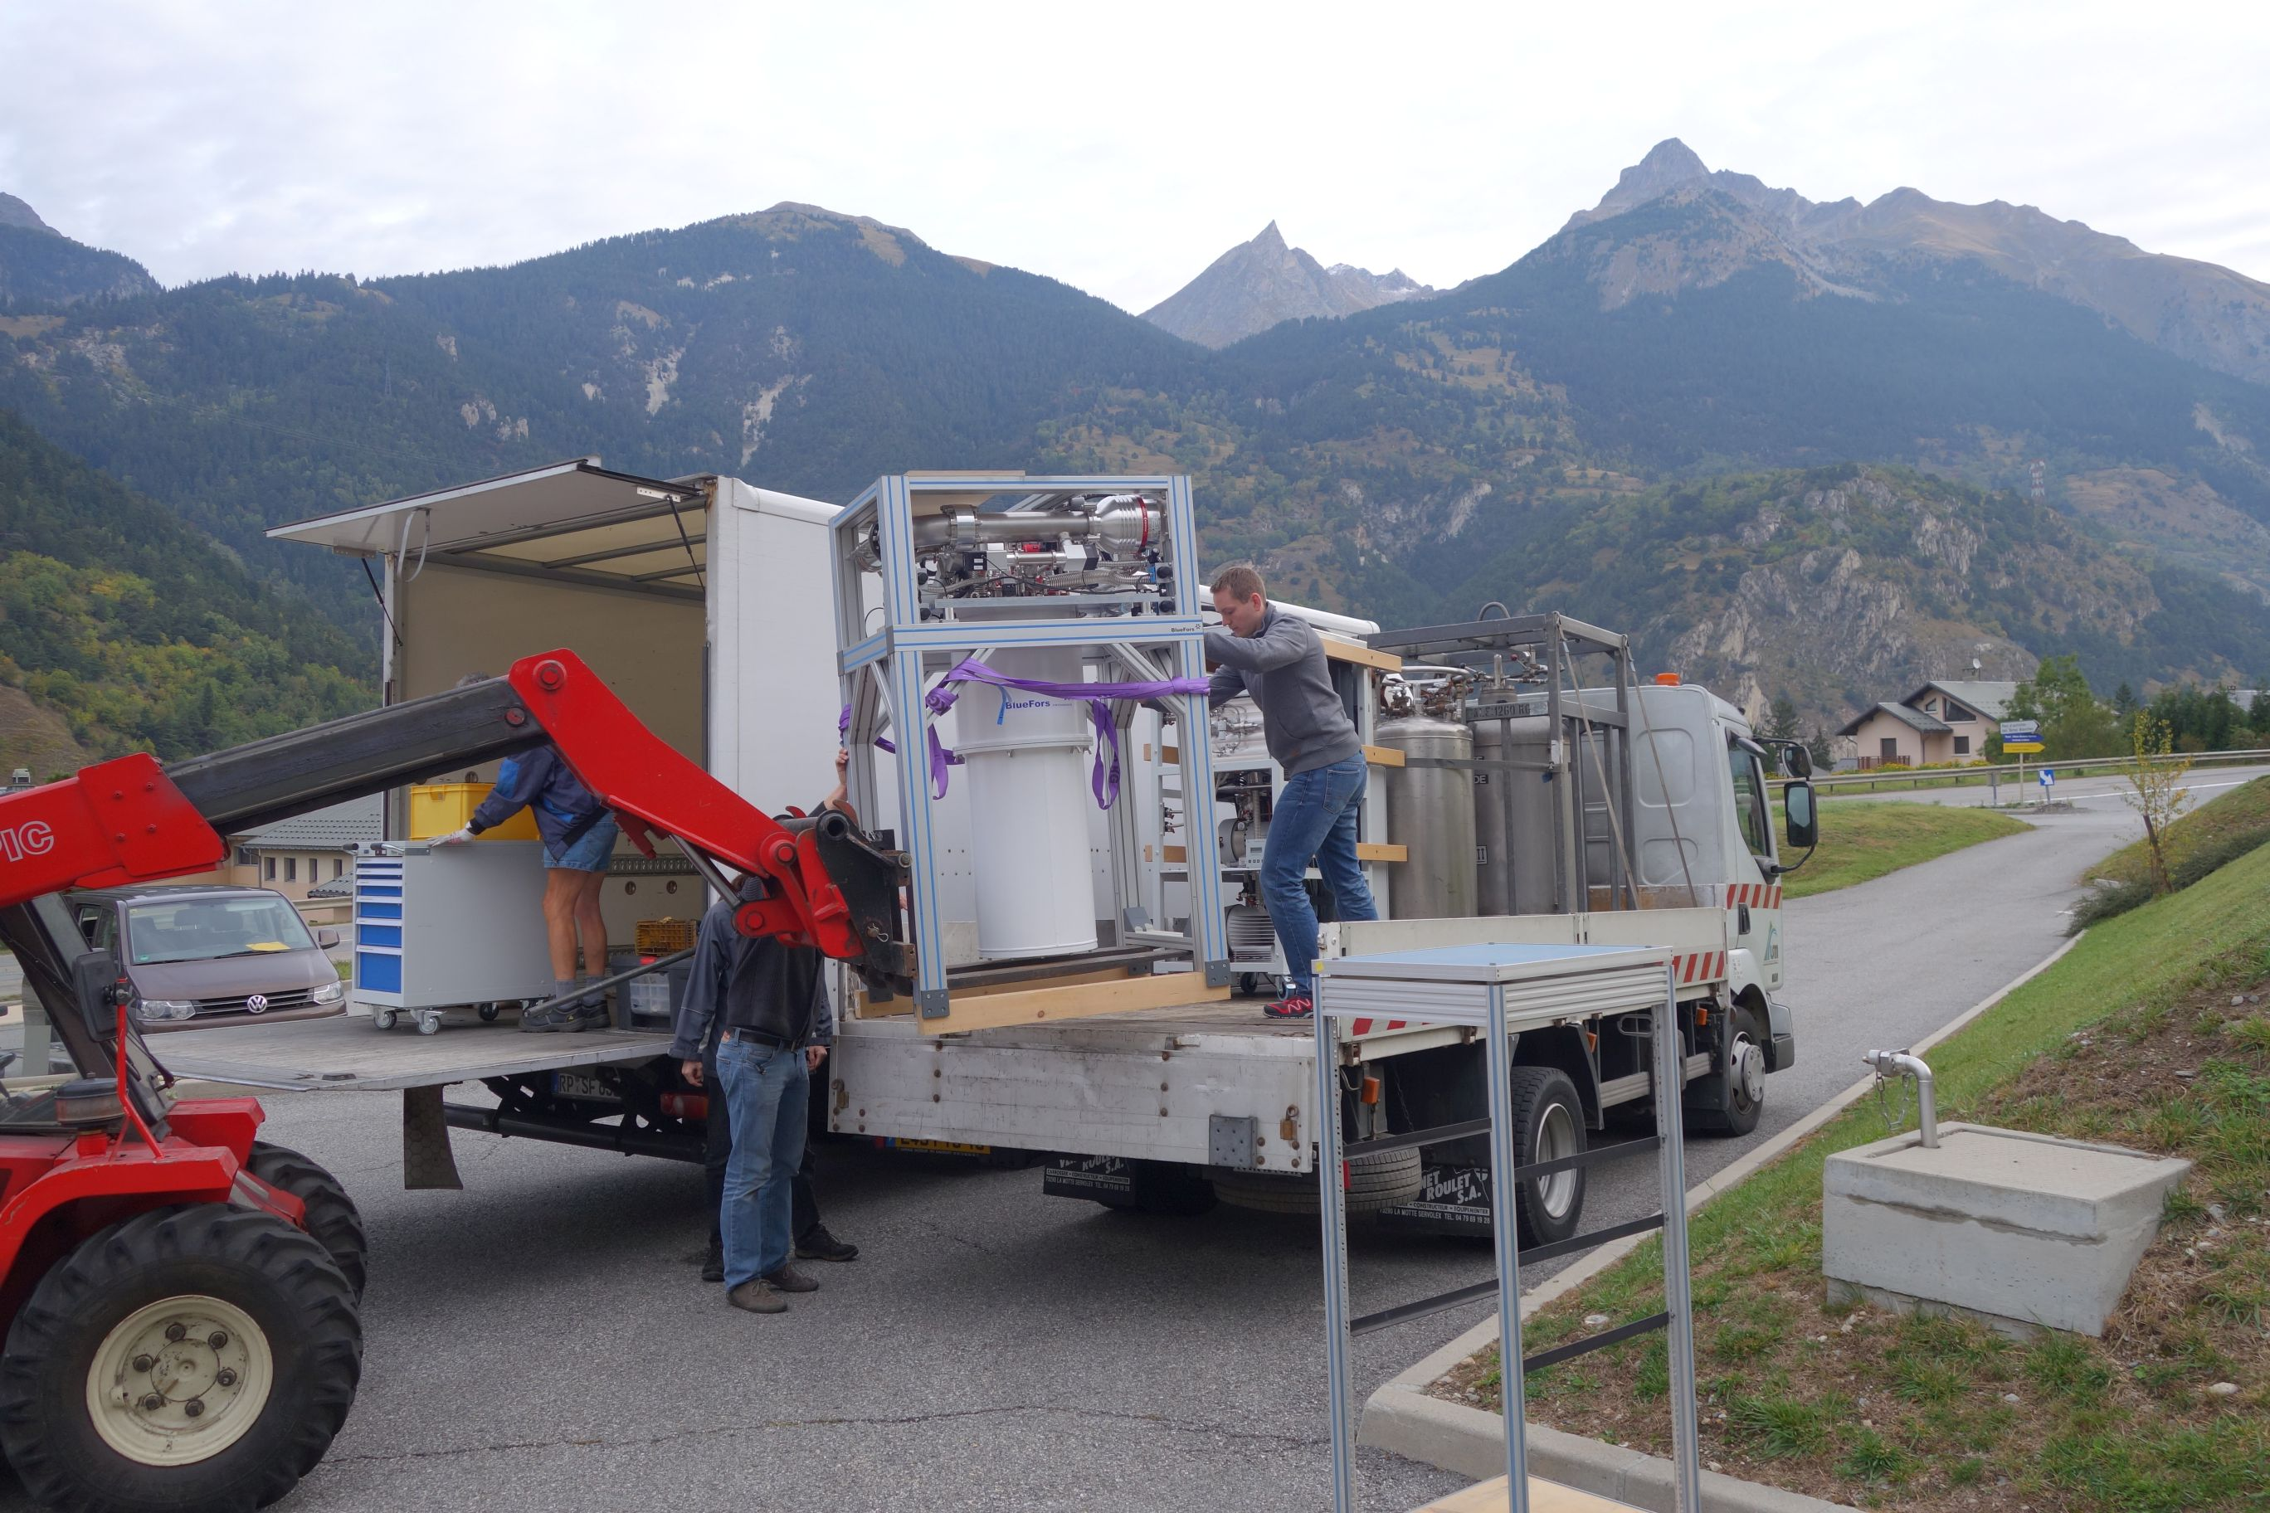
MMCs get more and more mobile
here @ entrance to Frejus tunnel between Italy and France

Slide 29
Two maXs-100 systems @ e-cooler of CRYRING @ GSI/FAIR: He-like Uranium
Beamtimes 2021 & 2025

Slide 30
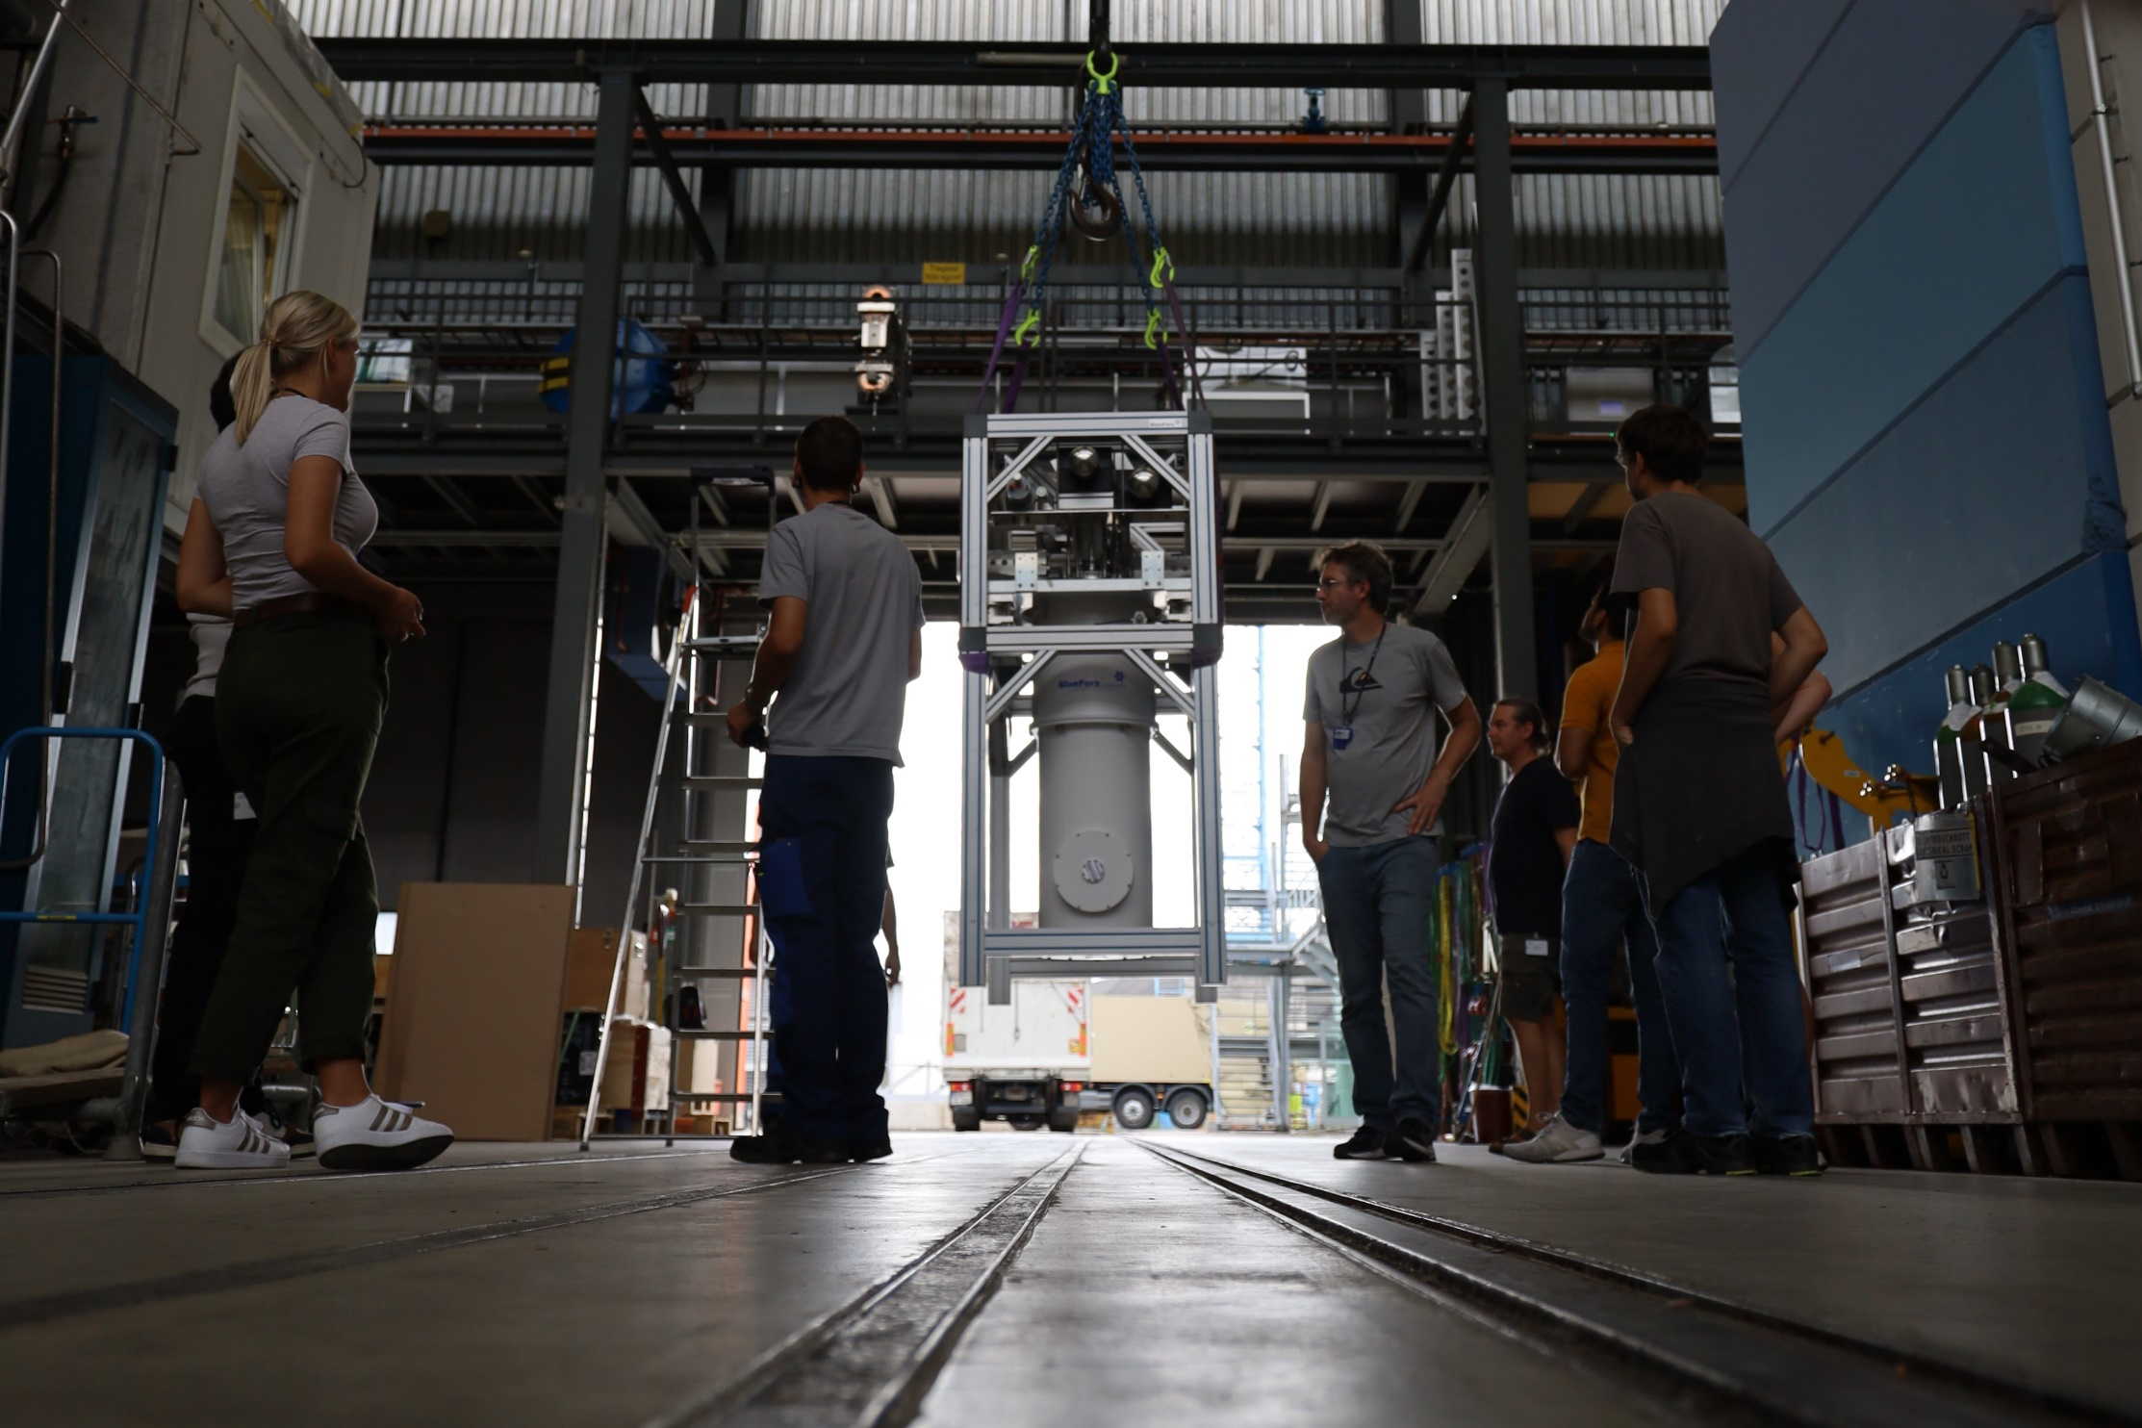
maXs-30 @ $μ$-beamline, PSI: muonic Li, B, C

Slide 31
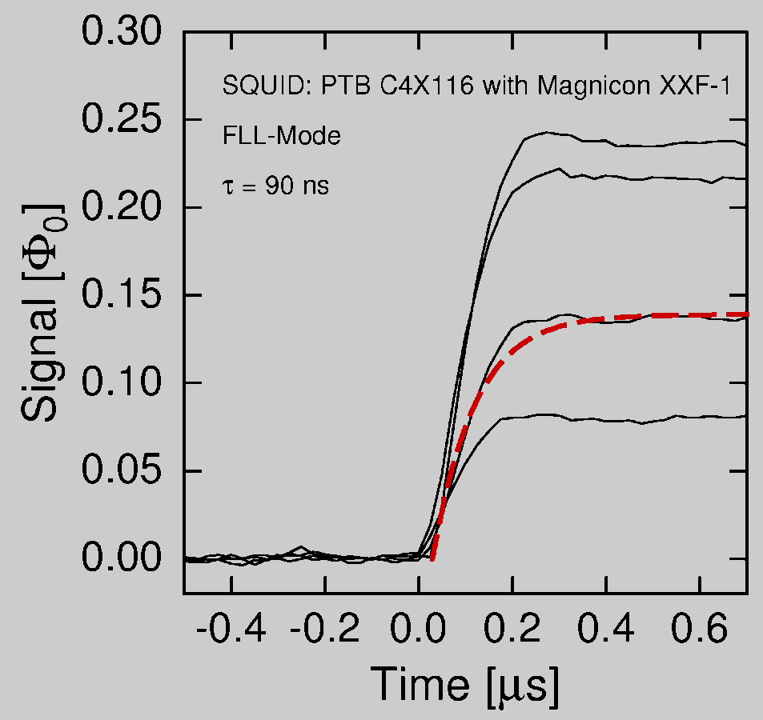
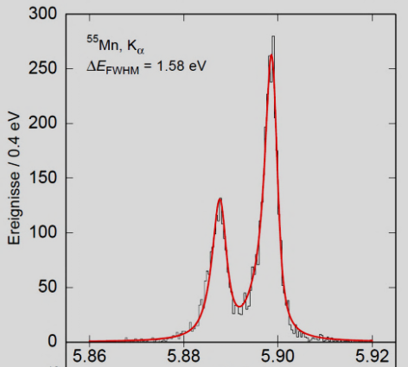
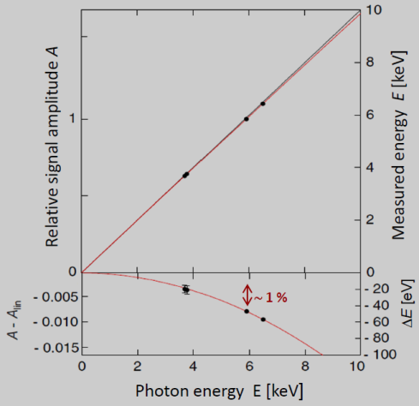
summary & outlook
metallic magnetic calorimeters combine in a unique way
energy calibration:
sparse set of calibration lines will allow for ppm-FS-accuracy for line-positions in fullrange
micro-fabrication works
scaling to pixelcounts > 100 in progress
large variety of sizes, stopping powers and resolutions
MMCs start to contribute to atomic, molecular, nuclear and astro-particle physics
time resolution
energy resolution
linearity

Slide 32
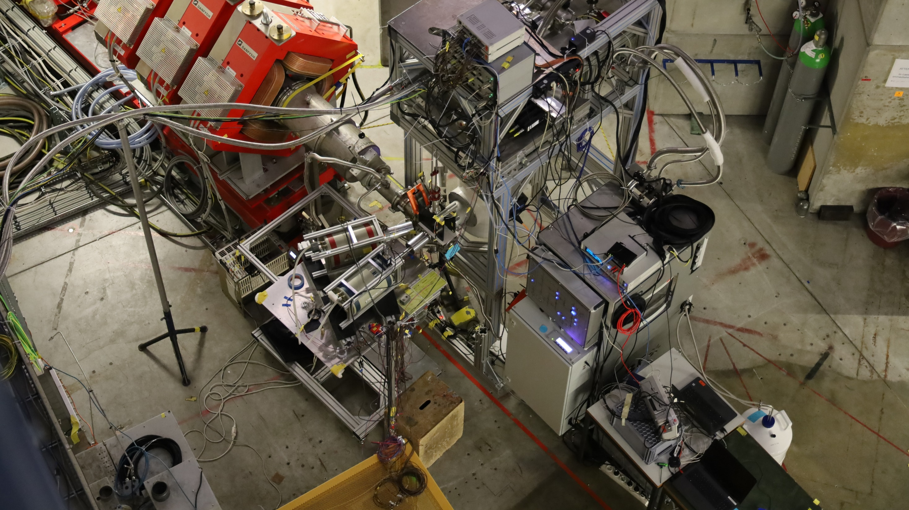
maXs-30 @ $μ$-beamline, PSI: muonic Li, B, C

Slide 33
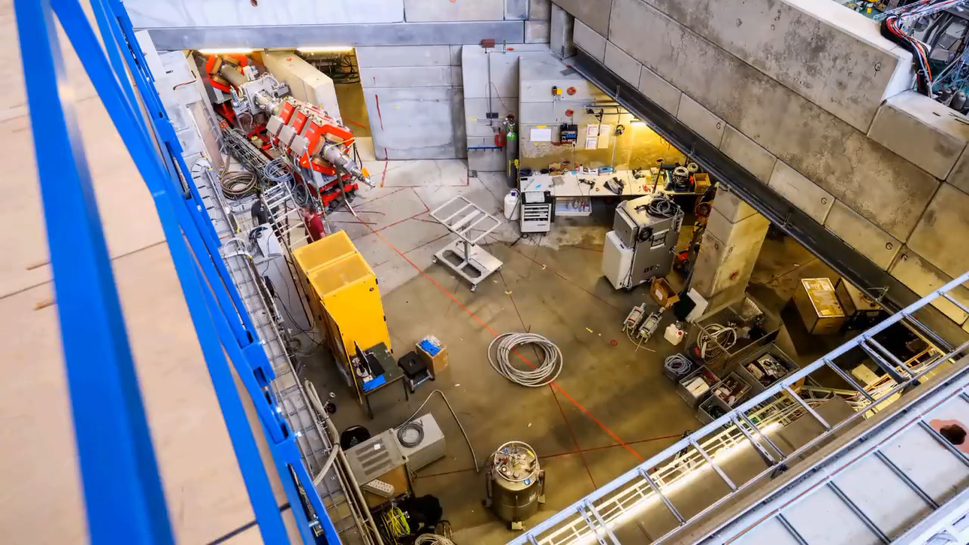
maXs-30 @ $μ$-beamline, PSI: muonic Li, B, C

Slide 34
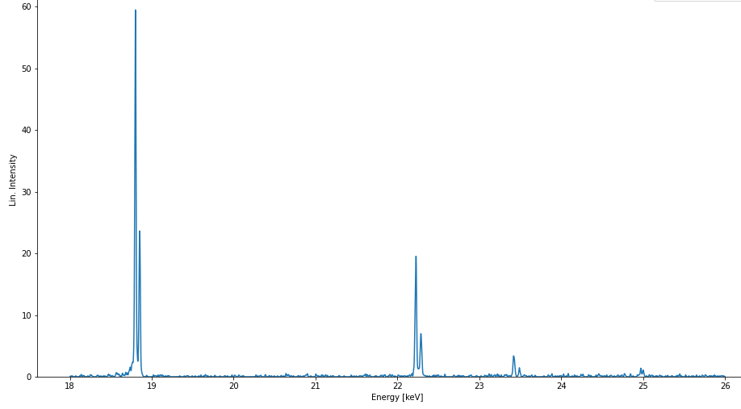
first broadband hi-res spectrum of muonic ⁶Li and ⁷Li
2p – 1s
preliminary
3p – 1s
4p – 1s

Slide 35
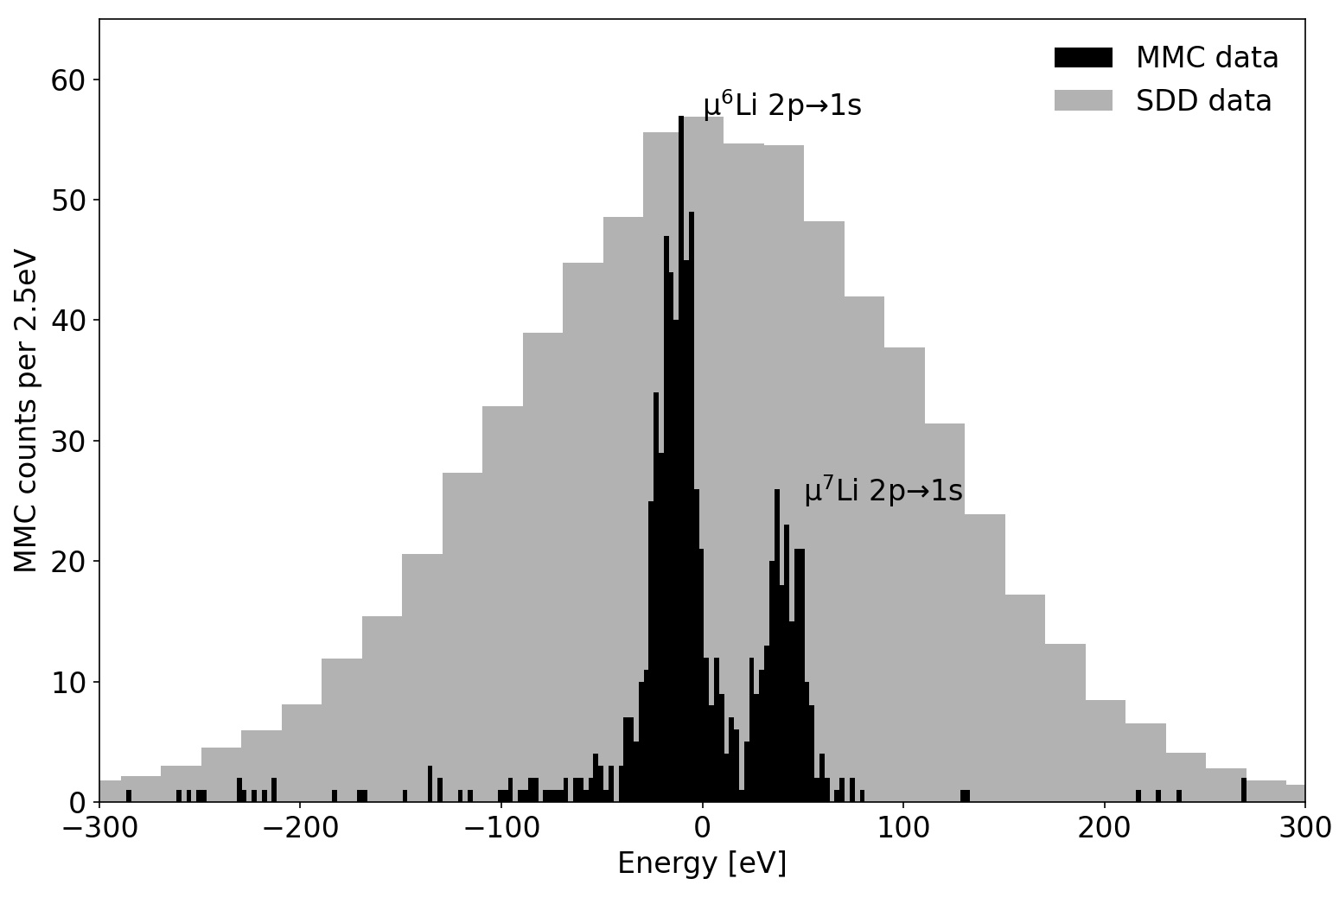
first broadband hi-res spectrum of muonic ⁶Li and ⁷Li
2p – 1s
preliminary
isotope shift resolved
3p – 1s
4p – 1s

Slide 36
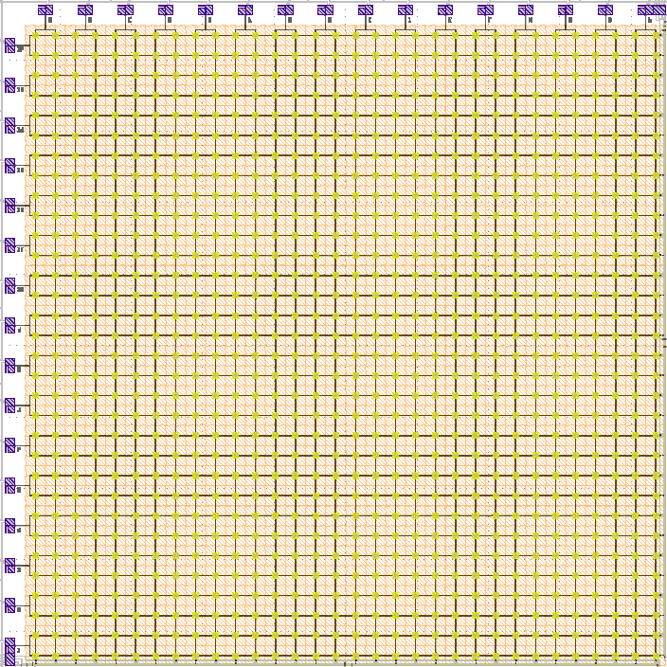
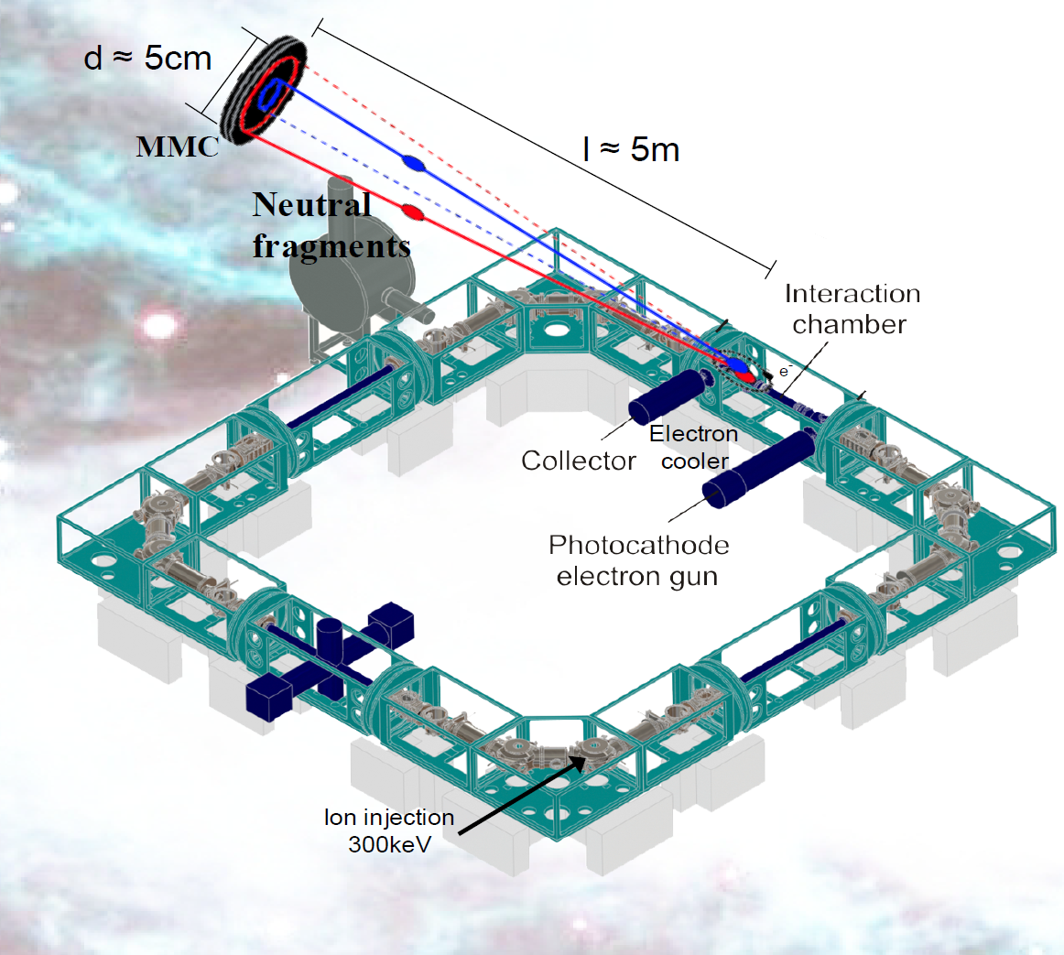
MOCCA: 4k-pixel molecule camera
to study reaction cross sections of molecular ions of cold interstellar plasmas
in the cryogenic storage ring CSR at MPI-K, HD
Position and energy resolved detection
of neutral molecular fragments
after neutralizing with an electron in the e-cooler
Heidelberg University, MPI-K Heidelberg, Columbia Astro Lab NY
MOCCA:
44.8mm × 44.8mm
64 × 64 pixels
resolution: ΔE = 250 eV (FWHM)
operated at T = 20 mK
16 two-stage SQUIDs to read-out 64 rows
16 two-stage SQUIDs to read-out 64 columns
T < 10K

Slide 37
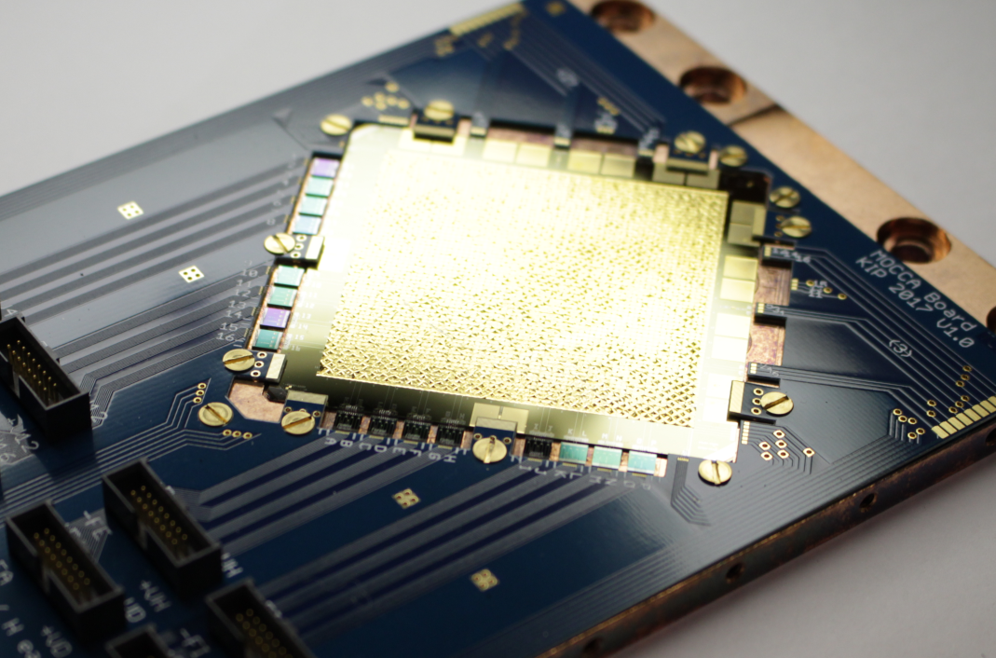
MOCCA: 4k-pixel molecule camera / hi-res alpha detector
45 mm
200 eV FWHM

