Slide 1

Phi meson properties in dense matter from pA collisions in a transport approach
Philipp Gubler (JAEA)
H.J. Kim and P. Gubler, Phys. Lett. B 805, 135412 (2020).
I.W. Park, H. Sako, K. Aoki, P. Gubler and S.H. Lee, Phys. Rev. D 107, 074033 (2023).
P. Gubler, M. Ichikawa, T. Song and E. Bratkovskaya, Phys. Rev. C 111, 034908 (2025).
M. Ichikawa, P. Gubler, et al., (KEK-PS E325 Collaboration), arXiv:2507.00420 [nucl-ex].
H.J. Kim (Hiroshima U.)
M. Ichikawa (JAEA)
T. Song (GSI)
E. Bratkovskaya (Goethe U. Frankfurt)
I.W. Park (Yonsei U.)
H. Sako (JAEA)
K. Aoki (KEK)
S.H. Lee (Yonsei U.)
M. Naruki (Kyoto U.)
S. Yokkaichi (RIKEN)
Talk at the ECT*-EMMI/GSI workshop “Penetrating Probes of Hot High-mu_B Matter: Theory Meets Experiment“,
Trento, Italy
July 24, 2025
Work done in collaboration
with:

Slide 2
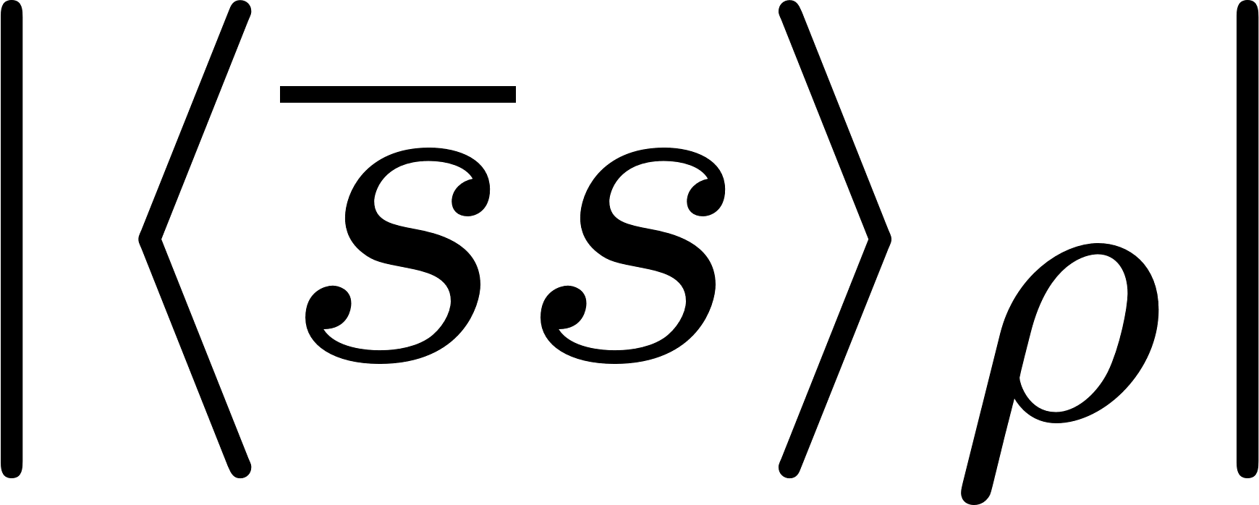
R. Muto et al. (KEK E325),
Phys. Rev. Lett. 98, 042501 (2007).
Introduction
Pion induced ϕ meson production
J. Adamczewski-Musch et al. (HADES),
Phys. Rev. Lett. 123, 022002 (2019).
Partial restoration of chiral symmetry
E16/E88 experiments at J-PARC
P95 experiment at J-PARC
Dilepton/K⁺K⁻ spectra from pA/πA reactions
S. Acharya et al. (ALICE Coll.),
Phys. Rev. Lett. 127, 172301 (2021).
Ｎ
T. Hatsuda and S.H. Lee,
Phys. Rev. C 46, R34 (1992).
Femtoscopy from LHC
P
P
P
J. Kim, P. Gubler and S.H. Lee,
Phys. Rev. D 105, 114053 (2022).
Chiral mixing?
Ｎ
Ｎ
ϕN bound state?
Ｎ
P
Ｎ
C. Sasaki,
Phys. Rev. D 106, 054034 (2022).
ϕ
ϕ
E. Chizzali et al.,
Phys. Lett. B 848, 138358 (2024).
P
Ｎ
Ｎ
R. Ejima et al.,
Phys. Rev. C 111, 055201 (2025).
Ｎ
P
B.-X. Sun et al.,
Commun. Theor. Phys.
75, 055301 (2023).
Photoproduction
Ｎ
P
ϕ-nucleus bound states?
I.I. Strakovsky et al.,
Phys. Rev. C 101, 045201 (2020).
Exotic dispersion relations
J.J. Cobos-Martínez et al.,
Phys. Rev. C 96, 035201 (2017).
Lattice QCD (HAL)
H.J. Kim and P. Gubler,
Phys. Lett. B 805, 135412 (2020).
I. Filikhin et al.,
Phys. Rev. C 110, 065202 (2024).
Y. Liu et al.,
Phys. Rev. D 106, 074507 (2022).

Slide 3
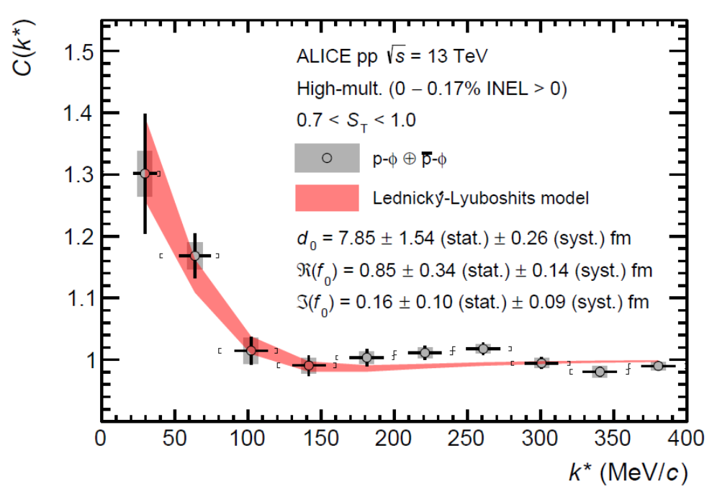
ALICE: pp
ϕN correlation function
Strongly attractive
Small absorption
Attraction!
Bound state in spin 1/2 channel?
E. Chizzali et al.,
Phys. Lett. B 848, 138358 (2024).
S. Acharya et al. (ALICE Coll.), Phys. Rev. Lett. 127, 172301 (2021).

Slide 4
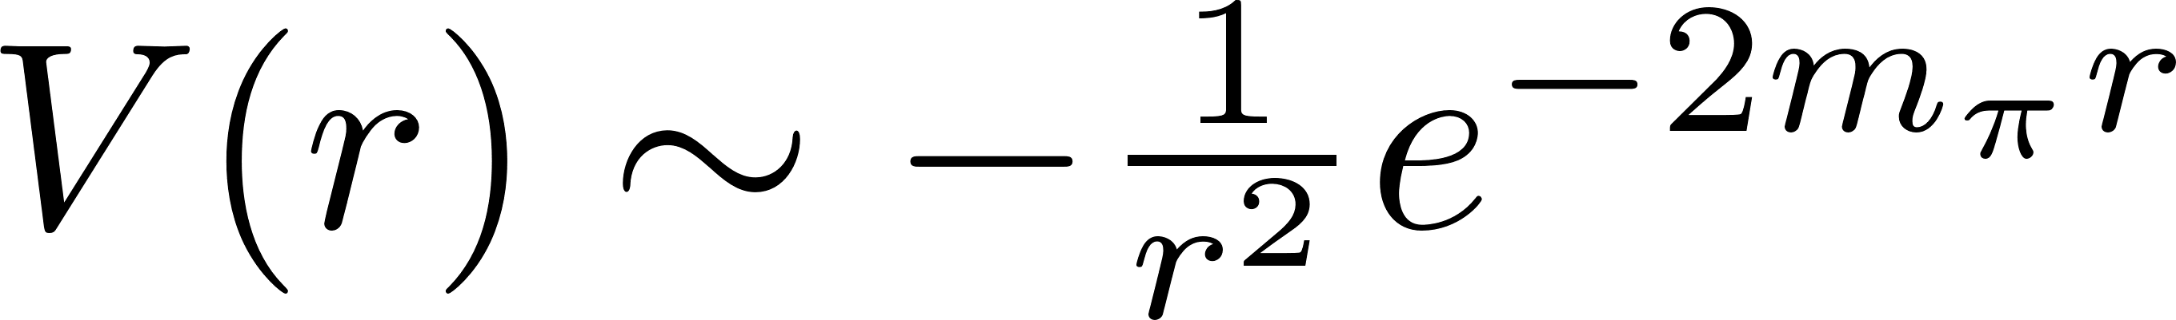
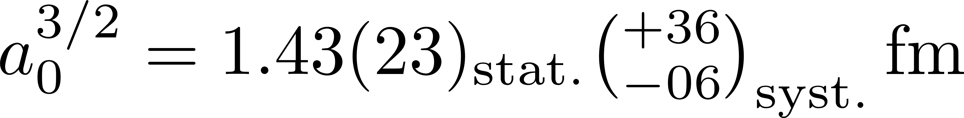
ϕN potential from HAL QCD
Spin 3/2 channel
Indication for a quite strong and attractive interaction!
Y. Lyu et al. (Lattice QCD, HAL QCD Collaboration), Phys. Rev. D 106, 074507 (2022).

Slide 5
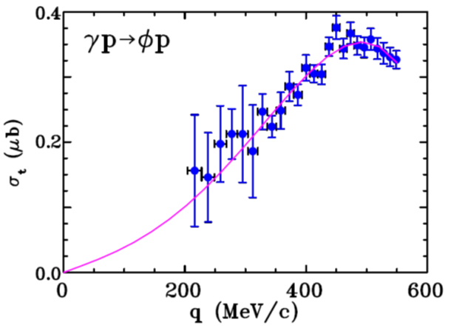
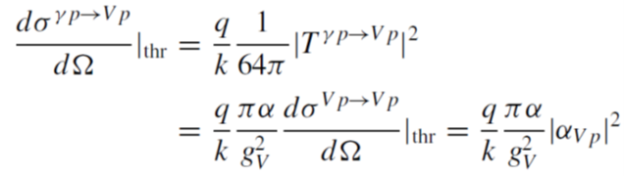

Photoproduction measurement (CLAS)
Vector meson dominance is assumed
Consistent with weak ϕN interaction
I.I. Strakovsky et al., Phys. Rev. C 101, 045201 (2020).

Slide 6
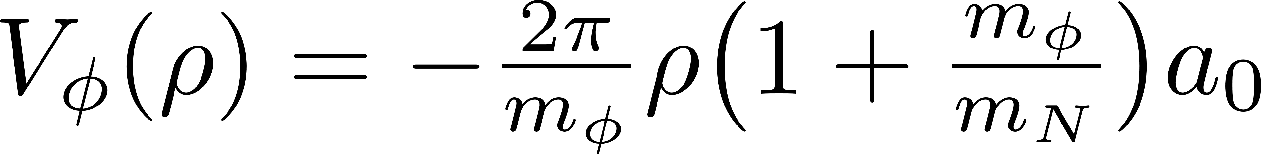
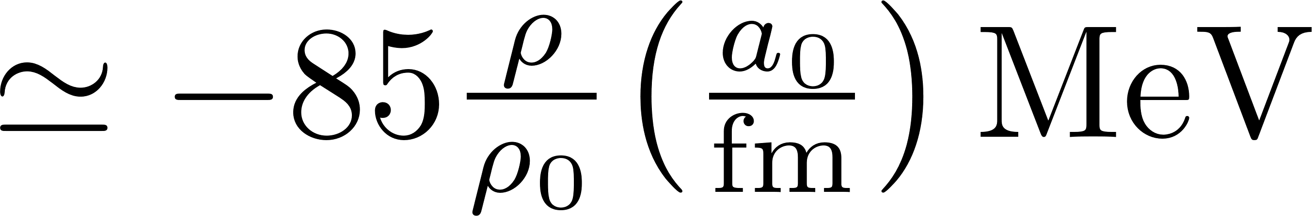
Simple relation between ϕN scattering length and
ϕ meson mass shift in nuclear matter
Valid within the linear density approximation
Larger than 100 MeV IF HAL QCD result is true for all spin configurations!
However, the above prescription seems problematic if a ϕN bound state (or resonance) is formed.
Need better theoretical understanding!

Slide 7
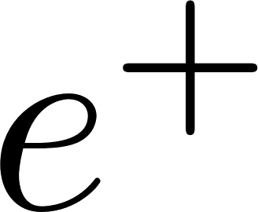

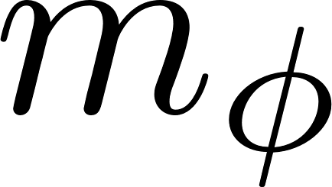
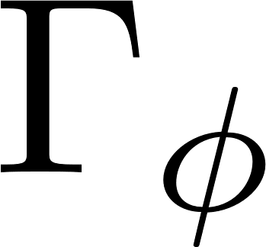
Dilepton spectrum from pA reaction
(studied in a transport approach)
Ｎ
P
?
P
P
Ｎ
Ｎ
P
P
Ｎ
ϕ
P
?
Ｎ
Ｎ
Ｎ
P
Ｎ
P

Slide 8
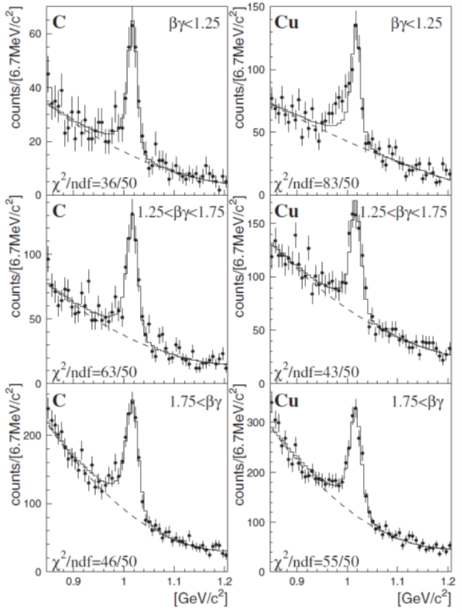
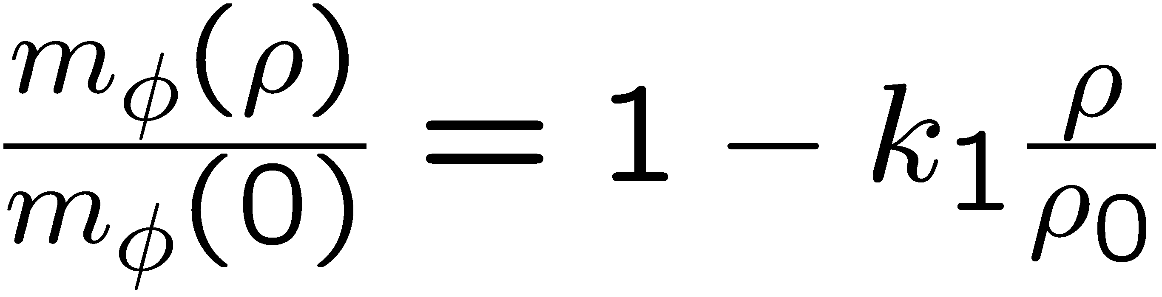

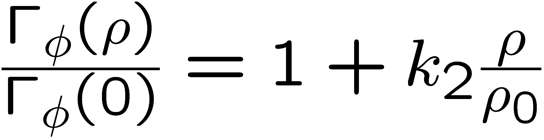

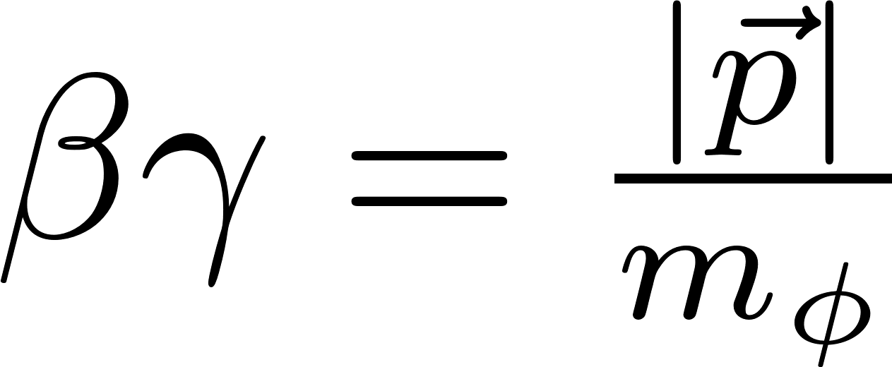
Previous experimental results
e
KEK
E325
12 GeV
pA-reaction
p
slow ϕs
φ
e
Pole mass:
intermediate ϕs
Pole width:
fast ϕs
Measurement is being repeated with 100x increased statistics at the J-PARC E16 experiment!
~
R. Muto et al. (E325 Collaboration), Phys. Rev. Lett. 98, 042501 (2007).

Slide 9
e
large probability of vector meson decay outside of the nucleus
Non-trivial non-equilibrium process??
Not included in previous analysis!
e
p
V
Off-shell behavior of vector mesons at finite density
density much below ρ₀
Not included in previous analysis!

Slide 10
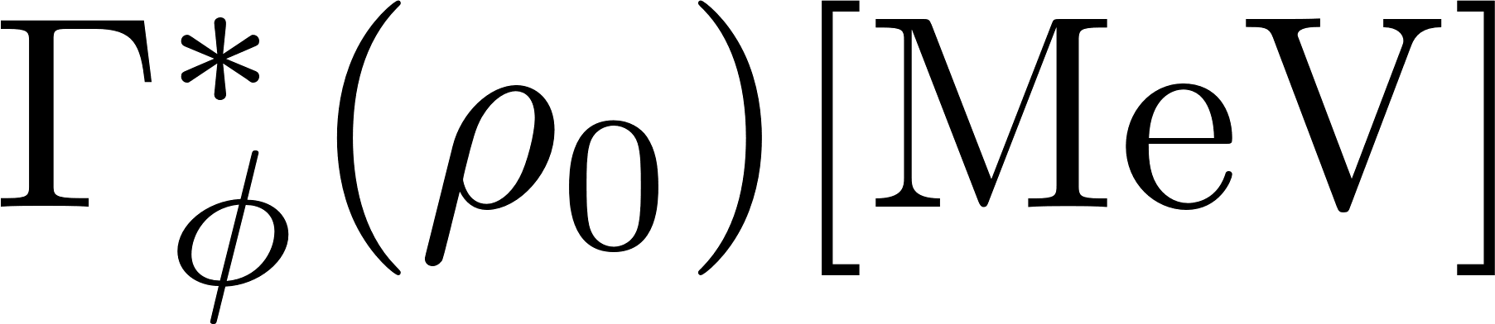
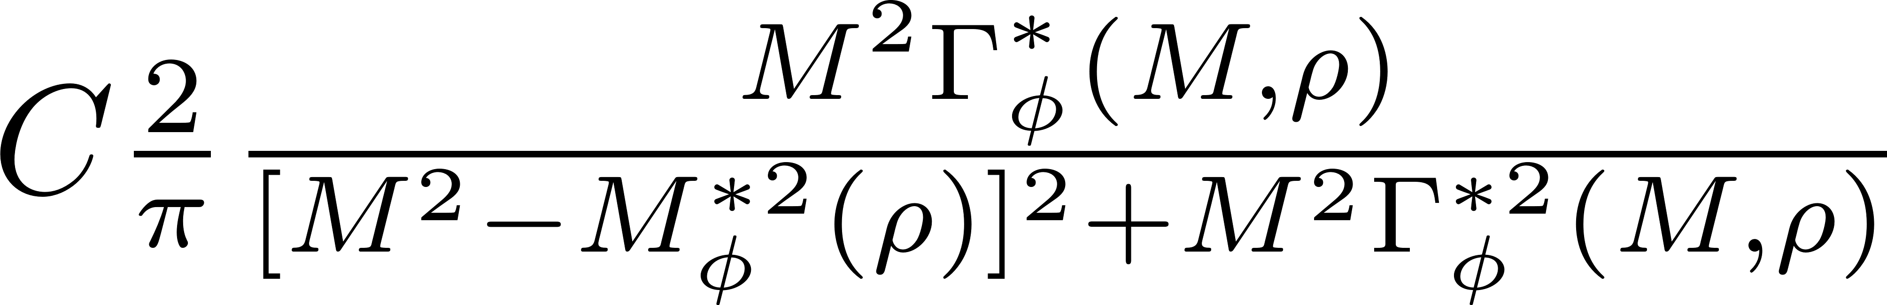
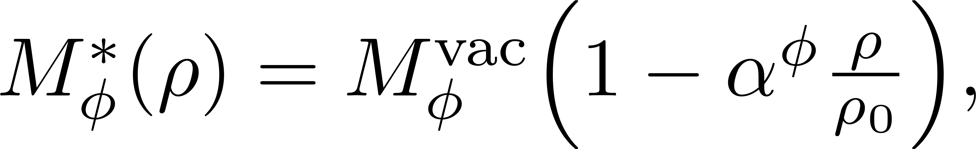
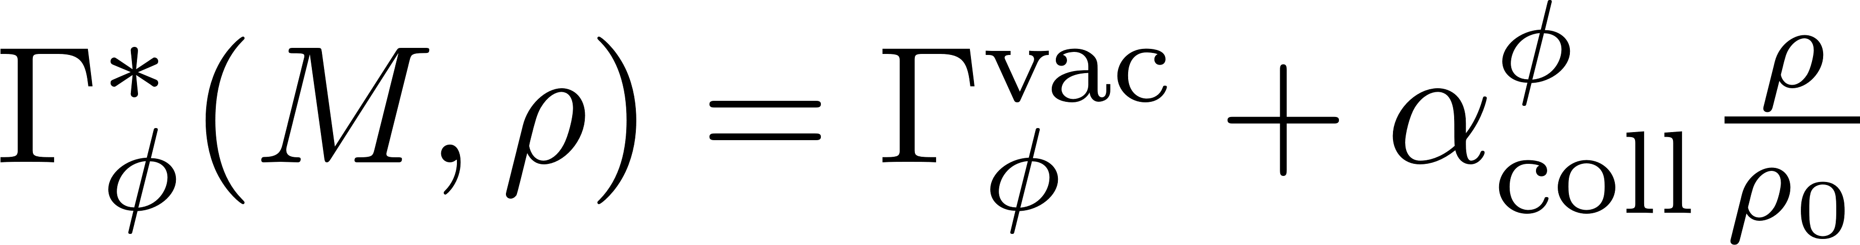
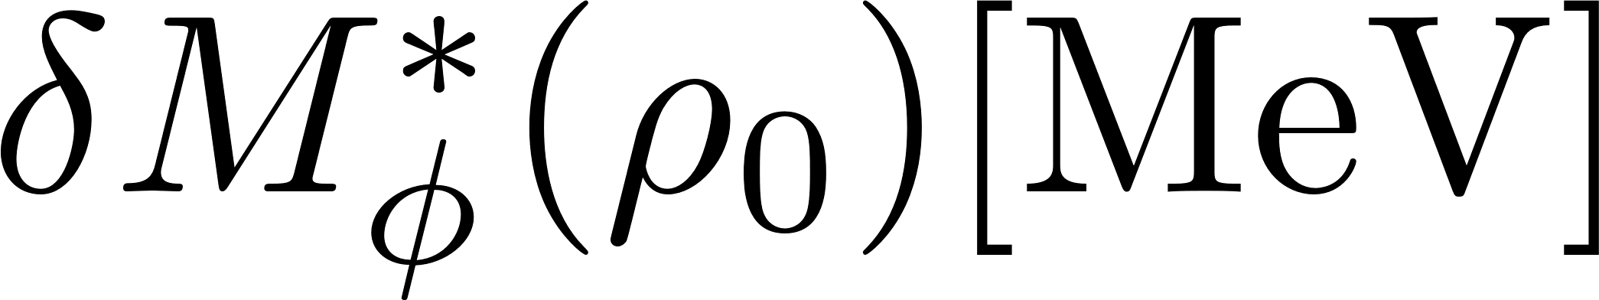
Our tool: transport simulation
PHSD (Parton Hadron String Dynamics)
Off-shell dynamics of vector mesons and kaons
(dynamical modification of the mesonic spectral function during the simulated reaction)
E.L. Bratkovskaya and W. Cassing, Nucl. Phys. A 807, 214 (2008).
W. Cassing and E.L. Bratkovskaya, Phys. Rev. C 78, 034919 (2008).
Simulated scenarios:
Used spectral function:
Relativistic Breit-Wigner with density dependent mass and width
vacuum
75
150
E325 result
-30
-60
-90
with
-120
-150

Slide 11
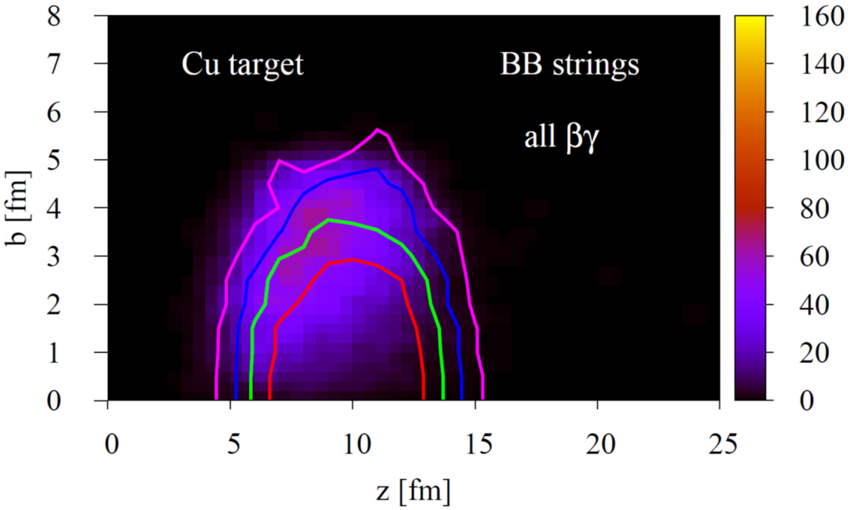
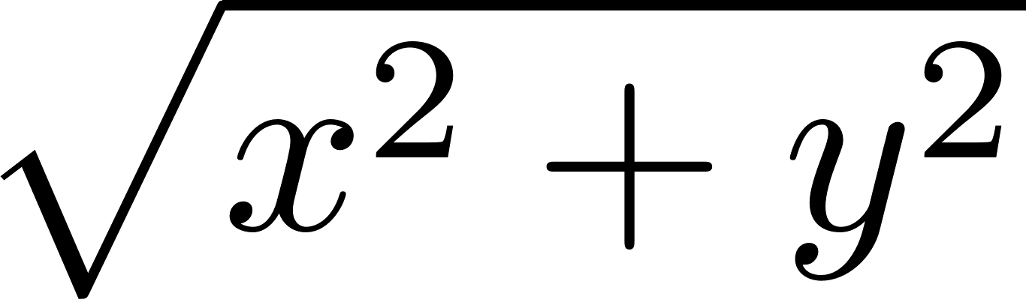
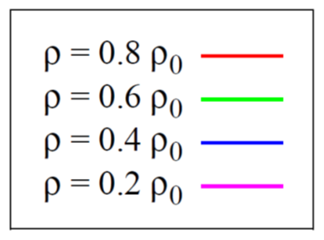
How are ϕ mesons produced in 12 GeV pA collisions?
Production through initial high-energy collisions (via strings)
Cu target
B
B
P
P
Occurs at target surface
P. Gubler, M. Ichikawa, T. Song and E. Bratkovskaya, Phys. Rev. C 111, 034908 (2025).

Slide 12
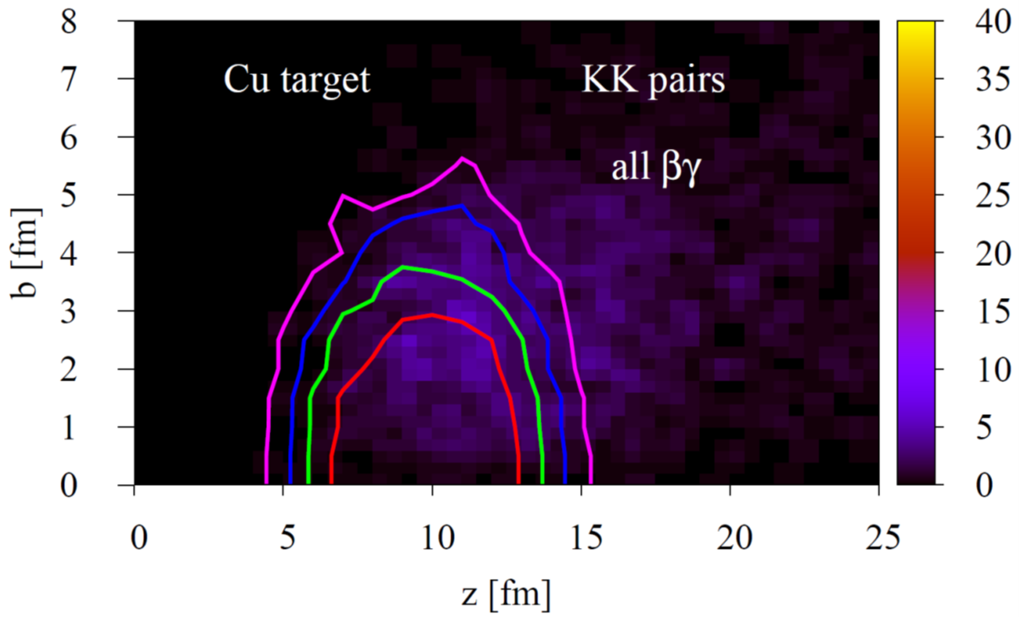
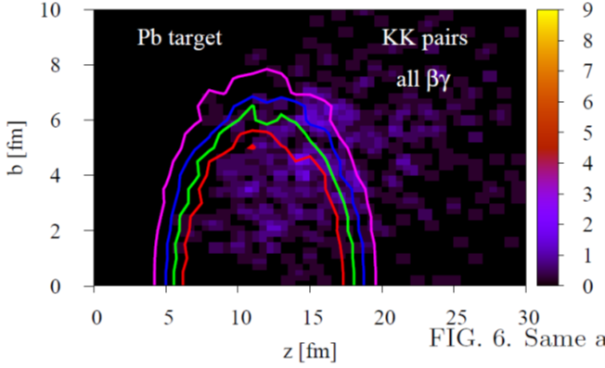
How are ϕ mesons produced?
Production through secondary low-energy hadron collisions
P
P
Occurs often outside of the target
P. Gubler, M. Ichikawa, T. Song and E. Bratkovskaya, Phys. Rev. C 111, 034908 (2025).

Slide 13
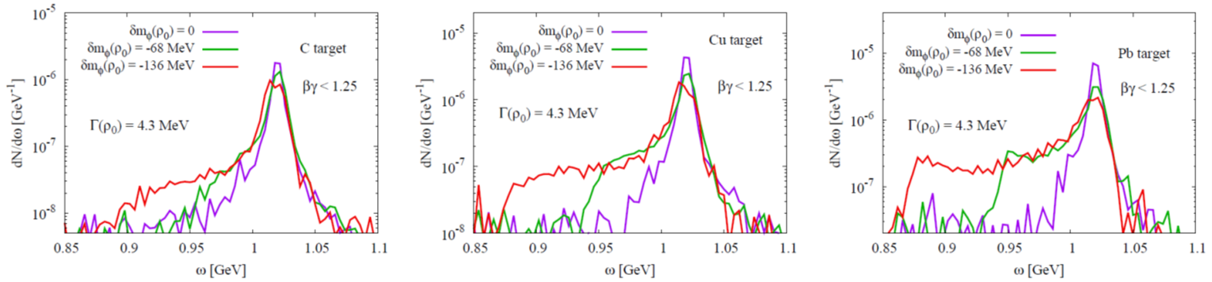
The obtained dilepton spectrum (without experimental effects)
Pure mass shift scenarios (no broadening)
Secondary peak can be generated for sufficient large mass shift scenario if the target is large enough (Pb here)
No second peak, but only shoulder structure for mass shift scenarios
(even before considering experimental resolution effects)
P. Gubler, M. Ichikawa, T. Song and E. Bratkovskaya, Phys. Rev. C 111, 034908 (2025).

Slide 14
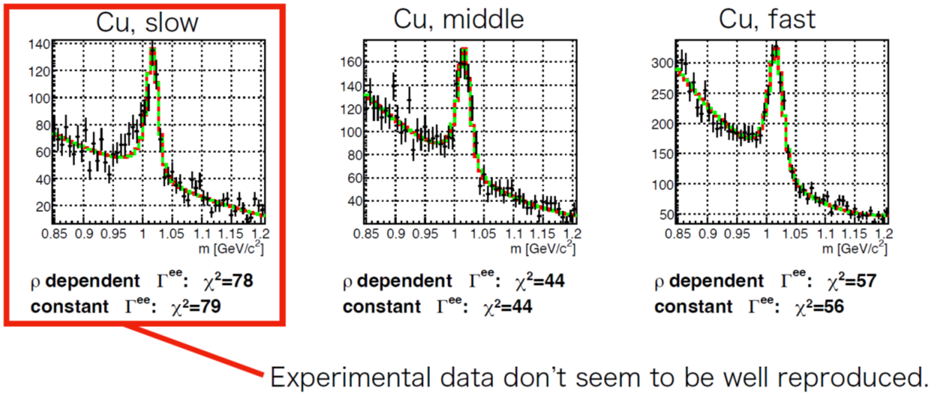
Comparison with KEK E325 dilepton data
First trial:
Momentum-independent mass shift and decay width
M. Ichikawa, P. Gubler, et al., (KEK-PS E325 Collaboration), arXiv:2507.00420 [nucl-ex].

Slide 15
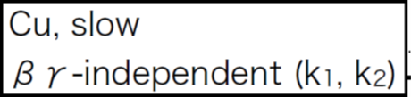
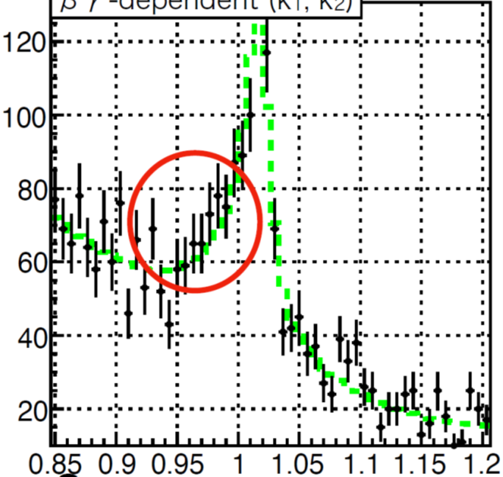
Comparison with KEK E325 dilepton data
Second trial:
Momentum-dependent mass shift and decay width
M. Ichikawa, P. Gubler, et al., (KEK-PS E325 Collaboration), arXiv:2507.00420 [nucl-ex].

Slide 16
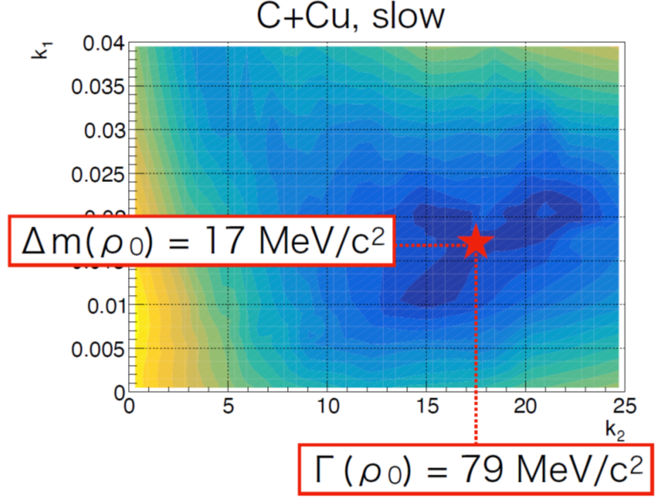
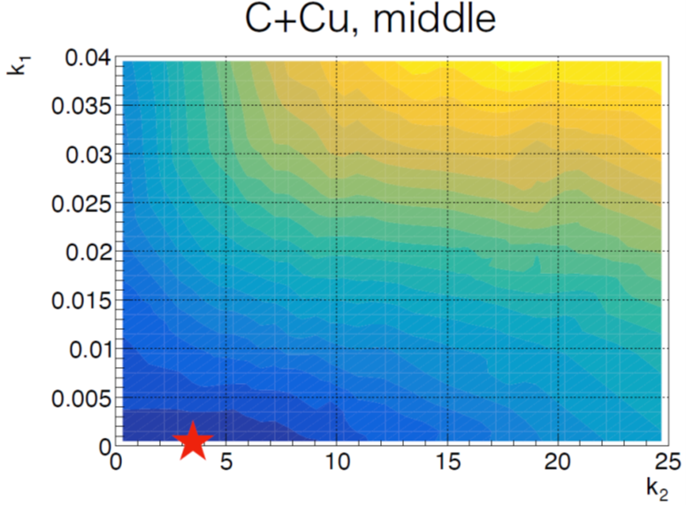
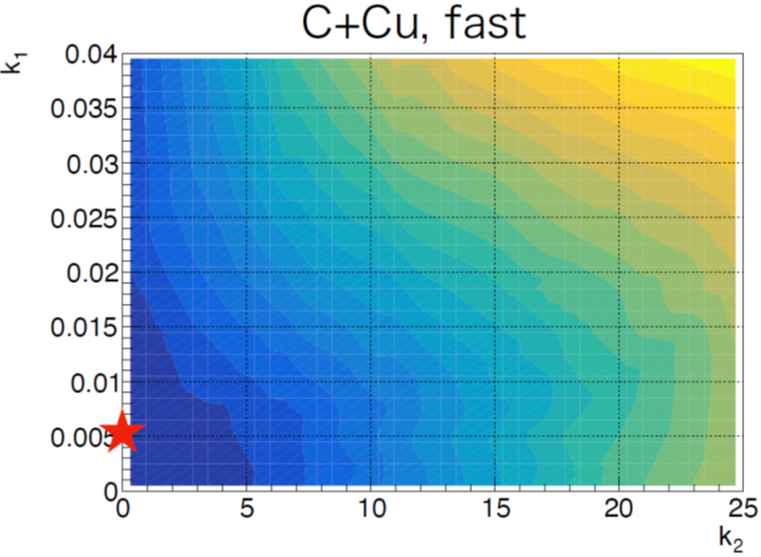
Comparison with KEK E325 dilepton data
Second trial:
Momentum-dependent mass shift and decay width
Case of density dependent partial decay width Γ^{ee}
Momentum dependence is needed to explain the data!
Smaller mass shift and stronger broadening than in the original E325 analysis!
M. Ichikawa, P. Gubler, et al., (KEK-PS E325 Collaboration), arXiv:2507.00420 [nucl-ex].

Slide 17
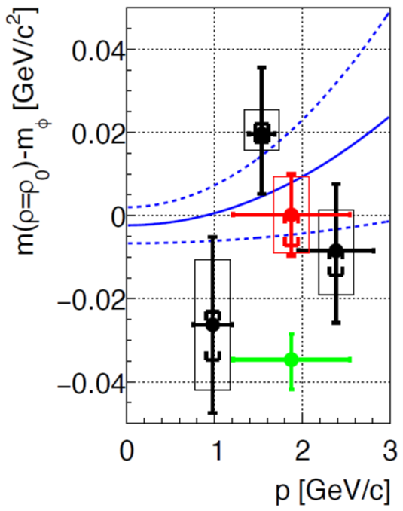
Final analysis results
Mass shift at ρ₀
Width shift at ρ₀
Momentum independent fit
Values extracted from
Transparency ratio measurement at COSY-ANKE
Previous KEK E325 analysis
M. Ichikawa, P. Gubler, et al., (KEK-PS E325 Collaboration), arXiv:2507.00420 [nucl-ex].

Slide 18
Role of spin
Ｎ
P
P
P
Ｎ
Ｎ
P
Ｎ
ϕ
?
P
Ｎ
Ｎ
Ｎ
P
Ｎ
P

Slide 19
Role of spin
meson at rest in nuclear matter
meson moving in nuclear matter
spin direction does not change physics (rotational symmetry)
spin direction changes physics (broken rotational symmetry)

Slide 20
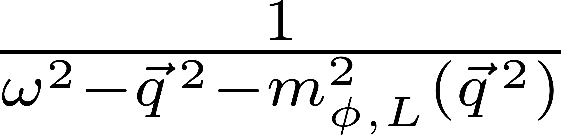
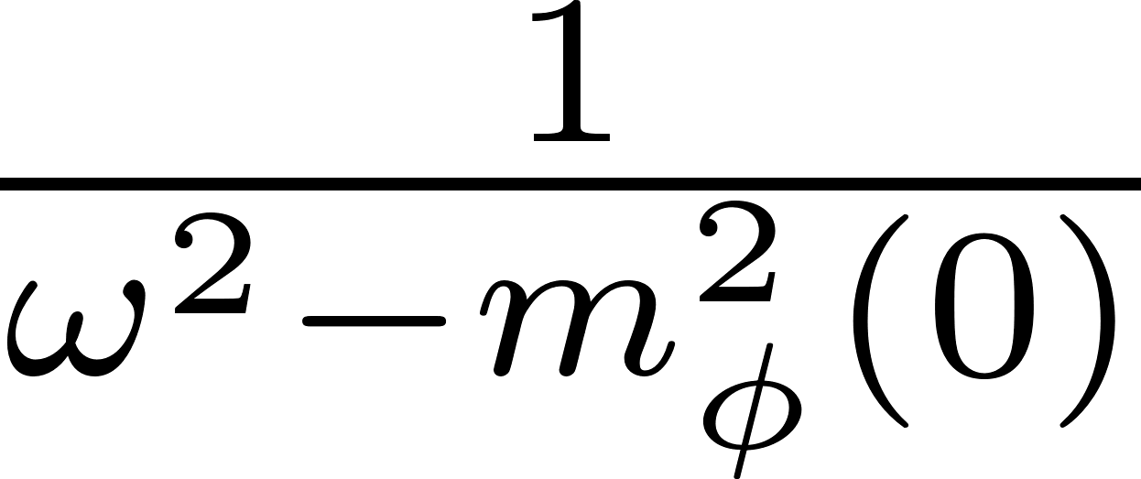
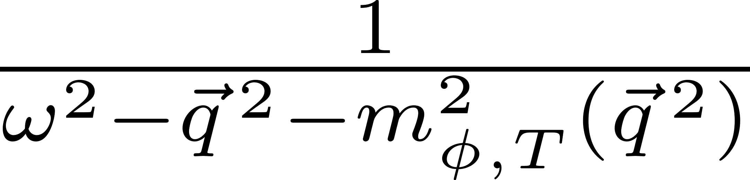

The φ meson with non-zero momentum
longitudinal part
transverse part
zero momentum
non-zero momentum

Slide 21
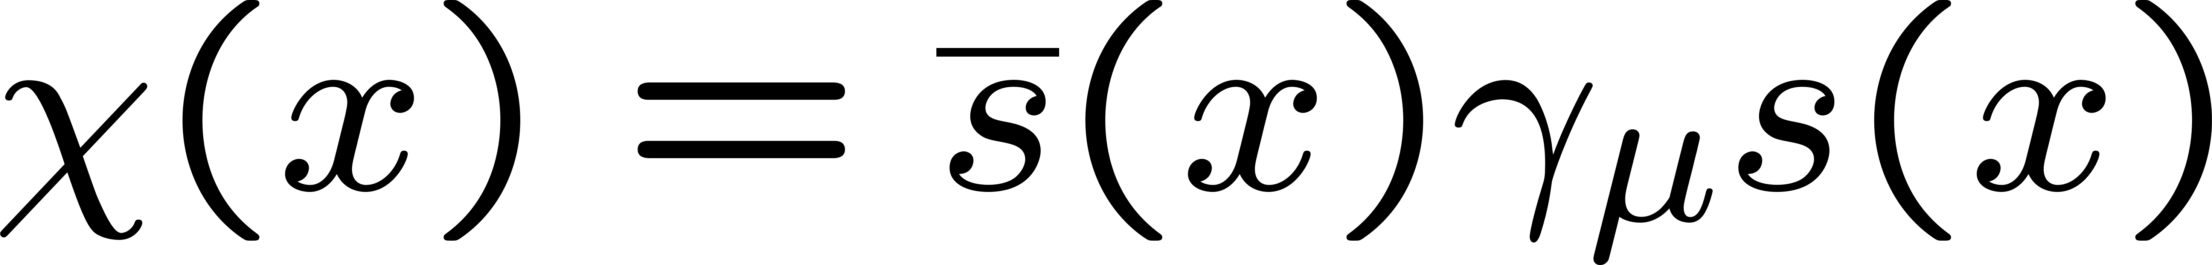
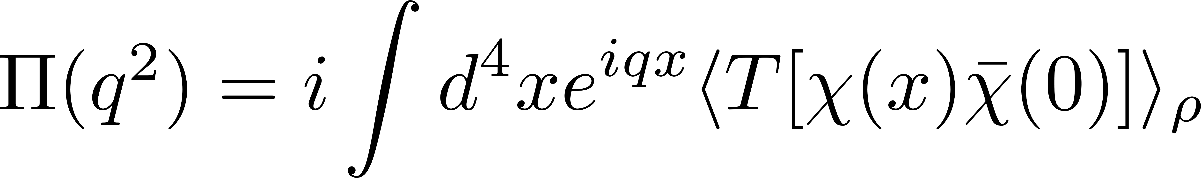
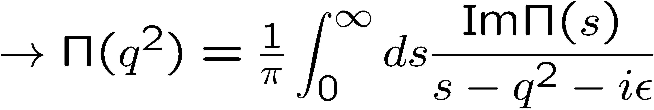
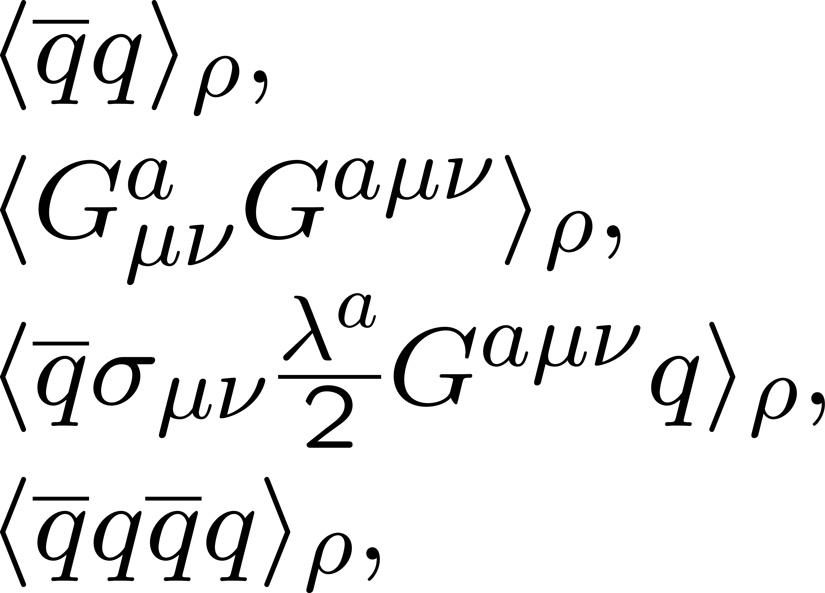
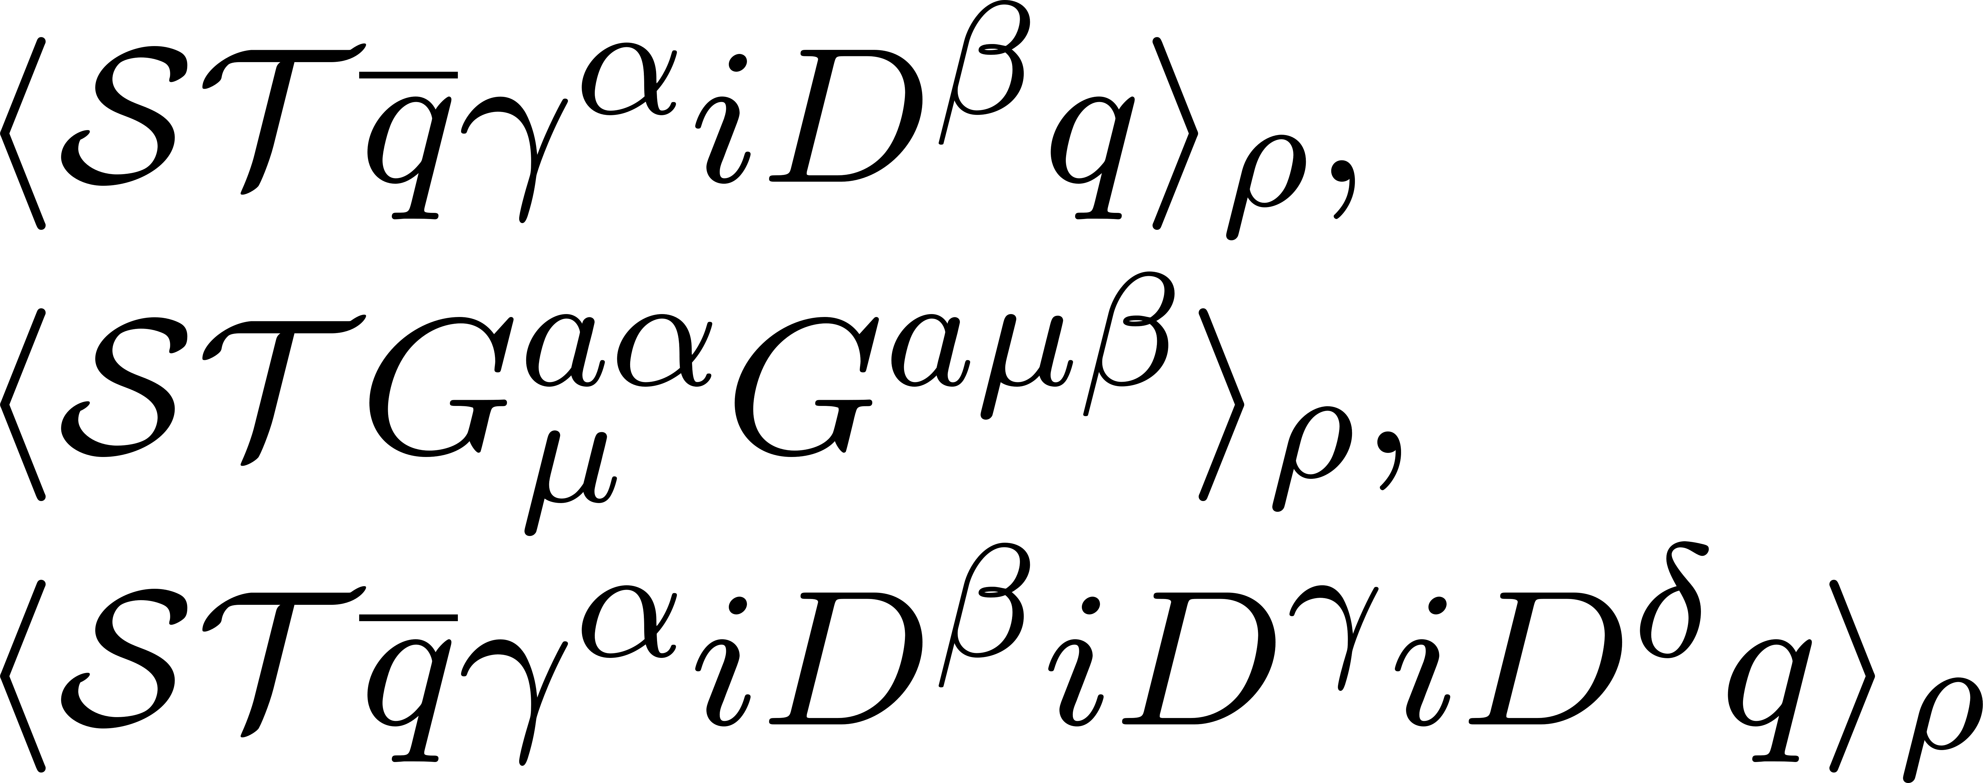
QCD sum rules
M.A. Shifman, A.I. Vainshtein and V.I. Zakharov, Nucl. Phys. B147, 385 (1979); B147, 448 (1979).
T. Hatsuda and S.H. Lee, Phys. Rev. C 46, R34 (1992).
Provides relation between QCD condensates and the hadron spectrum
spectral function
q²
OPE
scalar condensates:
same for longitudinal and transverse modes
non-scalar condensates:
cause difference between longitudinal and transverse modes

Slide 22
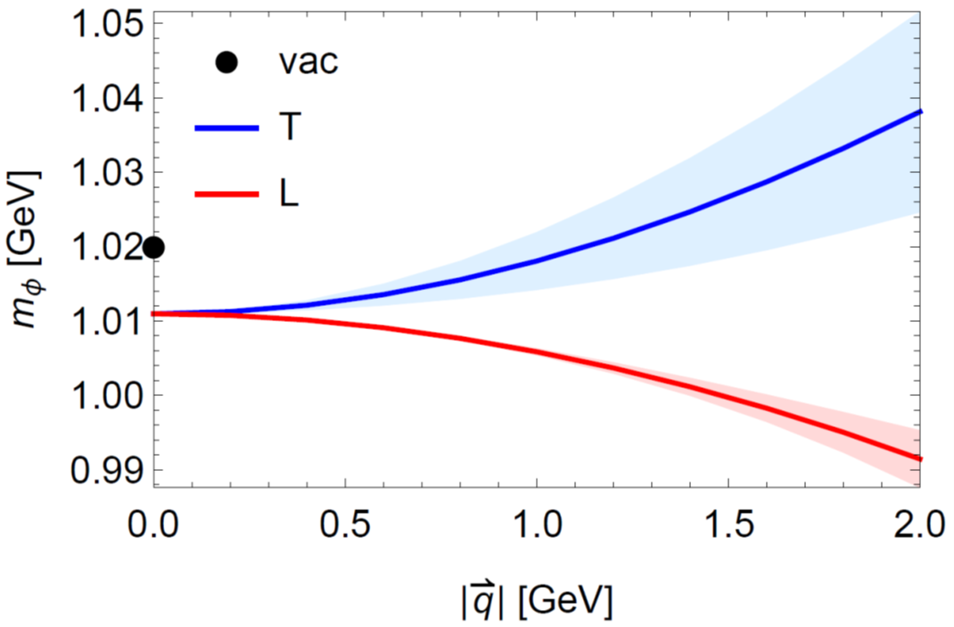
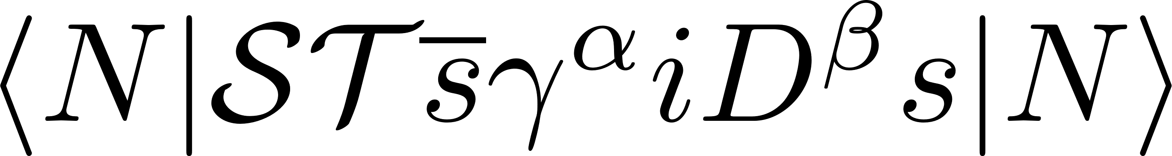
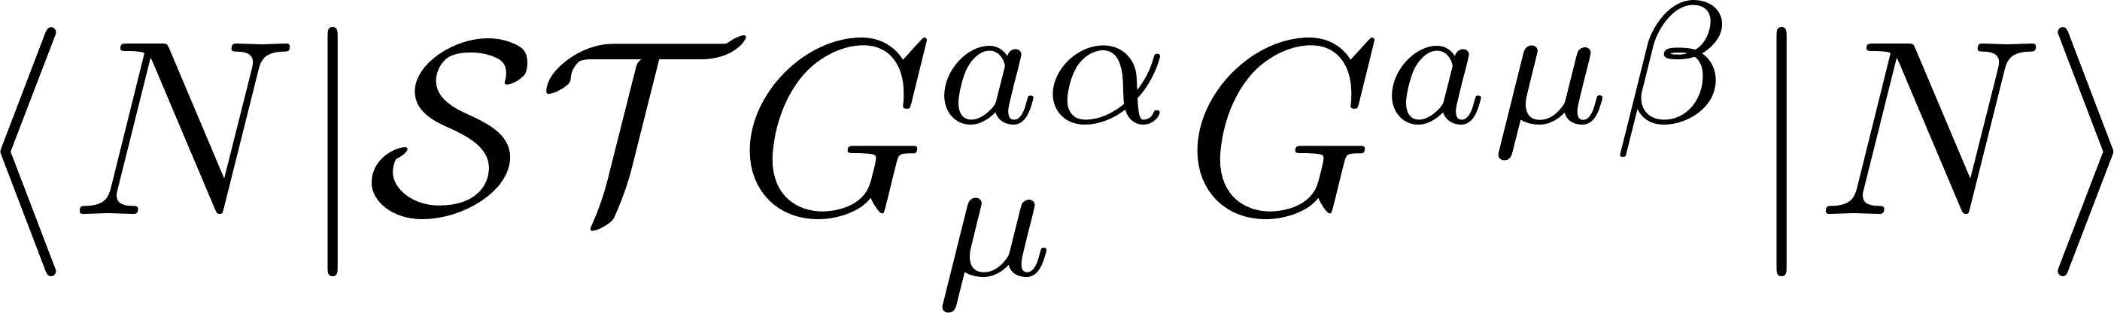
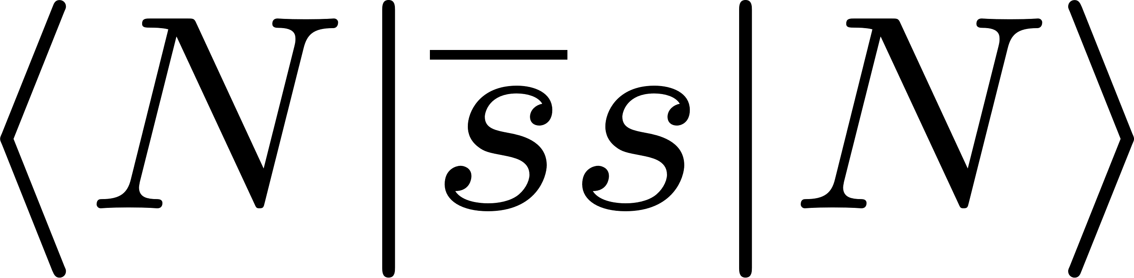
Results for the φ meson mass with non-zero momentum
caused by
＋
depends on
caused by
computed at normal nuclear matter density
Any sizable effect on polarization?
H.J. Kim and P. Gubler, Phys. Lett. B 805, 135412 (2020).

Slide 23
The angle-averaged di-lepton spectrum
Even without a double peak, momentum effects can be observed
Results of one-peak fits
H.J. Kim and P. Gubler, Phys. Lett. B 805, 135412 (2020).

Slide 24

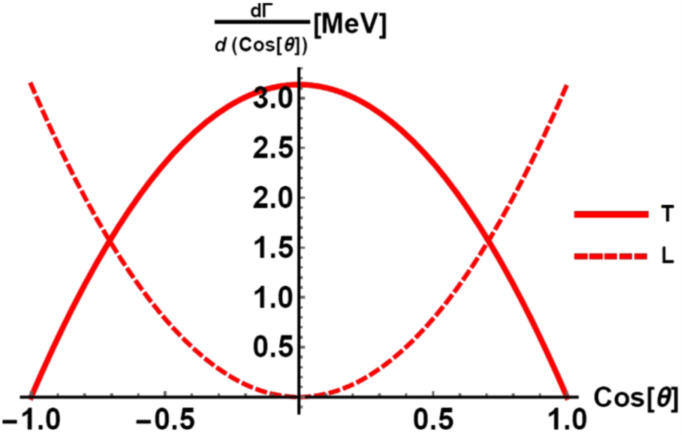
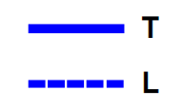
Angular distributions of ϕ meson dilepton and K⁺K⁻ decays
e⁺
Preferred mode for polarization measurement
ϕ
e⁻
Ideal for the J-PARC E88 experiment!
Dilepton decay angular distribution
K⁺K⁻ decay angular distribution
c.m. frame
c.m. frame
I.W. Park, H. Sako, K. Aoki, P. Gubler and S.H. Lee, Phys. Rev. D 107, 074033 (2023).

Slide 25
Summary and conclusions
A lot of new information about the ϕN interaction is becoming available from femtoscopy measurements and lattice QCD
What is the relation to the ϕ meson behavior in nuclear matter?
With the PHSD transport approach, we can now study pA reactions more reliably
Changed conclusions from previous analysis of experimental data
The dispersion relation of the ϕ meson is non-trivially modified in nuclear matter (longitudinal and transverse modes behave differently)
Valuable information will come from the J-PARC E88 experiment!

Slide 26
Backup slides

Slide 27
Issues of transport approaches
Reliability of transport simulations (dependence on different codes and approaches)
Need comparison of different codes (including QMC and BUU types)
Stability of the (undisturbed) target in the transport approach
Generally difficult to achieve in most transport models specialized in high-energy collisions, but is realized is some low-energy codes
Not so serious for KEK and J-PARC pA collisions, in which the phi mesons leave the target quickly??
Violation of energy or momentum conservation when mass shifted particles leave the dense medium
Relevant for E88, as kaons generated in dense matter are mass shifted

Slide 28




A simple example of dilepton decay of a longitudinally polarized ϕ
after decay
$$e^{+}$$
before decay
decay perpendicular to the ϕ meson momentum:
allowed
$$e^{−}$$
ϕ
decay parallel to the ϕ meson momentum:
not allowed
$$e^{−}$$
$$e^{+}$$
measurement in this direction can be used to observe purely transverse mode

Slide 29
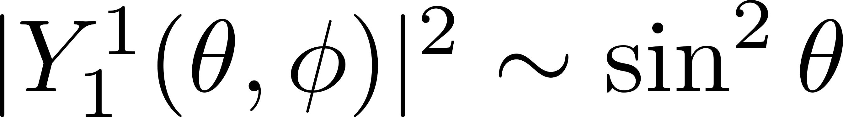




A simple example of K⁺K⁻ decay of a transeversly polarized ϕ
after decay
decay perpendicular to the ϕ meson momentum:
allowed
$$K^{+}$$
before decay
$$K^{−}$$
ϕ
decay parallel to the ϕ meson momentum:
not allowed
$$K^{−}$$
$$K^{+}$$
measurement in this direction can be used to observe purely longitudinal mode

Slide 30
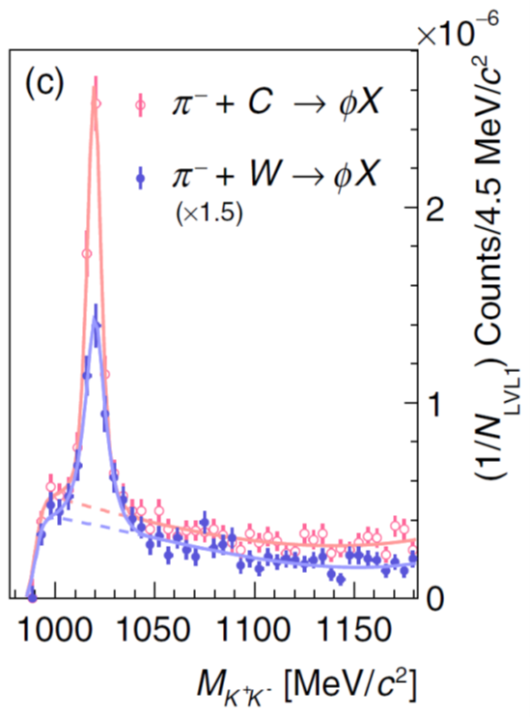
Many inconsistencies…
HADES:
1.7 GeV π⁻A-reaction
ALICE: pp
K⁺K⁻ - invariant mass spectrum
Measurement of ϕN correlation
Theoretical analysis of the of the total ϕ meson production cross section:
Attractive ϕ-nucleus potential:
-(50 - 100) MeV
Attraction!
Small imaginary part:
20 – 25 MeV
E. Ya. Paryev, Nucl. Phys. A 1032, 122624 (2023).
Large negative mass shift?
Small broadening?
S. Acharya et al. (ALICE Coll.),
Phys. Rev. Lett. 127, 172301 (2021).
J. Adamczewski-Musch et al. (HADES Coll.),
Phys. Rev. Lett. 123, 022002 (2019).
Photoproduction measurements
Y. Lyu et al. (Lattice QCD, HAL QCD Collaboration),
Phys. Rev. D 106, 074507 (2022).
I.I. Strakovsky et al. (CLAS),
Phys. Rev. C 101, 045201 (2020).
Hadronic Effective theory calculations

Slide 31
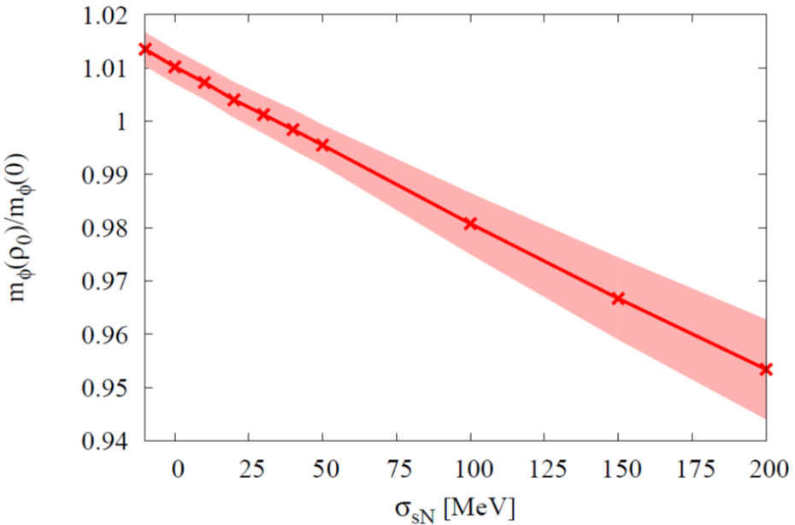

Why should we be interested?
The ϕ meson mass in nuclear matter probes the strange quark condensate at finite density!
ϕ meson mass at normal nuclear matter density from QCD sum rules
T. Hatsuda and S.H. Lee, Phys. Rev. C 46, R34 (1992).
P. Gubler and K. Ohtani, Phys. Rev. D 90, 094002 (2014).

Slide 32

An even newer analysis of the ALICE data
L.M. Abreu, P. Gubler, K.P. Khemchandani, A. Martínez Torres and A. Hosaka, arXiv:2409.05170 [hep-ph].
Starting point:
Hadronic Meson-Baryon interaction Lagrangian
1) Vector Meson-Baryon interaction: Based on Hidden Local Symmetry

Slide 33






Crucial ingredient: spin dependent vector meson-baryon interactions
Considered so far in Feijoo et al.
New!
Depend on spin configuration of the ϕN system (spin 1/2 or 3/2)
L.M. Abreu, P. Gubler, K.P. Khemchandani, A. Martínez Torres and A. Hosaka, arXiv:2409.05170 [hep-ph].

Slide 34








Next step:
Solve the Bethe-Salpeter equation in the Vector Meson-Baryon channel of interest
to obtain the full scattering amplitude T
Emergence of subtraction constants, which are parameters of the model
Loop contains divergence that needs to be regulated. We use dimensional regularization
L.M. Abreu, P. Gubler, K.P. Khemchandani, A. Martínez Torres and A. Hosaka, arXiv:2409.05170 [hep-ph].

Slide 35
The obtained correlation function (compared with ALICE data)
Reasonably good agreement without any parameter fitting!
L.M. Abreu, P. Gubler, K.P. Khemchandani, A. Martínez Torres and A. Hosaka, arXiv:2409.05170 [hep-ph].

Slide 36


A lot of recent theoretical activity
Testing the ϕ-nuclear potential in pion-induced ϕ meson production on nuclei near threshold, E. Y. Paryev, Nucl. Phys. A 1032, 122624 (2023).
The ϕp bound state in the unitary coupled-channel approximation,
B.-X. Sun, Y.-Y. Fan, Q.-Q. Cao, Commun. Theor. Phys. 75, 055301 (2023).
Possible ${}_{ϕ}^{3}H$ hypernucleus with the HAL QCD interaction,
I. Filikhin, R. Y. Kezerashvili, B. Vlahovic, Phys. Rev. D 110, L031502 (2024).
ϕ-p bound state and completeness of quantum states,
A. Kuros, R. Maj, S. Mrowczynski, arXiv:2408.11941 [hep-ph].
Bound states of ${}_{ϕ}^{9}{Be}$ and ${}_{ϕϕ}^{6}{He}$ with ϕ+α+α and ϕ+ϕ+α cluster models,
I. Filikhin, R. Y. Kezerashvili, B. Vlahovic, arXiv:2408.13415 [nucl-th].
Relevance of the coupled channels in the ϕp and ρ⁰p Correlation Functions ,
A. Feijoo, M. Korwieser, L. Fabbietti, arXiv:2407.01128 [hep-ph].

Slide 37

2) Pseudoscalar Meson-Baryon interaction: Based on Chiral Symmetry
3) Transition between Pseudoscalar and Vector Mesons: Treating Vector meson
as gauge boson in nonlinear sigma model (pion photoproduction + vector
meson dominance)
L.M. Abreu, P. Gubler, K.P. Khemchandani, A. Martínez Torres and A. Hosaka, arXiv:2409.???? [hep-ph].

Slide 38

Next step:
If possible, determine the parameters (subtraction constants) of the model from experimental data
For the spin 1/2 channel, scattering data are available for constraining the model parameters:
Regions used for the fit
K.P. Khemchandani, A. Martínez Torres, H. Nagahiro and A. Hosaka, Phys. Rev. D 88, 114016 (2013).
L.M. Abreu, P. Gubler, K.P. Khemchandani, A. Martínez Torres and A. Hosaka, arXiv:2409.???? [hep-ph].

Slide 39



Next step:
Calculate the correlation function and compare with the ALICE data
Scattering amplitudes:
See previous slide
We use a generalized Koonin-Pratt formula:
Source function:
Gaussian with radius of approx. 1 fm
Weights related to the multiplicity of pairs of primary particles created at the initial stage of the collision
Obtained from Thermal-Fist package
L.M. Abreu, P. Gubler, K.P. Khemchandani, A. Martínez Torres and A. Hosaka, arXiv:2409.???? [hep-ph].

Slide 40

The obtained correlation function (channel decomposed)
Similar to
A. Feijoo et al.,
arXiv:2407.01128 [hep-ph].
L.M. Abreu, P. Gubler, K.P. Khemchandani, A. Martínez Torres and A. Hosaka, arXiv:2409.???? [hep-ph].

Slide 41

The obtained scattering lengths
Large model parameter dependence!
Correlation function is not very sensitive to the scattering length
L.M. Abreu, P. Gubler, K.P. Khemchandani, A. Martínez Torres and A. Hosaka, Phys. Lett. B 860, 139175 (2025).

Slide 42

More recent results
HADES:
1.7 GeV π⁻A-reaction
K⁺K⁻ - invariant mass spectrum
Theoretical analysis of the of the total ϕ meson production cross section:
E. Ya. Paryev, Nucl. Phys. A 1032, 122624 (2023).
Attractive ϕ-nucleus potential:
-(50 - 100) MeV
J. Adamczewski-Musch et al. (HADES Coll.),
Phys. Rev. Lett. 123, 022002 (2019).
Relatively small imaginary part:
20 – 25 MeV

Slide 43
The ϕ meson in pA collisions
Experiments to be discussed in this talk
no strong interaction
strong interaction
no distortion of signal due to interaction with nuclear medium
e-
approximate density: normal nuclear density ρ₀
distortion of signal due to interaction with nuclear medium
K⁻
p
p
φ
φ
e⁺
K⁺
nucleus
nucleus
low (zero?) temperature
E325 (KEK)
E16 (J-PARC)
pion beam (HADES)
E88 (J-PARC)

Slide 44

The angle-averaged di-lepton spectrum
Computed at normal nuclear matter density
A double peak?
H.J. Kim and P. Gubler, Phys. Lett. B 805, 135412 (2020).

Slide 45

ϕ meson at rest in nuclear matter
The ϕ meson mass in nuclear matter probes the strange quark condensate at finite density!
Sum Rules + Experiment
Not consistent?
R. Muto et al.
(KEK, E325 Collaboration),
Phys. Rev. Lett. 98,
042501 (2007).
Lattice QCD
Experiment
Measurement will be repeated at the
J-PARC E16 experiment (with 100 times increased statistics!)

Slide 46

Experimental di-lepton spectrum
e
e
p
e
+
p
=
Experimentally observed spectrum
φ
φ
e
outside decay
inside decay

Slide 47


Can the two polarizations be disentangled?
Look at the angular distributions of various decay channels
To be measured soon at the J-PARC E16 experiment
New E88 experiment
at J-PARC (in a few years)

Slide 48






Full angular distribution of dilepton decay
Initial polarization:
Transverse polarization
Longitudinal polarization
other φ-dependent terms

Slide 49


Full angular distribution of dilepton decay
With
00-component of spin-density matrix
Unpolarized case: vanishing θ-dependence
φ-dependent terms

Slide 50
Full angular distribution of K⁺K⁻ decay
Transverse modes
Longitudinal mode
φ-dependent terms

