Slide 1
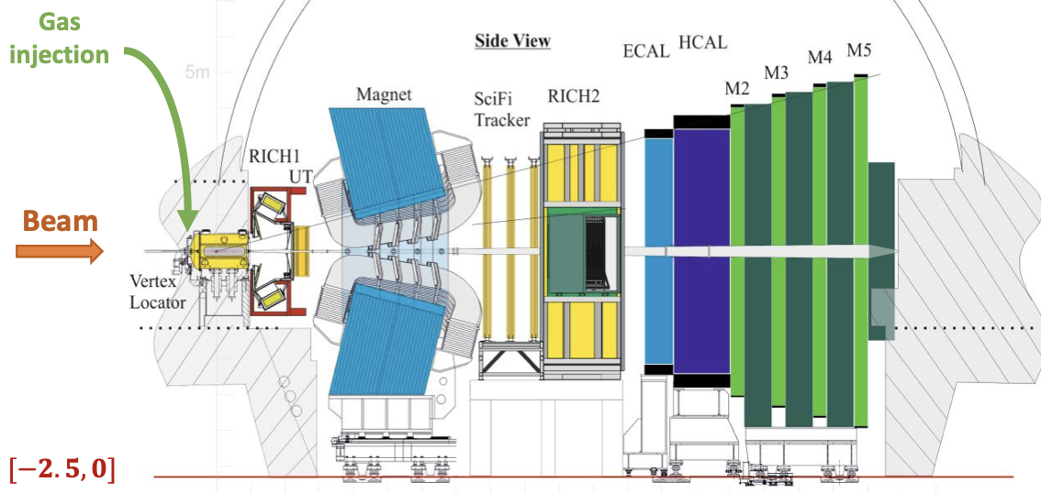
Heavy Flavor production at fixed-target LHC
Cesar Luiz da Silva
Los Alamos National Lab

Slide 2
History
Feasibility study on a dedicated fixed target experiment at LHC:
AFTER @ LHC : Phys.Rept. 911 (2021) 1-83
SMOG, a beam luminosity monitor used in LHCb is proposed to perform fixed target physics : Nucl.Instrum.Meth.A 553 (2005) 388-399
LHCb started the SMOG physics program with some heavy flavor measurements in pA and PbA collisions using injected gas: PRL 122 (2019) 13, 132002
A high-pressure gas cell is proposed to enhance SMOG luminosity, SMOG2 is born and started take data in 2023: Physical Review ACCELERATORS AND BEAMS 27, 111001 (2024)
Ongoing discussions to implement a fixed-target in ALICE using the beam halo, a bent crystal and a target : Eur. Phys. J. C (2023) 83:1053

Slide 3
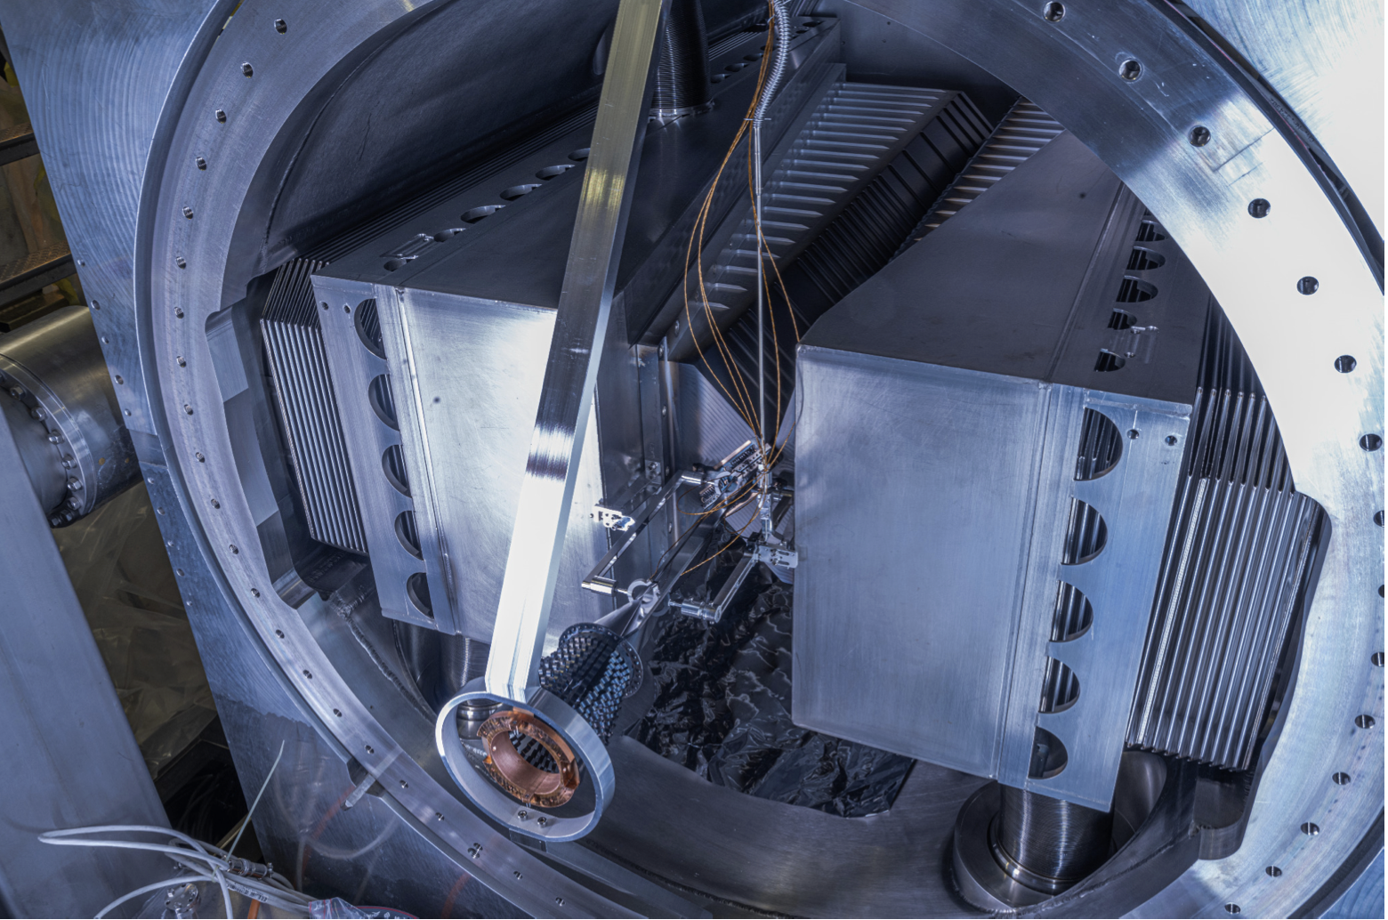
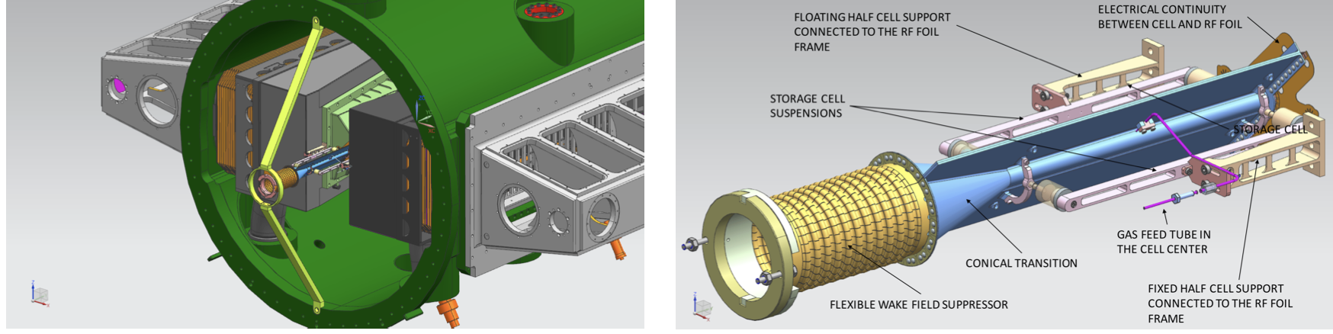
THE SMOG2 SYSTEM AT LHCb
Physical Review ACCELERATORS AND BEAMS 27, 111001 (2024)
5x 10⁻⁷ mbar gas confined in a 20 cm storage cell installed upstream the LHCb interaction point .
Can inject H₂, D₂, He, Ne, N₂, O₂, Ar, Kr, Xe → Fast switch between gas species.
LHCb can take PbA data at all centralities .

Slide 4
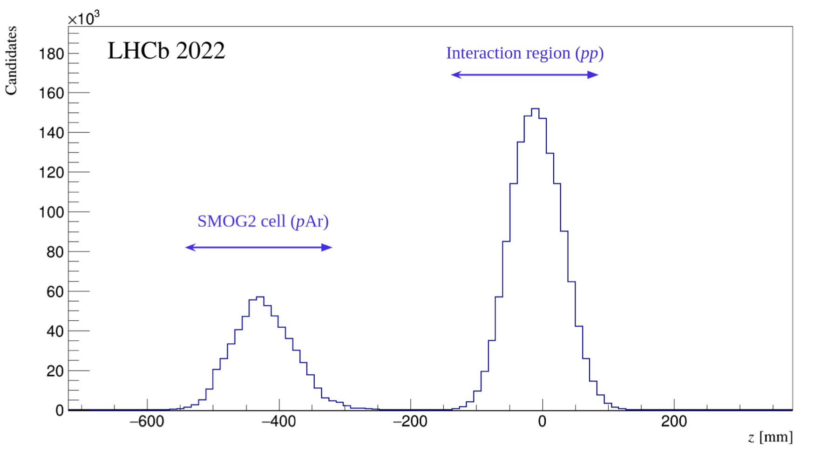
Physical Review ACCELERATORS AND BEAMS 27, 111001 (2024)

Slide 5
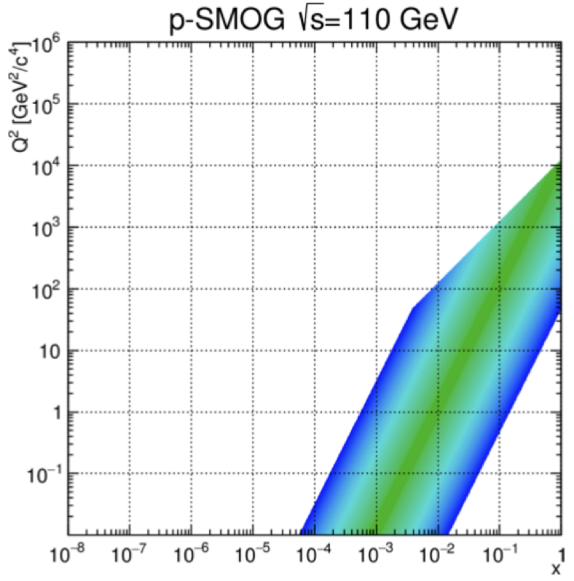
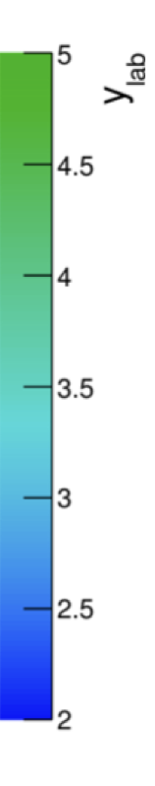
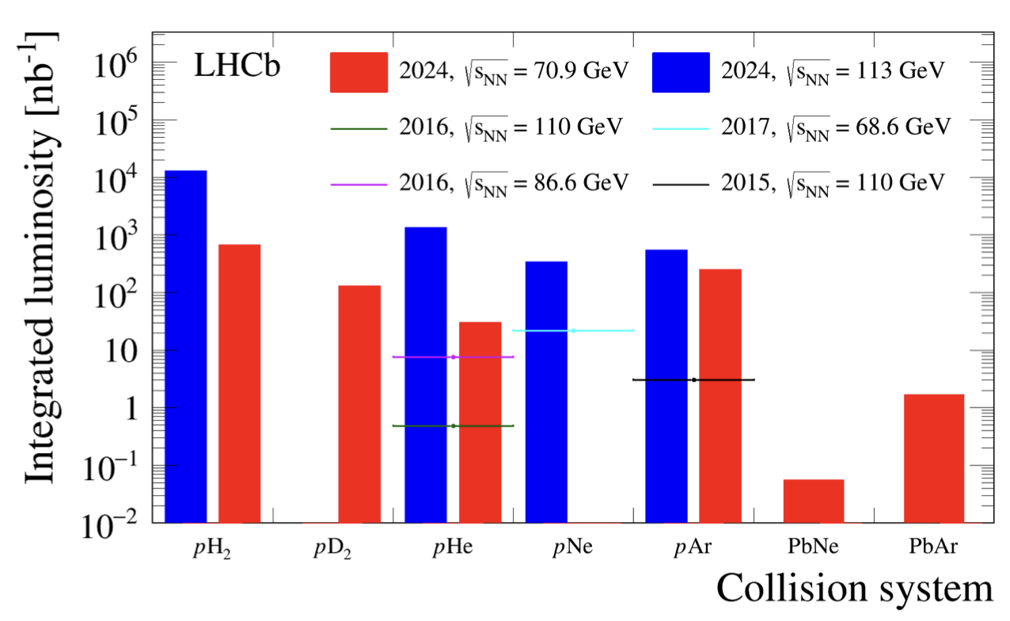
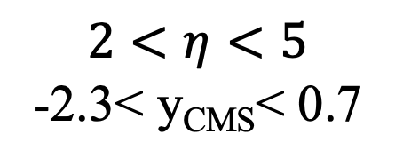
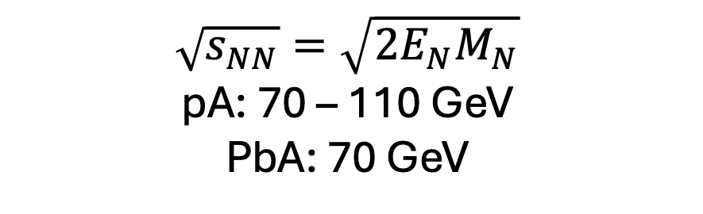
SMOG KINEMATICS AND LUMINOSITIES
$$\sqrt{s_{NN}}=\sqrt{2E_{N}M_{N}}$$
pA: 70 – 110 GeV
PbA: 70 GeV
$$2<η<5$$
-2.3< y_{CMS}< 0.7

Slide 6
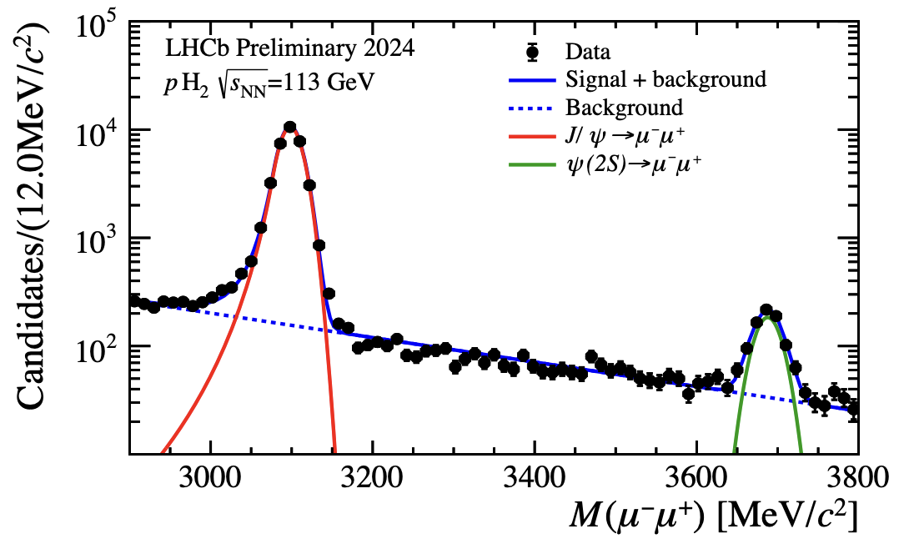
REFERENCE RUN

Slide 7
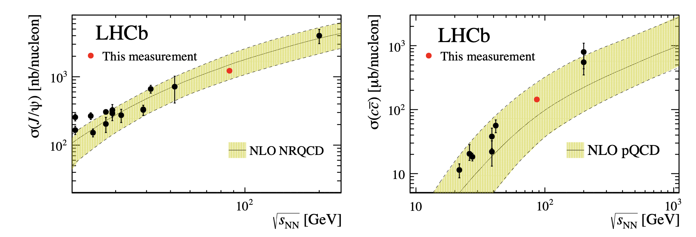
CHARM CROSS-SECTION AT LHC FT ENERGY
From pHe data
PRL 122 (2019) 13, 132002
PHENIX
PHENIX
HERA-B
E789
HERA-B
E789
$σ_{pp}∼37−39$ mb,
On the order of one $c\overline{c}$ pair produced in a single central PbAr collision

Slide 8
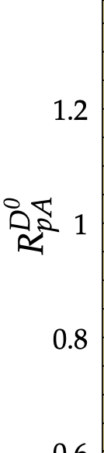
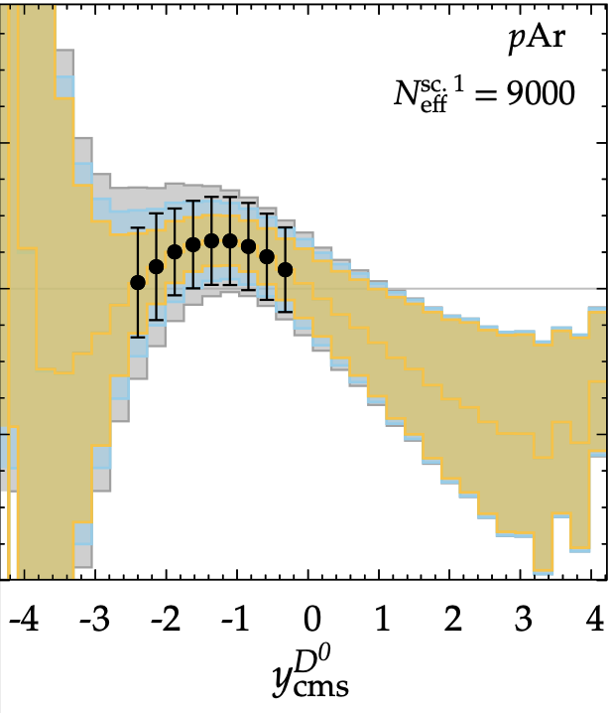
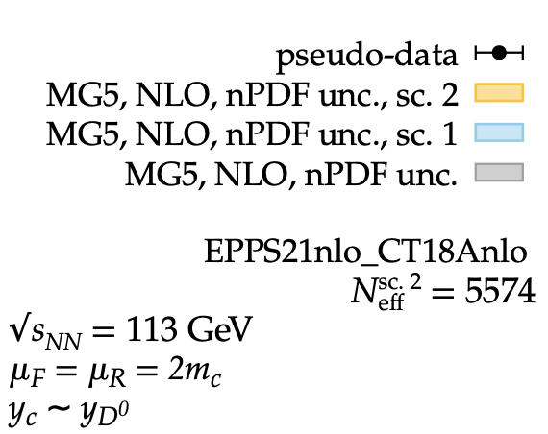
X-COVERAGE and INITIAL-STATE EFFECTS at LHC FT ENERGIES
PLB 866 (2025) 139554

Slide 9
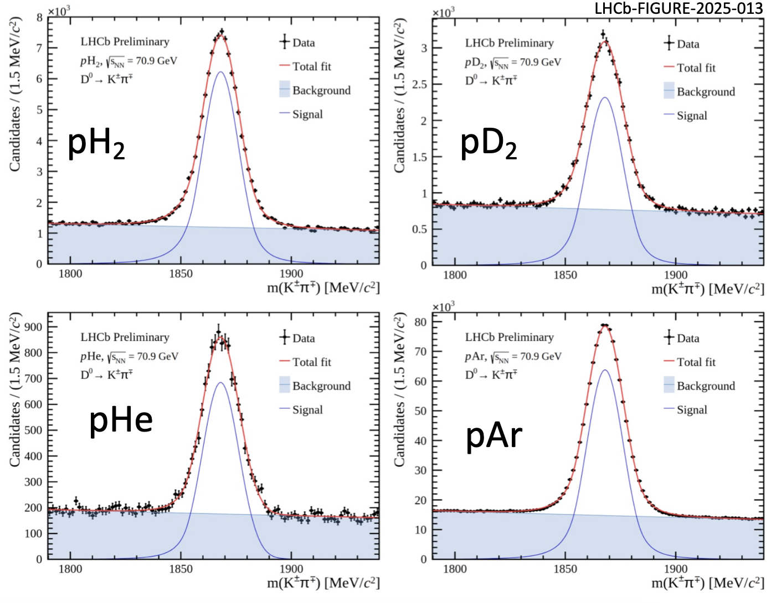
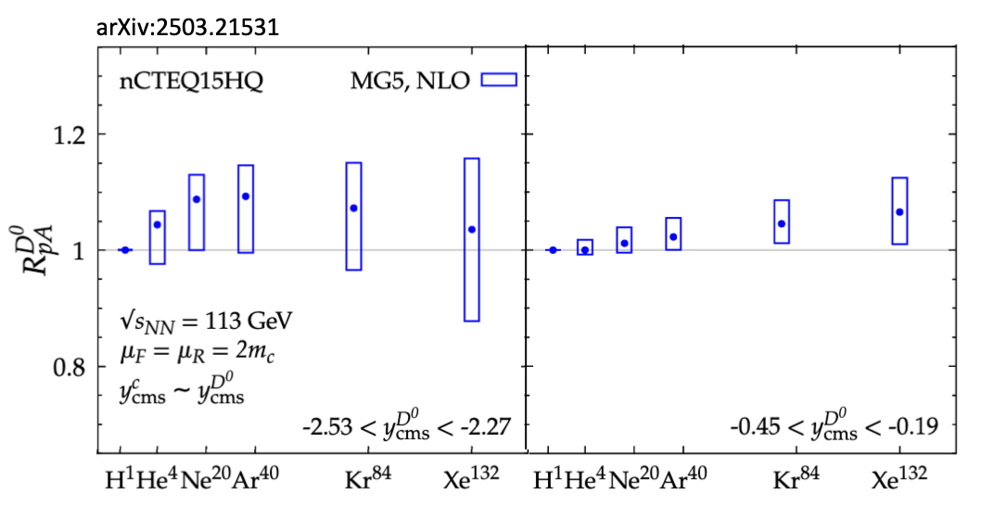
SMOG2->D⁰ data from 2024
Theoretical estimation
PLB 866 (2025) 139554

Slide 10
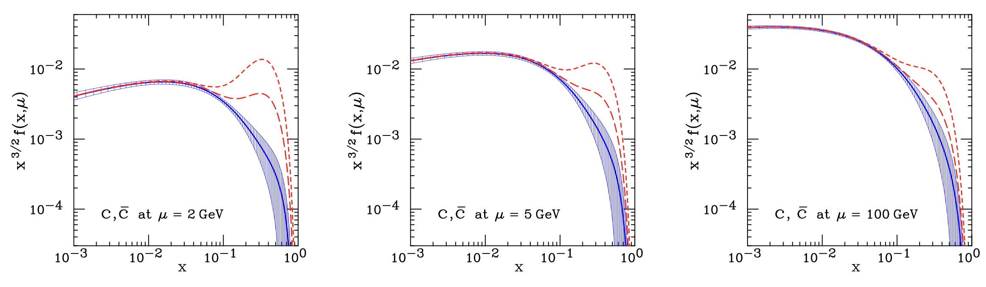
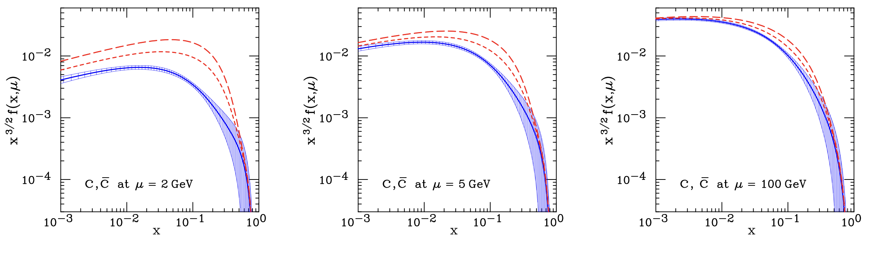
Potential to probe intrinsic charm in the proton
Phys.Rev.D 75 (2007) 054029
BHPS model
LHCb SMOG
LHCb SMOG
LHCb SMOG
Sea-like model

Slide 11
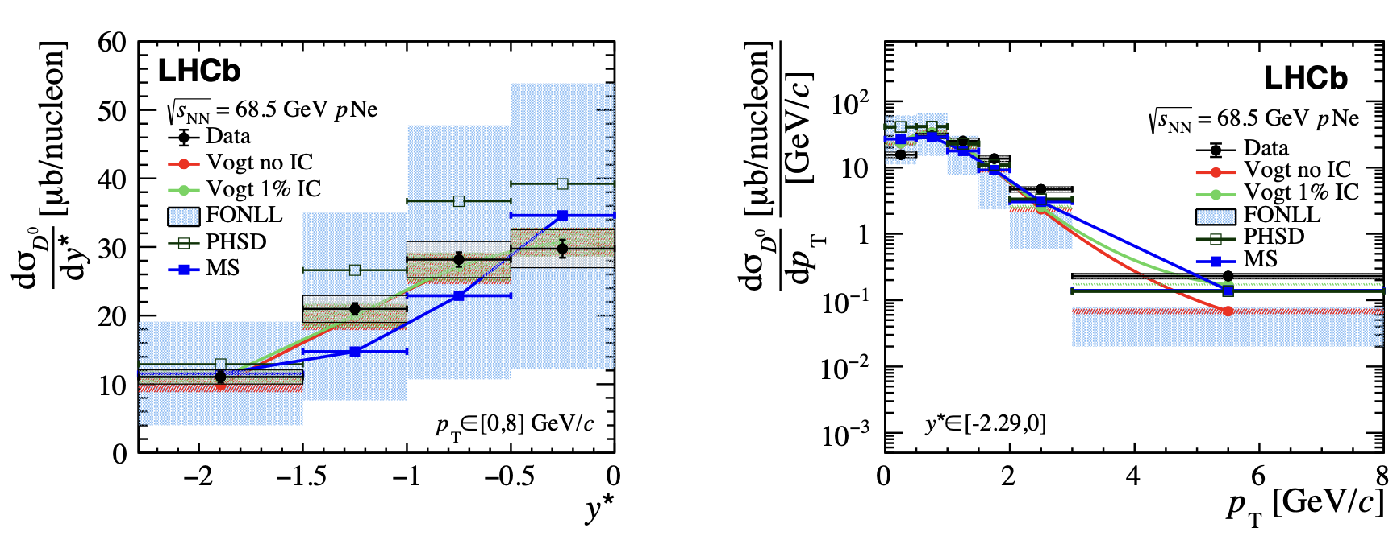
DIFFERENTIAL D⁰ CROSS-SECTION
Eur. Phys. J. C83 (2023) 541
MS: 1% intrinsic charm and 10% recombination contributions

Slide 12
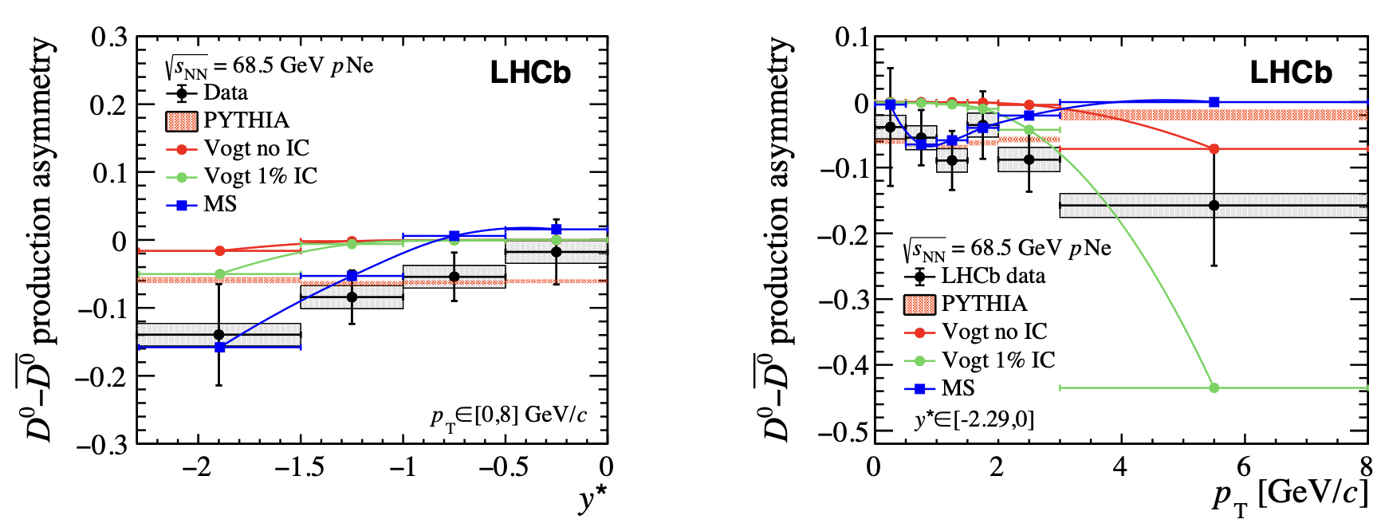
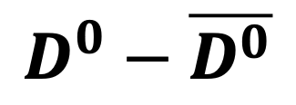
$$D^{0}−\overline{D^{0}}$$
Eur. Phys. J. C83 (2023) 541
MS: 1% intrinsic charm and 10% recombination contributions

Slide 13
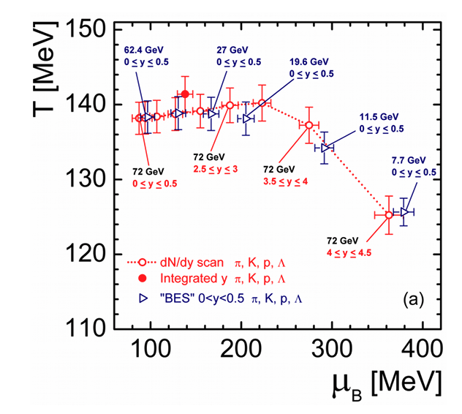
PHASE SPACE COVER BY FT AT LHC
UrQMD
PRC 98 (2018) 3, 034905
LHCb SMOG: -2.3< y< 0.7
ALICE FT: -5.2 < y < -3.4
Freeze-out
Rapidity scan can cover the same baryon chemical potential range of RHIC BES

Slide 14
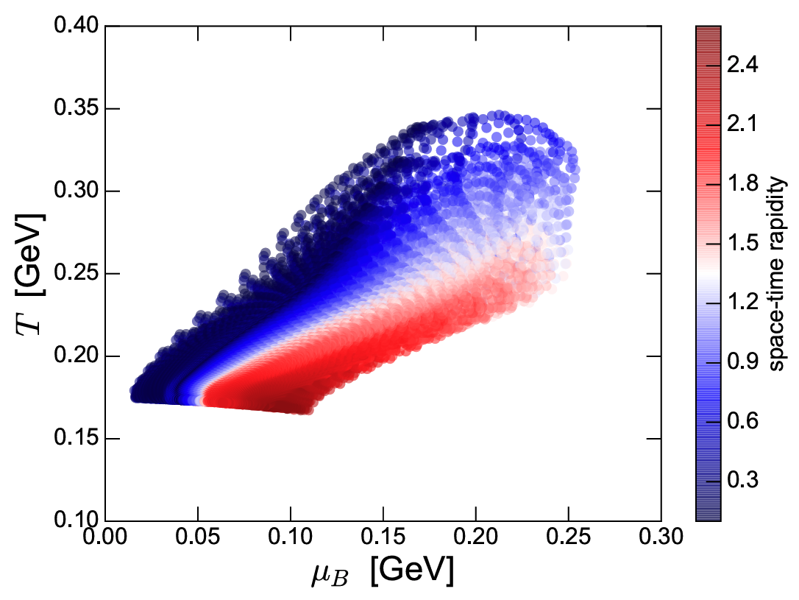
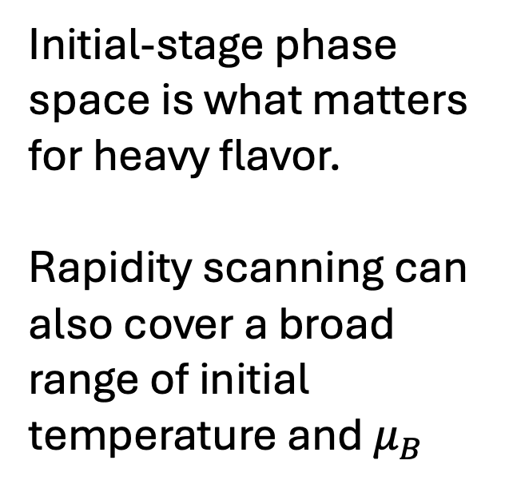
PHASE SPACE COVER BY FT AT LHC
Acta Phys. Polon. B50 (2019), 141-148
T at τ₀ = 0.64 fm/c
vHLLE+UrQMD
Initial-stage phase space is what matters for heavy flavor.
Rapidity scanning can also cover a broad range of initial temperature and $μ_{B}$

Slide 15
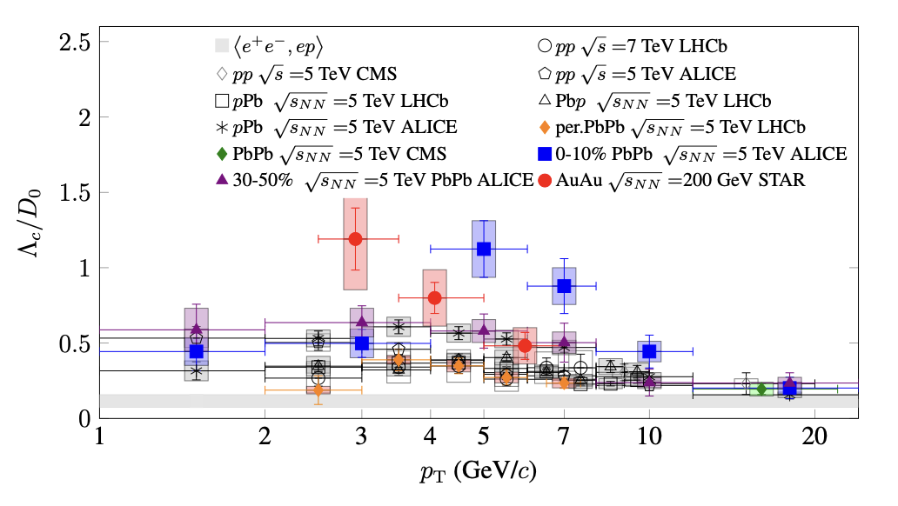
Baryon enhancement
Hot QCD White Paper arXiv:2303.17254

Slide 16
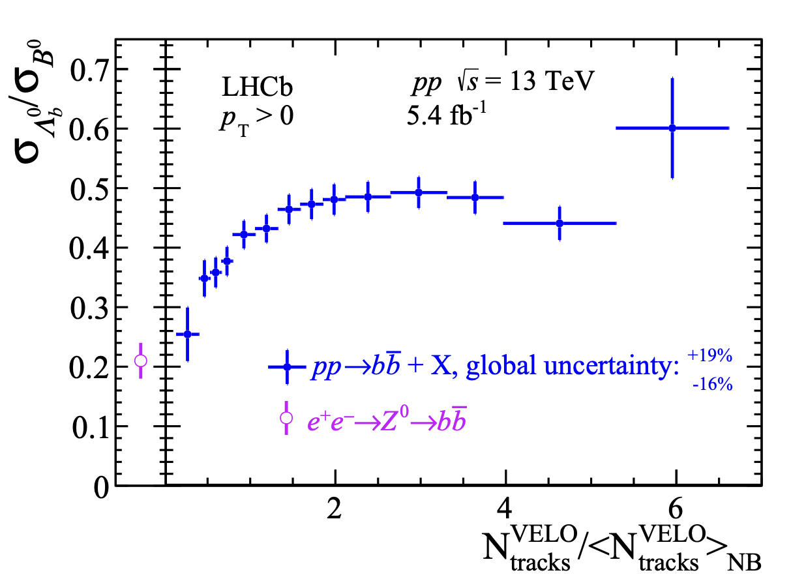
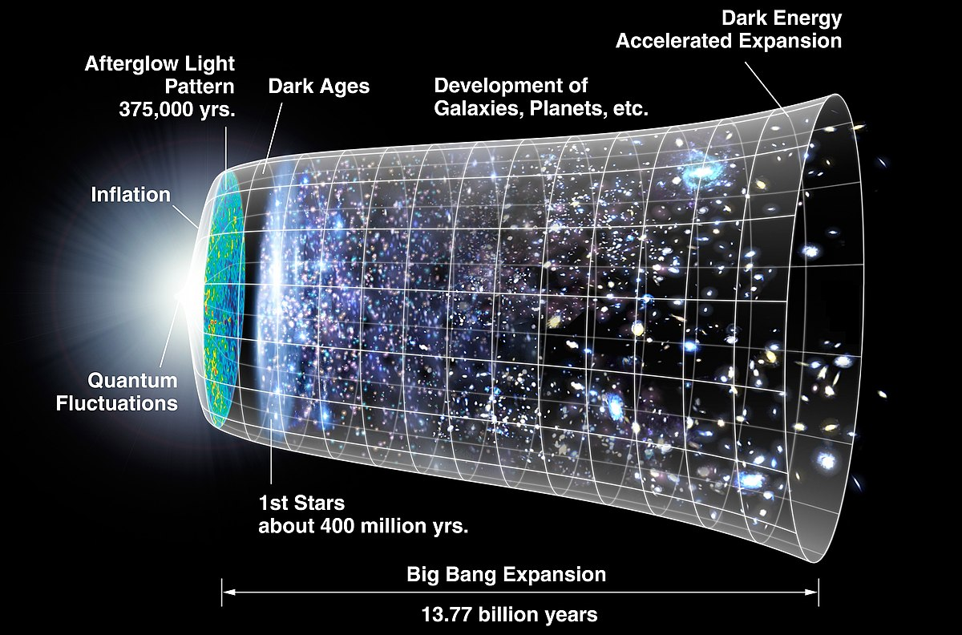
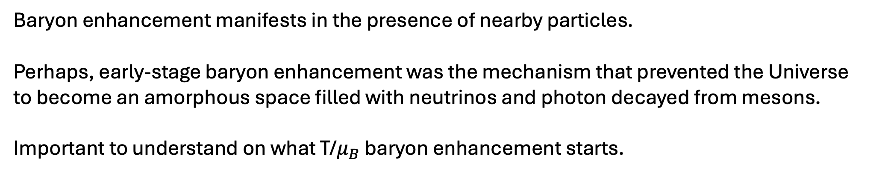
Baryon enhancement and its cosmological implications
PRL 132 (2024) 081901
Baryon enhancement manifests in the presence of nearby particles.
Perhaps, early-stage baryon enhancement was the mechanism that prevented the Universe to become an amorphous space filled with neutrinos and photon decayed from mesons.
Important to understand on what T/$μ_{B}$ baryon enhancement starts.

Slide 17
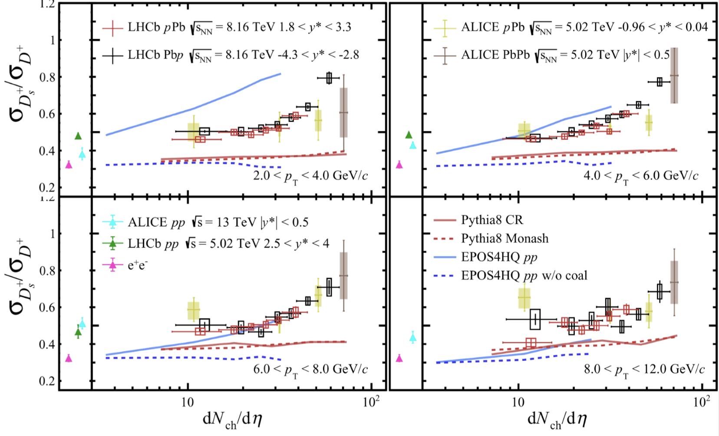
Strangeness enhancement
PRD 110, L031105
Data favors quark coalescence at high-energy.

Slide 18
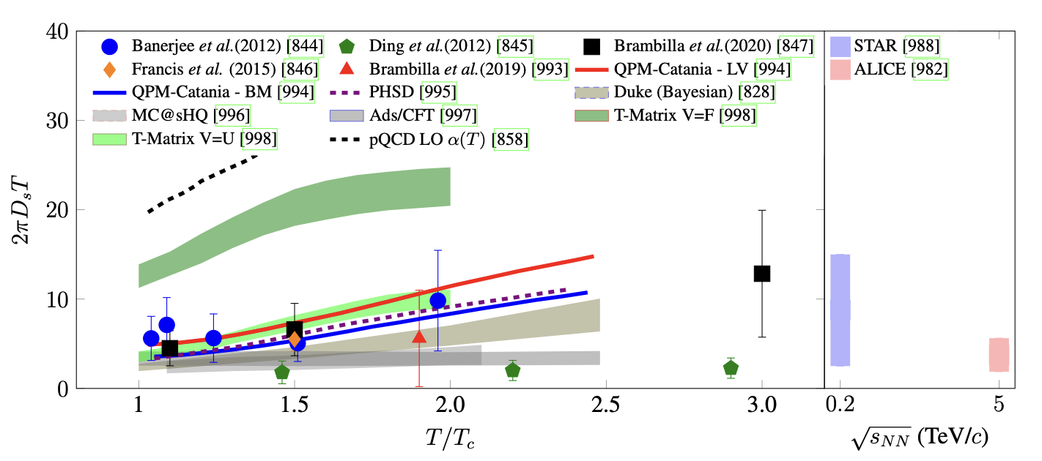
Diffusion and transport coefficient in QGP
Charm flow analysis in SMOG2 data would allow the study of charm diffusion at lower T.

Slide 19
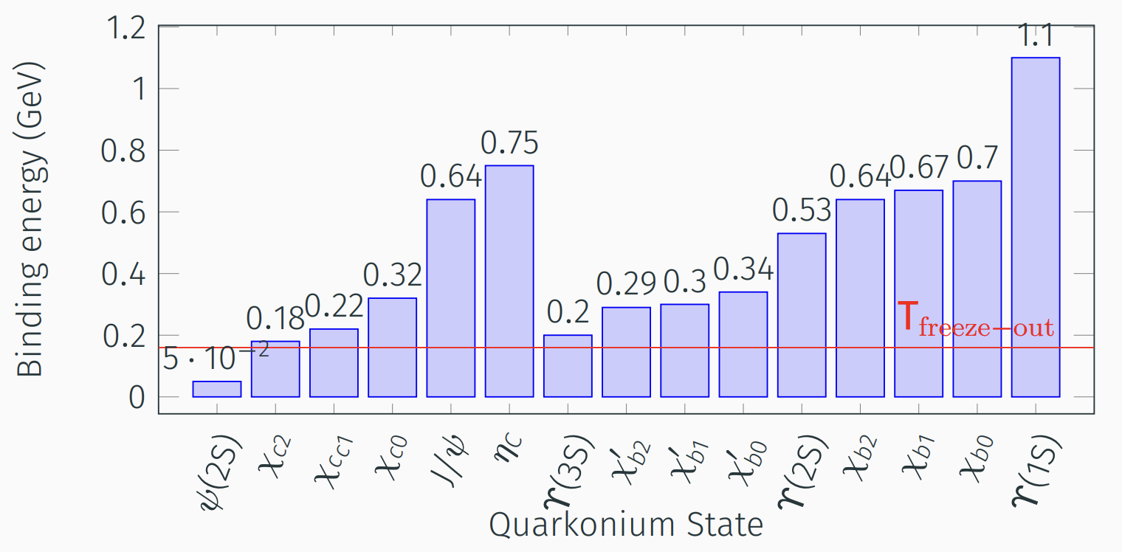
QUARKONIA

Slide 20
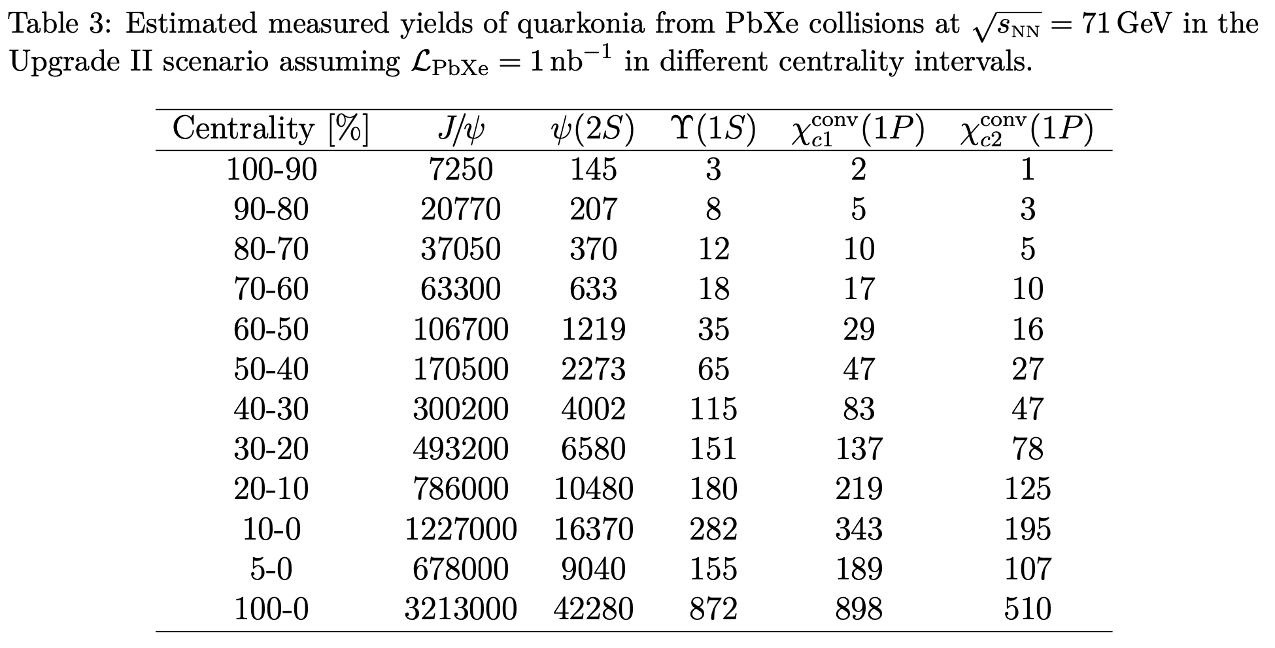
LHCb-PUB-2024-007 ; CERN-LHCb-PUB-2024-007
2 nb⁻¹ taken in 2024 PbAr run only.

Slide 21

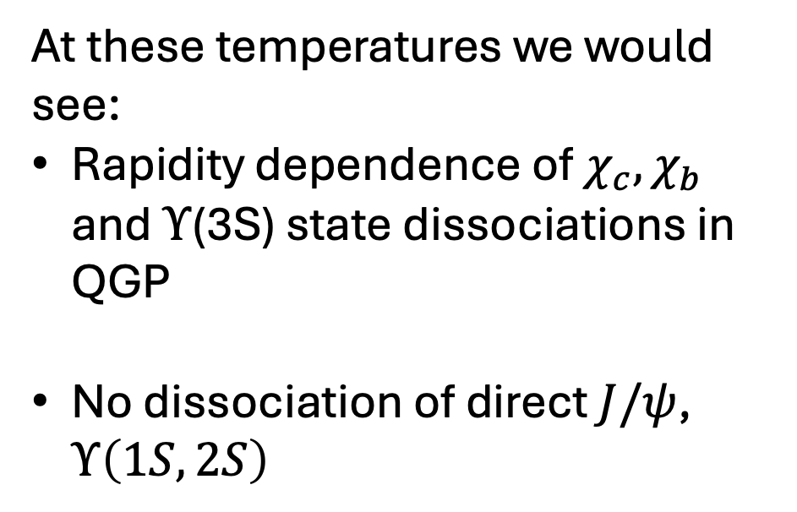


AN ESTIMATION ABOUT THE DISSOCIATION IN QGP
Acta Phys. Polon. B50 (2019), 141-148
T at τ₀ = 0.64 fm/c
vHLLE+UrQMD
At these temperatures we would see:
Rapidity dependence of $χ_{c}, χ_{b}$ and $Υ$(3S) state dissociations in QGP
No dissociation of direct $J/ψ$, $Υ\left(1S,2S\right)$
$$χ_{b}$$
$$χ_{C2},Υ(3S)$$
$$χ_{C1}$$

Slide 22
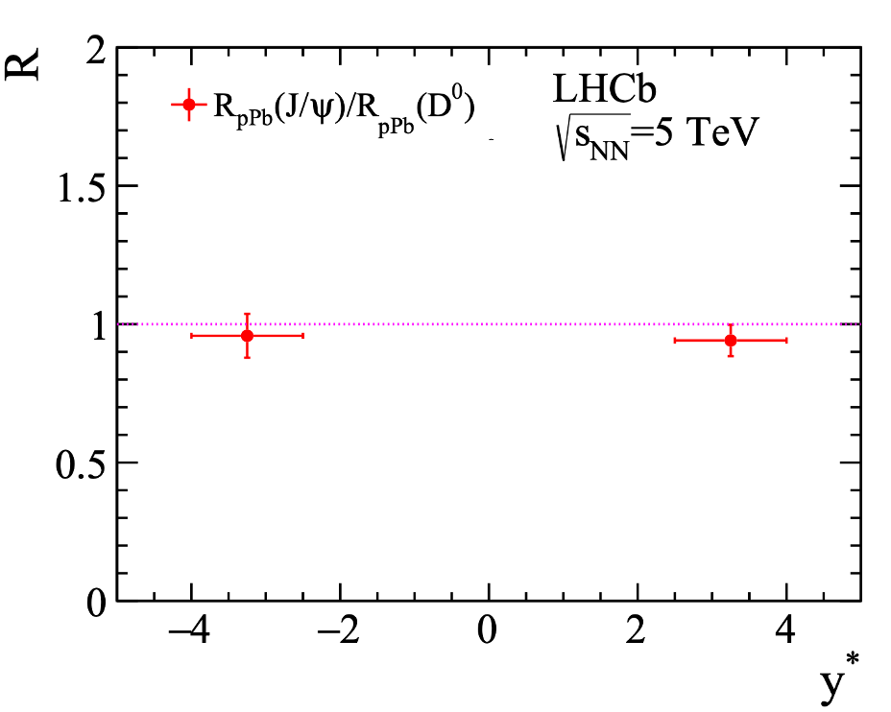
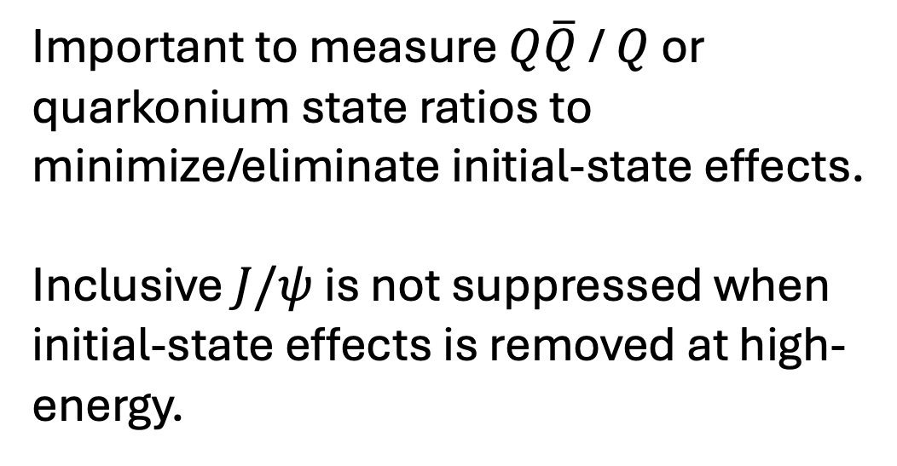
Controlling initial-state effects
JHEP 1710 (2017) 090
Important to measure $Q\overline{Q}$ / $Q$ or quarkonium state ratios to minimize/eliminate initial-state effects.
Inclusive $J/ψ$ is not suppressed when initial-state effects is removed at high-energy.

Slide 23

Fraction of $χ_{c}$ decays in prompt $J/ψ$.
PRL 132 (2024) 102302
PRD79, 012001 (2009)
PRL111, 202301 (2013)
CMS PAS HIN-22-003
$χ_{C1+c2}$ states with a binding energy 180-220 MeV are not affected by cold nuclear matter either.

Slide 24
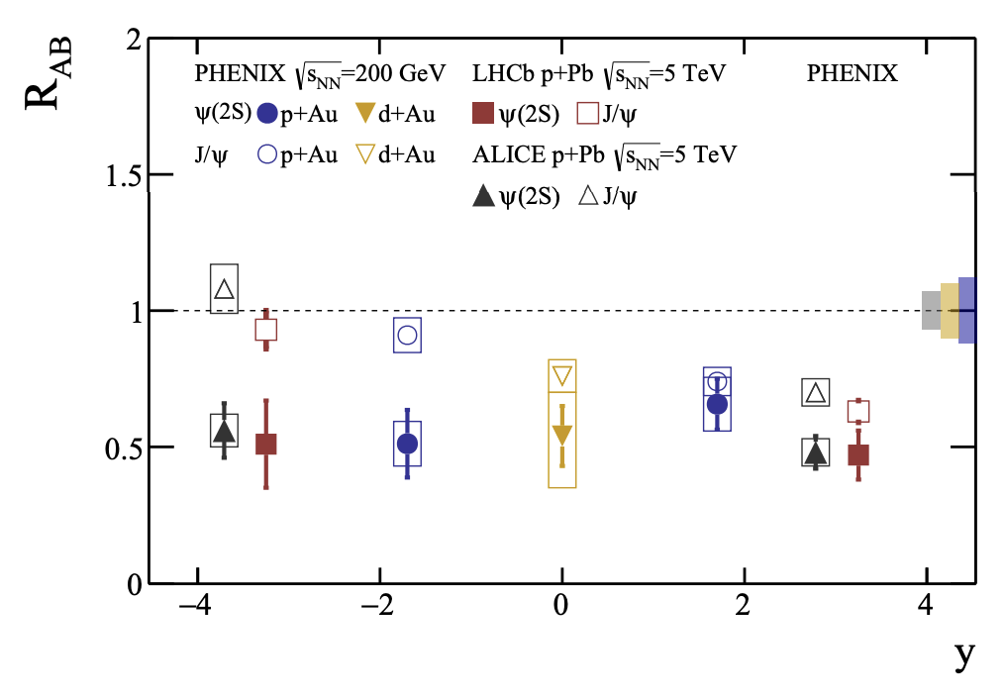
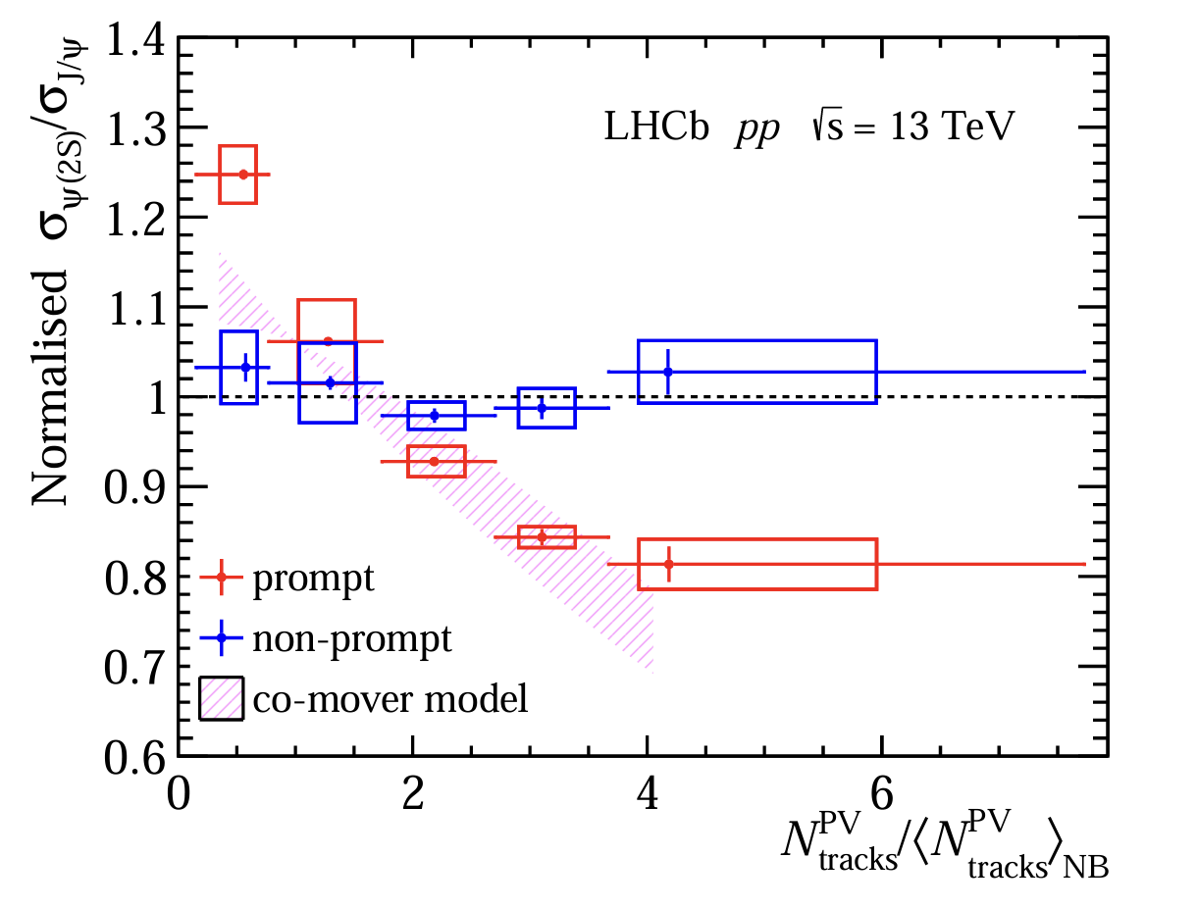
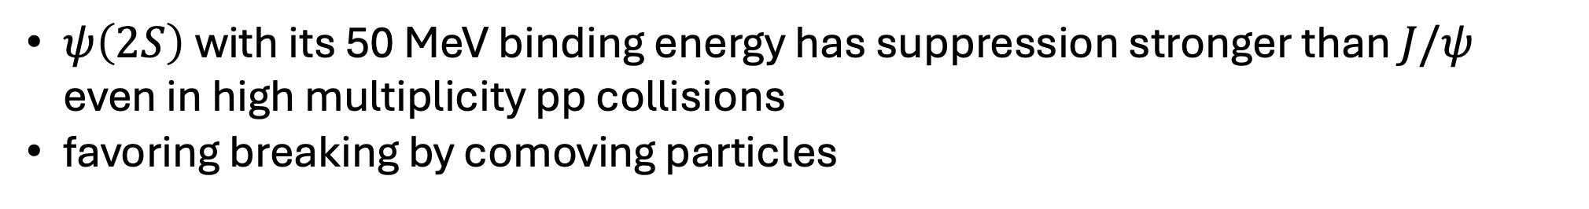
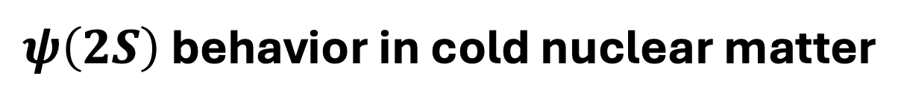
$ψ\left(2S\right)$ behavior in cold nuclear matter
JHEP05(2024)243
$ψ\left(2S\right)$with its 50 MeV binding energy has suppression stronger than $J/ψ$ even in high multiplicity pp collisions
favoring breaking by comoving particles

Slide 25

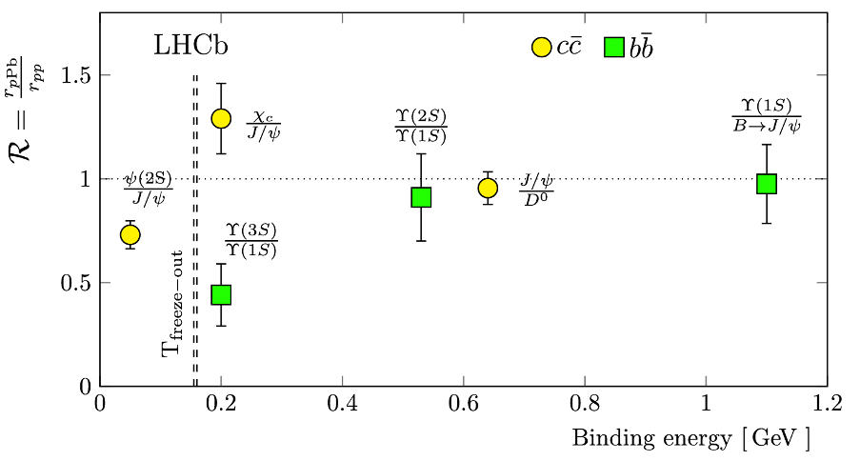







Quarkonium states in pPb collisions.
PRL 132 (2024) 102302
pPb -5.0<y*<-2.5
$Υ\left(1S\right)$ 1100 MeV
$\sqrt{s_{NN}}=$8.16 TeV
$J/ψ$ 640 MeV
$Υ(2S)$ 530 MeV
$χ_{b}(2P)$ 300 MeV
$χ_{c},Υ(3S)$180-220 MeV
freeze
$ψ(2S)$ 50 MeV
Freeze-out temperature
PLB 795, 15 (2019)
PRC 99, 044914 (2019)
PLB 834, 137473 (2022).
Doubled ratios btw. quarkonium states and corresponding HQ indicate no nuclear effects. Except $ψ\left(2S\right) and Υ\left(3S\right)$ states .

Slide 26
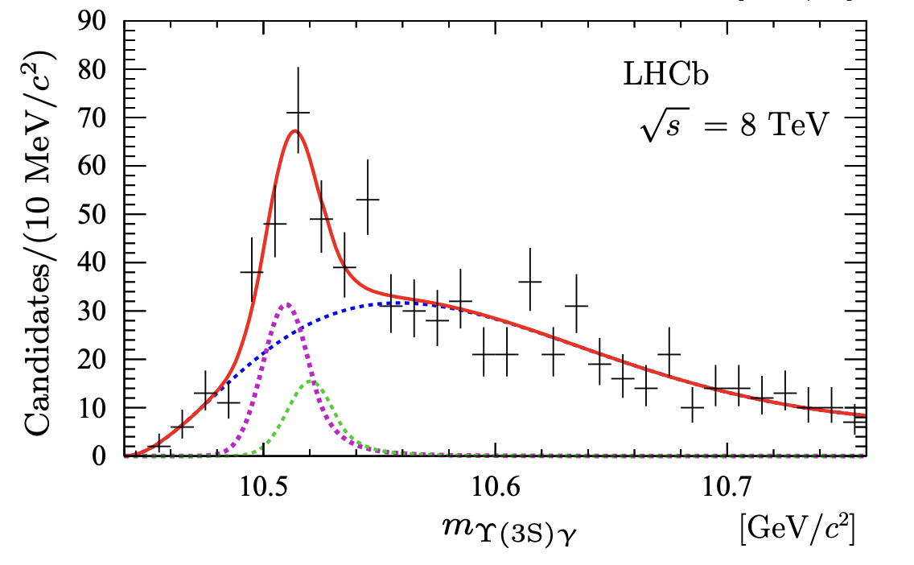
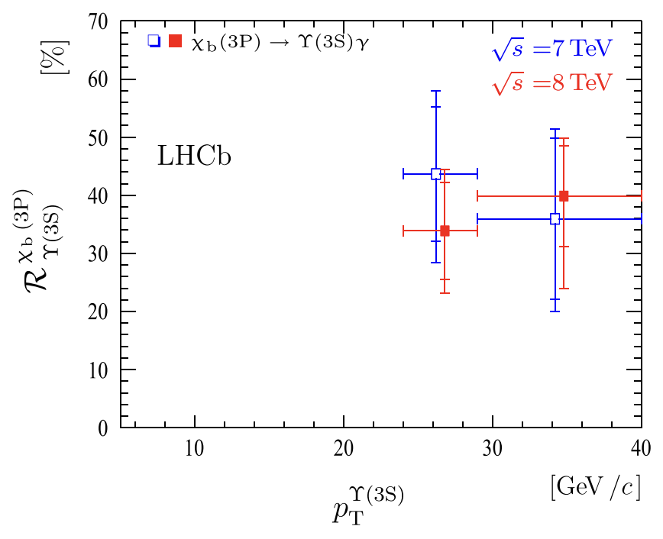

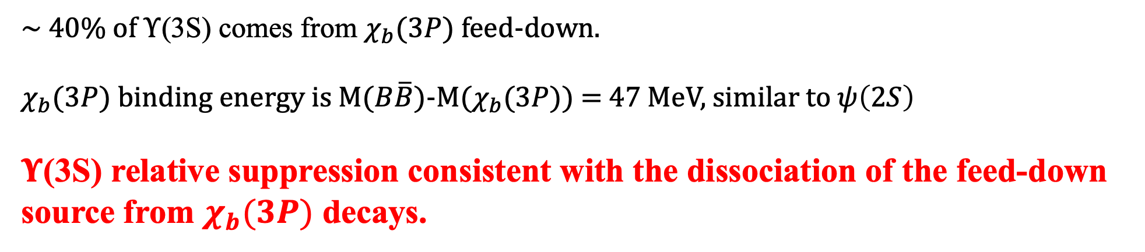

Why $Υ($3S) is dissociate and $χ_{c}$ is not ?
Eur. Phys. J. C (2014) 74:3092
$$χ_{b}(3P)$$
pp @
~ 40% of $Υ$(3S) comes from $χ_{b}(3P)$ feed-down.
$χ_{b}(3P)$ binding energy is M($B\overline{B}$)-M($χ_{b}(3P))$= 47 MeV, similar to $ψ\left(2S\right)$
$Υ$(3S) relative suppression consistent with the dissociation of the feed-down source from $χ_{b}(3P)$ decays.

Slide 27
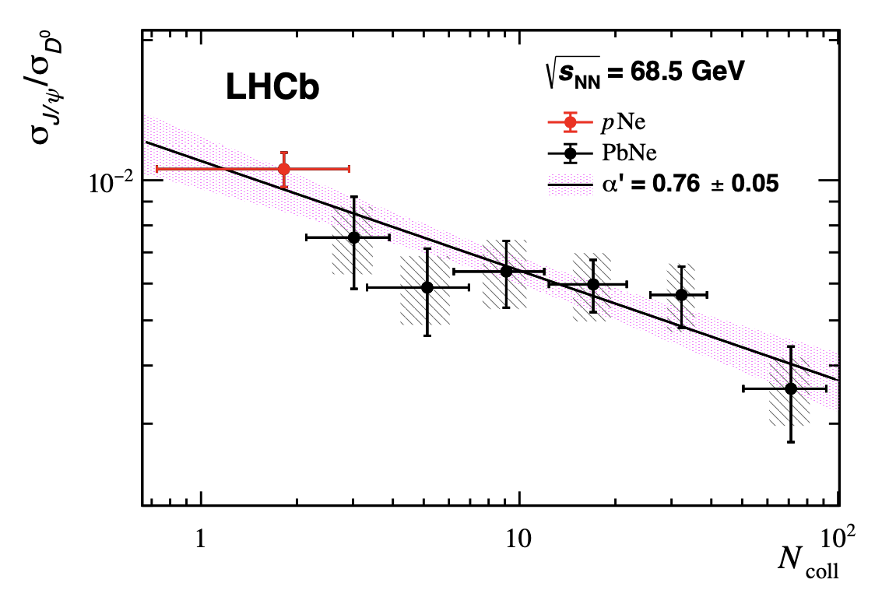
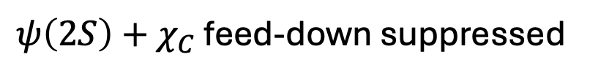
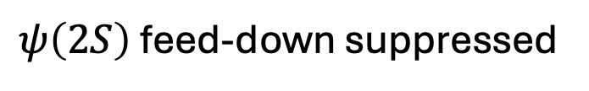
Inclusive $J/ψ$ relative suppression in SMOG data
Eur. Phys. J. C83 (2023) 658
$ψ\left(2S\right)$feed-down suppressed
$ψ\left(2S\right)+χ_{C}$ feed-down suppressed
Assuming CNM effects only on the $ψ\left(2S\right)$ contribution, based on high-energy observations..

Slide 28
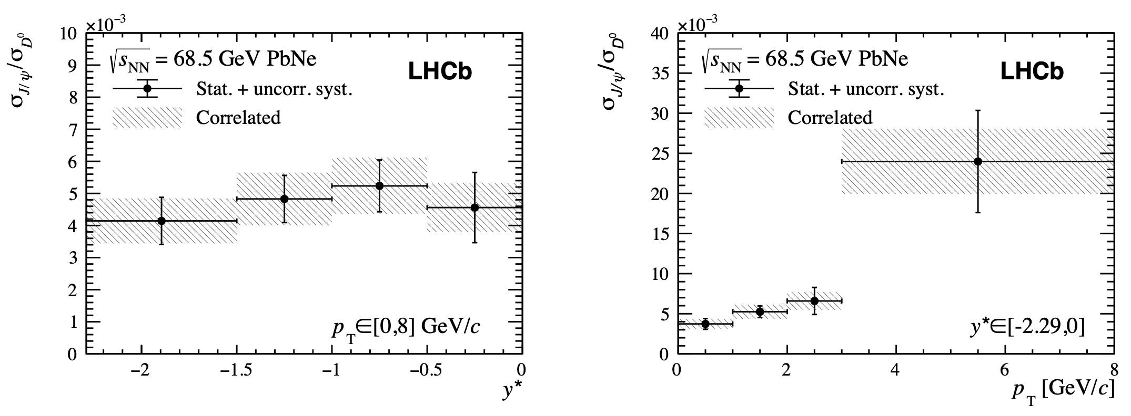
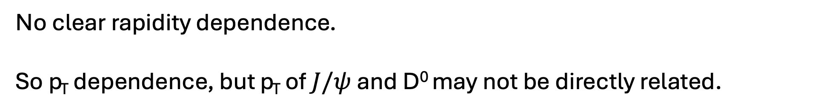
Inclusive $J/ψ$ relative suppression in SMOG data
No clear rapidity dependence.
So p_{T} dependence, but p_{T} of $J/ψ$ and D⁰ may not be directly related.

Slide 29
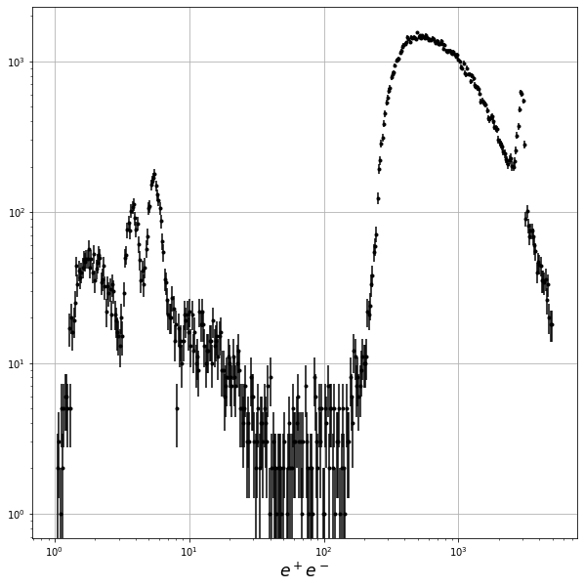
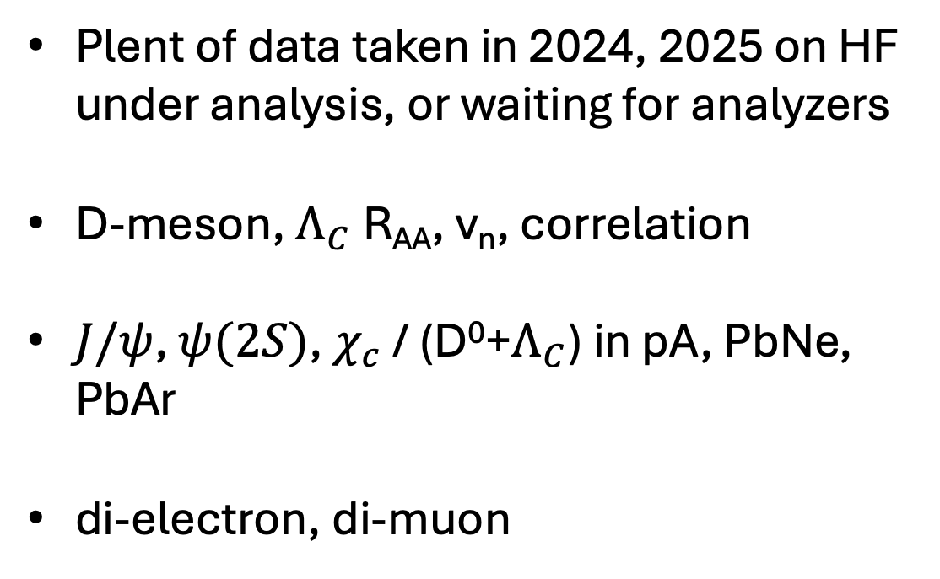
FUTURE PERSPECTIVES
PbPb UPC
Plent of data taken in 2024, 2025 on HF under analysis, or waiting for analyzers
D-meson, $Λ_{C}$ R_{AA}, v_{n}, correlation
$J/ψ$, $ψ(2S)$, $χ_{c}$ / (D⁰+$Λ_{C}$) in pA, PbNe, PbAr
di-electron, di-muon

Slide 30

FUTURE PERSPECTIVES
LHCb was not designed for fixed target energies.
One example is soft particles not able to cross the entire magnet.
A Magnet Station tracking has been proposed to cover very soft particles for rare decays, heavy ion and fixed target physics.
Installation starting in LS3.

Slide 31

Take Away
The LHCb SMOG program can scan $μ_{B}<250$MeV with high-statistics
Being a HF detector, LHCb can provide multiple analysis channels with heavy flavor and quarkonium states with several ways to mitigate backgrounds and non-QGP effects
New ideas are welcome

Slide 32
EXTRAS

Slide 33


Slide 34


Slide 35



