Slide 1



Discussion on open heavy flavor __________________________________________________________________________________________________
Vincenzo Greco – UniCT/INFN-LNS
Francesco Prino – INFN-TO
Penetrating Probes of Hot High-mu_B Matter: Theory Meets Experiment, ECT* Trento, 21-25 July 2025

Slide 2
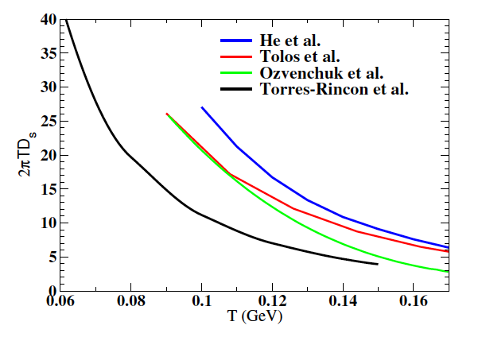
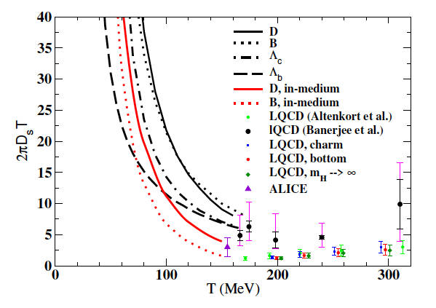


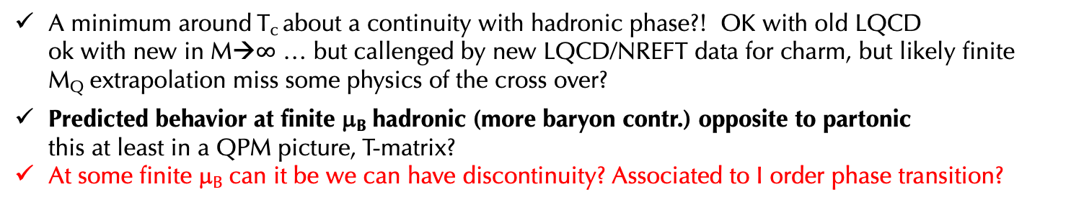
What about hadronic rescattering and D_{s} in the hadronic phase
Das,Torres-Rincon,Rapp, Phys.Rept. 1129 (2025)
μ_{B}$=$0
μ_{B}$=$0
A minimum around T_{c} about a continuity with hadronic phase?! OK with old LQCD
ok with new in M→$∞$ … but callenged by new LQCD/NREFT data for charm, but likely finite
M_{Q} extrapolation miss some physics of the cross over?
Predicted behavior at finite μ_{B} hadronic (more baryon contr.) opposite to partonic
this at least in a QPM picture, T-matrix?
At some finite μ_{B} can it be we can have discontinuity? Associated to I order phase transition?
Notes:
In QGP

Slide 3
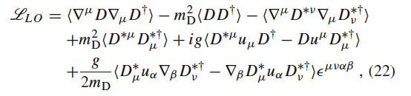
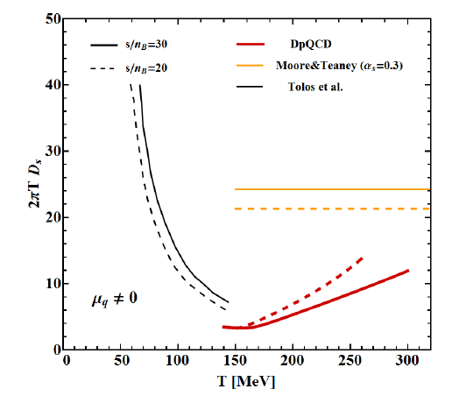
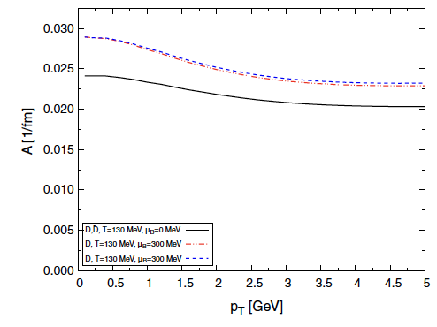



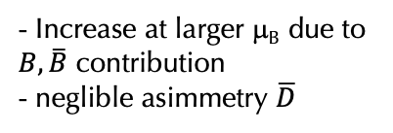
From RHIC-LHC charm 2πTD_{s} ~ 1-2 [τ_{th} (p=0)~1-2.5 fm/c] for T~T_{c} & small p_{T}
Which should about to hold for QGP at s/n_{B} ~ 20-30 (~NA60+ μ_{B}~250-300 MeV)
Berrehrah et al., PRC 91 (2015)
Inghirami et al., EPJC79 (2019)
μ_{B}$≠$0
Hadronic
Diffusion
Drag
2πTD_{s} ~ 12
μ_{B}$=$0
Tolos(2013)
- Increase at larger μ_{B} due to
$B,\overline{B}$ contribution
- neglible asimmetry $\overline{D}$
DQPM
τ_{th} ~40 fm
larger μ_{B}
Torres-Rincon
μ_{B}=0
$In hadronic matter very relevant? τ_{th}∼\frac{D_{s}\left(T\right)}{T^{2}}\sim T^{−4}$ rise very quickly in the hadronic phase
Calculation in DpQCD done without changing the EoS to finite μ_{B} one

Slide 4
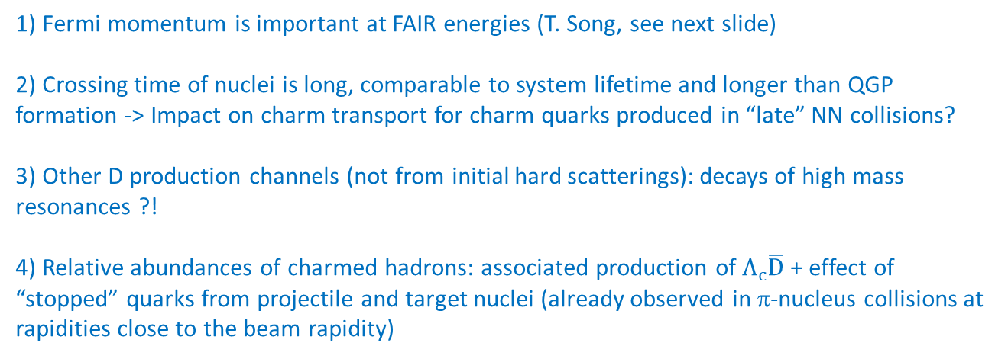
Charm production at low √s
________________________________________________________________________________________________________________
1) Fermi momentum is important at FAIR energies (T. Song, see next slide)
2) Crossing time of nuclei is long, comparable to system lifetime and longer than QGP formation -> Impact on charm transport for charm quarks produced in “late” NN collisions?
3) Other D production channels (not from initial hard scatterings): decays of high mass resonances ?!
4) Relative abundances of charmed hadrons: associated production of$Λ_{c}\overline{D}$ + effect of “stopped” quarks from projectile and target nuclei (already observed in π-nucleus collisions at rapidities close to the beam rapidity)

Slide 5
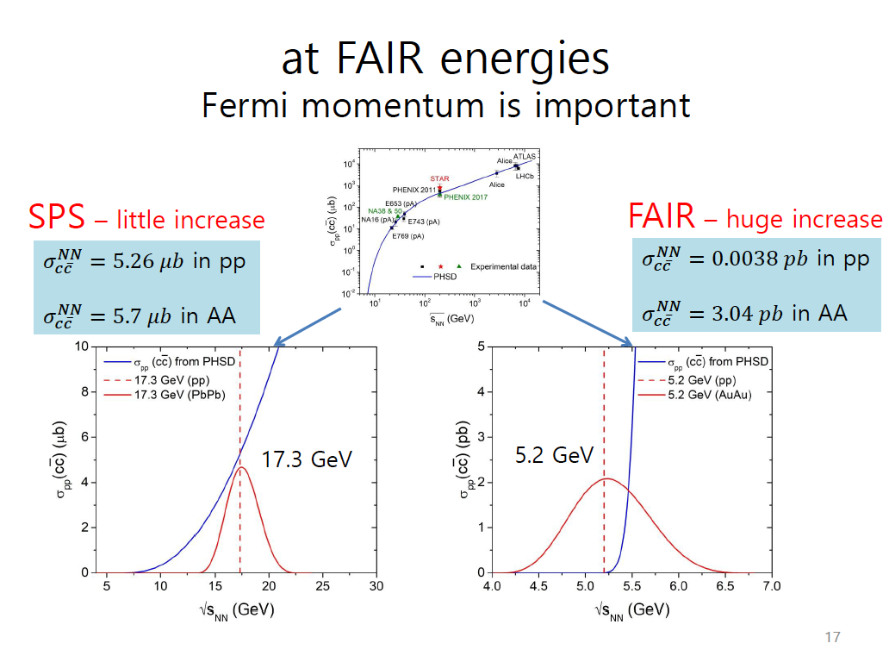
T. Song
Enhancement of 10³!
Enhancement of D production
NNLO-NNNLLζ effect > 15 GeV
(see R. Vogt, chap. 5.1. CBM book)

Slide 6
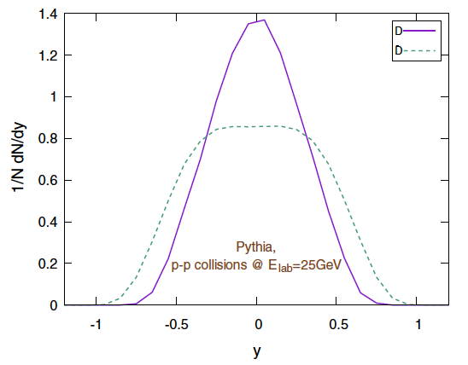
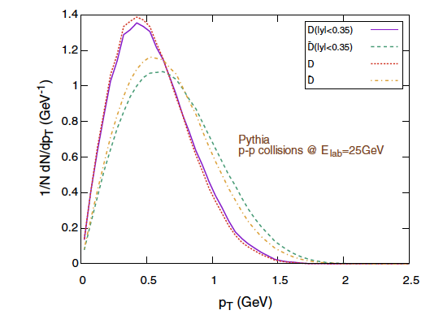
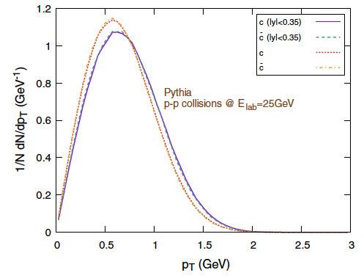
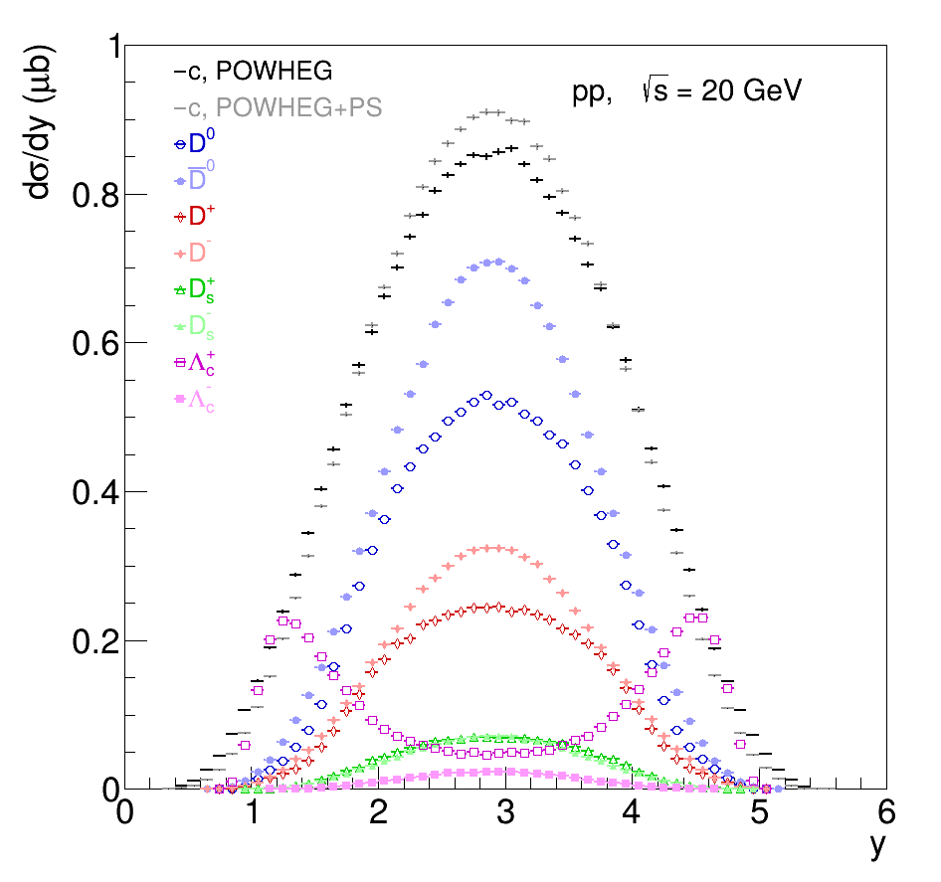
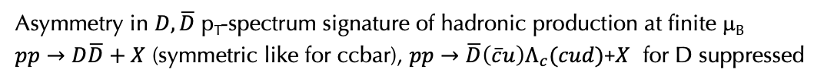
Open HF at FAIR R_{AA} and v₂
________________________________________________________________________________________________________________
Inghirami, Van Hees, Torres-Rincon,Bleicher, EPJC79(2019)
T<Tc
hadronic
T>Tc
SoftCoreQCD
Before hadronization
Asymmetry in $D,\overline{D}$ p_{T}-spectrum signature of hadronic production at finite μ_{B}
$pp→D\overline{D}+X$ (symmetric like for ccbar), $pp→\overline{D}\left(\overline{c}u\right)Λ_{c}(cud)$+$X$ for D suppressed
When charm/D mesons start to interact in the medium?
CBM book?

Slide 7
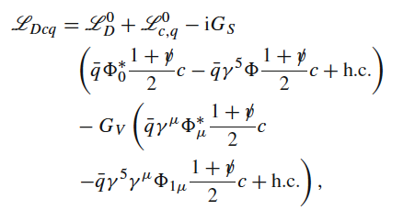
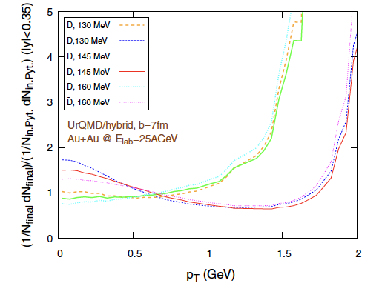
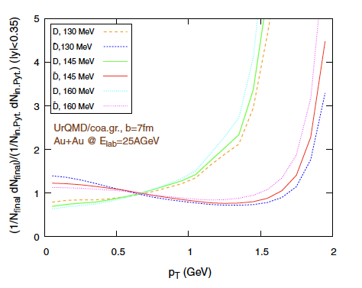


$$2πTD_{s}\sim 5$$
Open HF at FAIR R_{AA}
________________________________________________________________________________________________________________
2 approaches: urQMD/hybrid and UrQMD/coarse graining
separation of $D,\overline{D}$ mainly
due to different p_{T} distrib.
I succesfull approach at RHIC
Van Hees, Greco, Rapp, PRC73(06)
T_{c}
T_{c}
Run down to
T ~ 60 MeV
R_{AA}
R_{AA}
Inghirami et al., EPJC79(2019)
R_{AA} rise to infinite due to energy conservation in pp : $p_{T}^{max}=\frac{\left(\sqrt{s_{pp}}−2m_{c,D}\right)}{2}≅1.6−2 GeV$
It is not studied here but around the rise, it could be sensitive to D_{p}(T)

Slide 8
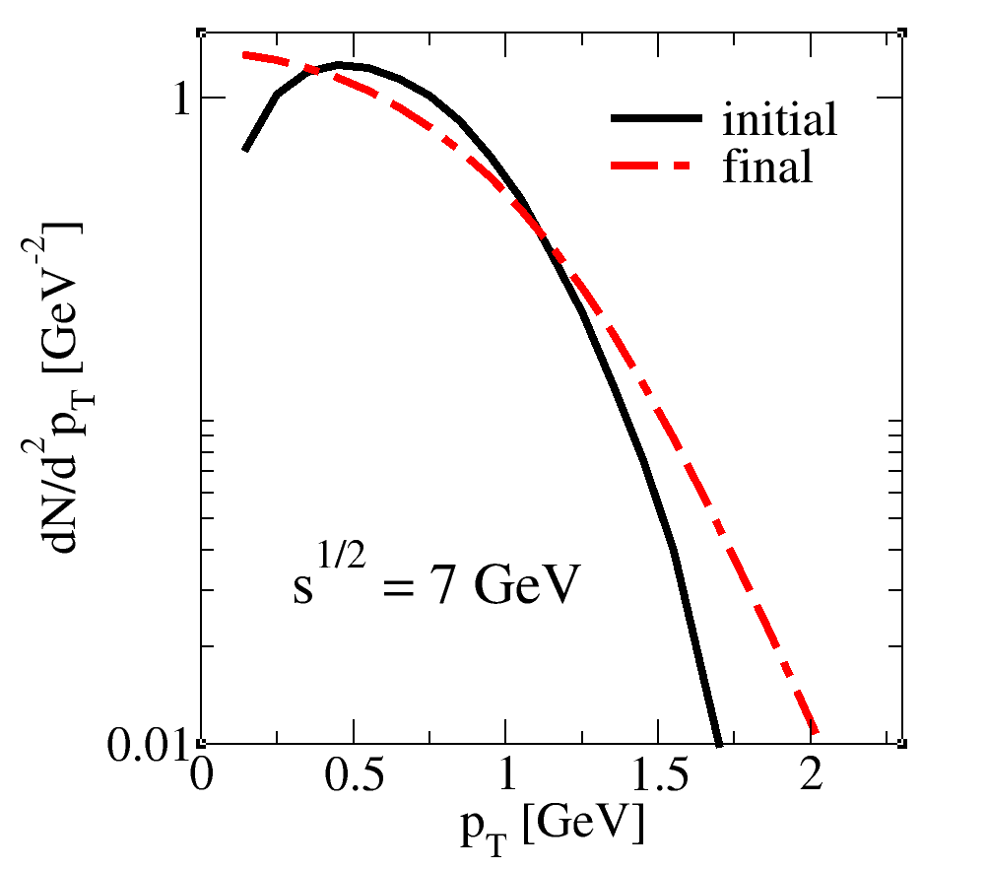
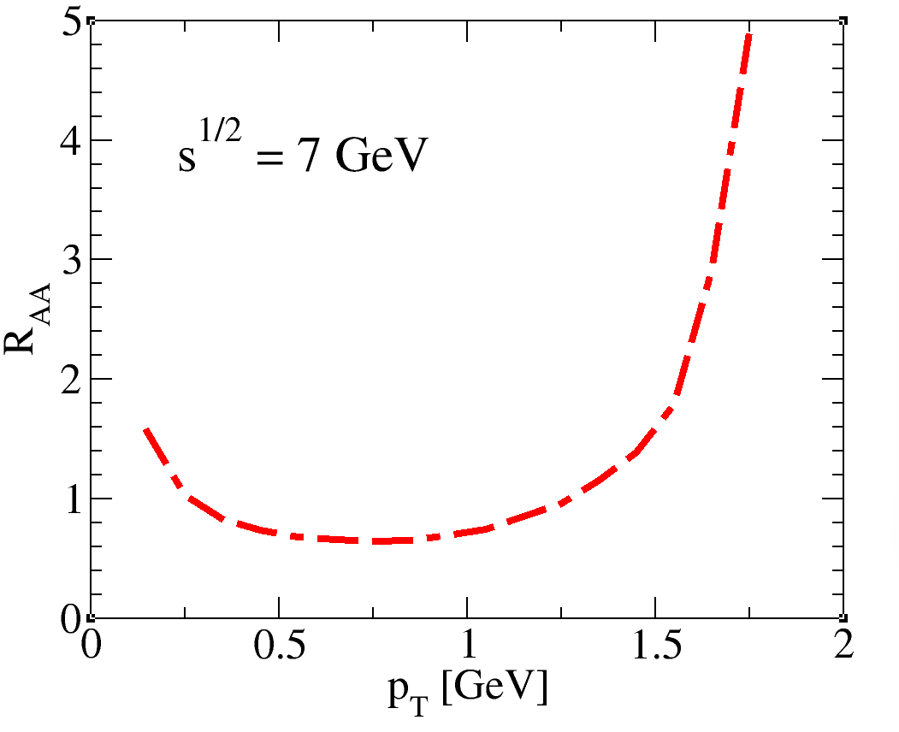
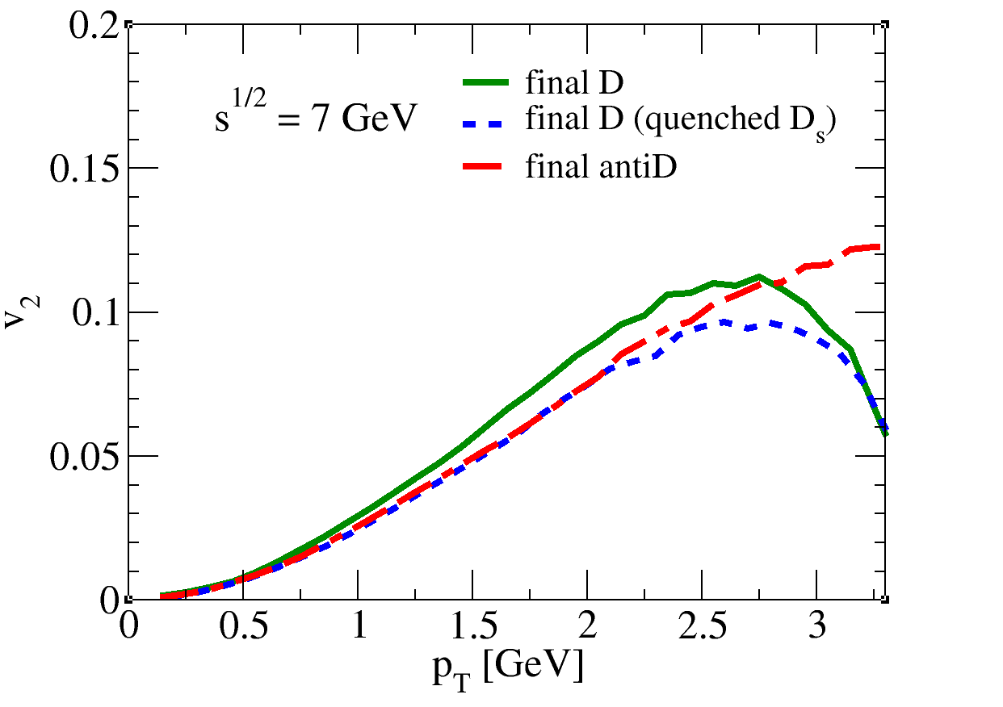
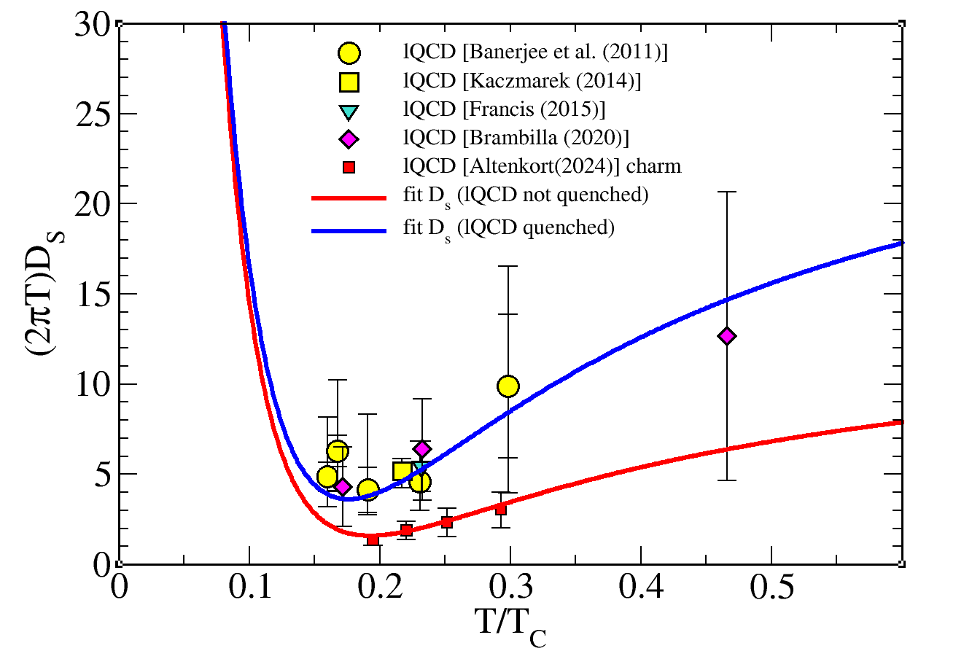
Our simulation AuAu@25AGev in the weekend…
with a PHSD coarse grained background – thanks to L. Oliva, M.L. Sambataro, S. Plumari
charm
- Modification of p_{T} spectrum opposite to RHIC/LHC
- v₂ could be sensitive to D_{s}(T) : ~ 20 % effect but at this
energy only T< 200-220 MeV explored

Slide 9
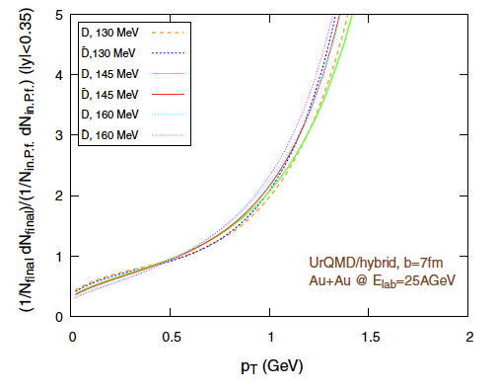

Open HF at FAIR R_{AA}
________________________________________________________________________________________________________________
separation of $D,\overline{D}$ mainly
due to different p_{T} distrib.
R_{AA}
R_{AA}
Inghirami et al., EPJC79(2019)
Changing the pp baseline for D, Dbar cut the difference between D and Dbar
This shows hadronization in pp is much more than Peterson fragmentation function
Could it be covered by coalescence + fragmentation?

Slide 10
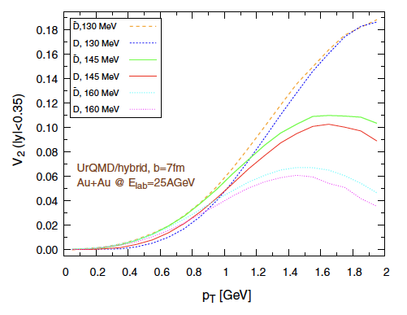
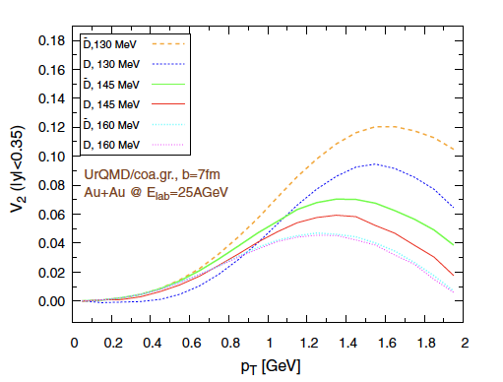
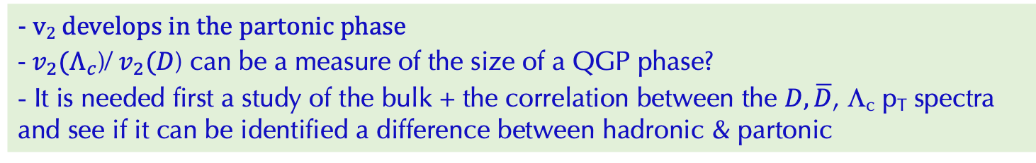
Open HF at FAIR R_{AA} and v₂
________________________________________________________________________________________________________________
T_{c}
T_{c}
Effect of viscosity/non-equilibrium
Need to calibrate the bulk dynamics
larger time
in the partonic
phase
Inghirami et al., EPJC79(2019)
- v₂ develops in the partonic phase
- $v_{2}(Λ_{c}$)/ $v_{2}(D$) can be a measure of the size of a QGP phase?
- It is needed first a study of the bulk + the correlation between the $D,\overline{D}$, Λ_{c} p_{T} spectra and see if it can be identified a difference between hadronic & partonic

Slide 11
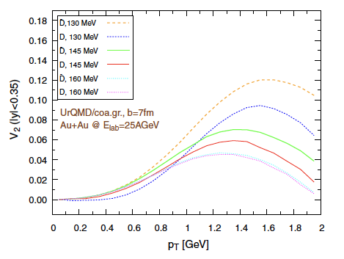
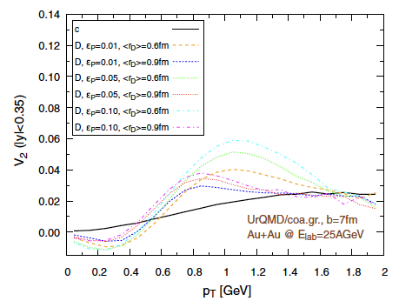
Final v₂
T_{c}=145 MeV
v₂ ~ 5%
Elliptic flow builds up in the partonic case (defined as T>145 MeV)
v₂ develops in the partonic phase D_{s} ~ 1/T⁴: could be a measure of its relevance vs $\sqrt{s}$

Slide 12
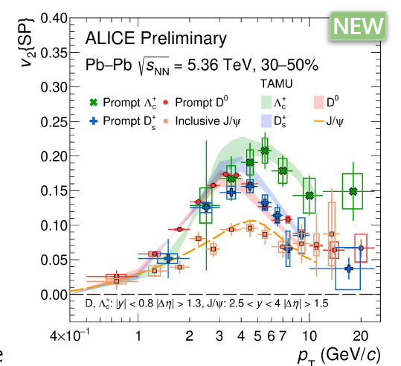
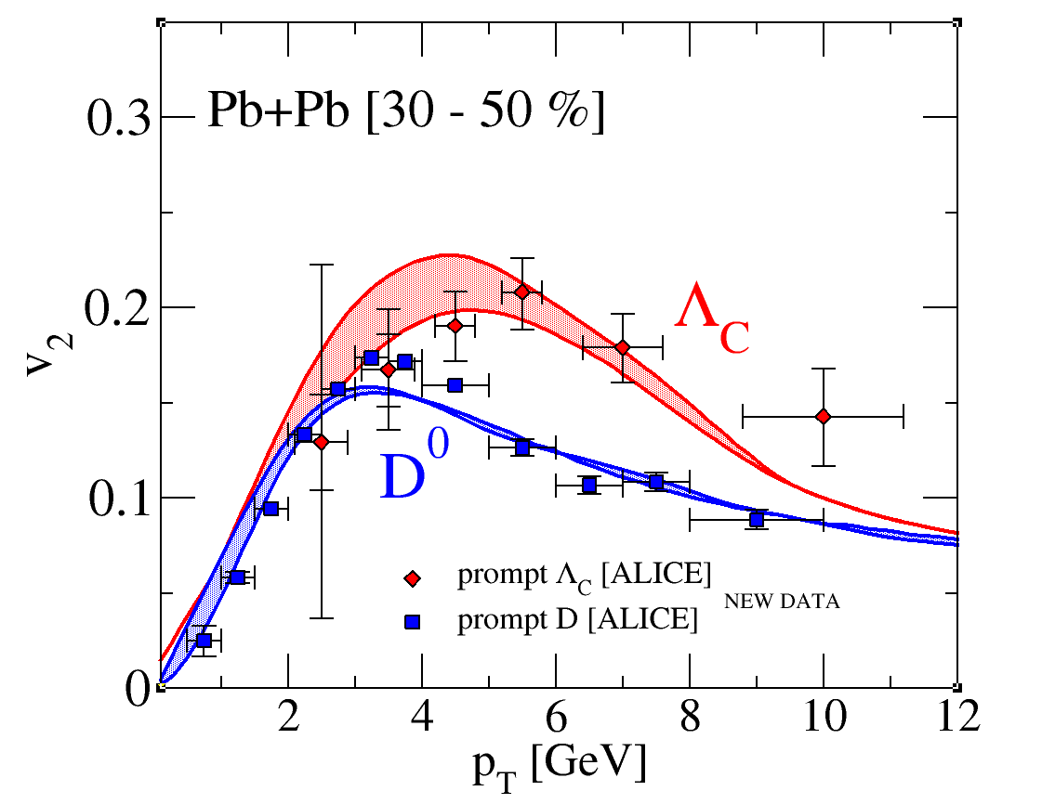
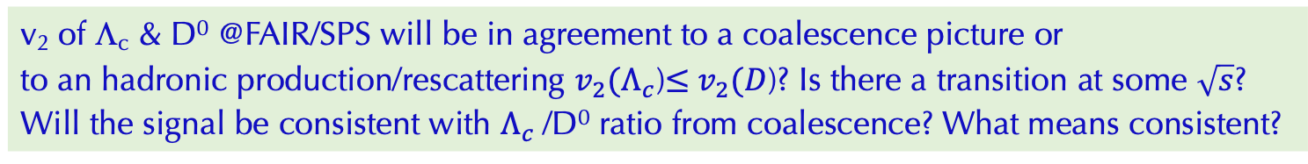
QM2025
Plumari, QM25
v₂ of Λ_{c} & D⁰ @FAIR/SPS will be in agreement to a coalescence picture or
to an hadronic production/rescattering $v_{2}(Λ_{c}$)$≤$ $v_{2}(D$)? Is there a transition at some $\sqrt{s}$?
Will the signal be consistent with $Λ_{c}$/D⁰ ratio from coalescence? What means consistent?
Notes:
It could be v2 of Lc is smaller than v2 of S, but Lc/D ratio is consistent with SHM so equilibrium production but implying a QGP dynamics/ colascence hadronization

Slide 13
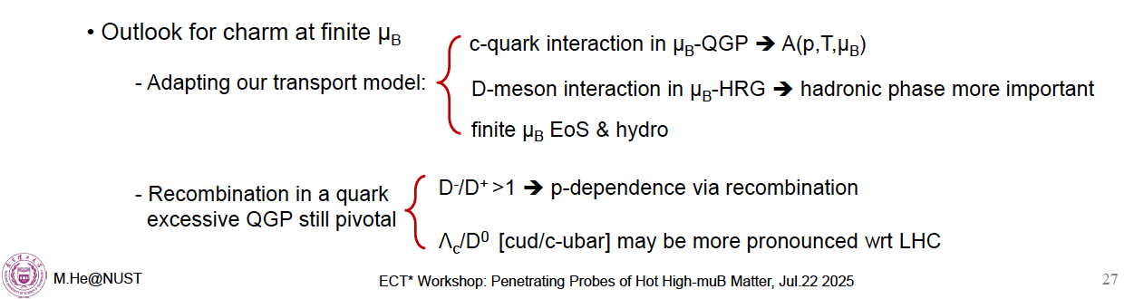

Slide 14
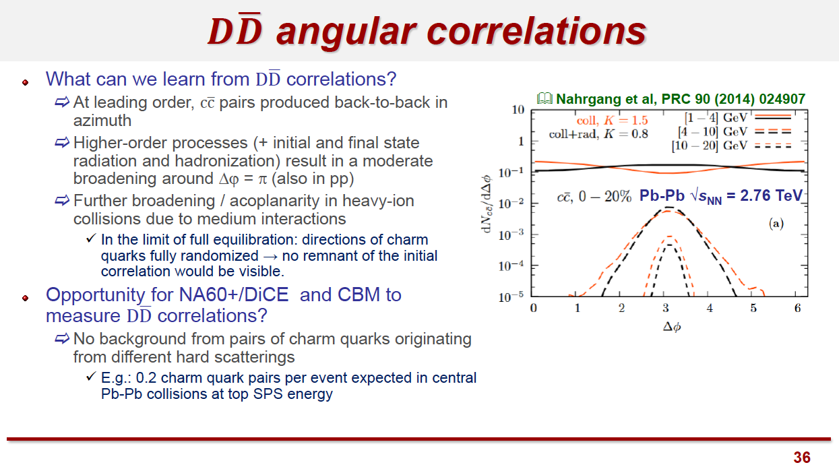

Slide 15
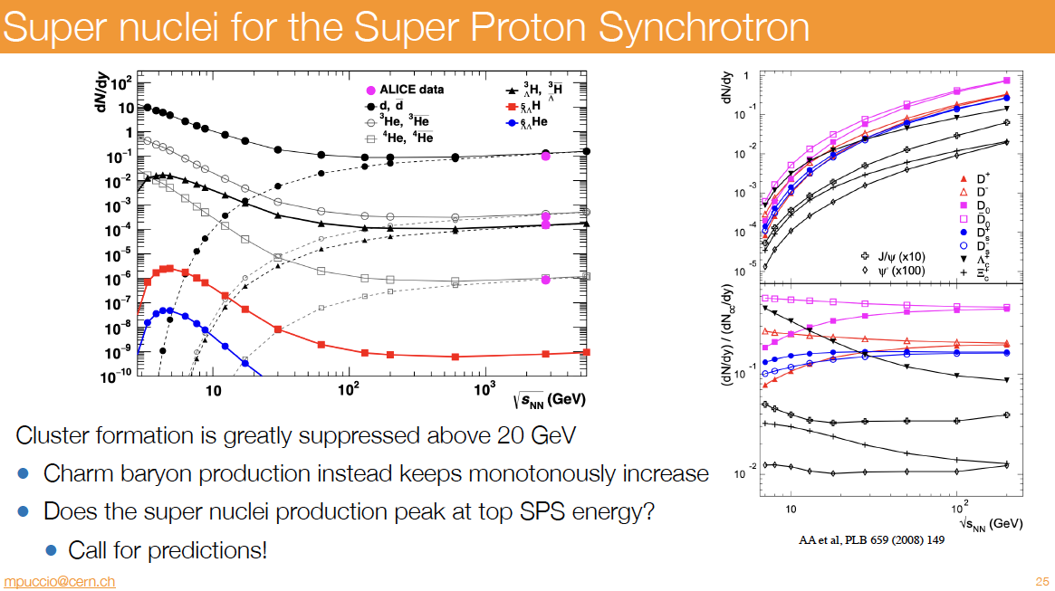

Slide 16
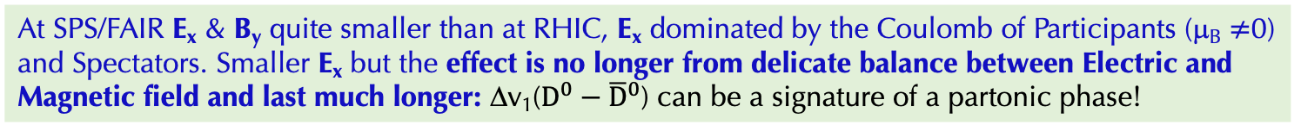
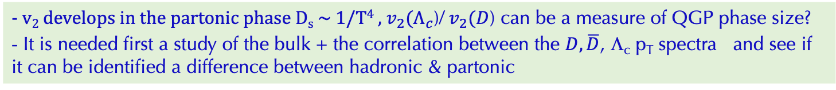
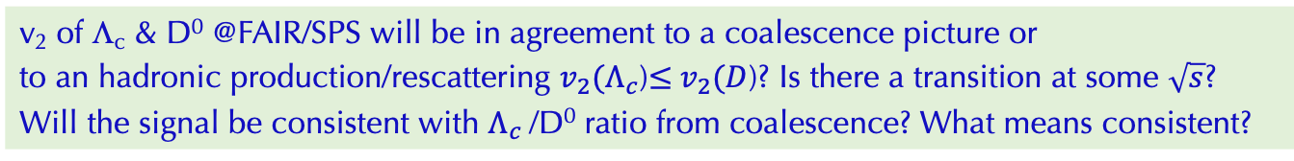
Comments on Charm at FAIR/SPS
@FAIR/SPS - T<<M_{c} , p$≈$M_{c ,} dN_{c}/dp_{T} very steep FDT/Brownian ambiguity will be irrelevant
At FAIR/SPS large Λ_{c}/D⁰? or does it go toward e⁺e⁻ or follow SHM wPDG res.?
or follow coalescence and hint to QGP phase?
v₂ of Λ_{c} & D⁰ @FAIR/SPS will be in agreement to a coalescence picture or
to an hadronic production/rescattering $v_{2}(Λ_{c}$)$≤$ $v_{2}(D$)? Is there a transition at some $\sqrt{s}$?
Will the signal be consistent with $Λ_{c}$/D⁰ ratio from coalescence? What means consistent?
v₁ is even more relevant and accessible at $\sqrt{s}$~ 5-20 GeV, NO studies TMK for D:
Should it drop→ becoming similar or smaller to light v₁? What this would mean?
At SPS/FAIR E_{x} & B_{y} quite smaller than at RHIC, E_{x} dominated by the Coulomb of Participants (μ_{B} $≠$0) and Spectators. Smaller E_{x} but the effect is no longer from delicate balance between Electric and Magnetic field and last much longer: Δv₁($D^{0}−{\overline{D}}^{0}$) can be a signature of a partonic phase!
- v₂ develops in the partonic phase D_{s} ~ 1/T⁴ , $v_{2}(Λ_{c}$)/ $v_{2}(D$) can be a measure of QGP phase size?
- It is needed first a study of the bulk + the correlation between the $D,\overline{D}$, Λ_{c} p_{T} spectra and see if it can be identified a difference between hadronic & partonic

Slide 17
Back-up Slide

Slide 18
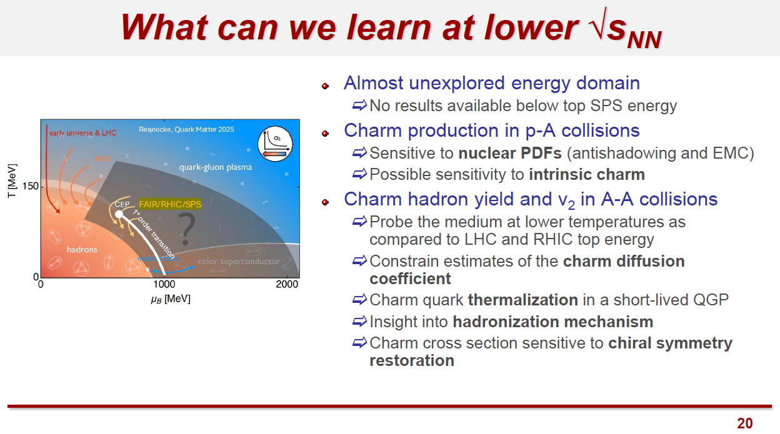

Slide 19
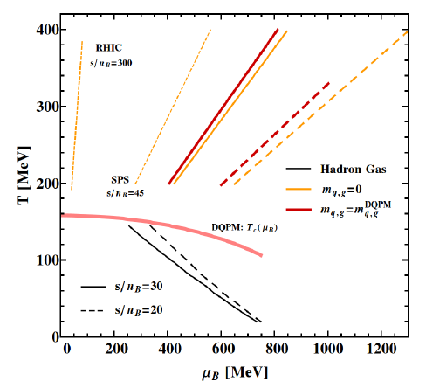

Slide 20
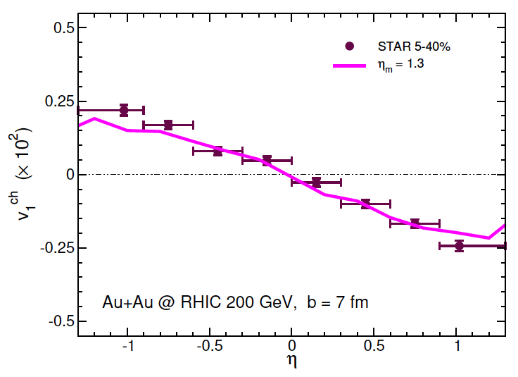
HQ Surprise also in the transverse flow v₁=<p_{x}/p_{T}>
__________________________________________________________________________________________________________________
Transverse flow
light hadrons
Would you expect charm quark to
have a smaller v₂ ? Or a smaller one due
to its mass?
x10⁻²
τ₀ < 0.1 fm/c
Bulk matter
tilted
Very surprising!
v₁ (HQ) ~ 30 times v₁ light hadrons (π,K,..)
dv₁/dy|_{exp}~ -0.0025
dv₁/dy=-0.080 ±0.017(stat)±0.016(syst)
v₁ is even more relevant and accessible at finite μ_{B},
NO studies TMK for D at 7-17 AGeV:
Should it drop→ similar or smaller to light v₁?
What this would mean?
charm
Needed non-perturbative HQ interaction close to AdS/CFT
QPM, charm tilted
Needed also initial “tilt” of bulk & none for HQ
L. Oliva et al., JHEP 05 (2021)

Slide 21
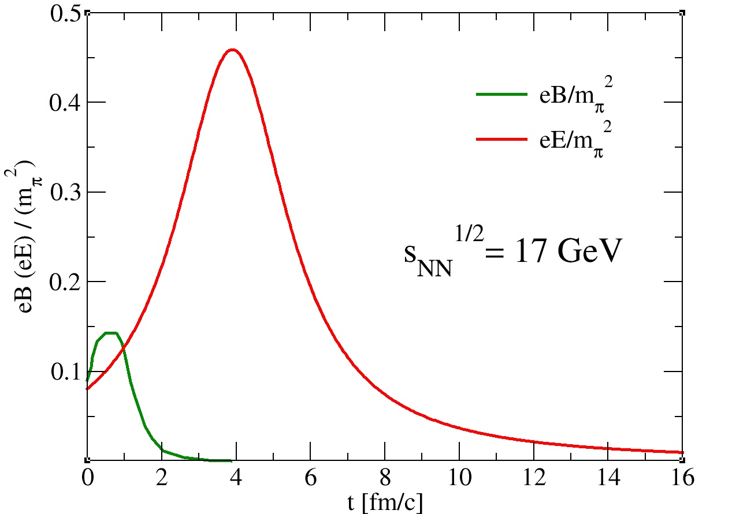
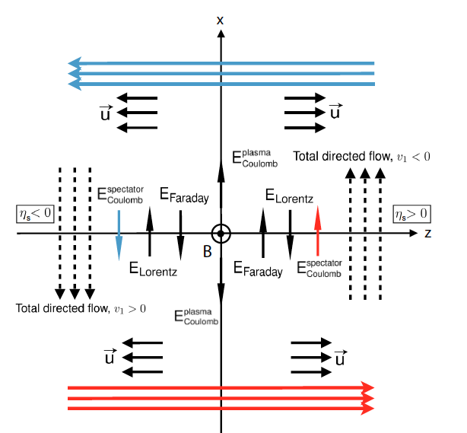
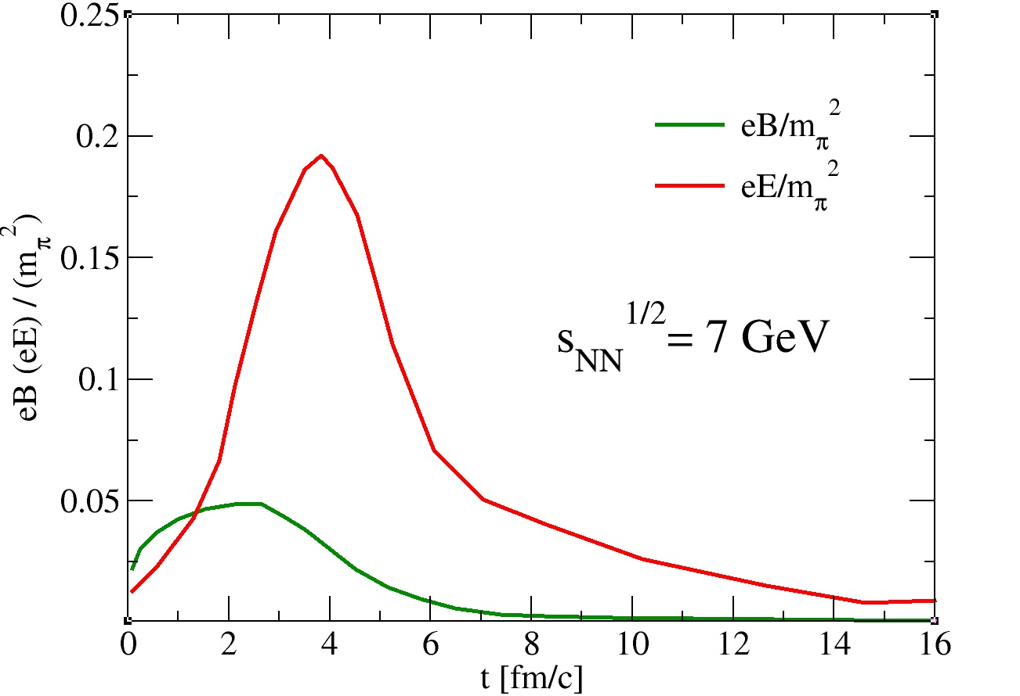



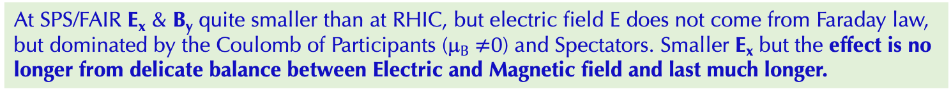

Impact of Magnetic Field at FAIR/SPS?
_________________________________________________________________________________________________________________________________________________________
At SPS/FAIR E_{x} & B_{y} quite smaller than at RHIC, but electric field E does not come from Faraday law, but dominated by the Coulomb of Participants (μ_{B} $≠$0) and Spectators. Smaller E_{x} but the effect is no longer from delicate balance between Electric and Magnetic field and last much longer.
Gursoy et al., PRC98 (2018)
V.V. Skokov et al., Int.J.Mod.Phys.A 24 (2009)
H. Taia et al., Phys.Rev.C 110 (2024)
STILL Δv₁ for $D^{0}−{\overline{D}}^{0}$ can be a signature of a partonic phase!

Slide 22
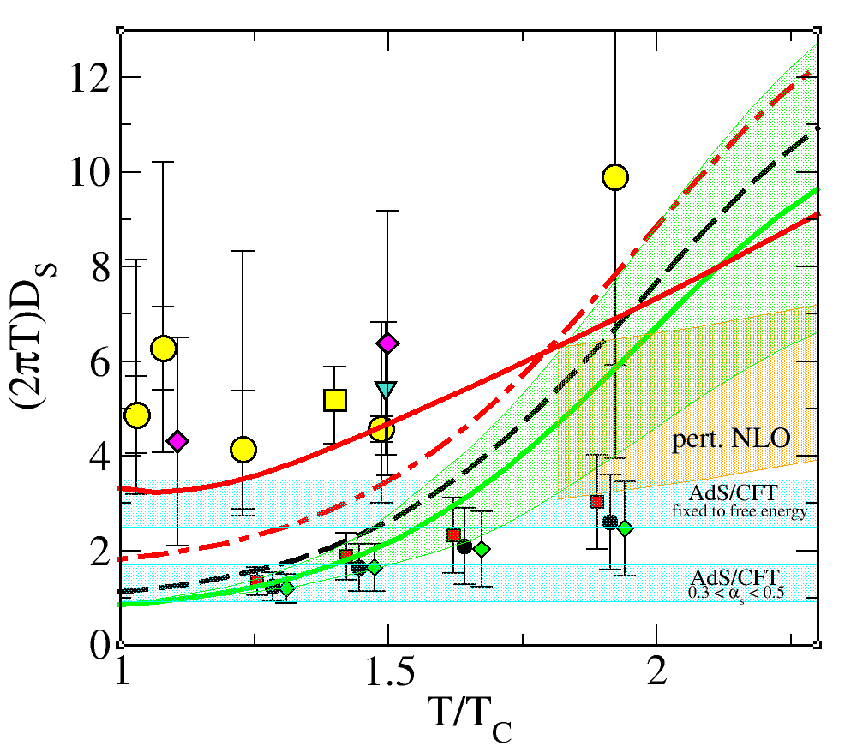
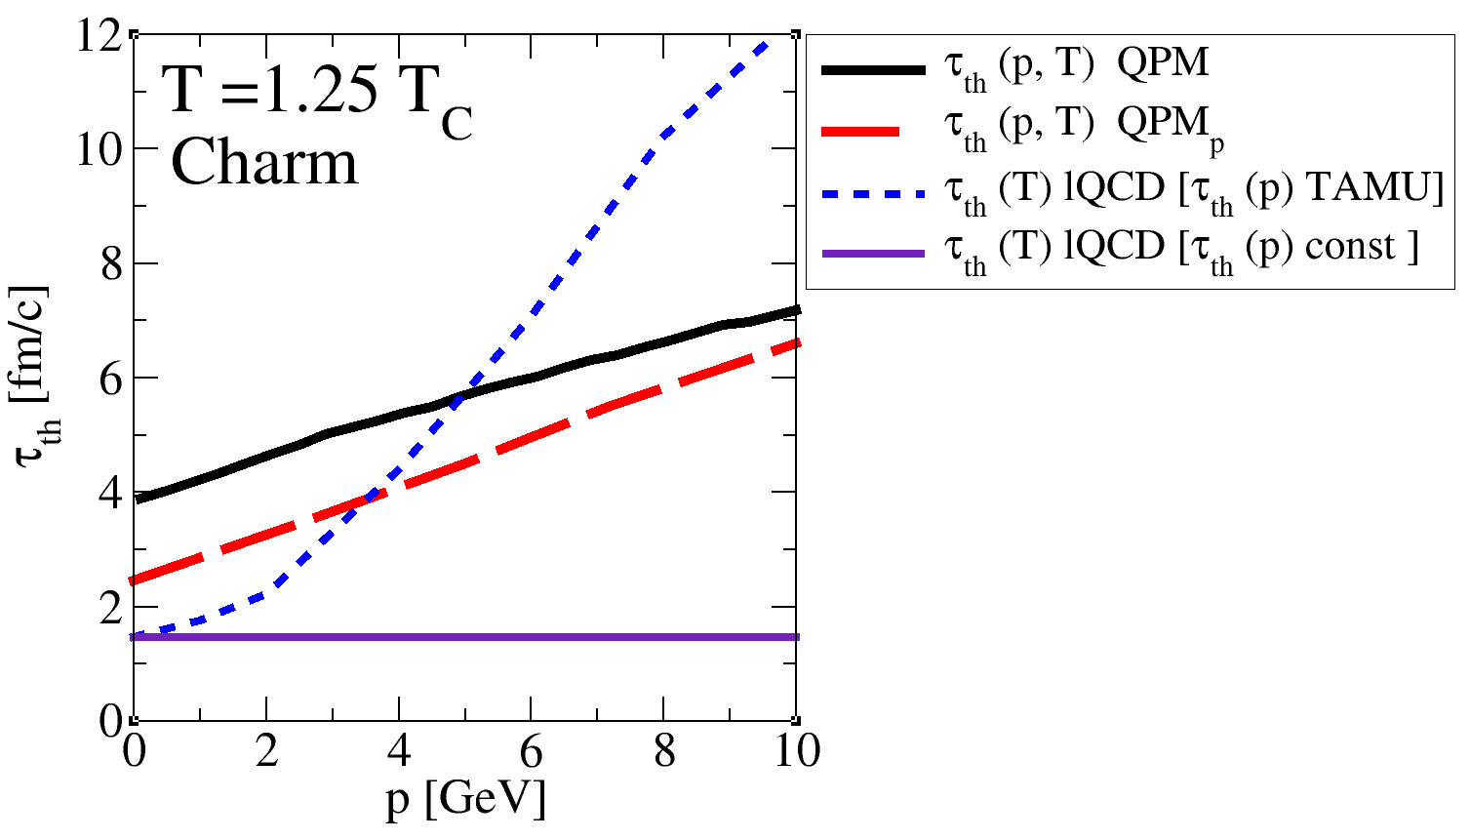


What implies new D_{s}/τ_{th} of charm form R_{AA} & v₂
__________________________________________________________________________________________________________________
LQCD-TAMU
QPM~PHSD-TAMUold
Region explored
from phenomenology
to determine D_{s}(T)
QPMp
LQCD-drag
τ=τ_{th} does not mean a full equilibrium has been reached it is a relaxation time
At T=1.25 T_{c}
QPMp implies τ_{th}(p→0)~2.4 fm/c
New LQCDC implies τ_{th}(p→0)~1.4 fm/c
LQCD-drag : $τ_{th}=γ^{−1}$ = $\frac{M_{c}}{T}D_{s}$

