Slide 1



Theory overview on open charm __________________________________________________________________________________________________
Vincenzo Greco –
University of Catania/INFN-LNS
Penetrating Probes of Hot High-mu_B Matter: Theory Meets Experiment, ECT* Trento, 21-25 July 2025

Slide 2
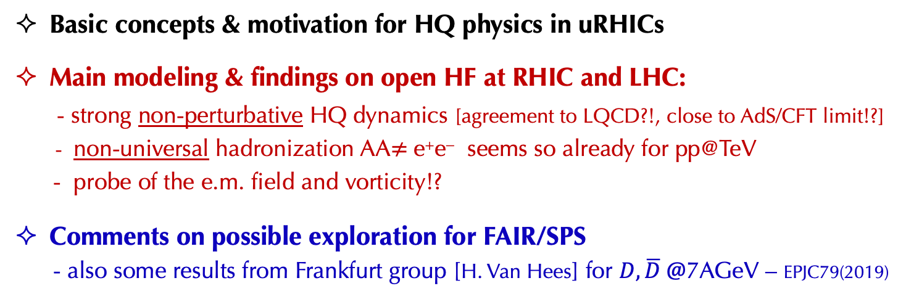
Outline
___________________________________________________________________________________________________________
Basic concepts & motivation for HQ physics in uRHICs
Main modeling & findings on open HF at RHIC and LHC:
- strong non-perturbative HQ dynamics [agreement to LQCD?!, close to AdS/CFT limit!?]
- non-universal hadronization AA$≠$e⁺e⁻ seems so already for pp@TeV
- probe of the e.m. field and vorticity!?
Comments on possible exploration for FAIR/SPS
- also some results from Frankfurt group [H. Van Hees] for $D,\overline{D} @$7AGeV – EPJC79(2019)
REAL DISCLAIMER: HF is a probe not yet really explored at 5-20 AGeV even theoretically &
I have never worked at all on HIC in this energy range
I likely may miss some relevant aspect

Slide 3
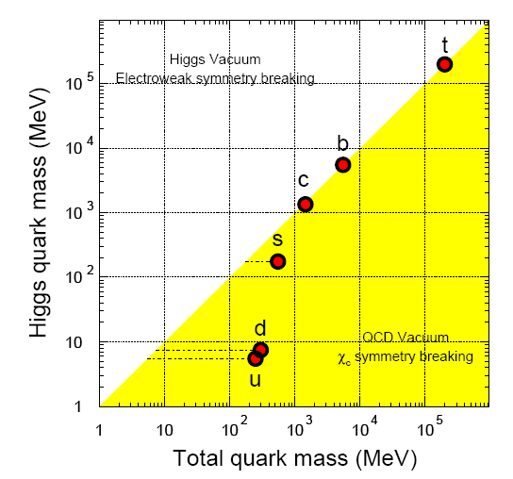
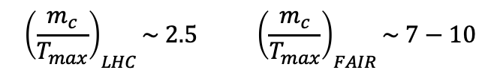
Basic Scales and specific of HQ@RHIC-LHC
_________________________________________________________________________________________________________
Why Heavy?
PARTICLE Physics: m_{c,b} >> Λ_{QCD} pQCD initial production
PLASMA Physics:
- m_{c,b} >> T_{RHIC,LHC} no thermal production
- m_{c,b} >> gT_{RHIC,LHC} soft scatterings → Brownian motion
Specific Features:
τ₀≈ 1/2m_{Q} (<0.1 fm/c)<< τ_{QGP} witness of all QGP evolution
τ_{th} ≈ τ_{QGP} >> τ_{q,g} carry more information of their evolution
LHC
<- Temperature
FAIR/NA60+
$${\left(\frac{m_{c}}{T_{max}}\right)}_{LHC}\sim 2.5 {\left(\frac{m_{c}}{T_{max}}\right)}_{FAIR}\sim 7−10$$
Reviews:
- F. Prino and R. Rapp, JPG (2019)
- X. Dong and VG, Prog.Part.Nucl.Phys. (2019)
- Jiaxing Zhao et al., Prog.Part.Nucl.Phys. (2020)

Slide 4
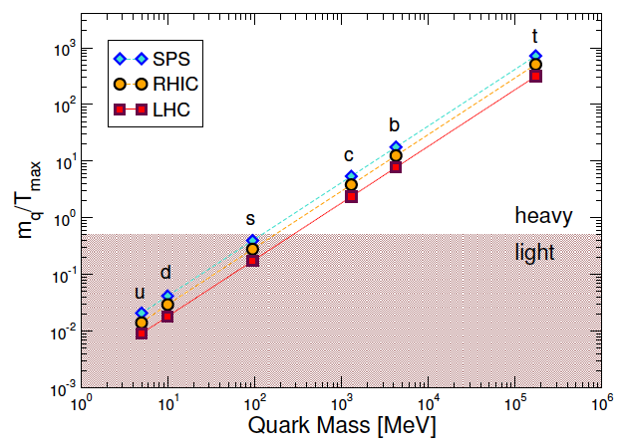
Basic Scales and specific of HQ
_________________________________________________________________________________________________________
Why Heavy?
PARTICLE Physics: m_{c,b} >> Λ_{QCD} pQCD initial production
PLASMA Physics:
- m_{c,b} >> T_{RHIC,LHC} no thermal production
- m_{c,b} >> gT_{RHIC,LHC} soft scatterings → Brownian motion
Specific Features:
τ₀≈ 1/2m_{Q} (<0.1 fm/c)<< τ_{QGP} witness of all QGP evolution
τ_{th} ≈ τ_{QGP} >> τ_{q,g} carry more information of their evolution
LHC
<- Temperature
FAIR/NA60+
* For HQ we know initial p_{T} distribution at variance with light quark & gluons
* HQ not created at hadronization by string breaking + constituent quarks picture

Slide 5

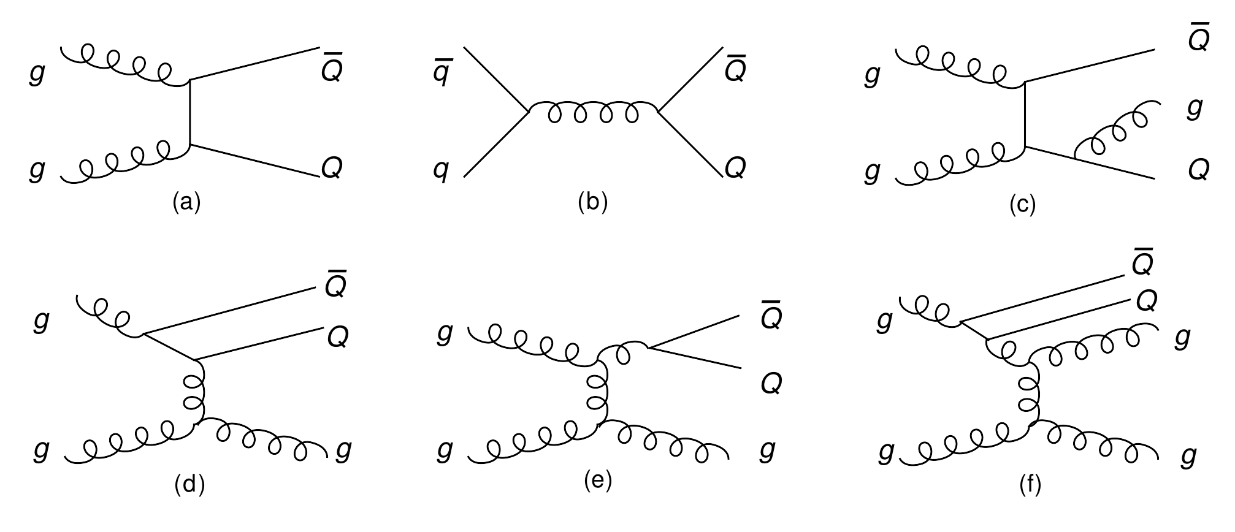
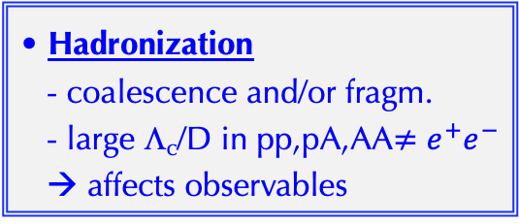
Studying the HF in uRHIC
________________________________________________________________________________________________________________
0 0.5 5 10
| | | |
τ [fm/c]
HF into Glasma
HF under e.m. field
HF under vorticity
B,D,Λc
b,c
τ₀ < 0.1 fm/c
b,c
initial production
pQCD-NLO
MC-NLO, POHWEG
- CNM effect [pp,pA exp.]
B,D, Λc
Dynamics of HF in QGP
Themalization (p_{T} ~ m_{c})
Transp. Coeff. of QCD matter D_{s}(T)
Radiative E_{loss} & Jet Quenching (p_{T}>>m_{c})
Adapted from
Rapp &Greco
Hadronization
- coalescence and/or fragm.
- large Λ_{c}/D in pp,pA,AA$≠e^{+}e^{−}$
→ affects observables

Slide 6
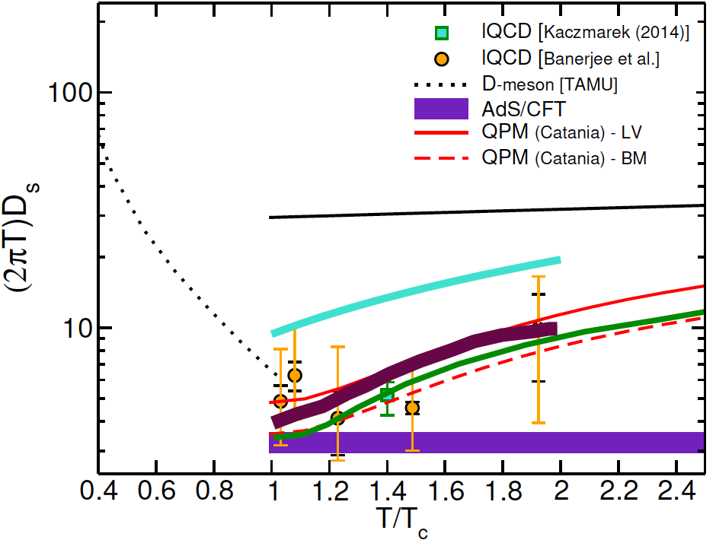



HQ link to Lattice QCD at finite T ________________________________________________________________________________________________________________________________________________________
Ab-initio Diffusion Transport Coefficient
Spectral function ρ_{E} extracted from euclidean color-electric correlator D_{E}(τ) →
Kubo formula diffusion in the p→0 limit:
$$\frac{D_{p}}{T^{3}}=\lim_{ω→0}{\frac{Tρ_{E}(ω)}{ω}}$$
By Fluct.Diss.Theor.→
$D_{s}=\frac{T^{2}}{D_{p}}$ = $\frac{T}{M_{Q}γ}=$ $\frac{T}{M_{Q}}τ_{th}$
$$\left\langle x^{2}\right\rangle \sim D_{s}t$$
Diffusion
Approximations/limitations:
Extraction of ρ_{E}(ω) from D_{E}(τ) is not a fullywell posed problem with a finite limited # of points
infinite HQ mass vs. charm quark, continuum extrapolation…
quenched N_{f}=0 → 2πTD_{s} ~4-5 << pQCD
[next unquenched QCD (2023-24)]
QM2017
TAMU
PHSD
τ_{th}≈5 fm/c
Diffusion
τ_{th}≈4 fm/c
HQ allow for developing a NRQCD EFT at finite T
& many-body T-matrix: V(r,T) deduced from LQCD

Slide 7
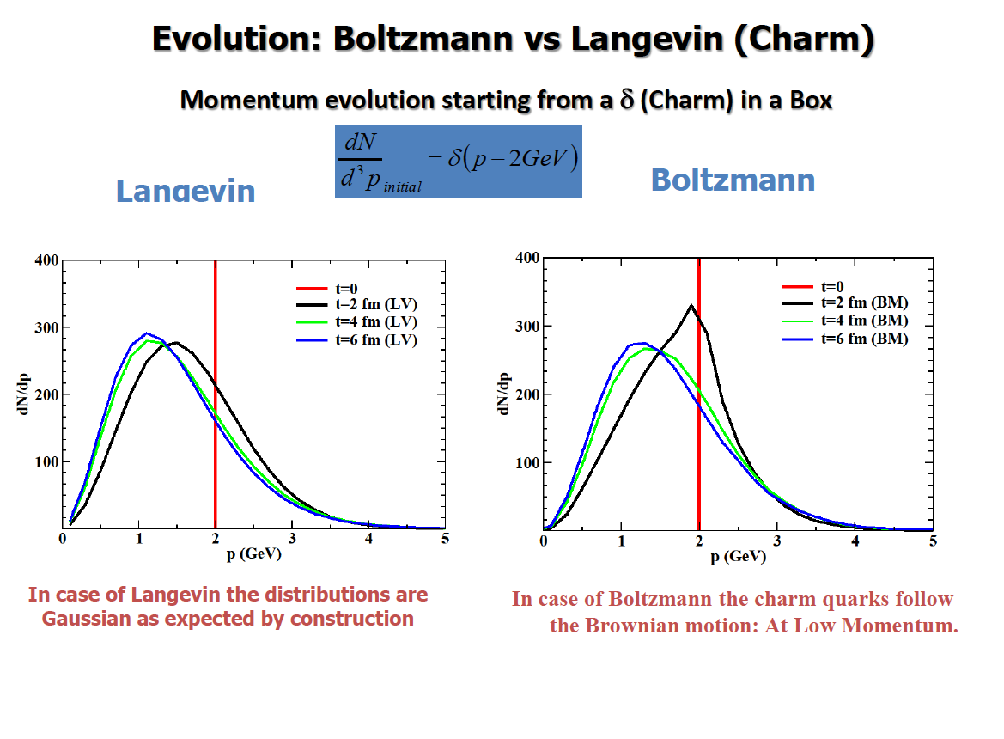
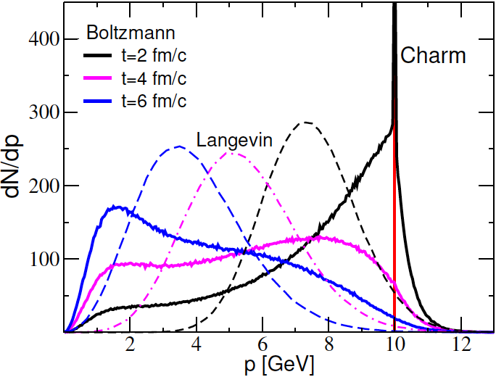
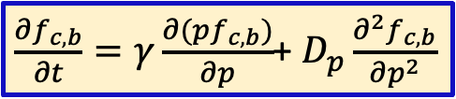
Standard Dynamics of Heavy Quarks in the QGP
Fokker-Planck approach (T<<m_{Q})
in Hydro/transport bulk
c,b quarks
D
K
$\frac{∂f_{c,b}}{∂t}=γ\frac{∂(pf_{c,b})}{∂p}$+ $D_{p}\frac{∂^{2}f_{c,b}}{∂p^{2}}$
e
B
ν_{e}
drag
diffusion
sQGP
|M|² scatt. matrix from:
HTL, pQCD coll., rad., T-matrix, QPM, NREFT, AdS/CFT…
Brownian Motion
limit
D_{p} =MTγ − Fluct. Diss. Theor.(FDT)
Space diffusion
coefficient
This is the main set up at least at p_{T} < 6-8 GeV
Brownian motion challenged for charm (M_{c} ~ 3 T~ gT)
→ Relativistic Boltzmann dynamics

Slide 8
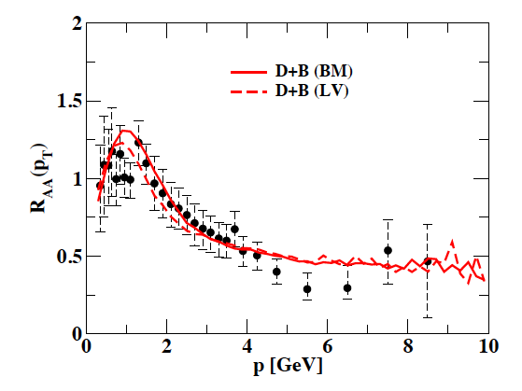
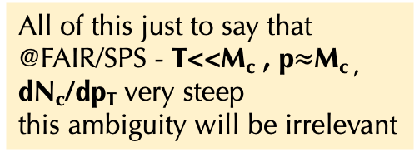
Fluctuation-Dissipation Th. in Brownian Motion
________________________________________________________________________________________________________________
Drag from M scattering matrix
Diffusion from M scattering matrix
Full FDT would be
(*)
but (*) would give quite different A or B at finite p_{T} wrt those evaluate from $ℳ$ scatt. matrix
Standard choices are $B_{||}=B_{⊥}=D_{p} from ℳ$ and $D_{p}(p)=TEA(p)$[supported by Boltzmann]
In general $ℳ$ contains more than a Brownian dynamics with gaussian fluctuations for p > M_{c}
≈ isotropic scatterings
All of this just to say that
@FAIR/SPS - T<<M_{c} , p$≈$M_{c ,}
dN_{c}/dp_{T} very steep
this ambiguity will be irrelevant
Α_{LV} reduced by 40%
m_{D}=1.6 GeV
m_{c}=1.4 GeV
S.K. Das et al.,PRC ‘14

Slide 9
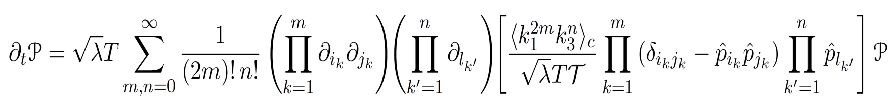
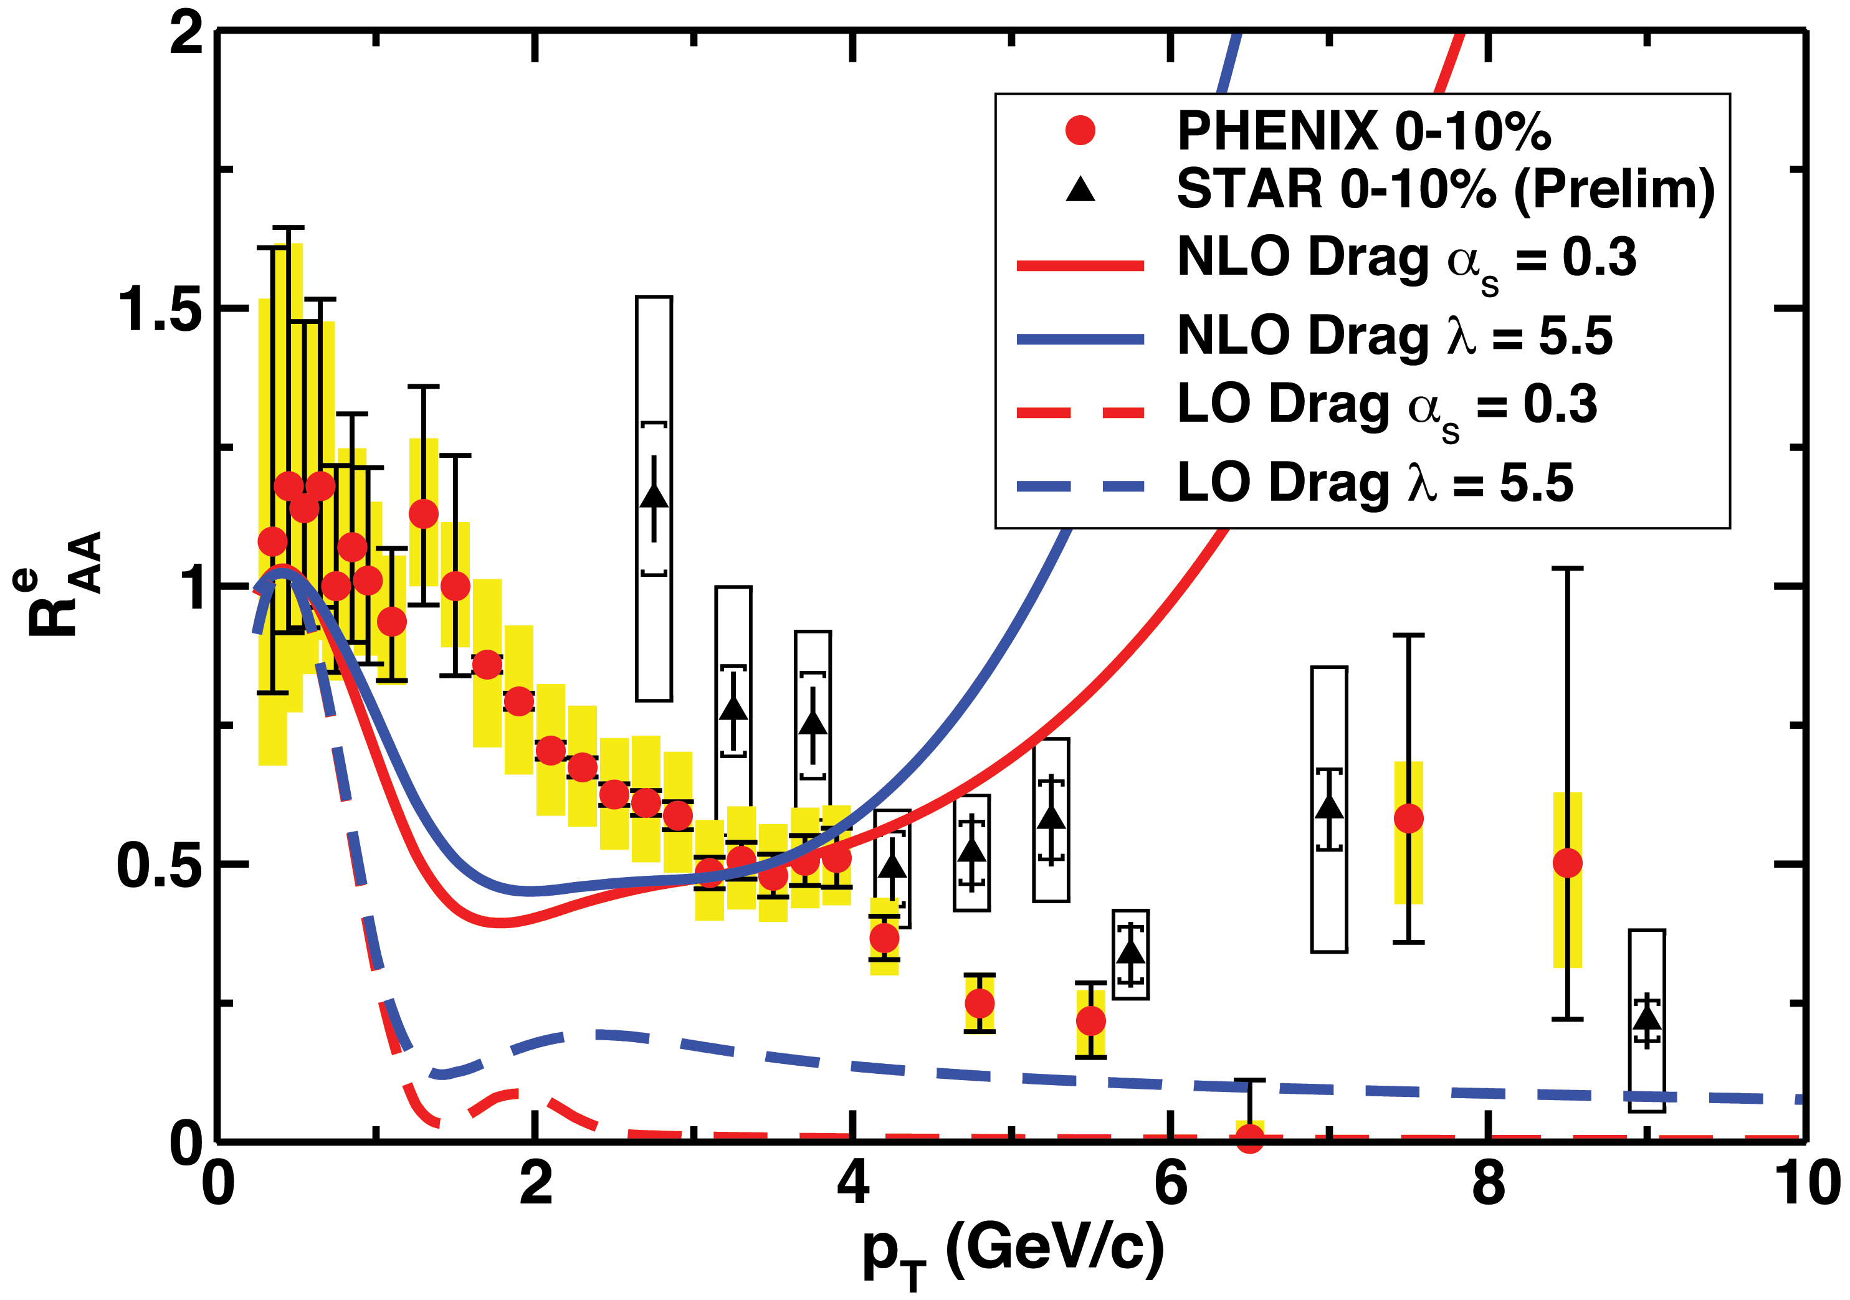
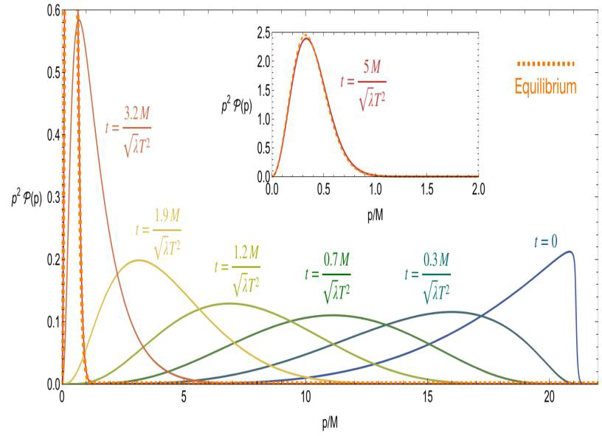


FDT and AdS/CFT
__________________________________________________________________________________________________________________
FDT
Rajagopal,Scheihing-Hitschfeldand,Wiedemann, JHEP 07 (2025)
Kolmogorov equation (generalized Fokker-Planck eq.), for P(k) – the transfer probability distribution of HQ propagating through the strongly coupled plasma, incorporates all higher-order moments beyond Gaussian
→ Full FDT in strong coupling
$λ=4πα_{s}N_{c}$ to be gauged to QCD
S. Gubser, PRD74(2006)
$2πTD_{s}≅\frac{4}{\sqrt{λ}}\frac{T_{QCD}^{2}}{T_{SYM}^{2}}=\frac{4}{\sqrt{λ}}\sqrt{3}$ from Drag γ
W. Horowitz, PRD91(15)
NLO means γ+D

Slide 10
Some main specific features of different approaches:
1) LBL-CCNU-Duke/QLBT?, pQCD* K(p_{T},T) + Bayesian → drag ≈ T
2) Nantes, HTL for |t|<|t*| + modified propagator 1/(t-km_{D}²) → forward peaked
+ EPOS4HQ
3) QPM-Catania, α_{s}(T) fitted to lQCD thermodynamics + Tree level diagrams
4) PHSD, like QPM + off-shell dynamics
5) BAMPS, pQCD LO radiative+elastic & α_{s}=0.6
6) TAMU, T-matrix scattering driven by V(r,T) from lQCD
7) Torino, HTL for |t|<|t*| starting from D_{p} in the FDT
8) CUJET, α_{s} (T) large increase at T→ T_{c} due to monopoles
9) DGLV, α_{s}(T) opacity expansion base on scattering on yukawa interaction
10) AdS/CFT, Drag ≈ T² like pQCD but 10-20 time larger (no p dep. for drag)
Shared feature Drag >> pQCD-LO and
some have stronger interaction as T→T_{c}

Slide 11
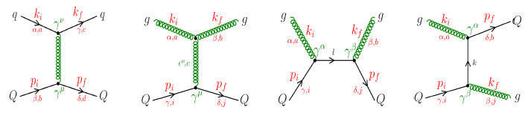
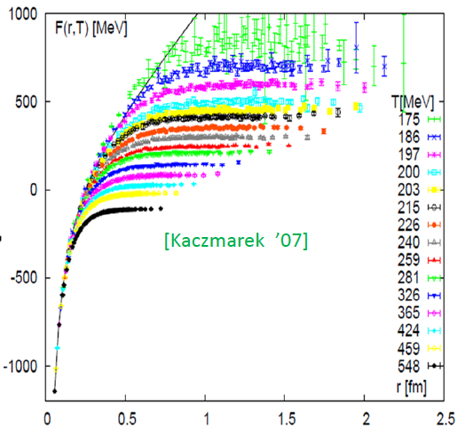
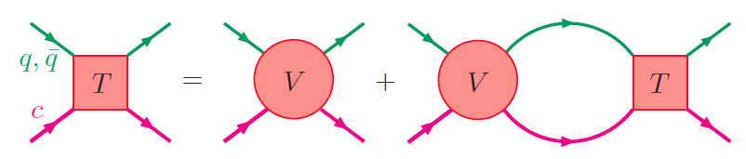
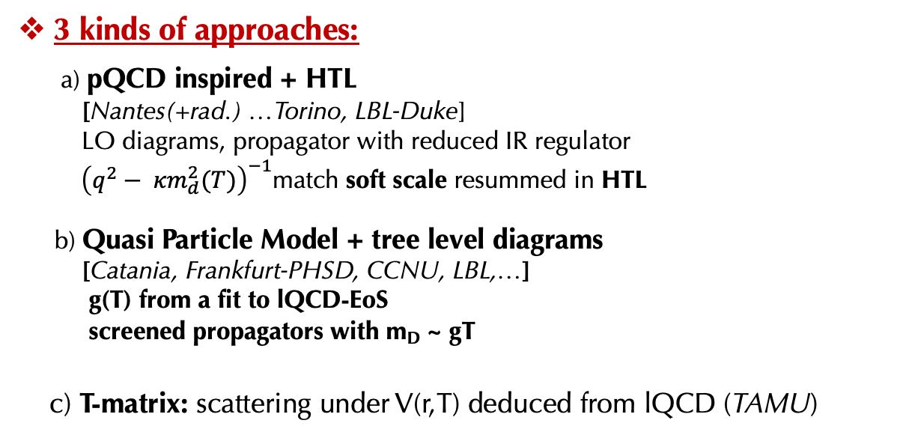
How HQ interact with the medium [low-medium p_{T}] __________________________________________________________________________________________________________________
Tree-level with vertex g(T)
& propagators renormalized
3 kinds of approaches:
a) pQCD inspired + HTL
[Nantes(+rad.) …Torino, LBL-Duke]
LO diagrams, propagator with reduced IR regulator
${\left(q^{2}− {κm}_{d}^{2}(T)\right)}^{−1}$match soft scale resummed in HTL
b) Quasi Particle Model + tree level diagrams
[Catania, Frankfurt-PHSD, CCNU, LBL,…]
g(T) from a fit to lQCD-EoS
screened propagators with m_{D} ~ gT
c) T-matrix: scattering under V(r,T) deduced from lQCD (TAMU)
F=U-TS
3D reduction of the Bethe–Salpeter is used to determine heavy-quark interactions

Slide 12
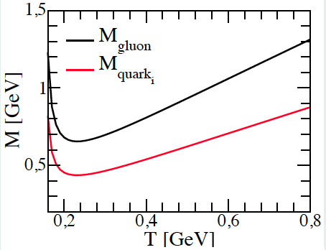



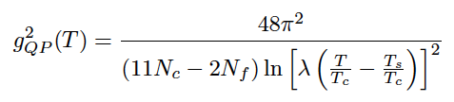
Simple QuasiParticle-Model fitting lQCD
Plumari, Alberico, Greco, Ratti, PRD84 (2011)
Interaction in thermal quasi-particle masses + B(T)
g(T) from a fit to ε from lQCD
-> good reproduction of P, e-3P, c_{s}(T) for T>T_{c}
λ=2.6
T_{s}=0.57 T_{c}
Main features: as T→T_{c} enhancement of the coupling
reminescent of confinement dynamics,

Slide 13
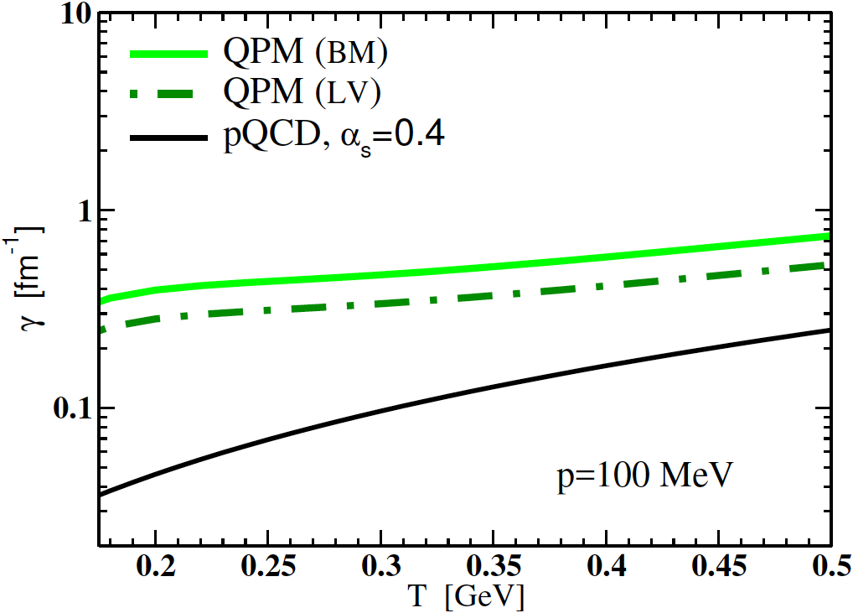
Drag Transport coefficient in QPM
____________________________________________________________________________________________________________________________________________________
Charm Drag
f(p,t=0)=δ(p-p₀) , <p>=p₀ e-^{γt}
Main feature:
- g(T) enhanced as T →T_{c}, weak dependence on T
interaction compensate decrease of ρ_{q,g}(T)
- Behavior similar to T-matrix
pQCD-LO or AdS/CFT γ (T)≈ 1/T²
Tree-level diagrams
with g(T) from the fit
to LQCD ε(T)

Slide 14
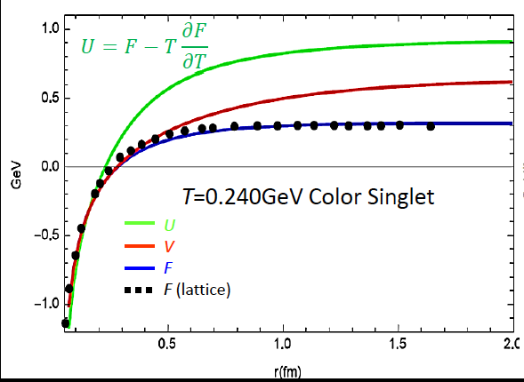
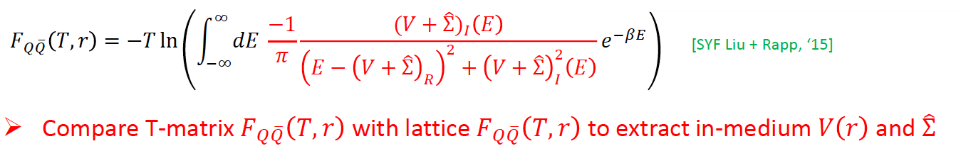
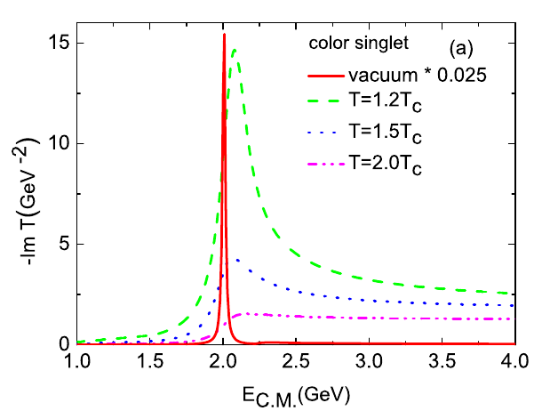
Resonant Elastic scattering with T-matrix
________________________________________________________________________________________________________________________________________________________
Scattering under a potential V(r,T) derived from lQCD Free-energy:
Van Hees, Greco, Rapp,
PRL100 (2008)
Fit screened Cornell V(r)+ Im. part. (pert.-like ansatz)+ relativistic corr.
F=U-TS
A way to solve the issue of V from F=U-TS, [SYF Liu+Rapp, 1612.09138]
V keeps long range remnants of confinement: resonant scattering
→ enhanced scattering toward T_{c} , emergence of di-quarks
Consistent with hadronization by coalescence
Scope: consistency with quarkonium correlator,
HQ susceptibilities, EoS, 3-body radiative scattering,…
Notes:
Possibility toinclude spin interaction + check the Im T figure with the new development
Infinite mass limit?

Slide 15

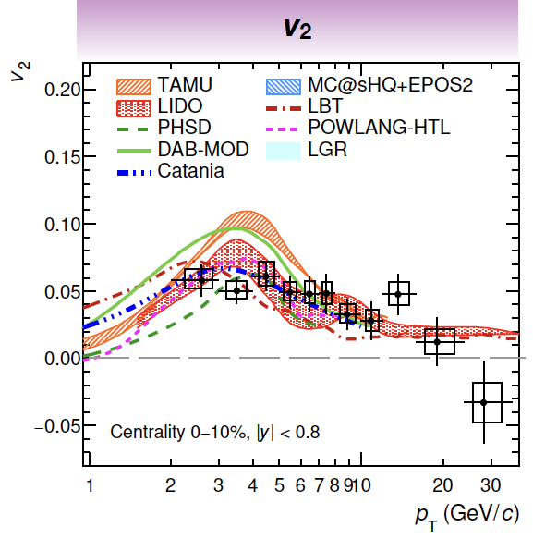
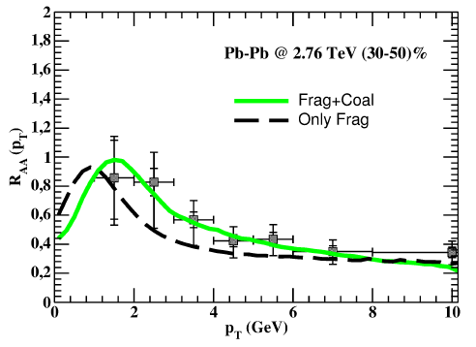
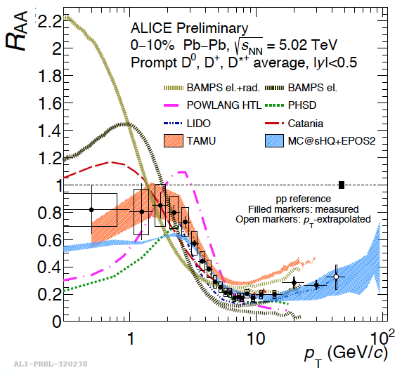
Studying the HF in uRHIC after Run2
________________________________________________________________________________________________________________
QPM-Catania
Notice the log-scale
Most models studies at p_{T}>1.5-2 GeV not small error bars
… and mainly not including impact of hadroning into Λ_{c}

Slide 16
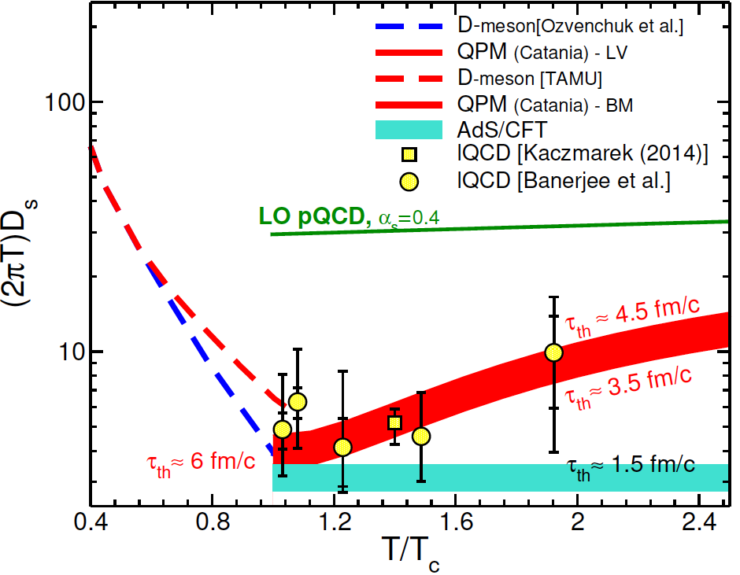

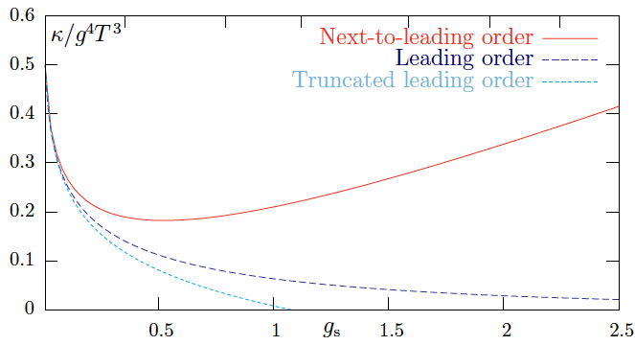

Diffusion Coefficient of Charm Quark: first stage
uRHIC created matter is the Hot QCD matter not in perturbative regime!
pQCD, Asymptotic free regime
τ_{th}~50 fm/c
Not a model fit to lQCD data!
Phenomenology R_{AA} & v₂ ≈ Lattice QCD
Infinite Strong Coupling (AdS/CFT)
$$\frac{D_{p}}{{g^{4}T}^{3}}∝\frac{1}{{TD}_{s}}$$
X. Dong and VG, Prog.Part.Nucl.Phys. (2019)
Largely non-perturbative D_{s} (close AdS/CFT)
even if M_{Q}>>Λ_{QCD} , m_{q} (bare)
τ_{th}(charm, p→0) < 5 fm/c
pQCD by itself indicates
a non-pert. behavior
Caron-Huot, G. Moore, JHEP(2008)
Notes:
U shape typical of phase trnsition
As T→Tc ticuhe the AdS limit

Slide 17
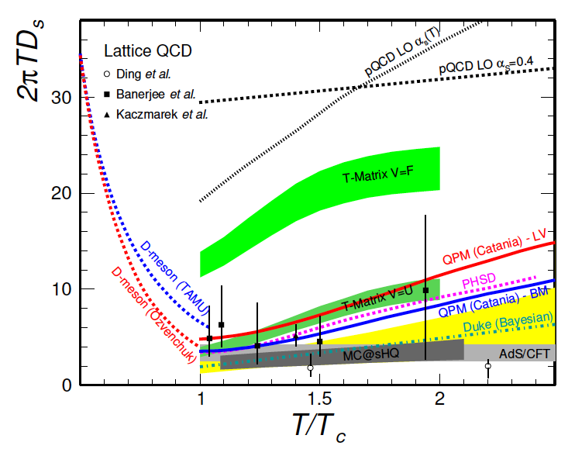
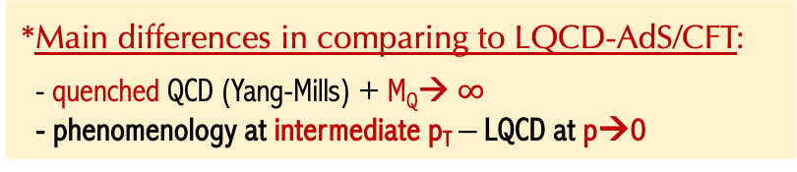
Diffusion of Charm Quark: first stage
________________________________________________________________________________________________________________
X. Dong & VG, Prog.Part.Nucl.Phys. (2019)
From R_{AA}(p_{T}) and v₂(p_{T}) of D mesons
*Main differences in comparing to LQCD-AdS/CFT:
- quenched QCD (Yang-Mills) + M_{Q}→ $∞$
- phenomenology at intermediate p_{T} – LQCD at p→0
*Main sources of differences in models:
- impact of hadronization («unexpected» large baryon production)
- momentum depedence of matrix elements
- data not enough precise/observable not enough constraining
(especially for p_{T}→0)
≈ 2.5-6 fm/c (p→0, T_{c})
Notes:
U shape typical of phase trnsition
As T→Tc ticuhe the AdS limit

Slide 18
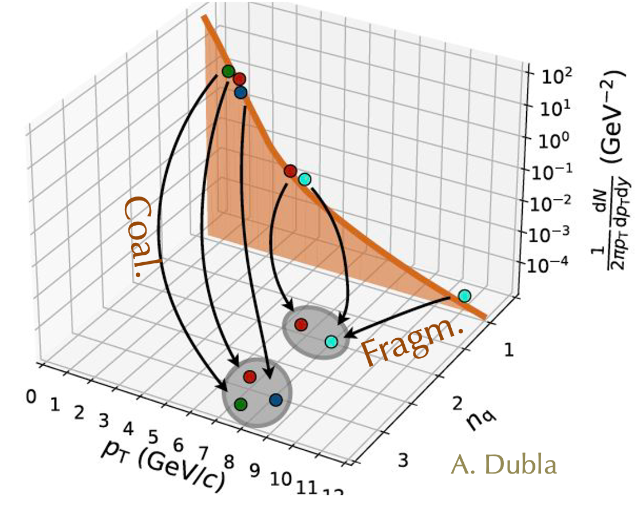
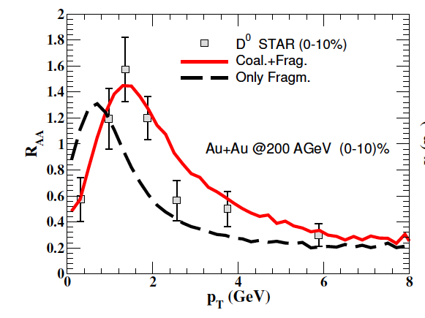
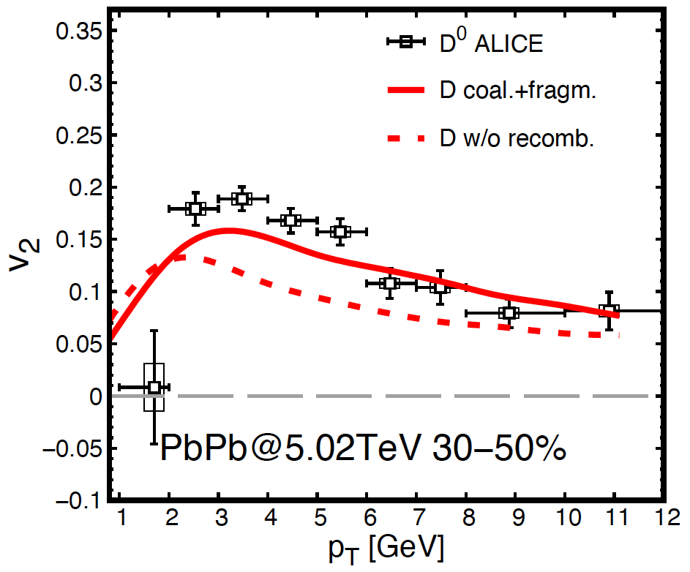
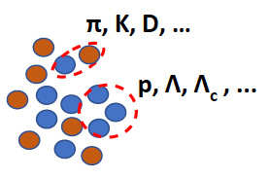
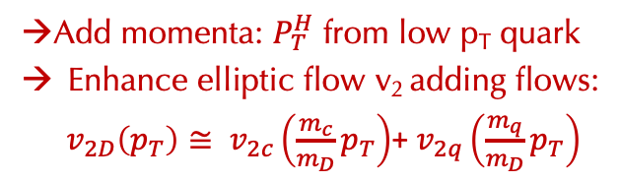
Impact of HF in-medium Hadronization
D meson
Coalesc.+fragm.
Coalesc+fragm.
Fragmention only
Fragmention only
Opposite to in-medium scattering Coalescence brings up both R_{AA} and v₂
→ toward experimental data
Phase-space coalescence: quark recombination
→Add momenta: $P_{T}^{H}$ from low p_{T} quark
Enhance elliptic flow v₂ adding flows:
$v_{2D}\left(p_{T}\right)≅ v_{2c}\left(\frac{m_{c}}{m_{D}}p_{T}\right)$+ $v_{2q}\left(\frac{m_{q}}{m_{D}}p_{T}\right)$
$$f_{M}(P_{H}=p_{1}+p_{2})≈f_{q}(p_{1})⨂f_{\overline{q}}(p_{2})⨂Φ_{M }(Δx,Δp)$$
Independent Fragmentation
Fries, Greco,Rapp, 2506.24023 , "Quark Gluon Plasma at Fifty - A Commemorative Journey", Springer Nature

Slide 19
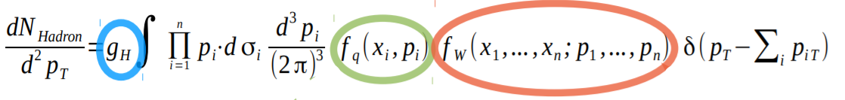
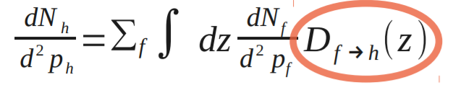
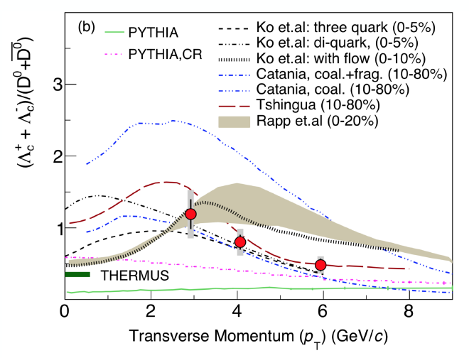
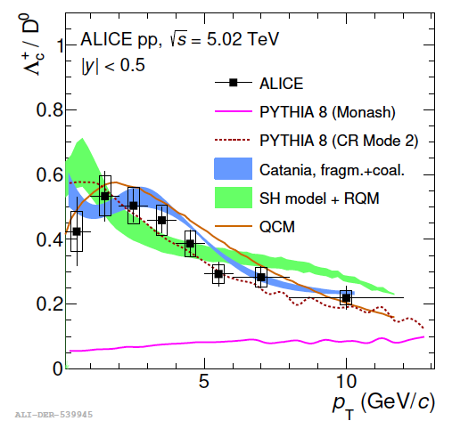
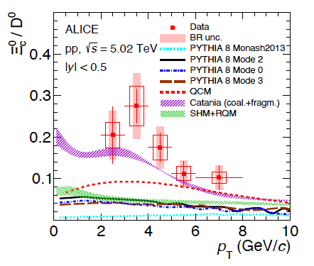
HF Baryon enhancement wrt e⁺e⁻ even in AA& pp@TeV ________________________________________________________________________________________________________________
Phase-space
coalescence
Parton Distrib. Funct.
Hadron Wigner function
Fragmentation
AA@RHIC-STAR
STAR, Phys.Rev.Lett. 124 (2020)
pp@LHC
pp@LHC
Au+Au@200AGeV
CATANIA (coal.+frag.)
e+e-
PYTHIA
V. Minissale et al., PLB (2021)
I⁰ prediction in coalescence [Ko PRC(2009)] of very large Λ_{c}/D⁰ >> SHM[PDG] >> e⁺e⁻(~PYTHIA)
Breaking of Universal Fragmentation Function already in pp in HF sector
OK SHM-wRQM resonances at least for Lc/D0, to be seen for Ξ_{c},Ω_{c}

Slide 20
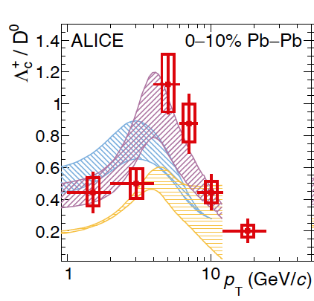
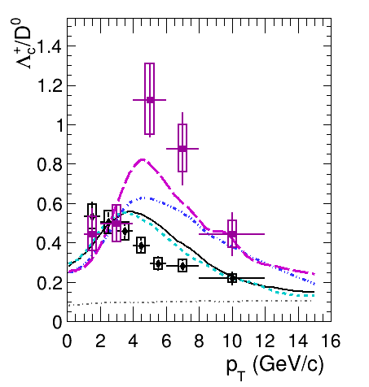
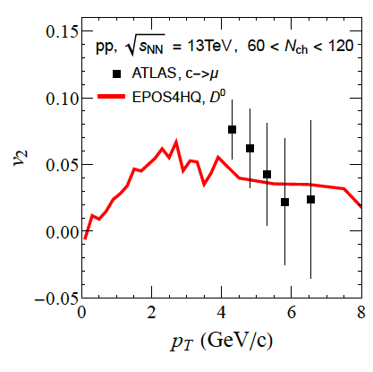
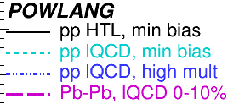

HF hadronization has stimulated several developments
__________________________________________________________________________________________________________________________
PYHTIA beyond Leading Color (LC)→ Color Reconnection (CR) in pp
Coalescence+Fragmentation approach applied to pp
Local Color Recombination: POWLANG in AA and in pp
Inclusion of HF Coalescence+ Fragmentation in EPOS (pp &AA)
even in pp v₂
At FAIR/SPS large Λ_{c}/D⁰? or does it go toward e⁺e⁻
or follow SHM wPDG res.?
or follow coalescence and hint to QGP phase?
AA
pp
Coalescence
Color Reconnection
Local Color Recombination
Yields modified from e⁺e⁻ (e⁻p) to pp, then from pp to AA mostly coupling to flowing QGP medium modifies p_{T} shape of the ratio Λc/D?

Slide 21
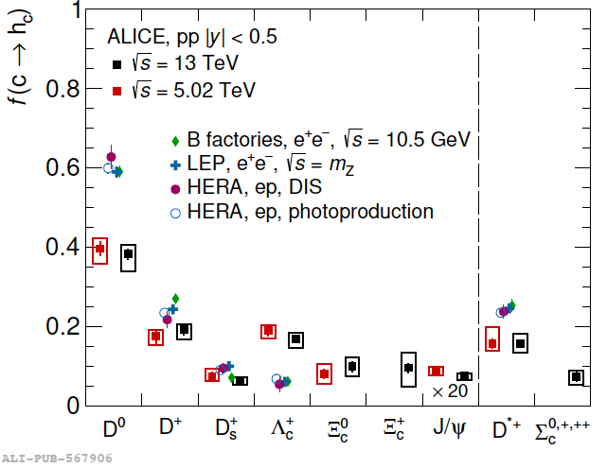
“Fragmentation” Fractions in pp Catania Coalescence ________________________________________________________________________________________________________________
Evidence of different “Fragmentation Fraction”
(FF) in pp at LHC wrt e⁺e⁻ & e⁻p
but similar to AA
CATANIA coal.+fragm. 5 TeV
Coalesc.+Fragm. very close to pp FF
OK SHM-RQM for Λc and D’s
Large Ξ_{c ,} Ω_{c} only in coalescence, lack of yield in PYTHIA, SHM-RQM,… but large error bars

Slide 22
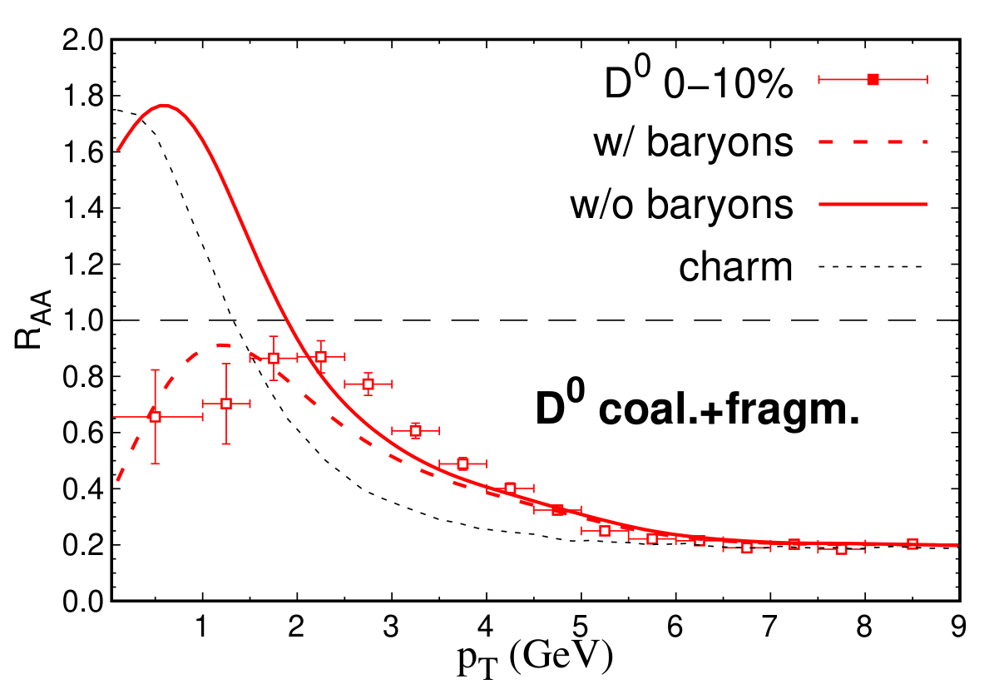
Studying charm in uRHICs – after Run 2
________________________________________________________________________________________________________________
Till 2019-20 the baryon production (Λ_{c},…)was discarded by theoretical approaches, but data at p_{T}> 2 GeV nearly blind to it.
Strong impact on R_{AA} low-intermediate p_{T}→ affect estimates of D_{s} p→0
not all models have done an update to this

Slide 23
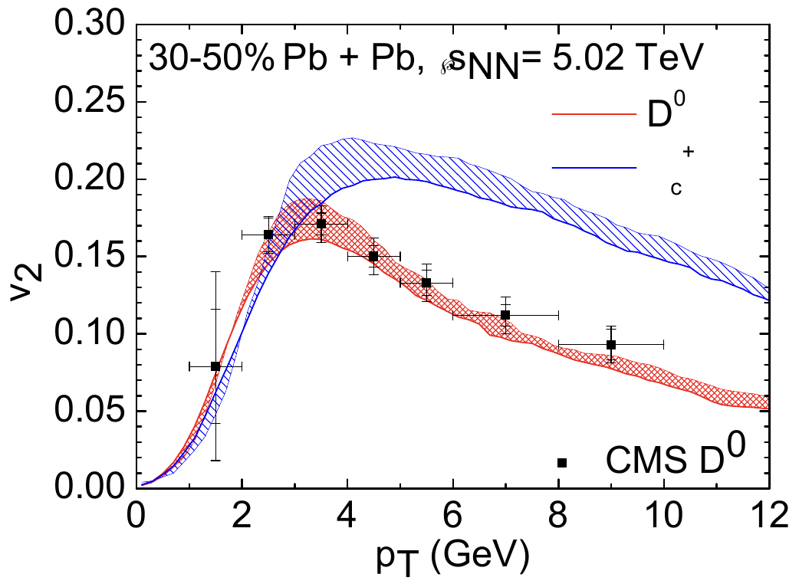
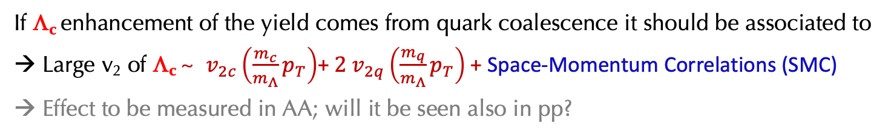
“See” Hadronization mechanism through elliptic flow
________________________________________________________________________________________________________________
If Λ_{c} enhancement of the yield comes from quark coalescence it should be associated to
Large v₂ of Λ_{c} ~ $v_{2c}\left(\frac{m_{c}}{m_{Λ}}p_{T}\right)$+ ${2 v}_{2q}\left(\frac{m_{q}}{m_{Λ}}p_{T}\right)$ + Space-Momentum Correlations (SMC)
Effect to be measured in AA; will it be seen also in pp?
Λ_{c} dominated by coalescence:
p_{T} range? self-consistent with Λ_{c}/D ratio?
TAMU
Λ_{c}
SMC
Catania, noSMC
Methods/tools of AA allow better insight
into hadronization in pp!?
He and Rapp, PRL 2020
Fries, Greco,Rapp, 2506.24023 , "Quark Gluon Plasma at Fifty - A Commemorative Journey", Springer Nature

Slide 24



QM2025
Plumari, QM25
v₂ of Λ_{c} & D⁰ @FAIR/SPS will be in agreement to a coalescence picture or
to an hadronic production/rescattering $v_{2}(Λ_{c}$)$≤$ $v_{2}(D$)? Is there a transition at some $\sqrt{s}$?
Will the signal be consistent with $Λ_{c}$/D⁰ ratio from coalescence? What means consistent?
Notes:
It could be v2 of Lc is smaller than v2 of S, but Lc/D ratio is consistent with SHM so equilibrium production but implying a QGP dynamics/ colascence hadronization

Slide 25
Some more recent development
In lattice QCD and effective models

Slide 26







LQCD update: non-quenched
________________________________________________________________________________________________________________
2+1 flavor lattice QCD with dynamical quarks (m_{π}≈ 320MeV)
L. Altenkort et al., PRL130 (2023)
D_{s} quite smaller than unquenched case suggests faster thermalization of HQs than previously estimated τ_{th}~1-1.5 fm/c
Finite mass require the magnetic part that is deduced deduced assuming a NREFT framework [ M_{Q} ≫ T ] where
Very weak mass dependence
L. Altenkort et al., PRL132 (2024)

Slide 27






T-matrix update → new LQCD
____________________________________________________________________________________________________________________
2 main improvements:
1) Relativistic spin corrections to static potentials
Quarkonia Spettroscopy
~30-50% larger drag
Z. Tang and R. Rapp,PRC108(2023)
2) Employ a T-matrix approach to compute static Wilson line correlator (WLC) → V(r,T)
Z. Tang, S. Mukherjee, P. Petreczky and R. Rapp, EPJA 60 (2024)
with the static 𝑄𝑄spectral function
* Potential from WLC shows less screening
at higher T compared to previous analysis based on HQ free energies
*A(p) shows harder p-dependence compared to results using HQ free energies.

Slide 28



QPM (N_{f}=2+1) extension to QPMp (N_{f}=2+1+1) ________________________________________________________________________________________________________________
From Dyson-Schwinger ( ~ PHSD group in N_{f}=2+1)
C. S. Fischer, J. Phys. G, R253 (2006)
H. Berrehrah, W. et al., PRC 93(2016)
M.L. Sambataro et al., EPJC84(2024)
Momentum dependent masses
p >> Λ_{QCD} m_{u,d,s}→ current masses
QPM extended from Nf = 2+1
to Nf = 2 + 1 + 1 (charm quark is included)
Pressure, trace anomaly including charm
Nf=2+1+1
m_{u,d,s}(p) expected but solves also a know issue…

Slide 29











Quark susceptibility from QPM to QPMp ________________________________________________________________________________________________________________
Case 1: $m_{c}=1.5 GeV$
Case 2: $m_{c}^{2}$= $m_{c0}^{2}+1/3g^{2}T^{2}$ with $m_{c0}=1.3 GeV$
Case 3: $m_{c}(T)$ fixed by charm $χ_{2}^{c}$
LIGHT
Quite different quark susceptibility $χ_{2}^{q}$
even if correspond to same ε_{lQCD}(T) ?!
$$\frac{ε}{T^{4}}\sim {\left(\frac{m}{T}\right)}^{3}K_{1}\left(\frac{m}{T}\right)+{3\left(\frac{m}{T}\right)}^{2}K_{2}\left(\frac{m}{T}\right)$$
STRANGE
$χ_{2}^{q}\sim$ ${\left(\frac{m}{T}\right)}^{2}K_{2}\left(\frac{m}{T}\right)$
$χ_{2}^{q}$weights higher p
of the distribution f(p) wrt ε
with m(p) one can have ε(Τ) like that of a massive gas
with $χ_{2}^{q}$ of a lighter mass gas
M.L. Sambataro et al. e-Print: 2404.17459, EPJC84(2024)

Slide 30




Diffusion D_{s}(T) from QPM to QPMp ___________________________________________________________________________________________________________________
M.L. Sambataro et al, Eur.Phys.J.C 84 (2024)
lQCD quenched w dynamical fermions
QPMp describes ε,P, χ_{q}, χ_{s} of LQCD and is closer than QPM to D_{S} to LQCD(new) with dynamical fermions
Still has a signficant mass dependence from charm to bottom not seen in LQCD + Non Rel. EFT
QPM
bottom
QPMp
M_{Q}→ $∞$
Can QPMp and/or LQCD new D_{s}(T) generate predictions for R_{AA}, v₂, v₃
in agreement with experimental data?
[QPMp p-dependence within the Bayesian analisys of Duke group]

Slide 31


What implies new D_{s}/τ_{th} of charm form R_{AA} & v₂
__________________________________________________________________________________________________________________
LQCD-TAMU
QPM~PHSD-TAMUold
Region explored
from phenomenology
to determine D_{s}(T)
QPMp
LQCD-drag
τ=τ_{th} does not mean a full equilibrium has been reached it is a relaxation time
At T=1.25 T_{c}
QPMp implies τ_{th}(p→0)~2.4 fm/c
New LQCDC implies τ_{th}(p→0)~1.4 fm/c
LQCD-drag : $τ_{th}=γ^{−1}$ = $\frac{M_{c}}{T}D_{s}$

Slide 32




τ_{th} - D_{s} of LQCD cannot be p-independent
________________________________________________________________________________________________________________
shadowing + Hadronization with both D’s, Λ_{c} included
LQCD-TAMU
QPMp
LQCD-drag
Ds(T)/τ_{th} of LQCD with no p-dependence out of phenomenology: only a strong p-dependence like in TAMU could make LQCD agree with exp. data
--> if τ_{th} (p=0)~1 fm/c strong p-dependence pointsto τ_{th} (p = 5GeV) ~ 5 fm/c
details of hadronization/impact of glasma/radiative E_{loss} may reshape QPMp / LQCD-TAMU
1.5 <τ_{th}(p<2 GeV)< 3 fm/c comparable to a possible partonic phase at SPS

Slide 33


Phase of Transition
________________________________________________________________________________________________________________
D_{s} (T, p→0) lattice QCD
Λ_{c}
QPM-Catania
Very small new LQCD-D_{s} (T) [τ_{th}(charm, p→0)~ 1-2 fm/c]: mass independent? down to charm mass?
Most studies at p_{T}>1.5-2 GeV [mainly not including impact of Λ_{c}], need new wave of prediction:
→ compare to LQCD need data p_{T}→ 0
→ need precision data at low p_{T} not only for D but also for Λ_{c}
→ add more esclusive observables: v_{n}(soft)-v_{n}(hard), angular $D\overline{D}$ correlation,…

Slide 34

HQ Surprise also in the transverse flow v₁=<p_{x}/p_{T}>
________________________________________________________________________________________________________________
Transverse flow
light hadrons
Would you expect charm quark to
have a smaller v₂ ? Or a smaller one due
to its mass?
x10⁻²
τ₀ < 0.1 fm/c
Bulk matter
tilted
Very surprising!
v₁ (HQ) ~ 30 times v₁ light hadrons (π,K,..)
dv₁/dy|_{exp}~ -0.0025

Slide 35
HQ Surprise also in the transverse flow v₁=<p_{x}/p_{T}>
__________________________________________________________________________________________________________________
Transverse flow
light hadrons
Would you expect charm quark to
have a smaller v₂ ? Or a smaller one due
to its mass?
x10⁻²
τ₀ < 0.1 fm/c
Bulk matter
tilted
Very surprising!
v₁ (HQ) ~ 30 times v₁ light hadrons (π,K,..)
dv₁/dy|_{exp}~ -0.0025
dv₁/dy=-0.080 ±0.017(stat)±0.016(syst)
v₁ is even more relevant and accessible at finite μ_{B},
NO studies TMK for D at 7-17 AGeV:
Should it drop→ similar or smaller to light v₁?
What this would mean?
charm
Needed non-perturbative HQ interaction close to AdS/CFT
QPM, charm tilted
Needed also initial “tilt” of bulk & none for HQ
L. Oliva et al., JHEP 05 (2021)

Slide 36


Charm as a probe of huge B Magnetic field
≈ 50m_{π}²
Magnetic field
≈ m_{π}²
medium
Schematic calculation: early time
behavior quite uncertain theoretically
(non eq., back-reaction, glasma…)
vacuum

Slide 37




Impact of Magnetic Field on Charm
_________________________________________________________________________________________________________________________________________________________
S.K.Das et al., PLB768(2017)
$F_{ext}$= qE +$\frac{q}{E_{p}}\left(p×B\right)$
HQ best probe for v₁ from e.m. field:
t_{form} ≈ 0.08 fm/c when By is ≈ its maximum
No contribution from neutral gluons diff. from π⁺/π⁻,$p/\overline{p}$
τ_{th}(c) ≈ τ_{QGP}>> τ_{e.m} (keep more memory effects)
Faraday
[+ Coulomb spectators]
Lorentz
x
${\overline{D}}^{0}−D^{0}$ splitting in v₂
c
J_{Faraday}
c
J_{Hall}
B_{y}
z,η
≈ O(10⁻²)
J_{Hall}
c
E_{x}
c
Time decreasing magnetic B_{y} creates E_{X} that induces
a current in opposite direction: delicate balance!
≈ 10-30 times larger than π⁺/π⁻!
For π⁺/π⁻, see Gursoy,Kharzeev, Rajagopal, PRC89(2014)

Slide 38


Balance between Magnetic and Electric currents
_________________________________________________________________________________________________
x
Das et al., PLB768 (2017)
c
J_{Faraday}
c
Decreasing magnetic field B_{y} creates E_{X} that induces
a current in opposite direction: delicate balance!
J_{Hall}
B_{y}
z,η
J_{Hall}
[Cancellation at 95% level]
c
E_{x}
c

Slide 39




v₁ transverse flow current measurement
________________________________________________________________________________________________________________
Oliva, Plumari, V.G., JHEP(2020)
STAR@RHIC: d(Δv₁)/dy|_{exp}= − 0.011 ±0.024(stat)±0.016(syst)
d(Δv₁)/dy|_{th.}= − 0.01, L. Oliva et al. ≈ 10 times larger than charged
but with current precision also consistent with 0!
First measurement ALICE@LHC- large systematic/statistic error opposite sign & magnitude ≈ 40 times larger than predictions
that would require a very slow By(t) [Y. Sun et al., PLB816(2021)

Slide 40

v₁ transverse flow current measurement
________________________________________________________________________________________________________________
Oliva, Plumari, V.G., JHEP(2020)
STAR@RHIC: d(Δv₁)/dy|_{exp}= − 0.011 ±0.024(stat)±0.016(syst)
≈ 10 times larger than charged, similar to S. Das et al., PLB768 (2017)
but with current precision also consistent with 0!
First measurement ALICE@LHC- large systematic/statistic error opposite sign & magnitude ≈ 40 times larger than predictions
if there is a Δv₁ for $D^{0}−{\overline{D}}^{0}$ from e.m. field
→ probe of deconfinement for heavy flavor
constraint on e.m. field → quantitative studies of Chiral Magnetic Effect (by local CP violation at high T)
+ several other effects

Slide 41








Impact of Magnetic Field at FAIR/SPS?
_________________________________________________________________________________________________________________________________________________________
At SPS/FAIR E_{x} & B_{y} quite smaller than at RHIC, but electric field E does not come from Faraday law, but dominated by the Coulomb of Participants (μ_{B} $≠$0) and Spectators. Smaller E_{x} but the effect is no longer from delicate balance between Electric and Magnetic field and last much longer.
Gursoy et al., PRC98 (2018)
V.V. Skokov et al., Int.J.Mod.Phys.A 24 (2009)
H. Taia et al., Phys.Rev.C 110 (2024)
STILL Δv₁ for $D^{0}−{\overline{D}}^{0}$ can be a signature of a partonic phase!

Slide 42
Charm transport coefficient
at finite μ_{B} and in hadronic matter

Slide 43





What about hadronic rescattering and D_{s} in the hadronic phase
Das,Torres-Rincon,Rapp, Phys.Rept. 1129 (2025)
μ_{B}$=$0
μ_{B}$=$0
A minimum around T_{c} about a continuity with hadronic phase?! OK with old LQCD
ok with new in M→$∞$ … but callenged by new LQCD/NREFT data for charm, but likely finite
M_{Q} extrapolation miss some physics of the cross over?
Predicted behavior at finite μ_{B} hadronic (more baryon contr.) opposite to partonic
this at least in a QPM picture, T-matrix?
At some finite μ_{B} can it be we can have discontinuty? Associated to I order phase transition?
Notes:
In QGP

Slide 44







From RHIC-LHC charm 2πTD_{s} ~ 1-2 [τ_{th} (p=0)~1-2.5 fm/c] for T~T_{c} & small p_{T}
Which should about to hold for QGP at s/n_{B} ~ 20-30 (~NA60+ μ_{B}~250-300 MeV)
Berrehrah et al., PRC 91 (2015)
Inghirami et al., EPJC79 (2019)
μ_{B}$≠$0
Hadronic
Diffusion
Drag
2πTD_{s} ~ 12
μ_{B}$=$0
Tolos(2013)
- Increase at larger μ_{B} due to
$B,\overline{B}$ contribution
- neglible asimmetry $\overline{D}$
DQPM
τ_{th} ~40 fm
larger μ_{B}
Torres-Rincon
μ_{B}=0
$τ_{th}∼\frac{D_{s}\left(T\right)}{T^{2}}\sim T^{−4}$ rise very quickly in the hadronic phase
Calculation in DpQCD done without changing the EoS to finite μ_{B} one

Slide 45

Summary ____________________________________________________________________________________________________
Open HF set up a strong connection among LQCD,NREFT/phenomenology/exp. observables:
- large non-perturbative interaction: Ds(T):
agreement of phenomenology to LQCD?! close to AdS/CFT?
- hadronization reveals pp@TeV much closer to AA than e⁺e⁻ or e⁻p!?
It is a Phase of Transition to a new PROGRESS:
- new LQCD results for D_{s}(T) → smaller than previous average estimate (τ_{th} (charm)~ 1-2 fm/c)
- better identify impact of baryon HF hadronization (large Λ_{c}/D) on estimate of D_{s}(T)
- Precision data @low pT|new observables: R_{AA} (Λ_{c}), v₂ (Λ_{c} ), light-HF v_{n} correl.,$D\overline{D}$ angular corr.
|extension to bottom|multicharm production (ALICE3)→ breakthrough

Slide 46
Back-up Slide

Slide 47


