Slide 1



Studying QCD matter at high net-baryon density with the HADES experiment
Szymon Harabasz
Penetrating Probes of Hot High-mu_B Matter: Theory Meets Experiment
ECT* Trento 21-25.07.2025

Slide 2
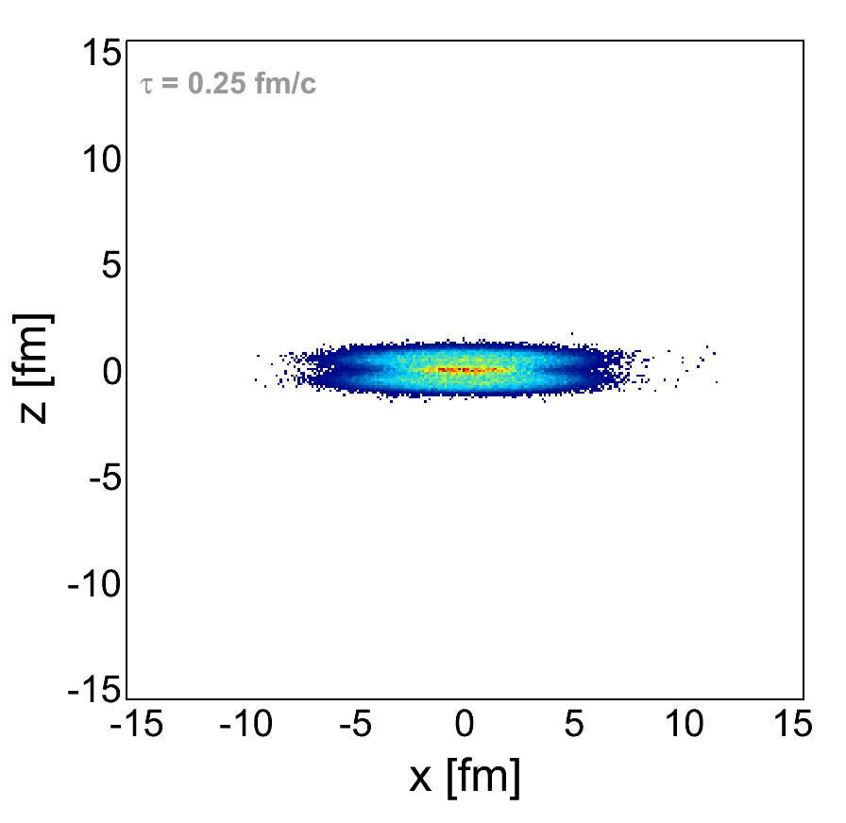
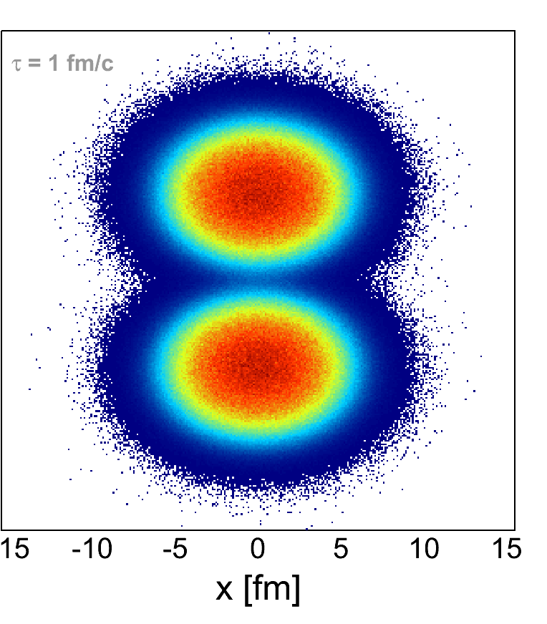
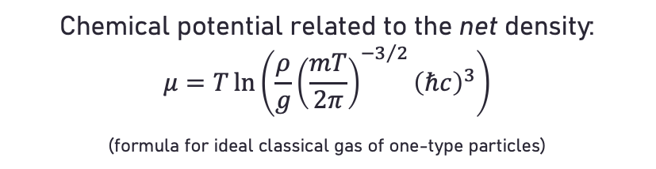


Strong interaction matter at extreme conditions
Statistical Hadronization Model of particle production
Borsanyi et al. [Wuppertal-Budapest Collab.], JHEP 1009 (2010) 073
Isserstedt, Buballa, Fischer, Gunkel, Phys. Rev. D 100 (2019) 074011
Gao, Pawlowski, Phys. Lett. B 820 (2021) 136584
Cuteri, Philipsen, Sciarra, JHEP 11 (2021) 141
McLerran, Pisarski, Nucl. Phys. A 796 (2007) 83
Glozman, Philipsen, Pisarski, Eur. Phys. J A 58 (2022) 12, 247
HADES, Nature Phys. 15 (2019) 10, 1040-1045
NA60, Specht et al., AIP Conf.Proc. 1322 (2010) 1, 1-10
Andronic et al., Nature 561 (2018) no.7723
Decreasing collision energy
$\sqrt{s_{NN}}=17.3$ GeV
$\sqrt{s_{NN}}=2.42$ GeV
Chemical potential related to the net density:
$$μ=T\ln\left(\frac{ρ}{g}{\left(\frac{mT}{2π}\right)}^{{−3}/2}{\left(ℏc\right)}^{3}\right)$$
(formula for ideal classical gas of one-type particles)
Animations: F. Seck (TU Darmstadt)
Model: UrQMD

Slide 3

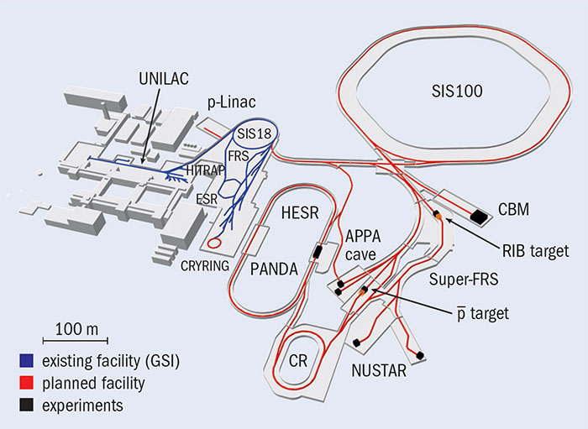
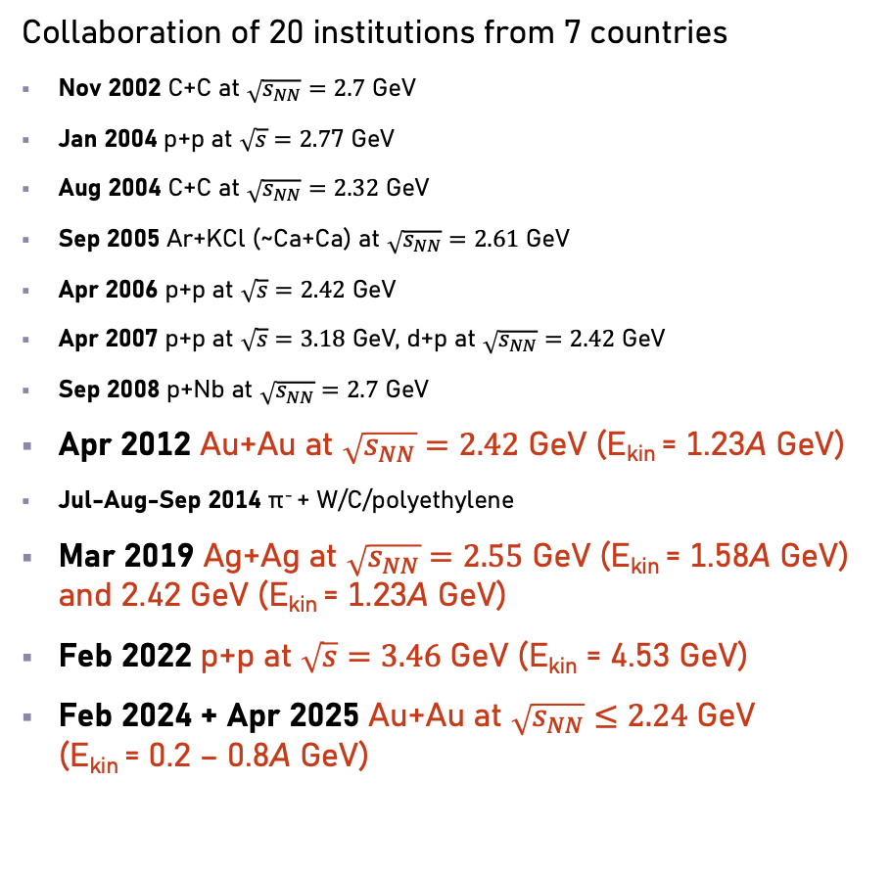
Space-time coordinates
Collaboration of 20 institutions from 7 countries
Nov 2002 C+C at $\sqrt{s_{NN}}=2.7$ GeV
Jan 2004 p+p at $\sqrt{s}=2.7$7 GeV
Aug 2004 C+C at $\sqrt{s_{NN}}=2.32$ GeV
Sep 2005 Ar+KCl (~Ca+Ca) at $\sqrt{s_{NN}}=2.61$ GeV
Apr 2006 p+p at $\sqrt{s}=2.42$ GeV
Apr 2007 p+p at $\sqrt{s}=3.18$ GeV, d+p at $\sqrt{s_{NN}}=2.42$ GeV
Sep 2008 p+Nb at $\sqrt{s_{NN}}=2.7$ GeV
Apr 2012 Au+Au at $\sqrt{s_{NN}}=2.42$ GeV (E_{kin} = 1.23A GeV)
Jul-Aug-Sep 2014 π⁻ + W/C/polyethylene
Mar 2019 Ag+Ag at $\sqrt{s_{NN}}=2.55$ GeV (E_{kin} = 1.58A GeV) and 2.42 GeV (E_{kin} = 1.23A GeV)
Feb 2022 p+p at $\sqrt{s}=3.46$ GeV (E_{kin} = 4.53 GeV)
Feb 2024 + Apr 2025 Au+Au at $\sqrt{s_{NN}}≤2.24$ GeV
(E_{kin} = 0.2 – 0.8A GeV)
Location: Darmstadt, Germany
now
after ~2029
(cave shared
with CBM)
Color: will be mentioned in this talk

Slide 4
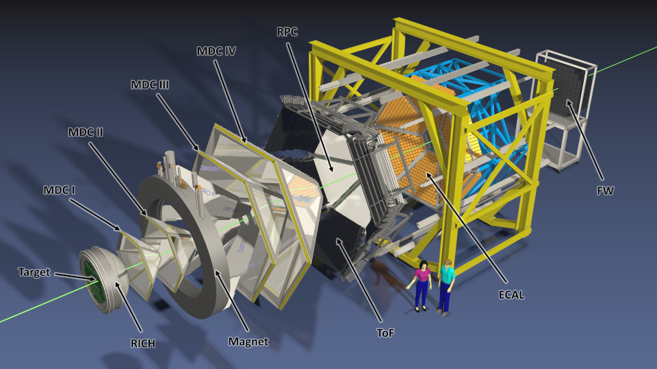
High Acceptance Di-Electron Spectrometer
Complex, multi-purpose detection system
Design optimized to study
heavy-ion collisions at SIS18
Focus on di-electrons, well capable to detect all charged particles

Slide 5
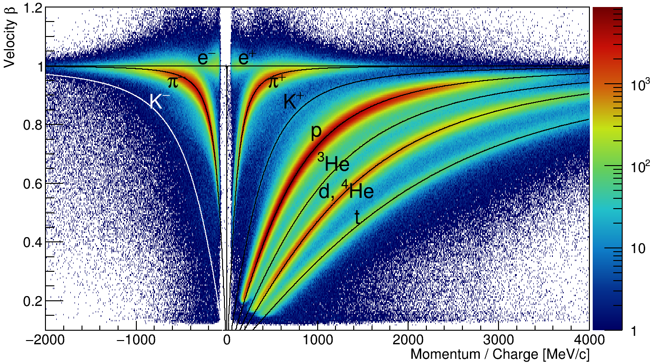
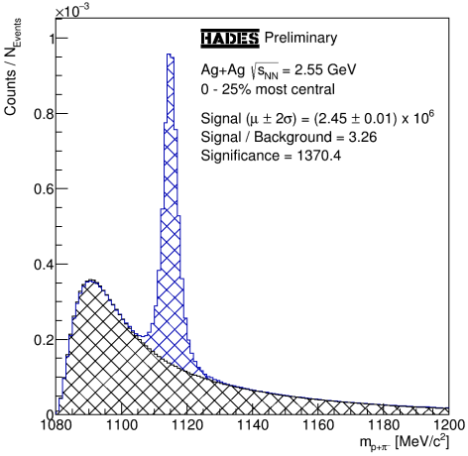
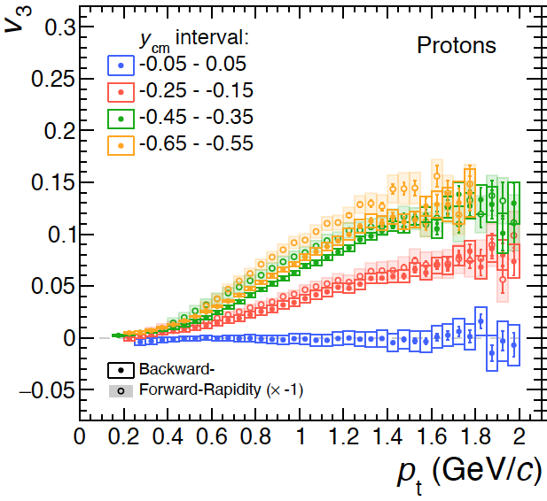
Particle detection capabilities
Charged particle detection:
leptons and hadrons
Strange particles reconstruction through weak decay channels
Collective motion
(high-order “flow” harmonics)

Slide 6
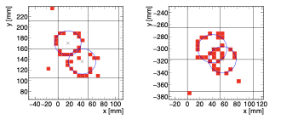
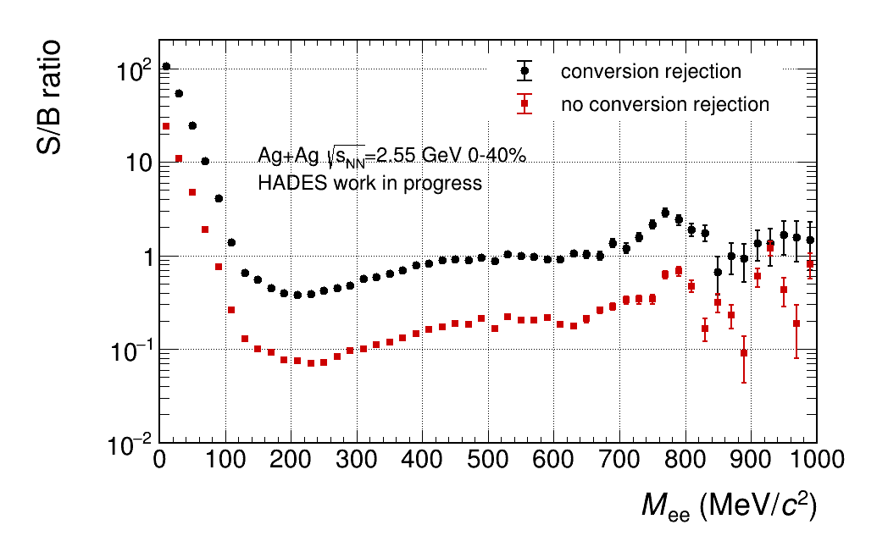
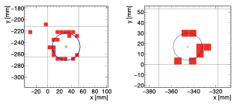
Dilepton reconstruction capabilities
Hadron-blind Ring Imaging Cherenkov detector
Precise discrimination between true and fake rings
Ability to recognize (and suppress) small-opening-angle pairs
Hugely improved ratio of signal to combinatorial background
PMT-based photodetector for HADES RICH

Slide 7
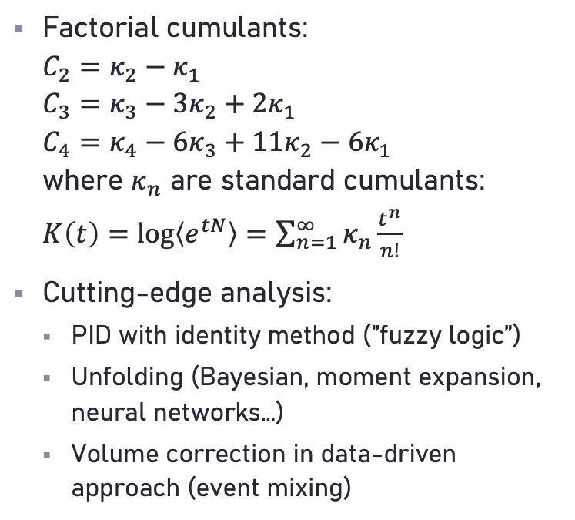
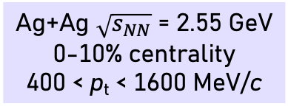
Fluctuations – protons
Ag+Ag $\sqrt{s_{NN}}$ = 2.55 GeV
0-10% centrality
400 < p_{t} < 1600 MeV/c
Braun-Munziger et al., Nucl. Phys. A 1008 (2021) 122141
Rustamov, Phys. Rev. C 110 (2024) 6, 064910
Nabroth for HADES, QM2025
Factorial cumulants:
$C_{2}=κ_{2}−κ_{1}$
$C_{3}=κ_{3}−3κ_{2}+2κ_{1}$
$C_{4}=κ_{4}−6κ_{3}+11κ_{2}−6κ_{1}$
where $κ_{n}$ are standard cumulants:
$K\left(t\right)=\log\left\langle e^{tN}\right\rangle =\sum_{n=1}^{∞}{κ_{n}\frac{t^{n}}{n!}}$
Cutting-edge analysis:
  PID with identity method (”fuzzy logic”)
  Unfolding (Bayesian, moment expansion, neural networks…)
  Volume correction in data-driven approach (event mixing)
0.6
2
C₂ / C₁
0-10 % Ag+Ag 1.58A GeV
C₃ / C₁
0-10 % Ag+Ag 1.58A GeV
0-10 % CE Baseline, attractive, ρ=0.8
1
0-10 % CE Baseline, attractive, ρ=0.8
0.4
0
−1
0.2
−2
HADES Work in Progress
HADES Work in Progress
0
0
0.1 0.2 0.3 0.4 0.5
−3
0 0.1 0.2 0.3 0.4 0.5
± Δy
± Δy
Trend described by Canonical baseline accounting for correlations and attractive potential

Slide 8
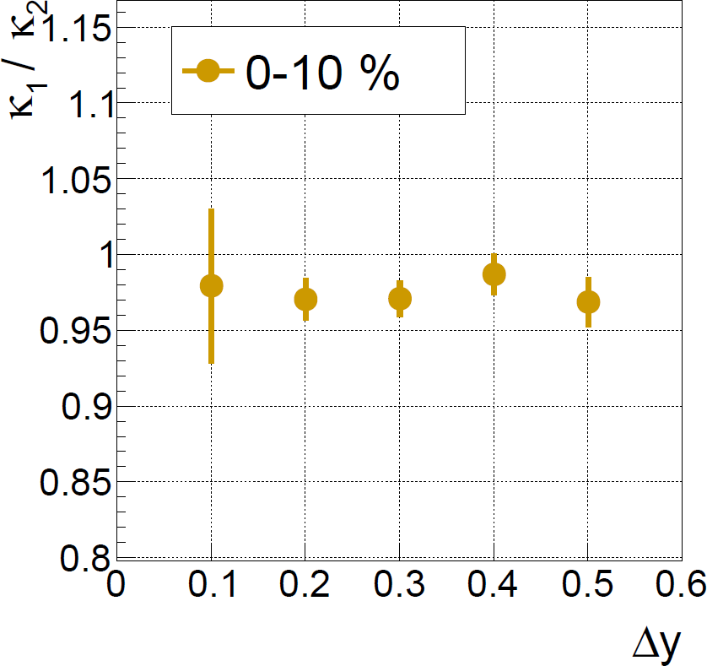
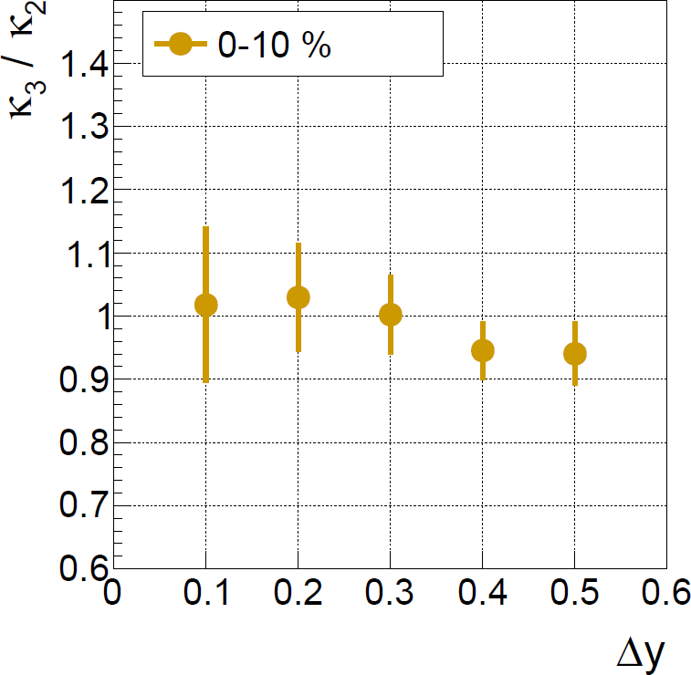
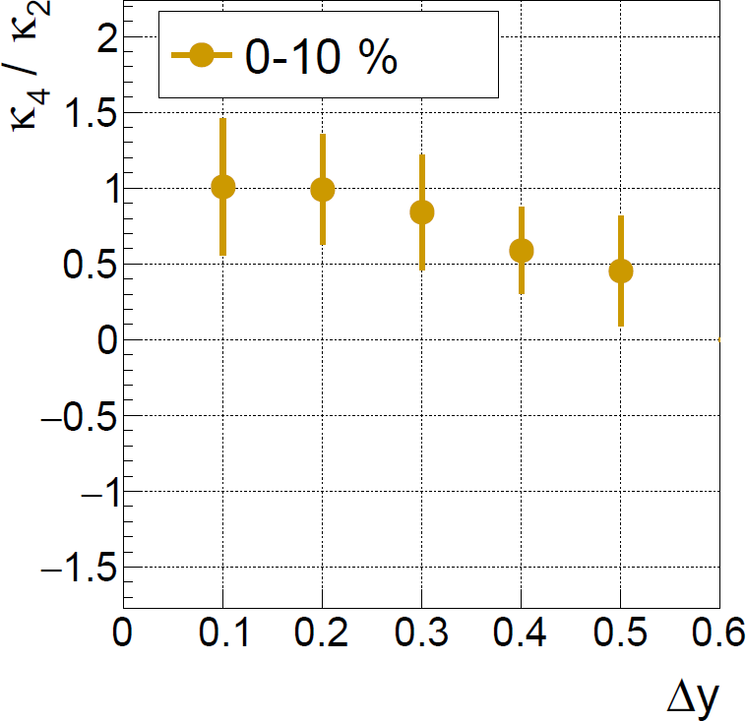
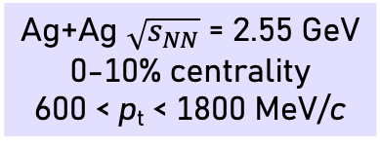
Fluctuations – deuterons
Ag+Ag $\sqrt{s_{NN}}$ = 2.55 GeV
0-10% centrality
600 < p_{t} < 1800 MeV/c
Nabroth for HADES, QM2025
Closer to the Poisson limit compared to protons
Proper Canonical baseline needs to be established

Slide 9
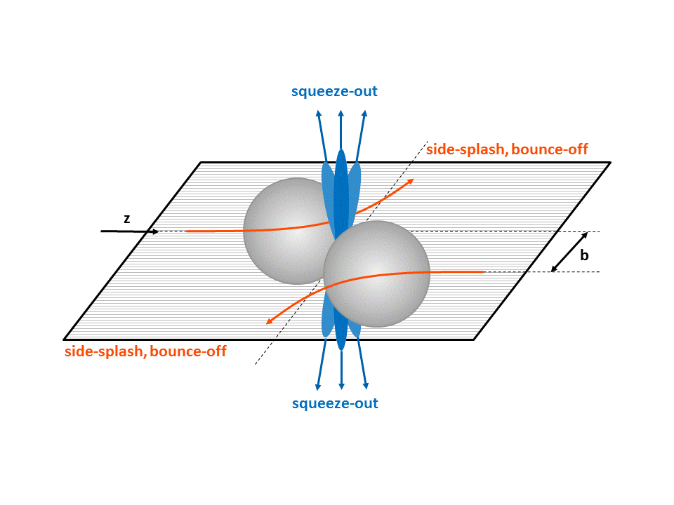
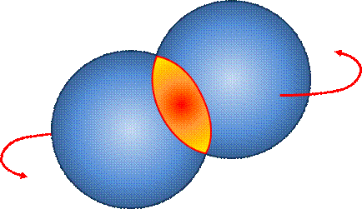
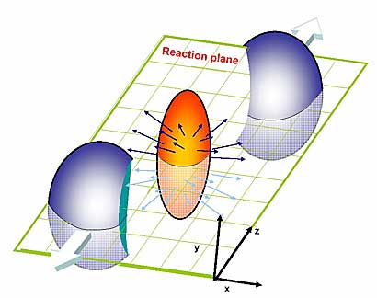
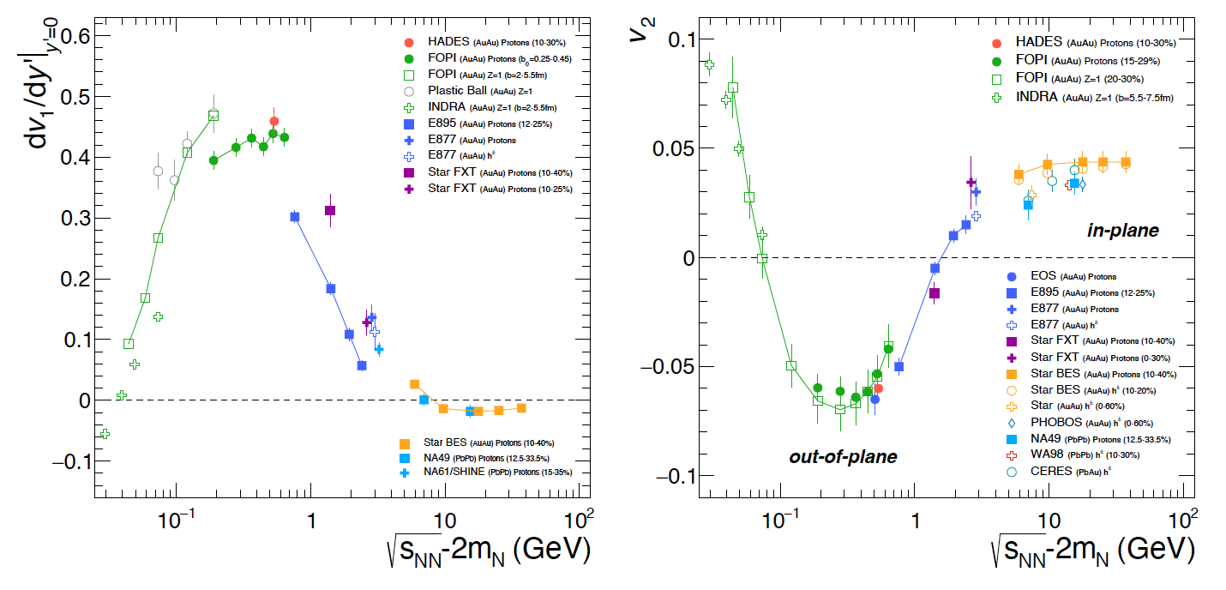
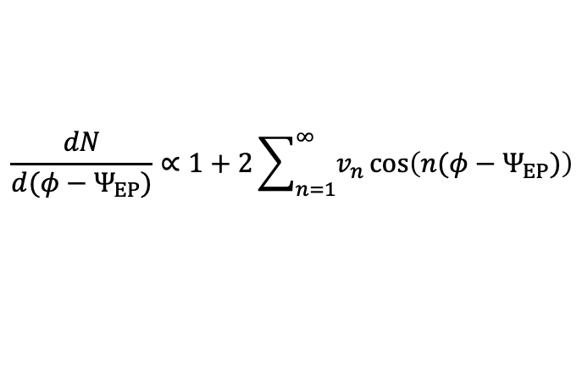
Azimuthal anisotropy (“flow”) with respect to the reaction plane (RP)
Fourier coefficients of the particle emission:
$$\frac{dN}{d(φ−Ψ_{EP})}∝1+2\sum_{n=1}^{∞}{v_{n}\cos\left(n(φ−Ψ_{EP})\right)}$$
v₁ antisymmetric around y = 0
Intermediate energy, v₂ < 0
High energy, v₂ > 0
HADES, Eur. Phys. J. A 59 (2023) 4, 80
Sensitivity to:
QCD equation of state
  Nuclear symmetry energy
  [v₂(y_{cm}) for protons]
  Constraints from comparing with predictions from microsocopic transport
Presence of the first-order phase transition
Wang et al., Phys. Lett. B 802 (2010) 135249
Paech et al., Nucl. Phys. A 681 (2001) 41-48
Steinheimer et al., Phys. Rev. C 89 (2014) 054913

Slide 10
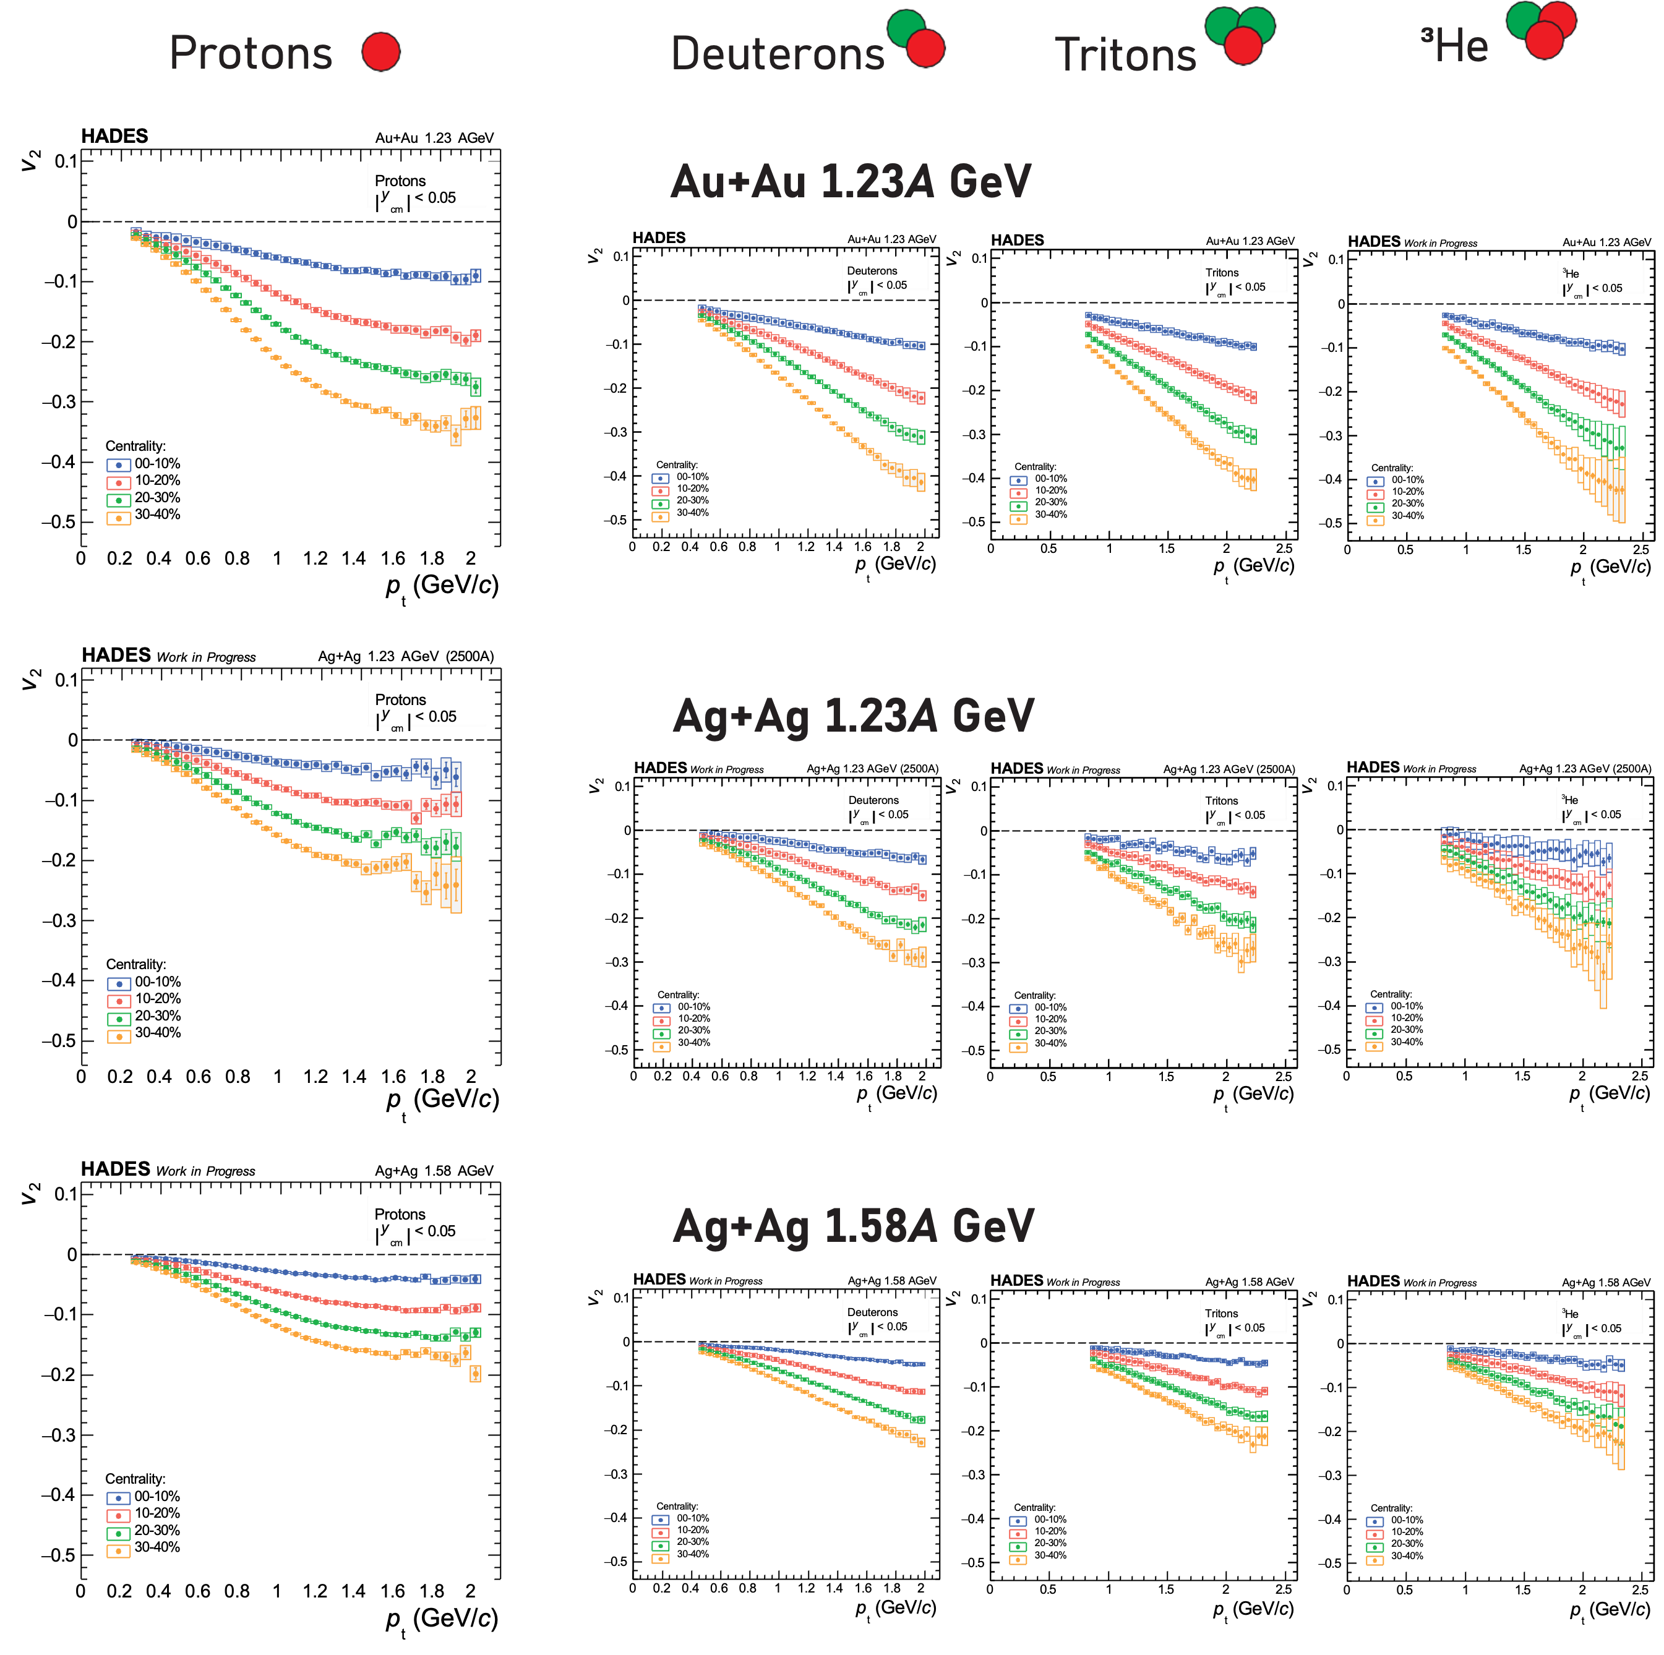
Systematic investigation
Kardan for HADES, QM2025
Excellent statistics allows to investigate the dependence of flow coefficients on
Collision energy
System size
Event centrality
Isospin of a light cluster
Phase space region

Slide 11
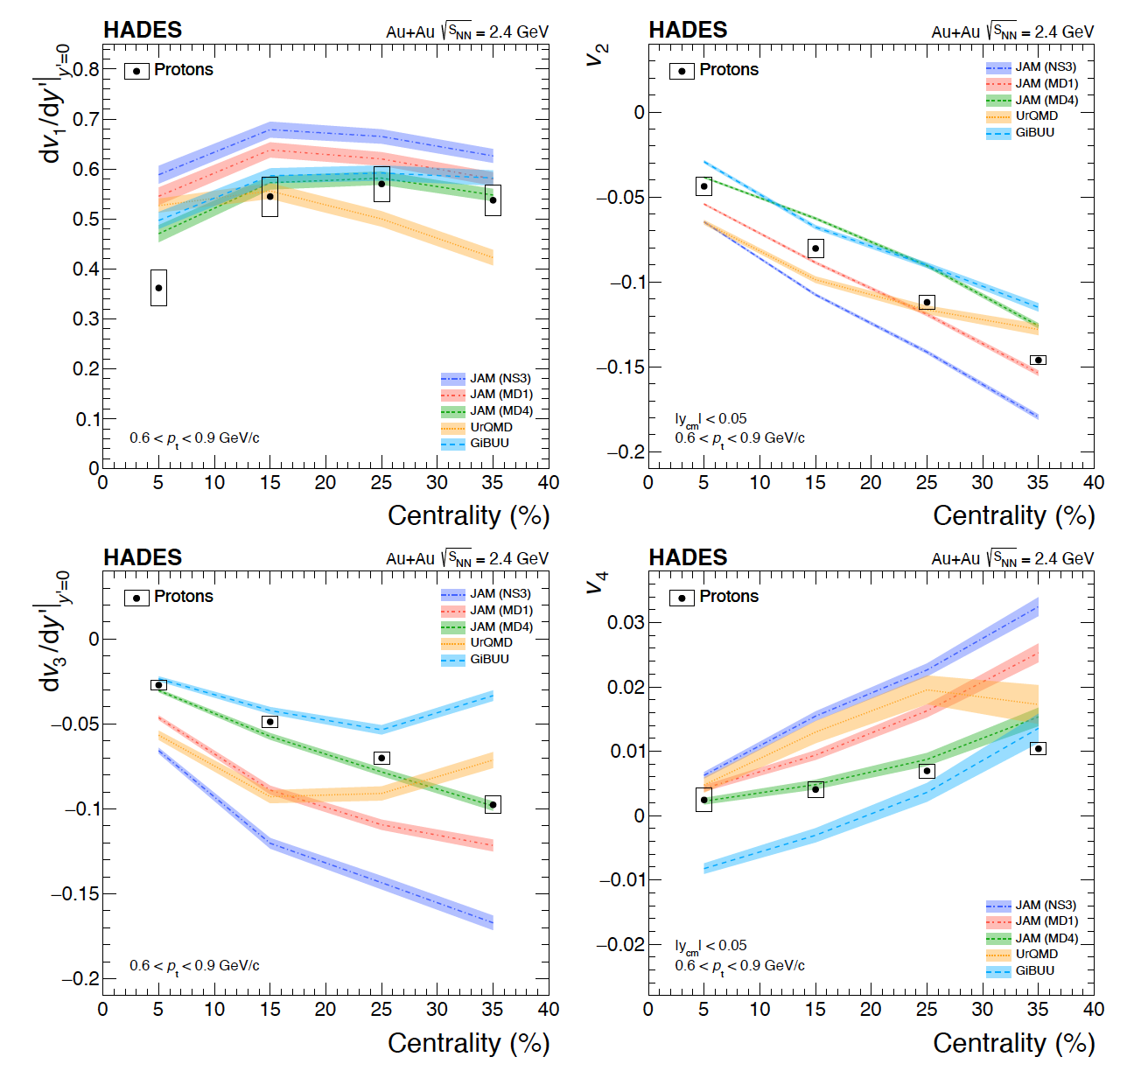
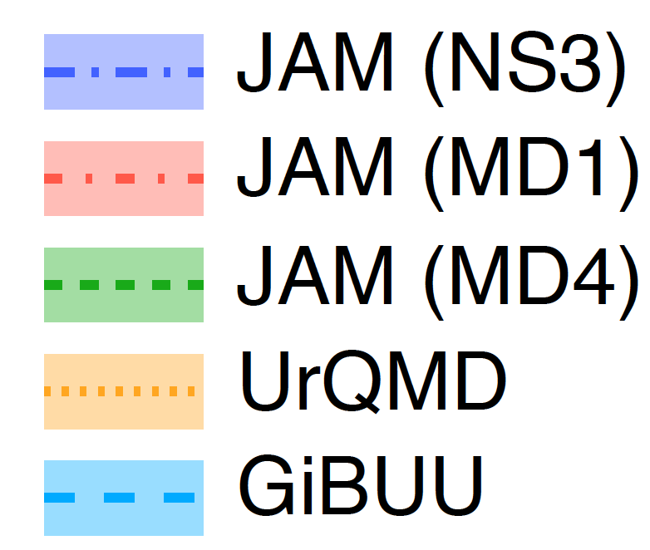
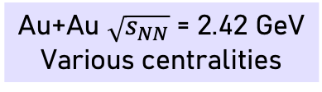
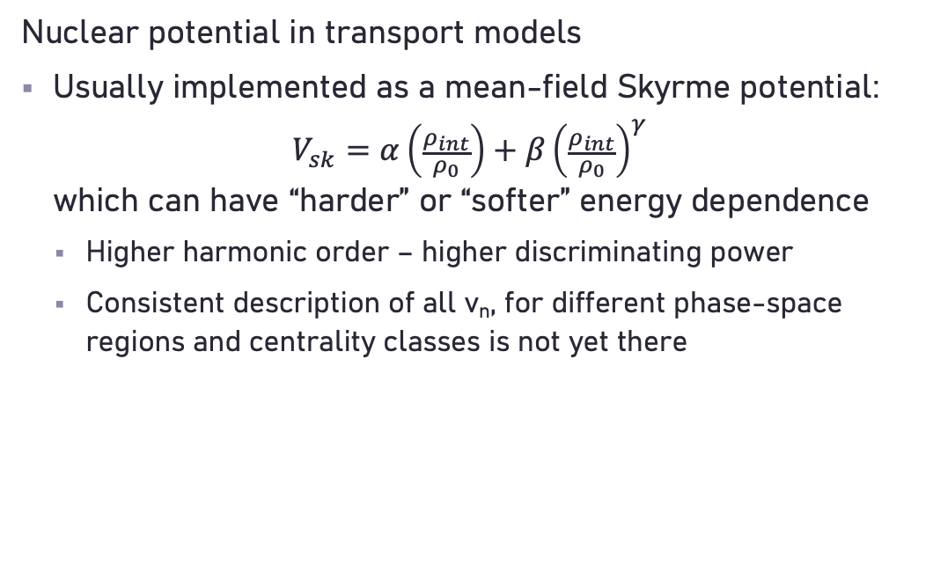
Hadron flow sensitive to the EoS
Au+Au $\sqrt{s_{NN}}$ = 2.42 GeV
Various centralities
Eur. Phys. J. A 59 (2023) 4, 80
hard, momentum-independent
hard, momentum-dependent
soft momentum-dependent
“hard EoS” (UrQMD 3.4)
“soft EoS” (GiBUU 2019, Skyrme 12)
Nuclear potential in transport models
Usually implemented as a mean-field Skyrme potential:
$V_{sk}=α\left(\frac{ρ_{int}}{ρ_{0}}\right)+β{\left(\frac{ρ_{int}}{ρ_{0}}\right)}^{γ}$
which can have “harder” or “softer” energy dependence
  Higher harmonic order – higher discriminating power
  Consistent description of all v_{n}, for different phase-space regions and centrality classes is not yet there

Slide 12
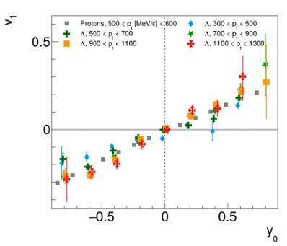
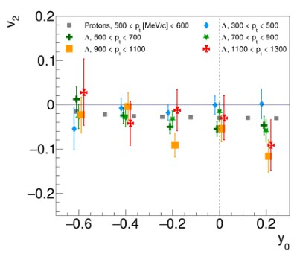
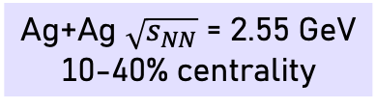
Flow of strange hadrons
Ag+Ag $\sqrt{s_{NN}}$ = 2.55 GeV
10-40% centrality
v₁ and v₂ of Λ and kaons are analyzed
Probe interactions of hadrons with nuclear matter
Possibility to compare with transport model calculations to draw conclusions
Orliński for HADES, QM2025
Ag+Ag 1.58A GeV
HADES Preliminary
Λ
Ag+Ag 1.58A GeV
HADES Preliminary
Λ

Slide 13
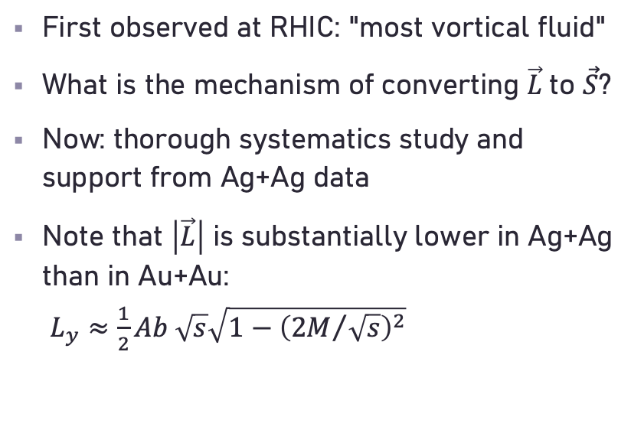
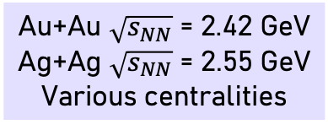
Global spin polarization
Au+Au $\sqrt{s_{NN}}$ = 2.42 GeV
Ag+Ag $\sqrt{s_{NN}}$ = 2.55 GeV
Various centralities
HADES, Phys. Lett. B 835 (2022) 137506
First observed at RHIC: "most vortical fluid"
What is the mechanism of converting $\vec{L}$to $\vec{S}$?
Now: thorough systematics study and support from Ag+Ag data
Note that $\left|\vec{L}\right|$ is substantially lower in Ag+Ag than in Au+Au:
$L_{y}≈\frac{1}{2}Ab \sqrt{s}\sqrt{1−{\left({2M}/{\sqrt{s}}\right)}^{2}}$

Slide 14
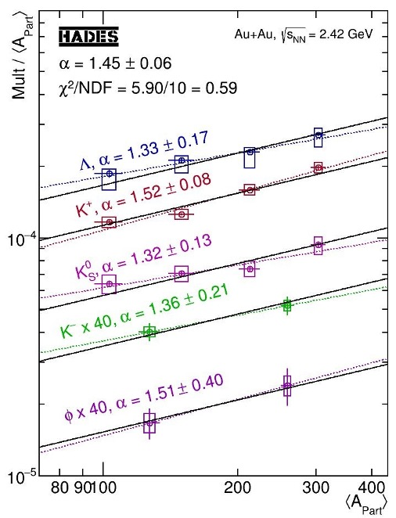
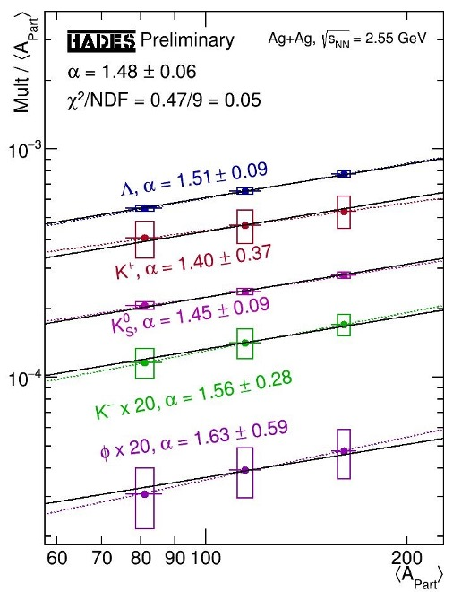
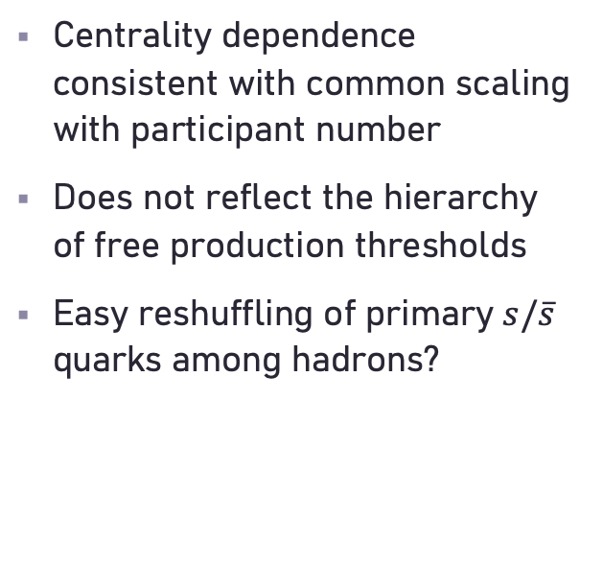
System with Multi-Particle Correlations?
Au+Au $\sqrt{s_{NN}}$ = 2.42 GeV
Ag+Ag $\sqrt{s_{NN}}$ = 2.55 GeV
Various centralities
Au+Au
Ag+Ag
Quantum percolation at ρ ~ 1.8ρ₀
Fukushima et al., Phys. Rev. D 102 (2020) 096017
HADES, Phys. Lett. B 793 (2019) 457
https://www.hepdata.net/record/ins1709767
Kohls for HADES, QM2023
Centrality dependence consistent with common scaling with participant number
Does not reflect the hierarchy of free production thresholds
Easy reshuffling of primary $s/\overline{s}$ quarks among hadrons?

Slide 15
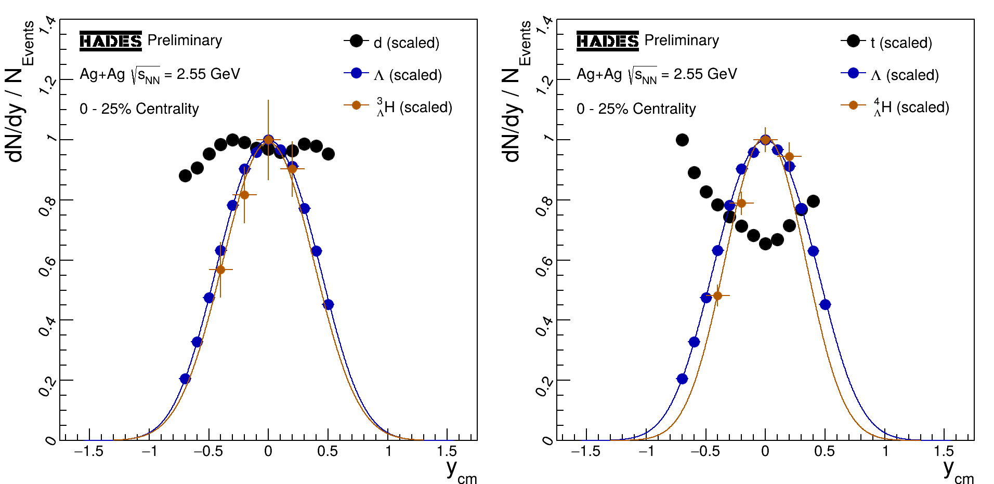
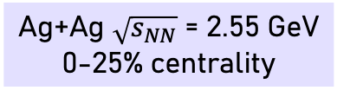
Hypernuclei production
Ag+Ag $\sqrt{s_{NN}}$ = 2.55 GeV
0-25% centrality
Spies for HADES, QM2025
Λ production close to the free NN threshold
Production of hypernuclei:
  Favored by baryon dominance in the fireball
  Limited by hyperon production
Measured rapidity distributions of hypernuclei resemble that of hyperons
  Different from non-strange clusters

Slide 16
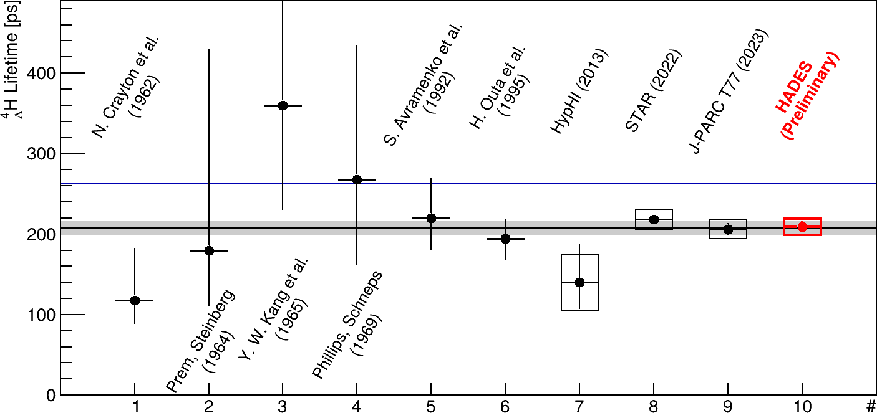
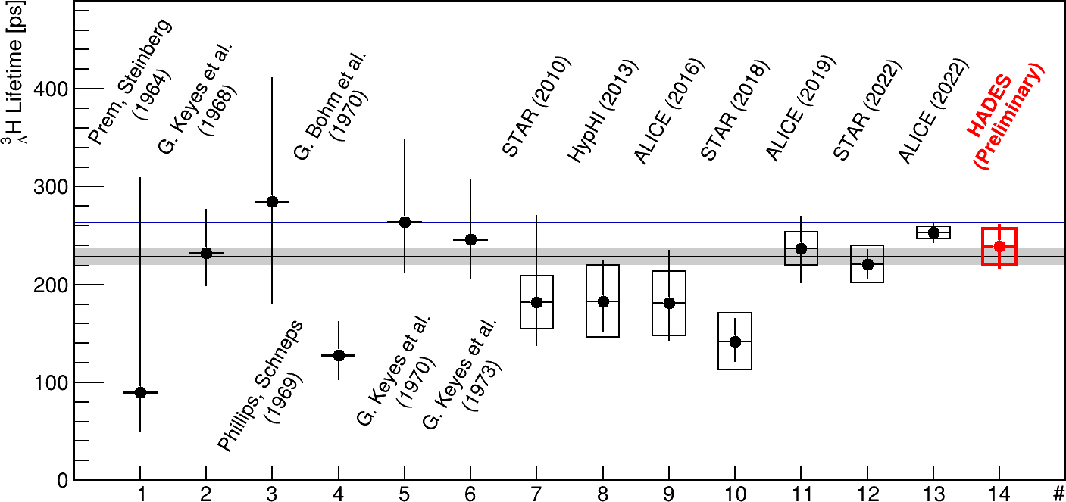
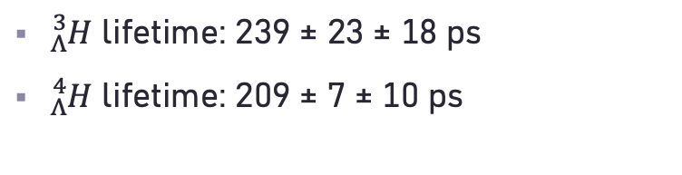
Measurement of hypernuclei lifetime
${}_{Λ}^{3}H$ lifetime: 239 ± 23 ± 18 ps
${}_{Λ}^{4}H$ lifetime: 209 ± 7 ± 10 ps
HADES results consistent with world data
Contribute with high precision
Spies for HADES, QM2025

Slide 17
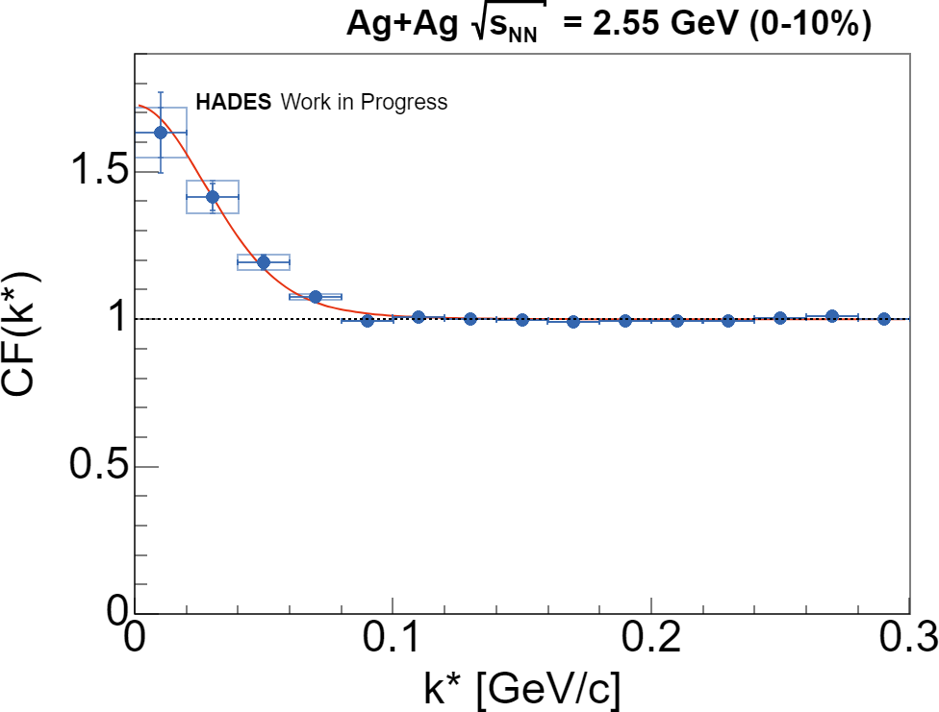
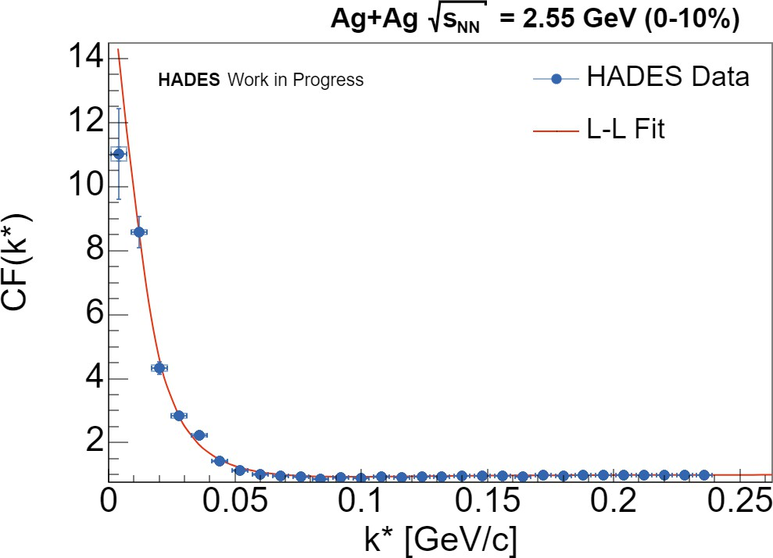
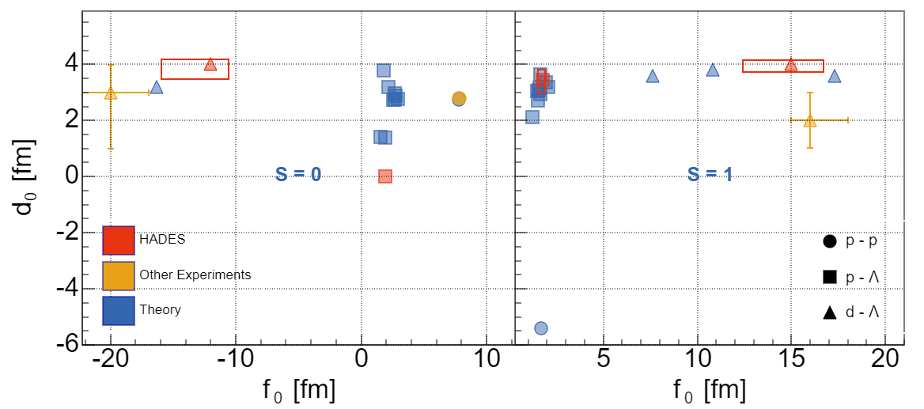
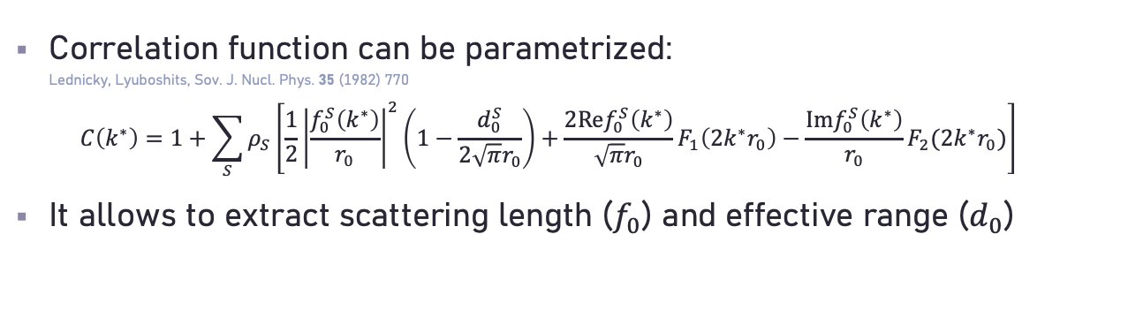
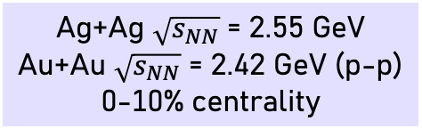
NN and NY interactions
Ag+Ag $\sqrt{s_{NN}}$ = 2.55 GeV
Au+Au $\sqrt{s_{NN}}$ = 2.42 GeV (p-p)
0-10% centrality
ALICE, Phys. Rev. C 99 (2019) 2, 024001
Rijken, Phys. Rev. C 73 (2006) 4, 044007
Green et al., International Conference on the nucleon-nucleon interaction,
University of Florida, Gainesville, March 23 - 25, 1967
Cobis, J.Phys. G 23 (1997) 401
Hammer, Nucl. Phys. A 705 (2002) 173
Alexander, Phys. Rev. 173 (1968) , 1452
Rijken, Prog. Theor. Phys. Suppl. 185 (2010) , 14
Y. Hu, CPOD 2024
Kołaś for HADES, QM2025
Comparing p-p, p-Λ, and d-Λ correlations
d-Λ
p-Λ
Correlation function can be parametrized:
Lednicky, Lyuboshits, Sov. J. Nucl. Phys. 35 (1982) 770
$C\left(k^{∗}\right)=1+\sum_{S}{ρ_{S}\left[\frac{1}{2}{\left|\frac{f_{0}^{S}\left(k^{∗}\right)}{r_{0}}\right|}^{2}\left(1−\frac{d_{0}^{S}}{2\sqrt{π}r_{0}}\right)+\frac{2Ref_{0}^{S}\left(k^{∗}\right)}{\sqrt{π}r_{0}}F_{1}\left(2k^{∗}r_{0}\right)−\frac{Imf_{0}^{S}\left(k^{∗}\right)}{r_{0}}F_{2}(2k^{∗}r_{0})\right]}$
It allows to extract scattering length ($f_{0}$) and effective range ($d_{0}$)
In line with the world data and theory predictions

Slide 18
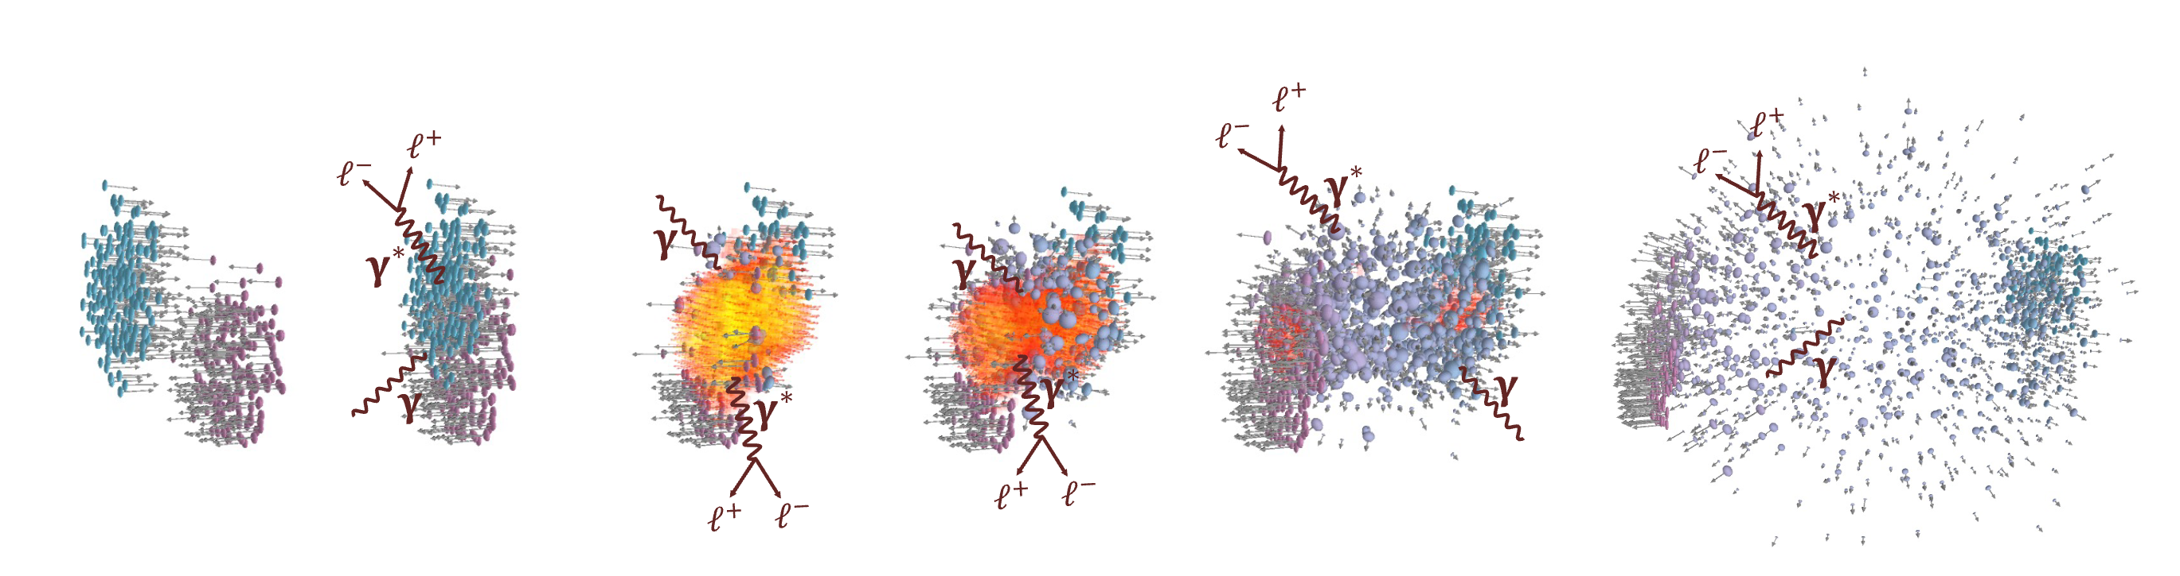
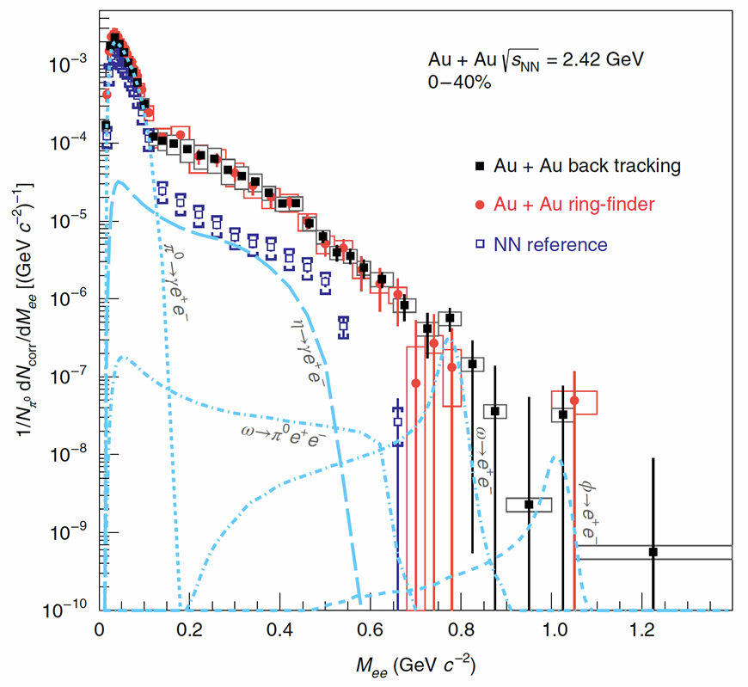
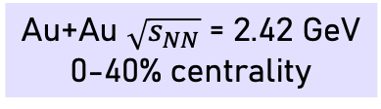
Dileptons
Au+Au $\sqrt{s_{NN}}$ = 2.42 GeV
0-40% centrality
  HADES, Nature Phys. 15 (2019) 1040
Main interest: radiation from hot and dense matter
The early stage is represented by separately measured p-p
and n-p collisions (NN reference)
The late stage is represented by the simulated source of hadrons decaying with dilepton production (freeze-out cocktail: π⁰, η, ω, φ)
Subtracting them gives excess yield
π⁰
η
φ
ω

Slide 19
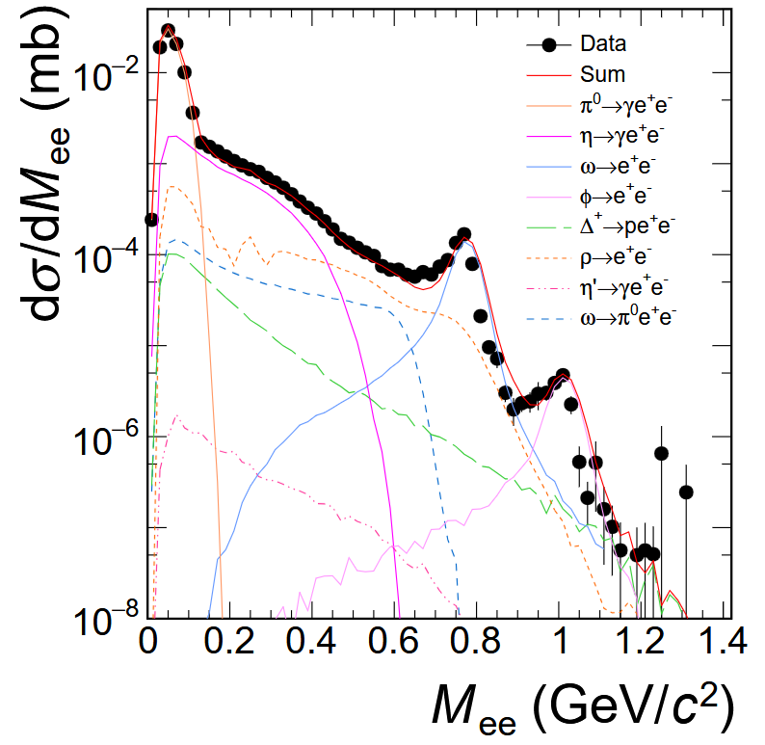

Reference spectra for future heavy-ion measurements
p+p $\sqrt{s}$ = 3.46 GeV
Abou-Yassine, PhD thesis 2024
Constraining existing models:
  Comparison with SMASH
  Cross sections adjusted to better match the data
Ingredients for reconstruction and study of hyperons
Study ρ, a₁, ω, and φ mesons, and baryonic resonances
Data will serve as a baseline for heavy-ion measurements with CBM at FAIR and STAR FXT

Slide 20




Hot and dense medium contribution to dilepton spectra
Au+Au $\sqrt{s_{NN}}$ = 2.42 GeV
0-40% centrality
See talk by Joachim Stroth
  Thermal dilepton production rates
  McLerran and Toimela, Phys. Rev. D 31 (1985) 545
Properly described by in-medium spectral function from many-body calculation
Rapp and Wambach, Adv. Nucl. Phys 25 (2000) 1
  Successful at all collision energies
  At low ones: local thermal equilibrium – coarse graining Galatyuk et al., Eur Phys. J A, 52 (2016) 5, 131
Crucial role of coupling to baryonic resonances
  HADES, Nature Phys. 15 (2019) 1040
Thermal factor
(“Planck-like” radiation)
$$\frac{dN_{ll}}{d^{4}qd^{4}x}=−\frac{α_{em}^{2}}{π^{3}}\frac{L\left(M^{2}\right)}{M^{2}}f^{B}\left(q_{0},T\right)ImΠ_{em}(M,q,T,μ_{B})$$
In-medium ρ spectral function
$$R=Δ, N\left(1520\right), a_{1}, …$$
$$ρ$$
>
>
$$h=N, π, K, …$$

Slide 21


Dilepton azimuthal anisotropy
Ag+Ag $\sqrt{s_{NN}}$ = 2.55 GeV
0-40% centrality
Schild for HADES, QM2025
Low invariant mass dominated by π⁰ Dalitz decays
  Elliptic flow comparable to charged pion results
  Attenuation due to missing momentum of the real photon (?)
At higher invariant mass, v₂ closer to 0
  Dilepton sources didn’t have time to “feel” the squeeze-out
  Early emission

Slide 22





Further constraints to the EoS by dilepton flow
Reichert et al., Phys. Lett. B 841 (2023) 137947
At early stages, pressure gradient is generated
– positive v₂ of the whole system
Only nucleons not hindered by spectator matter can decouple – negative v₂ of emitted particles
Dileptons decouple when they are produced and they might see the positive v₂!

Slide 23




Outlook: dilepton polarization
Ag+Ag $\sqrt{s_{NN}}$ = 2.55 GeV
0-40% centrality
  Angular distribution of $l^{+}l^{−}$ in $γ^{∗}$ rest frame depends on the polarization of $γ^{∗}$:
  $\frac{dN}{d^{4}xd^{4}qdΩ}=𝒩(1+λ_{θ}\cos^{2}{θ}+λ_{φ}\sin^{2}θ\cos{2φ}$
  $+λ_{θφ}\sin{2θ}\cos{φ+ λ_{φ}^{⊥}\sin^{2}θ\sin{2φ}+λ_{θφ}^{⊥}\sin{2θ}\sin{φ})}$
  Distinguish different $γ^{∗}$ production mechanisms
    Connection to the NN reference
  Sensitive to the degree of equilibration
  On-going work to extract coefficients of 2D angular distribution
Seck et al., Phys. Lett. B 861 (2025) 139267

Slide 24


Even lower-energy data:
Feb 2024 + Apr 2025
Au+Au $\sqrt{s_{NN}}$ = 2.24 GeV
See talk by Florian Seck
Au-Au collisions – beam energy scan
from E_{kin} = 0.2A GeV to 0.8A GeV
Main motivation:
  Changes in baryon number fluctuations due to proximity of the critical point of the nuclear liquid-gas phase transition
  Studying limitations of statistical hadronization models
For dileptons: observing disappearance of hot and dense medium?
Currently:
  Calibration of detector subsystems
  Optimizing methods of background removal
Schild for HADES, QM2025
Kim for HADES, QM2025

Slide 25
Single freeze-out scenario
HADES data:
M. Szala, Springer Proc.Phys. 250 (2020) 297-301
EPJA 56 (2020) 10, 259
PLB 778 (2018) 403-407
PLB 793 (2019) 457-463
Validation with non-strange hadrons
π⁺
proton
Fitted parameters:
Parameter | Value
T (MeV) | 70.3
R (fm) | 6.06
μ_{B} (MeV) | 876
H (GeV) | 0.0225
δ | 0.4
“Hubble constant”
of the fireball
Longitudinal eccentricity
in momentum space
SH et al., Phys Rev. C 102 (2020) 5, 054903,
Phys rev. C 107 (2023) 3, 034917

Slide 26



Resonance treatment
Dashen et al., Phys. Rev. 187 (1969) 345
Venugopalan, and Prakash, Nucl. Phys. A 546 (1992) 718
W. Weinhold, and B. Friman, Phys. Lett. B 433 (1998) 236
Lo, Eur. Phys. J. C 77 (2017) no.8, 533
πN phase shift in the P₃₃ channel
Spectral function:
$B_{l}\left(M\right)=2\frac{d}{dM}δ_{l}$
Sensitivity
of hadron spectra
Lo et al., Phys. Rev. C 96, 015207
GW WI08: Workman et al. Phys. Rev. C 86, 035202

Slide 27


Extracting broad signals in experiment
Kornakov and Galatyuk., Eur. Phys. J. A 55 (2019) 11, 204
HADES, Phys. Lett. B 819 (2021) 136421
Unprecedented statistical and systematic precision, allowing for multi-differential analysis

Slide 28

Comparison to thermal model
Kurach, Master’s thesis, Warsaw University of Technology (2024)
Interplay of freeze-out parameters:
  caseA: low T, low μ_{B}, large volume (clusters produced by coalescence, first minimum)
  caseB: high T, high μ_{B}, small volume (clusters produced by coalescence, other minimum)
  caseC: medium T, low μ_{B}, medium volume (clusters produced thermally, unique, but bad, minimum)
Phase shift corresponds to vacuum spectral function
Particle production at the freeze-out only

Slide 29


Adding Kinetic transport model
HADES data: Phys. Lett. B 819 (2021) 136421
Thermal model: Kurach, Master’s thesis
UrQMD: Reichert et al., J. Phys G 46 (2019) 105107
Calculation with public UrQMD version 3.4
If one of the daughter particles rescatters, the shape starts to resemble experimental data
  Dashed line
  Effect still too weak
  In most cases, none of the daughters rescatter
Shape without scattering similar to the thermal model
  Enhancement of thermal model at low mass
  Role of the thermal factor?
  Non-resonant part of the phase shift?
In-medium effects are too small in the kinetic transport.

Slide 30


Hint from dileptons
Possible perspective:
using in-medium Δ spectral function
Collisional broadening and Bremsstrahlung not effective enough in “melting” ρ meson
van Hees and Rapp, Phys. Lett. B 606 (2005) 59-66
Many-body calculation of ρ spectral function + CG (local thermal equilibrium) + thermal dilepton emission rates:
→ Practically structureless spectrum

Slide 31
Summary
HADES studies properties of QCD matter in the region of phase diagram complementary to other heavy-ion experiments
Trends of proton factorial cumulant ratios versus rapidity window are consistent with proper Canonical baseline
Abundant data on anisotropic flow, including light fragments and strangeness, constrains the EoS of hot and dense matter
Hypernuclei and femtoscopy with hyperons allow the study of interactions of strangeness with matter
Thermal dileptons are an important tool to access the hot and dense stage of system’s evolution
HADES dilepton data are consistent with the formation of medium in local equilibrium

Slide 32
Thank you for your attention

Slide 33
Backup slides

Slide 34


Baryons as extended objects
Exclusive analysis of π⁻p → n e⁺e⁻ at $\sqrt{s}$ = 1.49 GeV
π⁻p $\sqrt{s}$ = 1.49 GeV
Ratios to the case with the point-like form factor (”QED”)
Rising with the dilepton invariant mass
Vector Meson Dominance:
  VMD2 has $Γ=Γ_{0}{\left(\frac{M_{0}}{M_{ee}}\right)}^{2}$ and overshoots the data at low $M_{ee}$
  VMD1 has $Γ=Γ_{0}\frac{M_{ee}}{M_{0}}$ and leaves room for a contribution of direct $N−γ^{∗}$ coupling
  Therefore the “strict VMD” is excluded
Data: arXiv:2205.15914 [nucl-ex]
Zétényi: PRC 104, 015201 (2021)
Ramalho: PRD 95, 014003 (2017), PRD 101, 114008 (2020)

Slide 35




Contributing to energy and system-size dependence
Ag+Ag $\sqrt{s_{NN}}$ = 2.42 GeV
Ag+Ag $\sqrt{s_{NN}}$ = 2.55 GeV
0-40% centrality
Ag+Ag at $\sqrt{s_{NN}}=2.55$ GeV
Vector mesons peaks (ω, φ) visible
Possibility to study cross-sections and in-medium modifications of the spectral shape
First measurement of the yield above vector meson masses (“Intermediate Mass Region”)
Ag+Ag at $\sqrt{s_{NN}}=$ 2.42 GeV
Comparison with Au+Au at the same energy
Schild for HADES, QM2025
Vogel, QM2025

Slide 36



Outlook: extracting electrical conductivity
Ag+Ag $\sqrt{s_{NN}}$ = 2.42 GeV
0-40% centrality
HADES data – accepance coverage with default and reduced
magnetic field settings
Related to the spectral function:
$σ_{el}\left(T\right)=−e^{2}\lim_{q_{0}→0}{\frac{δ}{δq_{0}}ImΠ_{em}\left(q_{0},q=0;T\right)}$
where:
McLerran, Toimela, Phys. Rev. D 31 (1985) 545
$\frac{dN_{ll}}{d^{4}qd^{4}x}=−\frac{α_{em}^{2}}{π^{3}}\frac{L\left(M^{2}\right)}{M^{2}}f^{B}\left(q_{0},T\right)ImΠ_{em}(M,q;T)$
Studies at different T are complementary
Compare:
  Measured excess yield at low M_{ee}, p_{t,ee}
  Dilepton rate predicted using an appropriate
  in-medium spectral function
Udrea for HADES, QM2025
Spectral function
  Greif, Greiner, Denicol, Phys. Rev. D 93 (2016) 096012
  Atchison, Rapp, J. Phys. Conf. Ser. 832 (2017) 012057

Slide 37
Decoding the QCD phase structure with dileptons
  Seck et al., Phys. Rev. C 106 (2022) 014904
Calculations with kinetic transport and hydro
Hydro with CMF EoS, parameters set to have or not have a 1st order phase transiton
Phase transition causes a clear increase in dilepton yield
Higher statistics of experimental data would be needed

Slide 38

Lifetime of the fireball
  Galatyuk, JPS Conf. Proc. 32 (2020) 010079
Thermal radiation is emitted during the whole lifetime of the system
The integrated yield in 0.3 < M_{ee} / (GeV/c²) < 0.7 is the most sensitive to measure the lifetime
Heinz and Lee, Phys. Lett. B 259 (1991) 162
Barz, Friman, Knoll and Schulz, Phys. Lett. B 254 (1991) 315
Rapp, van Hees, Phys. Lett. B 753 (2016) 586
At a phase transition “production” of the latent heat would increase the lifetime

Slide 39

Drawing the QCD “caloric curve”
  Rapp and v. Hess, Phys. Lett. B 753 (2016) 586
  Galatyuk et al., Eur. Phys. J. A 52 (2016) 131
  https://github.com/tgalatyuk/QCD_caloric_curve
Temperature vs. energy density (collision energy as a proxy)
Up to now, only published data from HADES and NA60
Phase transition may manifest itself as a plateau
Nuclear liquid-gas
phase transition
Pochodzalla et al., Phys. Rev. Lett. 75 (1995) 1040-1043

Slide 40

Single freeze-out scenario
W. Broniowski and W. Florkowski, PRL 87 (2001) 272302
Chemical (= particle abundances fixed) and kinetic (= particle momenta fixed) freeze-outs coincide
Hadron yields are given by the integrals of hadron spectra
Feed-down from resonance decays included
Implemented in the event generator Therminator 2
Successful at RHIC, does it work at SIS18 energies?

Slide 41
Implementation at HADES
Ingredients of the method:
Fix parameters with particle multiplicity ratios:
  Six equations for six parameters:
M. Chojnacki et al., Comput. Phys. Comm. 103 (2012) 746-773
SH, W. Florkowski, T. Galatyuk et al., PRC 102 (2020) 5, 054903
SH, W. Florkowski, T. Galatyuk et al., PRC 107 (2023) 3, 034917
protons (incl. those bound in light nuclei): 124.1
π⁺: 9.3
π⁻: 17.1
K⁺: 0.0598
K⁻: 0.00056
Λ: 0.0822
T μ_{B} μ_{I3} μ_{S} γ_{S} R
H in Hubble-like expansion v = tanh(Hr)
δ - eccentricity parameter for the spheroid
in the momentum space
m_{T} spectra of p and π in five rapidity bins
Femtoscopic radii
ε - eccentricity parameter for the spheroid
in the position space

