Slide 1
Many-body theory for nuclear response functions and nuclear matter
Francesco Marino
Institut für Kernphysik and PRISMA+ Cluster of Excellence,
Johannes Gutenberg-Universität Mainz
Next generation ab initio nuclear theory
ECT*, Trento, Italy

Slide 2
Outline
Structure and dipole response of open-shell nuclei from coupled-cluster theory
Infinite nuclear matter from the Self-consistent Green’s functions approach

Slide 3
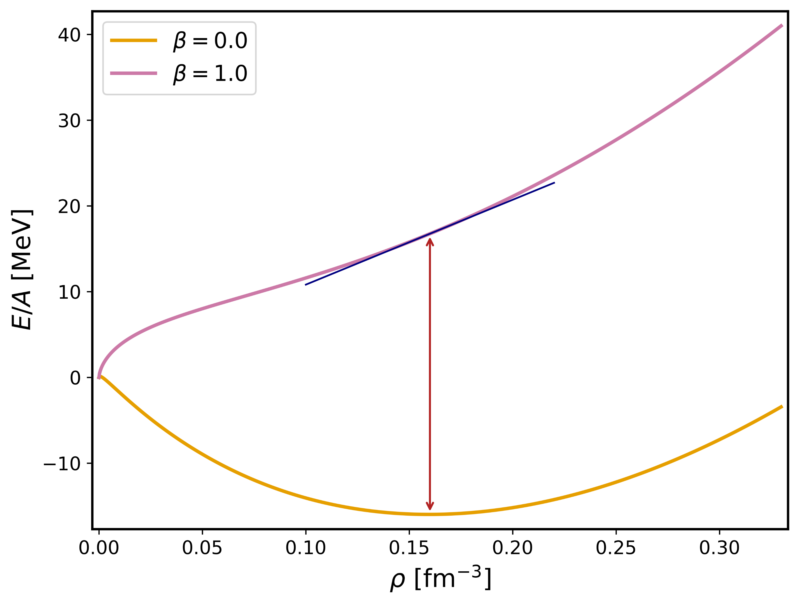
Nuclear matter equation of state
$$\frac{E}{A}\left(ρ,β\right)=\frac{E}{A}\left(ρ,0\right)+S\left(ρ\right)β^{2}+O(β^{4})$$
$$ρ=ρ_{n}+ρ_{p}$$
$$β=\frac{ρ_{n}−ρ_{p}}{ρ}$$
Symmetry energy
L
$$S\left(ρ\right)=J + \frac{ρ−ρ_{0}}{3ρ_{0}}L$$
$$ρ_{0}=0.16 fm^{−3 }$$
J
J: symmetry energy at saturation density
L: slope parameter

Slide 4
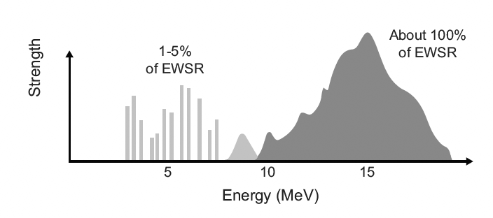
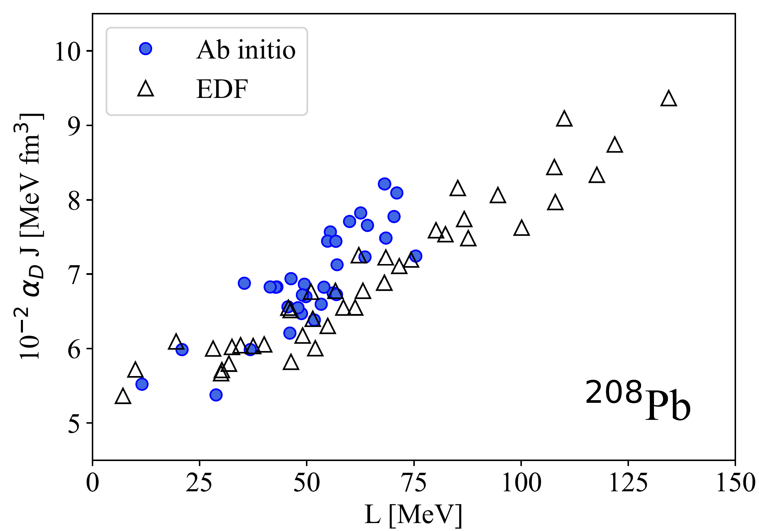
How to constrain L?
Electric dipole response
Electric dipole polarizability
$$α_{D}=2α\int{dω\frac{R(ω)}{ω}}$$
Excited bound
states
Giant Dipole
Resonance
Pygmy Dipole
Resonance
Courtesy: Francesca Bonaiti
Strong linear correlation between $α_{D}$ and the slope of the symmetry energy L

Slide 5
Part 1:
Structure and dipole response of open-shell nuclei

Slide 6
Coupled-cluster theory
Coupled-cluster (CC) ground-state
$$\left|Ψ_{0}\right\rangle =e^{T}|Φ_{0}⟩$$
$$|Φ_{0}⟩$$
Reference state
CCSDT-1: approximate triples
$$T≈T_{1}+T_{2}+T_{3}+…$$
n-particle n-hole amplitudes
CCSD
$$|Ψ_{0}⟩=$$
$$+$$
$$+$$
$$|Φ_{0}⟩$$
$1p1h$ excitations
$2p2h$ excitations
Hagen et al., Rep. Prog. Phys. 77, 096302 (2014)

Slide 7
Open-shell nuclei in coupled-cluster theory
Pairing
Deformation
Symmetry-breaking approaches
Bogoliubov CC
Deformed CC
Equations-of-motion
Tichai et al., Phys. Lett. B 851, 138571 (2024)
Hagen et al., Phys. Rev. C 105, 064311 (2022)
Closed-shell
$$\left|Ψ_{0}\right\rangle =e^{T}|Φ_{0}⟩$$
Excitation operator
Two-particle-removed (2PR) nucleus
$$|Ψ_{f}^{\left(A−2\right)}⟩=R_{f}^{(A−2)}\left|Ψ_{0}\right\rangle$$

Slide 8
Two-particle-removed coupled-cluster
$$R_{f}^{(A−2)}$$
See also
Two-particle-attached (2PA)
Two-hole
One-particle three-hole
Jansen, Phys. Rev. C 88, 024305 (2013)
Bonaiti et al., PRC 110, 044306 (2024)
$$\frac{1}{2}\sum_{ij}{r_{ij}c_{j}c_{i}}$$
$$\frac{1}{6}\sum_{ijka}{r_{ijk}^{a}}c_{a}^{†}c_{k}c_{j}c_{i}$$
$$R_{f}^{(A−2)}=$$
$$+$$
FM et al., arxiv:2504.11012 [PRC in press]

Slide 9
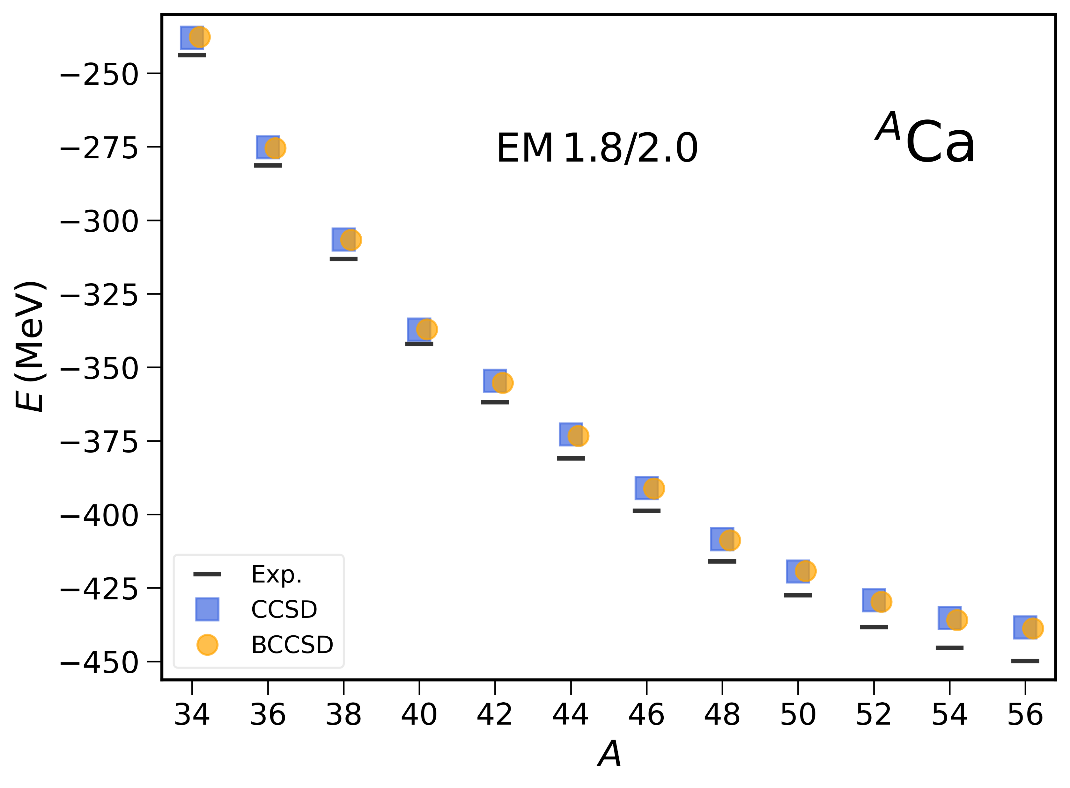
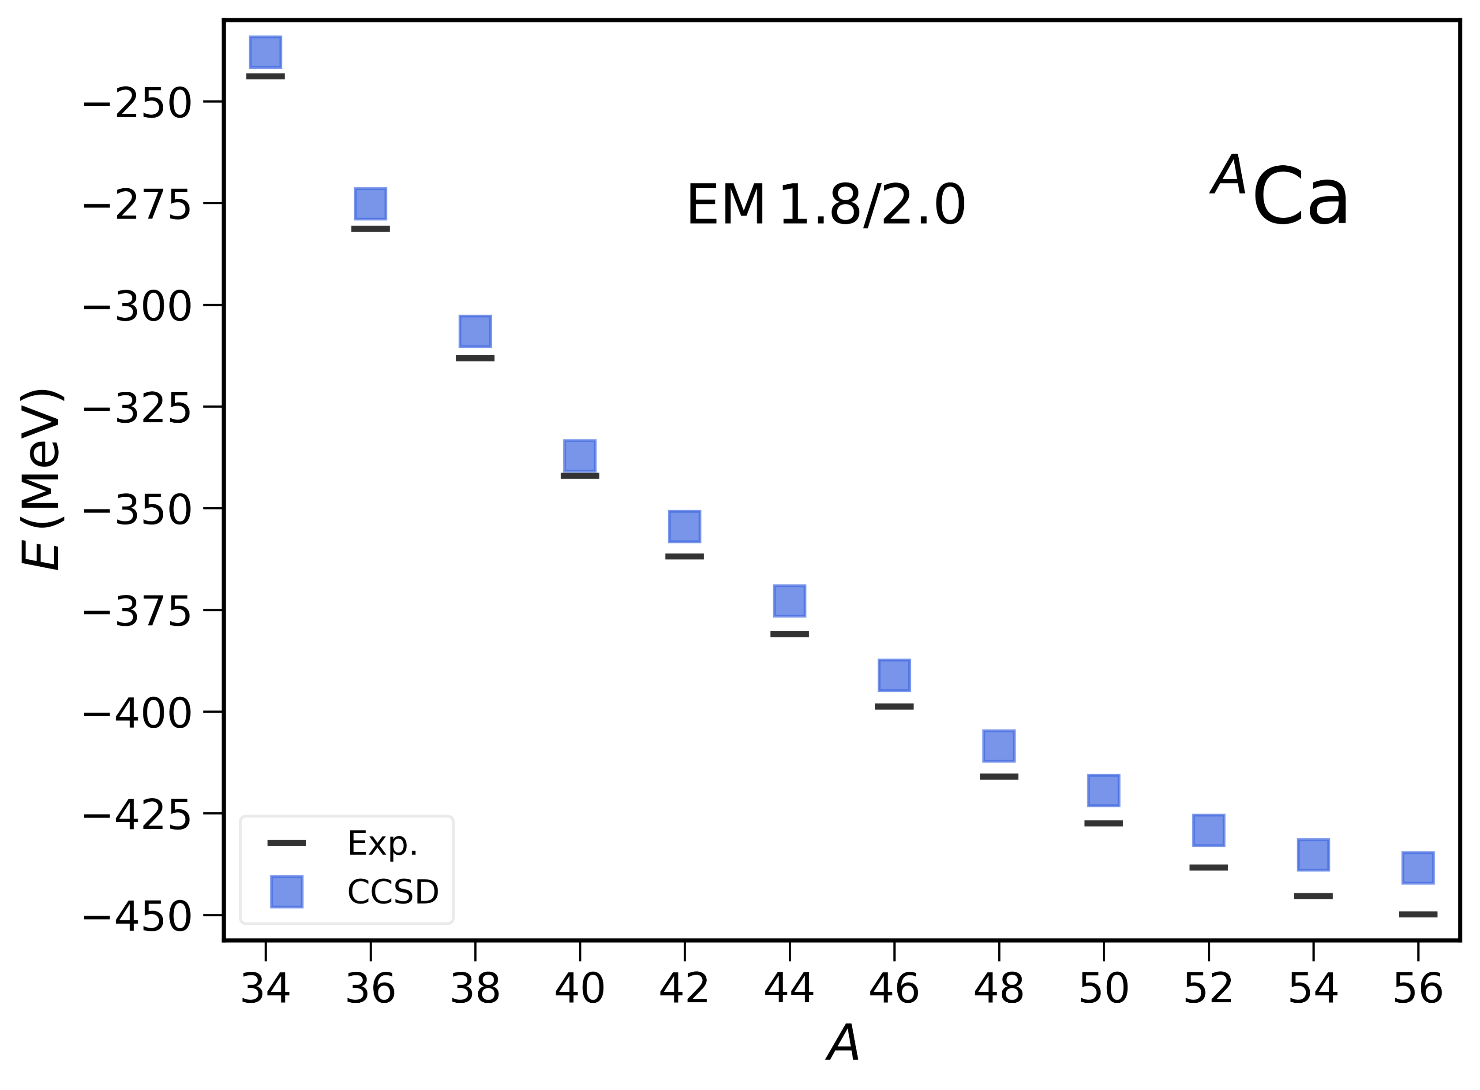
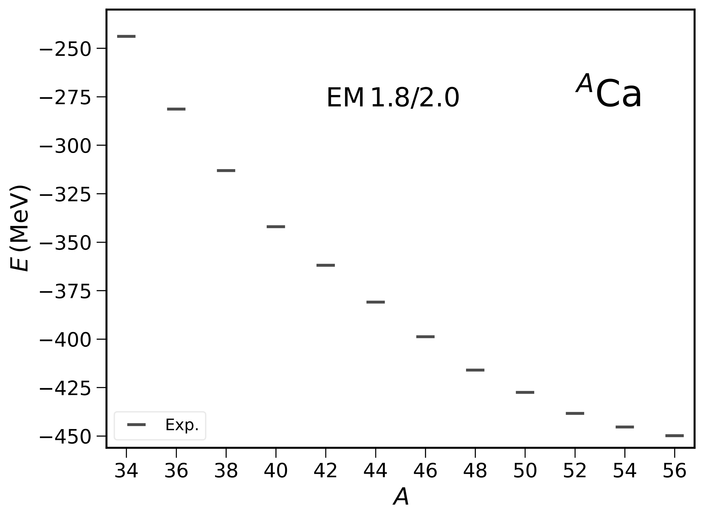
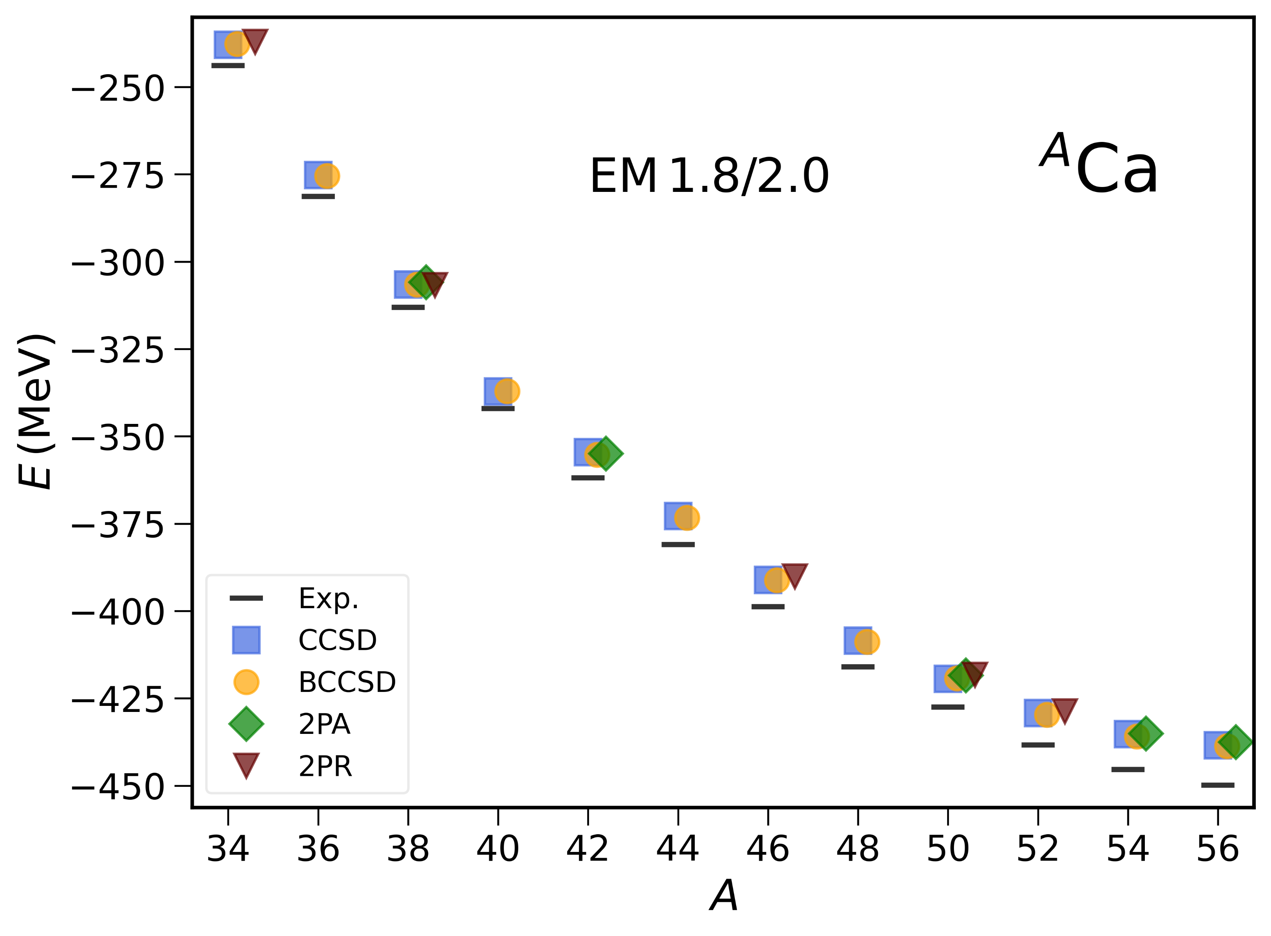
Binding energies - validation
FM et al., EPJ Web Conf. 324, 00021 (2025)
Experiment
Excellent agreement between CC variants at doubles level
Deformed CC
Bogoliubov CC
2PA
2PR

Slide 10
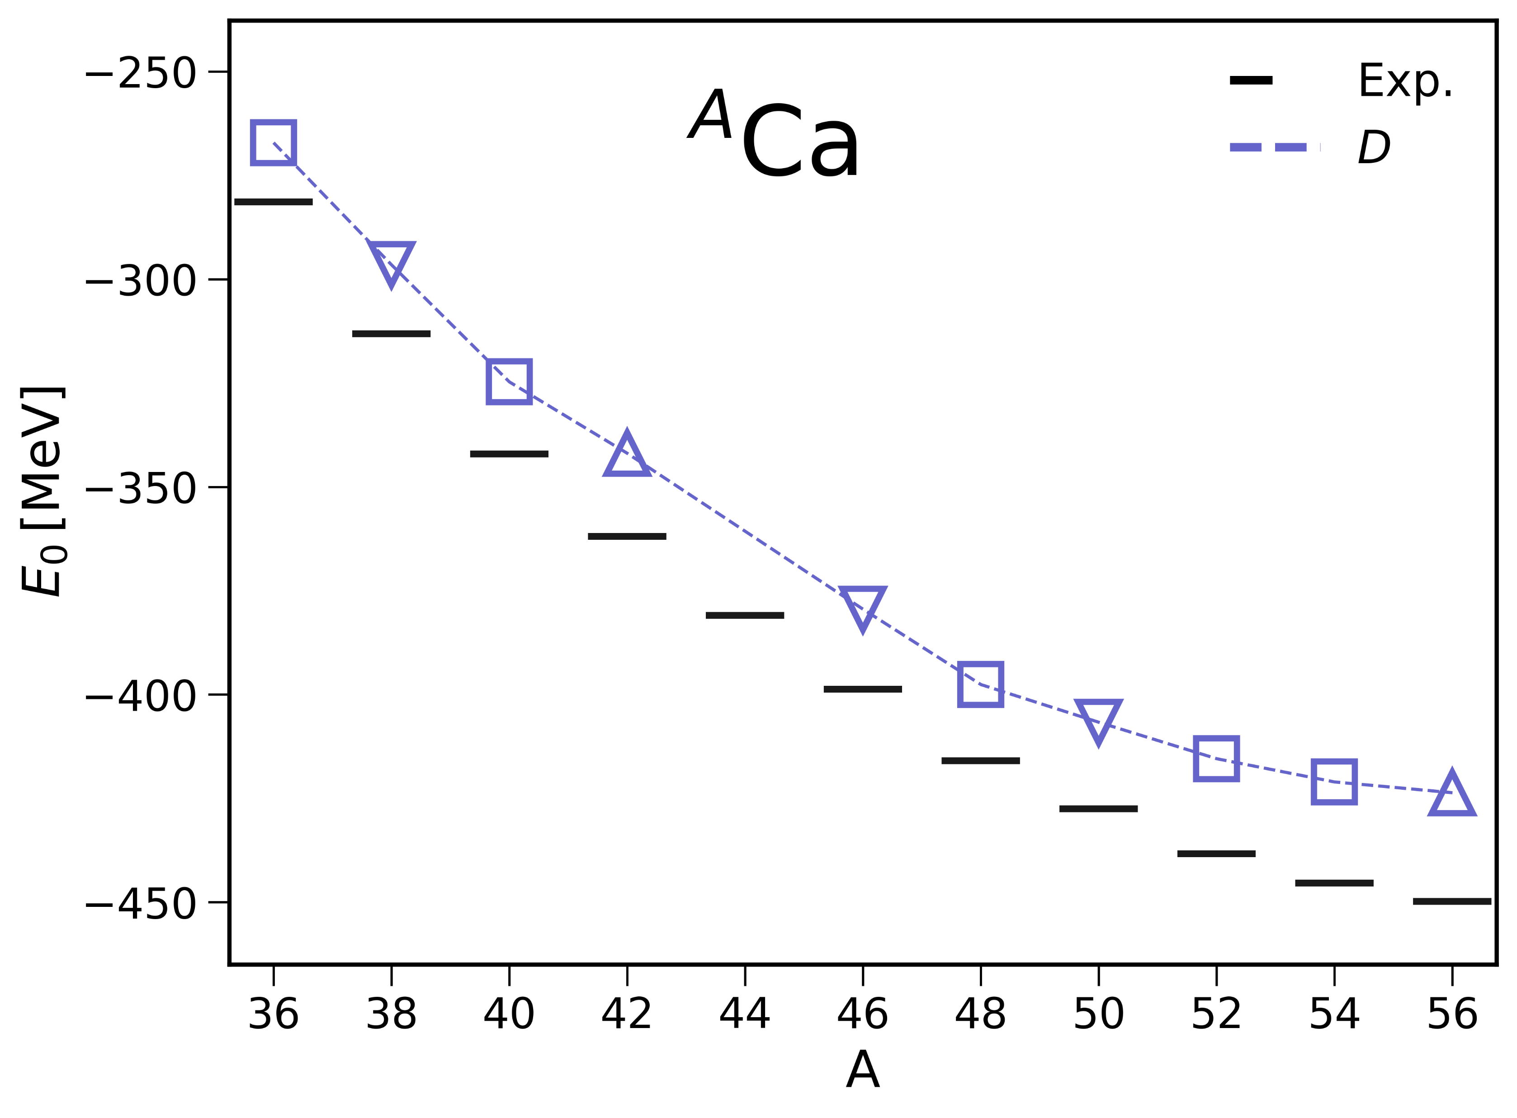
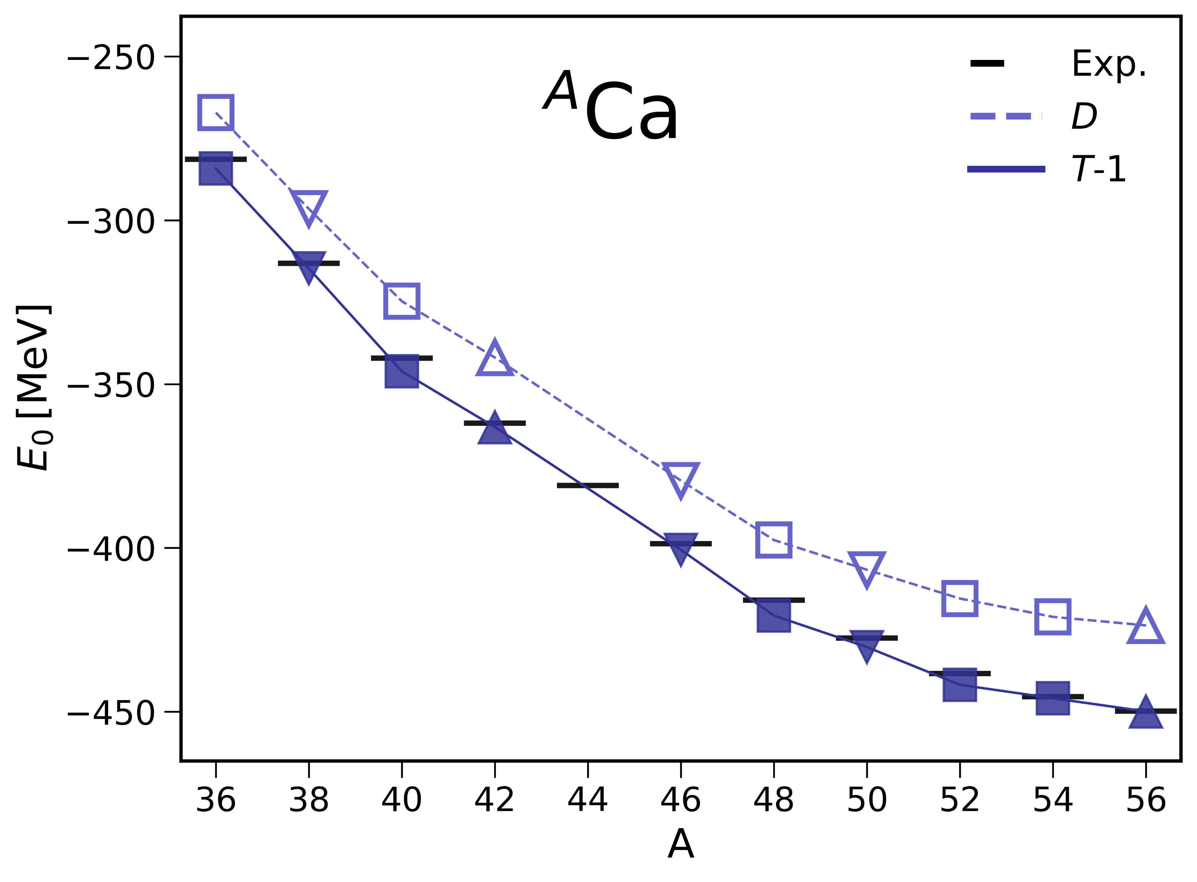
Binding energies in the Ca chain
ΔNNLO_{GO} (394)
Closed-shell
$$\left|Ψ_{0}\right\rangle$$
Open-shell
$$|Ψ_{f}^{\left(A±2\right)}⟩=R\left|Ψ_{0}\right\rangle$$
FM et al., arxiv:2504.11012
Experiment
$\left|Ψ_{0}\right\rangle$ at CCSD level
$\left|Ψ_{0}\right\rangle$ with triples

Slide 11
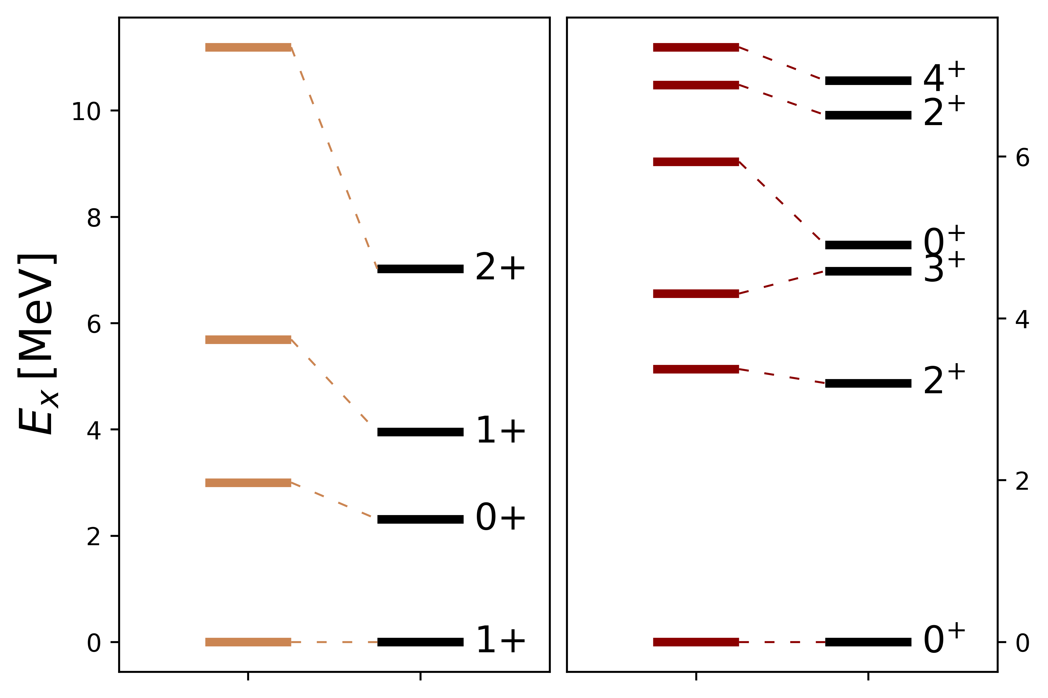
Excited states
¹⁴N
²²O
FM et al., arxiv:2504.11012
2PR
Exp.
2PR with the ΔNNLO_{GO} (394) interaction describes well several excited states

Slide 12
Nuclear response functions
$$R\left(ω\right)=\sum_{f}{{\left|\left\langle Ψ_{f}\left|Θ\right|Ψ_{0}\right\rangle \right|}^{2}δ(E_{f}−E_{0}−ω)}$$
$Θ$: excitation operator
Continuum
Lorentz integral transform (LIT)
$$L\left(σ,Γ\right)=\frac{Γ}{π}\int{dω\frac{R(ω)}{{\left(ω−σ\right)}^{2}+Γ^{2}}=\frac{Γ}{π}⟨{\tilde{Ψ}}_{L}|{\tilde{Ψ}}_{R}⟩ }$$
Bound pseudo-state$|{\tilde{Ψ}}_{R}⟩$
Bacca et al, Phys. Rev. Lett. 111, 122502 (2013)
LIT-CC ansatz
$$\left|{\tilde{Ψ}}_{R}^{(A−2)}\right\rangle =ℛ^{\left(A−2\right)}|Φ_{0}⟩$$

Slide 13
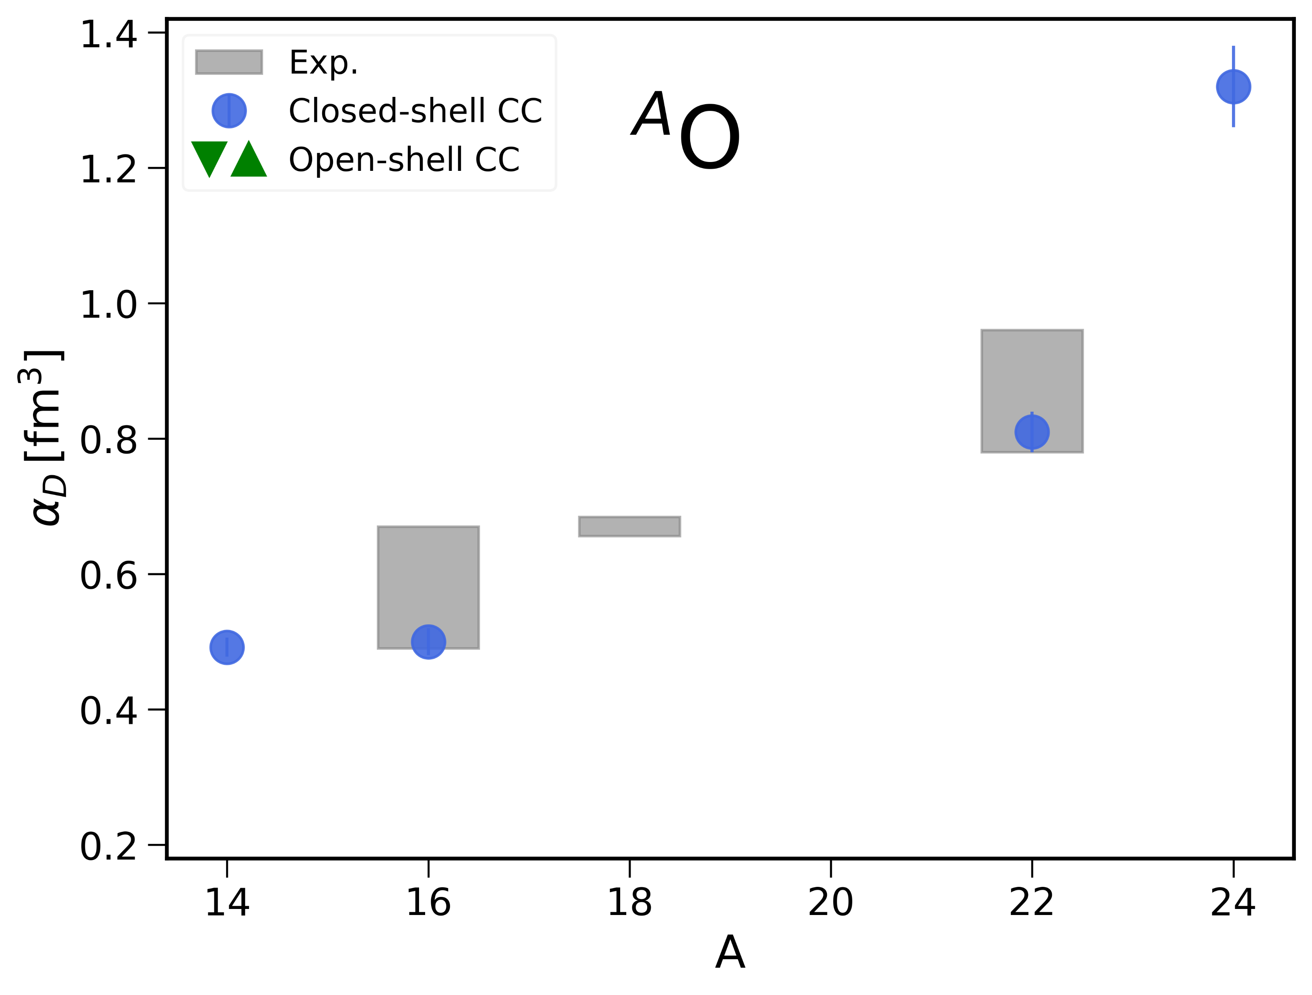
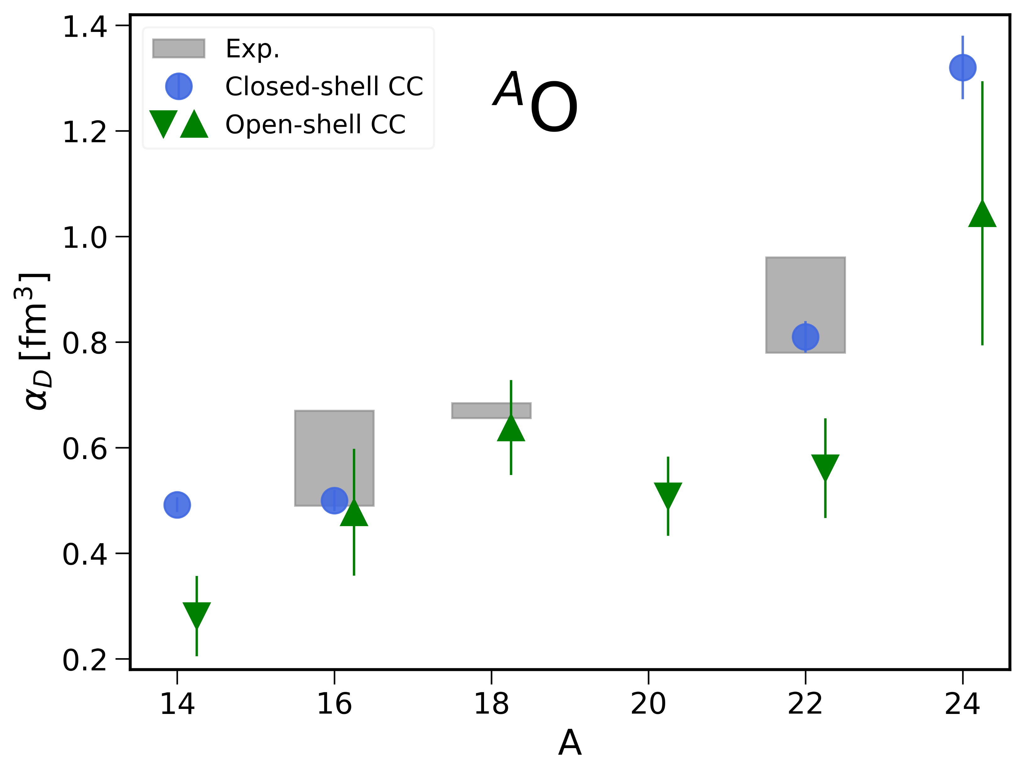
Electric dipole polarizability in O isotopes
Experiment
Closed-shell CC
FM et al., arxiv:2504.11012
2PA
2PR
ΔNNLO_{GO} (394)

Slide 14
Inverting the LIT
Problem: Determine the response function $R(ω)$ from the LIT
$$L(σ,Γ)$$
$$R(ω)$$
Ill-posed!
$$\tilde{R}\left(ω\right)=\sum_{n=1}^{ν}{c_{n}f_{n}\left(ω;α,β\right)}$$
$${f_{n}\left(ω;α,β\right)=ω}^{α}e^{−\frac{ω}{nβ}}$$
Uncertainties on $R\left(ω\right)$ from varying the number of basis states ν and width Γ

Slide 15
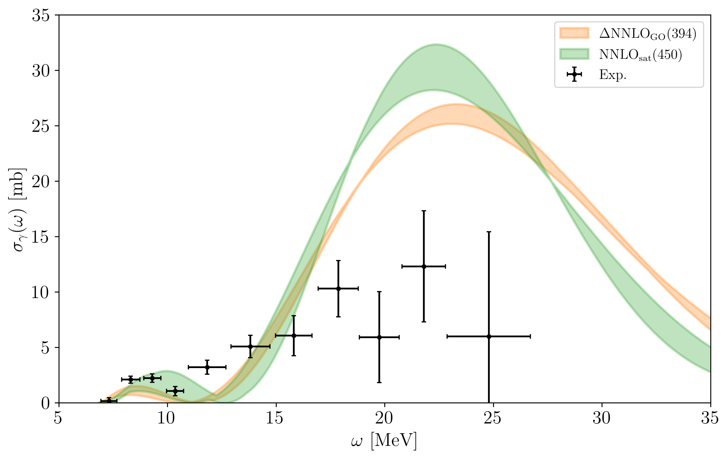
Photoneutron cross sections
Preliminary
$$σ_{γ}\left(ω\right)=4π^{2}αωR\left(ω\right)$$
²²O
Cross sections with quantified uncertainties from the inversion of the LIT
Exp. data from
Leistenschneider et al,
Phys. Rev. Lett. 86, 5442 (2001)
Credit: Miriam El Batchy

Slide 16
Part 2:
Green’s functions for infinite nuclear matter

Slide 17
Self-consistent Green’s functions
$$g\left(ω\right)=g^{\left(0\right)}\left(ω\right)+g^{\left(0\right)}\left(ω\right)Σ^{⋆}(ω)g(ω)$$
One-body propagator
Self-energy
Total energy
One-body observables
Normal self-energy
Pairing field
$$Σ^{⋆}\left(ω\right)=\left(\begin{matrix}Σ^{11}\left(ω\right) & Δ \\ Δ^{∗} & Σ^{22}\left(ω\right)\end{matrix}\right)$$
Gorkov superfluid formulation
Somà et al., Phys. Rev. C 84, 064317 (2011)
Barbieri et al., Phys. Rev. C 105, 044330 (2022)

Slide 18
Algebraic diagrammatic construction
$$Σ^{11}\left(ω\right)=Σ^{11(∞)} + \tilde{Σ}(ω)$$
Self-consistent GF
$$Σ^{⋆}=Σ^{⋆}\left[g\left(ω\right)\right]$$
Static self-energy
Dynamical self-energy
ADC(2)
ADC(3)
Algebraic diagrammatic construction (ADC)
ADC(3) includes third-order perturbation theory, ladders, rings…
Ladder
Ring
Raimondi et al., Phys Rev C 97, 054308 (2018)
Barbieri et al., Phys. Rev. C 105, 044330 (2022)

Slide 19
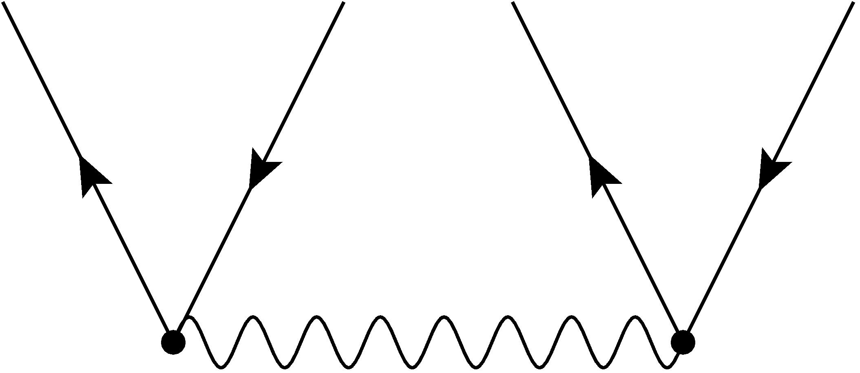
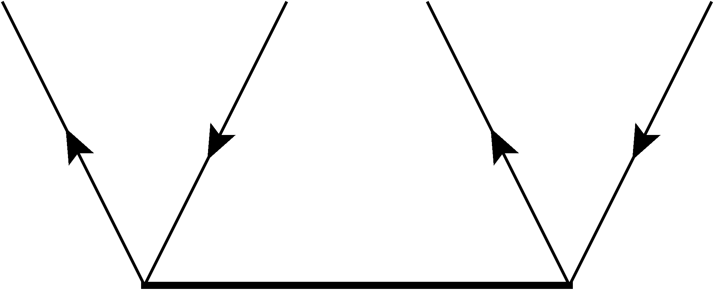
Combining ADC and coupled-cluster
Extension of ADC(3)
ADC(3)-D
$${(t^{\left(0\right)})}_{ij}^{ab }=\frac{ {\left\langle ab\left|v\right|ij\right\rangle }_{A}}{ε_{i}+ε_{j}−ε_{a}−ε_{b}}$$
In $\tilde{Σ}(ω)$, replace $t^{(0)}$ with converged $T_{2}$ amplitudes
$$t^{\left(0\right)}$$
$$t^{\left(CCD\right)}$$
Barbieri et al., Lect. Notes Phys. 936, 571 (2017)
FM, C. Barbieri, and G. Colò, to be submitted

Slide 20
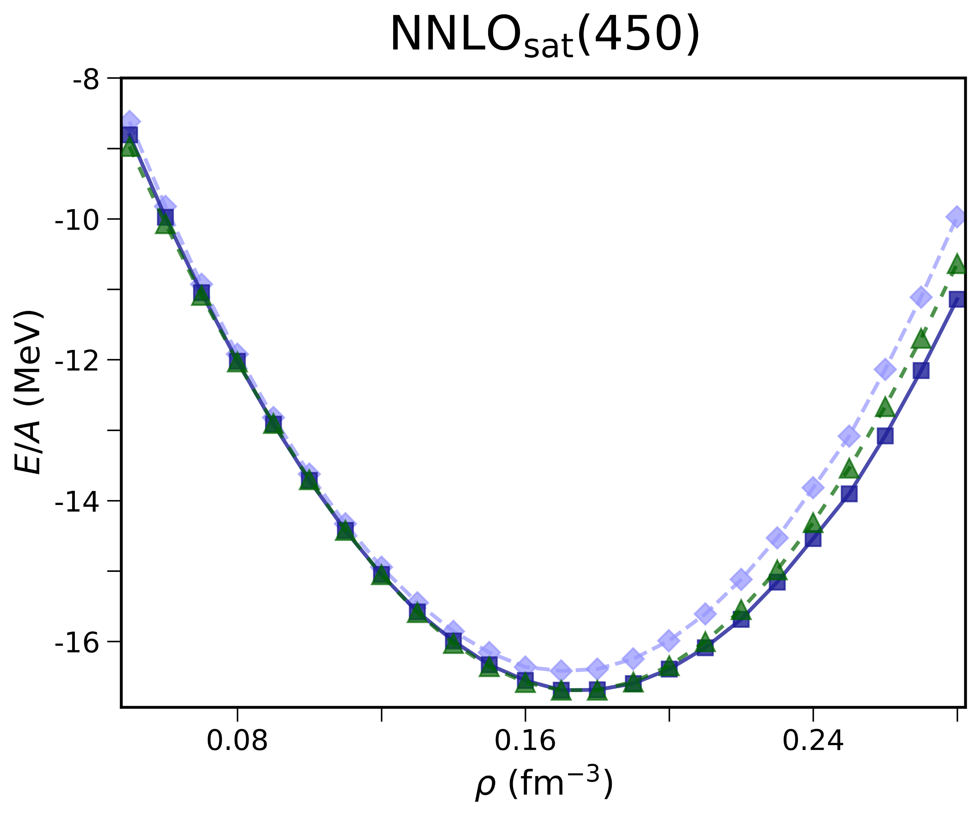
Equation of state
FM, W. Jiang and S. Novario, Phys. Rev. C 110, 054322 (2024)
Symmetric nuclear matter
ADC(3)
ADC(3)-D
CCD(T)
Many-body uncertainties on the nuclear matter EOS are well under control

Slide 21
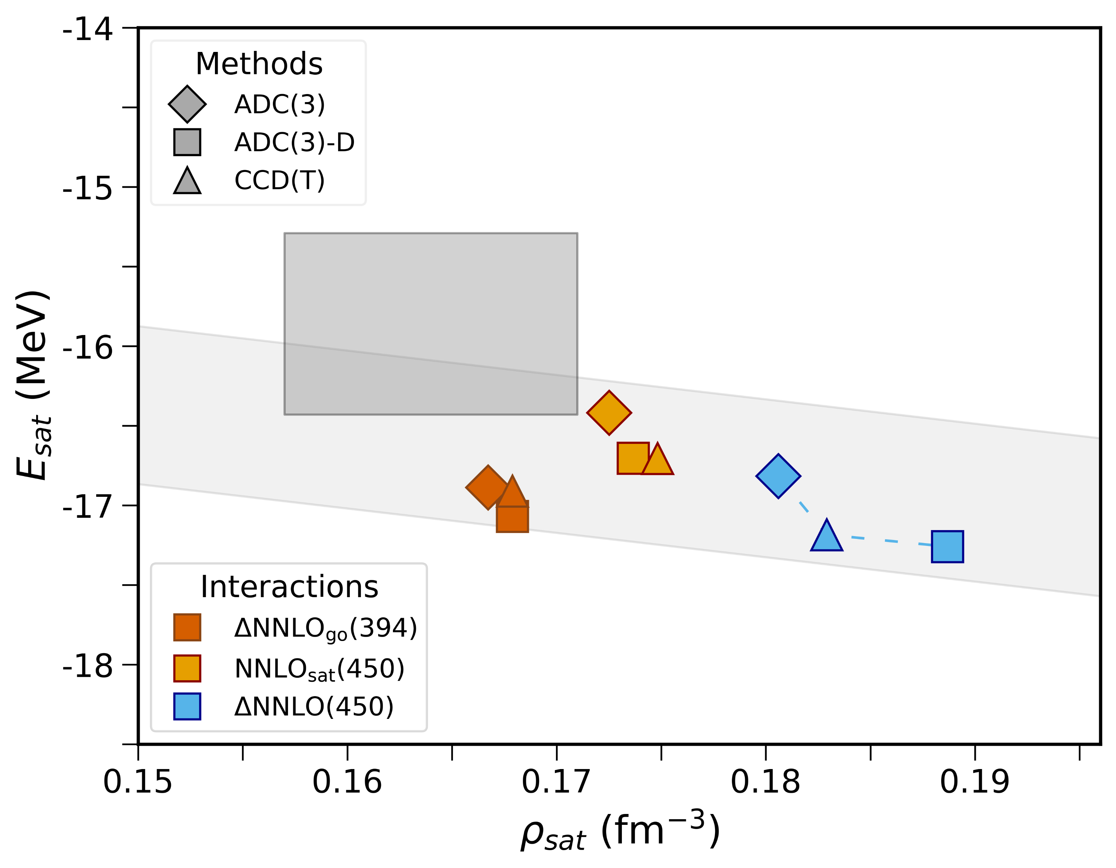
Saturation point of symmetric nuclear matter
Empirical saturation point
Linear correlation between saturation density and energy
FM et al., Phys. Rev. C 110, 054322 (2024)

Slide 22
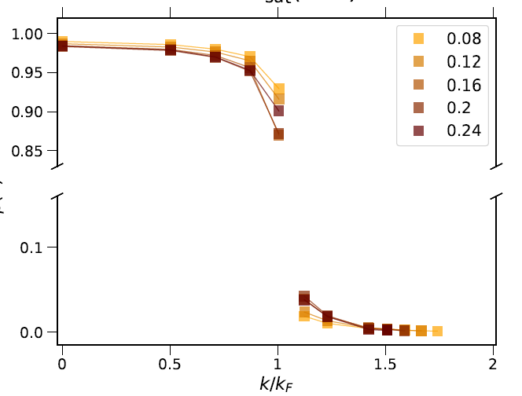
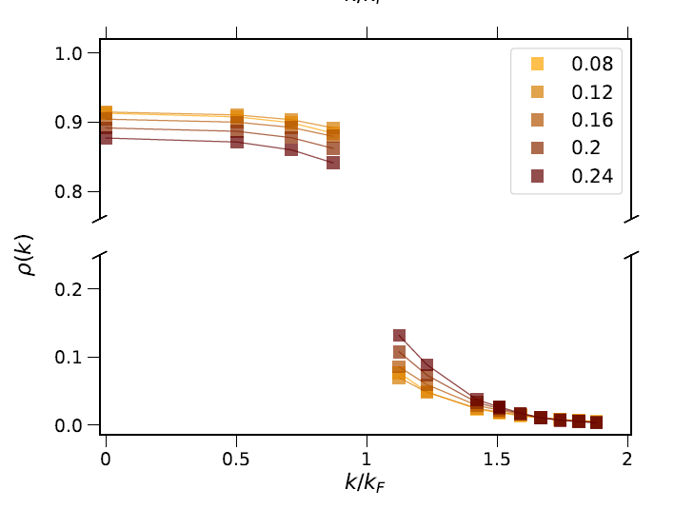
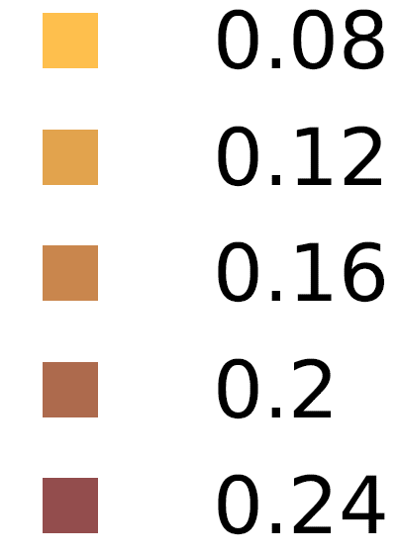
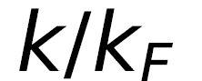
Momentum distributions
Pure neutron matter
Symmetric nuclear matter
$ρ$ [fm⁻³]
Discontinuity at the Fermi surface
High-momentum tail
FM et al, PoS QNP2024, 180 (2025)

Slide 23
Conclusions and perspectives
We have extended coupled-cluster theory to study the structure and dipole response functions of open-shell nuclei close to magicity
Ongoing: response of odd nuclei, response functions with theory uncertainties…
The ADC Green’s functions method is a powerful ab initio tool to study the EOS and single-particle properties of nuclear matter
Future developments: low-density neutron matter, quasi-particle properties …

Slide 24
Save the date!
Many-body Theory:
Nuclear Physics Meets Quantum Chemistry
Aug 24th – Sep 4th 2026
Organizers:
Francesco Marino (JGU Mainz)
Alexander Tichai (TU Darmstadt)
Sonia Bacca (JGU Mainz)
Jürgen Gauss (JGU Mainz)

Slide 25
Thank you for your attention!
Collaborators
Darmstadt: Alex Tichai
Mainz: Sonia Bacca, Miriam El Batchy, Weiguang Jiang
Milano: Carlo Barbieri, Gianluca Colò
Oak Ridge: Francesca Bonaiti , Gaute Hagen, Gustav Jansen

Slide 26
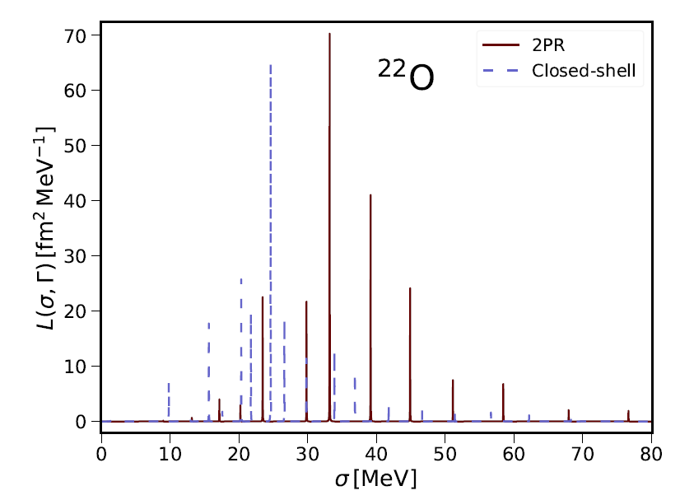
Discretized response function
$$L(σ,Γ→0)$$
2PR
Closed-shell

Slide 27
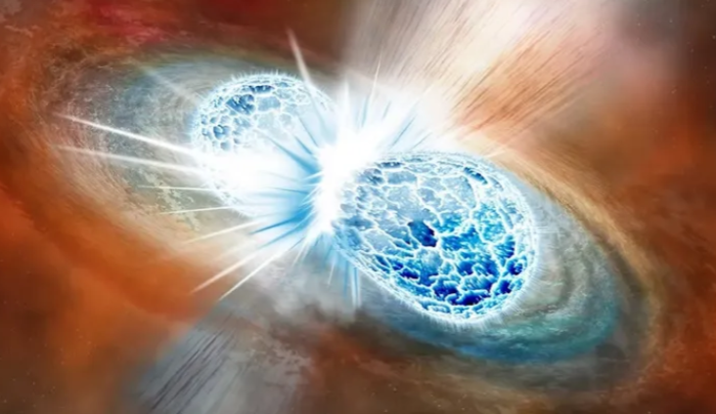
Nuclear matter
Neutron star
Neutron stars merger
Watts et al., Rev. Mod. Phys. 88, 021001 (2016)

Slide 28
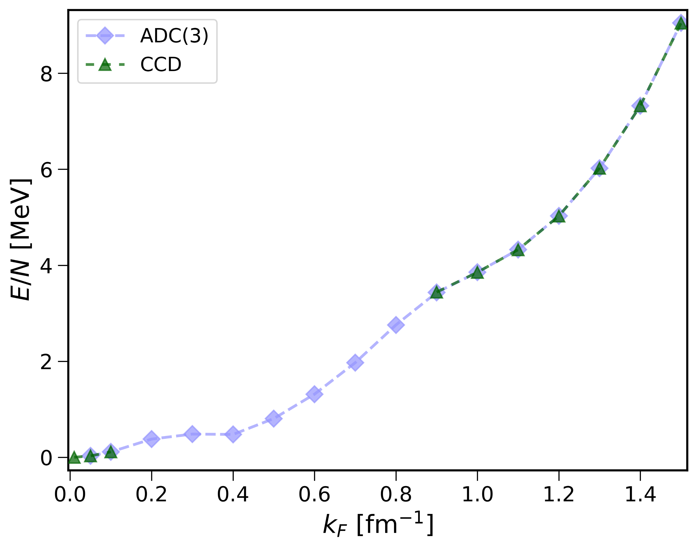
Low-density neutron matter
Neutron matter towards the unitary regime
Courtesy: Weiguang Jiang
ADC(3)
Including pairing allows ADC to converge at low k_{F}
CCD
Contact interaction
$$V\left(p,p^{′}\right)=−C f\left(p\right)f(p^{′})$$
with $a≈−200$fm
Preliminary

Slide 29
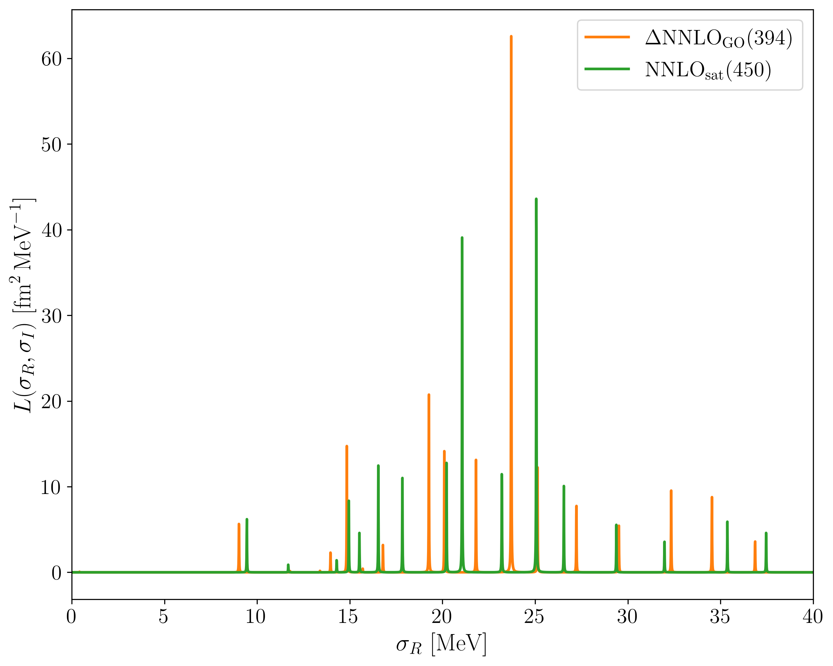
Discretized response function
Preliminary
$$L(σ,Γ→0)$$
²²O
ΔNNLO_{GO} (394)
NNLO_{sat} (450)
Closed-shell CC at the CCSD level
$$α_{D}=2α\int{dσ\frac{L(σ,Γ→0) }{σ}}$$

Slide 30
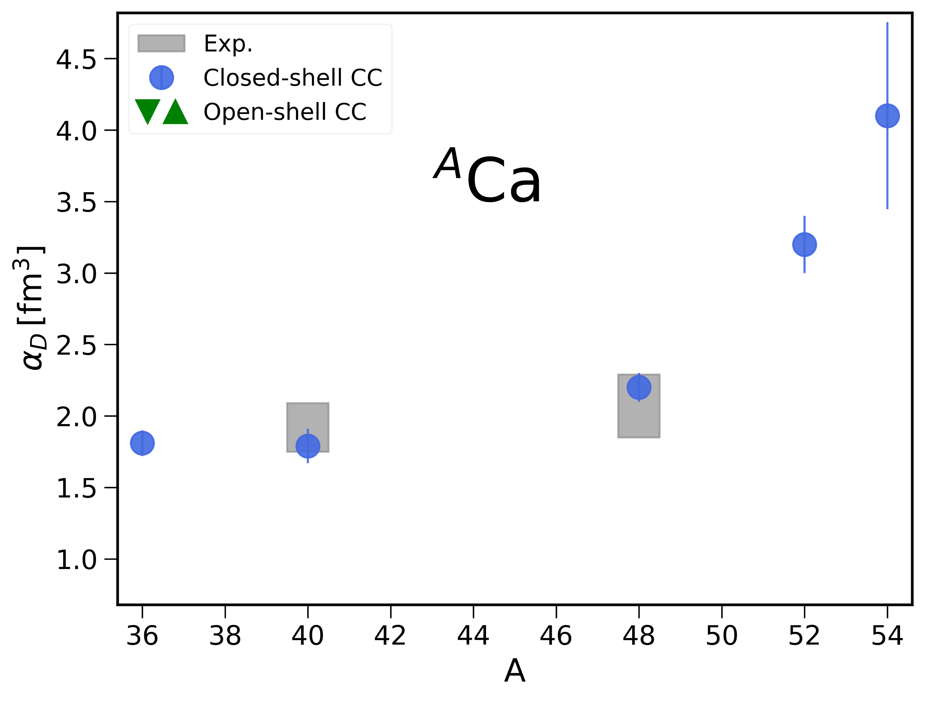
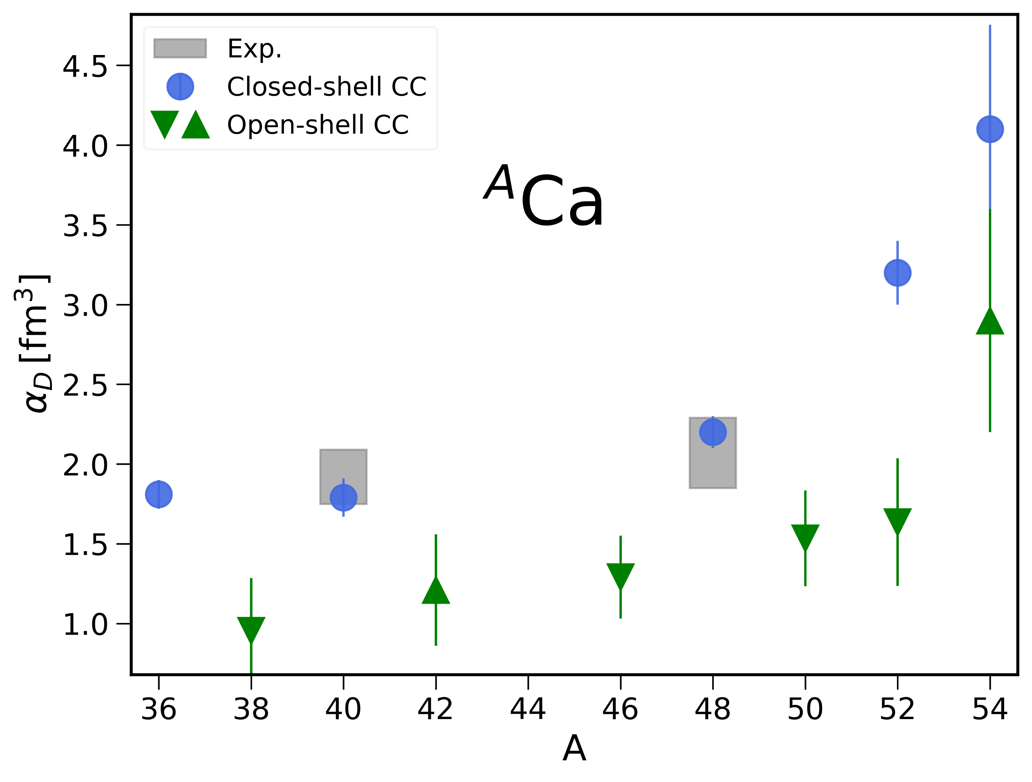
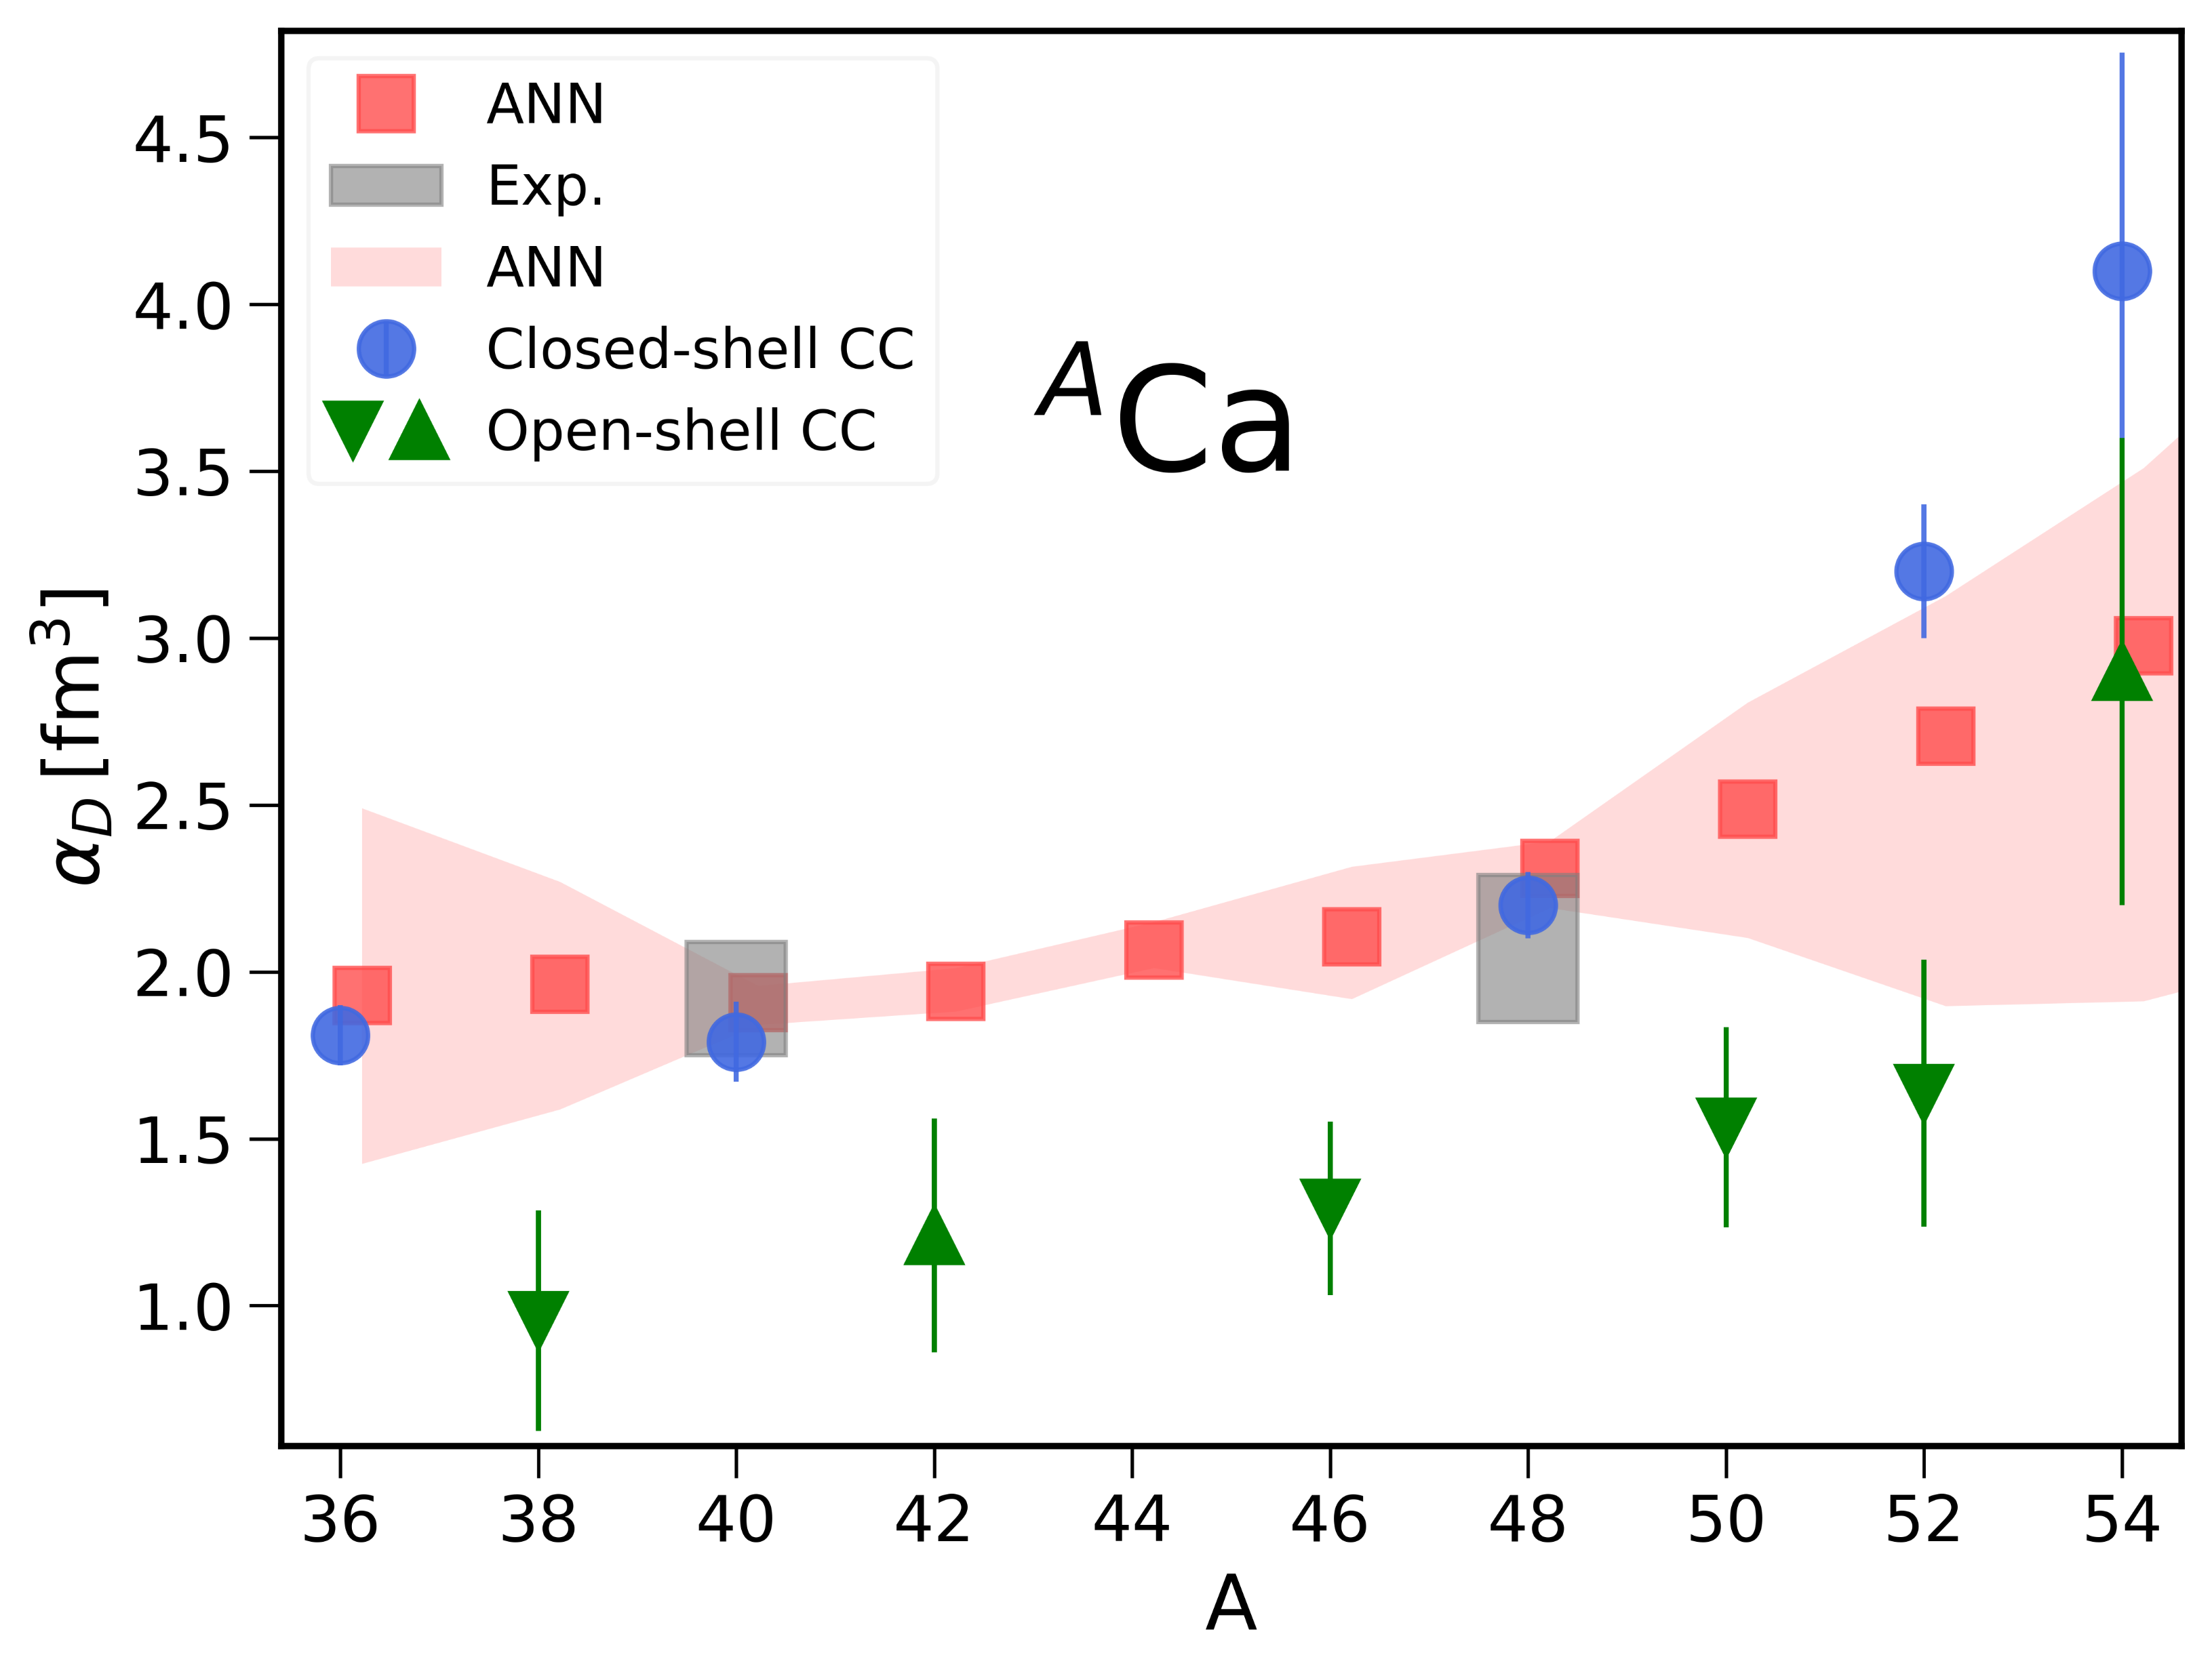
Electric dipole polarizability in Ca isotopes
FM et al., arxiv:2504.11012
Experiment
Closed-shell CC
2PA
2PR
Neural network
Jiang et al., Phys. Rev. C 111, L051308 (2025)
ΔNNLO_{GO} (394)

