Slide 1
Quantum formulas for rotational energies for ab initio calculations
Next generation ab initio nuclear theory workshop
ect*, Trento
July 15 (14-18), 2025
Some quantities to relate ab initio (and other) interactions to collective features (rotational spectrum) in a fully quantum multi-nucleon picture
Takaharu Otsuka
Supported by “Program for promoting research on the supercomputer Fugaku”, MEXT, Japan (JPMXP1020230411)

Slide 2
Outline
1. Quantum many-body formulation of “rotational energy”
(2. Triaxiality and rotational states)
This talk is based on

Slide 3
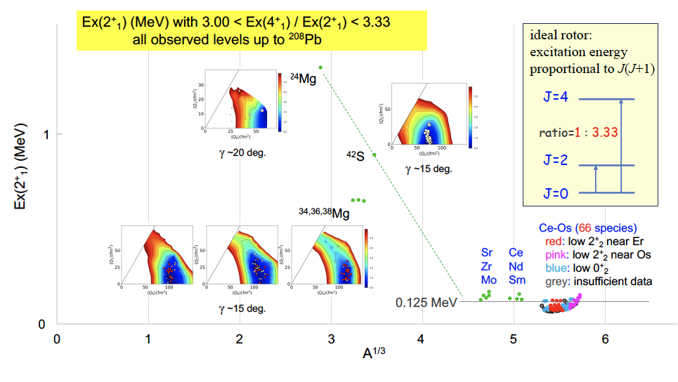
Appearance of (ground-state) rotational bands in nuclei
our focus (A=150-190)

Slide 4
Origin of the J(J+1) rule of rotational excitation energy
conventional description
Ring & Schuck,
The Nuclear Many-Body Problem
classical mechanics
time t, angle Ω(t)
rotation of rigid body
Bohr Hamiltonian
time t₀, angle Ω₀
quantization of free rotation of this rigid body
→ eigenstate with angular momentum h J
- superposition of states
at varying angles
- for axially symmetric shape,
J(J+1) rule is suggested
Thus, for axially symmetric shapes (I₃=0), the rotational kinetic energy is given by
T _{rot}
J ( J+1 )
- just kinetic energy of free
rotation

Slide 5
Nobel Prize 1975
rotation
……
J=4
ratio=1 : 3.33
ideal rotor:
Ex J(J+1) rule
J=2
J=0

Slide 6
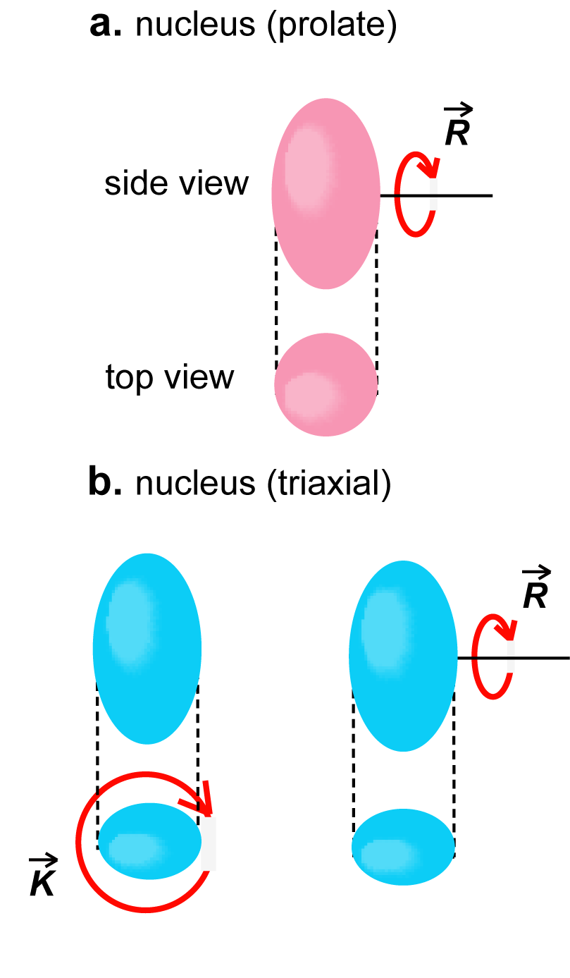
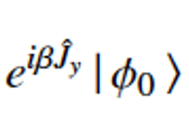
Let’s move to Quantum many-body derivation of rotational excitation energy
: intrinsic state (i.e., state in the body-fixed frame) with K=0
The member of angular momentum J of a rotational band
y axis
is given by the projected state
rotation about y axis
→ the energy is given by
H
y axis
β
energy kernel
y axis
polynomial expansion:
+ …
(stops at finite power)

Slide 7
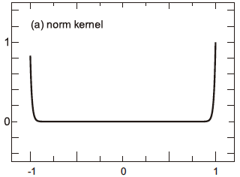
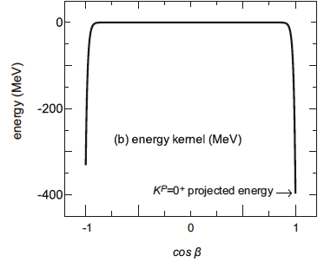
+ …
hierarchy expansion in terms of
a new feature in this analytic aspect
Legendre function satisfies the differential equation:
= F_{J}
norm and energy kernels
regions of cos β ~ 1 or -1
are relevant
similar expansion for β ~ -1
(MeV)

Slide 8
energy for J is given by
{
+ …}
norms are treated similarly
norm kernel
We substitute the first two terms, also for those for the normalization,
for
Leading order (LO) & Next to LO (NLO) :
substituting
+
deviation ~ 1.5 % to direct projection in the tests so far

Slide 9
LO + NLO + N2LO term,
deviation ~ 0 %
generalization: LO + NLO for a finite K, by utilizing the hypergeometric function,
coefficients are calculated
with intrinsic states of
assigned K values, differing
from those for K=0 in general
K mixing matrix elements can be obtained (not done yet, more complex).

Slide 10
Origin of the famous J(J+1)-K² rule of rotational excitation energy
conventional description
alternative view
classical mechanics
quantum mechanics for many-body system
time t, angle Ω(t)
rotation of rigid body
eigenstate with angular momentum h J
- superposition of states at varying angles
time t₀, angle Ω₀
H
- Hamiltonian H, including
interactions, couples
states created by
orienting the same
intrinsic state at
different angles
quantization of free rotation of this rigid body
→ eigenstate with angular momentum h J
- superposition of states
at varying angles
- resultant excitation energy
depicts the J(J+1) – K² rule
for strong deformation
- for axially symmetric shape,
J(J+1) rule is suggested
- this rule arises from
specific angle dependence
of superposition amplitudes,
which are governed by J
- lower K and J provide more binding energies
- just kinetic energy, no
interaction
- this feature is general and robust

Slide 11
The formula we can present is …
The energies of members of rotational bands of strongly deformed
nuclei are given in a unified form as
The coefficients are calculated with intrinsic states of relevant K values.
For instance,
with
K
K
intrinsic state of interest
Despite rather substantial differences from the present work, the underlaying picture can be partly shared with earlier works, Peierles & Yoccoz (1957), Verhaar (1963), Kamlah (1968), Siemens & Jensen (book, 1987).
The infinite Taylar expansion of Wigner d function with β ^{k} was used in Verhaar and Siemens & Jensen, but the d function is simply polynomials like (cos β -1) ^{k}, which leads to a finite expansion converging differently.

Slide 12
The Hamiltonian H stands for a nucleon Hamiltonian
which comprises SPEs, NN interactions, 3N
interactions, etc.
binding
energy
J=4
excitation
energy
J(J+1)
The rotational excitation energy represents a loss
of the binding energy as a function of J. ➔
J=0
J=2
The formulation is general and independent of Hamiltonian. They are valid for
ab initio calculations (such as ¹²C (R=2.99)) as well as for DFT approaches.
The quantum number K is practically conserved, as we’ll see it.
Thus, we do not need,
(i) the concept of free rotation of rigid rotor with E_{x}~kinetic rotational energy,
or
(ii) special algebraic term like Elliott SU(3).
What we need is just a strong deformation, that’s it. The J(J+1) rule appears in thousands of nuclei as a quantum many-body effect in binding energies.

Slide 13
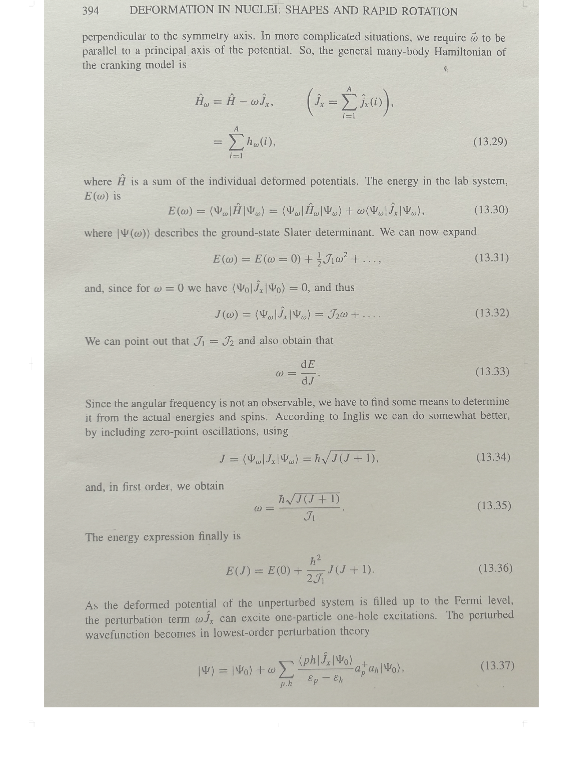
Another classical model:
Cranking model a la Inglis
From
K. Heyde,
“Basic Ideas and Concepts in
Nuclear Physics”,
2nd edition, (IOP, 1999)
at rest
|Ψ₀ >
ω = 0, J = 0
|Ψ >
ω given by

Slide 14
Atomic nucleus in ellipsoidal shape in Aage Bohr’s view
Ground state with J = 0 , i.e., no rotation
at rest
This is described with an ellipsoid at rest.
This may have been based on a classical or macroscopic view.
For J = 0, a slow rotation occurs.
Kinetic energy of this rotation ~ Excitation energy within rotational band.
This can be compared to Hydrogen atom in the ground state (forget intrinsic spin)
proton
electron
Are proton and electron at rest like this ? Of course, not
1s
2s
2p_{x}
Quantum mechanical picture :
The electron is “distributed” in probability
around the proton, referred to as electron cloud.
s state (zero rotational frequency)
➔ distribution is isotropic
National Science Museum

Slide 15
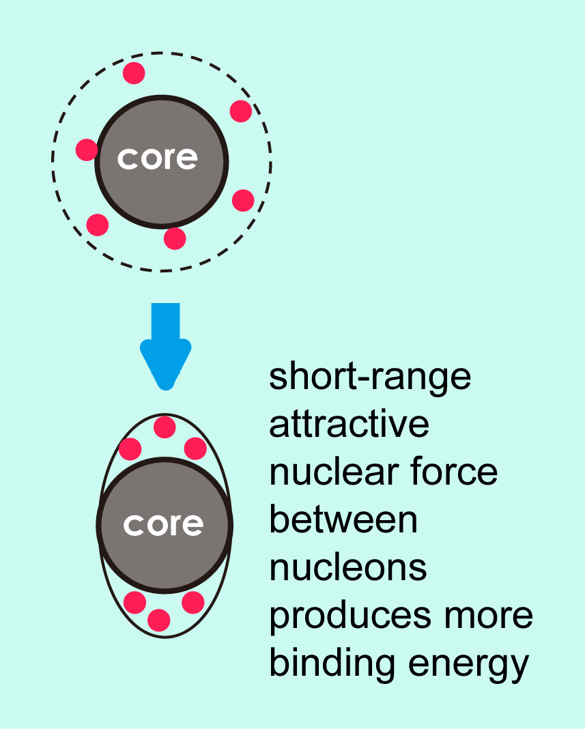
Revisit with Monte Carlo Shell Model (CI calculation)
3s_{1/2}
Effective interaction: G-matrix* + V_{MU}
* Brown, PRL 85, 5300 (2000)
2d_{5/2}
1g_{9/2}
2p_{1/2}
Nucleons are fully activated within this model space
1f_{5/2}
0i_{13/2}
0h_{9/2}
We performed Monte Carlo Shell Model (MCSM) calculations, where the largest case corresponds to the diagonalization of 3.9 x 10 ³¹ dim. matrix.
Its advanced version, Quasiparticle Vacua Shell Model (QVSM)* is used, in order to incorporate
pairing and deformation effects on an equal footing, with N-projected Bogoliubov basis vectors .
*Shimizu et al, PRC 103, 014312 (2021)
2p_{3/2}
2p_{3/2}
1f_{7/2}
1f_{7/2}
0h_{11/2}
0h_{11/2}
1d_{3/2}
0g_{7/2}
70
2s_{1/2}
1d_{5/2}
0g_{9/2}
¹¹⁰Zr
40
+ HFB (number VAP, J VBP) + GCM for analysis
proton
neutron
V_{MU} : same interaction for the description of shell evolution in exotic nuclei

Slide 16
Most advanced methodology in the MCSM is used
(Ordinary) MCSM: superposed Slater determinants with angular momentum and parity projections
QVSM(Quasiparticle Vacua Shell Model): superposed quasiparticle vacua with number, angular
momentum, and parity projections
Pairing correlations over many single-particle orbitals are already incorporated in each basis
vector because of its BCS-type character
quasiparticle vacuum
core (vacuum)
The QVSM code was fully used, but huge computer resources were still needed.

Slide 17
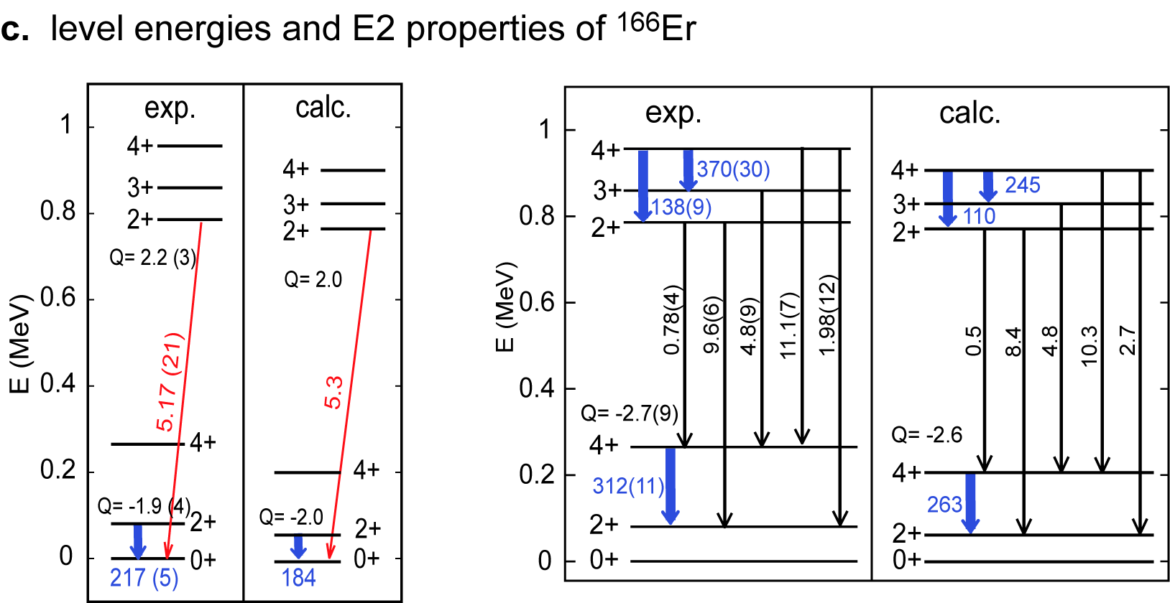
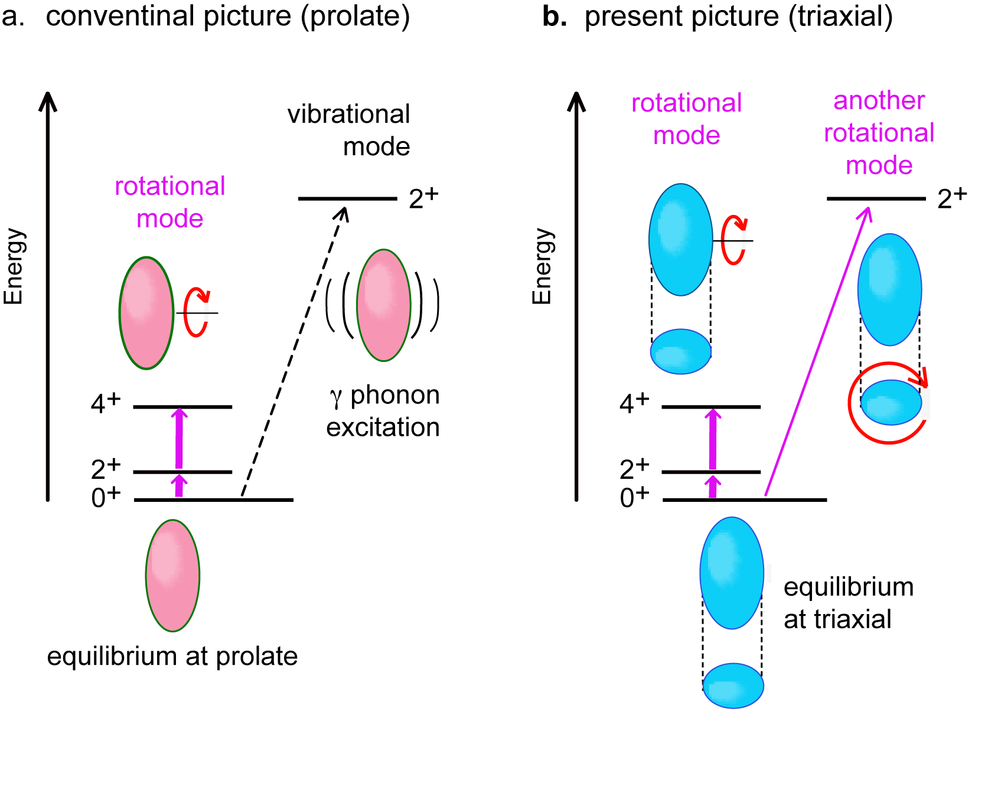
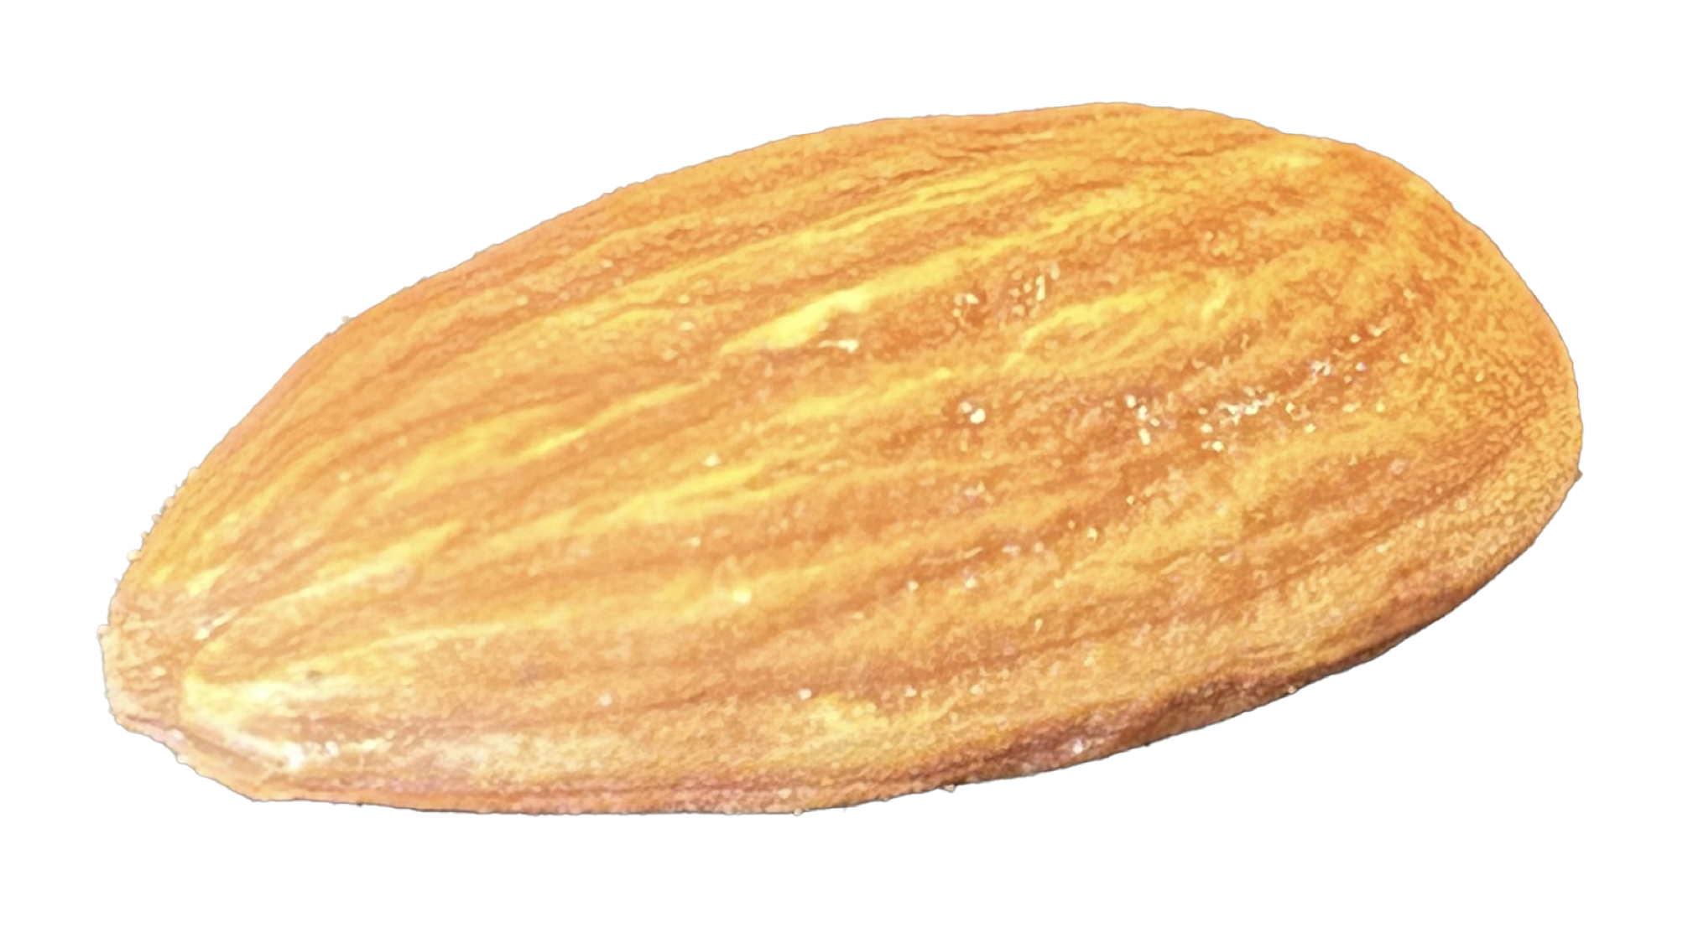
Aage Bohr’s picture
- axial symmetry -
Our picture
- triaxiality -
Result of MCSM calculation (QVSM)
E2 quantities in W.u.
K =2
K = 2
K = 0
K =0
circle
ellipse
Shapes of these eigenstates
will be discussed a little
(cannot rotate)

Slide 18
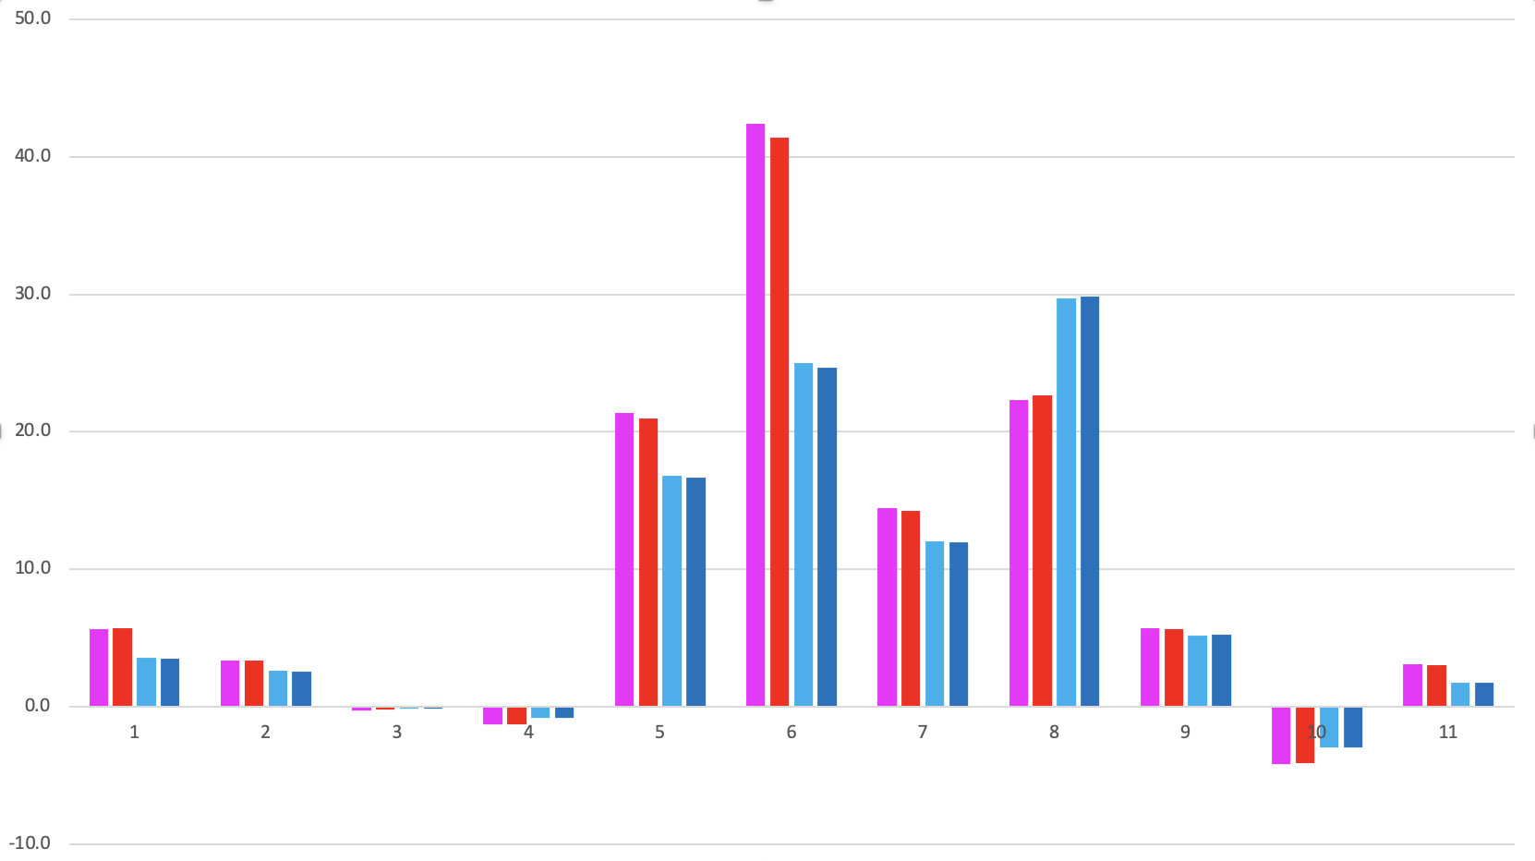
Decomposition of rotational excitation energies for two bands in ¹⁶⁶Er
dominated by NN interactions
40
kinetic term ~ 5% lowering
30
ground band
gamma band
20
Fraction (%)
2⁺₁ - 0⁺₁
10
4⁺₁ - 0⁺₁
3⁺₁ - 2⁺₂
4⁺₂ - 2⁺₂
0
p spe
n spe
pp mono
nn mono
pn cent qq
pp 0⁺ pairing
nn 0⁺ pairing
pn cent mono
pn cent higher
pn tens mono
pn tens multi

Slide 19
Outline
1. Quantum many-body formulation of “rotational energy”
2. Triaxiality and rotational states
This talk is based on

Slide 20
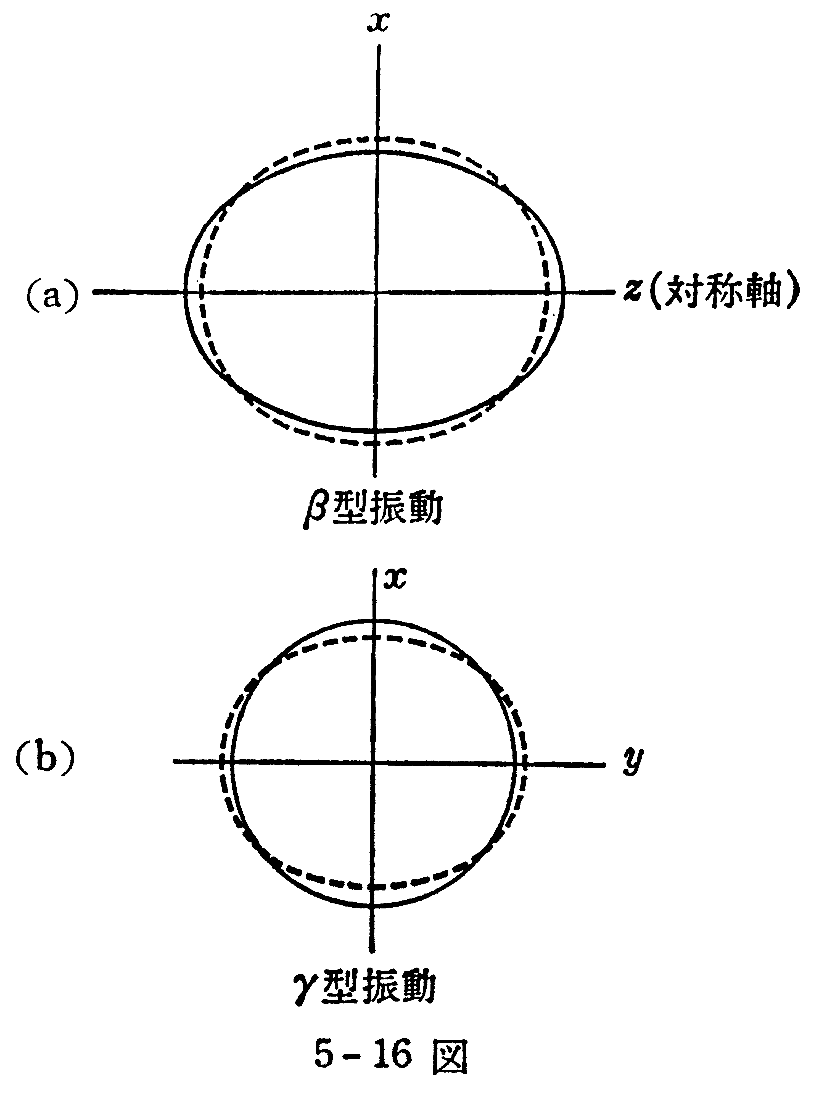
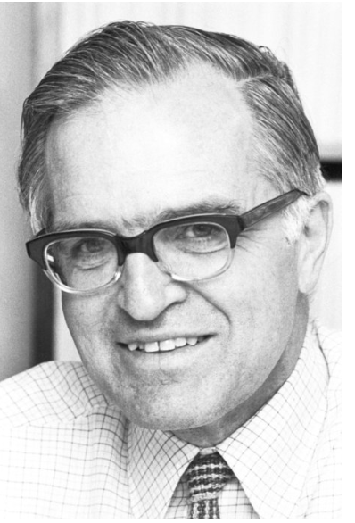
A case of the textbook example:
原子核 by M. Nogami
Aage Bohr
Novel Prize Lecture
(1975)
¹⁶⁶Er
γ – vibration
phonon
excitation
Aage N. Bohr, 1922-2009
Nobel Foundation archive
Axially symmetric
prolate ellipsoid
(equilibrium)
also emphasized in
A. Bohr and B. R. Mottelson,
Nuclear Structure II
(1975, Benjamin, New York)

Slide 21
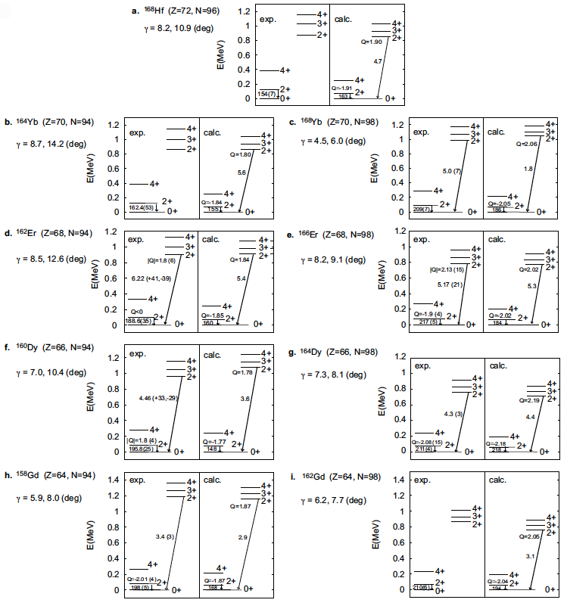
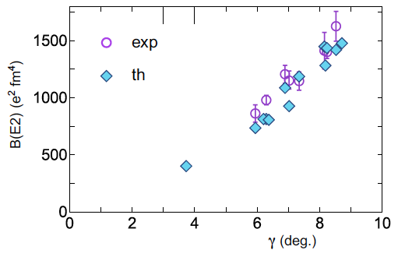
Medium triaxiality
systematically seen
with the same Hamiltonian
Levels, B(E2)’s
and Q-moments
: calc. γ ~ Multiple CoulEx value
A clear correlation between γ
and B(E2; 0⁺₁ -> 2⁺_{gamma} ) is seen.
(γ is not an accidental fluctuation)
¹⁶⁶Er
¹⁶⁴Dy
*
¹⁵⁸Gd
*⁾
B(E2) from 2⁺ at Ex~2.7 MeV of ¹⁵⁴Sm
γ = 3.7 deg (¹⁵⁴Sm)

Slide 22
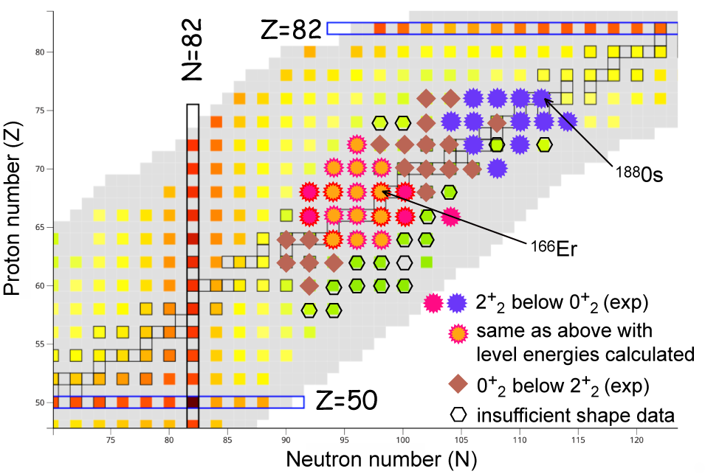
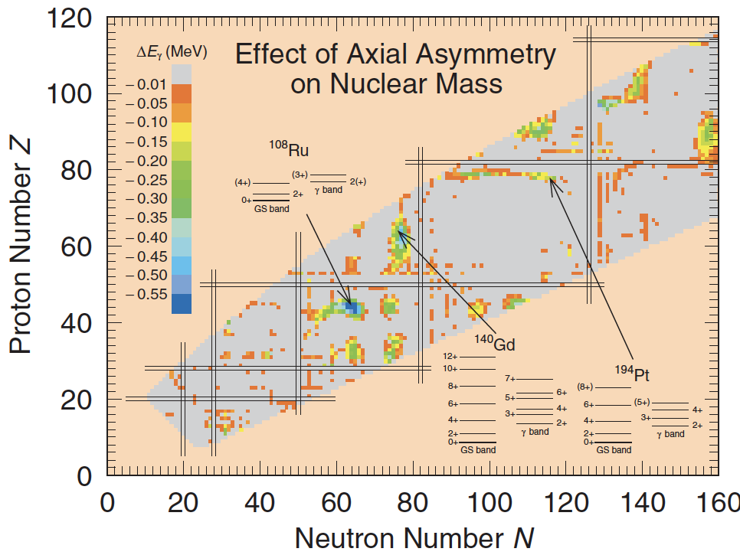
Appearance of triaxial shapes in the nuclear chart
Axially symmetric
Moller et al. (2006)
medium
triaxiality
~ small triaxiality

Slide 23
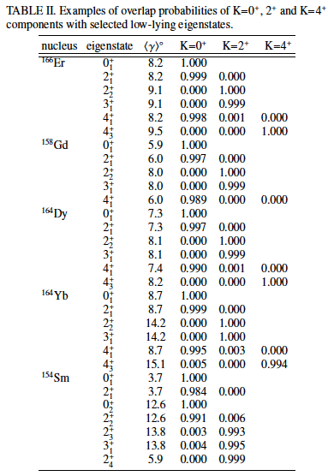
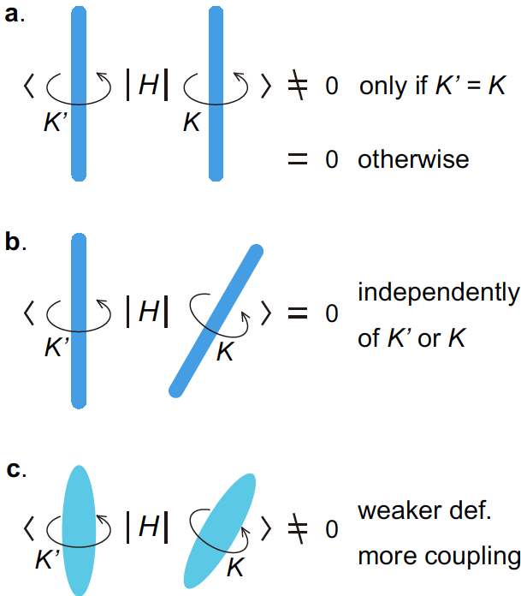
K quantum number is (practically) conserved, with substantial triaxiality
Robust mechanism for
good K with triaxiality
Rather strong K mixing may have been expected
in traditional picture for triaxial shapes.
Its rationale is not
clear to me.
K is now shown to be a good quantum number.
Dynamical symmetry as a many-body
effect (<−>Partial Dynamical Symmetry)

Slide 24
Summary
1. Rotational excitation energy proportional to J(J+1) can be derived in quantum many-body
framework, without resorting to the quantization of the free rotation of rigid body.
binding
energy
J=4
excitation
energy
J(J+1)
direct relation to NN, 3NF, …
J=0
J=2
… no or quite small rotational kinetic energy
2. Triaxial deformation occurs in virtually all deformed nuclei with varying degrees: substantial
triaxial deformation occurs in many deformed nuclei, such as ¹⁶⁶Er, ¹⁶⁴Dy, ¹⁵⁸Gd,
as consequences of NN interaction (particularly, tensor and hexadecupole forces).
3. K quantum number is practically conserved with triaxiality, contrary to traditional belief.
4. The J(J+1) rule arises independently of the interaction, with actual excitation energies
varying for different interactions. (It is not due to mass moment inertia in the classical sense.)

Slide 25
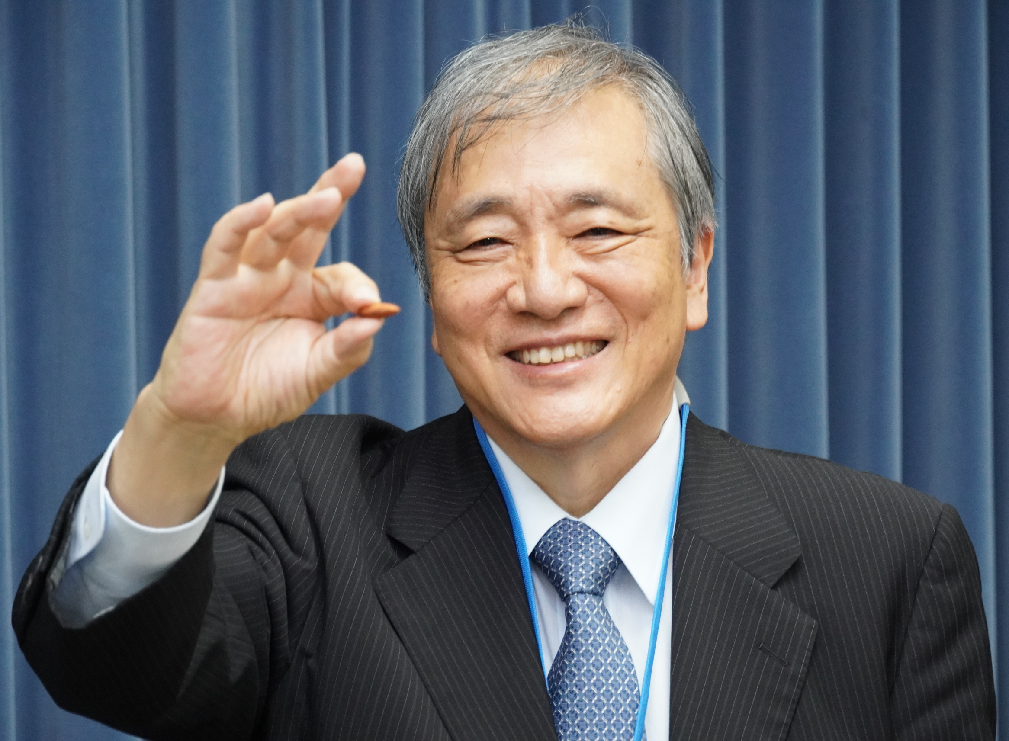
Public Relations
in Japan
… amusing
experience
雑誌ニュートン
８月号
まず結果から
７月号
Googleで検索
アーモンド＋原子核
More emphasis on
triaxiality
一部スポーツ紙
にも出ました
almond-like
shape

Slide 26
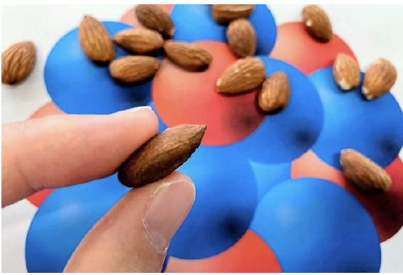
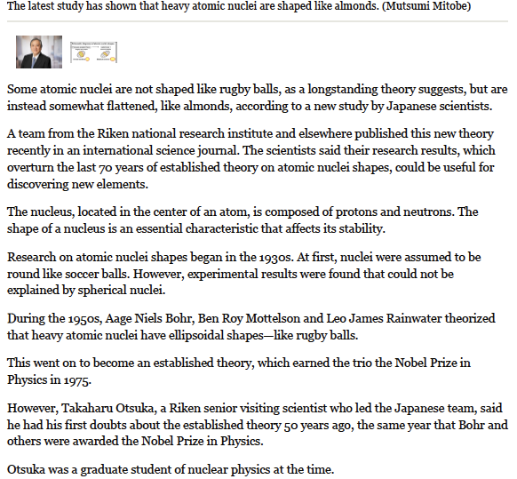
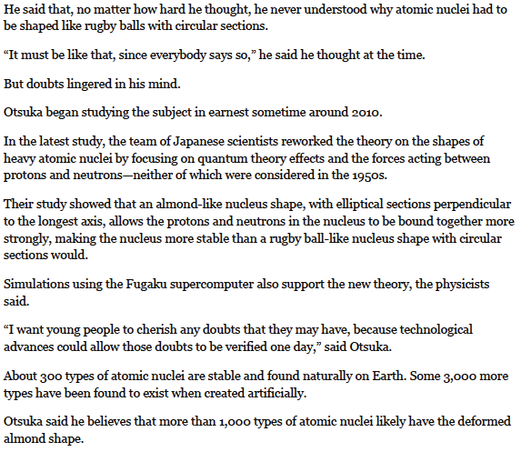
Also, English edition
Japanese counterpart
of New York Times
https://www.asahi.com/ajw/articles/15859206

Slide 27
E N D
Thank you

Slide 28
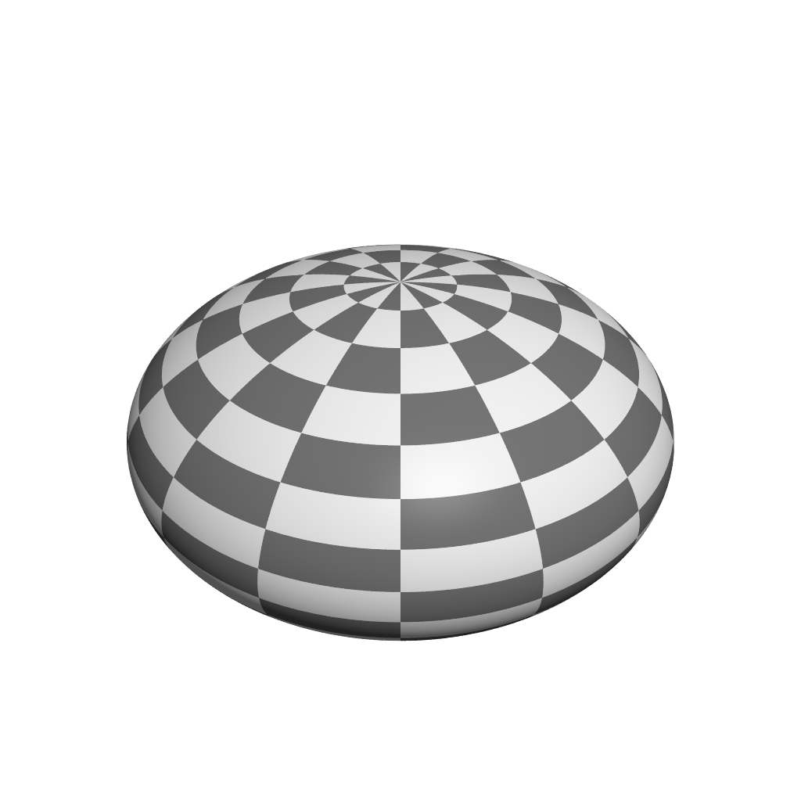
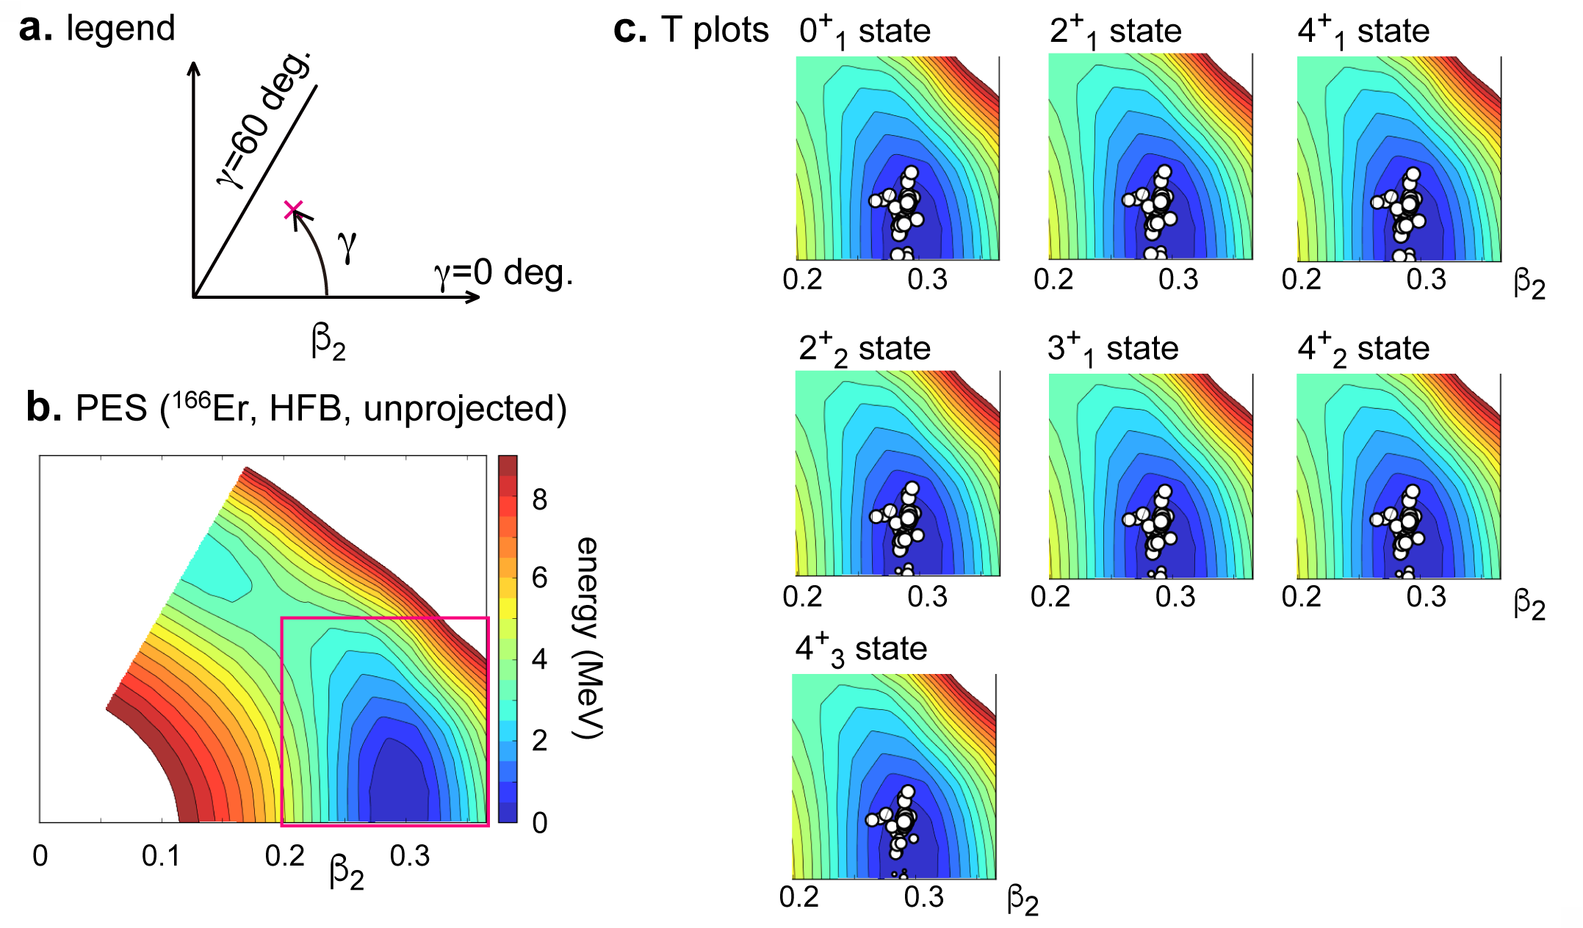
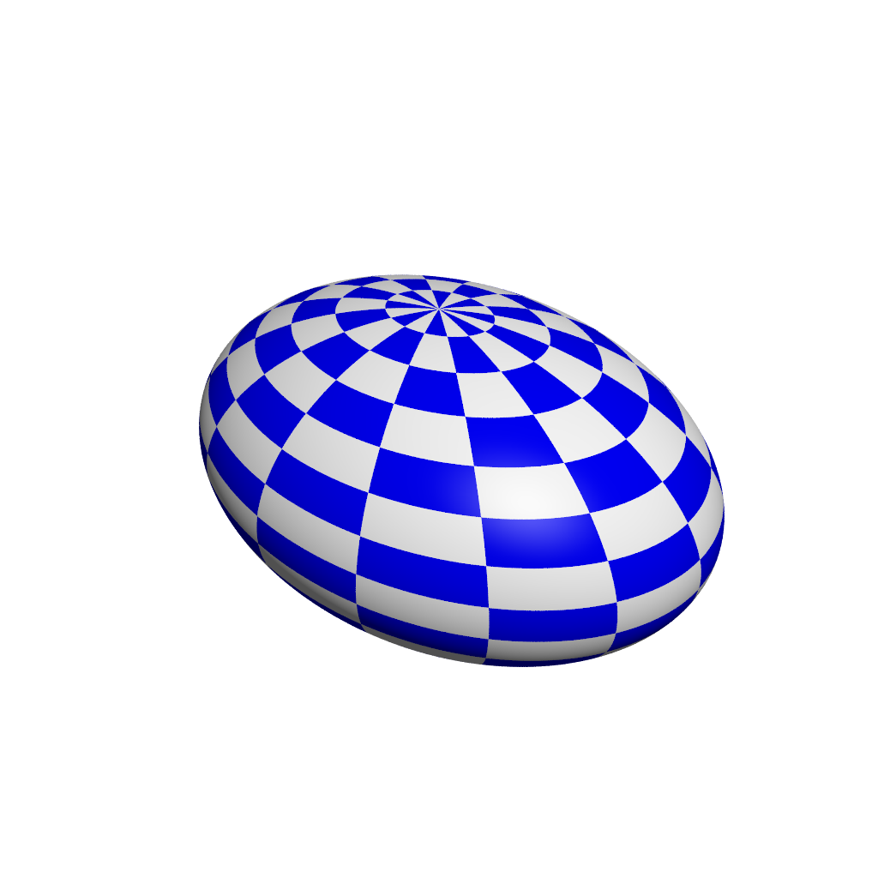
T-plots for the ground and lowest states of ¹⁶⁶Er
oblate
triaxial
triaxial with
<γ> = 8.4 deg
K = 0
prolate
triaxial with
<γ> = 9.1 deg
K = 2
<γ> = 9.5 deg
cut
K = 4
Similar result from Kumar invariant
<γ> ~ 9.2 deg, <β₂> ~ 0.30

Slide 29
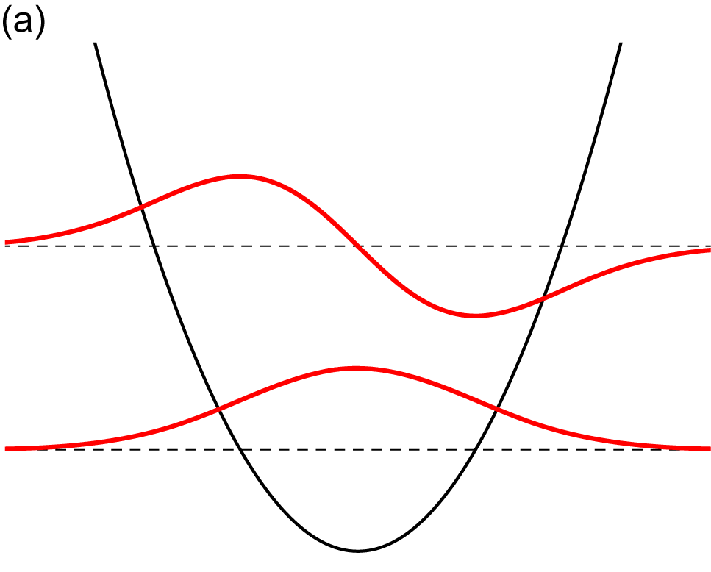
Energies and wave functions
of a particle confined in a
one-dimensional harmonic
oscillator potential
(= model of vibration)
“Vibrational” excitation of collective states
with respect to collective coordinates
(like β ₂ and γ )
Our eigenstates are written as
/N_{i}
oscillation
amplitude
basis vector (many-body
state) with shape parameters
N_{i} : relevant norm
peak
E₁
node
Expected basic pattern of the amplitudes
peak
peak
E₀
at rest
reference (ex, ground) state
vibrational mode
peak
peak
“node”
amplitude
γ
γ
shape parameter
peak
chosen to be real positive

Slide 30
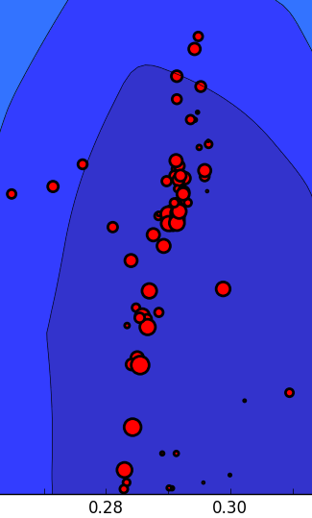
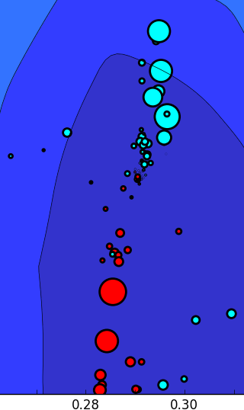
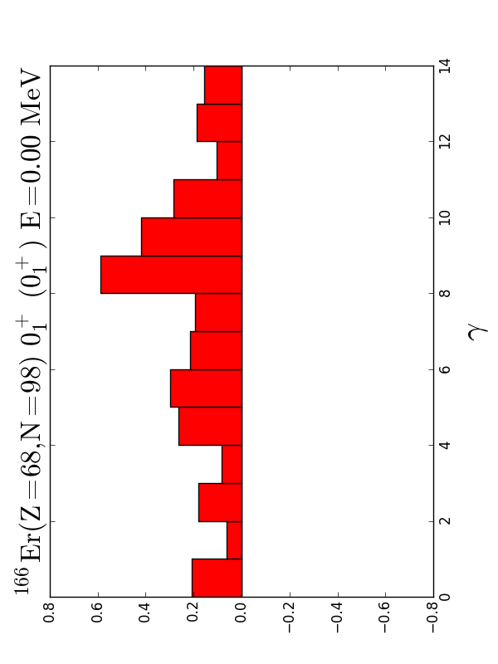
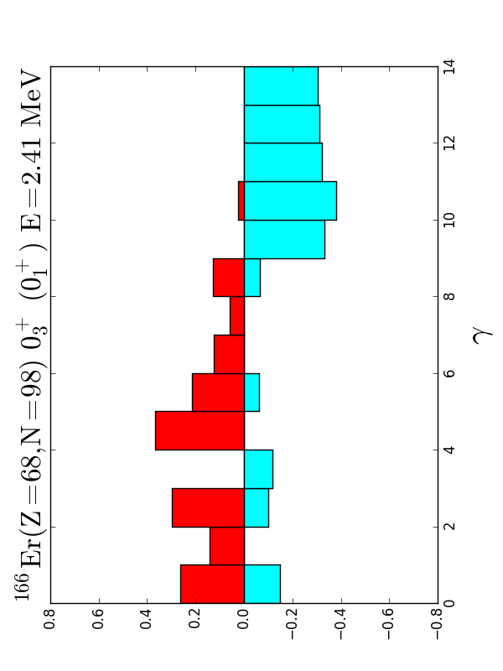
We can take superpositions within a given bin of γ, e.g., γ = 9 - 10 degrees,
separately for positive and negative amplitudes.
amplitudes are positive for 0⁺₁ state
as it is also the reference state
positive
amplitude
negative
amplitude
0⁺₃ state
0⁺₁
0⁺₃
K=0
K=0 vib
γ
γ
red (blue) circles : amplitudes are positive (negative)
This is a clear and important signature of the vibration in quantum
many-body language. No semi classical arguments used.

