Slide 1
Physics-Informed Neural Networks for the quantum many-body problem
Lorenzo Brevi , Department of Physics University of Milan
Antonio Mandarino, Department of Physics University of Milan
Carlo Barbieri, Department of Physics University of Milan
Enrico Prati, Department of Physics University of Milan

Slide 2
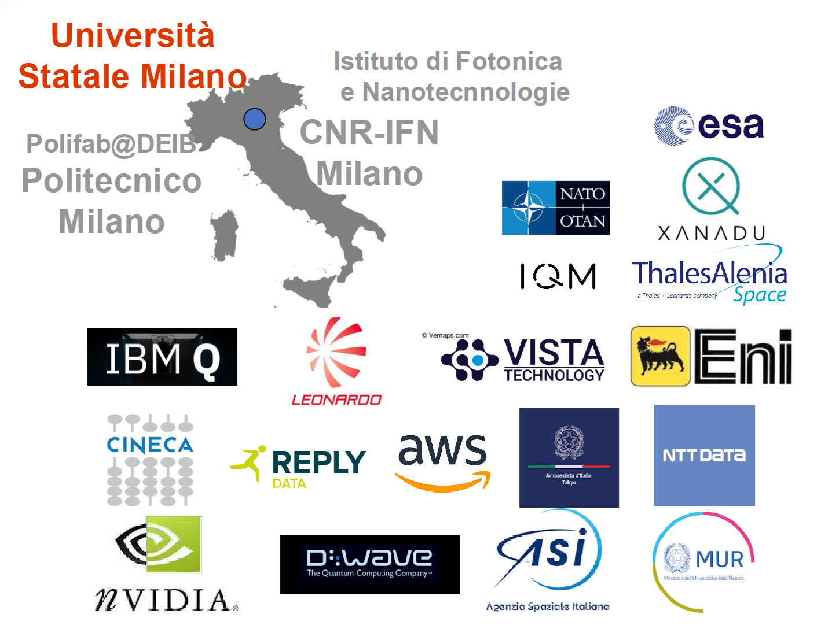
Quantum Intelligence Lab Milan, Italy
Quantum
Intelligence Lab
Head
Enrico Prati
PostDocs
Sebastiano Corli
Antonio Mandarino
Francesco Monzani
Pietro Torta
PhDs
Lorenzo Brevi
Rebecca Casati
Luca Nigro
Giorgio Panichi
Paolo Zentilini
+5MD +1BD
Notes:
Qua ci metto paper overview di arxiv. Sia qr code che foto abstract

Slide 3
Machine learning in complex systems
Challenges with State-of-the-art Machine Learning techniques
Possible solution: Exploit prior knowledge about the system
Require big data
Lack of robustness
No guarantee of convergence

Slide 4
Physics-informed neural networks
Add physics constraint to the network via additional losses
Used to solve partial differential equations
Partial derivatives with automatic differentiation
Can train with little to no points
Total loss = $MSE(μ\left(x\right),μ_{data}\left(x\right))$+$MSE(\frac{∂μ}{∂t}+N\left[μ;λ\right],0)$+$Others$
Total loss = $MSE(\frac{∂μ}{∂t}+N\left[μ;λ\right],0)$+$Others$
Loss_{data}
Loss_{PDE}
Loss_{Physics}
M. Raissi, P. Perdikaris, and G. Karniadakis, “Physics-informed neural networks: A deep learning framework for solving forward and inverse problems involving nonlinear partial differential equations,” Journal of Computational Physics, vol. 378, pp. 686–707, 2019.

Slide 5
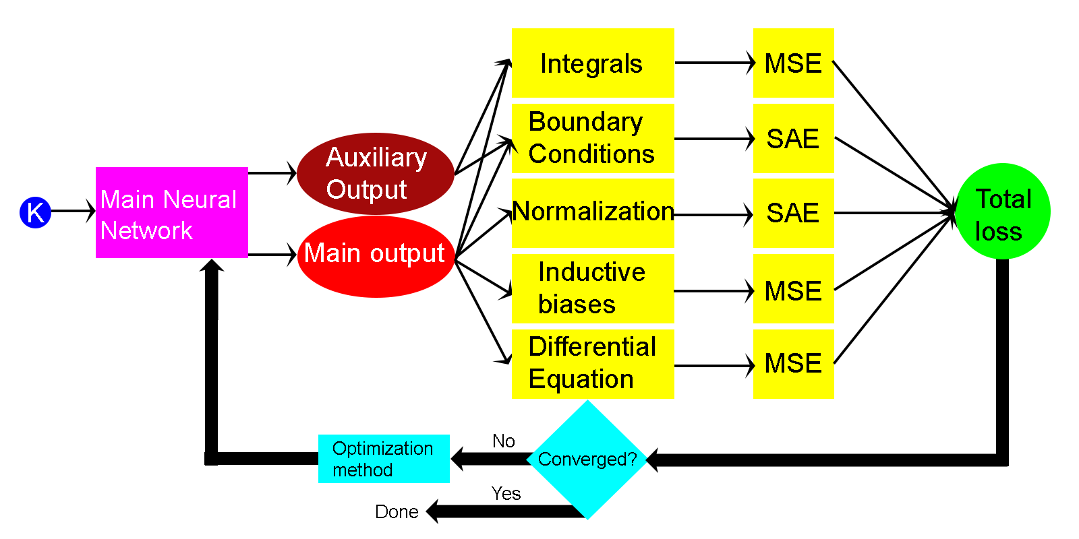
PINNs to address Schrödinger’s equation
Want to find:
Eigenfunction
Eigenvalue
Necessary losses:
Schrödinger’s equation
Normalization
Boundary conditions
Inductive biases
Orthogonality
LB.; A. Mandarino; E. Prati. A Tutorial on the Use of Physics-Informed Neural Networks to Compute the Spectrum of Quantum Systems. Technologies 2024, 12, 174. https://doi.org/10.3390/technologies 12100174

Slide 6
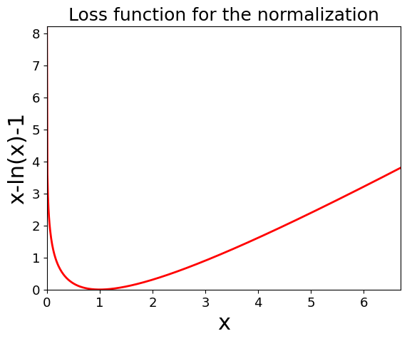
Normalization
$\int_{domain}{{|ψ(\vec{x})|}^{2}d\vec{x}}−\ln\left(\int_{domain}{{|ψ(\vec{x})|}^{2}d\vec{x}}\right)=1$
Removes local minima at $ψ\left(\vec{x}\right)=0 ∀\vec{x}$
Need to compute normalization integral

Slide 7
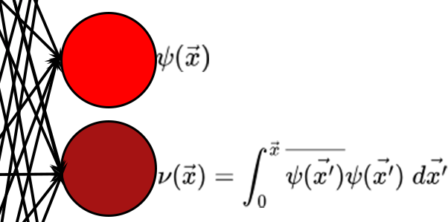
Integration methods
Auxiliary output
Gaussian Quadrature
Finite difference method
Need to define the correct mesh
Discretization errors
Easier computation
Use for loss $∇ν\left(\vec{x}\right)={|ψ(\vec{x})|}^{2}$
No discretization errors
Harder to train
L. Yuan, Y.-Q. Ni, X.-Y. Deng, and S. Hao, “A-pinn: Auxiliary physics informed neural networks for forward and inverse problems of nonlinear integro-differential equations”

Slide 8
Computing the Energy
E = $\frac{\left\langle ψ|\right.\left(H\left.|ψ\right\rangle \right)}{\left\langle ψ|\left.ψ\right\rangle \right.}$
$H\left.|ψ\right\rangle$ can be computed by the PINN
Automatic differentiation to compute derivatives in K
Find lowest energy state by adding the loss $w(t)e^{E}$

Slide 9
Pinn Losses
${Loss}_{Schrod}=MSE\left(Η\left.|ψ\right\rangle −\frac{\left\langle ψ|\right.\left(H\left.|ψ\right\rangle \right)}{\left\langle ψ|\left.ψ\right\rangle \right.}\left.|ψ\right\rangle ,0\right)$
${Loss}_{variational}=w(t)e^{E}$
${Loss}_{integ}=MSE\left(∇ν\left(\vec{x}\right),{|ψ(\vec{x})|}^{2}\right)$
${Loss}_{Norm}=SAE\left(\int_{domain}{{|ψ(\vec{x})|}^{2}d\vec{x}}−\ln\left(\int_{domain}{{\left|ψ\left(\vec{x}\right)\right|}^{2}d\vec{x}}\right),1\right)$
${Loss}_{{BC}_{s}}=SAE\left(ψ\left({\vec{x}}_{boundary}\right),{\vec{ψ}}_{0}\right)$
${Loss}_{Orthogonality}=MSE\left(\sum_{i≠j}{\left\langle ψ_{i} | ψ_{j}\right\rangle ,0}\right)$ (For excited states)
Inductive biases: Varies, i.e. $ψ\left(\vec{x}\right)=ψ\left(−\vec{x}\right)$

Slide 10
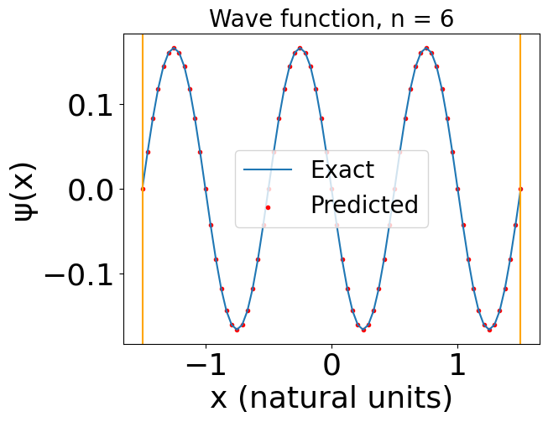
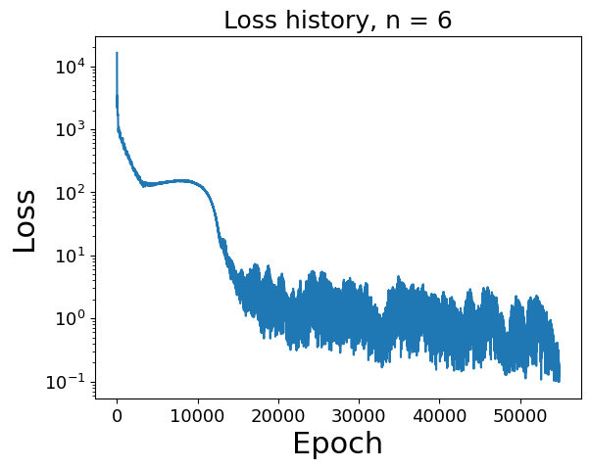
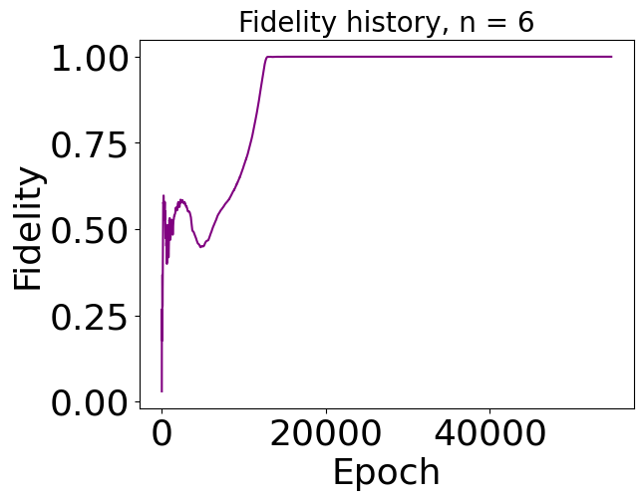
Example: Infinite potential well
Excited states!
$$V(x)=\left\{\begin{aligned}0 for −\frac{L}{2}<x<\frac{L}{2} \\ ∞ otherwise\end{aligned}\right.$$
$$V(x)=\left\{\begin{aligned}0 for −\frac{L}{2}<x<\frac{L}{2} \\ ∞ otherwise\end{aligned}\right.$$
$$\frac{E_{exact}−E_{PINN}}{E_{exact}}=1.78 Χ {10}^{−5}$$
Simplest quantum mechanical system
Well-known eigenvalues and eigenfunctions
Used to test the method and set up the following steps
LB.; A. Mandarino; E. Prati.
Technologies (2024) 12, 174.

Slide 11
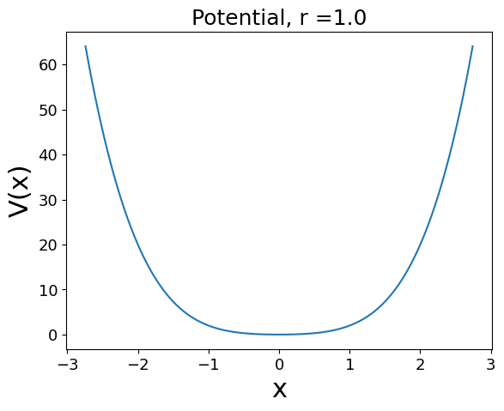
Example: the quantum harmonic and anharmonic oscillator
$$V= x^{2}+λx^{4}, λ>0$$
LB.; A. Mandarino; E. Prati Addressing the non-perturbative regime of the quantum anharmonic oscillator by physics-informed neural networks. 2024 New J. Phys. 26 103015 DOI 10.1088/1367-2630/ad8302

Slide 12
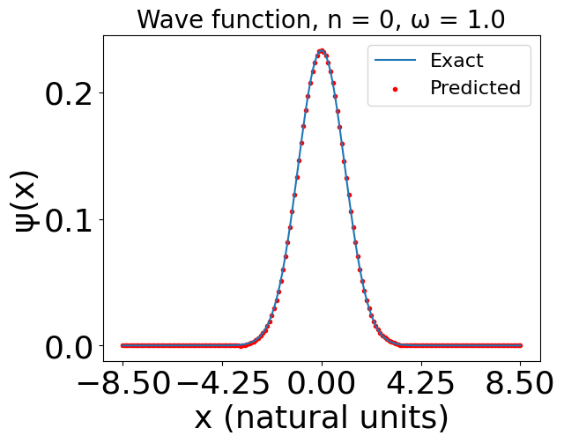
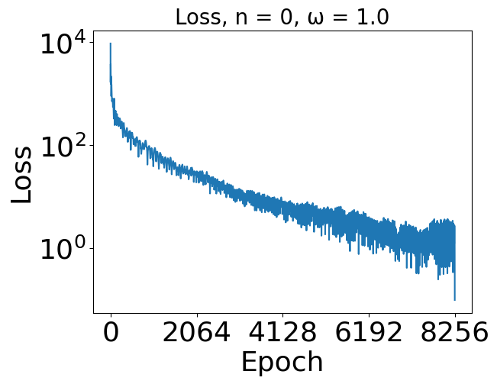
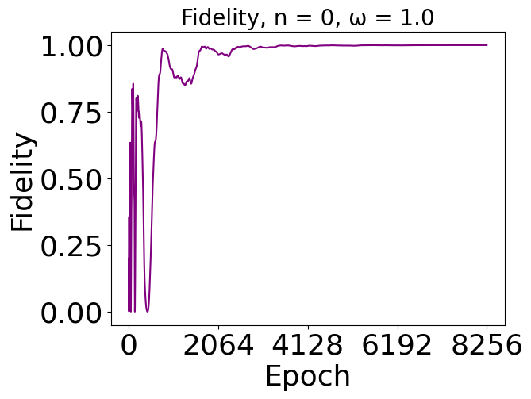
Results for the harmonic oscillator
$$\frac{E_{exact}−E_{PINN}}{E_{exact}}=7.45 Χ{ 10}^{−4}$$
$$λ =0$$

Slide 13
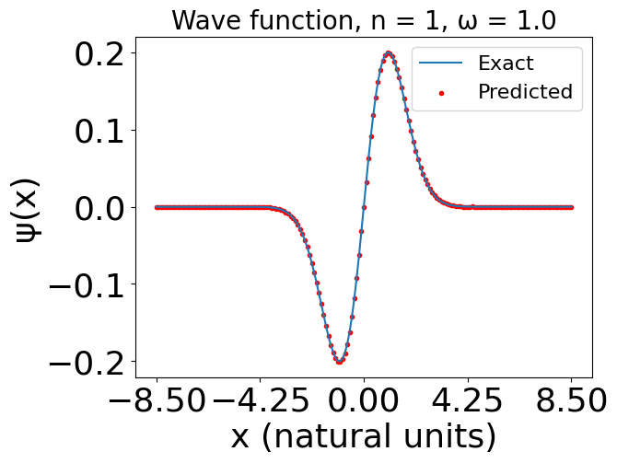
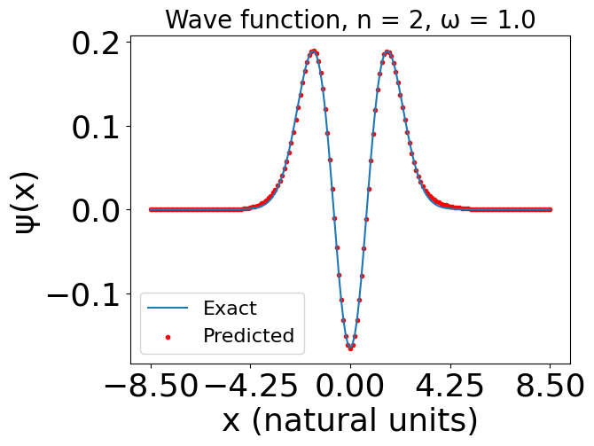
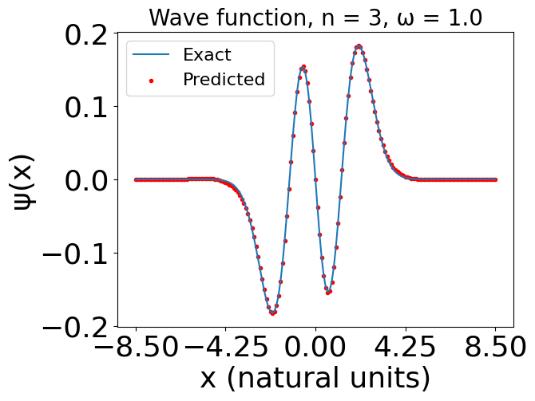
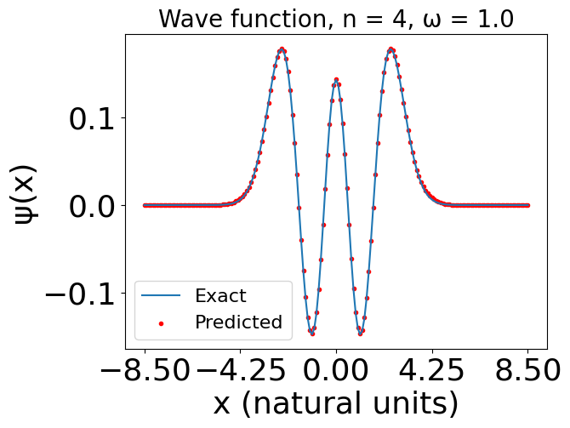
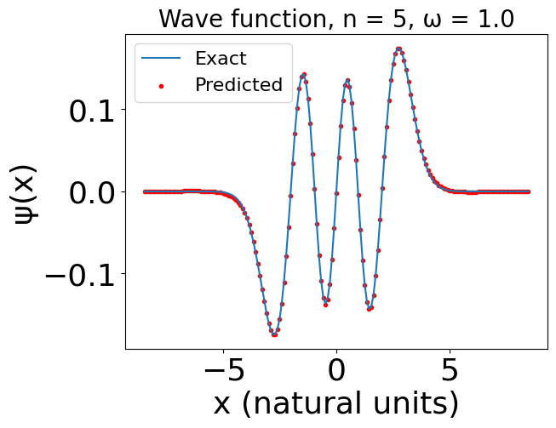

Slide 14
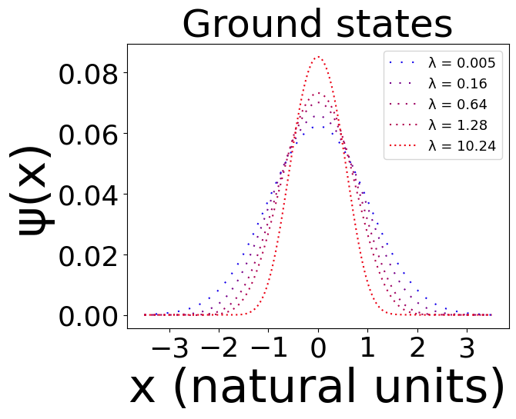
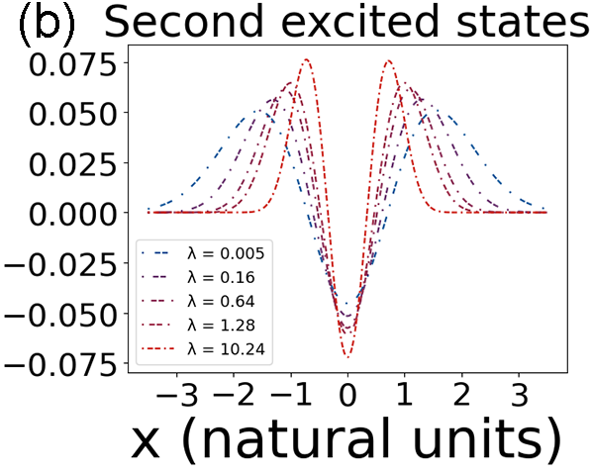
Results for the anharmonic oscillator
$$λ>0$$
LB.; A. Mandarino; E. Prati.
New J. Phys. (2024) 26 103015

Slide 15
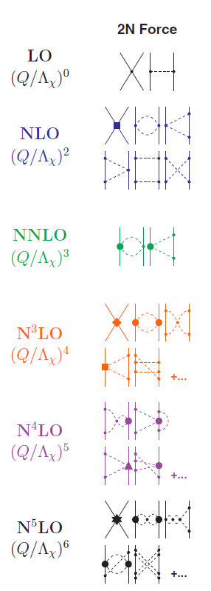
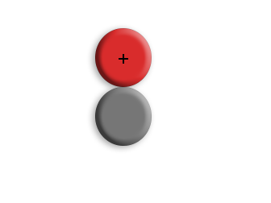
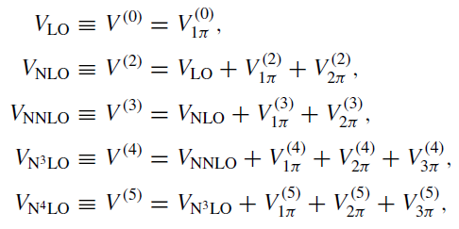
Deuteron in momentum space
Chiral Effective Field Theory
2-D output
In momentum space
D. R. Entem, R. Machleidt, and Y. Nosyk, “Consistent, high-quality two-nucleon potentials up to fifth order of the chiral expansion,” Journal of Physics: Conference Series, vol. 966, 2017.

Slide 16
Deuteron in momentum space
Chiral Effective Field Theory
2-D output
In momentum space
D. R. Entem, R. Machleidt, and Y. Nosyk, “Consistent, high-quality two-nucleon potentials up to fifth order of the chiral expansion,” Journal of Physics: Conference Series, vol. 966, 2017.

Slide 17
Schrödinger’s equation for the deuteron in momentum space
Schrödinger’s equation:
$$E\left({ψ_{s}(k_{i}) \atop ψ_{d}(k_{p})}\right)=$$
$$\int_{0}^{∞}{\left(\begin{matrix}\frac{{k′}^{2}}{2μ}\frac{δ(k_{i}−k′)}{{k′}^{2}}+V_{ss}(k_{i},k′) & V_{sd}(k_{i},k′) \\ V_{ds}(k_{p},k′) & V_{dd}(k_{p},k′)\end{matrix}\right){k′}^{2}\left({ψ_{s}(k′) \atop ψ_{d}(k′)}\right)dk′}$$

Slide 18
Training of the deuteron

Slide 19
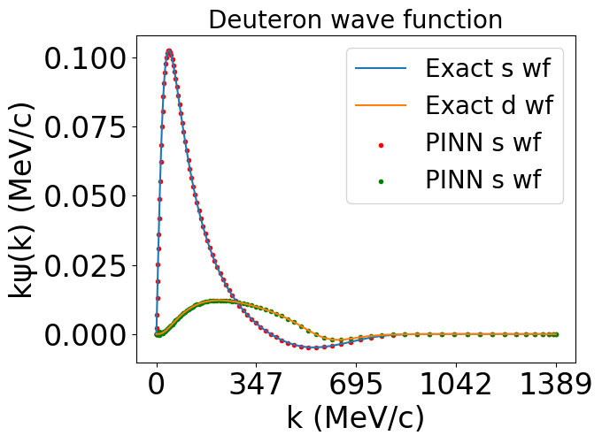
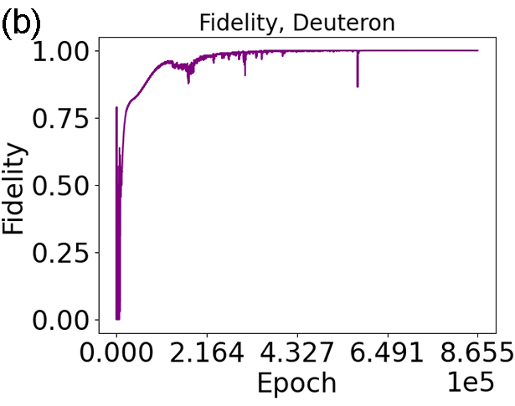
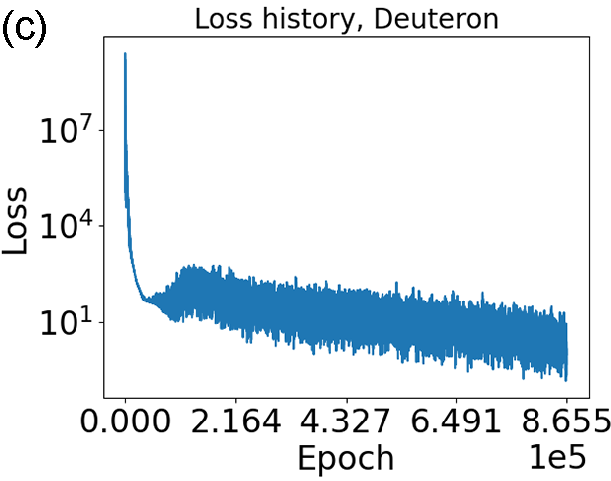
Results for the deuteron
$$\frac{E_{exact}−E_{PINN}}{E_{exact}}=−5.80 Χ{ 10}^{−5}$$
$$1/2$$

Slide 20
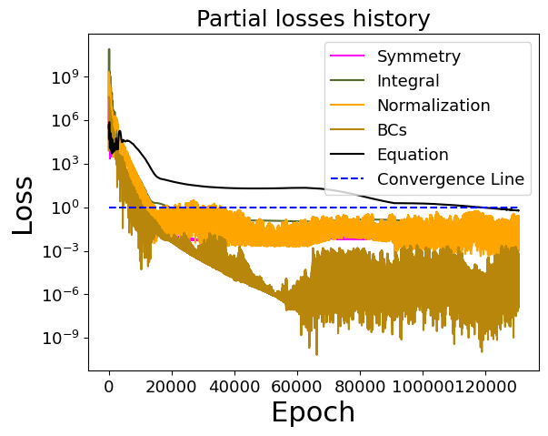
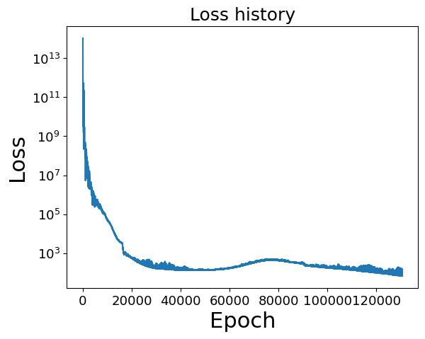
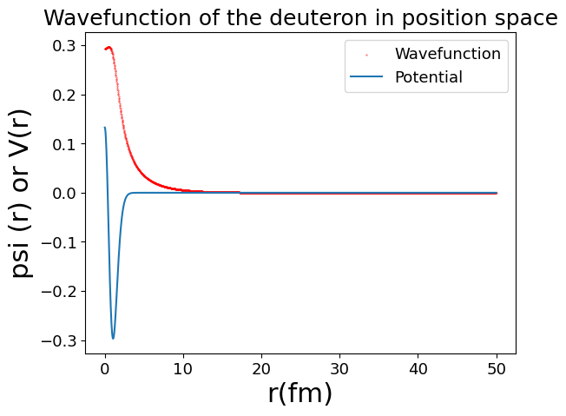
Deuteron in position space, minnesota potential
$$\frac{E_{exact}−E_{PINN}}{E_{exact}}=0.01$$
$${Loss}_{tot}={Loss}_{Schrod}+{Loss}_{Integ}+{Loss}_{Norm}+{Loss}_{{BC}_{s}}+{Loss}_{symmatry}$$

Slide 21
Future work
Spins and isospins of particles as inputs
Generalize to 3-D
Extend to larger nuclei

Slide 22
Conclusions
Initial studies for solving quantum many-body systems with Physics-Informed Neural Networks
Very few studies for unsupervised PINNs
Results published as the papers ‘‘Addressing the non-perturbative regime of the quantum anharmonic oscillator by physics-informed neural networks’’ and ‘‘A tutorial on the use of physics-informed neural networks to compute the spectrum of quantum systems’
Paper in preparation with the results for the deuteron

