Slide 1
Nuclear Density Functional Theory (DFT) for ground-state and collective excitations
Gianluca Colò
Dep. of Physics and INFN, Milano

Slide 2
The nuclear many-body problem
There are several combinations of nuclear Hamiltonians and many-body methods to solve the nuclear problem.
Ab initio approaches
Configuration interaction/Shell model
Mean-field and DFT
...

Slide 3
Ab initio nuclear structure
Techniques to solve the many-body problem that are exact, or systematically improvable, and can provide reliable estimates of the theoretical errors.
Results are sensitive to the choice of the Hamiltonian.
Quantum Monte Carlo (QMC)
Lattice EFT
In-medium similarity renormalization group (IMSRG)
Coupled cluster (CC)
Self-consistent Green’s function (SCGF)
No-core Shell Model (NCSM)
...
Image courtesy of A. Schwenk
Ab initio, depending on the specific implementation, has difficulties to handle heavy nuclei and excited states.

Slide 4
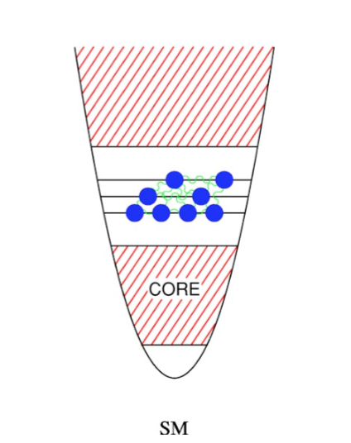
Shell model or Configuration Interaction
Nucleons (A) distributed within a given set of orbitals (n) in all possible ways.
Roughly combinatorial, but there are ways to restrict to good J and parity.
Diagonalization of H on this basis.
Analogous to CI for molecules.
Recent progress has been made concerning the SM embedded in the continuum.
Role of the core...
Talk by A. GARGANO (after coffee break) !!

Slide 5
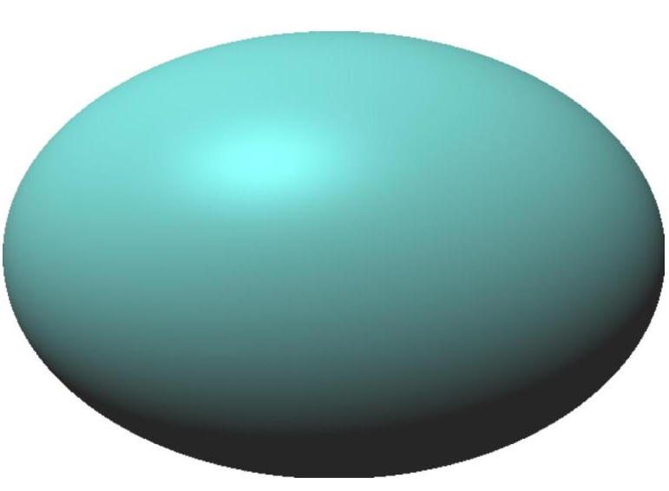
...
Giant Resonances and highly excited states
Spectroscopy of heavy nuclei
Reactions (transfer, fusion, fission)
Neutron stars
...
E_{X}
DFT
Z
H. Heigert, Front. Phys.2020
N

Slide 6
Glossary : DFT for Coulomb systems
According to Lévy and Lieb, for a system of fermions, it is possible to define an exact functional that relates energy and particle density:
In the case of electron systems, the Coulomb interaction is known. Density Functional Theory (DFT) was created initially (only) for electronic systems.
The lowest-order approximation for the energy (i.e. Hartree-Fock) is known but is not the DFT energy! There are also a few exact results for electrons.
Electronic DFT is called ab initio. Nonetheless, existing functionals usually include empirical parameters.

Slide 7
The Hohenberg-Kohn theorem
The original theorem and its proof can be found in P. Hohenberg, W. Kohn, Phys. Rev. 136, B864 (1964). They have in mind a system of interacting fermions (H = T + V) in some external potential V_{ext}.
There exist a functional of the fermion density
and the part denoted by F is universal (for nuclei, it would be the only part).
b) It holds:
The variational principle is written for the density. The w.f. may be even too large to write !! (Try as an exercise to estimate its dimension...)

Slide 8
The Kohn-Sham scheme
We assume that the density can be expressed in terms of single-particle orbitals, and that the kinetic energy has the simple form:
We have said that the energy must be minimized, but we add a constraint associated with the fact that we want orbitals that form an orthonormal set (Lagrange multiplier):
The variation of this quantity, (𝛿/𝛿ϕ*)... = 0 produces a Schrödinger-like equation:
“DFT is an exactification of Hartree-Fock” (W. Kohn).

Slide 9
The nuclear independent particle model
≈ MeV (levels from about -50 MeV)
Many experimental evidences point to the fact that nucleons move in nuclei, to a first approximation, as independent particles.
Examples: evidence of shells, ground-state of nuclei around closed shells (¹⁷O with Z=8, N=9 has J^{π}=5/2⁺) …
Red = HO
M.G. Mayer, J.H.D. Jensen

Slide 10
Glossary part 2: DFT for nuclei
In the case of nuclei, we do not have (yet) a “fundamental Hamiltonian” to start from. All EDFs are based on an ansatz for the form of E, and a parameter fit.
All started with the invention of HF with effective forces. At a given point, these forces have been seen only as a way to “generate” a total energy from . Thus, there is no considerable difference between HF and KS-DFT.
Skyrme...
Gogny...
...and covariant
EDFs

Slide 11
Skyrme force or “pseudo-potential”
attraction
short-range repulsion
There are velocity-dependent terms which mimic the finite-range.
The last term is a zero-range spin-orbit.
In total: 10 free parameters.
There are many existing Skyrme sets.
Some are available on Theo4Exp.

Slide 12
Total energy
E is the expectation value of H = T + v_{Skyrme} on an independent particle wave function, or Slater determinant.
Expectation values of 1-body and 2-body operators:

Slide 13
The expression for the energy can be found in P. Stevenson and M. Barton, PPNP 104, 142 (2019).
The expression is complicated because different kinds of densities appear...
However, the expression simplifies in even-even nuclei. Our code(s) are for spherical, even-even nuclei

Slide 14
From the total energy to HF equations
The total energy is written in terms of densities; and, in turn, the densities are written in terms of s.p. wave functions or orbitals.
This variation leads to HF (or HF-like) equations
Our code solves these equations in spherical symmetry, and on a radial mesh.
The method is iterative and, at convergence, the s.p. energies are stable while the energy reaches its MINIMUM.

Slide 15
Results
See the talk by Imane Moumene (after the coffee break).
Total energy and breakdown of different contributions, single-particle energies and wave functions, densities and some of their moments like <r²>.

Slide 16
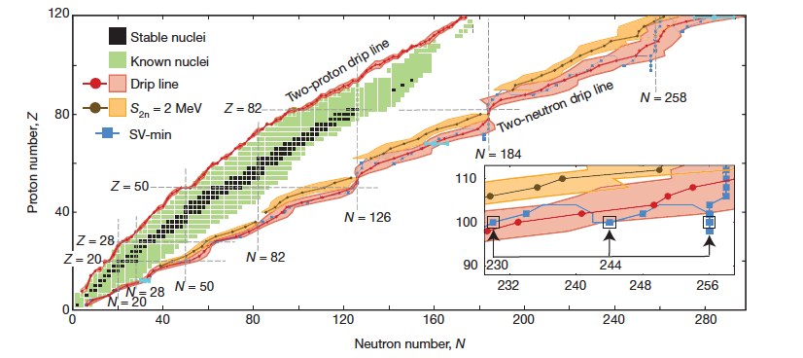
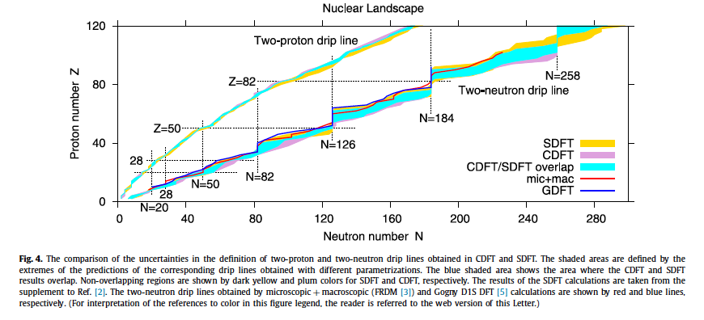
The drip lines
J. Erler et al., Nature 486, 509 (2012) - SEDF
A.V. Afanasjev et al., Phys. Lett. B726, 680 (2013) - CEDF

Slide 17
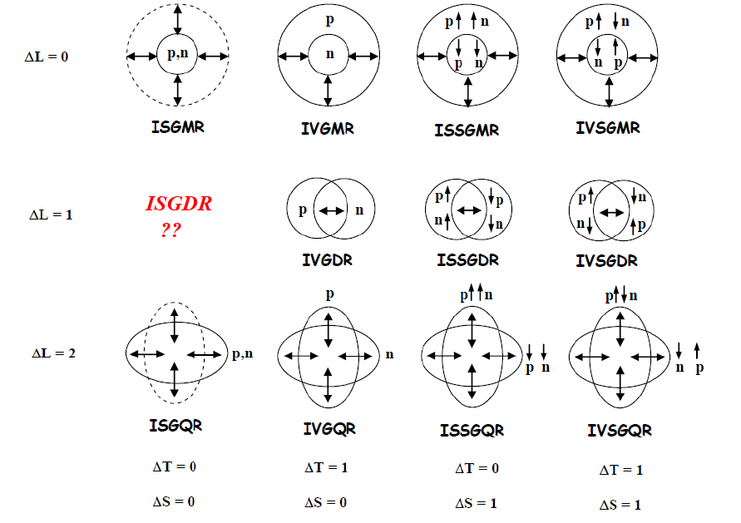
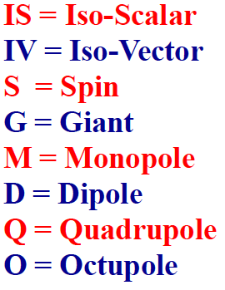
Nuclear collective vibrations
Figure by M. Harakeh

Slide 18
Strength function and operators
Isoscalar (T=0) vs. isovector (T=1) and electric (S=0) vs. magnetic (S=1) operators.
C.o.m. subtracted

Slide 19
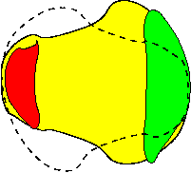
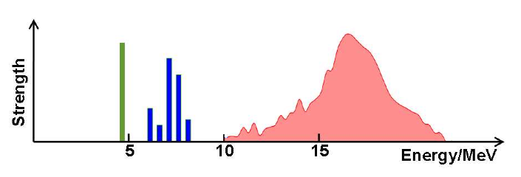

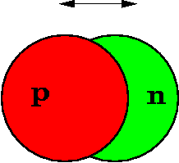
Collectivity
Given the strength function, one can define its moments:
Often, some states exhaust most of the total strength of or the EWSR.
Total strength
EWSR
2⁺⊗3⁻
GDR
PDR
Courtesy: N. Pietralla

Slide 20
Time-dependent Hartree-Fock or Kohn-Sham
In the time-dependent case, one can solve the evolution equation for the density directly:
From: P. Stevenson (U. Surrey)
This approach allows also studying large-amplitude motion (e.g. reactions).
If the equation for the density is linearized (small amplitude limit or linear response): Random Phase Approximation or RPA.

Slide 21
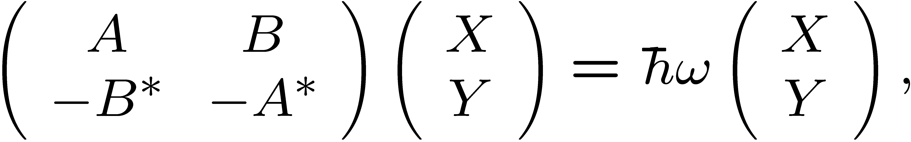
Matrix RPA and Finite Amplitude Method (FAM)
Small amplitude Harmonic approx.
Standard definition of the “forward” and “backward” amplitudes:
FAM: the calculation of the two-body matrix elements is avoided
Matrix formulation
G.C. et al., Computer Physics Commun. 184, 142 (2013).

Slide 22
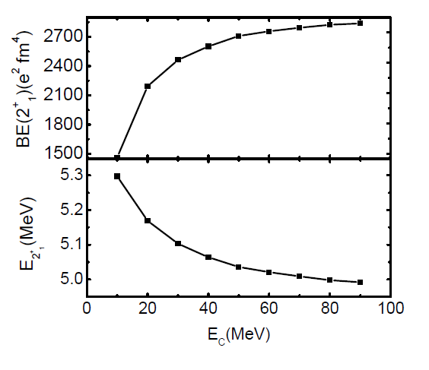
The RPA program
The continuum is discretized. The basis must be large due to the zero-range character of the force. Parameters: R, E_{C}.
One possible issue:
Since the code is spherical, it may be prone to instabilities when calculating e.g. 2⁺ states in a nucleus which is actually deformed.
Signal: imaginary solution.
²⁰⁸Pb - SGII
Cf. Imane’s talk for more details and examples.

Slide 23
RPA and collectivity: schematic model (I)
Schematic 2 x 2 case
Magnetic spin-flip
states (M1)
²⁰⁸Pb : h_{11/2} → h_{9/2} (proton)
i_{13/2} → i_{11/2} (neutron)

Slide 24
RPA and collectivity: schematic model (II)
Schematic N x N case
2hω
There is one “coherent state”:
Its transition amplitude is enhanced:
1hω
0hω
G. C., Theoretical Methods for Giant Resonances, in:
Handbook of Nuclear Physics, edited by I. Tanihata, H. Toki and T. Kajino
(Springer, 2022).

Slide 25
Giant resonances are NOT sharp states but have a large width (several MeV)
Internal mixing
Decay
If this picture clear in all details? We do not have systematic data and full understanding (cf. also β-delayed neutron emission).
This is a challenge for theory and may not simply call for parameter tuning but is related to fundamental questions (many-body theory, open quantum systems, the concept of thermalization...).

Slide 26
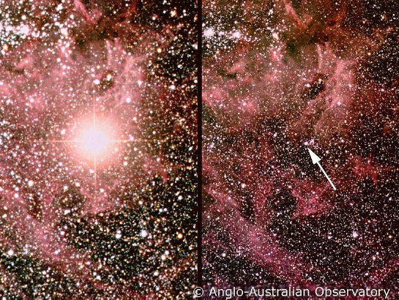
Giant Monopole Resonance
Example of study which is not carried out for mere “academic purposes”, but to shed light on more general properties of nature…
Breathing mode: in this case its energy is correlated with the compressibility of nuclear matter.
We better consider the density as a variable.
Incompressibility:
SN1987a
(around 240 MeV)
U. Garg, GC, PPNP 101 (2018) 55

Slide 27
All this did not consider pairing, namely it was supposed to work for magic nuclei...
...we move to the superfluid case

Slide 28
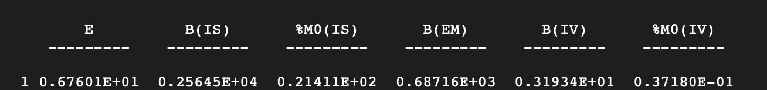
Exercise 1
¹⁶O RPA 3⁻ SLy5 default parameters
E_{exp}
6.13 MeV
²⁰O RPA 2⁺ SLy5 default parameters: instability!
²⁰O QRPA 2⁺ SLy5 box = 16 fm, E_{max} = 60 MeV:

Slide 29
Exercise 2
^{A}O : A=16-24
SLy5. Box size = 15 fm
A | E | E_{exp} | <r_{p}>^{1/2} | <r_{p}>^{1/2}_{exp} | <r_{n}>^{1/2} | 𝚫_{n}
16 | 128.40 | 127.52 | 2.68 | 2.59 | 2.66 | 0
18 | 141.18 | 139.81 | 2.69 | 2.68 | 2.83 | 1.19
20 | 153.36 | 151.40 | 2.70 |  | 2.96 | 1.29
22 | 163.30 | 162.00 | 2.71 |  | 3.06 | 0.76
24 | 171.30 | 168.90 | 2.74 |  | 3.20 | 0
Exp. energies from nndc.bnl.gov; exp. proton radii from De Vries et al., ATNDT 36, 495 (1987).

Slide 30
Exercise 3
arXiv:2506.13354v1

Slide 31
RPA and the nuclear Shell Model (SM)
In addition, the shell model cannot provide response at high energy (cross sections for high-E neutrinos, just to make an example, are doable within RPA and QRPA but not SM).

Slide 32
Backup slides

Slide 33
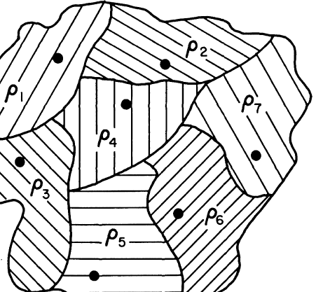
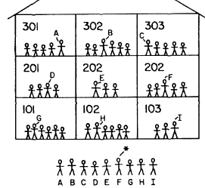
The constrained search approach by Lévy-Lieb
We consider all w.f.’s that correspond to a specific density with the symbol
“instead of finding the tallest child in the school by lining all of them in the yard, we just line in the yard the tallest pupils of each class...”

Slide 34
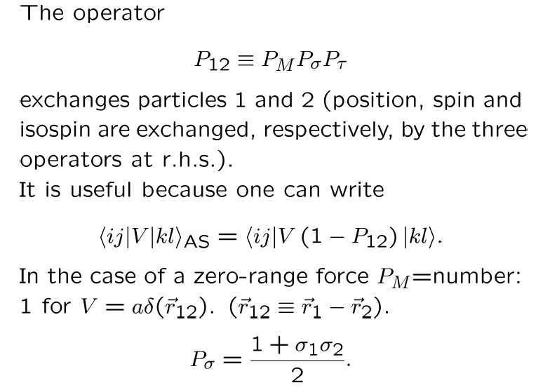
Note on exchange operators

Slide 35
Fitting the EDF parameters
Empirical saturation point
Masses of nuclei
Charge radii of nuclei
More pseudo-observables like the equation of state of neutron matter
More observables: excited states
A bit outside DFT philosophy: single-particle states and spin-orbit splittings
χ-square fitting is one widely used option to obtain the EDF parameters
Increasing number of studies that employ Bayesian techniques (parameter distributions)

Slide 36
Masses and charge radii of atomic nuclei
Masses: typical errors ≈ MeV. “Arches” show up.
X. Roca-Maza and N. Paar, PPNP 101, 96 (2018)
For radii the pictures is somehow more blurred. More fingerprints of the basic limitations of the current EDFs.
From M. Bender

Slide 37
RPA and TDHF
This comparison between TDHF and RPA (using Skyrme EDFs) is taken from:
S. Burrello et al., Phys. Rev. C99, 054314 (2019).

Slide 38
The nuclear EoS and the symmetry energy (I)
From the energy per particle as a function of the density we can extract the pressure.
For this reason, we call E/A the “equation of state” of nuclear matter.
In this quantity, the part that depends on the neutron-proton imbalance is poorly known.
Symmetry energy S
Symmetric matter EOS
Nuclear matter EOS
Odd powers forbidden by isospin symmetry
Up to densities relevant for nuclear physics this “quadratic approximation” seems to hold

Slide 39
The nuclear EoS and the symmetry energy (II)
Symmetry energy S
Symmetric matter EOS
Nuclear matter EOS
β=1
In turn, the symmetry energy can be expanded around a reference density.
One usually takes the saturation energy of symmetric matter:
β=0

Slide 40
The nuclear EoS and the symmetry energy (III)
Expansions around ρ₀= 0.16 fm⁻³ SATURATION POINT of SNM
J.M. Lattimer, Y. Lim, Astr. J. 771, 51 (2013)
B.A. Li and X. Han, PLB 727, 276 (2013)
M. Oertel et al., RMP 89, 015007 (2017)
B.A. Li et al., Prog. Part. Nucl. Phys. 99, 29 (2018)
J = S₀ = S_{v} = a₄ = a_{τ}

Slide 41
Symmetry energy from IV vibrations
Neutrons and protons oscillate in opposition of phase.
Promising observables to extract the properties of the symmetry energy.
Problems:
the nucleus is not a homogeneous system, it has a shell structure, and there is isoscalar/isovector mixing.

Slide 42
Giant Quadrupole Resonance
The ISGQR energy is sensitive to the effective mass.

Slide 43
Reminder on effective mass
Here, E is the single-particle energy, NOT the total energy.
First term: E-mass
Second term: k-mass

Slide 44
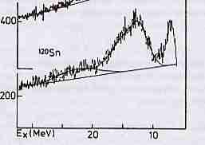
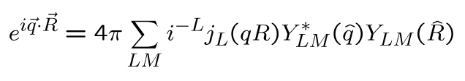
GRs excited in inelastic scattering
E.g. (α,α’): reaction theory should be used
DWBA
Simplifying (not realistic) assumptions: zero-range force, distorted waves reduced to plane waves:

Slide 45
With the previous assumptions:
If the argument is small,
and then the cross section for a given L is proportional to the matrix element of

