Slide 1



Modeling Dynamics of Weakly Bound Helium Dimers and Trimers Kicked by Laser Pulses
Qingze Guan
Department of Physics and Astronomy
Washington State University
in collaboration with Doerte Blume @ U of Oklahoma
and Reinhard Doerner’s group @ Frankfurt U
Jun. 09, 2025 @ ECT*
Supported by NSF!

Slide 2
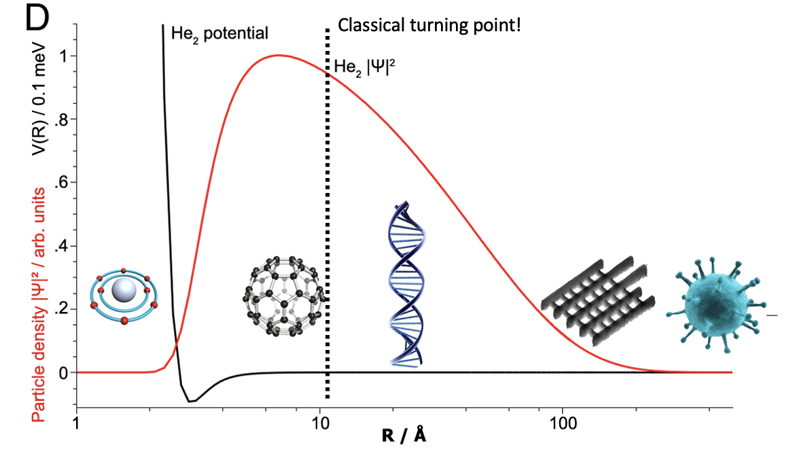

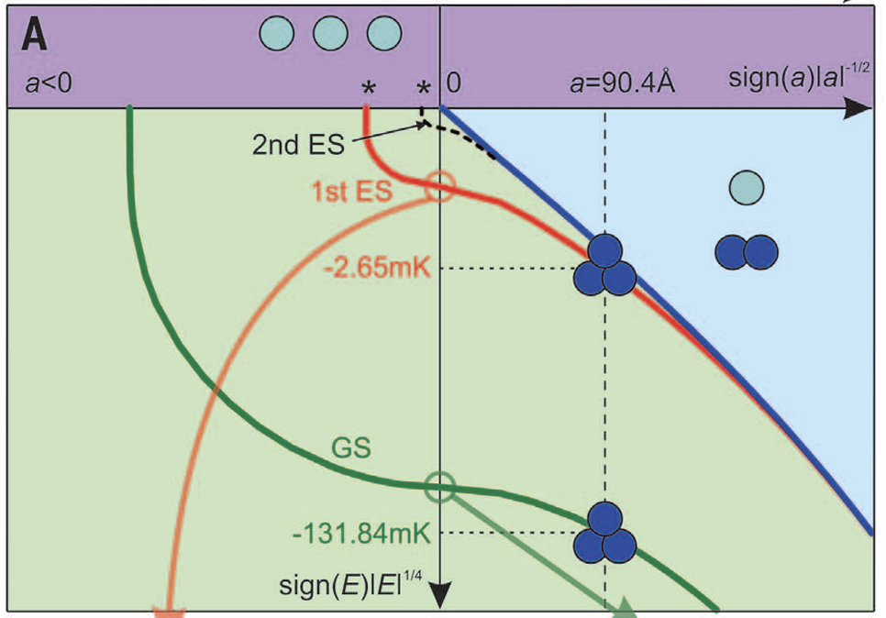
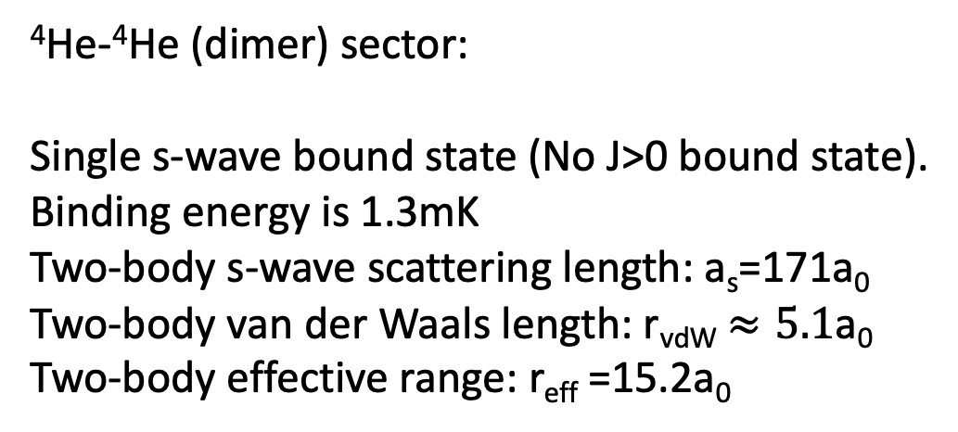
Some Backgrounds on Helium Systems
⁴He-⁴He (dimer) sector:
Single s-wave bound state (No J>0 bound state).
Binding energy is 1.3mK
Two-body s-wave scattering length: a_{s}=171a₀
Two-body van der Waals length: r_{vdW} $≈5.1$a₀
Two-body effective range: r_{eff} =15.2a₀
Image from PNAS 113, 14651 (2016) by Frankfurt group
⁴He-⁴He-⁴He (trimer) sector:
Two s-wave bound states (No J>0 bound state).
Ground state binding energy: 131mK
First excited state bind energy: 2.65mk
Figure from Science (2015) by Frankfurt group and Doerte

Slide 3
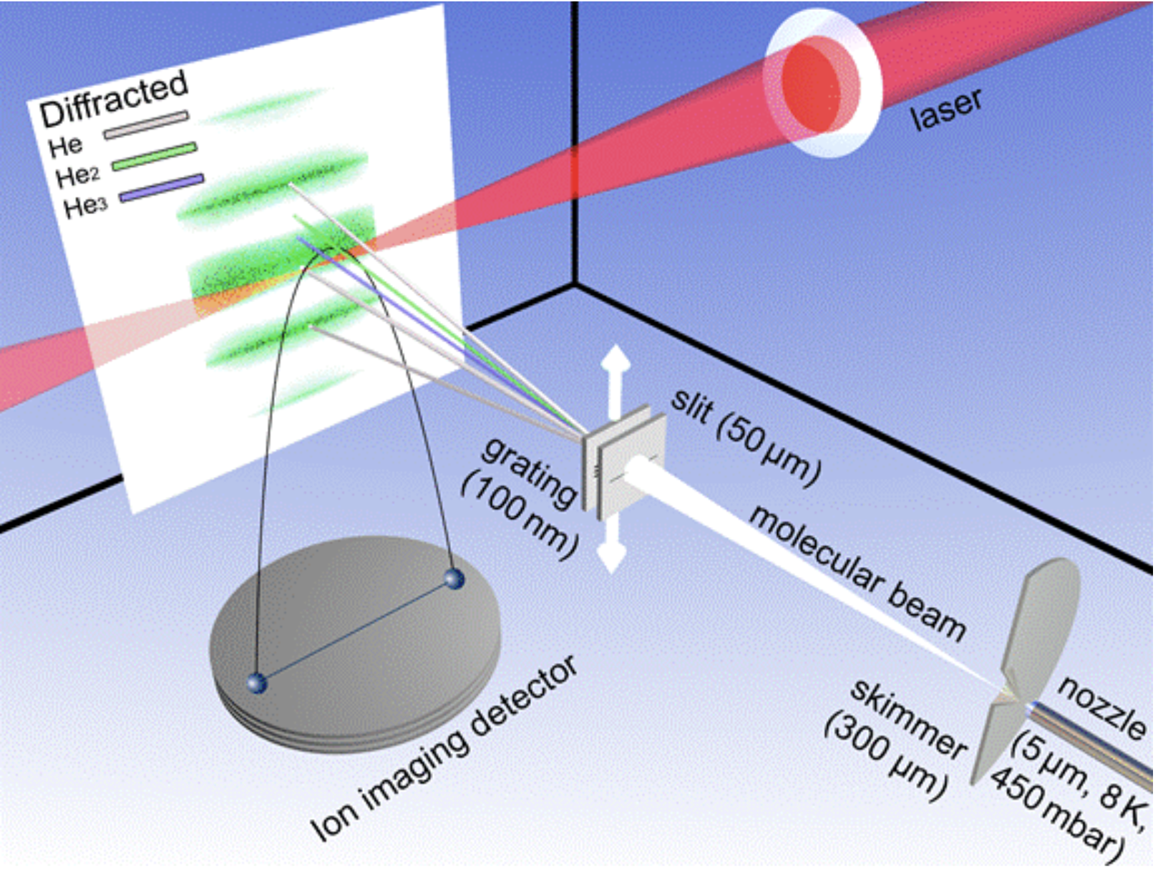
Observe He-Clusters---Frankfurt Experiment
Cool helium gas down to around 8K.
Shoot the molecule beam through a grating slit.
Separate different helium clusters by their diffraction angles.
Ionize the selected helium clusters for Coulomb explosion.
Detect the flying ions. See the next two slides for details.
Ionize He atoms
Coulomb explosion converts potential energy to kinetic energy

Slide 4
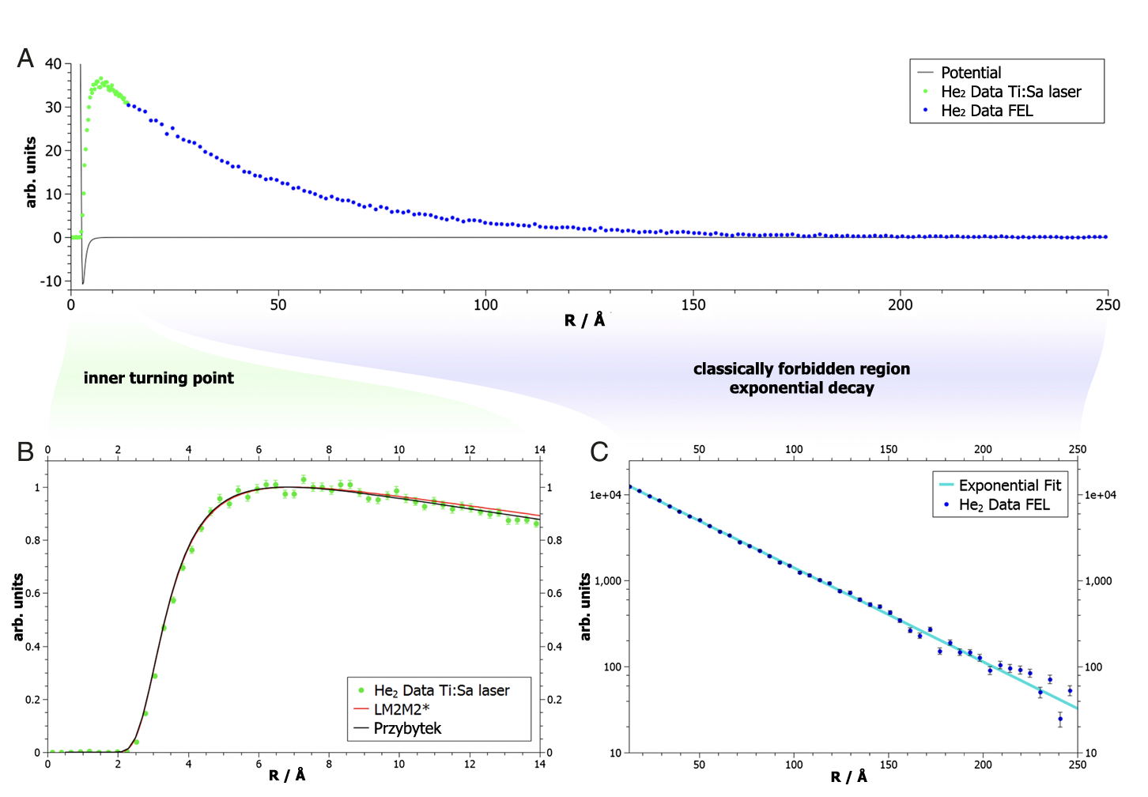
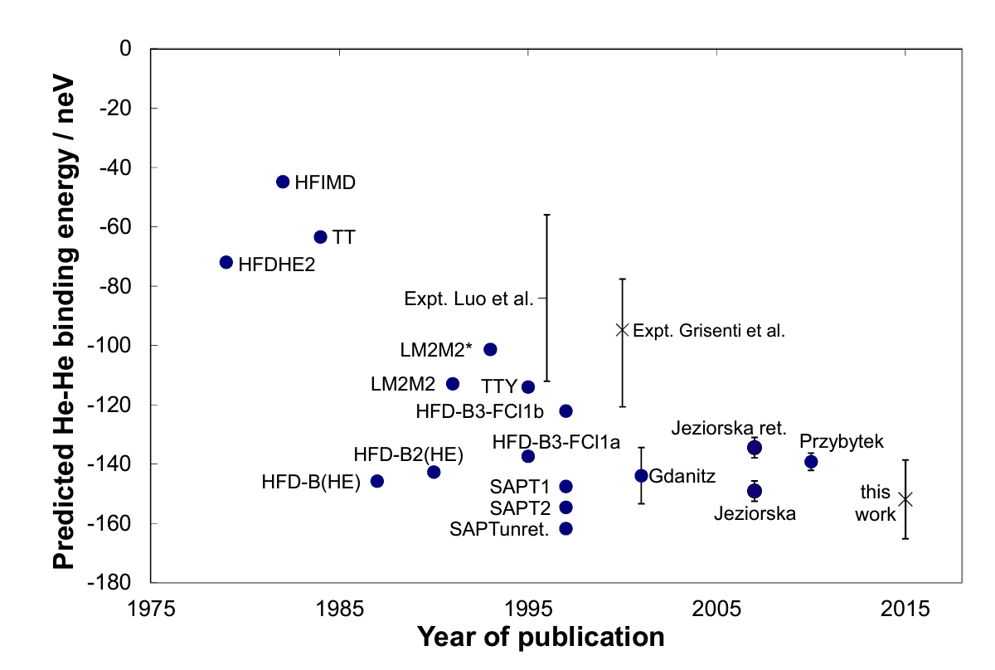

Measure ⁴He- Dimer Binding Energy
Frankfurt group, PNAS 113, 14651 (2015)
It has been a long-time desired work to accurately measure the binding energy.
Different model gives different results.

Slide 5
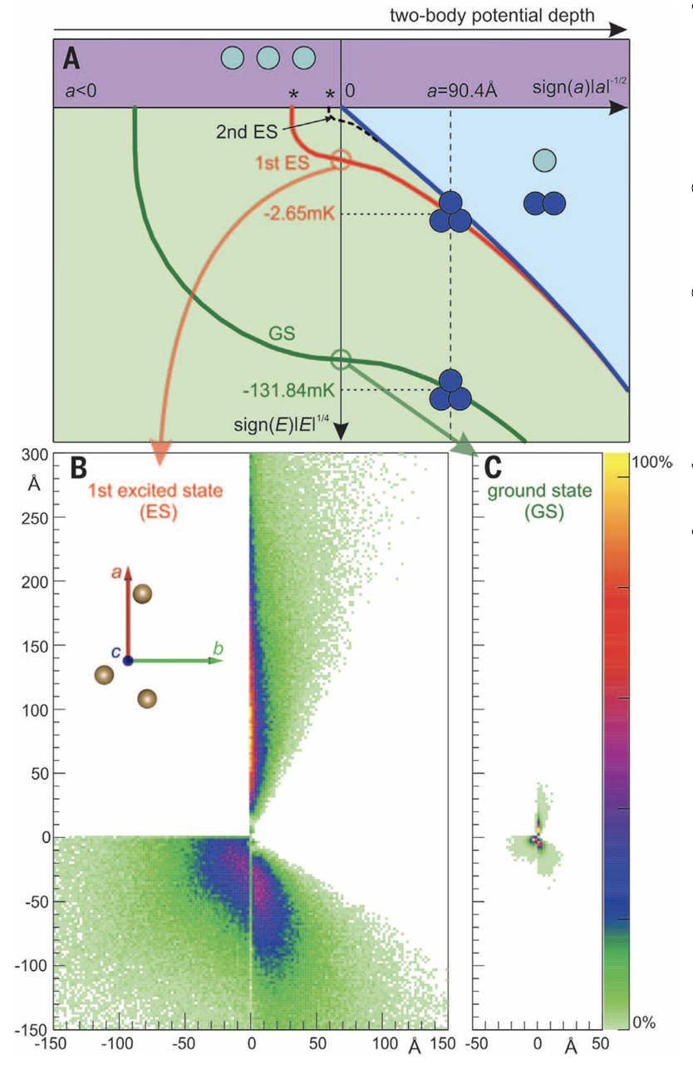
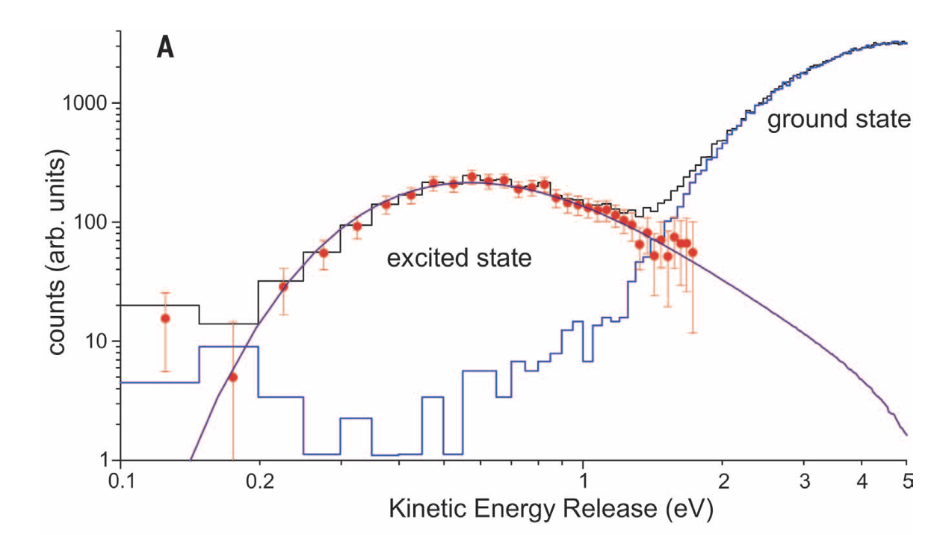
Observe ⁴He- Trimer---Efimov Physics
Frankfurt group and Doerte, Science 348, 551 (2015)
Higher nozzle pressure
Lower nozzle pressure
The kinetic energy release shows that the population of the excited trimer state can be controlled and measured experimentally!

Slide 6
Where To Go From Here…
Static properties:
  1. Look at other sectors, e.g., tetramer state tied to the trimer state and larger He clusters
  2. Look at other species, e.g., ³He-⁴He, He-Ne, Ne-Ne, Ar-Ar,… (more and more bound states)
  3. Gift of nature: close to unitarity for He system. Can the scattering length be tuned?
Dynamic properties:
  Initiate the dynamics of dimers and trimers using ultrashort laser pulse.
  How do fast lasers interact with helium molecules and control the dynamics?
  How different is the dynamics of the quantum halo state from the dynamics of the other tighter bound states?

Slide 7
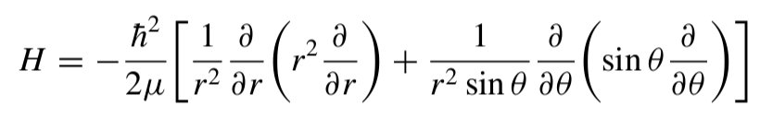


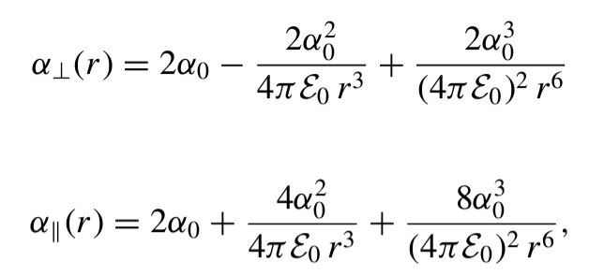
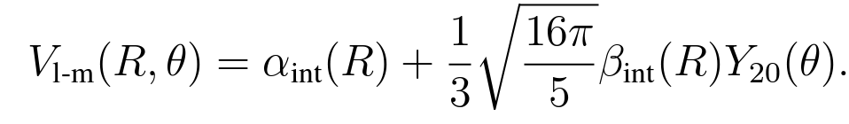
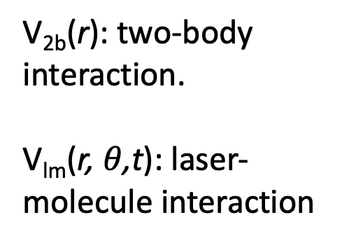
Model Helium Dimer Systems in External E-Fields
A laser in the z-direction is applied.
Theory framework (separate off c.o.m):
V_{2b}(r): two-body interaction.
V_{lm}(r, $θ$,t): laser-molecule interaction
: parallel and perpendicular polarizabilities from electronic structure calculations.
See A. D. Buckingham and R. S. Watts, Mol. Phys. 26, 7 (1973).

Slide 8
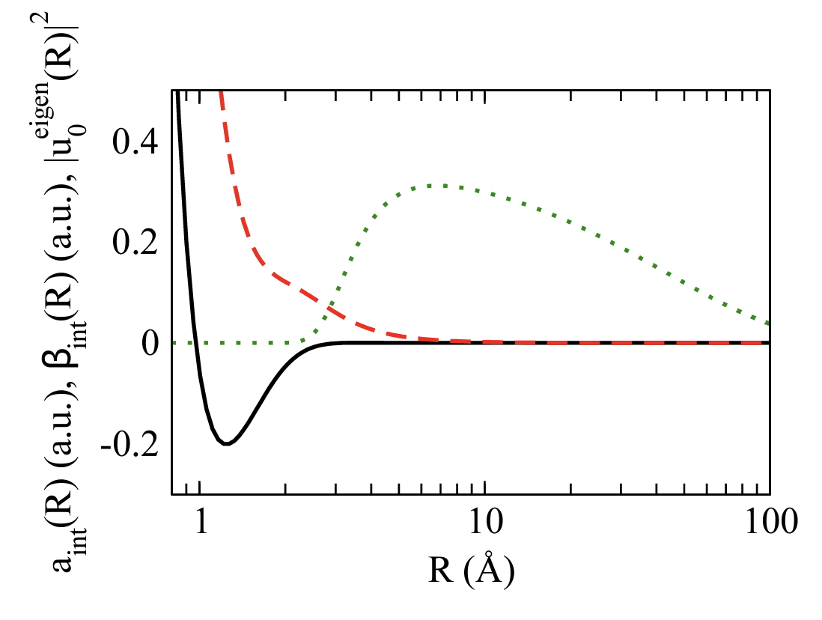
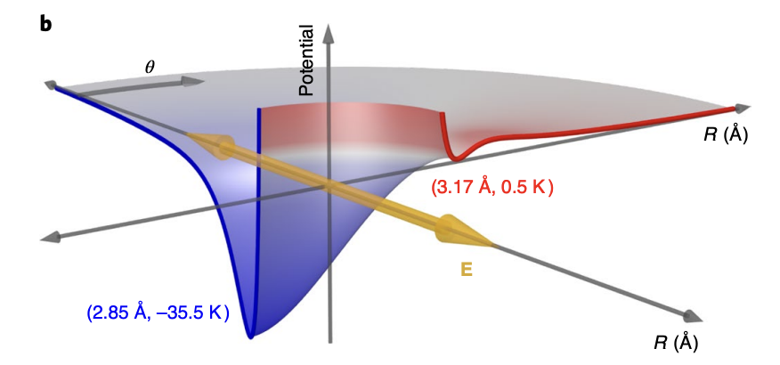
Tune Helium-Helium Interactions
External laser field modifies the inner region of the potential significantly.
E-field
Induced electric dipoles
E-field
Repulsive
Attractive
Modified He-He potential. The spherical symmetry is broken
Green: He dimer wave function
Red: anisotropic polarizability
Black: isotropic polarizability
Frankfurt group, Q. Guan, D. Blume, Nat. Phys. 17, 174 (2021)

Slide 9
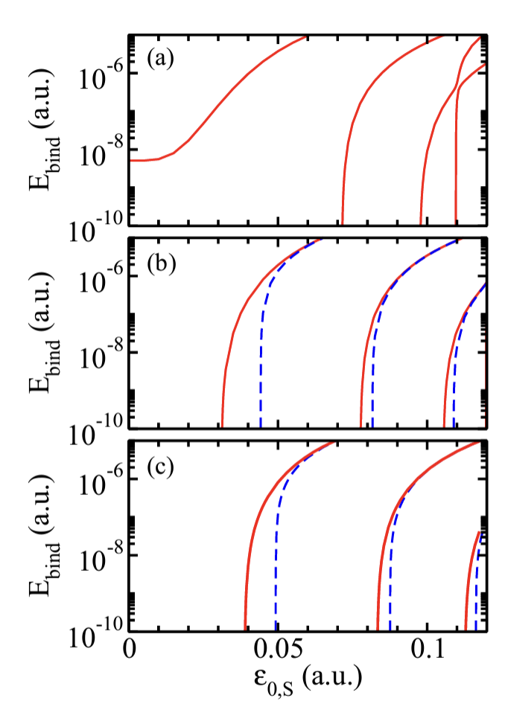
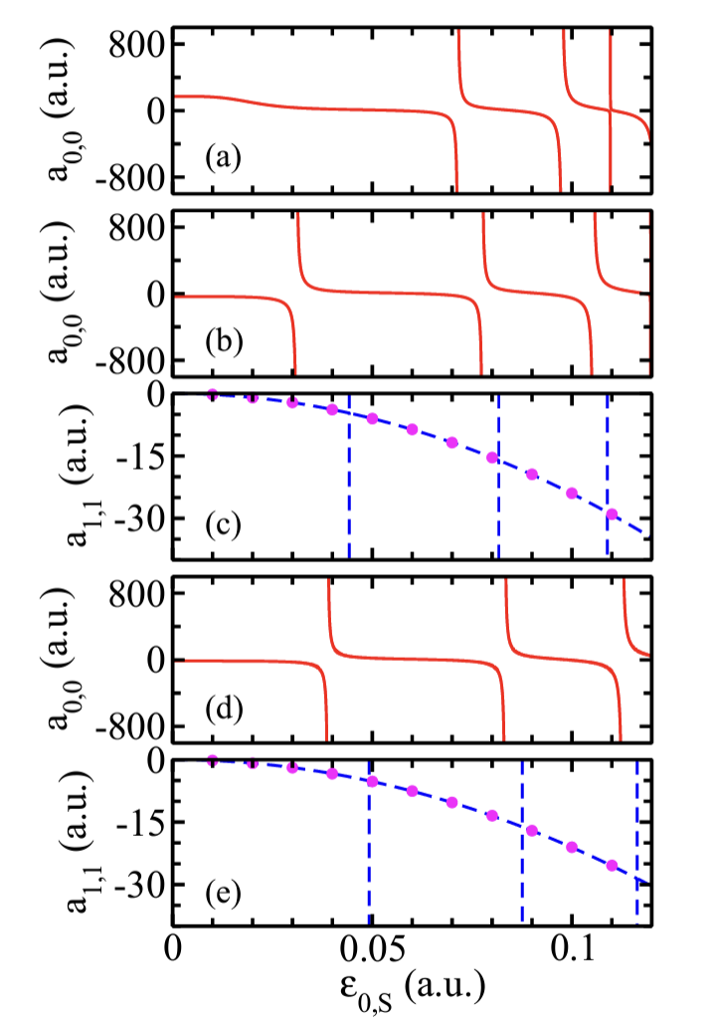
Tune Helium-Helium Interactions
Tune the binding energies:
Tune the scattering length:
Q. Guan, D. Blume, PRA 99, 033416 (2019)
s-wave
⁴He-⁴He
s-wave
With increasing laser intensity, more and more bound states are supported!
⁴He-³He
p-wave
s-wave
³He-³He
p-wave
Laser intensity
Binding energies are tunable!
0.1 a.u. is 3.51*10¹⁴W/cm²: Strong lasers!!

Slide 10
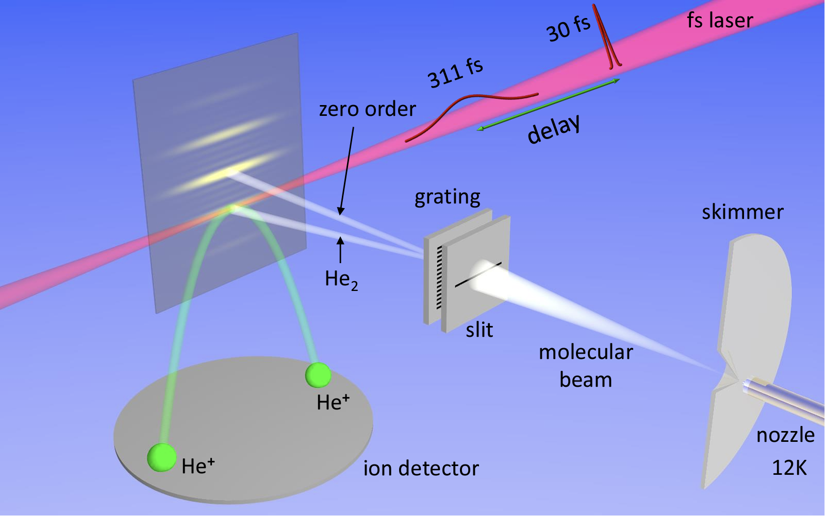
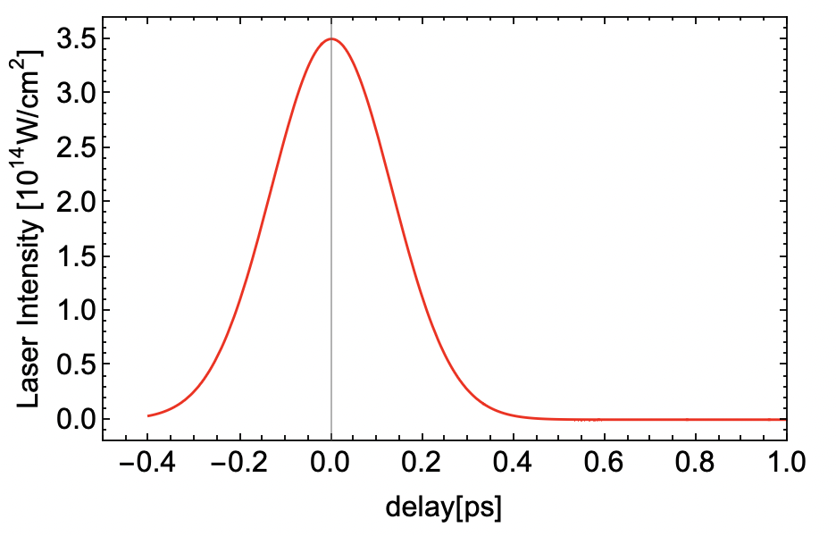

Dynamics in Strong Laser Pulse
It is non-trivial to hold such a strong laser field for a long time in experiment due to the constraint in laser powers.
It is possible if the pulse length is short. For example, we take a Gaussian pulse.
A 331fs Gaussian pulse is applied before the Coulomb explosion.
Remember lasers interact with dimers at short distance. What kind of dynamics do we expect?
We do we measure?
Let us look at the alignment signal <cos²($θ$)>!

Slide 11
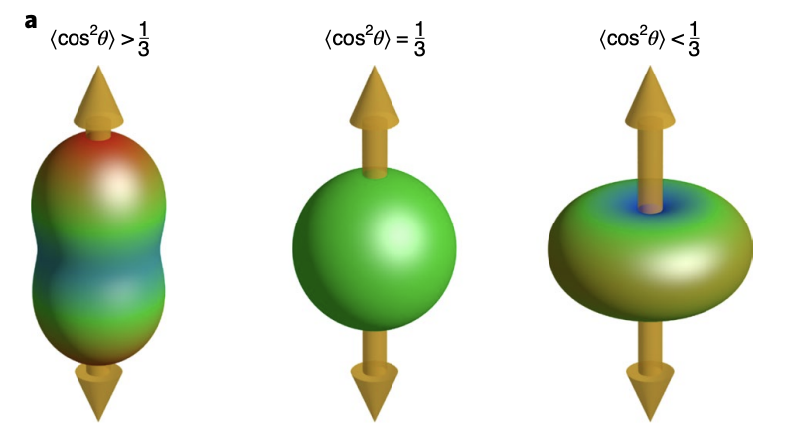
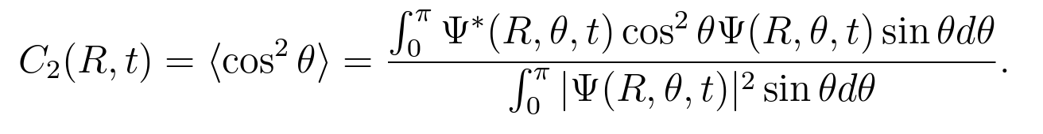
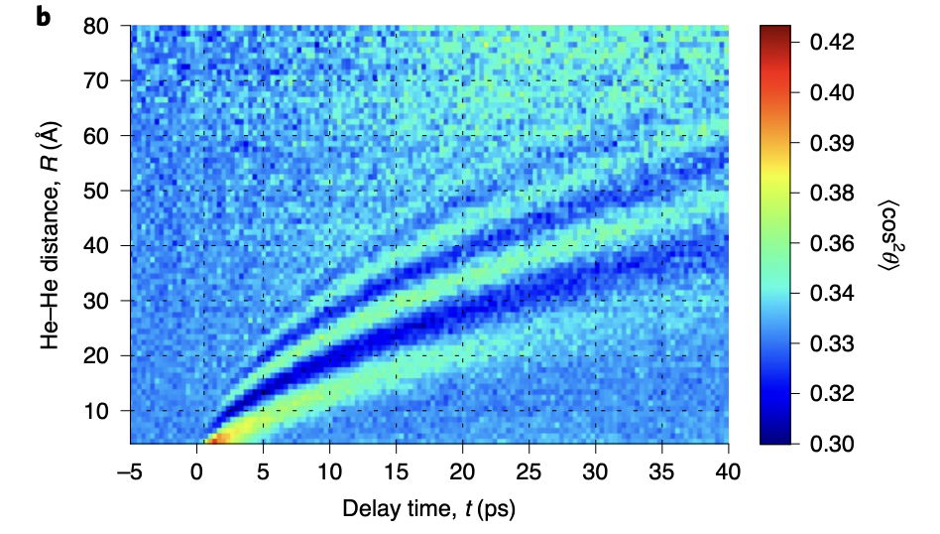
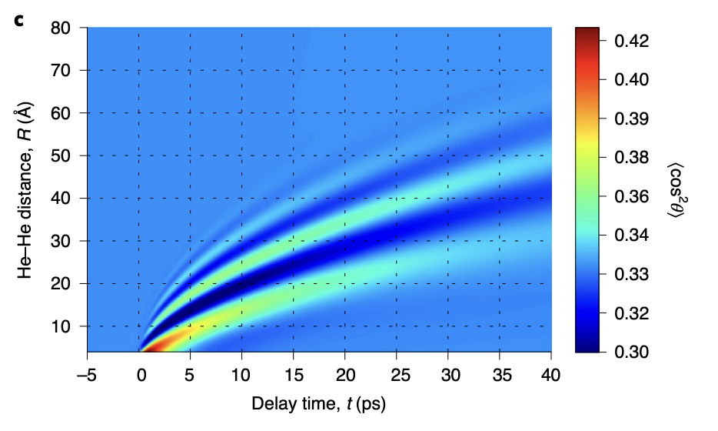
Dynamics Alignment Signals
For spherical symmetric wave function, we have <cos²($θ$)>=1/3. This is the reference point.
It thus motivates us to look at C₂(r, t), the alignment signal at various r values at different time
More aligned with the field
More perpendicular to the field
To start with, the dimer gets kicked only when they are close. The signal then propagate out.
Perfect agreement between theory and experiment!
Frankfurt group, Q. Guan, D. Blume, Nat. Phys. 17, 174 (2021)

Slide 12
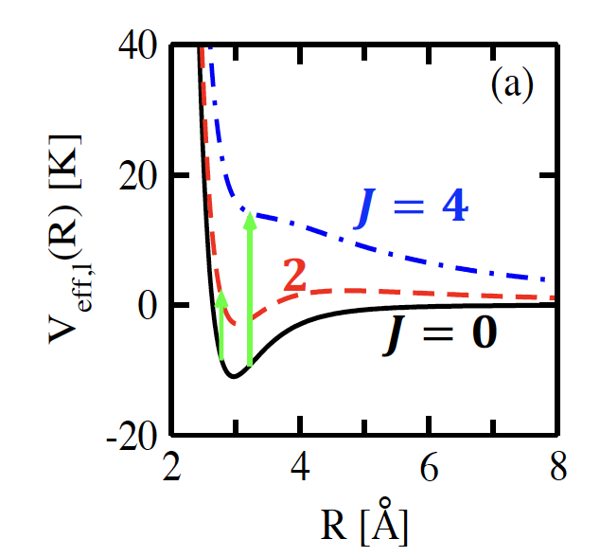
Explanation of the Interference Pattern
The laser-molecule interaction potential couples even J angular momentum channels
The helium dimer ground state occupies J=0 channel (s-wave). The pulse grabs population transfer from J=0 to J=2 and J=4.
All the higher J channels only have scattering states. All the populations in the higher J channels fly away.
The pulse transfers roughly 3% population to the d-wave channel (J=2) and negligible populations to the J=4 channel. It is expected that two channel model is enough (see next slide).

Slide 13
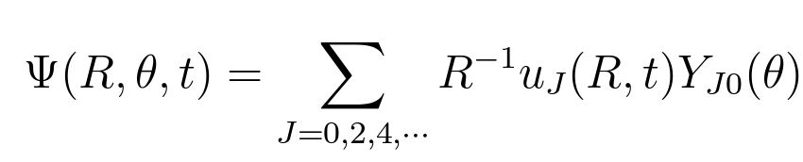
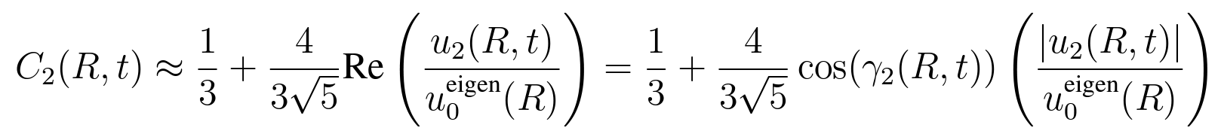
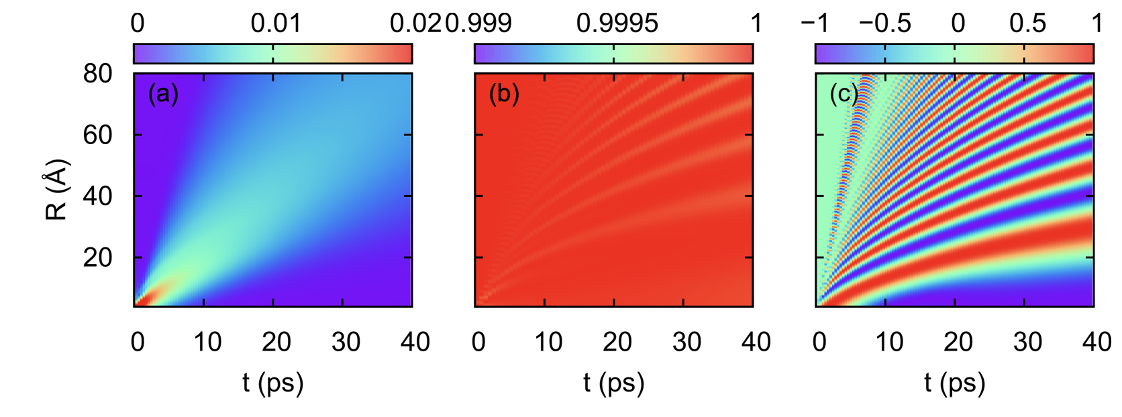


Explanation of the Interference Pattern
Decompose wave function into partial waves
Calculate the alignment signal using two channels (J=0 and J=2)
|u₀(R, t)|²
$γ$₀(R, t)
$γ$₂(R, t)
The finger patterns come from the interference between the J=0 bound state portion and the J=2 scattering portion!

Slide 14
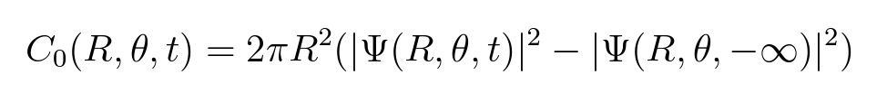
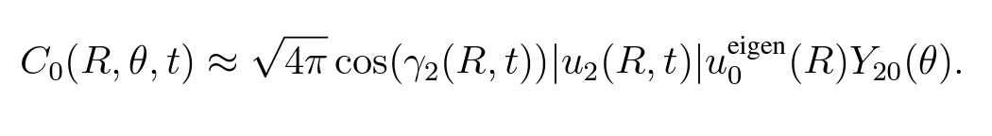
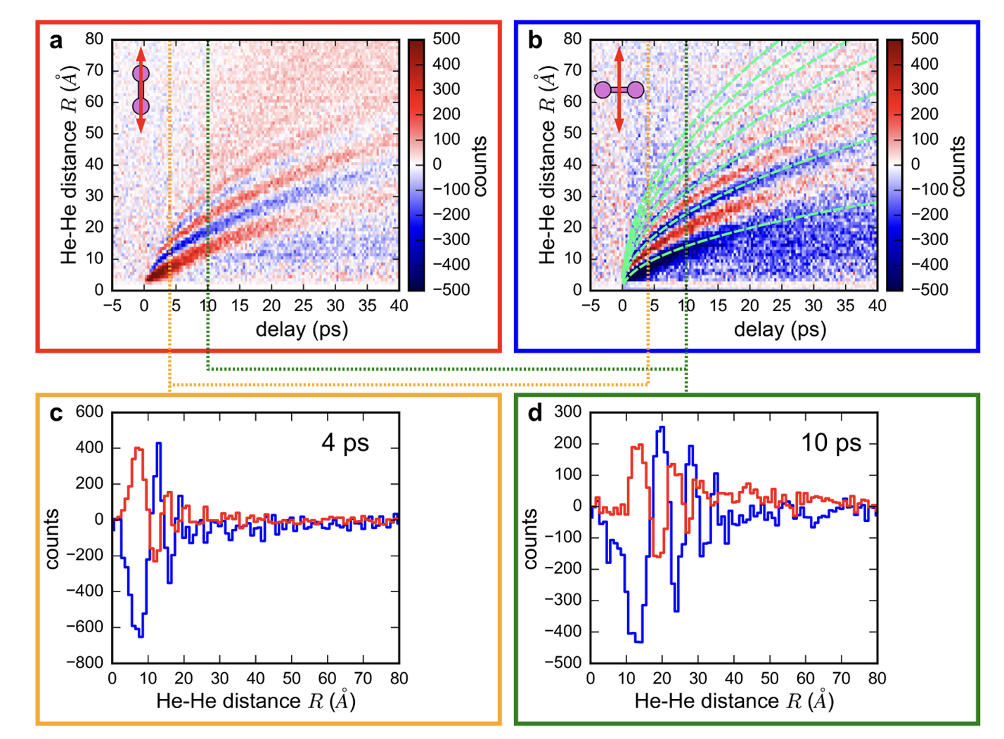

Another Observable
The alignment signal has a good resolution in r. The angle $θ$ is averaged away locally.
Density difference before and after the laser kick
Left panel: $θ=0$ (parallel to the pulse)
Right panel: $θ=π/2$ (perpendicular to the pulse)
Frankfurt group, Q. Guan, D. Blume, Nat. Phys. 17, 174 (2021)

Slide 15
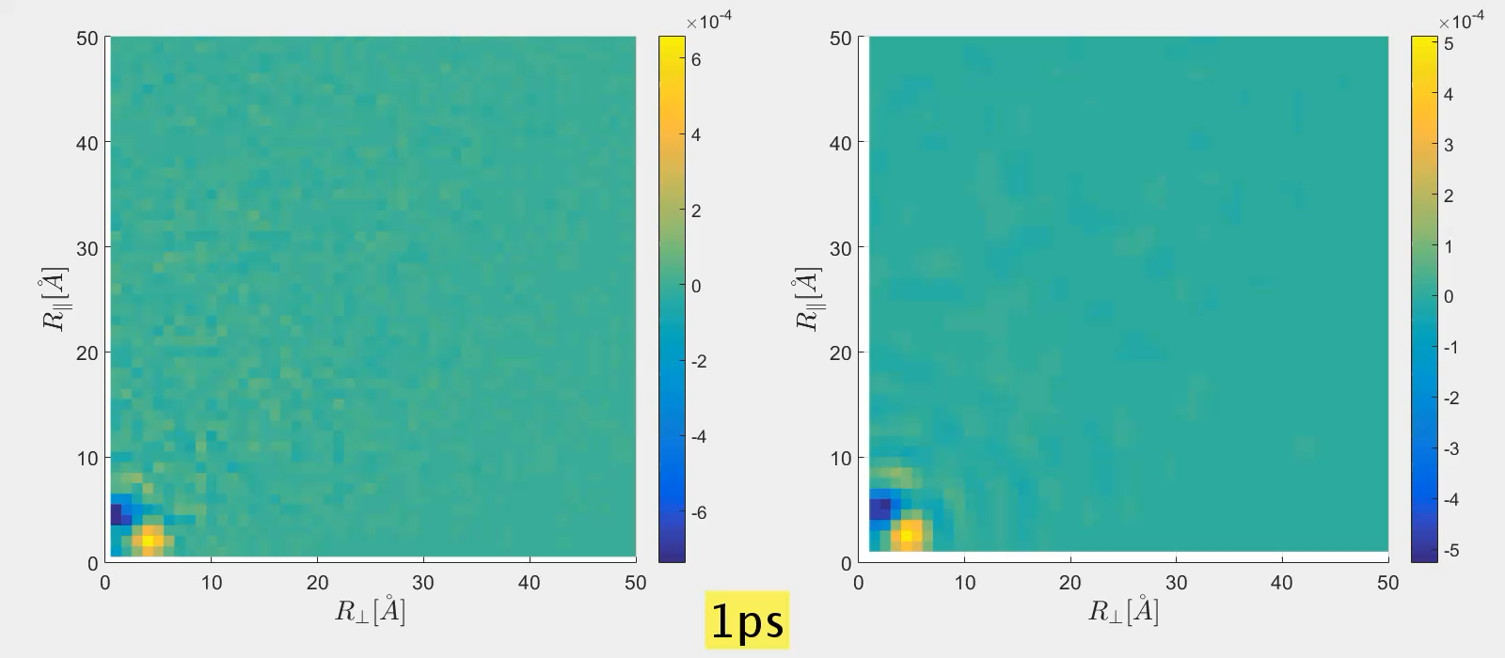
Full Theory Experiment Comparison of C₀(R, $θ$, t)
Frankfurt group, Q. Guan, D. Blume, Nat. Phys. 17, 174 (2021)

Slide 16
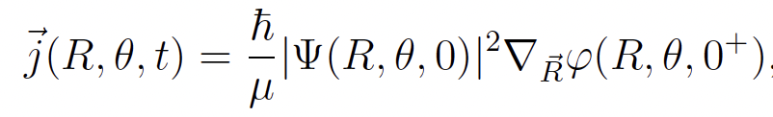
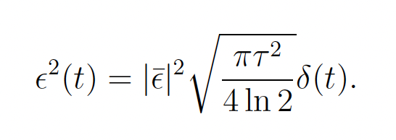
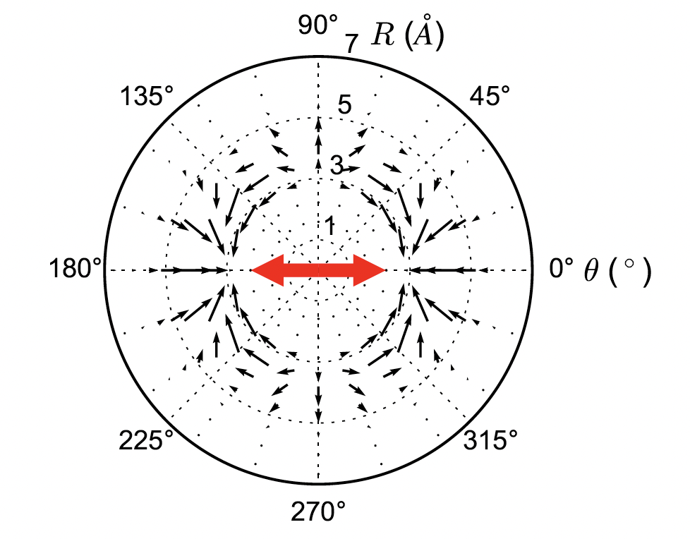
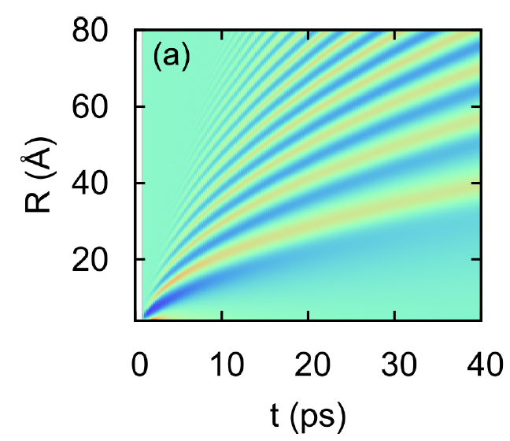
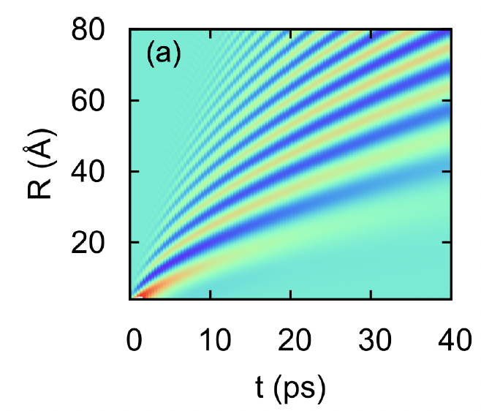

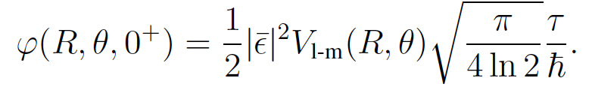
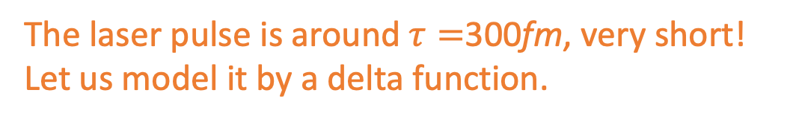
One More Lesson Learned From Kicked Dimer Dynamics
The laser pulse is around $τ=$300fm, very short! Let us model it by a delta function.
Flux of the kicked state:
Coefficient determined by area under the curve!
Alignment signal:
Delta-pulse
Gaussian-pulse
Wave function after the kick for delta-pulse:
Delta pulse is good enough!
Very useful for modeling the trimer dynamics!

Slide 17
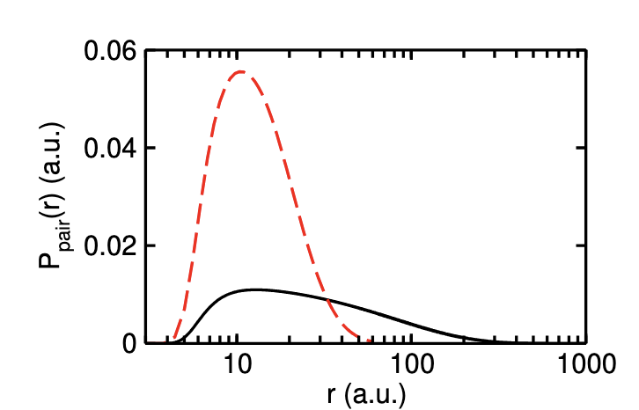
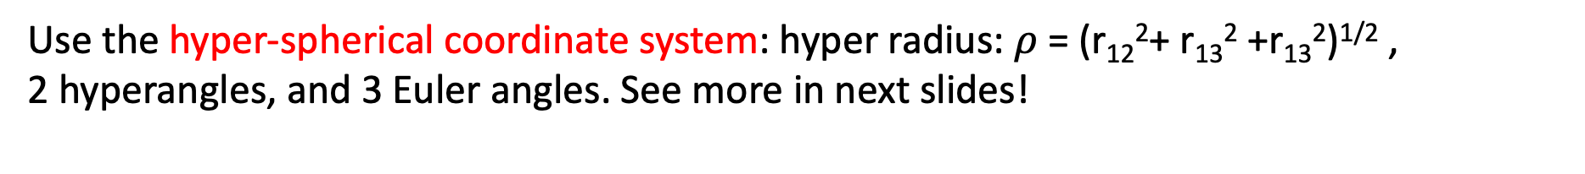
Helium Trimer System
The system has 6 dimensions: 3 Euler angles and 3 internal degrees in body-fixed frame.
Ground state Pair distribution function
View the system by three pairs.
Comparing to dimers, we can look at the dimer signal out of the trimer system!
Trimer
Dimer
Q. Guan, D. Blume, and Frankfurt group, PRA 111, 023108 (2025)
Use the hyper-spherical coordinate system: hyper radius: $ρ$ = (r₁₂²+ r₁₃² +r₁₃²)^{1/2} ,
2 hyperangles, and 3 Euler angles. See more in next slides!

Slide 18
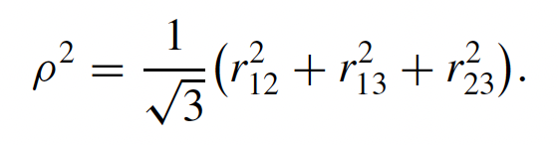
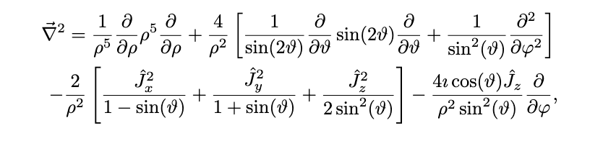
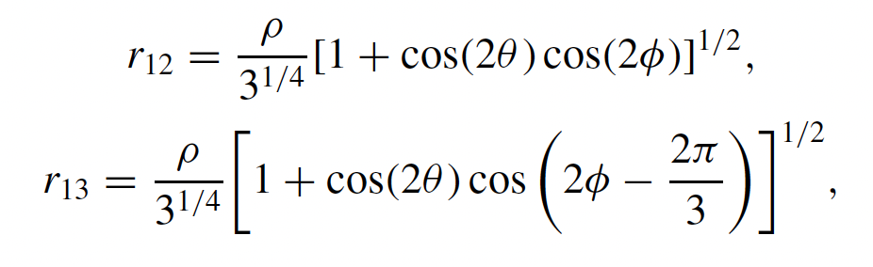


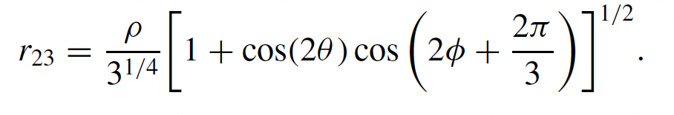

Hyperspherical Coordinates
Whitten-Smith’s coordinates:
Laplacian Operator (Kinetic energy):
The hyperradius describes the size of the trimer.
The hyperangles $θ$ and $φ$ describes the internal geometry of the trimer in the body-fixed frame.
J_{x}, J_{y}, J_{z} : Body-fixed angular momentum operator whose eigenstates are the famous Wigner-D matrix.
Rigid-rotor rotation is coupled to the internal dynamics!

Slide 19

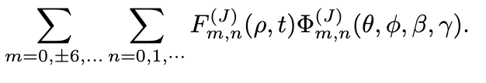
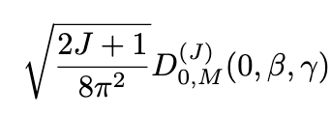

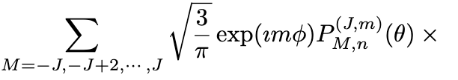
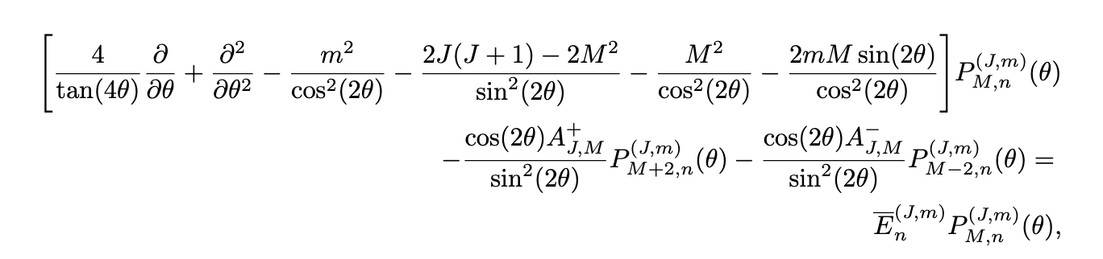



Helium Trimer Theory
Expand full wave function into partial waves:
Expand the partial waves further into partial waves of Wigner D matrices:
Channel function is labelled by 3 quantum numbers.
The P($θ$) function is obtained numerically:
Dynamics in hyperradius:
Couple body-rotation to internal dynamics.
He-He interactions

Slide 20








Model Pulse-Trimer interactions
1. Sum over 3 dimers interacting with E-fields:
4. Expand the kicked initial state into channel functions:
2. For a short laser pulse, use delta-kick pulse:
3. Get the kicked initial state:

Slide 21

A Movie of Trimer Scattering
Nielson Plot in the body-fixed frame (axis is chosen by the principal axis of the trimer).
Three atoms fly away.
Cannot see orientation and correlations in such a representation.
Many questions to ask: how the system flies apart, a+a+a or d+a? What happens in different time windows? How different is the dimer out of trimer than a pure dimer? Does atom interactions play a role?…

Slide 22


Unwrap the Kicked Initial State
As a comparison, the decomposition of the dimer system:
P^{(J=0)} = 98.83%. P^{(J=2)} = 1.04%. P^{(J=4)} = 0.124%
P^{(J=0, scattering)} = 1.39%
Decomposition of the full kicked state
Ground state Pair distribution function
Trimer
Dimer
Decomposition of J=0 channel
Laser interacts with the trimer system much stronger than the dimer system.

Slide 23


Unwrap the Kicked Initial State
Fix all the other angels (two Euler angles and one hyperangle)
(a) Real part of the kicked phase factor
(b) Real part of the kicked initial state
The phase oscillates strongly in the small $ρ$ region. The wavefunction almost vanishes in this region.
Similar to the dimer, the laser grabs population transfer predominantly around the boundary of the ground state wave function in the small $ρ$ region.

Slide 24



Unwrap the Kicked Initial State
Pair distribution functions
The scattering portion of the trimer J=0 channel includes both dimer-like and trimer-like features.
The dimer-like feature exists in the smaller r region; the trimer-like feature exists in the slightly larger r region.

Slide 25

Short-time Dynamics of the J=0 Scattering Portion

Slide 26


Short-time Dynamics of the J=0 Scattering Portion
In the short-time regime, the boundary of the scattering wave function is subject to the constraint predicted by the classical forbidden region of the trimer potential.
With time dynamics, interference pattern develops due to redirected flux near the boundary.

Slide 27





Long-time Dynamics of the J=0 Scattering Portion
The interference patterns propagate out.
Multiple sets of interference patterns are developed.
Two dominate configurations are peaked.

Slide 28




Compare Interacting Trimers with NI Trimers
(J=0+2 Scattering Portion)

Slide 29

Compare Interacting Trimers with NI Trimers
(Scattering Portion)
The kicked dimer has different behavior
The third atom is slightly pushed
Dimer size increases
Dimer size decreases
A global peak
The third atom moves faster for NI,
i.e., no attractive forces
Both increase

Slide 30

Dimer Out of Trimer Model
Idea: model the trimer dynamics using the pure dimer result
Motivation: the trimer ground state can be approximated by product of three Jastrow factors, 95% of the wavefunction is captured.
For the delta-pulse kick, the imprinted phase factor is product of three phase factors for dimers.
The kick is at short distance. We approximate the variational Jastrow factor by the dimer wave function.

Slide 31



Alignment Signal
---Dimer Out of Trimer Model
Trimer alignments using dimer model
Taylor expand the dimer wave function, $g_{dimer}$describes the dimer scattering portion.
C=10000
Adjust the amount of wavefunctions promoted to the scattering portion based on the dimer result due to account for difference between 2-body and 3-body contacts
dimer alignment
The dimer model captures the interference pattern to some degree.

Slide 32
Summary
Explored the tunability of binding of He dimer system.
Model the dynamics of He dimer kicked by short laser pulse, verified that the delta-kick model captures the dynamics very well.
Model the dynamics of He trimer kicked by the short laser pulse using delta-kick model and the hyperspherical coordinate approach.
Systematically analyze the dynamics in various aspects:
1. The initial state and the short time dynamics, a good measure of the universal physics in three-body sector as discussed in literature.
2. The pattern in the alignment signal is decoded, a dimer out of trimer model is constructed.
3. Good theory-experiment agreement is seen.

Slide 33




Acknowledgement
Exp: Frankfurt Group
Some of the other group members:
PI: Prof. Reinhard Dorner
Theory collaborator:
Prof. Doerte Blume at the University of Oklahoma
These works are supported by NSF

Slide 34
Dynamics of Weakly Bound Helium Dimers and Trimers Kicked by Short Laser Fields
Thanks!
Department of Physics and Astronomy
Washington State University
Jun. 09, 2025 @ ECT*

