Slide 1
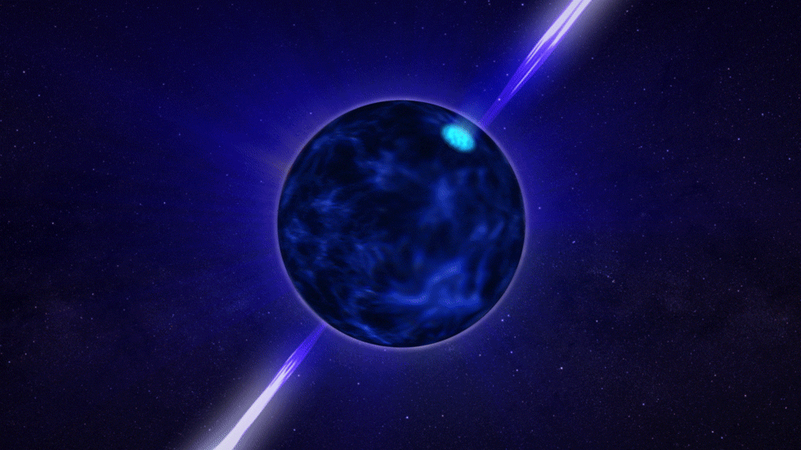
15 May 2025 ECT, Trento
Vortex Avalanches in Neutron Star Interiors
ApJ 984, 83 (2025)
Gary (I-Kang) Liu, Carlo Barenghi, Andrew Baggaley and Toby Wood

Slide 2
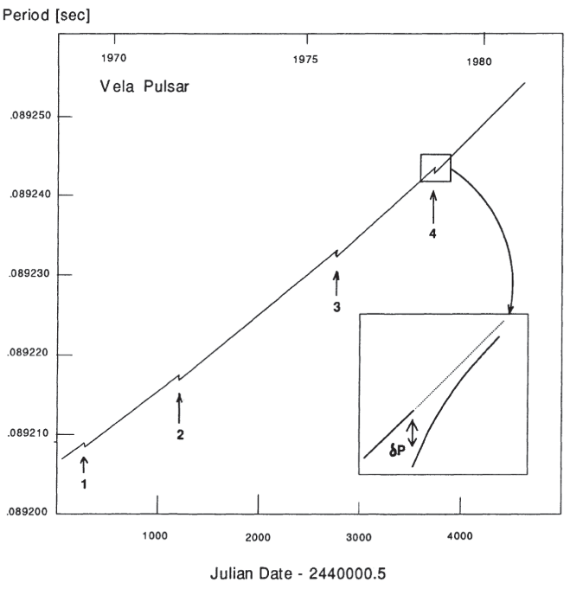
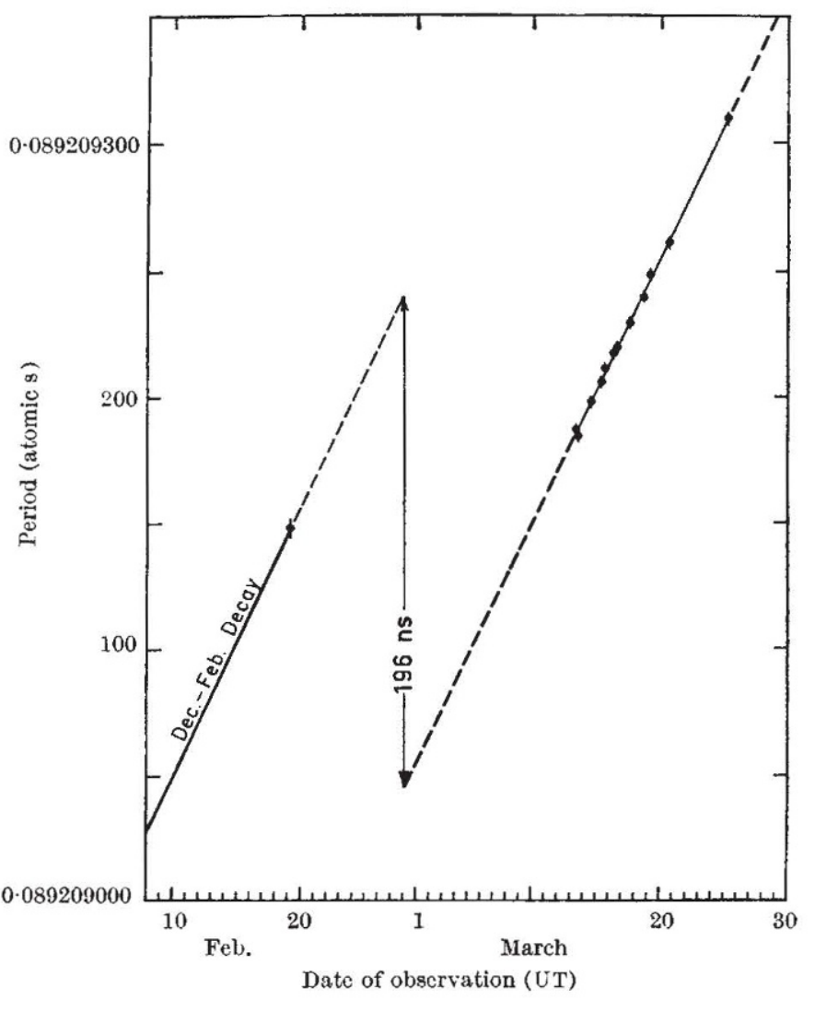
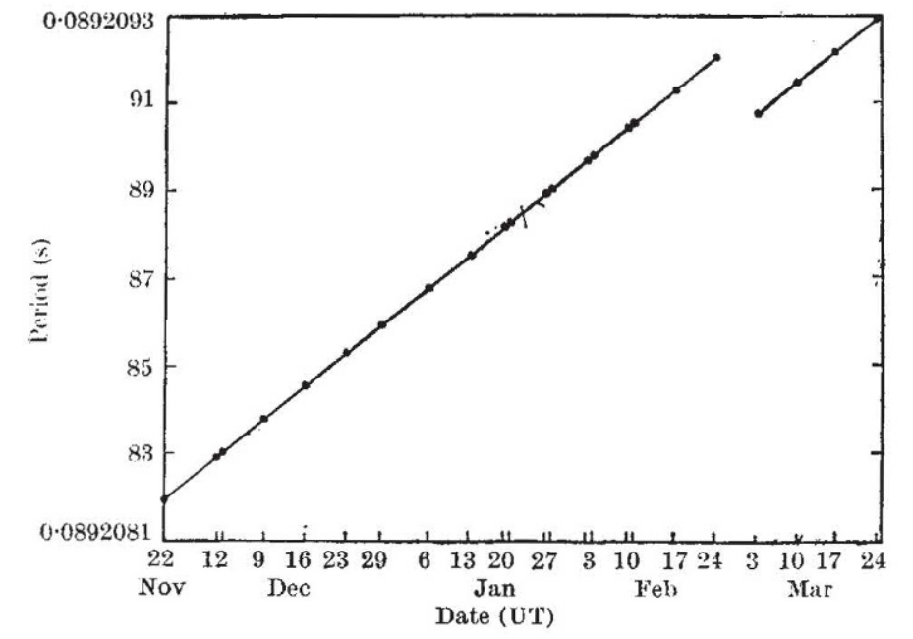
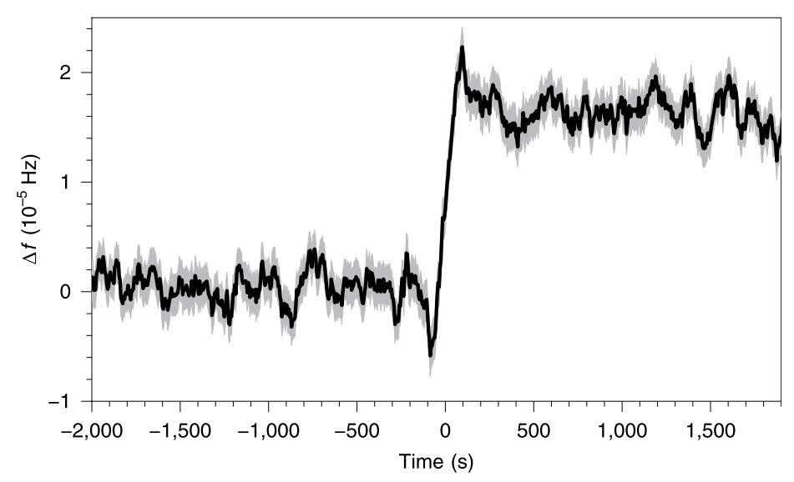
Neutron Stars
Sauls, SUPERFLUIDITY IN THE INTERIORS OF NEUTRON STARS, 1989
Radhakrishnan & Manchester, Nature 22, 228 (1969)
Reichley & Downs, Nature 22, 229 (1969)
Radhakrishnan & Manchester, Nature 22, 228 (1969)
Reichley & Downs, Nature 22, 229 (1969)
Credits: NASA’s Goddard Space Flight Center
https://www.nasa.gov/missions/station/nasa-continues-to-study-pulsars-50-years-after-their-chance-discovery/
G. Ashton et al., Nat. Astro. 3, 11432019)

Slide 3
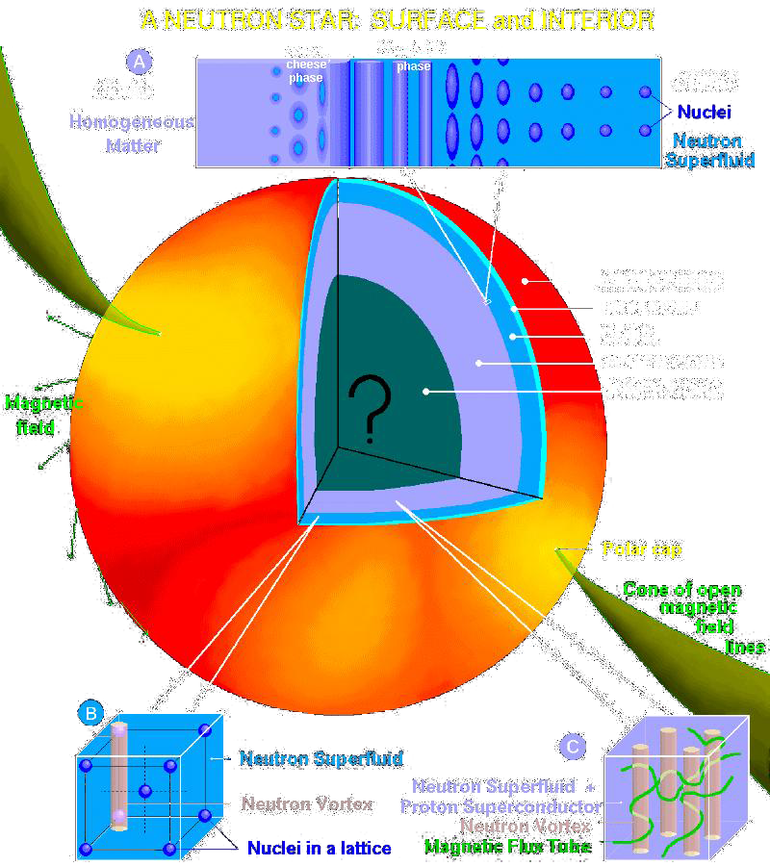
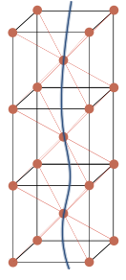
Neutron Stars
Radhakrishnan & Manchester, Nature 22, 228 (1969)
Reichley & Downs, Nature 22, 229 (1969)
D. Antonopoulou, B. Haskell & C. M Espinoza, Rep. Prog. Phys. 85, 126901 (2022)
Figure courtesy D. Page
Annu. Rev. Nucl. Part. Sci., 56, 327 (2006)
G. Ashton et al., Nat. Astro. 3, 11432019)

Slide 4
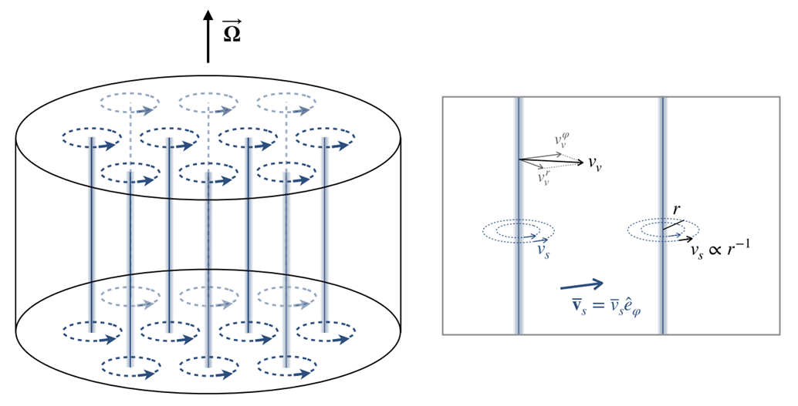
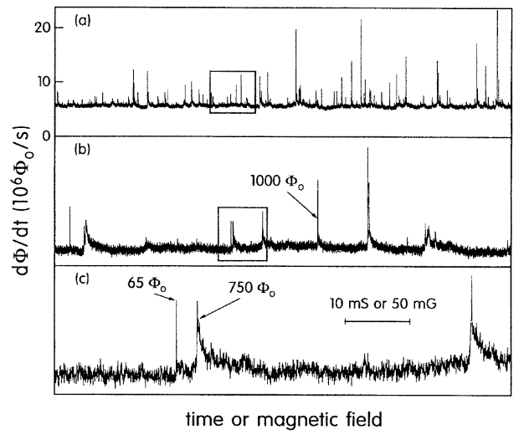
Vortex Avalanches
Analogy with type-II superconductor
Field, Witt, Nori, PRL 74, 7 (1995)
Antonopoulou, Haskell, Espinoza,
Rep. Prog. Phys. 85, 126901 (2022)

Slide 5
Vortex Avalanches
Self-Organized Criticality
P. Bak et al., PRL 59, 381 (1987); H. J. Jensen, Self-Organized Criticality (1998); A. Melatos et al, Astrophy. J. 672, 1103 (2008),
For an interaction-dominated many-body system in the presence of weak/slow driving with thresholds, SOC can emerge with the hallmarks,
Fractal structures in avalanches;
$1/f^{β}$event spectrum;
Power-law distribution in avalanche sizes
Exponential decays in waiting time
Examples: BTW sandplie, earthquakes, forest fires, solar flares, etc.
$$P\left(s\right)∝s^{a}$$
$$P\left(Δt\right)∝e^{−ηΔt}$$
YoutTube @siropksv
(x4 speed)

Slide 6
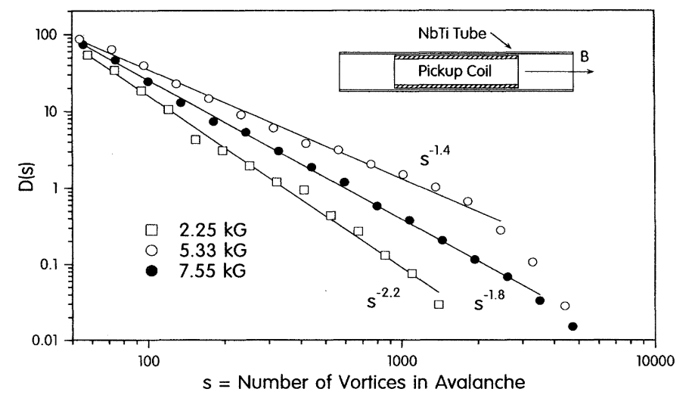
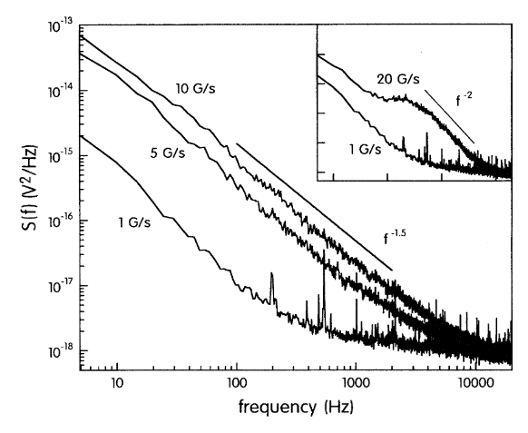
Vortex Avalanches
Analogy with type-II superconductor
Field, Witt, Nori, PRL 74, 7 (1995)

Slide 7
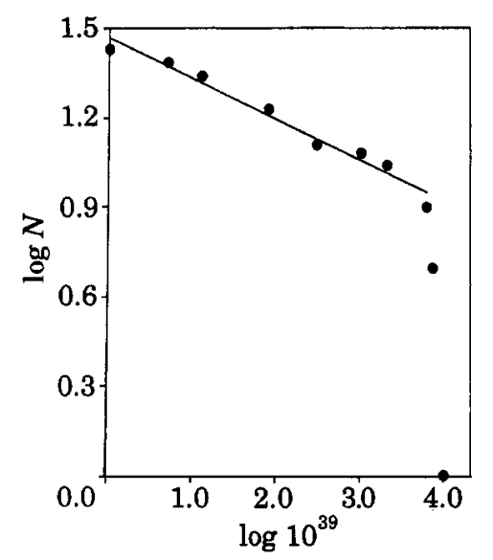
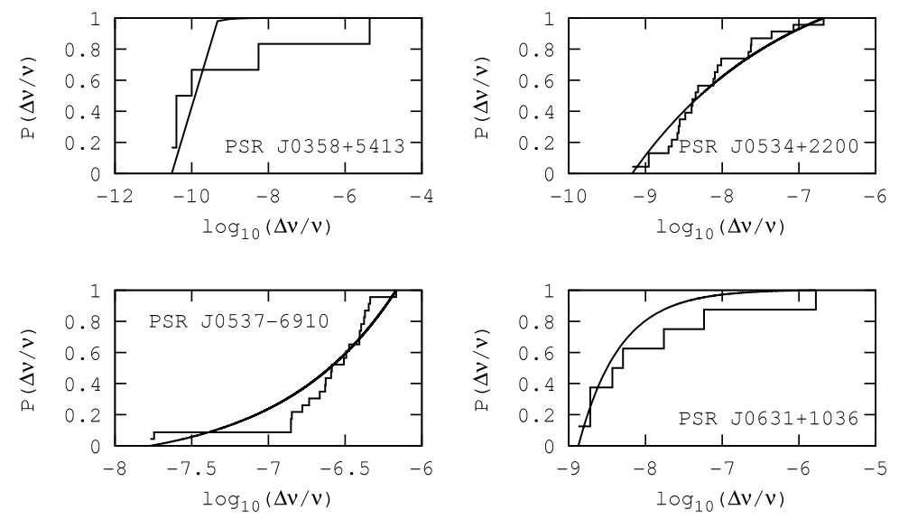
Vortex Avalanches
P. D. Morley and R. García-Pelayo, EPL 23 185 (1993)
A. Melatos et al, Astrophy. J. 672, 1103 (2008)
$$E_{g}≈\frac{2.91×{10}^{6}}{P^{2}}\frac{ΔΩ}{Ω}$$
$$CPDF\left(Δν/ν\right)∝{\left(\frac{Δν}{ν}\right)}^{a}$$

Slide 8
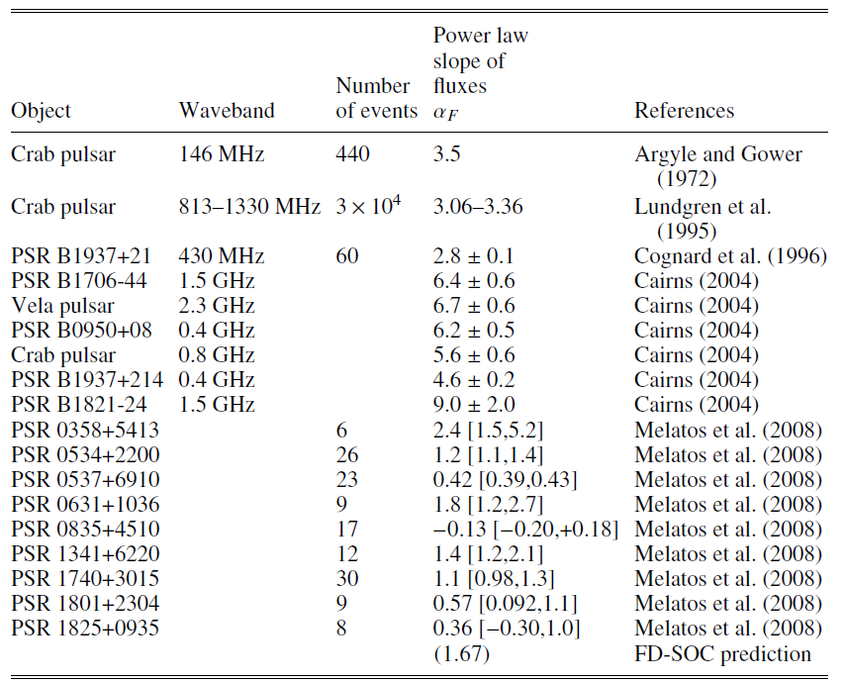
Vortex Avalanches
M. ASCHWANDEN, Power Laws in Astrophysics SOC systems (2025)

Slide 9
Numerical SF modelling
${10}^{7}−{10}^{18}$ Vortices for a glitch

Slide 10
Numerical SF modelling
${10}^{7}−{10}^{18}$ Vortices for a glitch
 | Literature | System | $$N_{v}$$ | Model
1 | Warszawski & Melatos, MNRAS 415, 1611 (2011) | 2D | ~10 | GPE: Harmonic trap
2 | Warszawski, Melatos & Berloff, PRB 85, 104503 (2012) | 2D | 34 | GPE: Harmonic trap
3 | Haskel & Melatos, MNRAS 461, 2200 (2016) | 2D | NA | Point vortex
4 | Drummond & Melatos, MNRAS 472, 4851 (2017) | 3D | ~10 | GPE: Hamonic trap + proton flux tubes
5 | Drummond & Melatos, MNRAS 475, 910 (2018) | 3D | ~10 | GPE: Hamonic trap + proton flux tubes
6 | Lonnborn et al. MNRAS 487, 702 (2019) | Quasi-2D | ~240 | Harmonic trap + Annular moat
7 | Howitt, Melatos & Haskell, MNRAS 498, 320 (2020) | 2D | 5000 | PVM
8 | Thong, Melatos & Drummond, MNRAS 521, 5724 (2023) | 3D | ~5 | GL: Harmonic trap
9 | Liu, Bagalley, Barenghi, Wood, ApJ 984, 83 (2025) | 2D | ~650 | GPE: Box

Slide 11
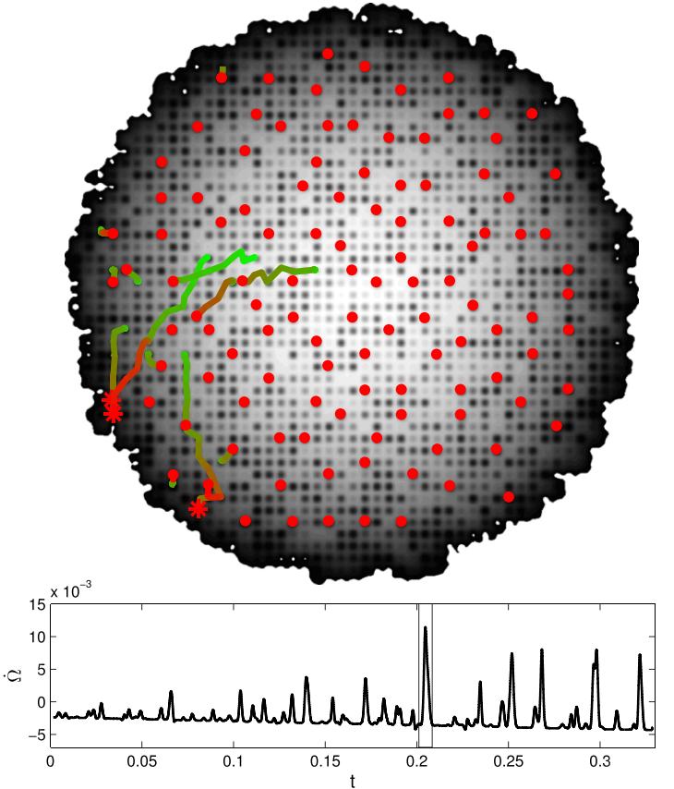
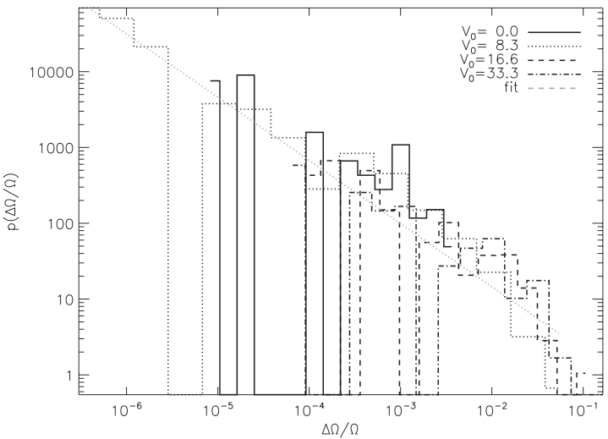
Gross-Pitaevskii Modelling
$$iℏ∂_{t}ψ\left(r,t\right)=\left(1−iγ\right)\left[−\frac{ℏ^{2}∇^{2}}{2m}+V\left(r,t\right)+g{\left|ψ\left(r,t\right)\right|}^{2}−Ω\left(t\right){\hat{L}}_{z}−μ\right]ψ\left(r,t\right)$$
$$I_{c}\frac{dΩ}{dt}=−\frac{d\left\langle {\hat{L}}_{z}\right\rangle }{dt}+N_{EM}$$
$$a≈−1$$
Warszawski & Melatos, MNRS 415, 1611 (2011)
Melatos, Douglas & Simula, Ap 807, 132 (2015)
$$τ=\frac{ℏ}{μ}$$
$$τ_{relax}=\frac{ℏ}{γμ}$$

Slide 12
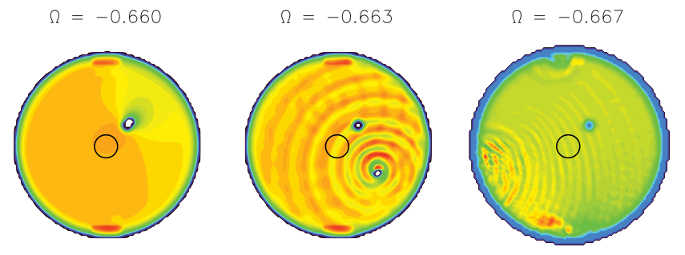
Gross-Pitaevskii Modelling
Vortex unpinning Mechanisms
Global shear force
$\vec{F}=ρ_{s}\vec{κ}×\left({\vec{v}}_{s}−{\vec{v}}_{v}\right)$
Acoustic knock
Interaction between proximity vortex
Warszawski, Melatos & Berloff, PRB 85, 104503 (2012)
Neglected in point/filament
vortex models
$${\dot{x}}_{k}=Ω_{k}{\vec{κ}}_{k}×x_{k}+\frac{bℏ}{2m}\sum_{j≠k}{\frac{{\hat{κ}}_{k}×\left(x_{j}−x_{k}\right)}{{\left|x_{j}−x_{k}\right|}^{2}}}$$
P. J. Torres et al., Physics Letters A 375, 3044 (2011) ; A. Moray et al., PRA 93, 033649 (2016)

Slide 13
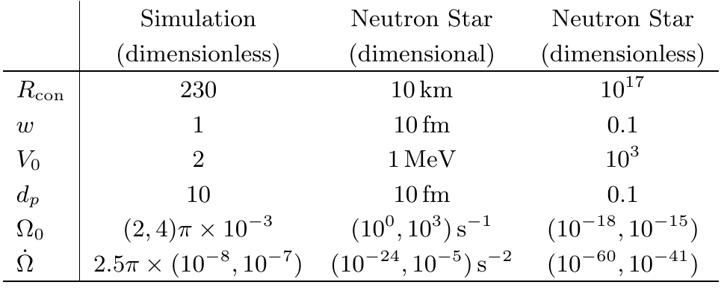
Gross-Pitaevskii Modelling
$$iℏ∂_{t}ψ\left(r,t\right)=\left(1−iγ\right)\left[−\frac{ℏ^{2}∇^{2}}{2m}+V\left(r\right)+g{\left|ψ\left(r,t\right)\right|}^{2}−Ω\left(t\right){\hat{L}}_{z}−μ\right]ψ\left(r,t\right)$$
$$V\left(r\right)=V_{trap}\left(r\right)+V_{pin}\left(r\right)+V_{eff}\left(r\right)$$
$$V_{pin}\left(r\right)=\sum_{j}{V_{0}e^{−{\left|r−r_{p,j}\right|}^{2}/w^{2}}}$$
$$V_{eff}\left(r,t\right)=\frac{1}{2}mΩ^{2}(t)r^{2}$$
Liu, Bagalley, Barenghi, Wood, ApJ 984, 83 (2025)
$$n_{v}≈{10}^{21} m^{−2}$$
$$n_{v}≈{10}^{7}m^{−2}$$

Slide 14
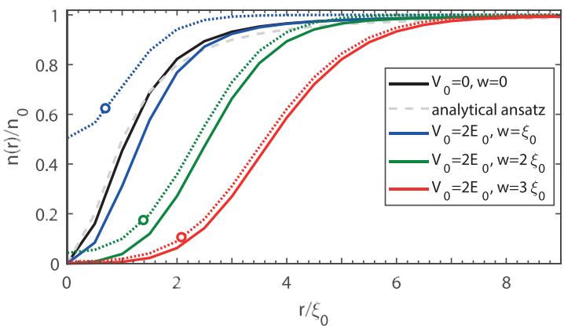
Gross-Pitaevskii Modelling
Vortex profile (single pinning site)
Liu, Prasad, Baggaley, Barenghi, Wood, JLTP (2024)

Slide 15
Gross-Pitaevskii Modelling
Vortex depinning dynamics (single pinning site)
Kicking
Quasi-adiabatic
Liu, Prasad, Baggaley, Barenghi, Wood, JLTP (2024)

Slide 16
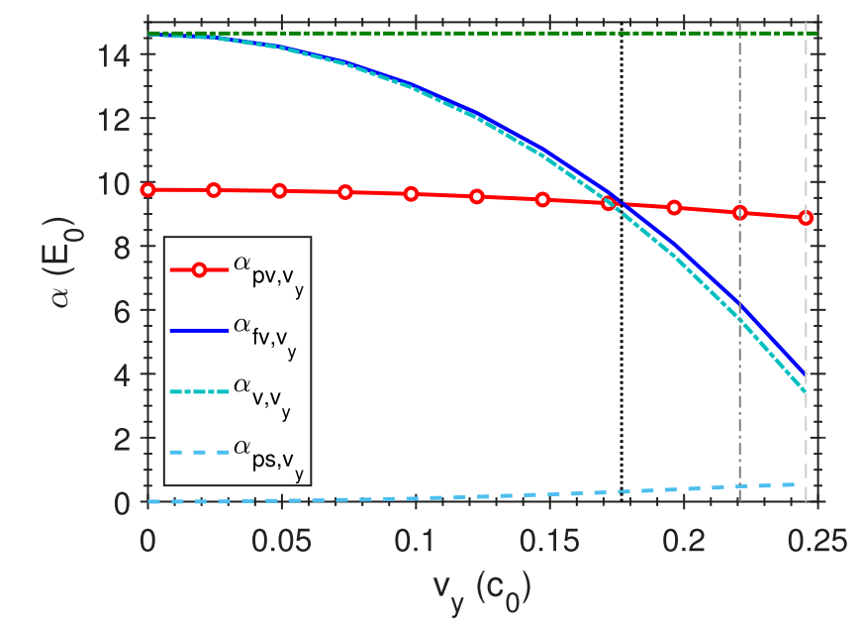
Gross-Pitaevskii Modelling
Vortex depinning dynamics (single pinning site)
$$v_{c,kick}$$
$$v_{c,E}$$
$$v_{c,qa}$$
Liu, Prasad, Baggaley, Barenghi, Wood, JLTP (2024)
Depinning requires additional energy or instability

Slide 17
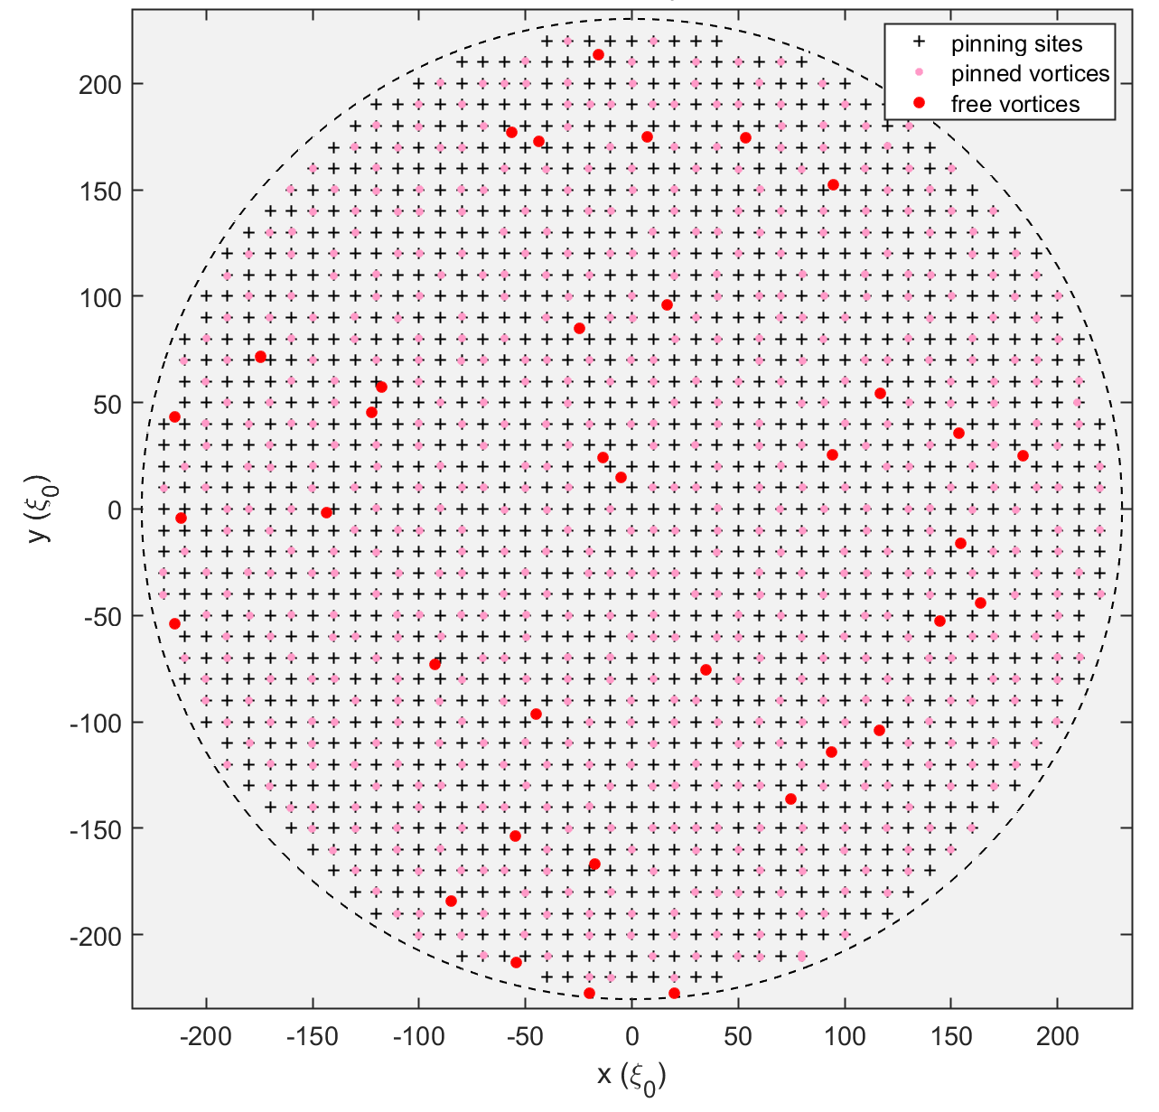
Gross-Pitaevskii Modelling
Liu, Bagalley, Barenghi, Wood, ApJ 984, 83 (2025)

Slide 18
Gross-Pitaevskii Modelling
Liu, Bagalley, Barenghi, Wood, ApJ 984, 83 (2025)

Slide 19
Gross-Pitaevskii Modelling
Liu, Bagalley, Barenghi, Wood, ApJ 984, 83 (2025)

Slide 20
Vortex Collective Motions
$$φ\left(r,t\right)={\left\langle \frac{1}{𝒩_{j,r}\left(t\right)}\sum_{{\left\{j,k\right\}}_{r}}{{\vec{v}}_{k}(t)}\right\rangle }_{j}$$
Liu, Bagalley, Barenghi, Wood, ApJ 984, 83 (2025)
$$φ$$

Slide 21
Vortex Collective Motions
$$φ\left(r,t\right)={\left\langle \frac{1}{𝒩_{j,r}\left(t\right)}\sum_{{\left\{j,k\right\}}_{r}}{{\vec{v}}_{k}(t)}\right\rangle }_{j}$$
Liu, Bagalley, Barenghi, Wood, ApJ 984, 83 (2025)
$$φ$$

Slide 22
Vortex Collective Motions
$$φ\left(r,t\right)={\left\langle \frac{1}{𝒩_{j,r}\left(t\right)}\sum_{{\left\{j,k\right\}}_{r}}{{\vec{v}}_{k}(t)}\right\rangle }_{j}$$
Liu, Bagalley, Barenghi, Wood, ApJ 984, 83 (2025)
$$φ$$

Slide 23
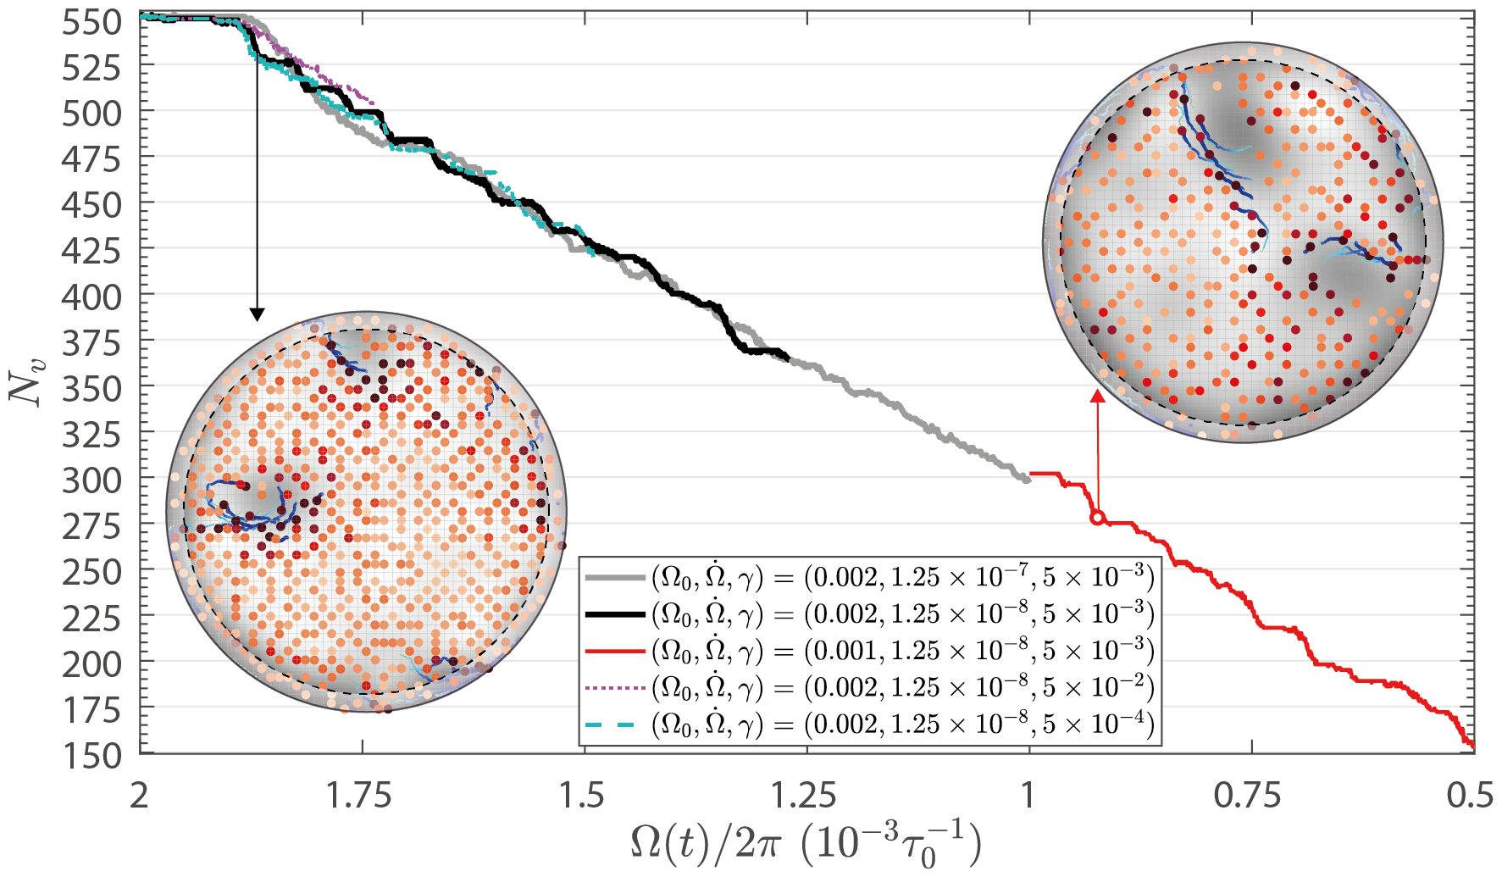
Vortex Collective Motion
Parameter space exploration
The system glitches when
Small dissipation
Low spinning-down rate
Liu, Bagalley, Barenghi, Wood, ApJ 984, 83 (2025)

Slide 24
Vortex Collective Motion
Point Vortex Model (PVM)
$$γ=0.1$$
t
$$γ=0.01$$
Howitt, Melatos & Haskell, MNRAS 498, 320 (2020)

Slide 25
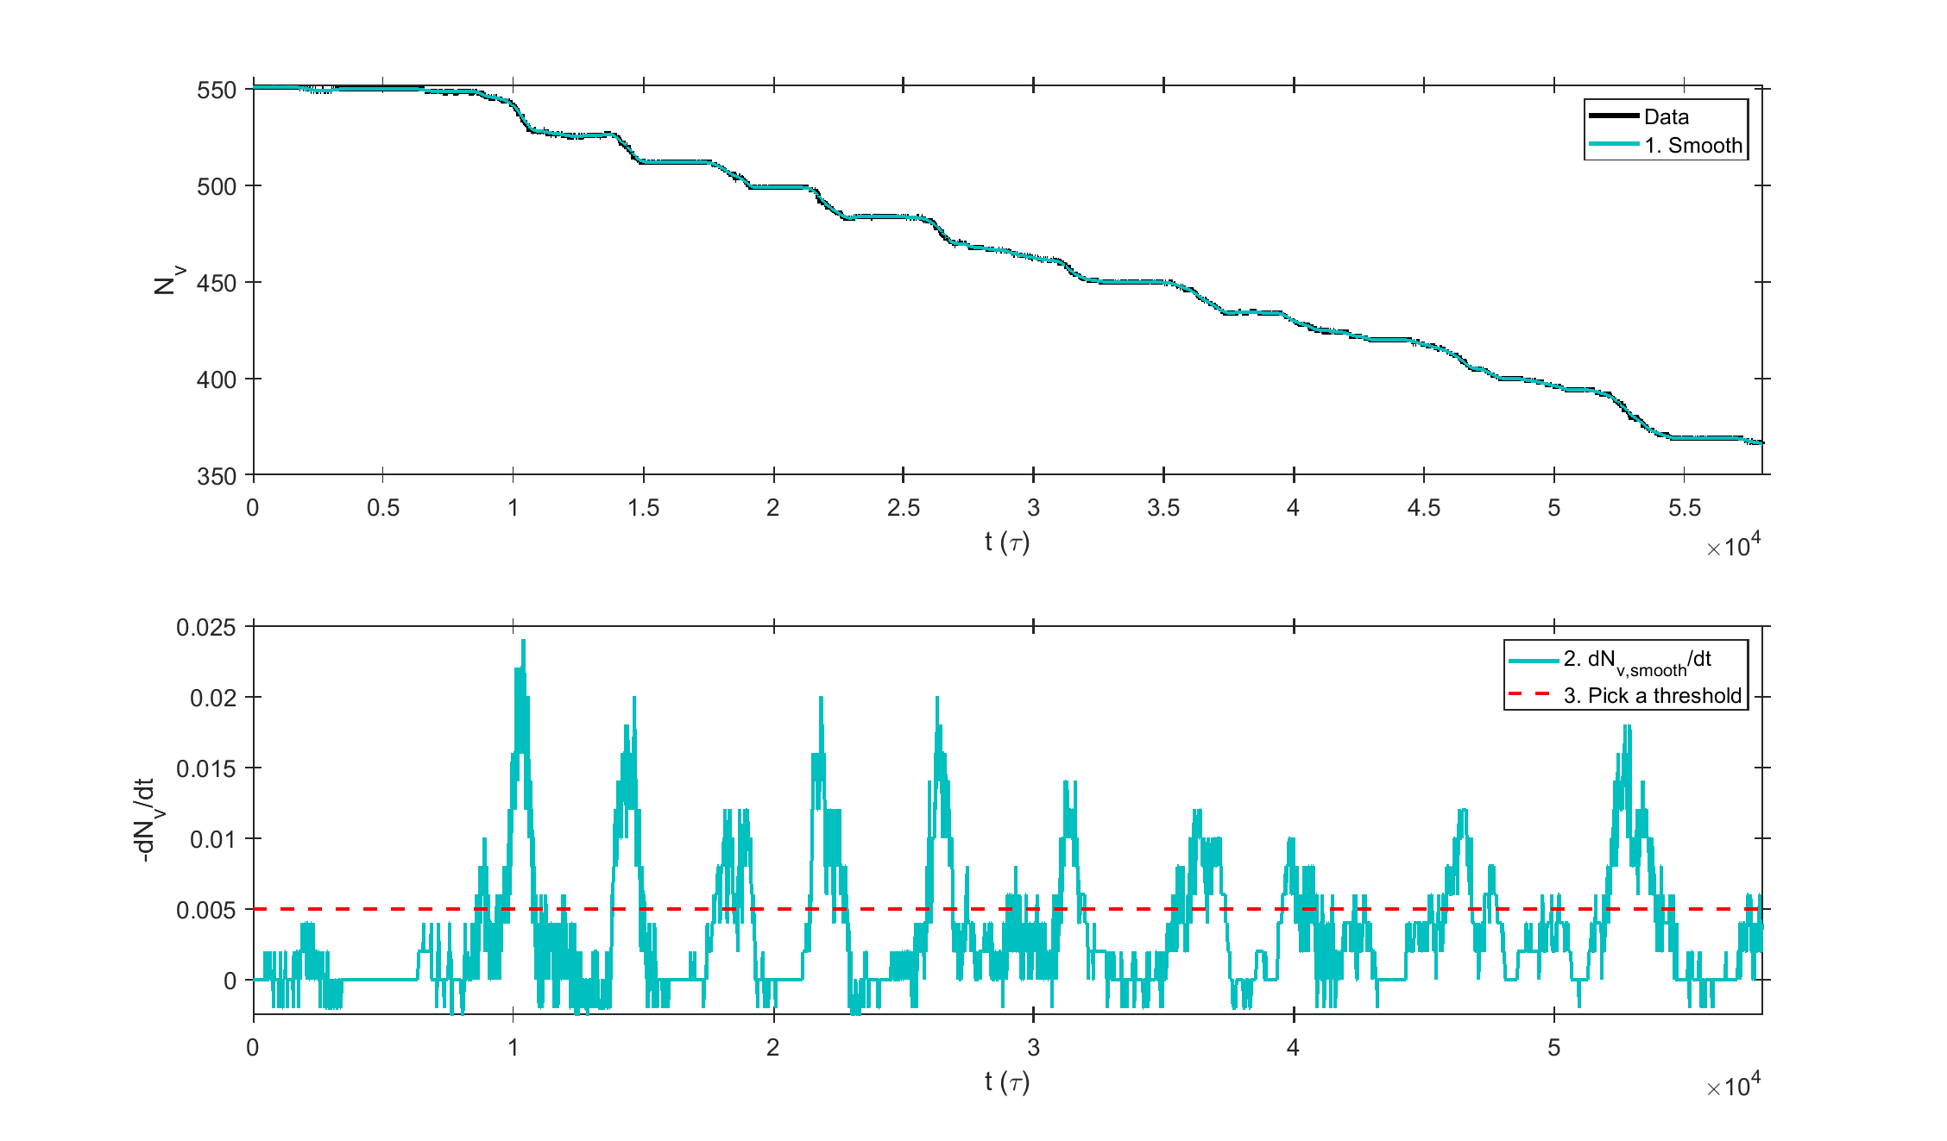
Vortex Avalanche Statistics, SOC?
Avalanche Detection – Tracing $N_{v}\left(t\right)$
Inspired by Warszawski & Melatos, MNRS 415, 1611 (2011)

Slide 26
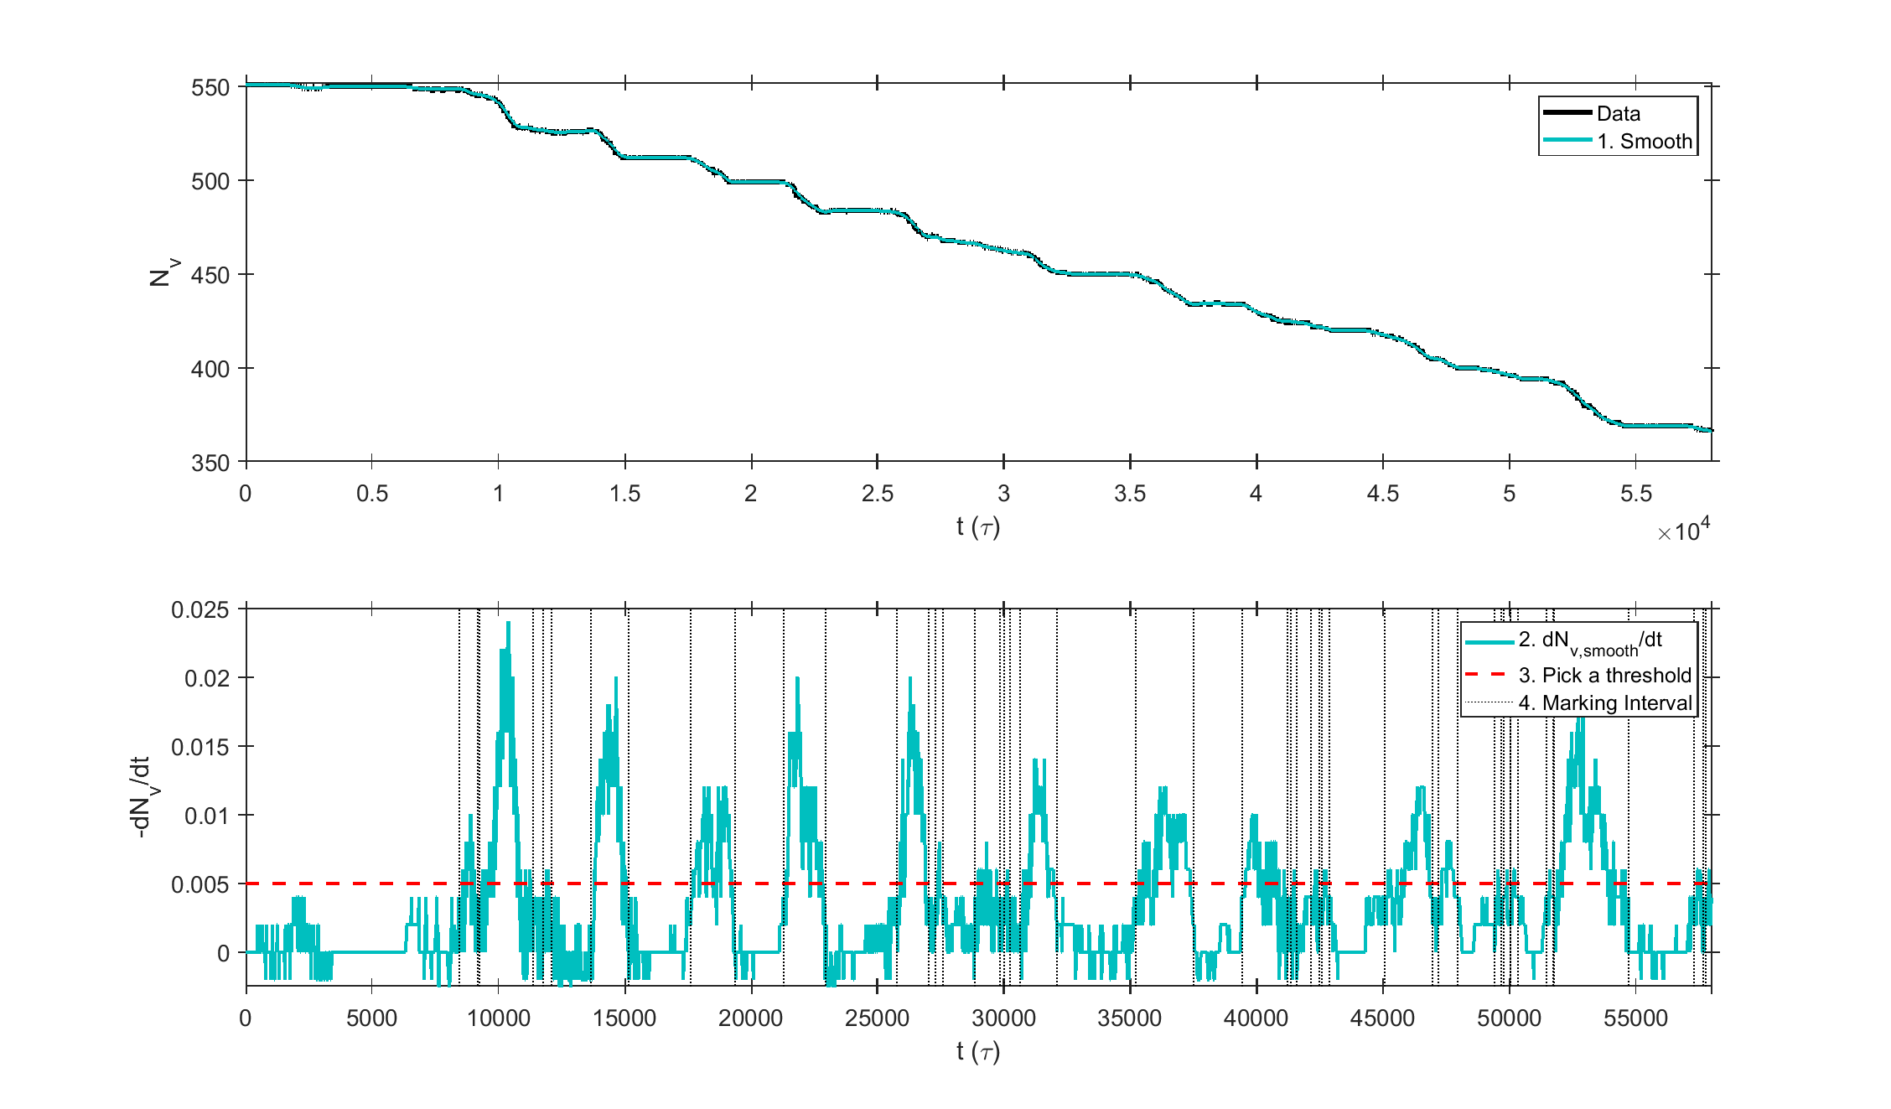
Vortex Avalanche Statistics, SOC?
Avalanche Detection – Tracing $N_{v}\left(t\right)$
Inspired by Warszawski & Melatos, MNRS 415, 1611 (2011)

Slide 27
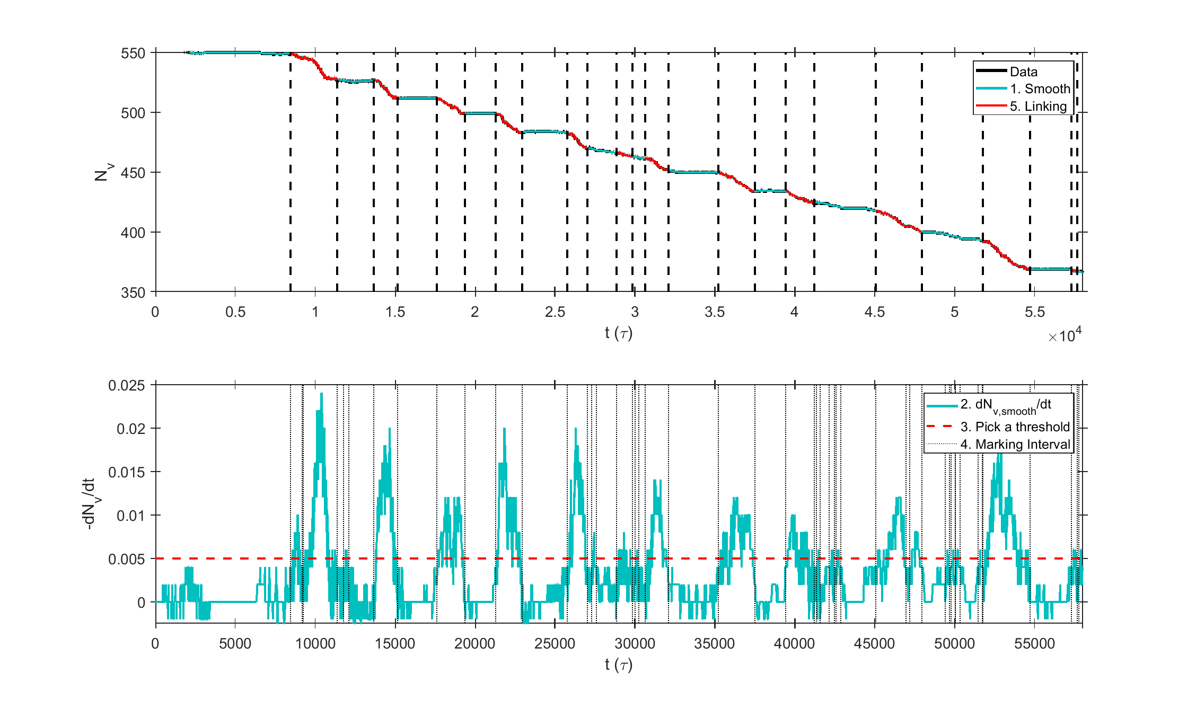
Vortex Avalanche Statistics, SOC?
Avalanche Detection – Tracing $N_{v}\left(t\right)$
Inspired by Warszawski & Melatos, MNRS 415, 1611 (2011)

Slide 28
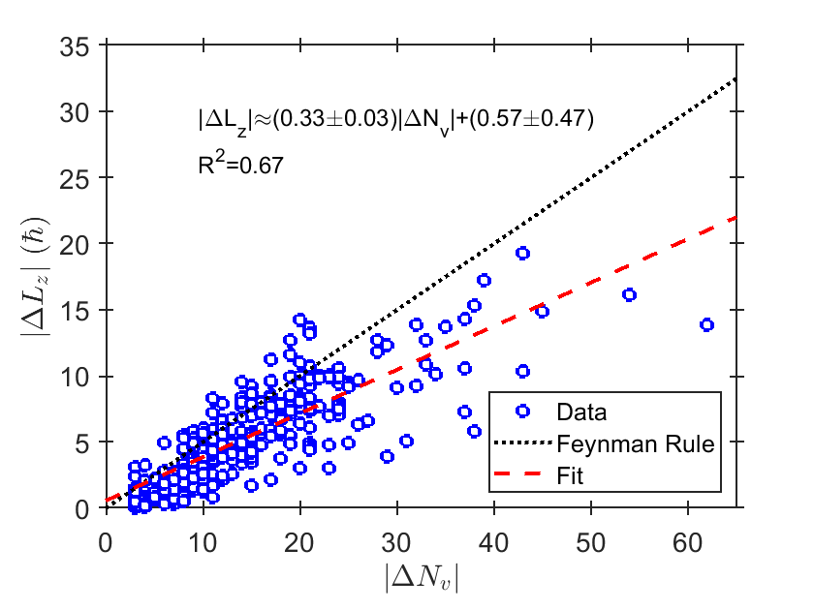
Vortex Avalanche Statistics, SOC?
$$N_{avg}=280$$
In Preparation
$$L_{z}=ℏ\sum_{j}{1−\frac{r_{v,j}^{2}}{R^{2}}}$$
A. L. Fetter, Phys. Rev. 138, 42 (1965)

Slide 29
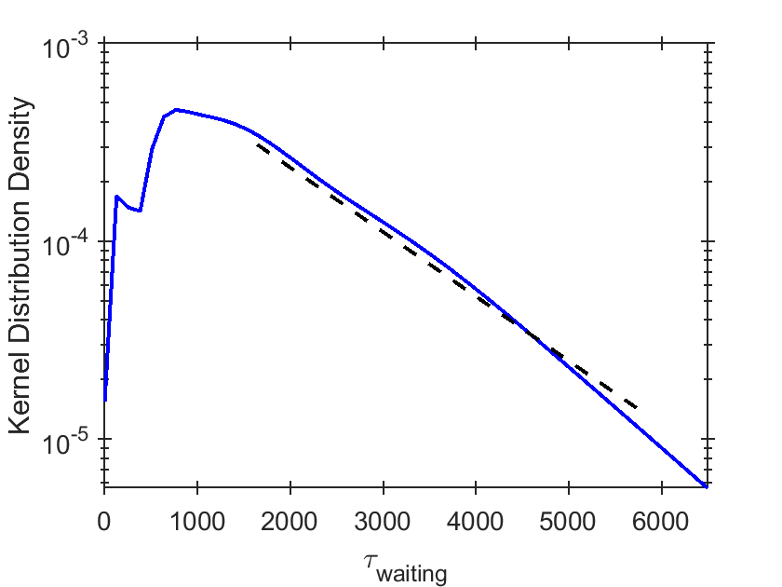
Vortex Avalanche Statistics, SOC?
Size and Wating-Time Distributions
$$\exp\left[−7.5τ_{waiting}/{10}^{4}\right]$$
In Preparation
J. Fuents et al., A&A 608, A131 (2017)
A. Basu, MNRAS 510, 4049–4062 (2022)

Slide 30
Vortex Avalanche Statistics, SOC?
Parameter dependance?
$$Ω_{0}=4π×{10}^{−3}$$
$$Ω_{0}=2π×{10}^{−3}$$
$$Ω_{0}=π×{10}^{−3}$$
In Preparation

Slide 31
Remarks
The depinning process of a pinned vortex requires additional energy or instabilities.
For the first time, we find convincing spatial-temporal evidence of avalanching behaviour resulting from vortex depinning and collective motion.
The collective motion is relevant to the post-relaxation period while the system reaches a new ‘quasi-steady’ state. (SOC?) [in preparation]
The vorticity voids get larger when the vortex density decreases.

Slide 32
Remarks
The depinning process of a pinned vortex requires additional energy or instabilities.
For the first time, we find convincing spatial-temporal evidence of avalanching behaviour resulting from vortex depinning and collective motion.
The collective motion is relevant to the post-relaxation period while the system reaches a new ‘quasi-steady’ state. (SOC?) [in preparation]
The vorticity voids get larger when the vortex density decreases.
Next Steps
Larger simulation (PVM)
Crust Feedback
3D GPE Simulation
GL simulation

Slide 33
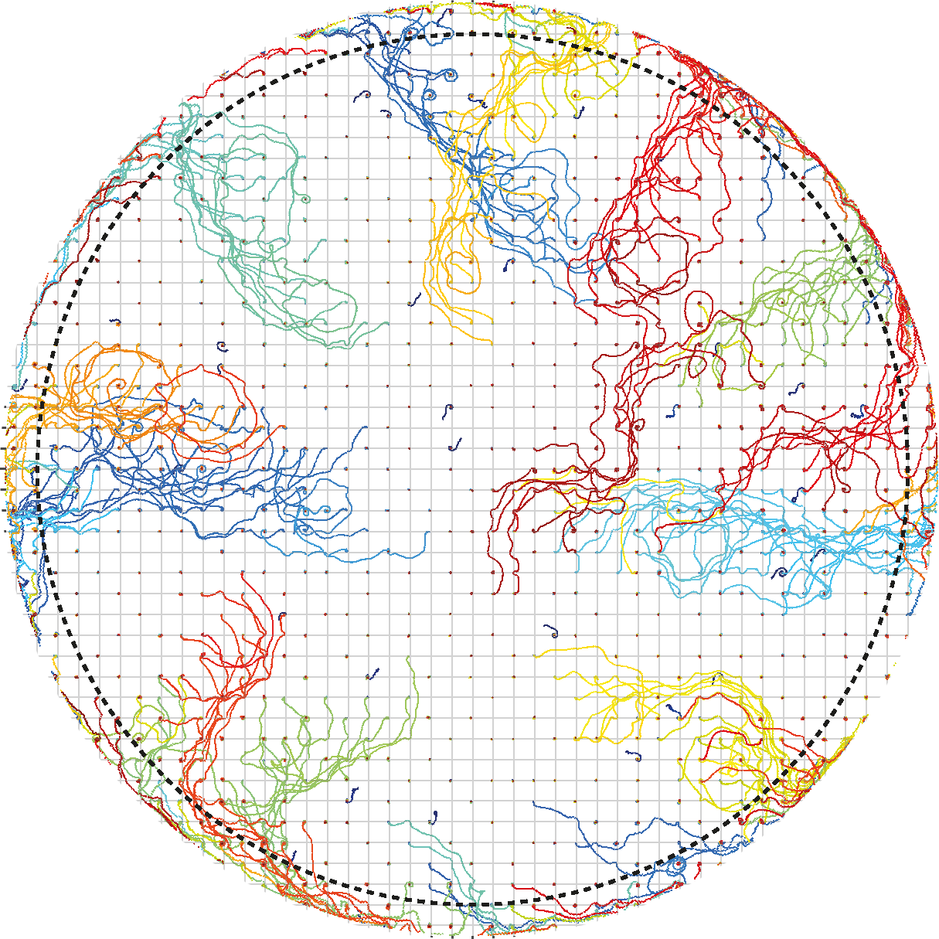
Thank You
15 May 2025 ECT, Trento

Slide 34
Random Pinning Sites

