Slide 1
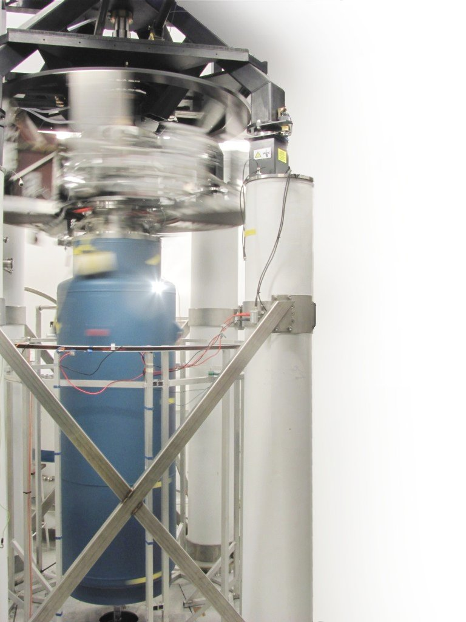
Laboratory neutron star analogues in the 2D vacuum of superfluid ³He
Samuli Autti
EPSRC Fellow, Lancaster University, UK

Slide 2
Laboratory neutron star analogues in superfluid ³He?
Samuli Autti
EPSRC Fellow, Lancaster University, UK

Slide 3
Laboratory neutron star analogues in superfluid ³He?
V. B. Eltsov, J. T. Mäkinen,
J. Rysti, V. V. Zavjalov, and G.E. Volovik
Low Temperature Lab, Aalto University
A. N. Yudin, A. N. Soldatov, and V. V. Dmitriev
Kapitza Institute, Moscow

Slide 4
Introduction: polar phase, vortex types
Detecting vortices
HQVs: magnetic resonance imaging
Magnon BEC in probing SQVs
pinning
Non-equilibrium studies
Kibble-Zurek + rotation drive
Critical velocities of SQVs and HQVs

Slide 5
Key takeaways:
Bulk superfluids may be a misleading reference for neutron star vortex physics.
If there is pinning, weak pinning requires fine-tuned parameters. Thus, strong pinning should be the default expectation.
We have carried out experiments that explore vortex non-dynamics in such conditions.
But: three open problems in their interpretation need solving before extrapolation is accessible

Slide 6
First vortex measurements [PRL 117, 255301 (2016)]
Non-dynamics of pinned vortices [PRR 2, 033013 (2020)]
Vortex creation in a phase transition [PRL 127, 115702 (2021)]
Rotation and phase transition [PRL 127, 115702 (2021), supplementary material]
The easiest way to find these and all the other papers we have written is arXiv.

Slide 7
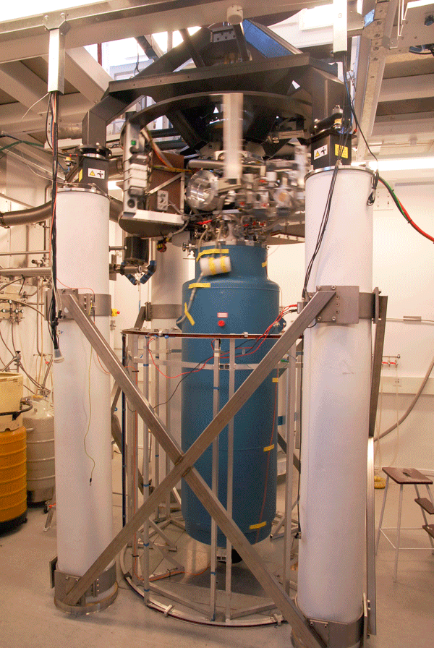
⁴He bath: 4.2K
4He evaporation stage: 1.4K
Distillation chamber: 0.6K
Mixing chamber: few mK
Nuclear stage: <100µK

Slide 8
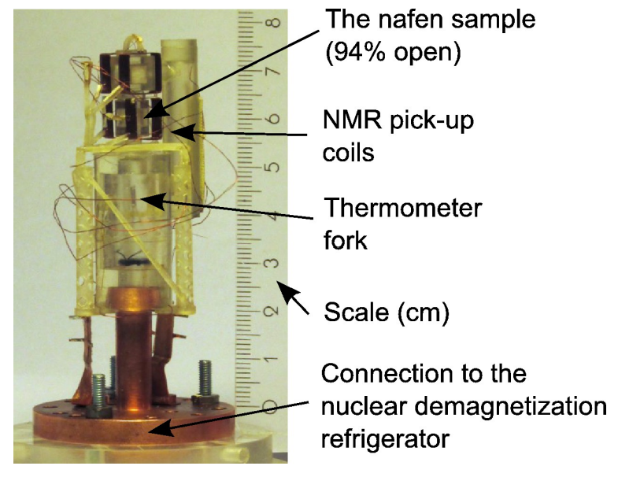
⁴He bath: 4.2K
4He evaporation stage: 1.4K
Distillation chamber: 0.6K
Mixing chamber: few mK
Nuclear stage: <100µK

Slide 9
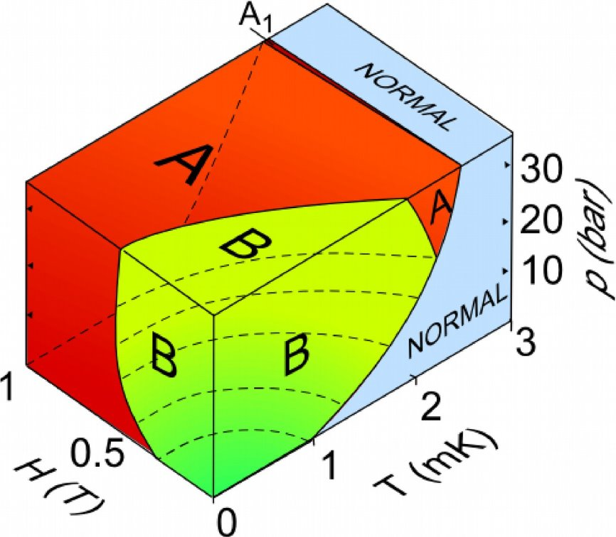
Polar phase of superfluid ³He
Fermi system, Cooper pairing with S=1 L=1 (p-wave triplet state)
Order parameter is a 3x3 complex matrix.
3 Superfluid phases in bulk, several other phases in restricted geometries.

Slide 10
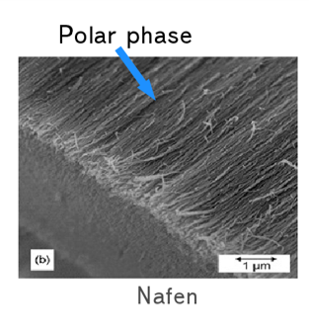
Polar phase of superfluid ³He
Fermi system, Cooper pairing with S=1 L=1 (p-wave triplet state)
Order parameter is a 3x3 complex matrix.
3 Superfluid phases in bulk, several other phases in restricted geometries.
In this talk: nafen (94% open), polar phase at p=7bar, Hγ/(2π)=374kHz

Slide 11
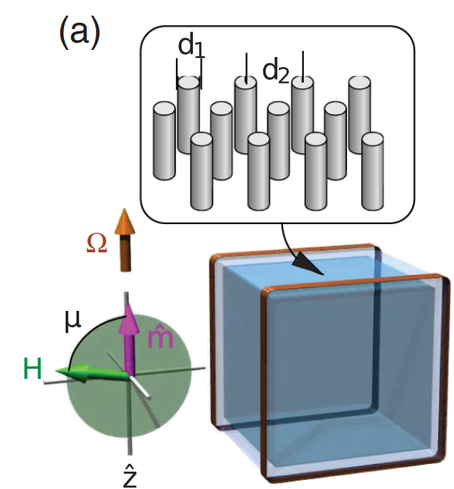
Polar phase of superfluid ³He
Fermi system, Cooper pairing with S=1 L=1 (p-wave triplet state)
Order parameter is a 3x3 complex matrix.
3 Superfluid phases in bulk, several other phases in restricted geometries.
In this talk: nafen (94% open), polar phase at p=7bar, Hγ/(2π)=374kHz
Coherence length ~ 50nm, Tc ~ 1.5mK
d₁~9nm
d₂~40nm

Slide 12
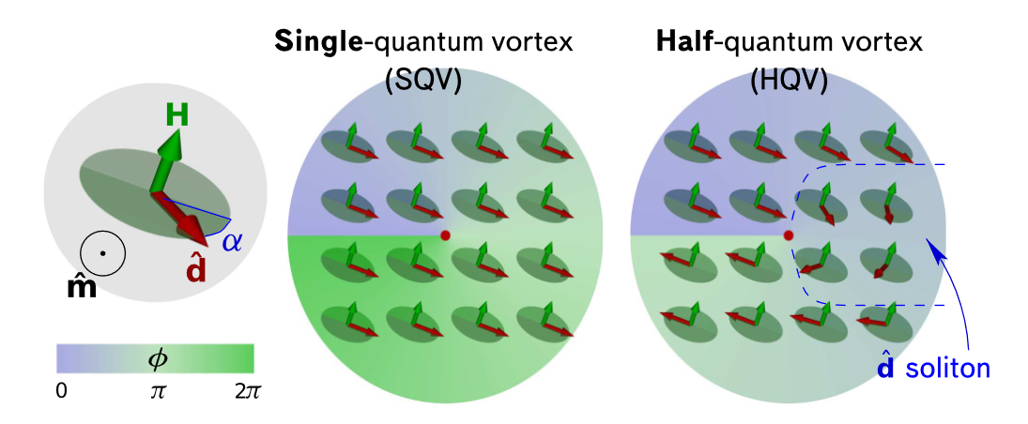
Vortex types in the polar phase

Slide 13
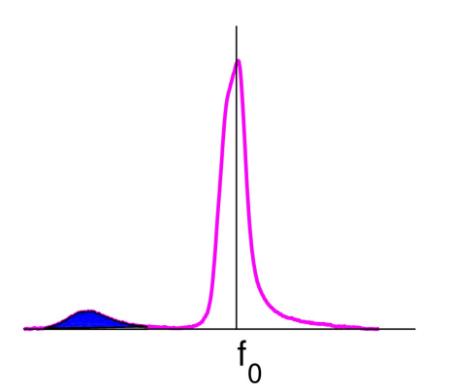
Detecting vortices

Slide 14
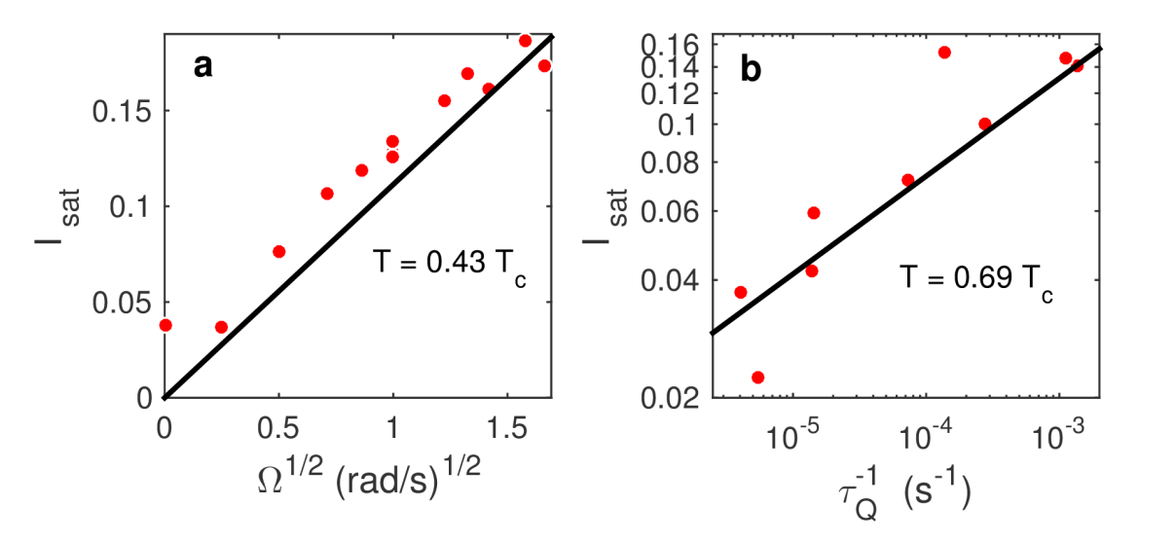
Detecting vortices
[PRL 117, 255301 (2016)]​

Slide 15
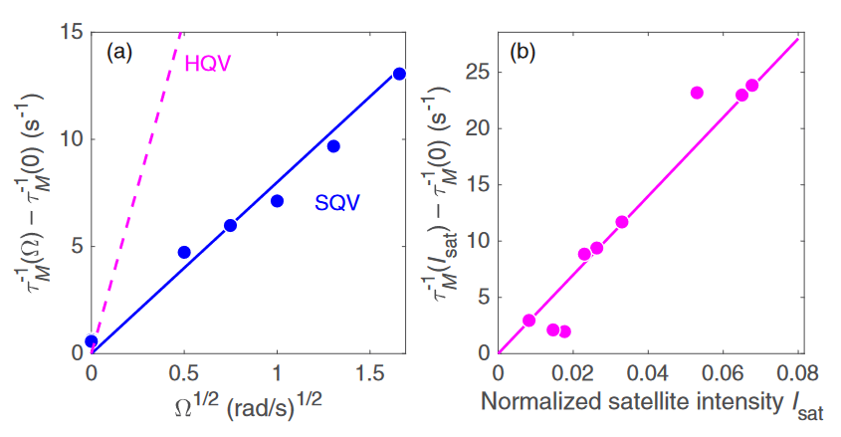
Detecting vortices
[PRL 117, 255301 (2016)]​
[PRR 2, 033013 (2020)]

Slide 16
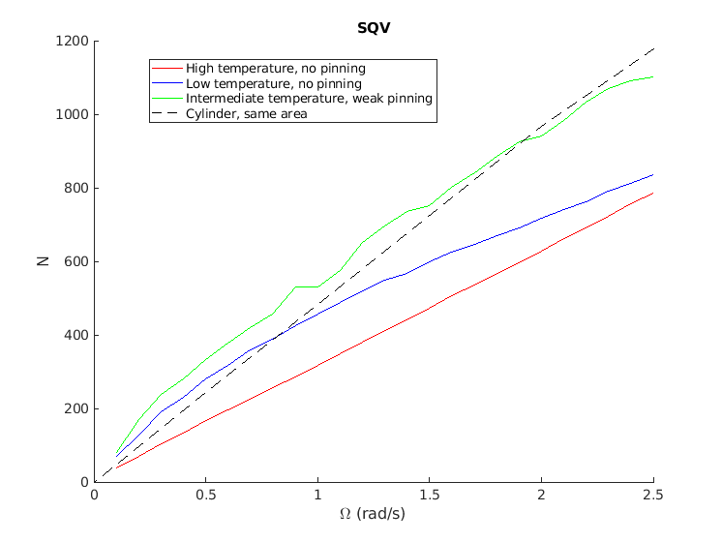
Detecting vortices

Slide 17
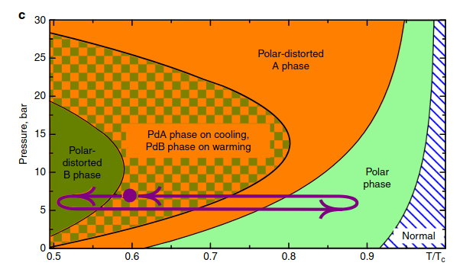
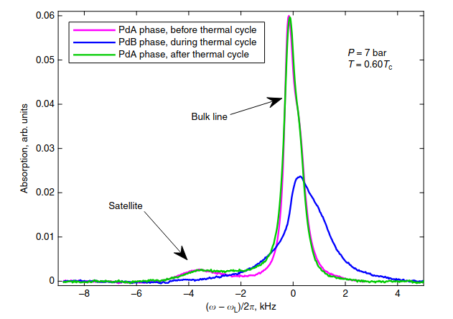
Strong pinning
Nature Commun. 10, 237 (2019)

Slide 18
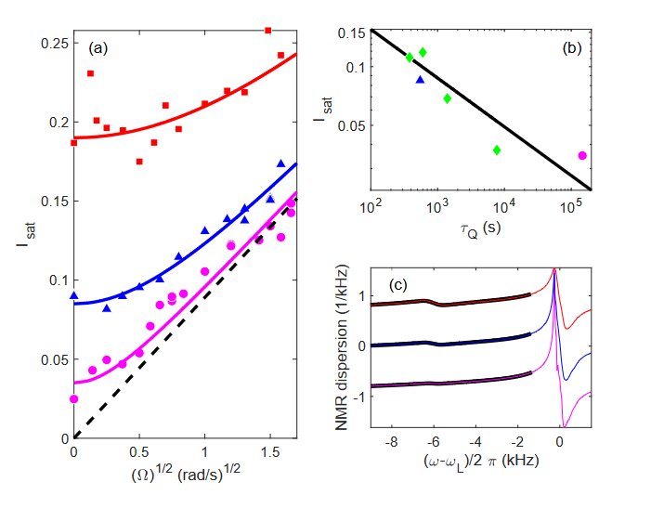
Superfluid transition in rotation
[PRL 127, 115702 (2021), supplementary material]​

Slide 19
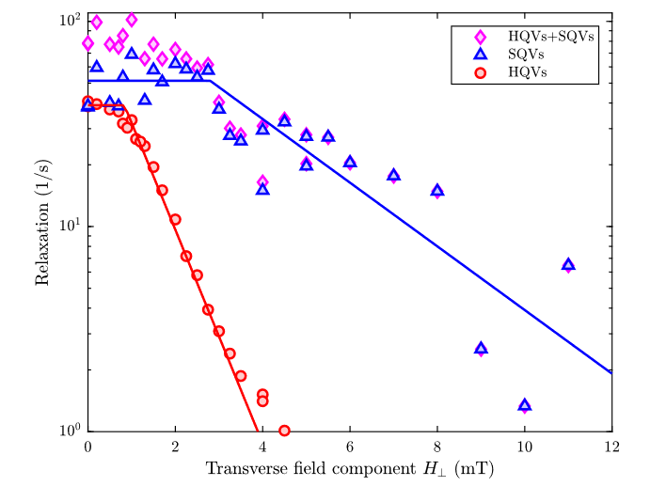
Superfluid transition in rotation
[PRL 127, 115702 (2021)]​
[PRL 127, 115702 (2021), supplementary material]​

Slide 20
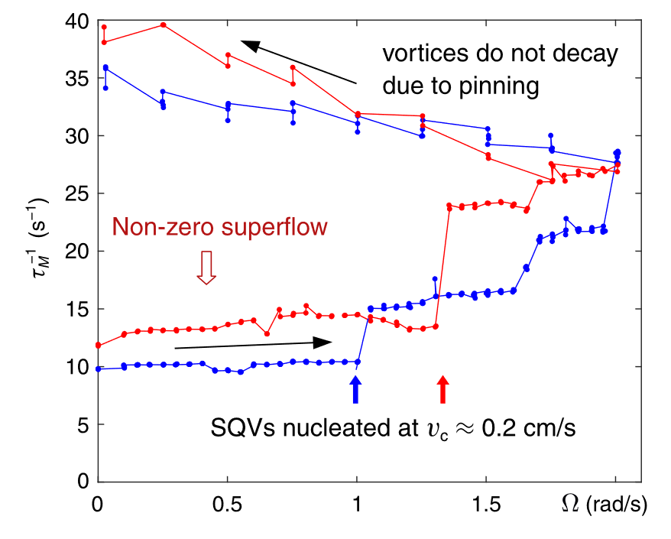
Critical velocities
[PRR 2, 033013 (2020)]

Slide 21
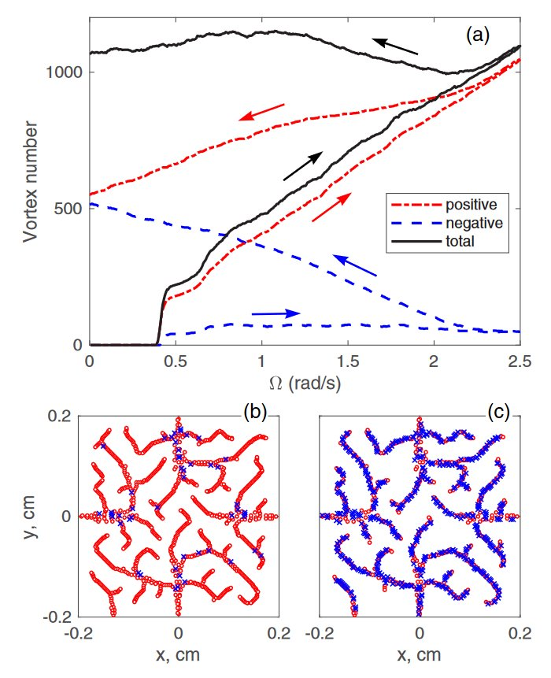
Critical velocities
[PRR 2, 033013 (2020)]

Slide 22
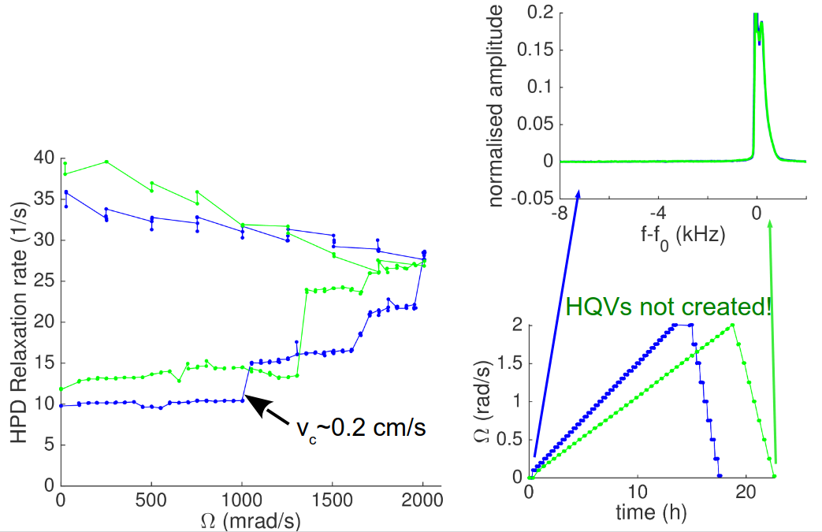

Slide 23
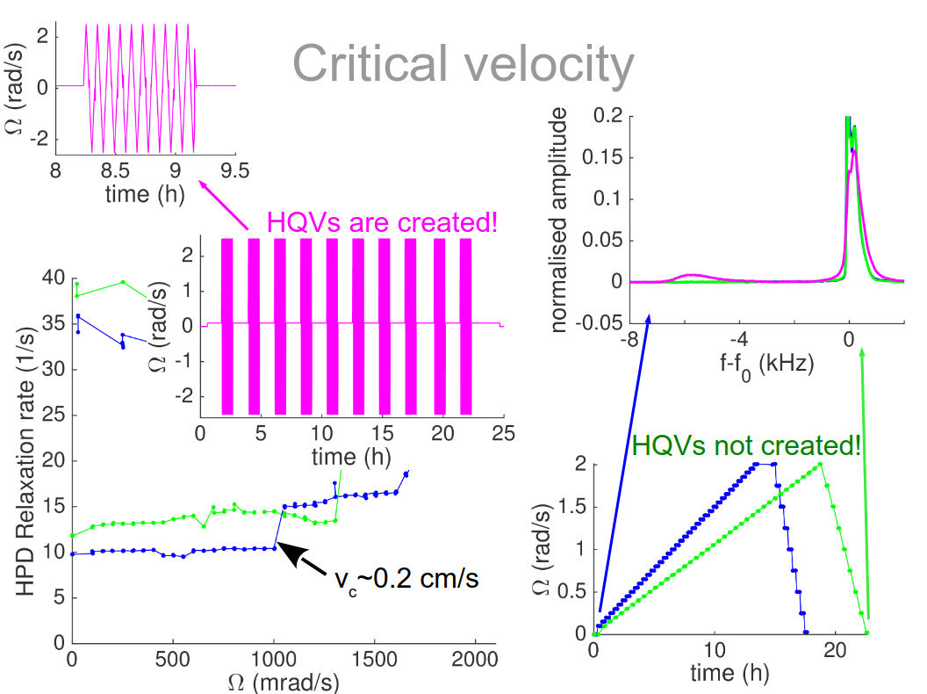

Slide 24
Key takeaways:
Bulk superfluids may be a misleading reference for neutron star vortex physics.
If there is pinning, weak pinning requires fine-tuned parameters. Thus, strong pinning should be the default expectation.
We have carried out experiments that explore vortex non-dynamics in such conditions.
But: three open problems in their interpretation need solving before extrapolation is accessible

Slide 25
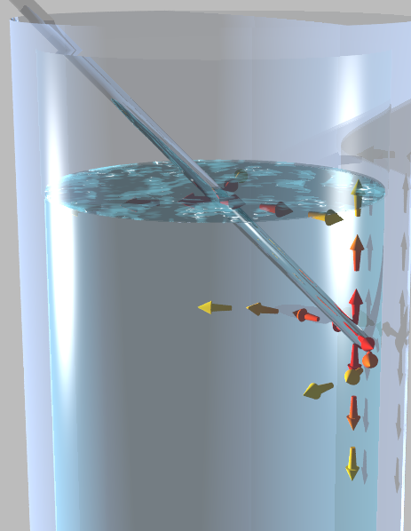
Two-dimensional vacuum of ³He-B
R. P. Haley, A. Jennings, A. Mayer, G. R. Pickett, M. Poole, R. Schanen, A. A. Soldatov, V. Tsepelin, J. Vonka, L. Whitehead, V. V. Zavjalov, D. E. Zmeev
Also: QUEST-DMC

Slide 26
Superfluid ³He
Fermi system, Cooper pairing with S=1 L=1 (p-wave triplet state)
Order parameter is a 3x3 complex matrix.
3 Superfluid phases in bulk, several other phases in restricted geometries.

Slide 27
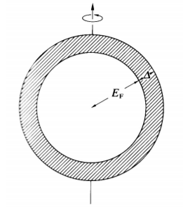
Superfluid ³He
Fermi system, Cooper pairing with S=1 L=1 (p-wave triplet state)
Order parameter is a 3x3 complex matrix.
3 Superfluid phases in bulk, several other phases in restricted geometries.
B phase: isotropic gap spectrum
Thermal excitations are broken Cooper pairs -- thermal and mehanical interaction with inserted macroscopic probes

Slide 28
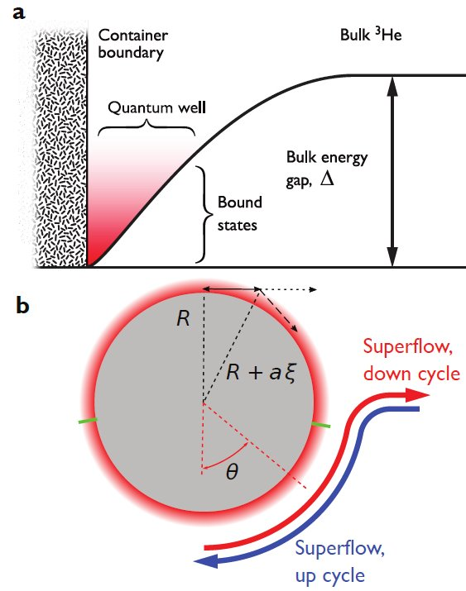
Bound states in superfluid ³He-B

Slide 29
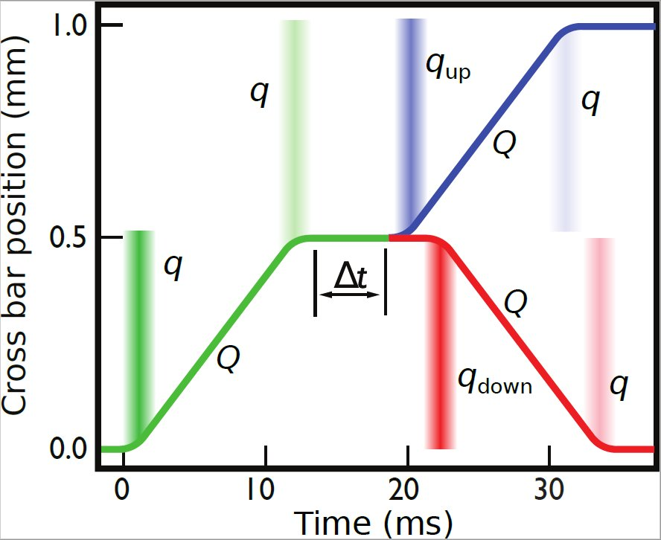
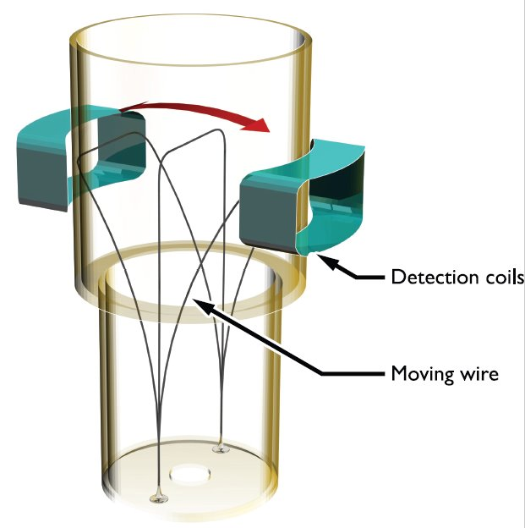
Bound state dynamics
[Nature Communications 14, 6819 (2023)] [Nature Communications 11, 4742 (2020)]

Slide 30
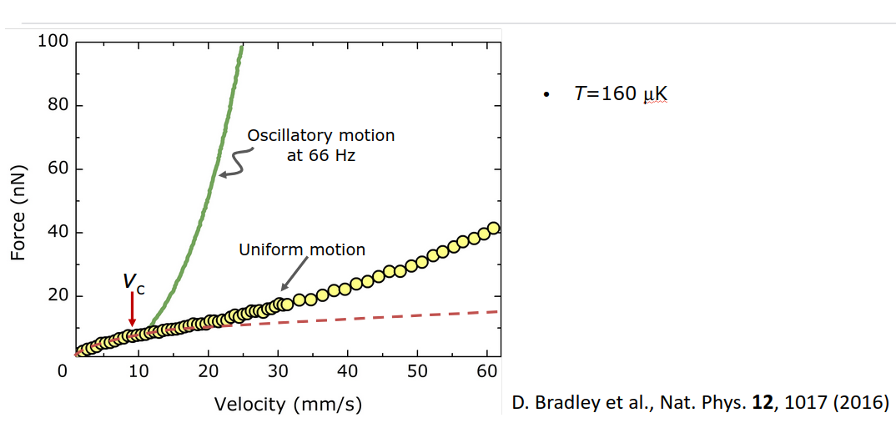

Slide 31
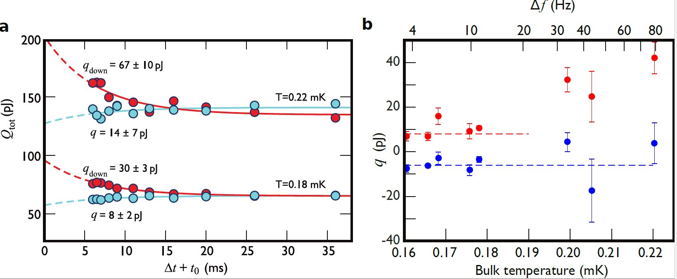
Bound state dynamics
[Nature Communications 14, 6819 (2023)] [Nature Communications 11, 4742 (2020)]

Slide 32
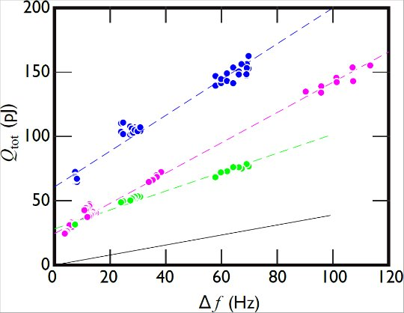
Bound state dynamics
[Nature Communications 14, 6819 (2023)] [Nature Communications 11, 4742 (2020)]

Slide 33
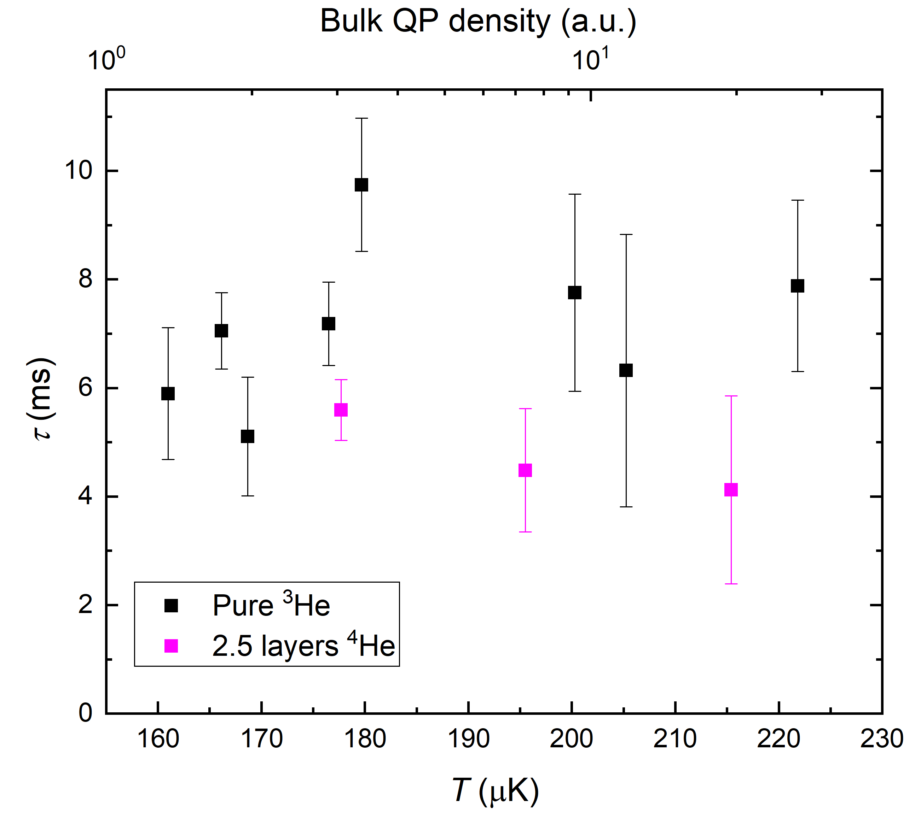
Bound state diffusion
Mean free path ~ 10µm
Quasiparticle velocity ~ v_{L} = 27mm/s
Diffusion time T=R²/2D ~10ms
[Nature Communications 14, 6819 (2023)] [Nature Communications 11, 4742 (2020)]

Slide 34
Thank you!

Slide 35
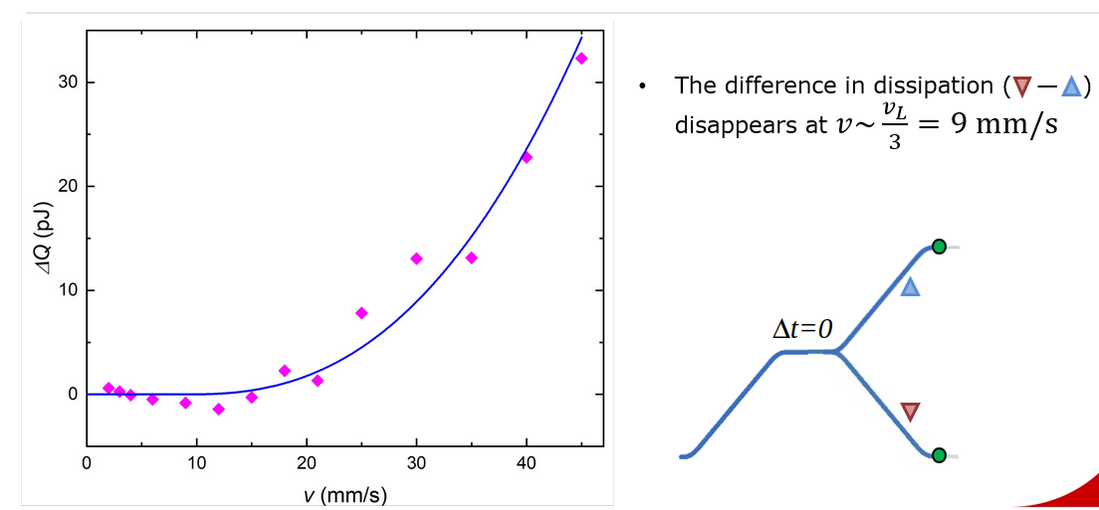

Slide 36
