Slide 1
Kelvin-Helmholtz Instability in Fermi superfluids:
short and long term dynamics
Diego Hernández Rajkov
CNR-INO and LENS
Nonequilibrium phenomena in superfluid systems: atomic nuclei, liquid helium, ultracold gases, and neutron stars
15 - 05 - 2025

Slide 2
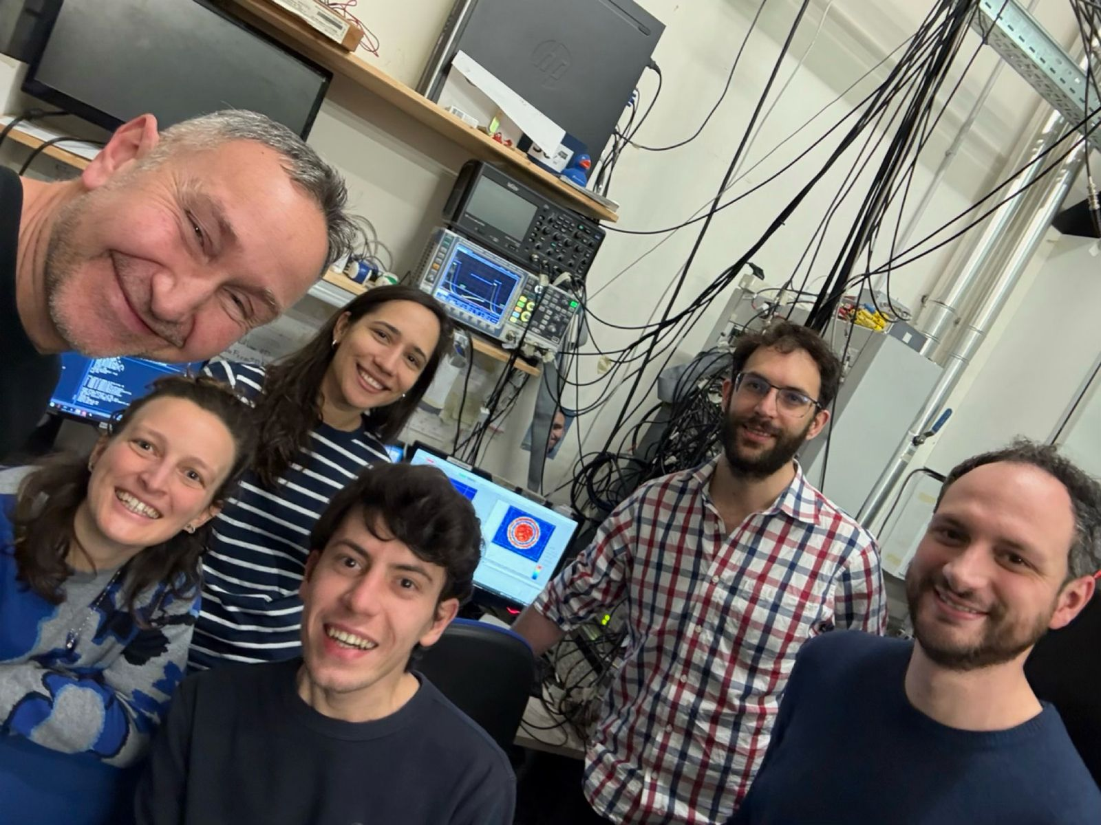
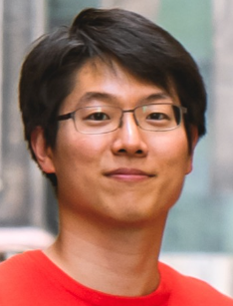
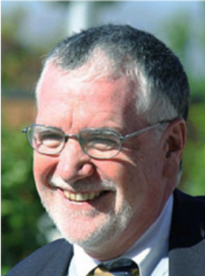
Theoretical collaborations:
Kwon, Scazza, Inguscio, Marino, Xhani, Pezze’, Donelli, Fort, M. Modugno, Galantucci,
A. Barresi, P. Magierski, G. Wlazlowski, P.Pieri, M. Pini,
S. Stringari (dynamics on annular superfluids)

Slide 3
Overview
The problem of the Kelvin-Helmholtz Instability:
Direct observation of the Kelvin-Helmholtz Instability from vortex arrays
Reaching a statistical steady state
Summary and perspective

Slide 4
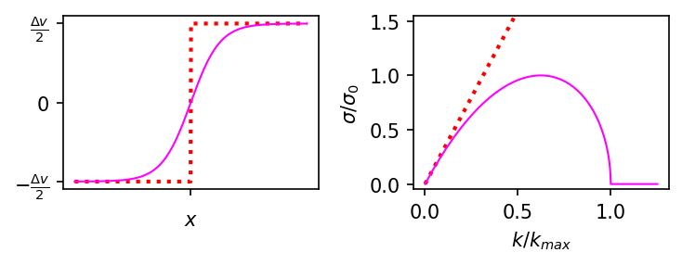
Growth rates of the Kelvin-Helmholtz Instability
2
https://www.youtube.com/watch?v=cTRQP6DSaqA&ab_channel=KevinSchaal
Notes:
FRECCE ROSSE E BLU NON SI VEEDONO. Prova frecce verdi frecce rotanti si vedono poco

Slide 5
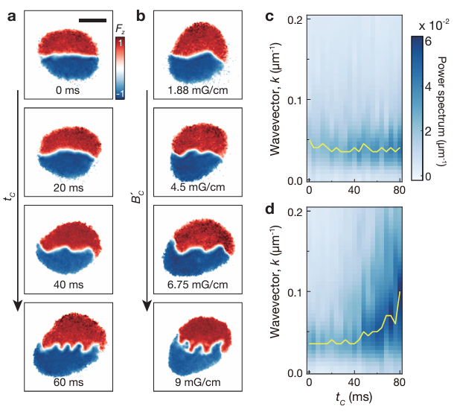
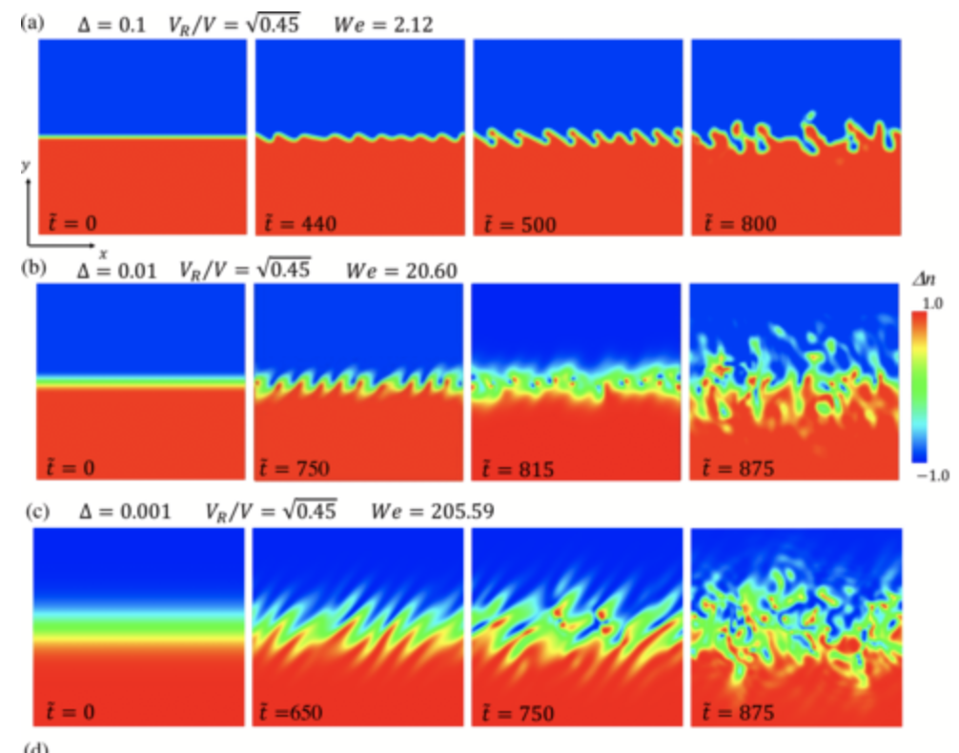
Kelvin-Helmholtz instability in superfluid mixtures
Haruya Kokubo, et al, Phys.Rev.A 104, 023312 (2021)
arXiv:2408.11217 (2024)
3

Slide 6
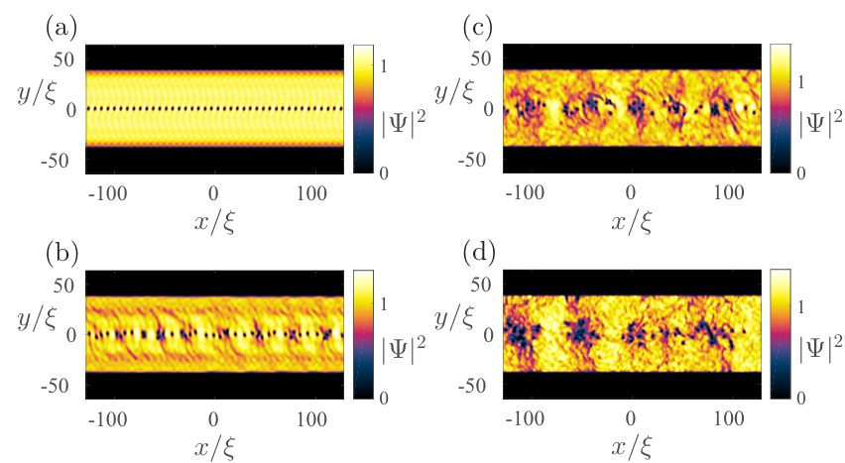
Kelvin-Helmholtz Instability in single-component superfluids
4
Baggaley, Parker, Phys. Rev. A 97, 053608 (2018), L.Giacomelli, I.Carusotto SciPost Phys. 14, 025 (2023)

Slide 7
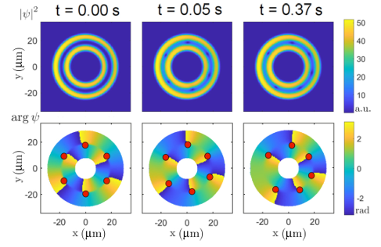
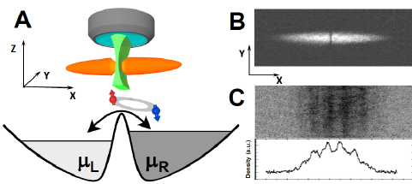
Vortex arrays from linear Josephson Junctions
Yurii Borysenko, Phys. Rev. A 111, 043308 (2025)
4
G.Valtolina et al. Science 350,1505-1508 (2015), N.Luick et al. Science 369,89-91 (2020)

Slide 8
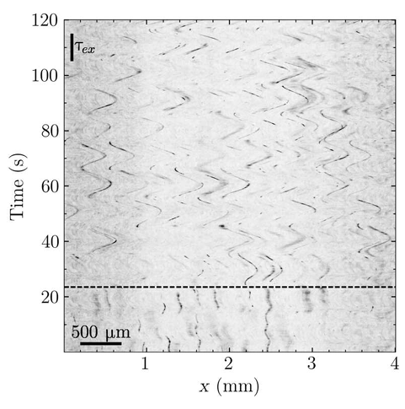
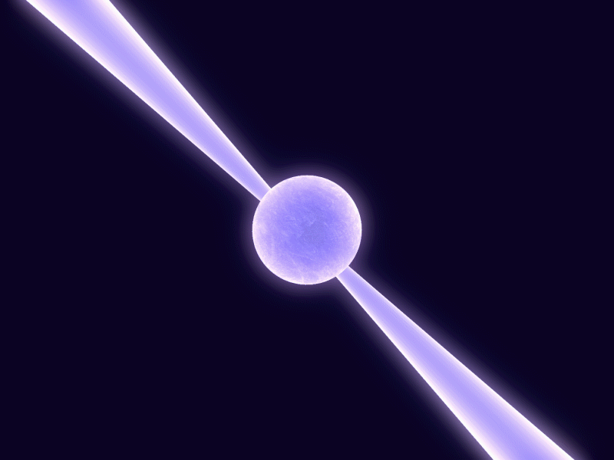
Kelvin-Helmholtz Instability in annular geometries
Vortex dance club
Charles Peretti, Mathieu Gibert, Sci. Adv.9,eadh2899(2023)
5

Slide 9
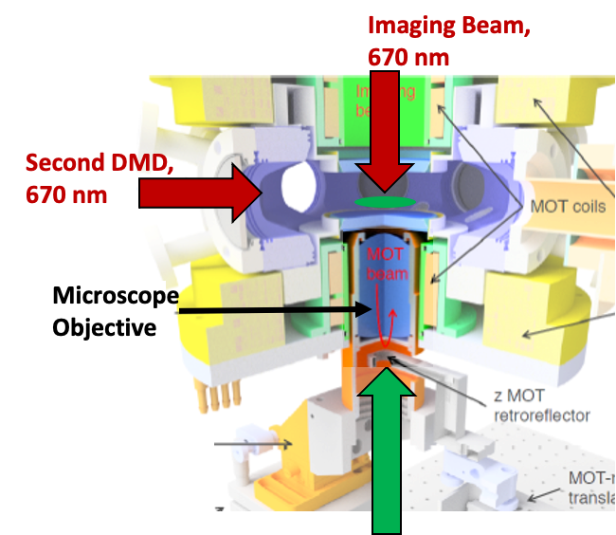
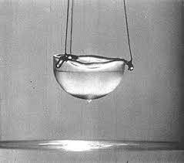
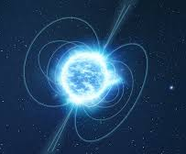
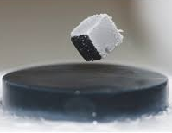
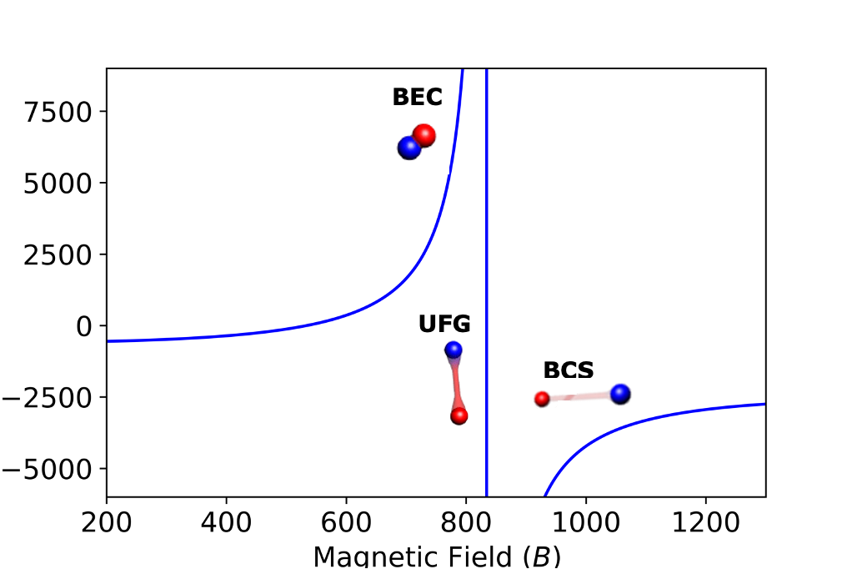
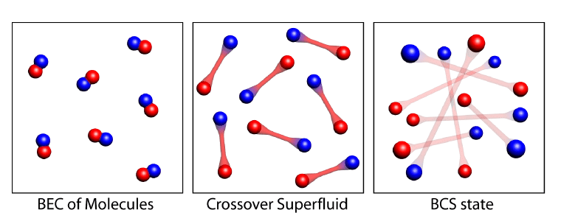
Fermionic quantum simulator
6

Slide 10
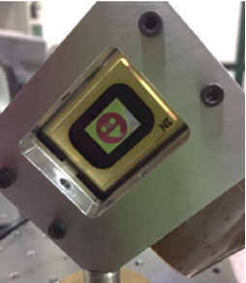
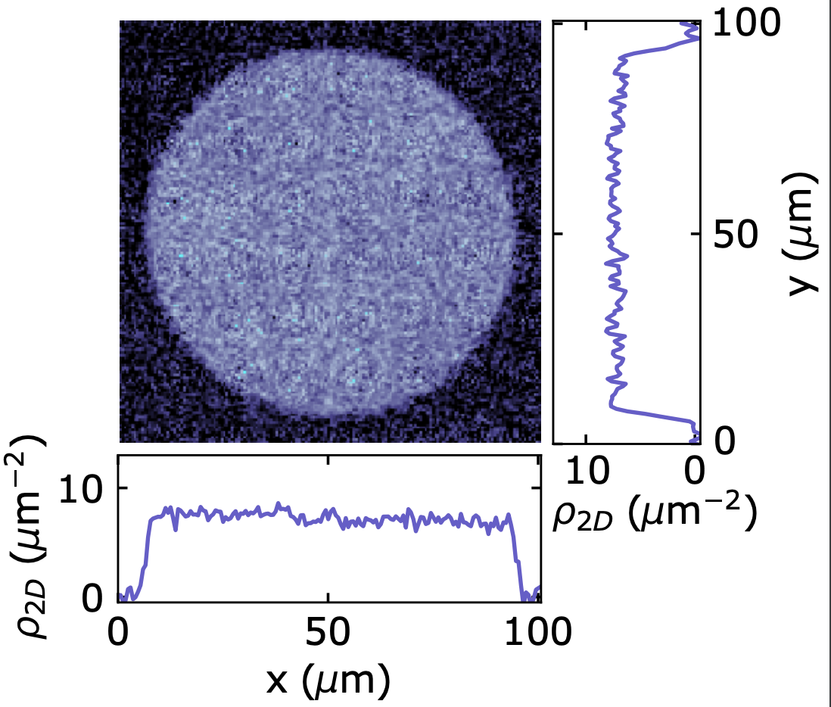
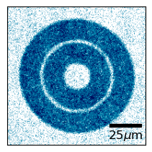
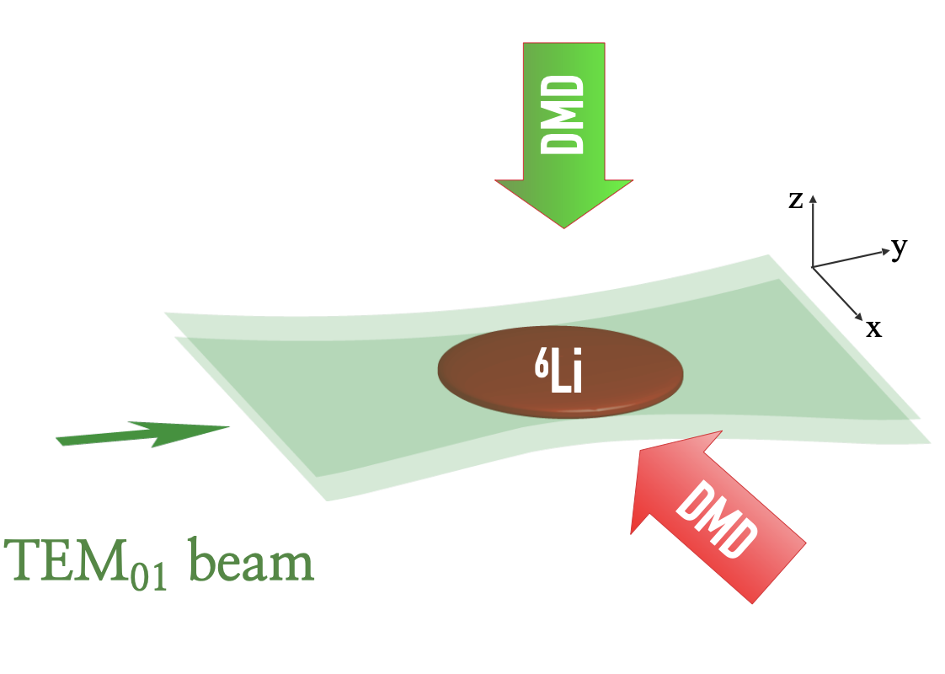
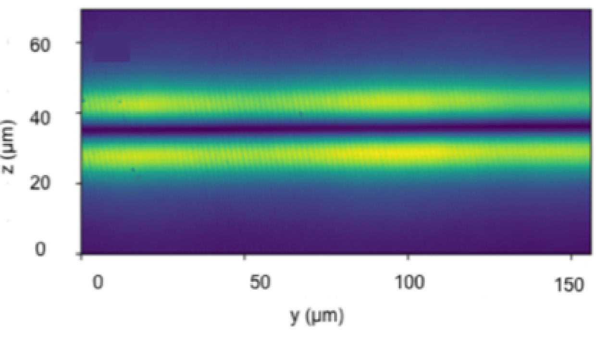
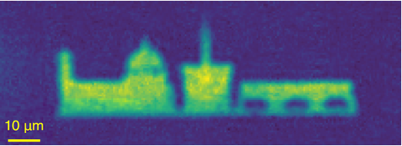
Homogeneous Fermi superfluids on arbitrary geometries
7
N. Navon et al., Nat. Phys. 17, 1334–1341 (2021)

Slide 11
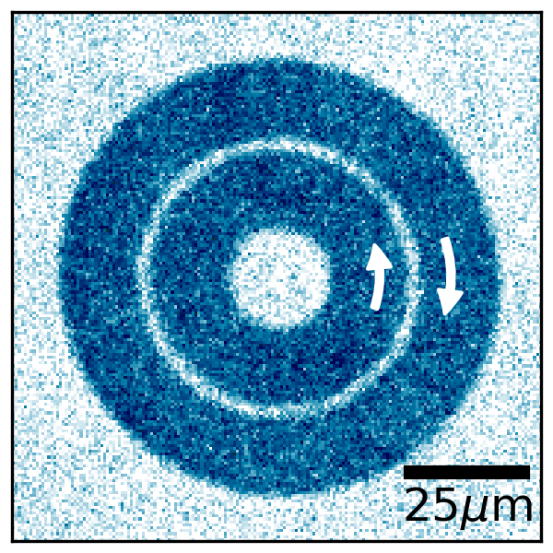
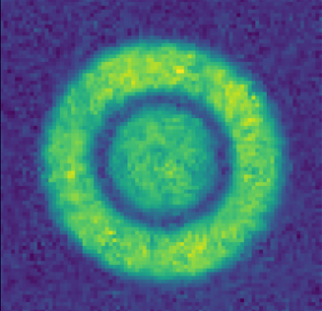
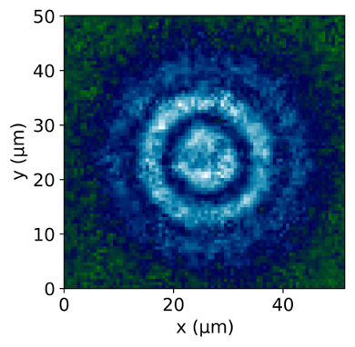
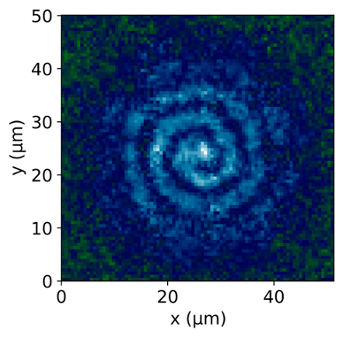
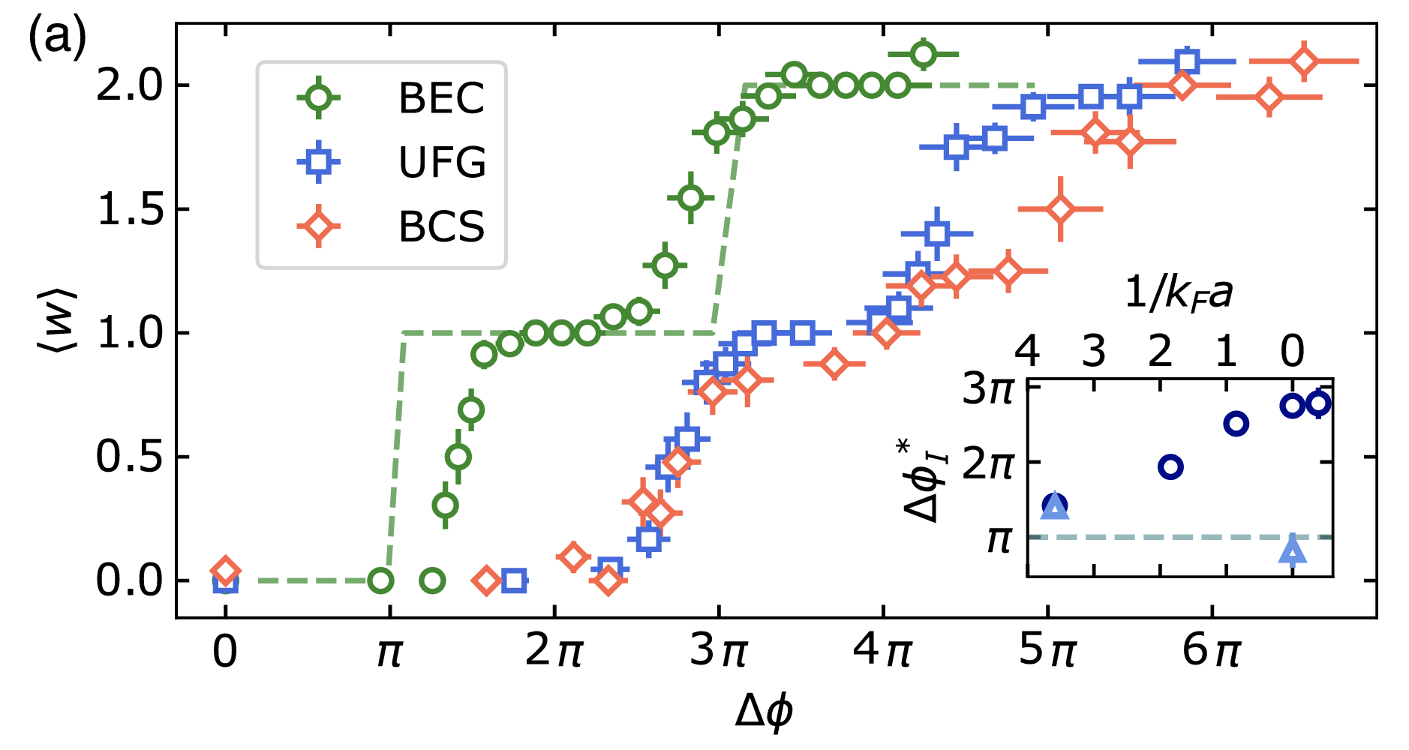
Persistent currents on annular superfluids
8
D. Hernandez-Rajkov et al Nat. Phys. 20, 939–944 (2024).
G. Del Pace, et al., Phys. Rev. X 12, 041037 (2022)

Slide 12
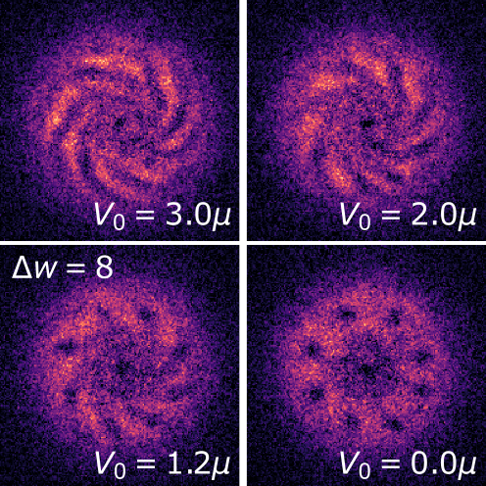
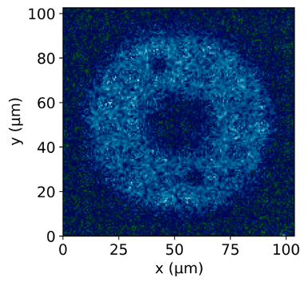
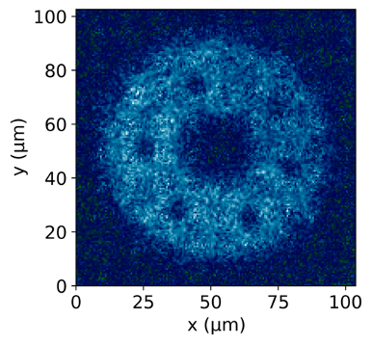
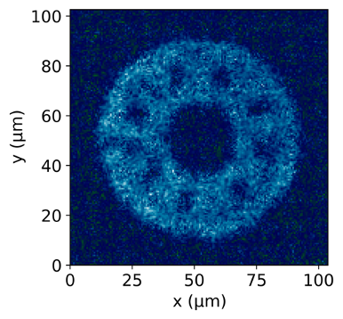
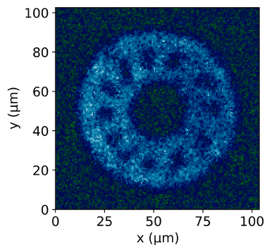
From persistent currents to vortex arrays
º
9
D. Hernandez-Rajkov et al Nat. Phys. 20, 939–944 (2024).

Slide 13
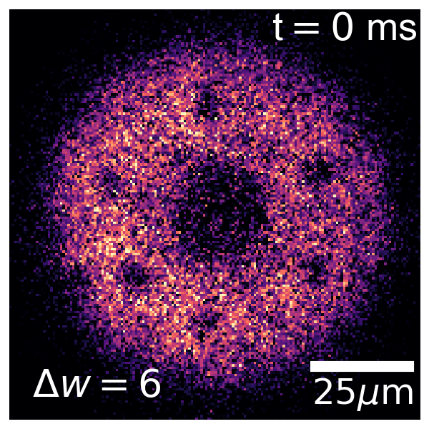
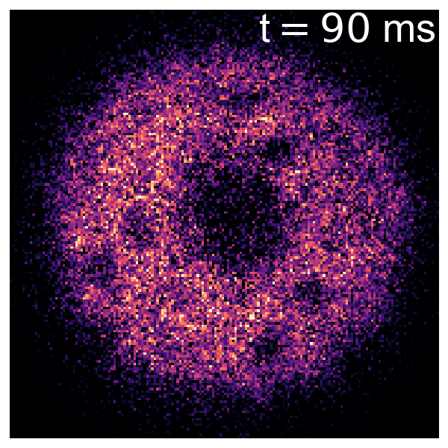
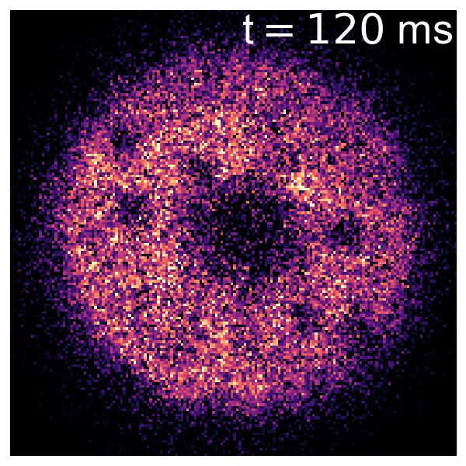
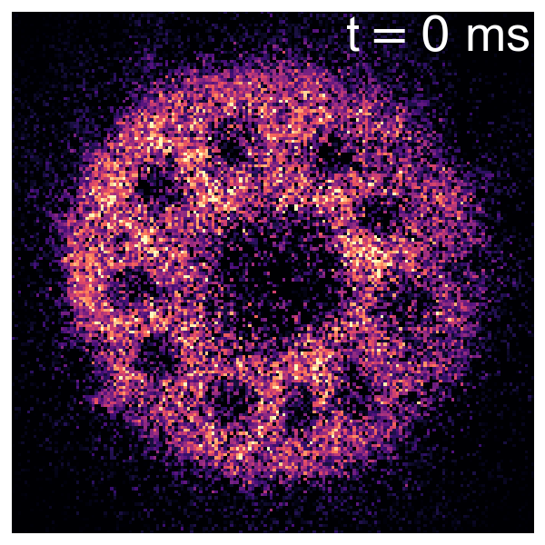
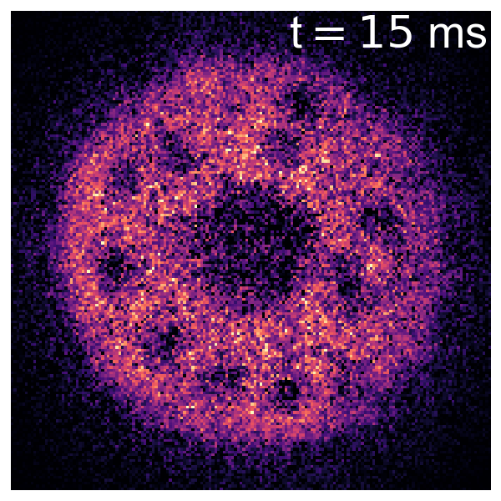
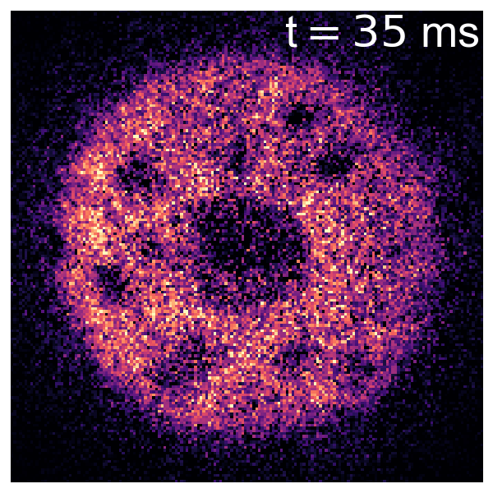
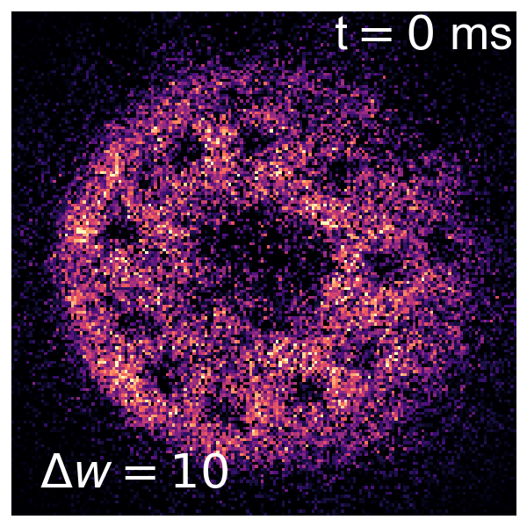
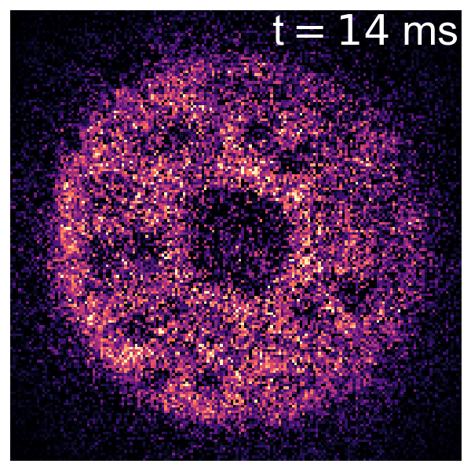
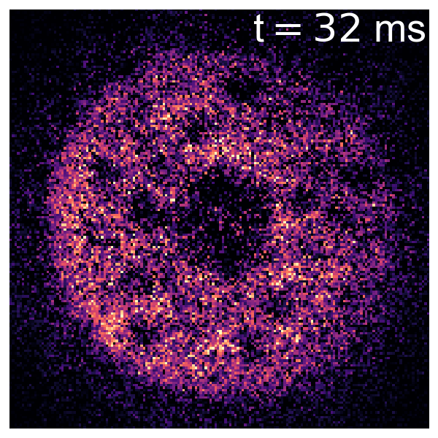
BEC
UFG
BCS
D. Hernandez-Rajkov et al Nat. Phys. 20, 939–944 (2024).

Slide 14
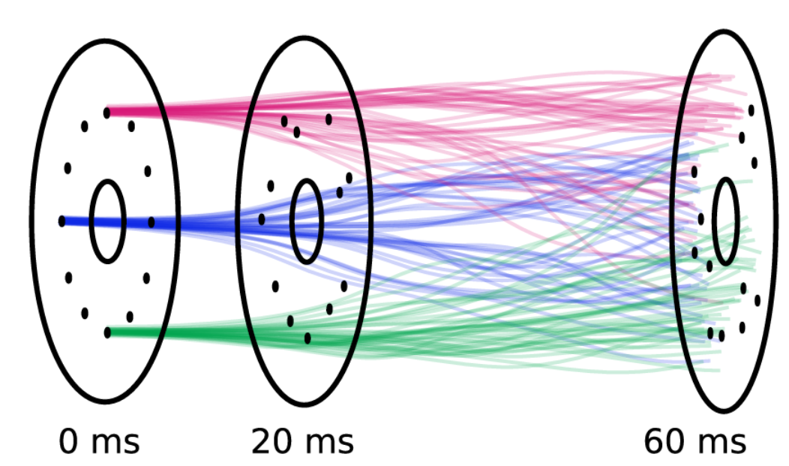
Many trajectories from a single starting condition
Chaotic-like behavior!
11
D. Hernandez-Rajkov et al Nat. Phys. 20, 939–944 (2024).

Slide 15
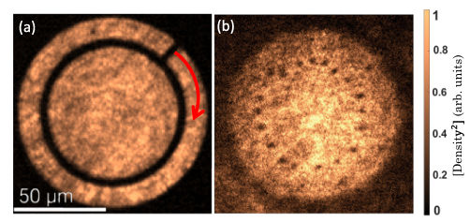
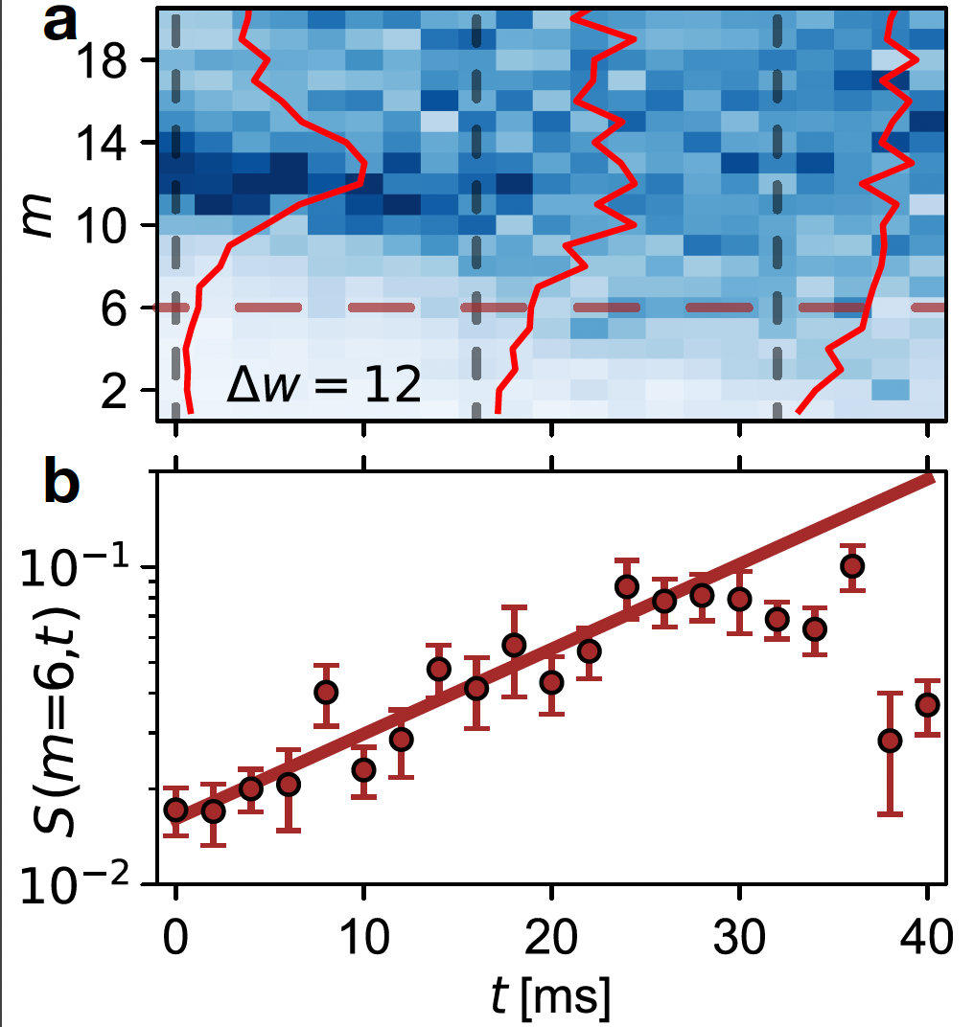
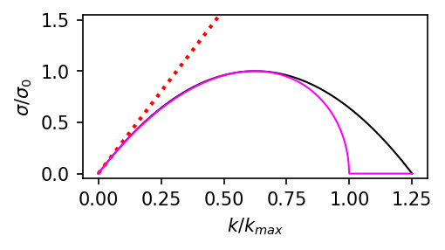
Statistical approach to vortex dynamics
Study angular vortex-vortex correlations in Fourier space
Also now in Phys. Rev. A 111, 023314 (2025)
12
D. Hernandez-Rajkov et al Nat. Phys. 20, 939–944 (2024).

Slide 16
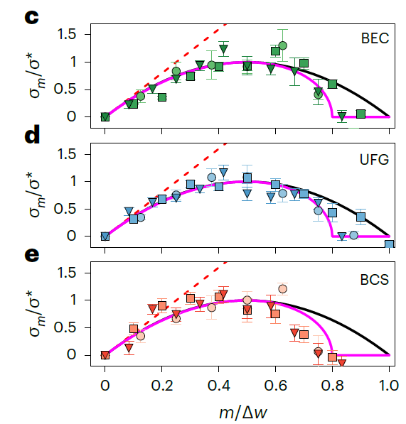
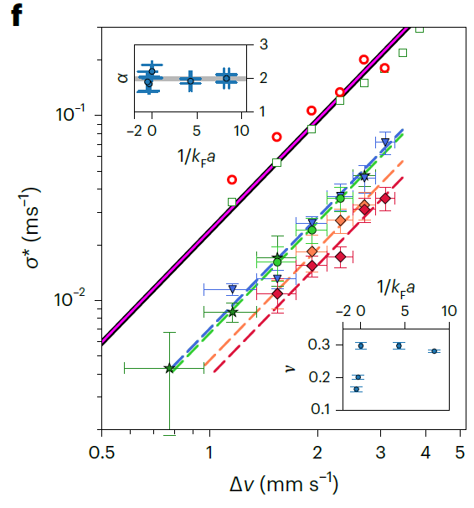
Growth rates of the Kelvin-Helmholtz Instability
N=8
N=10
N=12
13
D. Hernandez-Rajkov et al Nat. Phys. 20, 939–944 (2024).

Slide 17
Vortex dynamics in normal-superfluid mixtures
In the presence of a thermal component an additional mutual friction term appears
Balancing the forces on the vortex yields:
Solving for the vortex velocity for 2D vortex dynamics:
The values and microscopic origin depends significantly on the details of the superfluids
14
N B Kopnin 2002 Rep. Prog. Phys. 65 1633

Slide 18
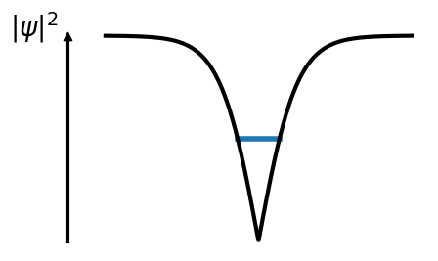
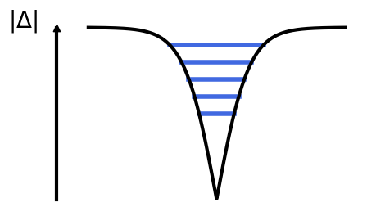
Quasiparticle-scattering as the origin of mutual friction
15

Slide 19
Mutual friction in Unitary Fermi Superfluids: effect of the bound states
He3-B 10 bar
He II
16
N. Grani, et al, arXiv.2503.21628 (2025)

Slide 20
Quantifying the observed mismatch: mutual friction
M. Caldara, A.Richaud, SciPost Phys. 17, 076 (2024)
Phys. Rev. A 111, 023314 (2025)
Additional physical effects? :
Inertial waves / Tkachenko waves
Fundamental Kelvin mode n=1
Local model to include normal component
17
D. Hernandez-Rajkov et al Nat. Phys. 20, 939–944 (2024), Randeria, Taylor, 2014

Slide 21
A key mechanism to spontaneously reach turbulent regimes in classical fluids.
Kelvin Helmholtz Instability of quantum vortices Quantum vortex turbulence
18

Slide 22
Long term dynamics: a statistical steady state
18
D. Hernandez-Rajkov et al, In preparation in collaboration with L.Galantucci

Slide 23
Long term dynamics: a statistical steady state
19
D. Hernandez-Rajkov et al, In preparation in collaboration with L.Galantucci

Slide 24
Long term dynamics: a statistical steady state
Phys. Rev. X 12, 01103 (2022)
20
D. Hernandez-Rajkov et al, In preparation in collaboration with L.Galantucci

Slide 25
Outlooks
i
e
21

Slide 26
Outlooks
Luca Galantucci, et al. arXiv:2501.08309
N. Grani, et al, arXiv.2503.21628 (2025)
Normal component effects
Look for cascade signatures
21

Slide 27
Theoretical collaborations:
Kwon, Scazza, Inguscio, Marino, Xhani, Pezze’, Donelli, Fort, M. Modugno, Galantucci,
A. Barresi, P. Magierski, G. Wlazlowski, P.Pieri, M. Pini,
S. Stringari (dynamics on annular superfluids)

