Slide 1
Gravitational form factors: theory and phenomenology
Feng Yuan
Lawrence Berkeley National Laboratory

Slide 2
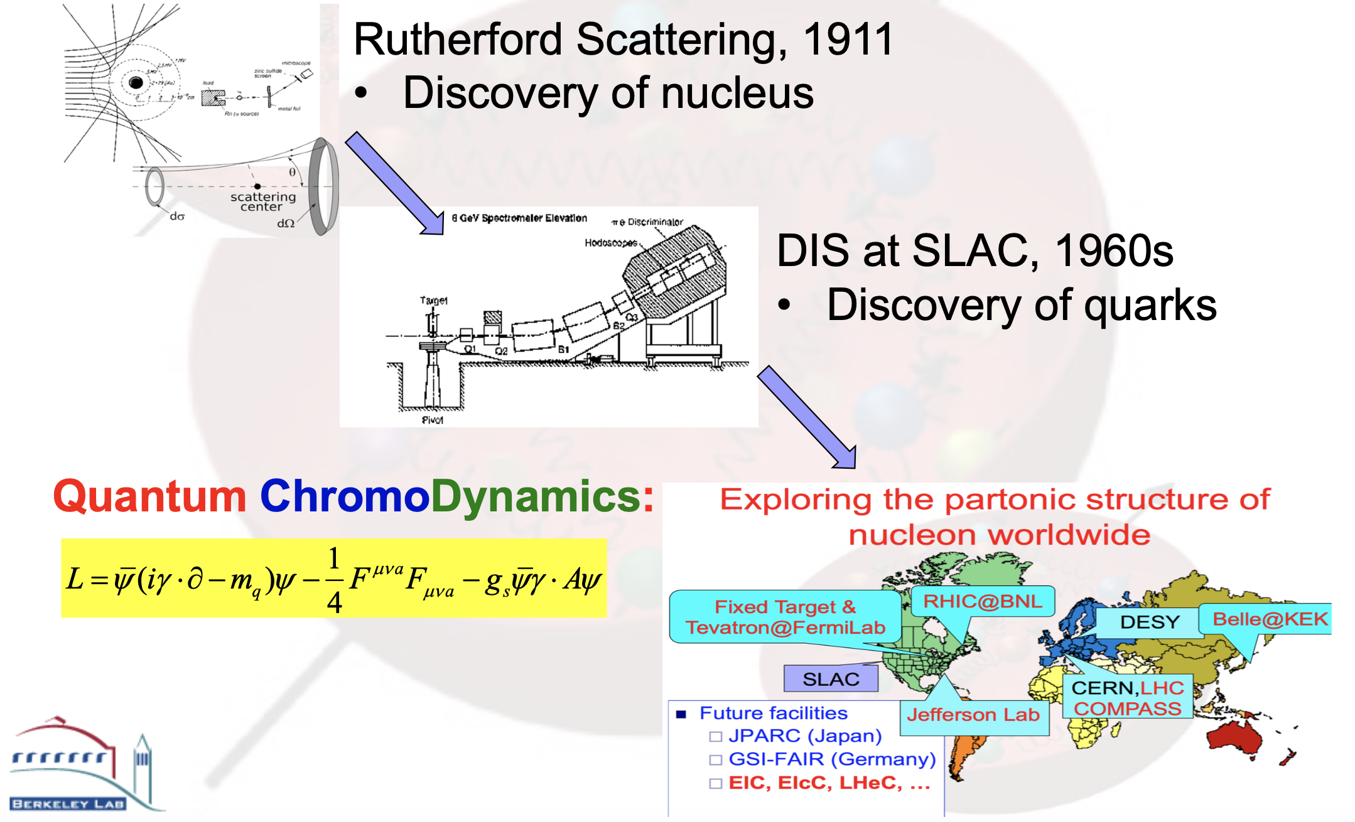
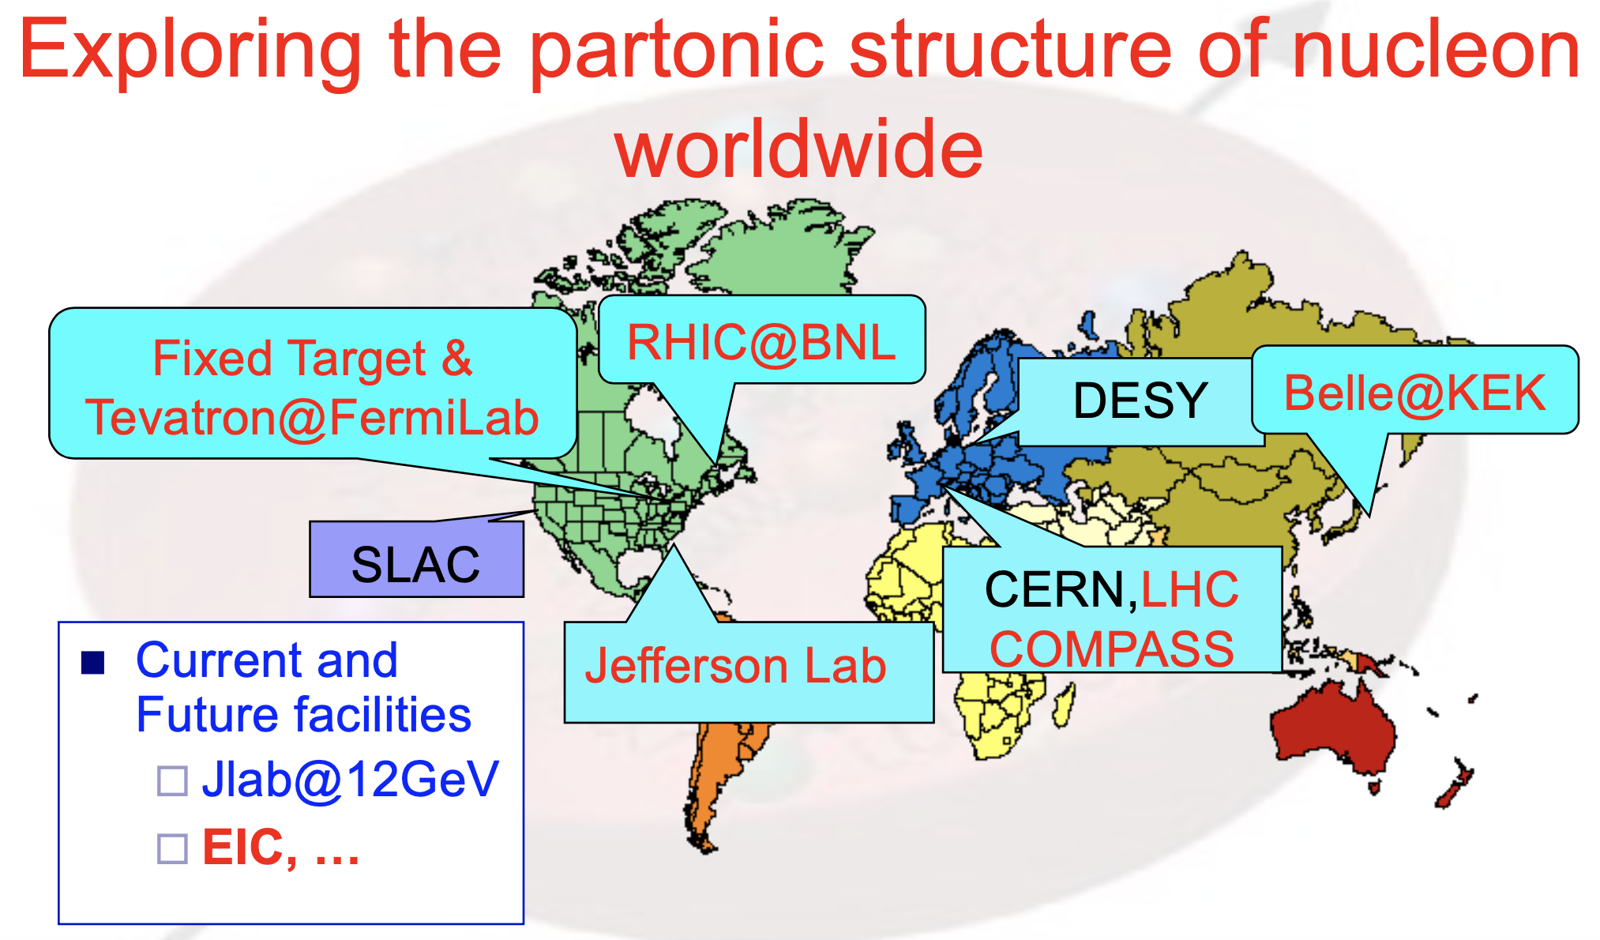
Exploring the nucleon/nucleus:
Of fundamental importance in science

Slide 3
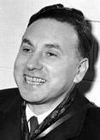
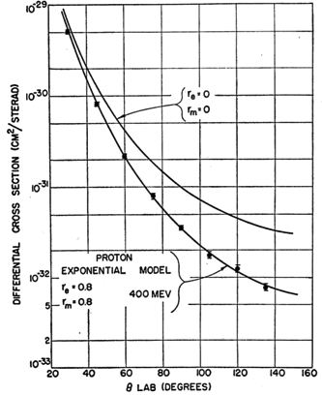
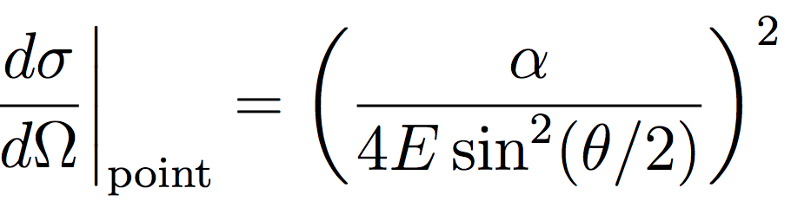
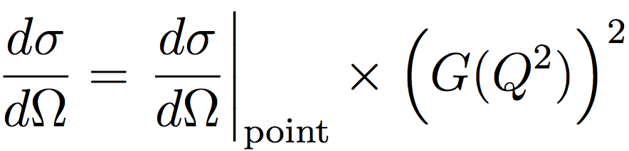
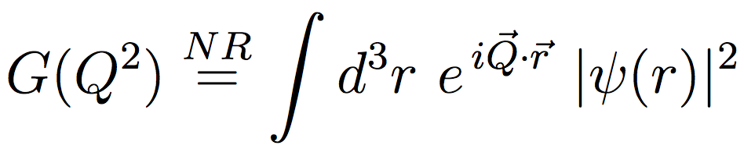
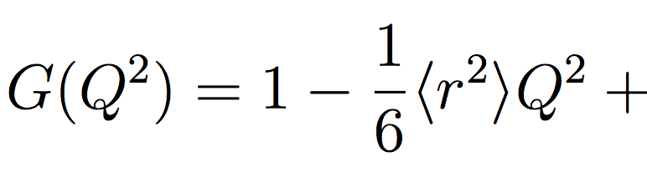
EM Form Factors finite size of nucleon
Rutherford scattering with electron
Hofstadter
Extended target
RevModPhys.28.214

Slide 4
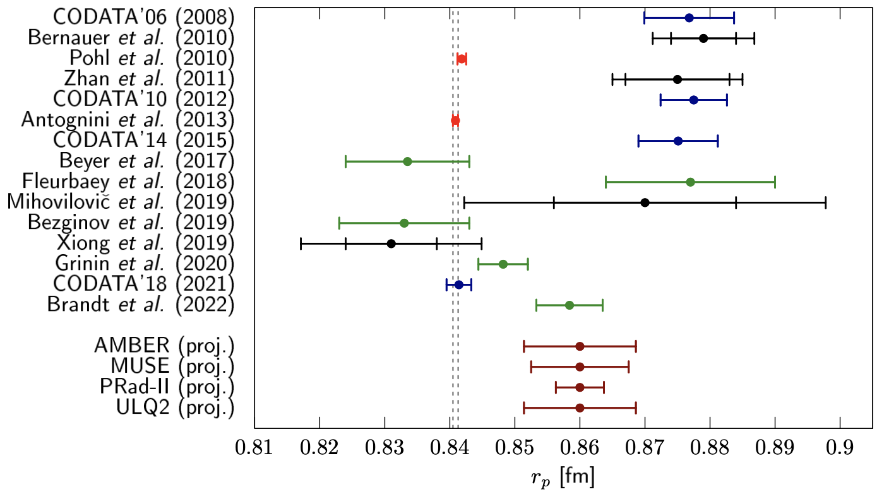
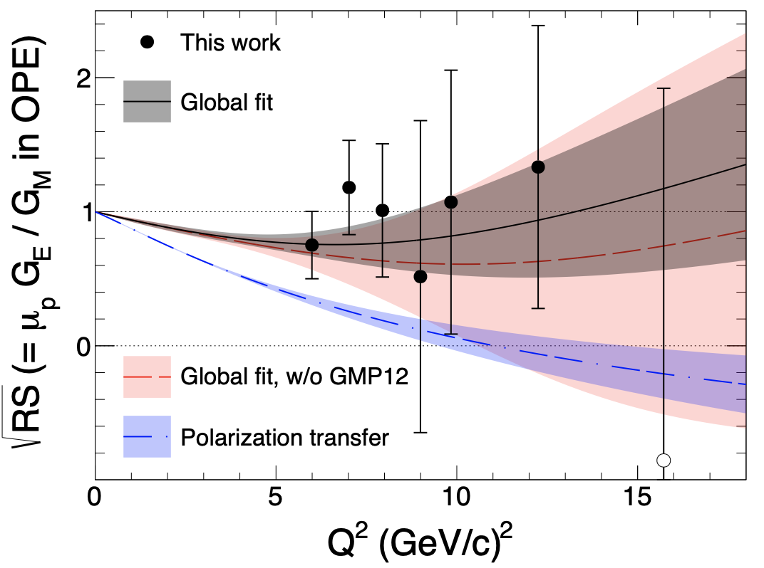
More than half century later: still an active research area
PRad: Xiong et al, Nature 575 (2019) 147
Christy et al., PRL 2022

Slide 5
EIC Science: from quark/gluon to cosmo
How do the nucleonic properties such as mass and spin emerge from partons and their underlying interactions?
How are partons inside the nucleon distributed in both momentum and position space?
What happens to the gluon density in nucleons and nuclei at small x? Does it saturate at high energy, giving rise to gluonic matter with universal properties in all nuclei (and perhaps even in nucleons)?
How do color-charged quarks and gluons, and jets, interact with a nuclear medium? How do confined hadronic states emerge from these quarks and gluons? How do the quark-gluon interactions generate nuclear binding?
Do signals from beyond-the-standard-model physics manifest in electron-proton/ion collisions? If so, what can we learn about the nature of these new particles and forces?
EIC Whitepaper for LRP
QCD Whitepaper, 2303.02579

Slide 6
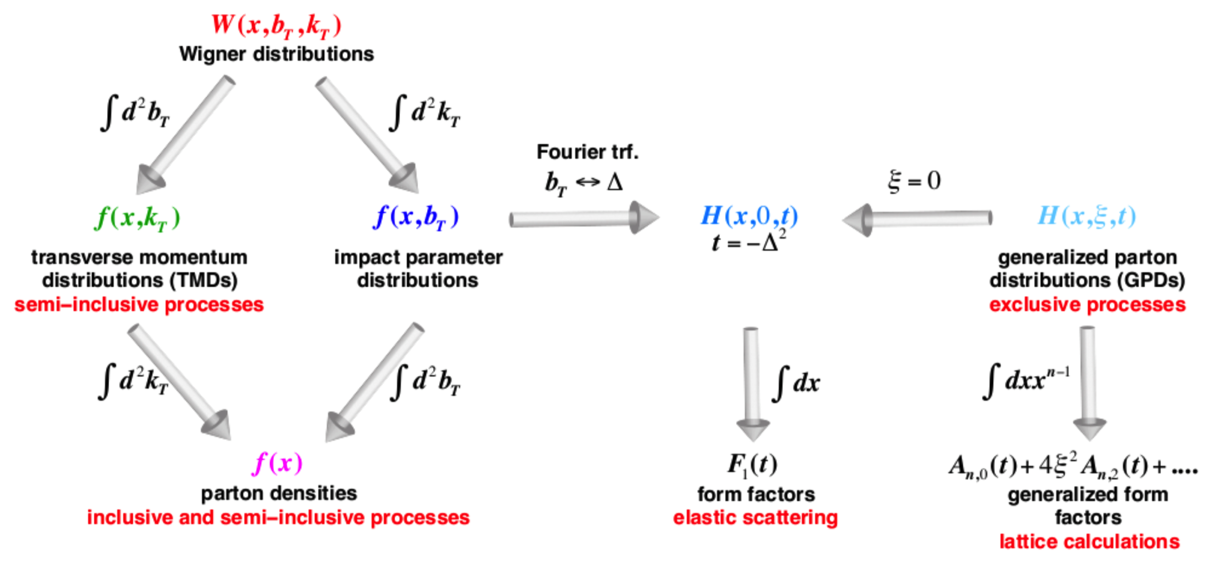
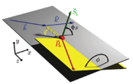
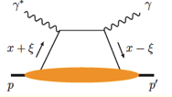
Gravitational Form Factors: important aspect of tomography
Wigner distributions (Belitsky, Ji, Yuan)
5D
3D
1D

Slide 7
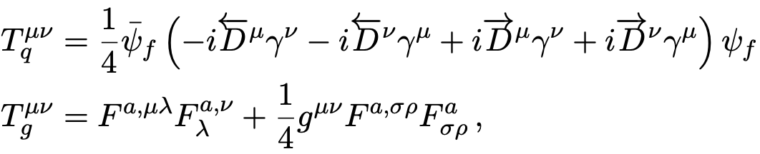
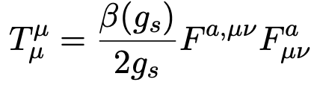
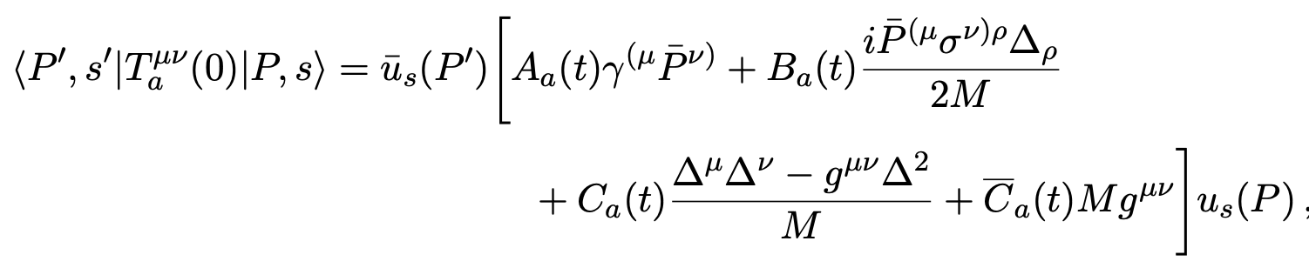
Energy-Momentum Tensor and GFFs
Quark and gluon contributions to EMT
Gravitational Form Factors (EMT Form Factors)
Kobzarev-Okun 1962;
Pagels 1966; Ji 1997

Slide 8
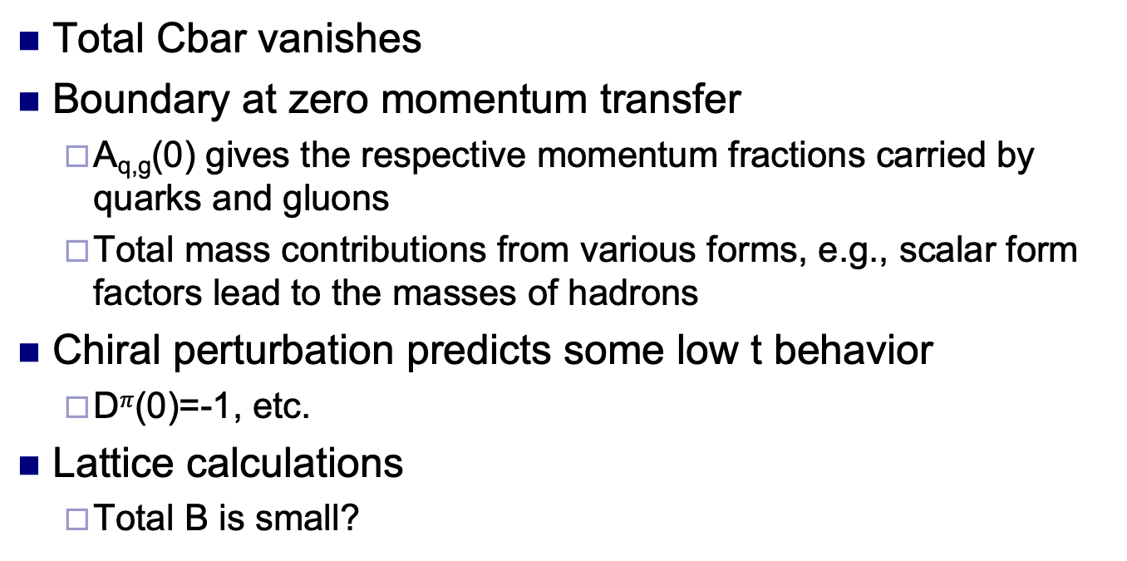
What do we know about GFFs
Total Cbar vanishes
Boundary at zero momentum transfer
  A_{q,g}(0) gives the respective momentum fractions carried by quarks and gluons
  Total mass contributions from various forms, e.g., scalar form factors lead to the masses of hadrons
Chiral perturbation predicts some low t behavior
  D$π$(0)=-1, etc.
Lattice calculations
  Total B is small?

Slide 9
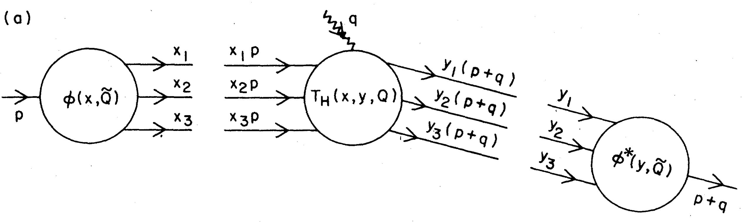
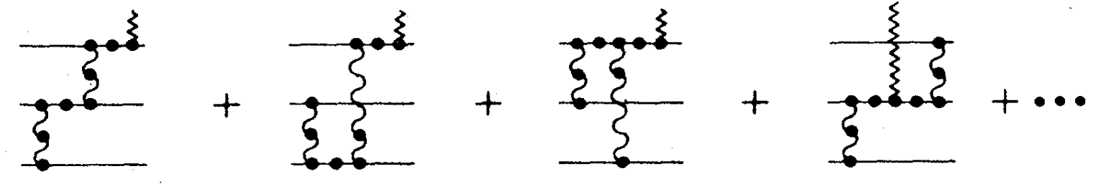
Perturbatively, one can compute the form factors at large momentum transfer
Lepage-Brodsky 1980
Efremov-Radyushkin 1980
Nucleon wave
function
Nucleon wave
function

Slide 10
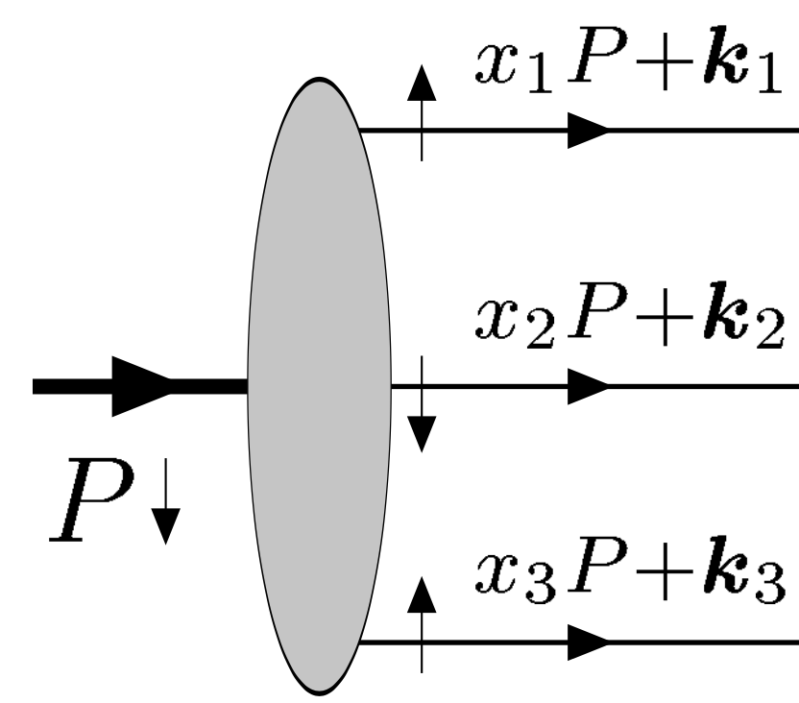
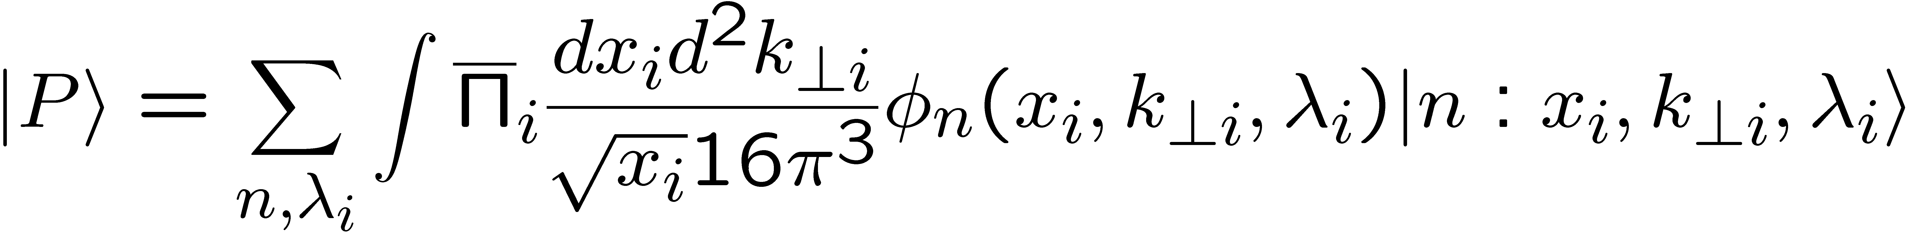
Light-cone Wave Functions
Lepage-Brodsky 1980
They are building blocks for the hadron structure
Fock state of n-partons: momentum fractions, transverse momenta, helicities
Can be used to compute the form factors, GPDs, and hard exclusive scattering amplitudes

Slide 11
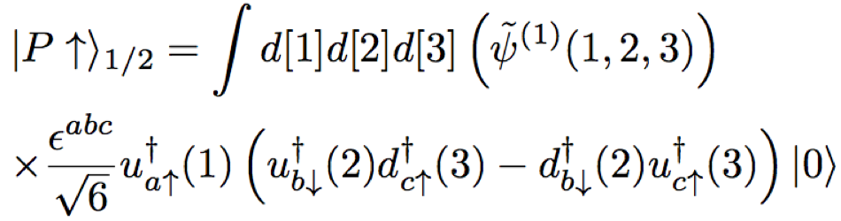
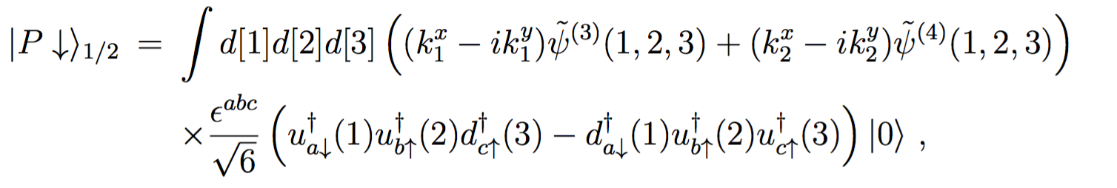
Nucleon’s 3-quarks WF
Ji, Ma, Yuan, 2002
Boffi, Pasquini, 2004
According to the general structure, six independent light-cone wave functions for three quarks component:
L_{z}=0
|L_{z}|=1

Slide 12
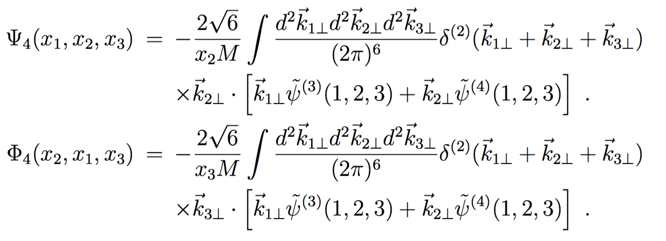
Distribution amplitudes
Integrate out the transverse momentum
  Twist-three (leading-twist)
  Twist-four (Braun-Fries-Mahnke-Stein 2000)

Slide 13
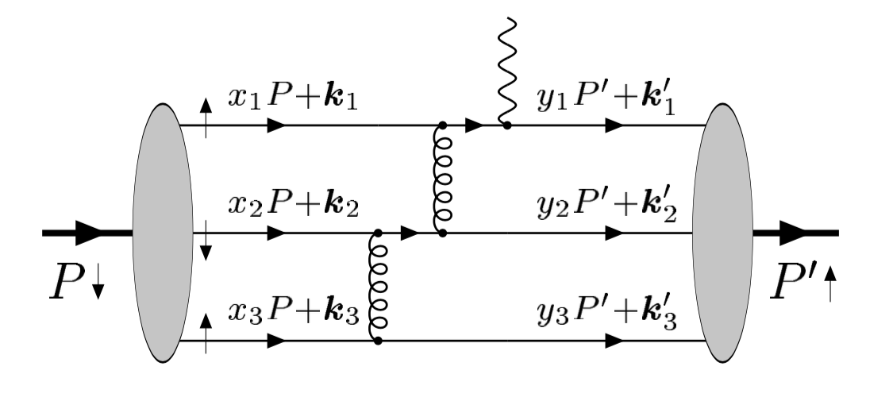
Form factor calculations
Compute the partonic scattering
amplitudes, convert to hadron’s
Leading-twist: direct integration of
k_{t}, higher-twist: need k_{t}-expansion
Two gluon exchanges are needed to generate large momentum transfer
Helicity-non-flip has power behavior, F₁~1/t^2
Helicity-flip amplitude has power behavior, F₂~1/t^3
Brodsky-Lepage 1981 for F₁
Belitsky-Ji-Yuan 2002 for F₂

Slide 14
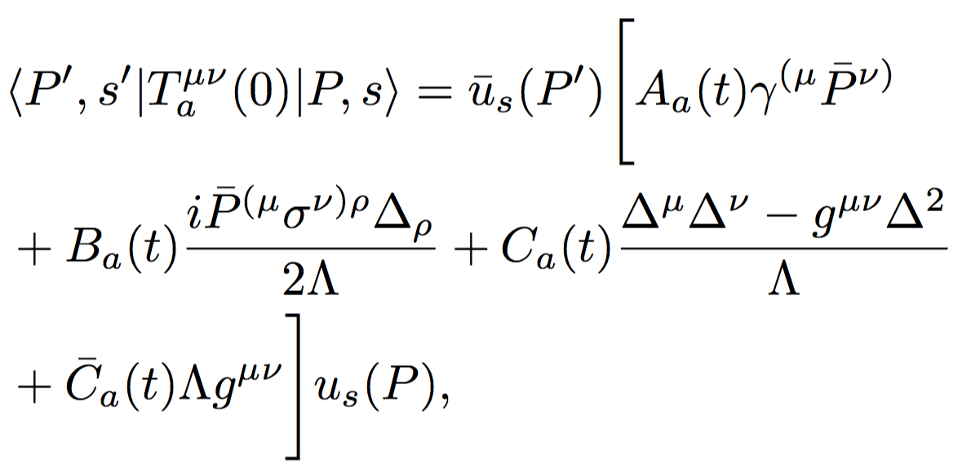
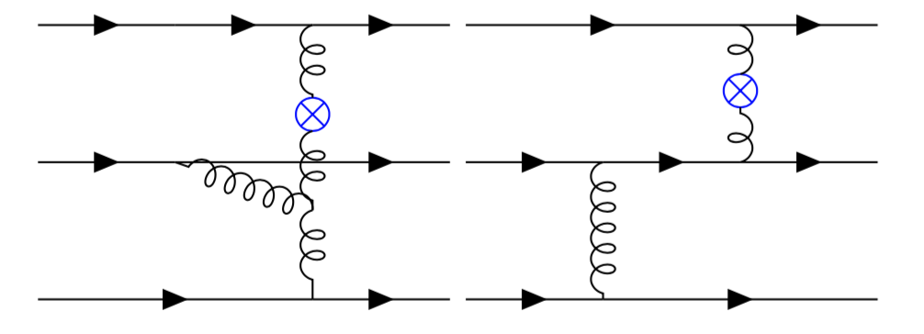
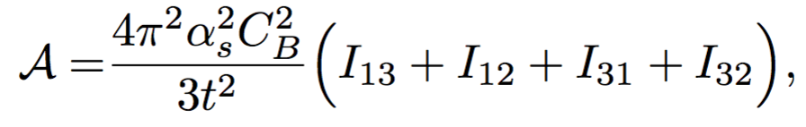
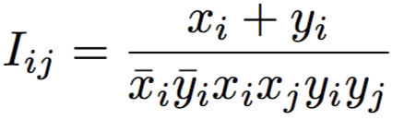
Gravitational FFs
No contribution from three-gluon vertex diagram
A_{g}~1/t^2
B_{g}, C_{g} scale as 1/t^3,Cbar_{g} scales as 1/t^2
Tong-Ma-Yuan, 2103.12047
2203.13493

Slide 15
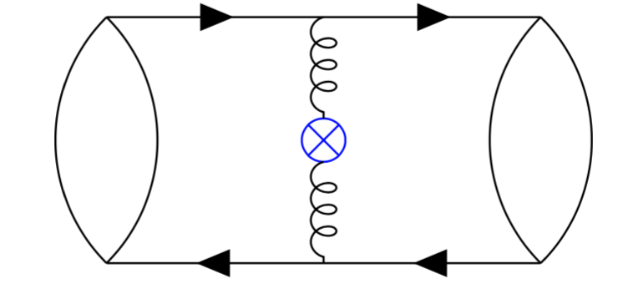
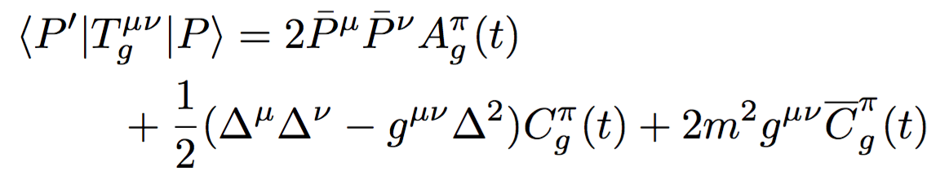
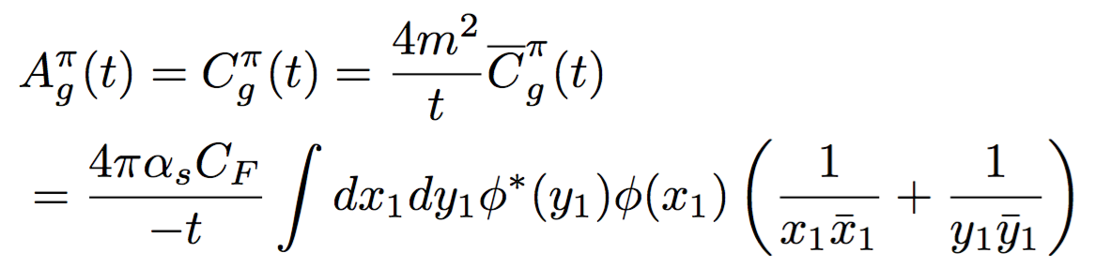
Gravitational form factors for Pions:
No much difference, only some surprises
Pion case
  A_{g}=C_{g}!!
  Cbar cancels between quarks and gluons
    Quark part from GPD quark at large-t (Hoodbhoy-Ji-Yuan 2003)
Tong-Ma-Yuan, 2103.12047;
earlier work: Tanaka, PRD 2018
May introduce some trivial feature to interpret the distribution as functions of r
Polyakov-Schweitzer 2018
Freese-Miller 2021

Slide 16
Implication: scalar factor factors
(F² term)

Slide 17
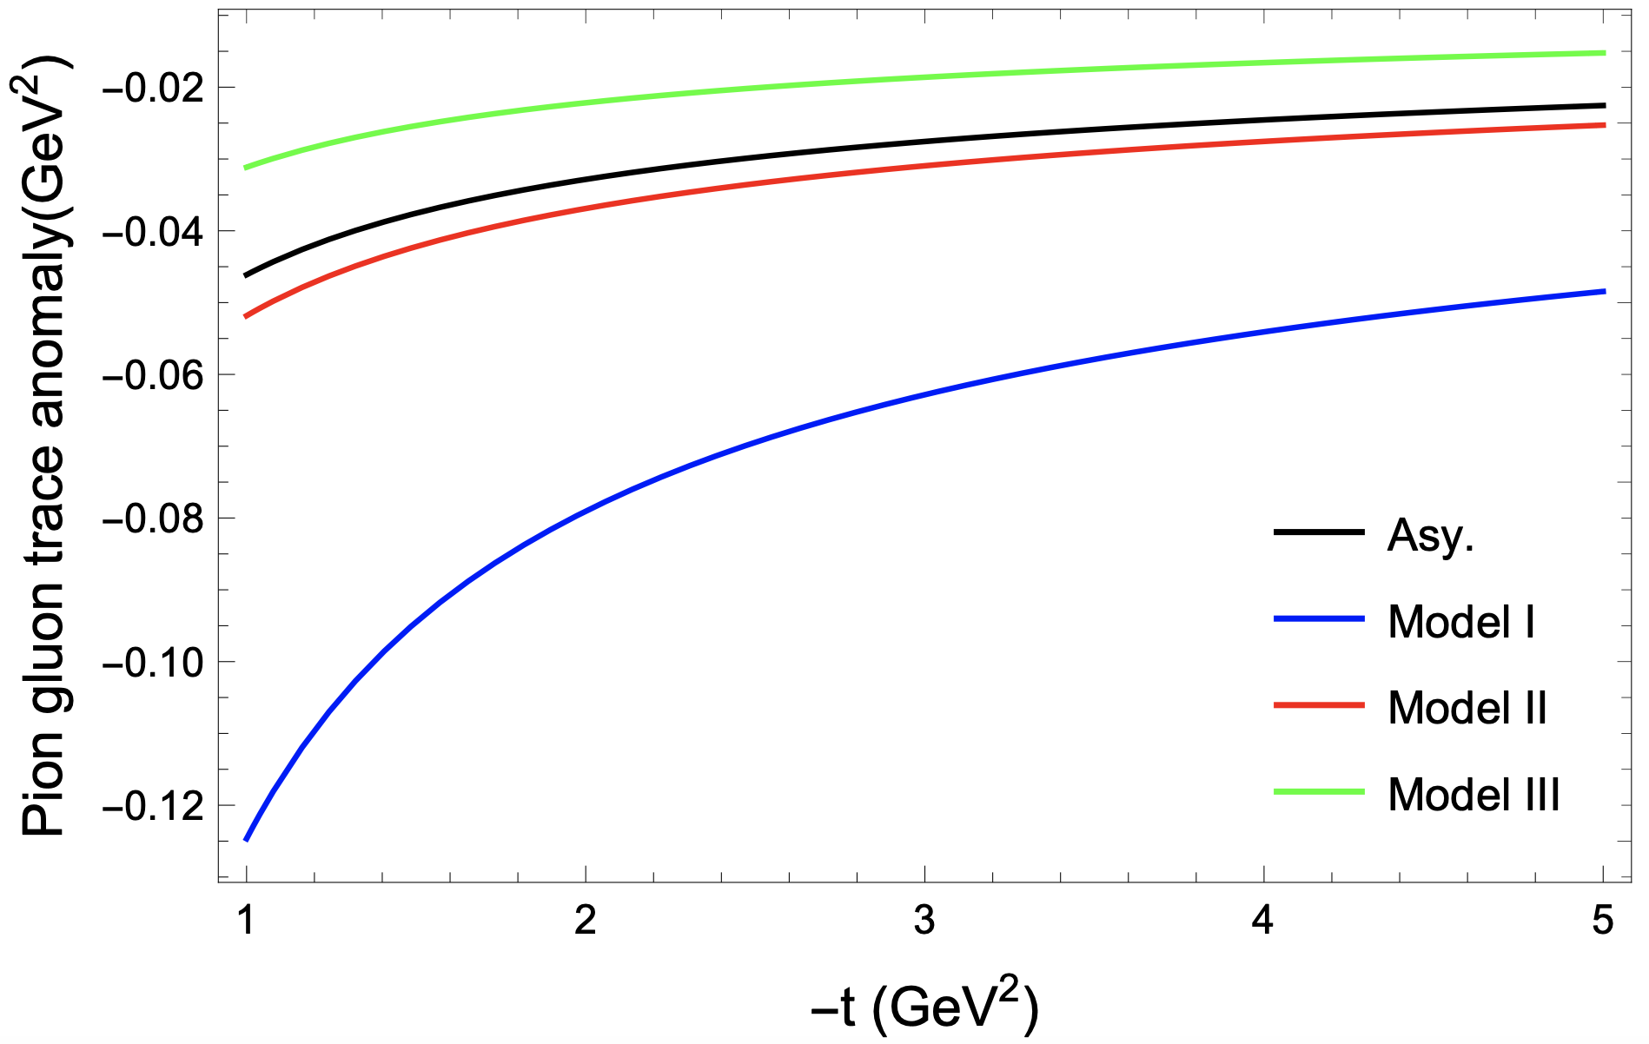
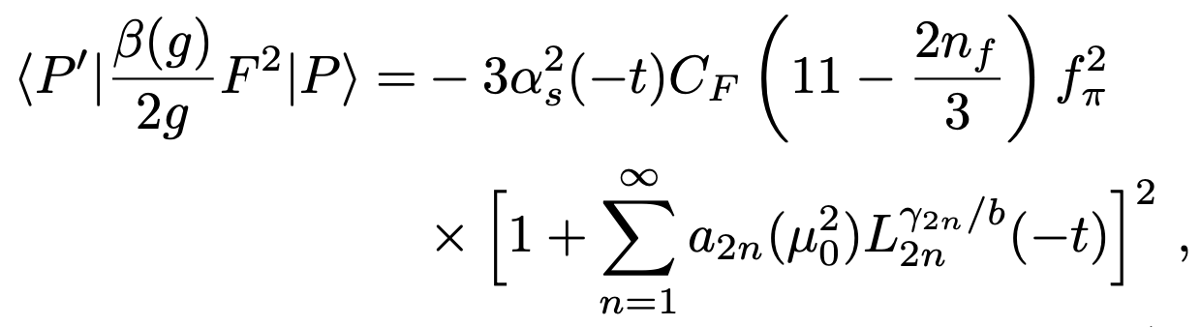
Scalar form factor of Pion
In the perturbative region:
at t=0, it leads to Pion mass
See also: X. Gao et al, 2206.04084

Slide 18
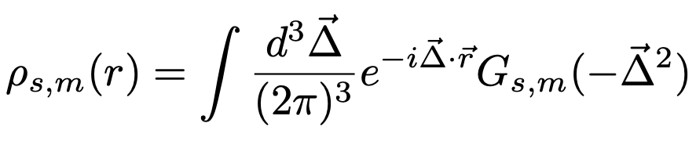

Parameterization at low-t from lattice calculations:
$$r2ρs(r)$$
Form factor
Pert. region
Changes sign around 0.4fm
See also, lattice simulation:
He et al, 2101.04942

Slide 19
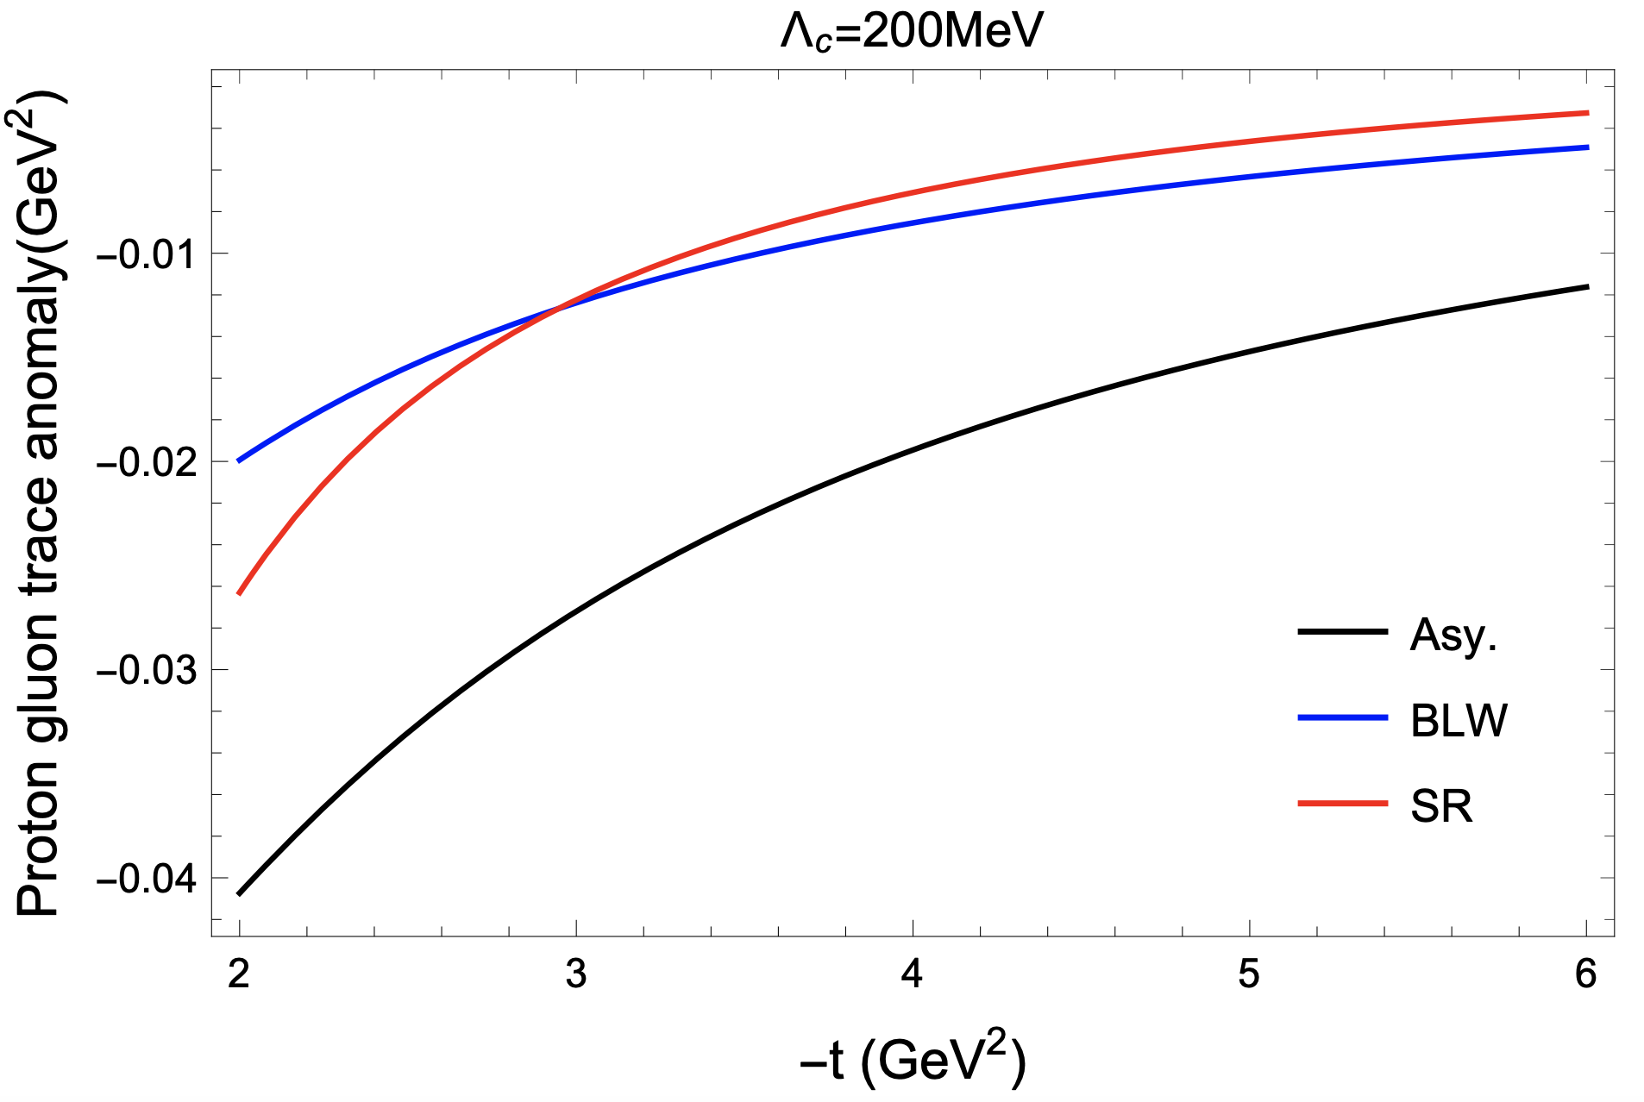
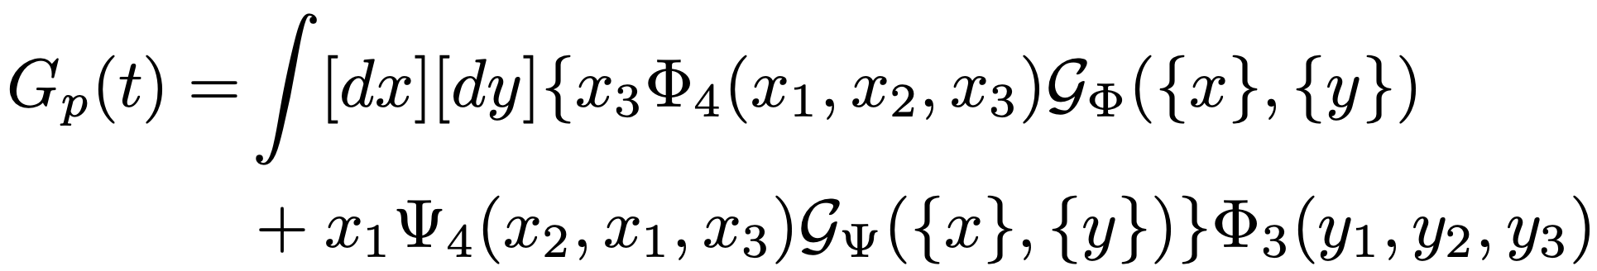
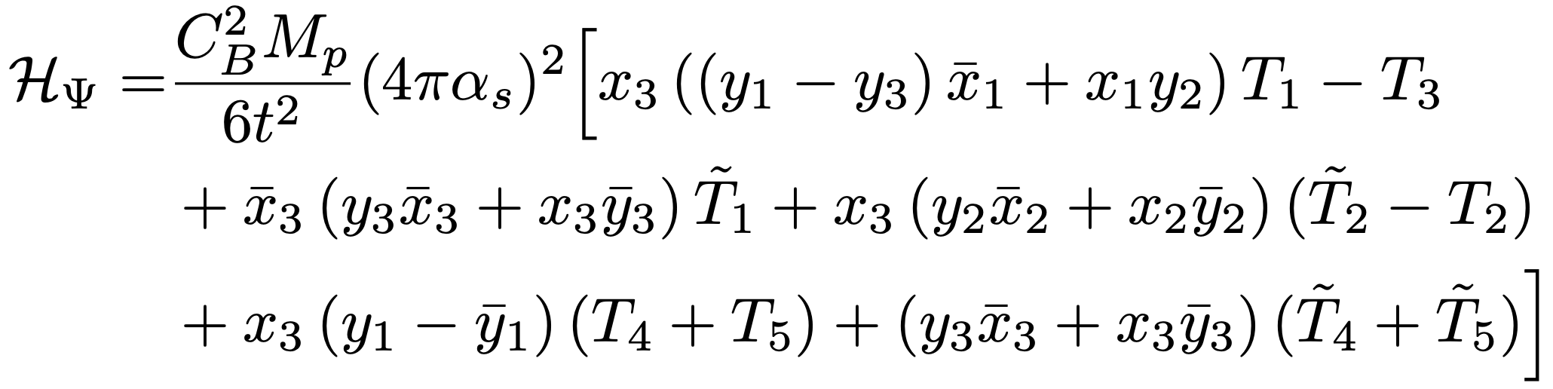
Scalar form factor of Nucleon
In the perturbative region:

Slide 20

Parameterization at low-t from lattice calculations
$$ρs(r)$$
Pert. region

Slide 21
How do we measure the GFFs if we have strong gravity ☺
Photon
Graviton
EM current
Energy-Momentum
current
Kobzarev-Okun 1962;
Pagels 1966; Ji 1997

Slide 22
How to measure the GFFs: through DPDs
Wigner distributions (Belitsky, Ji, Yuan)
5D
3D
1D

Slide 23
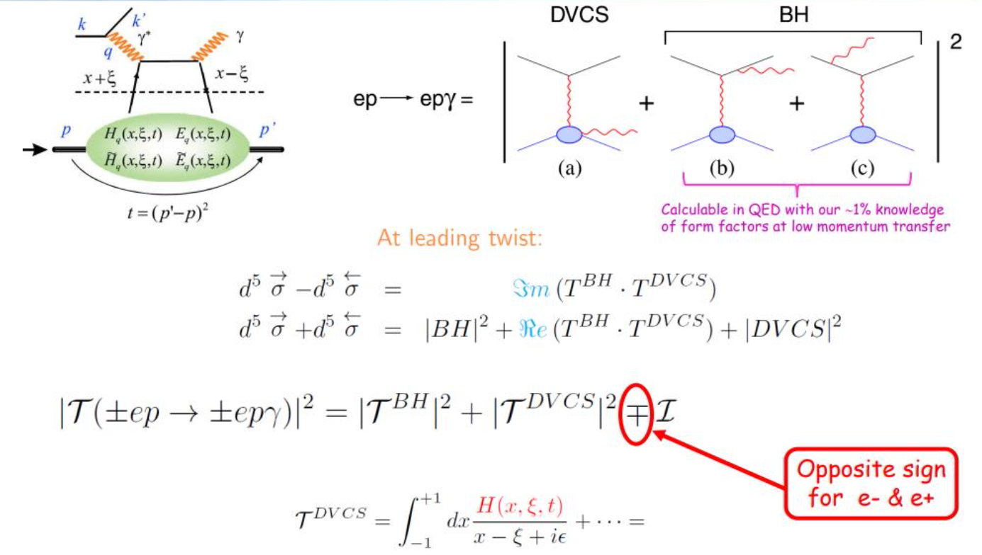
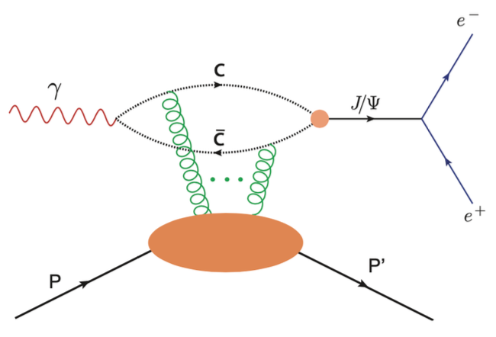
Access GPDs through exclusive processes
Quark GPDs
Gluon GPDs

Slide 24
Global analysis is greatly needed
Precision computations and phenomenology developments toward a global analysis to extract nucleon/nucleus structure from various observables
Theory developments at higher orders (NLO, NNLO) and the advanced computational techniques
QGT Collaboration

Slide 25
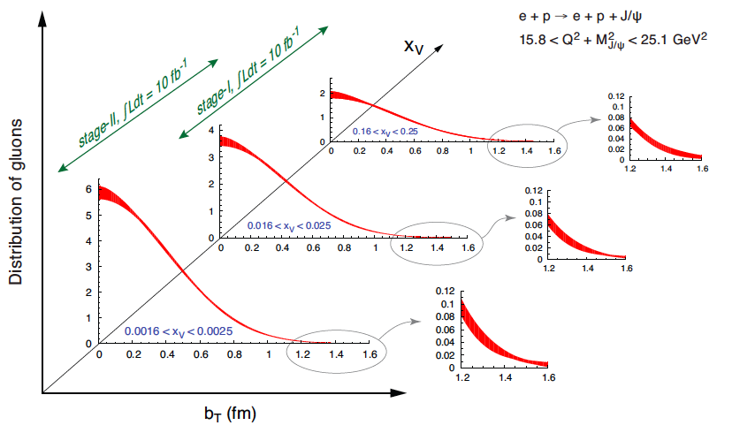
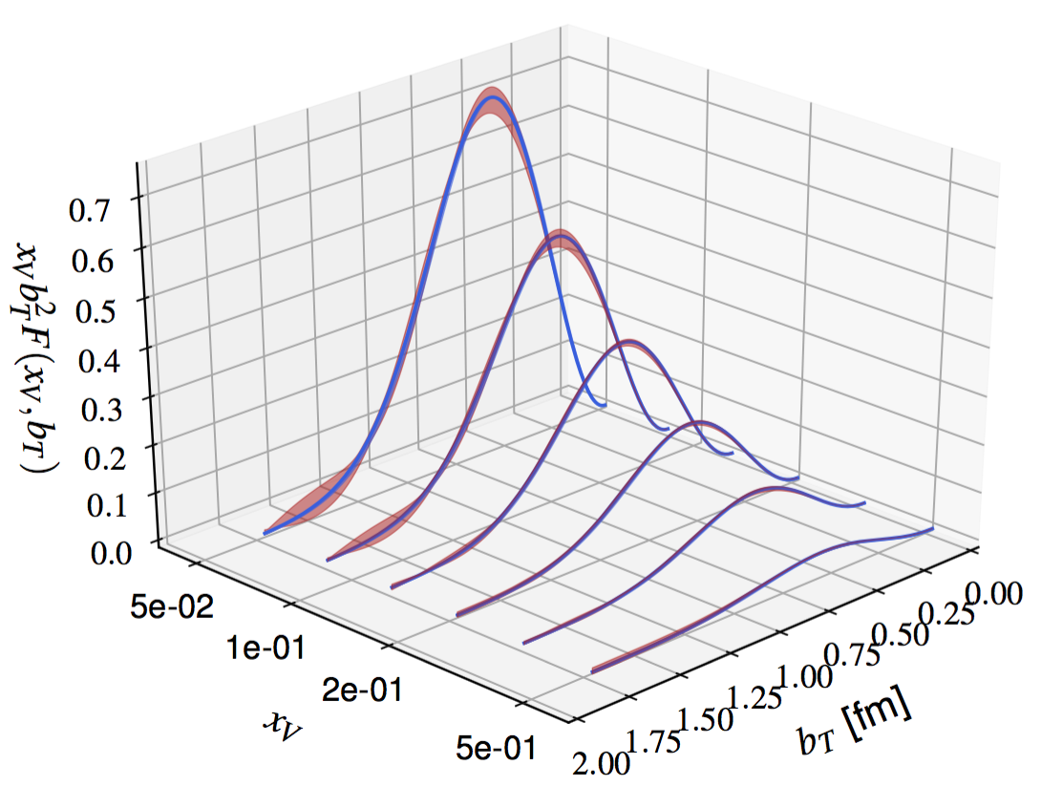
Alternatively: small-x and large-x
EIC-White paper, arXiv:1212.1701
Joosten, Meziani, 1802.02616

Slide 26
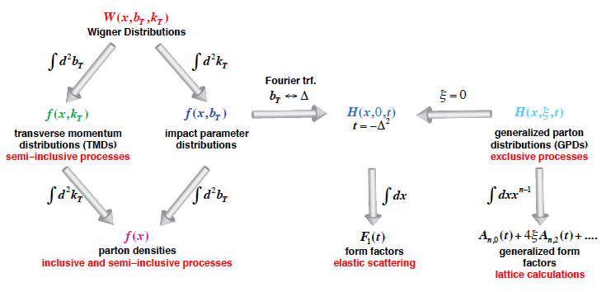
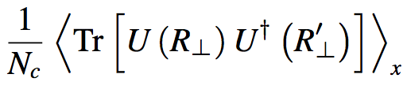
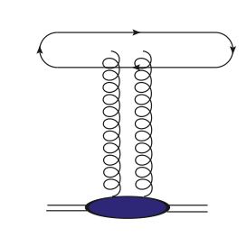
Nucleon/nucleus Tomography and
QCD landscape at small-x
Small-x
Hatta-Xiao-Yuan,1601.01585
earlier: Mueller, NPB 1999

Slide 27
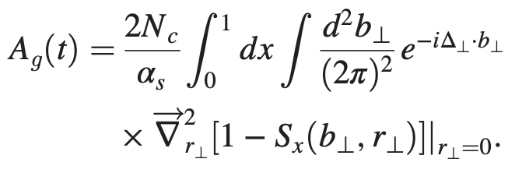
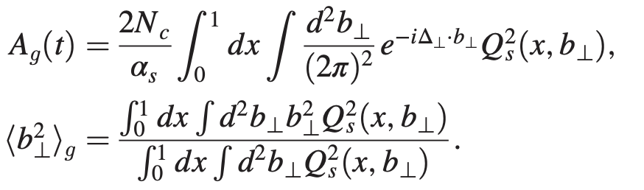


Color-glass-condensate calculations at small-x
Taking $ξ=0$, with impact parameter dependence of dipole amplitude → t-dependence
HERA data imply:
Hagiwara-Tong-Xiao, 2401.12840

Slide 28
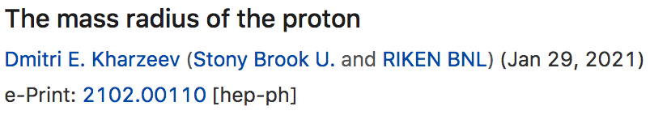
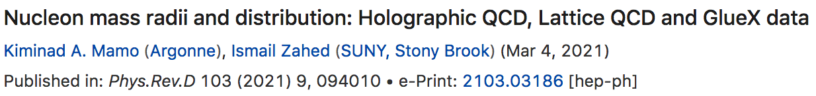


Large-x: near threshold, the proton mass distribution/mass radius is one of focuses
The analysis depends on models
  Vector meson dominance model
  Holographic model

Slide 29



Kharzeev’s Proposal
Kharzeev, 1996, 2021
Kharzeev et al., 1999
Vector meson dominance: photon transition to heavy quarkonium
The amplitude proportional to heavy quarkonium-nucleon interaction
  Applying OPE, lowest order gluonic operator contributes
    Peskin 1979; Luke-Manohar-Savage 1992; Kharzeev 1996; Wang-Yuan 2001

Slide 30

Rutherford scattering with heavy quarkonium
Graviton
X
The QCD dynamics involved in the on-shell photon (massless) transition to a massive heavy quarkonium does not allow a simple interpretation

Slide 31









Near-threshold J/$ψ$ photo-production to probe GPDs
CFF
GPD
GPD
GFF
Y. Guo et. al. Phys. Rev. D 103 9, 096010
Earlier references in GPD formalism:
Hoodbhoy 1996;
Koempel-Kroll-Metz-Zhou 2012 and references therein
We can then extract the GFFs from the gCFFs, utilizing the large skewness kinematics in the near-threshold region in the heavy quark limit.

Slide 32


Taylor expansion of the hard coefficient
Only the leading term corresponds to the gluonic gravitational form factors
Boussarie-Hatta 2020;
Hatta-Strikman 2021;
Guo-Ji-Liu 2021;

Slide 33






Systematics of large-$ξ$ expansion
Model
Radyushkin 1999
Guo-Ji-Yuan, PRD109.014014 (2024)

Slide 34





Next-leading order
Guo-Yuan-Zhao, 2501.10532
References for NLO GPD calculations:
Ivanov-Schafer-Szymanowski-Krasnikov,
hep-ph/0401131;
Chen-Qiao, 1903.00171.
Flett-Gracey-Jones-Teubner, 2105.07657

Slide 35


Combined fit to the exp. and lattice
Bayesian Inferring Nucleon's Gravitation Form Factors via
Near-threshold J/ψ Photoproduction, Guo-Yuan-Zhao, 2501.10532
With ξ > 0.5 data
Lattice: Pefkou et. al. Phys. Rev. D 105, 054509 (2022), Phys. Rev. Lett. 132, 251904 (2024)

Slide 36
Conclusion and Looking forward
Small-x and large-x provide complementary constraints on the gluonic gravitational form factors
With high precision data from current and near-future experiments at Jlab and EIC, we need to improve the theory precision, for GFFs and GPDs in general
  Carry out higher order perturbative QCD corrections (NLO+NNLO+..) and demonstrate the convergence
  Implement unbiased analysis: extending to wider kinematics; including more processes in the fit (DVCS, other mesons)

Slide 37


Nucleon gravitational form factors
DVCS exp.
Lattice
Burkert, Elouadrhiri, Girod,
Nature 2018
Shanahan, Detmold, PRL 2019

