Slide 1
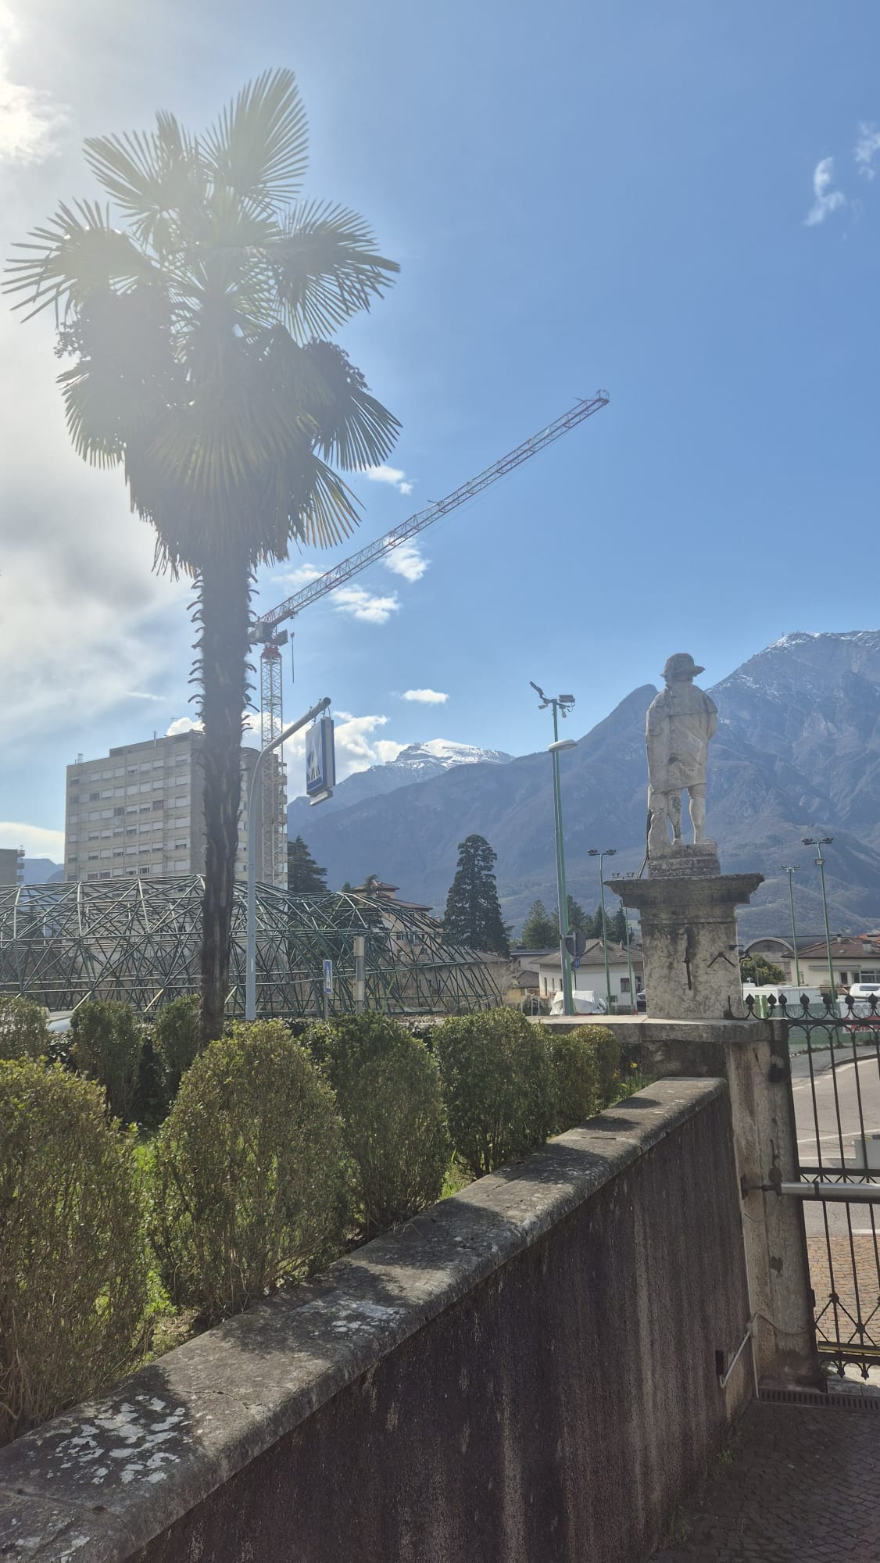
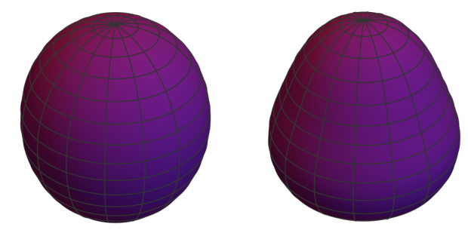
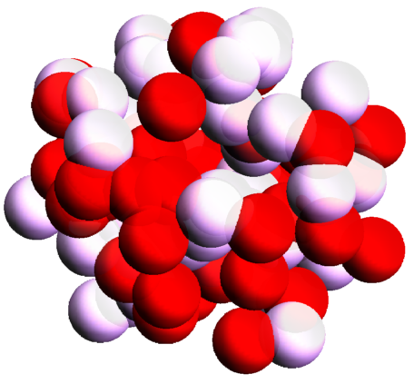
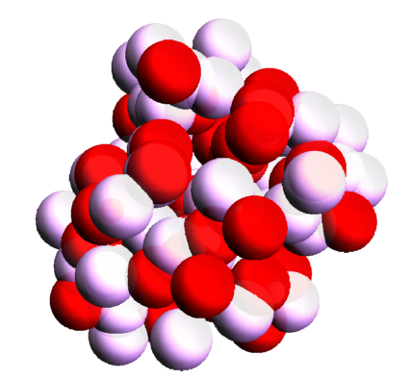
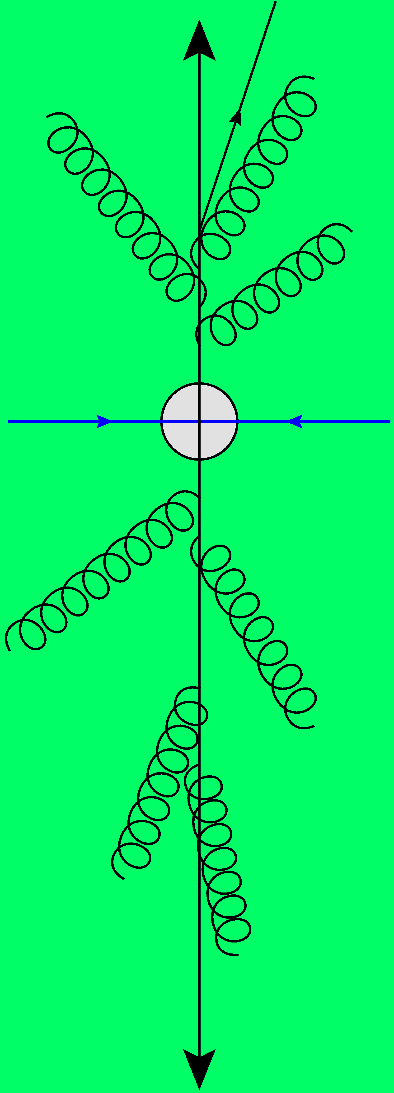
Magnetic fields in heavy ion collisions (?)
A discussion
Wilke van der Schee
Holographic perspectives on chiral transport and spin dynamics
Trento, 27 March 2025

Slide 2
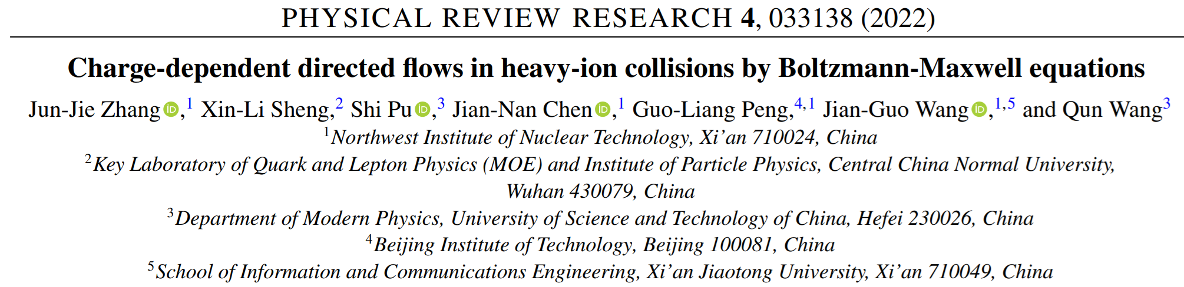
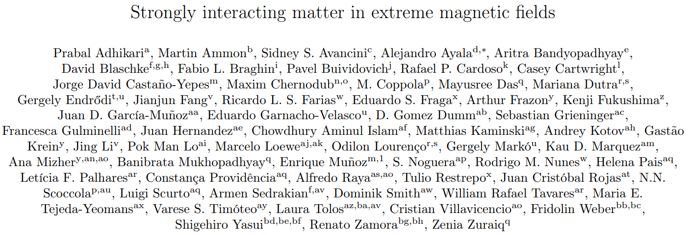
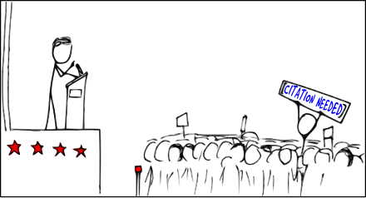
Is there a (significant!) magnetic field?
A small overview of magnetic fields versus time
Can we estimate this holographically?
Can we see this experimentally?

Slide 3
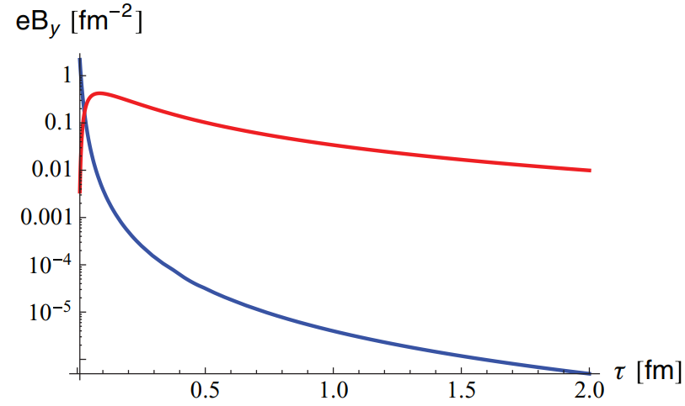
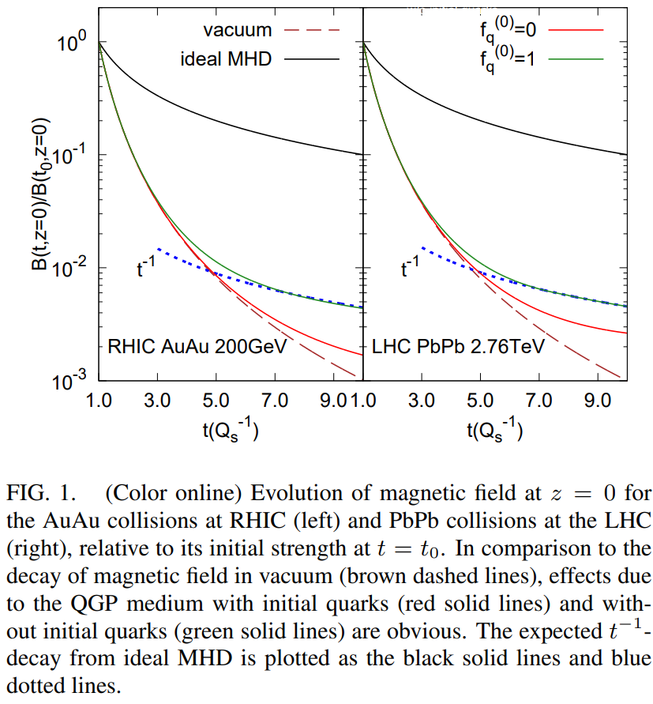
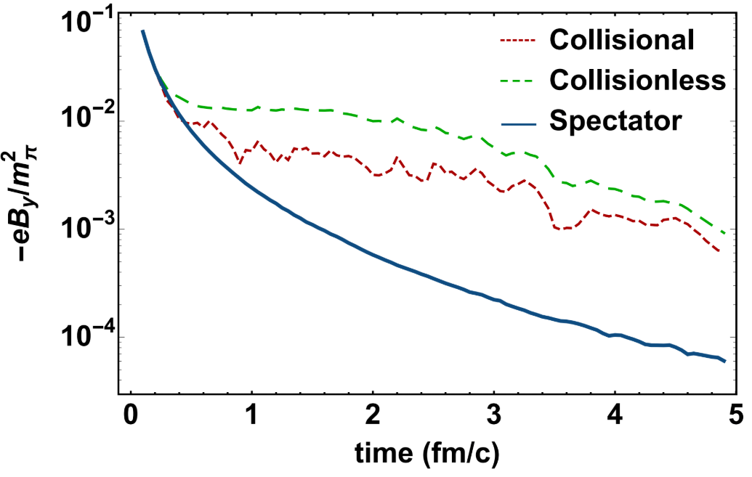
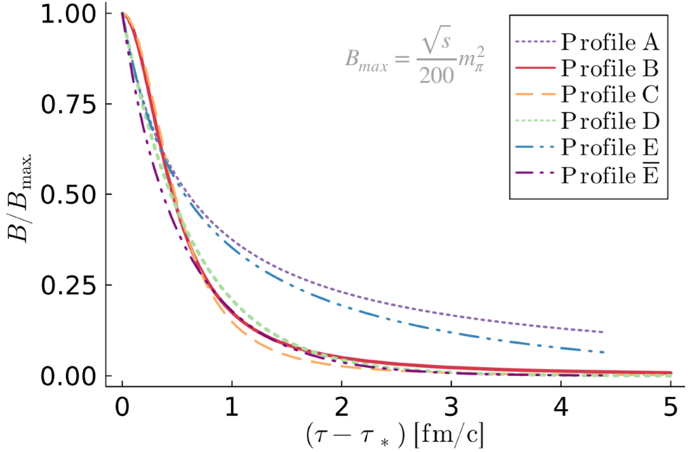
Is there a (significant!) magnetic field?
Umut Gursoy, Dmitri Kharzeev and Krishna Rajagopal (2014)
Mostly Faraday’s law
Jun-Jie Zhang, Xin-Li Sheng, Shi Pu, Jian-Nan Chen, Guo-Liang Peng, Jian-Guo Wang and Qun Wang (2022)
Li Yan and Xu-Guang Huang (2021)
Saturation/pre-equilibrium
Sergio Morales Tejera (this week)

Slide 4
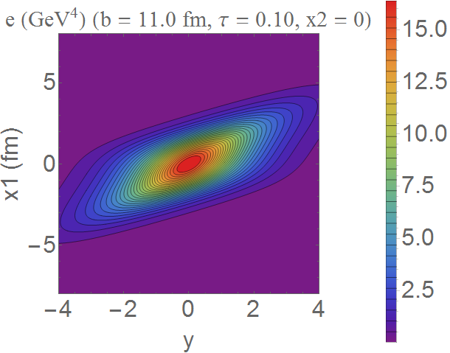
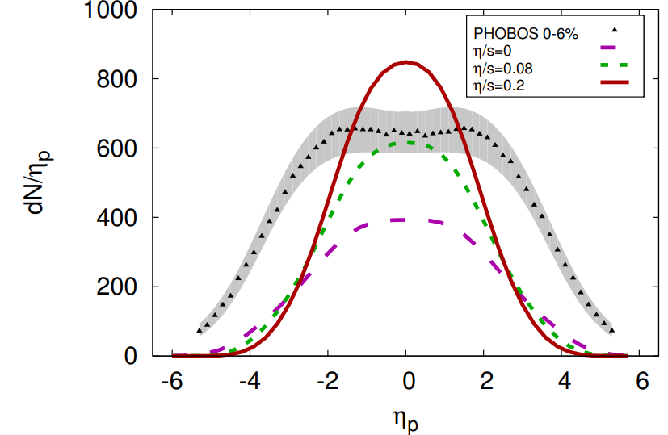
Colliding two holographic nuclei:
WS and Bjorn Schenke (2015)
Sebastian Waeber and Larry Yaffe (2022)
Locally in transverse plane: use shock waves (i.e. Gaussian rapidity)
→ Go and run hydro (MUSIC) and get particle spectra ☺

Slide 5
Colliding two holographic nuclei
Spectators source initial magnetic field
Dynamical magnetic field on boundary
Metric does not need to be backreacted; simplified locally 1+1D problem?
Work in progress in this workshop?

Slide 6
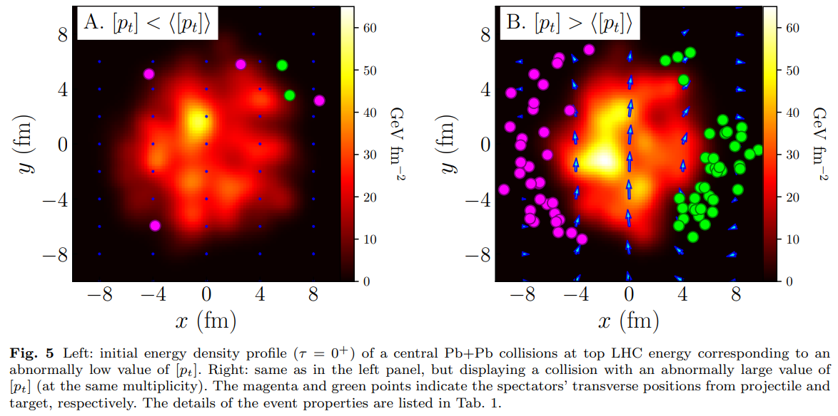
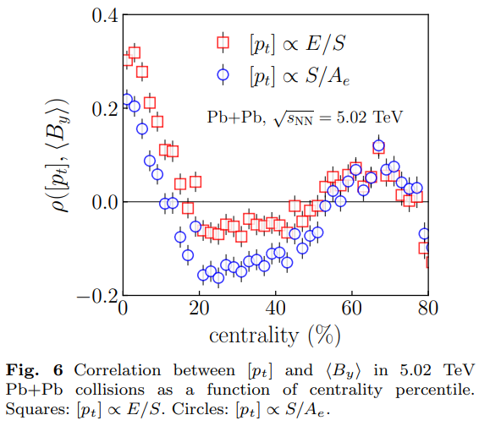
Varying the magnetic field
Event shape engineering to vary the magnetic field
Strong correlation both with mean p_{T} and number of spectators
Should maybe show up in directed flow of likesign/unlikesign flow?
Giuliano Giacalone and Chun Shen (2021)

Slide 7
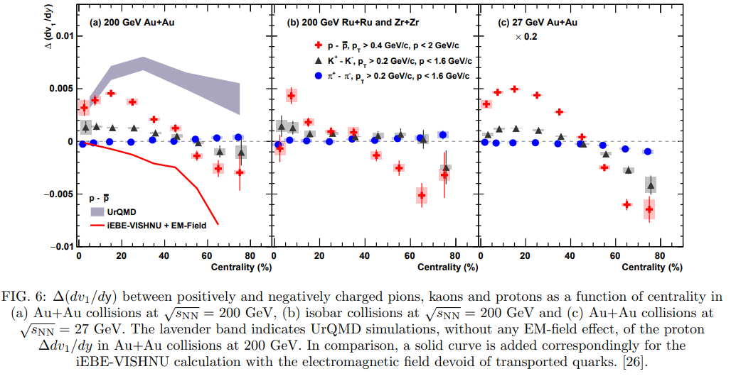
What can we measure?
Seems the right measurement..
Difference Ru/Zr? Not much modelling? Conclusion? LHC?
STAR, Observation of the electromagnetic field effect via charge-dependent directed flow in
heavy-ion collisions at the Relativistic Heavy Ion Collider (2023)

