Slide 1

Chiral Vortical Instability
in collaboration with S. Wang, K. Hattori, and X.-G. Huang
Andrey Sadofyev
LIP, Lisbon
Holographic perspectives on chiral transport and spin dynamics, ECT*, 2025

Slide 2
Generalized axial charge

Slide 3
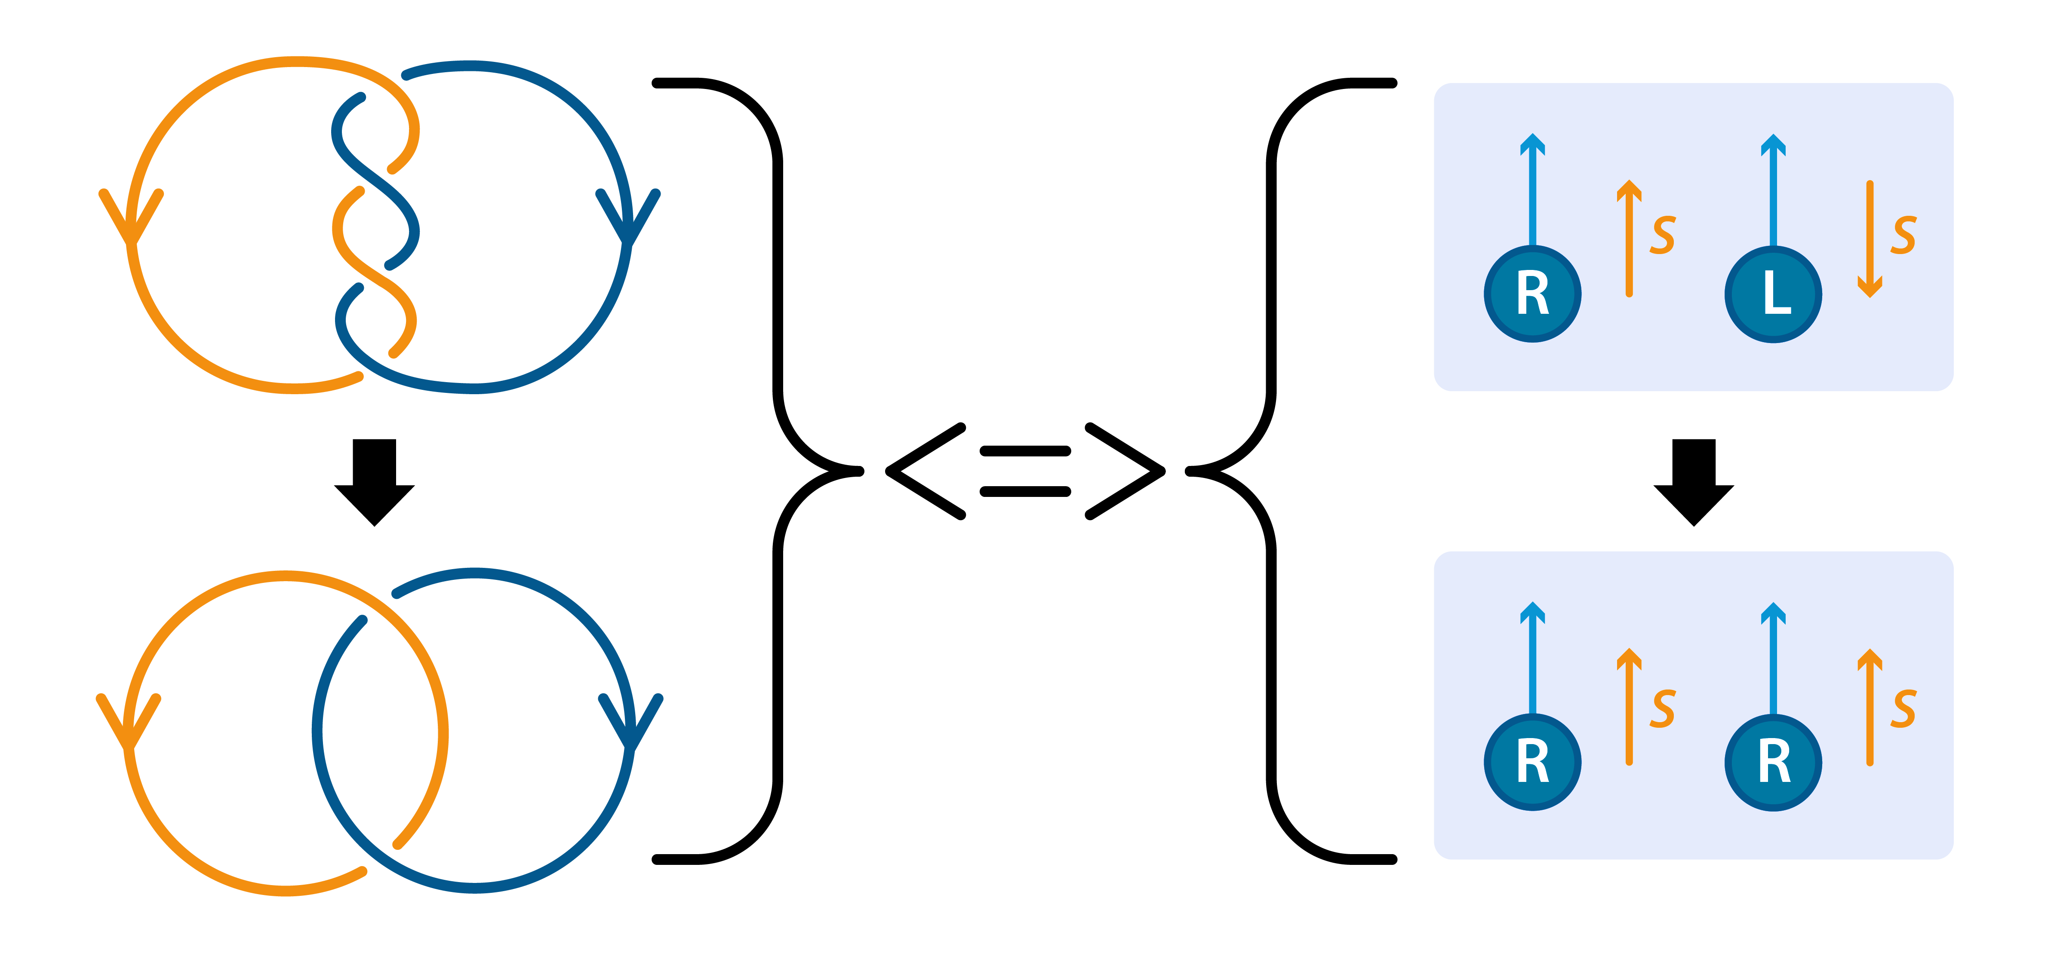
Generalized axial charge

Slide 4
J. Erdmenger, M. Haack, M. Kaminski, A. Yarom, JHEP, 2009
N. Banerjee et. al., JHEP, 2011
D.T. Son, P. Surowka, PRL, 2009
Generalized axial charge
EOMs
Constitutive relations
4

Slide 5


A. Avdoshkin, V. Kirilin, AS, V.I. Zakharov, PLB, 2016
Generalized axial charge
EOMs
Constitutive relations
ideal MHD limit
5

Slide 6
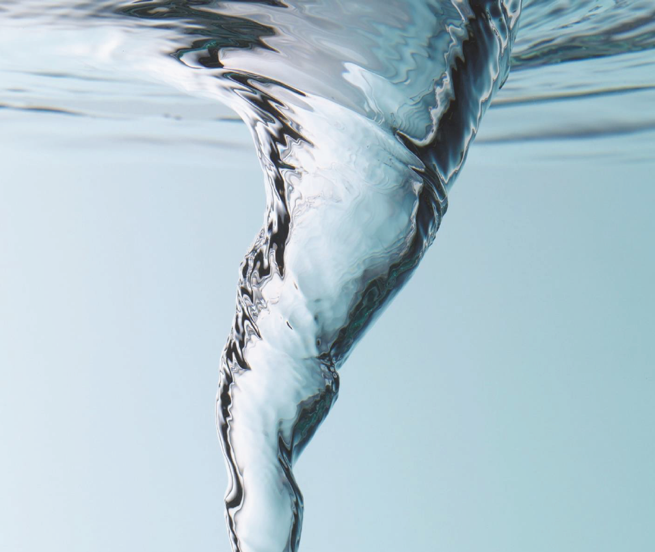
A. Avdoshkin, V. Kirilin, AS, V.I. Zakharov, PLB, 2016
N. Yamamoto, PRD, 2016
A. Avkhadiev, AS, PRD, 2017
V. Kirilin, AS, PRD, 2017
P. Wiegmann, A. Abanov, JHEP, 2022
C. Manuel, J. Torres-Rincon, PRD, 2023
Generalized axial charge
6

Slide 7
Rubakov (1986); M. Joyce, M. E. Shaposhnikov (1997); … Y. Akamatsu, N. Yamamoto, (2013)
A. Avdoshkin, V. Kirilin, AS, V.I. Zakharov, PLB, 2016
S. Wang, X.-G. Huang, PRD, 2024
Chiral instabilities
???
CMVI
CPI
7

Slide 8
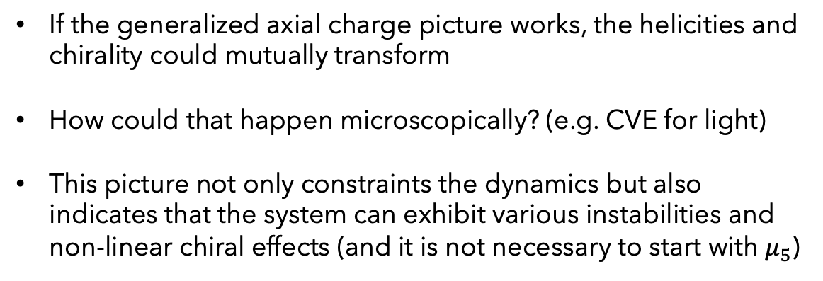
A. Avkhadiev, AS, PRD, 2017
N. Yamamoto, PRD, 2017
M. N. Chernodub, A. Cortijo, K. Landsteiner, PRD, 2018
Y. Hirono, D. Kharzeev, Y. Yin, PRL, 2016
V. Kirilin, AS, PRD, 2017
Chiral instabilities
If the generalized axial charge picture works, the helicities and chirality could mutually transform
How could that happen microscopically? (e.g. CVE for light)
This picture not only constraints the dynamics but also indicates that the system can exhibit various instabilities and non-linear chiral effects (and it is not necessary to start with $μ_{5}$)
8

Slide 9
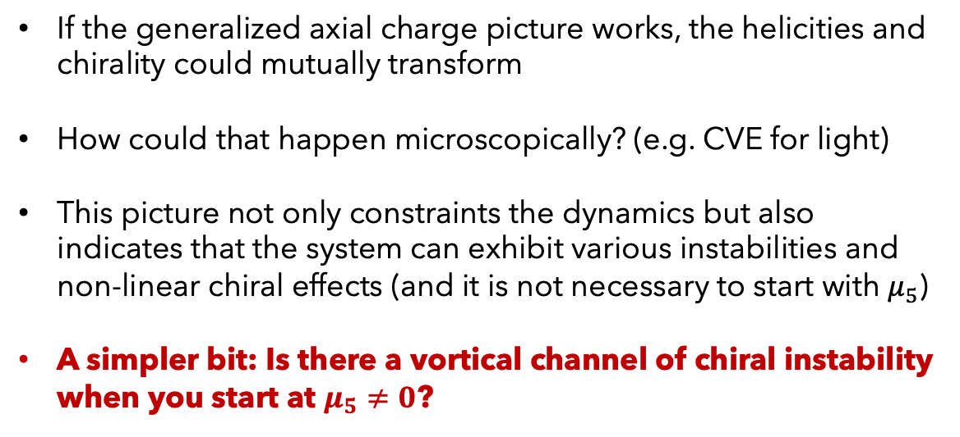
A. Avkhadiev, AS, PRD, 2017
N. Yamamoto, PRD, 2017
M. N. Chernodub, A. Cortijo, K. Landsteiner, PRD, 2018
Y. Hirono, D. Kharzeev, Y. Yin, PRL, 2016
V. Kirilin, AS, PRD, 2017
Chiral instabilities
If the generalized axial charge picture works, the helicities and chirality could mutually transform
How could that happen microscopically? (e.g. CVE for light)
This picture not only constraints the dynamics but also indicates that the system can exhibit various instabilities and non-linear chiral effects (and it is not necessary to start with $μ_{5}$)
A simpler bit: Is there a vortical channel of chiral instability when you start at $μ_{5}≠0$?
9

Slide 10
J. Erdmenger, M. Haack, M. Kaminski, A. Yarom, JHEP, 2009
N. Banerjee et. al., JHEP, 2011
Linearized hydrodynamics
No instability in LF at 1st order
10

Slide 11
B. Sahoo, H.-U. Yee, PLB, 2010
D. Kharzeev, H.-U. Yee, PRD, 2011
Linearized hydrodynamics
No instability in LF at 1st order
Chiral Shear Wave
11

Slide 12
B. Sahoo, H.-U. Yee, PLB, 2010
D. Kharzeev, H.-U. Yee, PRD, 2011
Chiral shear waves
unstable for
CSWs:
12

Slide 13
B. Sahoo, H.-U. Yee, PLB, 2010
D. Kharzeev, H.-U. Yee, PRD, 2011
Chiral shear waves
unstable for
CSWs:
Other frames:
13

Slide 14
B. Sahoo, H.-U. Yee, PLB, 2010
D. Kharzeev, H.-U. Yee, PRD, 2011
Chiral shear waves
unstable for
CSWs:
Other frames:
14

Slide 15
B. Sahoo, H.-U. Yee, PLB, 2010
D. Kharzeev, H.-U. Yee, PRD, 2011
Chiral shear waves
unstable for
CSWs:
Other frames:
15

Slide 16
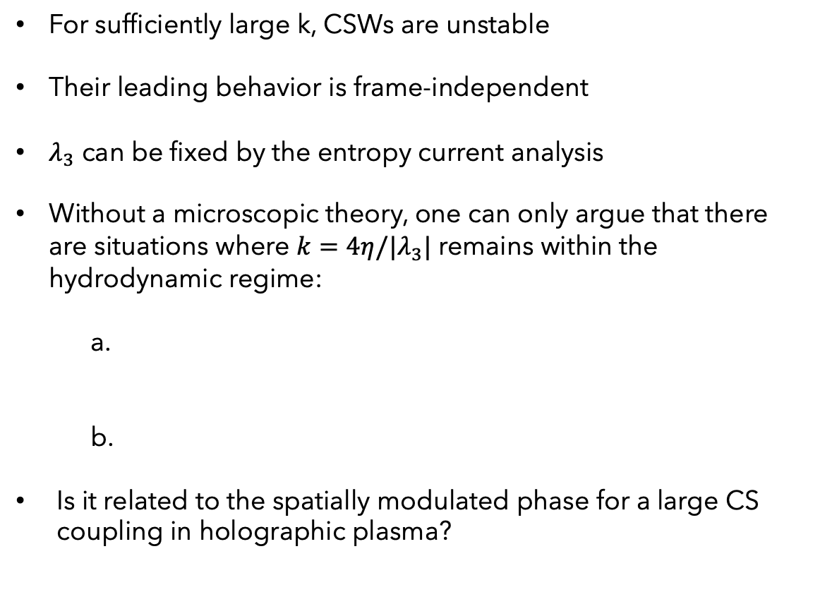
B. Sahoo, H.-U. Yee, PLB, 2010
D. Kharzeev, H.-U. Yee, PRD, 2011
S. Nakamura, H. Ooguri, C.-S. Park, PRD, 2010
Chiral vortical instability
For sufficiently large k, CSWs are unstable
Their leading behavior is frame-independent
$λ_{3}$ can be fixed by the entropy current analysis
Without a microscopic theory, one can only argue that there are situations where $k=4η/|λ_{3}|$ remains within the hydrodynamic regime:
Is it related to the spatially modulated phase for a large CS coupling in holographic plasma?
controls mixed
anomaly
16

Slide 17
Chiral vortical instability
We see that the modes of second-order chiral hydrodynamics are consistent with the presence of CVI, though it is pushed beyond the hydrodynamic regime (large k modes grow faster)
CSWs can become unstable within the hydrodynamic regime under specific conditions, e.g. low viscosity and large anomalous coefficient
CVI indicates the system's tendency to form spatially modulated flow configurations, likely consisting of self-linked vortices
Apparently, CVI enhances the development of the turbulent cascade
17

Slide 18
Chiral vortical instability
GABC flow
18

Slide 19
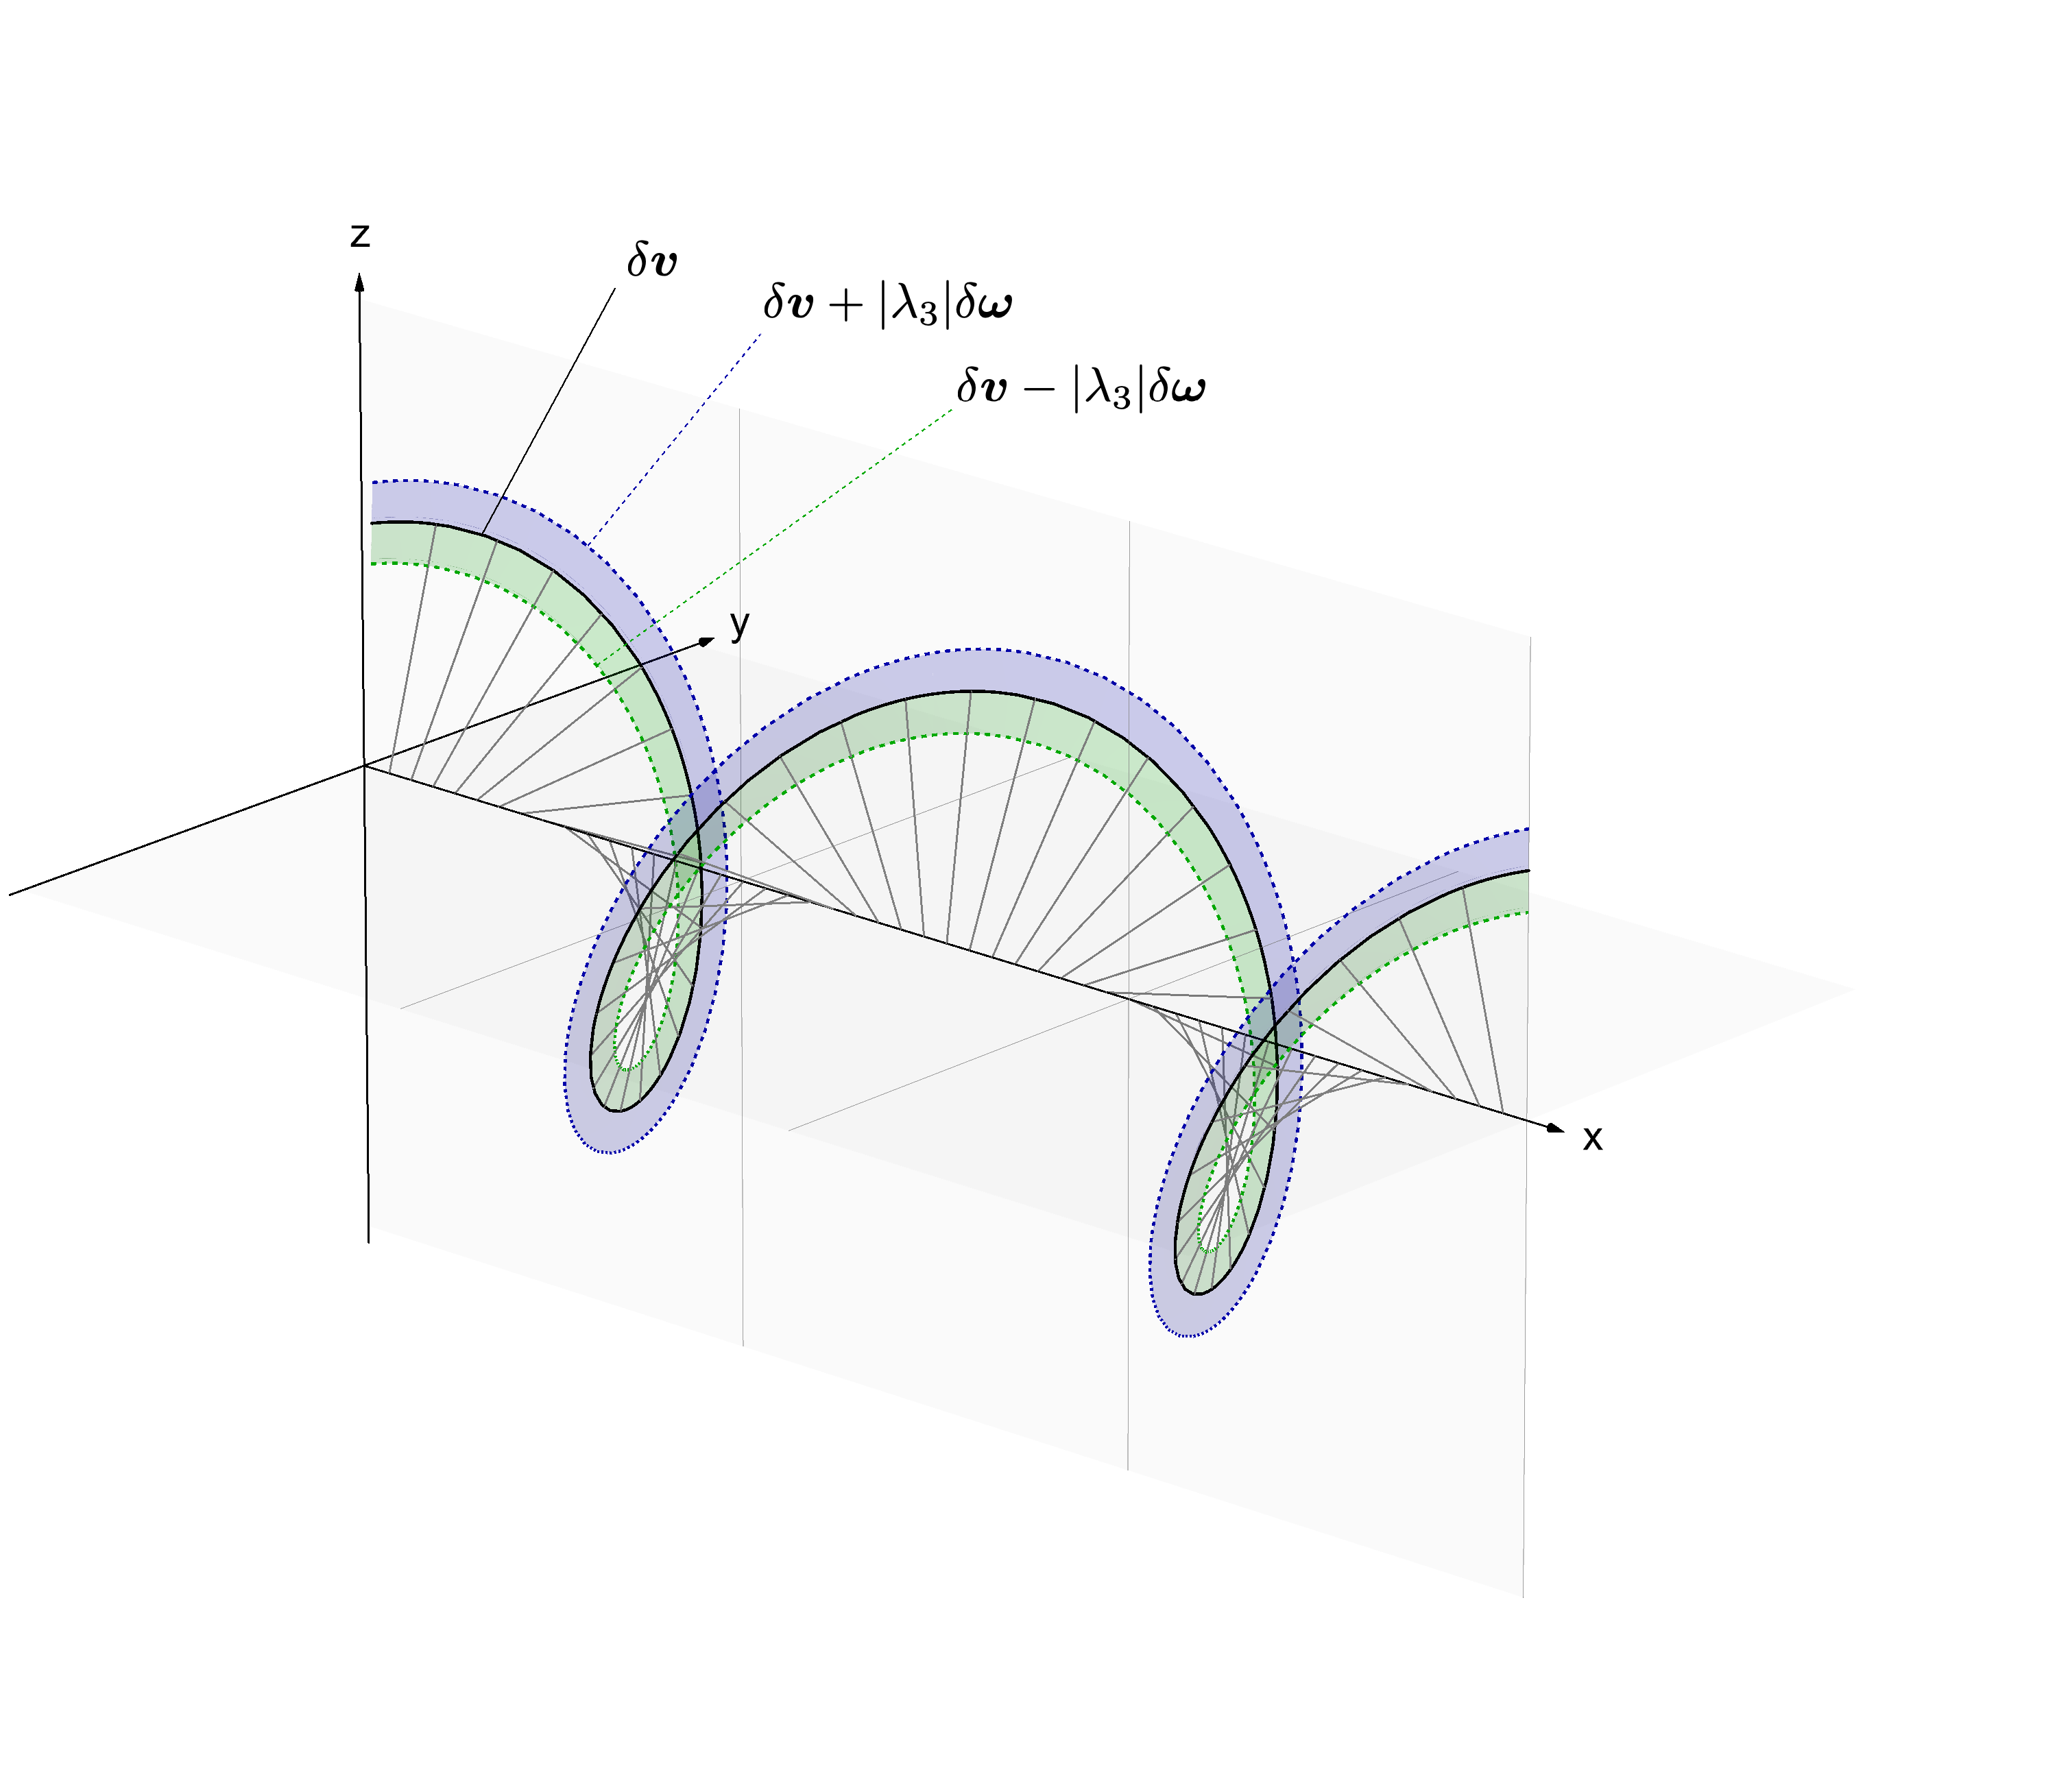
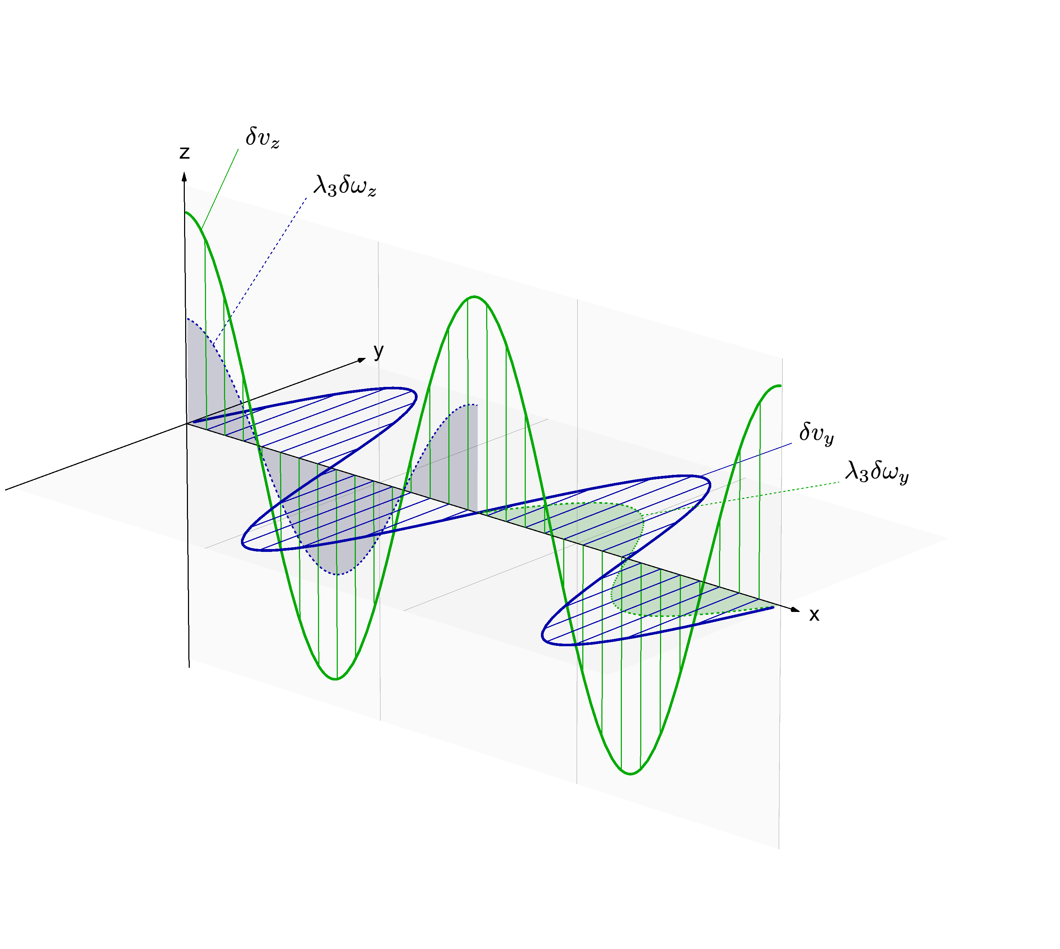
Chiral vortical instability
19

Slide 20
Chiral vortical instability
linearized
GABC:
Global rotation:
20

Slide 21
see e.g. F. Becattini, PRL, 2012
Chiral vortical instability
21

Slide 22
Chiral vortical instability
a solution
not anymore
22

Slide 23
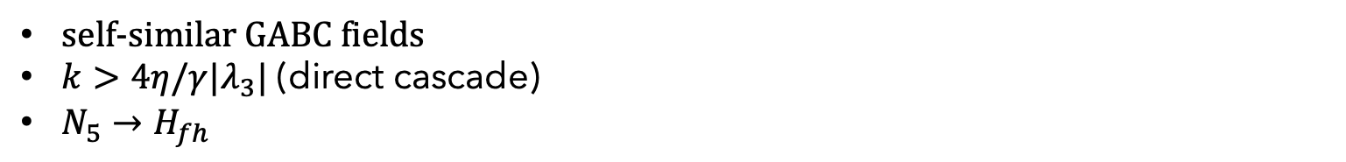
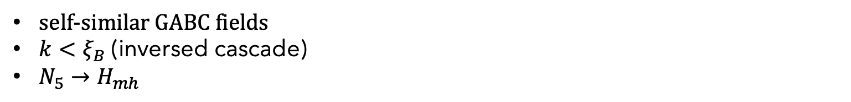
Chiral vortical instability
CPI:
self-similar GABC fields
$k<ξ_{B}$ (inversed cascade)
$N_{5}→H_{mh}$
CVI:
self-similar GABC fields
$k>4η/γ{|λ}_{3}|$ (direct cascade)
$N_{5}→H_{fh}$
23

Slide 24
Summary
Chiral media tend to generate helical flows at short distances, and the initial homogeneous state is unstable due to CVI
CSWs may become unstable within the hydrodynamic regime, suggesting that CVI persists at higher orders
Global rotation of chiral matter destabilizes, favoring helical solutions
Elementary static GABC flows solve the full nonlinear dynamics, shedding light on CVE development
Phenomenological implications: spin polarization in HIC, rotation of astrophysical and cosmological systems, etc.
24

