Slide 1



²⁶Al and ⁶⁰Fe Production in Rotating and
Non-Rotating Massive Stars
Agnese Falla
Sapienza Università di Roma
INAF – Osservatorio Astronomico di Roma
in collaboration with
Marco Limongi, INAF – Osservatorio Astronomico di Roma, Italy
Alessandro Chieffi, IAPS – Istituto di Astrofisica e Planetologia Spaziali, Italy
Lorenzo Roberti, Konkoly Observatory, Research Centre for Astronomy and Earth Sciences, Hungary
20/02/2025
Notes:
A topic that we have also mentioned in recent days.

Slide 2
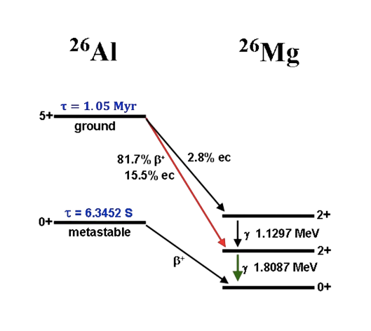
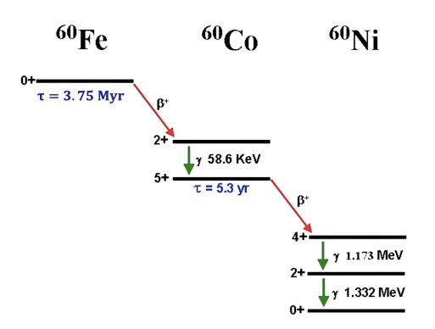
Production of ²⁶Al and ⁶⁰Fe in Massive Stars
Their lifetimes are shorter than the evolutionary timescales of the Galaxy and comparable
to the lifetimes of the more massive stars
Their detection demonstrates that nucleosynthesis is currently ongoing in the Galaxy and provides an unprecedented opportunity to identify the sites of such an activity
20/02/2025
1
Notes:
Al26-> decadimento a stato fondamentale del 26Mg

Slide 3
Production of ²⁶Al and ⁶⁰Fe in Massive Stars
⁶⁰Fe/²⁶Al flux ratio
Their lifetimes are shorter than the evolutionary timescales of the Galaxy and comparable
to the lifetimes of the more massive stars
Their detection demonstrates that nucleosynthesis is currently ongoing in the Galaxy and provides an unprecedented opportunity to identify the sites of such an activity
20/02/2025
1
Notes:
Al26-> decadimento a stato fondamentale del 26Mg

Slide 4
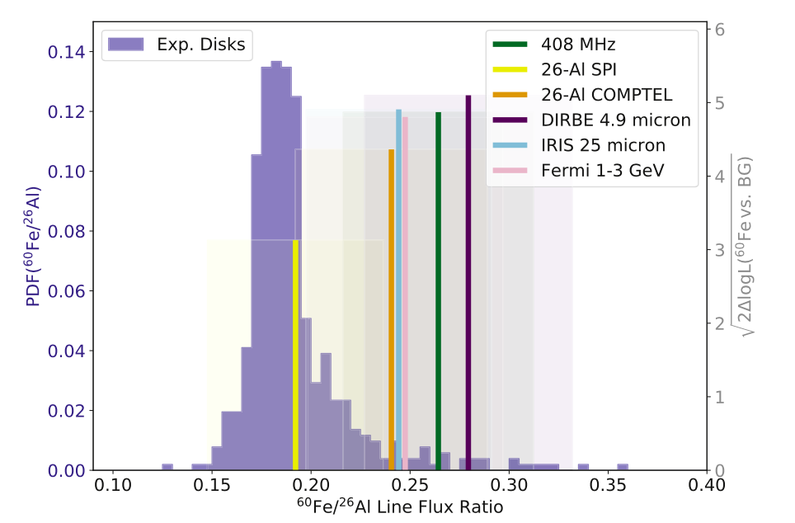
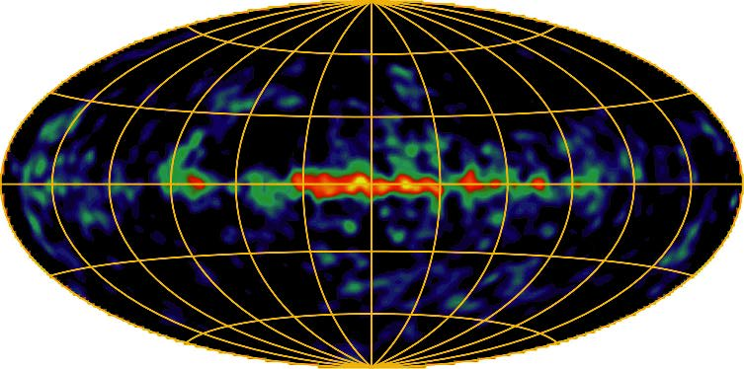


⁶⁰Fe/ ²⁶Al ratio - observations
Exponential grid maps: 0.184 $±$ 0.042
Best fit maps: 0.24 $±$ 0.04
(Wang et al. 2020)
Plüschke + 2000
20/02/2025
2

Slide 5
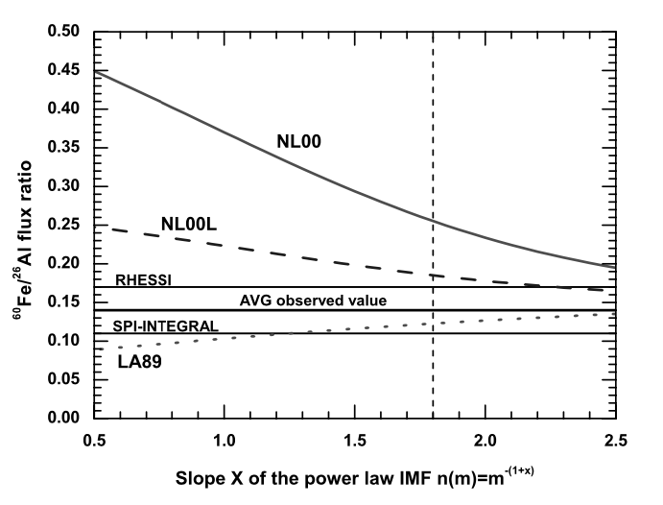
State of the art
Since the 1990s, various models have been developed, but the first comprehensive study of ²⁶Al and ⁶⁰Fe production in massive stars was carried out in 2006 (Limongi & Chieffi 2006).
Salpeter (x=1.35)
Kroupa (x=1.8)
-x
3
Notes:
NL00 osservata
LA89 teorica -> mass loss praticamente come fare SET R
Nl00 standard

Slide 6
State of the art
In 2018 a new homogeneous and extended set of rotating stellar models have been computed (Limongi & Chieffi 2018)
Pre-supernova evolutions (FRANEC)
Initial masses → 13, 15, 20, 25, 30, 40, 60, 80 and 120 M⊙
Initial rotational velocities → 0, 150, 300 km/s
Solar composition → [Fe/H] = 0
Explosions (HYPERION)
→ stars with M<=25M⊙ explode
→ stars with M>25M⊙ directly collapse into a remnant
Network of 339 nuclear species fully coupled to the physical evolution
New stellar yields + new observed values → updated analysis on the production of ²⁶Al and ⁶⁰Fe in massive stars
20/02/2025
4
Notes:
Network nucleare di 339 isotopy fully coupled -> unica soluzione per far convergere fisica e chimica.
updated

Slide 7
Total yields – LC18
²⁶Al
⁶⁰Fe
LC2018 : Limongi&Chieffi 2018 – rotating and non-rotating solar metallicity models ([Fe/H] = 0; v = 0, 150, 300 km/s)
(13 → 25 M☉ explode ejecting 0.07 M ☉ of ⁵⁶Ni, M>25M☉ fully collapse in the remnant, only the wind is ejected)
20/02/2025
5
Notes:
Convection, rotation induced mixing, mass loss

Slide 8
65-30-5
⁶⁰Fe/²⁶Al integrated ratio
20/02/2025
6

Slide 9
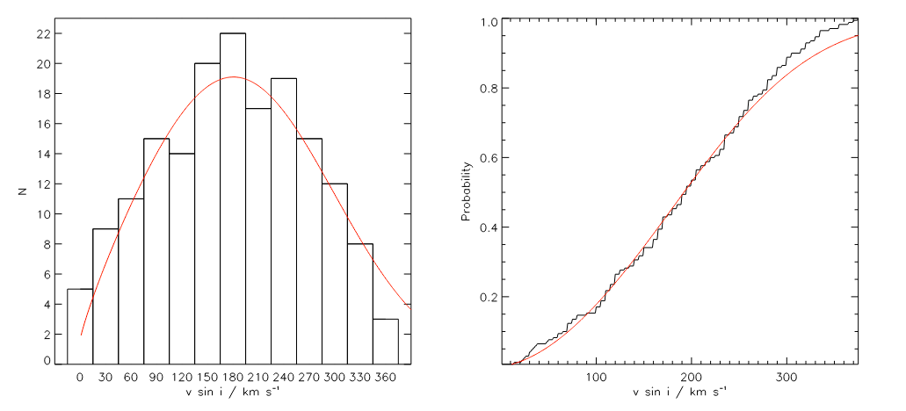

65-30-5
⁶⁰Fe/²⁶Al integrated ratio
$$av=250km/s$$
$$σ=110km/s$$
«The VLT-FLAMES survey of massive stars: stellar parameters and rotational velocities in NGC 3293, NGC 4755 and NGC 6611», P. L. Dufton et al. (2006)
20/02/2025
6

Slide 10
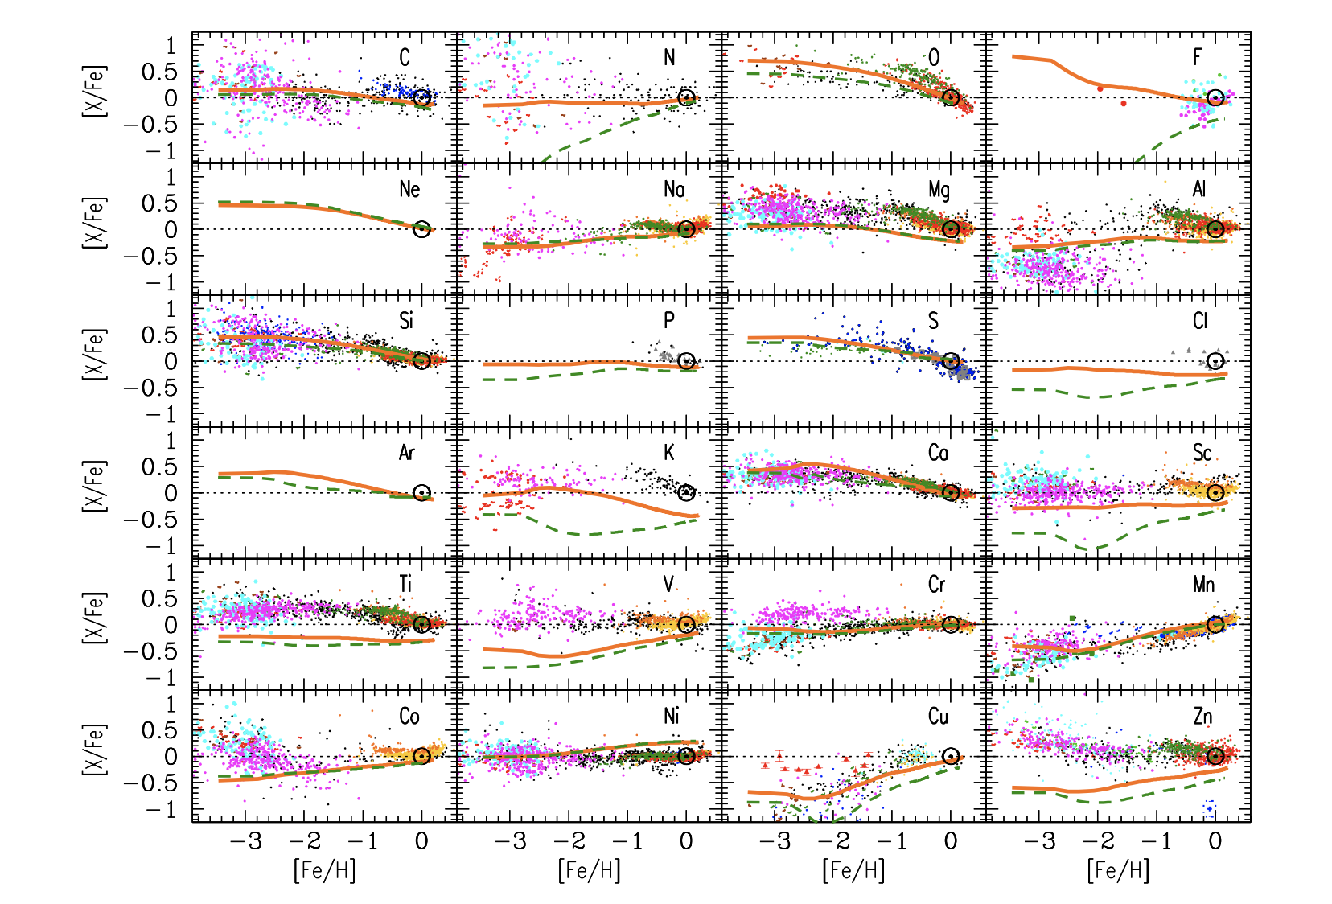
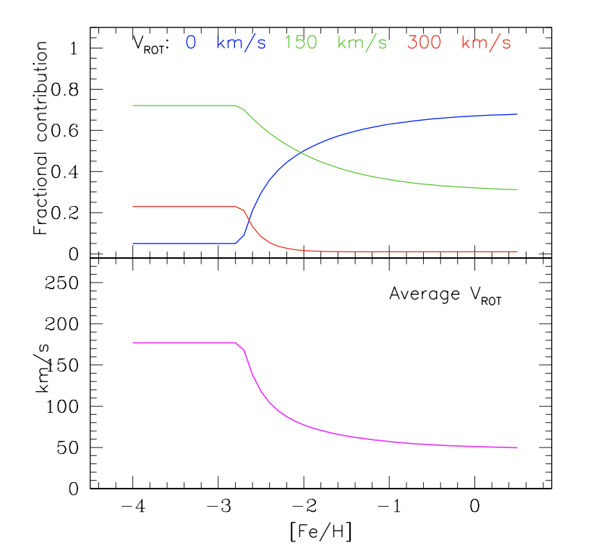
⁶⁰Fe/²⁶Al integrated ratio
65:30:5
«Chemical evolution with rotating massive star yields-I. The solar neighbourhood and the
s-process elements.» Prantzos et al., 2018
20/02/2025
7
Notes:
Z dependent distribution

Slide 11
65-30-5
⁶⁰Fe/²⁶Al integrated ratio
«Chemical evolution with rotating massive star yields-I. The solar neighbourhood and the s-process elements.» Prantzos et al., 2018
20/02/2025
8
Notes:
Peso 150km/s diff con dufton

Slide 12
65-30-5
⁶⁰Fe/²⁶Al integrated ratio
Are these three velocities enough to represent the trend of the ²⁶Al and ⁶⁰Fe yields?
Are the models at 150 km/s outliers?
«Chemical evolution with rotating massive star yields-I. The solar neighbourhood and the s-process elements.» Prantzos et al., 2018
20/02/2025
8
Notes:
Vista la non monotonicità…

Slide 13
Total yields – LC18 + Falla 2025
20 M☉
LC18 + Falla 2025: rotating and non-rotating solar metallicity models ([Fe/H] = 0; v = 0, 50, 100, 150, 200, 250, 300 km/s)
(13 → 25 M☉ explode ejecting 0.07 M ☉ of ⁵⁶Ni, M>25M☉ fully collapse in the remnant, only the wind is ejected)
20/02/2025
9
Notes:
Nuclear network di 339 isotopi

Slide 14
65-30-5
⁶⁰Fe/²⁶Al integrated ratio
20/02/2025
10

Slide 15
65-30-5
⁶⁰Fe/²⁶Al integrated ratio
20/02/2025
10

Slide 16
65-30-5
⁶⁰Fe/²⁶Al integrated ratio
«The VLT-FLAMES survey of massive stars: stellar parameters and rotational velocities in NGC 3293, NGC 4755 and NGC 6611», P. L. Dufton et al. (2006)
20/02/2025
11

Slide 17
65-30-5
⁶⁰Fe/²⁶Al integrated ratio
27% 0 km/s
22% 50 km/s
18% 100 km/s
14% 150 km/s
10% 200 km/s
6% 250 km/s
2% 300 km/s
«Chemical evolution with rotating massive star yields-I. The solar neighbourhood and the s-process elements.» Prantzos et al., 2018
20/02/2025
11

Slide 18
⁶⁰Fe/²⁶Al integrated ratio
Our prediction
(Wang et al. 2020)
0.24
20/02/2025
12

Slide 19
Conclusions
The observed ⁶⁰Fe/²⁶Al flux ratio can be successfully reproduced using a set of rotating and non-rotating massive star models;
This updated set of models provides a valuable tool for studying the chemical evolution of our Galaxy;
Key uncertainties/future work:
→ explodability of massive stars;
→ stellar mass-loss prescriptions;
→ nuclear reaction rates
20/02/2025
13
Notes:
Several key uncertainties still need to be addressed, particularly :
Battino, Umberto, et al. "Impact of Newly Measured Nuclear Reaction Rates on 26Al Ejected Yields from Massive Stars." Universe 10.5 (2024) -> nuovi set di reazioni
Spyrou, A., et al. "Enhanced production of 60Fe in massive stars." Nature Communications 15.1 (2024): 9608.
Which we hope to better understand thanks to these results. Thank you!

